Slide 1
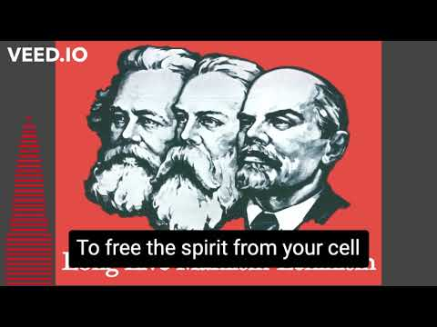
The Internationale - 1933 American Version by “The New Singers”

Slide 2
PSMLS mm/dd/yy - mm/dd/yy

Slide 3
What we’ll be learning today:
The 1991 Counter-Revolution in the USSR and how it began a period of American Unipolarity in world politics.
The start of the “Global War on Terrorism” as well as other US military interventions in the 1990s.
Domestic and trade issues during this period, including NAFTA, the WTO, PATRIOT Act and more.

Slide 4
1990’s: Counter-Revolution & American Unipolarity

Slide 5
Slide Title
Header
Body, (Use this slide for most slides. Try to only use 1-2 sentence paragraphs, leave 1 line open between them, include some sort of related images on the side and make sure to have this text at least 1 cm from the bottom of slide on most screens.)

Slide 6
Slide Title
Header
Body, (Use this slide for most slides. Try to only use 1-2 sentence paragraphs, leave 1 line open between them, include some sort of related images on the side and make sure to have this text at least 1 cm from the bottom of slide on most screens.)

Slide 7
Slide Title
Header
Body, (Use this slide for most slides. Try to only use 1-2 sentence paragraphs, leave 1 line open between them, include some sort of related images on the side and make sure to have this text at least 1 cm from the bottom of slide on most screens.)

Slide 8
Slide Title
Header
Body, (Use this slide for most slides. Try to only use 1-2 sentence paragraphs, leave 1 line open between them, include some sort of related images on the side and make sure to have this text at least 1 cm from the bottom of slide on most screens.)

Slide 9
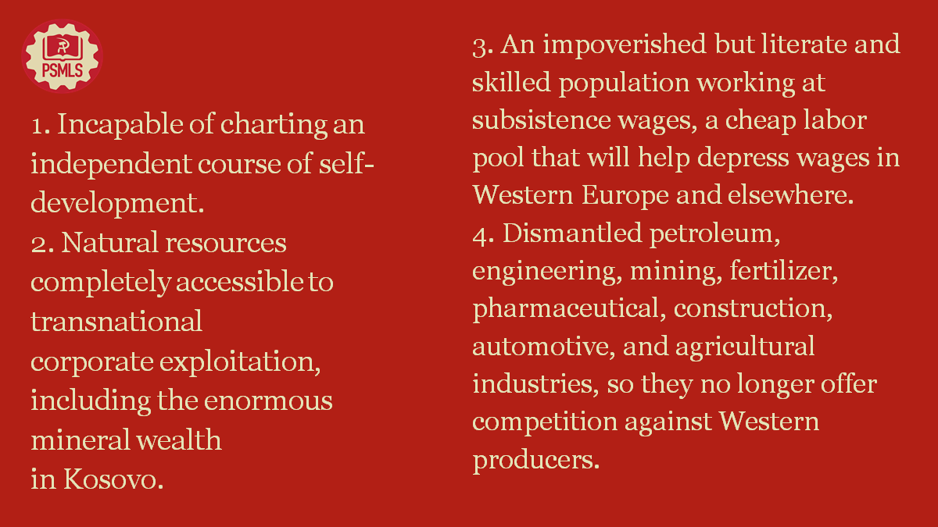
Slide Title
Header
Body, (Use this slide for most slides. Try to only use 1-2 sentence paragraphs, leave 1 line open between them, include some sort of related images on the side and make sure to have this text at least 1 cm from the bottom of slide on most screens.)

Slide 10
Slide Title
Header
Body, (Use this slide for most slides. Try to only use 1-2 sentence paragraphs, leave 1 line open between them, include some sort of related images on the side and make sure to have this text at least 1 cm from the bottom of slide on most screens.)

Slide 11
Slide Title
Header
Body, (Use this slide for most slides. Try to only use 1-2 sentence paragraphs, leave 1 line open between them, include some sort of related images on the side and make sure to have this text at least 1 cm from the bottom of slide on most screens.)

Slide 12
Discussion

Slide 13
US Imperialism and the Split in the Global Communist Movement

Slide 14
The Split in the Global Communist Movement
At the Counter-Revolution of 1991
The Soviet Union was a bulwark against US Imperialism expansion and united world Communist Parties.
With the counter-revolution, there was an immediate split in the Communist Party USA (CPUSA) between Party Leadership with Gus Hall and right-revisionists that formed the Committees of Correspondence in 1991.
The group argued for a rejection of Marxism-Leninism and adopt a “democratic socialist” orientation. Led by notable people like Angela Davis, Pete Seeger, and Gil Green

Slide 15
The Split in the Global Communist Movement
Split in US Communist Movement
The Split from the CPUSA of the Committees of Correspondence took a good portion of membership from the Party as well as absconding with property in San Francisco and other holdings.
There was a realignment of groups towards ultraleft tendencies like Trotskyism, New Left, Maoism as well as towards right opportunism like Social Democracy. Or as Jarvis Tyner called it in 1994, a “jettison of Marxism-Leninism in favor of an amalgam of every ideological trend on the left”
Gus Hall called the group “a thoroughly petty-bourgeois phenomenon” made up of those experiencing “ideological collapse, political dishonesty and simple greed”. -NYT 12/21/1994 interview

Slide 16
The Split in the Global Communist Movement
Split in Global Communist Movement
With the split, former suppressed fascist movements began to reappear. Per Northstar Compass, UPA-OUN reappeared and demanded recognition by then President Krawchuk of Ukraine as “patriots”.
In areas of the former sister republics of the USSR, Russian speakers were under discrimination and terror that “experts from the UN” stated that per rules of discrimination in the USA they saw none.
Former Warsaw Pact areas saw Communist parties dissolved, banned, and some even put on trial for trumped charges.
Source: Northstar Compass magazine 1993.

Slide 17
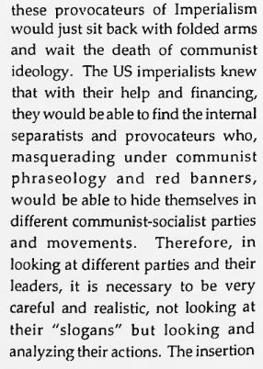
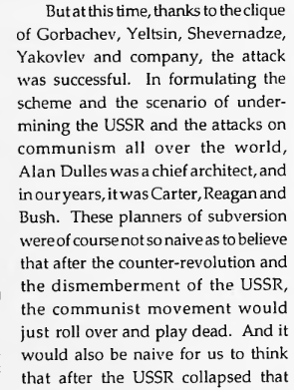
The Split in the Global Communist Movement
Per Professor Vladmir Harasymchuk in Northstar Compass:

Slide 18
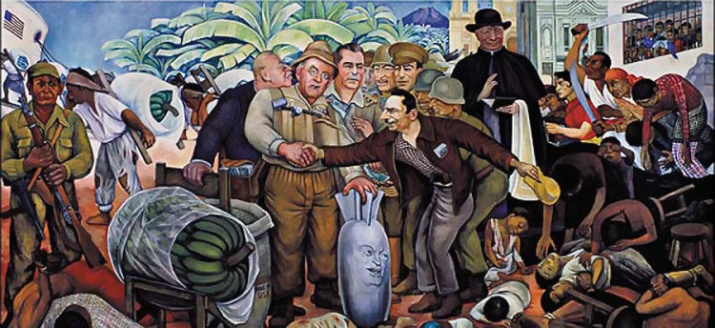
Diego Rivera: Glorious Victory (of the Dulles brothers and US Imperialism) [Depicting Guatemala overthrow]

Slide 19
Discussion

Slide 20
US in the Middle East:
Gulf War, September 11th and War on Terror

Slide 21
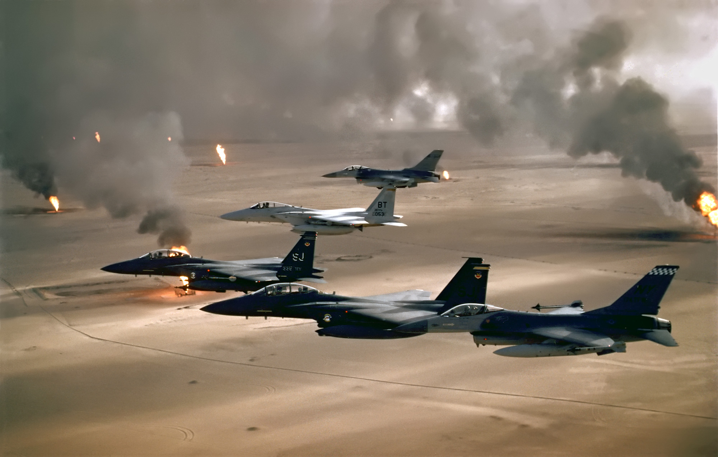
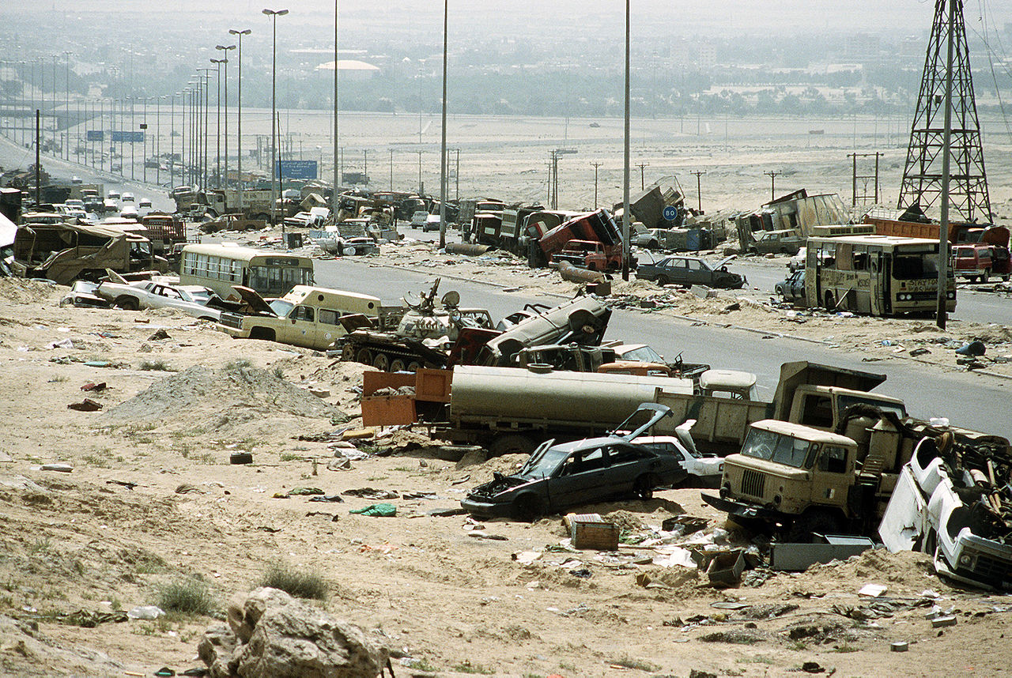
Gulf War
Operation Desert Storm
The Gulf War (1990-1991) was a conflict triggered by Iraq's invasion of Kuwait in August 1990, which was due to Kuwait increasing their oil output after the Iran-Iraq War at the behest of Saudi Arabia. An international coalition led by the United States, responded with military intervention to stop the Iraqi invasion of Kuwait.
Operation Desert Storm, launched in January 1991, saw a swift and overwhelming coalition victory, utilizing airstrikes and ground forces and committing the “Highway of Death” war crime. The war concluded with Iraq's expulsion from Kuwait, and Saddam Hussein remained in power, setting the stage for subsequent geopolitical tensions in the region.
The war was heavily propagandized and the footage shown to the American public was of highly advanced military equipment delivering blows to Iraqi forces and was not the same as the night to night, ugly but real footage of the Vietnam War.

Slide 22
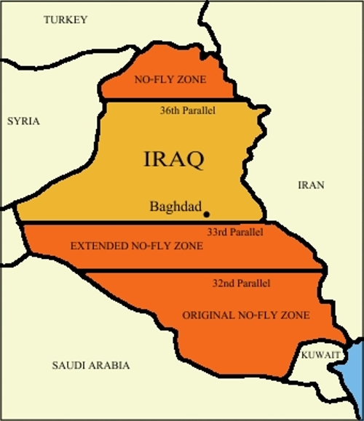
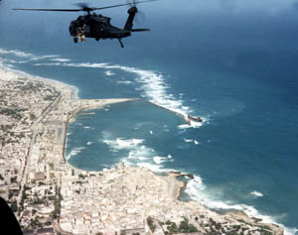
1990’s in the Middle East
Setting the Stage
While the ‘90-’91 Gulf War was the most flagrant US miltary intervention in the 1990’s, there were several more cases of intervention and interference in the region in the decade that set the stage for what was to come in the next decade:
Iraqi No-Fly Zones (1991-2003): In the aftermath of the Gulf War, the United States and its allies established no-fly zones over northern and southern Iraq to protect Kurdish and Shiite populations from potential reprisals by Iraq. These zones were maintained through regular military patrols and occasional airstrikes.
Operation Desert Fox (1998): This four-day bombing campaign targeted Iraq's weapons of mass destruction facilities in response to Iraq's lack of cooperation with UN weapons inspectors. It marked a significant escalation of tensions between the U.S. and Iraq.
Continued US military support for Zionist Israel, which continued to kill and displace Palestinians following the 1st Intifada and into the 2nd. This was a significant driver of Al-Quaeda and other terrorist activity in the Middle East.
Operation Restore Hope (1992-1993): US and UN forces dispatched soldiers to Somalia to counter the Somali National Alliance. At the end of the day, only 18 US soldiers died but hundreds of Somali militiamen and civilians were killed.

Slide 23
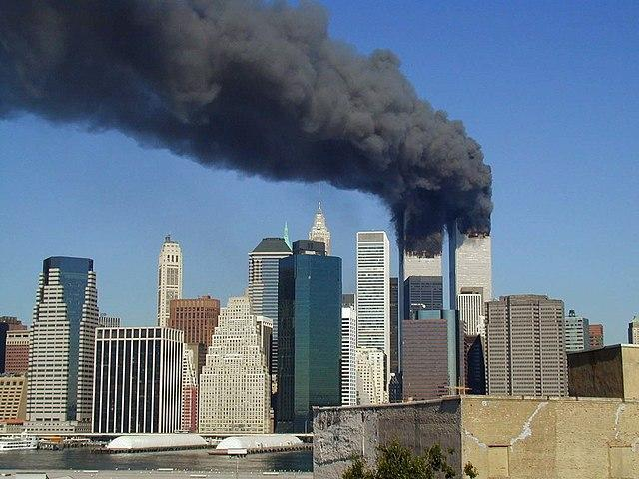
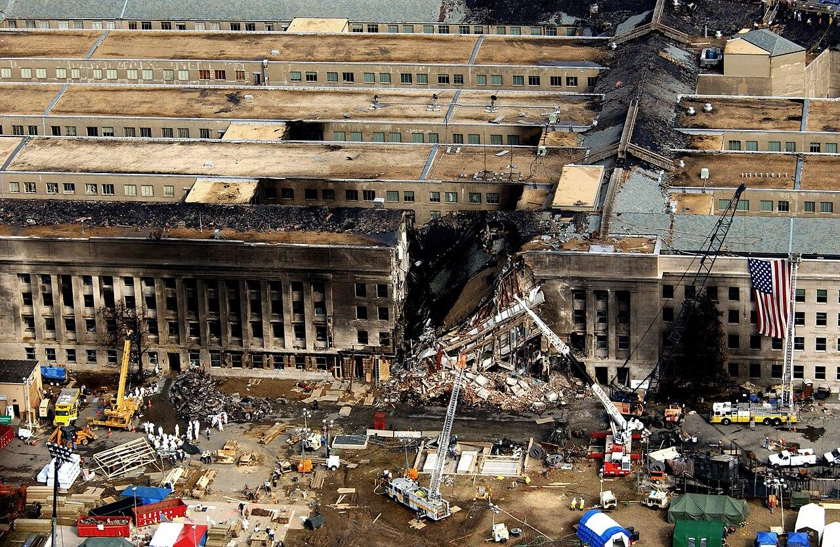
September 11th, 2001
Blowback
Of course, on September 11th, 2001, the United States was attacked by Al-Quaeda in a series of coordinated terrorist attacks on premier symbols of US imperialism including the World Trade Center in New York City and the Pentagon just outside of Washington DC. It was the 1st time the US was attacked since 1941.
Over 2,900 people died that day, and the death toll has since surpassed 3,000 due to government neglect of first responders and others affected by the collapse of the 2 World Trade Center towers.
Shortly after, Al-Qaeda claimed responsibility (though not before Donald Rumsfeld was trying to find any evidence of Iraqi involvement), and said in a letter in 2002 that:
“Why are we fighting and opposing you? The answer is very simple: Because you attacked us and continue to attack us. a) You attacked us in Palestine… b) You attacked us in Somalia; you supported the Russian atrocities against us in Chechnya, the Indian oppression against us in Kashmir, and the [Israeli] aggression against us in Lebanon… c.) Under your supervision, consent and orders, the governments of our countries which act as your agents, attack us on a daily basis”

Slide 24
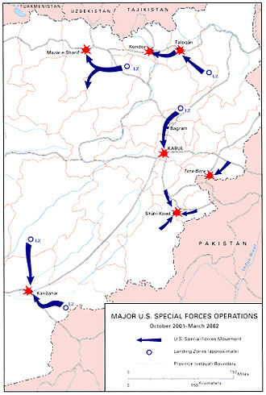
“The Global War on Terror”
Acting Out
Following 9/11, the American public was inundated by hawkish pro-war and nationalistic rhetoric; a false sense of patriotism and duty that was used to manufacture consent for war.
On October 7th, 2001, the United States began its invasion of Afghanistan, along with several other coalition countries, in Operation Enduring Freedom. While the invasion targeted Al-Qaeda for the September 11th attacks, it also targeted the Taliban, which had nothing to do with 9/11. This along with the shift in US focus to Iraq throughout 2002 and 2003, caused the bungling of the effort to capture Osama Bin-Laden and destroy Al-Qaeda and caused the War in Afghanistan to last nearly 20 years until US forces withdrew in 2021 and Afghanistan fell back into Taliban hands.
However, even before the invasion of Afghanistan the United States was not only trying to implicate Iraqi involvement however possible, but also was drawing up plans for a great imperialist campaign throughout the Middle East to topple regimes and extend US hegemony in the region.

Slide 25
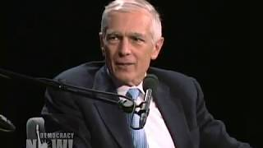
General Wesley Clark "We're going to take-out 7 countries in 5 years."

Slide 26
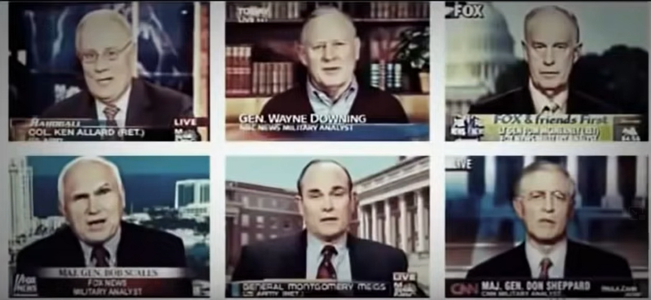
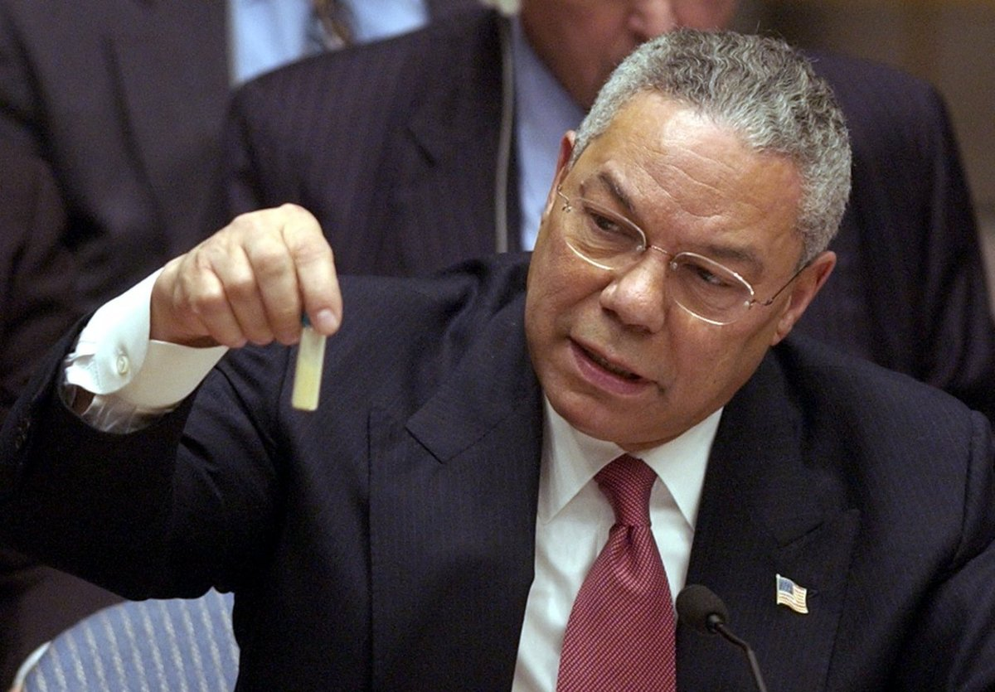
Manufacturing Consent
Before the Iraq War
Into 2002 and 2003 the United States and its corporate media spent millions of dollars and wasted no time in trying to convince the American public and the international community of the need to militarily intervene in Iraq, based off accusations of Iraq having “Weapons of Mass Destruction” or “WMDs.”
MSNBC, CNN and Fox had on over 75 retired generals and officers who repeated Pentagon talking points to boost the propaganda for war, meanwhile shows such as Phil Donahue were removed from air for criticizing the rush to war.
In February of 2003, Colin Powell (who was then Secretary of State under George W. Bush) went to the United Nations Security Council and presented false and faulty intelligence, including a vile of supposed anthrax, to make the argument for US intervention in Iraq.

Slide 27
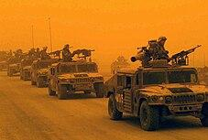
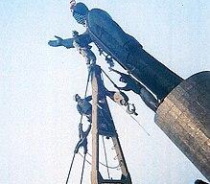
2003 Invasion of Iraq
War in Iraq
In March 2003, despite widespread global protests and skepticism about the intelligence regarding WMDs, the coalition illegally launched a preemptive invasion of Iraq.
The initial military campaign was swift, leading to the capture of Baghdad in April 2003. However, the expected WMDs were not found, and the war evolved into a protracted and complex insurgency, contributing to long-term instability in Iraq and shaping the geopolitical landscape of the Middle East for years to come.
In the 1st few years of the conflict, US atrocities at Abu Ghraib prison in Iraq were uncovered and US forces found themselves in incredibly bloody battles in Fallujah, Abu Ghraib, Najaf, Samarrah and Mosul. American forces captured Saddam Hussein in 2003, brought him to the US for medical treatment, and was sent back to Iraq to be sentenced to execution by hanging by the US-backed govt in Iraq.

Slide 28
Discussion & New Members Introductions

Slide 29
New Member Introductions
What is your name, pronouns and state (or country/territory)?
Where do you work? Is it unionized?
How did you find out about the People’s School?
What do you think about tonight's class?

Slide 30
Domestic and Trade Issues

Slide 31
Slide Title
Header
Body, (Use this slide for most slides. Try to only use 1-2 sentence paragraphs, leave 1 line open between them, include some sort of related images on the side and make sure to have this text at least 1 cm from the bottom of slide on most screens.)

Slide 32
Slide Title
Header
Body, (Use this slide for most slides. Try to only use 1-2 sentence paragraphs, leave 1 line open between them, include some sort of related images on the side and make sure to have this text at least 1 cm from the bottom of slide on most screens.)

Slide 33
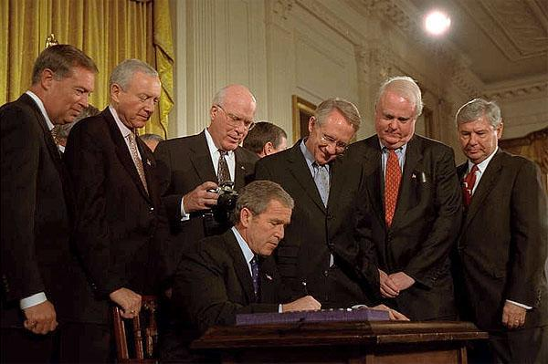
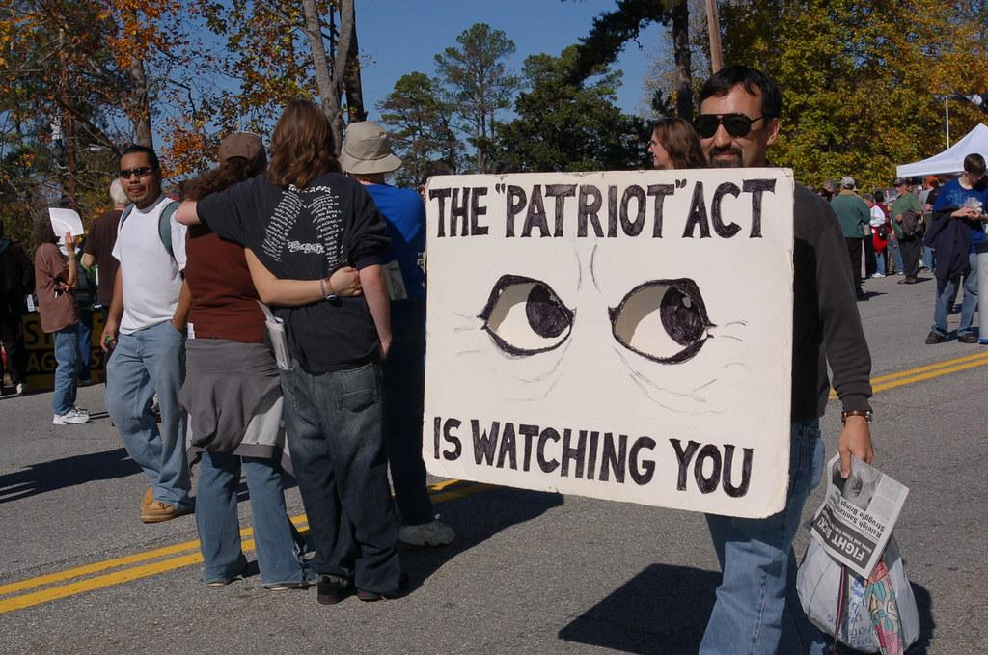
PATRIOT Act
Govt Repression Post 9/11
The USA PATRIOT Act, signed into law in October 2001, was a sweeping piece of legislation allegedly aimed at enhancing the U.S. government's ability to combat terrorism in the wake of the 9/11 attacks.
The Act granted law enforcement agencies increased surveillance and intelligence-gathering powers, allowing for the monitoring of communications, access to business records, and the expansion of information-sharing between agencies. While proponents argued that these measures were crucial for national security, the PATRIOT Act had a significant negative impact on American civil rights and liberties. It was an abuse of surveillance powers, as well as the erosion of privacy rights, due to the broad and often vague language used in the legislation.
The Act enabled warrantless searches, infringing on the Fourth Amendment, and disproportionately targeting specific communities, leading to a broader debate on the delicate balance between security measures and the preservation of individual freedoms. Currently the act remains expired, but was renewed for years under Democrat and Republican presidencies and house majorities.

Slide 34
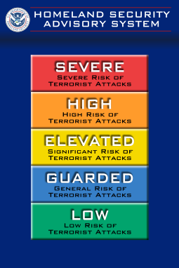
Homeland Security Act of 2002
Protecting the “Homeland”
The Homeland Security Act of 2002 was enacted in response to the 9/11 attacks and aimed to establish the Department of Homeland Security (DHS), consolidating various federal agencies responsible for protecting the United States from terrorist threats.
It negatively impacted American civil rights and liberties as the Act expanded the government's surveillance capabilities and granted broad authority to DHS, raising concerns about potential abuses of power and the erosion of privacy rights.
Furthermore, the legislation had significant implications for immigrants, as it led to increased scrutiny and stricter immigration policies. Measures like the creation of the Immigration and Customs Enforcement (ICE) agency and intensified border security contributed to the targeting of immigrant communities, which led to gross abuses of migrants into the Obama and Trump administrations.
It also introduced a temporary color coded “Homeland Security Advisory System” which induced fear in the American people over threats of terrorism and kept them supportive of the War on Terror on that basis.

Slide 35
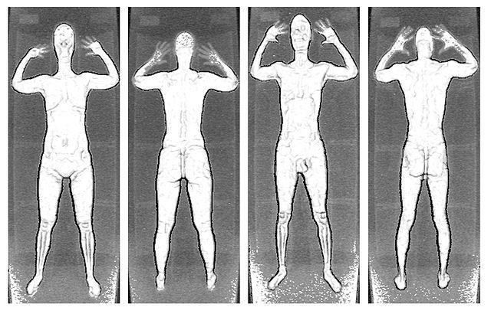
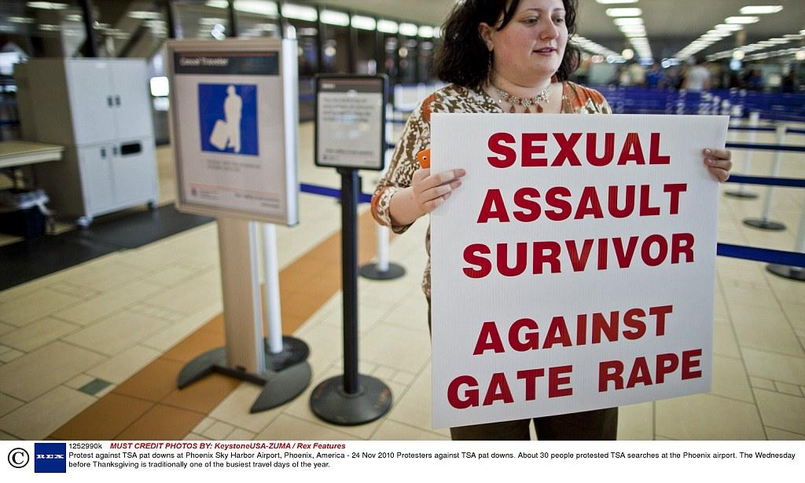
Transportation Security Administration
Tightening Security on Everyone
In the aftermath of the 9/11 attacks, the Transportation Security Administration (TSA) implemented extensive security measures at airports across the United States to prevent similar incidents and enhance aviation safety. These measures included stringent security screenings, the introduction of full-body scanners, and the implementation of thorough baggage checks.
While the heightened security was aimed at ensuring passenger safety, it also led to negative consequences for Americans traveling through airports during the 2000s. Passengers experienced longer lines, increased wait times, enhanced scrutiny, as well as increased levels of sexual assault at aiports.
The measures veered into invasions of privacy, with concerns raised about the effectiveness and necessity of certain screening methods. Additionally, the implementation of these security measures sparked debates about striking the right balance between protecting national security and preserving the convenience and civil liberties of air travelers. The airport security landscape evolved significantly, leaving a lasting impact on the travel experience for Americans during this period.

Slide 36
Discussion & Wrap Up

Slide 37
Announcements
Starting February, the PSMLS will only be once a week on Tuesday at 8 pm EST. This PCUSA members will have several options available to make-up this class if they miss it. This change is due to an observed overlap in attendance on both days, and allows us to have crucial meetings on Thursday that would otherwise be Thursday's PSMLS.
The PSMLS has endorsed the January 13th March on Washington for Gaza event in Washington DC!

Slide 38
Volunteers Needed!
We are in need of volunteers for the staff of the People’s School! Here’s a few roles we need filled:
People to help manage posting on our social media and podcast platforms
Video Editors, Audio Editors, Graphic Designers, Artists, Narrators
Facilitators, Web Controls, Moderators
Email info@peoplesschool.us if you’re interested and try to attend our next staff meeting on Feb 4th if possible.

Slide 39
PSMLS Propaganda
peoplesschool.us/media & peoplesschool.us/store
Materials to help promote the school!

Slide 40
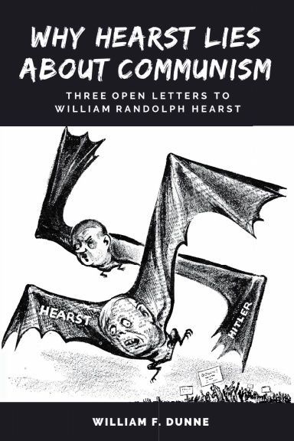
New Outlook Publishers
newoutlookpublishers.store
Latest Releases

Slide 41
Harry Bridges School of Labor
luel.us/laborschool/
The Harry Bridges School of Labor is a monthly class held 2x per month. Classes cover a variety of topics aimed at building class conscious among union members.
February’s class is “Paterson Silk Strike” and is February 7th, 2023 at 9pm EST/6pm PST and Saturday February 10th, 2023 at 7pm EST/4pm PST.
They are also releasing the recordings from the Harry Bridges School of Labor sessions on YouTube.

Slide 42
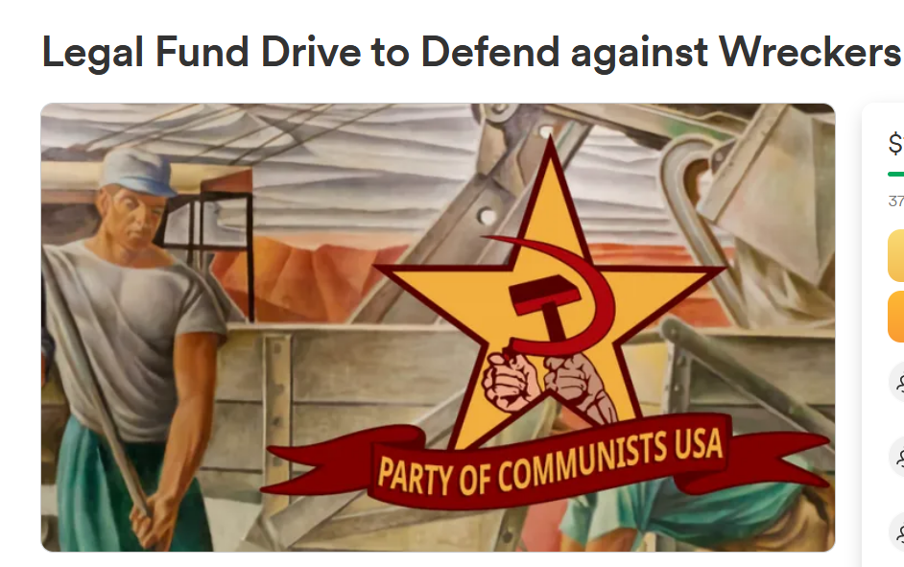
Legal Drive
In 2022 we were attacked and sabotaged by ultraleft wreckers that tried to steal the PSMLS and destroy the PCUSA. They failed, but they will be held accountable and there are still things they took from us that we’ve not got back, like videos, imagery, audio etc. That is why we still need donations to the legal drive.
If you support the school and want to see us continue to improve and keep delivering this education 51 weeks a year, please pitch in whatever you can and support the GoFundMe for the legal drive @ https://www.gofundme.com/f/legal-fund-to-defend-against-wreckers.
Anything helps!

Slide 43
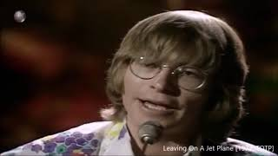
Let Us Begin (What Are We Making Weapons For) - John Denver (1986)

