Slide 1
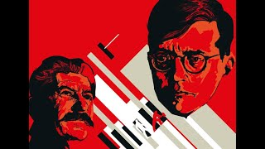
Shostakovich’s 7th 'Leningrad' Symphony

Slide 2
PSMLS mm/dd/yy - mm/dd/yy

Slide 3
What we’ll be learning today:
Historical context of what preceded the Siege of Leningrad, such as the war with Finland and the invasion of the USSR.
Learning about the Siege of Leningrad through the “Siege of Leningrad” film from the USFSP Soviet Film Archive project.

Slide 4
Background: Poland, Finland and Operation Barbarossa

Slide 5
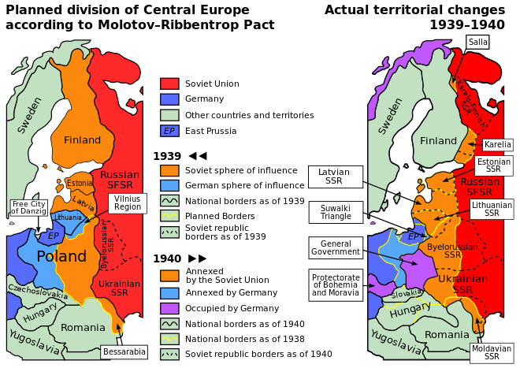
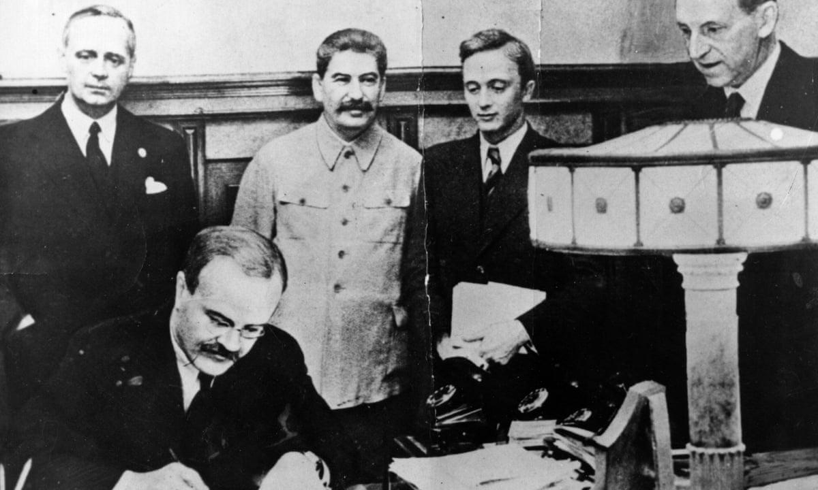
The Soviet-German Pact of Non-Aggression
Leading up to WW2
After Hitler rose to power in Germany in early 1933, Stalin's main foreign policy goal was to seek a Collective Security treaty with Western bourgeois democracies, namely France and the UK. Collective Security would mean a political-military alliance to nip in the bud any Nazi aggression.
Stalin's proposals were systematically rejected as France and Britain were instead doing their best to push Hitler in the direction he was leaning, that is to the East. Hitler's book Mein Kampf clearly exposed his "Drang nach Osten" objectives, German for "push to the east".
Well aware of inter-imperialist contradictions, Stalin as a master of dialectics, decided to return the favor to bourgeois democracies and concluded a pact of non aggression with Germany, in order to deflect the Nazi dagger and turn it back towards France and Britain. It was signed in Moscow on August 23rd, 1939.

Slide 6
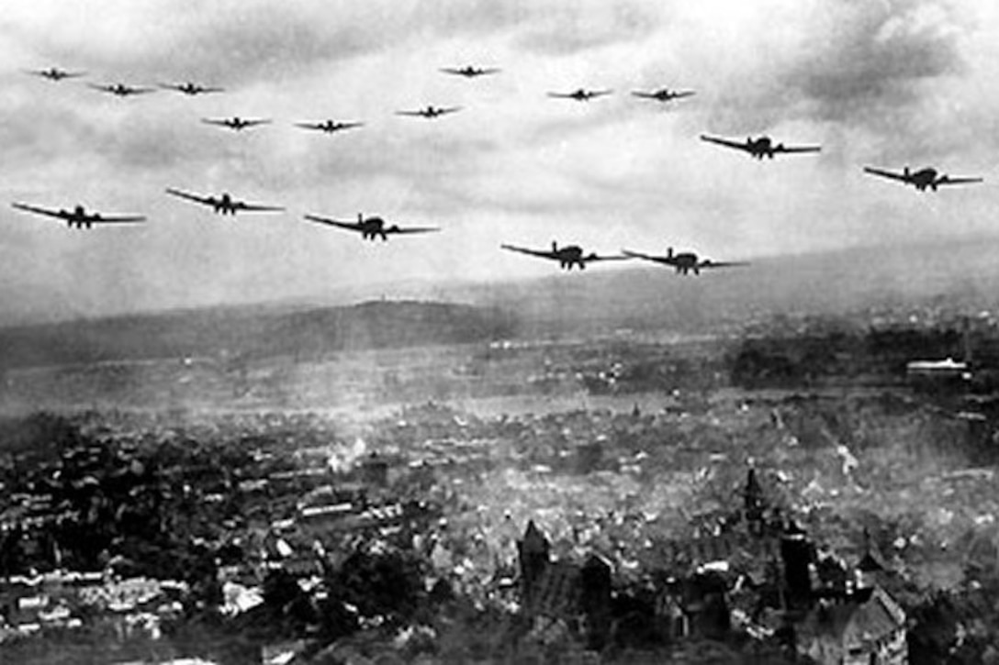
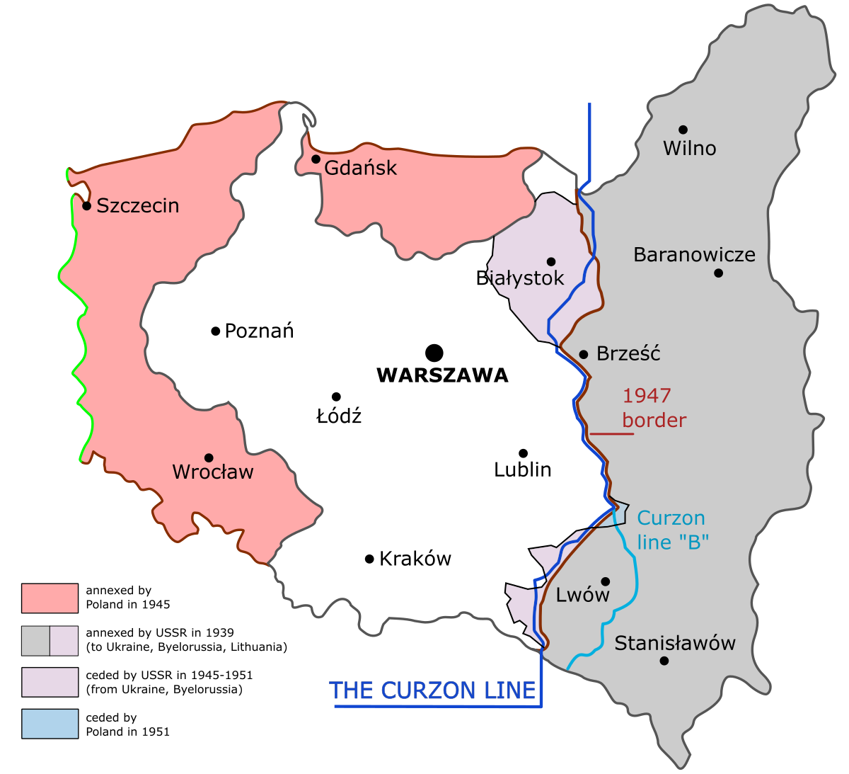
The Soviet-German Pact of Non-Aggression
War in Poland
World War II began a week later with Hitler attacking Poland. Poland was defeated in just 2 weeks and Stalin moved the Red Army west into Poland a few hundred miles to the Curzon Line.
The Curzon Line was the proposed eastern border of Poland after World War I, separating ethnic Poles from Belarusians and Ukrainians. In 1920, backed by France and the UK, Poland had attacked the Soviet State and conquered the western parts of Bielorussia (Belarus today) and Ukraine.
So in September 1939, all Stalin did was to recover what had been stolen from the USSR 20 years earlier.

Slide 7
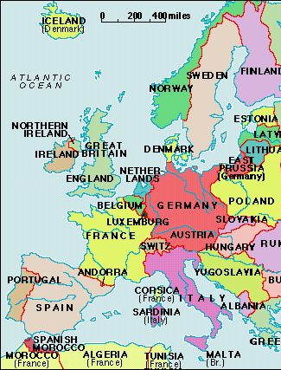
The Phony War and the Winter War
France and UK
France and the UK, following their treaty obligations declared war on Germany as soon as Hitler invaded Poland. They declared war but had zero intention to wage war. (Thus, it is called the “phony war”)
While Hitler was busy attacking Poland in the East, the Anglo-French could have easily crossed Germany's Western border with a few dozen divisions and smashed the Wehrmacht.
After the war many former Nazi generals admitted that Germany could have been defeated in September 1939 if the Anglo-French had wanted to.
However, the French bourgeoisie were too busy waging war on the French Communist Party and Britain was making plans to fight the USSR by proxies.

Slide 8
The Phony War and the Winter War
The Finnish Question
That is when the Finnish question came up. Finland was given its independence from the Tsarist empire right after the October Revolution. Then followed a short but bloody civil war that saw the defeat of the Finnish Bolsheviks by the Whites, under the ruthless anti-Communist Carl Mannerheim. A brutal reactionary régime was established in Finland with, of course, the full backing of the Anglo-French.
Leningrad, the historical cradle of Soviet Power was in a geographical precarious position at the cul-de-
sac of the gulf of Finland, an offshoot of the Baltic Sea, itself pretty much a closed up sea. Very similar to the Black sea in the south, offshoot of the Mediterranean, itself a closed up sea at Gibraltar.
To make things worse, Leningrad was located within cannon fire range of the Finnish artillery. Well
aware of this situation at a time when World War II had just begun and the Anglo-French were showing full hatred towards the USSR, Stalin had Molotov propose to the Finnish a fair readjustment of the border, where it would be pushed a few dozen kilometers away from Leningrad in exchange for 2 or 3 times more land in the north. It must be noted that after WWII all Finnish leaders were in agreement that Stalin's proposal was totally fair and should have been accepted. Of course Mannerheim, pushed by his Anglo-French masters, flatly rejected Molotov's deal.
War was inevitable and on November 30th, 1939 the Red Army crossed the Finnish border. A three and half months long war began that became known as the Winter War.

Slide 9
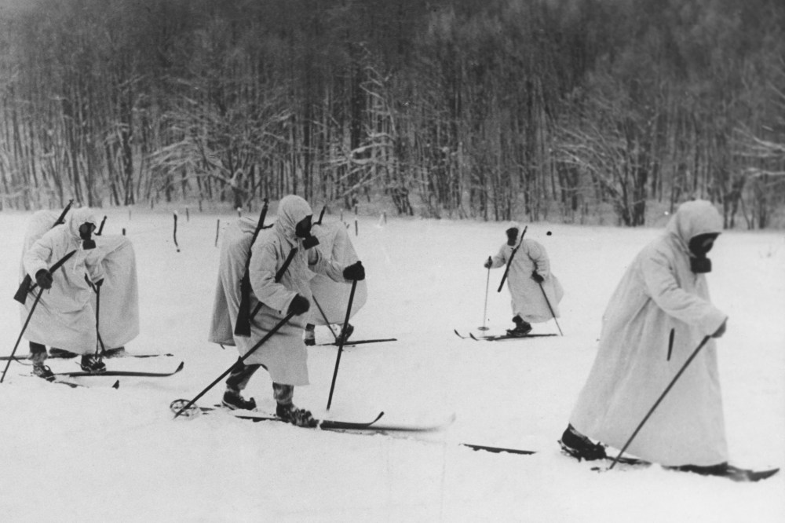
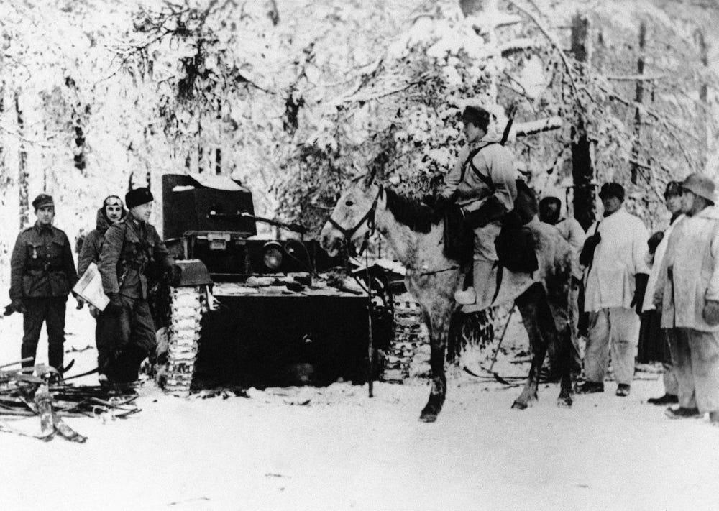
The Phony War and the Winter War
Winter War
France and the UK armed Mannerheim forces to the teeth, (similarly to how they’re arming Ukraine now.) At first the Red Army suffered enormous casualties, due to poor combat techniques, and inferior weapons. For example the Finnish were equipped with fully automatic self-loading rifles while Soviet soldiers only had bolt action rifles, not even semi-automatic. Also, Finnish troops were fast moving on skis while the Red had not yet adopted these tactics.
As it has been proven historically, Russians learn fast from their mistakes and soon were able to smash Mannerheim's forces. The war ended in March 1940 and valuable lessons were learned by Marshal Voroshilov from this conflict.
It must be noted that besides arming Mannerheim to the hilt, the Anglo-French, instead of fighting Nazis, frantically put together plans to invade the USSR in the Caucasus, thru the Caspian Sea and Black Sea.

Slide 10
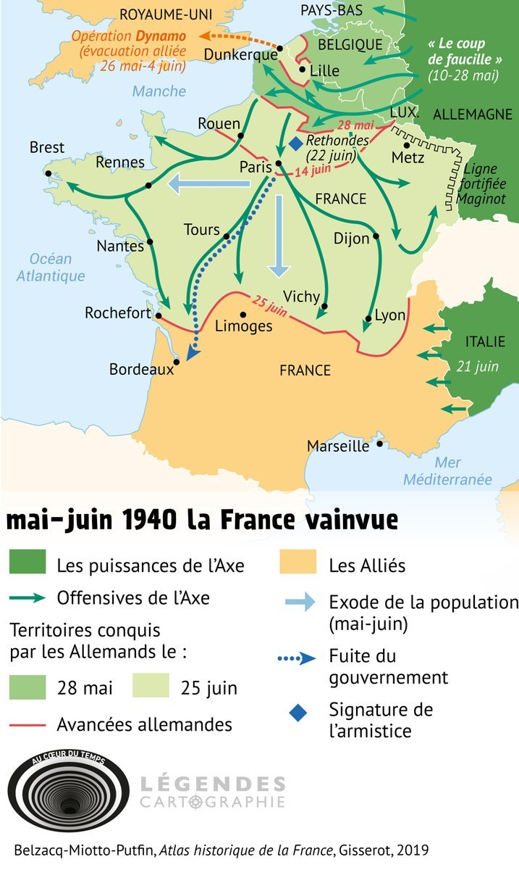
End of the Phony War, and the Baltics
War in West begins
The 8 months long Phony War finally ended on May 10th, 1940 when Hitler launched a surprise attack thru the Ardennes mountains and invaded 4 countries: France, Belgium, the Netherlands and Luxembourg.
Due to sabotage by the 5th column pro-Nazi elements in the government and armed forces, France quickly collapsed and was defeated in only 6 weeks.
The leading French bourgeoisie, to the exception of Charles de Gaulle, was just too happy to surrender to Hitler on June 22nd. For years its slogan had been "plutôt Hitler que le Front Populaire", French for "rather Hitler than the Popular Front.”

Slide 11
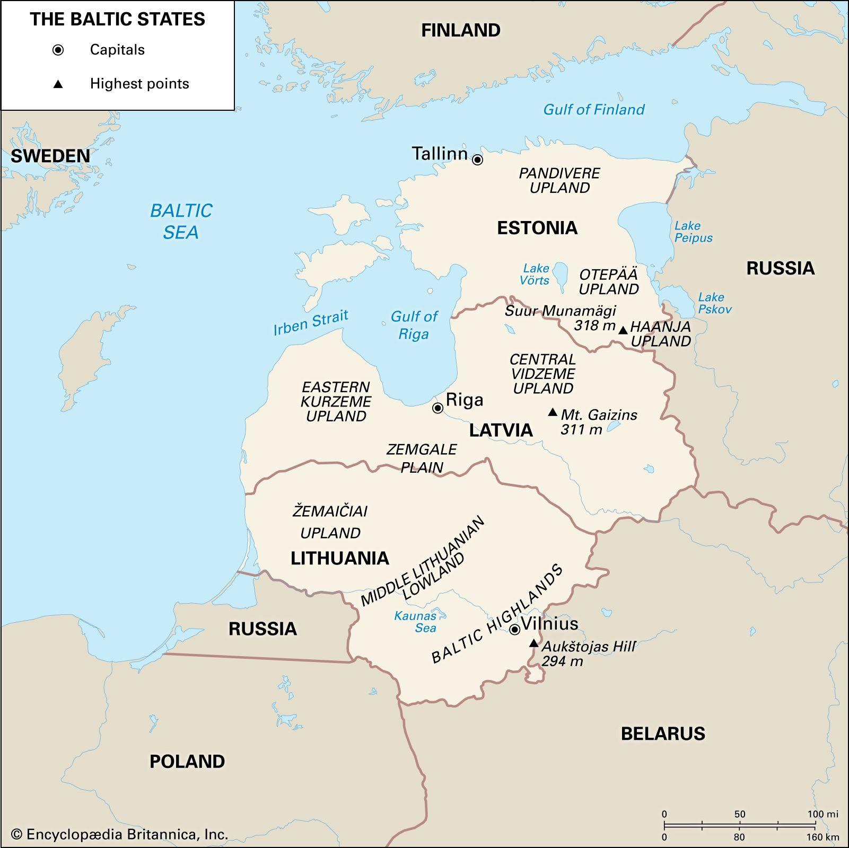
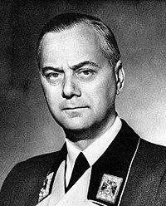
End of the Phony War, and the Baltics
The Baltics
Stalin was quite surprised at the fast collapse of France, as he thought that Germany and the Anglo- French would go at it for quite a while. For this reason he became concerned with the 3 Baltic states, Lithuania, Latvia and Estonia, the obvious gateway to Leningrad in the event of a German invasion.
In mid-June 1940, Stalin ordered the Red Army to move into the 3 Baltic states. Soviet power was established and each became SSR republics of the USSR.
One important fact must be noted. Since the Middle Ages, ethnic Germans formed the majority of the ruling class in the Baltics, especially in Latvia and Estonia. It is no surprise that the ideological godfather of Nazism was a German Balt, born in Estonia: Alfred Rosenberg. He left Estonia after the October Revolution and went to Germany where he co-founded and elaborated the ideology of the Nazi party NSDAP, National Socialist Party of German Workers. Hitler joined the party 8 months later.
After the invasion of the USSR, Rosenberg was the head of the Reich Ministry for the Occupied Eastern Territories and played a major part in the Nazi Holocaust of 27 million Soviet people. Rosenberg ended his career swinging at the end of a rope in Nuremberg in 1946.

Slide 12
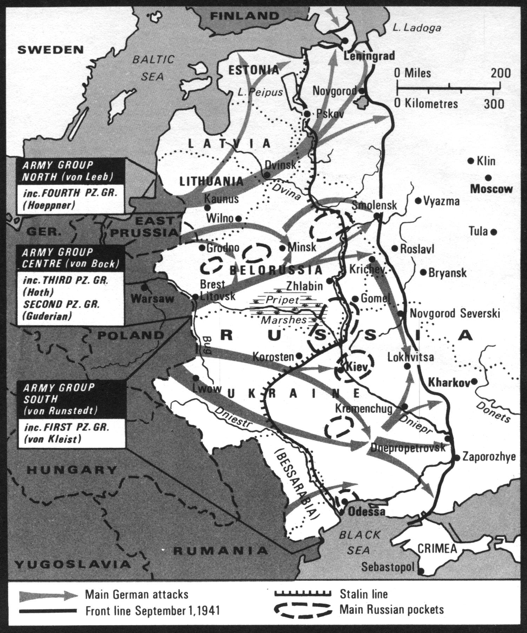
End of the Phony War, and the Baltics
The Baltics and Barbarossa
At the Nazi onslaught of Operation: Barbarossa on June 22nd, 1941, Hitler launched his Group Army North towards Leningrad, Group Army Center towards Moscow and Group Army South towards Kiev. Lithuania, Latvia and Estonia were quickly overran, often not without the help of local pro-Nazi collaborators, member of the overthrown bourgeois class, too happy to greet the Wehrmacht as liberators.
It must be noted that Kaja Kallas, current leader of Estonia, the birth country of Alfred Rosenberg, is the great granddaughter of the founder of the Estonian fascist militia that greeted the Nazi troops in 1941. Estonia is also today the country that gives the highest percentage of its GDP to the current UkroNazi régime in Kiev.

Slide 13
Discussion

Slide 14
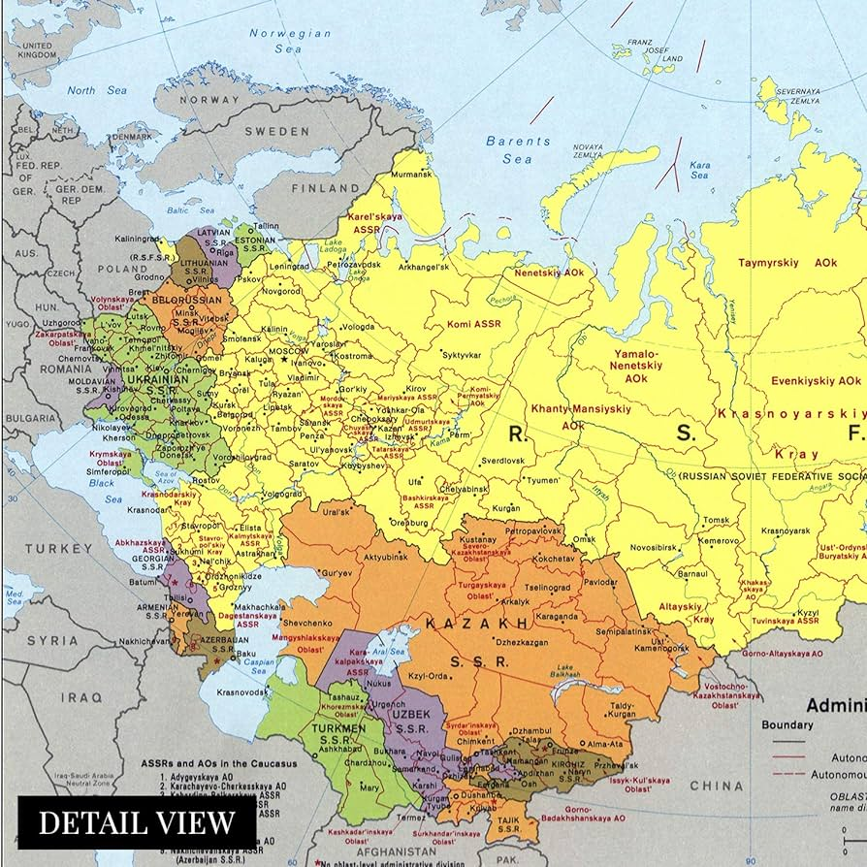
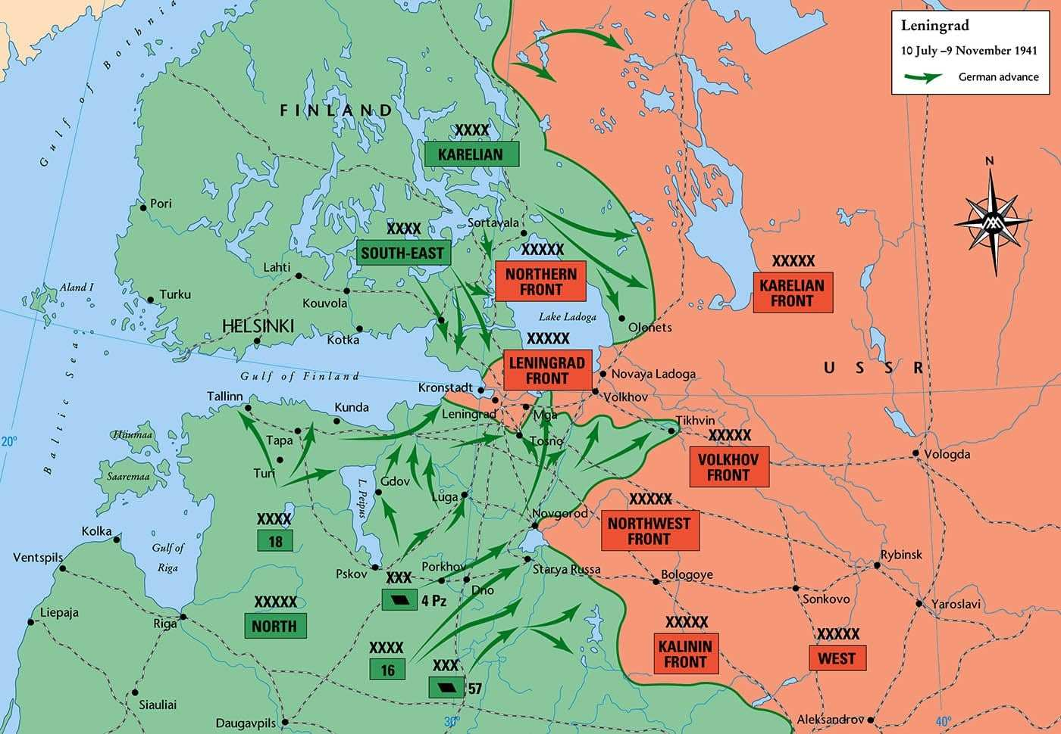
Map of Leningrad for reference

Slide 15
Siege of Leningrad Pt 1

Slide 16
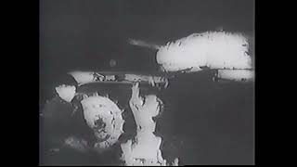
Siege of Leningrad - USFSP Soviet Film Archive

Slide 17
Discussion & New Members Introductions

Slide 18
New Member Introductions
What is your name, pronouns and state (or country/territory)?
Where do you work? Is it unionized?
How did you find out about the People’s School?
What do you think about tonight's class?

Slide 19
Siege of Leningrad Pt 2

Slide 20
Siege of Leningrad - USFSP Soviet Film Archive

Slide 21
Siege of Leningrad Pt 3

Slide 22
Siege of Leningrad - USFSP Soviet Film Archive

Slide 23
Discussion & Wrap Up

Slide 24
Announcements
Starting February, the PSMLS will only be once a week on Tuesday at 8 pm EST. This PCUSA members will have several options available to make-up this class if they miss it. This change is due to an observed overlap in attendance on both days, and allows us to have crucial meetings on Thursday that would otherwise be Thursday's PSMLS.

Slide 25
Volunteers Needed!
We are in need of volunteers for the staff of the People’s School! Here’s a few roles we need filled:
People to help manage posting on our social media and podcast platforms
Video Editors, Audio Editors, Graphic Designers, Artists, Narrators
Facilitators, Web Controls, Moderators
Email info@peoplesschool.us if you’re interested and try to attend our next staff meeting on Feb 4th if possible.

Slide 26
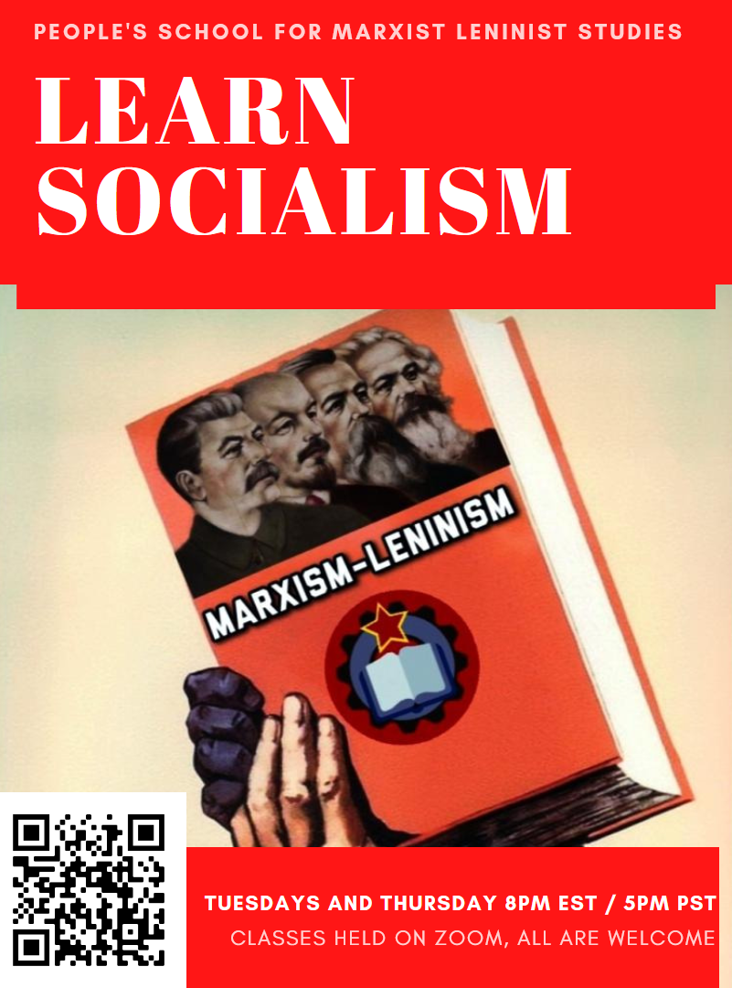
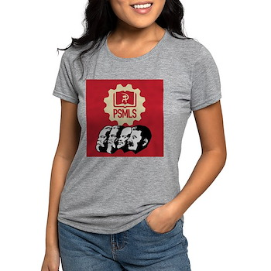
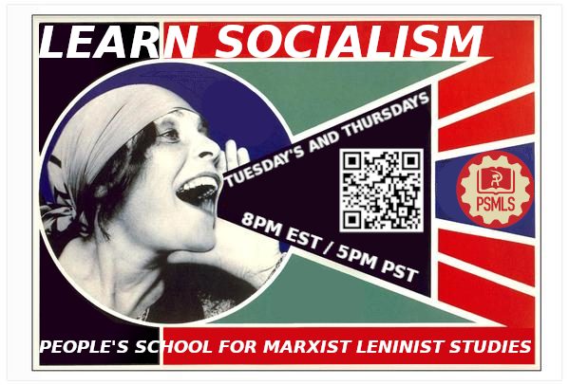
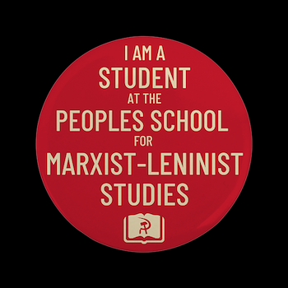
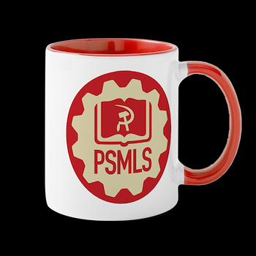
PSMLS Propaganda
peoplesschool.us/media & peoplesschool.us/store
Materials to help promote the school!

Slide 27
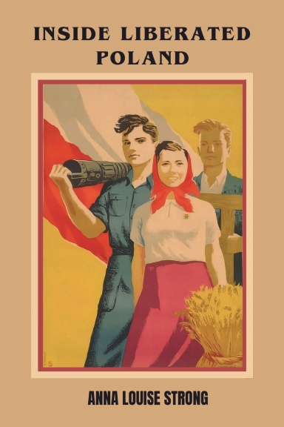
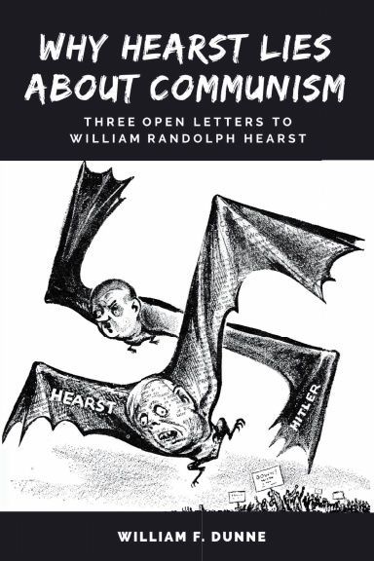
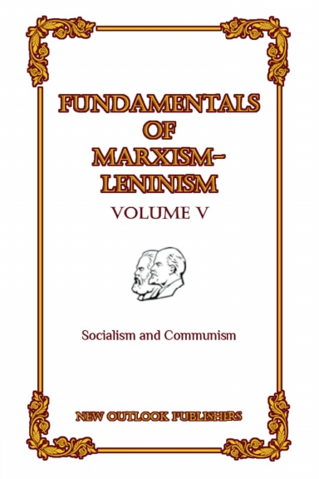
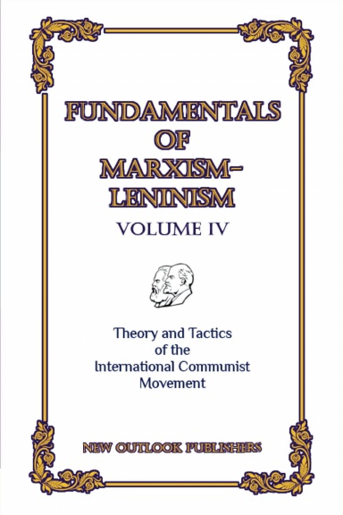
New Outlook Publishers
newoutlookpublishers.store
Latest Releases

Slide 28
Harry Bridges School of Labor
luel.us/laborschool/
The Harry Bridges School of Labor is a monthly class held 2x per month. Classes cover a variety of topics aimed at building class conscious among union members.
February’s class is February 7th, 2023 at 9pm EST/6pm PST and Saturday February 10th, 2023 at 7pm EST/4pm PST.
They are also releasing the recordings from the Harry Bridges School of Labor sessions on YouTube.

Slide 29
Shostakovich’s 7th 'Leningrad' Symphony

