Slide 1
I Didn’t Raise My Boy To Be A Soldier - 1914 Anti-War Song

Slide 2
PSMLS mm/dd/yy - mm/dd/yy

Slide 3
What we’ll be learning today:
The actions of the imperialists from 2005-2020, including under the last few years of the Bush Administration, as well as both the Obama and Trump administrations.
Domestic events in the United States during this time, and the sharpening of contradictions, making life more difficult for working class Americans to survive.

Slide 4
Series Recap

Slide 5
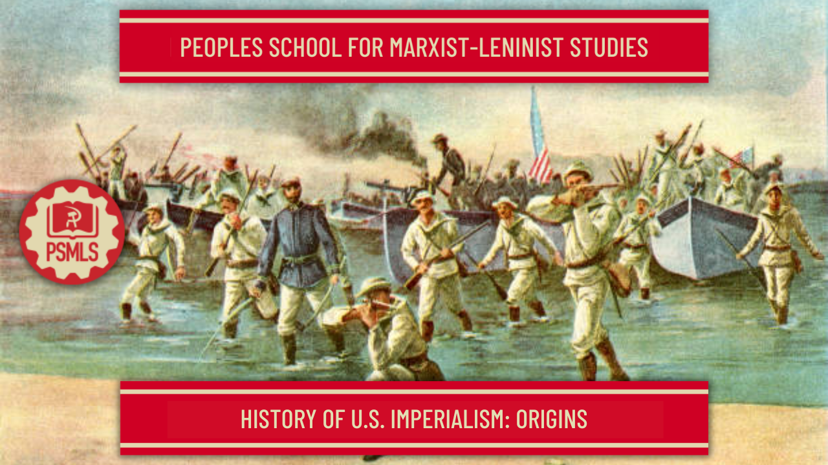
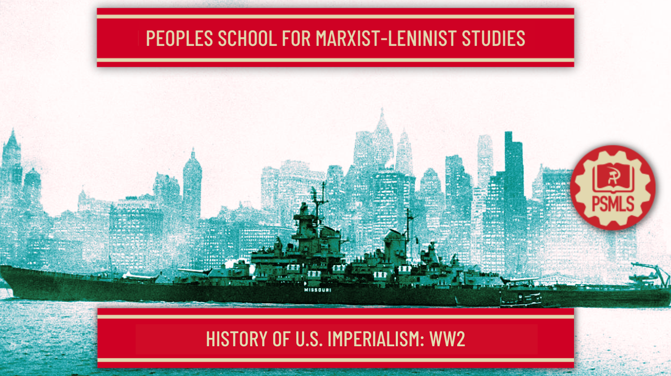
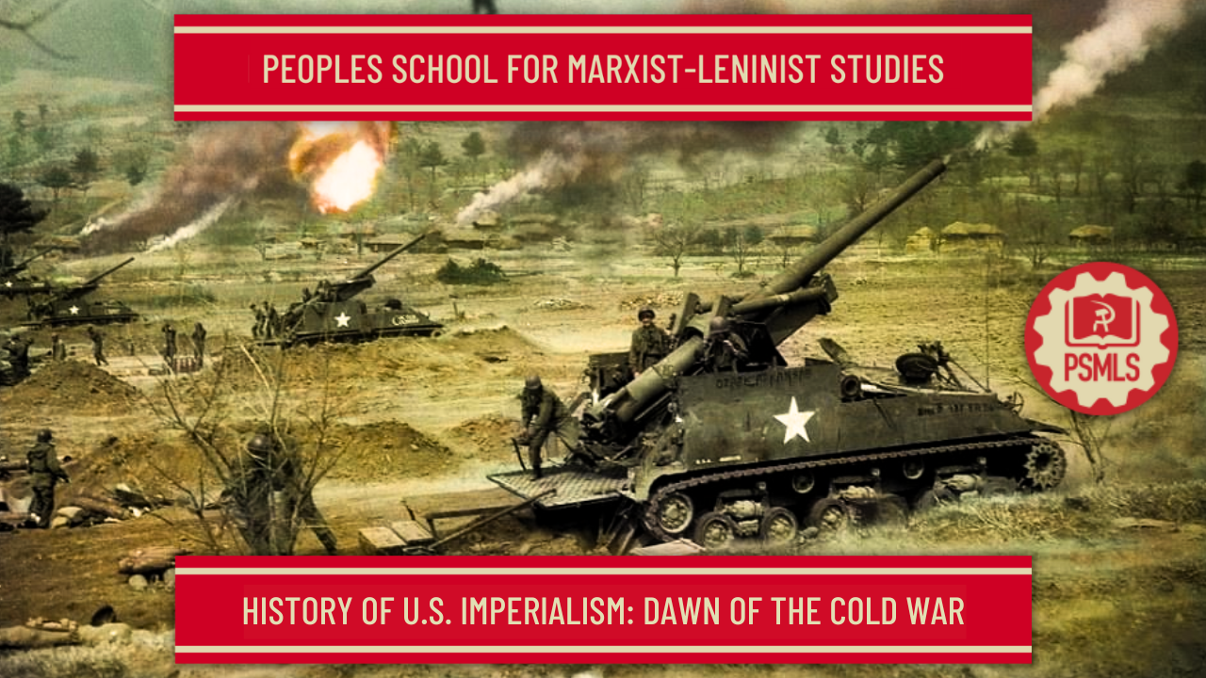
History of U.S. Imperialism series so far
Covered development of American Imperialism & the era from 1890’s-1914.
Covered WW1, the American intervention in the war and the Interwar Period.
Covered the Second World War and the nuances of American involvement in the war, including corporate collaboration with Nazis.
Covered the start of the Cold War, from about 1945-1960, including interventions in Greece, Ukraine, Korea, Iran, Guatemala and more.
Covered height of the Cold War, from about 1960-1975, including interventions in Cuba, Vietnam, Laos, Cambodia, Chile, Argentina and more.
Covered the end of the Cold War, from about 1975-1991, including interventions in Afghanistan, Grenada, Libya, Panama and more.

Slide 6
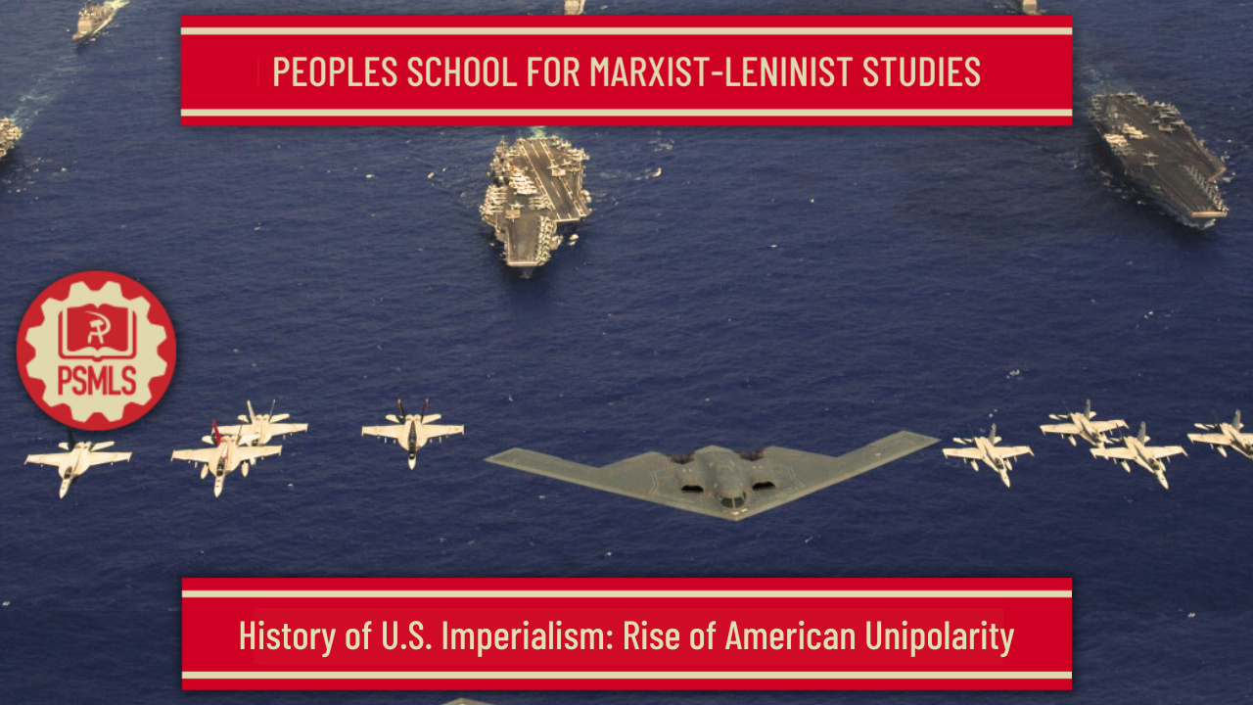
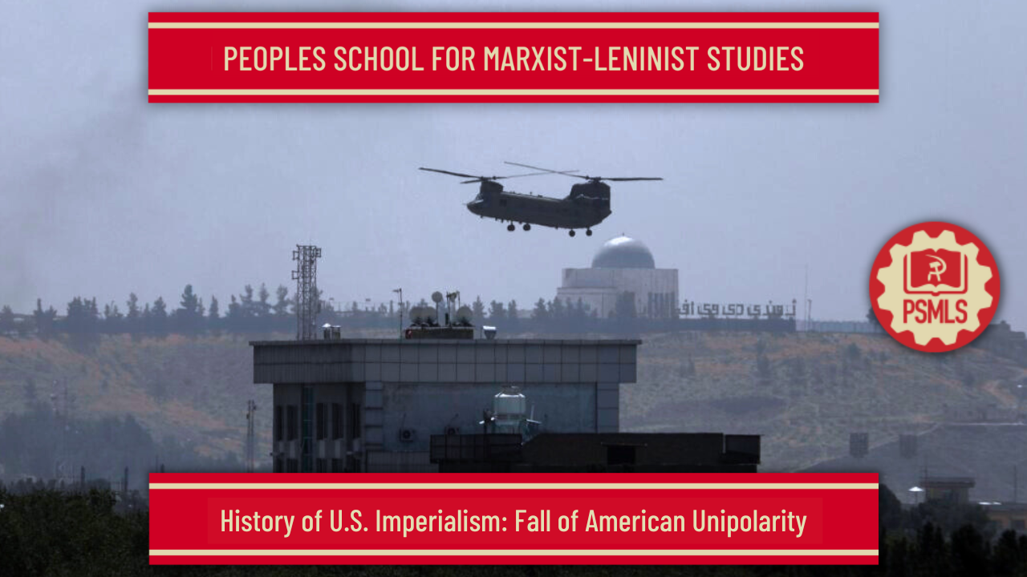
Where we are at: Rise and Fall of U.S. Unipolarity
This class covered the period between 1990 and 2005, with the rise of American unipolarity following the counter-revolution in the USSR in 1991. This class addressed the reckless foreign policy of the US and NATO that followed, and the blowback that occurred on September 11th, 2001, as well as beginning of the “War on Terror”
This class covers the period between 2005 and 2020, during the peak of American unipolarity in the world, and explores the many foreign interventions of the United States under Obama and Trump, as well as the 2008 financial crisis, the erosion of civil rights and liberties at home and other domestic issues of the era.
This class will end out our outlined series on the History of U.S. Imperialism, and will cover the period between 2020 and the present, with some prediction as to what may happen in the near future. It will expose the decline that American unipolarity is in, and highlight the ascendance of a new multipolar world.

Slide 7
Bush, Obama
and the “Global War on Terror”
2005-2016

Slide 8
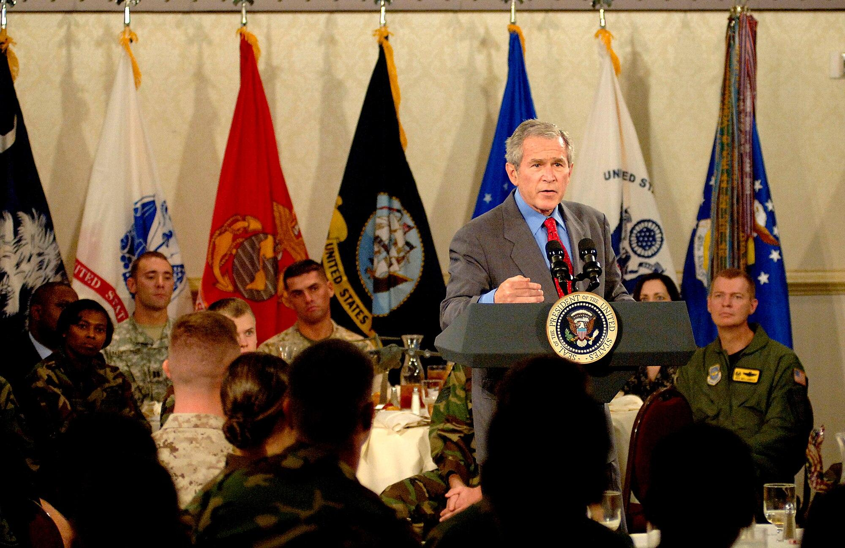
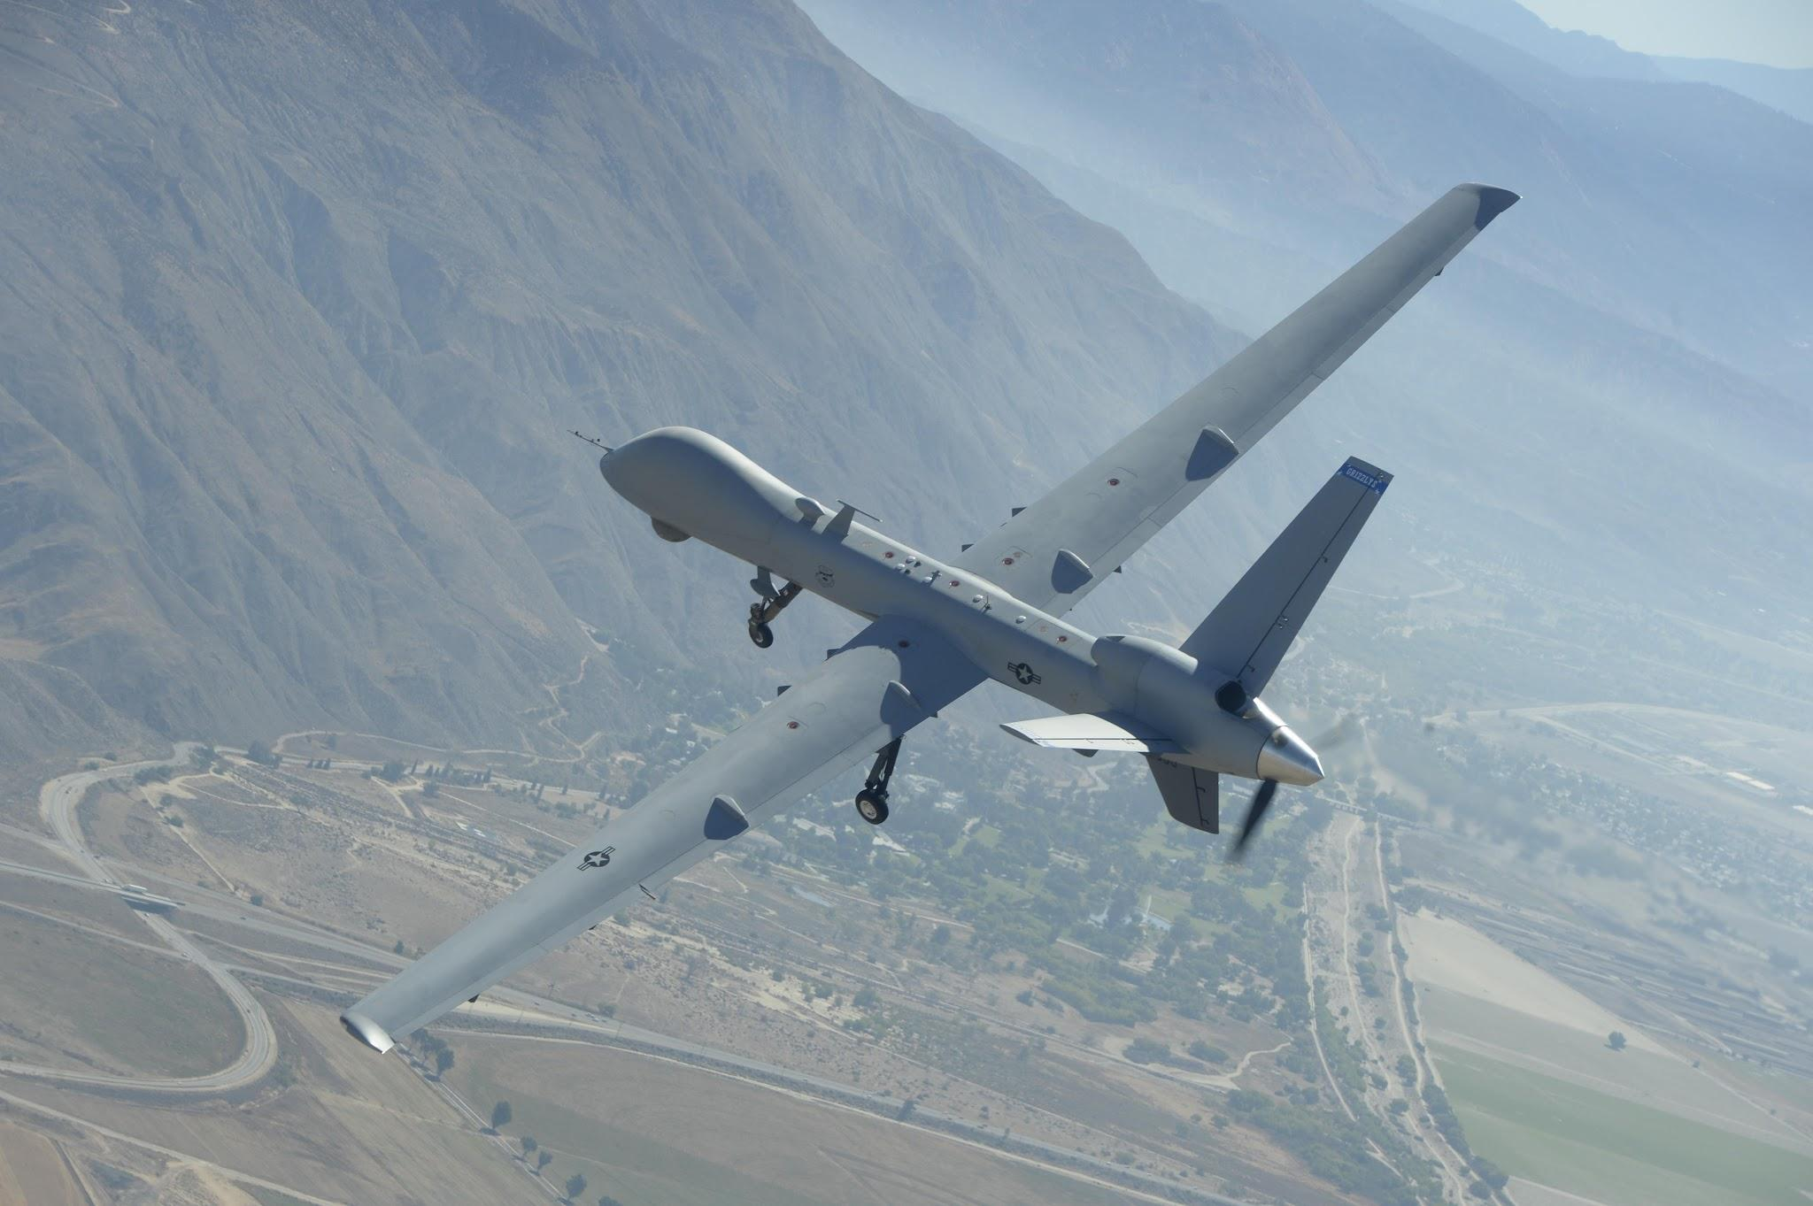
Late Bush Administration
“War on Terror” Spreads
By the 2nd term of the Bush Administration, the United States was not just involved in the bloody, large-scale invasions that were the War in Iraq and the War in Afghanistan, but was also involved in military operations in numerous countries in and out of the Middle East.
Operations from before, such as “counter-terrorism” operations in the Philippines, Georgia, Djibouti, Kenya, Ethiopia and Eritrea, drone operations in Yemen, Pakistan and Somalia. “Africom” was established in 2007 to spread US intervention into Africa as well. Drone warfare was especially becoming more commonplace, and civilian casualties would increase as U.S. troops remained undeployed in many areas.
The Bureau of Investigative Journalism (BIJ) reported that between January of 2004 and February of 2020, ~14,040 civilians in total had been killed in US drone strikes in Afghanistan, Pakistan, Somalia and Yemen, of which 284-454 were children.

Slide 9
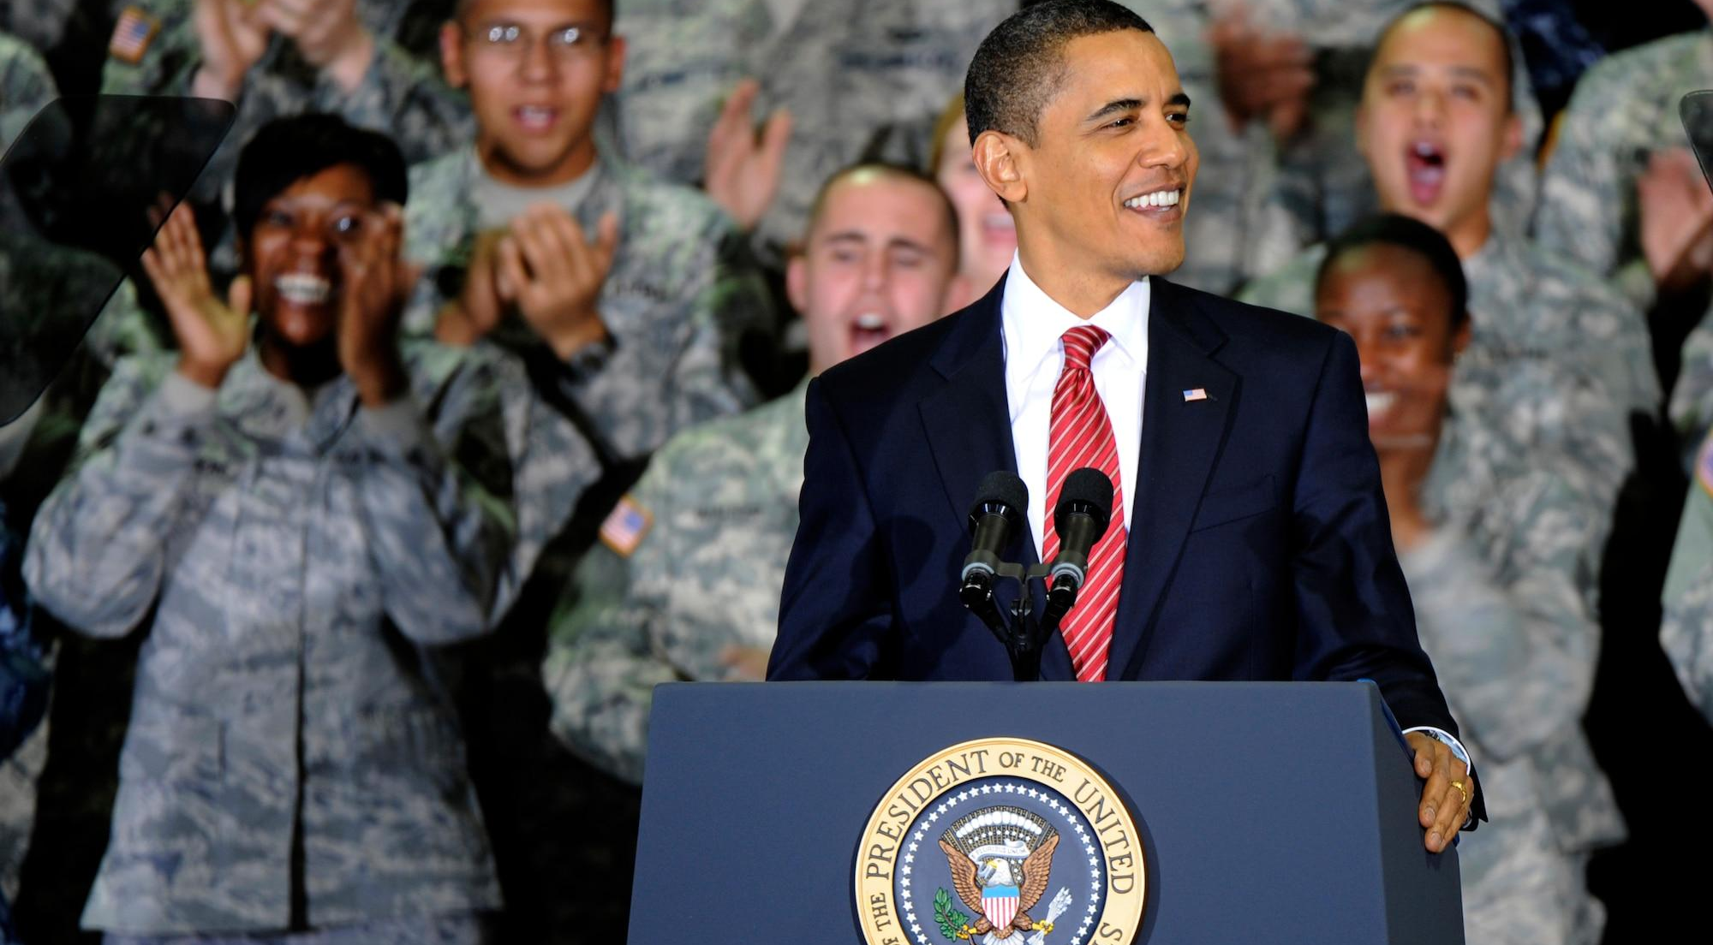
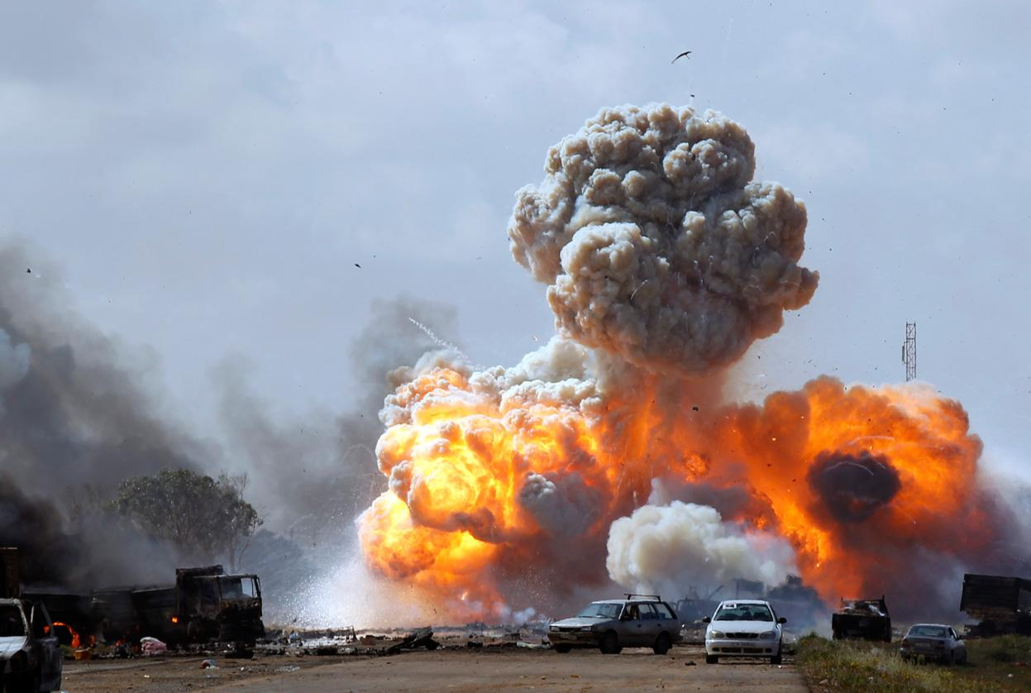
Barack Obama continues “War on Terror”
Imperialist “Hope” and Regime “Change”
Barack Obama ran with a narrative that the war in Afghanistan was a good war - a direct response to 9/11 and a targeted offensive at Al-Qaeda - and that the war in Iraq was a “dumb war” that he opposed. Despite this talk, it wasn’t until halfway through his 1st Administration that he “ended our combat mission in Iraq.”
That same year, 2011, NATO and the United States under Obama’s leadership waged a new war against Libya (then the Great Socialist People's Libyan Arab Jamahiriya) which was led by Muammar Gaddafi. NATO intervened after playing a part in creating the Libyan Civil War via involvement in the 2011 Arab Spring, which affected Libya. Libyan Rebel Forces massacred black Libyans and assassinated Muammar Gaddafi by sodomizing him with a bayonet on video.
Muammar Gaddafi was a long-time enemy of the west and in 2009, Gaddafi spoke of intentions to nationalize Libyan oil. 2010 Wikileaks cables showed oil companies frightened at this. The war opened up Libya to these oil interests, but also opened up open-air slave markets in Libya, as well as a power vaccum in Libya and the deaths of hundreds of civilians, which the US claimed it “had no knowledge of.”
Libya, 2011

Slide 10
Libya’s slave trade: ‘They sell Africans over there’

Slide 11
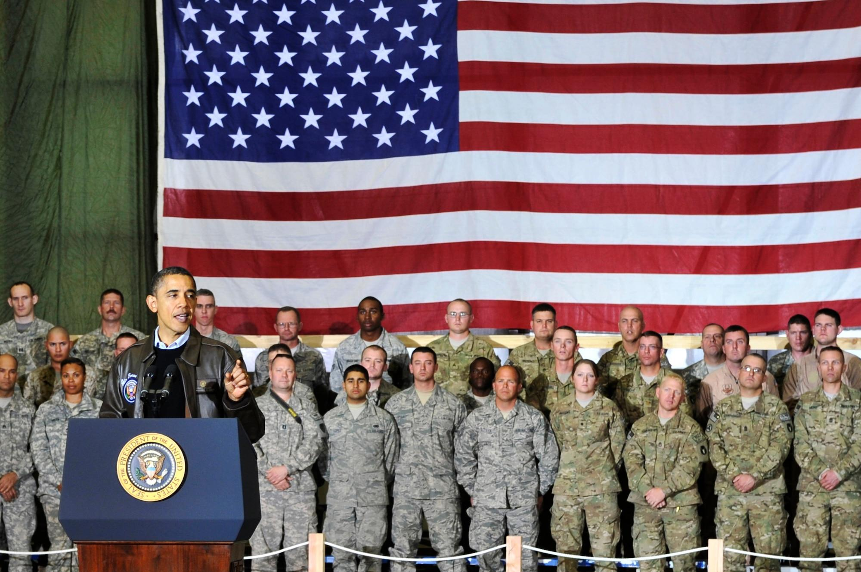
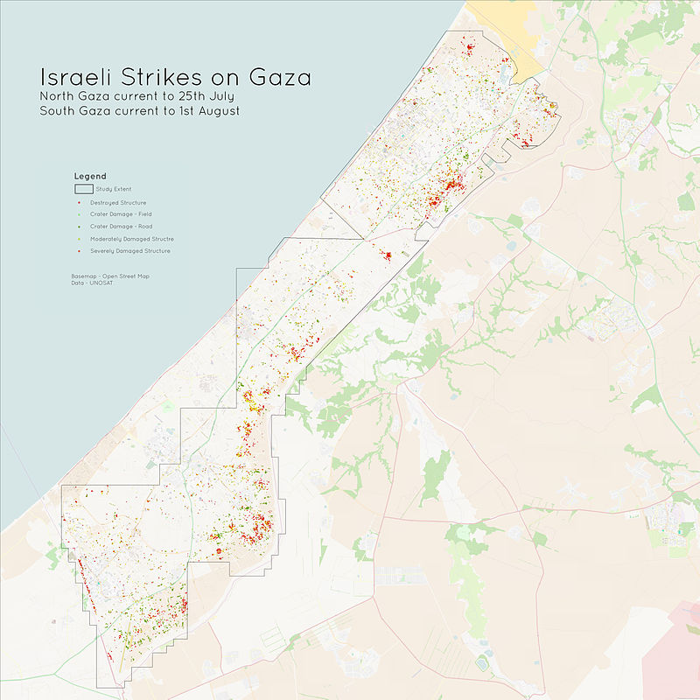
Barack Obama continues “War on Terror”
War on the Middle East
In 2011, Barack Obama announced to Americans on National Television that all American troops would be withdrawn from Iraq by the end of the year. However, 3 years later, he re-deployed US troops in Iraq and deployed US troops in Syria as part of “Operation Inherent Resolve” against the Daesh, better known as the Islamic State of Iraq and Syria or “ISIS” as they are known by the west.
In late ‘09, he increased the amount of troops in Afghanistan by 30,000, reaching almost 100,000, the peak of US troop presence in Afghanistan. In 2011, Osama Bin-Laden was assassinated by US Navy Seals in Pakistan and was dumped at sea, yet the war in Afghanistan continued for an entire decade.
During this time, the US-backed Zionist Israeli Government was also attacking Gaza and killing thousands of civilians, including in ‘08-’09 with Operation Cast Lead, which killed 1,181 civilians, Operation Pillar of Defense in 2012, which killed 103 civilians, and Operation Protective Edge, which killed about 2,251 civilians. Obama urged restraint, but fully supported the massacres.
2014

Slide 12
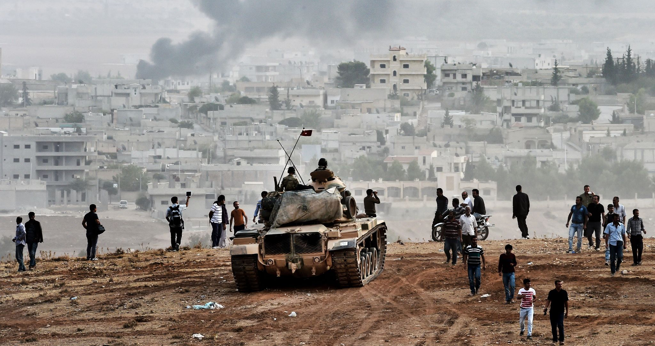
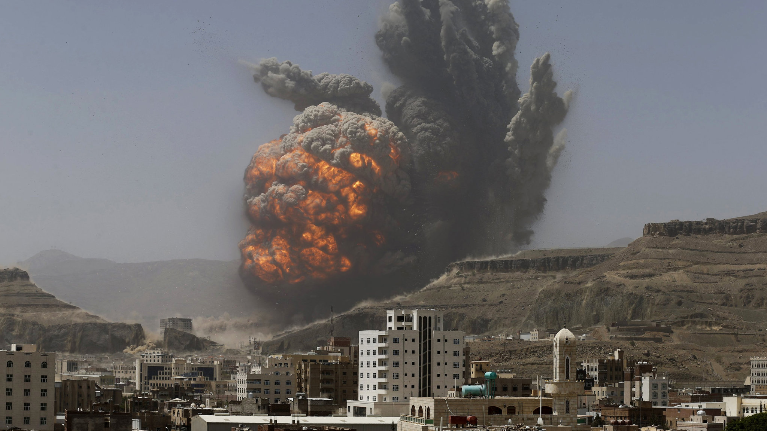
Barack Obama continues “War on Terror”
War on the Middle East cont.
The same strategy used in Libya was used again in Syria. The United States began supporting a wide array of anti-government forces, including those linked in many cases to ISIS. The government of Syria under the leadership of Bashar Al-Assad is opposed to US imperialism and is aided militarily by the Russian Federation. Syria did not fall like Libya, however, and Bashar Al-Assad still leads the country to this day.
Saudi Arabia and the UAE began a genocidal campaign in 2015 on Yemen in the midst of the Yemeni Civil War, which sprang from the 2011 Yemeni Revolution in which the Shiite Zaydist group “Ansar Allah”, known in the west as “The Houthis” revolted against the western-backed government of the Republic of Yemen, the same government that annexed the Soviet-backed People’s Democratic Republic of Yemen in 1990. The United States and United Kingdom pledged “technical support’ to this war.
The war has killed an estimated 12,907 Yemeni civilians, and there is clear evidence of multiple war crimes by the Saudi-led coalition, including airstrikes on residential areas, prisons, schools, school buses, hospitals etc. It has led to famine, an outbreak of Cholera and widespread displacement. The UN reports that over 377,000 people have died in total as a result of the war. The coalition has also imposed a blockade on Yemen, preventing food and medicine from reaching the country.
Syria, 2015
Yemen, 2015

Slide 13
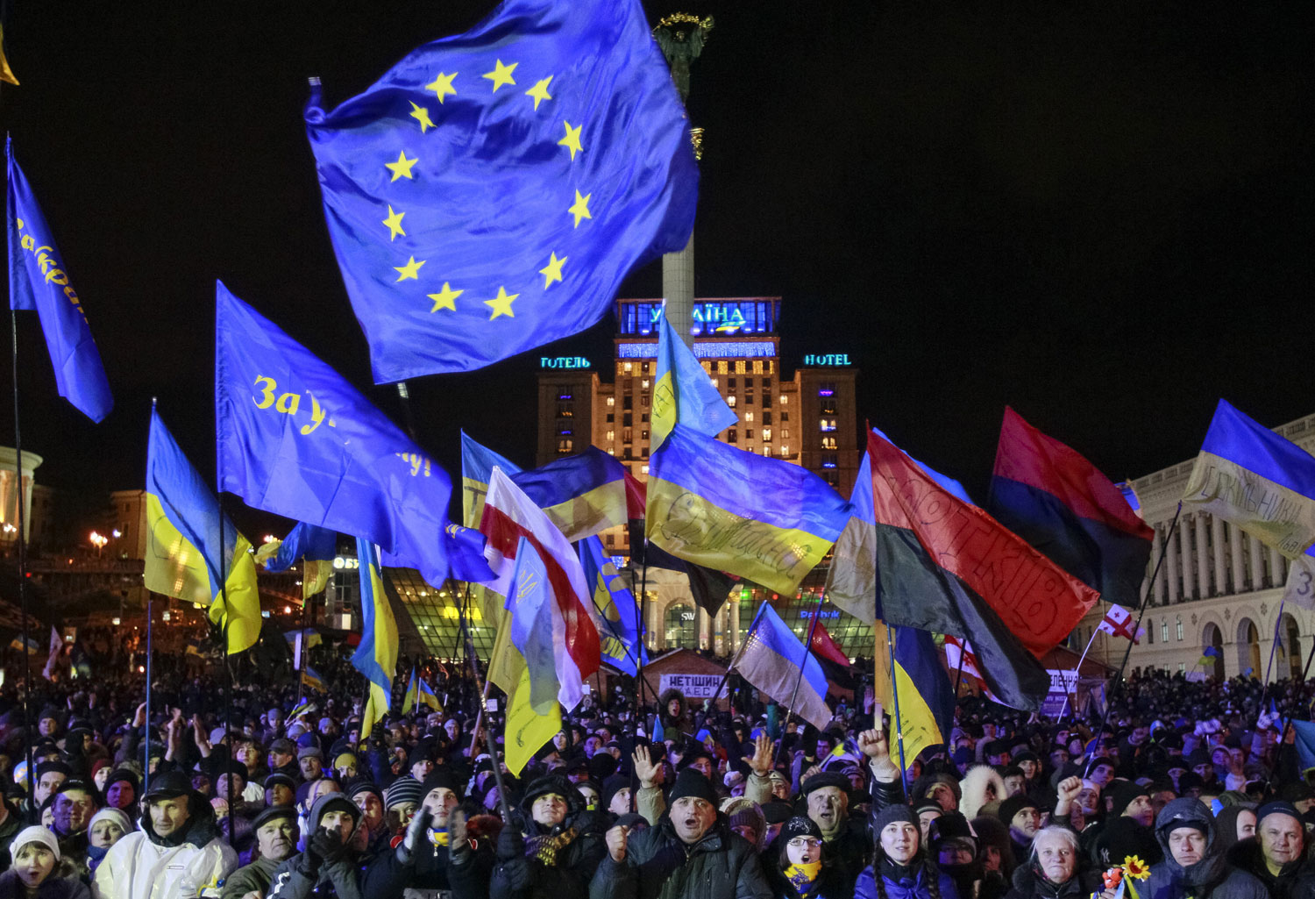
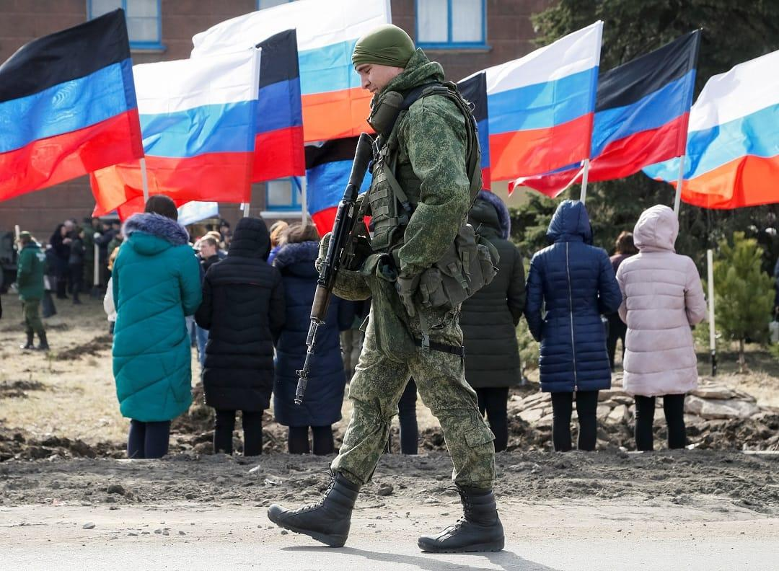
Involvement in Euromaidan Coup
Euromaidan, Kiev, 2014
Resuscitating Nazism
Foreign interference abroad was not limited to the Middle East under Obama, and one example of covert foreign intervention by the United States that would become very significant as time went on was the its involvement in the 2013-14 “Euromaidan” fascist coup in Ukraine.
Then President of Ukraine, Viktor Yanukovych, had halted an application for Ukraine to join the EU and instead aimed to build a better economic relationship with the Russian Federation, which was not friendly to NATO or the United States. The US had spent $5 billion on “democracy-building programs” in post-Soviet Ukraine, and during the anti-government protests that erupted with Neo-Nazi forces such as Svoboda and the Right Sector at its forefront, US Assistant Secretary of State for European and Eurasian Affairs, Victoria Nuland, and Geoffrey Pyatt, US Ambassador to Ukraine, spoke on a phone conversation about who they wanted to be in the Ukrainian government, Arseniy Yatsenyuk.
Rapidly the situation deteriorated, and Viktor Yanukovich fled Ukraine, Russian-speaking people in the East and South began counter-uprisings to resist the fascist coup, the new “provisional interim government” of Ukraine declared intent to remove protections for the Russian language, the CIA director met with now-acting Prime Minister Yatsenyuk, an “Anti-Terror Operation” was declared on the separatists and thus would begin an 8 year, US-backed, UkroNazi-led genocide on the people of the Donbas. Trade unionists were murdered in Odessa in a massive arson attack and an independence referendum in Crimea passed, allowing Crimean annexation by the Russian Federation.
Donbas, 2014

Slide 14
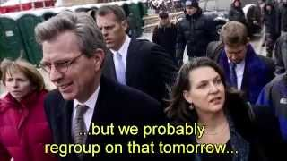
Victoria Nuland Leaked Phonecall

Slide 15
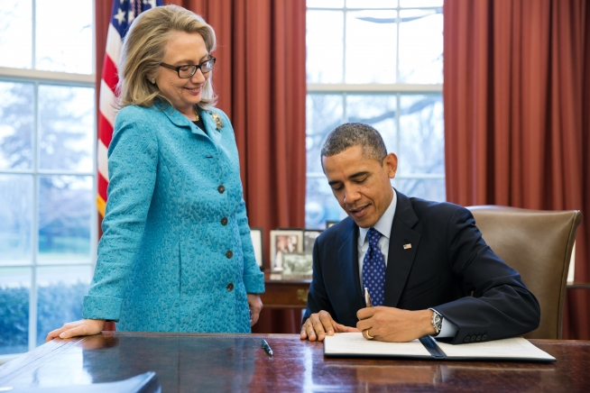
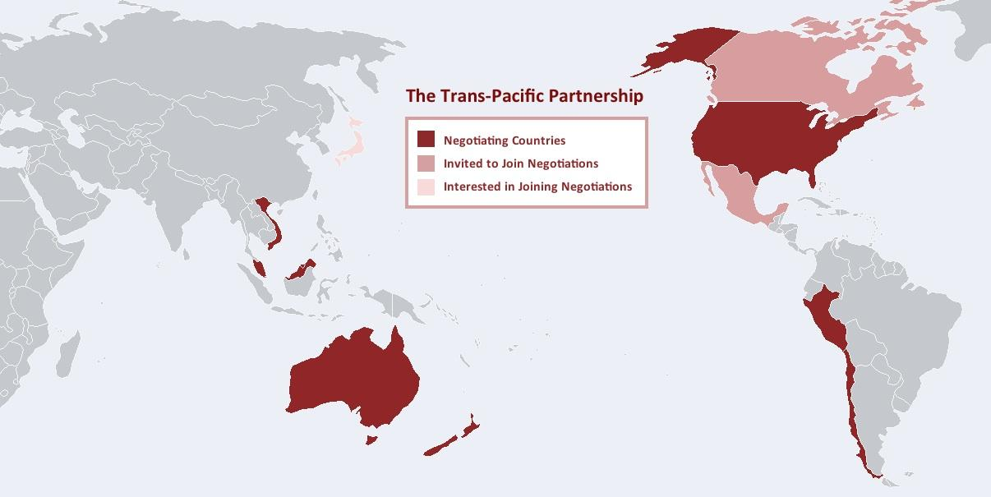
Pacific Pivot
“America’s Pacific Century”
In the Asia-Pacific region, the United States began retooling certain proxies and pushing tensions harder with the Peoples Republic of China and the Democratic Peoples Republic of Korea. Bases were upgraded, military drills with allies in the region increased, and military relationships with Japan, South Korea, Taiwan and the Philippines were strengthened.
Hillary Clinton coined the term “Pacific Pivot” in her 2011 article for Politico entitled “America’s Pacific Century.” This became the policy of the Obama Administration and the Trans Pacific Partnership was designed by Obama for this pivot, and was detrimental to the working class as it facilitated the outsourcing of jobs to countries with lower labor standards, resulting in wage stagnation and job losses in the United States. Furthermore, the agreement entrenched U.S. corporate dominance in global markets, enabling multinational corporations to exploit cheap labor and weaken workers' rights abroad.
The United States also supplied Taiwan with billions of US dollars worth of weapons during the Obama Administration, which weakened Chinese relations even as the US was on relatively good standing with them.

Slide 16
Other Interventions/Events under Obama
2007 and on: Multiple counter-terrorism operations were underway in the Sahel region of Africa, including in Niger, Chad, Mali and more. These operations were heavy on drone warfare and lead to the deaths of many civilians in these countries.
2011 - Uganda: Operation Observant Compass involved the deployment of U.S. special forces to Central Africa to assist in the hunt for Joseph Kony and the Lord's Resistance Army (LRA) as the US continued to back the brutal dictatorship of General Museveni.
2009 - Honduras: A US-backed coup against democratically elected center-left president Manuel Zelaya occurred in 2009 when Zelaya was kidnapped after a flight to a US air base in Costa Rica. The Honduran military, which carried out the coup, had received extensive training and support from the United States, including through the notorious School of the Americas (now the Western Hemisphere Institute for Security Cooperation).
Under Obama, Montenegro joined NATO, and Georgia and Ukraine began the processes of joining NATO. The Philippines and Tunisia became major non-NATO allies as well.

Slide 17
Discussion

Slide 18
Trump and the Unraveling of American Unipolarity
2016-2020

Slide 19
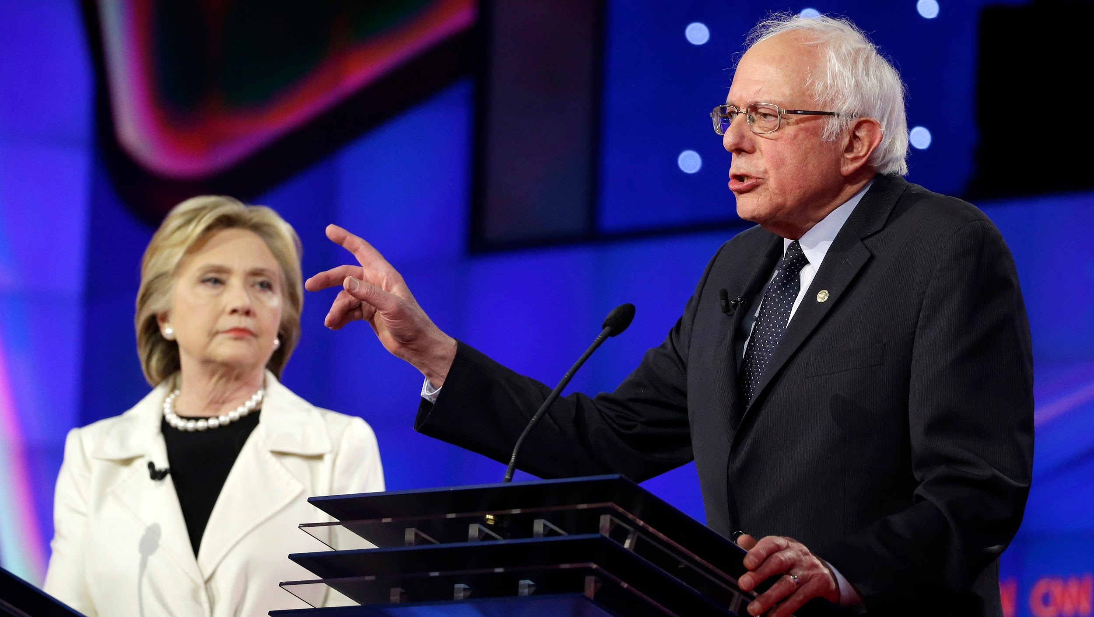
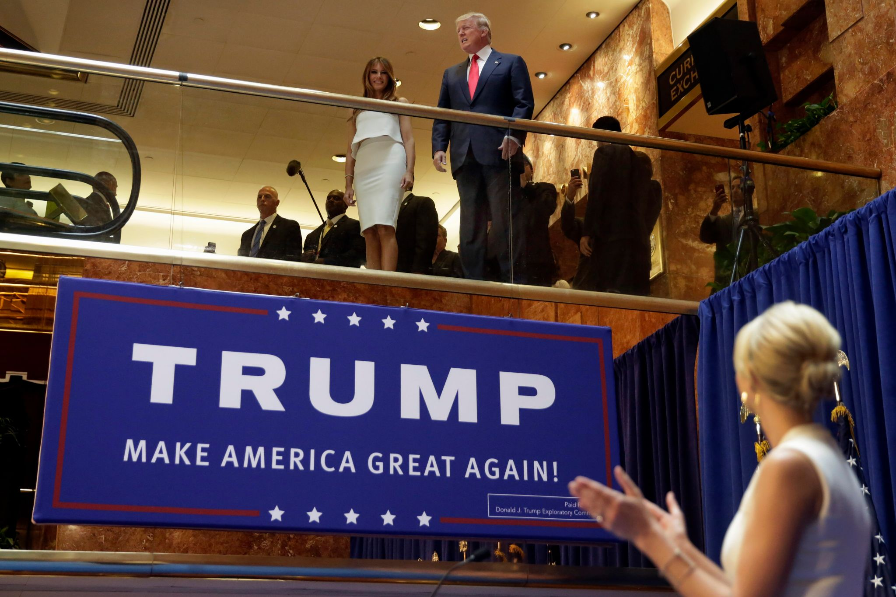
2016 Election & Donald Trump
Populism vs Neoliberalism
In 2016, it was time once again for the American people to pick a new president. In the Republican Party Primary, millionaire con-artist and long-time celebrity, Donald Trump, soared through to the nomination. Trump presented himself as an anti-establishment politician that would end wars and throw a wrench in wreckless capitalism.
On the Democrat side, the race was primarily between Hillary Clinton and Bernie Sanders, a Senator from Vermont who presented himself as a progressive candidate, almost a democratic socialist, that spoke to the woes of working class Americans who were struggling to survive and highlighting that the “top 1% needs to pay their fair share.” Despite Sanders galvanizing millions of supporters, the primary was essentially rigged for Clinton, who won the nomination and then subsequently lost the general election to Donald Trump.
Trump would become an inconsistent president, sometimes refraining from aggression that his military advisors were trying to convince him into and engaging in diplomacy more than his predecessors, and sometimes pushing more recklessly for war than other presidents, but overall continuing imperialist policy.

Slide 20
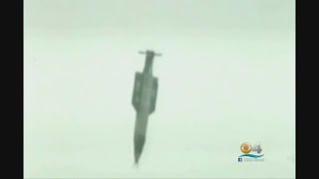
Mother Of All Bombs

Slide 21
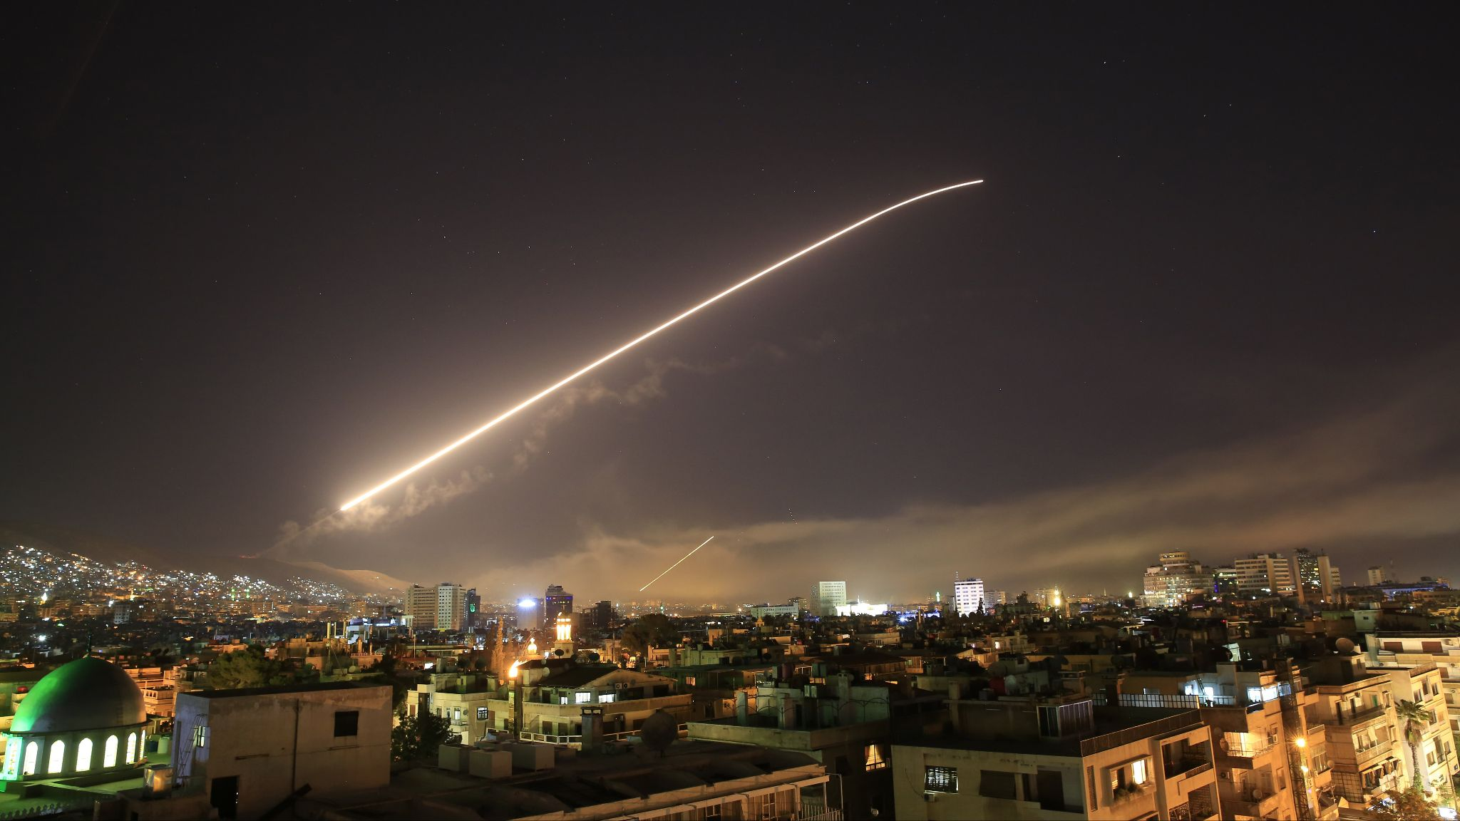
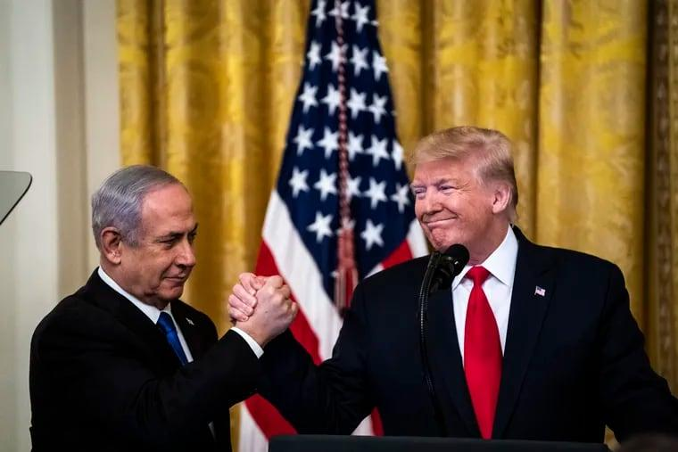
Middle East under Trump
Airstrike in Syria, 2018
“Bomb the hell out of them”
Operation Inherent Resolve accelerated under Trump, US involvement in the Saudi-led genocide in Yemen continued under Trump, US support for Zionist Israel was stengthened under Trump. He dropped the largest non-nuclear bomb in history on Afghanistan in 2017. Over 2200 drone strikes occurred in the first 2 yrs of Trump’s presidency, compared to around 1900 in the entire 8 years under Obama. Civilians killed in Afghanistan increased 330% from 2016 to 2019.
Multiple major airstrikes in Syria against government forces of Al-Assad occurred, including in 2017 and 2018, both based on false claims of chemical attacks on Syrian civilians by the Assad government (which were covered up by the Organization on the Prohibition of Chemical Weapons.) In January of 2020, after allegedly “Iranian-backed Iraqi militias” attacked the US embassy in Baghdad on New Years Eve, the United States lured Iranian General Qasem Soleimani into Iraq and assassinated him, along with multiple civilians, in a drone strike. In the weeks following, the US and Iran fought multiple skirmishes in the Persian Gulf and the United States nearly went to war with Iran.
Trump also significantly worsened the Israel/Palestine crisis, as he declared recognition of Jerusalem as the capital of Israel rather than Tel Aviv, and moved the US embassy from Tel Aviv to Jerusalem. This decision was condemned by 14 out of 15 UNSC members, as well as Hamas and the Palestinian National Authority. He also approved the largest single aid package to Israel in 2018, costing ~$550 million. The entirely peaceful Gazan “Great March of Return” was brutally fired upon in 2018 by Israeli forces, and the US defended this action as Israel’s “right to defend itself.”

Slide 22
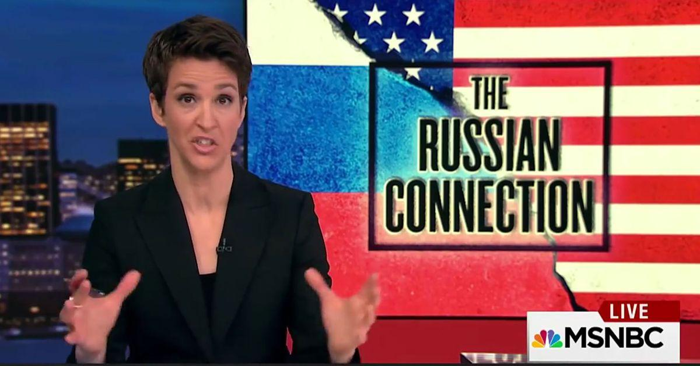
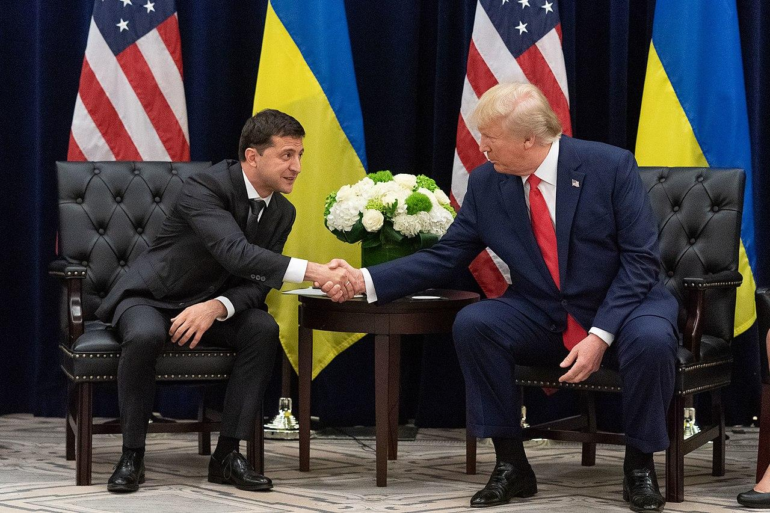
Anti-Russia Hysteria Takes Off
Russiagate, Trump and Ukraine
US-Russian relations hit shocking lows in the Trump administration, as mainstream media peddled a propaganda campaign called “Russiagate”, that claimed the Russian government interfered with the 2016 US election and that Vladimir Putin colluded with the Trump campaign. Numerous federal investigations, including those by the Mueller Report, failed to find conclusive evidence of collusion.
This fake scandal brought increased Russophobia into the United States and set the stage for anti-Russia propaganda before and during the 2022 Special Military Operation in Ukraine.
The truth is that under the Trump administration, Russian nationals were killed for the first time since the Cold War in the 2018 airstrike in Syria, Russian diplomats were expelled from the United States the same year, and in 2019 a $391 million aid package to Ukraine was passed (although it was held up briefly over a phone call between Trump and Zelenskiy which became a subject of the Russiagate scandal, but of course ended up being nothing significant.)

Slide 23
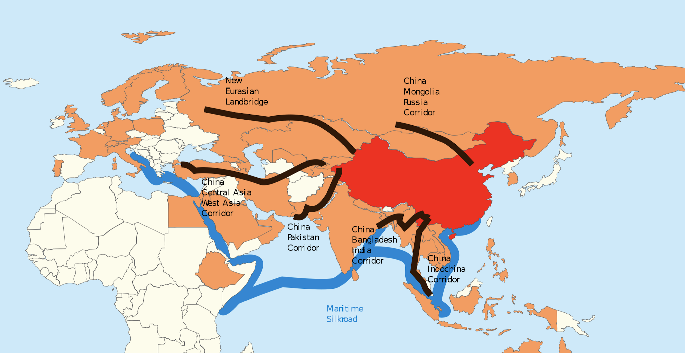
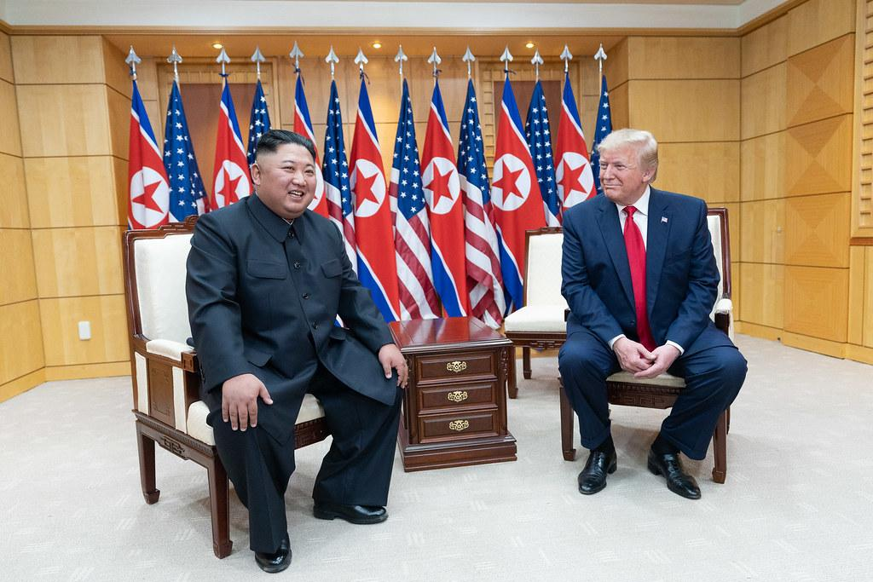
Developments in Pacific
Rise of China, Korean relations
In the 2010s, the People’s Republic of China experienced a significant rise in global influence, driven by ambitious initiatives like the Belt and Road Initiative (BRI). Launched in 2013, the BRI aimed to enhance connectivity and infrastructure development across Asia, Africa, and Europe, facilitating trade and bolstering China's economic and geopolitical clout. As the initiative expanded, China emerged as a major player in international development projects, challenging traditional Western dominance in global economic affairs.
Amid China's ascent, Western powers have engaged in information warfare with false propaganda about a supposed Uighur population in Xinjiang. These claims came from discredited German anthropologist Adrian Zenz, and the US has admitted that there is no substantive evidence to these claims. Furthermore, Western entities like the National Endowment for Democracy have supported the attempted color revolution in Hong Kong, providing funding and political backing to anti-China movements under the guise of defending human rights and democracy. Military aid for Taiwan continued as well.
On the Korean peninsula, 2018 saw an attempt at pursuing national reunification, with the DPRK’s Kim Jong Un meeting with RoK’s Moon Jae-In at the Demilitarized Zone. Trump, after initially trying to start nuclear war with the DPRK over twitter, actually went to the DMZ and also met with Kim Jong Un there, marking the 1st meeting of leaders of the DPRK and US ever (this was smeared by Democrats as “meeting with a communist dictator.”) Despite this, military aggression by the US and South Korea continued, and efforts at peaceful reunification have since stalled.

Slide 24
2019 - Venezuela: In April 2019, the Trump administration openly supported an attempted coup in Venezuela led by opposition leader Juan Guaidó, aiming to overthrow President Nicolás Maduro.
2017 and 2021: In 2017, the Trump Administration added the DPRK to the state sponsors of terrorism list, and on the final day of his presidency, added Cuba to the state sponsors of terrorism list. There was no credible evidence of supporting terrorism provided for either, merely state department propaganda.
2017 - Puerto Rico: Puerto Rico is hit by Hurricane Maria, category 4, that devastated the islands infrastructure, resulting in floods, no clean water, months-long blackouts and more. Without any representation in DC, the territory is neglected. Trump visited and threw paper towels at the people.
Other Interventions/Events under Trump
2017 - Niger: 4 US troops are killed in Niger after an ambush by militia forces. This was a surprise to many Americans who didn’t even know about the extent of the US’s shadow wars in Africa.
2019 - Bolivia: Following US allegations of electoral fraud in the October 2019 presidential election (and the discovery of lithium deposits in Bolivia), widespread protests erupted, prompting the Bolivian military to pressure Evo Morales to resign. This coup was followed by a military junta in Bolivia that lasted nearly a year.

Slide 25
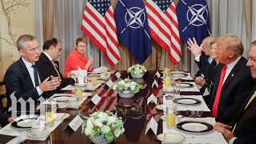
Trump and Stoltenberg get into tense exchange at NATO summit

Slide 26
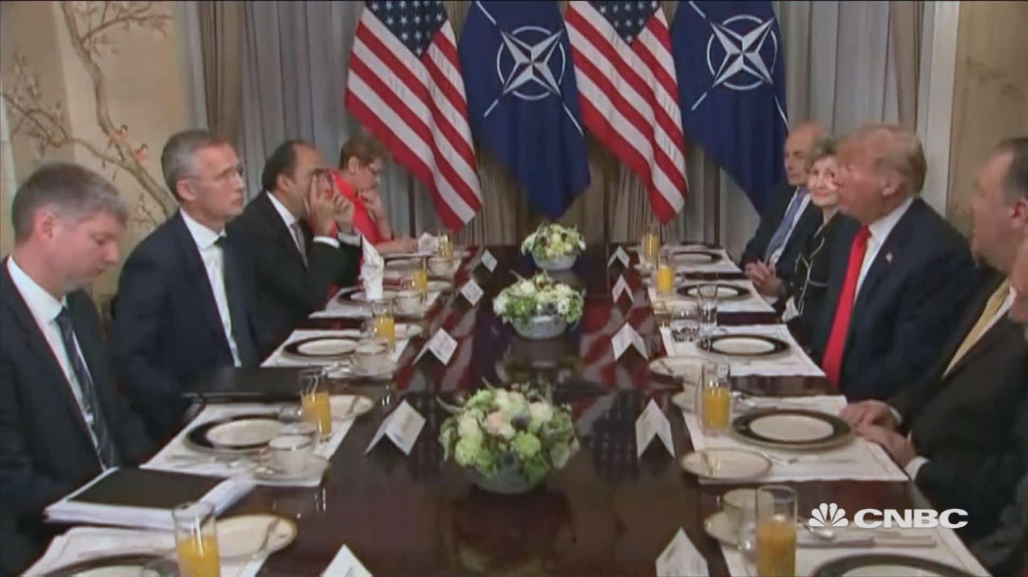
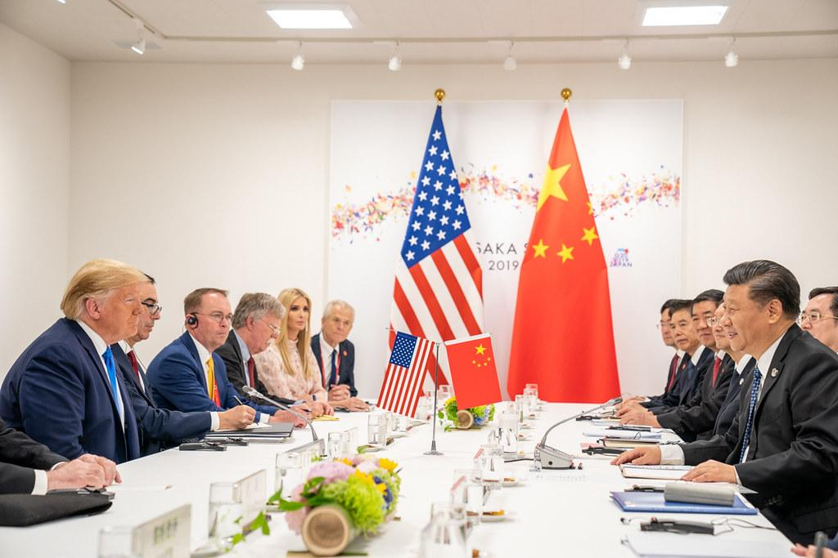
Cracks in the Empire Emerge
NATO, TPP and what Trump did right
During his presidency, Trump challenged imperialist alliances and trade agreements that had underpinned American global hegemony. He notably undermined NATO, criticizing member nations for insufficient defense spending and suggesting the United States might not honor its mutual defense commitments. Trump’s willingness to meet with leaders like Vladimir Putin, Xi Jinping, and Kim Jong Un was also a necessary effort at diplomacy.
Additionally, Trump withdrew the United States from the Trans-Pacific Partnership (TPP), a trade deal aimed at countering China's influence in the Asia-Pacific region, further isolating the US from its allies and weakening its economic leverage.
These actions, seen from an objective anti-imperialist perspective, marked a departure from traditional American imperialism, fostering divisions within the Western bloc and hastening the erosion of US hegemony on the global stage, strengthening the power of the BRICS nations and others and contributing to the rise of a multipolar world once again. All whether it was Trump’s intention or not.

Slide 27
Discussion & New Members Introductions

Slide 28
New Member Introductions
What is your name, pronouns and state (or country/territory)?
Where do you work? Is it unionized?
How did you find out about the People’s School?
What do you think about tonight's class?

Slide 29
Domestic Conditions in Late 2000’s and 2010’s America

Slide 30
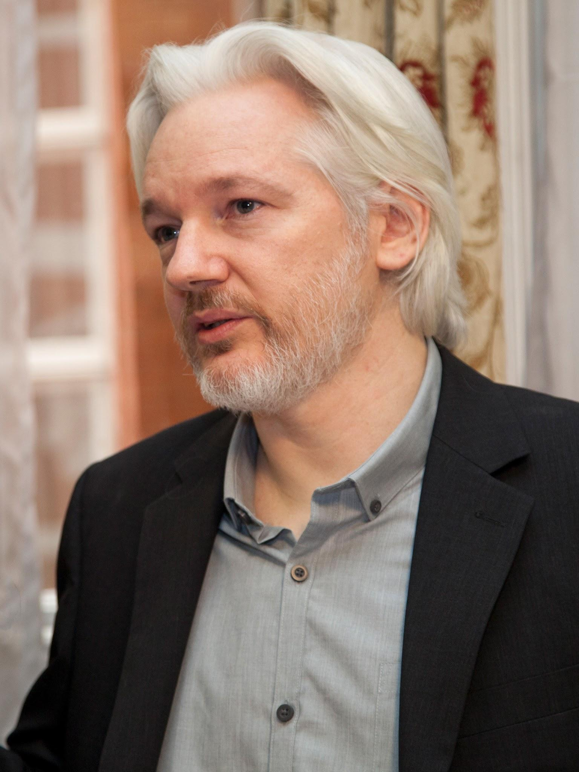
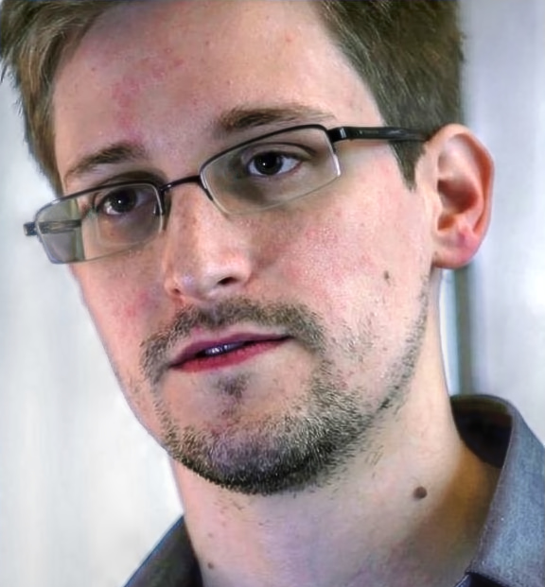
Repression against Whistleblowers
Chelsea Manning
Julian Assange
Edward
Snowden
American Heroes
WikiLeaks, founded by now imprisoned whistleblower Julian Assange, became a source for leaked government and corporate documents. Incredibly graphic war crimes of the US in Iraq were revealed in 2010 after they were delivered to WikiLeaks by Chelsea Manning.
Julian Assange and Chelsea Manning were both investigated for Espionage. Chelsea was convicted. Julian Assange was indicted in 2019 and the US has been trying to extradite him from London for years.
Another notable whistleblower of this era was Edward Snowden, a former CIA employee and NSA contractor who leaked classified documents revealing the existence of mass surveillance programs such as PRISM and XKeyscore, which allowed the NSA to collect and analyze vast amounts of personal data from both American citizens and individuals worldwide. He faced charges of Espionage and fled to Hong Kong, later Russia.

Slide 31
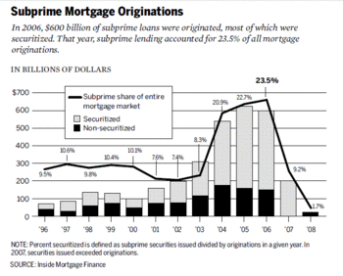
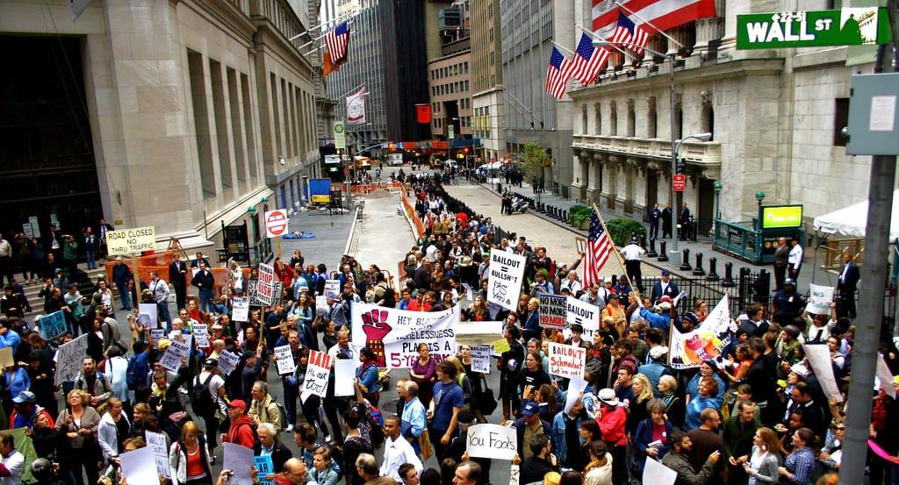
Financial Crisis
Occupy Wall St
2008 and The Great Recession
The 2008 financial crisis was triggered by the collapse of the subprime mortgage market, where the proliferation of high-risk mortgage loans bundled into complex financial products resulted in widespread defaults, leading to the failure of major financial institutions and ultimately causing a global economic downturn.
This upheaval devastated the working class, resulting in widespread job losses, home foreclosures, and depleted savings, while the elite were shielded by government bailouts. Subsequent austerity measures exacerbated the suffering of the proletariat, exacerbating poverty and insecurity, and exposing the inherent injustices of the capitalist system.
As the crisis unfolded, it laid bare the structural inequalities inherent within capitalism, amplifying the struggles of the working class. This would’ve been the perfect time for a Communist Party to take action, but the CPUSA had devolved into revisionism and liquidationism and did not rise to the occasion. Instead, disorganized, anarchistic movements like “Occupy Wall Street” appeared, threw their fit and withered away.
The working class would be the ones to take the brunt of this financial crisis and of the crumbling system of capitalism in the US for the years to come, as jobs were outsourced overseas, companies closed their doors and the people were hit with recession after recession.

Slide 32
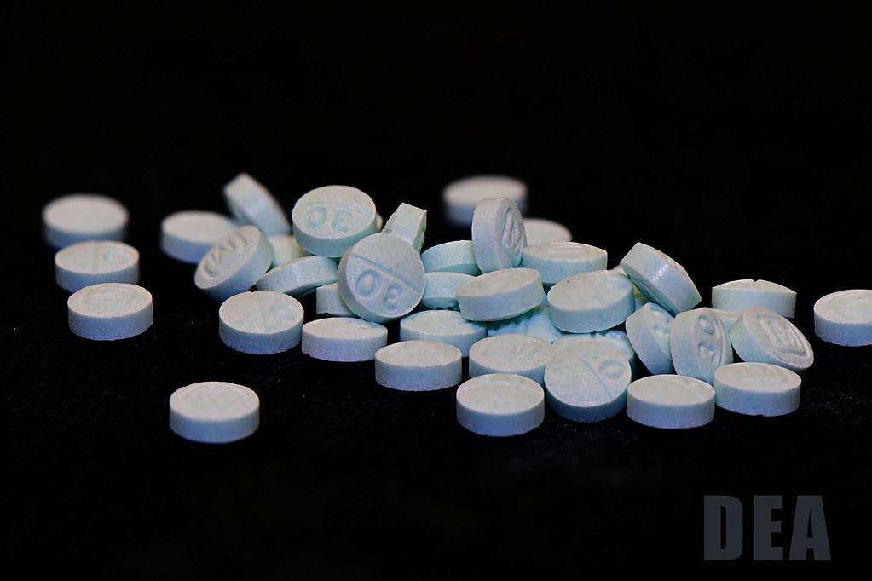
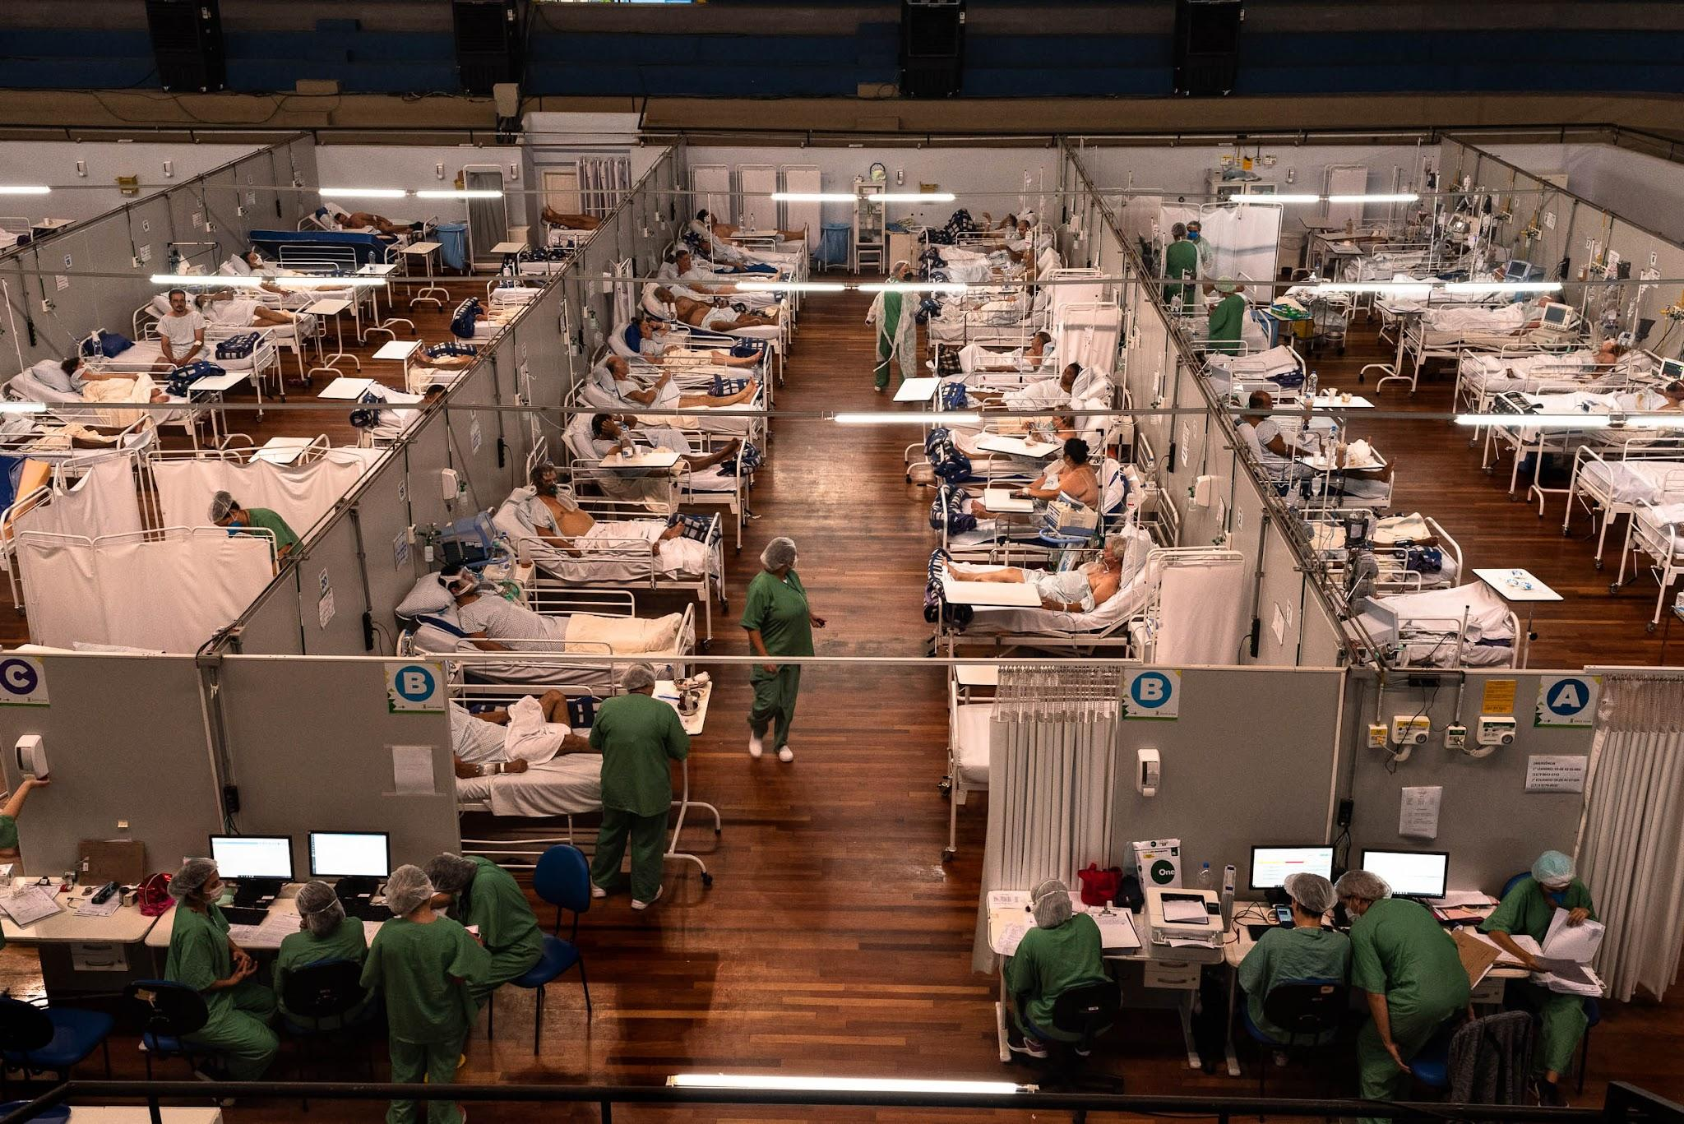
Public Health of the American People
Fentanyl pressed into shape of pharmaceuticals
US Field Hospital, June 2020
Opiates, Covid and For-Profit Healthcare
During the opioid epidemic, which began in the late 1990s and continued into the 2010s, millions of Americans struggled with addiction to prescription opioids, heroin, and exponentially more potent synthetic opioids like fentanyl, leading to a significant increase in overdose deaths and a public health crisis. The epidemic was fueled by overprescribing practices, pharmaceutical marketing tactics, and inadequate regulation of opioid medications, but also bears an eerie similarity to the crack epidemic in the 1980’s, in which the FBI and CIA were involved.
Meanwhile, the COVID-19 pandemic, which emerged in early 2020, exposed the vulnerabilities of the American healthcare system, with disparities in access to care, testing, and treatment exacerbating the impact of the virus, particularly among oppressed communities. The pandemic highlighted the lack of universal healthcare coverage, reliance on employer-based insurance, and profit-driven healthcare practices in the United States.
A bungled lockdown policy and continued bailouts for corporations while small businesses went under and workers got laid off exposed the sharpening contradictions between the ruling class and the American working class, which has bore the brunt of the century of imperialism and tasted none of the fruit.

Slide 33
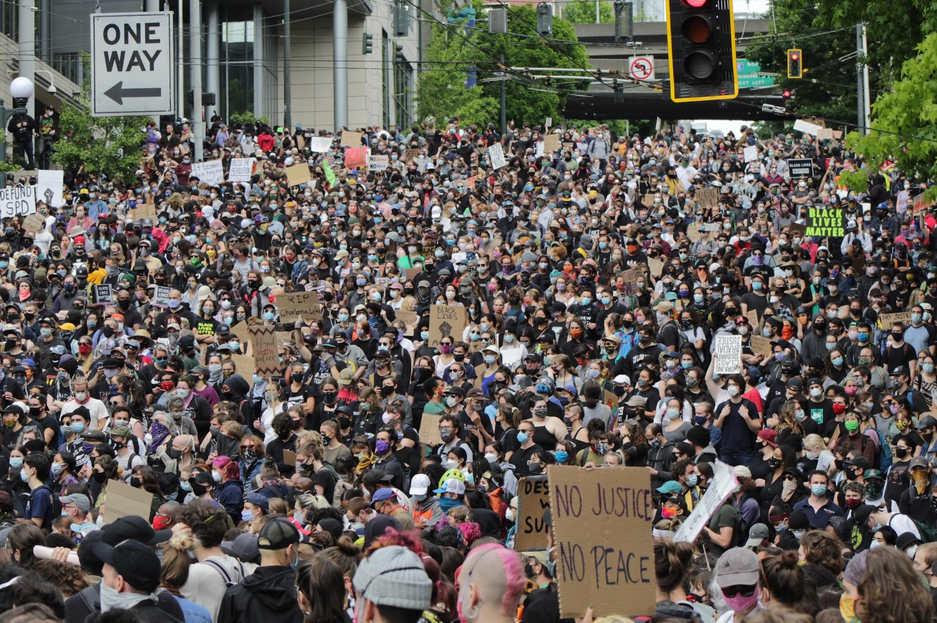
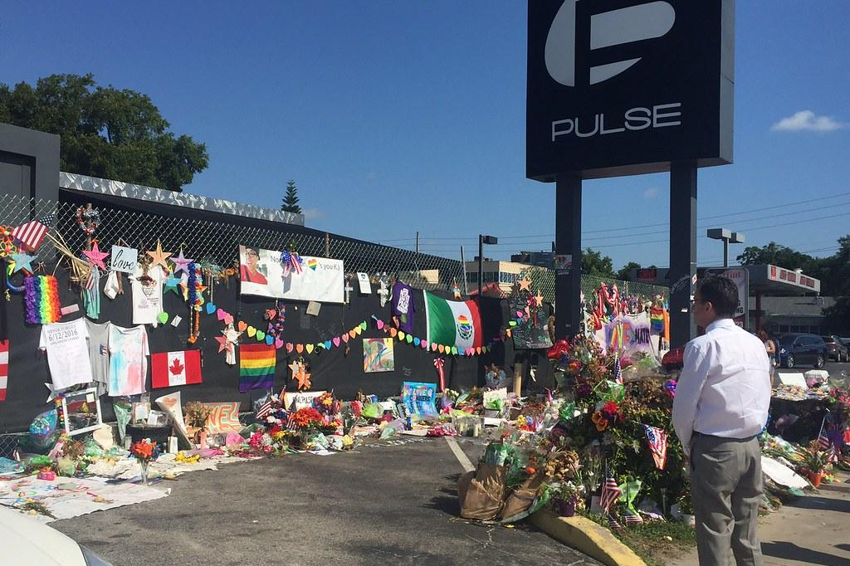
Civil Rights Struggles
George Floyd protests
Pulse Nightclub
Civil Rights Movements Continue
Civil rights and civil liberties continued to face challenges during this time. Besides the violations of the constitutional rights of all Americans with repressive legislation like the PATRIOT act, whistleblower crackdowns and more, marginalized communities in the country faced difficult civil rights struggles, especially more so under Trump.
Black Americans continue to face discrimination, police brutality, and disproportionately poorer, less safe, less healthy conditions. The movement and organization the movement is loosely based around, “Black Lives Matter” emerged in 2013 after the acquittal of the white murderer of Trayvon Martin, a black child, in 2012. This movement is unfortunately heavily influenced by the legacy of “New Left” political theory and movements. In 2020, after the police murder of George Floyd, a black man in Minneapolis, MN, over 15 million Americans participated in uprisings and demonstrations across the country, the largest protest in US history.
Furthermore, even despite victories for the LGBT+ community such as the 2015 legalization of same-sex marriage in all 50 states, LGBT+ people faced and continued to face harsh discrimination in work, healthcare, the military, housing and more. LGBT+ community was the victim of the 2nd deadliest mass shooting in US history in 2016, with the targeted shooting of 49 people at “Pulse”, a gay nightclub in Orlando, Florida.

Slide 34
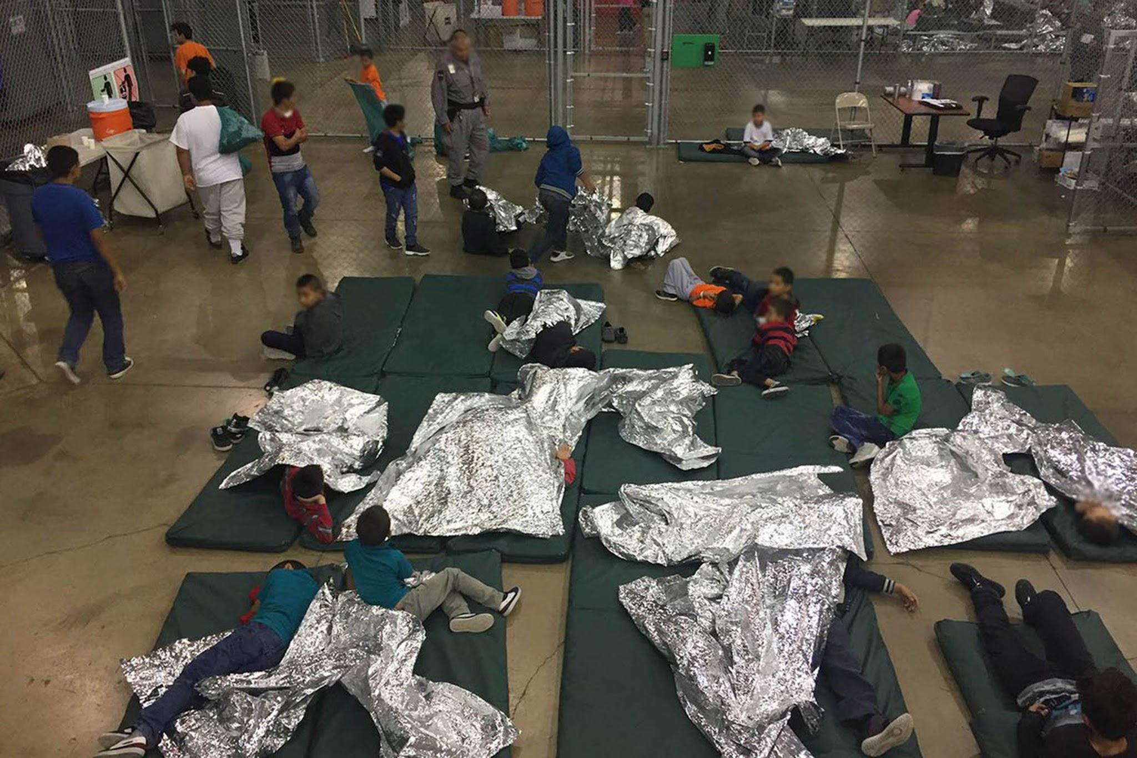
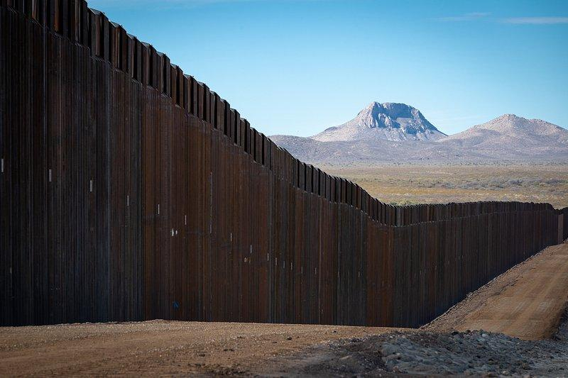
Immigration Crisis
Migrant “Detention Facility”, 2018
US/Mexico Border Wall
ICE, the Wall and Xenophobia
The establishment of Immigration and Customs Enforcement (ICE) under the Bush era laid the groundwork for aggressive immigration enforcement. During the Obama administration, the construction of detention facilities and the increase in deportations, coupled with the expansion of border enforcement, contributed to a harsh climate for immigrants.
Moreover, the Trump administration's implementation of the family separation policy, rollback of Deferred Action for Childhood Arrivals (DACA) and Temporary Protected Status (TPS), emphasis on constructing the “border wall”, and hostile rhetoric towards Latino communities exacerbated the crisis.
Middle Eastern immigrants also faced challenges under Trump as the Muslim travel ban, enacted by the Trump administration, restricted entry into the United States for citizens of seven predominantly Muslim countries—Iran, Iraq, Libya, Somalia, Sudan, Syria, and Yemen.

Slide 35
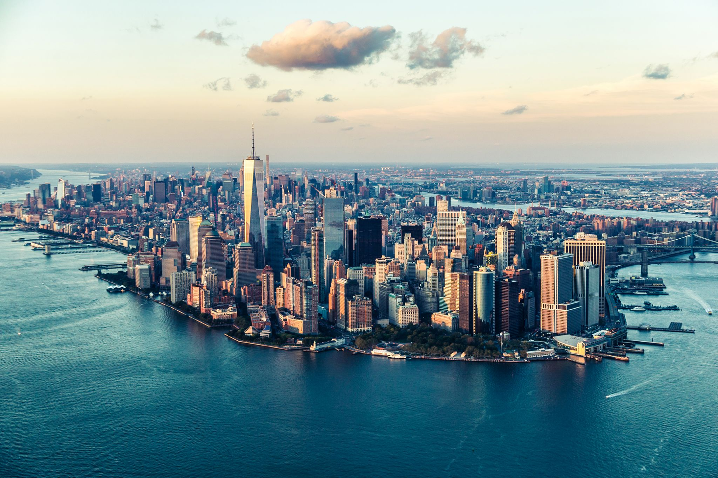
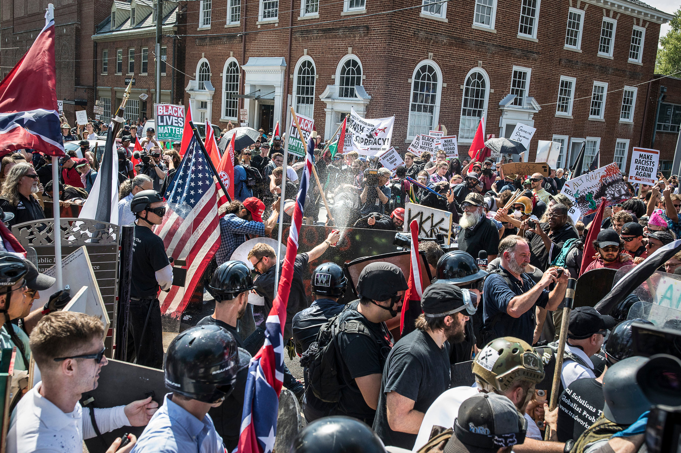
Immigration Crisis
Charlottesville VA, 2017
American Imperialism in 2020
By 2020, the United States had come closer than ever to achieving the idea of “full-spectrum dominance” of land, air, sea, space and cyberspace. US CYBER COMMAND was launched in 2009 to perfect cyber-warfare in the rapidly developing internet age. In 2019, the United States Space Force, an entirely new branch of the US military focused on space-warfare was established. In 2020, there were more than 800 military bases in 800 countries, 11 aircraft carriers and naval fleets in every ocean, and the US spent $732 billion on its military (more than the next 10 nations combined). The period of the 2010’s is undoubtedly the height of US imperialism.
The US also spent $194 billion on law enforcement in 2020, far more than any other country and making US law enforcement #3 in terms of spending it it were considered a national military, second to only the American and Chinese militaries.
However, the working class has not seen nearly as much federal money spent on housing, education, infrastructure or the environment. Working-class Americans continued to feel the crushing weight of rising rent and bills while getting paid the same low wages. Hundreds of thousands of Americans were homeless at any given time. Adding to this, increasing political polarization has resulted in increased division in the working class and the rise of reactionary fascist movements on the right and reactionary radical movements on the left, which have begun to conflict with each other. The cracks in the empire are getting bigger.
This series will be concluded next month, on Mar 12th, w/ History of U.S. Imperialism: Fall of American Unipolarity, covering the events from 2020-the present.

Slide 36
Discussion & Wrap Up

Slide 37
Announcements

Slide 38
Volunteers Needed!
We are in need of volunteers for the staff of the People’s School! Here’s a few roles we need filled:
People to help manage posting on our social media and podcast platforms
Video Editors, Audio Editors, Graphic Designers, Artists, Narrators
Facilitators, Web Controls, Moderators
Email info@peoplesschool.us if you’re interested and try to attend our next staff meeting on Mar 7th if possible.

Slide 39
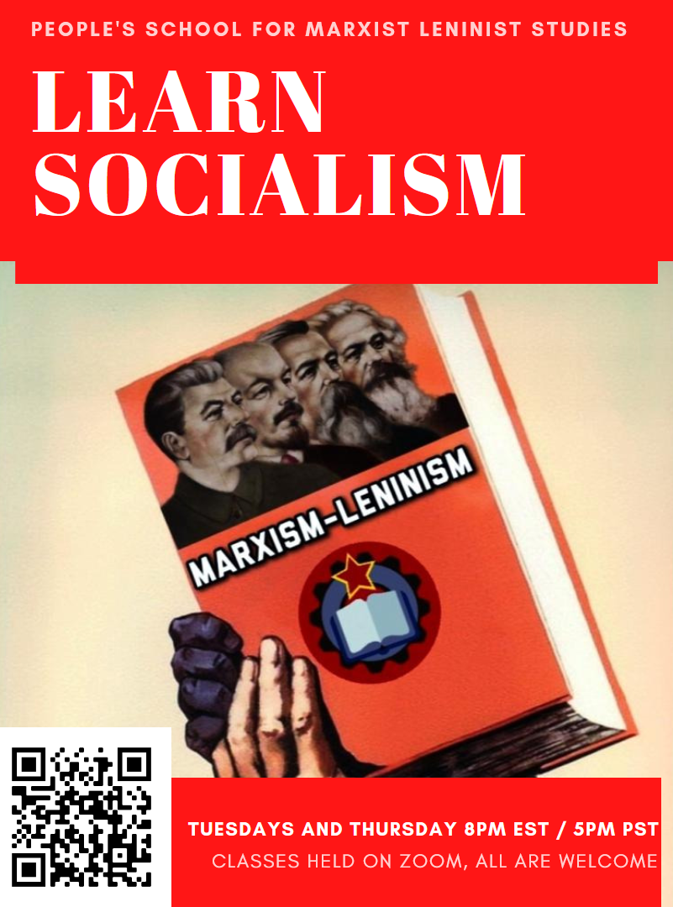
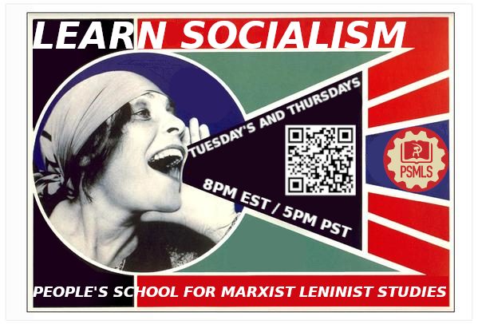
PSMLS Propaganda
peoplesschool.us/media & peoplesschool.us/store
Materials to help promote the school!

Slide 40
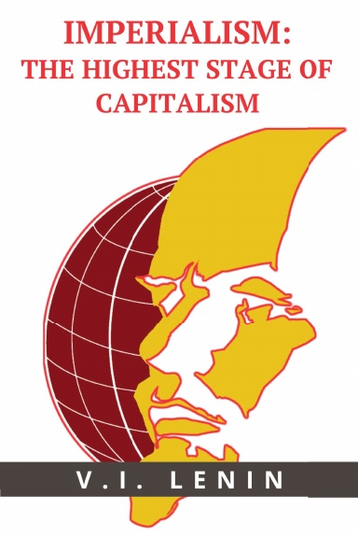
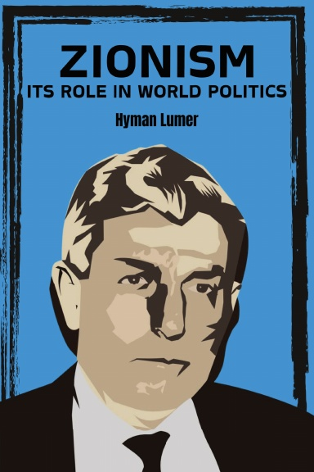
New Outlook Publishers
newoutlookpublishers.store
Relevant and Latest Releases

Slide 41
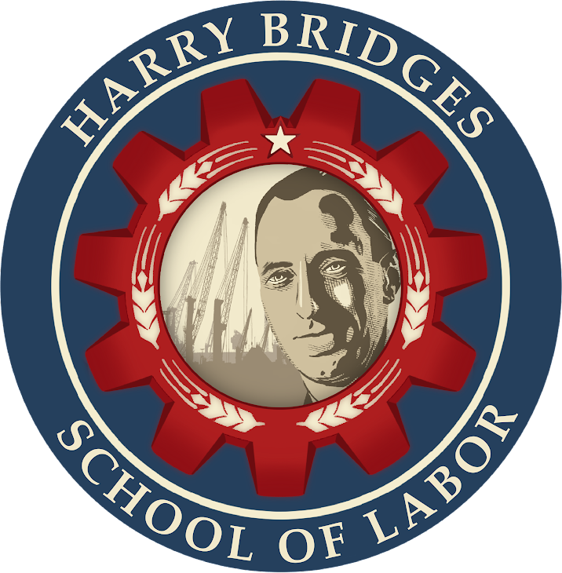
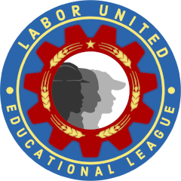
Harry Bridges School of Labor
luel.us/laborschool/
The Harry Bridges School of Labor is a monthly class held 2x per month. Classes cover a variety of topics aimed at building class conscious among union members.
The third session for 2024 of the Harry Bridges School of Labor will be a viewing of Norma Rae with a discussion on the real life Norma Rae, Crystal Lee Sutton. This class will be presented by partner organization Women for Racial and Economic Equality (WREE). This session with take place on March 6, 2024 at 9pm EST/6pm PST and Saturday March 9, 2024 at 7pm EST/4pm PST.
They are also releasing the recordings from the Harry Bridges School of Labor sessions on YouTube.

Slide 42
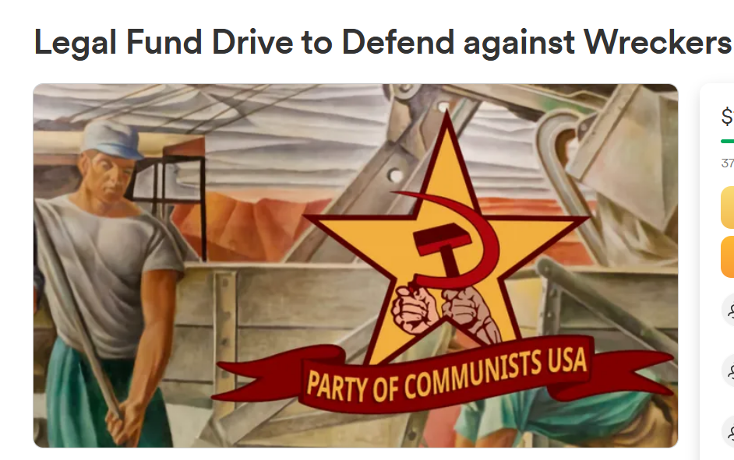
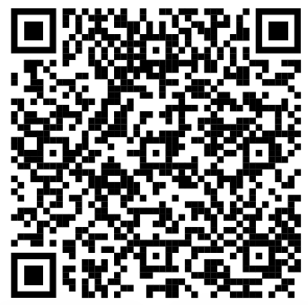
Legal Drive
In 2022 we were attacked and sabotaged by ultraleft wreckers that tried to steal the PSMLS and destroy the PCUSA. They failed, but they will be held accountable and there are still things they took from us that we’ve not got back, like videos, imagery, audio etc. That is why we still need donations to the legal drive.
If you support the school and want to see us continue to improve and keep delivering this education 51 weeks a year, please pitch in whatever you can and support the GoFundMe for the legal drive @ https://www.gofundme.com/f/legal-fund-to-defend-against-wreckers.
Anything helps!

Slide 43
I Didn’t Raise My Boy To Be A Soldier - 1914 Anti-War Song

