Slide 1
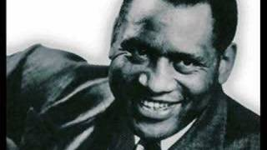
The Internationale - 1933 American Version by “The New Singers”

Slide 2
PSMLS mm/dd/yy - mm/dd/yy

Slide 3
What we’ll be learning today:
Reading from Henry Winston’s “Strategy for a Black Agenda”, critiquing the Black Panther Party and their tactics and explaining the San Rafael incident and how it affected Angela Davis and the CPUSA.

Slide 13
Discussion

Slide 14
Maoism and Black Liberation

Slide 24
Discussion & New Members Introductions

Slide 25
New Member Introductions
What is your name, pronouns and state (or country/territory)?
Where do you work? Is it unionized?
How did you find out about the People’s School?
What do you think about tonight's class?

Slide 26
The Meaning of San Rafael Continued

Slide 35
Discussion & Wrap Up

Slide 36
Announcements

Slide 37
Volunteers Needed!
We are in need of volunteers for the staff of the People’s School! Here’s a few roles we need filled:
People to help manage posting on our social media and podcast platforms
Video Editors, Audio Editors, Graphic Designers, Artists, Narrators
Facilitators, Web Controls, Moderators
Email info@peoplesschool.us if you’re interested and try to attend our next staff meeting on Mar 7th if possible.

Slide 38
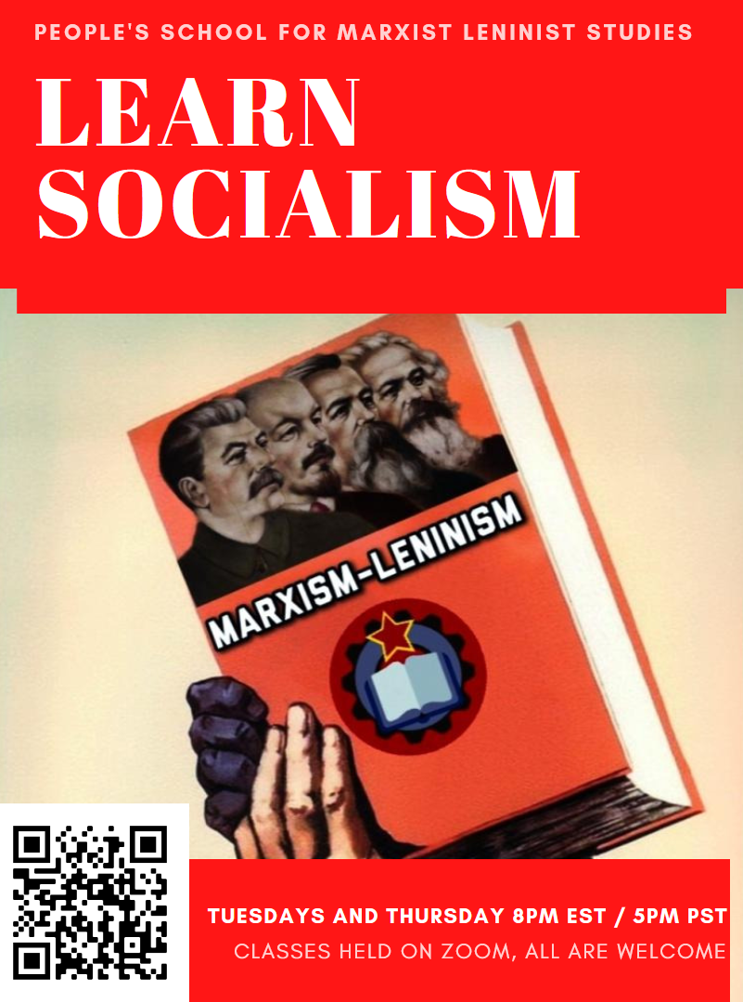
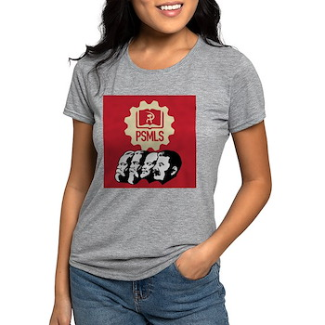
PSMLS Propaganda
peoplesschool.us/media & peoplesschool.us/store
Materials to help promote the school!

Slide 39
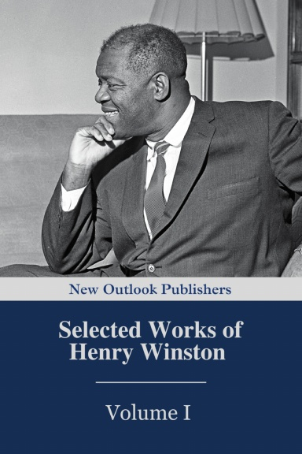
New Outlook Publishers
newoutlookpublishers.store
Relevant and Latest Releases

Slide 40
Harry Bridges School of Labor
luel.us/laborschool/
The Harry Bridges School of Labor is a monthly class held 2x per month. Classes cover a variety of topics aimed at building class conscious among union members.
The third session for 2024 of the Harry Bridges School of Labor will be a viewing of Norma Rae with a discussion on the real life Norma Rae, Crystal Lee Sutton. This class will be presented by partner organization Women for Racial and Economic Equality (WREE). This session with take place on March 6, 2024 at 9pm EST/6pm PST and Saturday March 9, 2024 at 7pm EST/4pm PST.
They are also releasing the recordings from the Harry Bridges School of Labor sessions on YouTube.

Slide 41
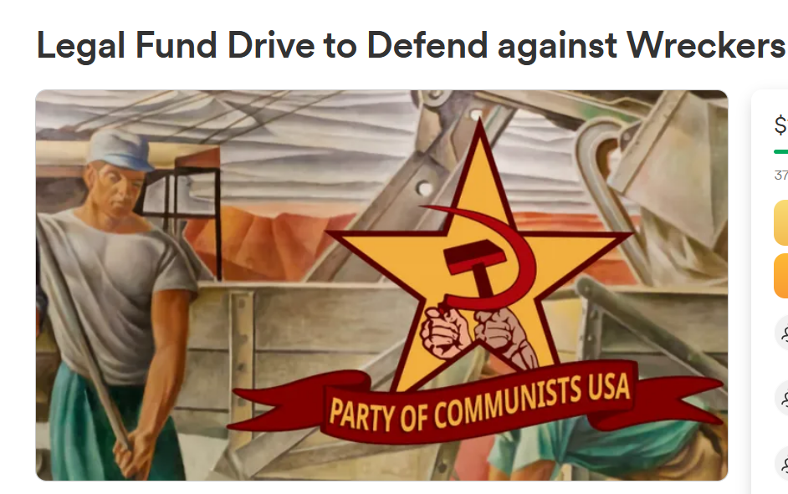
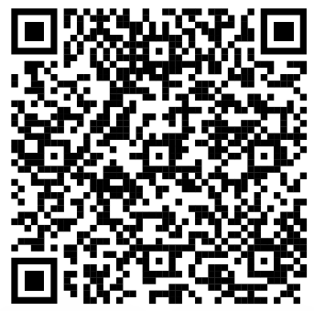
Legal Drive
In 2022 we were attacked and sabotaged by ultraleft wreckers that tried to steal the PSMLS and destroy the PCUSA. They failed, but they will be held accountable and there are still things they took from us that we’ve not got back, like videos, imagery, audio etc. That is why we still need donations to the legal drive.
If you support the school and want to see us continue to improve and keep delivering this education 51 weeks a year, please pitch in whatever you can and support the GoFundMe for the legal drive @ https://www.gofundme.com/f/legal-fund-to-defend-against-wreckers.
Anything helps!

Slide 42
Anthem of the USSR/Soviet Union by Paul Robeson

