Slide 1
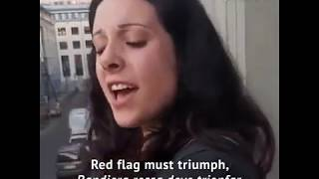
Bandiera Rossa

Slide 2
PSMLS mm/dd/yy - mm/dd/yy

Slide 3
What we’ll be learning today:
Studying the history of Women Communists with a focus on the last half of the 20th Century and today.
Presenting brief biographies on Vilma Castro, Mariela Castro, Angela Davis, Claudia Jones, Emma Tenayuca, Kim Jong Suk, the Nightwitches & Marina Raskova, Ethel Rosenberg, Anne Braden and more.

Slide 4
Claudia Jones, Ethel Rosenberg, Angela Davis and Mariela Castro

Slide 5
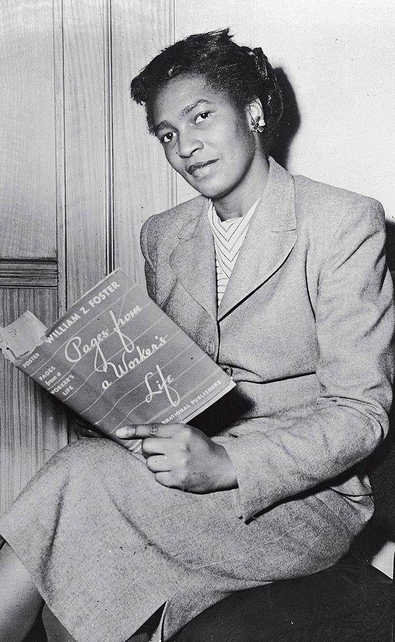
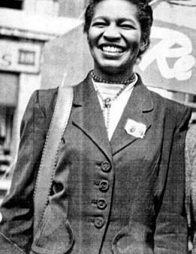
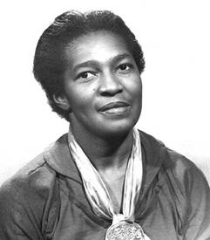
Claudia Jones

Slide 6
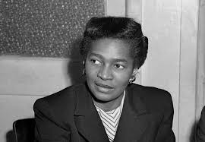
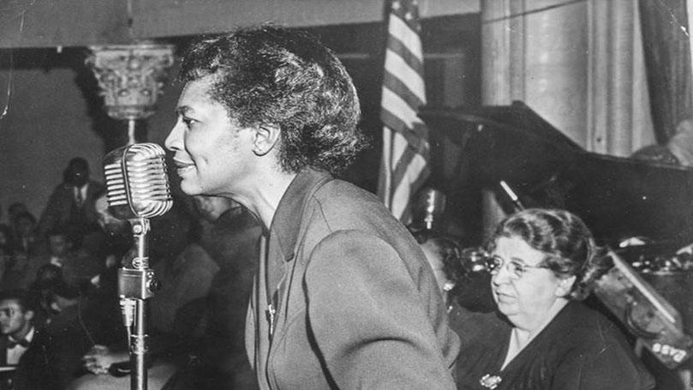
Claudia Jones
Claudia Jones, born in Trinidad and Tobago in 1915, was a prominent figure in the American communist movement. She immigrated to the United States and became a leading member of the Communist Party USA (CPUSA) in the 1930s. As a dedicated communist, Jones tirelessly advocated for racial and gender equality, intertwining her activism with Marxist ideology.
Within the CPUSA, she served as the editor for the party's newspaper, The Daily Worker, where she utilized her platform to denounce racial discrimination and fight for the rights of African Americans and other marginalized groups. Jones's commitment to socialism and her leadership within the CPUSA made her a pivotal figure in the struggle for civil rights and social justice in the mid-20th century United States.

Slide 7
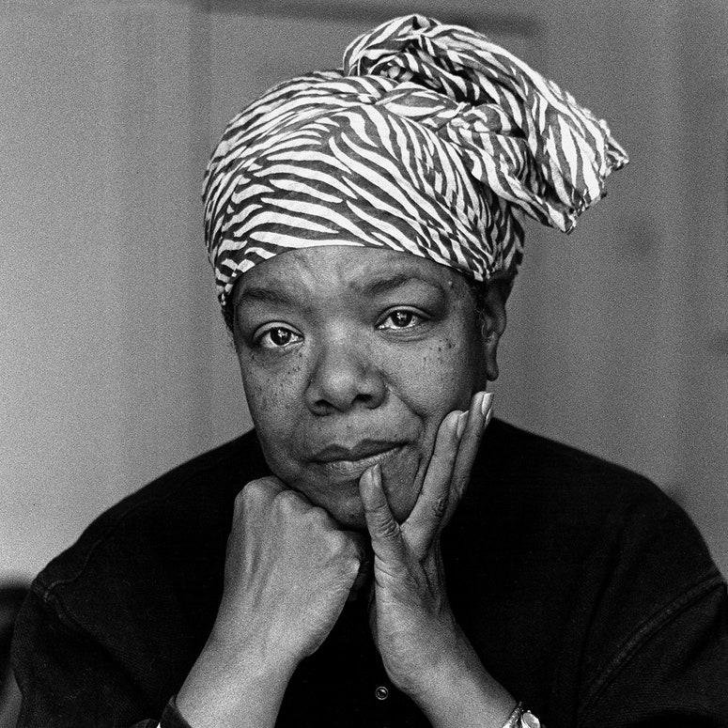
Claudia Jones
Jones was also instrumental in establishing the Southern Negro Youth Congress, advocating for the rights of African American youth in the South. Unfortunately, her activism led to persecution by the US government, resulting in her imprisonment and eventual deportation from the United States in 1955.
Tragically, Claudia Jones passed away in 1964 due to heart failure, just a few years after being deported, while living in London, England, where she continued her political work until her death.

Slide 8
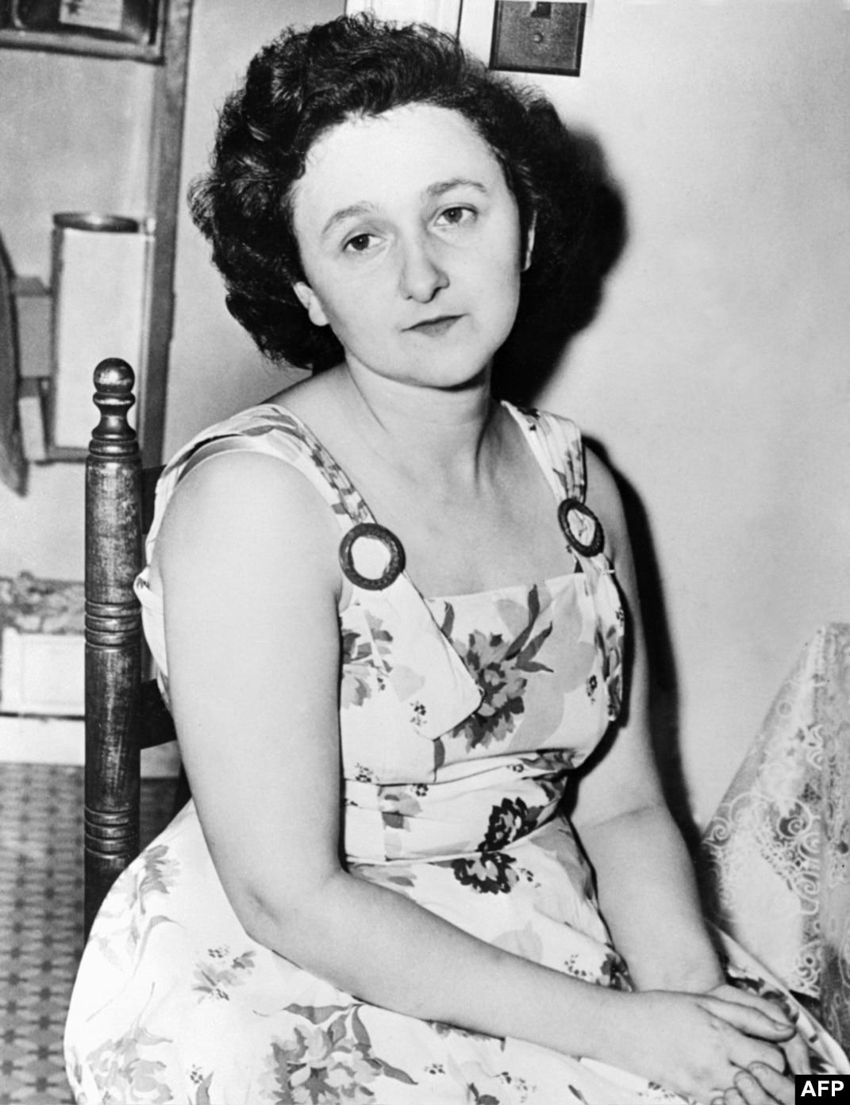
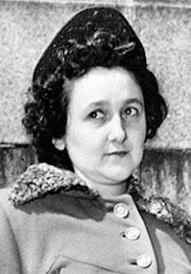
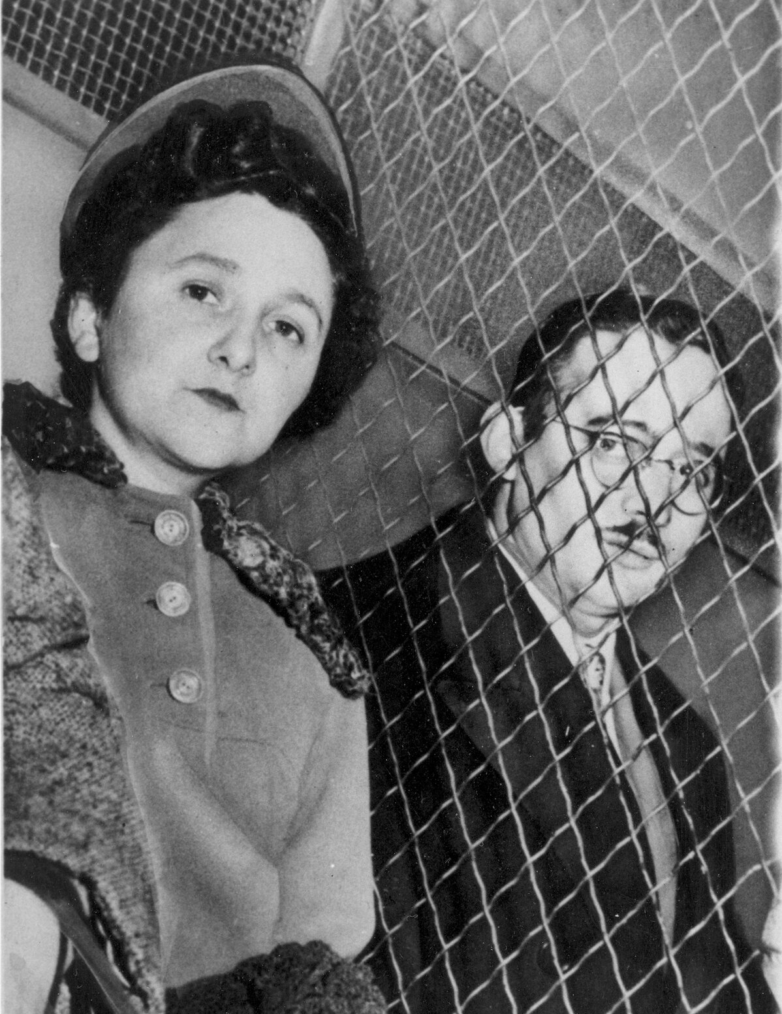
Ethel Rosenberg

Slide 9
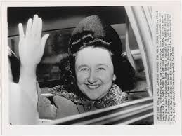
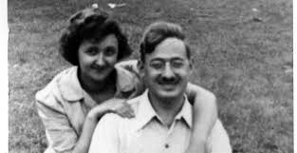
Ethel Rosenberg
Ethel Rosenberg was an American communist activist born in 1915, known for her involvement in the American Communist Party. Alongside her husband, Julius Rosenberg, she became embroiled in one of the most notorious espionage cases of the 20th century. Ethel's communist affiliations were central to her identity, as she participated actively in the Communist Party USA (CPUSA) during the 1940s and 1950s.
Although her specific roles within the CPUSA are not extensively documented, her political beliefs and associations with leftist circles drew intense scrutiny during the McCarthy era, ultimately leading to her and her husband's controversial trial and execution in 1953 for allegedly passing atomic secrets to the Soviet Union.

Slide 10
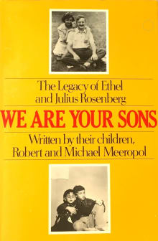
Ethel Rosenberg
Ethel Rosenberg's execution in 1953, alongside her husband Julius, sparked widespread controversy and criticism due to doubts about the fairness of their trial. Many scholars argue that the evidence against Ethel was weak, and her involvement in the alleged espionage was exaggerated.
The execution of Ethel Rosenberg, who maintained her innocence until her death, was widely viewed as unjust and politically motivated, driven by anti-communist hysteria during the McCarthy era. Decades after their deaths, the movement to achieve justice for Ethel and Julius Rosenberg continues, with calls for their exoneration and to reopen their case gaining momentum among activists, scholars, and even some government officials who believe they were wrongly convicted. The case remains a poignant symbol of the dangers of political persecution of communists and the erosion of civil liberties in times of national paranoia.

Slide 11
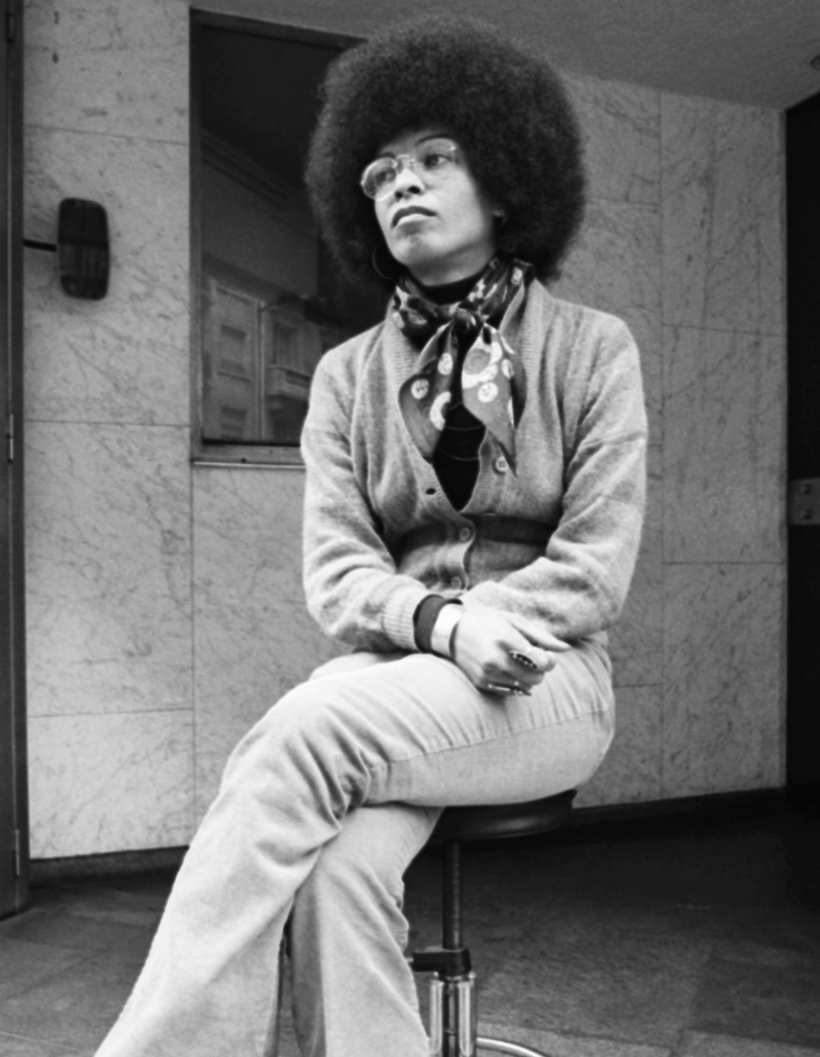
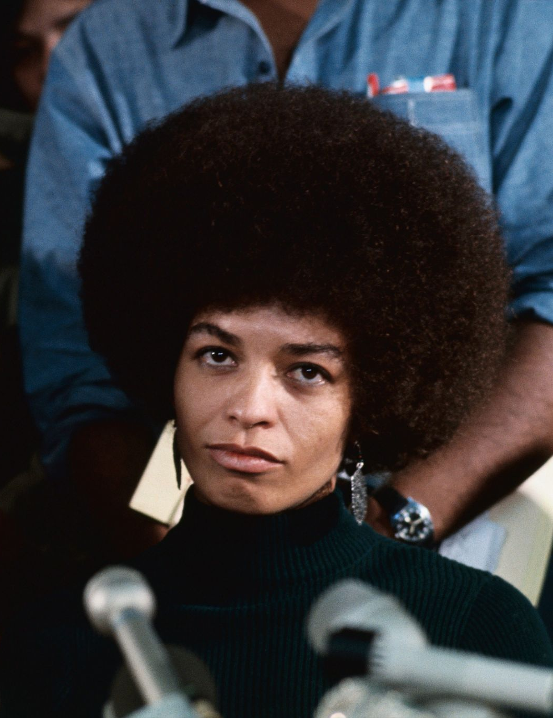
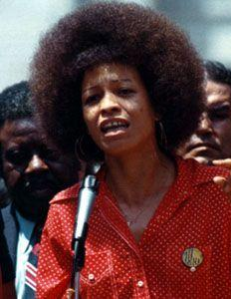
Angela Davis 1944-(alive)

Slide 12
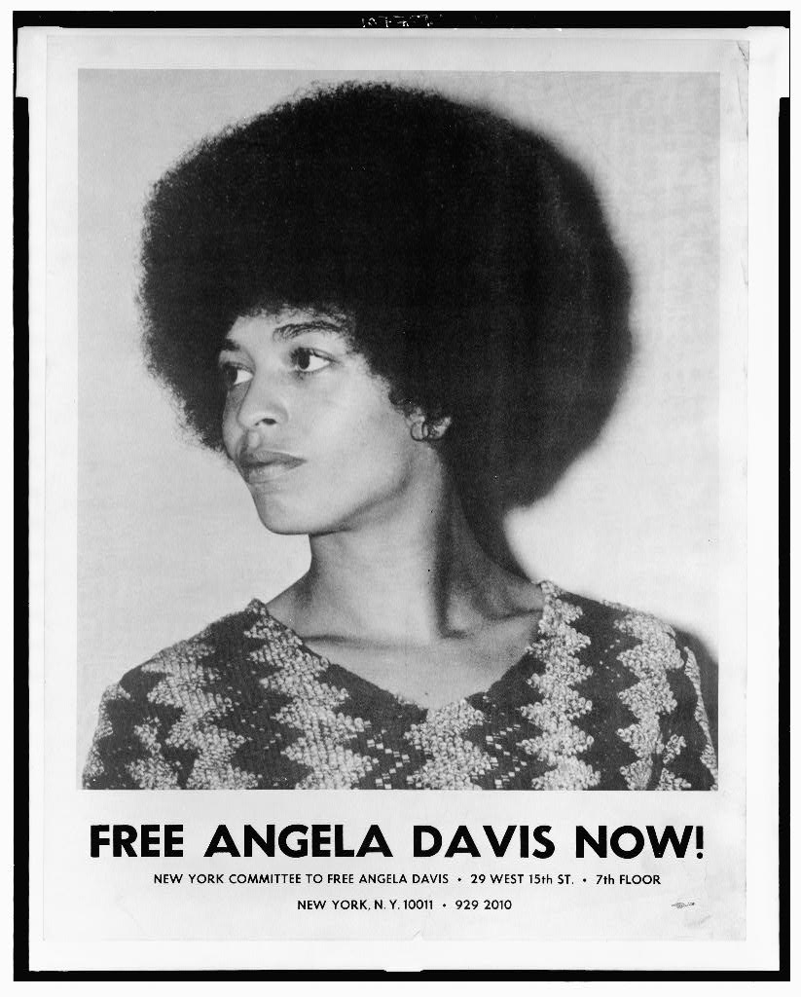
Angela Davis
Angela Davis, born in 1944, is a prominent black, American political activist, scholar, and author, known for her involvement in the CPUSA. Davis rose to prominence in the 1960s and 1970s as a vocal advocate for civil rights, feminism, and prison abolition. As a committed communist, she aligned herself with Marxist ideology and became a member of the CPUSA during her youth.
Davis gained international attention after being framed for aiding a prison escape and murder in the 1970 San Rafael Incident, although she was ultimately acquitted of all charges. Throughout the 1970s, Davis continued her activism, focusing on issues of racial injustice and systemic oppression, while maintaining her affiliation with the CPUSA, as well as the Los Angeles Chapter of the Black Panther Party (BPP). She also was the Vice Presidential Candidate in 1980 and 1984 in Gus Hall’s presidential campaigns those years.

Slide 13
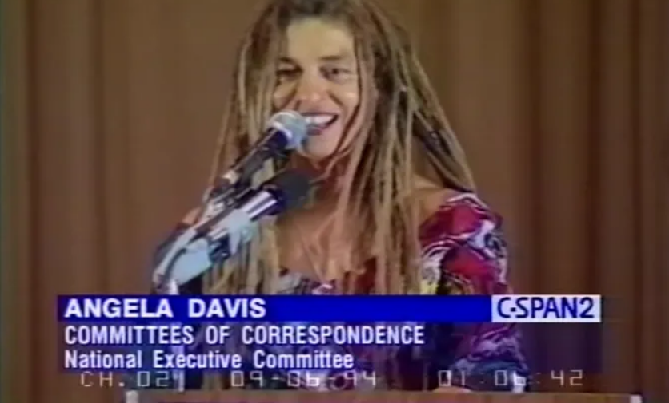
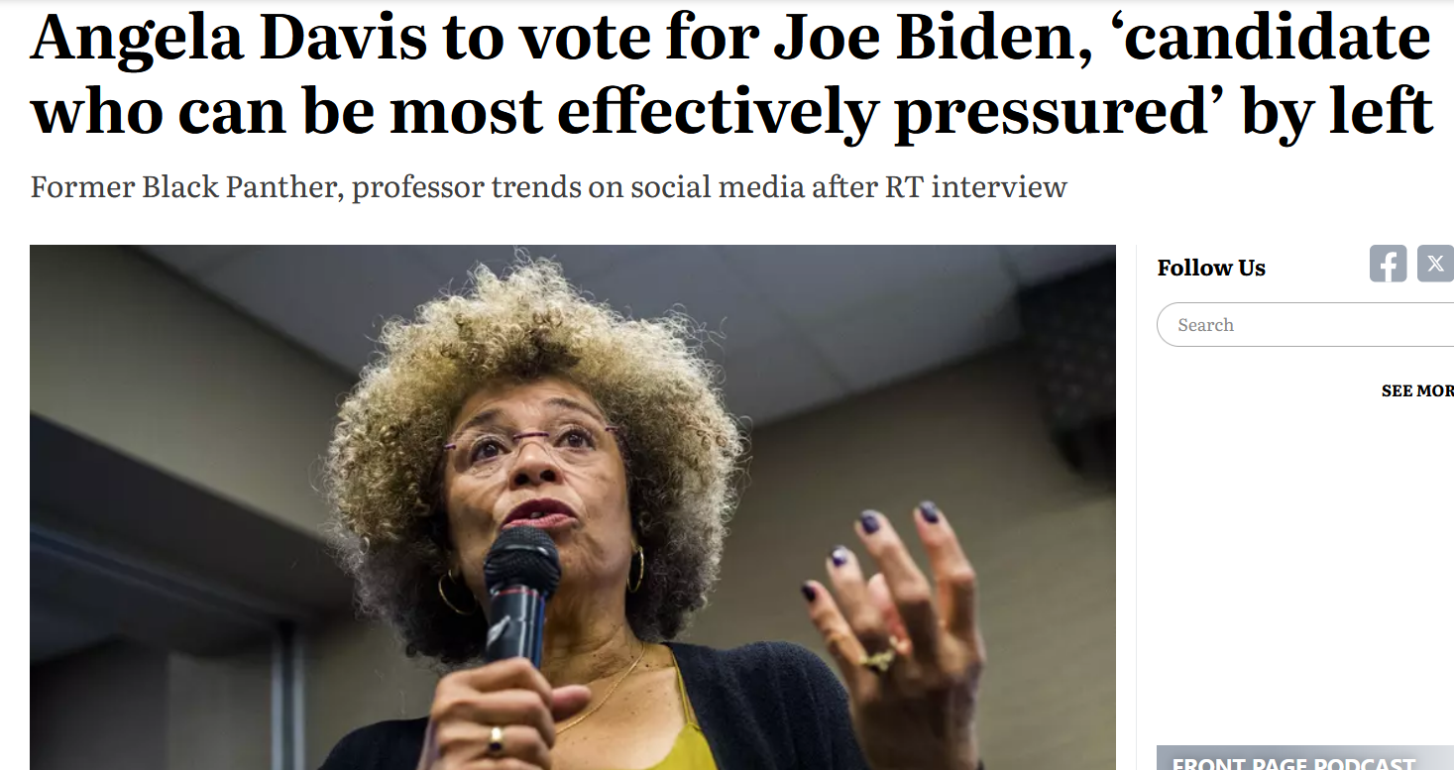
Angela Davis
As we say, “A person can play a progressive role at one time in history and a regressive, reactionary role at another.” Angela Davis is the perfect example of someone once great who has ultimately betrayed the movement and her own legacy. In the late 1980’s, she was part of the CPUSA faction that supported Mikhail Gorbachev as he enabled a counter-revolution in the USSR.
She then left the CPUSA in 1991, abandoning the Marxist-Leninist principles she once professed. Davis embraced New Left theory, departing from Marxist-Leninist ideology. Her support for the presidencies of Democrats Barack Obama and Joe Biden, both holding a record of imperialism as well as oppression and repression of the working class, reflects a compromise of her previous revolutionary stances in favor of mainstream politics. These shifts show an objective departure from Davis's earlier revolutionary fervor towards more moderate and establishment-friendly positions.

Slide 14
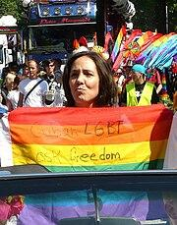
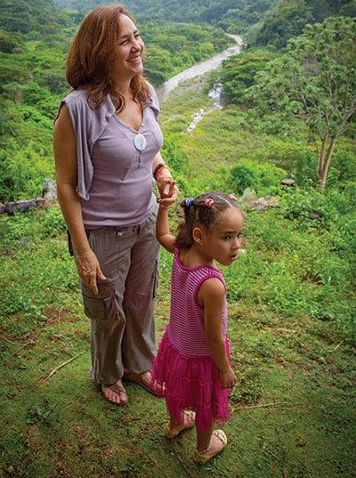
Mariela Castro

Slide 15
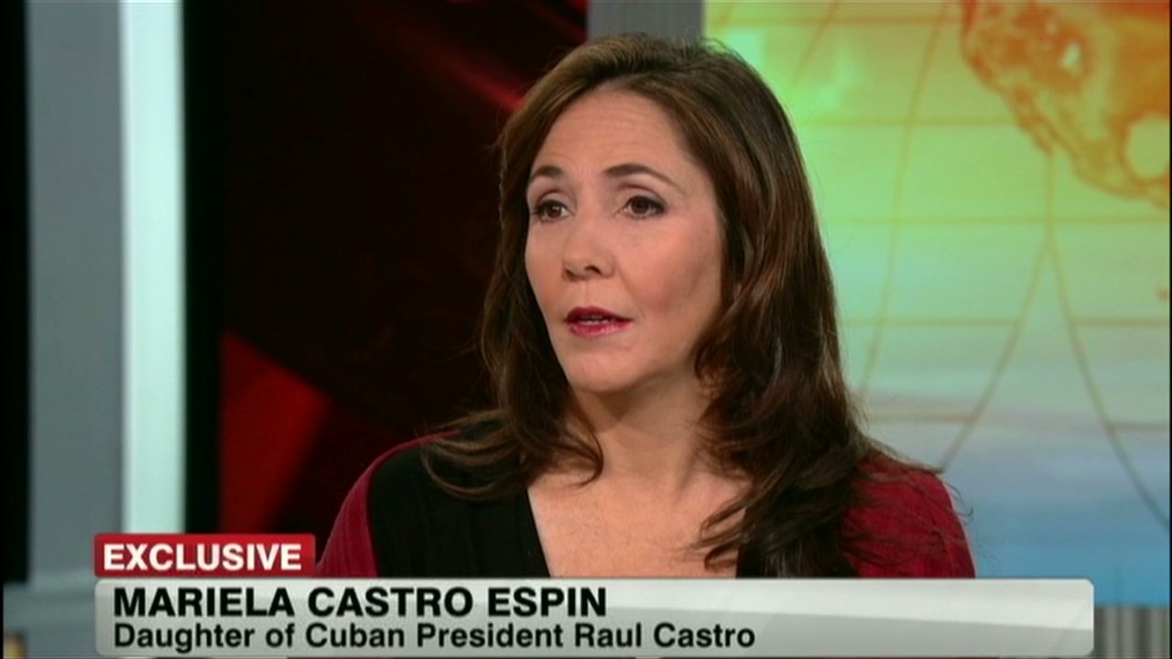
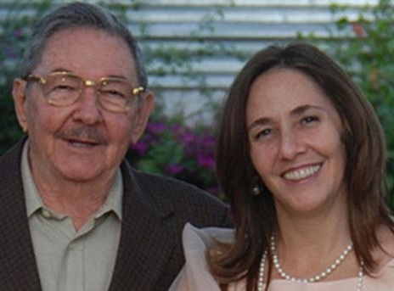
Mariela Castro
Mariela Castro, born in 1962, is a prominent Cuban communist and LGBT+ rights activist, and is also the daughter of Raul Castro, the former President of Cuba, and Vilma Espin, a revolutionary and feminist icon. As the daughter of Raul Castro and Vilma Espin, Mariela has been deeply involved in Cuba's political landscape and socialist agenda, continuing the Castro legacy to this day.
She has dedicated her activism to advocating for LGBT+ rights in Cuba, founding the National Center for Sex Education (CENESEX) in 1989 to promote sexual health and equality. Additionally, Mariela Castro has been a vocal advocate for lifting the economic blockade imposed on Cuba by the United States, arguing that it hinders the country's development and exacerbates social inequalities. Her commitment to communist principles and her tireless efforts in advancing LGBT+ rights and challenging the blockade have solidified her as a significant figure in Cuban politics and activism.

Slide 16
Discussion

Slide 17
Nightwitches, Rosa Parks and Kim Jong Suk

Slide 18
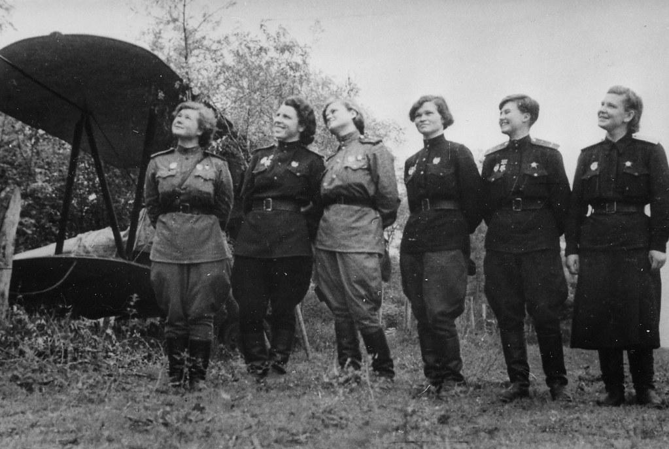
Nightwitches

Slide 19
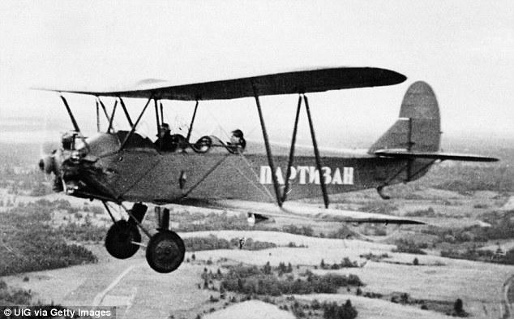
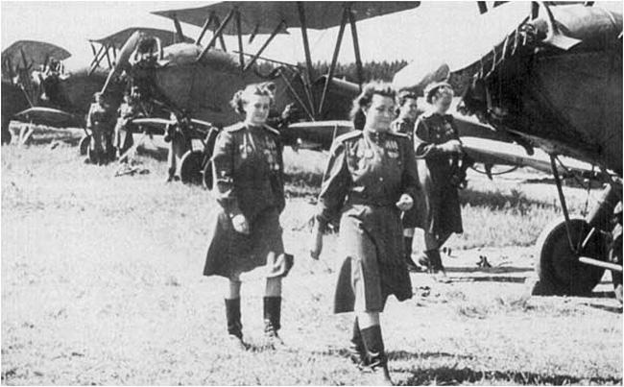
Nightwitches and Marina Raskova
The all-women part of the 588th Night Bomber Aviation Regiment were the first female pilots to directly engage in combat. Their main goal was to disrupt German sleep patterns, along with bombing important targets.
They were so successful at their job, the Germans gave them the derogatory name Nachthexen, which these women wore as a badge of honor. At the end of the war, 22 Night Witches won the highest award, the Hero of the Soviet Union award.

Slide 20
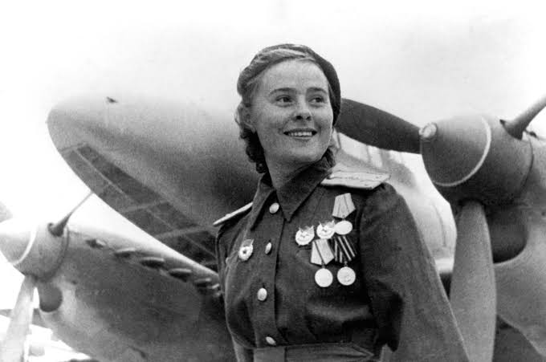
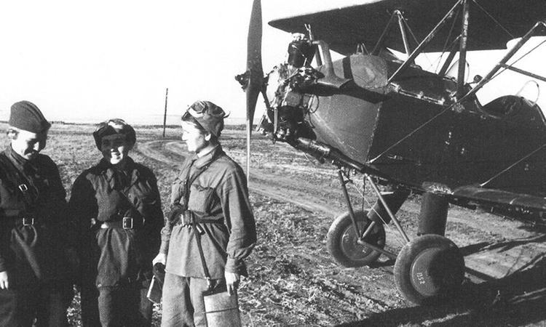
Nightwitches and Marina Raskova
Marina Raskova was the organizer of the Night Witches. While there were women pilots, they were not allowed to take battle to the skies with male compatriots. Raskova showed Stalin the many letters women wrote protesting the discrimination, and eventually he created 3 all-women aviation groups:
586th Fighter Aviation Regiment
587th Bomber Aviation Regiment
588th Night Bomber Aviation Regiment

Slide 21
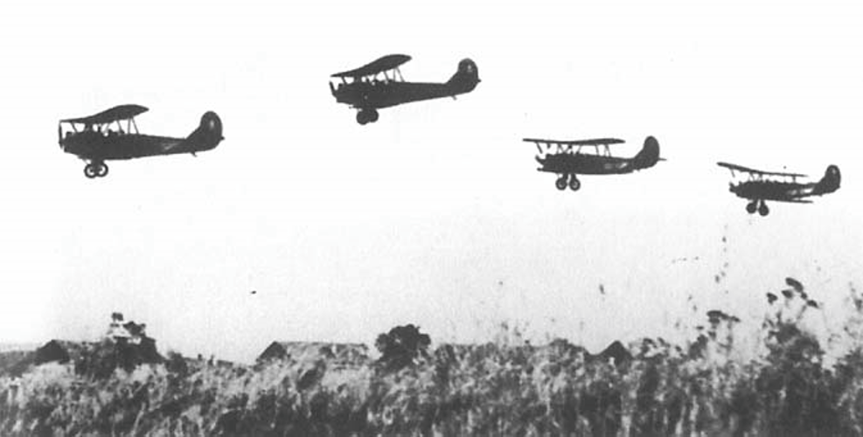
Nightwitches and Marina Raskova
Just like today, the Night Witches fought against the same problems. Many of their male counterparts saw them as inferior, even though the Night Witches were accomplishing their jobs.
They were also given Polikarpov Po-2 biplanes, which were outdated and ill-suited for combat. However, despite these challenges, the Night Witches proved their capabilities time and again, demonstrating unparalleled skill and bravery in their daring nighttime bombing raids.

Slide 22
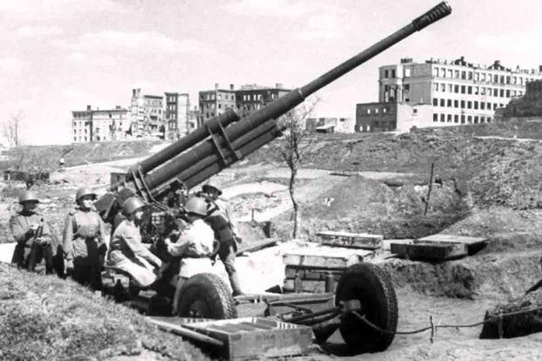
Women of Stalingrad

Slide 23
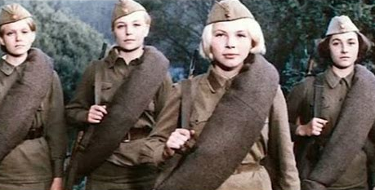
BATTLE OF STALINGRAD

Slide 24
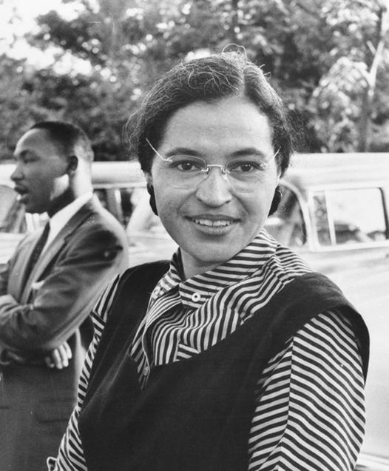
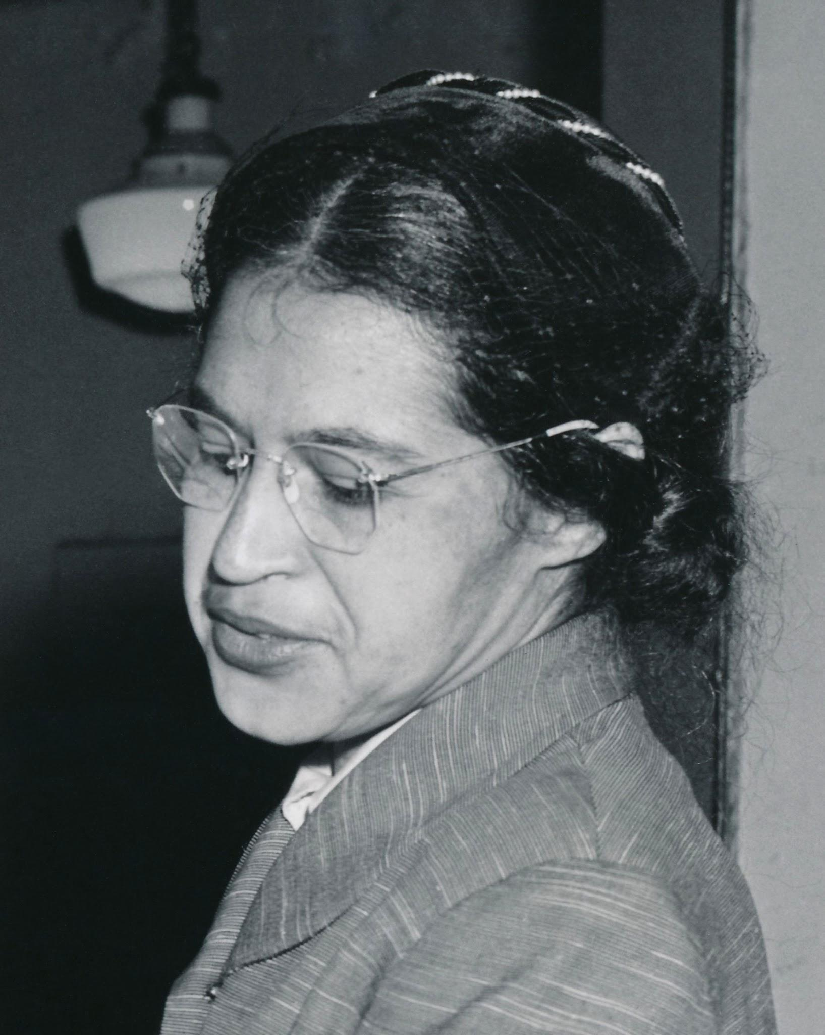
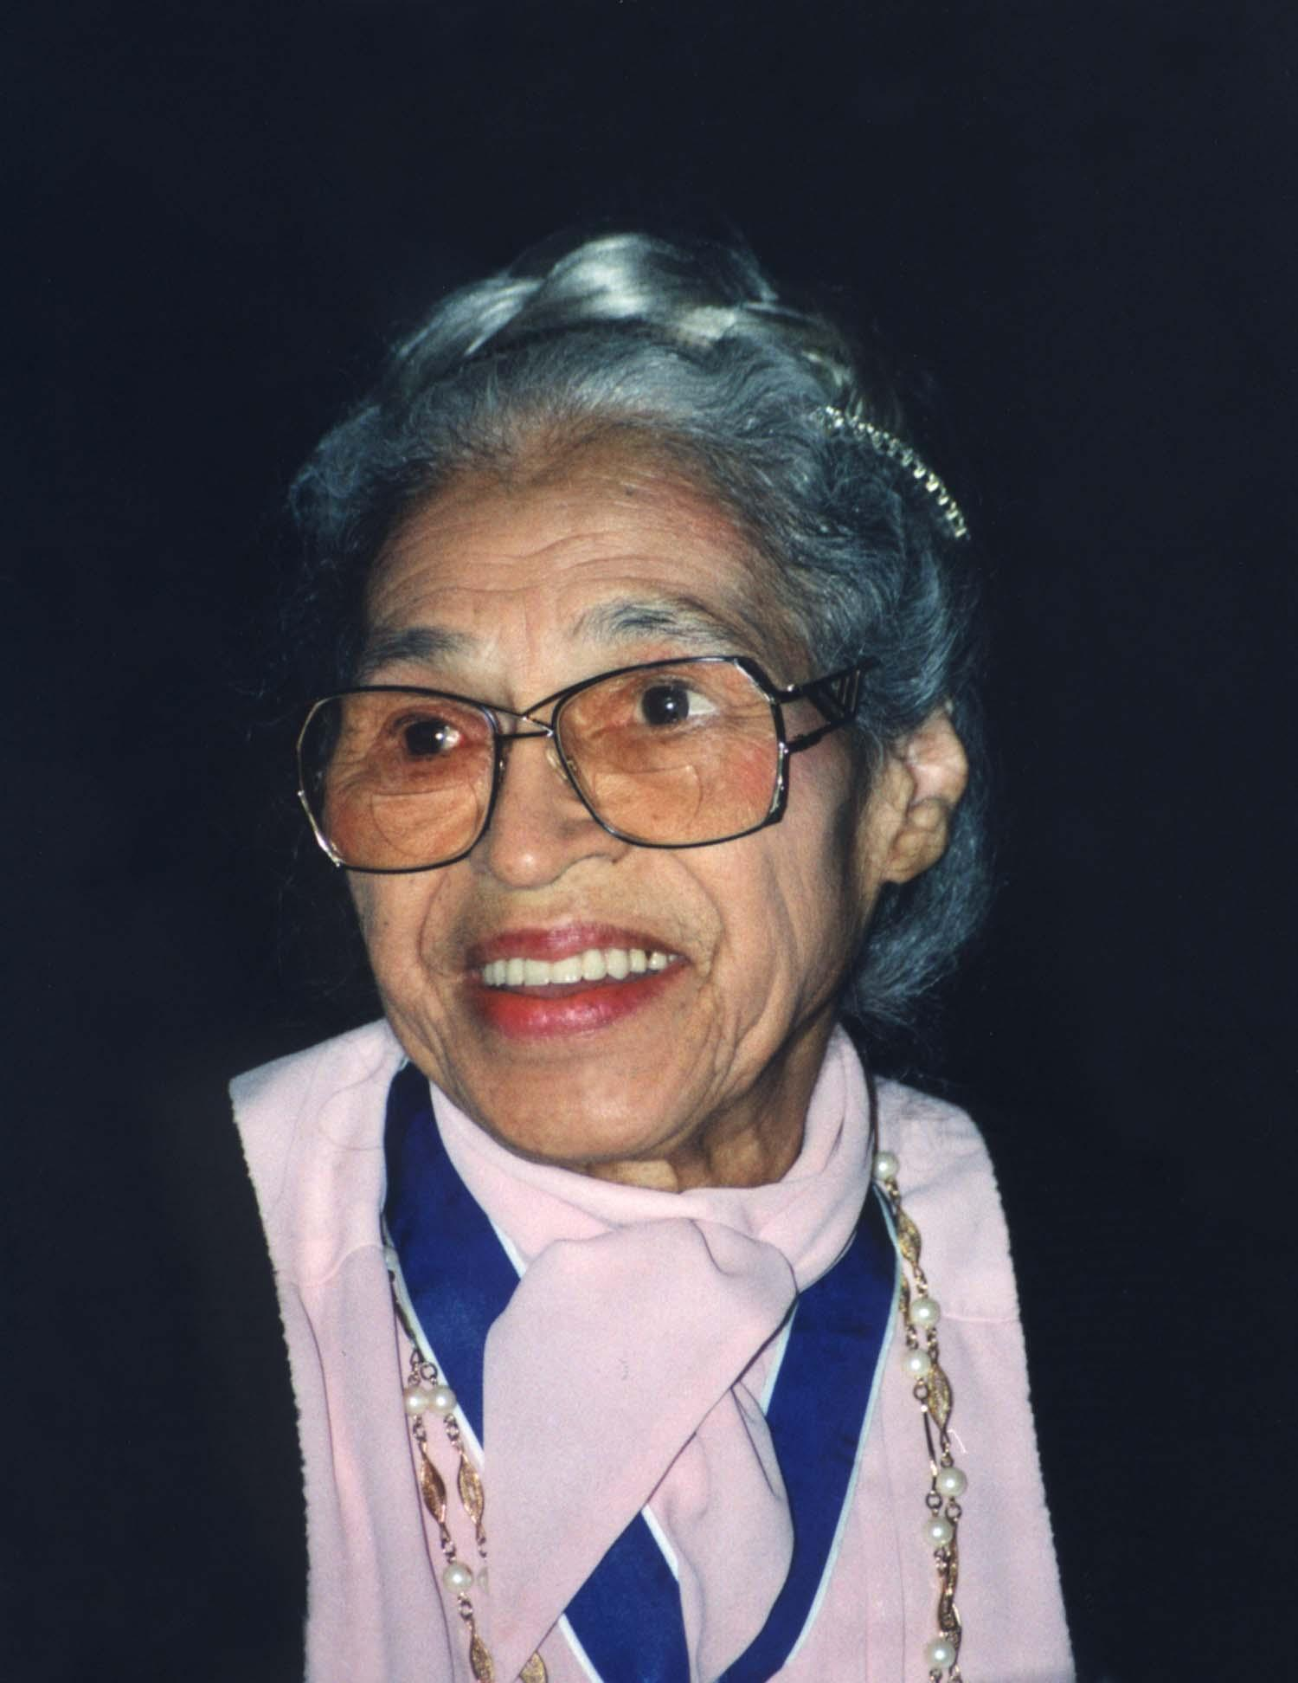
Rosa Parks

Slide 25
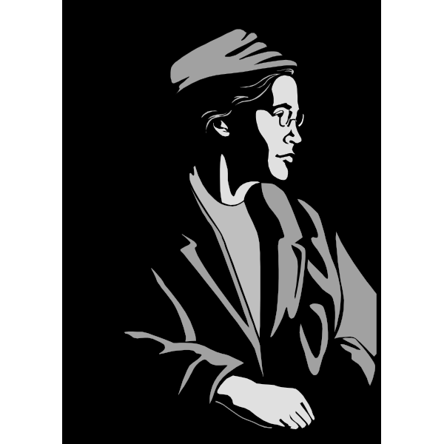
Rosa Parks
Born in Tuskegee, Alabama on on February 4, 1913. At this time, segregation was going strong. Later on, she married Raymond Parks, who was also an activist.
She has a long history of activism, and she is a fellow traveler. In other words, she may not have officially been a communist, but she often attended meetings and events with her husband, who was a communist.

Slide 26
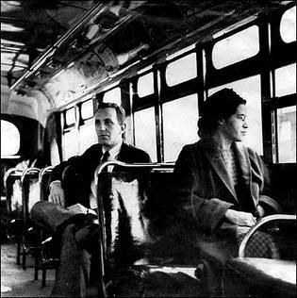
Rosa Parks
In 1943, she joined the National Association for the Advancement of Colored People (NAACP). For many people, her most notable action was refusing to give up her seat on the bus, but she spent much of her life fighting to make sure black people had the rights they were denied.
“People always say that I didn’t give up my seat because I was tired, but that isn’t true. I was not tired physically, or no more tired than I usually was at the end of a working day. I was not old, although some people have an image of me as being old then. I was forty-two. No, the only tired I was, was tired of giving in.” - Rosa Parks

Slide 27
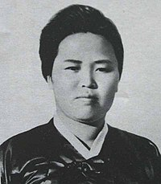
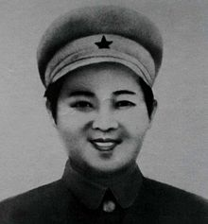
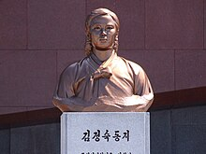
Kim Jong Suk

Slide 28
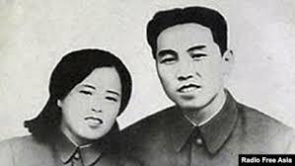
Kim Jong Suk
Born 1917 in North Hamgyong Province of Japanese Korea, she eventually moved to China where she joined Kim Il Sung’s guerrilla forces.
Throughout her youth, she saw many things that caused her to become upset with the contradictions and exploitation such as share-cropping. Her family worked on a landowners farm, and when he caught them picking some grains for themselves, he accused them of stealing. The contradiction being that they grew the crops but do not see any of the value of their work.

Slide 29
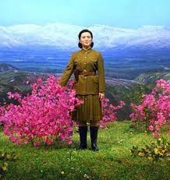
Kim Jong Suk
In 1931, as the Korean unrest under Japanese rule rose, Kim Jong Suk was recruited into the Young Communist League. She started with basic tasks such as distributing leaflets, but she was soon entrusted with more important tasks, eventually being admitted into the Children’s Vanguard. Later, she would become Kim Il Sung’s bodyguard, even taking bullets meant for him.
As time went on, she became more and more important to the movement. She went from distributing literature, protecting Kim Il Sung, to strategic planning to make sure everyone was ready to fight

Slide 30
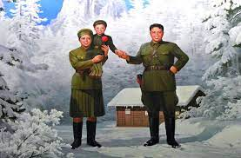
Kim Jong Suk
Sadly, at age 32, Kim Jong Suk passed away, leaving behind her husband, Kim Il Sung, and son, Kim Jong Il.
She also left behind her mark on history, as many North Koreans fondly remember her actions as an anti-Japanese Imperialist fighter and a revolutionary. Her dedication to and care for the movement are what earned her the title “Mother of Korea.”

Slide 31
Discussion & New Members Introductions

Slide 32
New Member Introductions
What is your name, pronouns and state (or country/territory)?
Where do you work? Is it unionized?
How did you find out about the People’s School?
What do you think about tonight's class?

Slide 33
Emma Tenayuca, Anne Braden, Vilma Castro and the Women of the PCUSA

Slide 34
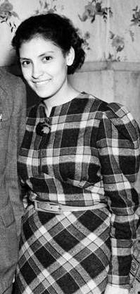
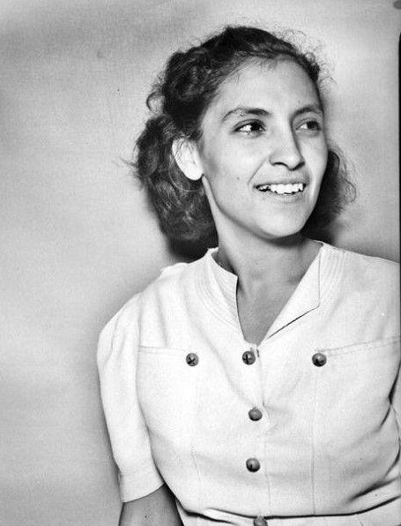
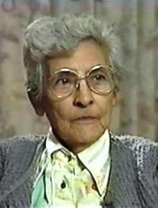
Emma Tenayuca 1916-1999

Slide 35
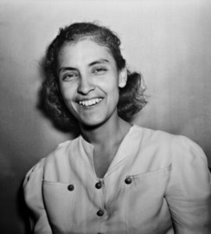
Emma Tenayuca was born in San Antonio, Texas on December 21, 1916
On Jan. 31, 1938, 12,000 pecan shellers, mostly Mexican American women, marched out of the factories in San Antonio to demand better working conditions and higher wages. They unanimously elected Emma Tenayuca as their strike leader.
“What started out as a movement for organization for equal wages turned into a mass movement against starvation, for civil rights, for a minimum wage law, and it changed the character of West Side San Antonio.”
Emma Tenayuca 1938

Slide 36
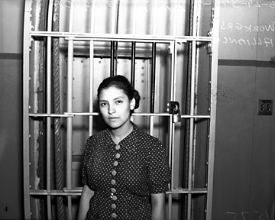
Contact with fired workers led her to join the Communist Party in 1937 and the Workers Alliance (WA) in 1936, an organization of the unemployed founded by Socialists and Communists, 90 percent of whom were pecan shellers and agricultural workers.
The WA held demonstrations for jobs, not relief, and demanded that Mexican workers had the right to strike without fear of deportation, and to a minimum wage and hour law.
As a result of anti-Mexican, anti-Communist, and anti-union hysteria,
she was forced to leave Texas to ensure her own safety and well being.
Emma Tenayuca inside jail,
June, 1937, San Antonio, Texas

Slide 37
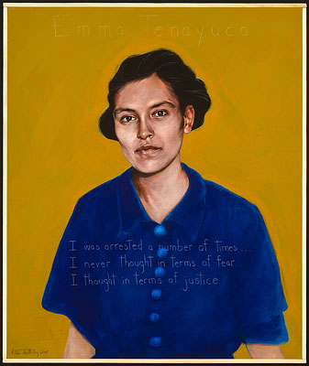
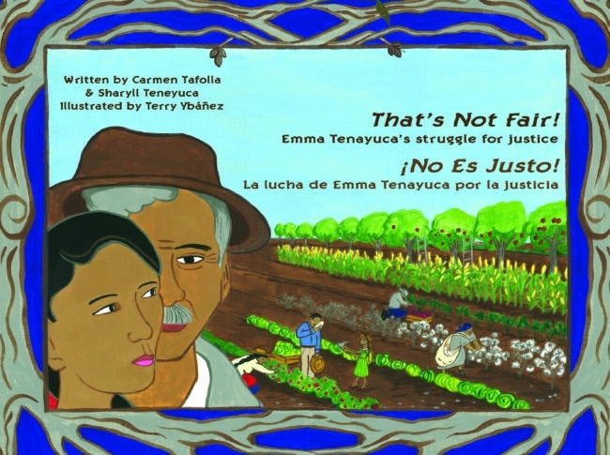
The picture book begins with her childhood in San Antonio, Texas and describes her role in the 1938 strike by 12,000 workers.
“I was arrested a number of times. …
I never thought in terms of fear.
I thought in terms of justice.”
Notes:
https://americanswhotellthetruth.org/portraits/emma-tenayuca/
https://bookshop.org/p/books/that-s-not-fair-no-es-justo-emma-tenayuca-s-struggle-for-justice-la-lucha-de-emma-tenayuca-por-la-justicia-carmen-tafolla/9498226?ean=9780916727338

Slide 38
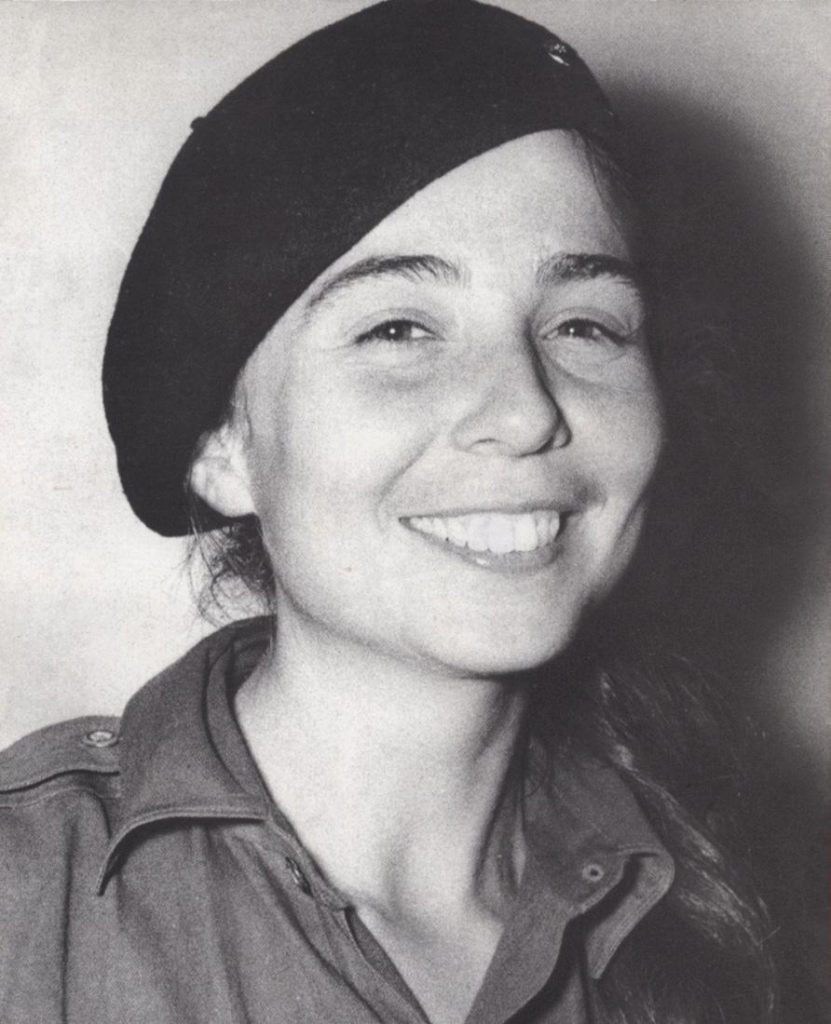
Vilma Espin 1930-2017

Slide 39
Vilma Espin
Vilma Espin, known for her fervent activism against the Batista regime, was not only a college protester but also a key figure in the Cuban Student Revolution of 1953, where she demonstrated her commitment to overthrowing the oppressive government.
With her degree in Chemical Engineering, Espin brought intellectual prowess to her revolutionary activities, harnessing her education to support the cause of social justice. Joining the Oriente Revolutionary Action (ARO) further solidified her dedication to the revolutionary movement, where she actively participated in clandestine activities aimed at challenging the Batista regime.
Espin's pivotal encounter with Fidel Castro in Mexico in 1956 marked the beginning of a revolutionary friendship, as she became a trusted courier for Castro. She married Raul Castro in 1959, shortly after the success of the Cuban Revolution, cementing their partnership both personally and politically. Their daughter, Mariela Castro, was born on July 27, 1962.

Slide 40
Vilma Espin
During the revolution, Fidel - exiled in Mexico - used Vilma, code name ‘Debra’, to communicate with the ARO in Cuba. The police were searching for Debra for two years, eventually discovering her. Because the people of Cuba were supporting the ARO, she was warned in time to escape to the Sierra Maestra Mountains, the headquarters of the Julio 26 Movement. Following the revolution, the Cuban women, who also helped in the Revolution, sent a delegation to Vilma to help them fight the chauvinistic culture that pervaded Cuba. The literacy rate was abysmal in the countryside, hygiene was non-existent, women had no rights, and mortality rates for both mothers and babies were high.
In her first year, she supervised the opening of 800 nursery day care centers. It was easy, the men and women were paid to work, the mansions and governmental buildings were re-purposed, the workers received all the materials they needed, and they organized community outreach committees. To combat literacy and poor hygiene among the dwellers of the mountainous areas, Fidel used trains to bring 4000 village women to Havana for months at a time while they learned how to organize, how to machine sew, proper health care procedures, etc. These women, upon graduation were then sent, with government authority ,back to their villages to be community leaders. To this day, one of her daughters still carries on the progressive work of the Federation.

Slide 41
“The Revolution has, in today’s Cuban women, a true army, as impressive political force. And for this reason we say that the Revolution is simply invincible.”
“The Revolution has, in today's Cuban women, a true army, as an impressive political force. And for this reason, we say that the Revolution is simply invincible.” Fidel Castro
Speech given at the Closing Session
of the Fourth Congress of the
Federation of Cuban Women on
International Working Women Day
March 8, 1985
Closing session of the Fourth Congress of the
Federation of Cuban

Slide 42
Anne Braden 1924-2006

Slide 43
Anne Braden
Anne Braden rejected her segregationist, privileged past to become one of the civil rights movement’s staunchest white allies. In the 1950s, she was indicted on charges of sedition in a famous case after she helped buy a house for a Black family (the Wades) in an all-white suburb of Louisville, Kentucky.
“As long as people of color can be written off as expendable, and therefore acceptable victims of the most extreme inequities, none of the basic injustices of our society will be addressed; they will only get worse.” - Anne Braden
Anne Braden and Rosa Parks. Source: Wisconsin Historical Society

Slide 44
Anne Braden
Anne and her husband Carl Braden worked on Henry Wallace’s campaign for the presidency. Anne Braden edited the Southern Conference Educational Fund newspaper, The Southern Patriot. She wrote and organized for the southern civil rights movement before violations became national news.
During McCarthyism, Anne was charged with sedition. In 1967, the Bradens were again indicted on charges of sedition, for helping to organize a protest against strip mining in eastern Kentucky.
“What you win in the immediate battles is little compared to the effort you put into it, but if you see it as a part of this total movement to build a new world, you know what could be. You do have a choice. You don't have to be a part of the world of the lynchers. You can join the other America. There is another America!” - Anne Braden

Slide 45
Anne Braden - Flobots

Slide 46
“It was Rosa Parks and MLK who convinced me to join the struggle, it was Anne Braden who showed me how to do it.” Bob Zellner - Student Nonviolent Coordinating Committee (SNCC)

Slide 47
Women of the PCUSA

Slide 48
MEET YOUR FELLOW WOMEN COMRADES
Hanna PA
Kayla CO
Laura MO
Victoria TX
Isa WA
Shelly AR
Katharina CA
Leanna NJ
Missi OR
Karen AR
Elizabeth VA
Kayla NY
Anna CA
Sarah PA
Shruti NY
Kamryn OR
Jane MO
Keylyn CA
Katie WA
PAST & PRESENT ACTIVITIES
National Director of PSMLS School
Many article contributions for all our publications
Treasurer, Recording Secretary & Membership Secretary of the Secretariat
Project to promote Worker’s Children Fairy Tales
WREE - Women for Racial & Economic Equality
Representatives to National and International Coalition Events
Original creative art submissions for publications, events, and propoganda
Sponsors and participants in many rallies, protests, and campaigns

Slide 49
Discussion & Wrap Up

Slide 50
Announcements
We are looking for content submissions for Vol IV 2024 of New Masses! Send any submissions to info@partyofcommunistsusa.net and kamryns@johnreedcenter.net.
The Peoples School for Marxist-Leninist Studies has began posting videos on our TikTok channel @peoplesschool! Please subscribe to the channel and like and share our content!
The Peoples School has posted 2 articles on peoplesschool.us which are compilations of content relating to the Black struggle for Black History Month and on the history of Ukraine for the 2 year Anniversary of the beginning of the Special Military Operation in Ukraine. Keep an eye out for a compilation on the women’s struggle for Women’s History Month!

Slide 51
Volunteers Needed!
We are in need of volunteers for the staff of the People’s School! Here’s a few roles we need filled:
People to help manage posting on our social media and podcast platforms
Video Editors, Audio Editors, Graphic Designers, Artists, Narrators
Facilitators, Web Controls, Moderators
Email info@peoplesschool.us if you’re interested and try to attend our next staff meeting on Mar 7th if possible.

Slide 52
PSMLS Propaganda
peoplesschool.us/media & peoplesschool.us/store
Materials to help promote the school!

Slide 53
New Outlook Publishers
newoutlookpublishers.store
Relevant and Latest Releases
Relevant

Slide 54
Harry Bridges School of Labor
luel.us/laborschool/
The Harry Bridges School of Labor is a monthly class held 2x per month. Classes cover a variety of topics aimed at building class conscious among union members.
The third session for 2024 of the Harry Bridges School of Labor will be a viewing of Norma Rae with a discussion on the real life Norma Rae, Crystal Lee Sutton. This class will be presented by partner organization Women for Racial and Economic Equality (WREE). This session with take place on March 6, 2024 at 9pm EST/6pm PST and Saturday March 9, 2024 at 7pm EST/4pm PST.
They are also releasing the recordings from the Harry Bridges School of Labor sessions on YouTube.

Slide 55
Legal Drive
In 2022 we were attacked and sabotaged by ultraleft wreckers that tried to steal the PSMLS and destroy the PCUSA. They failed, but they will be held accountable and there are still things they took from us that we’ve not got back, like videos, imagery, audio etc. That is why we still need donations to the legal drive.
If you support the school and want to see us continue to improve and keep delivering this education 51 weeks a year, please pitch in whatever you can and support the GoFundMe for the legal drive @ https://www.gofundme.com/f/legal-fund-to-defend-against-wreckers.
Anything helps!

Slide 56
Bandiera Rossa

