Slide 1

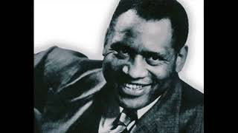
The House I Live In - 1941 version sung by Paul Robeson

Slide 2
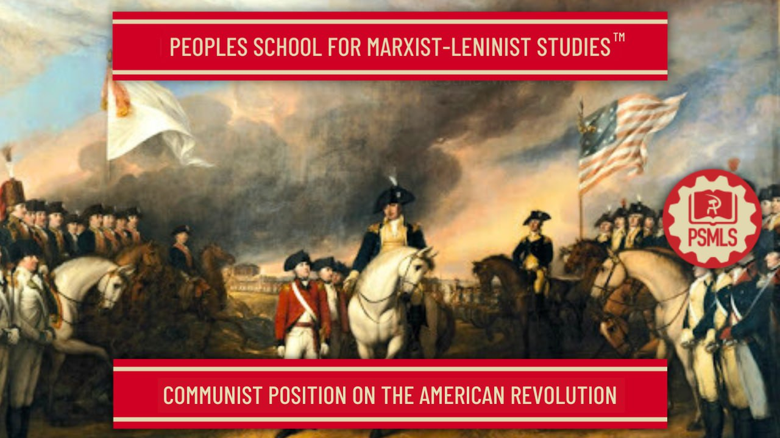
PSMLS 06/27/23 - 06/29/23

Slide 3
What we’ll be learning today:
A brief history of lead-up to the Revolution. Structure of the Colonial Government
The beginning of the Revolution.
A Polemic against Ultra-leftism of the Revolution

Slide 4
Introduction
The Colonial and Revolutionary Periods of American History are full of contradictions, internal and external. Internally between the various classes: the Bourgeoisie, Petty Bourgeoisie, Proletariat, and Slaves, between the colonists and indigenous peoples, between slaves and slaveowners, and between women and the exclusion from suffrage and equality with their male counterparts. There were the external contradictions as well between the colonists and the British Empire, the British and the French empires, the British Bourgeoisie and Proletariat against the Monarchy and Aristocracy, and between the British Bourgeoisie and the Proletariat.
The History of the American Revolution is complex and only through the process of dialectical and historical materialist analysis can the dynamics and the transient nature of this era be understood properly. All the contradictions stated above feed into the ebbing and flowing between progress and reaction. Understanding that level of consciousness is dependent on the modes of production and social being of humanity in its proper context is also important.
This class serves only as an introduction into the Revolutionary American period and further independent reading is insisted upon. Communists have always held that the American War for Independence was the first installment of the American Bourgeois Democratic Revolution with the completion coming nearly a century later during the American Civil War and the abolition of chattel slavery.

Slide 5
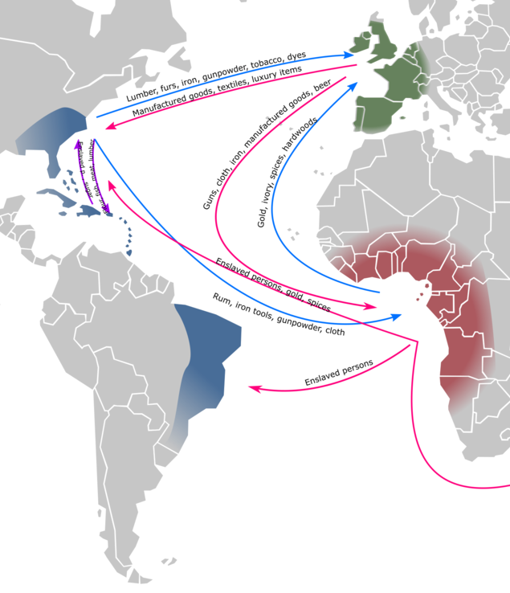

Why did the English decide to colonize North America?
The primary factor motivating European nations to create colonies was to gain access to resources. The initial hope was to find faster trade routes to Asia but when that proved difficult the goal changed to gather unique or valuable trade goods from the Americas.
Some of the goods were produced using imported slave labor using enslaved Africans from West Africa who were traded for. While other goods like furs were still being trapped by Native Americans who sold it to the Europeans.
Many Europeans also immigrated to the Americas seeking a better life. This is pre-industrial pre-capitalist Europe with few opportunities to escape peasantry or other forms of debt.
The main economic theory was mercantilism, which would influence capitalism, the focus was to maximize exports and minimize imports. Thus a country needed a lot of resources ideally a monopoly on a resource.
To the European nations the colonies were only there to make money and gather resources. To the colonists they were pioneers expanding the home nations territory
This wampum was presented to William Penn by the Lenape to signify the peace treaty they signed

Slide 6
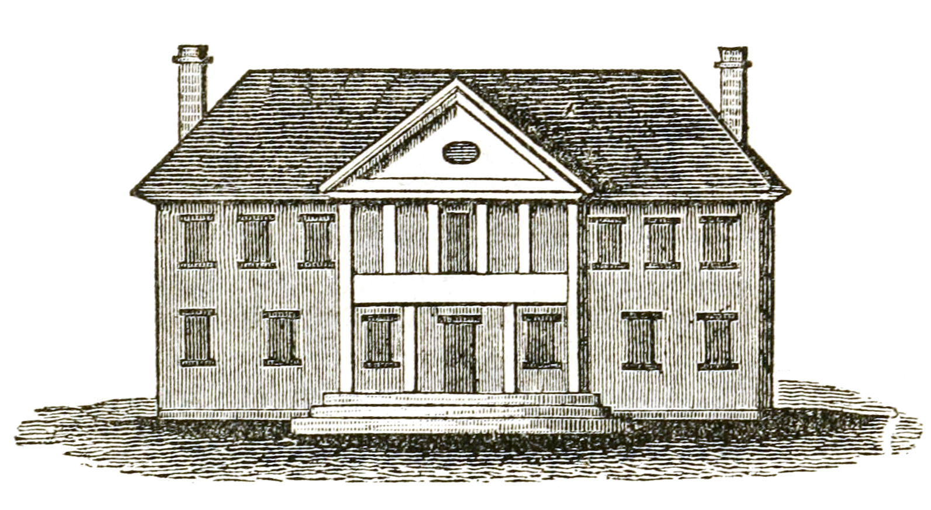
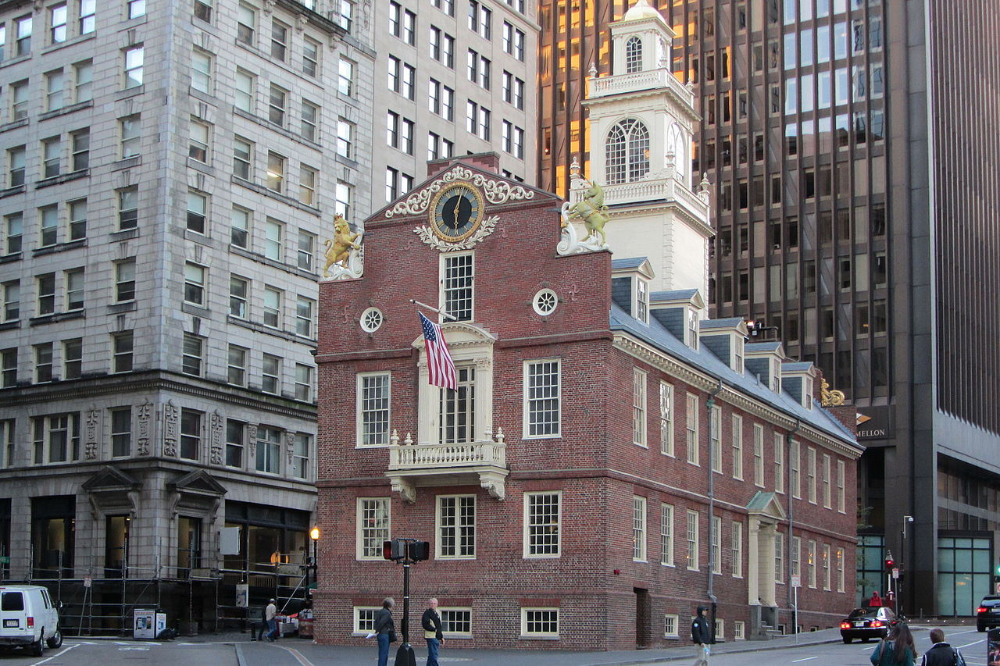
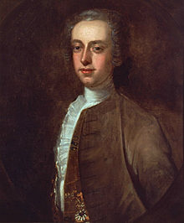
A summary of Colonial American governments
Each colony had limited self government modeled on the British model of government. With a unelected Governor appointed by the British monarch directly and answerable to them alone. They were responsible for upholding the monarch’s wishes in the colony and protect royal power. They could veto any legislation, send the assemblies home whenever they wished.
Below them was an elected assembly which often had different names but they functioned very similar. They only voters were white males who owned sufficient property to be “independent” this excluded laborers, small farmers, indentured servants, as well as African-Americans (free or enslaved), Native Americans (who were considered outside the colonies anyway) and women.
There was conflict between the unelected governor and the elected assembly but this was mostly based on each branch wanting more power rather than a genuine fight for democracy. But these conflicts would come to a head during the Revolution as the Royal governors fought against their subjects to defend their jobs and their monarch.

Slide 7
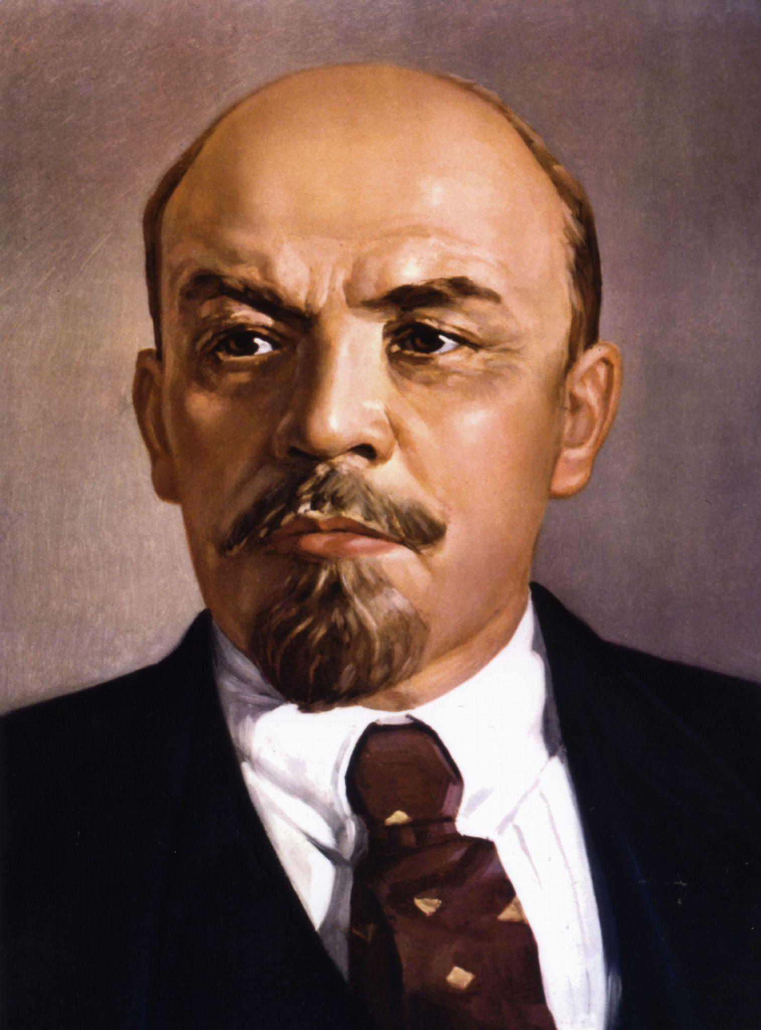
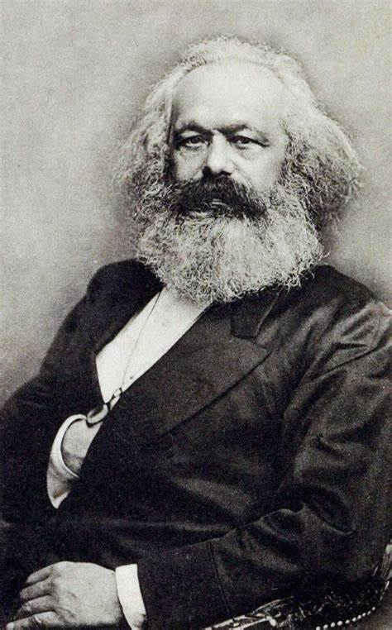
Lenin and Marx remarks on American Revolution
The history of modern, civilised America opened with one of those great, really liberating, really revolutionary wars of which there have been so few compared to the vast number of wars of conquest which, like the present imperialist war, were caused by squabbles among kings, landowners or capitalists over the division of usurped lands or ill-gotten gains. That was the war the American people waged against the British robbers who oppressed America and held her in colonial slavery, in the same way as these “civilised” bloodsuckers are still oppressing and holding in colonial slavery hundreds of millions of people in India, Egypt, and all parts of the world. - Lenin in Letter to the American Workers
The workingmen of Europe feel sure that, as the American War of Independence initiated a new era of ascendancy for the middle class, so the American Antislavery War will do for the working classes. They consider it an earnest of the epoch to come that it fell to the lot of Abraham Lincoln, the single-minded son of the working class, to lead his country through the matchless struggle for the rescue of an enchained race and the reconstruction of a social world. - Marx in Address of the International Working Men's Association to Abraham Lincoln, President of the United States of America (1865)

Slide 8
After the Seven Years War

Slide 9
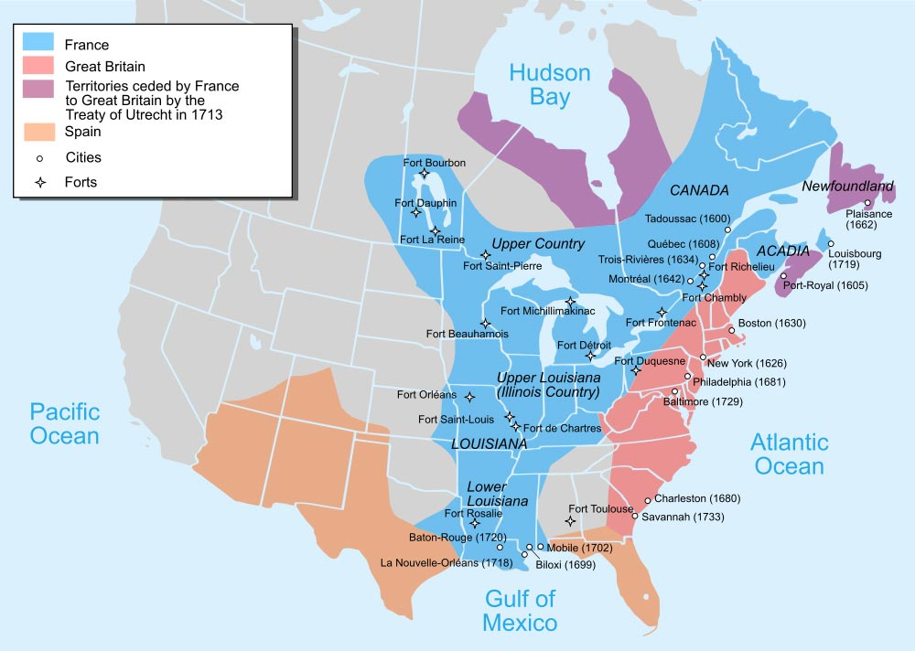
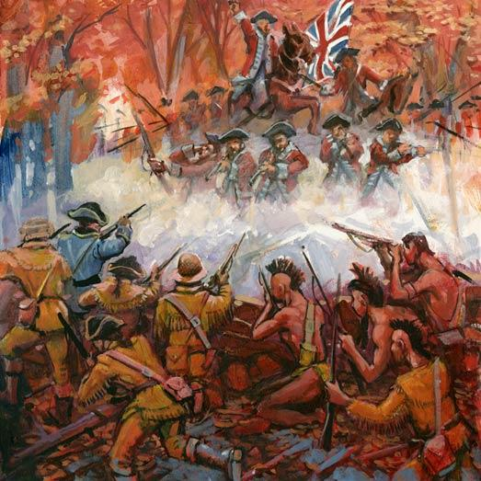
Seven Years War and French and Indian War
Wars for colonial conquest at a glance
Across the globe, the British and French empires struggled against each other for colonial conquest.
From 1754 to 1763, the theatre in the American Colonies fought their segment popularly known as the French and Indian War
For the British and their Colonial governors, the war was meant to kick the French out and establish a monopoly of American commodity markets by the East India Company
For the colonies, particularly in Pennsylvania and Virginia, the war was for access to the Ohio River Valley which belonged to Natives who mostly traded with the French
The war cost £140,000,000 in 1763, equivalent to about $29 billion today

Slide 10
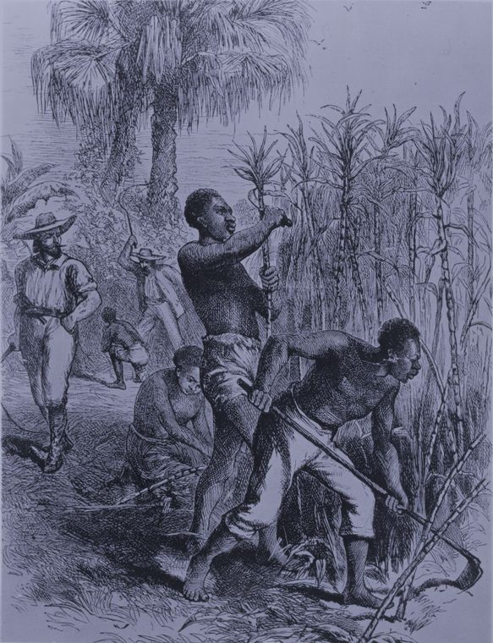
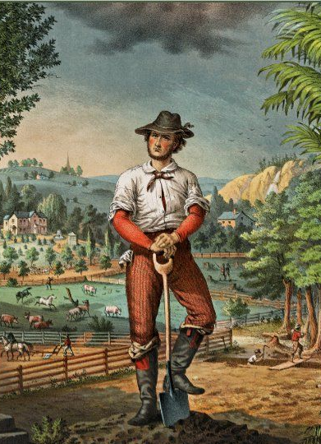
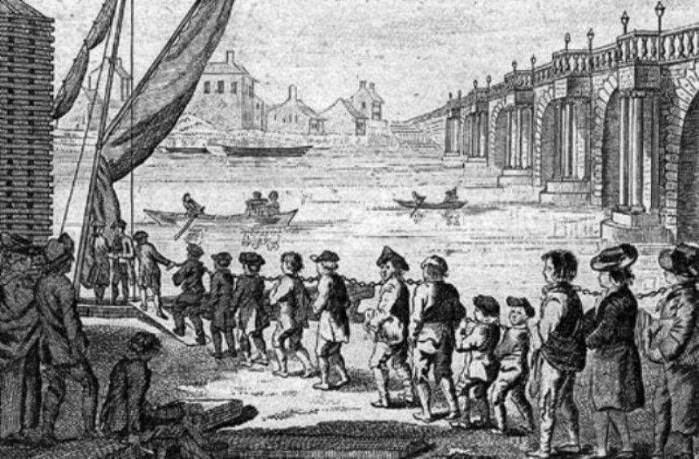
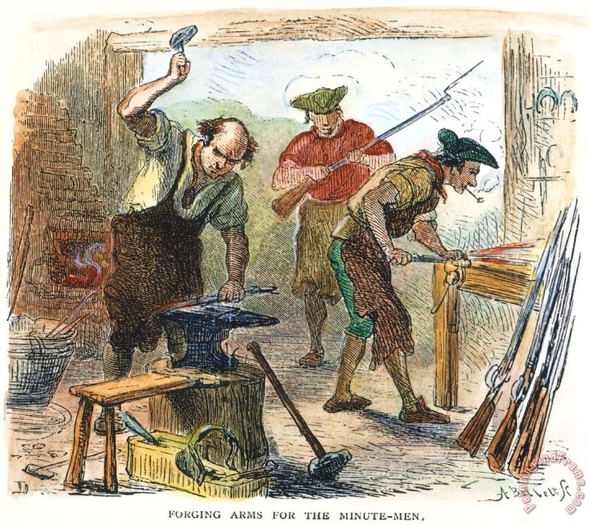
Class Structure of Colonial America
Classes in the Colonies
Of the nearly 3 million Colonists in America the breakdown by class can roughly be broken down as such:
  The largest class was the Petty Bourgeoisie, the small property owners such as yeoman farmers, fur traders, small merchants, master craftsman, artisans etc made up about 40 percent of the population
  Proletariat(landless laborers) such as apprentices, laborers, indentured servants, farm workers, sailors/shiphands, etc made up approximately 20 percent of the population
  Slaves made up about 13 percent of the population
  The rest were the national bourgeoisie who were comprised of slave owning gentry, large merchants, land speculators, etc made up the rest
Source: Social Structure of Revolutionary America by Jackson Turner Main

Slide 11
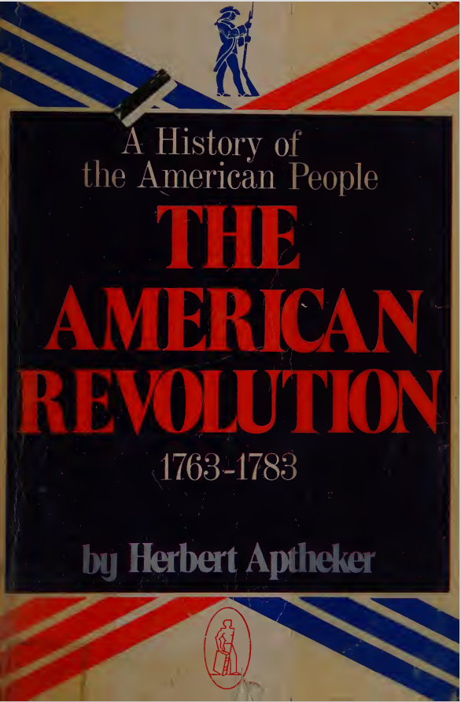
Effects of the Seven Years War
Up until the late 18th century, the American Colonies had an agrarian economy, however, due to the richest Gentry and due to degrading soil conditions from inefficient tobacco plantations and farming, there was a need to utilize new fertile land.
The American Colonists, particularly the rich Gentry expected to gain access to the Ohio River Valley but the British empire instituted the Proclamation of 1763 to restrict westward movement in order to benefit British land speculators
“Moreover, this Proclamation Line, barring further American westward movement, (temporarily, the British promised) sought to favor British land speculators (as well as fur-traders), and had blasted the hopes of the Ohio Land Company—in which George Washington, Richard Henry Lee, and George Mason were major investors—in favor of the British Vandalia Company. This cut-throat competition continued down to the days of Revolution, so that, for example, Virginia land claims to acreage in present Kentucky and Ohio were threatened, in 1774, by the Walpole Company, in which such figures as Lord Camden and the Earl of Hertford had invested and which had been sponsored by George Grenville, himself, the same man who was Prime Minister from 1763-65.”
- Passage from the American Revolution by old CPUSA Historian Herbert Aptheker

Slide 12
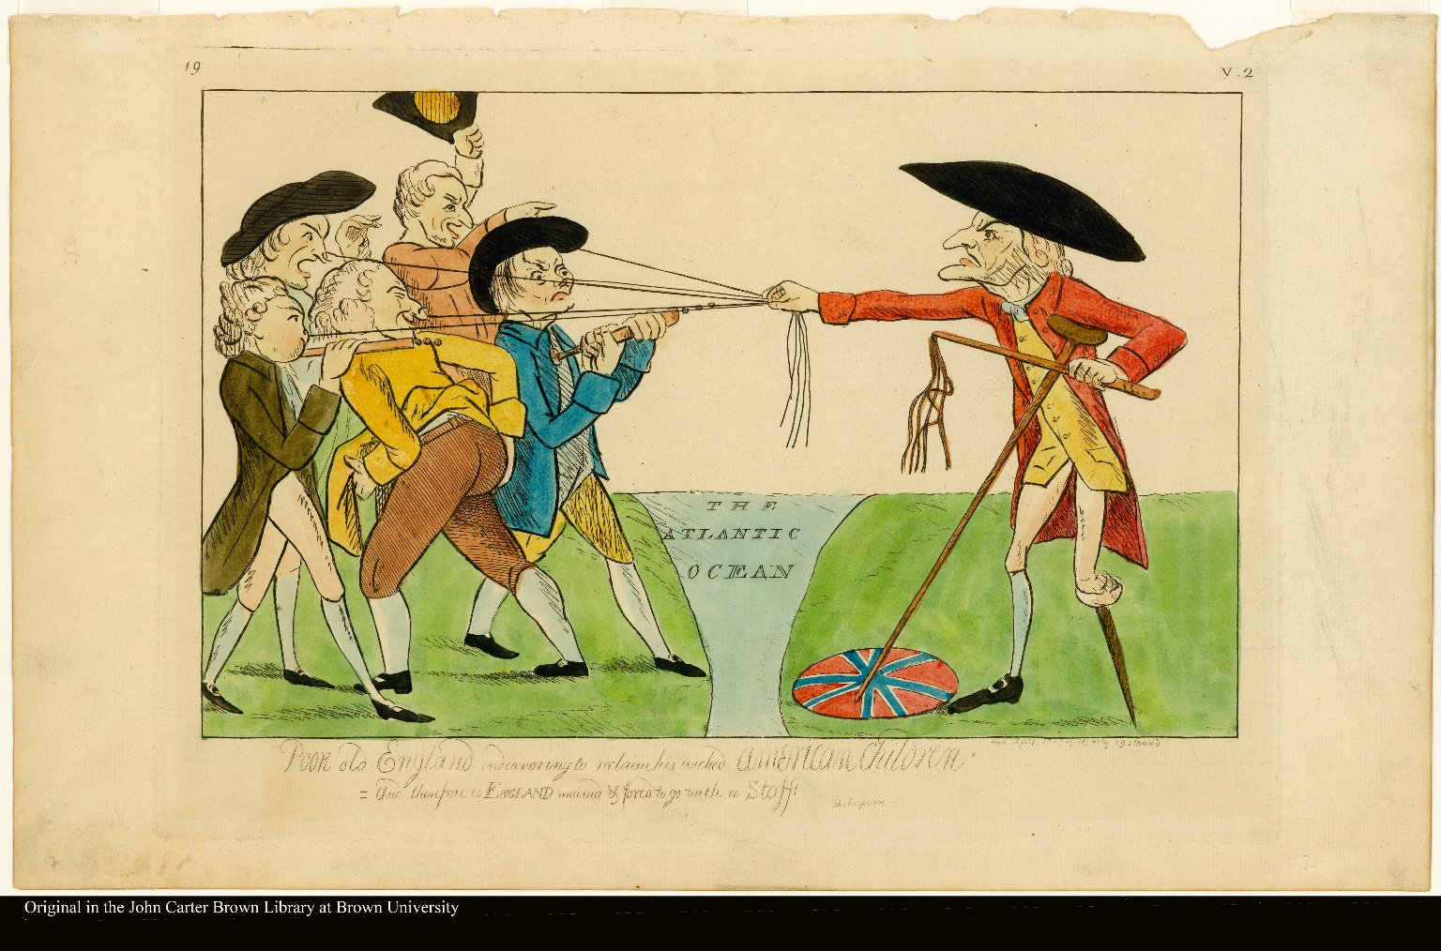
Effects of the Seven Years War cont.
Political and economic effects of the Seven Years War
“The sun never shined on a cause of greater worth. ’Tis not the affair of a city, a country, a province, or a kingdom, but of a continent of at least one eighth part of the habitable globe.” the removal of the French from the territory, the American colonists saw the true nature of the relationship with the British empire
  “The colonists felt the weight of British policy in very concrete and provoking ways. They saw increased centralization of administration; enhanced militarization of colonial life and the stationing of thousands of soldiers in America; increasing British restrictions upon established civil rights. They saw efforts to establish an Episcopate in America; whittle away the political democracy that had been established in certain of the colonies and inhibit its appearance elsewhere; make the judiciary in the colonies quite independent of the colonists or their legislatures; vitiate the powers of the colonial legislatures in additional ways, particularly by curbing their power over the purse; confine the colonists within a narrow strip of land hugging the seacoast; rigidly enforce the commercial and manufacturing restrictions. They saw an ever more prominent role being given to the British navy; trials without jury established in certain colonial cases; swarms of officeholders moving in from England to take over the American civil service; writs of assistance being issued and the sanctity of their homes violated; coveys of informers crowding the ports and being paid for bringing misery to others; new and burdensome systems of taxation concocted and levied; new restraints placed upon their economic development, and monopolies given to favored English companies or individualist summed itself up, in the opinion of Thomas Jefferson, expressed in 1774, as “a deliberate and systematical plan of reducing us to slavery.””
- Passage from the American Revolution by Herbert Aptheker

Slide 13
Discussion

Slide 14
Prelude to the Revolution

Slide 15
More Passages of American Revolution by Herbert Aptheker
Curtis P. Nettels, in his valuable study, George Washington and American Independence (1951), put this very well: British authorities, after 1763, shuddered at the idea of democracy and could be counted on to oppose levelers and reformers in every conceivable way. If the colonies should declare independence, they would be obliged to establish governments on a new basis of authority. Since the resistance was a popular movement, it was inevitable that new governments would rest directly on the people as a whole. To base government on popular sovereignty was to invite its complete democratization. Then farewell to the political power of the aristocracy, which owed its origin to* acts of an English monarch and which had long been upheld by anti-democratic arts and practices. The nature of the colonial movement gave great impetus to the democratic argument. For if the colonial argument rested 50 The American Revolution on the injustice of the arbitrary power of Parliament to rule, did not the same argument apply to those who, wherever they might be, were ruled by others over whom they had no control whatsoever? Thus, British apologists heaped ridicule on the colonial argument that Parliamentary taxation was tyrannical since the Americans had no representation in that body, by declaring that whole cities and boroughs and whole classes of British society also had no direct representation in Parliament or could cast no vote for its Members (note that they were not called Representatives). But these British apologists had logic on their side only assuming a static quality to the political and social order.

Slide 16
More Passages of American Revolution by Herbert Aptheker cont.
Nothing, however, is static and certainly not political and social orders. For what happened was that, in the colonies, the masses who had been deprived of the suffrage or had suffered underrepresentation (as those in the West) now demanded fuller political rights on the basis of the very arguments used by provincial assemblies vis-d-vis Parliament, and the British masses likewise raised the same demands. Here are two typical examples of such argument, and that they were published is at least as significant as the fact that they were developed. A Philadelphia mechanic contributed the following letter to the Pennsylvania Gazette, September 27, 1770: It has been customary for a certain company of leading men to nominate persons, and to settle the ticket, for Assemblymen, Commissioners, Assessors, etc., without ever permitting the affirmative or negative voice of a mechanic to interfere. . . . This we have tamely submitted to so long, that those gentlemen make no scruple to say, that the mechanics (though by far the most numerous, especially in this country), have no right to be consulted; that is, in fact have no right to speak or think for themselves. Have we not an equal right of electing or being elected? ... I think it absolutely necessary that one or two mechanics be elected to represent so large a body of inhabitants. And here is a letter in the Pennsylvania Journal, April 5, 1776: Do not the mechanics and farmers constitute ninety-nine out of a hundred of the people of America? If these by their occupations, are to be excluded from having any share in the choice of their rulers, or forms of government, would it not be best to Class Divisions and Revolutions 51 acknowledge the jurisdiction of the British Parliament, which is composed entirely of GENTLEMEN? So far as the masses in the colonies were concerned, “their [democratic] desires,” correctly wrote Allan Nevins in his pioneering study, The American States During and After the Revolution (1924), “were among the springs which gave the revolutionary movement its irresistible power.”

Slide 17
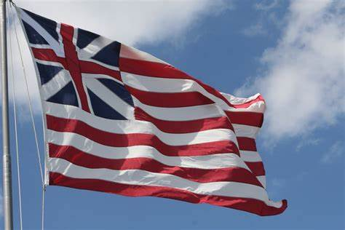
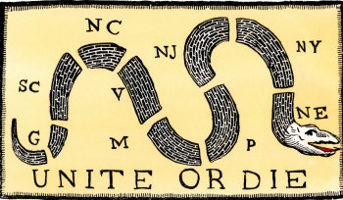
More Passages of American Revolution by Herbert Aptheker cont.
The American Revolution was the result of the interpenetration of three currents: The fundamental conflict in interest between the rulers of the colonizing power and the vast majority of the colonists; the class stratification within the colonies themselves and the resulting class struggles that marked colonial history which almost always found the British imperial power as a bulwark of the reactionary or the conservative interests in such struggles; and the developing sense of American nationality. The Nature of the Revolution transcending class lines, which resulted from the varied origins of the colonies’ peoples, their physical separation from England, the different fauna and flora and climate of their surroundings, their different problems and interests, their own developing culture and psychology and even language, their own common history, and from their own experience of common hostility— varying in degree with place and time—towards the powers that-be in England.
Grand Union Flag adopted in December 1775 and made obsolete in June 1777 after the Flag Act of 1777 was passed. It represented the Unity of the 13 Colonies against Britain.
Unite or Die originally Join or Die was Political Cartoon by Benjamin Franklin originally for the Seven Years War but revived in the lead up to the American Revolution.

Slide 18
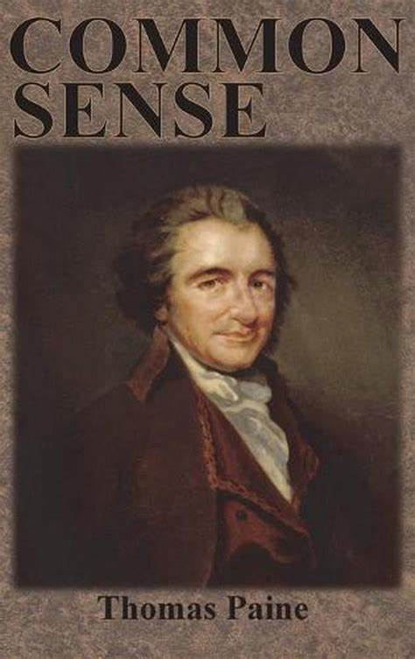
Quotes from Thomas Paine’s Common Sense
“I have heard it asserted by some that as America hath flourished under her former connection with Great Britain, that the same connection is necessary towards her future happiness, and will always have the same effect. Nothing can be more fallacious than this kind of argument. We may as well assert that because a child has thrived upon milk, that it is never to have meat, or that the first twenty years of our lives is to become a precedent for the next twenty…”
“Alas, we have been long led away by ancient prejudices and made large sacrifices to superstition. We have boasted the protection of Great Britain without considering that her motive was interest not attachment; and that she did not protect us from our enemies on our account; but from her enemies on her own account, from those who had no quarrel with us on any other account, and who will always be our enemies on the same account. Let Britain waive her pretensions [claims] to the continent, or the continent throw off the dependence, and we should be at peace with France and Spain were they at war with Britain. The miseries of Hanover last war ought to warn us against connections.”

Slide 19
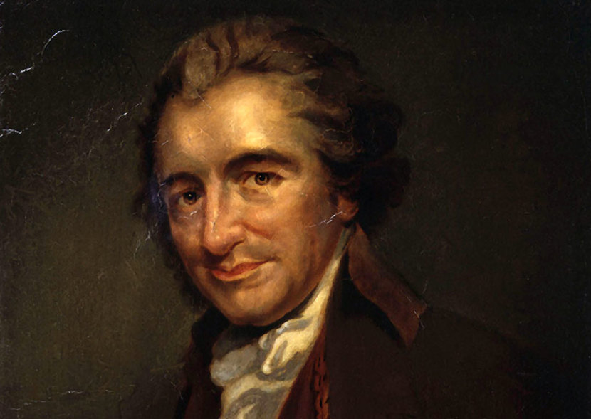
Quotes from Thomas Paine’s Common Sense
“But Britain is the parent country, say some. Then the more shame upon her conduct. Even brutes do not devour their young, nor savages make war upon their families;14 wherefore, the assertion, if true, turns to her reproach; but it happens not to be true, or only partly so, and the phrase parent or mother country hath been jesuitically adopted by the king and his parasites with a low papistical design of gaining an unfair bias on the credulous weakness of our minds. Europe, and not England, is the parent country of America. This new world hath been the asylum for the persecuted lovers of civil and religious liberty from every part of Europe. Hither have they fled, not from the tender embraces of the mother, but from the cruelty of the monster; and it is so far true of England that the same tyranny which drove the first emigrants from home pursues their descendants still.”
Thomas Paine (1737 - 1809) was an English American Enlightenment Era Writer who supported the American and French Revolutions

Slide 20
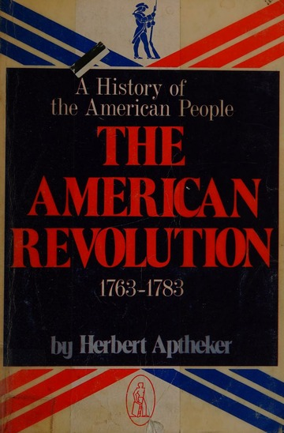
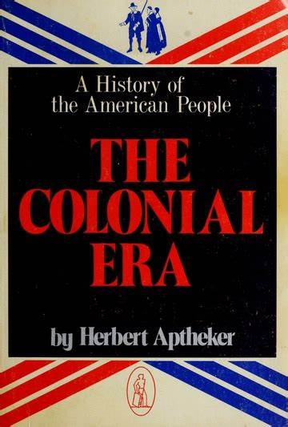
Recommended Further Reading
The American Revolution 1763-1783 - Herbert Aptheker
The Colonial Era - Herbert Aptheker
Common Sense - Thomas Paine

Slide 21
Discussion

Slide 22
Start of the American Revolution

Slide 23
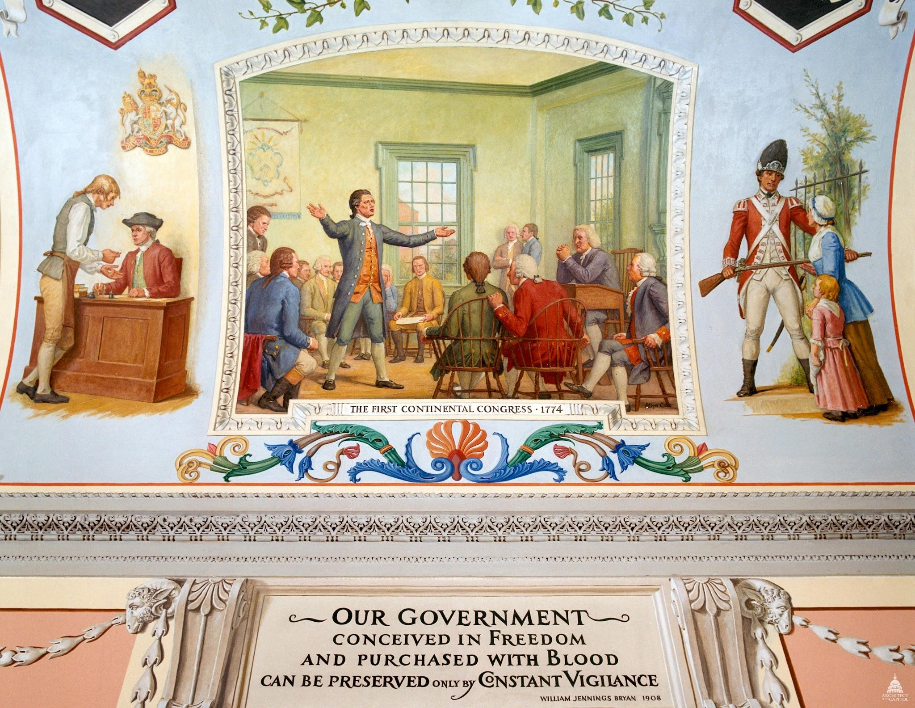
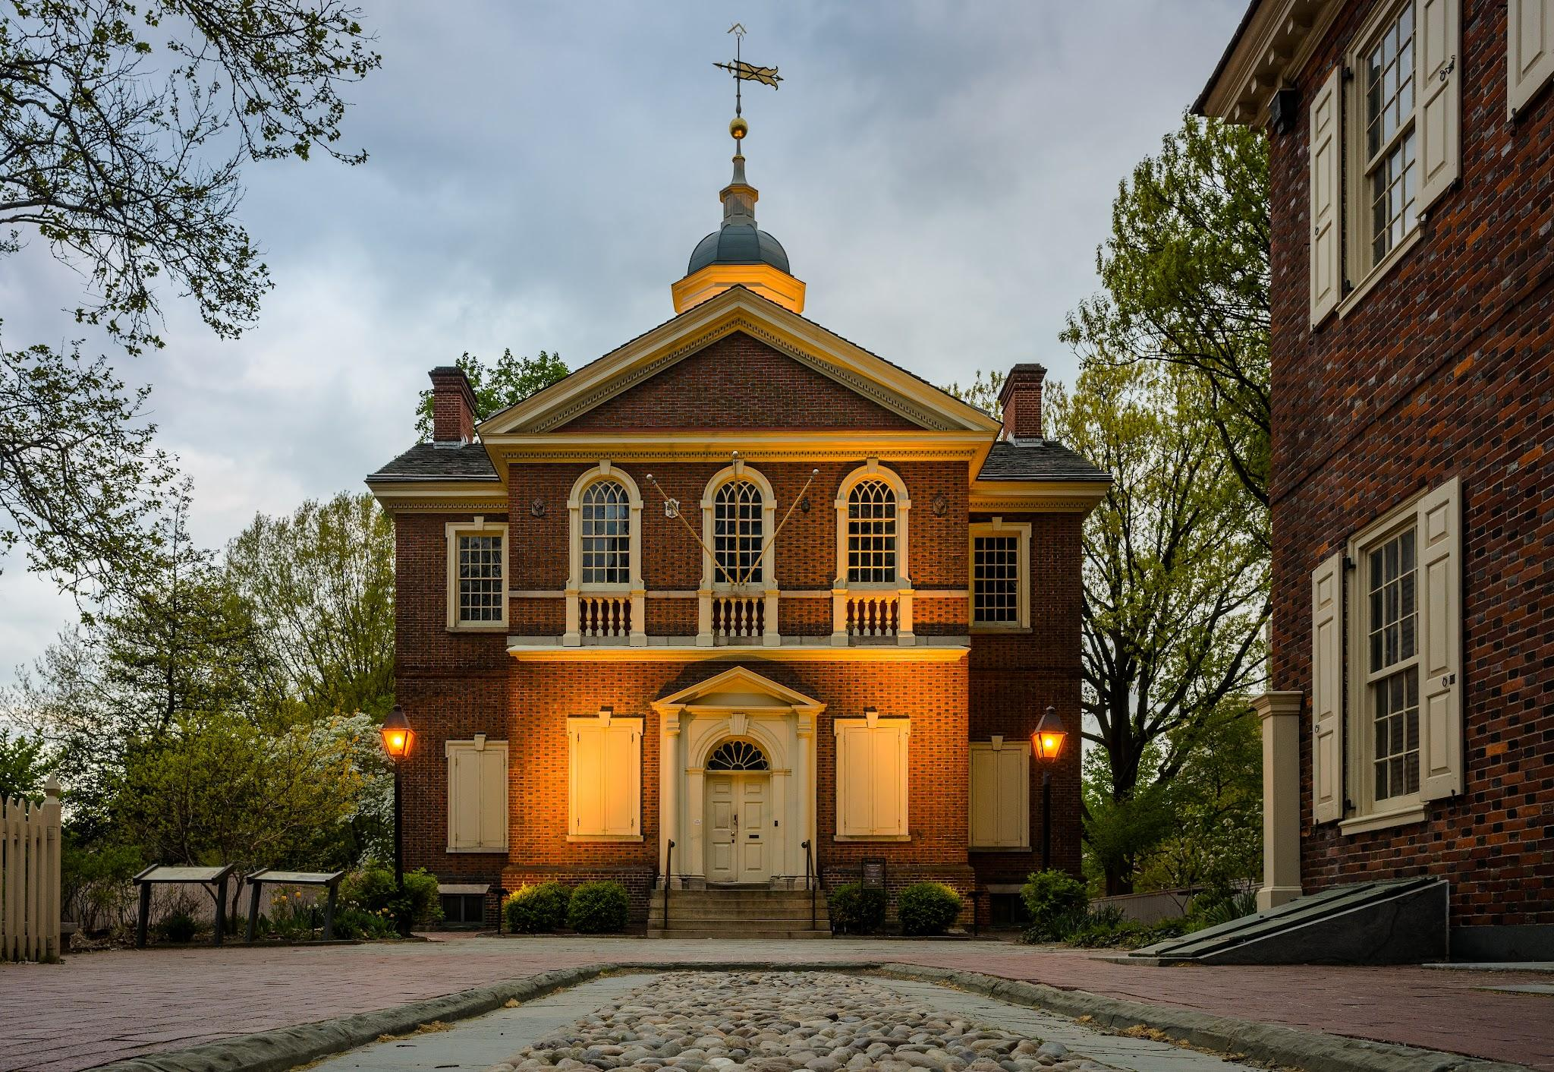
Start of the American Revolution
First Continental Congress
In the September and October of 1774, the delegates of 12 of 13 British colonies met in Philadelphia, Pennsylvania to convene the First Continental Congress. Grievances against the King of Britain were issued. The meetings for which were held at the Carpenter’s Hall, and the event can be thought of as analogous to the first congress of a revolutionary party today.
There was much debate between the right and left in attendance about maintaining a relationship with Great Britain vs declaring independence from them. They settled on a compromise, the Continental Association, which banned British goods and called for fundamental rights for Americans, many of which would later translate into the Bill of Rights of the US Constitution.
Also endorsed by the Congress were the Suffolk Resolves of Suffolk County, Massachusetts, which rejected the Massachusetts Government Act and urged colonies to raise their own militias against the British.

Slide 24
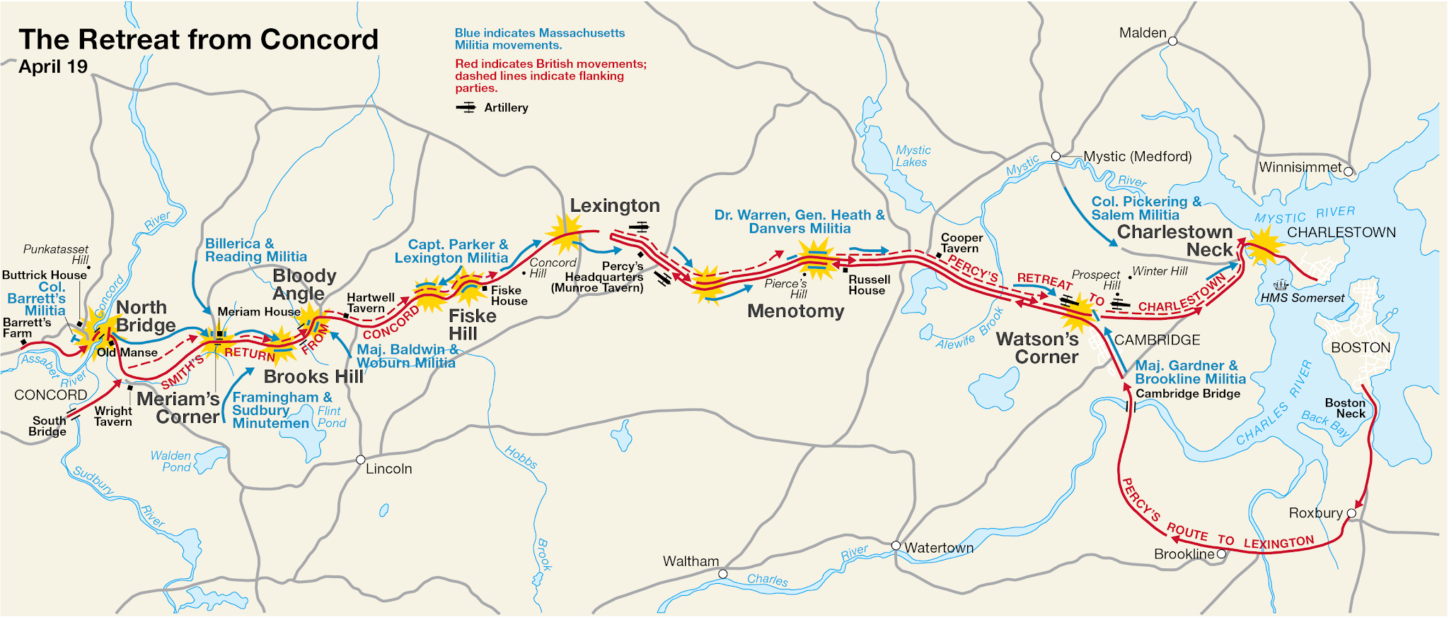
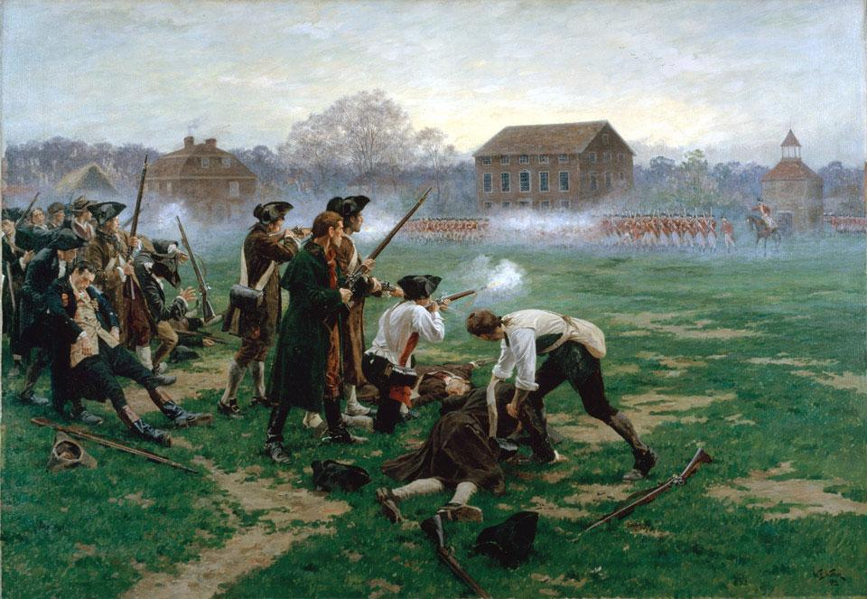
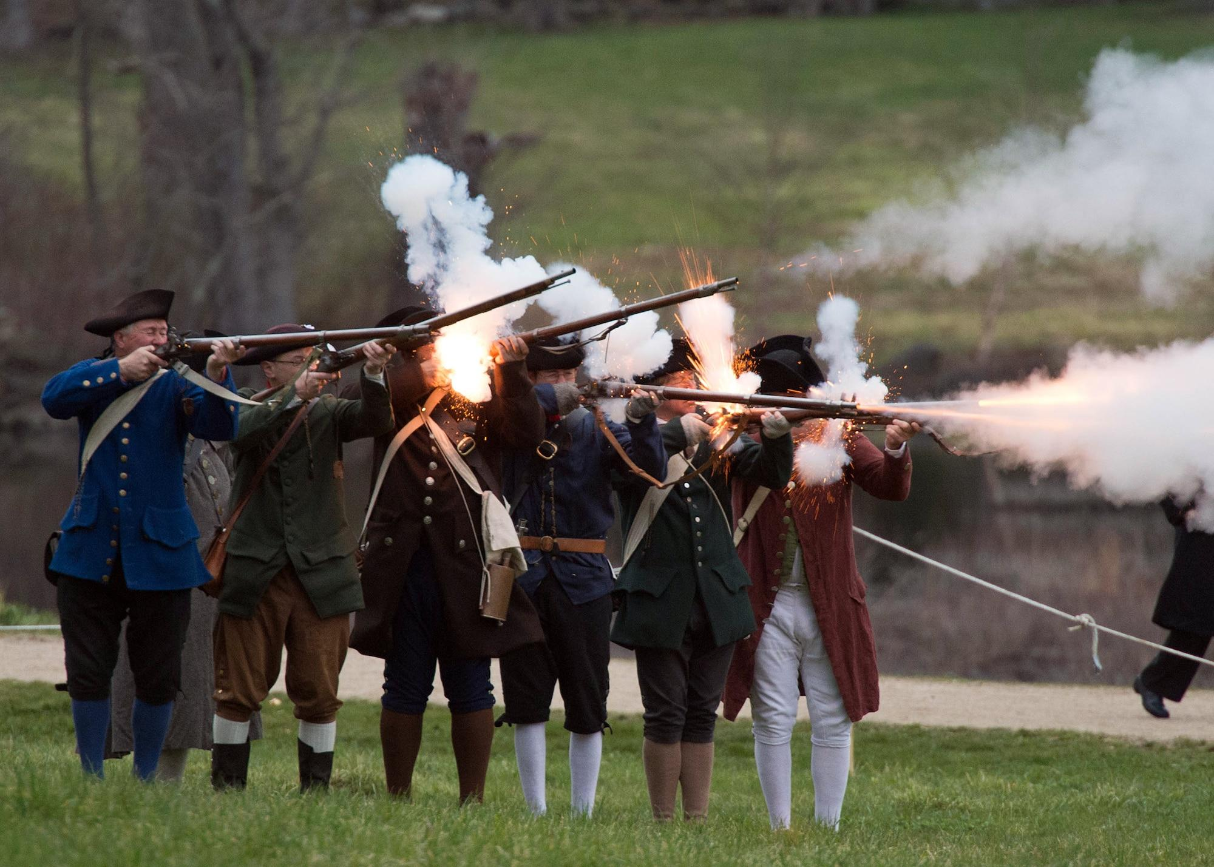
Battles of Lexington and Concord
The war itself broke out in the colony of Massachusetts in 1775. In February ‘75, Massachusetts was declared to be in a state of rebellion by the British and a British Garrison set out to disarm the militias in Massachusetts.
On April 19th of 1775, the British arrived at the town of Lexington, meeting about 80 militiamen assembled, including “Minutemen.” A shot was fired, most likely by British forces. This is known as “The Shot Heard ‘Round The World.” Many shots were fired back and forth following this.
The American militiamen retreated to Concord, where more fighters were assembled, especially after they realized the British soldiers were firing ammunition from their Muskets, rather than just powder. These men had become skilled in guerilla warfare and had a great knowledge of the countryside, allowing them to cover from and attack pursuing British forces.

Slide 25
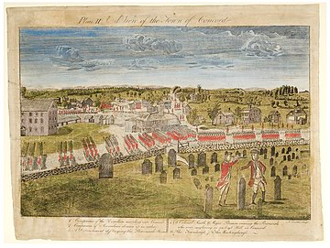
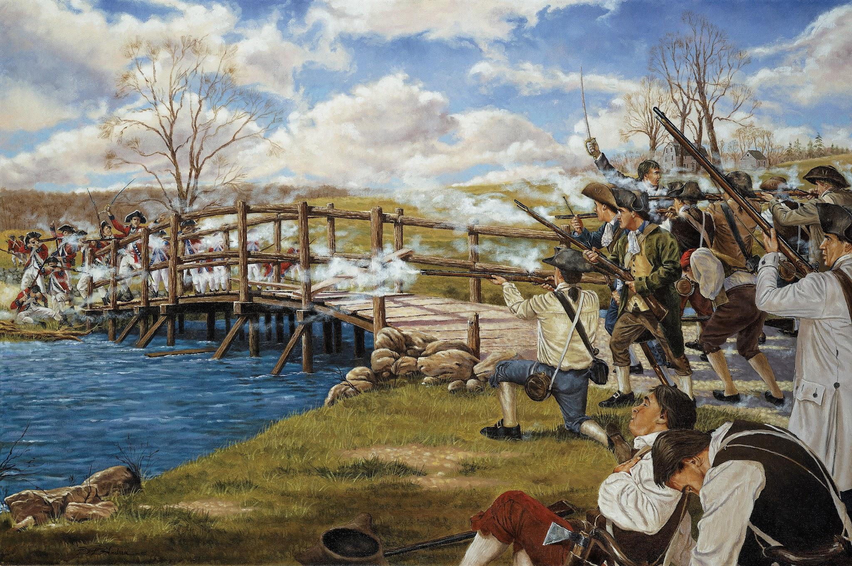
Battles of Lexington and Concord
At Concord, there were approximately 500 militiamen, who had heard of the defeat at Lexington and prepared themselves strategically. 700 British soldiers advanced toward Concord and found themselves across the Concord River about 90 soldiers strong at North Bridge. As they attempted an advance across the bridge, they were fired upon by the militiamen.
The British began to suffer heavy injuries and losses and retreated. The militiamen assessed the situation, met with their families and headed out, pursuing the British back to Boston.
Many more battles occurred on the way back, including at Brooks Hill, Bloody Angle, Fiske Hill, Menotomy, Watson’s Corner and Charlestown. At every battle, the militia forces grew. American militia forces grew from 500 at Concord to 15,000 by the time they surrounded Boston in the morning of April 20th, 1775.
The revolutionary war had officially begun.

Slide 26
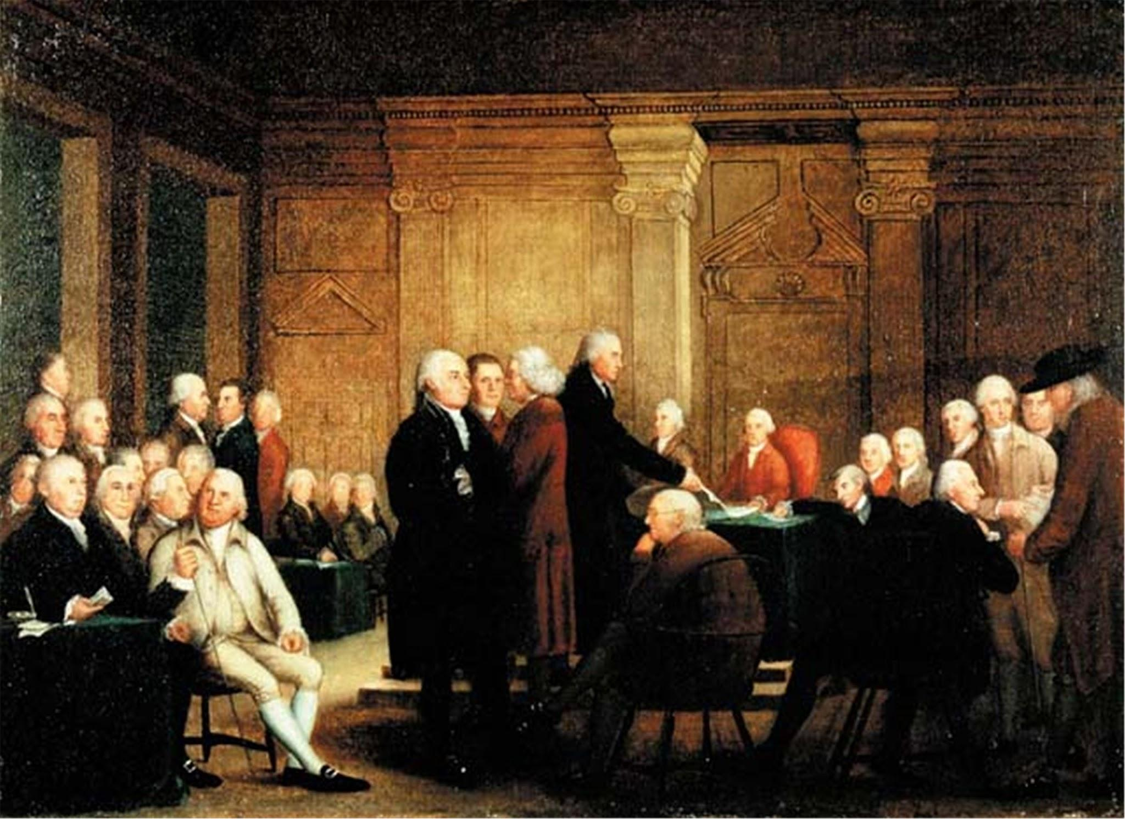
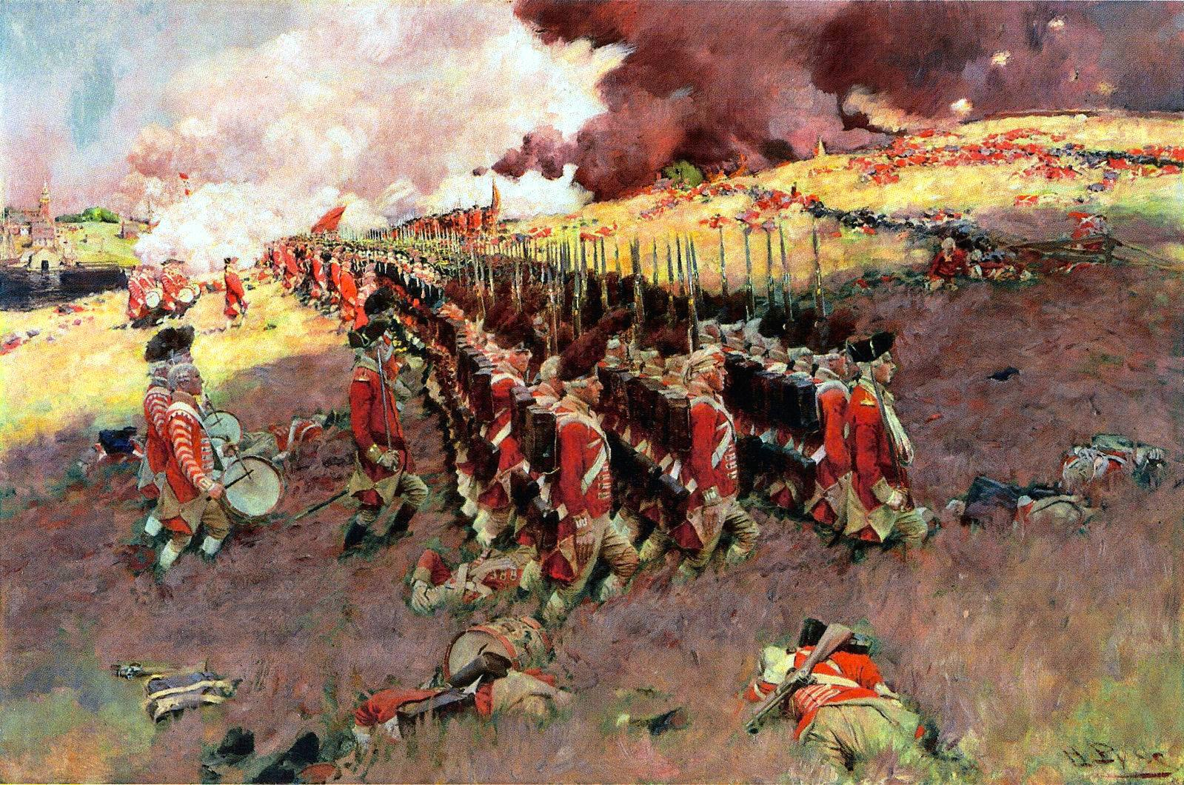
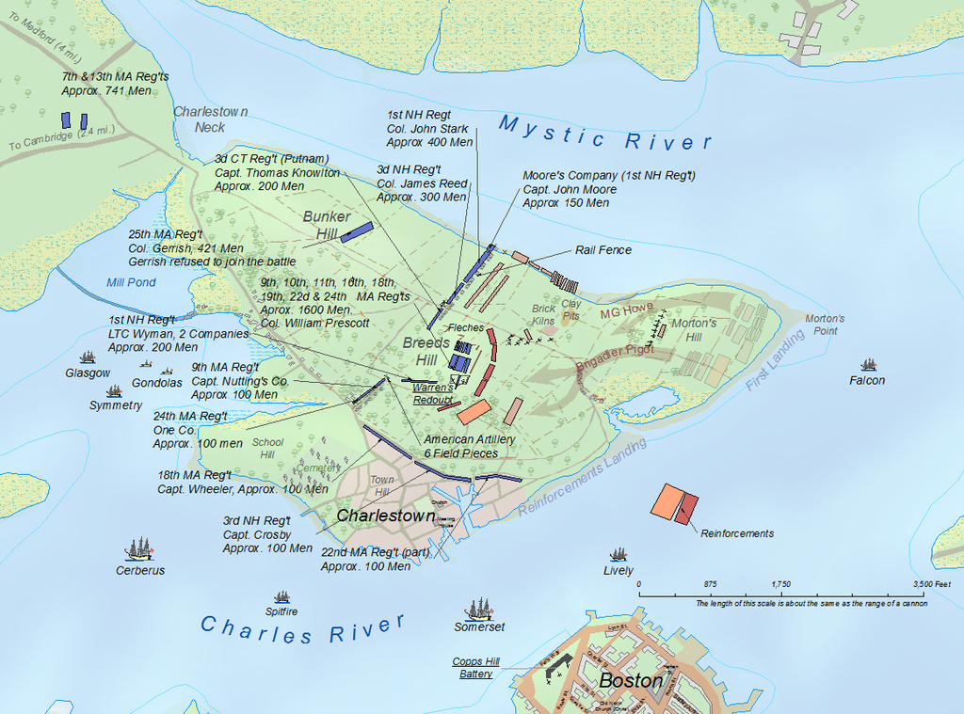
Start of the American Revolution
Second Continental Congress & Bunker Hill
On May 10th, 1775, delegates from all 13 colonies gathered for the Second Continental Congress. This same day, American forces captured Fort Ticonderoga near what is now the southwest border of the states of New York and Vermont.
This Congress would lead the Americans through the war and would be the revolutionary organ behind the Continental Army, which was established on June 14th, 1775 out of the Massachusetts militia and with George Washington as the general at its command.
On June 17th, the Battle of Bunker Hill during the Siege of Boston occurred. British forces captured Bunker and Breed’s Hills, which were the ideal spots for American militia to assault the city, but did not stop American forces from being able to access Boston.

Slide 27
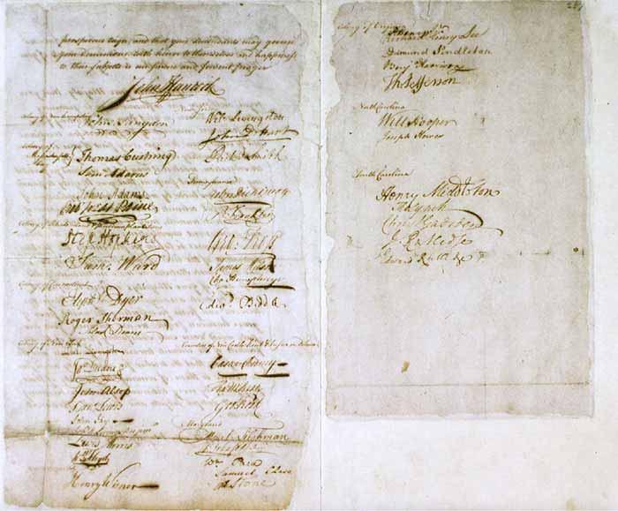
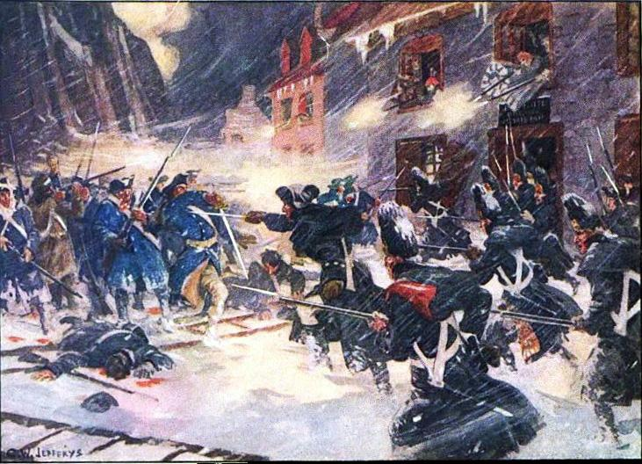
Start of the American Revolution
Assault on Canada and War in America
The Second Continental Congress sends the Olive Branch Petition to King George III, but this is ignored as he says the Americans are already in open rebellion and war against the British.
Following the defeat at Bunker Hill, the Continental Army begins an expedition to capture Montreal and Quebec, led by Benedict Arnold. Montreal is successfully captured, but Quebec is not. This ends the American entry into what would later be Canada.
Battles begin taking place in the Southern colonies too, such as South Carolina and Virginia. The war is intensifying and spreading at this point. Artillery from Ticonderoga is also being hauled to Boston for a final capture of the city.

Slide 28
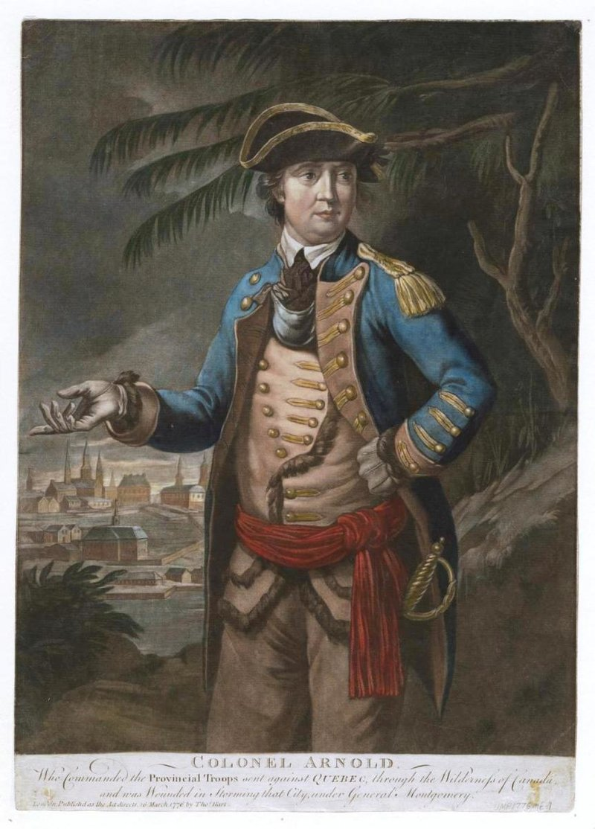
Note on the Treachery of Benedict Arnold by Earl Browder
Just as Leon Trotsky who played a positive role in the October Revolution just to betray the revolution, Benedict Arnold was a hero for the revolutionary cause early on to become a counter- revolutionary later on.
Earl Browder wrote on Benedict Arnold in Traitors of American History:
“First, there is Benedict Arnold, whose name takes its place alongside that of Judas for Americans as synonymous with the utmost depths of treachery. Arnold was a close intimate of George Washington; he was described as "brilliant" and "gallant." He was ordered to be tried by court-martial, by act of Congress, but was let off with a reprimand. Washington defended Arnold, disapproved of the court-martial, and afterward invited Arnold to resume a post of honor in the army, and on his request gave him command of the principal military post in the country, West Point. One and a half years before receiving this appointment Arnold was already in treasonable connections with the British. Within a few weeks after receiving this command, Arnold plotted to surrender West Point to the British at a date and hour when Washington, Lafayette, and others were to arrive at West Point. The plot failed only because the go-between, Major Andre, was caught returning through the lines with the documents of the plot—Trotsky and his friends a century and a half later had learned to burn their documents! Arnold escaped, and openly joined the British, receiving a reward of $30,000 and a brigadier's commission.”

Slide 29
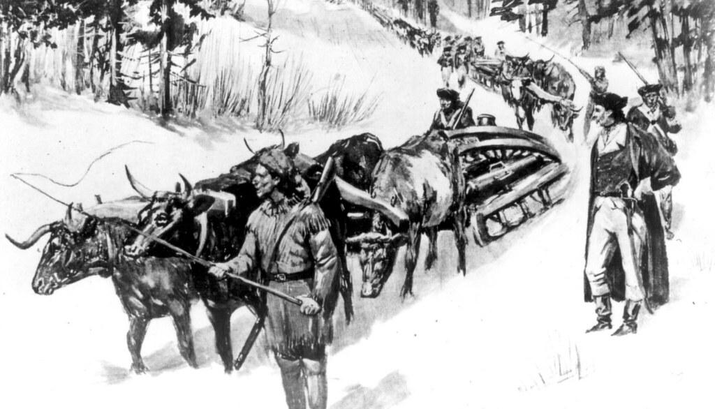
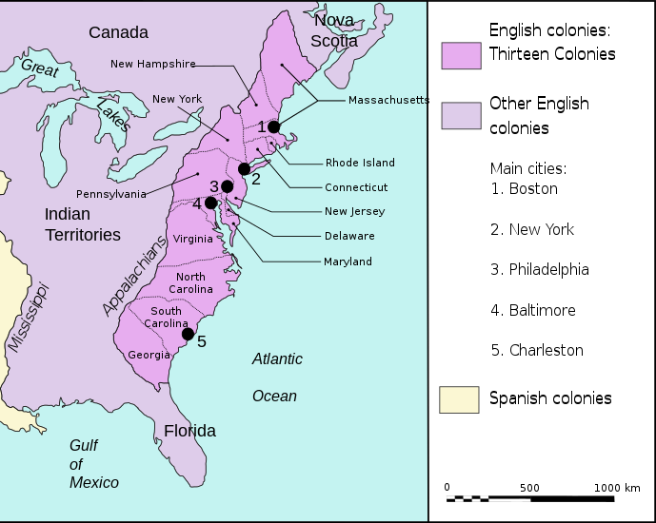
Start of the American Revolution
The Capture of Boston
By January of 1776, the artillery from Ticonderoga, nicknamed “the noble train of artillery,” led by Henry Knox, reached Boston. The artillery was set up in Dorchester Heights, which was a great place overlooking the city to assault from.
In March of 1776, British soldiers attempted firing on the fortification, but could not reach it from their position. The only other alternative to ending the threat of the artillery was to assault it with troops.
The British instead found their position indefensible and withdrew from Boston, taking their soldiers and supplies to Nova Scotia to prepare for a counter-attack at a later date. American forces captured Boston, the last place the British actually controlled in the 13 colonies, and now held control over the entire territory and were prepared to declare independence in July.

Slide 30
Discussion & New Members Introductions

Slide 31
New Member Introductions
What is your name, pronouns and state (or country/territory)?
Where do you work? Is it unionized?
How did you find out about the People’s School?
What do you think about tonight's class?

Slide 32
Polemic against Ultra-Left Narratives on the Revolution

Slide 33
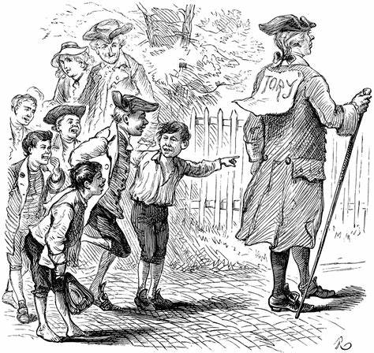
Gerald Horne’s British Monarchy Apologia
The Communist movement around the world has always held the incomplete revolution theory, the theory that the American War for Independence was only the first installment which would be completed with the American Civil War. The American Revolution ushered in the world bourgeois democratic revolutions from France to Haiti, from Bolivar’s Venezuela to Martí’s Cuban revolution, from Russian Revolutions of 1905 and February 1917 to Vietnam’s independence from France and many more. The American Revolution transformed the world. While capitalism was developing already in countries like Britain, it was in the American colonies that the national liberation and democratic revolutions were born.
Today, however, sections of the left have introduced the theory that the American Revolution was counterrevolutionary. The theory claims to be Marxist-Leninist but guts the struggle of class struggle and national liberation.

Slide 34
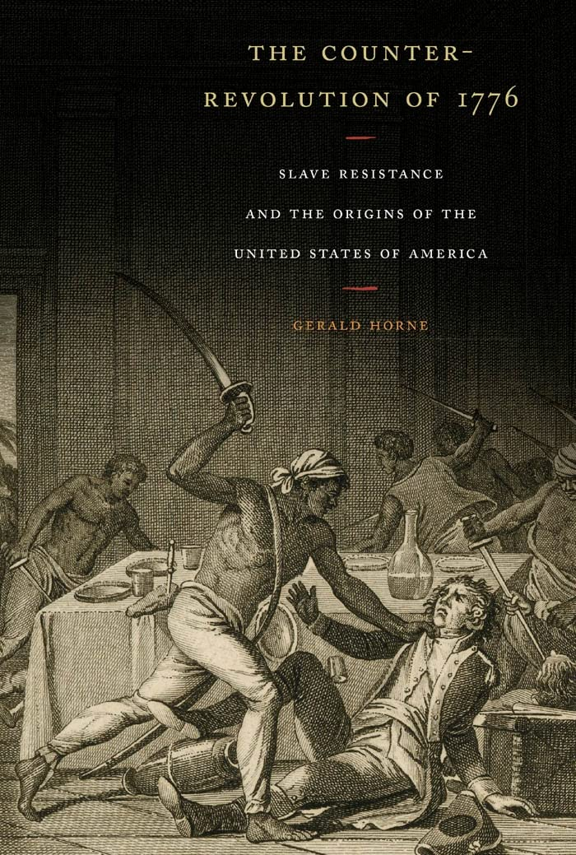
Gerald Horne’s British Monarchy Apologia
Gerald Horne’s Book: The Counter-Revolution of 1776 seems to be the biggest contemporary source for disavowing the American Revolution and the Declaration of Independence
His central thesis is that the American Revolution was not a war fought for national liberation but against abolition. This could not be further from the truth. Up until July 5th, 1775, a year before the Declaration of Independence, the American Colonies sought to avoid splitting from the British Empire. The British, who also used slavery, had just finished the Seven Years War with France and Spain. It was experiencing crippling debt and relied on its colonies, especially the American Colonies to pay that debt.
Ask yourself: does it really make sense that the British who colonized and enslaved a large portion of the Earth is now willing to break ties with its colonies over the morality of slavery?

Slide 35
British Apologia: Gerald Horne’s Counter-revolution of 1776
“Surely, the uniting of Europeans from varying ethnicities under the umbrella of “whiteness” broadened immeasurably the anti-London project, with a handsome payoff delivered to many of the anti-colonial participants in the form of land that once was controlled by the indigenous, often stocked with enslaved Africans—not to mention a modicum of civil rights denied to those who were not defined as “white.” Ironically, the founders of the republic have been hailed and lionized by left, right, and center for—in effect—creating the first apartheid state.”
“Ultimately, the mainland(American Colonies) model based on “racial” privilege overwhelmed the London model based on “ethnic” privilege. London’s “ethnic” approach implicitly—at times explicitly—sacrificed the interests of Irish and Scots and Welsh (and even the English of certain class backgrounds) and made up for the shortfall by seeking to attract Africans to the banner, a policy propelled not least by competition with Madrid. But such a policy could only alienate mainland settlers, driving them toward a unilateral declaration of independence on 4 July 1776.”
Throughout Horne’s text, there is never a class analysis of the American Revolution. He simply holds the American people as a monolith represented solely by the slave-owners.
Why does he do this? Horne does this because a class analysis would shatter his idealistic narrative. If he had done a class analysis, how could he explain the overwhelming support for the Revolution by all classes? How could the leaders of the revolution, who were censored from the press by the Loyalists, able to propagandize American proletariat and petty bourgeois to go to war and risk death and financial instability if they relied solely on grassroots propaganda campaigns? A class analysis would only harm his narrative.

Slide 36
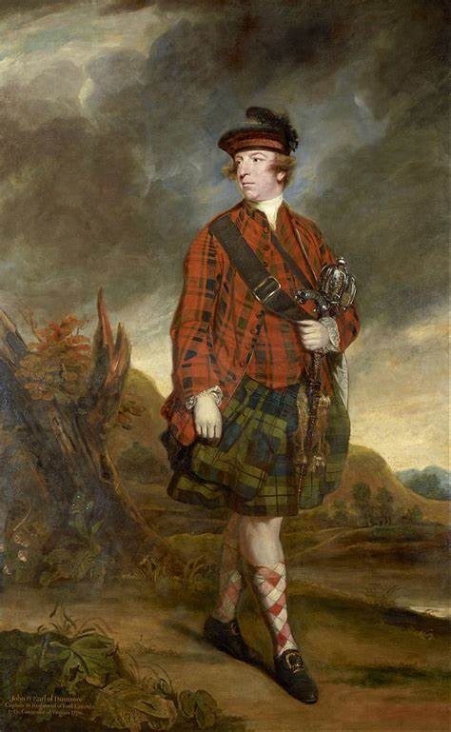
British Apologia: Gerald Horne’s Counter-revolution of 1776
“These Africans played a pivotal role in spurring once proud British subjects to revolt against the Crown, thanks to the final colonial governor in Virginia, Lord Dunmore: he was viewed as a villain by the rebels, particularly after his notorious November 1775 decree to free and arm enslaved Africans in order to squash the anti-colonial revolt.”
Here Horne is using the Dunmore Proclamation that lured slaves to British war efforts as proof that the war was fought over slavery. However, this was merely a tactic of economic war against the colonists by destabilizing the economy. A tactic of war should never be confused with the objectives and principles behind the war.
“In other words, from 1756 to 1763, London fought an expensive and largely successful war against Paris and Madrid to oust the latter two from a good deal of North America to the benefit of the colonists, then sought to raise taxes to pay for this gigantic venture—only to have the settlers go behind the back of London and conspire with Spain and France against Britain.”
In this quote, Horne is showing his apologia to the British Monarchy by glorifying the “valiant” effort of the British to defend the Colonies from the French and Spanish. How absurd! Horne has it completely backwards, the Colonies were dragged into a war that had been serving British interest for decades prior. The British did not care about the colonists, it was worried about monopolizing the market for itself!
John Murray 4th Earl of Dunmore also known as Lord Dunmore.

Slide 37
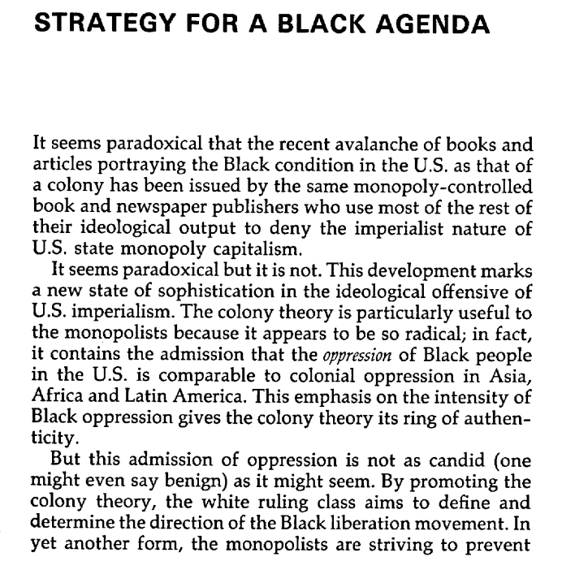
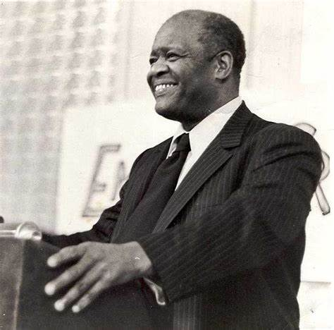
Henry Winston on New Leftist Historical Revisionism
`
Henry Winston served as the Chairman of the CPUSA from 1966 to 1986

Slide 38
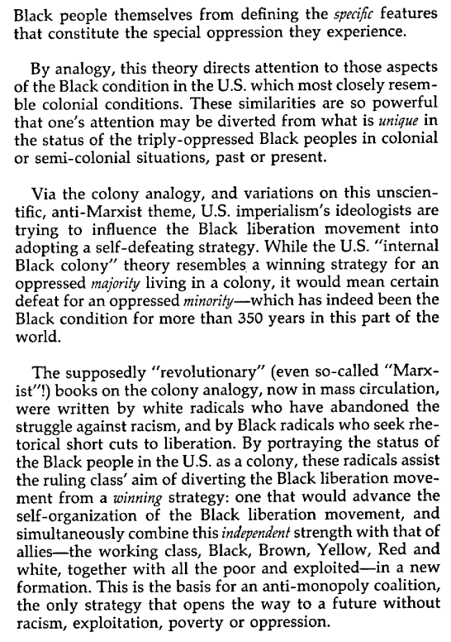
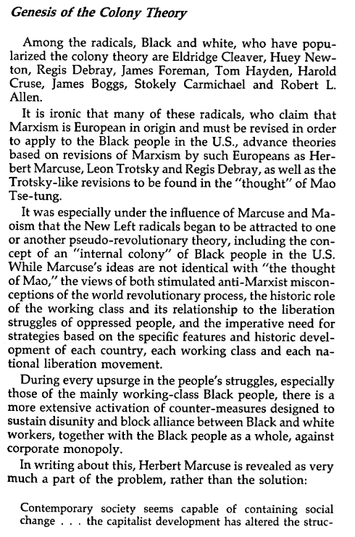
Henry Winston on New Leftist Historical Revisionism continued
`

Slide 39
Discussion & Wrap Up Introductions

Slide 40
Announcements
We are looking for content submissions for Vol IV 2024 of New Masses! It is in production and we are excited to receive comrades’ art, poetry or prose! Send any submissions to info@partyofcommunistsusa.net and kamryns@johnreedcenter.net. Please send it ASAP!
The Peoples School for Marxist-Leninist Studies regained control of the original PSMLS YouTube channel we lost due to wreckers in 2022. SInce regaining control, we are re-uploading all our videos posted on the other channel since then. Check them out to see what we were talking about back then and make sure to like, share and subscribe to both channels!
PCUSA cell chairs need to be calling the people in their cell and reminding them of the PSMLS classes each week.

Slide 41
Volunteers Needed!
We are in need of volunteers for the staff of the People’s School! Here’s a few roles we need filled:
People to help manage posting on our social media and podcast platforms
Video Editors, Audio Editors, Graphic Designers, Artists, Narrators
Facilitators, Web Controls, Moderators
We will train you for these positions! No experience is fine!
Email info@peoplesschool.us if you’re interested, and we will get you into the roles we need you in.

Slide 42





PSMLS Propaganda
peoplesschool.us/media
Materials to help promote the school!

Slide 43

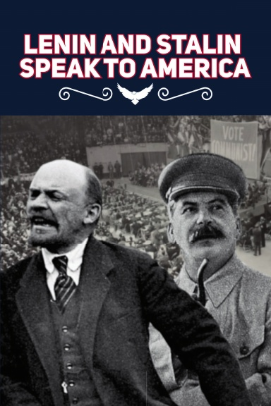
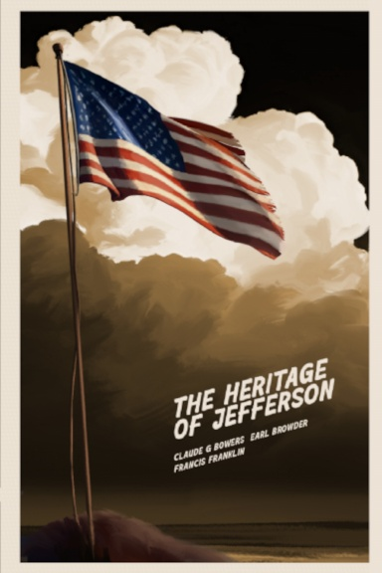
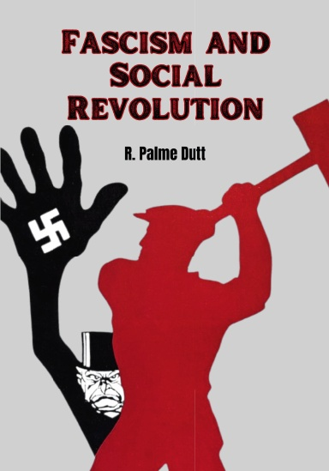
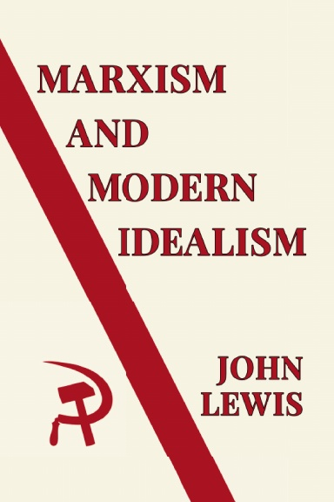
New Outlook Publishers
newoutlookpublishers.store
Most Relevant
Latest Releases

Slide 44

New Outlook Publishers - Volunteers Needed!
newoutlookpublishers.store
New Outlook Publishers is looking for Volunteers!
NOP is looking for assistance in the following areas:
Formatters
Cover Artists
Please reach out to scottp@johnreedcenter.net if interested and attend the next New Outlook Publishers staff meeting on August 28th 2024 at 8 PM EST.

Slide 45

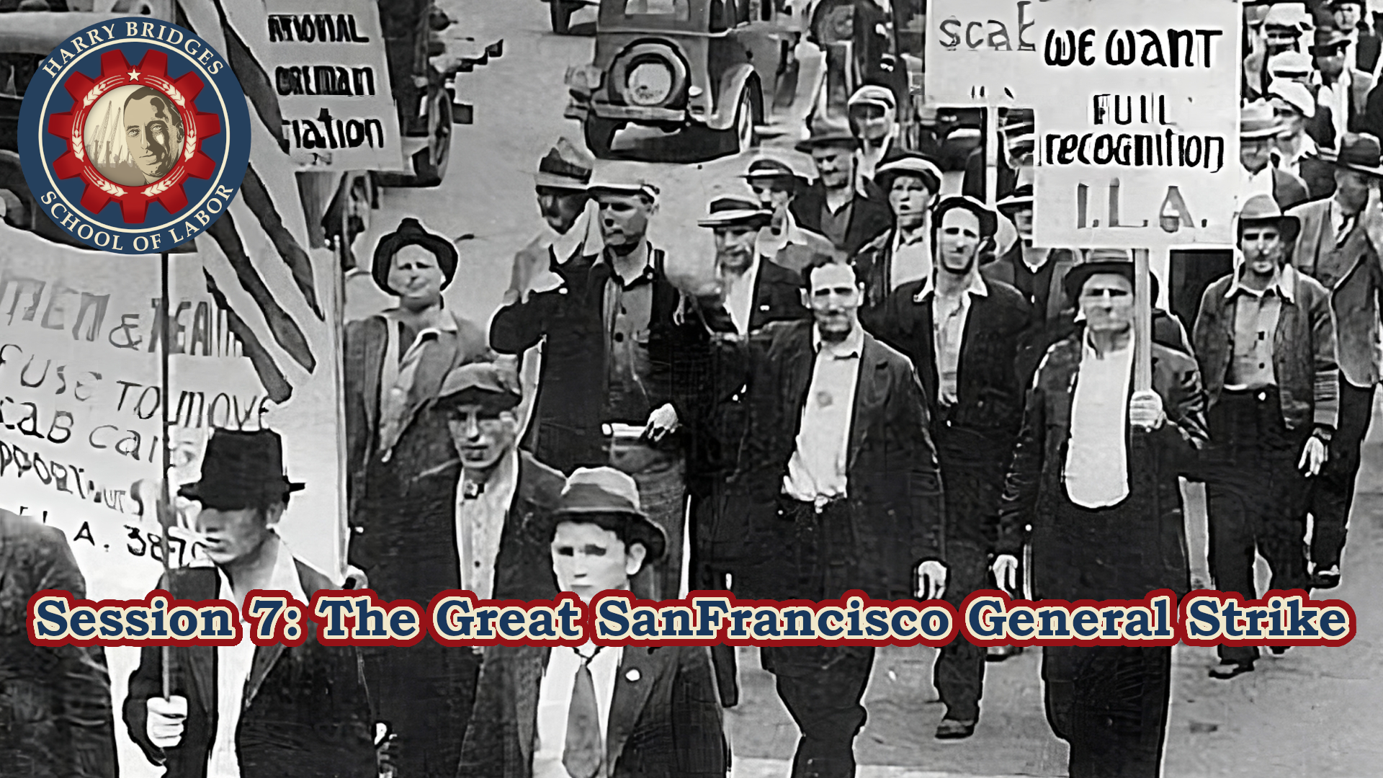
Harry Bridges School of Labor
https://luel.us/laborschool/
Launched in Spring 2023, the Harry Bridges School of Labor is a monthly class held 2x per month. Classes will cover a variety of topics aimed at building class conscious among union members.
Next Class will be on July 3rd (9pm EDT) and 6th (7pm EDT), and will cover The Great San Francisco General Strike. There will also be a collaboration with the PSMLS on July 23rd on the school’s namesake, Harry Bridges.

Slide 46

This Land Is Your Land - 1944 version by Woody Guthrie

