Slide 1
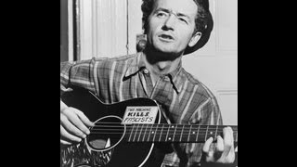
"Dear Mister Eisenhower" (lyrics Woody Guthrie, performed by Pete Seeger)

Slide 2

The Jewish
Peoples Schule Presents: The Rosenberg Murders

Slide 3
Overview
The Trial of Ethel & Julius Rosenberg: The need for BOTH Julius and Ethel Rosenberg to be exonerated
The “Shush” Jews aid the reactionaries: History of “looking the other way” within the Jewish community
The Legacy of the Rosenbergs: Tying persecution of the Rosenbergs to today’s witch hunt of the left by the “anti-Christians”, and anti-capitalists

Slide 4
The Trial of Ethel and Julius Rosenberg

Slide 5
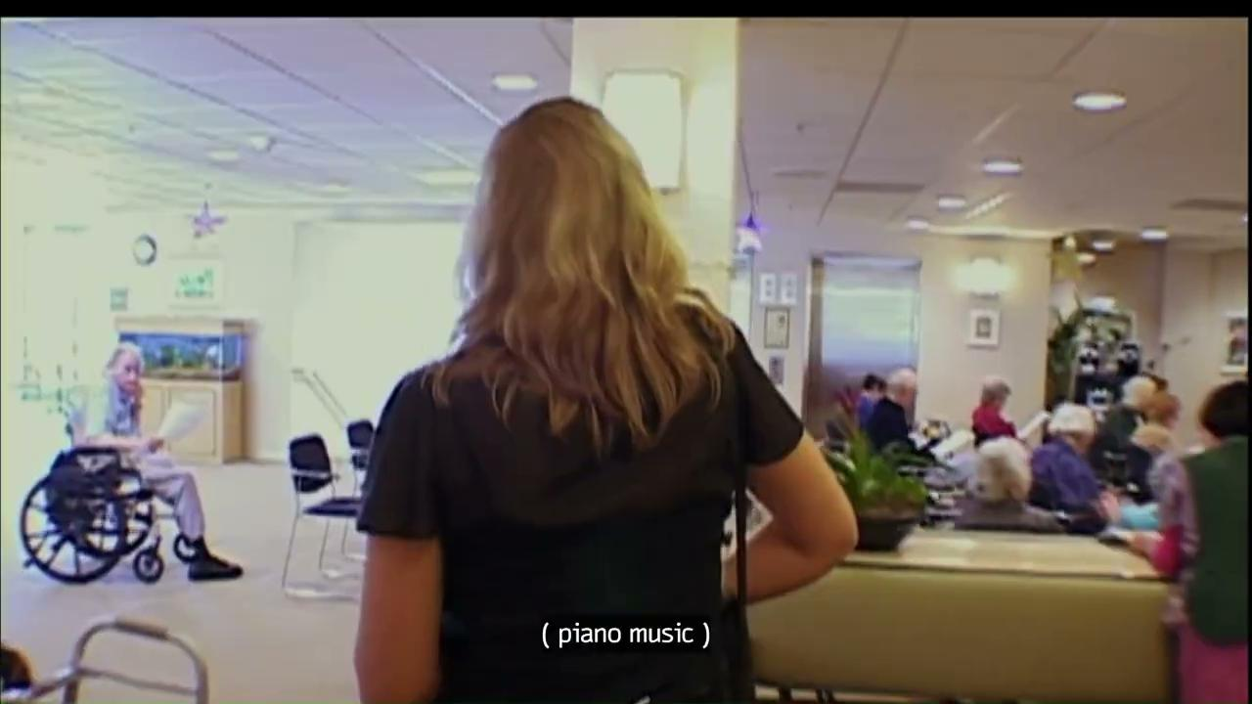
From the Documentary Heir of an Execution -
Interview with Harry Steingart - Secretary Treasure of the FAECT-CIO

Slide 6
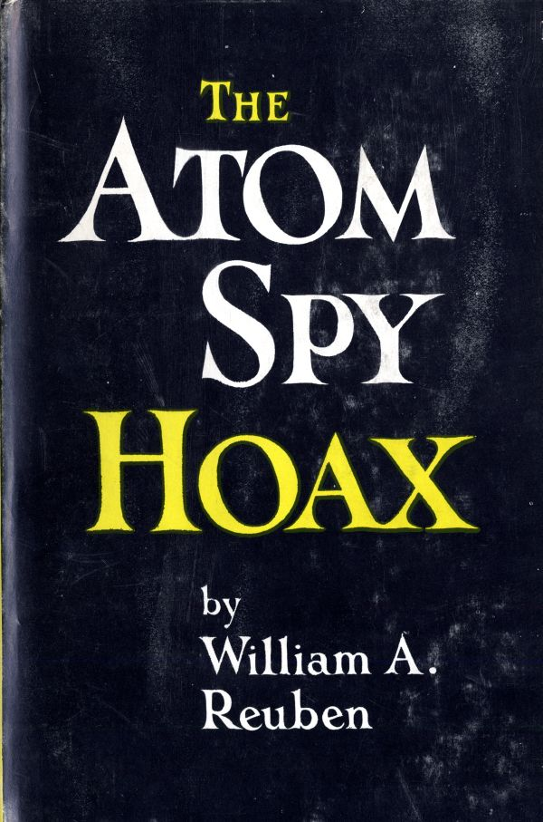
Why the prosecution tried to bribe the Rosenbergs?
The beginning of the Cold War
The entire American press (in 1945) was virtually in unanimous agreement that there was no "secret” to the bomb. Practically all information media agreed with the scientists, and government officials that science, industrial capacity and "know-how" were the only elements needed to smash the atom for destructive as well as useful purposes; that the Soviet Union would develop the atom bomb in three to five years.
This Section is taken from this book

Slide 7
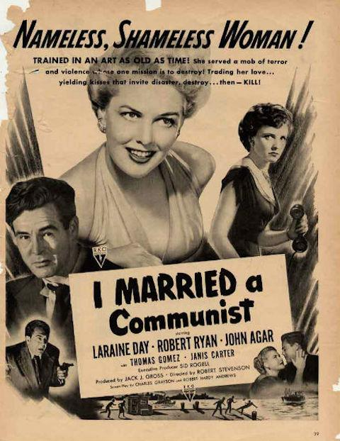
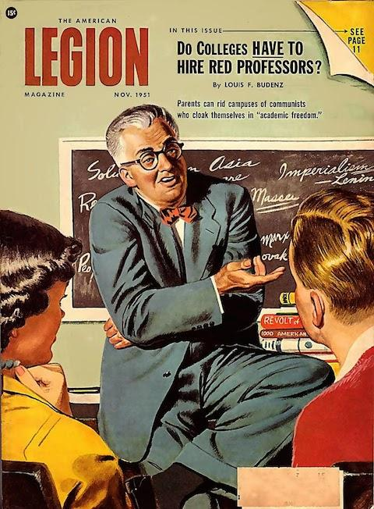
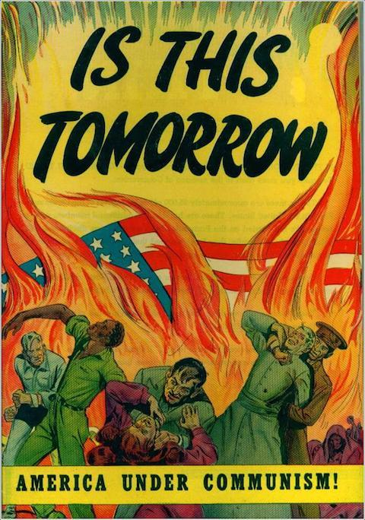
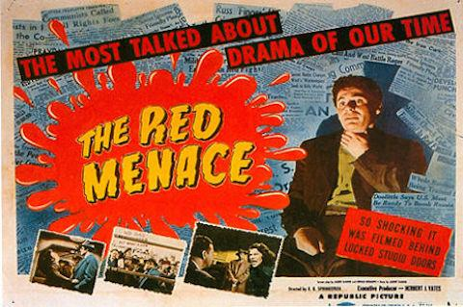
Why the prosecution tried to bribe the Rosenbergs?
But, as had been true in the Fall of 1945 during discussions about the problems surrounding the United States' possession of the atom bomb, there was no chance for reasoned debate. The militarists, politicians, and financiers came up with a startling discovery that, like a deus ex machina, resolved the problems that had arisen after three years of the Cold War. This produced headlines that made ending the Cold War unthinkable. It justified increased military spending and undermined the effectiveness of Soviet peace bids. It also created an argument that the West could not trust the Soviet Union. After three full years of Cold War defense spending, signs appeared of an impending drop in employment. Thus, despite three and a half years of Cold War with enormous defense spending, the Marshall Plan, the Truman Doctrine, and the North Atlantic Treaty, something more was needed.

Slide 8
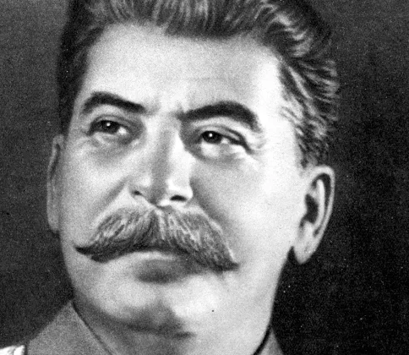
Why the prosecution tried to bribe the Rosenbergs?
Considering the fact that this total transformation of public opinion was achieved on the basis of unsupported charges and unsubstantiated newspaper headlines, it should not be difficult at all for us to comprehend that the next logical development in these proceedings would be taken almost as a matter of course: the production of the “atom spy" or "a-spies" who had given, as the headline writers and spy-hunters were fond of phrasing it, the atom bomb to Stalin.
While the "Communist-spy" trials, as the majority of press was soon to lump the trials of Judith Coplon, Alger Hiss and the eleven Communist Party leaders were going on, The Un-American Activities Committee kept up its work. This work to be in the vanguard of a drive to convince the American people not only that there were atomic "secrets" which could be stolen but that all "Reds” which before long would become interchangeable with anyone who opposed McCarthy or the Committee or who had ever supported the New Deal were agents of Moscow, engaged in either sabotage or spying.

Slide 9
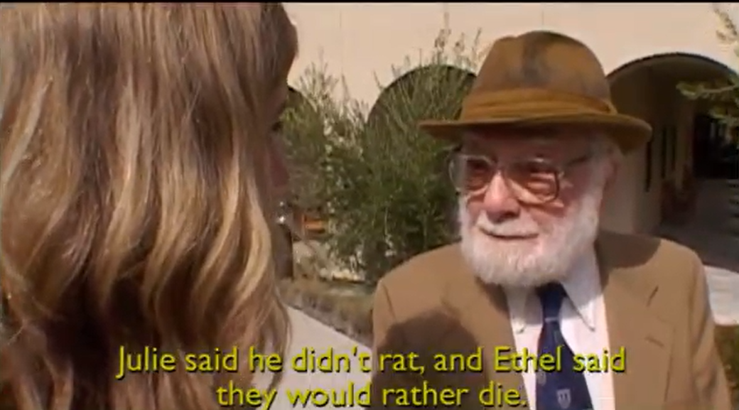
So, why the prosecution tried to bribe the Rosenbergs?
The FBI devised a plan, with the prosecution of the Rosenbergs:
To win the Rosenbergs confidence in prison and try to persuade them that the USSR in fact was an antisemitic power intent on exterminating the Jews. Once their illusions about the Soviet Union were shattered, the Rosenbergs might then receive clemency in exchange for an appeal to Jews in all countries to get out of the communist movement and seek to destroy it.
It was unfortunate but not surprising that several of the America’s most respected Jewish intellectuals, among whom were many former leftists, felt obliged to take cover, even to become turncoats.
Not a few engaged in denouncing the “anti-Semitism” of Stalin who led the Soviet Union against Hitler and ended the Holocaust.

Slide 10
A CIA Memorandum
(transcribed from original)
CIA Memorandum
Subject: The Rosenberg Case January 22, 1953
PROPOSAL: A concerted effort to convince Julius and Ethel Rosenberg, convicted atom spies now under sentence of death, that the Soviet regime they serve is persecuting and ultimately bent on exterminating the Jews under its sovereignty. The action desired of the Rosenbergs is that they appeal to Jews in all countries to get out of the communist movement and seek to destroy it. IN return, the death sentence would be commuted.
ADVANTAGES: The importance of success in this venture can scarcely be overstated from a psychological warfare standpoint. The Communist Parties throughout the world have built up the Rosenbergs as heroes and as martyrs to “American anti-semitism.” Their recantation would entail backfiring of this entire Soviet propaganda effort. It would be virtually impossible for world Communism to ignore or successfully discredit the Rosenbergs. The couple is ideally situated to serve as leading instruments of a psychological warfare campaign designed to split world communism on the Jewish issue, to create disaffected groups within the membership of the Parties, to utilize these groups for further infiltration and for intelligence work. (Whether the defection of the Rosenbergs would yield significant information concerning other Soviet espionage groups is a matter for the FBI to appraise.)
…
https://www.rfc.org/sites/default/files/item_05_cia_memo_1.doc

Slide 11
Four Reasons Why The Rosenbergs Must Be Exonerated
4 REASONS
To preserve Democracy and its institutions by prohibiting their corrupt use against the people.
To condemn the state’s use of violence for destroying citizen’s individual rights and bodies.
To prevent future political conditions leaving martyrdom as sole remaining means of political speech against a corrupt state.
To acknowledge the valor and sacrifice of the Rosenbergs and their families loss.
Critical analysis of the Rosenberg Trial reveals how invalidation of Democracy and its institutions are used as weapons in an ideological war. It serves as a warning, informing tactics and strategy for confronting the reactionary state and it's apparatus.
The Rosenberg’s character and culture were the first targets of assassination. When the state failed at their attempt, it assassinated the Rosenbergs themselves.
Rather than permit the state to corrupt and invalidate their inherent right as human beings, their personal integrity and their patriotism, the Rosenbergs surrendered their lives in defiance of the state’s monopoly over fear and authority. They were martyrs.
The Rosenbergs sacrificed their lives to protect their comrades and their Party. They saved many lives and prevented the remains of the Party from being systematically dismantled.
The Rosenberg executions were plainly unjust. Their trial was a spectacle celebrating state sanctioned violence. If not exonerated, the state’s culpability remains ambiguous and it’s victims unspoken for, leaving the path open for additional injustice.

Slide 12
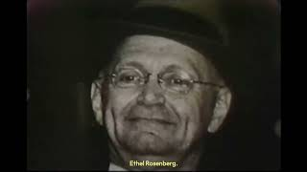
Bob Considine witness to the Rosenberg executions

Slide 13
Discussion & New Members Introduction

Slide 14
New Members Introduction
What is your name, pronouns and state (or country/territory)?
Where do you work? Is it unionized?
How did you find out about the People’s School?
What do you think about tonight's class?

Slide 15
The “Shush” Jews Aid the Reactionaries

Slide 16
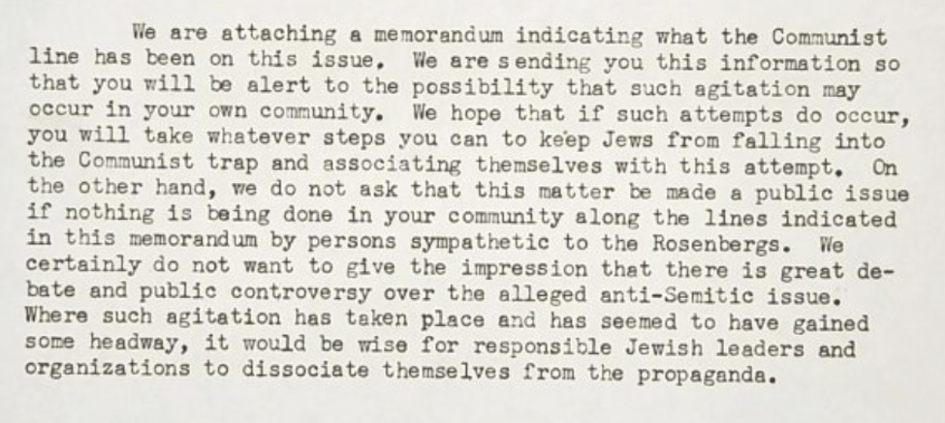
AJC Blames Communism-The Memo
The AJC was founded in New York in 1906 to defend the civil and religious rights of Jews and other minorities throughout the world. Given the illustrious history of the organization and their strong stance against discrimination, one might expect the AJC files to contain materials about their defense of the Rosenbergs, or at a minimum, their denunciation of the antisemitism surrounding the affair or the severity of the punishment. But the archives tell a different story.
The cover letter for a memorandum called “The Defense of Ethel and Julius Rosenberg: A Communist Attempt to Inject the Jewish Issue,” dated March 27, 1952, warns, “In recent months Communists have been attempting to agitate concerning these condemned persons and to inject into the situation a suggestion that there are anti-Semitic implications to the conviction and the sentences. The AJC believes there is no foundation for such charges.”

Slide 17
AJC Blames Communism-More Memos
A memorandum from February 28, 1952, warning Jewish organizations not to let their buildings be used for meetings in support of the Rosenbergs, clearly spells out the roots of this anxiety among the Jewish community: “We have a directive to dissociate Jews and Communism in the American mind…Jewish organizations should be warned that the FBI has been making careful note of pro-Communist meetings and that these pro-Rosenberg meetings will surely go into the record…The Jewish community owes nothing to the Rosenbergs and must not be put into a position wherein the general public assumes that the Jewish community is on the side of the Rosenbergs…”
In a letter dated December 23, 1952, ” AJC director S. Andhil Fineberg acknowledges, “We are in a tough situation, skillfully concocted by the Communists. If they were not conducting an international campaign of slander against the United States, the survival of the Rosenbergs by granting clemency would be a different matter than it now is…It is a very ticklish problem wherein we can and should make it clear that there is no ‘Jewish Interests’ and no civil liberties issues involved.

Slide 18
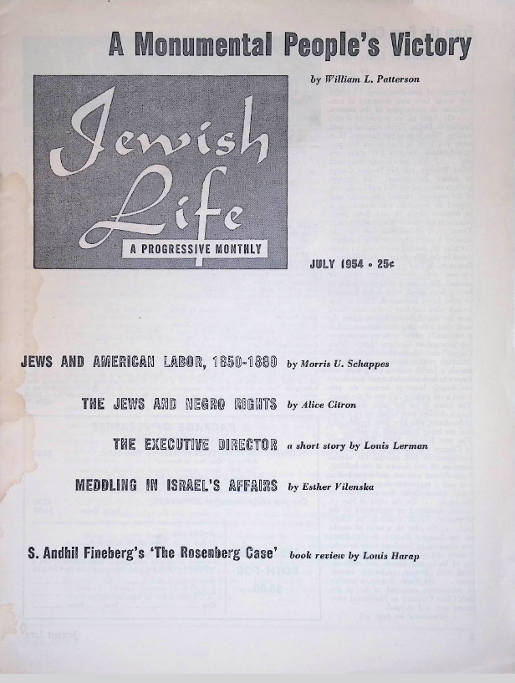
As every sane person knows, and as even Army Secretary Robert T. Stevens has declared, no proof or evidence of espionage at all was uncovered. McCarthy himself was at last forced to admit this. Fineberg’s acceptance of the McCarthyite hoax is shocking enough in any public person, but more so in a “leader” in a Jewish “defense” organization. For, as even the Anti-Defamation League has now been forced to admit, “rampant anti-Semitism” (the ADL’s phrase) was one of the motives for the groundless Monmouth charges.
“The Charge of Anti-Semitism”
Anti-Semitism entered the case, basically, through the fact that Judge Irving Kaufman decreed the death sentence in order to appease the anti-Semites and that the case is exploited by anti-Semites. This was stated in one form or another in non-left and anti-communist Yiddish and English-Jewish sources. (For instance, Mr. Danzis in the Jewish Day, April 12, 1951—note the date!—the Yiddish poet H. Leivik, Day, April 16, 1951; also Rabbi Louis D. Gross, Jewish Examiner, March 14, 1952; Rabbi G. George Fox, Chicago Sentinel, February 14, 1952).
Finally, a memorandum dated June 19, 1950, from the files of the Greenglass attorneys summarizing an interview of the lawyers with Ruth Greenglass, states that she said that “The Jewish Daily Forward, which is certainly not a leftist newspaper, is very excited about the anti-Semitic issue and has offered a lawyer.” It is a lie, therefore, that the Rosenberg Committee “injected the false issue of anti-Semitism into the case,” as a statement by major Jewish organizations approvingly quoted by Fineberg asserts.
From the article S. Andil Fineberg’s ‘The Rosenberg Case’ in Jewish Life July 1954. Louis Harap responds to the falsehoods in the book. read more on ujpfo.org

Slide 19
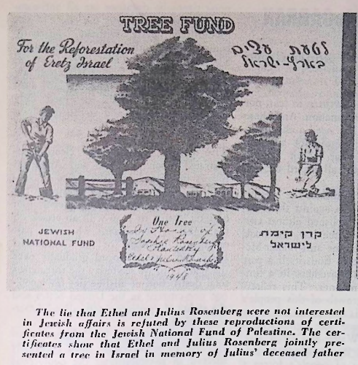
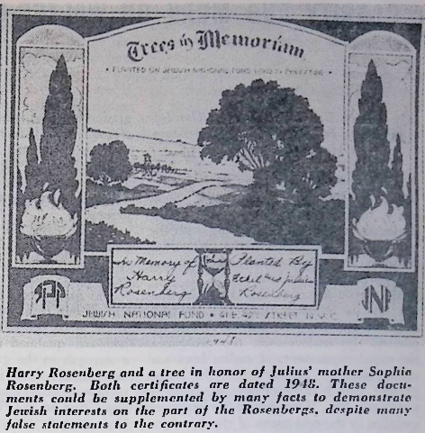
An “International Communist Plot"
Finally, there is the question of Fineberg’s charge that the world campaign for clemency was a plot of what he calls the “international communist network.” All the millions of non-communists and anti-communists who urgently and even passionately petitioned for clemency were “dupes” of the communists, “unsophisticated people,” etc., etc. Such a statement can only have been made by the most prejudiced McCarthyite bigot. Consider Fineberg’s colossal ignorance—or worse—when he talks about “the alleged American hysteria about Russia” (p. 73, emphasis added). French President Vincent Auriol, French writers, the Pope, cardinals and other church dignitaries from all over the world, labor leaders, the British and French chief rabbis and hundreds of clergymen and rabbis all over the world including Israel, 2400 United States church men and rabbis, practically the entire people of France and Italy as well as vast sections of Western Europe, Asia and Latin America—all of these called forclemency for the Rosenbergs.

Slide 20
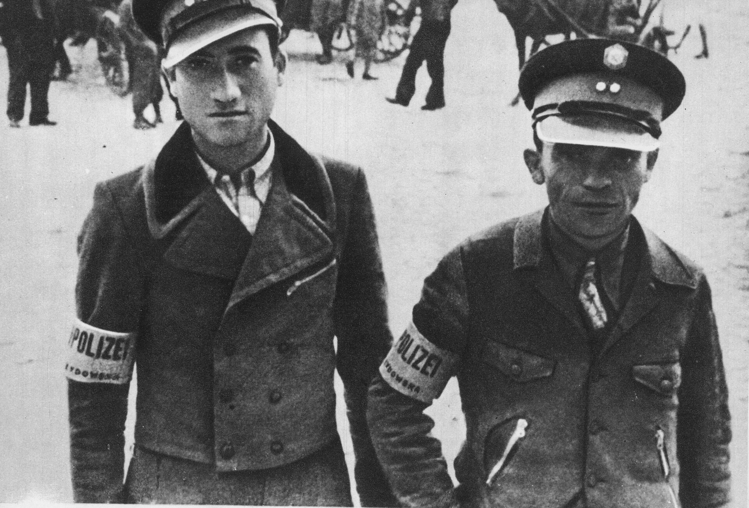
Fineberg has traded on the lack of public knowledge of the case and aims to confuse the public further. As the evidence brought forward in this review shows, Fineberg is a McCarthyite and Judenrat element in the Jewish community. He has with this book done a profound disservice to American justice and democracy and to the Jewish people. Just as the Rosenberg case itself was staged in order to promote the “cold war,” so the book is designed to serve the same purpose.
Judenrat: was an administrative body established by Nazi Party authorities during World War II to manage enforce Nazi orders in Jewish ghettos, such as choosing people for “deportation”.

Slide 21
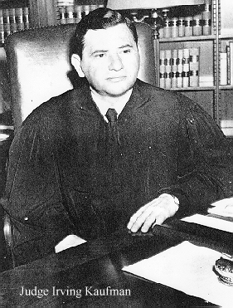
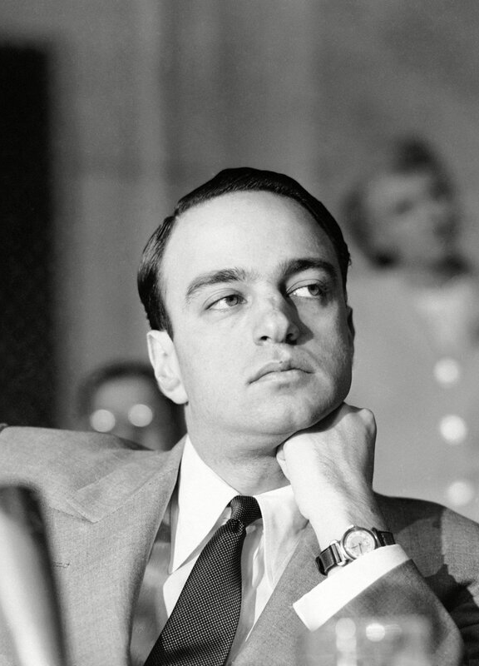
from the Rosenberg Fund for Children’s website
Two of the men most commonly associated with the Rosenberg case appear in Rosler's collage: Judge Irving R. Kaufman and Attorney Roy Cohn, the chief prosecutorial assistant. These are Jewish men associated with a Jewish case. The execution of a Jewish couple so soon after the national attention paid to the millions of Jewish victims of the Holocaust was a sensitive subject in the United States. Although many have claimed that the fact that Jews were on both sides of this trial prove that anti-Semitism was not a significant factor in terms of cultural pressure, there is another way of looking at this almost totally Jewish production; the presence of Jews on both sides of the case allowed the public to, in essence, put all Jews on trial.
Judge Irbing Kaufman and Attorney Roy Cohn

Slide 22
As historian Deborah Dash Moore noted in her essay, “Reconsidering the Rosenbergs: Symbol and Substance in Second Generation American Jewish Consciousness," in the fall 1988 edition of the Journal of American Ethnic History, the jury, which was intentionally devoid of any Jews, "had the opportunity to choose its Jews, which ones were believable, acceptable" (p. 28). The jury foreman in the case agreed with this description of the trial as a contest between the Jews: "I felt good that this was a strictly Jewish show. It was Jew against Jew. It wasn't the Christians hanging the Jews” (as quoted in Radosh and Milton, The Rosenberg File, p. 288).
But in many ways it was “Christians hanging the Jews.” It was a way for the public to separate out reliable (anti-Communist) Jews from spies (Communist Jews). And many anti-Communist Jews were more than happy to oblige the gentile public.
In the atmosphere of the anti-Communist hysteria which marked the fifties of Joe McCarthy, the 'good' Jews (read: most of the Jewish establishment) sought to get points by disassociating themselves from the 'bad' Jews. They saw this case as the ultimate shonda (disgrace) to the Jewish community,"

Slide 23
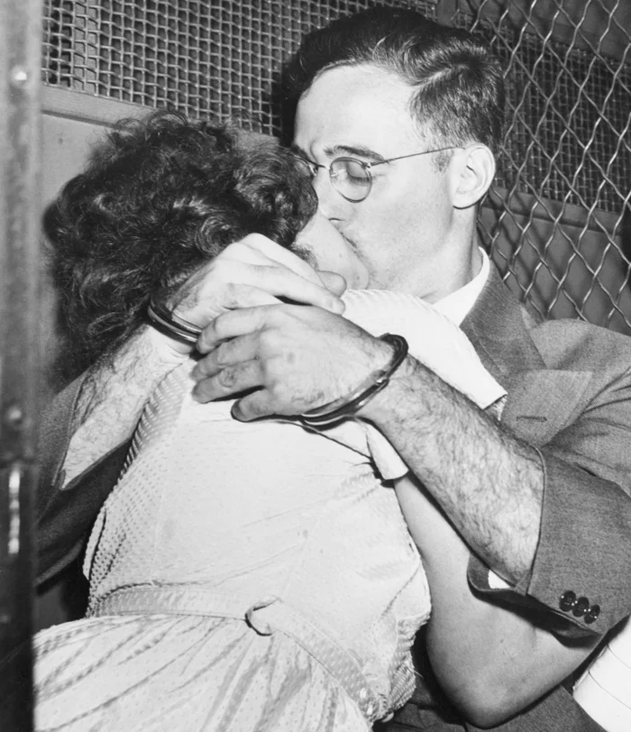
With Jews on both sides of the case, and with Communism already linked in the public mind with Judaism, the Jewish establishment of the 1950s refused to support the Rosenbergs. When I interviewed Emily Alman (who with her husband co-founded the Committee to Secure Justice in the Rosenberg Case) in February 1994 as part of my research for my undergraduate thesis, she remembered that although, "we had Jews all over the place ... Jews were on our side," the Jewish establishment did not support the Committee’s work:

Slide 24
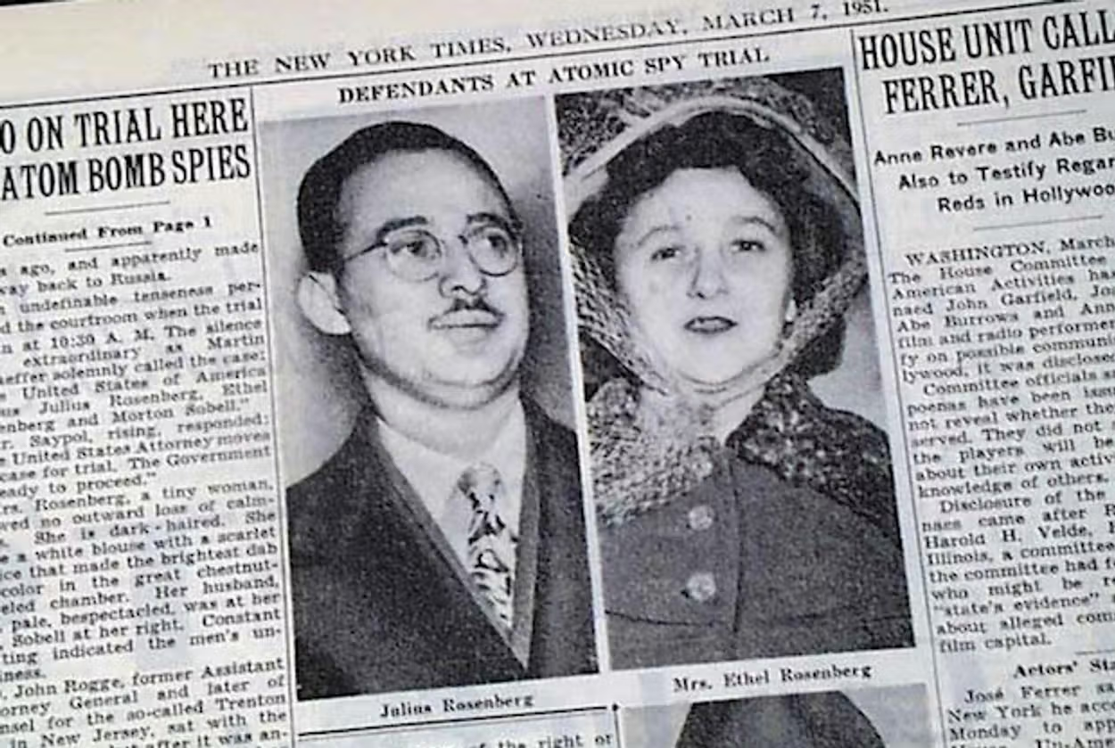
The official Jewish response to the case….was to say, “We are not Communists.” Let me give you one [example]. I was working at the 96th Street Y and Fretz, who was on my board, set me up to have a luncheon with Sultzberger and his family, who owned The New York Times. He was part of the Times family and also part of the Jewish establishment and I think their daughter married Kaufman’s clerk ... So I'm sitting at the table with them and we talked about the Rosenbergs.
He said, "They must be executed," and I said, "What if they are innocent?" I mean I was sitting as a guest at his table and his wife was trying to get him to listen to me a little ... And he said coldly, "Any Jew who is a Communist deserves to be executed."
That was it. They were traitors and Jews aren't traitors ... This was very much the attitude of the Jewish establishment.

Slide 25
Discussion

Slide 26
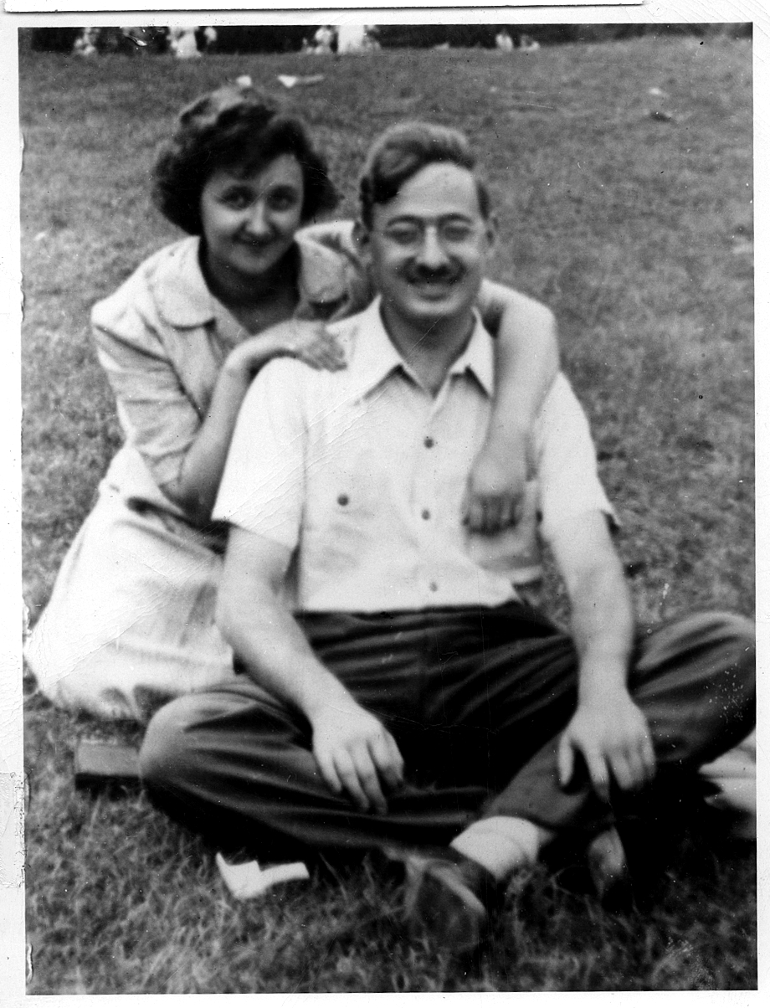
The Legacy of the Rosenbergs

Slide 27
Last Letter from Rosenberg Couple to their Sons
Dearest Sweethearts, my most precious children,
Only this morning it looked like we might be together again after all. Now that this cannot be, I want so much for you to know all that I have come to know. Unfortunately, I may write only a few simple words; the rest your own lives must teach you, even as mine taught me.
At first, of course, you will grieve bitterly for us, but you will not grieve alone. That is our consolation and it must eventually be yours.
Eventually, too you must come to believe that life is worth the living. Be comforted that even now, with the end of ours slowly approaching, that we know this with a conviction that defeats the executioner!

Slide 28
Last Letter from Rosenberg Couple to their Sons
Your lives must teach you, too, that good cannot flourish in the midst of evil; that freedom and all the things that go to make up a truly satisfying and worthwhile life, must sometime be purchased very dearly. Be comforted then that we were serene and understood with the deepest kind of understanding, that civilization had not as yet progressed to the point where life did not have to be lost for the sake of life; and that we were comforted in the sure knowledge that others would carry on after us.We wish we might have had the tremendous joy and gratification of living our lives out with you. Your Daddy who is with me in the last momentous hours, sends his heart and all the love that is in it for his dearest boys. Always remember that we were innocent and could not wrong our conscience.
We press you close and kiss you with all our strength.
Lovingly,
Daddy and Mommy
Julie Ethel

Slide 29
Last Letter from Rosenberg Couple to their Sons
P.S. to Manny: The Ten Commandments religious medal and chain and my wedding ring--I wish you to present to our children as a token of our undying love.
P.S.--to Manny
Please be certain to give my best wishes to _________. Tell him I love and honor him with all my heart-- Tell him I want him to know that I feel he shares my triumph-- For I have no fear and no regrets-- Only that the release from the trap was not completely effectuated and the qualities I possessed could not expand to their fullest capacities-- I want him to have the pleasure of knowing how much he meant to me, how much he did to help me grow up-- All our love to all our dear ones.
Love you so much-- Ethel
The blank was referring to Ethel’s psychiatrist

Slide 30
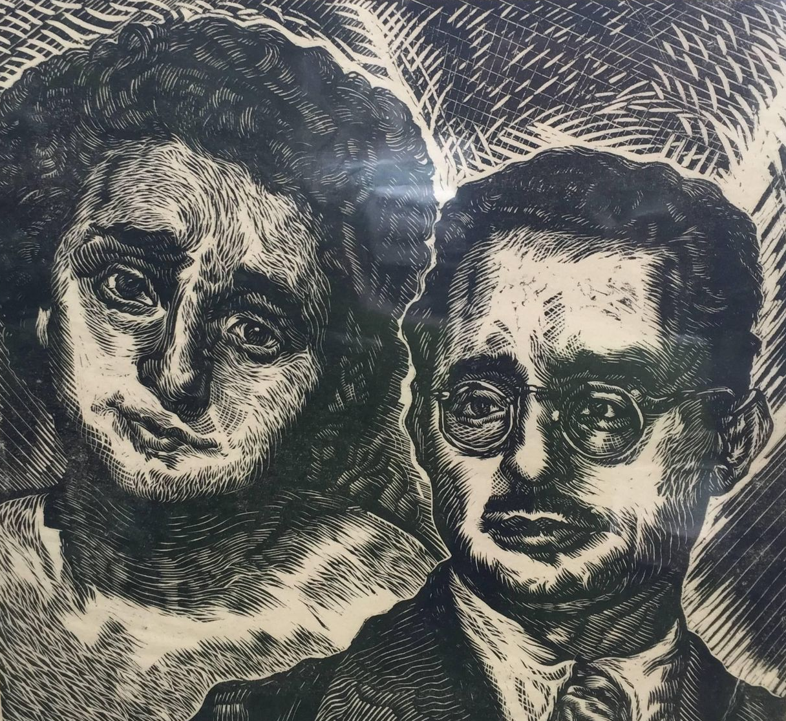
THE ROSENBERG CASE:
Personal Story of a Campaign
By Ray Waterman
On June 20th, the Rosenbergs were safely dead.
Again and again, that week I asked myself the question: Why did people care so much about the Rosenbergs? Why did I? What was it that brought us on the streets night after night—not for an hour or two but for four, five and six hours at a time? What was it about this one issue which “as uniting in common activity people of diverse political and religious beliefs?”
In those same six days terrible things were happening all over the world—in Malaya, in Kenya, in Germany, in Korea—things which involved not one family, but countless families, in loss and calamity, and many of us taking part in the Rosenberg campaign were keenly aware of these events. Yet, it was the Rosenbergs who at this time dominated our thoughts and actions. Why was it?

Slide 31
THE ROSENBERG CASE:
Personal Story of a Campaign
By Ray Waterman
An artist friend explained to me the peculiar Rosenberg phenomena in these words: "That in this one struggle between the Rosenbergs and the American government we saw all at once. We saw all at once the life and death struggles being fought out everywhere between the privilege and the deprived."
But more than that. In their persons, in their bearing, in their sane and tender writings, Ethel and Julius Rosenberg symbolized for us the greatness of little people. I think this above all, was why we worked so hard for their release.

Slide 32
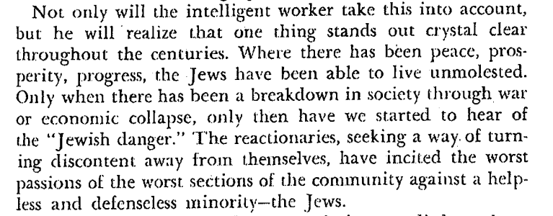
From Anti-Semitism: What it Means and How to Combat It by William Gallacher, M. P. and Earl Browder-1943

Slide 33
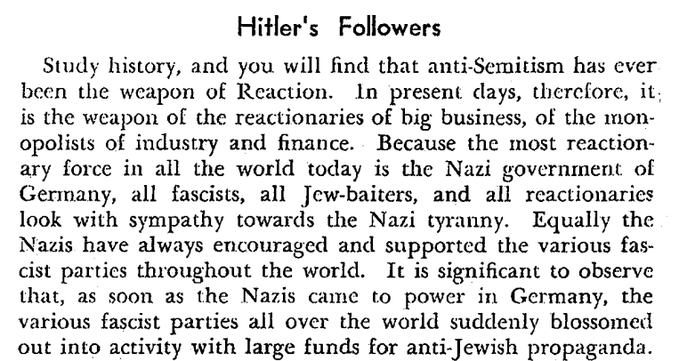
From Anti-Semitism: What it Means and How to Combat It by William Gallacher, M. P. and Earl Browder-1943

Slide 34
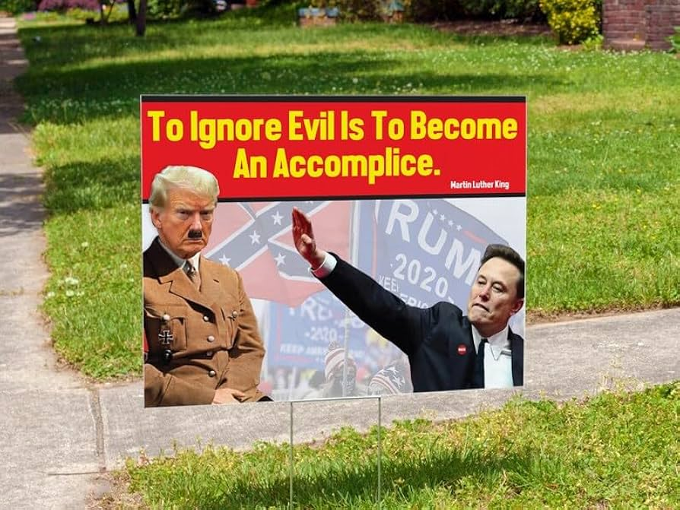
Fascism in America
Under Trump, we see our democratic freedom eroding as immigrants are unlawfully imprisoned and disappeared to foreign prisons with human rights abuses and horrific conditions. Politicians and activists who are standing up to governmental overreach are also being carried away in handcuffs as well.
Similar to Adolf Hitler’s use of Jew-baiting, Trump has attacked minority groups in order to turn discontent from themselves onto others. Trump has attacked latino immigrant, trans peoples, muslims, and the poor. Similar to Nazi Germany, we find members of these communities betray their own people and become the modern version of the judenrat.
“It seems that Elon Musk made an awkward gesture in a moment of enthusiasm, not a Nazi salute,” the Anti-Defamation League wrote after the billionaire made not one but two sieg heils at a Washington D.C. inaugural celebration for Trump.

Slide 35
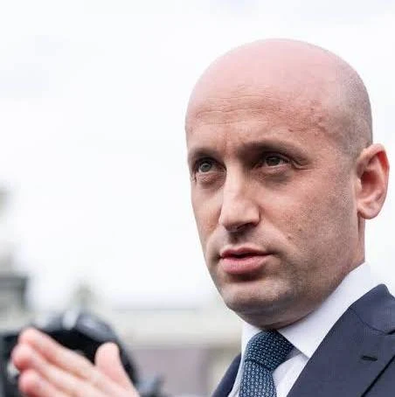
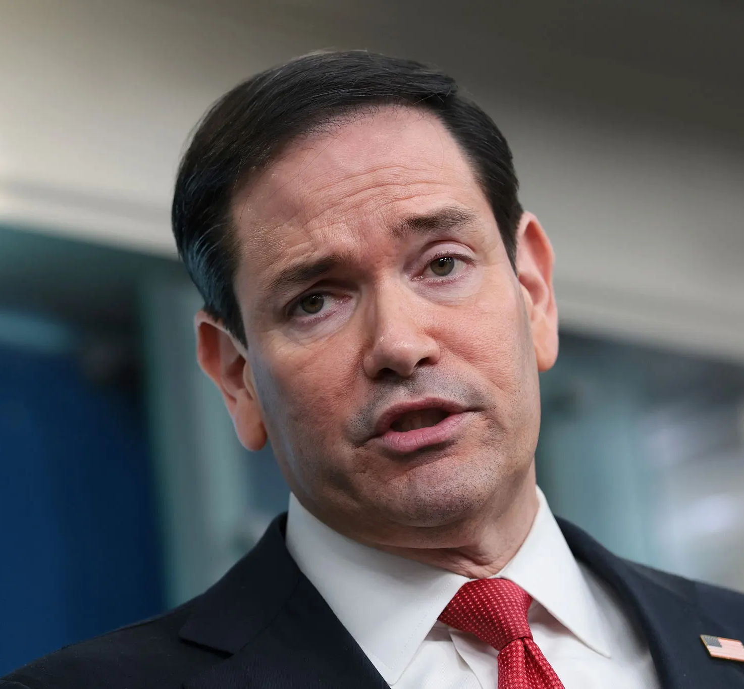
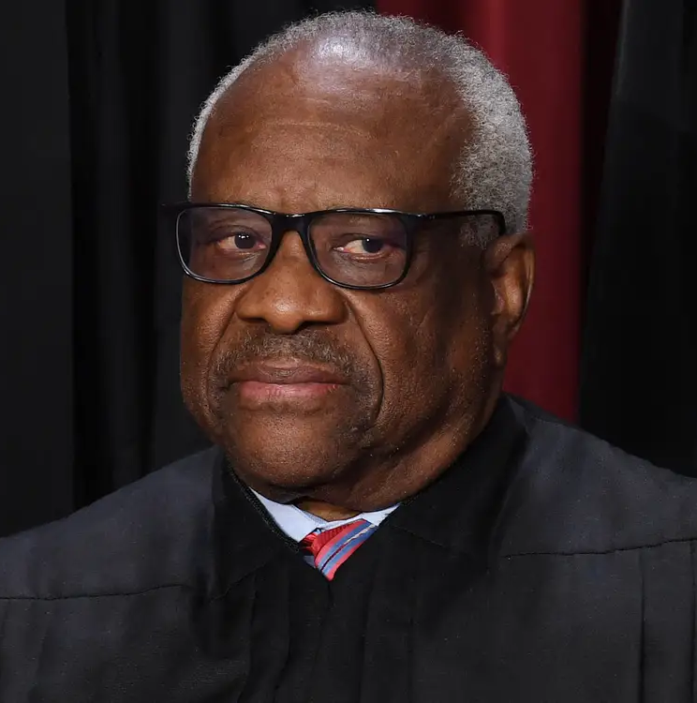
Traitors to their People
Stephen Miller, Trump’s advisor on immigration, own ancestors fled anti-Jewish pogroms in Eastern Europe to find refuge in America.
As more people recognize the corruption and anti-democratic actions of the Trump administration, it is important to carry on the legacy of the Rosenbergs. Unlike many of their Jewish peers, such as Judge Kauffman and the AJC, the Rosenbergs did not accept handouts to protect themselves. Today, capitalism creates a powerful social force that compels conformity and deep irrationality that the weak-hearted easily follow. Some of these Judenrats, Gusanos, and Uncle Tom's turn against their own people to keep power.
US Secretary of State Marco Rubio, is okay with putting the Cuban island in increasingly dire conditions, including rolling blackouts.
Supreme Court Judge Clarence Thomas ruled in favor of gutting the Voting Rights Act.

Slide 36
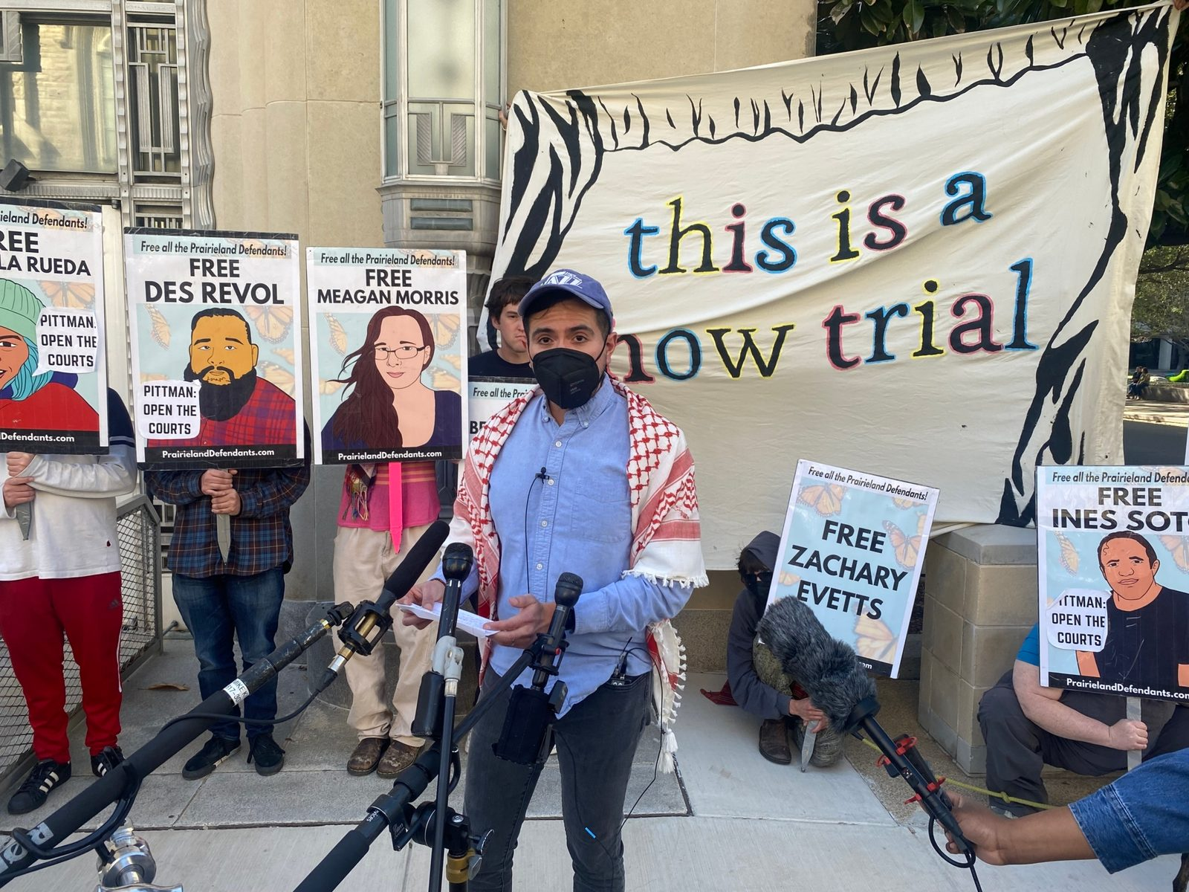
We need to keep honoring the Rosenbergs and keep standing up to injustice and fascism. Even now, people in courtrooms face questionable charges that echo the same story used against the Rosenbergs.
In the federal “Prairieland” trial, nine activists were charged after a protest outside an Immigration and Customs Enforcement detention center. The case was full of false claims meant to make ‘anti-fa’ seem like a threat to safety in the US.
The Prairieland case became a key part of the Trump administration’s push to stop growing opposition and target the Left. In October 2025, when the first charges were announced, FBI Director Kash Patel said it was the “first time” the government had arrested “Antifa-aligned anarchist violent extremists” and charged them with terrorism. But antifa is not a formal group and has no official members or leaders.
Juan Vargas, a member of the Prairieland Support Committee, speaks to media in front of the federal courthouse in Fort Worth, Texas, after the verdict was delivered on March 13. Photo: Adam Federman

Slide 37
Discussion

Slide 38

Jewish
Peoples Schule (official school of the United Jewish Peoples Fraternal Order)
The Jewish Peoples Schule educates in fraternity along secular, progressive lines to our Jewish and non-Jewish friends to share and relate the historical struggles of the Jewish peoples to other Peoples’ struggles against oppression.
United Jewish Peoples Fraternal Order is carrying the work and legacy from the Jewish Peoples Fraternal Order started in 1930 by Jewish-Americans on secular lines. To work on secular lines means that we are inclusive to all people regardless of faith or religion. It also means we can experience the Jewish culture, traditions and holidays while we organize to build worker power.

Slide 39

Announcements
Please like, subscribe, and share our youtube page and its videos as well as our social media pages.
PCUSA Cell Chairs need to call members of their cells to remind them about attendance.
The next issue of New Masses (2025) has begun production. If you have art you want us to feature, email it to info@partyofcommunistsusa.net.

Slide 40
Volunteers Needed!
We are in need of volunteers for the staff of the People’s School! Here’s a few roles we need filled:
People to help manage posting on our social media and podcast platforms
Video Editors, Audio Editors, Graphic Designers, Artists, Narrators
Facilitators, Web Controls, Moderators
Email info@peoplesschool.us if you’re interested and try to attend our next staff meeting if possible.

Slide 41


Slide 42

Happy Pride Month!
Happy Pride from People’s United LGBT+ Society!
During this pride month, attend a parade near you. Download our brochure and our Stonewall Lives Bulletin and distribute. https://peopleslgbt.org/
Literature can also be requested using the literature request form on the member’s portal.

Slide 43

View From Left Field
https://viewfromleftfield.libsyn.com
The Old PSMLS Youtube is now the Youtube of View From Left Field, a podcast of analysis and discussion of current events from a progressive perspective.
Like the Youtube videos and subscribe with 5 star ratings on your podcast platforms.

Slide 44

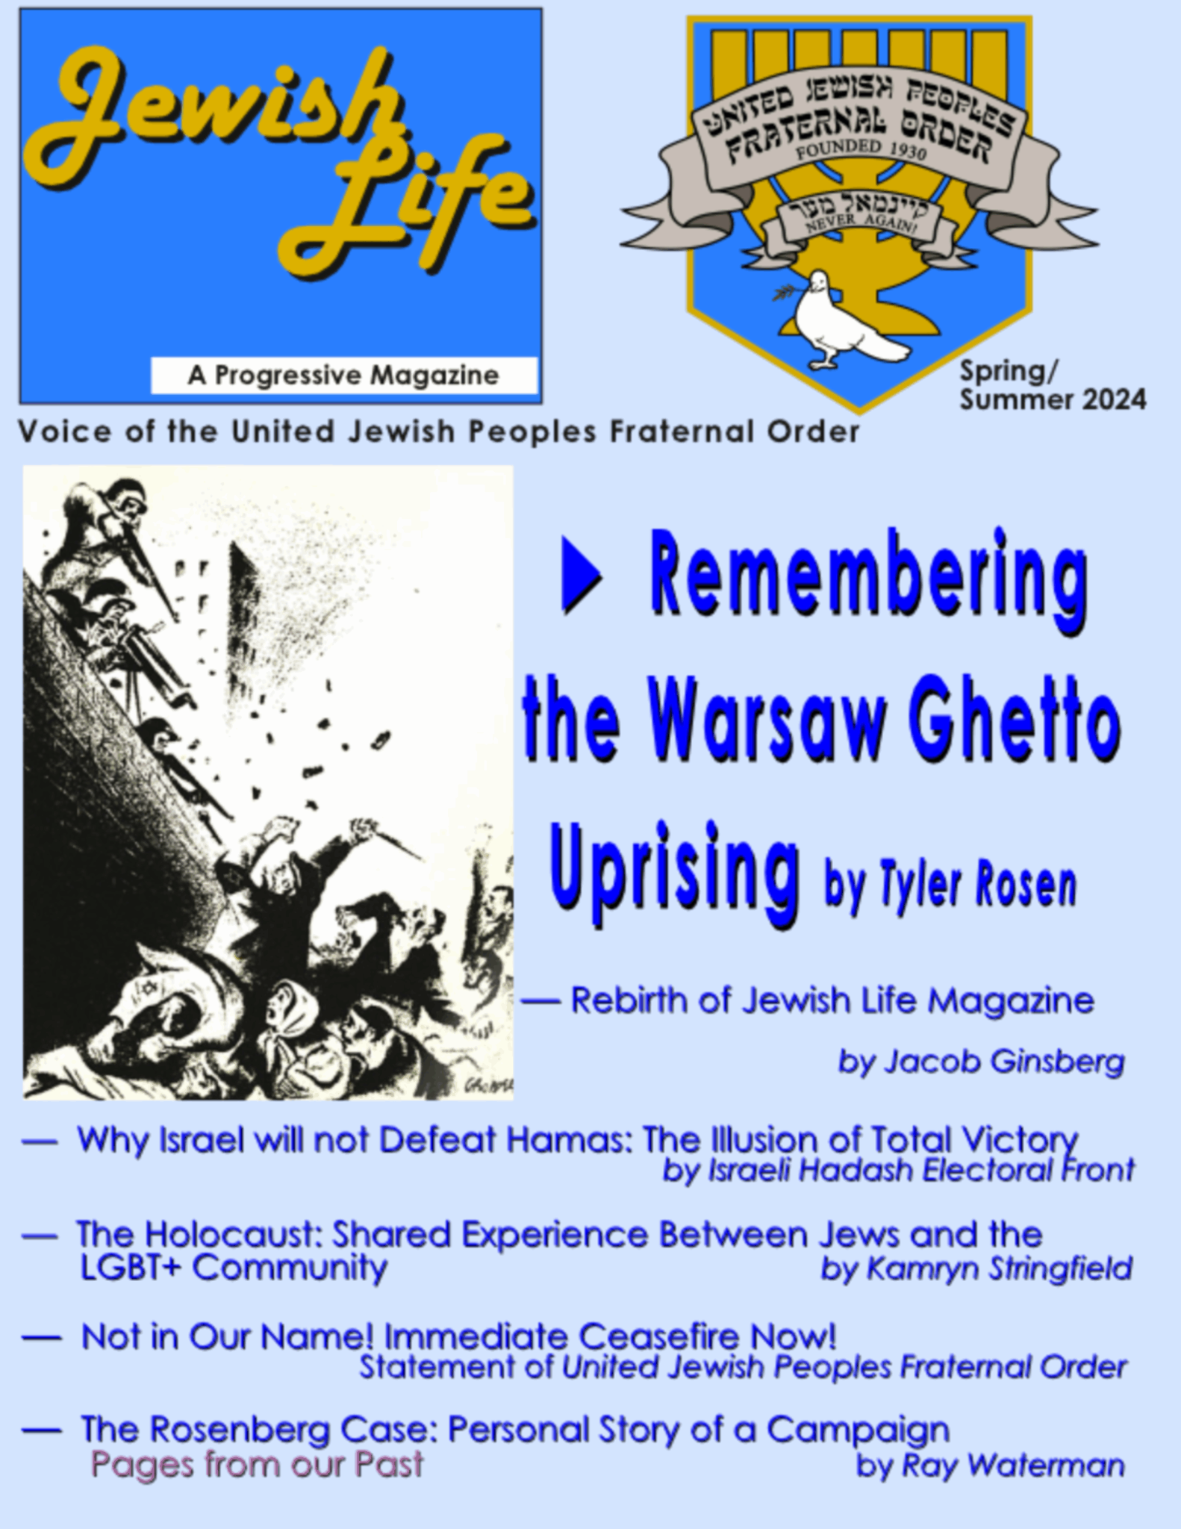
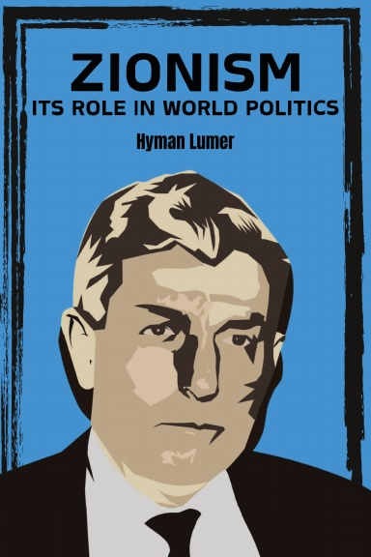


New Outlook Publishers
newoutlookpublishers.store
Relevant and Latest Releases

Slide 45



Harry Bridges School of Labor
luel.us/laborschool/
The Harry Bridges School of Labor is a monthly class covering a variety of topics aimed at building class consciousness among union members. For class schedule and other information, please visit the website at luel.us/laborschool.

Slide 46
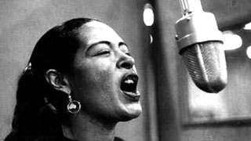
Billie Holiday-Strange Fruit- written by Abel Meeropol. Meeropol and his wife, Anne, adopted the Rosenbergs' two sons, Michael and Robert.

Slide 59
Discussion

