Slide 1

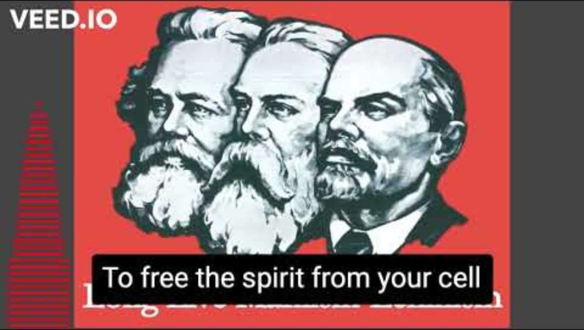
The Internationale

Slide 2


Slide 3
What we’ll be learning today:
Introduction of Dr. Barry Lituchy
What is Fascism?
Concentration Camps – What was Auschwitz?
Connections to the Present

Slide 4
Introducing: Dr. Barry Lituchy

Slide 5
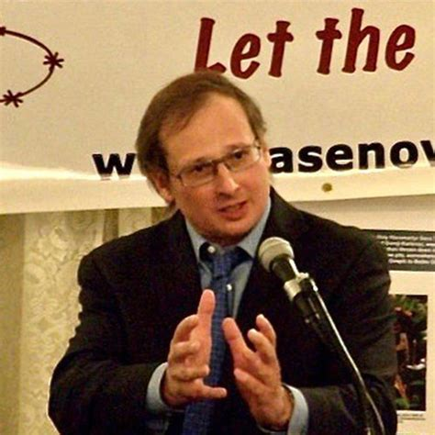
Dr. Barry Lituchy
Background
Co-President of the Holocaust Memorial Committee in Brooklyn, which overseas the Holocaust Memorial Park in New York City.
Assistant Professor of Political Science at Brooklyn College
Execuitive Director of the Jasenovac Reseawrch Institute.

Slide 6
Fascism – What is it?

Slide 7
Fascism – What is it?
Per Georgi Dmitrov:
Fascism is:
Fascism is a most ferocious attack by capital on the mass of the working people;
Fascism is unbridled chauvinism and predatory war;
Fascism is rabid reaction and counter-revolution;
Fascism is the most vicious enemy of the working class and of all working people.

Slide 8
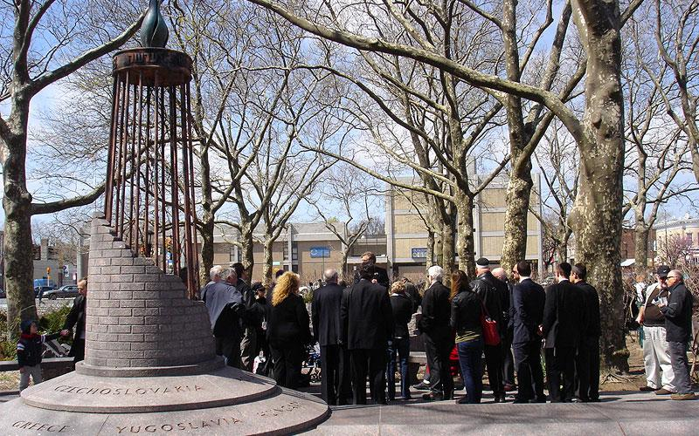
Fascism – What is it?
What did it do and what did it set up?
Who were the victims of fascism?
Why does fascism promote genocide?

Slide 9
Discussion

Slide 10
Concentration Camps – What was Auschwitz?

Slide 11

What was Auschwitz?

Slide 12
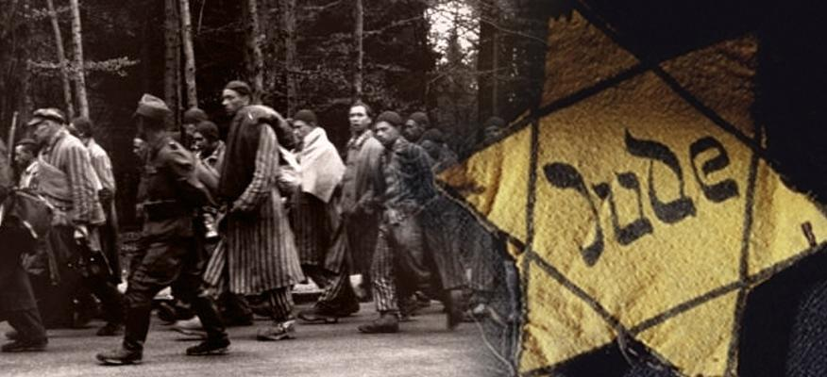
What was Auschwitz?

Slide 13
Discussion

Slide 14
Connections to the Present

Slide 15
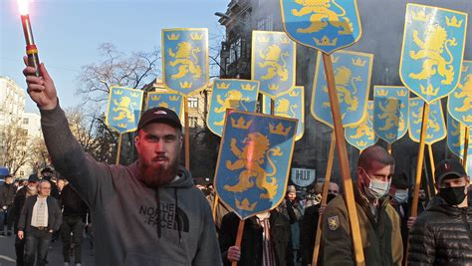
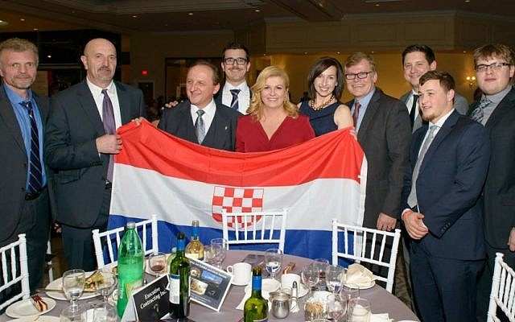
Connections to the Present and
Fascist Calls for Genocide.
    Why did the Fascists want to invade the Soviet Union?
    Why is the struggle of the Red Army important to human history?
    Why does the Washington Holocaust Museum doesn’t want to acknowledge that the Russians were victims of genocide?
    What is going on in other places of the world like Croatia, Ukraine, Israel, etc., and why is the United States being the promoter of all this?

Slide 16
Discussion & New Members Introductions

Slide 17
New Member Introductions
What is your name, pronouns and state (or country/territory)?
Where do you work? Is it unionized?
How did you find out about the People’s School?
What do you think about tonight's class?

Slide 18
Discussion & Wrap Up Introductions

Slide 19
Announcements
THE PEOPLE’S SCHOOL WILL START BEING ON TUESDAY ONLY STARTING FEBRUARY 6TH.
We are looking for content submissions for Vol IV 2024 of New Masses! Send any submissions to info@partyofcommunistsusa.net and kamryns@johnreedcenter.net
The Peoples School for Marxist Leninist Studies has began posting videos on our TikTok channel @peoplesschool! Please subscribe to the channel and like and share our content!

Slide 20
Volunteers Needed!
We are in need of volunteers for the staff of the People’s School! Here’s a few roles we need filled:
People to help manage posting on our social media and podcast platforms
Video Editors, Audio Editors, Graphic Designers, Artists, Narrators
Facilitators, Web Controls, Moderators
Email info@peoplesschool.us if you’re interested and try to attend our next staff meeting on January _ if possible.

Slide 21








PSMLS Propaganda
peoplesschool.us/media & peoplesschool.us/store
Materials to help promote the school!

Slide 22





New Outlook Publishers
newoutlookpublishers.store
Latest Releases and (some) Titles Offered:

Slide 23
New Outlook Publishers – Volunteers Needed!
New Outlook Publishers is looking for volunteers!
NOP is looking for assistance in the following areas:
Layout Editors
Cover Artists
Proofreaders
Please reach out to scottc@johnreedcenter.net if
interested and attend the next New Outlook Publishers staff meeting on January 24th at 8:30 PM EST.

Slide 24
Legal Drive
Last year we were attacked and sabotaged by ultraleft wreckers that tried to steal the PSMLS and destroy the PCUSA. They failed, but they will be held accountable and there are still things they took from us that we’ve not got back, like videos, imagery, audio etc. That is why we still need donations to the legal drive.
If you support the school and want to see us continue to improve and keep delivering this education 51 weeks a year, please pitch in whatever you can and support the GoFundMe for the legal drive at https://www.gofundme.com/f/legal-fund-to-defend-against-wreckers. Anything helps!

Slide 25
The Internationale

