Slide 1

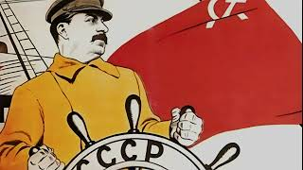
The Internationale

Slide 2

PSMLS 1/20/26

Slide 3
What we’ll be learning today:
Why do we need a revolutionary vanguard?
Components of the party program
Building the mass movements & creating effective leadership

Slide 4
Ch. 1 & 6 - Characteristics and Political Tactics of The Vanguard Party

Slide 5
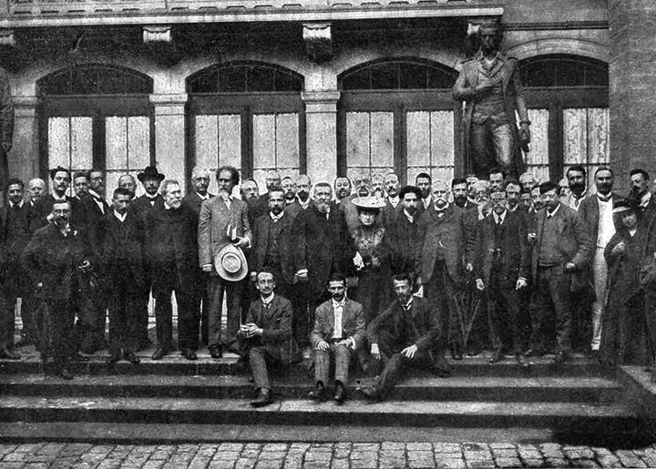
Bourgeois Vs Proletarian Internationalism
The recognition of internationalism in word, and the substitution of petty-bourgeois nationalism and pacifism for it in deed, in all propaganda, agitation and practical work, is a very common thing. The struggle against this evil, against the most deeply rooted petty-bourgeois national prejudices, comes the more to the forefront, the more the task of transforming the dictatorship of the proletariat from a national one (i.e., existing in one country and incapable of determining world politics) into an international one (i.e., a dictatorship of the proletariat covering at least several advanced countries and capable of exercising decisive influence upon the whole of world politics) becomes a pressing question of the day. Petty-bourgeois nationalism proclaims as internationalism the bare recognition of the equality of nations, and nothing more while preserving national egoism intact. Proletarian internationalism demands, firstly, that the interests of the proletarian struggle in one country be subordinated to the interests of that struggle on a world scale, and, secondly, that a nation which is achieving victory over the bourgeoisie be able and willing to make the greatest national sacrifices for the sake of overthrowing international capital.
The 2nd International (Pictured Above) Exemplified Petty-bourgeois Nationalism and Pacifism in the Name of International Solidarity

Slide 6
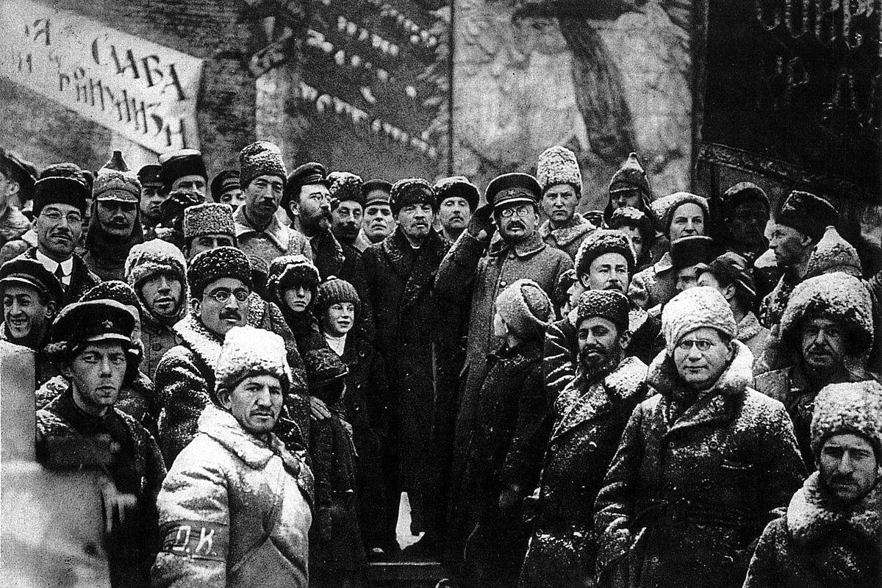
Look Beyond the Particularities of the Separate Steps of the Struggle
This unalterable truth, the Social-Democratic Party has always used all its strength to spread among the proletariat and the whole people. The real, i.e., the mass struggle for freedom has passed through and will always pass through the most diverse and often unexpected stages: it cannot be otherwise, because of the immense difficulty of the struggle, the complexity of its problems and the changeable composition of those who are struggling. Leading the struggle of the proletariat at every steр of the development of this struggle and under all circumstances, Social-Democracy, as the conscious spokesman of the aspirations of the working class, must always have in mind the general and basic interests of this struggle as a whole. Beyond the particular interests of the working class, Social-Democracy teaches us not to forget the general interests - beyond the particularities of the separate steps of the struggle, not to forget the fundamental tasks of the entire struggle as a whole.
Vladimir Lenin and other Soviet leaders celebrating the second anniversary of the October Revolution in Red Square, Moscow

Slide 7
An Eternally Critical Attitude Toward Small Improvements
That is why it is quite natural that Social-Democracy as the party of the revolutionary proletariat is so solicitous of its programme, so meticulously defines its final aim long beforehand - the aim of complete liberation of the working people - and looks so jealously at any attempt to trim down this final aim; for this same reason Social-Democracy is so dogmatically strict and doctrinarily unbending in separating small, immediate, economic and political aims from the final aim. Whoever is fighting for all, for complete victory, cannot but be on the lookout lest small gains should bind one's hands, divert one from the path, force one to forget that which is relatively far off and without which all small gains are but the vanity of vanities. On the contrary, this care for programmes, this eternally critical attitude to small, gradual improvements cannot be understood by and is foreign to the bourgeois parties, even those that are the most freedom-loving and people-loving.
Meeting of the Central Committee of the R.S.D.L.P.(B.) October, 1917

Slide 8
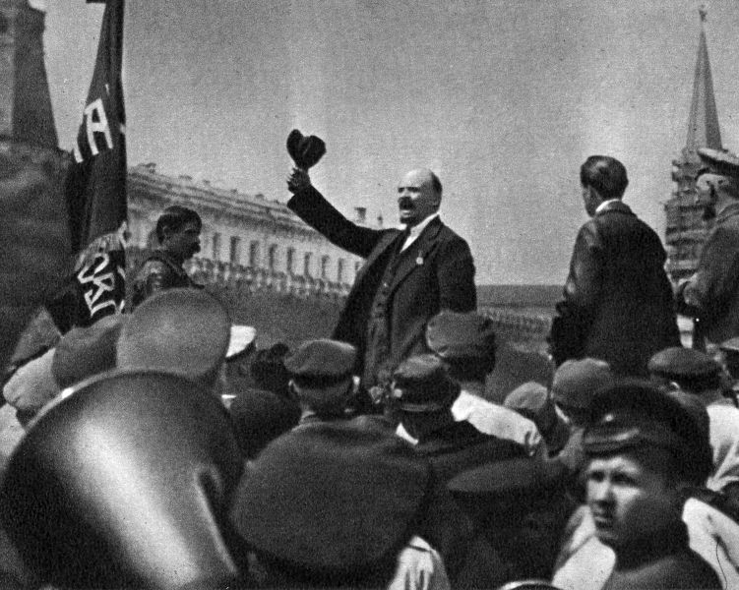
Always Support the Smallest Demands for the Correction of Evil
We repeat: this is the basic, typical reasoning of all opportunists throughout the world. To what conclusion does this reasoning inevitably lead? To the conclusion that it is not necessary to have any kind of revolutionary programme, revolutionary party, revolutionary tactics. Reforms are necessary, and that is all. Revolutionary Social-Democracy is not necessary. A party of democratic and socialist reform is necessary. Indeed, is it not clear that there will always be people in the world who feel the unsatisfactoriness of things as they are? Of course, always. Is it not equally clear that the smallest correction of this unsatisfactory situation will always be advocated by the biggest number of dissatisfied people? Of course, always. This means that it is our task, the task of the advanced and "conscious" people, always to support the smallest demands for the correction of evil. This is the most reliable, most practical task, and all sorts of talk of some kind of "fundamental" demands and so on-this is only the talk of "utopians," only "revolutionary phrases." One must make a choice - and one must make a choice always between the existing evil and the smallest of the current projects for its correction.

Slide 9
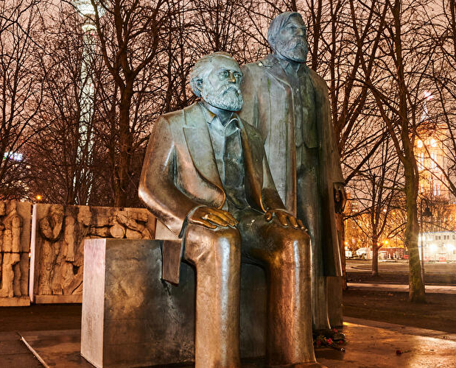
Marxism is not Dogma, it is the Cornerstone of the Science of Socialism
We stand wholly on the basis of the theory of Marx: this theory was the first to transform Socialism from a utopia into a science, to lay down a firm foundation for this science and to indicate the path that must be followed in further developing this science and elaborating it in all its parts. There cannot be a strong Socialist Party without a revolutionary theory which unites all Socialists, from which they draw all their convictions, and which they apply in their methods of struggle and means of action. To defend such a theory, which to the best of your knowledge you consider to be true, against unfounded attacks and attempts to vitiate it, does not imply that you are an enemy of all criticism. We do not regard Marx's theory as something final and inviolable; on the contrary, we are convinced that it has only laid the cornerstones of the science which Socialists must advance in all directions if they do not want to lag behind the march of life.

Slide 10
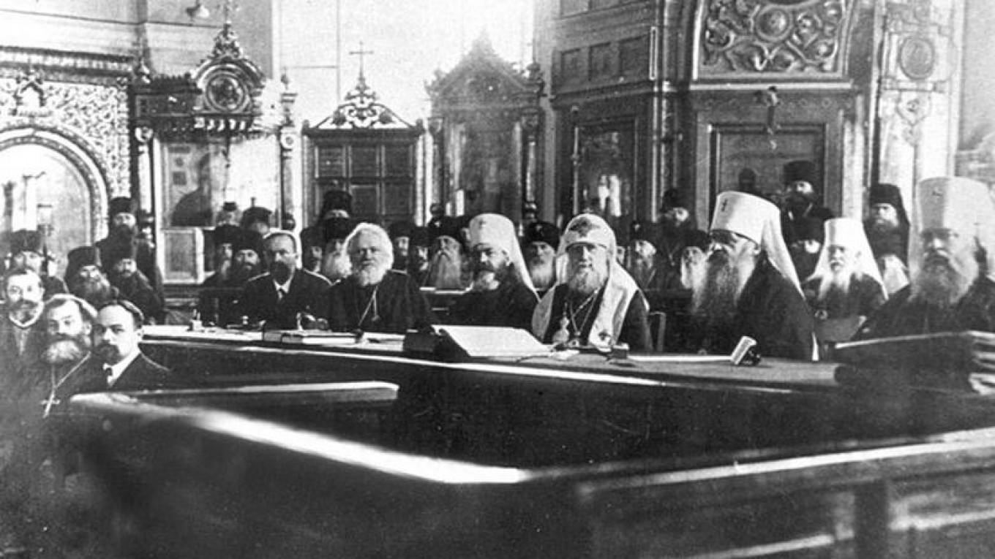
The Church, The State, and The Party
Religion must be of no concern to the state, and religious societies must have no connection with governmental authority. Everyone must be absolutely free to profess any religion he pleases, or no religion whatever, i.e., to be an atheist, which every socialist is, as a rule. Our Programme is based entirely on the scientific, and moreover the materialist, world-outlook. An explanation of our Programme, therefore, necessarily includes an explanation of the true historical and economic roots of the religious fog. Our propaganda necessarily includes the propaganda of atheism; the publication of the appropriate scientific literature, which the autocratic feudal government has hitherto strictly forbidden and persecuted, must now form one of the fields of our Party work. We shall now probably have to follow the advice Engels once gave to the German Socialists: to translate and widely disseminate the literature of the eighteenth-century French Enlighteners and atheists.
Russian Orthodox Church, 1917

Slide 11
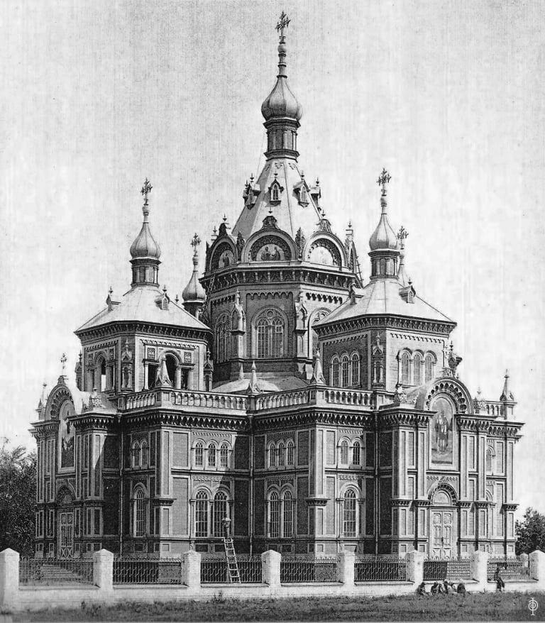
Why We Should Not Set Forth Atheism in Our Program
But, it would be stupid to think that, in a society based on the endless oppression and coarsening of the worker masses, religious prejudices could be dispelled by purely propaganda methods. It would be bourgeois narrow-mindedness to forget that the yoke of religion that weighs upon mankind is merely a product and reflection of the economic yoke within society. No number of pamphlets and no amount of preaching can enlighten the proletariat, if it is not enlightened by its own struggle against the dark forces of capitalism. Unity in this really revolutionary struggle of the oppressed class for the creation of a paradise on earth is more important to us than unity of proletarian opinion on paradise in heaven. That is the reason why we do not and should not set forth our atheism in our Programme; that is why we do not and should not prohibit proletarians who still retain vestiges of their old prejudices from associating themselves with our Party.
Early 20th Century View of the Russian Orthodox, Church of the Transfiguration of the Lord

Slide 12
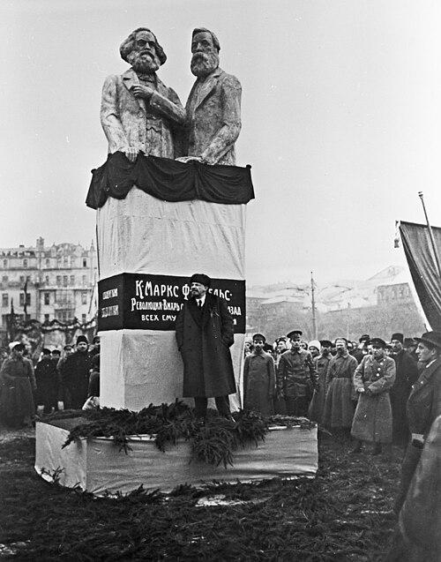
Evaluate the Current Political Moment and Give Exact Answers to Present Problems
Without a programme, it is impossible for the party to be a more or less integral political organism, able always to hold to a line through each and every turn of events. Without a tactical line, based on an evaluation of the current political moment and giving exact answers to the "accursed problems" of the present, it is possible to have a small group of theoreticians, but not an operative political unit. Without an evaluation of the "аctive," topical or "fashionable" ideological-political trends, a programme and tactics can degenerate into dead "points," which it is unthinkable to realize in life, and to apply to thousands of detailed, and most concrete questions of practice, with an understanding of the essence of things, an understanding of "what it is all about."

Slide 13

Socialist Parties are Not Debating Clubs
Operating in a new situation, among more conscious and more united enemies, the working class must also reorganize its own party, the Russian Social-Democratic Labour Party. In place of the leader-intellectual it puts forward leaders from the ranks of the workers. A new type of social-democrat worker party man is growing up who independently carries on all the work of the party and is able to rally, unite and organize ten and a hundred times bigger proletarian masses, as compared with the former.
Socialist parties are not debating clubs, but organizations of the fighting proletariat; and when a number of battalions have gone over to the enemy, they must be named and branded as traitors, and we must not allow ourselves to be "caught" by hypocritical assertions to the effect that "not everybody" understands imperialism "in the same way," or that the question has not been "sufficiently discussed," etc., etc.
"Long live the world revolution!" Soviet poster, 1933

Slide 14
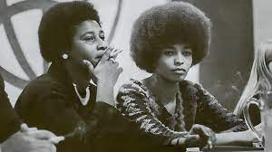
False Alternatives to the Party Formation (ie. Committees of Correspondence)
And indeed, in the epoch of capitalism, when the masses of the workers are constantly subjected to exploitation and cannot develop their human faculties, the most characteristic feature of working-class political parties is that they can embrace only а minority of their class. A political party can comprise only a minority of the class, just as the really class-conscious workers in any capitalist society constitute only a minority of all the workers. That is why we have to admit that only this class-conscious minority can guide and take the lead of the broad masses of the workers. And if (one) says that he is opposed to parties but at the same time is in favour of a minority, composed of the best organized and the most revolutionary workers, showing the way to the whole of the proletariat, then I say that there is really no difference between us. What is an organized minority? If this minority is truly class-conscious, if it is able to lead the masses, if it is capable of answering every question that comes up on the order of the day, then essentially it is a party.
Angela Davis and Charlene Mitchell, Key Figures in the CCDS Following the Dissolution of the CPUSA

Slide 15
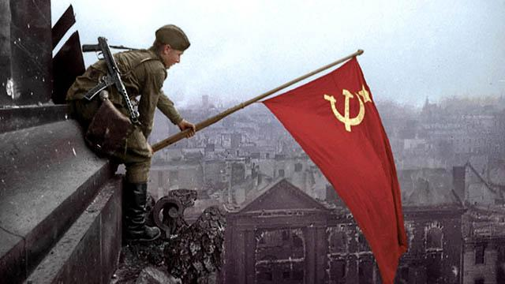
Never Waver on the Question of Our Existence, Be Vigilant Against Those Who Would Bury Us
A party which wishes to exist, can permit neither the slightest wavering on the question of its existence nor any compromise with those who might bury it. There is no end to the number of those who wish to play the role of go-betweens in such a compromise, but all these people, to use an old expression, are burning oil for nothing and wasting their time.
With reformists and Mensheviks in the ranks, victory in the proletarian revolution is impossible; it is impossible to defend it. This is obvious in principle.
Against the social-traitors, against reformism and opportunism, this political line can and must be followed in all spheres of the struggle without exception. And then we shall win the working masses. And with the working masses the Marxist centralized political party, the vanguard of the proletariat, will take the people along the right road to the triumph of proletarian dictatorship, to proletarian instead of bourgeois democracy, to the Soviet Republic, to the socialist system.

Slide 16
Discussion

Slide 17
New Member Introductions
What is your name, pronouns and state (or country/territory)?
Where do you work? Is it unionized?
How did you find out about the People’s School?
What do you think about tonight's class?

Slide 18
Section 2 - Components of the Party Program

Slide 19
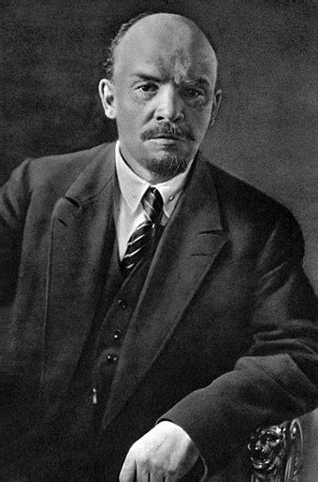
The Two Principles of Russian Social Democratic-Labor Party
Russian Social-Democracy, both in the person of its founders, the members of the "Emancipation of Labour" group and in the person of those Russian Social-Democratic organizations which founded the "Russian Social-Democratic Labour Party," have always recognized the following two basic principles:
1) The essence of Social-Democracy: the organization of the class struggle of the proletariat with the aim of winning political power, the transfer of all the means of production to the hands of the whole of society and the replacing of the capitalist economy with socialist economy;
2) The task of Russian Social-Democracy: to organize the Russian workers' revolutionary party which sets as its immediate aim- the overthrow of the autocracy, the winning of political freedom. Whoever departs from these basic principles (exactly formulated in the programme of the "Emancipation of Labour" group and expressed in the "Manifesto of the Russian Social-Democratic Labour Party") departs from Social-Democracy.
From "A Retrograde Direction in Russian Social-Democracy" (end of 1899).

Slide 20
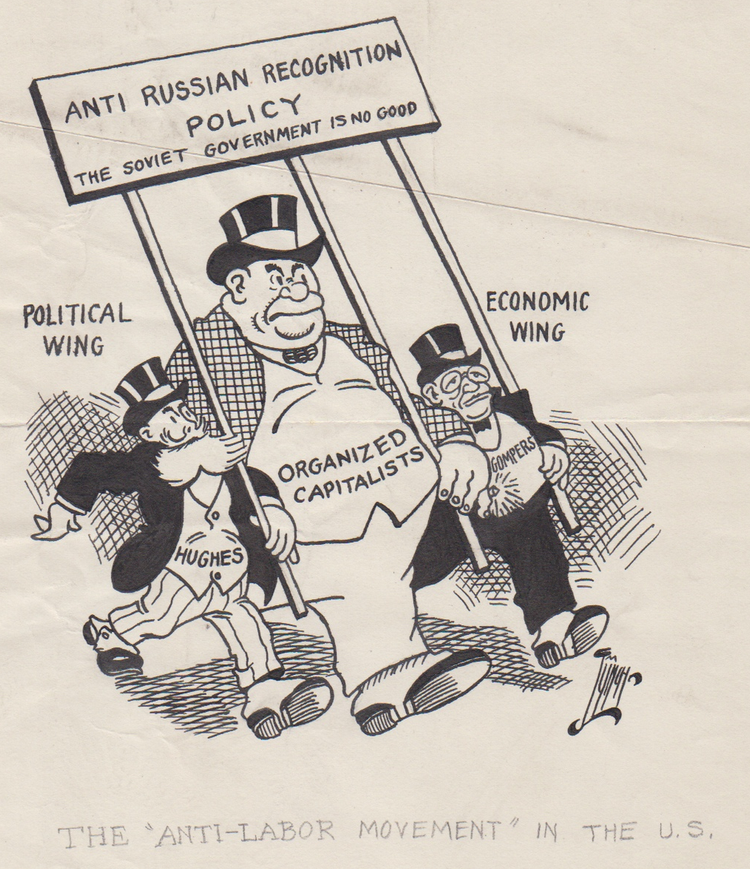
The Party Must Take the Lead in Everything
That only the political party of the working class, i.e., the Communist Party, is capable of uniting, training and organizing a vanguard of the proletariat and of the whole mass of the working people that alone will be capable of withstanding the inevitable petty-bourgeois vacillations of this mass and the inevitable traditions and relapses of narrow craft unionism or craft prejudices among the proletariat, and of guiding all the united activities of the whole of the proletariat, i.e., of leading it politically, and through it, the whole mass of the working people.
From "Preliminary Draft of the Resolution · of the 10th Congress of the Russian Communist Party on the Syndicalist and Anarchist Deviation in Our Party" (March 1921).

Slide 21
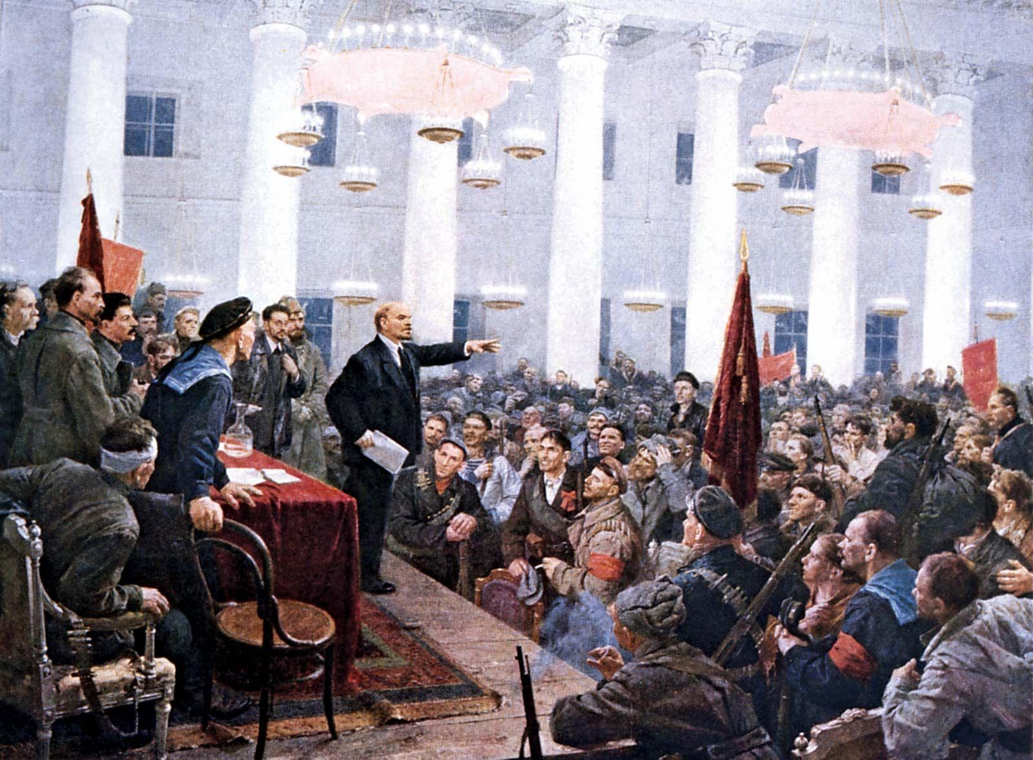
The Party Must Take the Lead in Everything
For the first time in history a socialist party has managed, in main outline, to fulfil the task of winning power and of suppressing the exploiters, and has managed to approach very close to the task of administration. We must prove worthy executors of this most difficult (and most grateful) task of the socialist revolution. We must ponder over the fact that in addition to being able to convince people, in addition to being able to conquer in civil war, it is necessary to be able to do practical organizational work in order that the administration may be successful. It is a very difficult task, because it is a matter of organizing in a new way the most deep-rooted, the economic foundations of life of tens and tens of millions of people. And it is a very grateful task because, only after it has been fulfilled (in the principal and main outlines) will it be possible to say that Russia has become not only a Soviet, but also a Socialist Republic.
From "The Immediate Tasks of the
Soviet Government" (March-April 1918).

Slide 22

Communism Vs. Syndicalism
Communism says: The vanguard of the proletariat, the Communist Party, leads the non-Party masses of the workers, educates, prepares, teaches and trains the masses (the "school" of Communism), first the workers and then the peasants, in order that they may eventually concentrate in their hands the entire management of the whole of national economy.
Syndicalism transfers to the masses of non-Party workers, who are divided according to industry, the management of branches of industry (the "Chief Committees and Central Boards"), thus destroying the need for the Party, and without carrying on prolonged work either in training the masses or in actually concentrating in their hands the management of the whole of national economy.
From "The Party Crisis" ( January 19, 1921).

Slide 23

From the Party Program of the PCUSA
From the prologue of the Party Program:
  American Communists came into existence as a party, at a turning point in world affairs and in the international working-class movement, created by the development of imperialism, the catastrophic First World War, and the outbreak of the great Russian Revolution that gave birth to the first workers’ socialist state, the Soviet Union. These history-making events affected every part of the world, including the United States. These events had their influence on, and contributed to the founding of a Communist Party.
  Contrary to the red–baiting slander, American Communists formed a Party that was not formed from “the outside.” It was created by the conditions and the world forces within our own country. It was a response to the sufferings caused by WWI, of the masses of our people. It was a response to the corporate juggernaut of exploitation, to racism, high prices and lowered living standards — all while the bankers and industrialists made fabulous profits. The war and the economic conditions led to big strikes, mass discontent and growing radicalism. Capitalism was leading the United States into a dead–end alley.

Slide 24
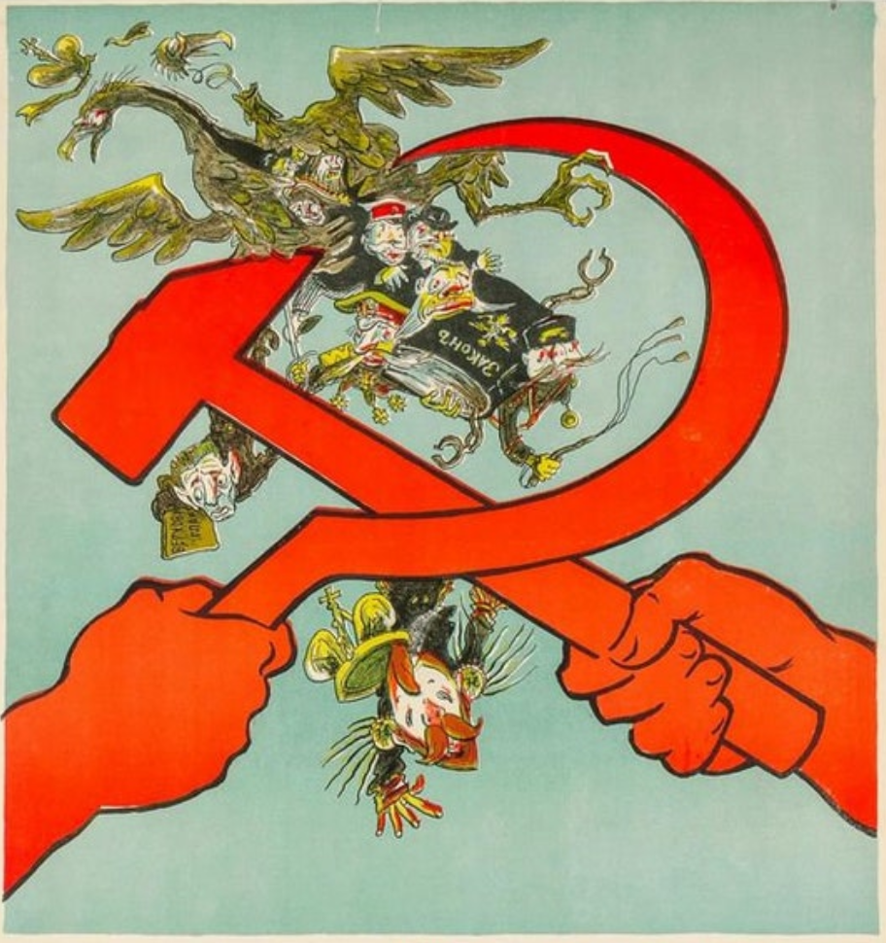
From the Party Program of the PCUSA
From the prologue of the Party Program:
  “To each according to human contribution is a principle of distribution considered to be one of the defining features of socialism. It refers to an arrangement whereby individual compensation is reflective of one’s contribution to the social product (total output of the economy) in terms of effort, labor and productivity. This is held in contrast to the method of distribution and compensation in capitalism, where those who own private property receive unearned income in the form of interest, rent, or profit by virtue of ownership irrespective of their contribution to the social product.”

Slide 25
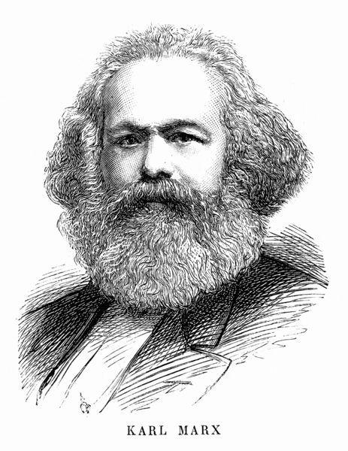
From the Party Program of the PCUSA
From the prologue of the Party Program:
  We understand the scientific analysis by Marx: “In a higher phase of communist society, after the enslaving subordination of the individual to the division of labor, and therewith also the antithesis between mental and physical labor, has vanished; after labor has become not only a means of life but life’s prime want; after the productive forces have also increased with the all-around development of the individual, and all the springs of cooperative wealth flow more abundantly — only then can the narrow horizon of bourgeois right be crossed in its entirety and society inscribe on its banners: From each according to [human] ability, to each according to [human need]. *[Marx, Critique of the Gotha Programme, 1875]

Slide 26
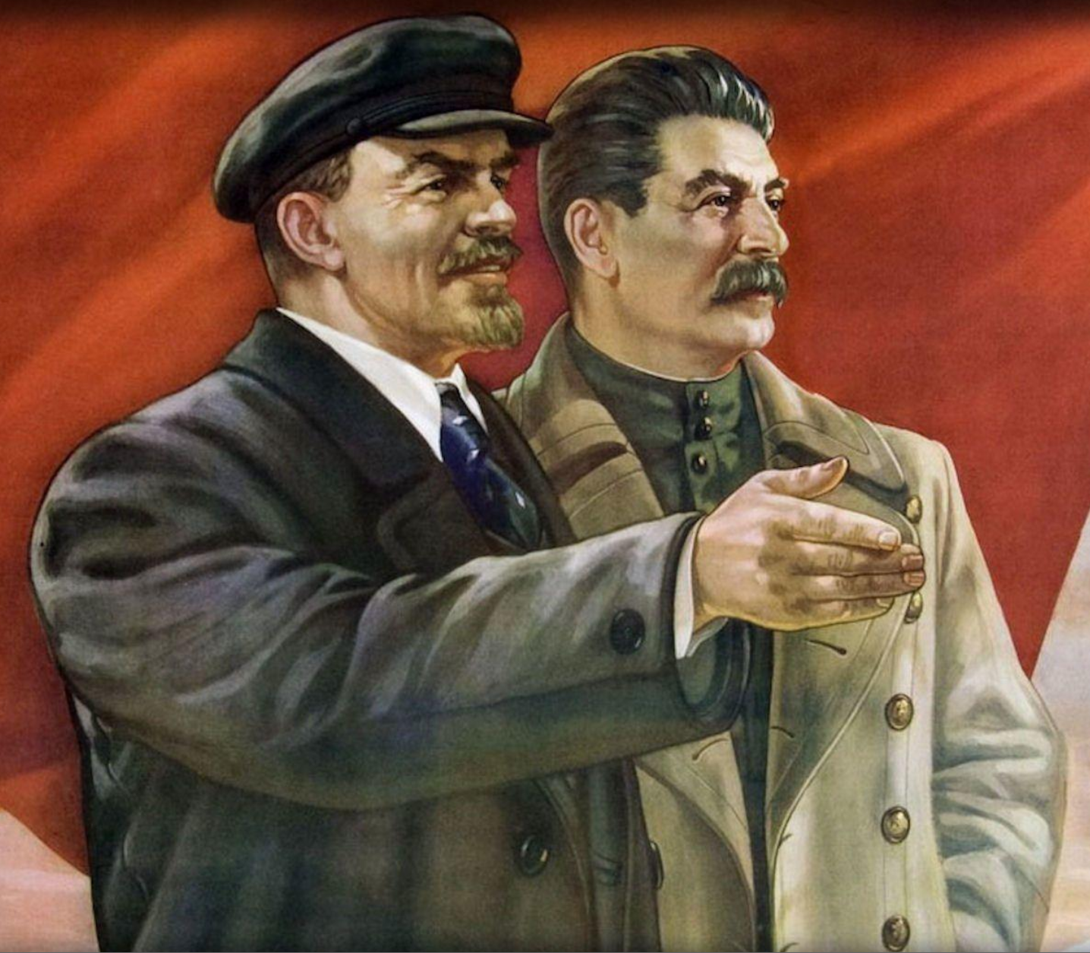
From the Party Program of the PCUSA
From the prologue of the Party Program:
  Stalin’s most famous use of the concept is in the 1936 Soviet Constitution. There it is written that “The principle applied in the U.S.S.R. is that of socialism: “From each according to [human] ability, to each according to [human] work.” It is especially noteworthy that Stalin’s formulation says the principle of socialism, and not full communism.” That is why we are for socialism at this point in the development of society. We seek a change from capitalism to socialism. Socialism is a temporary stage of development, a necessary transition on the road to Communism and the complete liberation of the working class.

Slide 27
Questions for Consideration
Lenin mentioned tasks for the Russian Social Democrats over 100 years ago. What similar tasks do we face today?
Lenin spoke on some of the errors of syndicalism. What errors of other ultraleft or right deviation movements are corrected by correct application of Marxism-Leninism?
The Party Program of the PCUSA outlines various demands in it. What are some demands heard today by various democratic and progressive groups that the Party must go beyond? E.G. pushing for advocating a pay raise in a workplace as the be-all end-all demand by a trade union. What beyond just this should Communists work towards?
PCUSA Party Program at: https://partyofcommunistsusa.net/program/

Slide 28
Discussion

Slide 29
Ch. 4 & 5: Building The Mass Movements & Creating Effective Leadership

Slide 30
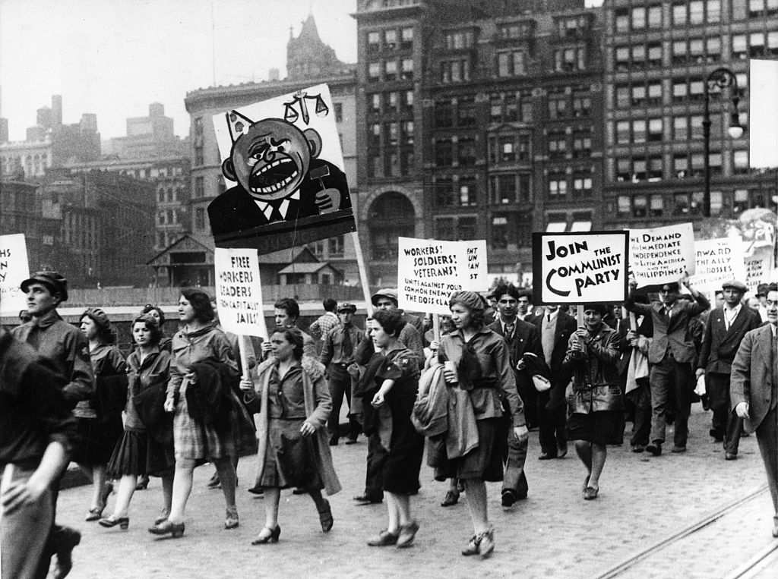
IV. The Party Must Give its Support to the Revolutionary Mass Movements
Victory over capitalism requires the leading Communist Party link itself inseparably with the whole life of its class, and through it, the whole mass of exploited, and to succeed in completely winning over the confidence of this class and the masses.
Conversely, it is only under the leadership of the Communist Party that the proletariat can display the full force of its revolutionary onslaught and neutralize the resistance of the minority of labor aristocracy and old trade union leaders corrupted by capitalism.

Slide 31
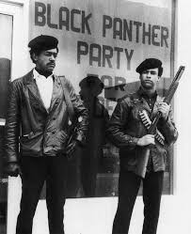
The Party Must Give its Support to the Revolutionary Mass Movements
“There is no doubt that without revolutionary violence, the proletariat could not be victorious, but there can also be no doubt that revolutionary violence is a necessary and proper method of the revolution only at definite moments of its development, only under definite and special conditions, while the much deeper, permanent characteristic of the condition of revolutionary victories was and remains the organization of the proletarian masses, the organization of the working people.”
From “Speech in Memory of Y.M. Sverdlov” (March 18, 1919)
The Black Panther Party is an example of a party which utilized violence at the wrong time - a time when the organizations of the working masses were moving into disunity.

Slide 32
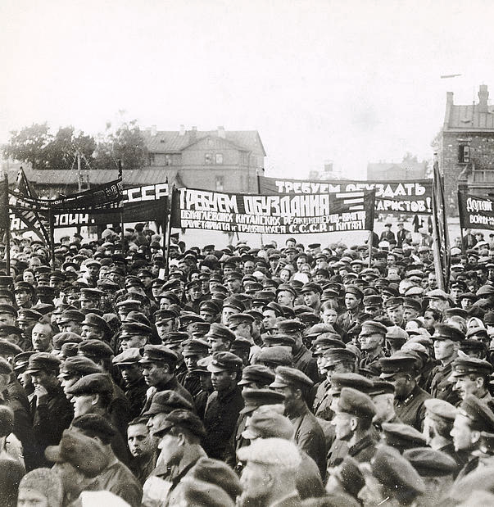
The Party Must Give its Support to the Revolutionary Mass Movements
The chief source of our strength is the conscientiousness and heroism of the workers, who the laboring peasant must sympathize with and support. Our victories lie in the direct appeal of our party and of the Soviet government to the working masses, recognizing every new problem as it arose and our ability to explain to the masses why it’s necessary to devote all energies first to one, then another aspect of Soviet work at any given moment.
Our ability to rouse the energy, heroism and enthusiasm of the masses to concentrate every ounce of effort on the most important task of the hour.
Communist Mass Meeting In Moscow

Slide 33
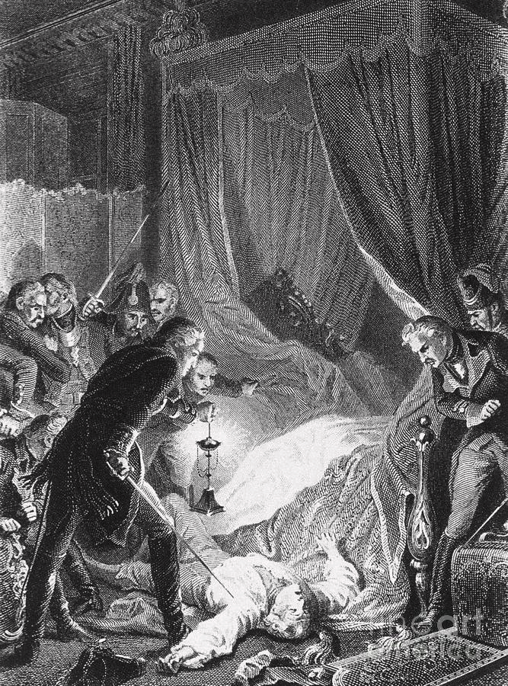
The Party Must Educate the Masses on the Marxian Program, and Raise them up to a Wider Revolutionary Struggle
The party of the proletariat is educated on the Marxian program, the tens of millions of toilers in our country must be educated in the same way.
We think that a whole hundred assassinations of tsars will never have such an arousing and educational effect as will the mere participation by tens of thousands of working people in meetings discussing their vital interests and their connection to politics.
Participation in a struggle that really raises more new “untouched” strata of the proletariat to a more conscious life and wider revolutionary struggle.

Slide 34
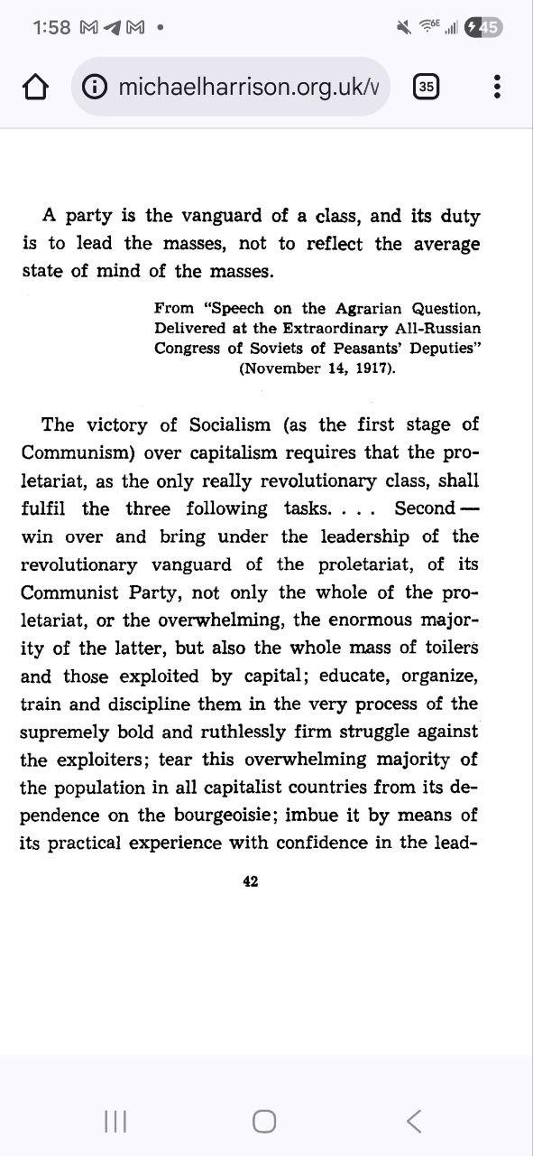
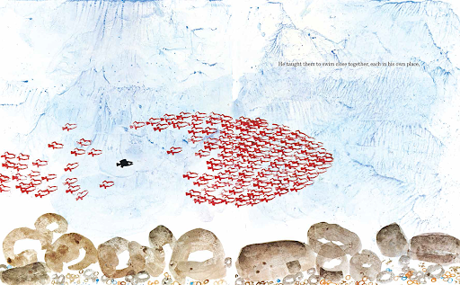
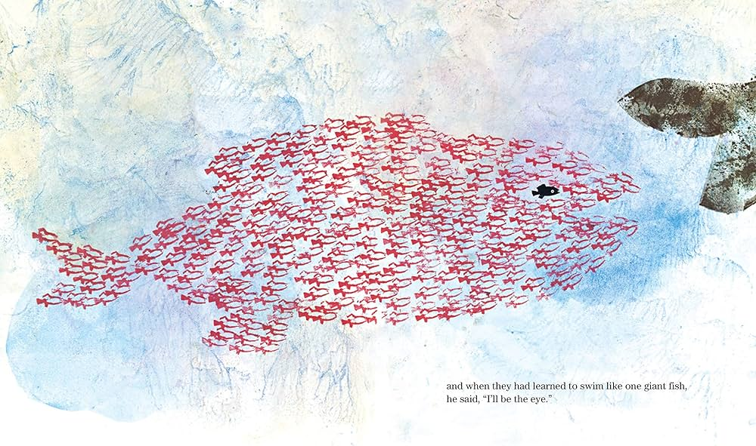
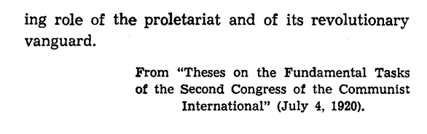
The Party Must Educate the Masses on the Marxian Program, and Raise them up to a Wider Revolutionary Struggle
Scene from Swimmy: the black fish is leading the masses of fish to unite and fight back against a large threat

Slide 35
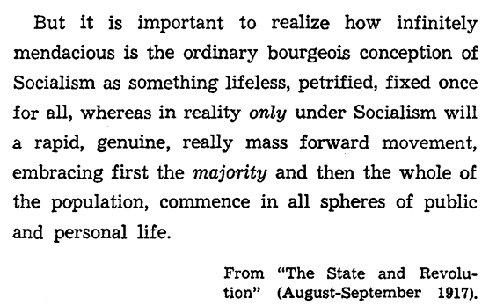
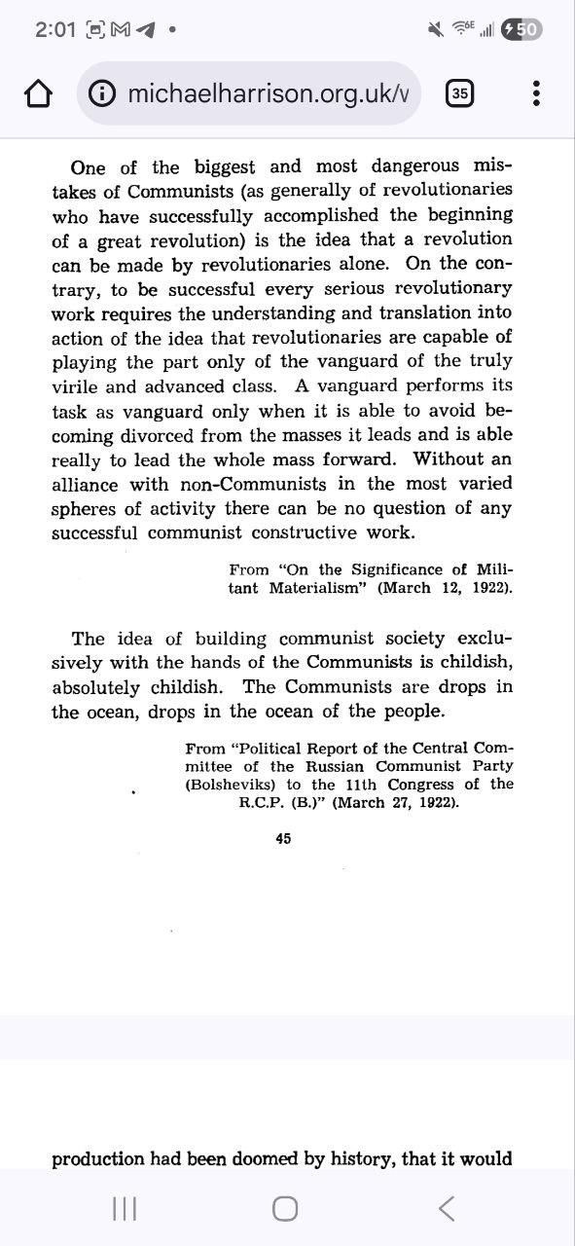
The Party Must Bring into Play the Initiative of the Masses, and Turn the Cause of Socialism into a Real Mass Movement

Slide 36
The Party Must Bring into Play the Initiative of the Masses, and Turn the Cause of Socialism into a Real Mass Movement
Not a single sensible Socialist has ever written that we could devise the forms of organization of the new society according to a predetermined pattern and at one stroke.
The best experts on capitalist society who foresaw its development, through scientific precision, could tell us that the means of production were doomed by history, and it would burst, the exploiters would inevitably be expropriated.
We knew this when we took power for the purpose of socialist reorganization, but we could not know the form this transformation would take, or the rate of development of complete reorganization.
Collective experience alone can give us guidance in this respect.

Slide 37
The Party Must Bring into Play the Initiative of the Masses, and Turn the Cause of Socialism into a Real Mass Movement
The intellectuals accustomed to serving the capitalists think the common people will be unable to cope with the great organizational tasks of the socialist revolution. But their calculations will fall: educated men are already coming to the side of the people and helping break the resistance of the servants of capital. There are many talented organizers among the peasants and working class who are only just beginning to gain consciousness on the task of building socialist society.
The most important task if to develop this independent initiative of workers and exploited toilers as widely as possible in creative organizational work.
Every literate rank and file worker and peasant who can judge people and has practical experience is capable of organizational work.

Slide 38
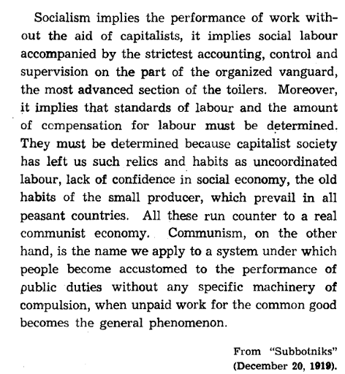
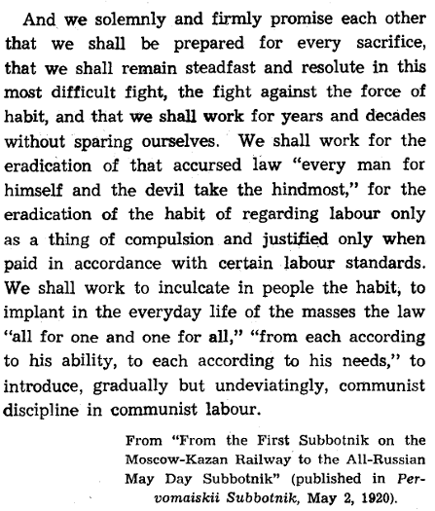
The Party Must Undeviatingly Inculcate the Principles of Communism in the Minds of the Masses, and Introduce Communist Discipline in Communist Labor

Slide 39
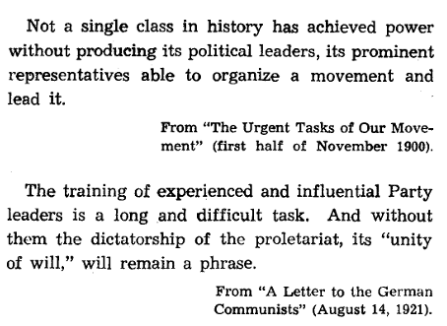
V. The Party Must Have the Most Authoritative and Experienced Leaders
The leaders of the party are the most authoritative and experienced revolutionaries who are always in advance of the revolutionary initiative of the masses and can find speedy and correct solutions to intricate political problems

Slide 40
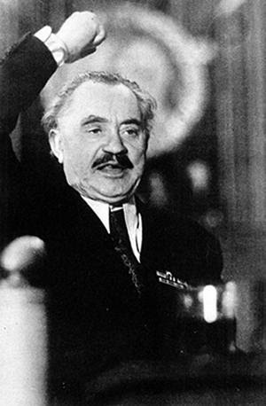
V. The Party Must Have the Most Authoritative and Experienced Leaders
To go do far in this connection as to contrast, in general, dictatorship of the masses to dictatorship of leaders is absurd. In actuality, under the cover of the slogan “Down with the leaders!” the old leaders who hold common sense human views are replaced by new leaders who talk nonsense.
The German revolution inspired the workers to rise and there was “unrest in the army.” The duty of revolutionary leadership was to lead the masses towards revolution, not to miss the opportune moment, when the arming of the workers and influence of the German revolution could have decided the issue in one stroke.

Slide 41
V. The Party Must Have the Most Authoritative and Experienced Leaders
All the great revolutionary thinkers have not been afraid to learn from the experience of the great movements of the oppressed classes.
There is no trace of utopianism in Marx, he did not invent a “new” society. He studied the birth of the new society out of the old, the forms of transition from the latter to the former as a historical process.
He examined the actual experience of a mass proletarian movement and drew practical lessons from it. He learned from the Paris Commune.
If the party suspends the public activities of their leaders due to slander from the bourgeoisie, the party would suffer, the proletariat would be harmed and its enemies would rejoice.
We must safeguard the working power of the party and guard its leaders from wasting time on filthy slander.

Slide 42
V. The Party Must Have the Most Authoritative and Experienced Leaders
In the example of Germany, their organization embraces the crowd, everything proceeds from them. In return, the crowd of millions values and clings to its tried political leaders.
Hostile parties in parliament would tease Socialists, and yet Germans would only smile with contempt at the demagogic attempts to turn the crowd against the leaders.
Political thinking is developed enough among the germans that they understand that without the tried and talented leaders, professionally trained and schooled by the long experience of working in perfect harmony, no class in modern society could wage a determined struggle.

Slide 43
Discussion & New Members Introductions

Slide 44
Discussion & Wrap Up

Slide 45
Announcements
PCUSA Cell Chairs need to call members of their cells to remind them about attendance.
The next issue of New Masses (2026) has begun production. If you have art you want us to feature, email it to info@partyofcommunistsusa.net.

Slide 46
Volunteers Needed!
We are in need of volunteers for the staff of the People’s School! Here’s a few roles we need filled:
People to help manage posting on our social media and podcast platforms
Video Editors, Audio Editors, Graphic Designers, Artists, Narrators
Web Controls, Moderators
Email info@peoplesschool.us if you’re interested and try to attend our next staff meeting if possible.

Slide 47

View From Left Field
https://viewfromleftfield.libsyn.com
The Old PSMLS Youtube is now the Youtube of View From Left Field, a podcast of analysis and discussion of current events from a progressive perspective.
Like the Youtube videos and subscribe with 5 star ratings on your podcast platforms.

Slide 48


New Masses is a Marxist cultural journal continuing the work of The Liberator founded in 1919.
New Masses will have a showing of The Cranes are Flying on January 31, 2026 at 6 PM EST til 8 PM EST. This movie depicts life on the home front in the Soviet Union during the Great Patriotic War and its effects.

Slide 49


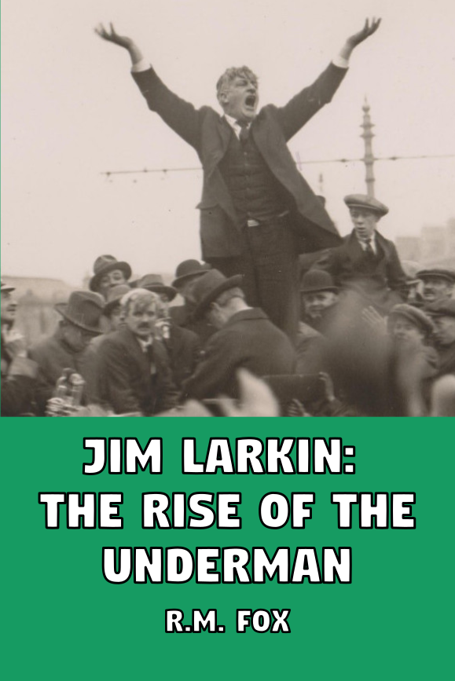

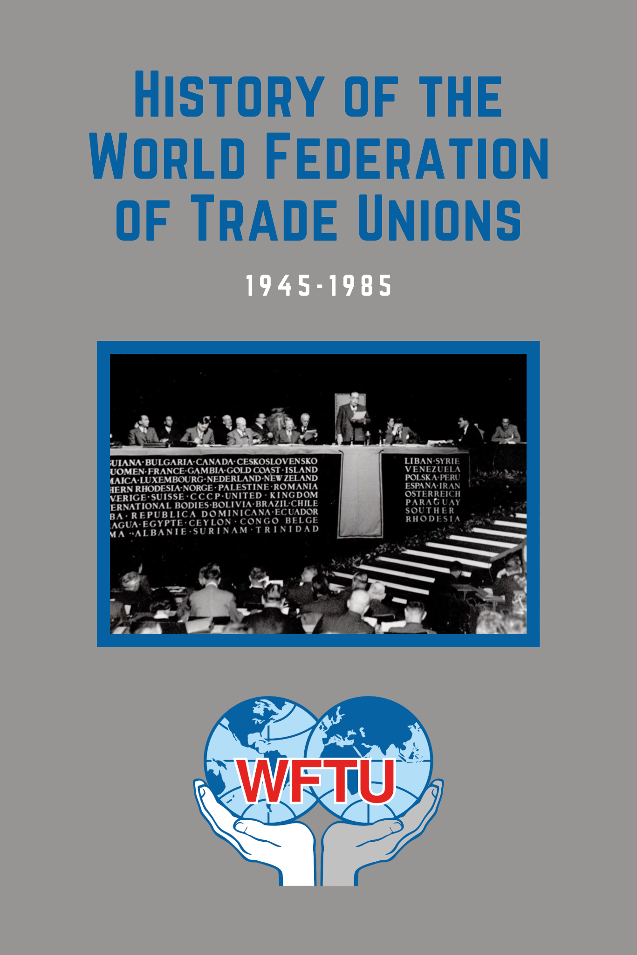
New Outlook Publishers
newoutlookpublishers.store
Latest Releases

Slide 50



Harry Bridges School of Labor
luel.us/laborschool/
The Harry Bridges School of Labor is a monthly class covering a variety of topics aimed at building class consciousness among union members. For class schedule and other information, please visit the website at luel.us/laborschool.

Slide 51


