Slide 1

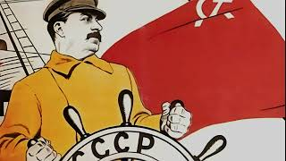
The Internationale

Slide 2
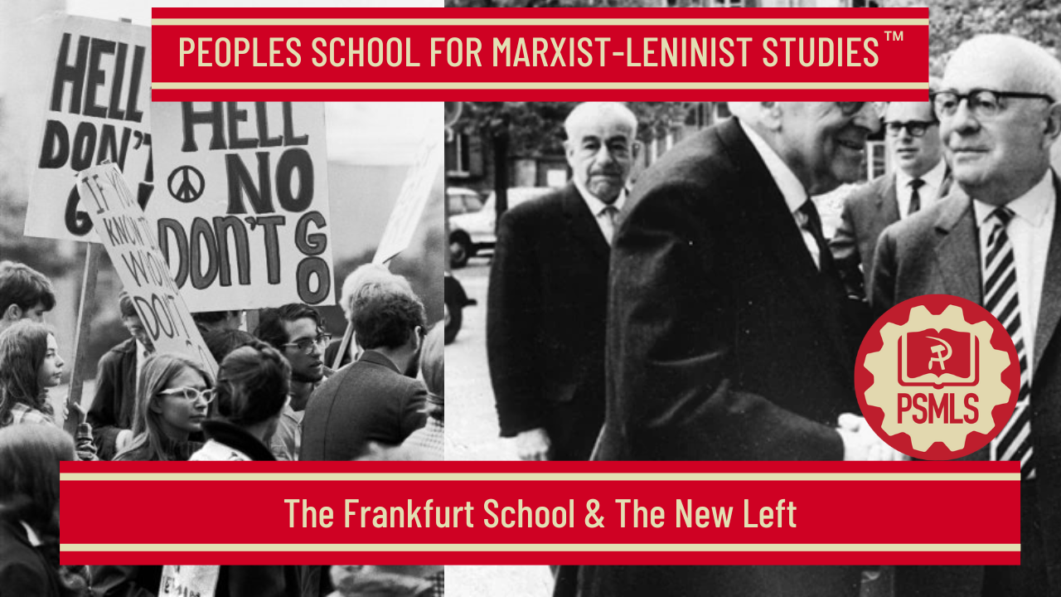
PSMLS 1/6/26

Slide 3
What we’ll be learning today:
The Frankfurt School’s Connection to the CIA
Impact of the New Left
Connection with Maoism

Slide 4
The Frankfurt School and the CIA: Imperial Theory Production in the Pursuit of a “Compatible Left”

Slide 5
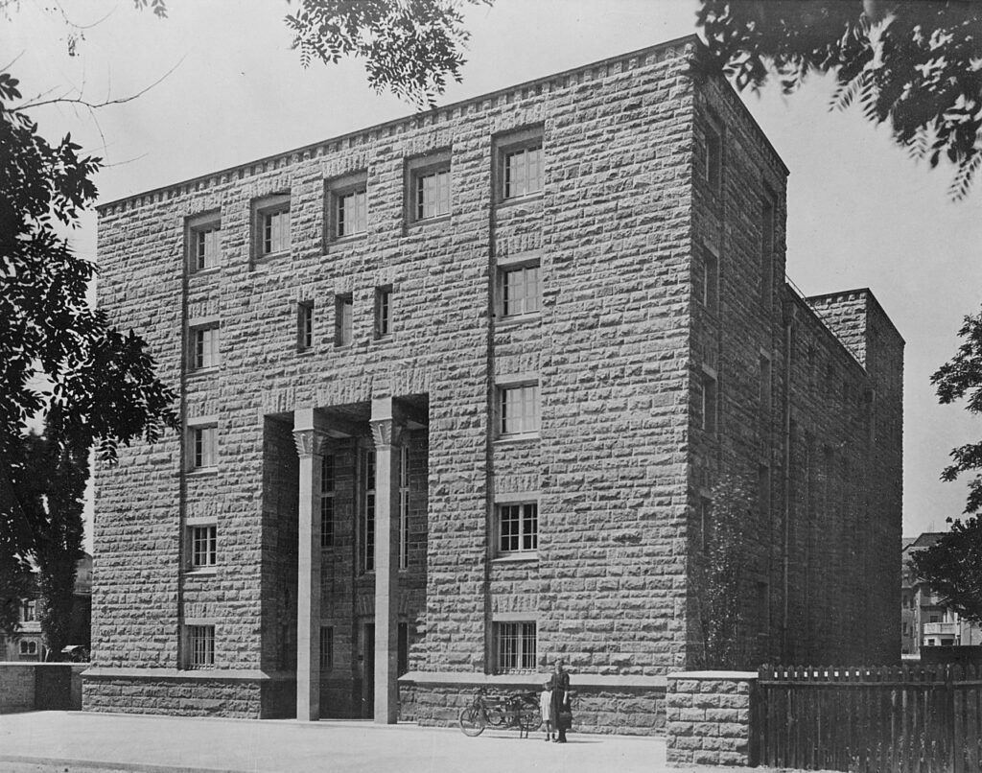
Pro-Western, Anti-Communist, Faux Radicals
Frankfurt School critical theory has been—along with French theory—one of the hottest commodities of the global theory industry. Together, they serve as the common source for so many of the trend-setting forms of theoretical critique that currently dominate the academic market in the capitalist world, from postcolonial and decolonial theory to queer theory, Afro-pessimism and beyond. The Frankfurt School’s political orientation has therefore had a foundational effect on the globalized Western intelligentsia. Cultivating an appearance of radicality, they recuperated the very activity of critique within a pro-Western, anti-communist ideology. They publicly expressed their social-chauvinistic disgust with what they described as the savage barbarians in the East, who dared to take up the weapon of Marxist theory à la Lenin and use it to act on the principle that they could rule themselves. From the relative comforts of their capitalist-funded professorial citadel in the West, they defended the superiority of the Euro-American world that promoted them against what they referred to as the leveling project of the bolshevized barbarians in the uncivilized periphery.”
A photo of the Institute for Social Research AKA the "Frankfurt School," founded at the University of Frankfurt, Germany, in 1923

Slide 6
Attempting to Redefine the Left
The first generation of the Institute for Social Research (the Frankfurt School)—particularly Theodor Adorno and Max Horkheimer —are towering figures in what is referred to as Western or cultural Marxism. It is important to re-contextualize the Institute for Social Research’s work in relationship to international class struggle. One of the most significant features of this context was the desperate attempt, on the part of the capitalist ruling class, its state managers and ideologues, to redefine the Left—in the words of cold warrior CIA agent Thomas Braden—as the “compatible,” meaning non-communist, Left. As Braden and others involved have explained in detail, one important facet of this struggle consisted in the use of foundation money and CIA front groups like the Congress for Cultural Freedom (CCF) to promote anti-communism and lure Leftists into taking positions against actually existing socialism. In order to shore up the compatible, non-communist Left over and against the threat of actually existing socialism, what better tactic than to champion scholars like these as some of the most important, and even most radical, Marxist thinkers of the 20th century? “Marxism” can thereby be redefined as a kind of anti-communist critical theory that is not directly connected to class struggle from below but rather freely criticizes all forms of “domination,” and which ultimately sides with capitalist control societies over and against the purported “fascist” horrors of powerful socialist states.

Slide 7
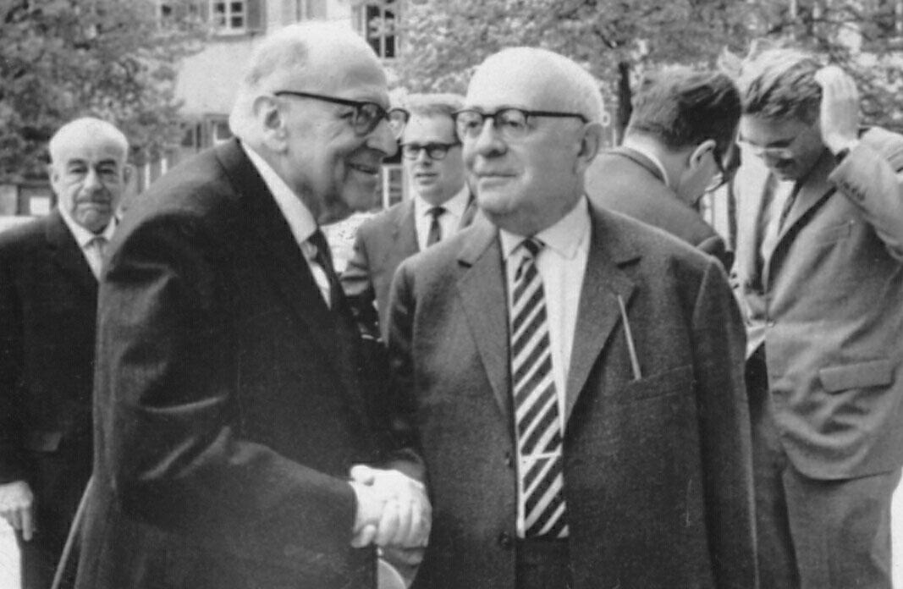
Distanced from Mass Politics
Although their early lives were marked by the world-historical events of the Russian Revolution and the attempted revolution in Germany, Adorno and Horkheimer were esthetes wary of the supposed morass of mass politics. While their interest in Marxism was piqued by these incidents, it was primarily of an intellectual nature. Horkheimer did become marginally involved in activities around the Munich council republic after WWI, particularly by providing support for some of those involved after the council had been brutally suppressed. However, he—the same is true a fortiori of Adorno—“continued to maintain his distance from the explosive political events of the time and to devote himself primarily to his own personal concerns.”
Max Horkheimer (left) and Theodor Adorno in April 1964 in Heidelberg, Germany.

Slide 8
The Rejection of Lenin and the Working Class
Their class standing was far from insignificant in this regard, for it positions them and their political outlook within the larger, objective world of the social relations of production. Both Frankfurt School theorists were from affluent families. Adorno’s father was a “wealthy wine merchant” and Horkheimer’s was a “millionaire” who “owned several textile factories.”[11] Adorno “had no personal ties at all to socialist political life” and maintained throughout his life “a deep aversion to formal membership of any party organization.” Similarly, Horkheimer was never “an overt member of any working-class party.”The same is generally true of the other figures involved in the early years of the Frankfurt School: “none of those belonging to the Horkheimer circle was politically active; none of them had his origins either in the labor movement or in Marxism.” Horkheimer sought to preserve the supposed independence of theory and “rejected the position of Lenin, Lukács, and the Bolsheviks that critical theory must be ‘rooted’” in the working class, or more specifically working-class parties. He encouraged critical theorists to operate as intellectual free agents rather than grounding their research in the proletariat, which was a type of work that he disparaged as “totalitarian propaganda.” Adorno’s overall position, like Herbert Marcuse’s, was summarized in the following terms: “the Bolshevik party, which Lenin made the vanguard of the October Revolution, was a centralizing and repressive institution which would shape the Soviet State in its image and turn the dictatorship of the proletariat into its own dictatorship.”

Slide 9
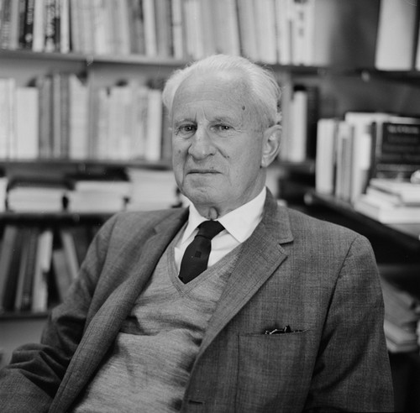
Prostitutes Selling Their Skills and Opinions
This refusal to overtly participate in progressive politics was intensified when the leaders of the Institute moved it to the United States in the early 1930s. Horkheimer had words like Marxism, revolution and communism expunged from its publications in order to avoid offending its U.S. sponsors. Furthermore, any type of political activity was strictly forbidden, as Herbert Marcuse (a prominent figure in the Frankfurt School) later explained. Horkheimer put his energy into securing corporate and state funding for the Institute, and he even hired a public relations firm to promote its work in the U.S. Another émigré from Germany, Bertolt Brecht, was thus not fully unjustified when he critically described the Frankfurt scholars as—in the words of Stuart Jeffries—“prostitutes in their quest for foundation support during their American exile, selling their skills and opinions as commodities in order to support the dominant ideology of oppressive U.S. society.” They were indeed intellectual free agents unrestrained by any working-class organizations in their pursuit of corporate and state sponsorship for their brand of market-savvy critical theory.
Herbert Marcuse (above) was also the leading intellectual in the Rockefeller Foundation’s Marxism-Leninism Project, where he worked hand in glove with his close friend, Philip Mosely, who was a high-level, long-term CIA advisor.

Slide 10

Analysts and Propagandists for the U.S. National Security State
It is important to recall that five of the eight members of the Horkheimer circle had worked as analysts and propagandists for the U.S. government and national security state, which “had a vested interest in the continuing loyalty of the Frankfurt School because a number of its members were working on sensitive government research projects.” While Horkheimer and Adorno were not amongst them, since they received more support from the Institute, the latter of the two originally emigrated to the United States to work for Paul Lazarsfeld’s Office of Radio Research, one of the “de facto adjuncts of government psychological warfare programs.” This center for communication studies received a substantial grant of $67,000 from the Rockefeller Foundation and worked very closely with the U.S. national security state (government money made up over 75 percent of its annual budget). The Rockefeller Foundation also funded Horkheimer’s first return to Germany in April 1948, when he took up a guest professorship at Frankfurt University.
The lobby of the CIA Original Headquarters Building, opened in the early 1960s.

Slide 11
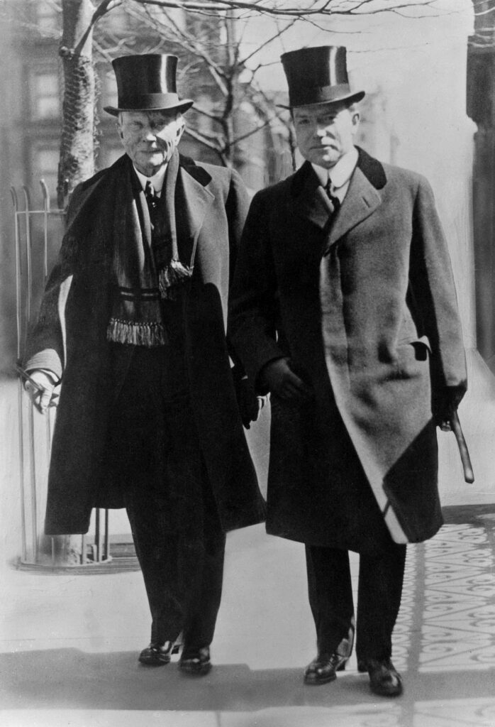
A Conduit for CIA Money
Lest we forget, the Rockefellers are one of the greatest gangster families in the history of U.S. capitalism, and they use their foundation as a tax shelter that allows them to mobilize a portion of their stolen wealth “in the corruption of intellectual activity and culture.” They were, moreover, directly involved in the national security state during the time of the Frankfurt School’s sponsorship. After serving as the director of the Office of Coordinator of Inter-American Affairs (a federal propaganda agency whose work resembled that of the Office of Strategic Services and the CIA), Nelson Rockefeller became, in 1954, the “‘super-coordinator’ for clandestine intelligence operations, with the title of Special Assistant to the President for Cold War Strategy.” He also allowed the Rockefeller Fund to be used as a conduit for CIA money, very much like a large number of other capitalist foundations that have an extensive history of working hand-in-glove with the CIA (as revealed by the Church Committee report and other sources).
John D. Rockefeller, Senior (left) and John D. Rockefeller, Junior

Slide 12
Funded by Imperialists and Employed by Former Nazi Leaders
With all of these ties to the capitalist ruling class and the U.S. empire, it is nowise surprising that the U.S. government supported the Institute’s move back to West Germany with a very significant grant in 1950 of 435,000 DM ($103,695, or the equivalent of $1,195,926 dollars in 2022). These funds were administered by John McCloy, the US High Commissioner of Germany. McCloy was a core member of the U.S. power elite, who had worked as a jurist and banker for big oil and IG Farben, and who granted extensive pardons and commutations to Nazi war criminals. After having served as one of the architects of the US national security state during WWII, he—in a career move indicative of the intimate relationship between the deep state and the capitalist ruling class—went on to become the chairman of Chase Manhattan Bank, of the Council of Foreign Relations, and of the Ford Foundation. In addition to the funds provided by McCloy, the Institute also received support from private donors, the Society of Social Research, and the city of Frankfurt. In 1954, it even signed a research contract with the Mannesmann corporation, which “had been a founding member of the Anti-Bolshevik League and had financed the Nazi Party.” During WWII, Mannesmann used slave labor, and its Chairman of the Board was the Nazi Wilhelm Zangen, the War Economy Leader of the Third Reich. The Frankfurt School’s postwar contract with this company was for a sociological study of worker’s opinions, with the implicit implication that such a study would help management stall or prevent socialist organizing.

Slide 13
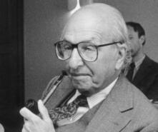
CIA Controlled Cultural War Around the World
Perhaps the clearest explanation of why capitalist governments and the corporatocracy would support the Institute for Social Research is to be found in the words of Shepard Stone. Stone, we should note, had a background in journalism and military intelligence before going on to serve as the Director of International Affairs at the Ford Foundation, where he worked closely with the CIA in funding cultural projects around the world (Stone even became the President of the International Association for Cultural Freedom, which was the new name given to the Congress for Cultural Freedom in a rebranding effort after its CIA origins had been revealed). When Stone was the director of public affairs for the High Commission for Occupied Germany in the 1940s, he sent a personal note to the U.S. State Department to encourage it to extend Adorno’s passport: “The Institute of Frankfurt is helping to train German leaders who will know something of democratic techniques. I believe it is important for our over-all democratic objectives in Germany that such men as Professor Adorno have an opportunity to work in that country.” The Institute was doing the kind of ideological work that the U.S. state and capitalist ruling class wanted to—and did—support.
Shepherd Stone (above) Was Instrumental in a Number of CIA Front Groups and Associated “Cultural Foundations,” Including the Ford Foundation’s International Affairs program and the Congress for Cultural Freedom

Slide 14
Discussion

Slide 15
Impact of The New Left

Slide 16
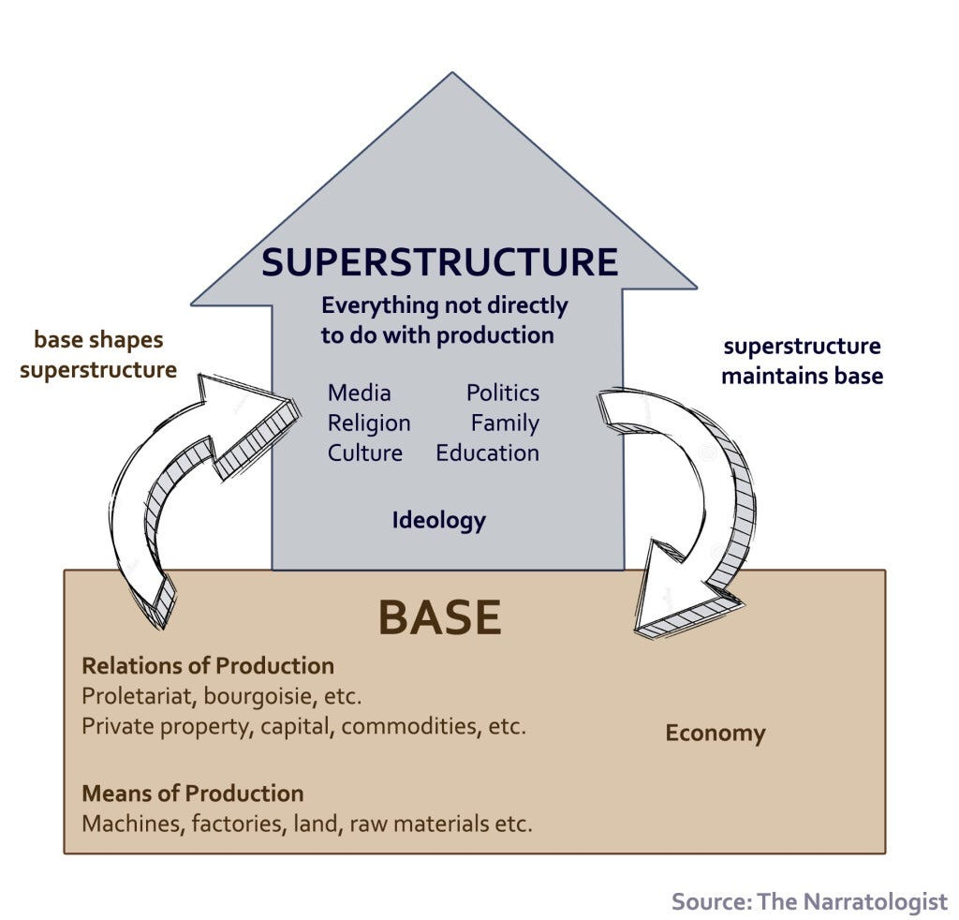
“Critical Theory”: What is it?
A philosophical approach to culture, and especially to literature, that considers the social, historical, and ideological forces and structures which produce and constrain it.
Critical theory originated from the Frankfurt School, which deviated from Marxism by incorporating Freudian psychoanalysis, Weberian sociology, and Nietzsche’s postmodernism.
Thus, critical theorists view social change as happening through the superstructure, not the economic base.

Slide 17
How it Waters Down Marxism
Main Strategic Differences: Marxist-Leninism focuses on establishing a socialist state through a vanguard party, creating a dictatorship of the proletariat. Critical Theory, especially the Frankfurt School, often deviates from this and sees revolution as a broader cultural and intellectual shift, sometimes decentralized.
Main Focus: Marxist-Leninism prioritizes the economic base and class struggle for national liberation and smashing imperialism. Critical Theory redundantly tries to expand to ideals on cultural, racial, and gender oppression, mostly by integrating Freud and postmodernism, neglecting core economic issues.
Theories vs. Practices: Marxist-Leninism describes Marxism as a "guide to action," demanding concrete political practice. Critical Theory often has abstract theories, leading to less grounding in immediate revolutionary needs.

Slide 18
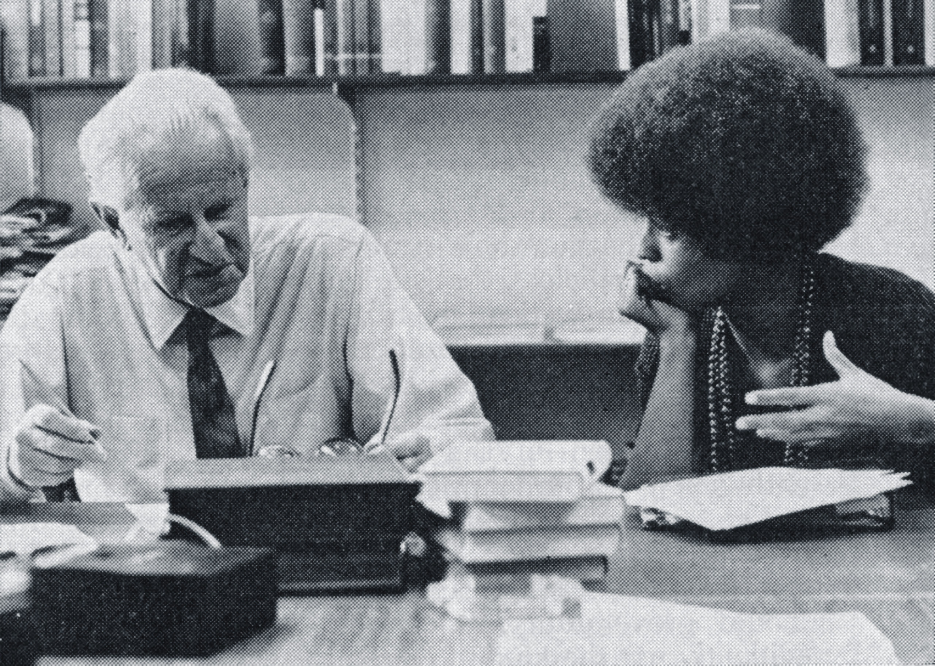
Splitting the Communist Movement
Angela Davis was at one point in time, a loyal member of the CPUSA. However, she studied under Herbert Marcuse, who introduced the ideas of critical theory to Davis.
Critical Theory focuses more on emancipation through ideological critique, communication, and changing social consciousness.
Many proponents of Critical Theory looked upon the Soviet Union as a totalitarian state. Hence, when the policies of cultural and economic liberalization in the form of Glasnost and Perestroika were introduced in the USSR, many critical theorists viewed it as a positive change.

Slide 19

Splitting the Communist Movement
This divergence in understanding caused a split in the communist movement. Angela Davis and many of her followers welcomed these changes in the USSR, and split off from the CPUSA to form the Committees of Correspondence for Democracy and Socialism.
But what exactly were Glasnost and Perestroika, and how did they affect the communist movement?
Glasnost involved loosening state control over media, allowing for broader dissemination of news and information, including dissent.
Perestroika introduced the free market to an economy that was previously stabilized with price controls.
They are often cited as one of the causes of the collapse of the USSR. The analysis of the critical theorists was wrong.

Slide 20
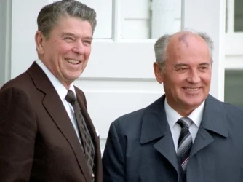
Splitting the Communist Movement
Contrary to their theory of liberation being achieved simply through greater communication and a change in social consciousness, the exact opposite happened.
The people of the USSR who had previously lived in a society where food and rent were affordable, were now plunged into economic chaos and instability.
Not only did it impact the Soviet people, but the communist movement worldwide took a huge blow. Many in the CPUSA became disillusioned and left. The CIA’s use of the New Left to sabotage communism’s progression was unfortunately a success.

Slide 21
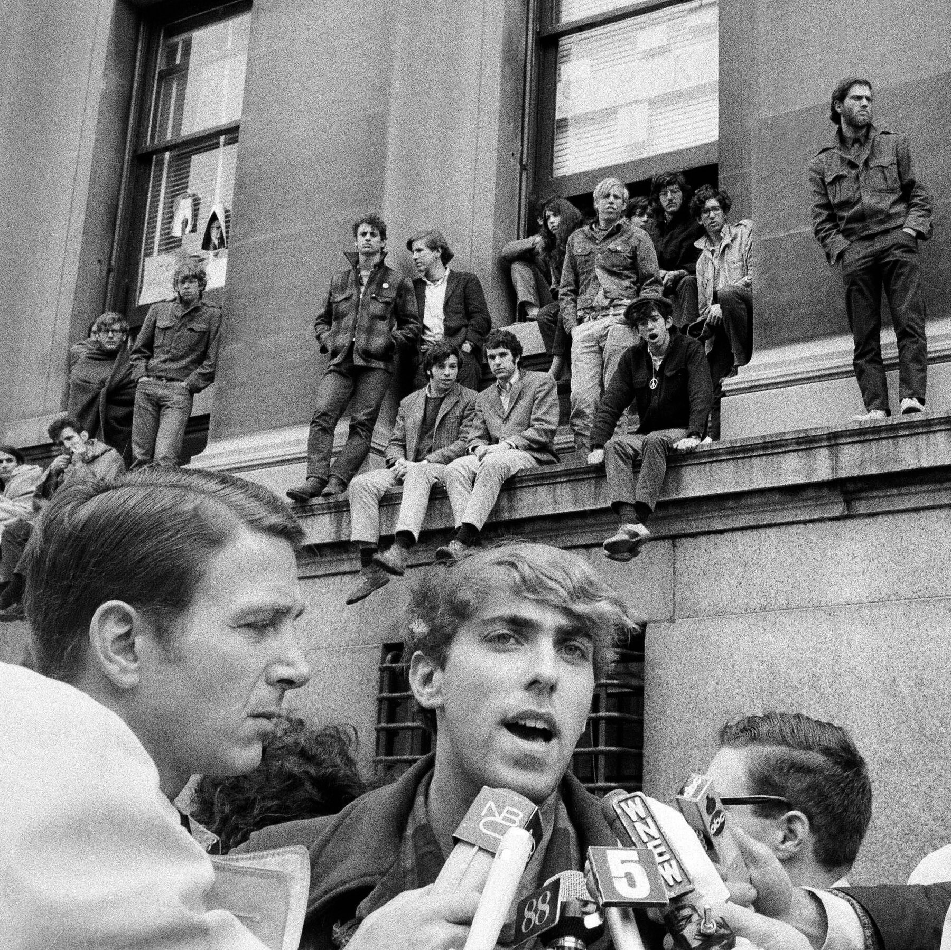
Peace Movements of the 60s and 70s
Marxist-Leninism believes the working class is the main force for the revolution. Losing patience with the working class, critical theorists like Herbert Marcuse looked to other groups, such as students and racial minorities, as potential sources of radical change. This shift is redundant, divisive, and abandons class struggle and the working class itself.
Critical theory's emphasis on culture, ideology, and "mass culture" is an abandonment of the materialist analysis of the economic base of capitalism. This focus on the "superstructure" is considered, "academic Marxism”, that merged with "reactionary bourgeois ideologies”. It is not a practical guide for revolutionary action.

Slide 22

Peace Movements of the 60s and 70s
The peace movements of the 60s and 70s focused on social issues like civil rights, anti-war activism (especially Vietnam), feminism, environmentalism, and gay rights, advocating for "participatory democracy" and rejecting the "Establishment," with groups like Students for a Democratic Society (SDS) leading the charge from university campuses.
The Marxists of the Old Left viewed these social issues as being an essential part of the class struggle. However the popular social movements of the 80s viewed these struggles as being separate but equal from the class struggle.

Slide 23
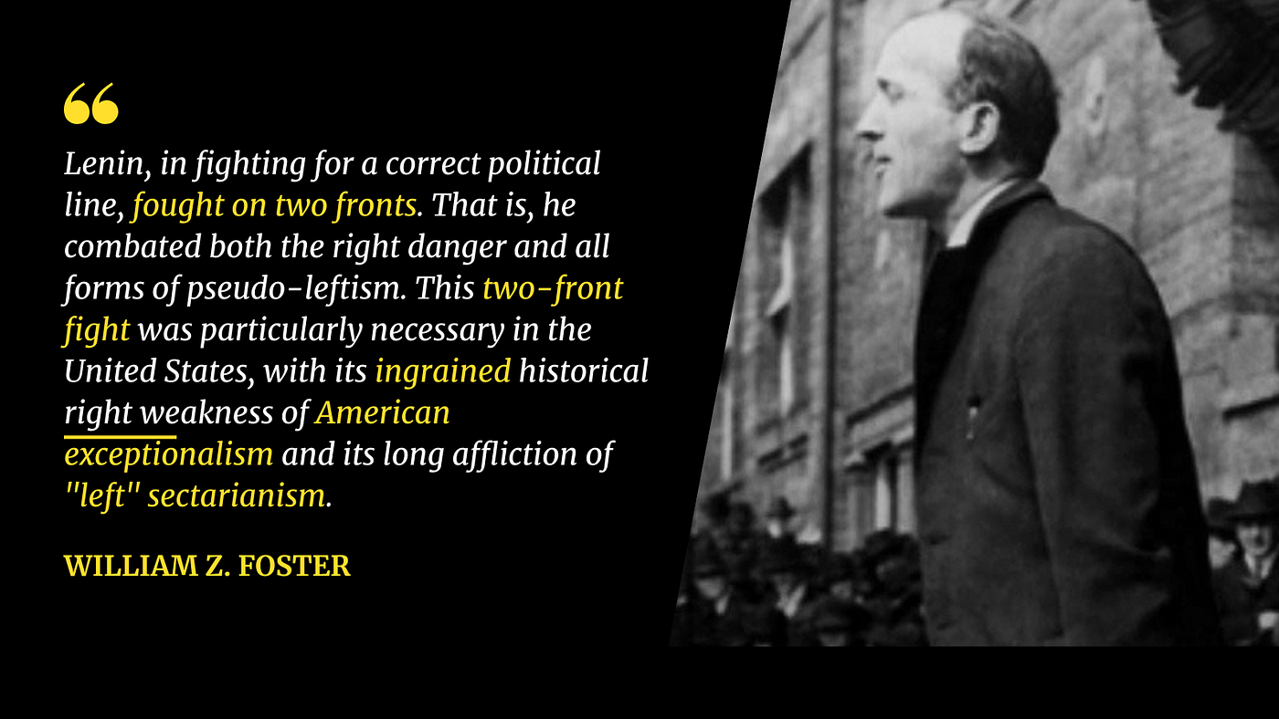
Conclusion
Marxist-Leninism emphasizes the need for a disciplined and centralized vanguard party to lead the Working Class in revolution in order to establish a socialist state. Critical Theory’s influence on the New Left, promoted a decentralized, participatory, and anti-authoritarian organizations, which are a form of "ultra-leftism" or "anarchism” that always eventually fail.
The impact of the New Left has caused the progressive movements to be scattered and disorganized. This is especially apparent in the modern day, with so many different splits in the left dividing and misleading any people who want to learn about and become involved with progressive politics.

Slide 24
Discussion & New Members Introductions

Slide 25
New Member Introductions
What is your name, pronouns and state (or country/territory)?
Where do you work? Is it unionized?
How did you find out about the People’s School?
What do you think about tonight's class?

Slide 26
Connection to Maoism

Slide 27
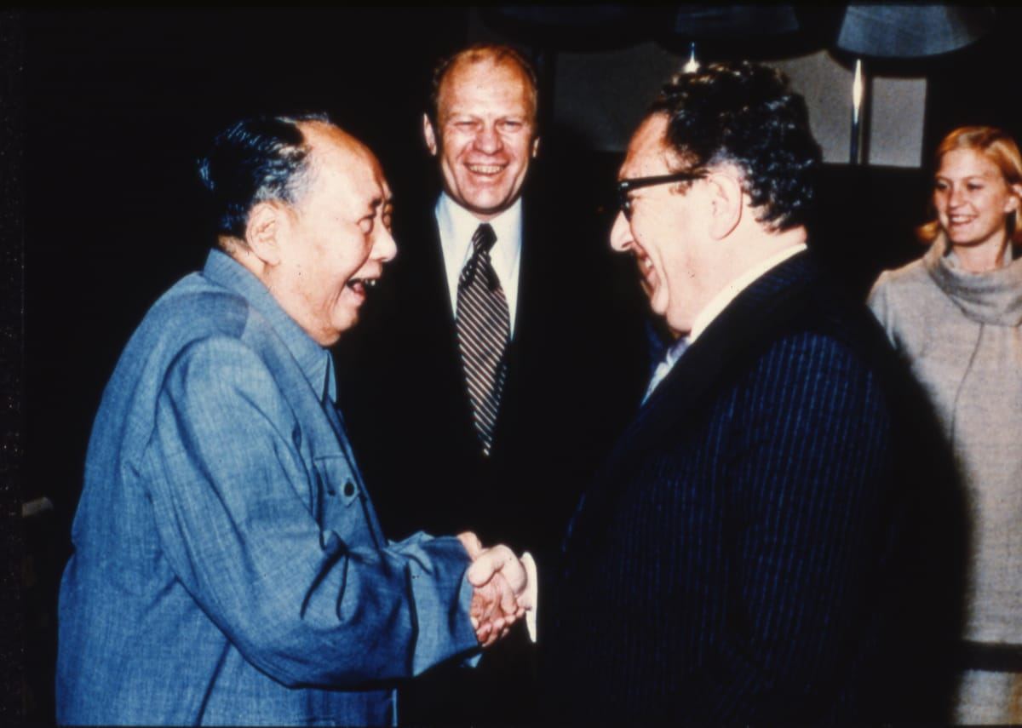
Maoism: A Supplement to the Fragmentation of the New Left
Maoism attempts to present itself as Marxism-Leninism. It presents itself as “anti-Revisionist” return to “revolutionary communism.”
In reality, Maoism, both domestically and internationally, especially after the Sino-Soviet Split in 1961, has played a counter-revolutionary role
Objectively, Maoism has served domestically, and employed through the FBI’s COINTELPRO, as a force to disunify the left and working class movement
Internationally, Maoism’s “Third-World Theory” served as a bulwark against internationalist solidarity between the Soviet Union and the national liberation struggles of the semi-colonies in Africa, Asia, and South America
It is no surprise that imperialist strategist, Henry Kissinger, saw in Maoism a united front against the Soviet Union
CPC Chairman Mao Zedong (left) friendly with Secretary of State Henry Kissinger (right) and President Gerald Ford (back)

Slide 28
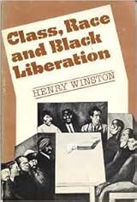
Class Nature
Maoism, basing itself on the Chinese Revolution of 1949, places the emphasis on the petty bourgeoisie
In China, the leading role was placed in the hands of the small peasantry
In the US, where the peasantry is non-existent, Maoism places the leading role into mainly the intelligentsia (for example: Students for a Democratic Society)
To demonstrate the Petty Bourgeois distortions in Maoist theory, we will observe the following passage from Class, Race, and Black Liberation by Henry Winston

Slide 29
Class Nature
From Class, Race, and Black Liberation by Henry Winston
The contradictions between ourselves and the enemy are antagonistic contradictions. Within the ranks of the people, the contradictions among the working people are non-antagonistic, while those between the exploited and the exploiting classes have a non-antagonistic aspect in addition to an antagonistic aspect.
Continuing, Mao says: In our country, the contradiction between the working class and the national bourgeoisie belongs to the category of contradictions among the people. By and large, the class struggle between the two is a class struggle within the ranks of the people, because the Chinese national bourgeoisie has a dual character. {On The Correct Handling Of Contradictions Among The People, by Mao Tse-tung. Foreign Languages Press, Peking, 1966, pp. 2-3. Emphasis added—H.W.)
In speaking of the “contradictions between ourselves and the enemy," Mao violates the class essence of scientific socialism. “Ourselves" is not a class, but a subjective, arbitrary designation. By substituting “ourselves" for class as the source of antagonistic contradictions, Mao also opens the way for an equally subjective, arbitrary definition of the “enemy."

Slide 30
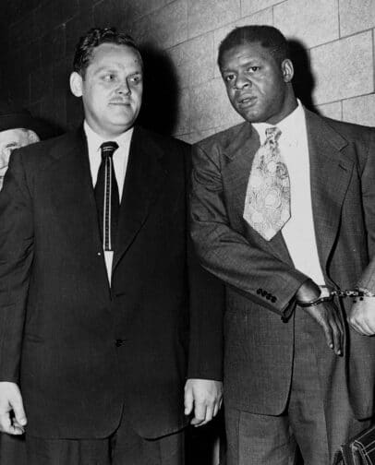
International Aspects
Third World Theory - Claims that the Soviet Union is “Social Imperialist” and that the “third world” should reject support from the Soviet Union in their anti-colonial struggles
Rejected the Leninist line on Peaceful Co-existence (supporting the struggle for the capitalist countries to live in peace and without exploiting the socialist countries like Cuba) as a “Rapprochement with Imperialism” (Read Gus Hall’s The Only Choice Peaceful Co-existence from NOP)
Passage from Class, Race, and Black Liberation by Comrade Henry Winston
“The theory that the fight for detente means “rapprochement" with
imperialism—resulting in “abandonment" of national liberation movements and “playing down" the “grievances of oppressed nationalities"—coincides with the Maoist/Baraka view that peaceful coexistence slows down the revolutionary process, while imperialist aggression “fuels" revolution. (The credibility of this “super-revolutionary" theory is hardly enhanced by the role of the Maoist Chinese as accomplices to U.S. imperialism and fascist South Africa!)”
General Secretary Gus Hall (Left) and future National Chair Henry Winston (Right) (1949)

Slide 31
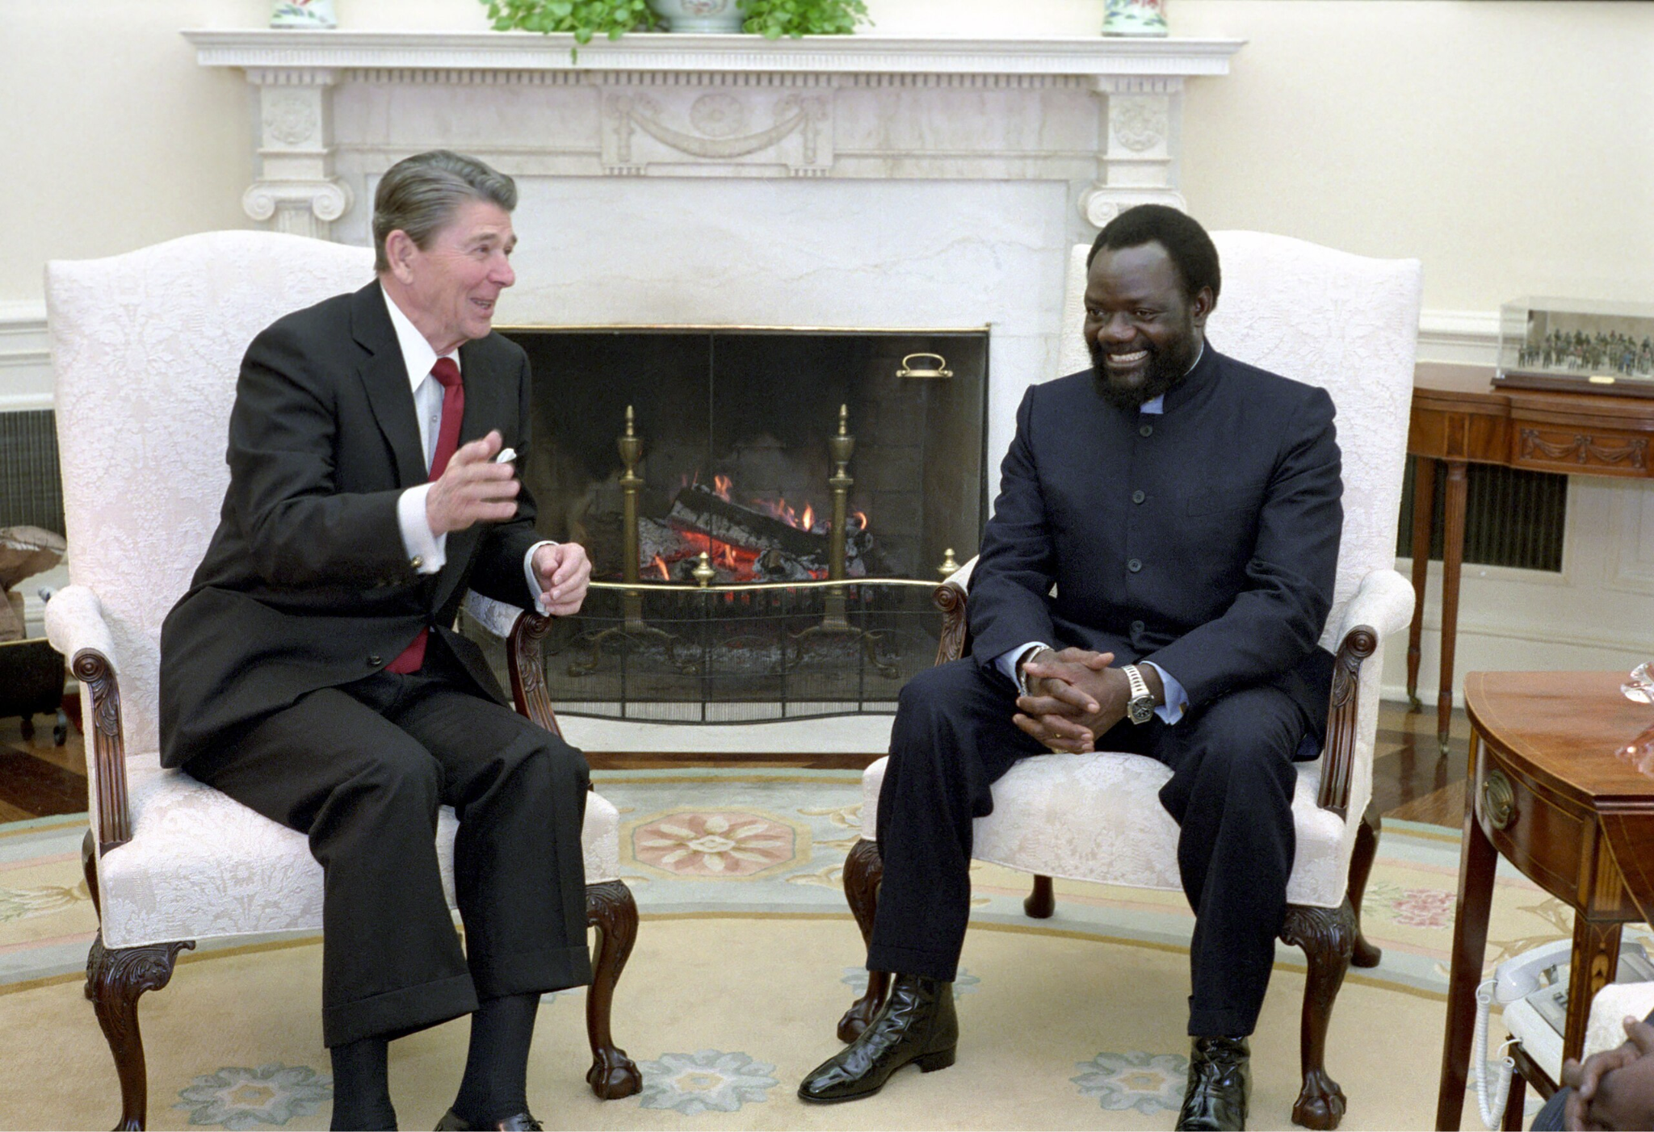
International Aspects
As African and world protest mounted against the military intervention in Angola by the United States, Maoist China and fascist South Africa, the Maoists hastily revised their tactics—but not their strategy. According to the Maoists, events in Angola were not the result of a contradiction between the people, led by the MPLA (Popular Movement for the Liberation of Angola), and the imperialists, assisted by the Savimbis and Robertos. Instead, the Maoists, together with their imperialist allies, began to proclaim that the contradiction between the MPLA and its opponents was simply a contradiction among the Angolan people!
Thus, the Maoist theory of contradictions serves the imperialists' strategy, which is two-pronged: On one hand, this strategy calls for destruction of the People's Republic of Angola by outright milit means. But if this cannot be achieved, attempts will be made to force the MPLA to enter a "coalition,"—a "black fraternity"—with the compliances of imperialism.
Jonas Savimbi was the leader of UNITA. UNITA was one of several groups which waged a guerrilla war against Portuguese colonial rule from 1966 to 1974. Once independence was achieved, it then became an anti-communist group which confronted the ruling MPLA. Backed by the U.S., Maoist China, and was strongly supported by the conservative Heritage Foundation.

Slide 32
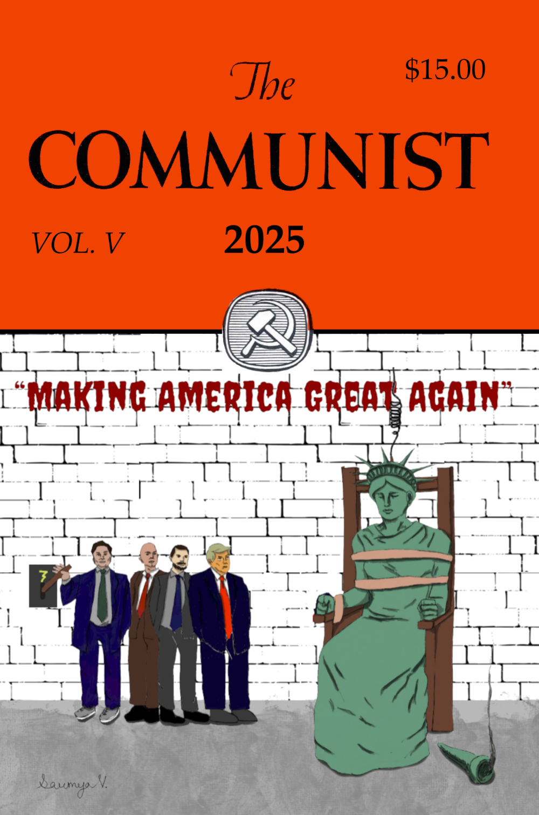
International Aspects
In South Africa, the anti-apartheid movement that was led by the African National Congress (ANC) inspired by Nelson Mandela was set-back due to the reckless, individualistic actions of the separatist Maoist formation of the Pan African Congress (PAC).
The PAC was headed by a South African trade unionist linked with the C.I.A, and had the support of anti-Soviet, Maoist intellectuals like George Padmore. Padmore had the support of the so-called International Free Tinanced by the C.I.A.
With Padmore’s encouragement, this group returned to South Africa, supported by the Chinese Maoists. The group’s first aim was to subvert the ANC’s revolutionary program. The members joined the ANC with the intention to influence it with its separatist, gun-toting, “revolutionary” ideology and organized the Pan-African Congress. The group formally became the PAC as a split off from the African National Congress in 1968.
From the article “Ultra-Left Adventurism” in The Communist 2025 by Jerry Ginsberg

Slide 33
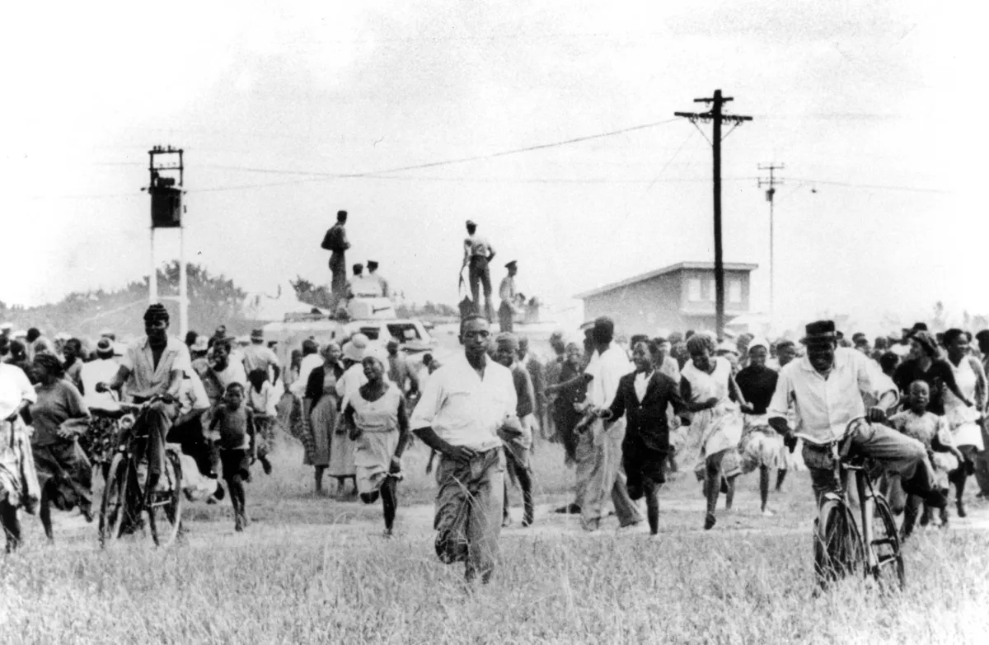
International Aspects
Winston in South Africa: Neo-Pan Africanism and Maoism goes into how the PAC members sabotaged the leadership of the ANC by promoting their adventurist protests in front of police stations in Sharpeville, South Africa.:
The “leaders” of the Pan Africanist Congress, who called the people to the police stations in the name of “Congress,” were serving the apartheid rulers through a strategy directed against the liberation movement. They undermined unity and diverted the people’s forces from a realistic action under conditions of fascist terror, [underlined for emphasis] which the ANC had set to begin the March 31 Anti-Pass National Work stoppage—an action aimed at confronting the regime with the mass unity of the people. By calling upon the people to appear at the fascist police stations, the PAC provocateurs were not only signaling to the fascist regime that the united front of the liberation movement had been breached—in addition, by deceitfully calling this separate action they trapped an unarmed people into a direct confrontation with armed, strong points of South African fascism.
People flee the shooting at the police station. Nearly all the dead and injured had been shot in the back. Photo: Africa Media Online

Slide 34
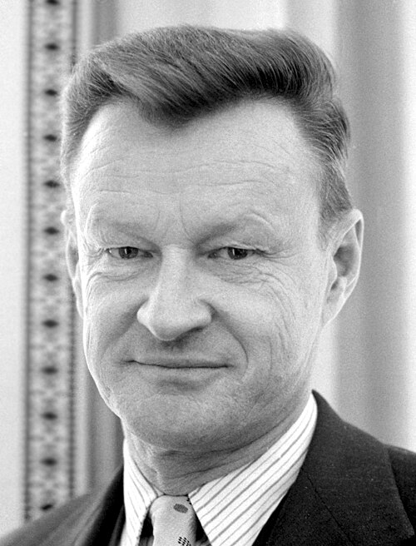
International Aspects
Former US National Security Adviser Zbigniew Brzezinski under Lyndon B Johnson and Jimmy Carter described how he convinced China to support the Khmer Rouge in 1979:
“I encouraged the Chinese to support Pol Pot. Pol Pot was an abomination. We could never support him, but China could.” According to Brzezinski, the USA “winked, semi-publicly” at Chinese and Thai aid to the Khmer Rouge. Well into the 1980s, the United States itself would support the Khmer Rouge against Cambodia's neighbor and America's old wartime enemy, the Vietnamese Communists which was supported by the Soviet Union.
Integrated closely into the CIA's intelligence and psychological warfare units after WWII, organizations like the Congress for Cultural Freedom, according to the CIA's own website, helped to solidify the CIA's emerging strategy of promoting the non-Communist left—the strategy that would soon become the theoretical foundation of the agency's political operations against Communism over the next two decades.
Zbigniew Brzeziński - National Security Advisor

Slide 35
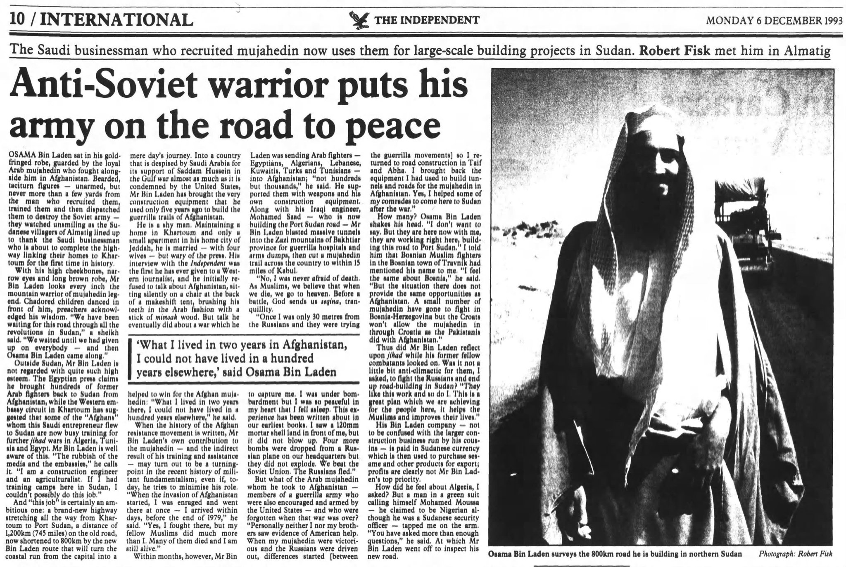
International Aspects
In the case of Afghanistan, handpicked by U.S. administrators to participate in a UNESCO/Columbia University program, Hafizullah Amin was sent to New York in 1957. He later completed a master's degree at Columbia–coincidentally, at a time when Brzezinski was gaining prominence there as a professor. Later Amin would become General Secretary of the Afghan Communist Party.
Amin would develop an analysis that was nothing but in name Marxist. Rather than pulling a Marxist-Leninist theory of leading a revolution through a labor-led strategy, Amin through his education at Columbia put those responsible for the education of the youth of the country, the intelligentsia in the seat of the “revolutionary class.” It was through intelligentsia that the ground would gradually be prepared for the revolution, according to Amin’s analysis that he took back to Afghanistan. His revisionist strategy aimed first at the radicalization of Afghan teachers, and through them the radicalization of the Afghan population, especially the rural population. This would gain the support of Maoist China.
Amin deliberately initiated a policy closing mosques which only fueled a growing religious fanaticism that would empower the anti-socialist movement of the Mujahadeen, which included the Taliban and Al-Qaida.

Slide 36
Domestic Aspects
By
Replacing Marxist-Leninist internationalism with a vulgar nationalism/racial separatism (for example Sakaism and Internal Colony Theory)
Rejecting Anti-Monopoly and Civil Rights movement as revisionism
Baraka Versus Congressional Black Caucus From Class, Race, and Black Liberation by Henry Winston :
The record of Imamu Amiri Baraka testifies to the impossibility of pursuing a wrong strategy in Africa and a correct one at home.
In Africa, Baraka, guided by Mao's theory on contradictions, joins with U.S. imperialism and apartheid South Africa in demanding replacement of the anti-imperialist government of the People's Republic
of Angola by a "coalition" controlled by the accomplices of neocolonialism.
At home, however, Baraka opposes all forms of struggle leading to a real coalition—a people's alternative to monopoly. For instance, coinciding with his support to the imperialist and/or Maoist offensive against Angola, Baraka has launched an offensive against the more than 3,000 Black elected officials in the United States—in particular, against the Congressional Black Caucus.

Slide 37
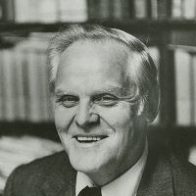
Domestic Aspects
Finally, and perhaps the most pressing and important tactic of our generation, promoted by Gus Hall and Henry Winston, is the anti-monopoly coalition. Gus Hall, in Working Class USA, explains, “Anti-monopoly movements do not call for the abolition of the capitalist system, but objectively they are anti-capitalist because they weaken the position and power of the capitalist class and give broad-based support to the issues and struggles of the working class. The movements against monopoly are not in and of themselves for socialism. But objectively they clear the path toward socialism.”
The American left have a rich history to inspire the working class of this country, regardless of how much the ultra-left deny the revolutionary potential of the industrial proletariat and the working class at large. Instead, the Maoists and Anarchists want to throw all Marxist-Leninist tactics in the “dustbin of history”, viewing them as outdated. On the contrary, the theory of Marxism-Leninism has withstood the attacks of the ultra-left and provides the most concise and correct theoretical outlook for the working class to this day.
Gus Hall General Secretary of Communist Party, USA

Slide 38
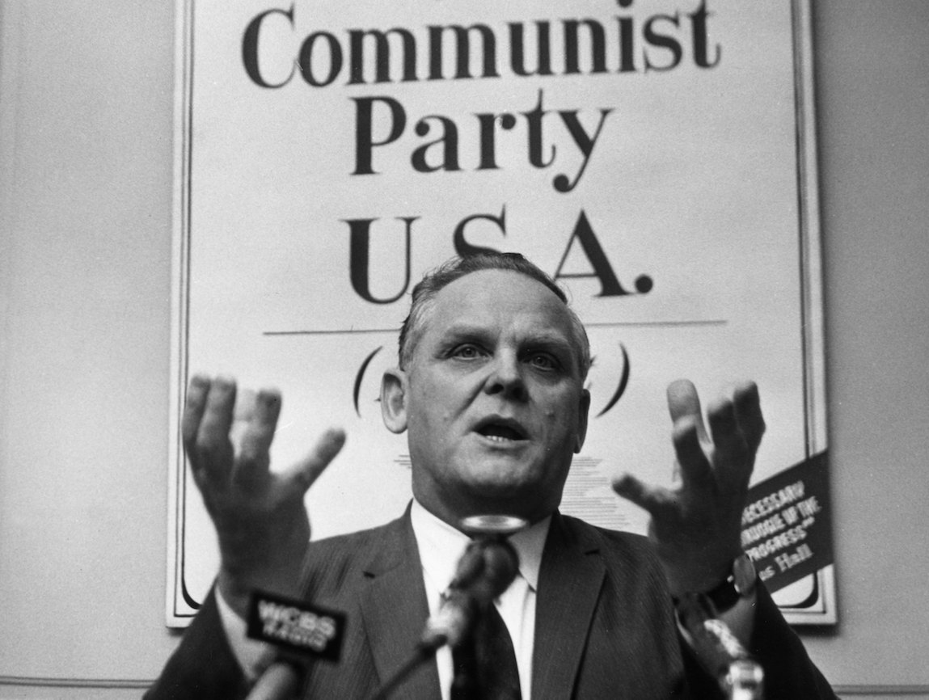
Maoism: Two Sides of One Coin
From Comrade Gus Hall’s “Opportunism: The Destructive Germ”
If the political and ideological antibodies are not on the job, opportunism takes qualitative leaps and very quickly reaches the point where it turns into complete capitulation and betrayal of working-class interests. However, even when opportunism reaches the level of betrayal, because it is unprincipled it still tries to operate behind a smokescreen of radical and even revolutionary cliches. Maoism is a most clear-cut showcase of opportunism, including its ugly, final decaying stage, in which opportunism and social chauvinism have become fully developed and have formed an alliance with imperialism. Maoism has become “overripe for its open, vulgar alliance with the bourgeoisie and the general staff."
The military aggression against the people of Vietnam by China is a classic example of the end result of bourgeois nationalism and opportunism when they go unchallenged.

Slide 39
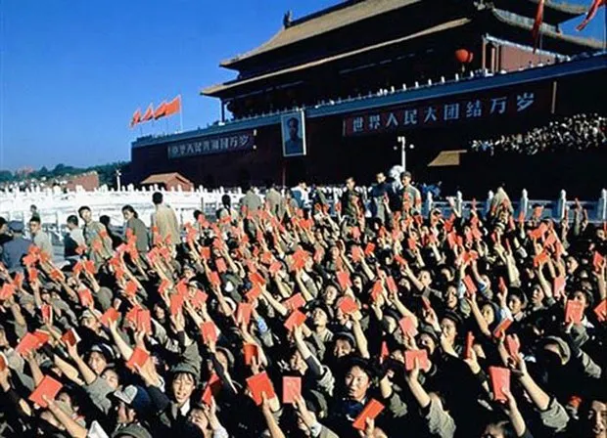
Maoism: Two Sides of One Coin
From Comrade Gus Hall’s “Opportunism: The Destructive Germ”
From the day it took root in the Communist Party of China, Maoism has been, in its basic essence, anti-working class. Maoism is a mixture of petty-bourgeois radical empty-headedness, the backward mentality of the feudal warlords, the arrogant nationalism of the capitalist class—all wrapped up and held together with the glue of opportunism. It has trained a leading cadre of imperialist-oriented, unprincipled opportunists.
China's military aggression is anti-working class, anti-socialist and anti-national liberation. This criminal attack should provoke second thoughts among many forces within the world revolutionary process. The leaders, including Communist leaders, who have for opportunistic reasons encouraged and fed Maoism must in all honesty take a second, hard look at what they have contributed, directly or indirectly, to the present criminal acts of Maoism. Without the opportunistic encouragement by forces within the world revolutionary process Maoism would most likely not have reached its present ugly stage.
Cadets holding Mao’s little Red Book. Mao himself reportedly liked the books’ resemblance to books of quotations by philosophers such as Confucius.

Slide 40
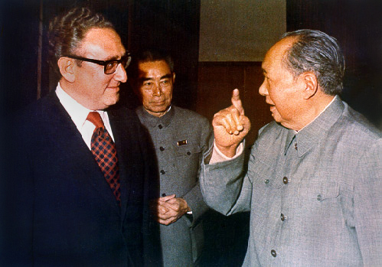
Maoism: Two Sides of One Coin
From Comrade Gus Hall’s “Opportunism: The Destructive Germ”
The opportunistic fig leaves that "Maoism is China’s internal affair," or "We should not criticize other parties," or "We treat each Party equally, in the same manner" have been blown away. If we are to learn anything we must draw the lesson that not to fight opportunism within the ranks of the forces of the world revolutionary process is itself opportunism and can only lead to serious setbacks.
Maoism is also proof of how the Right and “Left” varieties of opportunism are, in fact, two sides of one coin. Until a few years ago Maoism covered itself with the most Left radical and revolutionary words and phrases of any in the world. They accused everybody of being soft and prettifying U.S. imperialism. Trade with the U.S. was “betrayal.” Agreement to stop atmospheric A-bomb testing was “being a dupe of U.S. imperialism.” Calling for a coalition against the monopolies was “reformism”, etc. It was always obvious that this was a phony cover for opportunism. So without stopping to take a breath Maoism switched and became the real prettifier of U.S. imperialism. The switch was easy because it was only a change of covers.
United States National Security Advisor Henry Kissinger and Chairman of the Chinese Communist Party Mao Zedong, with Chinese Premier Zhou Enlai behind them in Beijing, early 70s.

Slide 41
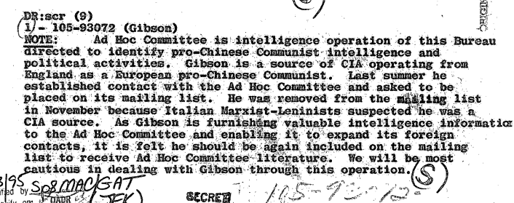
FBI created and infiltrated Ad Hoc Committee for Scientific Socialism hails Maoism
from Hsinhua News (now known as Xinhua News) - 1967
Peking, August 11 (Hsinhua) – The Ad Hoc Committee for a Marxist-Leninist party of the United States, in a letter congratulating China’s successful explosion of its first hydrogen bomb, saluted the thought of Mao Tse-tung as “Marxism in the era of dying imperialism and of revolution of the oppressed peoples of the earth.”
The letter said that Mao Tse-tung’s thought is “the leading force in the world which combats imperialism and modern day revisionism. Only under such guidance could the great people of China achieve this scientific advancement with such outstanding success.”
The letter also praised the Communist Party of China for its stalwart and steadfast defense of the Arab nations in the struggle against Israel, tool of U.S. imperialism. “The complicity of the Soviet and U.S. governments in their underhanded plots was never more clear to the world. Once again China stands in the forefront of the oppressed peoples’ struggles,” the letter said.
The letter pointed out in conclusion that in the heartland of world imperialism – the United States, the oppressed workers “join in the struggles of the oppressed peoples of the world and that the revolutionary winds of the world’s oppressed will bring to death the reactionary evil designs of world imperialism.”
Declassified FBI document admitting that the Maoist Ad Hoc Committee for Scientific Socialism was a creation of the FBI
Retrieved from: https://www.archives.gov/files/research/jfk/releases/docid-32339279.pdf

Slide 42
Discussion & Wrap Up

Slide 43
Announcements
PCUSA Cell Chairs need to call members of their cells to remind them about attendance.
The next issue of New Masses (2026) has begun production. If you have art you want us to feature, email it to info@partyofcommunistsusa.net.

Slide 44
Volunteers Needed!
We are in need of volunteers for the staff of the People’s School! Here’s a few roles we need filled:
People to help manage posting on our social media and podcast platforms
Video Editors, Audio Editors, Graphic Designers, Artists, Narrators
Web Controls, Moderators
Email info@peoplesschool.us if you’re interested and try to attend our next staff meeting if possible.

Slide 45

View From Left Field
https://viewfromleftfield.libsyn.com
The Old PSMLS Youtube is now the Youtube of View From Left Field, a podcast of analysis and discussion of current events from a progressive perspective.
Like the Youtube videos and subscribe with 5 star ratings on your podcast platforms.

Slide 46

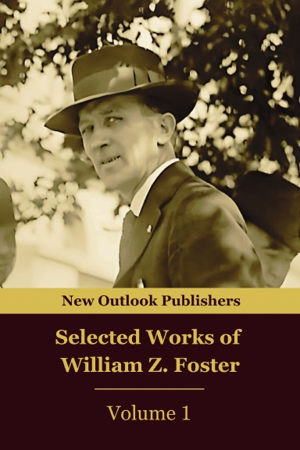

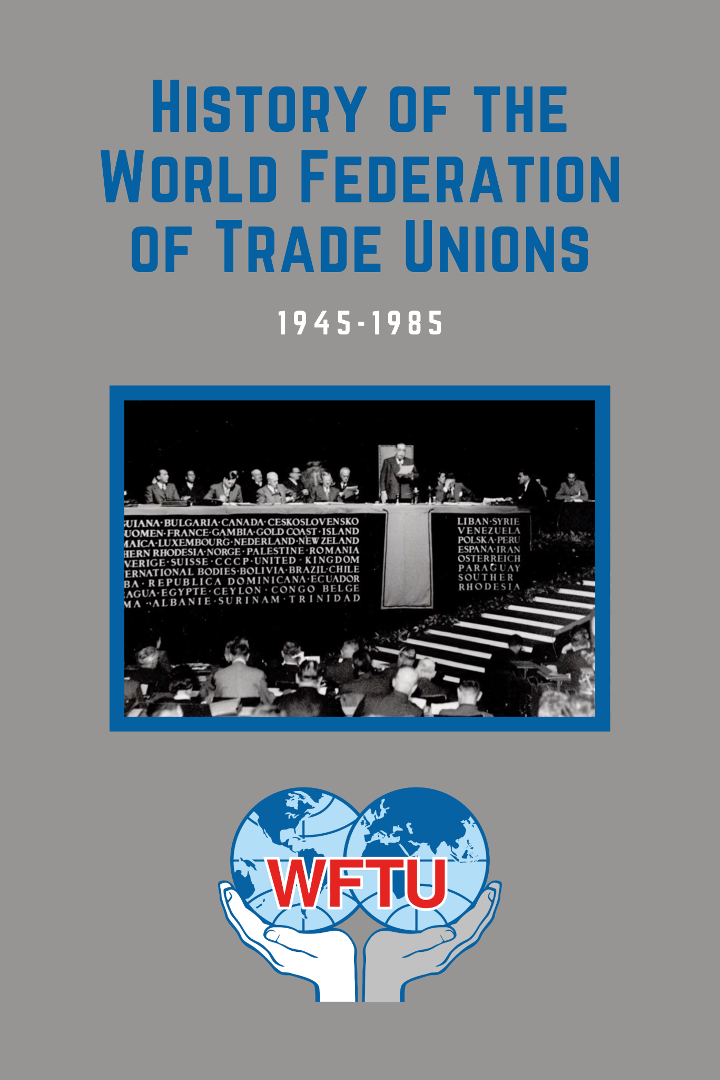

New Outlook Publishers
newoutlookpublishers.store
Relevant and Latest Releases

Slide 47


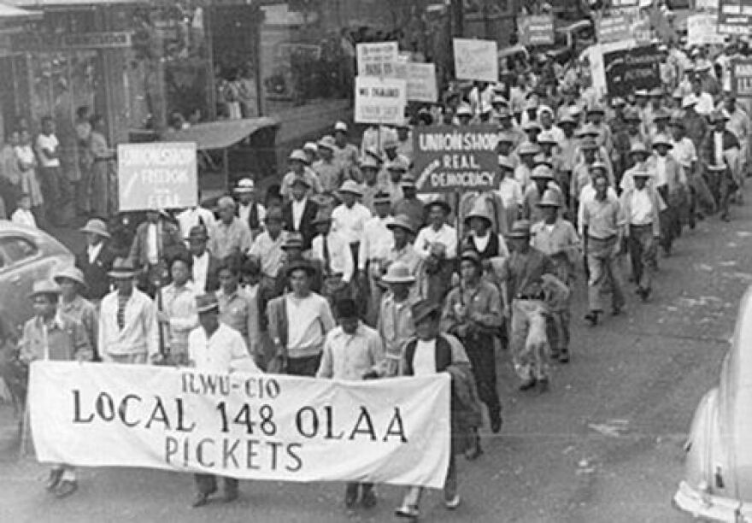
Harry Bridges School of Labor
luel.us/laborschool/
The Harry Bridges School of Labor is a monthly class covering a variety of topics aimed at building class consciousness among union members.

Slide 48


Slide 49
Discussion

