Slide 1

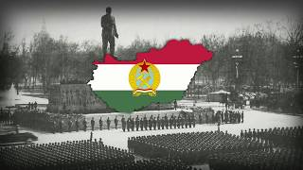
“A felszabadulás dala”(A Song of Liberation) - Written by Erno Rossa

Slide 2
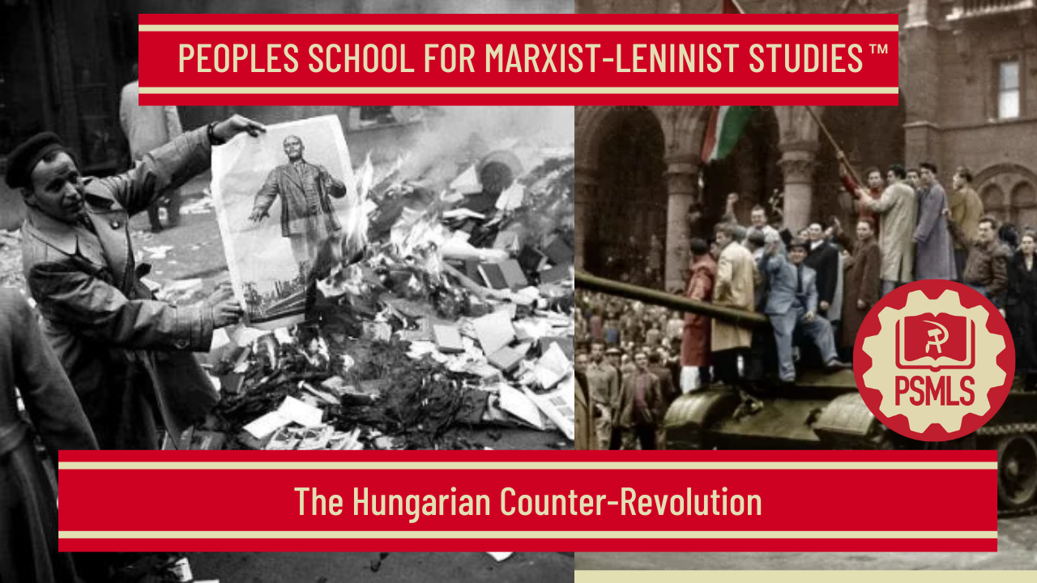
PSMLS 10/28/25

Slide 3
What we’ll be learning today:
Note on effects of Secret Speech
Background of Hungarian history and conditions that led to the counter-revolution
The events of the 1956 Counter-Revolution
How western imperialists conduct counter-revolution, examples in the modern day

Slide 4
A Note on the so-called Secret Speech and its role in creating chaos in the Communist Movement

Slide 5
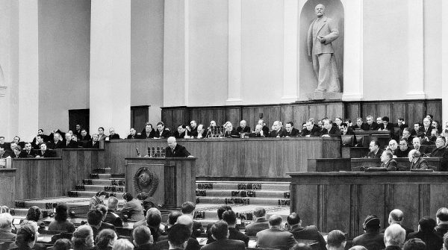
During the 20th Congress of the CPSU, in February 1956, General Secretary Nikita Khrushchev made the speech that would later be known as the “Secret Speech.” This speech had disastrous effects for the International Communist movement and provided ammunition to the enemies of Communism which have made and still made copious use of.
To be sure, Khrushchev, despite the damage he caused, did put down the counter-revolutionary attempts by fascist and monarchist forces of the same year in Poland and Hungary as we will see in this class. Not only did Khrushchev put a stop to counter-revolution, but during his tenure, he contributed to the expansion of socialism in countries such as Cuba, Mozambique, and Angola. These contributions cannot be forgotten and Khrushchev cannot be characterized the executioner of the Soviet Union.
That being said, his “Secret Speech,” whose effects deserve a class of their own, caused irreparable damage that led to divisions in the International Communist Movement.
Khrushchev addressing 20th Congress of CPSU

Slide 6
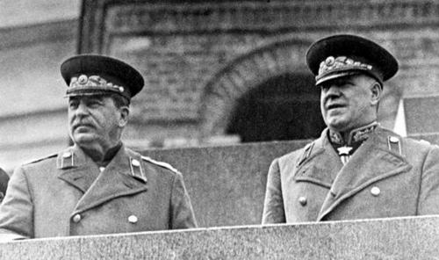
The speech over-emphasized alleged mistakes under Stalin’s leadership and de-emphasized all the massive accomplishments made by Stalin, the rapid industrialization of the Soviet Union; the defeat of fascism in Europe; the protection of Jewish, Romani, and other minority groups against the Nazi extermination efforts; the expansion of socialism to Eastern and Central Europe as well as in China and North Korea; and many other accomplishments.
The speech provided credence to and downplayed the counter-revolutionary activities by the enemies of socialism such as Laszlo Rajk who conspired with ex-Horthy forces to undermine the Hungarian Peoples Democracy in 1949 as well as the Trotsky-Bukharin-Zinoviev bloc whose subversion included sabotage of munitions factories in the face of Nazi aggression.
As we present the class tonight, it must be understood that after the 20th Congress, all Communist sources adopted the same line created by Khrushchev. Stalin, having passed 3 years prior, and leaders such as Matyas Rakosi, Erno Gero, and others who supported Stalin’s leadership being forced to resign from the Hungarian Working Peoples Party (the Marxist-Leninist party of Hungary), there was no-one to defend their line. Thus, all the works we draw from tonight, are tainted in various degrees. The analyses of the Hungarian Counter-Revolution of 1956 and the reactionary forces that perpetrated it are correct. Attendees should note that some of the authors over-exaggerate the disparity between the development of heavy industries and the light consumer product industries.
Comrade Stalin and Comrade Field Marshall Zhukov at Red Square

Slide 7
In 1956, thousands of Communist Party members around the world, including the CPUSA, left the Communist movement out of distrust sowed by the speech.
As we present the class tonight, it must be understood that after the 20th Congress, all Communist sources adopted the same line created by Khrushchev. Stalin, having passed 3 years prior, and leaders such as Matyas Rakosi, Erno Gero, and others who supported Stalin’s leadership being forced to resign from the Hungarian Working Peoples Party (the Marxist-Leninist party of Hungary), there was no-one to defend their line. Thus, all the works we draw from tonight, are tainted in various degrees.
The analyses of the Hungarian Counter-Revolution of 1956 and the reactionary forces that perpetrated it are generally correct.
However, attendees should note that some of the authors over-exaggerate the disparity between the development of heavy industries and the light consumer product industries. The same authors also over-exaggerate the “lack of party democracy” and the “need to democratize.” These analyses opened up the door to divisions.
In 1956, thousands of Communist Party members around the world, including the CPUSA, left the Communist movement out of distrust sowed by the speech.
As we present the class tonight, it must be understood that after the 20th Congress, all Communist sources adopted the same line created by Khrushchev. Stalin, having passed 3 years prior, and leaders such as Matyas Rakosi, Erno Gero, and others who supported Stalin’s leadership being forced to resign from the Hungarian Working Peoples Party (the Marxist-Leninist party of Hungary), there was no-one to defend their line. Thus, all the works we draw from tonight, are tainted in various degrees. The analyses of the Hungarian Counter-Revolution of 1956 and the reactionary forces that perpetrated it are correct. Attendees should note that some of the authors over-exaggerate the disparity between the development of heavy industries and the light consumer product industries.

Slide 8
Background & Conditions that led to 1956 Counter-Revolution

Slide 9
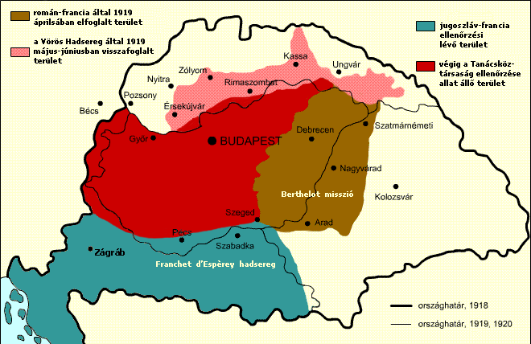
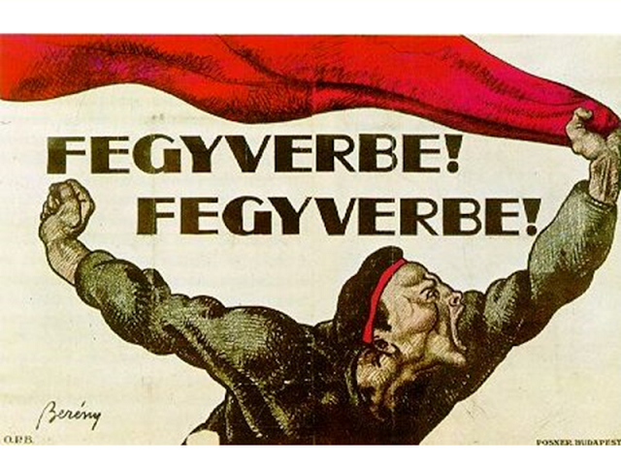
Hungarian Socialist Revolution of 1919
Post WWI a wave of socialist revolutions occurred across Europe (Russia, Germany, Finland, Hungary).
Hungary became a Socialist Republic for 133 days under Bela Kun and the Hungarian Red Army. Held immense support amongst industrial proletariat, little in the countryside.
French, Romanian, Yugoslav, Czechoslovak intervention to defeat the Hungarian Soviet Republic. Led to defeat of Red Hungary and the rise of Miklos Horthy & the White Terror.

Slide 10
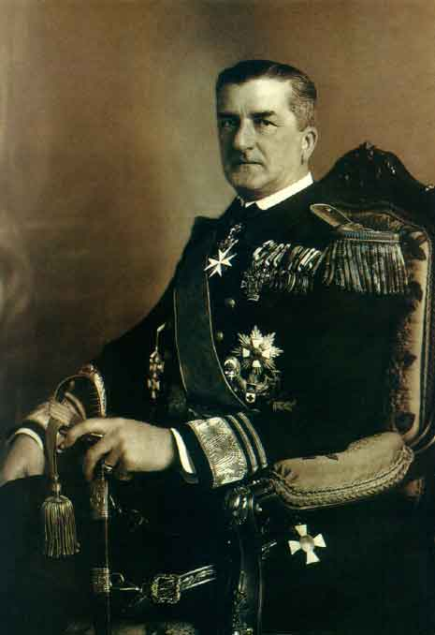

White Terror & Horthy Regime
Horthy: The Franco of Hungary
Miklos Horthy was a Hungarian admiral who led counter revolutionary forces during the Hungarian Revolution. Came to power through the defeat of the Hungarian Soviet Republic. Propped up by the Entente.
Horthy’s White terror imprisoned tens of thousands and murdered thousands. Banned all communist & workers parties, trade unions, mass organizations. Established a fake “parliament” with only rightist parties allowed. Similar to Finland in the interwar period.
State backed anti-semitism, no Jews were allowed in universities or government positions. Hungarian nationalism & anti-semitism paved the way for the Holocaust of Hungarian Jews during WWII.

Slide 11
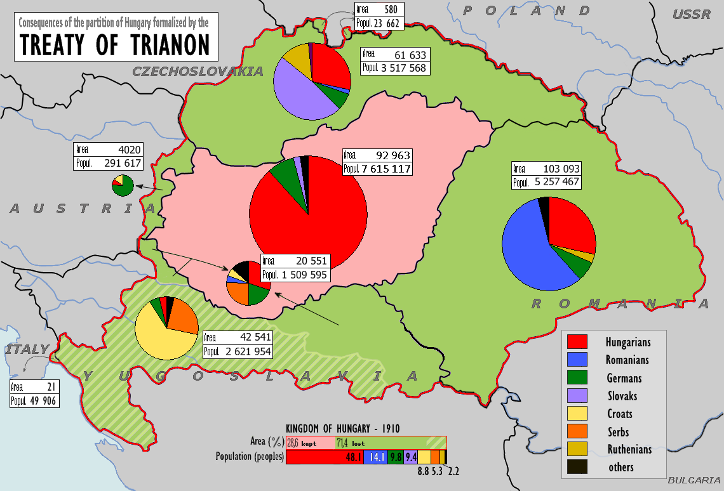
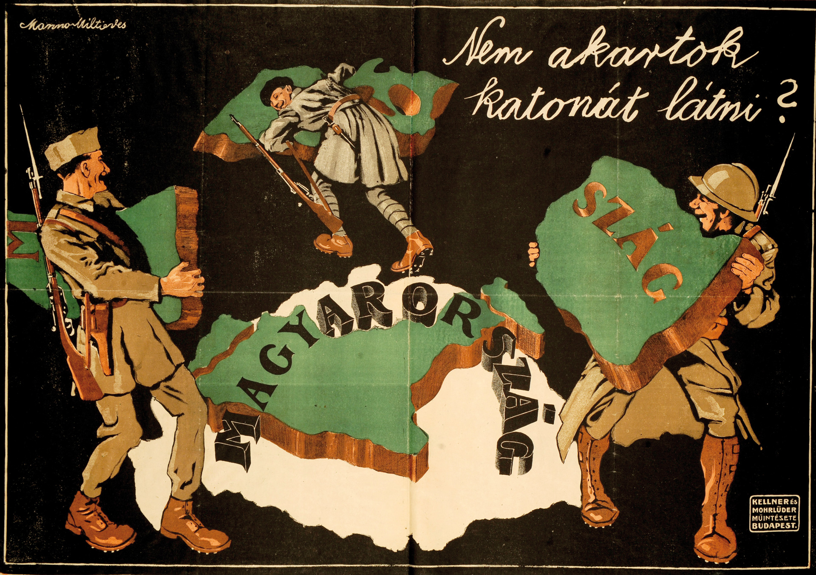
The Interwar Period
Hungary During the Interwar:
The Treaty of Trianon led to Hungary losing ⅓ of its entire population and intense revanchism in Hungary, similar to Germany during the interwar period.
Semi-feudal conditions in the countryside. Vast majority of the population were peasants who owned less than 8.25% 0f all land in Hungary. A collection of 400 magnate families & the Catholic Church owned most of the land in Hungary.
Government of the estate owners of the Esterhazy-Karolyi class. Less than 30% of Hungarians were allowed to vote. Hungarian ruling class even opposed industrial capitalism. Weak capitalist class, most industry and financed were foreign owned.
Close connections with Fascist Italy and Nazi Germany.

Slide 12
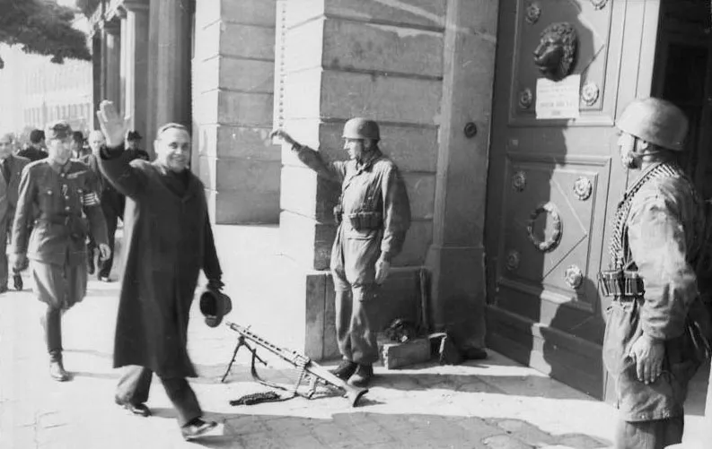
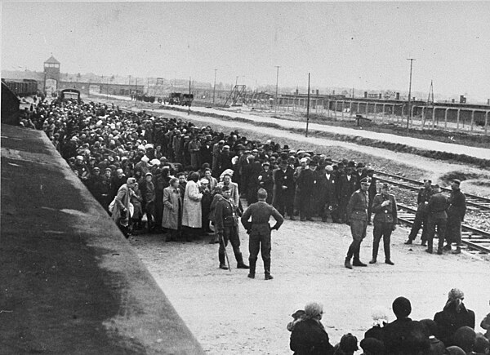
Hungary during WWII
Hungary joined the Anti-Comintern Pact (The Axis) in 1940. Helped Germany invade the USSR in 1941 with Operation Barbarossa.
Hungarian Armies committed horrific war crimes in the USSR alongside the Germans. The Hungarian Second Army was wiped out in the Battle of Stalingrad.
Horthy sabotaged resistance efforts to switch sides with constant anti-Sovietism. Nazi coup occurred in 1944 Hungary leading the Arrow Cross Party to rise to power.
564,000 Hungarian Jews were deported and killed as a result of the Holocaust in Hungary.
The Soviets liberated Hungary in 1945 and established a provisional government (not a communist one).

Slide 13
Effects of Khrushchev's Secret Speech
Anti-Stalinism in Herbert Aptheker’s work
Khrushchev's infamous Secret Speech which was delivered at the 20th Congress of the CPSU denounces Stalin as a “cult of personality” and paints him as an oppressive tyrant who murdered thousands of innocent people through purges. Khrushchev likely did this to discredit other party members loyal to Stalin, like Molotov, Malenkov and Kaganovich.
The speech was a huge blow to the Communist movement worldwide, leading many to abandon the cause or engage in anti-Stalin revisionism. It should be noted that even many western historians were skeptical about Khrushchev's efforts to lay all the blame on Stalin. The speech also fails to explain how the Soviet Union remained progressive and democratic all throughout Stalin’s time as Premier if he was supposedly a tyrant.
Unfortunately, Aptheker adopted this anti-Stalinist view, writing that “it is clear and admitted now by all that the USSR itself, under the leadership of Joseph Stalin, practiced bullying tactics which were often contemptuous of the national feelings of the fraternal, but weaker, states seeking to build socialism.”
This bias should be kept in mind when interpreting his work.

Slide 14
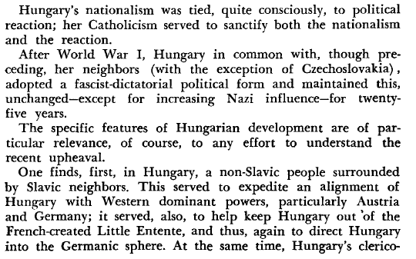
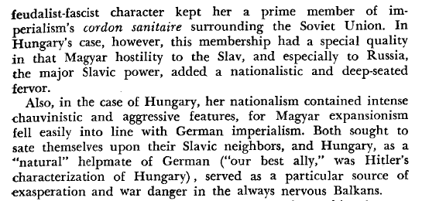
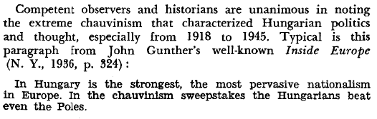
Hungarian Nationalism
Hungarian nationalism was deeply ingrained in the monarchy and church. From the 1830s, language laws required voters, lawyers and priests to be fluent in Hungarian. These laws discriminated against Slavic and Romanian minorities. Jewish people were barred from holding any sort of political position. By the 1900s, anti-Semitism was a deep, pervasive idea held among all classes and segments of Hungarian society.
During the rise of the Austro-Hungarian Empire, Hungarians sought Magyar national power over the ethnic minorities instead of full political independence. The Croats, Serbs, Slovaks and Romanians were minorities, but in combination they nearly equalled the number of ethnic Magyars.
The Roman Catholic church was an integral part of the ruling class. In property, politics and ideology it was identical with and a bulwark of the clerical feudalist fascist regimes which ruled over Hungary for a thousand years.

Slide 15
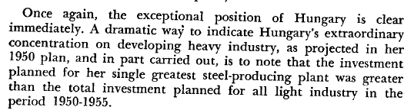

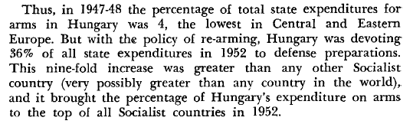
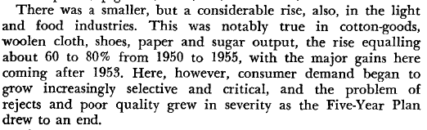
Note on Apthekar’s View of Heavy Industry
The transition to socialism in Hungary was faced with much opposition from the ruling class. Hungary was deeply entrenched in feudalism and not as industrialized as other European countries. Socialist reforms such as land redistribution, construction of public facilities and industrialization greatly improved the lives of many Hungarians.
In the following slide, Apthekar claims that citizens who were previously living with next to nothing apparently grew impatient when they didn’t receive enough provisions due to the focus on industrial development and agricultural production remaining at pre-war levels.
This is telling of his bias, aligning with Khrushchev's view that Stalin overemphasized heavy industry and that socialist countries should focus on small commodity production.

Slide 16
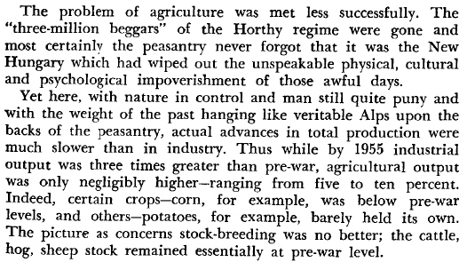
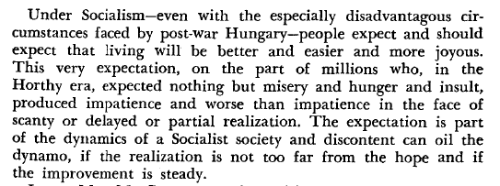
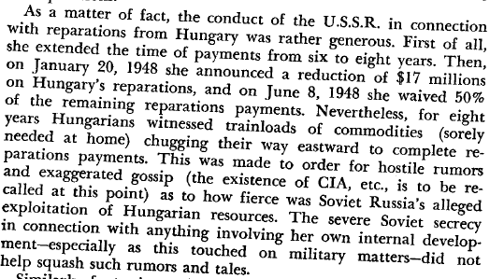
Problems with Socialist Reforms cont.

Slide 17
Importation of Fascists to the US
Committee for a Free Europe (1949) & the Lodge Act (1950)
The Committee for a Free Europe was an anti-communist CIA front organization. It was funded by corporations such as Standard Oil, US Steel and Ford Motor Company. Related to it was Radio Free Europe and the Free Europe Press. This front utilized political exiles to establish psychological warfare techniques to be used against the Soviet Union and its satellites.
Defection was encouraged and defectors rewarded to engage in propaganda and infiltration as well as to return to their native lands as “sleeper” leaders for future crises. Many of the members were reactionaries and conducted acts of terrorism and violence. The influence of these groups was directly linked to the 1956 uprising. Ferenc Nagy, former prime minister of Hungary, was one such asylum seeker who was intended to be a “sleeper” leader for Hungary had the attempted revolution succeeded.
The Lodge Act provided for the recruitment of an anti-communist “Foreign Legion” selected from defectors of Soviet countries. These men received “specialized” training and after 5 years in the US army, rewarded with citizenship.

Slide 18
Discussion

Slide 19
The Hungarian Counter-Revolution

Slide 20
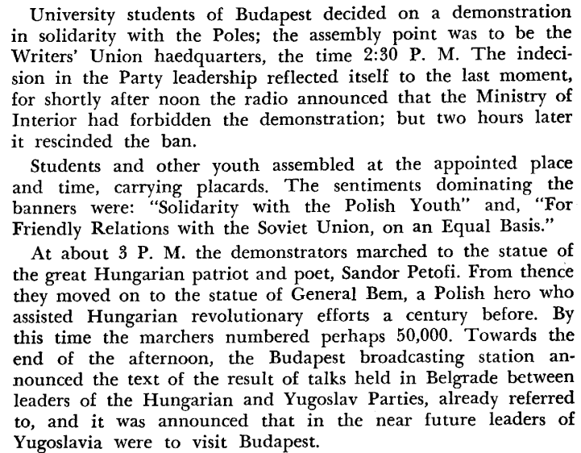
Hungarian Students Inspired by Polish Counter-revolution Attempt

Slide 21
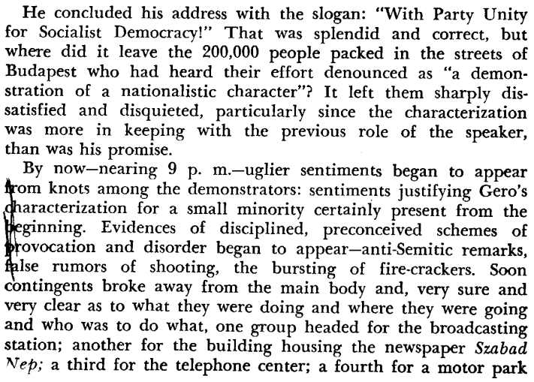
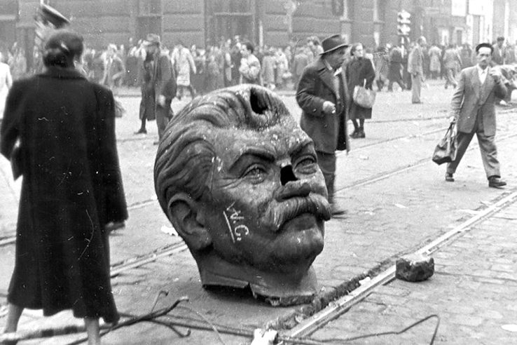
October 23, 1956
Toppled statue of Joseph Stalin
Budapest, Hungary
October 23, 1956

Slide 22
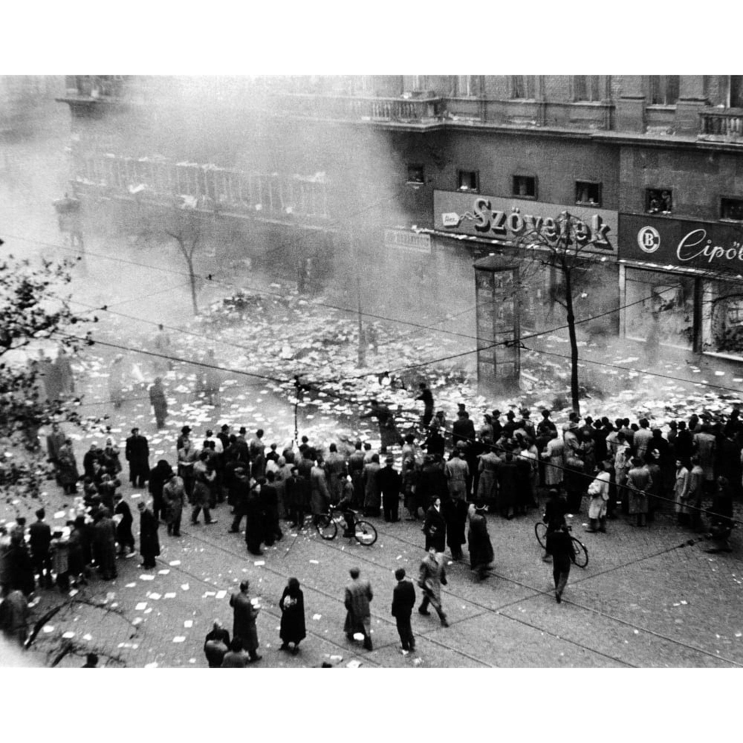
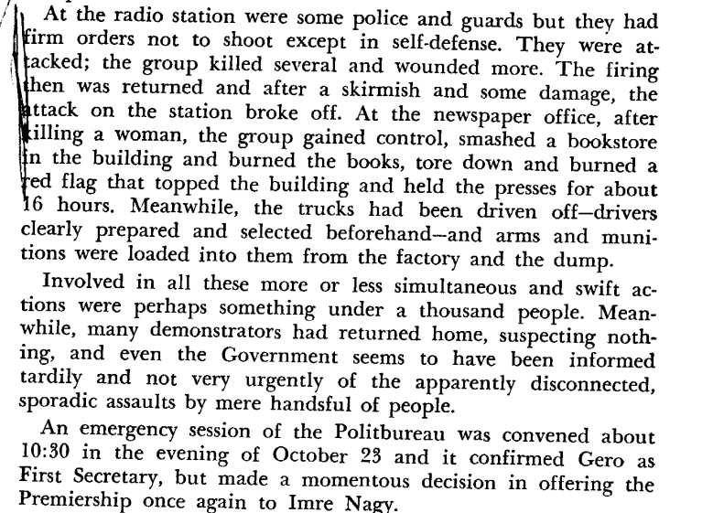
Protesters destroy Budapest Bookstore and Marxist-Leninist Literature

Slide 23
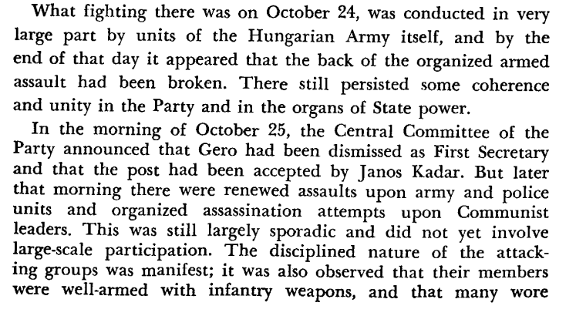
October 24 and 25

Slide 24
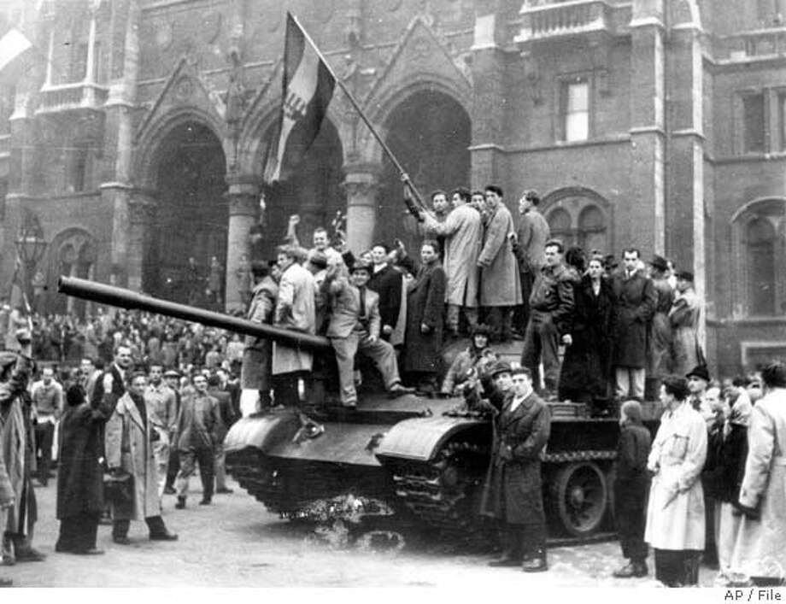
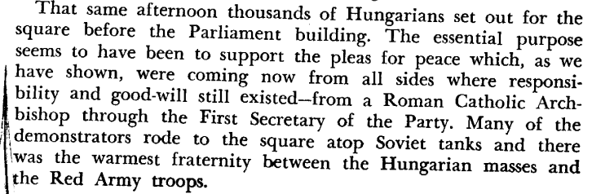
Demonstrators join in fraternity with the Soviet Union after attacks by fascist attacks

Slide 25
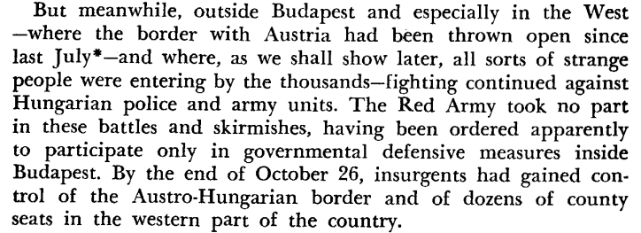
October 26

Slide 26
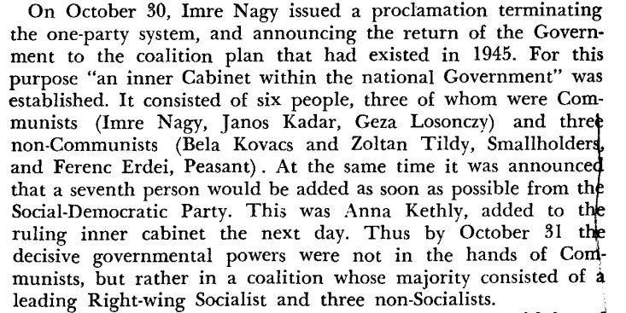
October 30

Slide 27
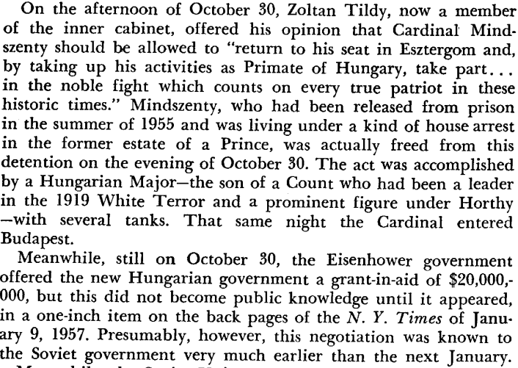
October 30 - Release of Cardinal Mindszenty

Slide 28
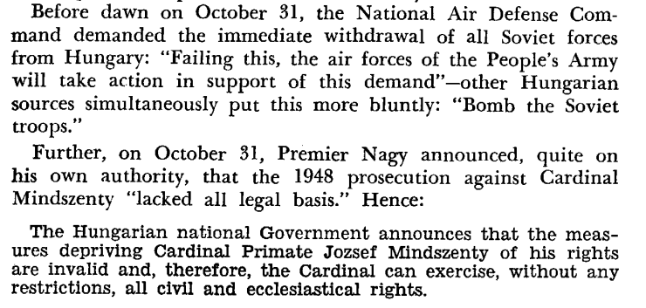
October 31

Slide 29
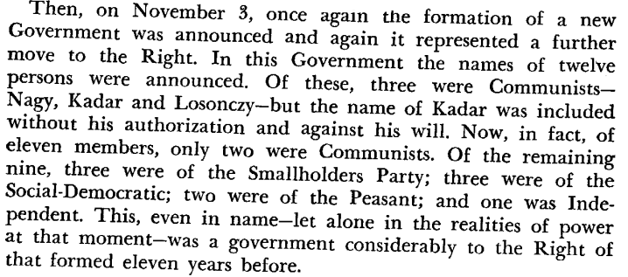
November 3

Slide 30
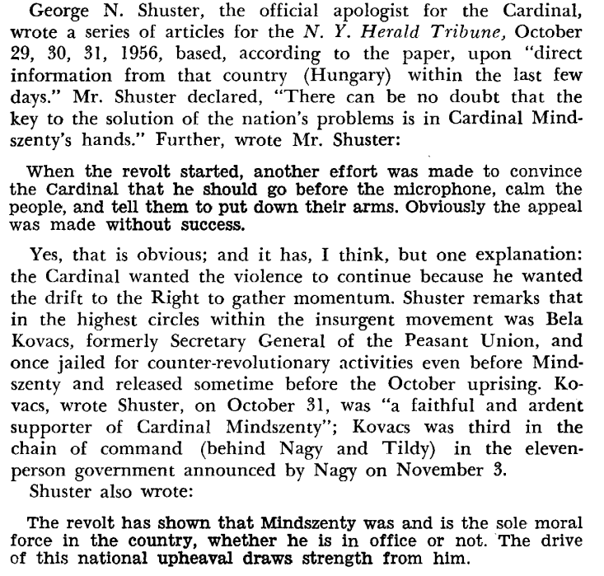
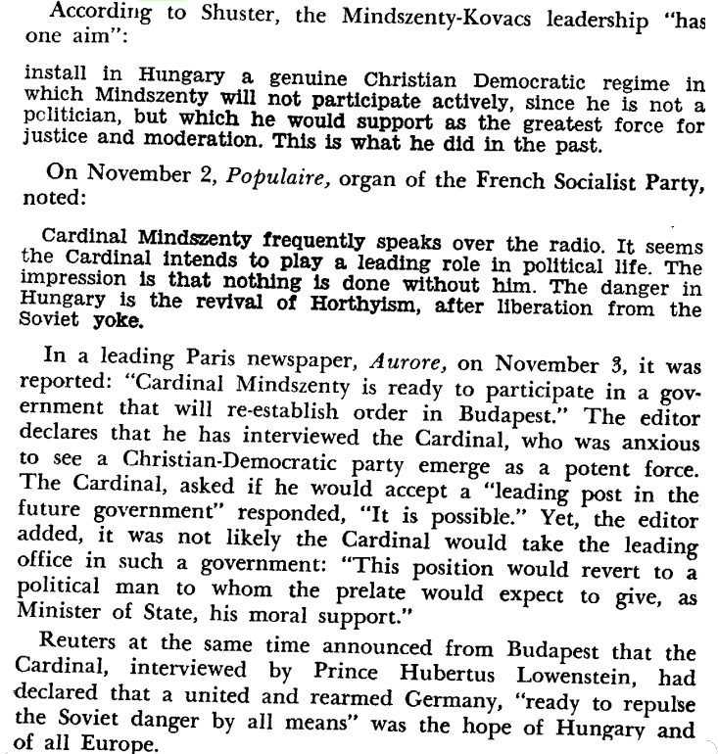
The US and Europe planned for Cardinal Mindszenty to take over Hungary

Slide 31
The CIA and U.S. Security State Involvement in the Counter-Revolution
The CIA and the U.S. Government claim that they had no involvement in the Hungarian Counter-revolution and despite the track record of U.S. imperialism, they were largely successful in spreading this falsehood far and wide. Without evidence to prove otherwise, many who would normally be expected to see through this propaganda were inclined to parrot the talking points of the U.S. Empire ie. that the Soviet government was solely to blame for the violent rebellion that occurred in Hungary in 1956. The CIA claimed vehemently that they had no fore-knowledge or participation in the so called “uprising.”
A public report released by the CIA in 1958 on the subject claims "This breath-taking and undreamed-of state of affairs not only caught many Hungarians off-guard, it also caught us off-guard, for which we can hardly be blamed since we had no inside information, little outside information, and could not read the Russians' minds."
They further claim that the U.S. security state could not have played a part in the counter-revolution because "Small psychological warfare and paramilitary units came into being in the early 1950s, (including the Hungarian National Council headed by Bela Varga), and occasional reconnaissance missions took place at that time, (but) the prospects for penetrating into Hungary deteriorated by 1953 when stepped up controls by Hungarian security forces and `the meager talent available' among potential agents made cross-border operations essentially untenable."

Slide 32
The CIA and U.S. Security State Involvment in the Counter-Revolution
The first publicly available evidence that the CIA’s preferred narrative was in fact a pack of lies, came in the form of the book “Legacy of Ashes: The History of the CIA” by Tim Weiner. Published in 2007, the book purports to be a “hidden history of the CIA.” The book is based on more than 50’000 documents taken mostly from the CIA archives, and contains many revelations about formerly secret CIA programs. We learn from this book that in fact the CIA was extremely interested in fomenting unrest in Hungary in general, and directly involved with escalating the conflict to open violence. From the book (p. 129 -130):
“On October 28 (1956), Wisner (a founding member of the CIA and Deputy Director) flew to Paris and convened a few trusted members of an American delegation attending a NATO conference on the question of Eastern Europe. Its members included Bill Griffith, the senior policy adviser at Radio Free Europe's Munich headquarters. Wisner, exultant at a real revolt against communism in the making, pushed Griffith to pump up the propaganda. His exhortations produced a memo from Radio Free Europe's director in New York to the Hungarian staff in Munich: "All restraints have gone off," it read. "No holds barred. Repeat: no holds barred." Beginning that evening, Radio Free Europe urged the citizens of Hungary to sabotage railroads, tear down telephone lines, arm the partisans, blow up tanks, and fight the Soviets to the death. "This is RFE, the Voice of Free Hungary," the radio announced. "In the case of a tank attack, all the light weapons should open fire at the gun sights." Listeners were advised to throw "a Molotov cocktail... a wine bottle of one liter filled with gasoline … on the grated ventilation slit over the engine." The sign-off was "Freedom or Death!"

Slide 33
The CIA and U.S. Security State Involvment in the Counter-Revolution
“That night, Imre Nagy, a former prime minister who had been expelled from the Communist Party by hardliners, went on the state radio station to denounce the "terrible mistakes and crimes of these past ten years." He said that Russian troops would leave Budapest, that the old state security forces would be dissolved, and that a "new government, relying on the people's power," would fight for democratic self-rule. In seventy-two hours, Nagy would form a working coalition government, abolish one-party rule, break with Moscow, declare Hungary a neutral country, and turn to the United Nations and the United States for help. But as Nagy took power and sought to dismantle Soviet control over Hungary, Allen Dulles deemed him a failure. He told the president that the Vatican's man in Hungary, Cardinal Mindszenty, newly released from house arrest, could and should lead the nation. That became the party line on Radio Free Europe: "A reborn Hungary, and the appointed leader sent by God, have met each other in these hours." The CIA's radios falsely accused Nagy of inviting Soviet troops into Budapest. They attacked him as a traitor, a liar, a murderer. He once had been a communist and so he was forever damned. Three new CIA frequencies were on the air at this hour. From Frankfurt, exiled Russian Solidarists said an army of freedom fighters was heading for the Hungarian border. From Vienna, the CIA amplified the low-wattage broadcasts of Hungarian partisans and beamed them back to Budapest. From Athens, the CIA's psychological warriors suggested that the Russians be sent to the gallows.”

Slide 34
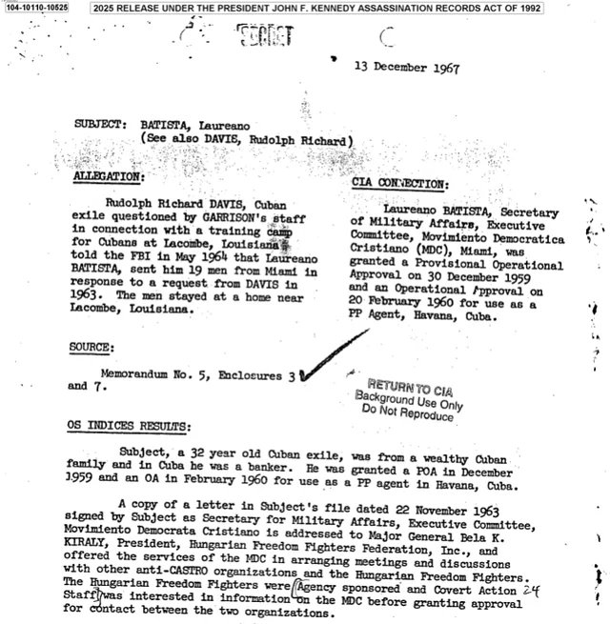
The CIA and U.S. Security State Involvement in the Counter-Revolution
Further documentation released in 2025 under the JFK Assassination Records Act of 1992 paints an even more damning picture of U.S. clandistine involvement in the lead-up to the supposed “uprising.” The document to the right contains evidence that the CIA was actively supporting and perhaps even giving orders to the “Hungarian Freedom Fighters” who would later go on to form an important part of the counter-revolution.

Slide 35
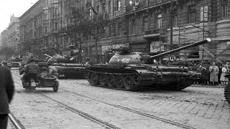
Last broadcast of Free Hungarian Radio before Soviet Intervention

Slide 36
Discussion & New Members Introductions

Slide 37
New Member Introductions
What is your name, pronouns and state (or country/territory)?
Where do you work? Is it unionized?
How did you find out about the People’s School?
What do you think about tonight's class?

Slide 38
Counter-revolution in the Modern Day

Slide 39
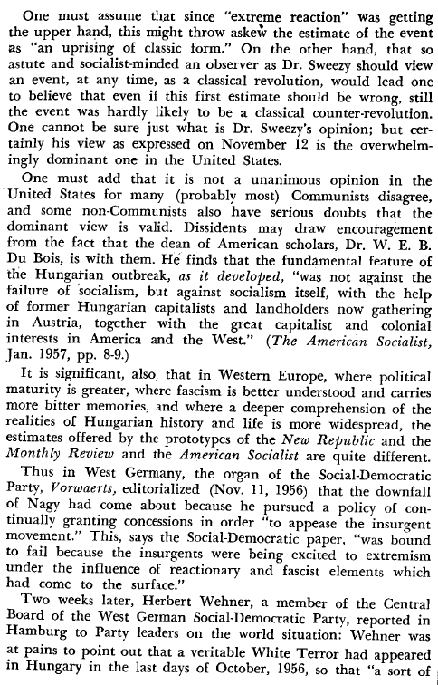
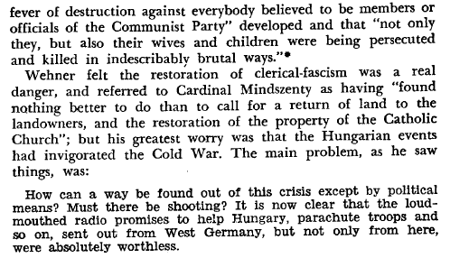
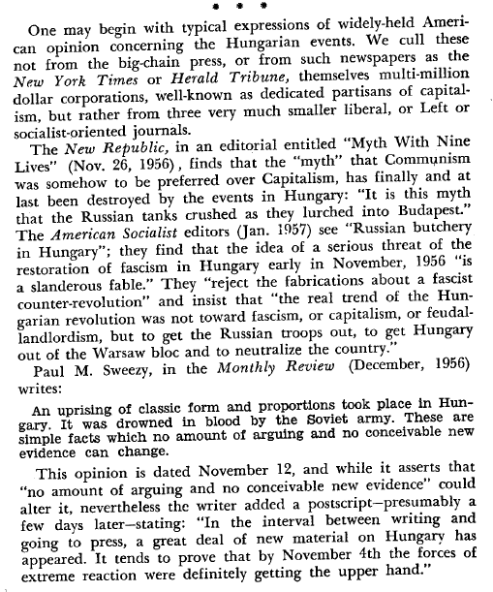
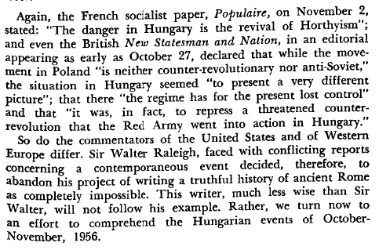
Portrayal of Hungary in the US vs Europe

Slide 40
Color Revolutions
It’s fair to say the 56 Hungarian counter-revolution was an example of what is known today as a “color
Revolution”.
The term “color revolution” was coined in the early 21st century to designate at first popular
movements, but later directed at establishing in Eastern Europe regimes favorable to Western so-called
liberal democracies.
These so called “revolutions” did not actually overthrow socialist governments, but mostly capitalist countries not friendly enough to Western imperialism.
The method is always the same: support popular and grievances through the intense use of
internet and foreign NGO’s, and bring to power Western puppets. Often protestors are youth, who are naïve and impressionable whose frustrations are easily manipulated
Often, there are signs that the protests are artificial. Symbols representing monarchy and feudalism inexplicably show up at protests (ex: country’s flag under monarchy).

Slide 41
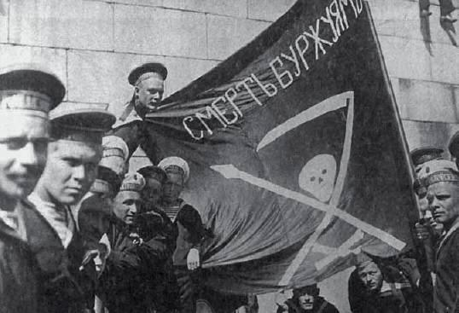
Kronstadt anti-Soviet Uprising 1921
One could say the first color revolutions were the many anti-communist uprisings of the 20th century.
It began in March 1921 at Kronstadt, outside of Petrograd when sailors rebelled against the Soviet
Republic. They reflected the discontent of peasant masses after 4 years of “war communism” at the end of the Civil War. Their slogan was: “Soviet yes, but without the Bolsheviks”. They were fully supported by French British and Russian capitalists, including White Tsarists.
Kronstadt Sailors

Slide 42
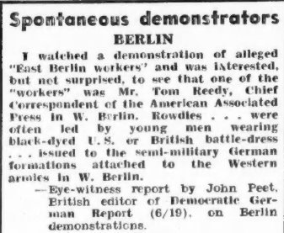
German Democratic Republic Uprisings 1953
In June 1953, shortly after Stalin’s death, a similar revolt happened in East Berlin. While still in the process of rebuilding what was destroyed in WWII, the reactionaries with their backers in Bonn, Washington, and London, took advantage of the death of Comrade Stalin to destroy the German Democratic Republic.
Thanks to rapid Soviet intervention, socialist order was quickly restored. The radio in the American sector of West Berlin had been blasting the news of the first workers going on strike in order to fan the flames of anti-communism in East Germany.
The events of October 1956 in Hungary followed that familiar playbook.
Excerpt from the newspaper National Guardian July 6th, 1953

Slide 43
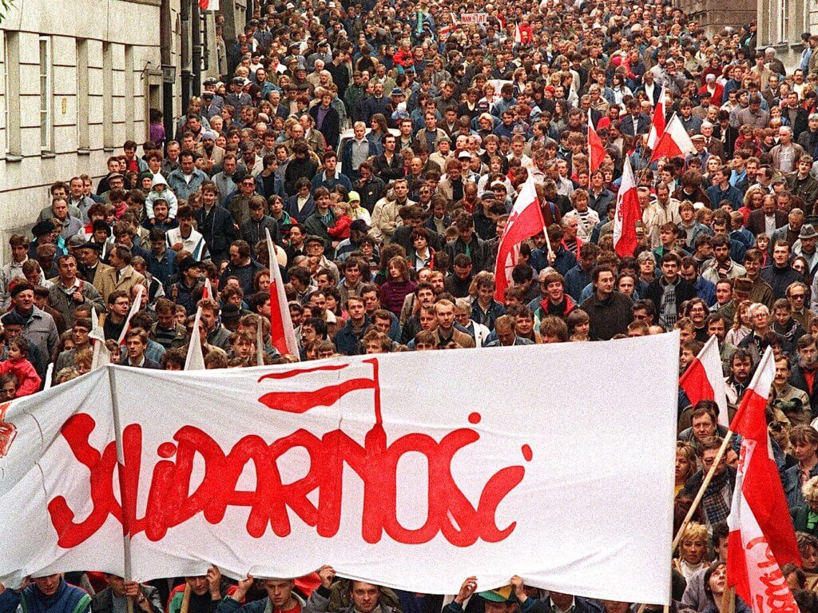
Solidarity Movement - Poland
Once again there was a 12 year gap until the next color revolution. This time it was Poland in 1980 with the Solidarity movement.
In 1978 a new Catholic pope had been elected in Rome, John Paul II born in Poland, a rabid anti-communist. This wasn’t lost on the CIA who saw a great opportunity. In August 1980 a trade union was founded at the Lenin shipyard in Gdansk. Its name was Solidarity, its leader Lech Walesa, also a rabid anti-communist. Solidarity had the CIA’s and the Vatican’s fingerprints all over. Lech Walesa quickly became the poster child of the so-called Free World.
By 1981 Solidarity reached a membership of an incredible 10 millions.
In 1983 Walesa received the Nobel Peace Prize, in passing that same prize awarded in 2009 to Obama, the U.S. president who ordered the most drone strikes, and once said “turns out I’m really good at killing People”. Solidary was instrumental in overthrowing socialism and Walesa became capitalist Poland's first president from 1990 to 1995.

Slide 44
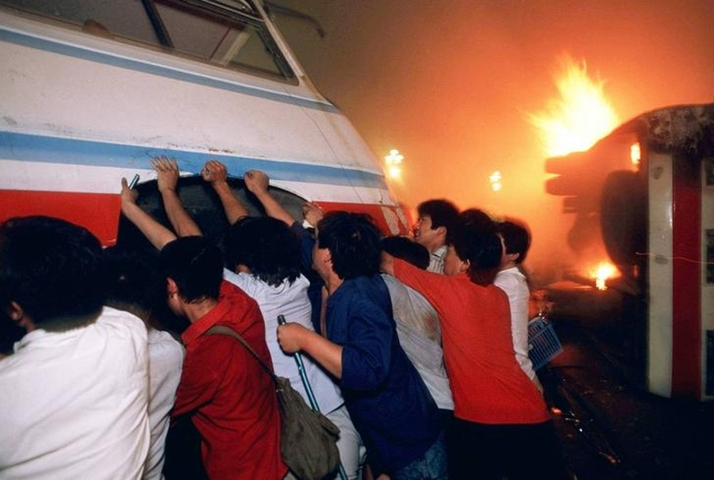
Chinese Color Revolutions
The People’s Republic of China wasn’t spared either by color revolutions.
In June 1989 the Tiananmen Square protests were an attempt to overthrow the Communist Party of China. It must be noted that the so-called “democracy protestors” were marching at the sound of the Internationale. Once again they never openly rejected socialism but pretended to improve it.
The CIA and Western ideologues are expert dialecticians and master wolves who know how to invite the sheep to the dinner table.
In 2019-2020 the West pulled the “Water Revolution” in Hong Kong.
Protests were broadcasted 24/7 in Western media, and protestors didn’t even hesitate to march with
U.S. and U.K. flags.
Protesters burn and flip buses outside Tiananmen Square 1989

Slide 45
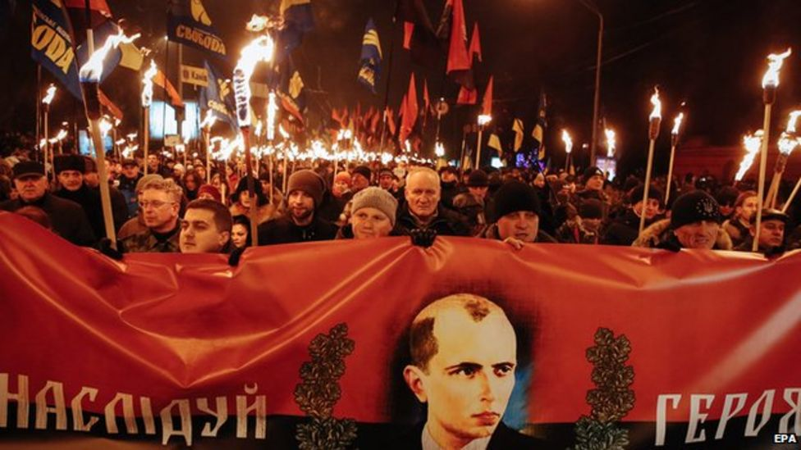
EuroMaidan - Ukraine 2013 and 2015
Of course the most infamous “color revolution” of late was the 2014 Euromaïdan that overthrew a bourgeois government in Kiev, whose mortal sin was to be too friendly with Russia and not friendly enough with EU & NATO. During her envoy to Ukraine in 2014, Victoria Nuland hand-picked herself the new Kiev government at the time, publicly
admitted years later that the U.S. had spent $5B to bring “freedom and democracy” to Ukraine.
Just like all color revolutions from Kronstadt to Budapest, Euromaïdan began with somewhat of a legitimate popular discontent, and was quickly funneled by the West into installing a lapdog puppet régime, this time openly fascist.
Annual Ukrainian march to celebrate Nazi leader Stephan Bandera’s birthday. January 2015.

Slide 46
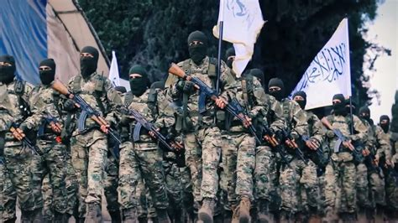
Jihadist takeover of Syria 2024
In December of 2024, the democratically elected Bashar Al-Assad of the secular Baathist party was toppled by American, Israeli, and EU supported Al Qaeda terrorists called the Hay'at Tahrir al-Sham (HTS).
This Fundamentalist-Jihadist terrorist group, with the support of groups like ISIS, have turned Syria into failed state similar to Afghanistan in the 1990s where warlords are constantly at war and where public executions of so-called infidels are the norm
Jihadist HTS fighters, how were they able to afford their equipment?

Slide 47
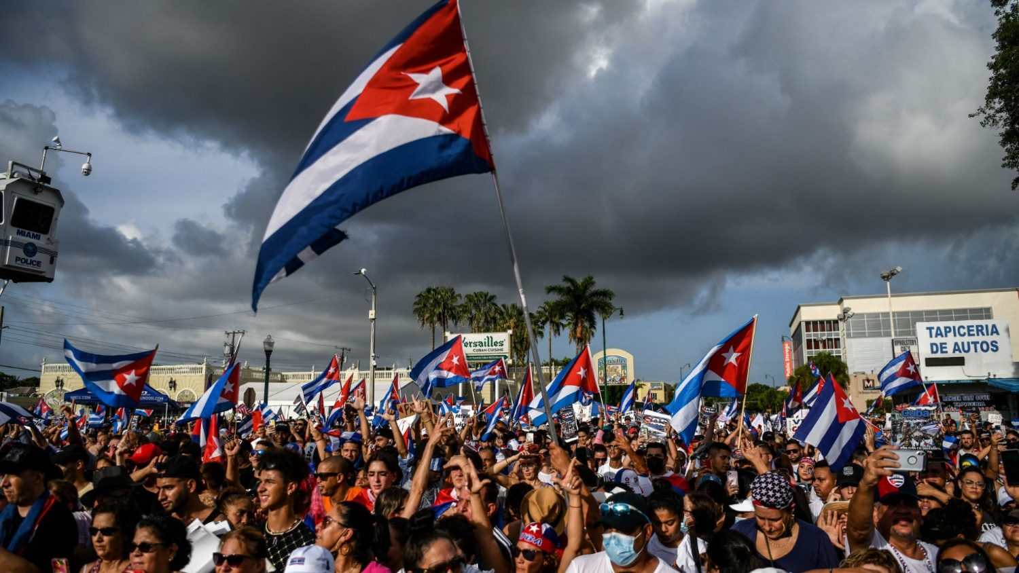
Cuba
In 2021, rumors spread online of protests in Cuba. While some posts showed thousands of protestors, in reality these counter-revolutionary protests were small and images of counter-protests in support of the Cuban government, which were massive, were used in these online posts to mislead people.

Slide 48
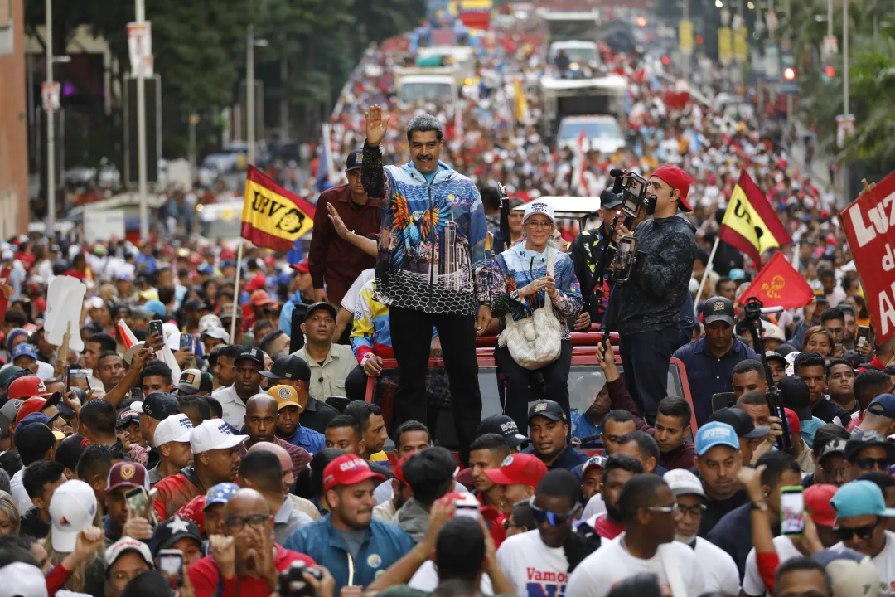
Venezuela Today
Today, American Imperialism has its sights on Venezuela.
Despite the Nicolas Maduro’s electoral win in July 2024, the Trump administration continues to claim the elections were a “sham.”
Trump has ordered the bombings of boats off the coast of Venezuela and is responsible for at least 34 deaths under the false pretense that these boats are drug smugglers.
This renewed effort of regime change is attempt to enforce a modern day “Monroe Doctrine”
Nicolas Maduro in a crowd of supporters month before 2024 election

Slide 49
Discussion & Wrap Up

Slide 50
Announcements
PCUSA Cell Chairs need to call members of their cells to remind them about attendance.
The next issue of New Masses (2026) has begun production. If you have art you want us to feature, email it to info@partyofcommunistsusa.net.

Slide 51
Volunteers Needed!
We are in need of volunteers for the staff of the People’s School! Here’s a few roles we need filled:
People to help manage posting on our social media and podcast platforms
Video Editors, Audio Editors, Graphic Designers, Artists, Narrators
Web Controls, Moderators
Email info@peoplesschool.us if you’re interested and try to attend our next staff meeting if possible.

Slide 52

View From Left Field
https://viewfromleftfield.libsyn.com
The Old PSMLS Youtube is now the Youtube of View From Left Field, a podcast of analysis and discussion of current events from a progressive perspective.
Like the Youtube videos and subscribe with 5 star ratings on your podcast platforms.

Slide 53


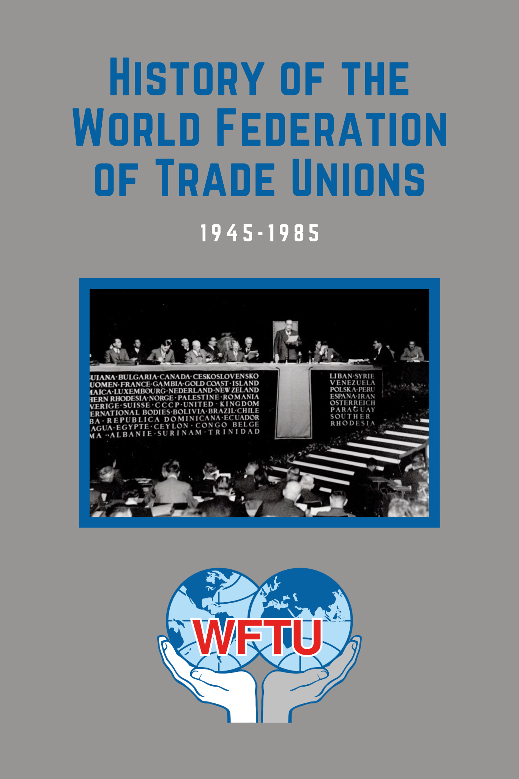


New Outlook Publishers
newoutlookpublishers.store
Relevant and Latest Releases

Slide 54



Harry Bridges School of Labor
luel.us/laborschool/
The Harry Bridges School of Labor is a monthly class covering a variety of topics aimed at building class consciousness among union members.
November’s class is on the 1946 Sugar Strike. Class will be November 8th, 2025 at 7pm EST/4pm PST.

Slide 55

Internacionálé- Hungarian Soviet Republic Anthem [1919]

