Slide 1

Intro-The Young’Uns - Cable Street

Slide 2
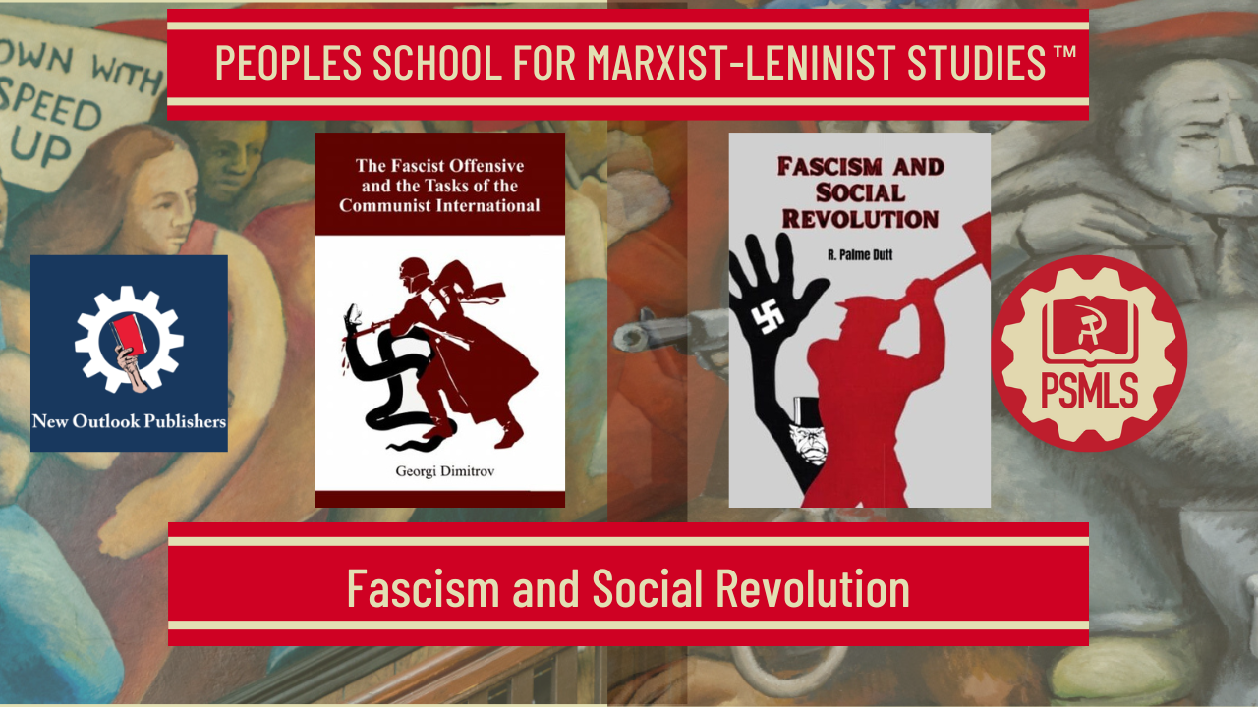
``
PSMLS 10/21/2025

Slide 3

What we’ll be learning today:
A brief explanation of the third period of the Comintern and its role in combating fascism.
A short biography on R. Palme Dutt.
Analysis of fascism, Lenin (and Fascism) on the Women’s Question.
The Fight against fascism and the Popular Front.

Slide 4
Biography of R. Palme Dutt, Fascism and Social Revolution, and Explanation of the Third Period

Slide 5
Note on the the book
Originally published before the 7th Congress of the Communist International(Comintern), Fascism and Social Revolution was written as Hitler assumed power as the Fuhrer of German 3rd Reich
The main error of the 3rd Period was that the Comintern viewed Social Revolution as the immediate task of the Communists and that fascism was simple bourgeois reaction that laid bare the class struggle between the proletariat and the capitalist dictatorship
At the time, the Communists were being persecuted by the Social Democrats and the Social Democrats played a virtually passive role in the rise of fascism. The Communists adopted the thesis that the Social Democrats were the moderate wing of fascism and therefore underestimated the true threat of fascism.
Another major error of this period was the underestimation of the peoples’ (including the working class) faith in bourgeois democracy. This underestimation led to the view that reforms would further disorganize the masses and accelerate the drive of fascism.
These facts must be kept in mind as we study the “Fascism and Social Revolution” by R. Palme Dutt.

Slide 6
THE ACTIVITY OF THE EXECUTIVE COMMITTEE OF THE COMMUNIST INTERNATIONAL
Resolution on the Report of Comrade Pieck Adopted August 1, 1935
The Seventh World Congress of the Communist International notes the serious shortcomings in the work of a number of Sections of the Communist International—the belated carrying out of the tactics of the united front, inability to mobilize the masses around partial demands political as well as economic in character, failure to realize the necessity of struggling in defence of the remnants of bourgeois democracy, failure to realize the necessity of creating an anti imperialist People’s Front in the colonial and dependent countries, disparagement of work in the reformist and fascist trade unions and mass organizations of the working people formed by bourgeois parties, underestimation of the importance of work among the working women, underestimation of the importance of work among the peasantry and the urban petty-bourgeois masses, also the delay with which the Executive Committee gave political assistance to these Sections. Taking into consideration the constantly growing importance and responsibility of the Communist Parties, which are called to head the movement of the masses in process of revolutionization, taking into consideration the necessity of concentrating day-to-day leadership within the Sections themselves, the Seventh World Congress of the Communist International directs the Executive Committee of the Communist International.

Slide 7

A Brief Explanation of the Periods Under the Communist International

Slide 8
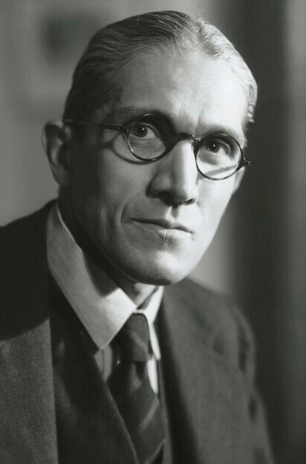
R. Palme Dutt
Rajani Palme Dutt (R. Palme Dutt) was born in 1896.
He and his brother Clemens were founding members of the Communist Party of Great Britain in 1920.
R. Palme Dutt was an influential Communist who was the 4th General Secretary of the CPGB.
He never abandoned Stalin and the Soviet Union. He was supportive of Stalin and questioned Nikita Khrushchev's Secret Speech. He had a portrait of Stalin in his office and said that it will only come down when he dies.

Slide 9
Discussion

Slide 10
II. The Character of Fascism and the Women’s Question

Slide 11
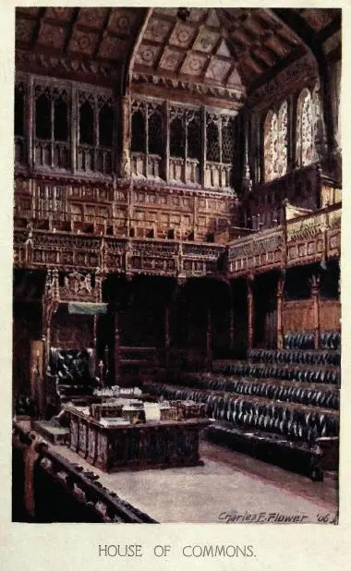
The Old Liberal Parties Begin to Wane
From: Fascism and Social Revolution by R. Palme Dutt, Ch. 3, Sec. 4
From the outset of the imperialist era liberalism and parliamentarism has in fact been on the wane. Parliamentary democracy was essentially the form through which the rising bourgeoisie carried through its struggle against feudalism and against old privileged forms, carrying the working class in their wake in this struggle. On this basis was built up liberalism in its heyday in the nineteenth century. The workers were drawn in the tow of bourgeois liberal politics. It was the achievement of Marxism to cut through this bondage. In Britain, where the capitalist world monopoly gave the bourgeoisie superior resources and the possibility to create a privileged section of a minority of the workers, Marxism made the slowest progress, and liberal-labour politics survived longest. As the class struggle of the proletariat against the bourgeoisie began to replace the old struggle against the pre-bourgeois forms, a political shifting followed. The old Liberal Parties began to wane before Social Democracy; the bourgeoisie increasingly coalesced with the remnants of the older (monarchist, militarist, landowning) forces.
The British House of Commons Est. 1801

Slide 12
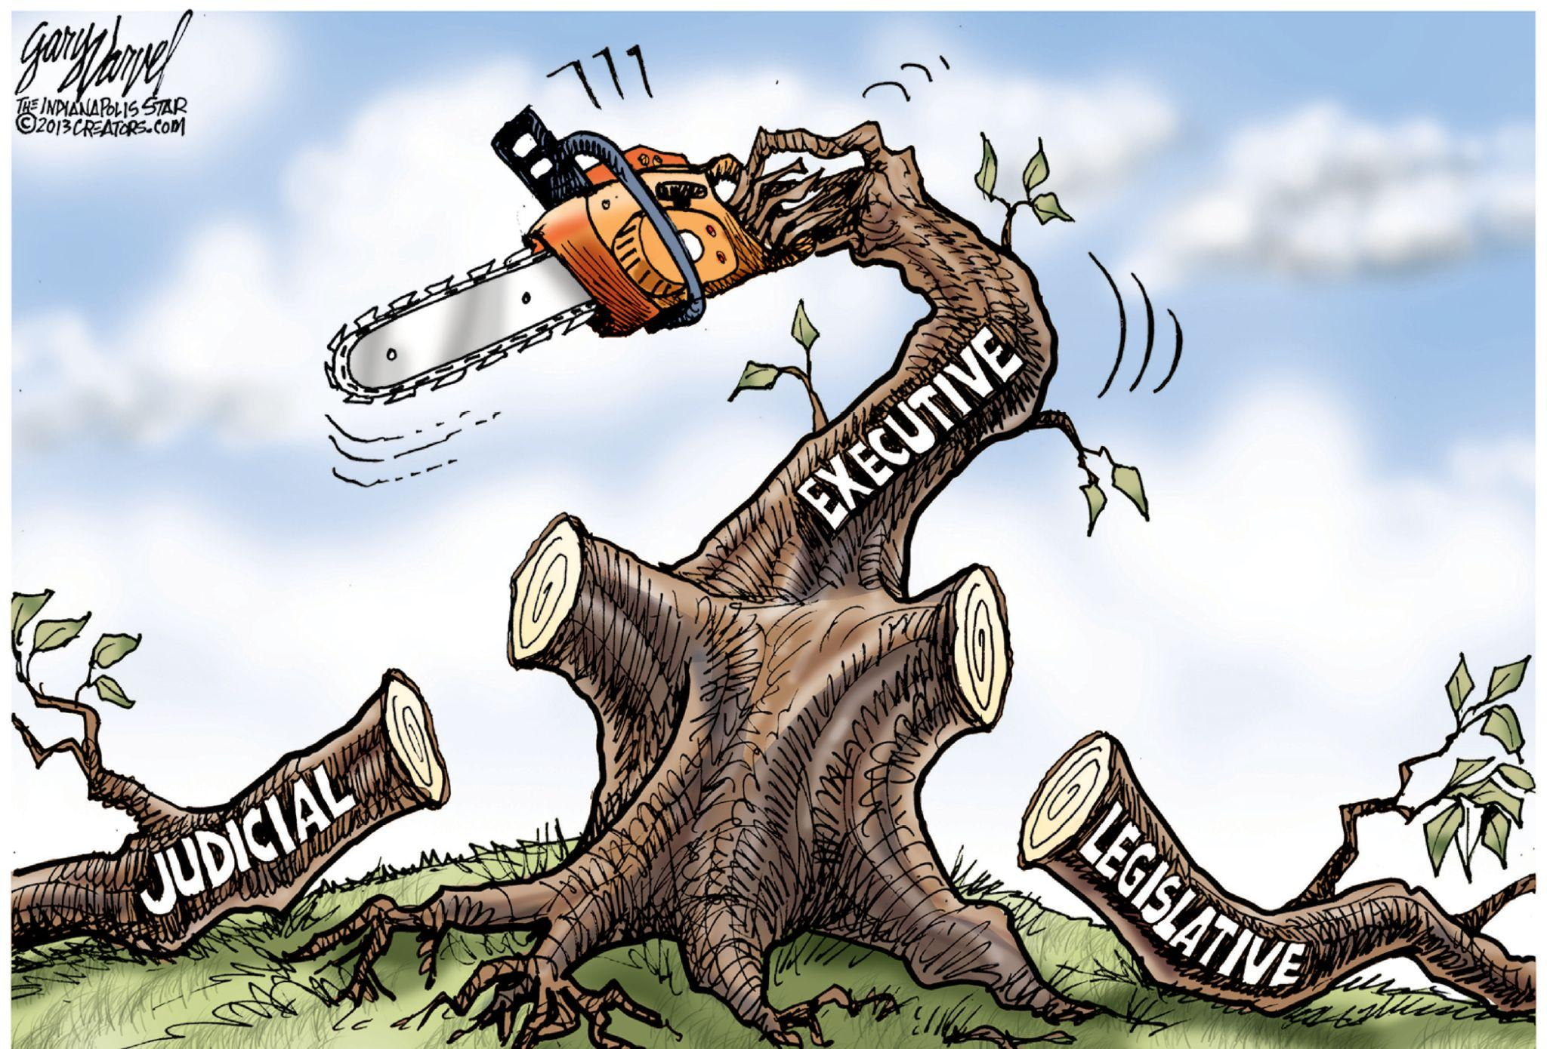
The Governing Role is Concentrated in the Executive
Nevertheless, parliamentary democracy remained as the most useful basis of the bourgeoisie for the deception of the masses and holding in of the class struggle, so long as this means of restraining the workers was adequate. To-day, when the intensification of the class struggle can no longer be held in by these forms, the bourgeoisie increasingly turns its back on parliamentary democracy in favor of more direct and open forms of coercion and the authoritarian state. This is a measure of the weakening of the bourgeoisie. The era of imperialism, of centralized monopoly capitalism, already increasingly made the parliamentary democratic forms a caricature. While in appearance the extension of the suffrage was increasing “democracy,” in reality the governing role was being directly removed from parliament and concentrated in the executive, into the Cabinet, and even into extra-parliamentary forms (The CIA, Department of Defense/Security Council, The Military-Industrial Complex etc.) wholly removed from “democracy,” (for example, support for U.S. involvement in the genocidal war on Gaza is as low as 32%, but this has had little to no effect on the conduct of Trump administration towards Isreal).

Slide 13

Finance Capital Holds the Power and Buys Off the Workers
Corresponding to the realities of monopoly capitalism, the routine of government was in fact in the hands of an increasingly strengthened and centralized bureaucracy; effective power and the decision of policy lay with the handful of leaders of finance-capital; meanwhile the puppet-show of parliament, responsible Ministers, elections and nominally opposing parties, became increasingly recognized as a decorative appendage of the Constitution for purposes of window-dressing (Elon Musk was able to largely ignore democratically elected institutions in his corrupt attack on the U.S. Government with the DOGE program). This was equally conspicuous in the “democracies” of the United States, France and Britain. Nevertheless, Liberalism enjoyed one last blooming in the earlier or pre-war period of imperialism—but in the new form of Liberal imperialism with its deceptive program of “social reform.” The super-profits of imperialism provided the means in the imperialist countries to endeavor to buy off the revolt of the advancing workers with a show of meager concessions to a minority. Thus they utilize “social reform” legislation, alongside coercion, in order to endeavor to stem the advance of Socialism.

Slide 14
Social Reform Liberal Imperialism
On the basis of imperialist exploitation was built up the short-lived twentieth-century renaissance of Social Reform Liberalism of the Lloyd George era, which tried to stem the rising tide of working-class revolt with a loudly advertised show of concessions and concern for the “condition of the people,” and with noisy campaigns of denunciation of the landlords and the aristocracy, while the real aims of imperialism and war-preparation were pressed forward, and all the forces of the State were employed against the militant working-class struggle. The Social Democratic and Labour Parties after the war tried to carry forward the role of Social Reform Liberal Imperialism, but under basically changed conditions—in a far more advanced stage of the class struggle, and in the midst of the crisis and decline of capitalism. Therefore they could not attain any corresponding measure of success; the appeal they could make to the masses on behalf of parliamentary reformism no longer evoked enthusiasm; the reforms they could achieve were limited by the economic crisis, the weakening national finances, and the weight of the war-debts they had to carry; the repressive and coercive measures they had to exercise against the class struggle were far heavier. But even the limited measure of social reform concessions began to break down and dwindle under the pressure of the economic crisis.

Slide 15

Class Struggle Bursts Through Democratic Illusions
With the rising colonial revolts, the basis of imperialism began to weaken. The stream of super-profits diminished; the conflict of the rival monopolist capitalisms became more intense. Thus a reverse movement set in, no longer to the extension of social concessions, but on the contrary to the cutting down and withdrawal of concessions already granted. This process received its powerful demonstration in the history and fall of the Second Labour Government and the crisis of 1931. From this point the class struggle is forced increasingly into the open, bursting through the thin cover of liberal and parliamentary democratic illusions. Even Social Democracy is forced to speak of the “collapse of reformism” and the “end of social reform,” and the consequent inevitability of a “frontal” attack on capital (so the general propaganda line of the Leicester Labour Party Conference in 1932), at the same time as it merges in practice still more completely into alliance with monopoly capitalism and repression of the workers
A Federal Court Recently Had to Order the Trump Administration to Restore Full Food Stamp Benefits After It Was Revealed That Only Half of the Payments Would Be Provided, Warning of “Irreparable Harm”

Slide 16

The Establishment of Open Forms of Dictatorship
The confrontation of the working class and capitalism can no longer be covered by liberal and reformist pretenses of improving conditions under capitalism. From this point the demand becomes increasingly strong from the representatives of capitalism for the throwing aside or modification of the old parliamentary democratic forms, which no longer serve their purpose, and the establishment of open and strengthened forms of repression and dictatorship. The revolt against “democracy” and “parliament,” which was already marked in bourgeois circles before the war, but was still confined in direct expression to the narrower reactionary circles, now become general in all current expression. The practice of modern capitalism moves increasingly away from parliamentary-democratic forms to strengthened and more open coercion and class-dictatorship. This applies not only to the directly Fascist states, but also to the diminishing number of imperialist states which still remain nominally “democratic.”

Slide 17
Increasing the Powers of the Executive, Bureaucracy, and Police
The confrontation of the working class and capitalism can no longer be covered by liberal and reformist pretenses of improving conditions under capitalism. From this point the demand becomes increasingly strong from the representatives of capitalism for the throwing aside or modification of the old parliamentary democratic forms, which no longer serve their purpose, and the establishment of open and strengthened forms of repression and dictatorship. The revolt against “democracy” and “parliament,” which was already marked in bourgeois circles before the war, but was still confined in direct expression to the narrower reactionary circles, now become general in all current expression. The practice of modern capitalism moves increasingly away from parliamentary-democratic forms to strengthened and more open coercion and class-dictatorship. This applies not only to the directly Fascist states, but also to the diminishing number of imperialist states which still remain nominally “democratic.” Modern legislation increases the powers of the executive, of the bureaucracy and of the police, and more and more restricts the limits of the legal working-class movement, of the right of meeting and association, and of the right to strike. The Trump administration has relied on unilateral executive orders more often than not to implement such policies as deploying U.S. Military forces into American cities for the purpose of harassing and instilling fear in the masses. The immoral and often illegal process of disappearing and deporting immigrants from the U.S. without due process, is another example of this slide toward authoritarianism and the curtailing of civil liberties.

Slide 18

The Contradiction Between Oligarchy and Working-Class Freedom
The stream against parliamentary democracy is rising on all sides, although this does not mean that capitalism has yet exhausted its uses. But the real issue is commonly confused by the vulgar propagandist treatment that the attack on “democracy” is a parallel attack of Communism and Fascism. On the contrary. The critique of Communism or Marxism against capitalist democracy is not that it is “too democratic,” but that it is “not democratic enough,” that it is in reality only a deceitful cover for capitalist dictatorship, and that real democracy for the workers can only be achieved when the proletarian dictatorship breaks the power of the capitalist class. The movement of modern capitalism, on the other hand, against parliamentary democracy is a movement to strengthen repression of the working class and establish the open and violent dictatorship of monopoly capital. The reality of this contradiction between oligarchic dictatorship and working-class freedom breaks through the old illusory trappings of parliamentary democracy.
The Statue of Oligarchy Overshadows the Statue of Liberty

Slide 19
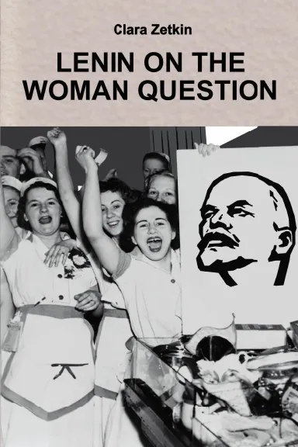
Lenin on the Women’s Question
The dependence of the solution of the women’s question upon the realisation of a Communist society was constantly emphasised by Lenin:
“The full liberation of woman and her real equality with man requires a communist economy, a common social organisation of production and consumption and the participation of woman in general production. Only through this will woman take the same place in society as man.” (Lenin, Speech to Moscow Conference of Working Women.)
The Soviet Union illustrates the advance towards this position, where for the first time in the world’s history the real equality of women is being built up and established among all the peoples in its territory.
But capitalism in the period of the general crisis begins to reverse the engines and move in the opposite direction. It is no longer hunting for new reserves of labour-power to exploit. On the contrary, it can no longer find employment for the existing labour force. Hence the cry begins to be sounded increasingly,
For more on the Communist treatment of the woman question, you can purchase Lenin on the Woman Question at New Outlook Publishers: newoutlookpublishers.store

Slide 20
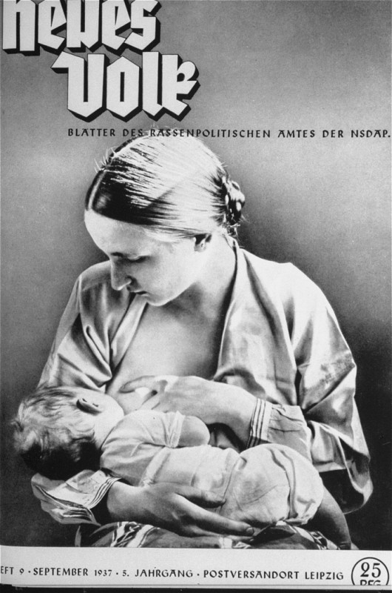
Fascism and the Women’s Question
Hence the cry begins to be sounded increasingly, always from the beginning voiced by the clerical-reactionary forces, but now increasingly taken up by modern capitalism as a whole, to drive women out of industry and thus assist to “solve” unemployment by increasing the number of dependents to be maintained on each wage. This cry is taken up in its sharpest and most undisguised form by Fascism, here as in every sphere voicing the most reactionary tendencies of capitalism in extreme decay. Back to the home! Back to economic dependence on marriage as the sole career for women! Cut down women’s education! Expel women from employment and give the jobs to men! Back to pots and pans! Produce more cannon-fodder for war! Back to kitchen slavery! This is the line of Fascism on the women’s question.
Hitler writes:
“In the case of female education the main stress should be laid on bodily training, and after that on development of character and last of all, on intellect. But the one absolute aim of female education must be with a view to the future mother.” (Mein Kampf, p. 163.)
The cover of a Nazi publication on race, Neues Volk (New People), portrays motherhood with this ideal image of an "Aryan" mother and child. Germany, September 1937

Slide 21
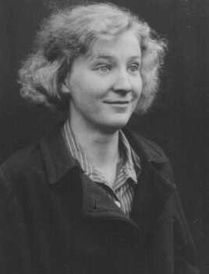
Fascism and the Women’s Question
It is an error to suppose that the reactionary Fascist attitude to women is simply a reflection of a religious-reactionary outlook and yearnings for a pre-industrial type of civilisation. The fact that the policy of minute bonuses (not in cash, but in orders on the large shops, and repayable) for marriage, on the condition that the woman passes out of industry, and the violent propaganda for more births, are accompanied at the same time by the policy of wholesale sterilisation of the alleged unfit or mentally weak (i.e., of those likely to produce offspring unfit for military service or of those politically unreliable), this latter practice being extremely offensive to traditional religious sentiment, is sufficient evidence that the policy as a whole is not simply the policy of religious-reactionary romanticism, but the conscious reactionary policy of modern capitalism in its most extreme decay.
Photo to the Right: On July 14, 1933, the Nazi dictatorship enacted the Law for the Prevention of Offspring with Hereditary Diseases. Gerda D., a shopworker, was one of an estimated 400,000 Germans who were forcibly sterilized. She was sterilized after a disputed diagnosis of schizophrenia.

Slide 22
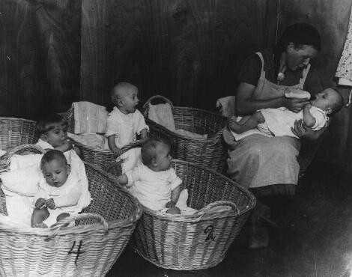
Fascism and the Women’s Question
Modern capitalism, while freely exploiting women in industry at sweated rates so far as it has use for their labour, kicks the remainder out of industry whom it cannot employ, bidding them become dependent on male wage-earners and thus save its total bill for wages or unemployment relief, and at the same time calls on them to perform their service in producing plenty of recruits for the increasing needs of the slaughterhouses of imperialist war.
This is the viewpoint of modern capitalism in extreme decay, or Fascism, on the role of women. In this key question of the role of women, as in its attitude to culture, or in its use of torture and re-introduction of barbaric beheadings, Fascism reveals typically its degraded social, political and cultural level.
German propaganda photograph of a kindergarten for German infants promotes the nurturing role of women on the home front. Germany, 1941.

Slide 23
Discussion

Slide 24
III. Fight Against Fascism & The Popular Front

Slide 25
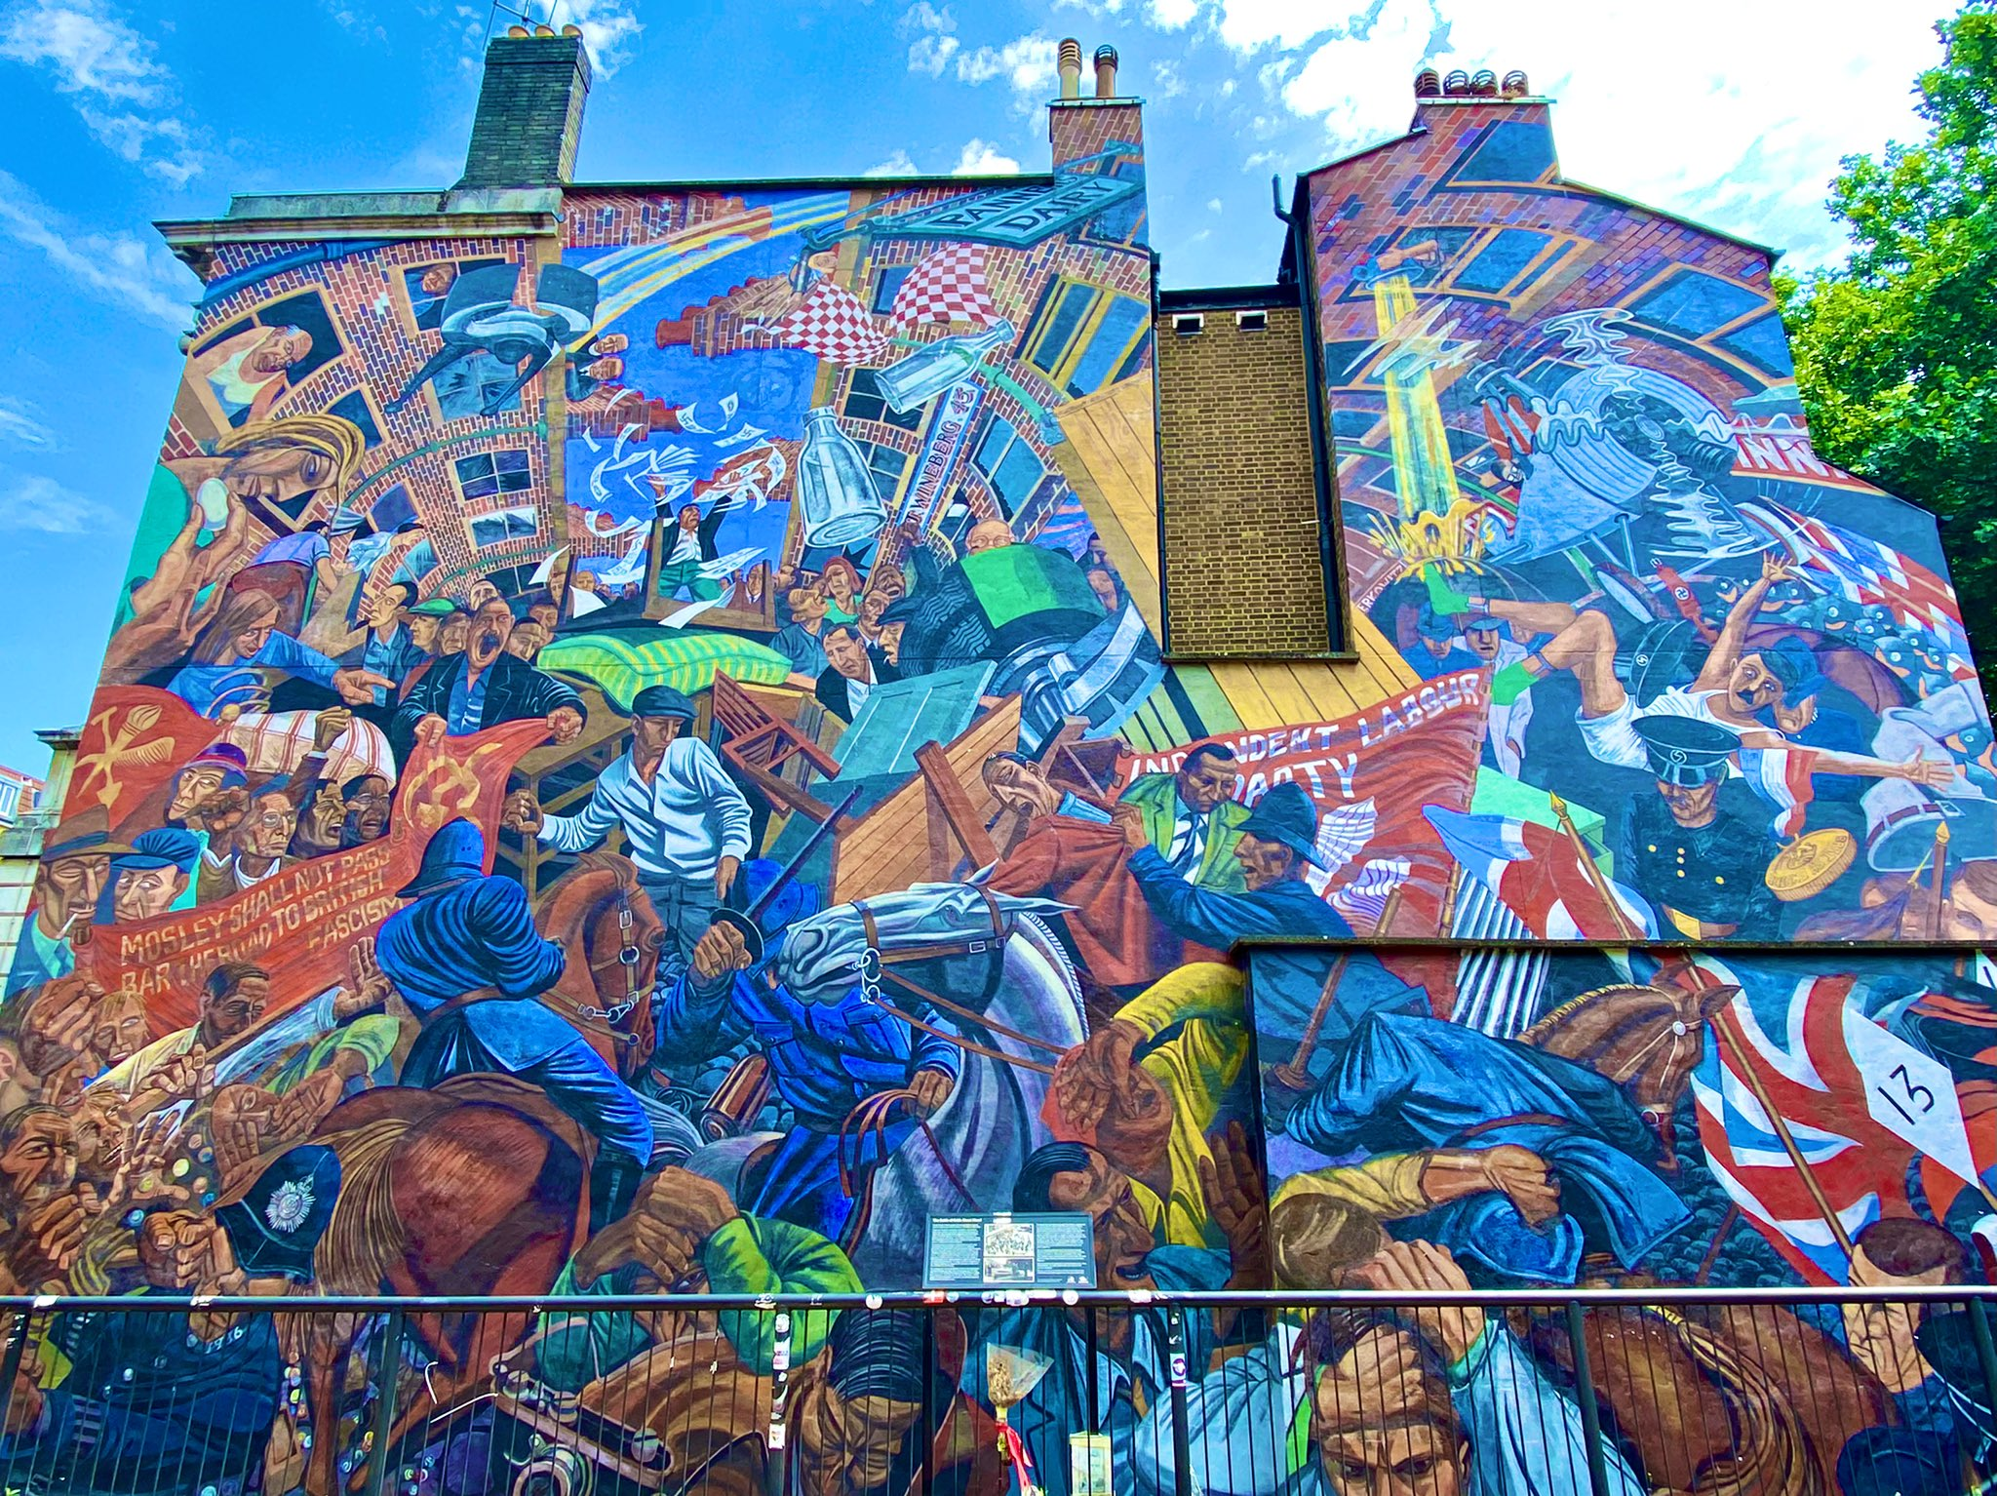
Fight Against Fascism
Fascism develops in the first place in and through the forms of bourgeois democracy. In consequence, the fight against Fascism cannot be conducted on the basis of trusting to bourgeois “ democracy ” as the defence against Fascism.
The stronger the fight of the workers in the early stages, within the still nominally maintained “democratic” forms, the less easy becomes the advance of the bourgeoisie to the further stages, to the open Fascist forms. Hence the importance of the united working-class front.
‘The Cable Street Mural’ - Located in East London, this mural depicts the Battle of Cable Street in 1936. Various factions of anti-fascist protesters - including communists, anarchists, socialists, and trade unionists - demonstrated against a march of Oswald Mosley’s British Union of Fascists. The counter-demonstration escalated into a clash with the Metropolitan Police.

Slide 26
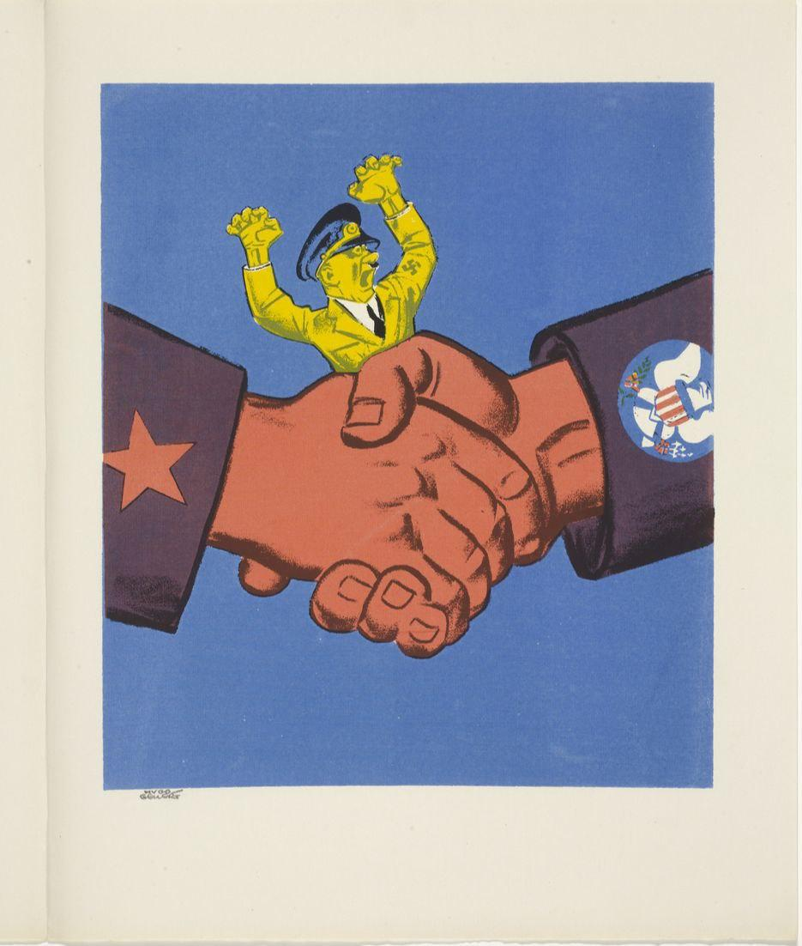
Fight Against Fascism
Bourgeois democrats and reformists argue that “Fascism is the consequence of Communism” leading to slogans such as “To defeat Fascism, root out Communism.” This line is expressed in the abstract slogan “ Democracy versus Dictatorship,” presented without reference to class-relations.
The conception of Communism as the cause of Fascism is as shallow in understanding of the real working of social forces as it is illusory in fact. The growth of the working-class revolution (Communism), and the growth of violent capitalist repression, are in reality both equally the consequence and outcome and expression of the growing crisis and break-up of capitalism. They develop as parallel parts of the single process of the gathering revolutionary crisis.
“Before the war,” declared Lenin (speech to the All-Russian Conference of the Bolshevik Party in May 1917), “England was the freest country in the world. There was freedom in England because there was no revolutionary movement there.” Does this mean that the masses in pre-war England were fortunate because they had no revolutionary movement? On the contrary. The formal “freedom” was only the mirror, the counterpart, of the real subjection. The “freedom” was conditional on the masses accepting passively their servitude and looking only for the crumbs of reforms. But so soon as the workers begin to stir against their servitude and to fight consciously for their liberation, the “freedom” rapidly disappears and gives place to the whip. And that is the meaning of Fascism.

Slide 27
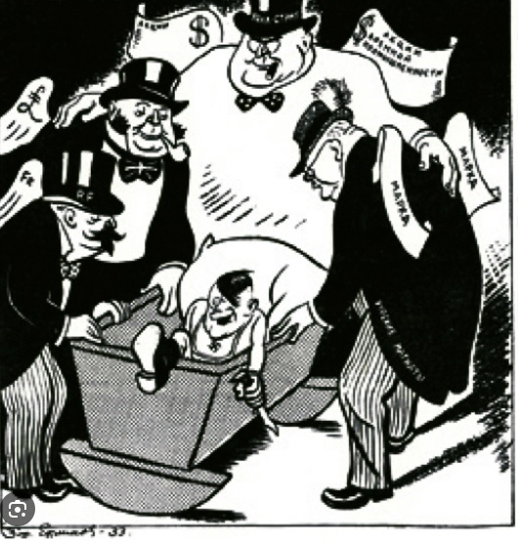
Fight Against Fascism
Fascism marks the extreme intensification of the capitalist dictatorship and offensive against the working class; but it marks thereby at the same time the growth of capitalist contradictions and the growth of the revolutionary awakening of the working class. The short definition given by the Thirteenth Plenum of the Executive of the Communist International in 1933 declares: “Fascism is the open terrorist dictatorship of the most reactionary, most chauvinist and most imperialist elements of finance capital.”
The victory of fascism in Germany, Comrade Stalin said at the Seventeenth Congress of the Communist Party of the Soviet Union, “ . . . must be regarded not only as a symptom of the weakness of the working class and as a result of the betrayal of the working class by Social-Democracy, which paved the way for fascism; it must also be regarded as a symptom of the weakness of the bourgeoisie, as a symptom of the fact that the bourgeoisie is already unable to rule by the old methods of parliamentarism and bourgeois democracy, and, as a consequence, is compelled in its home policy to resort to terroristic methods of administration—it must be taken as a symptom of the fact that it is no longer able to find a way out of the present situation on the basis of a peaceful foreign policy, and, as a consequence, it is compelled to resort to a policy of war.”
Soviet political cartoon depicting French, British, and American capitalists nurturing a young Hitler.

Slide 28
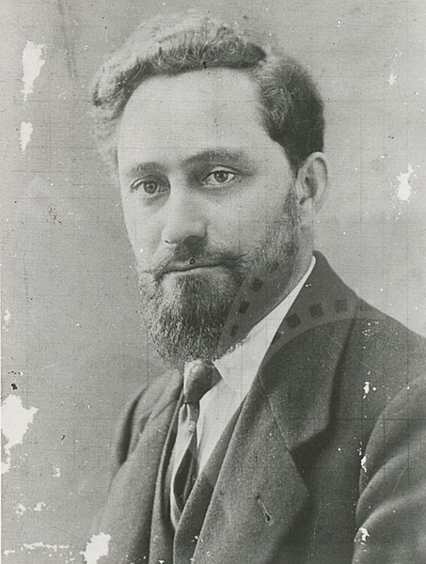
The Popular Front
Report by Comrade Dimitrov at the 7th Congress of the Communist International
Comrades, millions of workers and working people of the capitalist countries ask the question: How can fascism be prevented from coming to power and how can fascism be overthrown after it has attained power? To this the Communist International replies: The first thing that must be done, the thing with which to begin, is to form a united front, to establish unity of action of the workers in every factory, in every district, in every region, in every country, all over the world. Unity of action of the proletariat on a national and international scale is the mighty weapon which renders the working class capable not only of successful defence but also of successful counter-attack against fascism, against the class enemy.
Is it not clear that joint action by the supporters of the parties and organizations of the two Internationals, the Communist and the Second International, would make it easier for the masses to repulse the fascist onslaught, and would heighten the political importance of the working class? Joint action by the parties of both Internationals against fascism, however, would not be confined in its effects to influencing their present adherents, the Communists and Social-Democrats; it would also exert a powerful influence on the ranks of the Catholic, Anarchist and unorganized workers, even upon those who have temporarily become the victims of fascist demagogy.
Moreover, a powerful united front of the proletariat would exert tremendous influence on all other strata of the working people, on the peasantry, on the urban petty bourgeoisie, on the intelligentsia. A united front would inspire the wavering groups with faith in the strength of the working class.
Georgi Dimitrov
Notes:
Georgi Dimitrov, 7th Congress of the Communist International

Slide 29
The Popular Front
The establishment of unity of action by all sections of the working class, irrespective of the party or organization to which they belong, is necessary even before the majority of the working class is united in the struggle for the overthrow of capitalism and the victory of the proletarian revolution.
The Communist International puts no conditions for unity of action except one, and that an elementary condition acceptable for all workers, viz., that the unity of action be directed against fascism, against the offensive of capital, against the threat of war, against the class enemy. This is our condition.
We must find and advance those slogans and forms of struggle which arise from the vital needs of the masses, from the level of their fighting capacity at the present stage of development. We must point out to the masses what they must do today to defend themselves against capitalist spoliation and fascist barbarity. We must strive to establish the widest united front with the aid of joint action by workers’ organizations of different trends for the defence of the vital interests of the labouring masses. This means:
First, joint struggle really to shift the burden of the consequences of the crisis onto the shoulders of the ruling classes, the shoulders of the capitalists, landlords—in a word, to the shoulders of the rich.
Second, joint struggle against all forms of the fascist offensive, in defence of the gains and the rights of the working people, against the destruction of bourgeois-democratic liberties.
Third, joint struggle against the approaching danger of imperialist war, a struggle that will make the preparation of such a war more difficult.
We must tirelessly prepare the working class for a rapid change in forms and methods of struggle when there is a change in the situation. As the movement grows and the unity of the working class strengthens, we must go further, and prepare the transition from the defensive to the offensive against capital, steering toward the organization of a mass political strike. It must be an absolute condition of such a strike to draw into it the main trade unions of the countries concerned.
Notes:
“There are wiseacres who will sense in all this a digression from our basic positions, some sort of turn to the Right from the straight line of Bolshevism. Well, in my country, Bulgaria, they say that a hungry chicken always dreams of millet. (Laughter, loud applause.) Let those political chickens think so. (Laughter, loud applause.)” - the closing of the report

Slide 30
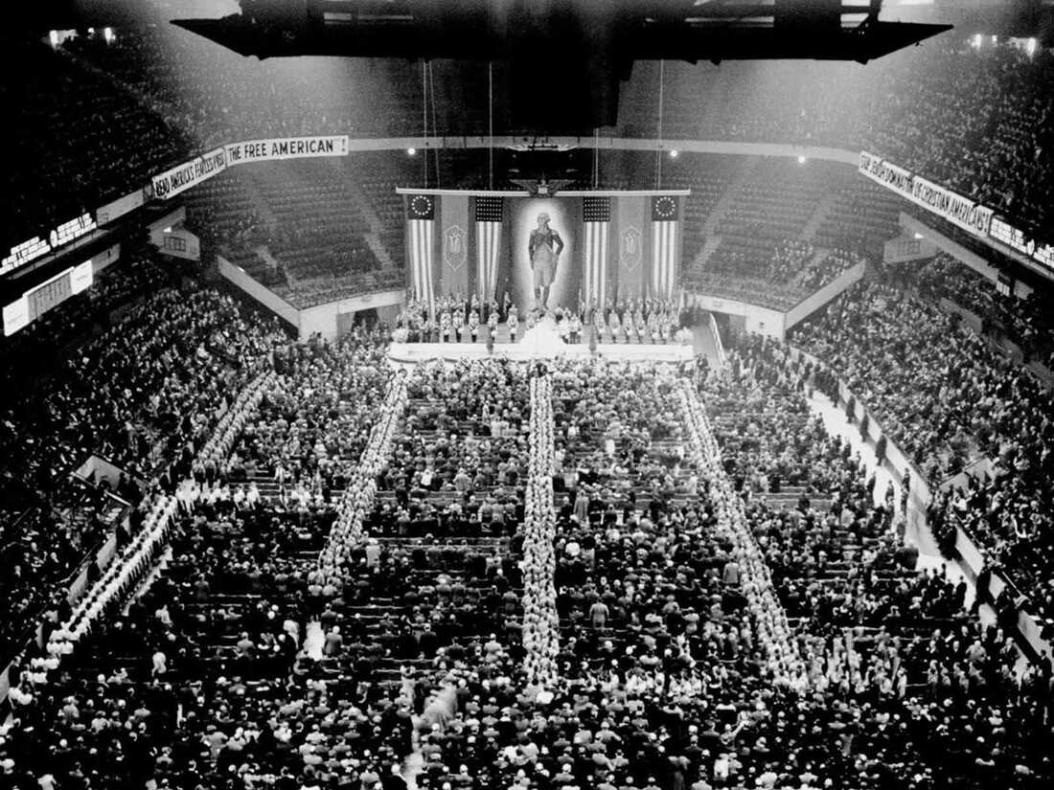
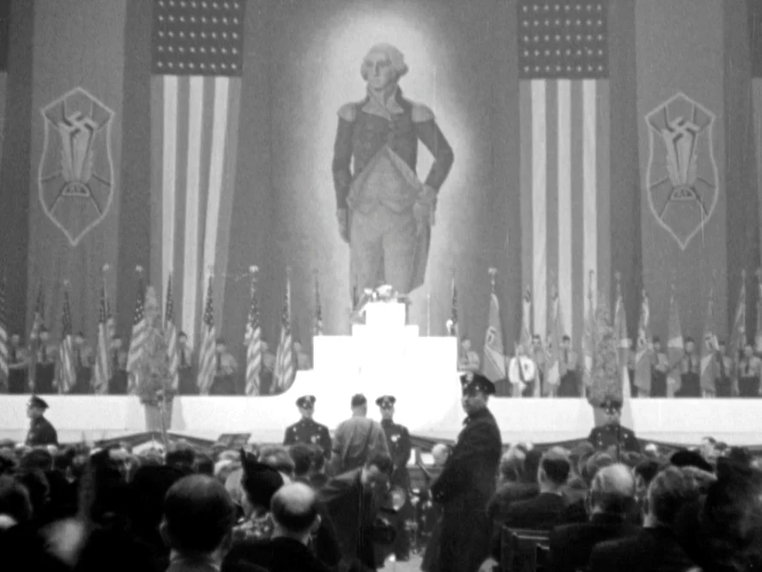
The Popular Front
Key Questions of the United Front in The United States of America
Embryo American fascism is trying to direct the disillusionment and discontent of these masses into reactionary fascist channels. It is a peculiarity of the development of American fascism that at the present stage it comes forward principally in the guise of an opposition to fascism, which it accuses of being an “un-American” tendency imported from abroad. In contradistinction to German fascism, which acts under anti-constitutional slogans, American fascism tries to portray itself as the custodian of the Constitution and “American democracy.” It does not as yet represent a directly menacing force. But if it succeeds in penetrating to the wide masses who have become disillusioned with the old bourgeois parties it may become a serious menace in the very near future.
And what would the victory of fascism in the United States involve? For the mass of working people it would, of course, involve the unprecedented strengthening of the regime of exploitation and the destruction of the working-class movement. And what would be the international significance of this victory of fascism? As we know, the United States is not Hungary, or Finland, or Bulgaria, or Latvia. The victory of fascism in the United States would vitally change the whole international situation.
Under these circumstances, can the American proletariat content itself with organizing only its class conscious vanguard, which is prepared to follow the revolutionary path? No.
Feb 20, 1939 - Nazi rally at Madison Square Garden is attended by 20,000 Americans
Notes:
Georgi Dimitrov, 7th Congress of the Communist International

Slide 31
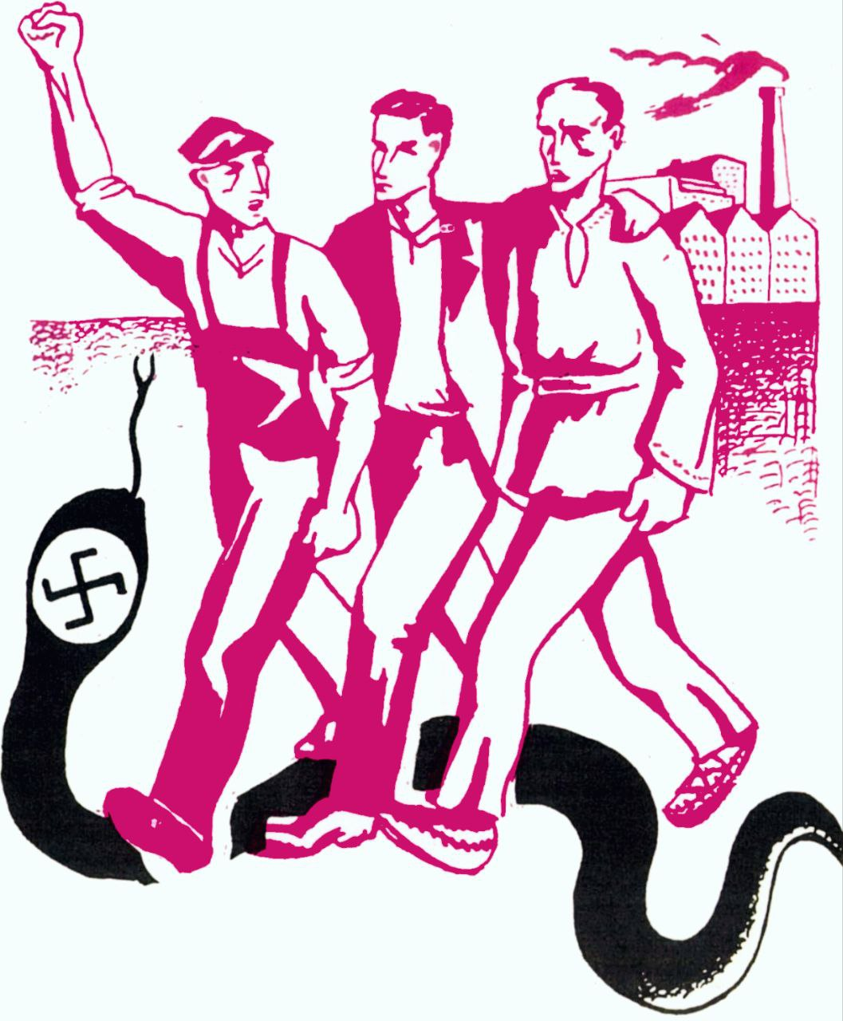
The Popular Front
We want to eradicate from our ranks all self-satisfied sectarianism, which above all blocks our road to the masses and impedes the carrying out of a truly Bolshevik mass policy. We want to intensify in every way the struggle against all concrete manifestations of Right opportunism, realizing that the danger from this side will increase precisely in the practice of carrying out our mass policy and struggle. We want the Communists of each country promptly to draw and apply all the lessons that can be drawn from their own experience as the revolutionary vanguard of the proletariat. We want them as quickly as possible to learn how to sail on the turbulent waters of the class struggle, and not to remain on the shore as observers and registrars of the surging waves in the expectation of fine weather.
This is what we want!
And we want all this because only in this way will the working class at the head of all the working people, welded into a million strong revolutionary army, led by the Communist International and possessed of so great and wise a pilot as our leader Comrade Stalin, be able to fulfill its historical mission with certainty—to sweep fascism off the face of the earth and, together with it, capitalism!
Notes:
Georgi Dimitrov, 7th Congress of the Communist International

Slide 32
Discussion & New Members Introductions

Slide 33
New Member Introductions
What is your name and state (or country/territory)?
Where do you work? Is it unionized?
How did you find out about the People’s School?
What do you think about tonight's class?

Slide 34


Slide 35
Final Discussion & Wrap Up

Slide 36
Announcements
PCUSA Cell Chairs need to call members of their cells to remind them about attendance.
The next issue of New Masses (2026) has begun production. If you have art you want us to feature, email it to info@partyofcommunistsusa.net.

Slide 37
Volunteers Needed!
We are in need of volunteers for the staff of the People’s School! Here’s a few roles we need filled:
People to help manage posting on our social media and podcast platforms
Video Editors, Audio Editors, Graphic Designers, Artists, Narrators
Web Controls, Moderators
Email info@peoplesschool.us if you’re interested and try to attend our next staff meeting on Nov 2nd if possible.

Slide 38

Jewish
Peoples Schule
The Jewish Peoples Schule educates in fraternity along secular, progressive lines to our Jewish and non-Jewish friends to share and relate the historical struggles of the Jewish peoples to other peoples’ struggles against oppression.
During Chanukah, let’s learn together about the Maccabean struggle and its lessons in the struggle against fascism today . December 20th, 2025 7:30 PM to 9:00 PM EASTERN

Slide 39

View From Left Field
https://viewfromleftfield.libsyn.com
The Old PSMLS Youtube is now the Youtube of View From Left Field, a podcast of analysis and discussion of current events from a progressive perspective.
Like the Youtube videos and subscribe with 5 star ratings on your podcast platforms.

Slide 40

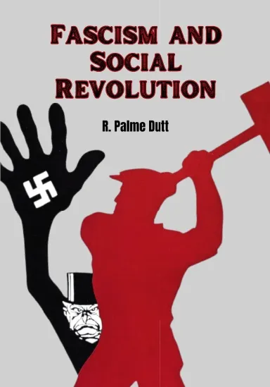

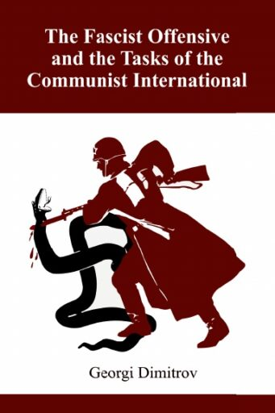
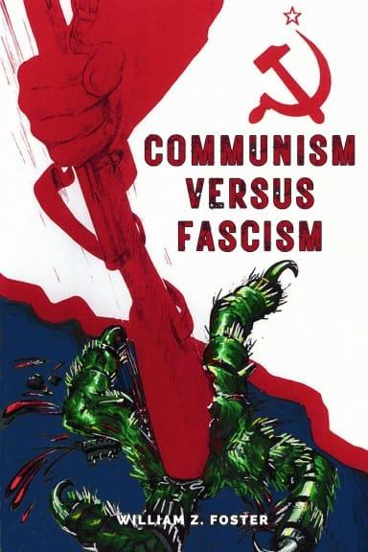
New Outlook Publishers
newoutlookpublishers.store
Relevant & Latest Releases

Slide 41


Harry Bridges School of Labor
luel.us/laborschool/
The Harry Bridges School of Labor is a monthly class covering a variety of topics aimed at building class consciousness among union members.
December’s class will cover of the History of Trade Union Unity League.

Slide 42

Outro- Tear the Fascists Down - Woody Guthrie

