Slide 1


The Internationale

Slide 2
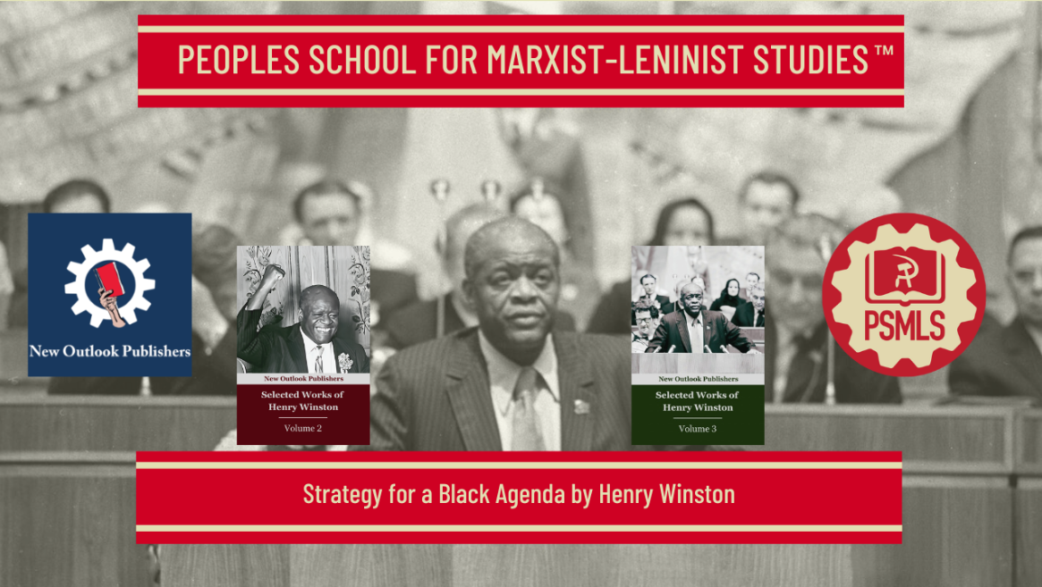
PSMLS 2.10.26

Slide 3
What we’ll be learning today:
The Crisis of the Black Panther Party & The Meaning of San Rafael
Explanation of the National Question, Interview with Henry Winston
From Anti-Slavery to Anti-Monopoly & Strategy for a Black Agenda

Slide 4
The Crisis of the Black Panther Party & The Meaning of San Rafael

Slide 5
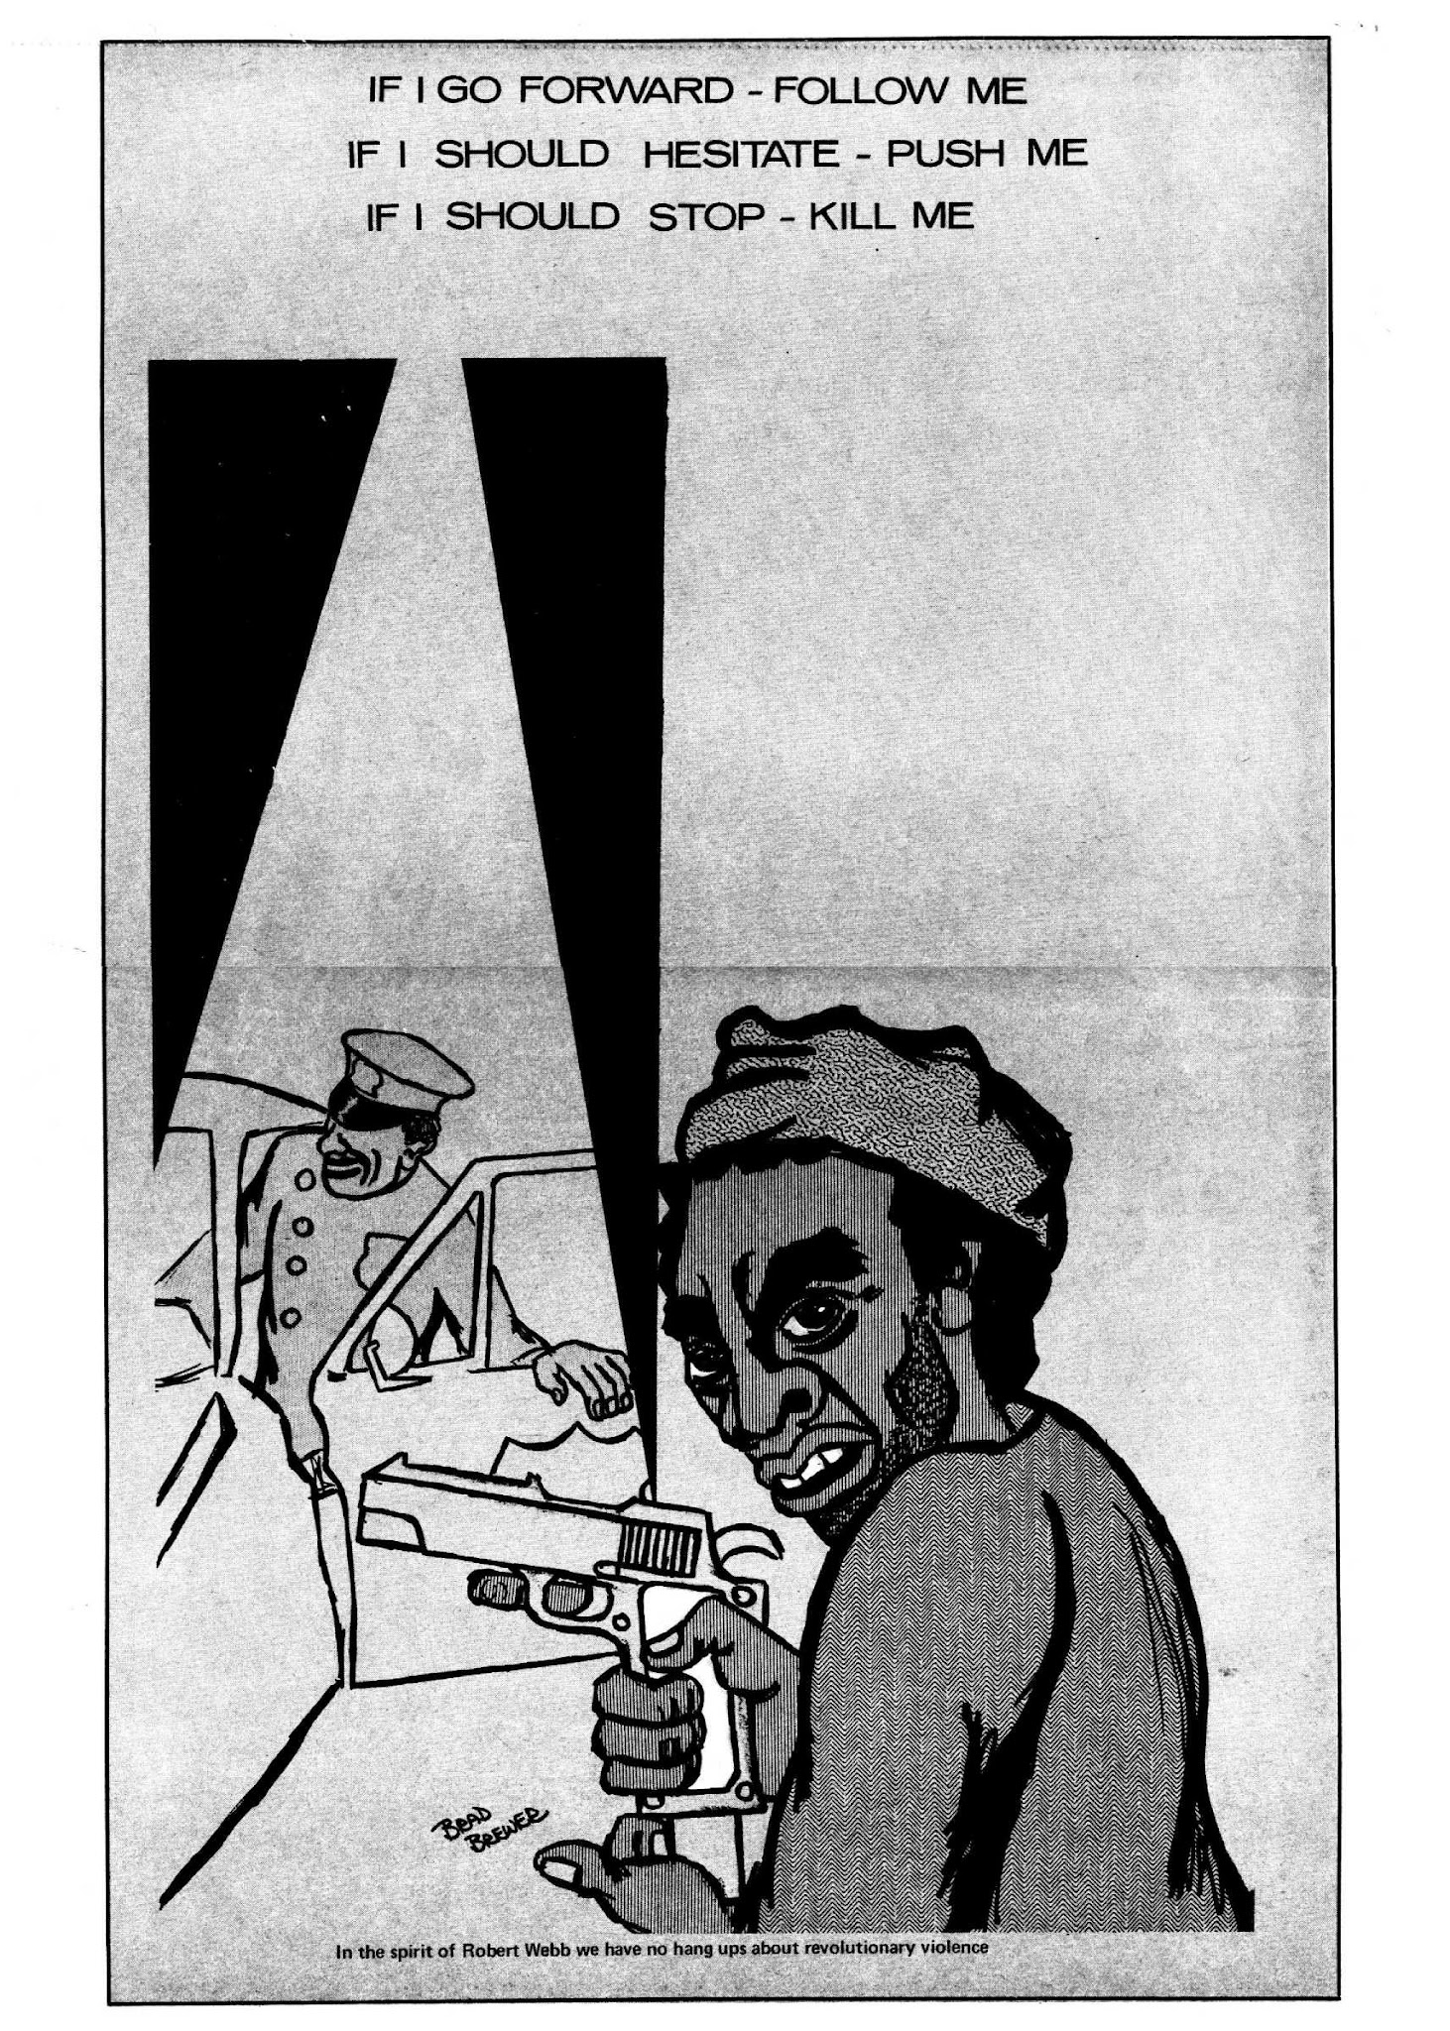
Statement of the Political Committee of the Communist Party USA after San Rafael:
How could an organization which portrayed itself as the revolutionary vanguard become so quickly isolated from the people? Why were the hopes of so many militant and courageous Black youths who were attracted to the party turned into frustration and even tragedy? No answer to these questions can be given without taking into account the attacks and frame ups launched by the class enemy against the party, Yet even these brutal and murderous attacks, conducted both from within and outside the organization, cannot alone explain the crisis of the Black Panther Party.

Slide 6
Strategy—Defensive or Offensive?
When Newton advocated guns and a defensive Strategy as the solution for Black people, he was wrong on both counts. Not only did the people refuse to relate to the gun, but they also rejected the concept of a defensive strategy. Black people have been warding off attacks for 400 years. They want and need an offensive strategy to build a great popular movement to end racist oppression.
In his concept of self-defense, Newton endeavored to respond to the oppression of his people. However, this concept excluded the masses of the people from their own liberation struggle. It involved the idea of an elite few acting for the masses—in fact, supplanting them.
Thus, even before Cleaver joined the Black Black Panther Party, Newton had substituted elitism for mass struggle. Cleaver’s influence brought the elitist concept to new levels of anarchistic, adventurist confusion and provocation—but his ideology was nevertheless inherent in the original concepts on which the Black Panther Party was founded.

Slide 7
The Image-Makers and “Revolution”
It is apparent that neither Newton nor Cleaver have ever based their tactics on the working class and its revolutionary Science, Marxism-Leninism. At the present moment, while Cleaver’s opportunism continues along an ultra-Leftist course and Newton’s has taken a Right opportunist form (although he attempts to maintain a Leftist image), both base their policies on the lumpenproletariat.
In order to give some semblance of credibility to the “revolutionary” role they assign the lumpen elements, Newton and Cleaver would have us believe that the Black unemployed, those on welfare, and high school dropouts are all part of the lumpenproletariat. This is an insult to Black men, women and youth. People are not lumpen simply because they are denied jobs, and when Newton and Cleaver make such claims they sound like Black Moynihans.
Notes:
The 1965 "Moynihan Report," officially titled The Negro Family: The Case For National Action, was a controversial document written by Assistant Labor Secretary Daniel Patrick Moynihan. It argued that the high rate of unmarried births, broken homes, and "matriarchal" structures in Black communities—rooted in systemic oppression—would cripple future racial progress and argued in support of government intervention to “reset” the negro race.

Slide 8
The Image-Makers and “Revolution”
Today, in the citadel of imperialism in the era of its decline, there is a massive increase in the army of the unemployed. Alongside this, the number of lumpen elements also increases. However, these groups do not merge: each has its distinct characteristics. As Marx wrote in The Class Struggles in France, the lumpenproletariat “forms a mass sharply differentiated from the industrial proletariat.”
Specifically the lumpen elements are those so demoralized by the system that they are not only jobless, but that to them a job is unthinkable. It is their declassed parasitical status and outlook that sharply distinguish them from the great mass of the unemployed, who are searching for and demanding jobs and the opportunity for a decent life. That is why, in addition to making the distinction that Marx emphasized, it is now even more necessary than in Marx’s time to clearly distinguish between the lumpenproletariat and the great mass of unemployed, which includes so many youth (particularly Black and Brown) who have never been regularly employed.
Notes:
The 1965 "Moynihan Report," officially titled The Negro Family: The Case For National Action, was a controversial document written by Assistant Labor Secretary Daniel Patrick Moynihan. It argued that the high rate of unmarried births, broken homes, and "matriarchal" structures in Black communities—rooted in systemic oppression—would cripple future racial progress and argued in support of government intervention to “reset” the negro race.

Slide 9
Incredible Thrust Backward
Between mid-April and the end of May, 1971, Huey P. Newton became increasingly frank in describing his new course. What he only hinted at in the April 17 Black Panther, he made astoundingly clear in the May 29 issue, when he described what he calls a “survival program,” i.e., survival through “Black capitalism.”
Announcing that the Panthers will now operate factories in ghettos, he went on to say: “We will have no overhead because our collective—we’ll exploit our collective by making them work free. We’ll do this not just to justify ourselves, like philanthropists, to save someone from going without shoes, even though this is part of the cause of our problems. People make the revolution; we will give the process a forward thrust. If we suffer from genocide, We won’t be around to change things. So in this way our survival program is very practical.”
Far from being either “practical” or a “forward thrust,” this is an incredibly reactionary thrust backward.

Slide 10
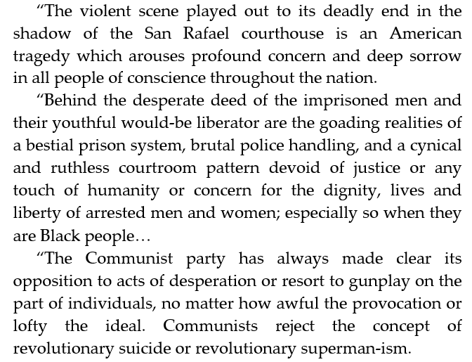
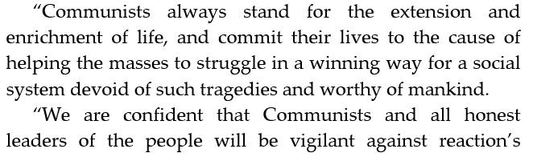

Statement of the Political Committee of the Communist Party USA after San Rafael:

Slide 11
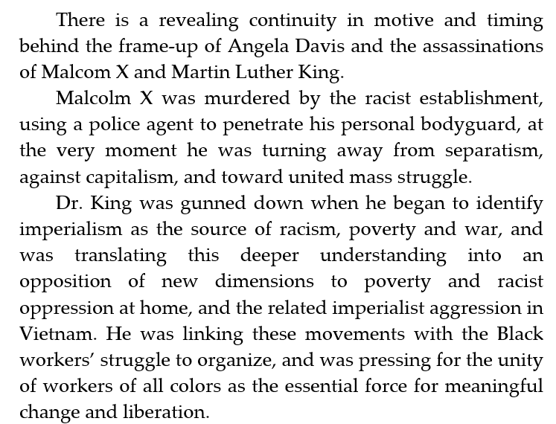
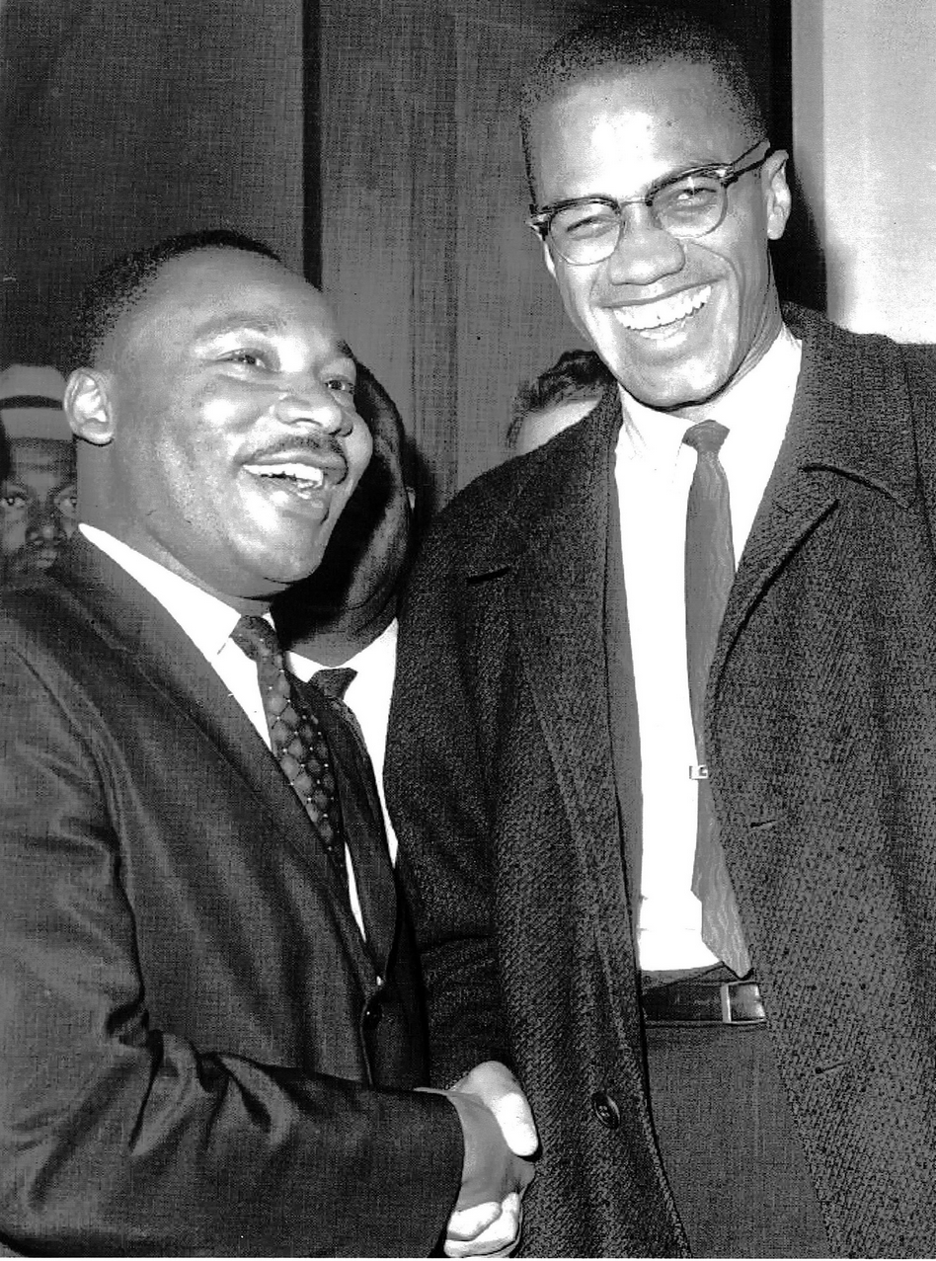
The Meaning of San Rafael

Slide 12
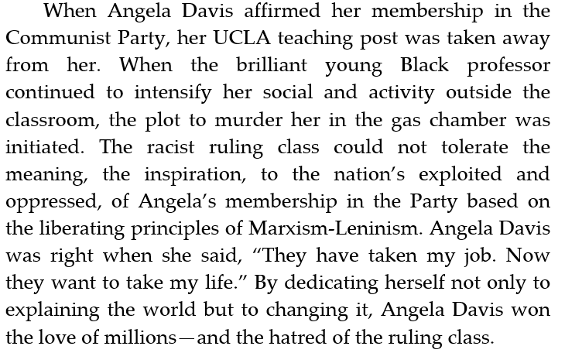
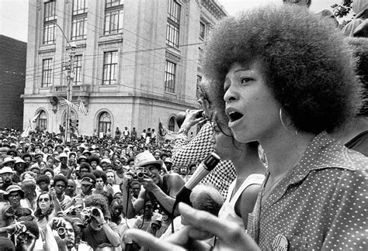
The Meaning of San Rafael

Slide 13
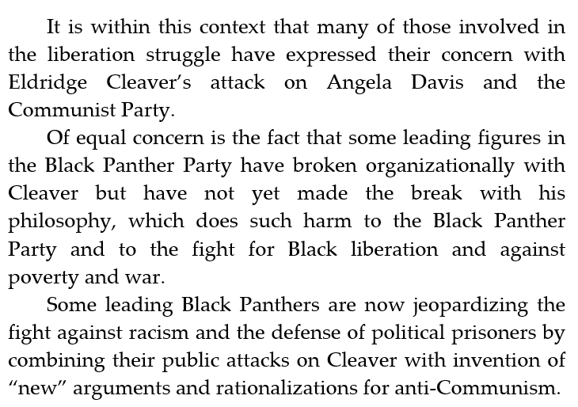
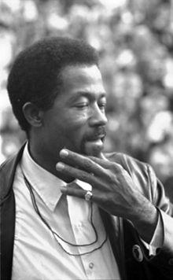
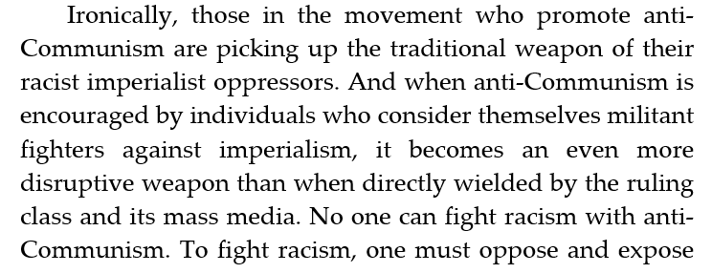
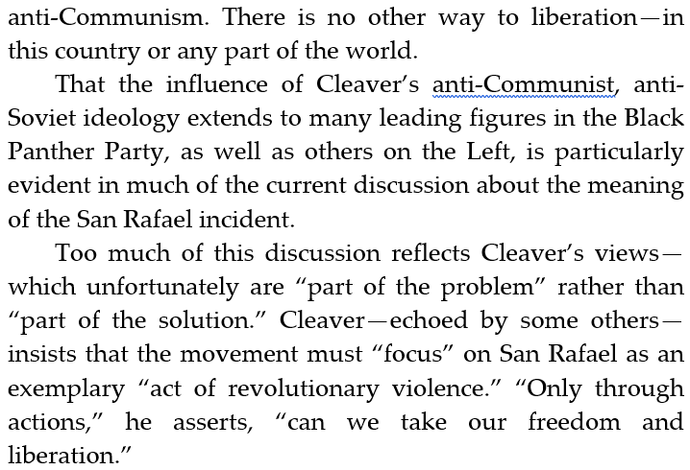
The Meaning of San Rafael
Eldridge Cleaver

Slide 14
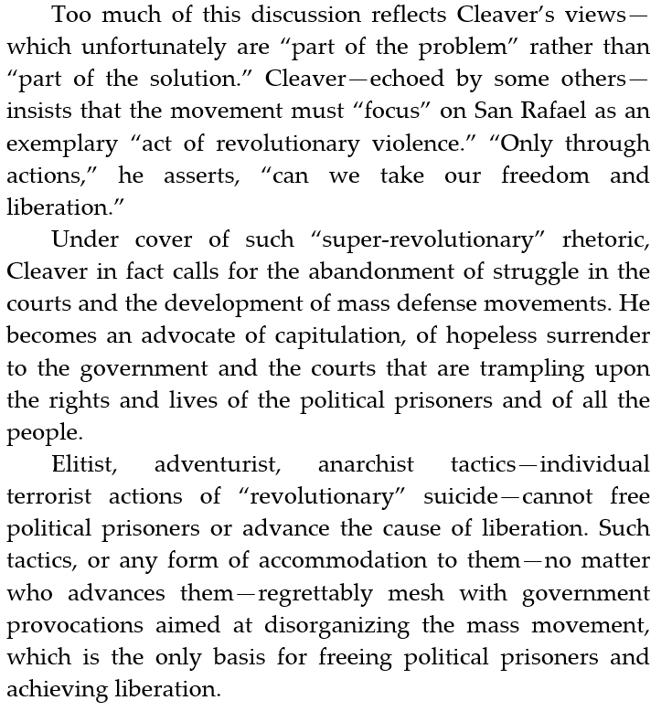
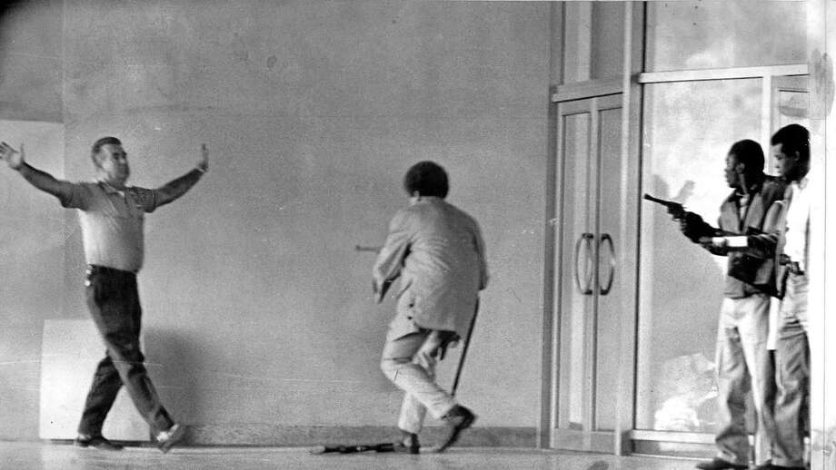
The Meaning of San Rafael

Slide 15
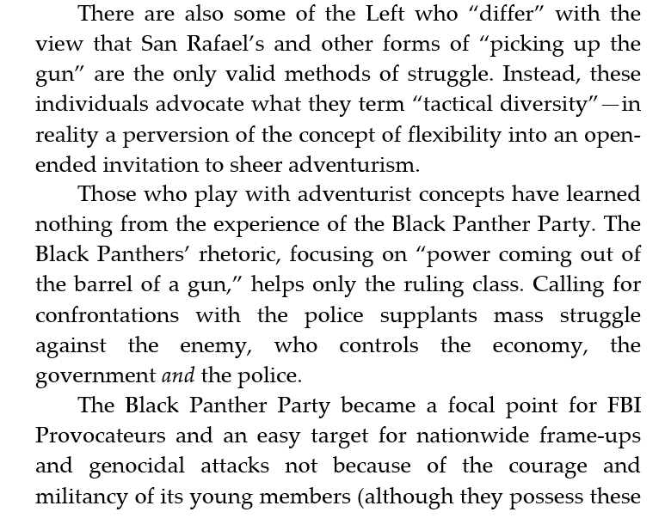
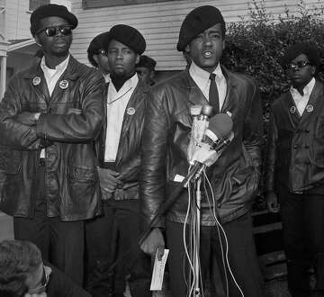
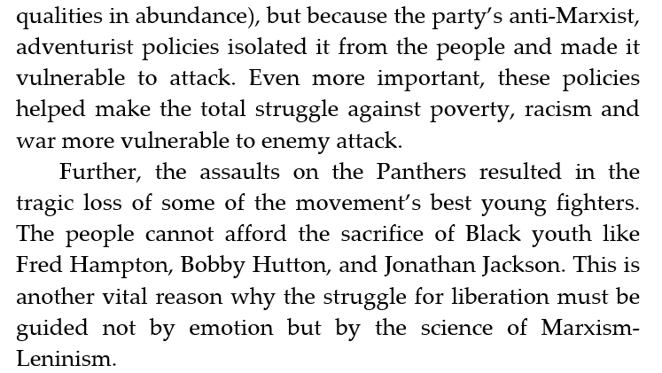
The Meaning of San Rafael

Slide 16

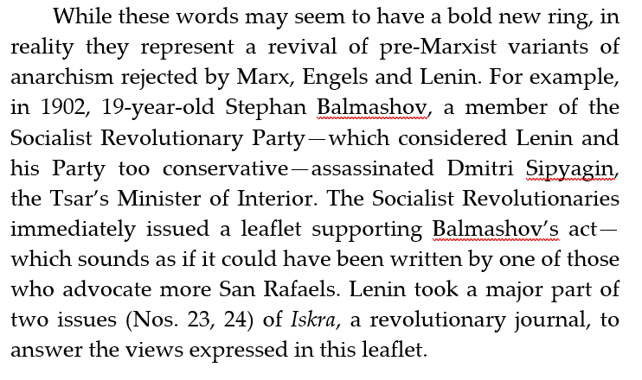
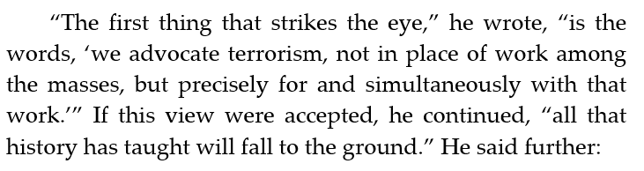
The Meaning of San Rafael

Slide 17
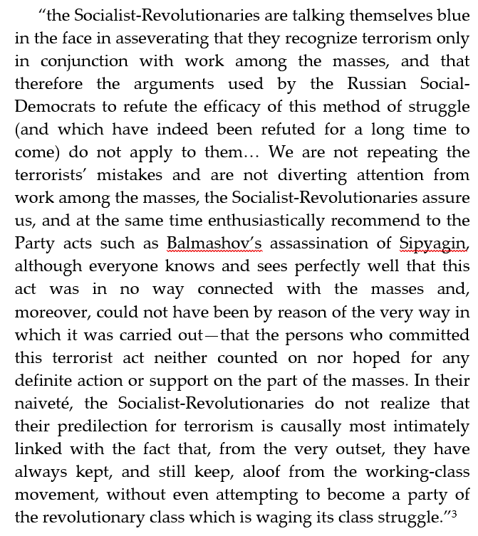
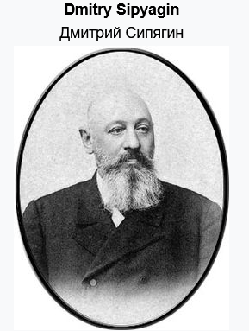
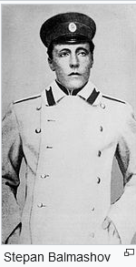
The Meaning of San Rafael

Slide 18
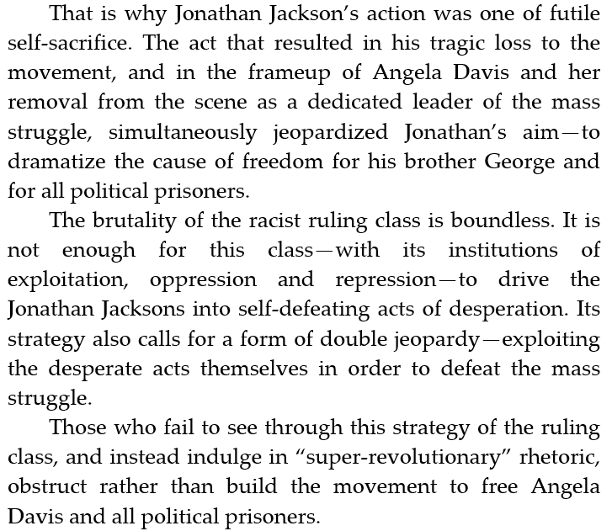
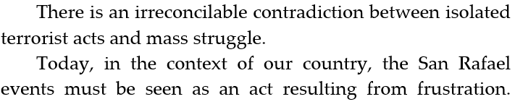
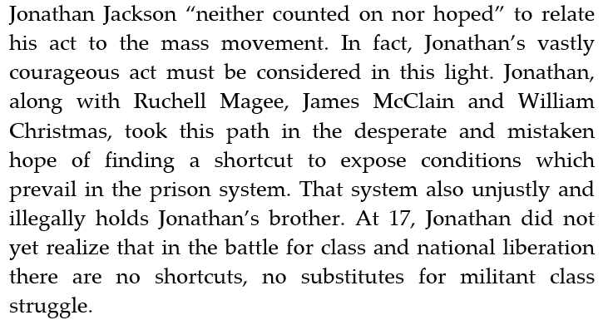
The Meaning of San Rafael

Slide 19
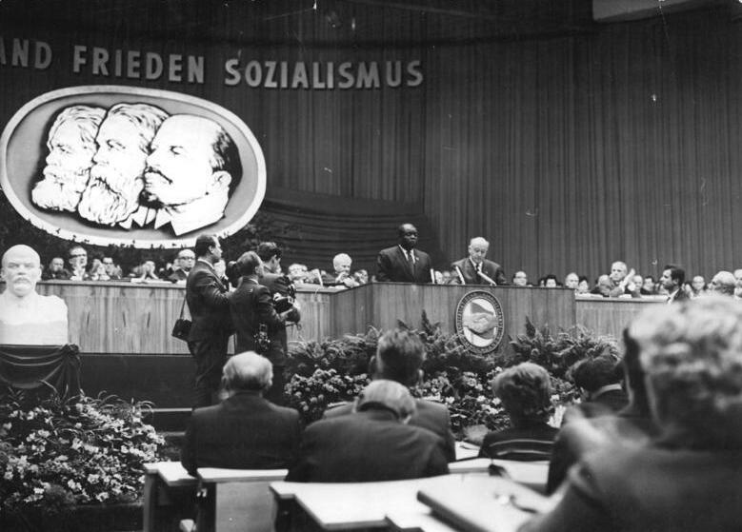
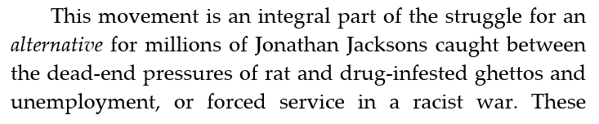
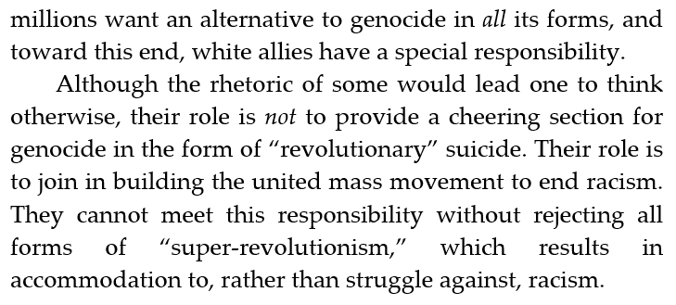
The Meaning of San Rafael

Slide 20
Discussion & New Members Introductions

Slide 21
New Member Introductions
What is your name, pronouns and state (or country/territory)?
Where do you work? Is it unionized?
How did you find out about the People’s School?
What do you think about tonight's class?

Slide 22
The National Question, Interview with Henry Winston

Slide 23
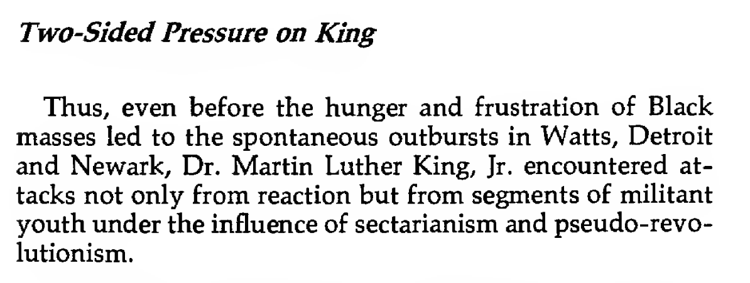
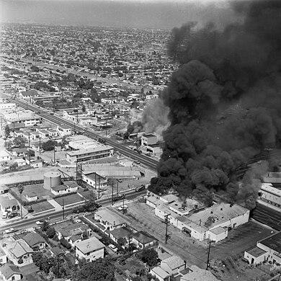
Chapter 15: Strategy for a Black Agenda - Strategy for a Black Agenda
The Watts riots, sometimes referred to as the Watts Rebellion or Watts Uprising, took place in the Watts neighborhood and its surrounding areas of Los Angeles from August 11 to 16, 1965.

Slide 24
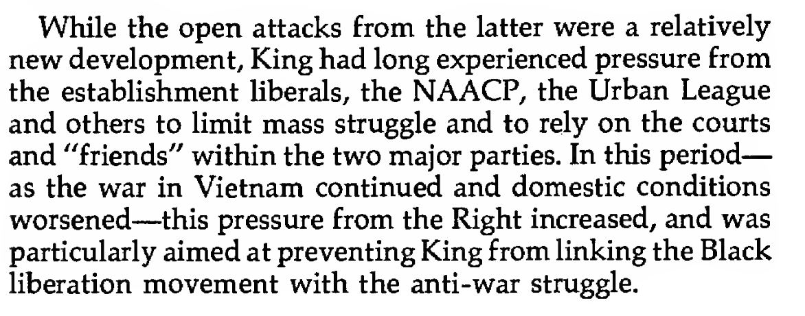
Chapter 15: Strategy for a Black Agenda - Strategy for a Black Agenda

Slide 25
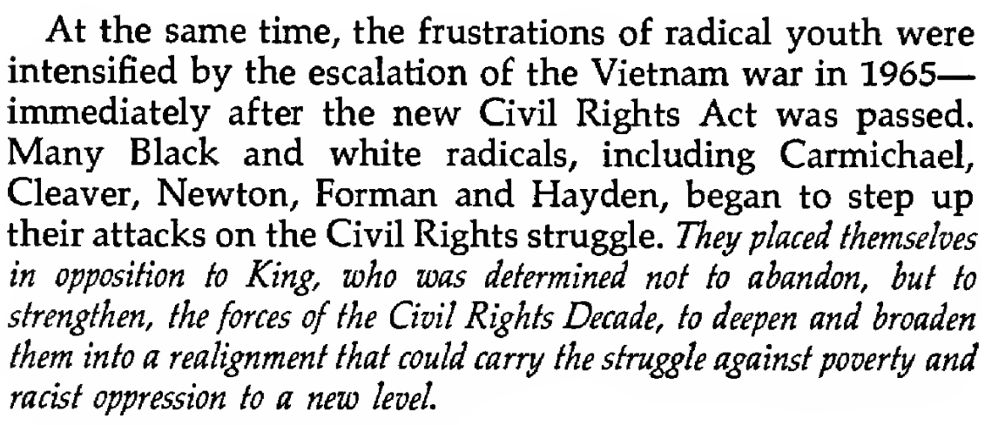
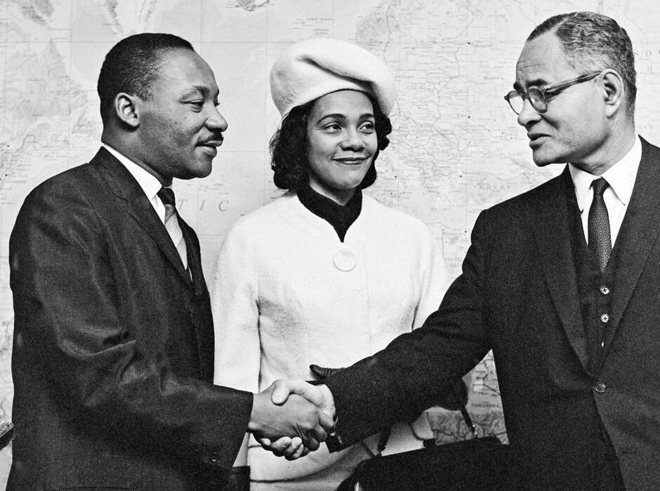
Chapter 15: Strategy for a Black Agenda - Strategy for a Black Agenda
During their visit to the United Nations, in 1964, Dr. Martin Luther King and his wife Coretta Scott King are greeted by Mr. Ralph J. Bunche, UN Under-Secretary for Special Political Affairs.
Photo: © UN Photo/Yutaka Nagata

Slide 26
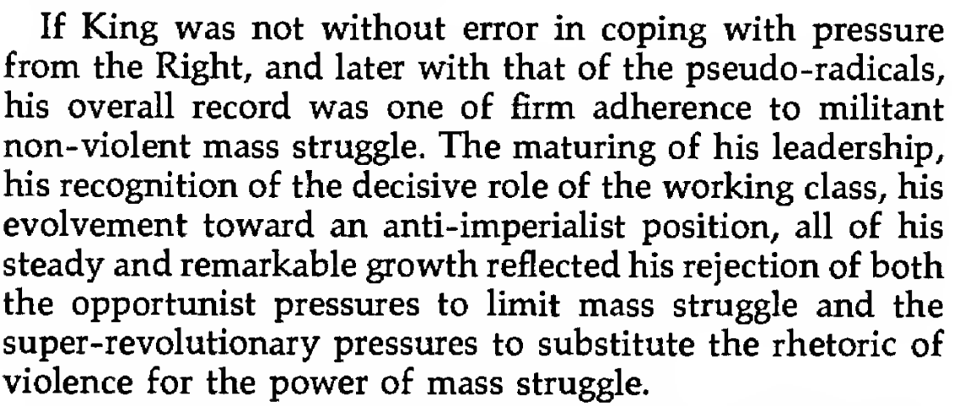
Chapter 15: Strategy for a Black Agenda - Strategy for a Black Agenda

Slide 27

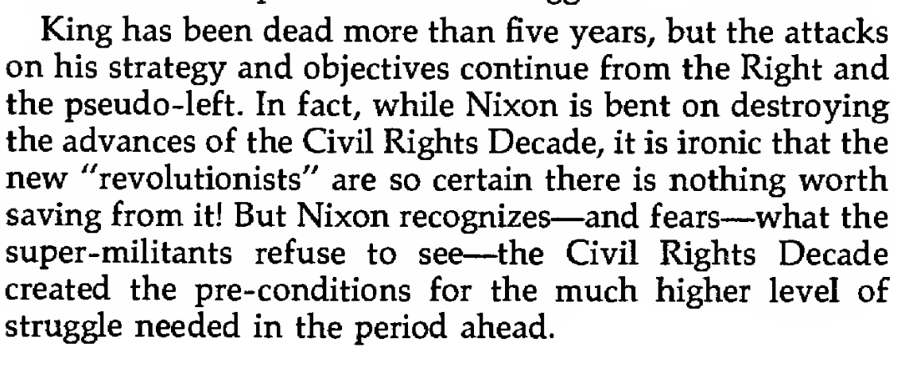
Chapter 15: Strategy for a Black Agenda - Strategy for a Black Agenda

Slide 28
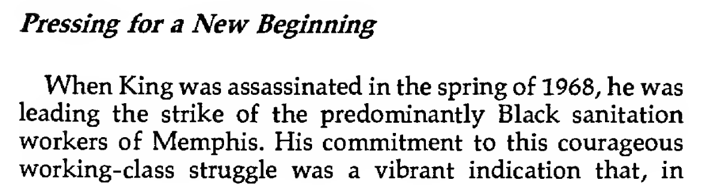
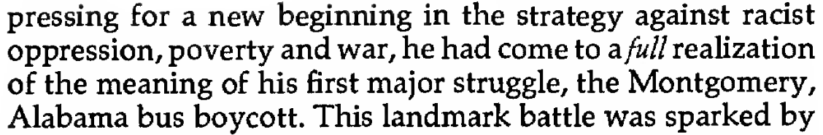
Chapter 15: Strategy for a Black Agenda - Strategy for a Black Agenda

Slide 29
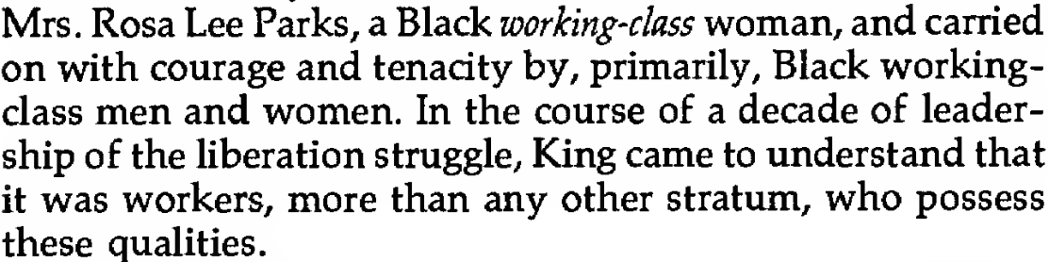
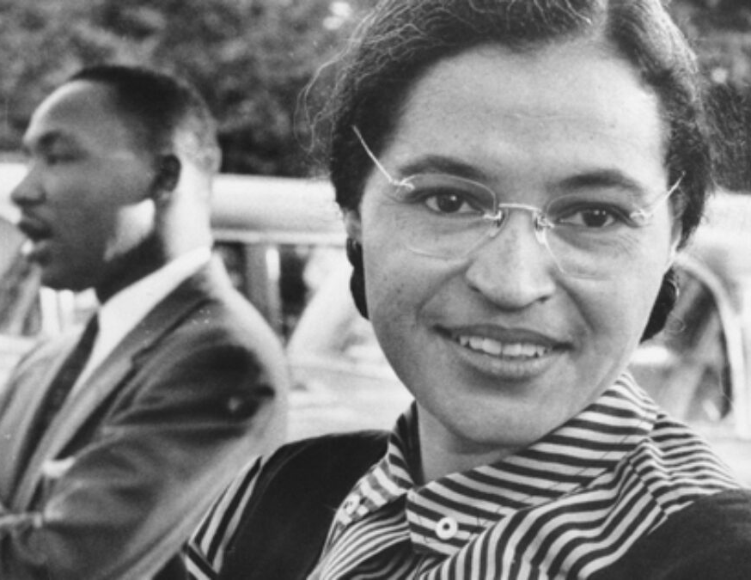
Chapter 15: Strategy for a Black Agenda - Strategy for a Black Agenda

Slide 30
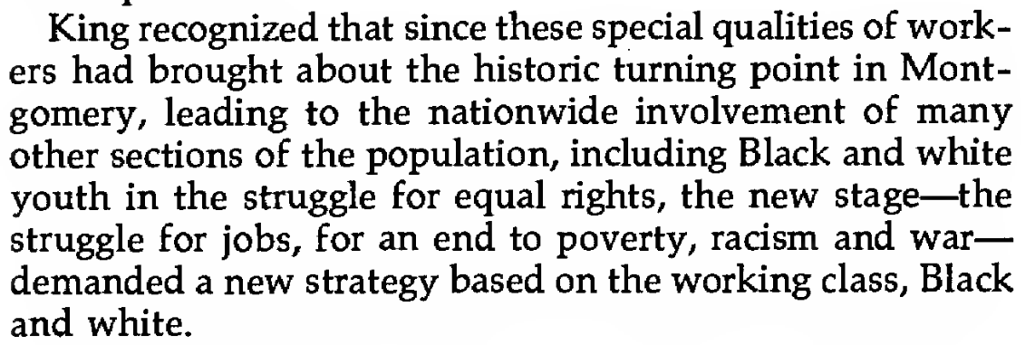
Chapter 15: Strategy for a Black Agenda - Strategy for a Black Agenda

Slide 31
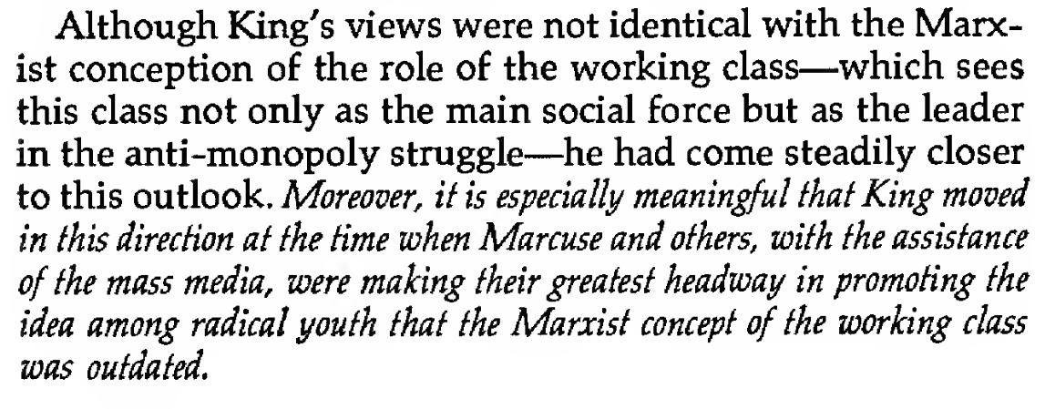
Chapter 15: Strategy for a Black Agenda - Strategy for a Black Agenda

Slide 32
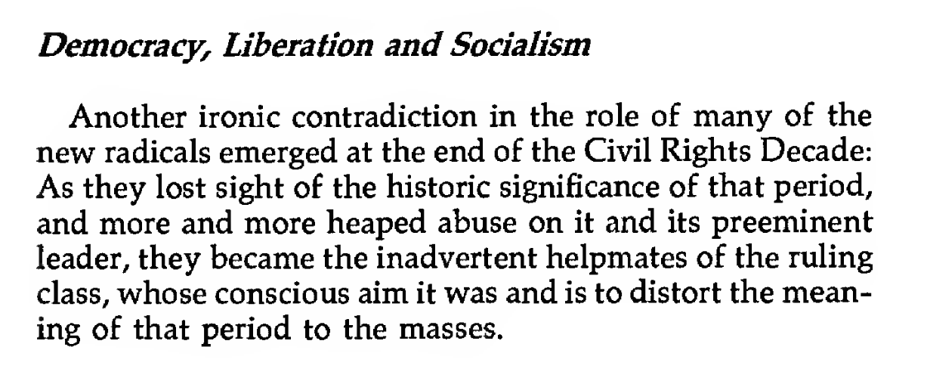
Chapter 15: Strategy for a Black Agenda - Strategy for a Black Agenda

Slide 33
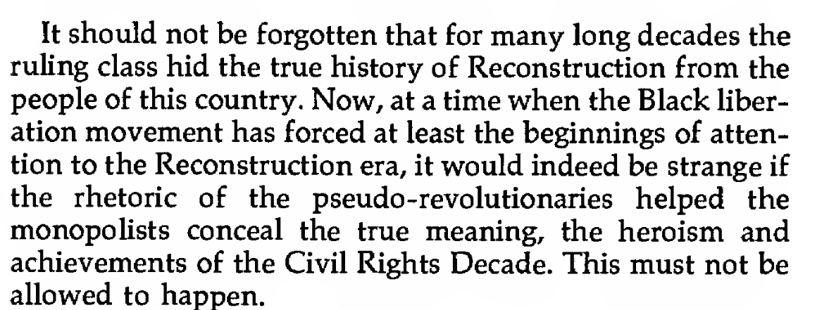
Chapter 15: Strategy for a Black Agenda - Strategy for a Black Agenda

Slide 34
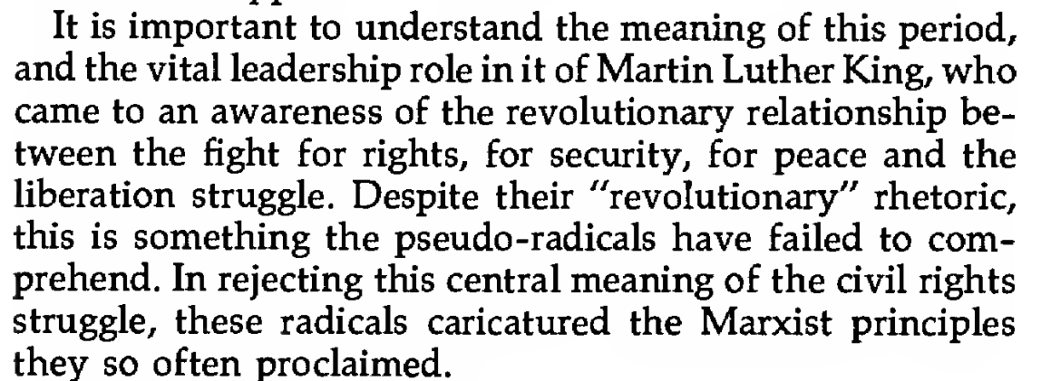
Chapter 15: Strategy for a Black Agenda - Strategy for a Black Agenda

Slide 35
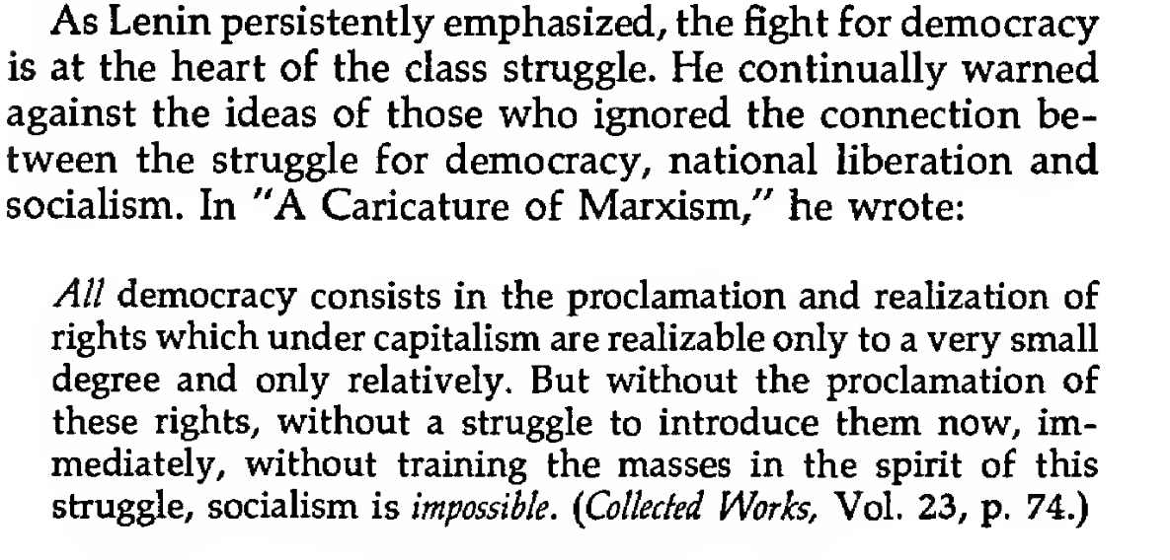
Chapter 15: Strategy for a Black Agenda - Strategy for a Black Agenda

Slide 36
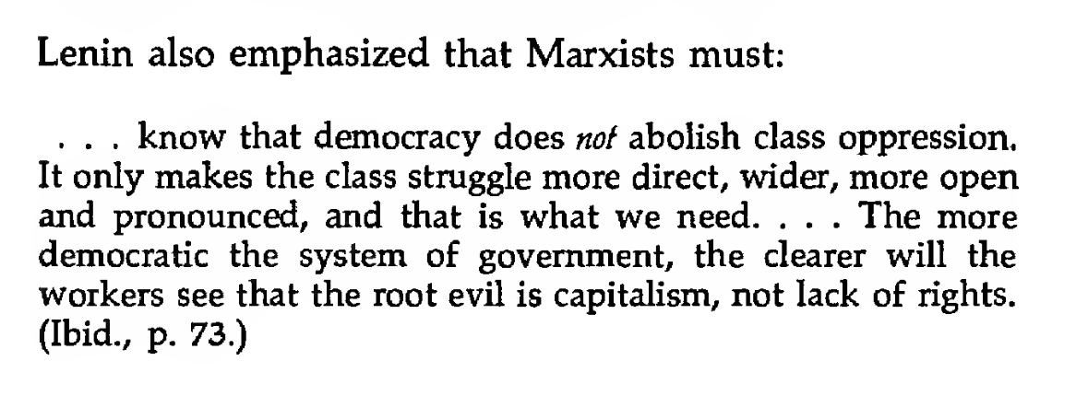
Chapter 15: Strategy for a Black Agenda - Strategy for a Black Agenda

Slide 37
Marxism & the National Question
In Marxism & the National Question, Stalin defines what constitutes a nation:
“A nation is a historically constituted, stable community of people, formed on the basis of a common language, territory, economic life, and psychological make-up manifested in a common culture.
It goes without saying that a nation, like every historical phenomenon, is subject to the law of change, has its history, its beginning and end.
It must be emphasized that none of the above characteristics taken separately is sufficient to define a nation. More than that, it is sufficient for a single one of these characteristics to be lacking and the nation ceases to be a nation.
It is possible to conceive of people possessing a common "national character" who, nevertheless, cannot be said to constitute a single nation if they are economically disunited, inhabit different territories, speak different languages, and so forth.”

Slide 38
The Black Belt Thesis
In the late 1920s, the Communist International passed and the CPUSA adopted a resolution stating that “the Negro question in the United States must be viewed from the standpoint of its peculiarity, namely, as the question of an oppressed nation” with distinctions “between the position of the Negro in the South and in the North.” The distinctions were a particular point of debate, as the Great Migration and changing class character of the African American masses necessitated revision of the original position.
In 1946, Claudia Jones wrote an essay, On The Right to Self-Determination for the Negro People in the Black Belt, Political Affairs, Vol. 25, No. 1, 1946. She wrote that for Black Americans in the North, “the struggle for equal rights… is chiefly that of heightening the fight to secure equal participation in every sphere of American life” which is “enhanced by the presence of a large and growing Negro proletariat”. In the South, particularly the Black Belt, she says that Black people are “an historically developed community of people, with a common language, a common territory, and a common economic life, all of which are manifest in a common culture” and therefore are an oppressed nation.
Her writing clearly states that although Black Americans residing in the Black Belt constitute a nation, this does not negate their struggle for equal rights and integration.

Slide 39
The Black Belt Thesis
During the Civil Rights Movement, the masses of African Americans struggled to secure integration “in every sphere of American life” on the basis of economic, democratic, political and social equality.
These struggles occurred at the peak of the second Great Migration. Black Americans in the South moved to urban centers in Northeastern, Western and Midwestern regions of the country, dropping the population of Black southerners from almost 80% to just over 50%.
During the 1950s, at the height of the McCarthyism, at both the 16th and 17th National Conventions, Party members debated the question of separatism. James Jackson, Party leader and founder of the Southern Negro Youth Congress (SNYC) concluded that the issue of Black liberation is still a national question, however Black Americans “are not constituted as a nation” and are an oppressed racial minority “who are a historically determined component of the American nation in the United States.”

Slide 40
The Black Belt Thesis
Ultimately, the Party adopted James Jackson’s analysis of the African American national question, explaining in Theoretical Aspects of the Negro Question in the United States that,
…the requisite preparation of the forces for effecting fundamental social change in the system necessitates the completion of the bourgeois-democratic norms of political, economic, and social development for the South in general and the Negro people in particular. Furthermore, a condition for accomplishing the prerequisite unity of the American working class with its class allies for advanced social struggle is to level main rails of the color bar. The struggle of the Negro people for the democratic goals of political, economic and social equality feeds into the general stream of the historic working class cause of our time – a powerful current which raises the torrential power of the whole cause of social advance.
This analysis was formed through participation in the Civil Rights Movement, lived experiences of Black workers along with Black members and candid observations of the historical trajectory of African American workers in struggle for equality that informed the analysis as well as the decision to adopt it as the Party’s official outlook.

Slide 41

Henry Winston on the Self-Determination, Black Belt Thesis and the National Question.

Slide 42
Discussion

Slide 43
From Anti-Slavery to Anti-Monopoly & A Strategy for a Black Agenda

Slide 44
Monopoly’s New Assault
Monopoly capital, within today’s context, aims to repeat the kind of assault on the people’s rights that led to the betrayal of Reconstruction. Reaction of that period, through racism and violence, prepared the way for the Supreme Court to void the Civil Rights Act of 1875, whose passage had been won by the supporters of Reconstruction to solidify the gains they had made. Reaction’s aim then was to push the country into a long era of segregation and semi-slavery. Today state monopoly capitalism seeks to wipe out every trace of the struggles of the recent Civil Rights Decade. The betrayal of Reconstruction, it should be remembered, was the signal for a three-sided attack against the masses. The Old Slave Codes were replaced by the new Black Codes, and the former chattel slaves were forced into semi-slavery, segregation and racist oppression. At the same time, the escalation of the military plunder and massacre of the Indians was entering a climactic stage. And simultaneously, the courts that upheld the betrayal of Emancipation were declaring that workers, Black and white, did not have the right to organize. In other words, the courts had not only revived Chief Justice Roger B. Taney’s pre-Civil War doctrine that the Black man “had no rights which the white man was bound to respect.” They had also extended this into another phase of repression—that labor, whatever its color, had no rights that capital was bound to respect.

Slide 45
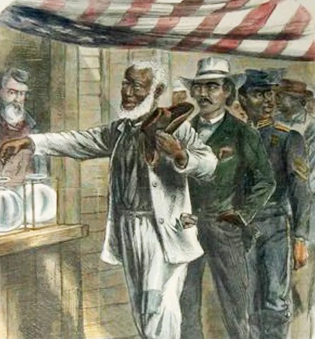
60 Years of Struggle Against the Violence of the Bosses’ Government
In 1875, when the robber barons were joining with the former slave owners to prepare for the 1877 betrayal of Reconstruction, Judge Holden Owen, presiding over the trial of striking Pennsylvania miners, declared: “Any agreement, combination or confederation to increase the price of any vendible commodity, merchandise or anything else is a conspiracy under the laws of the U.S.” Of course, this doctrine—like Nixon’s wage-”price” freeze—was applied only to labor, never to the capitalists’ profits.
Because of the perpetuation of racism and the resulting division between the triply-oppressed Black workers and the exploited white workers, it took more than 60 years of struggle against the bosses’ government-supported violence to win the right to organize. Today, the rights of labor are once again under grave attack, and labor’s fate, as in the past, is inseparably bound up with that of the Black liberation movement.
During Reconstruction, white terrorist groups like the Ku Klux Klan terrorized freed Black people.

Slide 46
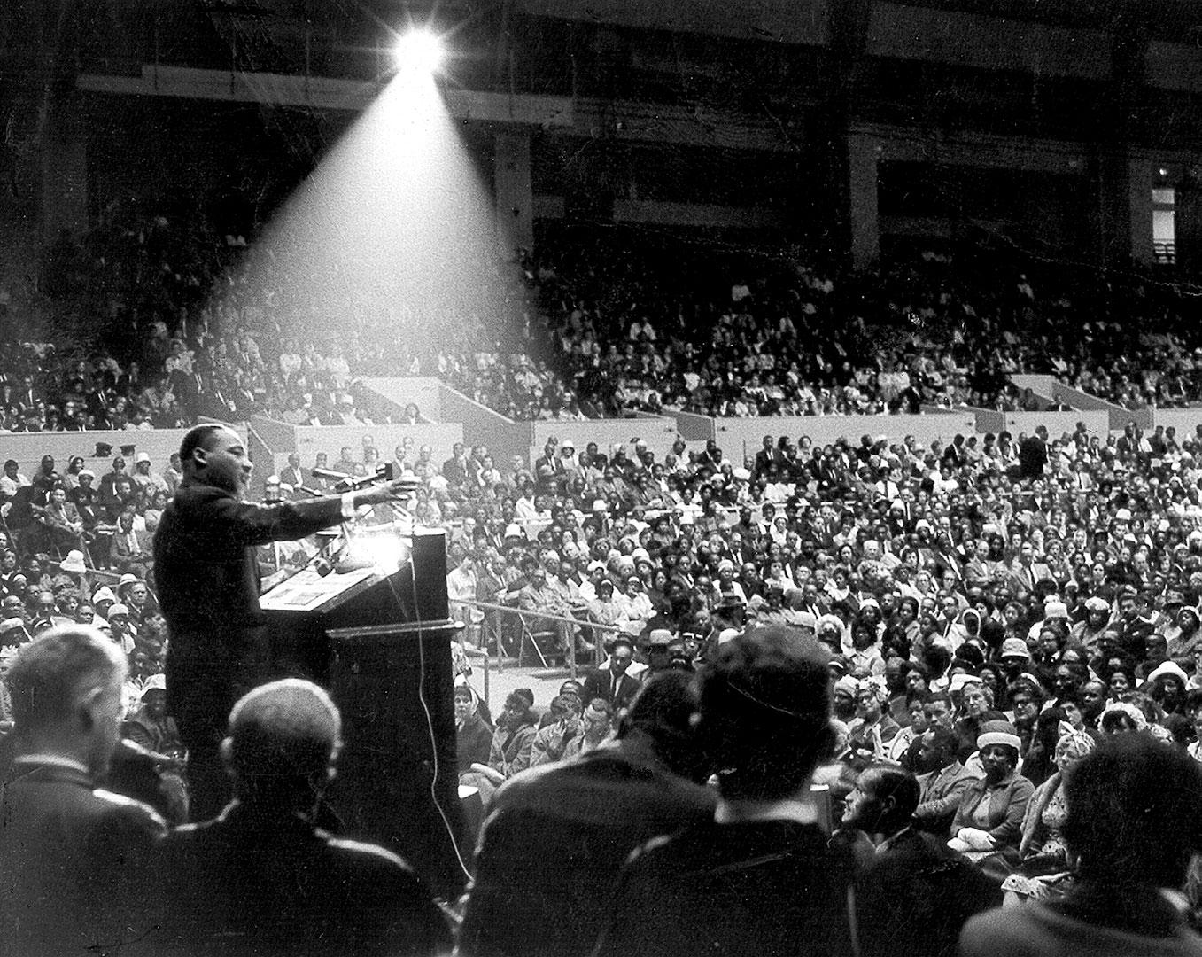
MLK Jr.’s Commitment to the Working Class
When King was assassinated in the spring of 1968, he was leading the strike of the predominantly Black sanitation workers of Memphis. His commitment to this courageous working-class was a vibrant indication that, in pressing for a new beginning in the strategy against racist oppression, poverty and war, he had come to a full realization of the meaning of his first major struggle, the Montgomery, Alabama bus boycott. This landmark battle was sparked by Mrs. Rosa Lee parks, a Black working-class woman, and carried on with courage and tenacity by, primarily, Black working-class men and women. In the course of a decade of leadership of the liberation struggle, King came to understand that it was workers, more than any other stratum, who possess these qualities.
The Rev. Martin Luther King Jr. speaks at an interfaith rally at the Cow Palace in San Francisco on May 30, 1964.

Slide 47
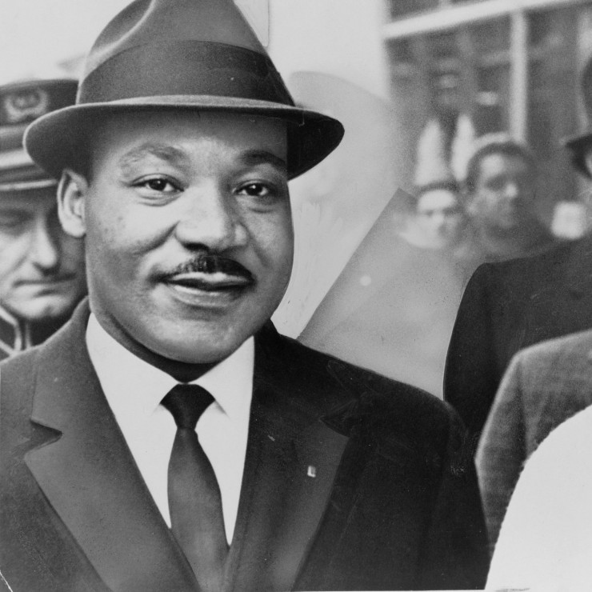
Punished for Moving in the Right Direction
King recognized that since these special qualities of workers had brought about the historic turning point in Montgomery, leading to the nationwide involvement of many other sections of the including Black and white youth in the for equal rights, the new stage—the struggle for jobs, for an end to poverty, racism and war—demanded a new strategy based on the working class, Black and white.
Although King’s views were not identical with the Marxist conception of the role of the working class—which sees this class not only as the main social force but as the leader in the anti-monopoly struggle—he had come steadily closer to this outlook. Moreover, it is especially meaningful that King moved in this direction at the time When Marcuse and others, with the assistance of the mass media, were making their greatest headway in promoting the idea among radical youth that the Marxist concept of the working class was outdated.

Slide 48
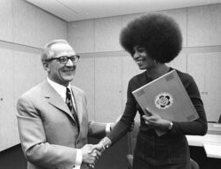
Genesis Of the Colony Theory
Among the radicals, Black and white, who have popularized the colony theory are Eldridge Cleaver, Huey Newton, Regis Debray, James Foreman, Tom Hayden, Harold Cruse, James Boggs, Stokely Carmichael and Robert L. Allen. It is ironic that many of these radicals, who claim that Marxism is European in origin and must be revised in order to apply to the Black people in the U.S., advance theories based on revisions of Marxism by such Europeans as Herbert Marcuse, Leon Trotsky and Regis Debray, as well as the Trotsky-like revisions to be found in the “thought” of Mao Tse-tung. It was especially under the influence of Marcuse and Maoism that the New Left radicals began to be attracted to one or another pseudo-revolutionary theory, including the concept of an “’internal colony” of Black people in the U.S. While Marcuse’s ideas are not identical with “the thought of Mao,” the views of both stimulated anti-Marxist misconceptions of the world revolutionary process, the historic role of the working class and its relationship to the liberation struggles of oppressed people, and the imperative need for strategies based on the specific features and historic development of each country, each working class and each national liberation movement.
Herbert Marcuse with his most famous student, Angela Davis

Slide 49

Marcuse, Maoism, and the New Left
During every upsurge in the people’s struggles, especially those of the mainly working-class Black people, there is a more extensive activation of counter-measures designed to sustain disunity and block alliance between Black and white workers, together with the Black people as a whole, against corporate monopoly.
In writing about this, Marcuse is revealed as very much a part of the problem, rather than the solution: Contemporary society seems capable of containing social change . . . the capitalist development has altered the structure and function of these two classes (bourgeoisie and proletariat) in such a way that they no longer appear to be agents of social transformation. An overriding interest in the preservation of the status quo unites the former antagonists in the most advanced areas of contemporary society.
Poster of Huey P. Newton sitting in a rattan throne chair while wearing a beret and holding a rifle and spear.

Slide 50

The Academic Elitist
Marcuse also makes it clear that his elitist contempt is not limited to the working class: “Technological controls appear to be the very embodiment of Reason for the benefit of all social groups and interests—to such an extent that all contradiction seems irrational and all counteraction impossible . . .”
And he spells out even more precisely which “social groups” are included in his elitist contempt in the following quotation: If the worker and his boss enjoy the same television program and visit the same resort places, if the typist is attractively made up as the daughter of her employer, if the Negro owns a Cadillac, if they all read the same newspaper, then this assimilation (!!!—H.W) indicates not the disappearance of classes, but the extent to which the needs and satisfactions that serve the preservation of the Establishment are shared by the underlying population.

Slide 51

Mass Satisfaction Instead of Mass Hatred of Exploitation, Poverty and Racist Oppression
There is, of course, no more truth to Marcuse’s assertion that Ford assembly line workers go to “the same resort places” as the Ford family (except as moonlighting waiters trying to make ends meet!) than to his racist stereotype of the Cadillac-owning Black workers. It is with such fantasies that Marcuse seeks to convince us that, even though classes have not disappeared, the struggle for class and national liberation has been eliminated because of “the extent to which the needs and satisfactions . . . of the Establishment are shared by the underlying population.”
This Alice-in-Wonderland vision of mass satisfaction—instead of mass hatred of exploitation, poverty and racist oppression—forms the core of Marcuse’s “revolutionary” ideology. And his inclusion of Black people among those incapable of “counteraction” is a direct ideological descendant of the racist stereotype of the “happy,” “docile” slave. It is logical that Marcuse’s contempt of the working class and of Black people be accompanied by hatred of the Soviet Union! The Soviet Union embodies the power of the working class and of formerly oppressed peoples. It is precisely such forces that will end exploitation and racism in the U.S. and internationally.

Slide 52

Short-Cut Theories are a Roadblock
It is not far-fetched to assert that those influenced by Marcusian ideology—which dismisses the masses, Black and white, as incapable of struggle against racism and exploitation—would be receptive to any theory seeming to offer a “short cut” to mass struggle. In the recent period these “short cuts” took the form of advocating “instant revolution,” “power out of the barrel of a gun,” “urban guerrilla warfare,” etc. However, as this rhetoric became increasingly exposed as a roadblock to mass struggle, the colony theory emerged as a new diversion. The colony theory, with its radical ring of protest against oppression, has great attraction for radicals on the Left and for advocates of “Black capitalism” on the Right. Although concealed by a rhetorical facade of “colonization,” “under-development,” etc., both these groups can be found on a parallel—or even a common—platform of accommodation to monopoly. However, those radicals who advance the “Black colony in the U.S.” theory fail to see the historic distinction between the effect of the slave trade on Africa—which altered Africa’s relationships internally and externally and resulted in the colonial subjugation of many African peoples—and the role of slavery within the United States.
Black Panther Party outside of the Capitol building in Olympia protesting a gun-control bill - February 28, 1969

Slide 53
Winston On Marx and Capital
The African people transported to slavery within the U.S. became the basis of and impetus for the most rapid rate of original capitalist accumulation in history. Every people, on every continent, has passed through one or another form of slavery in the course of world history. But slavery in the United States was unique: it was the most massive, the most brutal type, because it was directly tied to the capitalist market, to the rise of capitalism. Karl Marx wrote:
. . . as soon as people, whose production still moves within the lower forms of slave-labour . . . are drawn into the whirlpool of an international market dominated by the capitalistic mode of production, the sale of their products for export becoming their principal interest, the civilized horrors of overwork are grafted on the barbaric horrors of slavery, serfdom, etc. . . . But in proportion, as the export of cotton became of vital interest to these states, the over-working of the Negro and sometimes using up of his life in 7 years of became a factor in a calculated and calculating system. It was no longer a question of obtaining from him a certain quantity of useful products. It was now a question of production of surplus-labor itself. (Capital, Vol. l, p. 236, International Publishers, 1967.)

Slide 54
Winston On Marx and Capital Cont.
Many times Marx compared the inhuman exploitation of workers in the textile mills of England and New England in the pre-organization days of the working class with that of the slaves in the South. At the same time, Marx did not confuse analogies in intensity of exploitation with scientific explanations, as do the contemporary advocates of the colony theory. Marx never lost sight of the distinction between the nature and role of exploitation on a directly capitalist basis.
Marx, for instance, quoted this statement from the County Magistrate of Nottingham, which appeared in the London Daily Telegram of January 17, 1860:
. . . There was an amount of privation and suffering among that portion of the population connected with the lace trade, unknown in other parts of the kingdom, indeed, in the civilized world. . . . Children of nine or ten years are dragged from their squalid beds at two, three, or four o’clock in the morning and compelled to work for a bare subsistence until ten, eleven, or twelve at night, their limbs wearing away, their frames dwindling, their faces whitening, and their humanity absolutely sinking into a stone-like utterly horrible to contemplate. . . . We declaim against the Virginian and Carolinian cotton-planters. Is their black market, their lash, and their barter of human flesh more detestable than this slow sacrifice of humanity which takes place in order that veils and collars may be fabricated for the benefit of capitalists? (Ibid. , pp. 243-244.)

Slide 55
Moynihan-Kissinger Doctrine and the “Third World”

Slide 56

Who was Daniel Moynihan and why is he important?
Moynihan served as Assistant to the Labor Secretary under JFK and Lyndon B. Johnson and as Assistant to President for Domestic Affairs
He was later made the US Ambassador to the UN
In 1965, he published a report that sought to take blame for poverty in the black communities away from corporate America and placed the blame on family structures within the black community
Daniel Moynihan

Slide 57

Moynihan Report Briefly

Slide 58

Moynihan Report Briefly

Slide 59


Slide 60

Moynihan Report Briefly

Slide 61

Daniel Bell’s “Revolution of Rising Entitlements”

Slide 62


Daniel Bell’s “Revolution of Rising Entitlements”
We see that inflation is generally directly proportional with unemployment and inversely proportional to economic growth

Slide 63

The Anti-Monopoly Coalition is Needed to Halt the Crisis in Capitalism

Slide 64


The Anti-Monopoly Coalition is Needed to Halt the Crisis in Capitalism

Slide 65

The Anti-Monopoly Coalition is Needed to Halt the Crisis in Capitalism

Slide 66
Discussion

Slide 67
Discussion & Wrap Up

Slide 68
Announcements
PCUSA Cell Chairs need to call members of their cells to remind them about attendance.
The next issue of New Masses (2026) has begun production. If you have art you want us to feature, email it to info@partyofcommunistsusa.net.

Slide 69
Volunteers Needed!
We are in need of volunteers for the staff of the People’s School! Here’s a few roles we need filled:
People to help manage posting on our social media and podcast platforms
Video Editors, Audio Editors, Graphic Designers, Artists, Narrators
Web Controls, Moderators
Email info@peoplesschool.us if you’re interested and try to attend our next staff meeting if possible.

Slide 70

View From Left Field
https://viewfromleftfield.libsyn.com
The Old PSMLS Youtube is now the Youtube of View From Left Field, a podcast of analysis and discussion of current events from a progressive perspective.
Like the Youtube videos and subscribe with 5 star ratings on your podcast platforms.

Slide 71





New Outlook Publishers
newoutlookpublishers.store
Relevant and Latest Releases

Slide 72



Harry Bridges School of Labor
luel.us/laborschool/
The Harry Bridges School of Labor is a monthly class covering a variety of topics aimed at building class consciousness among union members. For class schedule and other information, please visit the website at luel.us/laborschool.

Slide 73

The Internationale

