Slide 1

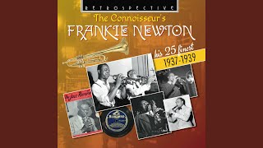
Frankie Newton - Port of Harlem Blues

Slide 2
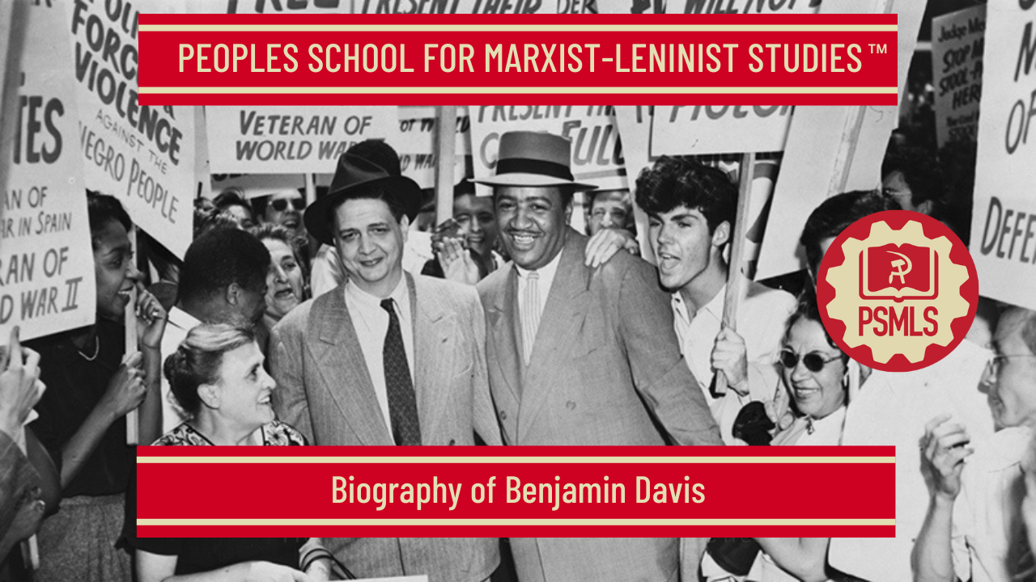
PSMLS 2/17/2026

Slide 3
What we’ll be learning today:
Biography of Benjamin Davis
Excerpts from Why I’m a Communist
What does Ben Davis mean for today?

Slide 4
A Communist Lawyer in the Jim Crow South: Selections from the Autobiography of Benjamin Davis

Slide 5
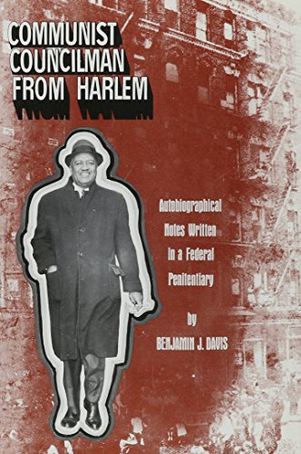
Born Into a Segregated World
The early years of my life in Atlanta followed a middle-class standard of living which was the consequence of my father’s economic success. Naturally, this, in some degree, spared me some of the social burdens and handicaps of the jim-crow system. I attended Summer Hill public school from the first to the sixth grades. It was, of course, segregated. There were no sidewalks, and I can remember wading through seas of mud whenever it rained. The teachers and the principal were all Negro. In fact, from my birth in Dawson until I finished public school in Atlanta, I lived in a world entirely apart from white Americans—I lived in the Negro-American world. I went to Negro churches, played with Negro children, went to segregated Negro schools, lived in a ghetto with Negro drug stores, barber shops, movies, haberdasheries, and so on. White people were a strange lot to me. The only contact I had with them was hateful. I regarded them as colorless—especially physically—somewhat inferior, wicked and authoritarian. I observed them as policemen —bosses with no other mission in life but to oppress, arrest and mistreat Negroes. Such was my experience—the only experience afforded by the social setup of the “free world” of the early 1900’s. Such was the experience of every Negro kid, and it drew us together in a strong common bond—one that binds all Negroes together, irrespective of social position, age, sex, color, creed, political affiliation or economic status.

Slide 6
A Southern Education
It seemed as natural to my father that I should attend Morehouse College, rather than Atlanta University. I preferred Morehouse—its football fame was far and beyond the others. But my preference at this age was hardly decisive, to put it mildly. There were certain secondary considerations which entered my father’s thinking. He was a self-made man, and he thought his own upbringing was the only path to individual success and achievement. While he was determined that my sister and I should get the best education possible, he was, by the same token, afraid of any softness of character that our relatively high standard of living might engender. He was constantly haunted by the specter of an indulged, good-for-nothing son. I heard this note in every disagreement between us, every time he disapproved of me. He wanted to balance my easy life at home with hard, tough discipline. He figured that Morehouse with its rough-and-ready boys’ student body was better suited to his aim than Atlanta University, a co-educational institution. What was more, he wanted to get me away from having a car at my disposal, and the like. So I entered Morehouse as a boarding student, living on the campus, with all the restrictions the other boys had (one had to get a permit to leave the campus), eating the same plain, modest fare—with no more privileges than the poorest farmer’s son from the backwoods of Georgia. The students at Morehouse were, by and large, sons of poor parents, with quite a few working their way through. I was a boarding student for the entire seven years I attended, going across town to my home once or twice a month to spend weekends.

Slide 7
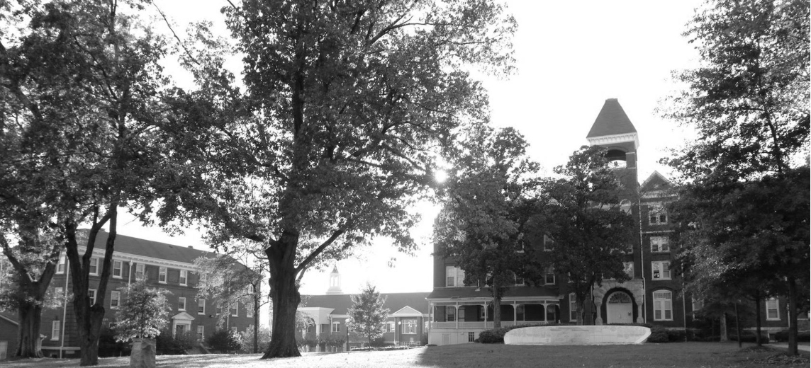
The Sun Rose and Set in Morehouse
The seven years at Morehouse were spent during a highly formative period of my youth. The sun rose and set in Morehouse, and it was here that my democratic orientation toward life received its grounding. Here, too, I learned more about my people, their potentialities and talents. The seven years served to seal off my mind further from whites—except as unknown and repressive strangers.
Morehouse College
Along with my studies, I learned human warmth. I also learned that Negroes ran colleges as efficiently as anyone and that Negro students—far from being “shiftless,” as the slanderous white supremacists maintained—were full of ambition and high purpose. I learned, too, what a “religious atmosphere” is—the meaningful phrase that still adorns the ads of Southern Negro institutions in The Crisis. In practice, a religious atmosphere is one in which free thought is forbidden. If religion is designed to deaden the militant dissatisfaction of the masses, it also becomes a potent weapon in wangling donations from white philanthropists who are titillated at the sight of a “healthy corps of religious, spiritual singing Negroes.” Negro college presidents became past masters in the use of this weapon. (Such are the blessings of Christianity.)

Slide 8
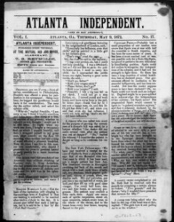
A Detour into Journalism
After finishing my law course at Harvard, I did not enter immediately into the practice of my profession. I detoured into the field of journalism. By the time I got out of law school, I was pretty weary of school in general and law in particular. I had been attending school every year from the time I was six until I was twenty-five. And these 19 years had brought me no closer, I thought, to the solution of the problem that hammered at me every day—the securing of my birthright as a free and equal American citizen. In many respects the problem had even been intensified in school. The contradiction set up within me was between the rare luck of my being able to attend such highly rated institutions and the inferior status imposed upon me by the society of which Amherst and Harvard were social pillars. When I returned to Atlanta after my final year at law school, my father wanted me to enter the office of a Negro assistant federal attorney in Illinois. But I demurred: I wanted to look around a bit. Finally, I consented to enter a firm of publishers’ representatives that secured national advertisements for my father’s paper, the Atlanta Independent. My job was to edit the literary material and to supervise the publication of the advertising insert. I remained at this work from 1929 to the middle of 1931.

Slide 9
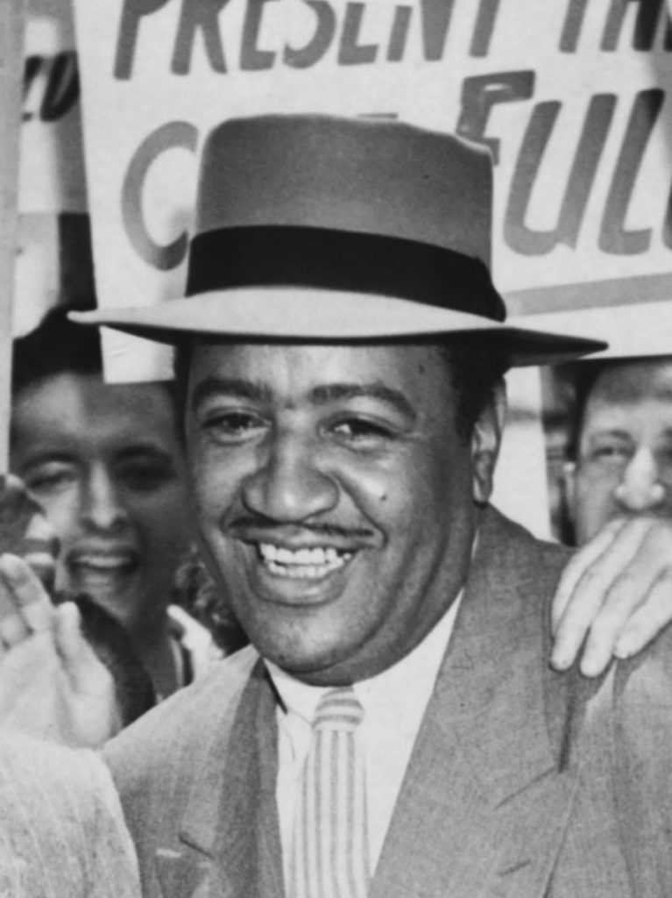
Searching for the “Holy Grail”
The quest for an answer to my problems had taken me through college and law school into practical journalism; from Atlanta to Massachusetts, to Illinois and Maryland and back to Atlanta, but I had not found the “holy grail.’ I might as well, I reasoned, begin the practice of law. So I did, in January of 1932. I began to practice law in Atlanta, after having been admitted to the Georgia bar. It wasn’t so much that I wanted to practice law but that I was profoundly influenced by the conditions of 1932—the great depression and its devastating effects upon my own people. These entered into my thinking and concerned me more than the actual practice of the law—with its pleadings and technicalities. At the time there were only four other Negro lawyers in Atlanta—probably less than a dozen throughout the state. The courts are the main pillars of the jim-crow system. Negro oppression extended to literate Negro lawyers no less than to illiterate Negro sharecroppers. It made the role of a Negro lawyer fighting for justice a tragic-comic spectacle. If he dared to represent a white client—assuming that some such insane litigant could be found—he invited a lynching and the white client invited ostracism, if not worse, as a betrayer of white supremacy. No Negro lawyer wanted to submit himself to such a hazard to life and limb, unless, of course, he deliberately set out to challenge it.
Benjamin Davis

Slide 10

Becoming Closer to the Fate of Your People
In the field of civil rights and equality before the law, the frame-up of the nine Scottsboro boys early in 1931 was the measure of justice to the Negro in the South. These youths—all in their teens—were bumming their way on a freight train in search of work to aid their poverty-stricken families. They were snatched from the freight and charged with raping two white girls, also hoboing in search of employment. They were quickly railroaded to a death sentence, which they narrowly escaped when the conscience of the nation was aroused by the efforts of the Communist Party and the International Labor Defense. This, then, was the social and economic background against which I entered upon the practice of law. It contrasted rather sharply with the relative security that I had known as a middleclass person who possessed the necessary equipment for a moderately successful career—for a Negro, that is. Of course, I had learned certain positive lessons of struggle from my father and mother, and I had suffered painful, humiliating and sometimes threatening experiences as a Negro youth. These deeply rooted realities drew me closer to the fate of my people. On this mixed, patternless and somewhat contradictory background, my objectives began to take shape when I began my practice—and especially when I entered into the Herndon case.

Slide 11
The Herndon Case
In June 1932, I read in the Atlanta Constitution that Angelo Herndon, a 19-year-old Negro Communist youth, had been charged with “attempting to incite insurrection”—in violation of a Georgia statute which carried the death penalty. As originally passed in 1861 by the Georgia Legislature, the law was directed against slave insurrections, but was revised in 1871 to apply to both white and Negro “insurrections.” A brief conference with my law partner, and I was off. Herndon was imprisoned in the Fulton County Towers. I went there at once and, as an attorney, gained permission to interview him. Herndon led an unemployed demonstration to the Fulton County Courthouse to demand bread, jobs and relief, he was arrested, and the anti-insurrection law, passed 66 years before and applying to an entirely different situation, was dug up to get Herndon. Actually, the real aim was to intimidate the people in the growing unemployed movement, to beat down their struggle against starvation and, above all, to stop what might one day drive the Southern plantation owners and lynch officials from power—the unity of Negro and white. Herndon had been selected as the target because, as in all such situations, the Negro is the most convenient scapegoat. He was indicted and held without bail. I was greatly impressed by Herndon’s story and demeanor and I offered at once to serve as council without fee. It was most shocking to me that a man could be put on trial for his life on the facts he had told me. I pledged then and there that I would move heaven and earth to secure his freedom and vindication.

Slide 12
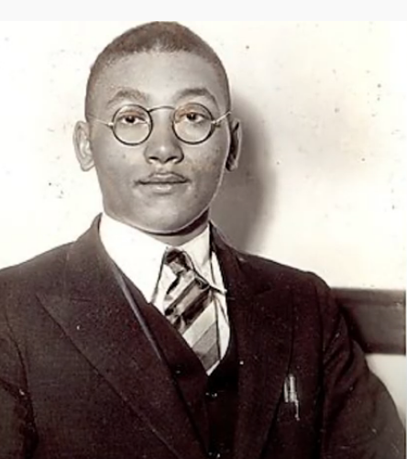
“I am still an organizer of the Communist Party,”
A couple of weeks after we were retained, we moved for bail for Herndon. He was released on a $5,000 bond, which was obtained until his conviction in January 1933. We offered him a place to live, decent clothing and a job as soon as he was released. But he declined all our assistance, saying, in effect, that his work was cut out for him and that he had “urgent business” with his comrades. “What sort of business?” I inquired. “I am still an organizer of the Communist Party,” he said. “I’ve lost a lot of valuable time in jail. The key thing now is the organization of the unemployed and that’s what I want to give my main time to.” “But I need you most of the time in preparing your defense.” “I’ll be ready anytime you want me. I'll get in touch with you every day, and you let me know when you want me.” This attitude was somewhat surprising to me. Here was a man on trial for his life, who, immediately upon his release from jail, wished to return to the very activities for which he was under indictment. He didn’t want any commiseration even from his lawyer. He was right, of course; if his activities were perfectly legal and constitutional, why shouldn’t he continue them?
Angelo Herndon

Slide 13
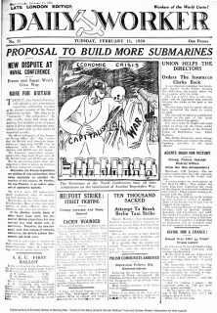
Marxist Classics and Communist Literature
The state police, who have no jurisdiction over federal property, had seized him and had confiscated his papers without a shred of authority. We secured a return of this material—mostly books, pamphlets, leaflets and old copies of the Daily Worker. The state officials, however, after releasing him from custody, arrested him at his home—this time legally. There they confiscated a number of leaflets, books and other educational material. Some of it pertained to the unemployed councils, others were Marxist classics and literature published by the U.S. Communist Party. The state based its case upon three of these pamphlets and an article in an issue of the Daily Worker. The pamphlets were: The Communist Position on the Negro Question, another on the lynch oppression of the Negro people, and a third, entitled Communism and Christianism—an attempt by Bishop William Montgomery Brown, retired, to relate Marxism to Christian ethics. The article in the Daily Worker was entitled, “Everythng is Peaches Down in Georgia.” It was a Satire, citing the lynching, police brutality, peonage, unemployment, starvation and repression imposed upon the Negro and his poverty-stricken white fellow-Georgians.

Slide 14
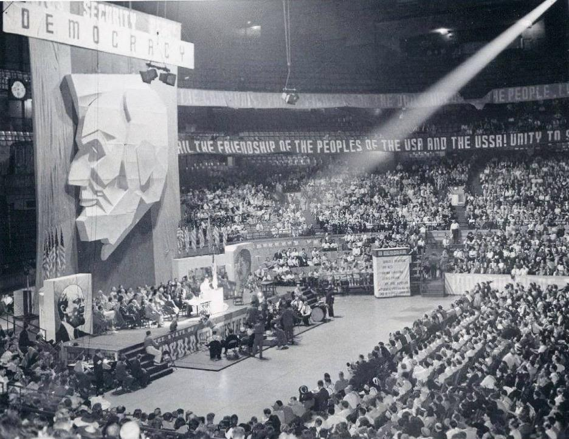
Witnessing a Communist Cell in Operation
I not only read these four pieces of literature; I studied them diligently. In seeking to understand them thoroughly, I followed up all the references, going frequently to the classics by Marx, Engels, Lenin and Stalin. By the time the trial rolled around, I had a fair grasp of some of the basic theoretical principles of Marxism and of the program of the U.S. Communist Party. But this was only one part of my preparation. I considered it essential to learn about the practical side at first hand. I wanted to see for myself, and it was arranged that I should attend a few sessions of a Communist branch. In this and subsequent meetings I found that the usual procedure was to discuss a major political issue, international or domestic, to make plans and proposals on local questions—unemployment, lynch terror, the Herndon case—pay dues (10¢ a month). They usually ended with refreshments. Occasionally classes in citizenship and in elementary reading and writing were held. (Later, after I myself became a member, I often taught these classes.) Thus I witnessed a Communist branch in actual operation. I liked the experience so well that I never permitted a week to pass without attending a meeting. I enjoyed the society of these people even though they were cautious at first—until they felt sure that I was sincere and not a “plant” in lawyer’s guise
CPUSA Convention - 1930s

Slide 15
The Path of Liberation
Our last witness in this case was the defendant himself. Under the laws of Georgia a defendant could make only an unsworn statement on the stand and was immune from both direct and cross examination. Herndon kept the courtroom enthralled for 35 minutes, uttering the now famous words: “No matter what you do with this Angelo Herndon, thousands more will arise to take his place, to fight the battles of the Negro people and the workers until they are free.” To the Negro people in that courtroom, and for the oppressed, colored and white, all over the world, these words gave inspiration and strength. This was the climax of the trial. It had arrayed the world of white supremacy and racial hatred against the forces of freedom and dignity. Later that evening, I turned over to my client my application to become a member of the Communist Party. My association and experience with the Communists and the study of Marxism incidental to my preparation for the defense (as well as my own victimization as a Negro by the jim-crow system) resulted in that decision. I was, at 29 years old, sure of the Marxist outlook as the path of liberation for the Negro people, the path that would lead to the betterment of the entire American people. At last I was able to counterpose to my father a solution of the struggle that he had engaged in for 50 years of his life without getting nearer to first-class citizenship. What I had not found at Morehouse, Amherst and Harvard I had discovered in a dingy Georgia courtroom whose realities were far more penetrating than the abstractions of classical scholarship

Slide 16
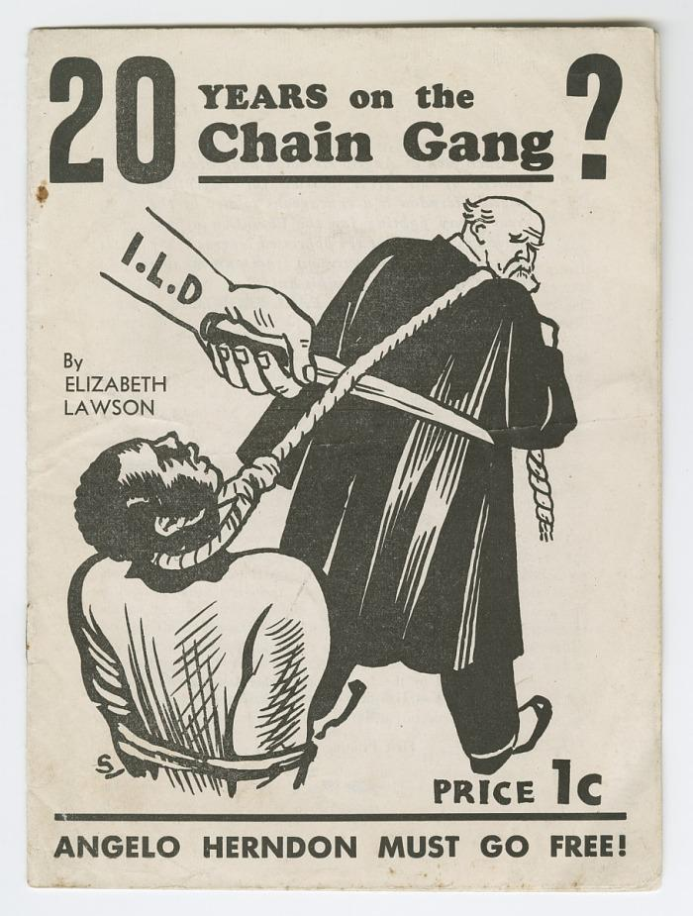
Finding the Holy Grail
I was amazed when the jury took three hours to arrive at a verdict. “Have you arrived at a verdict?” the court inquired. “We have, your Honor,” said the foreman. “What is it?” “We, the jury, find the defendant guilty—with a recommendation of mercy.” I knew what that meant—20 years on a Georgia chain gang. A living death! There was a sigh in the courtroom. I made two motions—one to set aside the verdict, the other to continue my client’s bail. Both were summarily denied. The bailiffs latched vigorously on to Herndon’s arms and practically shoved him out of the courtroom. I grabbed his hand. We looked at each other with understanding. I assured him of an immediate appeal. As for me, I had entered the trial as his lawyer and ended it as his Communist comrade.

Slide 17
Discussion & New Members Introductions

Slide 18
New Member Introductions
What is your name, pronouns and state (or country/territory)?
Where do you work? Is it unionized?
How did you find out about the People’s School?
What do you think about tonight's class?

Slide 19
Why I’m a Communist by Ben Davis

Slide 20
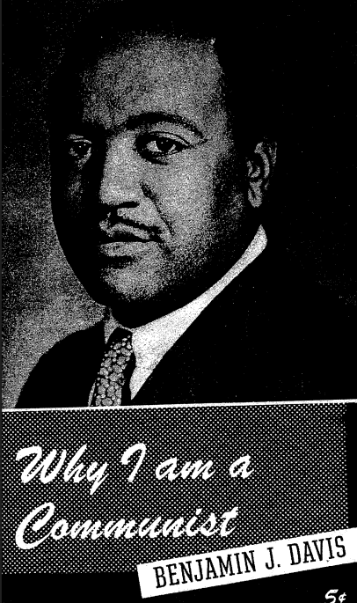
Reading from Why I am A Communist
In this section we’ll read from “Why I am a Communist” written by Benjamin J. Davis and published in the June 1947 issue of Phylon.

Slide 21
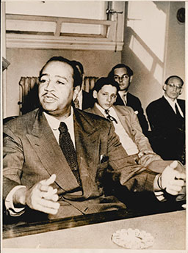
Negro Americans Want First-Class Citizenship
As a Negro American, I want to be free. I want equal opportunities, equal rights; I want to be accorded the 7 same dignity as a human being and the same status as a citizen as any other American. This is my constitutional right. I want first-class, unconditional citizenship. I want it, and am entitled to it, now.
I want to be free of discrimination, Jim Crow, segregation, lynch law; I want to be free of second-class citizenship. This is the deepest and most determined desire of the fifteen million Negro citizens of America. All Negroes, in one form or another—or to one degree or another—are affected by Jim Crow, segregation and discrimination. The Negro workers, that is, the great mass of Negroes, bear the heaviest brunt of the national Jim Crow system.
I am a typical American, who loves liberty and freedom —the same liberty and freedom that a Dewey and a Truman would sacrifice to the golden altar of American imperialism, in the name of "fighting Communism."
Out of my personal experiences as a Negro American, and in quest of the liberty, freedom and equal rights proclaimed in the Constitution, the Bill of Rights and the Declaration of Independence, I, like thousands of other Negroes—and white citizens—joined the Communist Party.

Slide 22
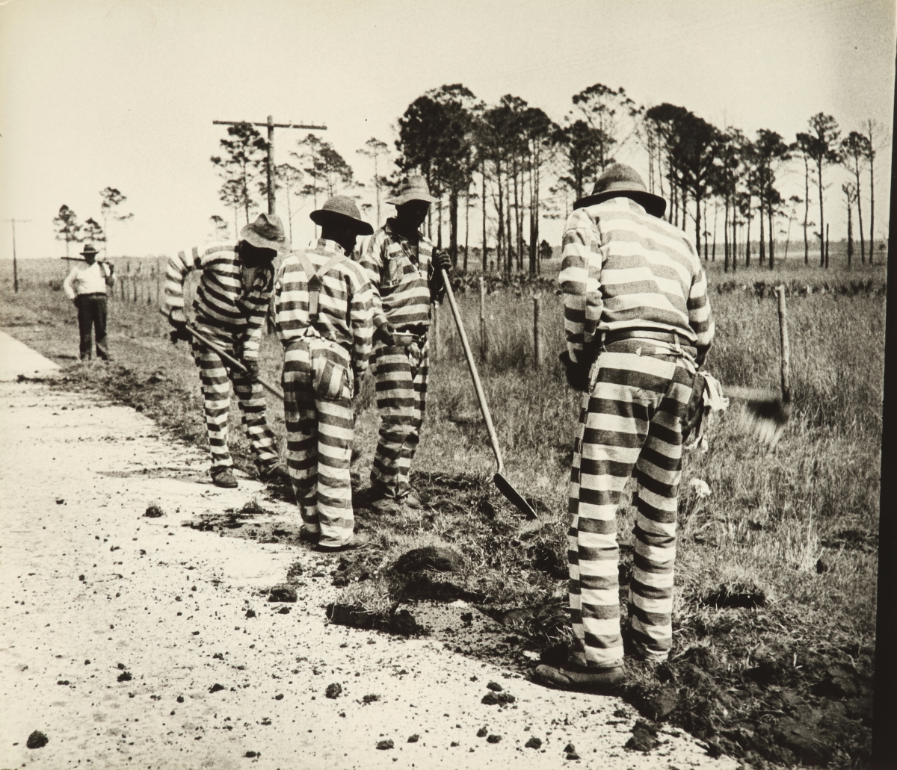
I Joined in the Heat of Battle
I became a member of the Party in January, 1933, in the heat of battle. At the time, I was serving as defense attorney for Angelo Herndon in Atlanta, Georgia, where Herndon, an eighteen-year-old Negro youth, had been framed on a charge of inciting to insurrection—a charge based on an antiquated and outmoded statute.
The charge carried with it the death penalty, but the jury "mercifully" —as I was given to understand by the judge—recommended twenty years for young Herndon on the Georgia chaingang! Such "mercy," of course, meant a living death instead of an instantaneous death in the electric chair.
His sentence was so raw that, after an extended campaign of mass pressure and public opinion led principally by the Communist Party and International Labor Defense, he was finally freed.

Slide 23
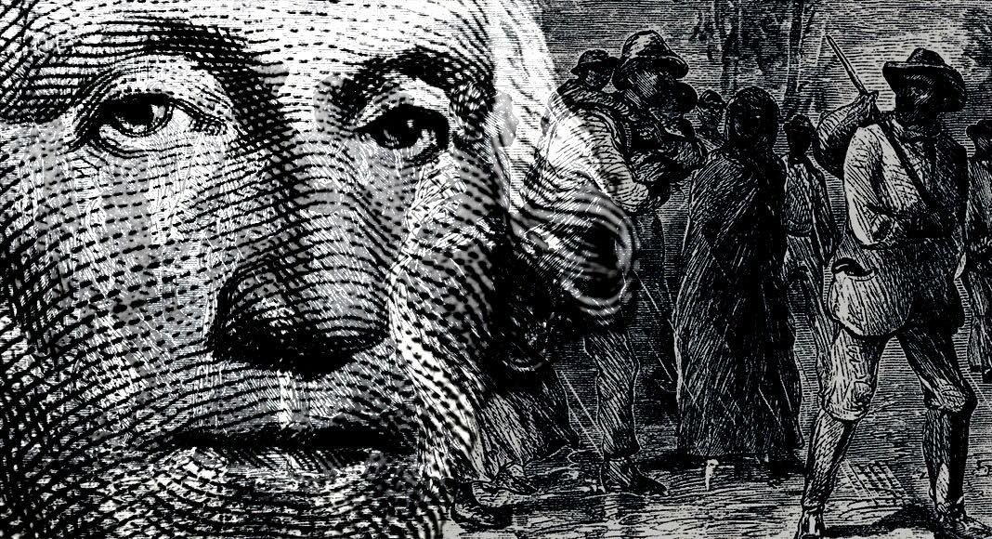
Capitalism Breeds Racial Hatred
Racial, religious and other discriminations are weapons of capitalism to intensify its exploitation of certain sections of the population, to keep down the wages and working conditions of the working class, and to prevent the working people from uniting against the common foe—capitalism.
The Negro people constitute the most oppressed section of the population, and in the Black Belt of the deep South, where they're in the majority, they constitute a source of super-profits for Wall Street—the brain center of American capitalism. When capitalism is abolished—as it will be when the majority of American people so decide—the basis will have been laid for the real brotherhood of man, implicit in the Declaration of Independence.
The only place where there is such brotherhood is in the Soviet Union, which, in 1917, abolished capitalism, and now more than 50 nationalities, many of them darker peoples, live in freedom and equality. Can there be any wonder that political minions of Wall Street rave against the Soviets? And is there a sounder reason for the closest collaboration between the United States and Russia?
Naomi Koo for ProMarket

Slide 24
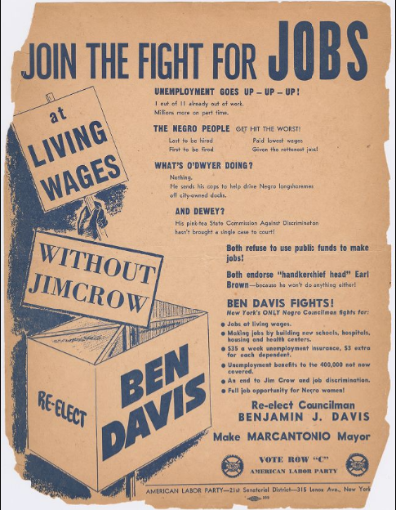
Labor Is The Negro People’s Ally
No section of the population has a greater interest in seeing one united labor movement in America than the Negro, who, like labor itself, has been constantly victimized by this split.
"Negro and white, unite and fight the common oppressor' must be transformed into reality wherever man is exploited or oppressed. Simultaneously, the broadest unity of the Negro people's movement on a local and national scale, is not only crucial, but it is the deepest desire of the Negro people.
Finally, it is essential that the Negro people take their place on the basis of equality in the growing movement in America for independent political action—for the creation of a national third party, based upon the labor movement, the poor farmers, the middle class and the antifascist majority of the American people.
What this country needs is a new political party in which labor and the people—Negro and white—will be the dominant force in its policies, instead of the National Association of Manufacturers and the U. S. Chamber of Commerce and assorted Wall Street pirates.

Slide 25
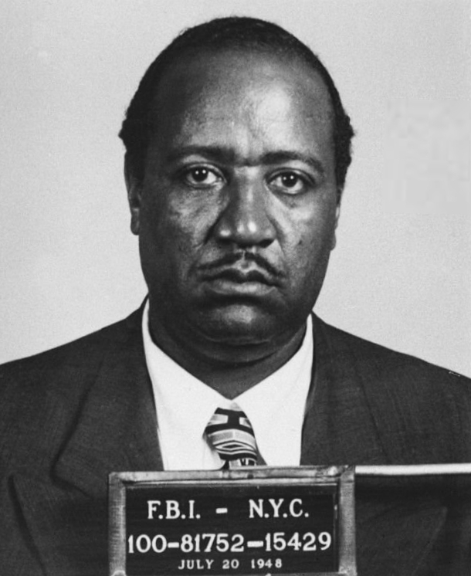
Democracy In Danger
The issue is not Communism versus capitalism or fascism. The fascists use this posing of the issue in order to confuse the people and to extinguish democracy, whether capitalist, as in our country, or the higher socialist form as in the Soviet Union.
Hitler's anti-Communist crusade was a smokescreen behind which he extinguished democracy in the seventeen countries conquered by Nazism. None of these countries was Communist or Socialist.
On the international front, the Soviet Union—because Wall Street, through the Truman Administration and its Republican backers, insists on bolstering world reaction as in Greece, Turkey and China—is now leading the camp of democracy. The Communists, in America, as all over the world, who gave their lives for the independence of their countries against the Hitler conquerors, are among the staunchest defenders of democracy in the present postwar period.
July 1948, Davis was charged with conspiring to overthrow the federal government under the Smith Act – a World War II-era charge that rested on Davis's association with the Communist Party.[3] He was tried along with eleven other defendants for their communist beliefs and party affiliation in the Smith Act trials. Paul Robeson, noted actor, singer, and civil rights activist publicly advocated for Davis and his fellow defendants. His conviction was announced on October 13, only a few weeks before the election.
Photo Credit/Article Wikipedia

Slide 26
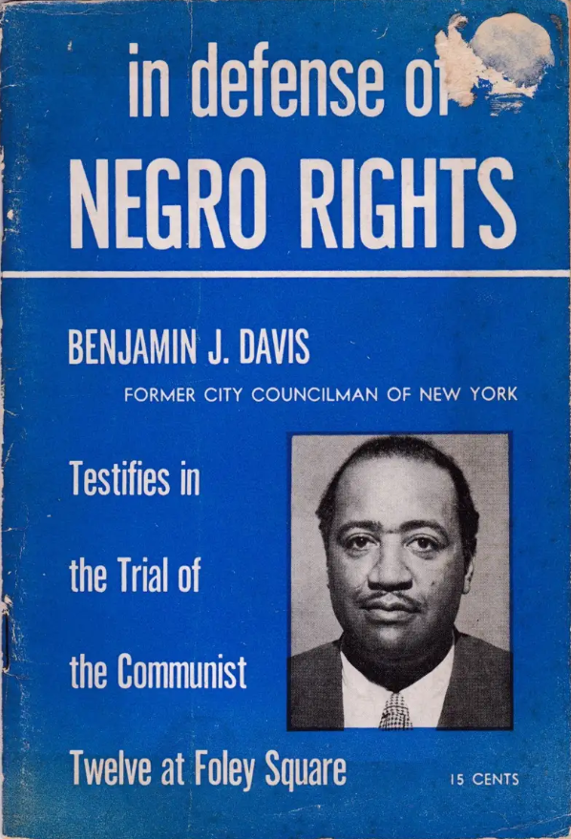
The Communist Party Fights for Negro Rights
The Party's great contribution to American democracy was first dramatized in the celebrated Scottsboro case, where it not only burned the plight of the Negro into the conscience of America" for the first time since the Civil War, but it did something entirely new. It brought for the first time the struggle for Negro rights to the labor movement, and gave flesh and blood to the Marxist classic that "labor in a white skin can never be free while labor in a black skin is branded."
White chauvinism is not tolerated in the Communist Party. The Communist Party recognizes Negro ability and uses it. No other political party in America, while prating about Negro rights in words, has seen fit to elevate a Negro to such a post of honor and responsibility as that held by the young Negro veteran and leader, Henry Winston, Administrative Secretary of the Communist Party.
They see the forces of democracy—of labor and the people—growing all over the world, including our own land. The future belongs to the people. Whether one is a member of the Communist Party or not—or agrees in toto with it—one must recognize that the future is not assured without a strong and ever-expanding Communist Party here, as in the other countries of the world. I want that future as quickly as possible—that's why I am a Communist.

Slide 27
Discussion

Slide 28
Ben Davis’ Legacy Today

Slide 29
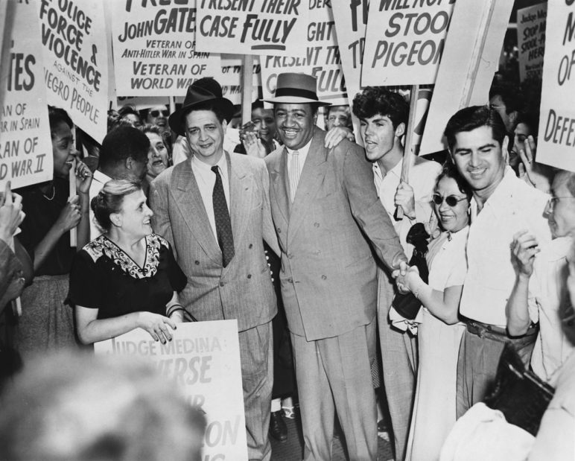
Rent Control
Ben Davis and Peter Cacchione brought up “rent control” in NY and the laws today come from them.
Davis and Cacchione introduced over 100 progressive bills, at a time when the Tammany Hall conservatives made up most of the council. They were the first members of council to establish neighborhood offices.

Slide 30
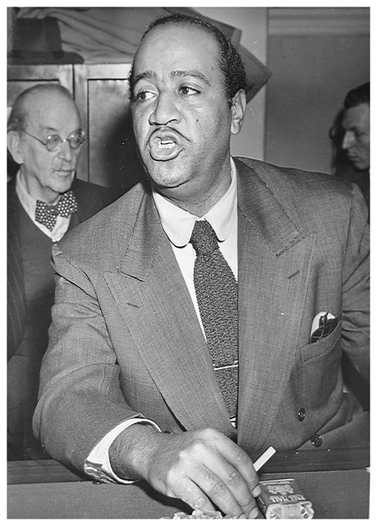
Establishing a Progressive NYC
Davis introduced the bill that established the first official “Negro History Week” celebration.
When Stuyvesant Town, a Rockefeller-sponsored housing complex on the Lower East Side of Manhattan, refused to rent to Blacks and Jews, Davis fought against this discrimination.
He was in the forefront of the fight to integrate professional baseball.
He was part of a leftist, working-class multiracial coalition in Harlem that challenged the powerful financial interests that controlled Harlem, and forced real change.

Slide 31
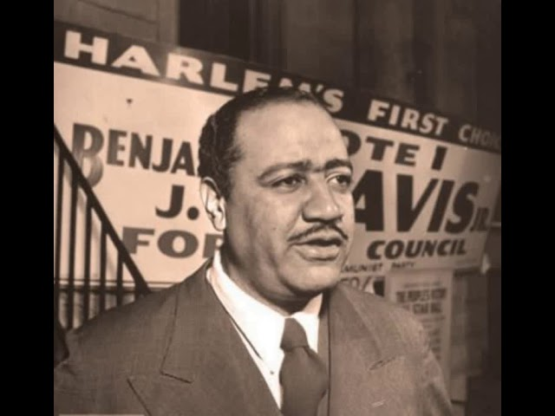
Establishing a Progressive NYC
Davis fought against the Taft-Hartley Act and supported the efforts of organized labor, which helped make New York a union town.
Davis was a strong supporter of socialism and the Soviet Union. He fought against the Cold War anticommunism and he saw anti communism as directly related to racism here at home.

Slide 32
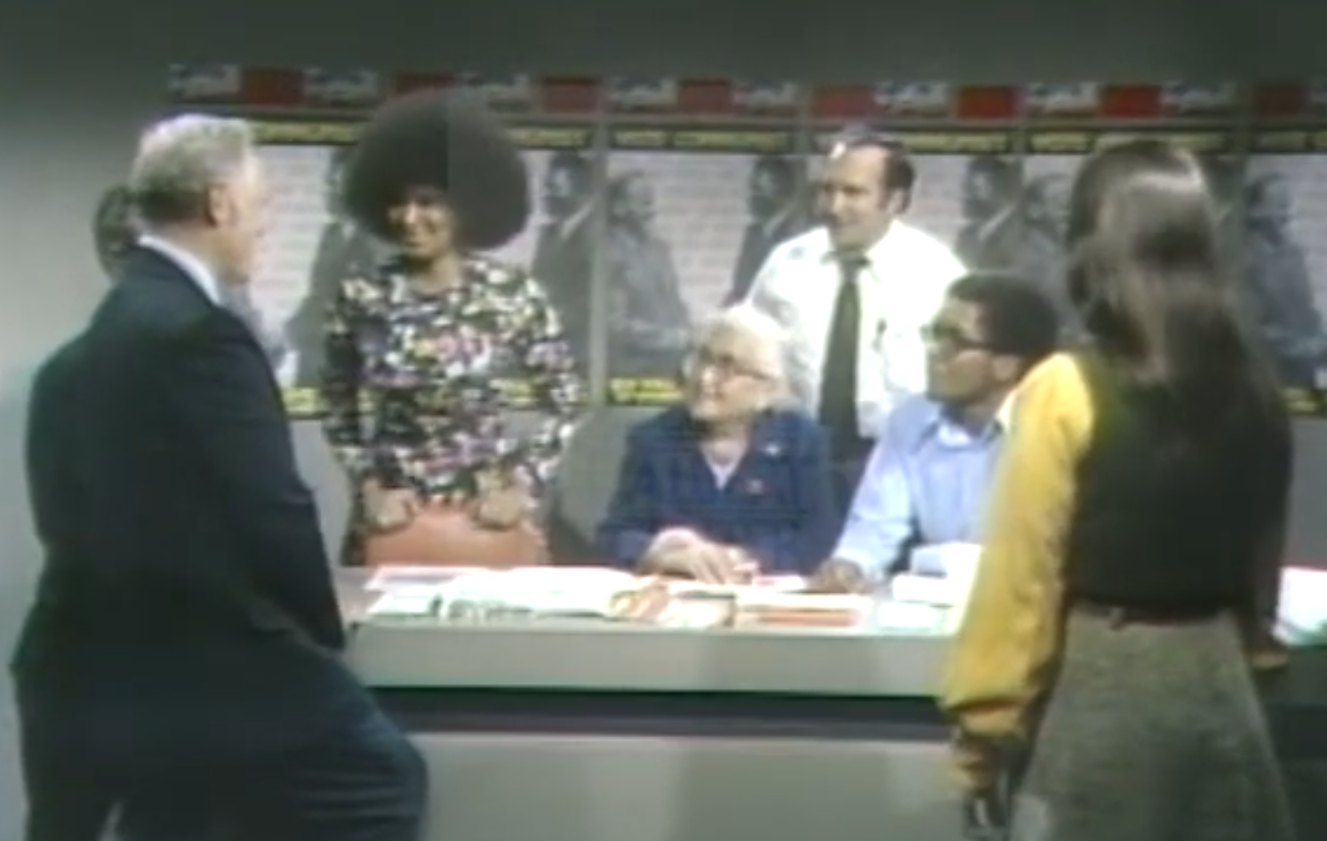
Black Communists in Political Office
Benjamin Davis was an important role model to show that communists, especially black communists, could be elected to office. He was the first one in New York City and that was the highest office black communists got into.
Led to later vice president candidacy of James Ford, Jarvis Tyner and Angela Davis on Party ticket.

Slide 33
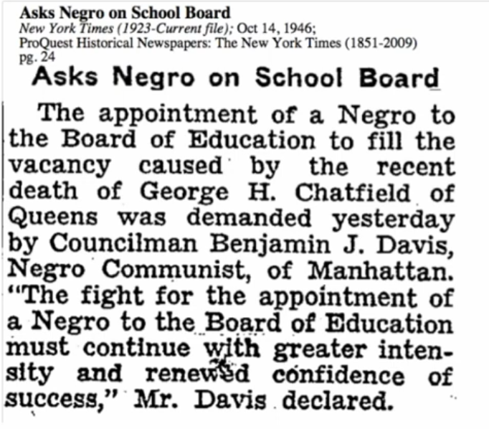
Black Communists in Political Office
In New York city locally, he pushed for the appointment of African-Americans to the local school board.
His push for racial integration in the school board system was before Brown vs. Board of Education of Topeka in 1954 with federal order of integration.

Slide 34
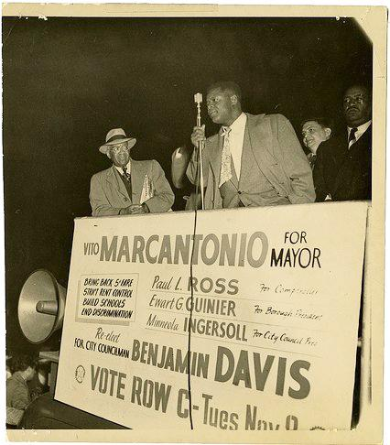
Reflections from New York Comrades
For comrades in New York, especially New York city, what were you told about Benjamin Davis?
What is the legacy of Benjamin Davis that you experience?

Slide 35
Discussion & Wrap Up

Slide 36
Announcements
PCUSA Cell Chairs need to call members of their cells to remind them about attendance.
The next issue of New Masses (2026) has begun production. If you have art you want us to feature, email it to info@partyofcommunistsusa.net.

Slide 37
Volunteers Needed!
We are in need of volunteers for the staff of the People’s School! Here’s a few roles we need filled:
People to help manage posting on our social media and podcast platforms
Video Editors, Audio Editors, Graphic Designers, Artists, Narrators
Web Controls, Moderators
Email info@peoplesschool.us if you’re interested and try to attend our next staff meeting if possible.

Slide 38

View From Left Field
https://viewfromleftfield.libsyn.com
The Old PSMLS Youtube is now the Youtube of View From Left Field, a podcast of analysis and discussion of current events from a progressive perspective.
Like the Youtube videos and subscribe with 5 star ratings on your podcast platforms.

Slide 39

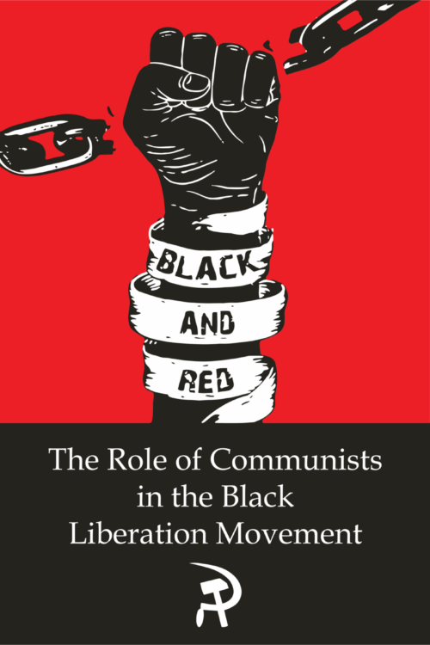
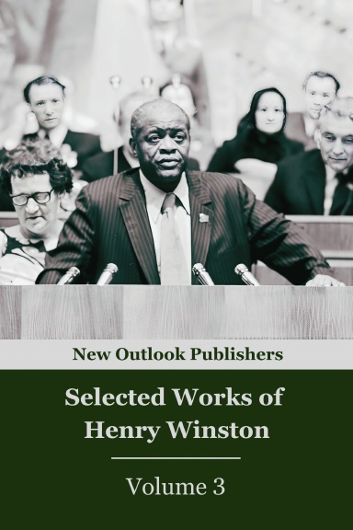
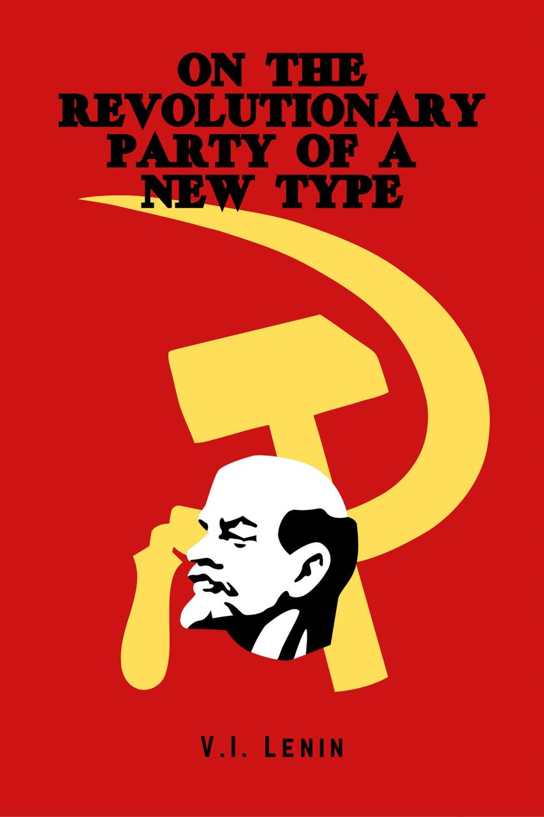
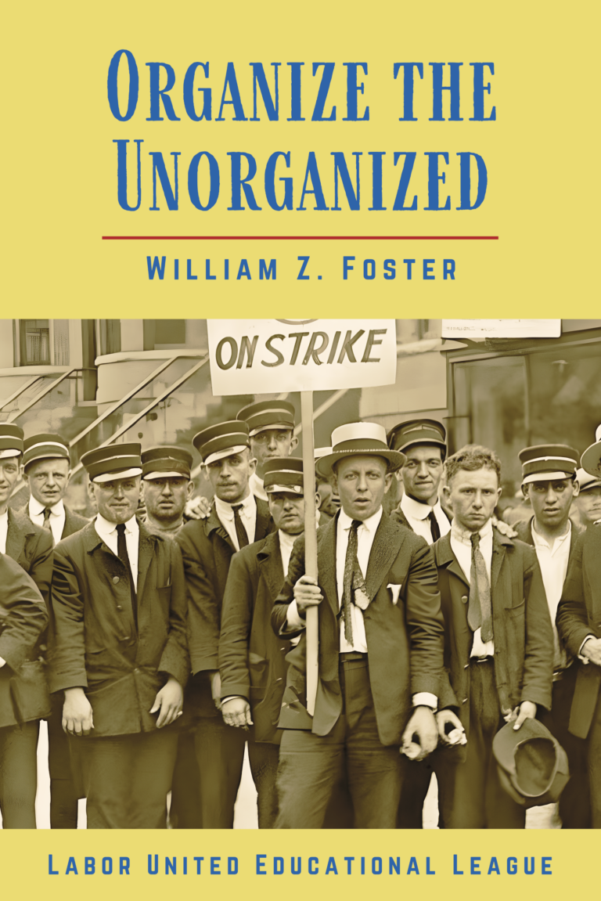
New Outlook Publishers
newoutlookpublishers.store
Relevant and Latest Releases

Slide 40
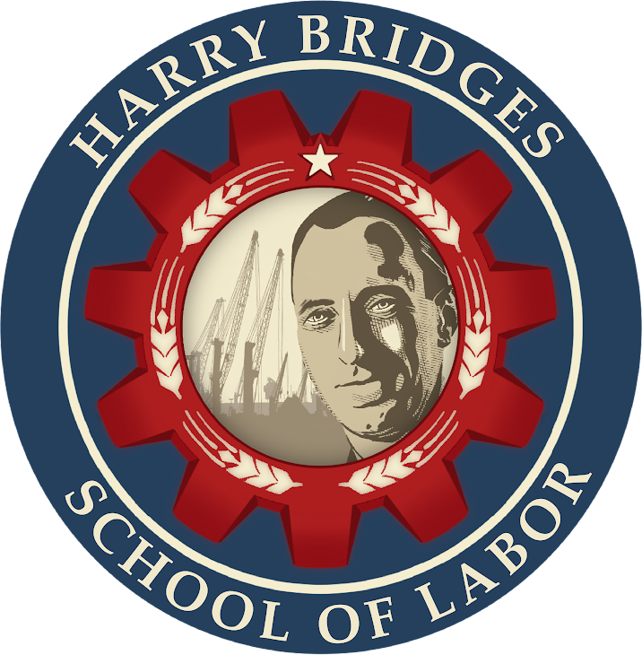
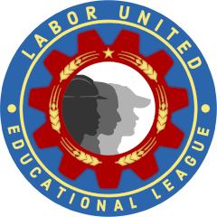
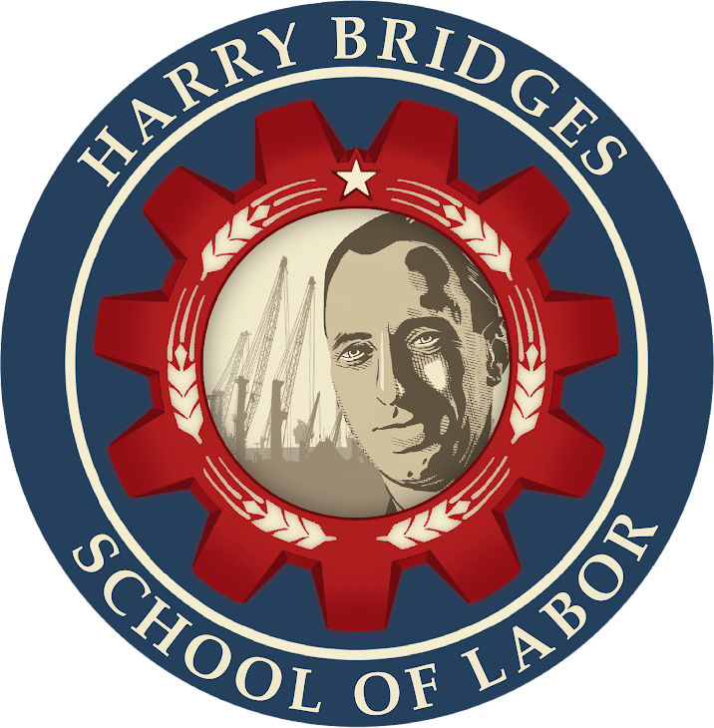
Harry Bridges School of Labor
luel.us/laborschool/
The Harry Bridges School of Labor is a monthly class covering a variety of topics aimed at building class consciousness among union members. For class schedule and other information, please visit the website at luel.us/laborschool.

Slide 41
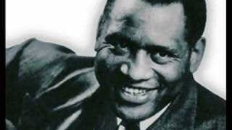
The House I Live In - Paul Robeson

