Slide 1

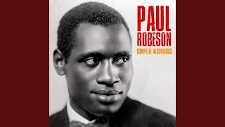
Go Down Moses - Paul Robeson

Slide 2
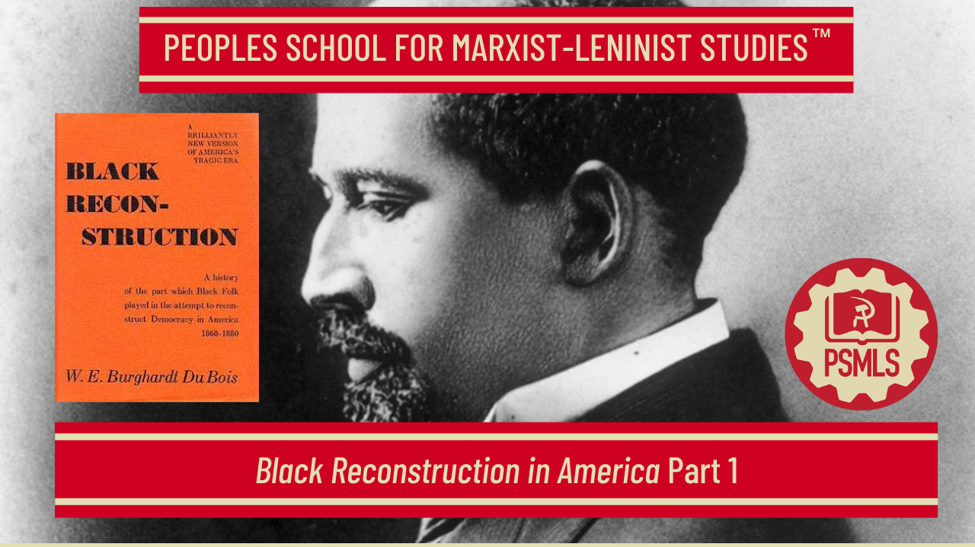

PSMLS 2/3/26

Slide 3
What we’ll be learning today:
In conjunction with People’s Anti-Racist Coordinating Committee
Background, context and first 2 chapters: black & white workers
Ch. 3: The Planter, Ch. 4: The General Strike
Ch. 5: The Coming of the Lord

Slide 4
Introduction - W.E.B DuBois and Black Reconstruction in America

Slide 5
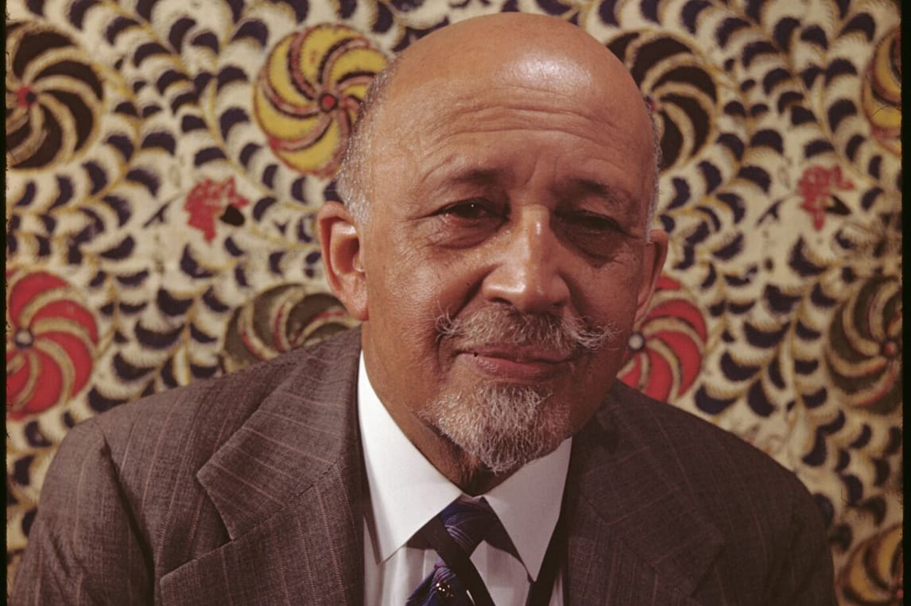
W.E.B. Du Bois: A Pioneer
of Socialism
Of French and African descent, Du Bois grew up in Great Barrington, Massachusetts.
Du Bois received his doctorate from Harvard. He began to document the oppression of Black people and their strivings for equality in the 1890s
He banded with other Black leaders and began the Niagara Movement which served as the forerunner of the National Association for the Advancement of Colored People (NAACP).
Du Bois rejected the argument that progress for Blacks is realizable even if the urgent problems facing an oppressed people are ignored. "We must not turn aside from the great object of Socialism to take up the issue of the American Negro; let the question wait; when the objects of Socialism are achieved, this problem will be settled along with other problems.” And this led him to observe that "No recent convention of Socialism has dared to face fairly the Negro problem and make a straightforward declaration that they re gard Negroes as men in the same sense that other persons are." ( W.E.B. DuBois New Review, February, 1913)
Notes:
https://leninists.org/images/0/02/Black_Liberation_Journal_Fall_1983.pdf

Slide 6
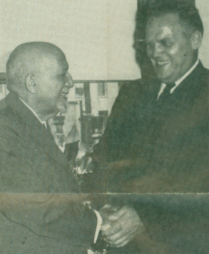
W.E.B. Du Bois: A Pioneer
of Socialism
In 1961 Du Bois joined the Communist Party. He explained in his autobiography how he reached this decision:
“I have studied socialism and communism long and carefully in lands where they are practiced and in conversation with their adherents, and with wide reading. I now state my conclusion frankly and clearly: I believe in communism… I believe that all men should be employed according to their ability and that wealth and services should be distributed according to need. Once I thought that these ends could be attained under capitalism, means of production privately owned, and used in accord with free individual initiative. After earnest observation I now believe that private ownership of capital and free enterprise are leading the world to disaster.”
W.E.B Du Bois meeting with General Secretary Gus Hall. (Oct 1961 - People’s World Archives)
Notes:
https://leninists.org/images/0/02/Black_Liberation_Journal_Fall_1983.pdf

Slide 7
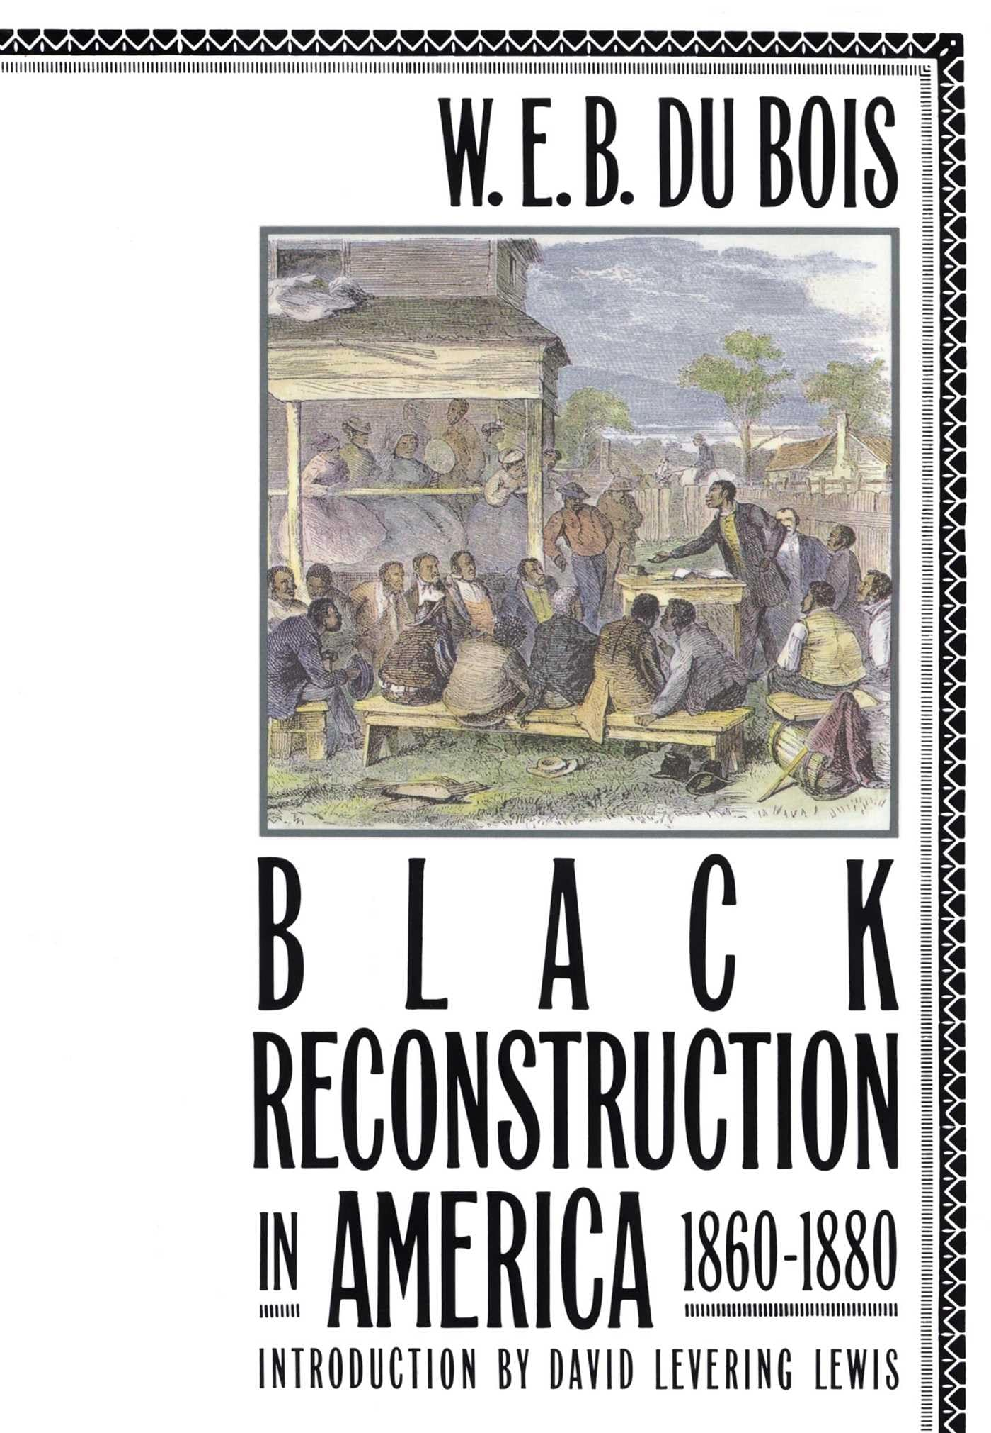
From the Introduction of Black Reconstruction in America 1860-1880
In Black Reconstruction, DuBois argued that Reconstruction had given the defeated South democratic government free public schools and progressive social legislation which was unprecedented. One of the goals of Black Reconstruction was surely to open up the world of scholarship to that opportunity for “real and new democracy" that had once existed in the immediate aftermath of the Civil War.
At this time, African-American scholars were not silent, only unheard or dismissed by the white academy. Mainstream historians had deplored universal manhood suffrage in the South as the greatest folly.
In the final exchange of letters with its editor, Du Bois refused to allow Britannica to publish his article on ‘The Negro in the United States’ unless the following two sentences were included:
"White historians have ascribed the faults and failures of Reconstruction to Negro ignorance and corruption. But the Negro insists that it was Negro loyalty and the Negro vote alone that restored the South to the Union; established the new Democracy, both for white and black, and instituted the public schools." Editor F. H. Hooper regretted that he could not "pass the article with this new paragraph" and, therefore, was compelled to reject it.
Notes:
https://leninists.org/images/0/02/Black_Liberation_Journal_Fall_1983.pdf

Slide 8
From the Introduction of Black Reconstruction in America 1860-1880
Because it was ignored by the American Historical Review and widely disparaged by mainstream historians during the Cold War Era, the impression persists that Black Reconstruction received scant notice at the time or, to the extent that it did, was one of the dismissed as serious scholarship.
But, there were historians that found Du Bois work magnificent and a refutation of scandalous white histographers. Yale historian William Macdonald believed that Du Bois was “absolutely justified in the rancorous onslaught on American historians of the Civil War Period.”
The premier African-American sociologist of the day, Charles S Johnson managed to engage the mind of the book masterfully, but was dismissive of its ‘Marxist reductionism’:
"The major thesis of this book is that the result of the Civil War was an enfranchisement of labor, black and white, but the entrenched bigotries of the 'landed oligarchy' and the ignorant racial prejudices of white labor so weakened the strength of labor as to render it helpless before the forces of industrialism and capitalism."
Notes:
https://leninists.org/images/0/02/Black_Liberation_Journal_Fall_1983.pdf

Slide 9
From the Introduction of Black Reconstruction in America 1860-1880
When the eighty-five-year-old Du Bois came as a political pariah to Berkeley in spring of 1953, he was informed by students who came to hear him in a nearby Unitarian church that Black Reconstruction was alive and well in their history department. Little more than a decade would pass before other historians would publish their works on the Reconstruction Period that accepted the ‘revisionists’ view of Blacks contributing to the democratic struggle in the South.
In 1969, six years after its author's death in Ghana, the war against racist Reconstruction historiography had been won. As Du Bois biographer Elliott Rudwick wrote: America's Unfinished Revolution. 1863-1877 (1988), "it remains to this day the best summary of Negro participation in the governments of the Southern states during Reconstruction.”
David Levering Lewis
Notes:
https://leninists.org/images/0/02/Black_Liberation_Journal_Fall_1983.pdf

Slide 10
Section 1 - The Black Workers
How black men, coming to America in the sixteenth, seventeenth, eighteenth and nineteenth centuries, became a central thread in the history of the United States, at once a challenge to its democracy and always an important part of its economic history and social development

Slide 11
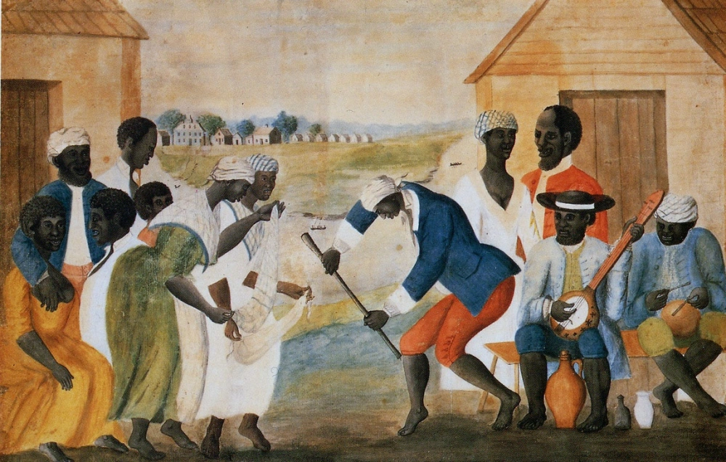
The Black Worker
The most dramatic episode in American history was the sudden move to free four million black slaves in an effort to stop a great civil war, to end forty years of bitter controversy, and to appease the moral sense of civilization.
The anomaly of slavery plagued a nation which asserted the equality of all men, and sought to derive powers of government from the consent of the governed. America had more than half a million black slaves, forming nearly one-fifth of the population of a new nation.
Most of them went through West Indian tutelage then finally appeared in the United States. They brought with them their religion and rhythmic song, and some traces of their art and tribal customs. After two and one-half centuries, they became a settled working population, speaking English or French, professing Christianity, and used principally in agricultural toil. They mixed with the white and native Americans and thus today [in 1935] less than 25% of the Negro Americans are of unmixed african descent.
Notes:
https://leninists.org/images/0/02/Black_Liberation_Journal_Fall_1983.pdf

Slide 12
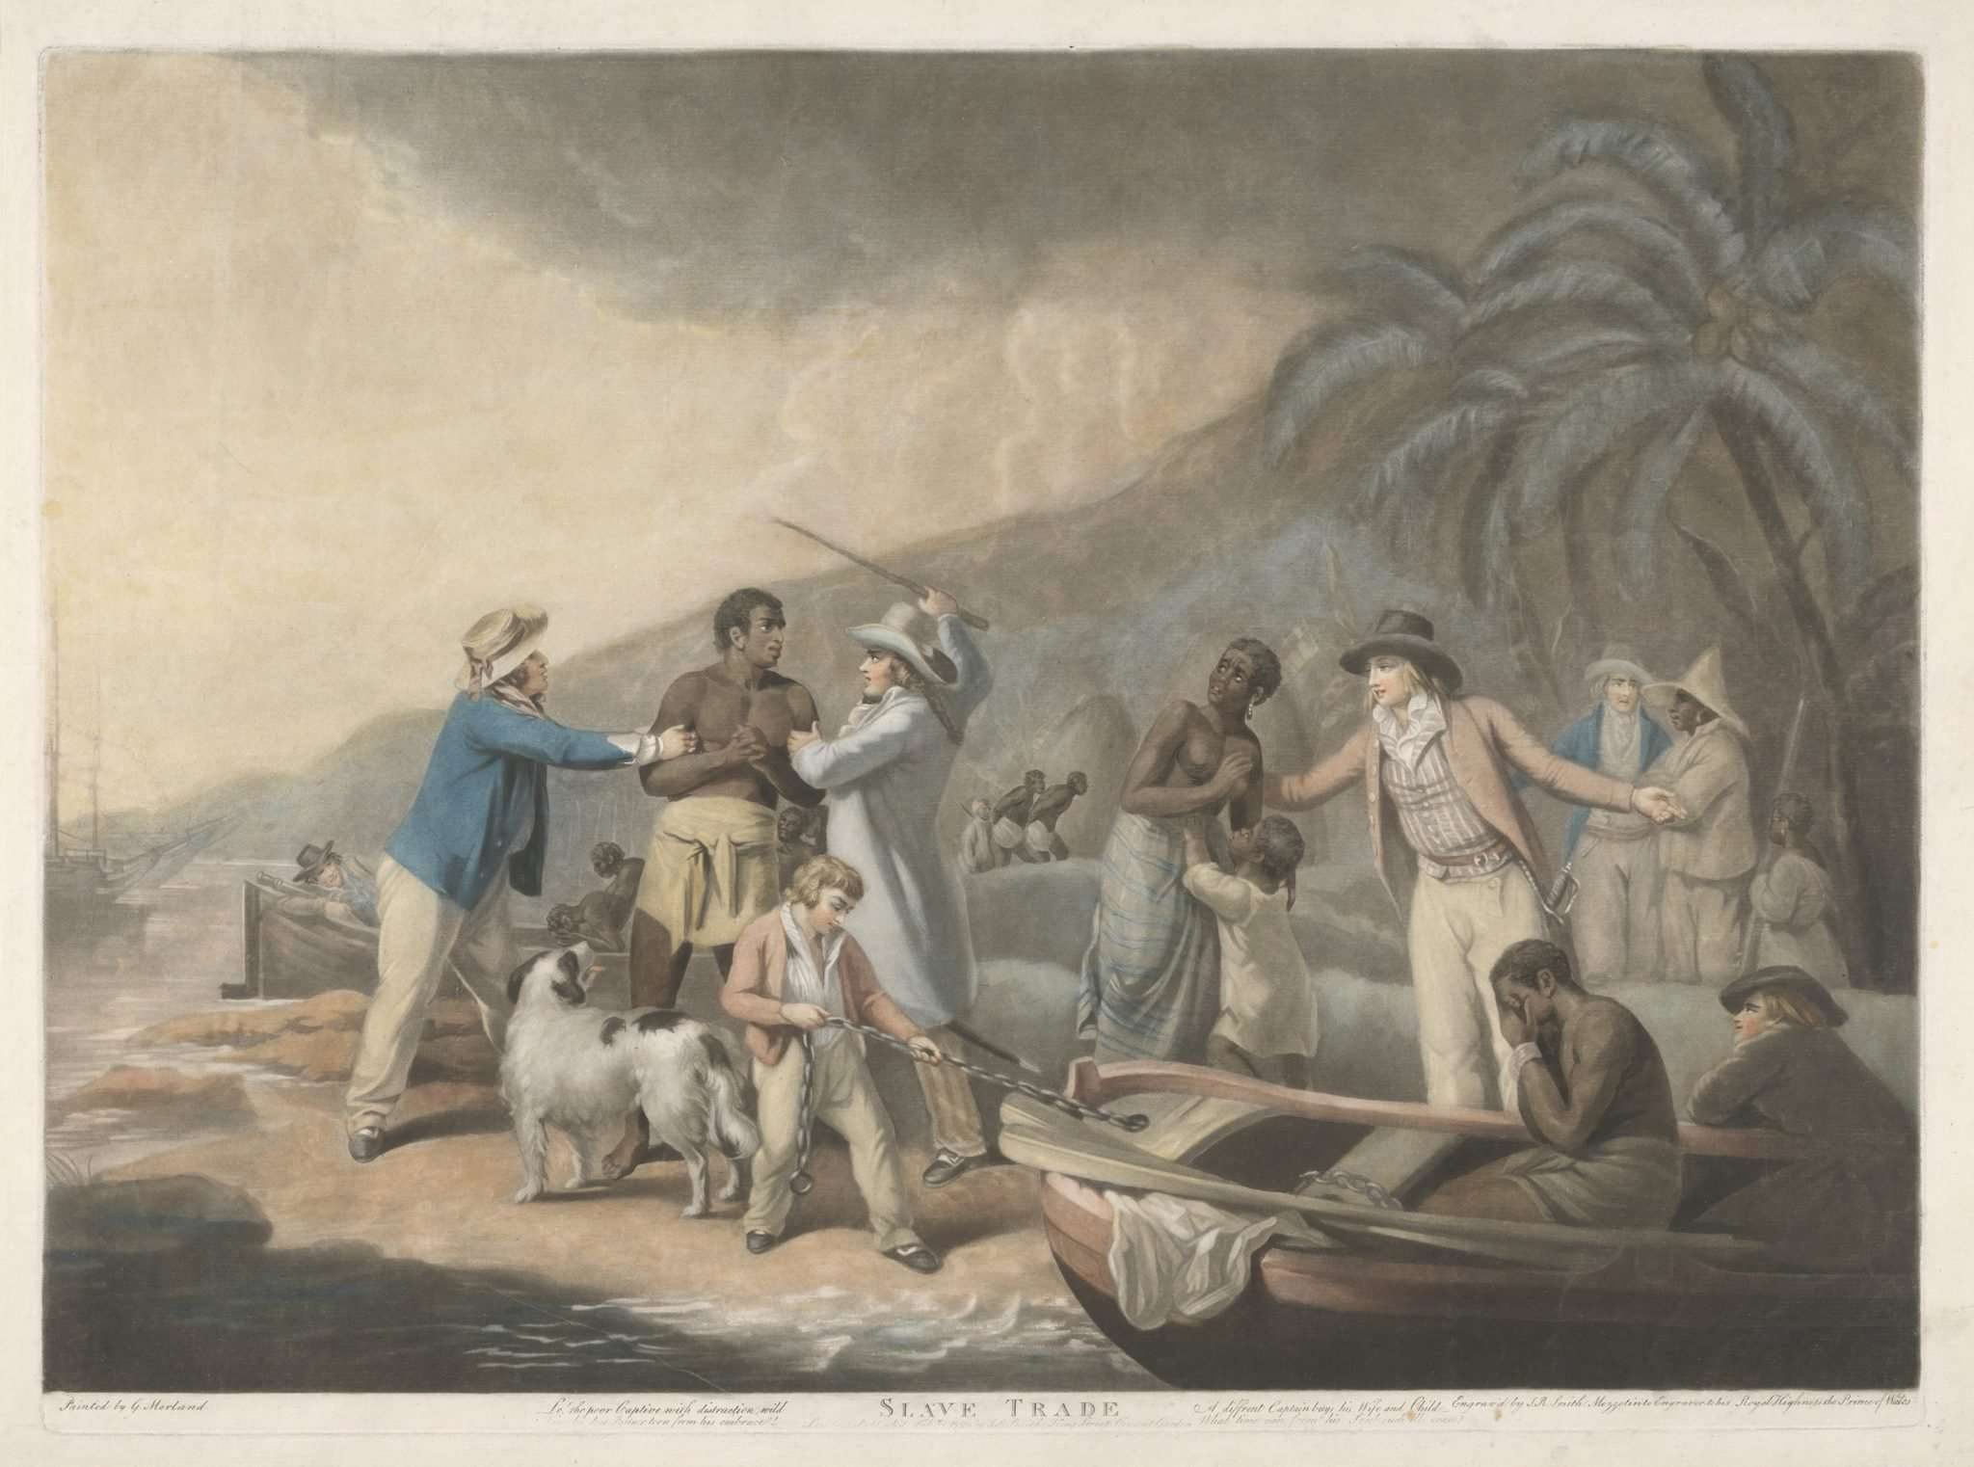
The Black Worker
So long as slavery was a matter of race and color, it made the conscience of the nation uneasy and continually affronted its ideals. Those who wrote the Constitution sought by every evasion, and almost by subterfuge, to keep recognition of slavery out of the basic form of the new government.
They began with prohibition of the slave trade, hoping that without new populations coming in, the existing enslaved people would die out and the issue of slavery would resolve itself. They miscalculated, or did not foresee the changing economic world. In the West Indies it was profitable to kill the slaves by overwork then import more. But in America without a slave trade, it paid to conserve the slave and let him multiply.
When the Negroes were not dying out, new excuses and explanations came about. It was a matter of social condition. Gradually these people would be free; but freedom could only come to the bulk as the freed were transplanted to their own land and country, since the living together of black and white in America was unthinkable. So again the nation waited, and its conscience sank to sleep.
Notes:
https://leninists.org/images/0/02/Black_Liberation_Journal_Fall_1983.pdf

Slide 13
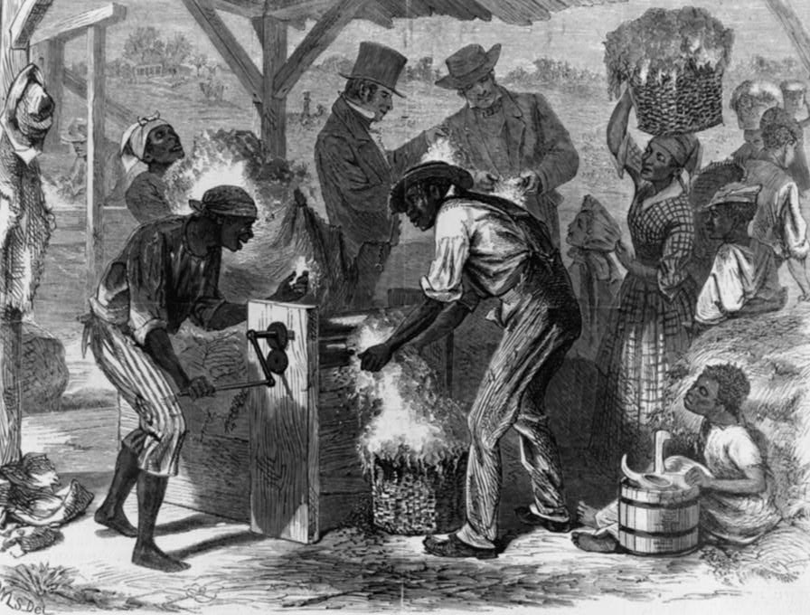
The Black Worker
But wealth and work multiplied, slowly but mightily these black workers were integrated into modern industry.
Americans raised not just sugar as a cheap sweetening, rice for food and tobacco as a new luxury; but they began to grow cotton so swiftly that the 9,000 bales of cotton which the new nation scarcely noticed in 1791 became 79,000 in 1800. With this increase, walked economic revolution in a dozen different lines. The cotton crop reached one-half million bales in 1822, a million bales in 1831, two million in 1840, three million in 1852, and in the year of secession, stood at the then enormous total of five million bales.
“First cotton gin” from Harpers Weekly. 1869 illustration depicting event of some 70 years earlier by William L. Sheppard. (Library of Congress, Prints and Photographs division)
Notes:
https://leninists.org/images/0/02/Black_Liberation_Journal_Fall_1983.pdf

Slide 14
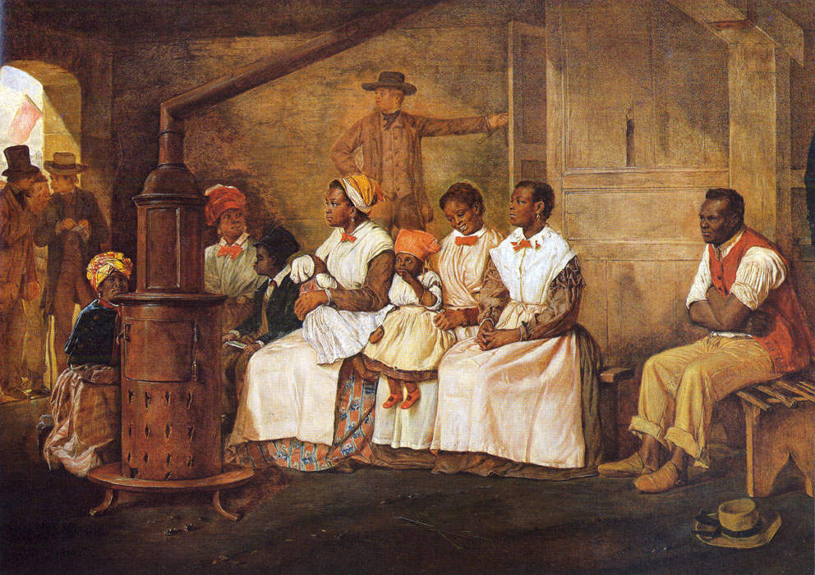
The Black Worker
The matter of his investment in land and slaves greatly curtailed the owner's freedom of action. Under the competition of growing industrial organization, the slave system was the source of immense profits.
But it was difficult for the slave owner and landlord to keep a large or even reasonable share of these profits. The price of the slave produced in the open market could be hammered down by merchants and traders acting with knowledge and collusion. The slave owner was continually forced to find his profit not in the high price of cotton and sugar, but in beating even further down the cost of his slave labor.
This made the slave owners in early days kill the slave by overwork and renew their working stock. It led to the widely organized interstate slave trade between the Border States and the Cotton Kingdom of the Southern South; it led to neglect and the breaking up of families, and it could not protect the slave against the cruelty, lust and neglect of certain owners.
Eyre Crowe, Slaves Waiting for Sale, Richmond, Virginia, 1861.
Notes:
https://leninists.org/images/0/02/Black_Liberation_Journal_Fall_1983.pdf

Slide 15
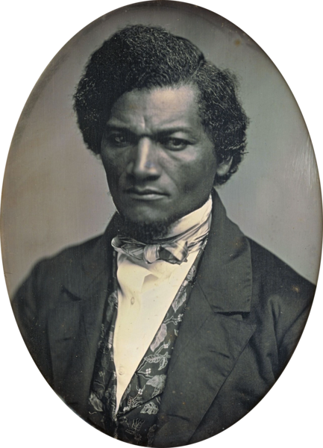
The Black Worker
Thus human slavery in the South led in two contradictory and paradoxical directions - toward the deliberate commercial breeding and sale of human labor for profit and toward the intermingling of black and white blood. The slaveholders shrank from acknowledging either set of facts but they were clear and undeniable.
Up from this slavery gradually climbed the Free Negro with clearer, modern expression and more definite aim long before the emancipation of 1863. His greatest effort lay in his cooperation with the Abolition movement. He knew he was not free until all Negroes were free. Individual Negroes became exhibits of the possibilities of the Negro race, if once it was raised above the status of slavery. Even when, as so often, the Negro became Court Jester to the ignorant American mob, he made his plea in his songs and antics .
Frederick Douglass
Notes:
https://leninists.org/images/0/02/Black_Liberation_Journal_Fall_1983.pdf

Slide 16
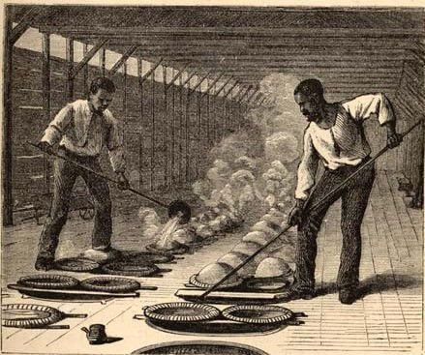
The Black Worker
Above all, the black worker was the ultimate exploited. He formed that mass of labor which had neither desire nor power to escape from the labor status in order to directly exploit other laborers, or indirectly, by alliance with capital, to share in their exploitation.
To be sure, the black mass, developed again and again, here and there, capitalistic groups in New Orleans, in Charleston and in Philadelphia; groups willing to join white capital in exploiting labor; but they were driven back into the mass by racial prejudice before they had reached a permanent foothold; and thus became all the more bitter against all organization which by means of race prejudice, or the monopoly of wealth, sought to exclude men from making a living.
It was thus the black worker, as founding stone of a new economic system in the nineteenth century and for the modern world, who brought civil war in America. He was its underlying cause, in spite of every effort to base the strife upon union and national power.
Notes:
https://leninists.org/images/0/02/Black_Liberation_Journal_Fall_1983.pdf

Slide 17
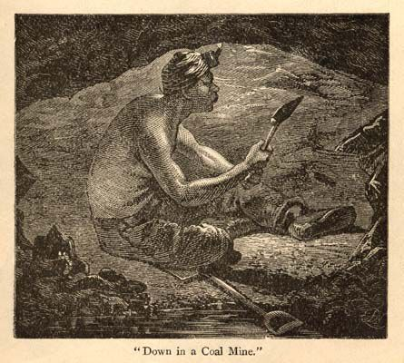
The Black Worker
Here is the real modern labor problem. Here is the kernel of the problem of Religion and Democracy, of Humanity. Words and futile gestures avail nothing. Out of the exploitation of the dark proletariat comes the Surplus Value filched from human beasts which, in cultured lands, the Machine and harnessed Power veil and conceal. The emancipation of man is the emancipation of labor and the emancipation of labor is the freeing of that basic majority of workers who are yellow, brown and black
Notes:
https://leninists.org/images/0/02/Black_Liberation_Journal_Fall_1983.pdf

Slide 18
Section 1 - The White Workers
How America became the laborer's Promised Land; and flocking here from all the world the white workers competed with black slaves, with new floods of foreigners, and with growing exploitation, until they fought slavery to save democracy and then lost democracy in a new and vaster slavery

Slide 19
The White Workers
The opportunity for real and new democracy in America was broad. Political power was at first confined to property holders and an aristocracy of birth and learning. But it was never securely based on land. Land was free and both land and property were possible to nearly every thrifty worker. Schools began early, multiplied and opened their doors even to the poor laborer. Birth began to count for less and less and America became to the world a land of opportunity. So the world came to America, even before the Revolution, and during the nineteenth century, nineteen million immigrants entered the United States.
The new labor that came to the United States was poor, used to oppression and accustomed to a low standard of living. Yet after reaching America, it was not willing to regard itself as a permanent laboring class. In light of this fact, the labor movement among white Americans must be studied.
The successful, well paid American laboring class formed, because of its property and ideals, a petty bourgeoisie ready always to join capital in exploiting common labor, white and black, foreign and native.
The more energetic and thrifty among the immigrants caught the prevalent American idea that here labor could become emancipated from the necessity of continuous toil and that an increasing proportion could join the class of exploiters, that is of those who made their income chiefly by profit derived through the hiring of labor.

Slide 20
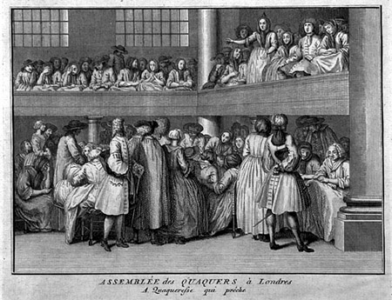
The White Workers
These workers came to oppose slavery not so much from moral as from the economic fear of being reduced by competition to the level of slaves. They wanted a chance to become capitalists; and they found that chance threatened by the competition of a working class whose status at the bottom of the economic structure seemed permanent and inescapable. At first, black slavery jarred upon them, and as early as the seventeenth century German immigrants to Pennsylvania asked the Quakers innocently if slavery was in accord with the Golden Rule.
Then, gradually, as succeeding immigrants were thrown in difficult and exasperating competition with black workers, their attitude changed. These were the very years when the white worker was beginning to understand the early American doctrine of wealth and property; to escape the liability of imprisonment for debt, and even to gain the right of universal suffrage. He found pouring into cities like New York and Philadelphia emancipated Negroes with low standards of living, competing for the jobs which the lower class of unskilled white laborers wanted.

Slide 21
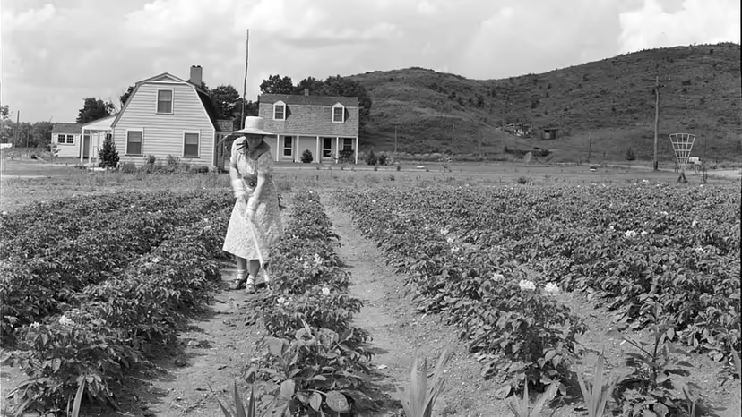
The White Workers
In the forties came quite a different class, the English and German workers, who had tried by organization to fight the machine and in the end had to some degree envisaged the Marxian reorganization of industry through trade unions and class struggle. The attitude of these people toward the Negro was varied and contradictory. At first they blurted out their disapprobation of slavery on principle. It was a phase of all wage slavery. Then they began to see a way out for the worker in America through the free land of the West. Here was a solution such as was impossible in Europe: plenty of land, rich land, land coming daily nearer its own markets, to which the worker could retreat and restore the industrial balance ruined in Europe by the expropriation of the worker from the soil. Or in other words, the worker in America saw a chance to increase his wage and regulate his conditions of employment much greater than in Europe. The trade unions could have a material backing that they could not have in Germany, France or England. This thought, curiously enough, instead of increasing the sympathy for the slave turned it directly into rivalry and enmity.
Homesteaders, like this woman at work in her garden in West Virginia, were promised 160 acres of free land as long as they were willing to work that land.

Slide 22
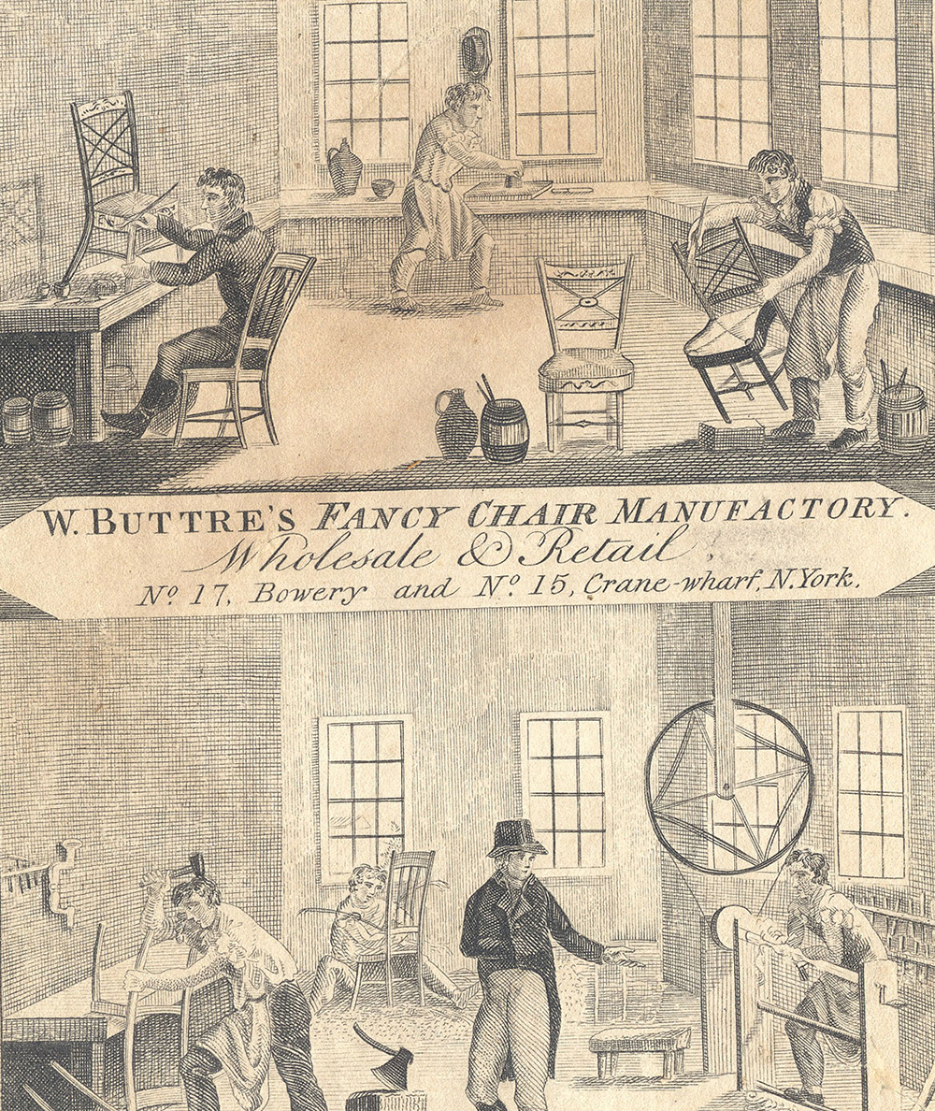
The White Workers
Here, then, were two labor movements: the movement to give the black worker a minimum legal status which would enable him to sell his own labor, and another movement which proposed to increase the wage and better the condition of the working class in America, now largely composed of foreign immigrants, and dispute with the new American capitalism the basis upon which the new wealth was to be divided. Broad philanthropy and a wide knowledge of the elements of human progress would have led these two movements to unite and in their union to become irresistible. It was difficult, almost impossible, for this to be clear to the white labor leaders of the thirties. They had their particularistic grievances and one of these was the competition of free Negro labor. Beyond this they could easily vision a new and tremendous competition of black workers after all the slaves became free. What they did not see nor understand was that this competition was present and would continue and would be emphasized if the Negro continued as a slave worker. On the other hand, the Abolitionists did not realize the plight of the white laborer, especially the semi-skilled and unskilled worker.

Slide 23
The White Workers
The labor movement in England continued to emphasize the importance of attacking slavery; and the agitation, started by the work of Frederick Douglass and others, increased in importance and activity. In 1857, George I. Holyoake sent an anti-slavery address to America, signed by l,800 English workingmen, whom Karl Marx himself was guiding in England, and this made the black American worker a central text. They pointed out the fact that the black worker was furnishing the raw material which the English capitalist was exploiting together with the English worker. This same year, the United States Supreme Court sent down the Dred Scott decision that Negroes were not citizens.
This English initiative had at first but limited influence in America. The trade unions were willing to admit that the Negroes ought to be free sometime; but at the present, self-preservation called for their slavery; and after all, whites were a different grade of workers from blacks. Even when the Marxian ideas arrived, there was a split; the earlier representatives of the Marxian philosophy in America agreed with the older Union movement in deprecating any entanglement with the abolition controversy. After all, abolition represented capital. The whole movement was based on mawkish sentimentality, and not on the demands of the workers, at least of the white workers. And so the early American Marxists simply gave up the idea of intruding the black worker into the socialist commonwealth at that time.

Slide 24
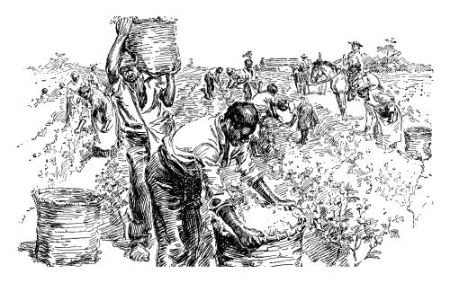
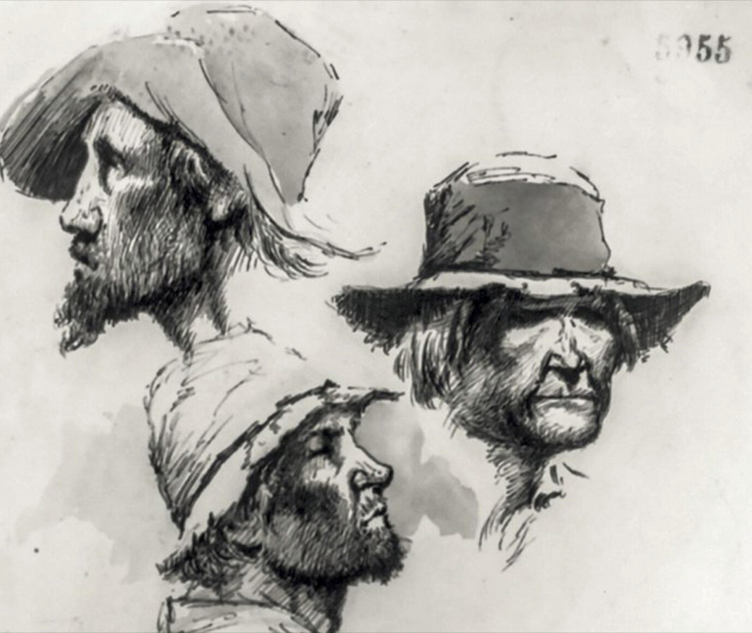
The White Workers
Indeed, the plight of the white working class throughout the world today is directly traceable to Negro slavery in America, on which modern commerce and industry was founded, and which persisted to threaten free labor until it was partially overthrown in 1863. The resulting color caste founded and retained by capitalism was adopted, forwarded and approved by white labor, and resulted in subordination of colored labor to white profits the world over. Thus the majority of the world's laborers, by the insistence of white labor, became the basis of a system of industry which ruined democracy and showed its perfect fruit in World War and Depression. And this book seeks to tell that story.

Slide 25
Discussion & New Members Introductions

Slide 26
New Member Introductions
What is your name, pronouns and state (or country/territory)?
Where do you work? Is it unionized?
How did you find out about the People’s School?
What do you think about tonight's class?

Slide 27
The Planter & The General Strike

Slide 28
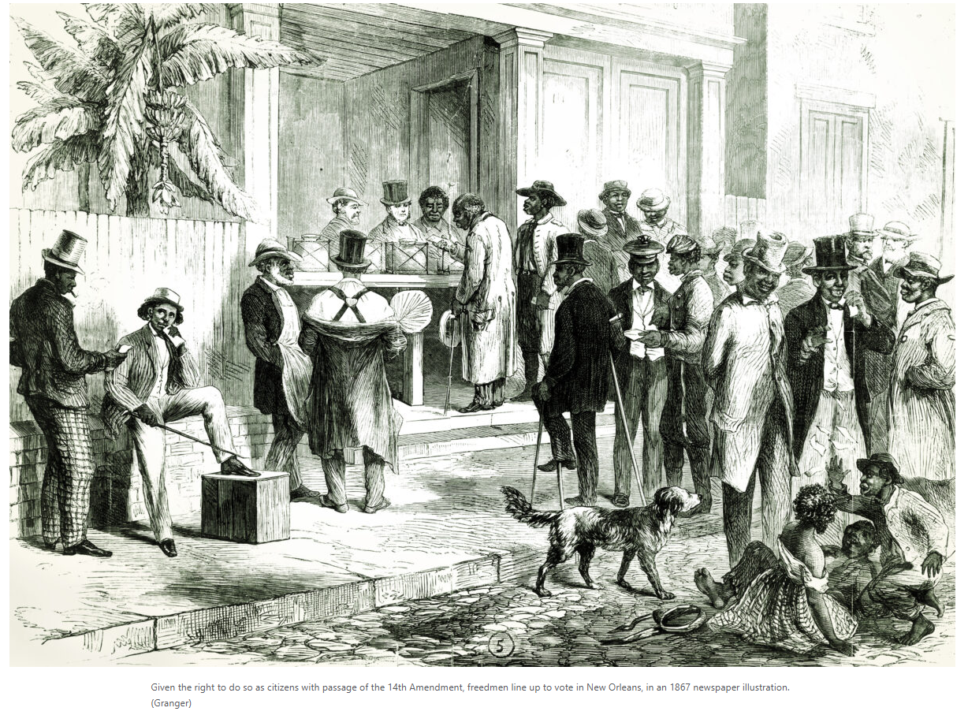
The Planter
Since it was beneath the dignity of a "gentleman" to encumber himself with the details of his finances, this lordly excuse enabled the planter to place between himself and the black slave a series of intermediaries through whom bitter pressure and exploitation could be exercised and large crops raised. For the very reason that the planters did not give attention to details, there was wide tendency to commercialize their growing business of supplying raw materials for an expanding modern industry.
They were the last to comprehend the revolution through which that industry was passing and their efforts to increase income succeeded only at the cost of raping the land and degrading the laborers.

Slide 29
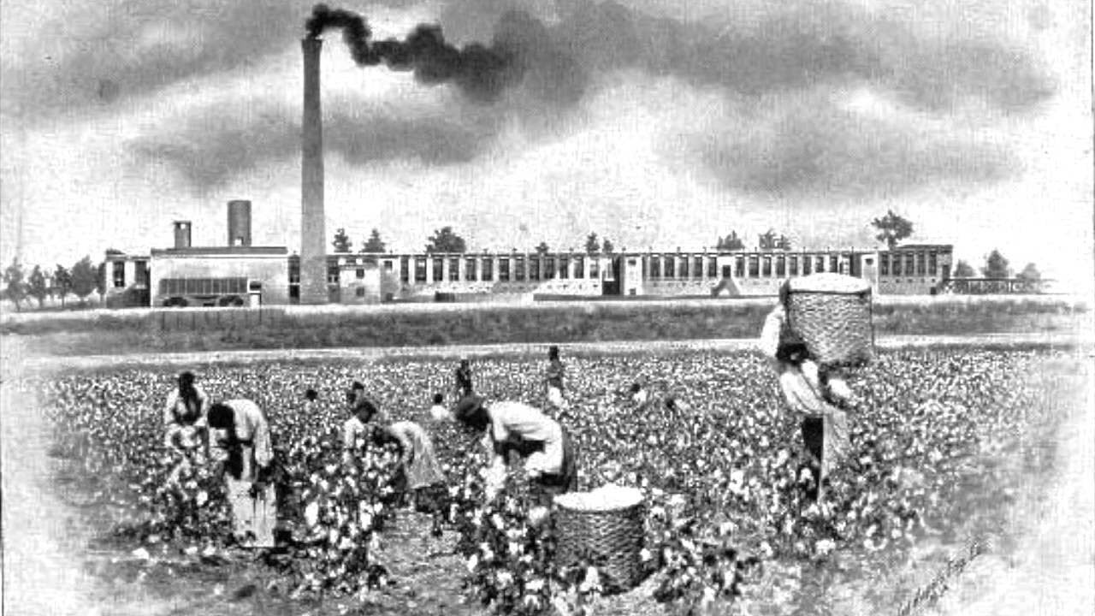
The Planter
Theoretically there were many ways of increasing the income of the planter; practically there was but one. The planter might sell his crops at higher prices; he might increase his crop by intensive farming, or he might reduce the cost of handling and transporting his crops; he might increase his crops by making his laborers work harder and giving them smaller wages. In practice, the planter, so far as prices were concerned, was at the mercy of the market.
Merchants and manufacturers by intelligence and close combination set the current prices of raw material. Their power thus exercised over agriculture was not unlimited but it was so large, so continuous and so steadily and intelligently exerted that it gradually reduced agriculture to a subsidiary industry whose returns scarcely supported the farmer and his labor.

Slide 30
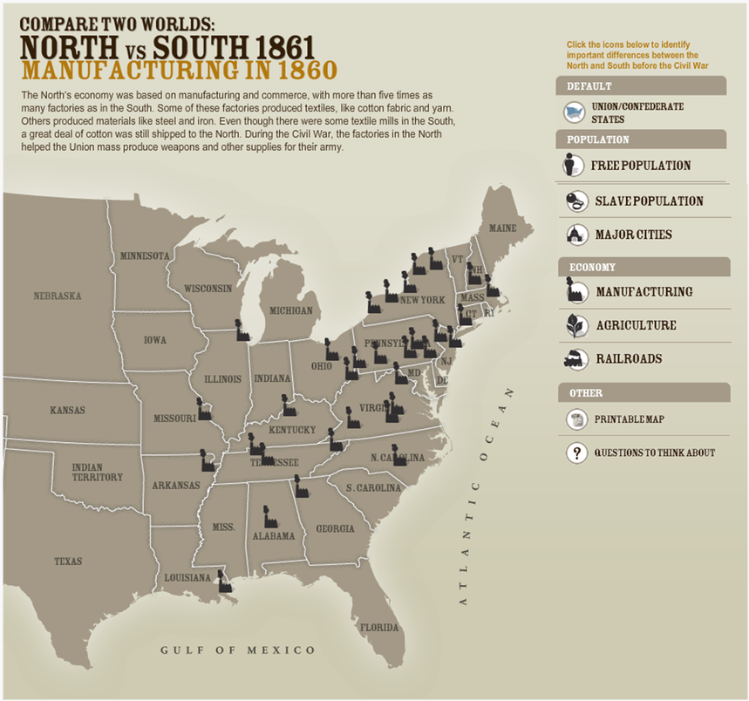
The Planter
The Southern planter in the fifties was in a key position to attempt to break and arrest the growth of this domination of all industry by trade and manufacture. But he was too lazy and self-indulgent to do this and he would not apply his intelligence to the problem. His capitalistic rivals of the North were hard-working, simple-living zealots devoting their whole energy and intelligence to building up an industrial system. They quickly monopolized transport and mines and factories and they were more than willing to include the big plantations. But the planter wanted results without effort. He wanted large income without corresponding investment and he insisted furiously upon a system of production which excluded intelligent labor, machinery, and modern methods. He toyed with the idea of local manufactures and ships and railroads. But this entailed too much work and sacrifice.

Slide 31
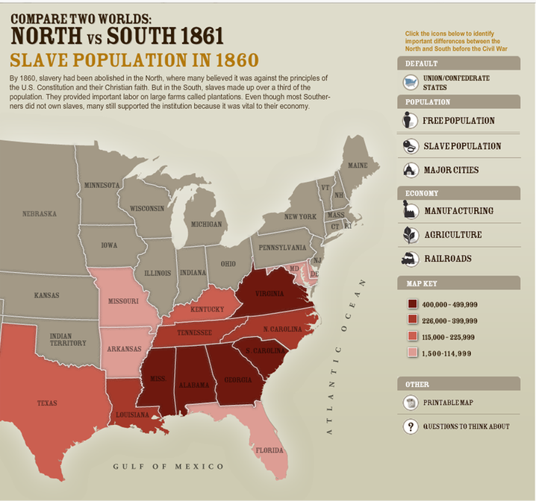
The Planter
The result was that Northern and European industry set prices for Southern cotton, tobacco and sugar which left a narrow margin of profit for the planter.
He could retaliate only by more ruthlessly exploiting his slave labor so as to get the largest crops at the least expense. He was therefore not deliberately cruel to his slaves, but he had to raise cotton enough to satisfy his pretensions and self-indulgence, even if it brutalized and commercialized his slave labor.
Thus slavery was the economic lag of the 16th century carried over into the 19th century and bringing by contrast and by friction moral lapses and political difficulties.

Slide 32
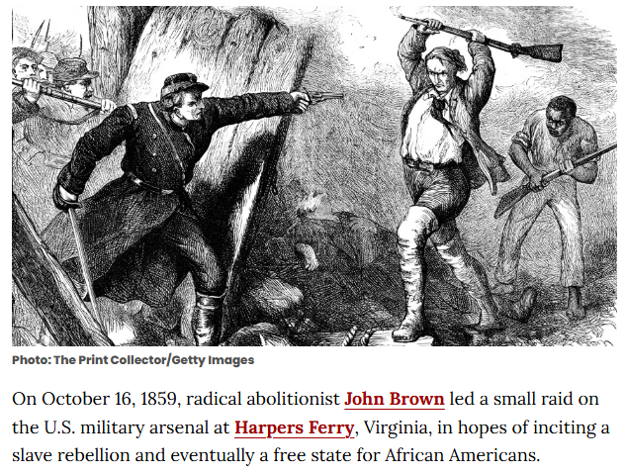
The General Strike
Both North and South ignored in differing degrees the interests of the laboring classes. The North expected patriotism and union to make white labor fight; the South expected all white men to defend the slaveholders' property. Both North and South expected at most a sharp, quick fight and victory; more probably the South expected to secede peaceably, and then outside the Union, to impose terms which would include national recognition of slavery, new slave territory and new cheap slaves.
Both sections ignored the Negro. To the Northern masses the Negro was a curiosity, a sub-human minstrel, willingly and naturally a slave, and treated as well as he deserved to be. He had not sense enough to revolt and help Northern armies, even if Northern armies were trying to emancipate him, which they were not. Negroes on the whole were considered cowards and inferior beings whose very presence in America was unfortunate. The abolitionists, it was true, expected action on the part of the Negro, but how much, they could not say. Only John Brown knew just how revolt had come and would come and he was dead.

Slide 33
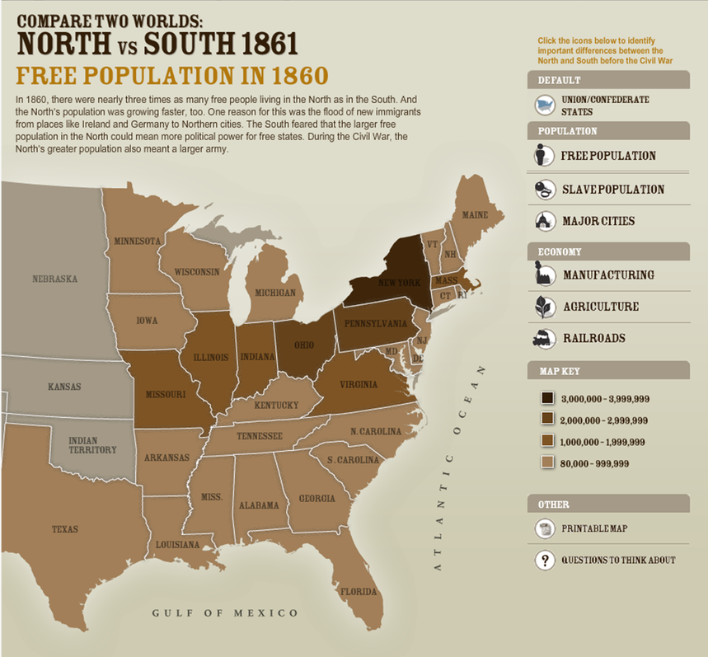
The General Strike
On the other hand, the tremendous economic ideal of keeping this great market for goods, the United States, together with all its possibilities of agriculture, manufacture, trade and profit, appealed to both the West and the North; and what was then much more significant, it appealed to the Border States.
The Border States wanted the cotton belt in the Union so that they could sell it their surplus slaves; but they also wanted to be in the same union with the North and West, where the profit of trade was large and increasing.
The duty then of saving the Union became the great rallying cry of a war which for a long time made the Border States hesitate and confine secession to the far South. And yet they all knew that the only thing that really threatened the Union was slavery and the only remedy was Abolition.

Slide 34
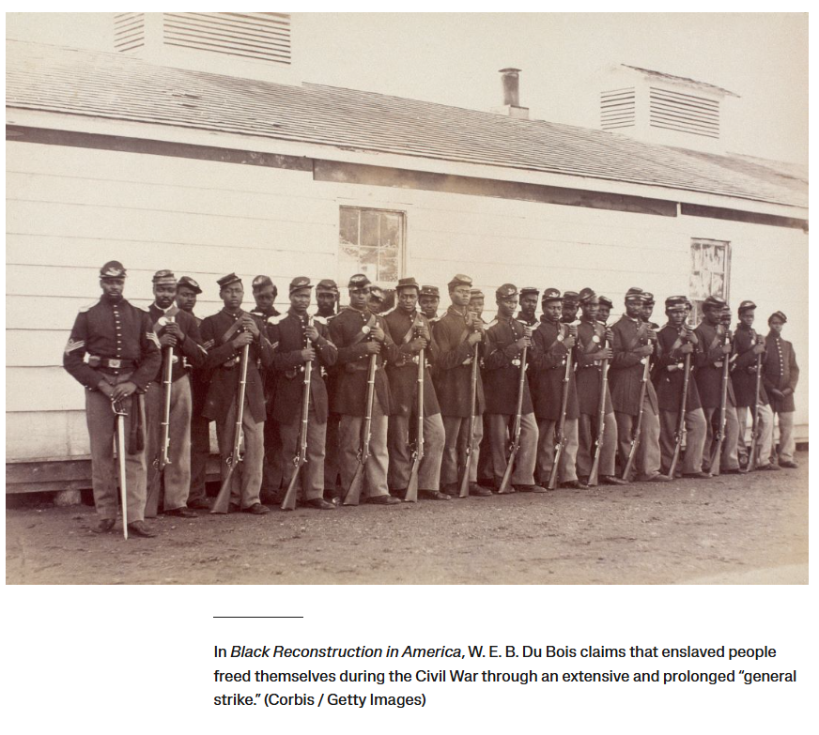
The General Strike
Thus the Negro himself was not seriously considered by the majority of men, North or South. And yet from the very beginning, the Negro occupied the center of the stage because of very simple physical reasons: the war was in the South and in the South were 3,953,740 black slaves and 261,918 free Negroes.
What was to be the relation of this mass of workers to the war? What did the war mean to the Negroes, and what did the Negroes mean to the war? There are two theories, both rather over-elaborated: the one that the Negro did nothing but faithfully serve his master until emancipation was thrust upon him; the other that the Negro immediately, just as quickly as the presence of Northern soldiers made it possible, left serfdom and took his stand with the army of freedom.

Slide 35
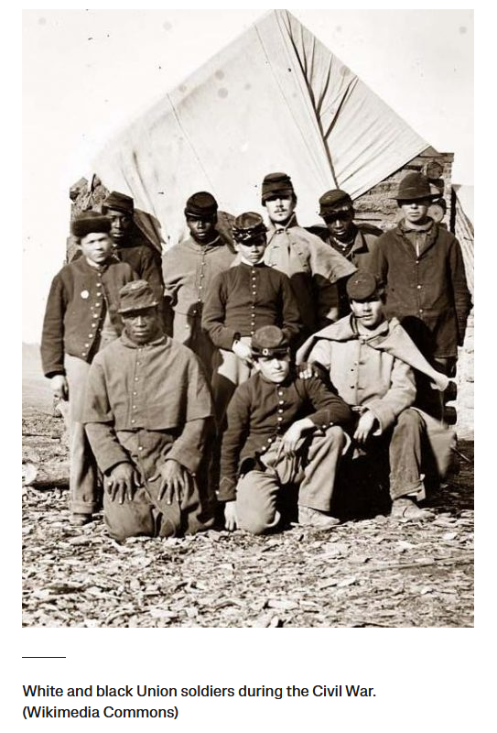
The General Strike
It must be borne in mind that nine-tenths of the four million black slaves could neither read nor write, and that the overwhelming majority of them were isolated on country plan-tations. Any mass movement under such circumstances must materialize slowly and painfully. What the Negro did was to look and listen and try to see where his interest lay. There was no use in seeking refuge in an army which was not an army of freedom; and there was no sense in revolting against armed masters who were conquering the world.
As soon, however, as it became clear that the Union armies would not or could not return fugitive slaves, and that the masters with all their fume and fury were uncertain of victory, the slave entered upon a general strike against slavery by the same methods that he had used during the period of the fugitive slave. He ran away to the first place of safety and offered his services to the Federal Army.
So that in this way it was really true that he served his former master and served the emancipating army; and it was also true that this withdrawal and bestowal of his labor decided the war.

Slide 36
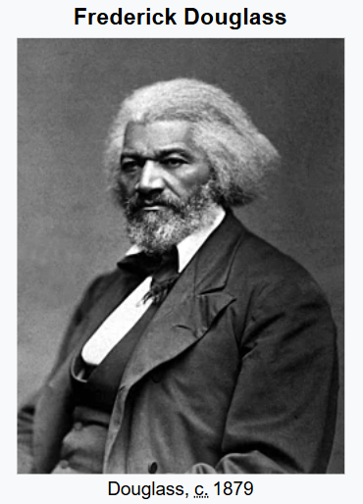
The General Strike
It was as Frederick Douglass said in Boston in 1865, that the Civil War was begun "in the interests of slavery on both sides.”
The South was fighting to take slavery out of the Union, and the North fighting to keep it in the Union; the South fighting to get it beyond the limits of the United States Constitution, and the North fighting for the old guarantees;-both despising the Negro, both insulting the Negro."
It was, therefore, at first by no means clear to most of the four million Negroes in slavery what this war might mean to them. They crouched consciously and moved silently, listening, hoping and hesitating. The watchfulness of the South was redoubled. They spread propaganda: the Yankees were not only not thinking of setting them free, but if they did anything, they would sell them into worse slavery in the West Indies.

Slide 37
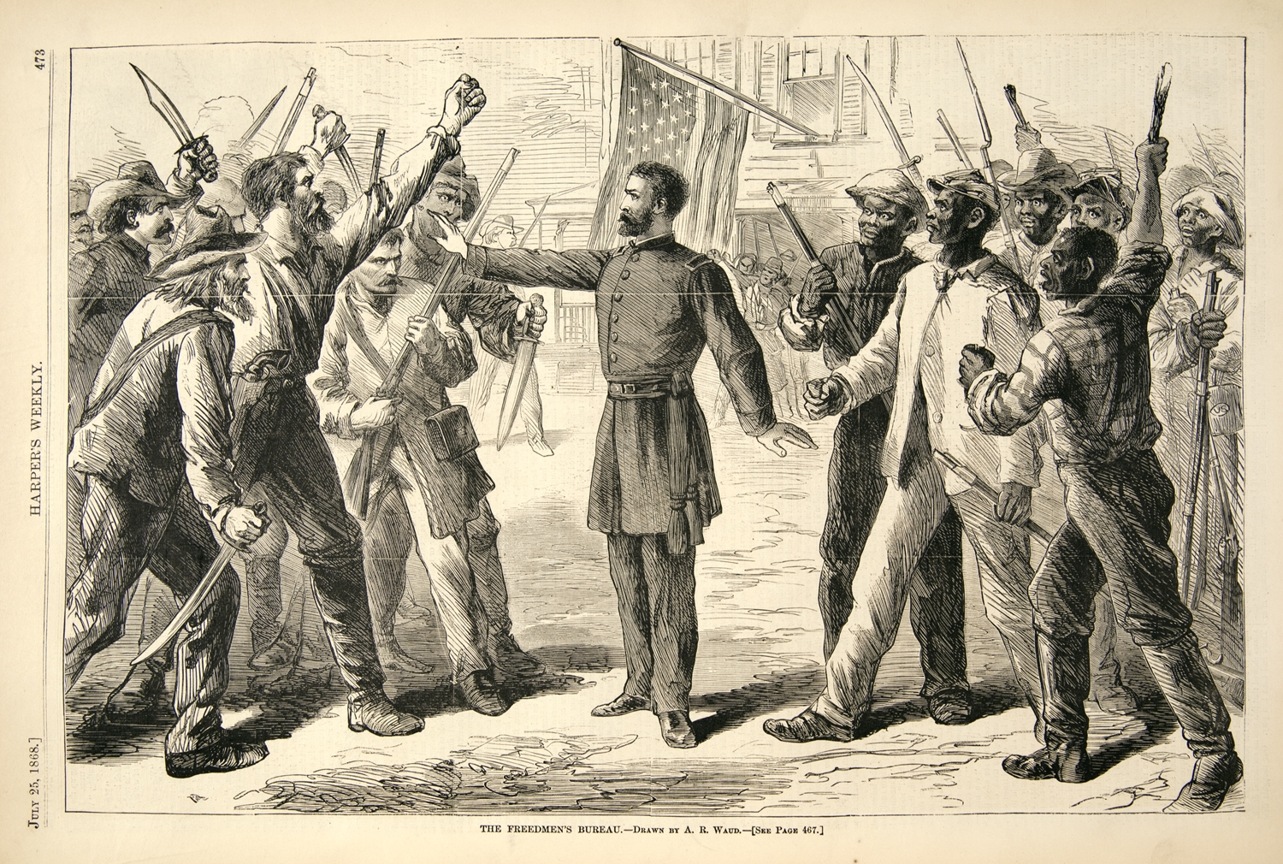
The General Strike
Except for slavery, it was said: The poor would occupy the position in society that the slaves do—as the poor in the North and in Europe do, for there must be a menial class in society and in 'every civilized country on the globe, besides the Confederate States, the poor are the inferiors and menials of the rich.'
Slavery was a greater blessing to the non-slaveholding poor than to the owners of slaves, and since it gave the poor a start in society that it would take them generations to work out, they should thank God for it and fight and die for it as they would for their 'own liberty and the dearest birthright of freemen."
But the poor whites were losing faith. They saw that poverty was fighting the war, not wealth.

Slide 38
Discussion

Slide 39
THE COMING OF THE LORD:
How the Negro became free because the North could not win the Civil War if he remained in slavery; And how arms in his hands, and the prospect of arms in a million more black hands, brought peace and emancipation to America

Slide 40
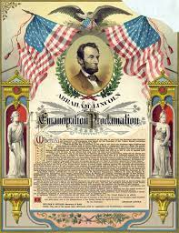
Soldiers Fighting for Their Own Freedom
In the last chapter, we chronicled the swarming of the slaves to
meet the approaching Union armies; in this we consider how these slaves were transformed in part from laborers to soldiers fighting for their own freedom; and in succeeding chapters, we shall treat the organization of free labor after the war. On the first of January, 1863, Abraham Lincoln declared four million slaves "thenceforward and forever free." The truth was less than this. The Emancipation Proclamation applied only to the slaves of those states or parts of states still in rebellion against the United States government. Hundreds of thousands of such slaves were already free by their own action and that of the invading armies. In their cases, Lincoln's proclamation only added possible legal sanction to an accomplished fact.

Slide 41
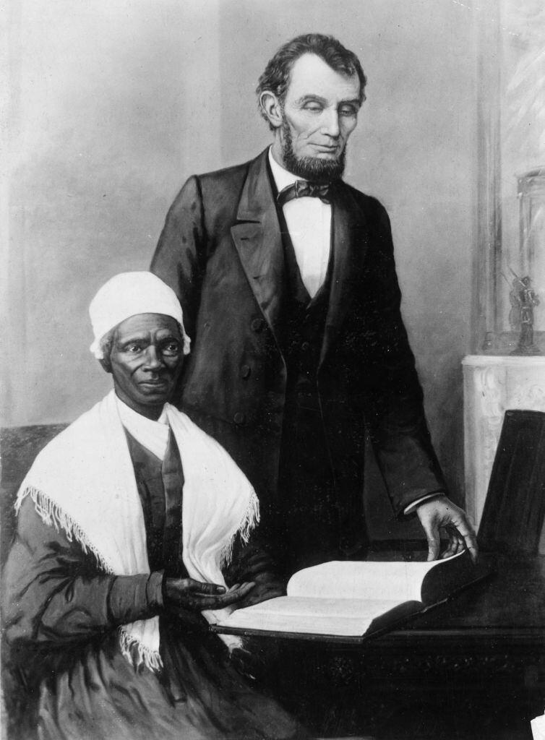
The Ulterior Motives for Emancipation
To the majority of slaves still within the Confederate lines, the proclamation would apply only if they followed the fugitives. And this Abraham Lincoln determined to induce them to do, and thus to break the back of the rebellion by depriving the South of its principal labor force. Emancipation had thus two ulterior objects. It was designed to make easier the replacement of unwilling Northern white soldiers with black soldiers; and it sought to put behind the war a new push toward Northern victory by the mighty impact of a great moral ideal, both in the North and in Europe. This national right-about-face had been gradually and carefully accomplished only by the consummate tact of a leader of men who went no faster than his nation marched but just as fast; and also by the unwearying will of the Abolitionists, who forced the nation onward.
1862: Abraham Lincoln reading the Bible with abolitionist Sojourner Truth, a formerly enslaved woman, in a print presented to the President by the Black community of Baltimore to commemorate the Emancipation Proclamation

Slide 42
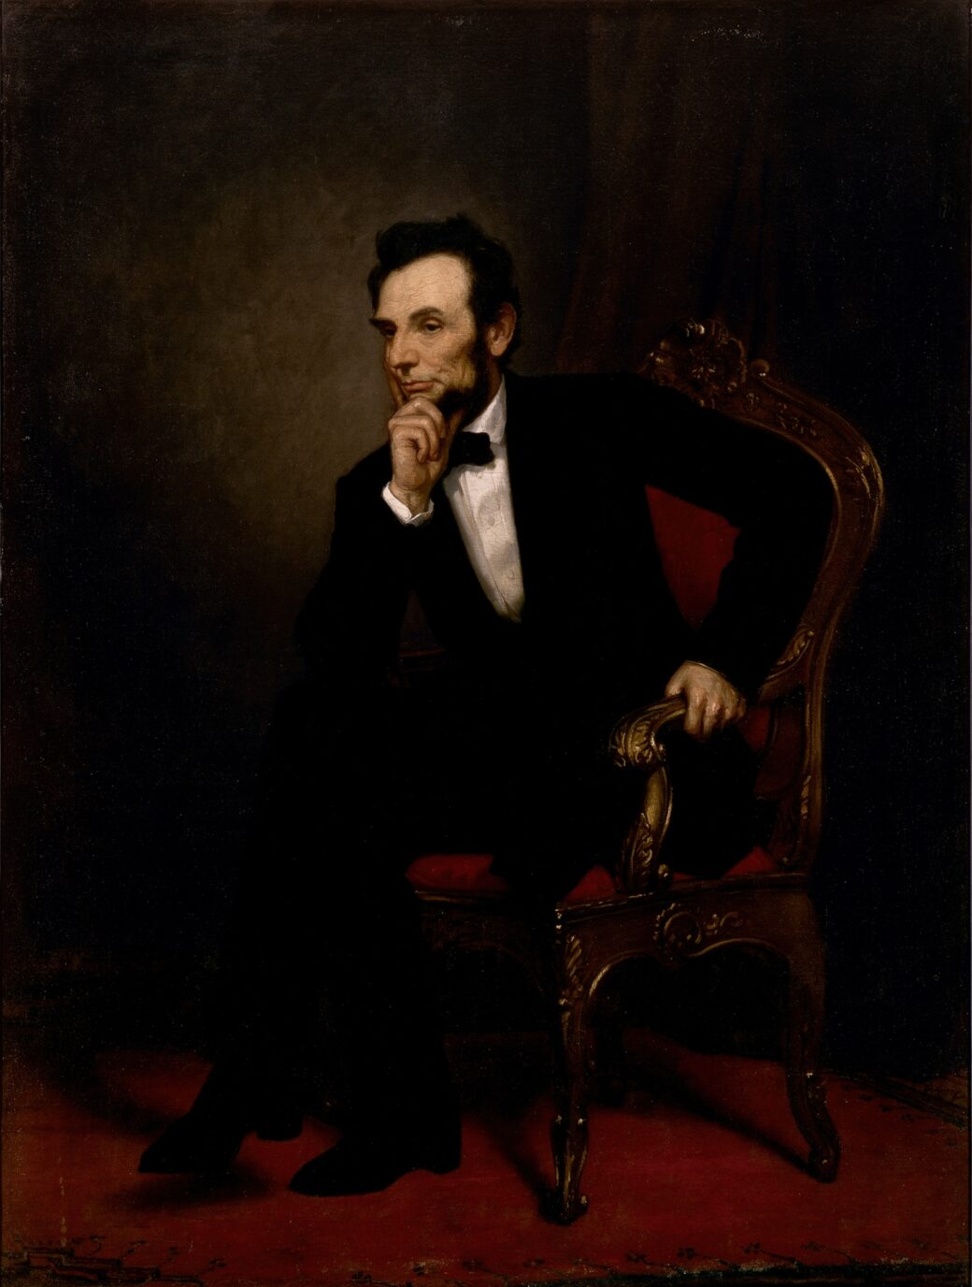
Lincoln Vacillates
In September, 1862, Lincoln said to representatives of the Chicago Protestants: "I admit that slavery is at the root of the rebellion, or at least its sine qua non....I will also concede that Emancipation would help us in Europe....I grant, further, that it would help somewhat at the North, though not so much, I fear, as you and those you represent imagine.... And then, unquestionably, it would weaken the Rebels by drawing off their laborers, which is of great importance; but I am not so sure we could do much with the Blacks. If we were to arm them, I fear that in a few weeks the arms would be in the hands of the Rebels… What good would a proclamation of Emancipation from me do, especially as we are now situated? I do not want to issue a document that the whole world will see must necessarily be inoperative, like the Pope's bull against the comet...." Nevertheless, just nine days later, Lincoln issued his preliminary Emancipation Proclamation. What caused the sudden change? Was it the mounting mass of Negroes rushing into Union lines? Was it the fighting of Negro soldiers which showed that weapons given to them were never found in the hands of Confederates, or was it the curious international situation?

Slide 43
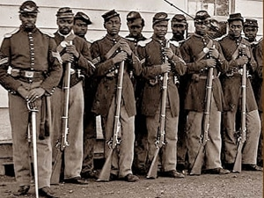
A Special Admonition
The final proclamation was issued January 1, 1863, and carried a special admonition to the colored people: "And I hereby enjoin upon the people so declared to be free to abstain from all violence, unless in necessary self-defense; and I recommend to them that, in all cases when allowed, they labor faithfully for reasonable wages."
"And I further declare and make known that such persons, of suitable condition, will be received into the armed service of the United States to garrison forts, positions, stations, and other places, and to man vessels of all sorts in said service. And upon this act, sincerely believed to be an act of justice, warranted by the Constitution upon military necessity, I invoke the considerate judgment of mankind, and the gracious favor of Almighty God."

Slide 44
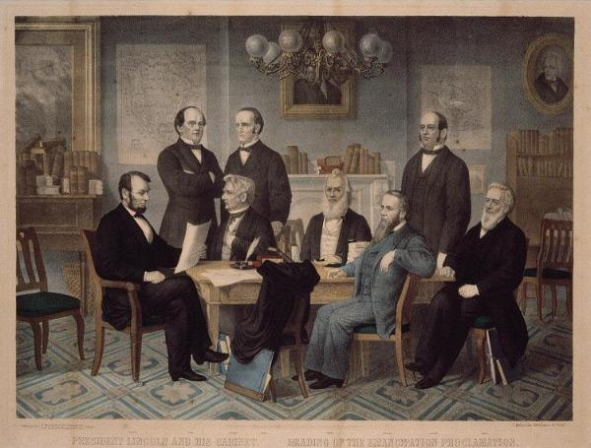
From Pessimism and Despair to Boundless Faith
The reaction to emancipation in the North was unfavorable so far as political results indicated, although many motives influenced the voters. Only among Negroes and in England was the reaction favorable, and both counted. The Proclamation made four and a half million laborers willing almost in mass to sacrifice their last drop of blood for their new-found country. It sent them into transports of joy and sacrifice. It changed all their pessimism and despair into boundless faith. It was the Coming of the Lord. The Proclamation had an undoubted and immediate effect upon England. The upper classes were strongly in favor of the Confederacy, and sure that the Yankees were fighting only for a high tariff and hurt vanity. Free-trade England was repelled by this program, and attracted by the free trade which the Confederacy offered. There was strong demand among manufacturers to have the government interfere and recognize the Southern States as an independent nation. The church and universities were in favor of the Confederacy, and all the great periodicals. Even the philanthropists, like Lord Shaftesbury, Carlyle, Buxton and Gladstone, threw their sympathies to the South. Carlyle sneered at people "cutting each other's throats because one half of them prefer hiring their servants for life, and the other by the hour."
The Cabinet of President Abraham Lincoln

Slide 45
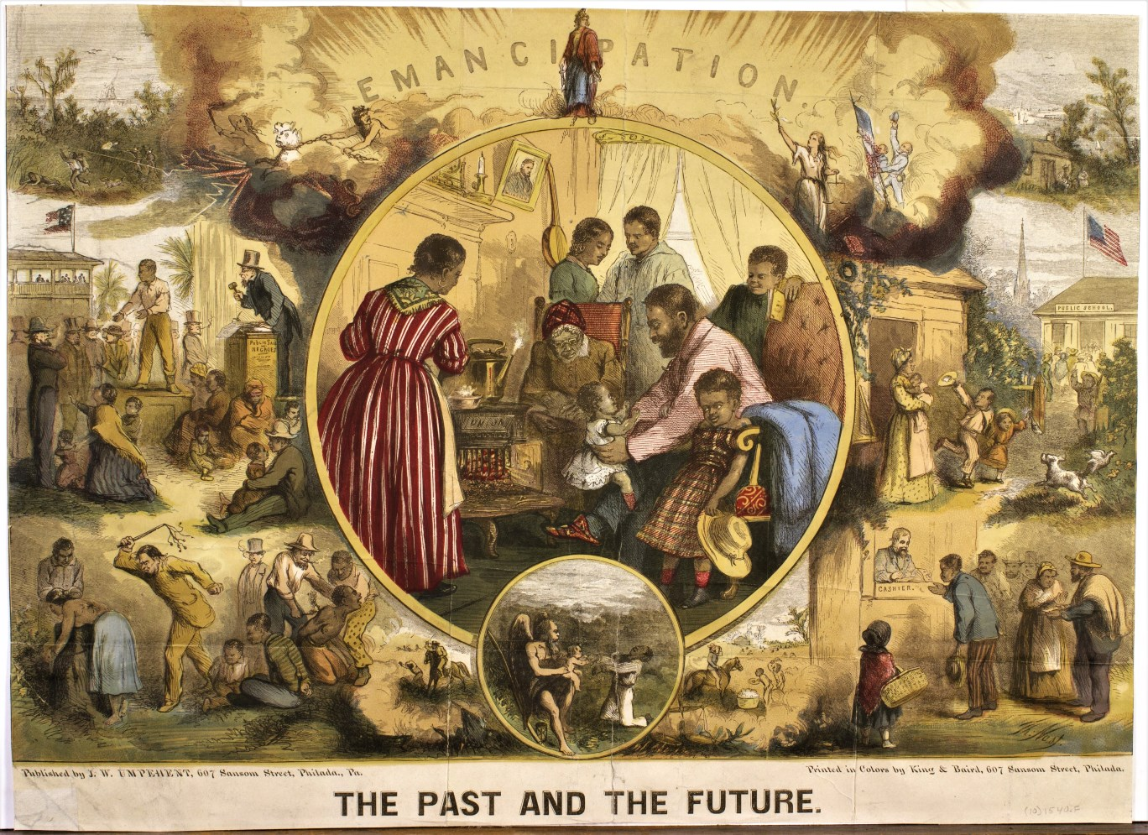
Great Distress Among English Laborers
Public opinion stood back of the English government and was in favor of the South ; but Garrison and Douglass by their visits, and later Harriet Beecher Stowe, had influenced the opinion of the middle and laboring classes. Nevertheless, it was reported in 1862 : "We find only here and there among the Englishmen one who does not fanatically side with the slave states." Various meetings in favor of the South were arranged by the workingmen and the General Council of Workingmen's Associations opposed the pro-Southern movement. The war had created a great scarcity of cotton in addition to an over-production of the cotton industry in England in 1860, so that the effect of the blockade was not felt until later. But the factories closed, and more than half the looms and spindles lay idle. Especially in Lancashire there was great distress among laborers. Fever and prostitution were prevalent in 1865.
Emancipation. The Past and Future by Thomas Nast, 1865

Slide 46
Marx and the English Workers Condemn Racism and the Confederacy
Up until 1863, it was argued with some show of right that the North was not fighting to free the slaves; but on the contrary, in Lincoln's own words, "was perfectly willing to settle the war and leave the Negroes in slavery." But as soon as Lincoln issued the Emancipation Proclamation, the workingmen of England held hundreds of meetings all over the country and in all industrial sections, and hailed his action.
On December 31, 1863, at meetings held simultaneously in London and Manchester, addresses were sent to Lincoln, drafted by Karl Marx. Marx wrote in the London address, "Sir: We who offer this address are Englishmen and workingmen. We prize as our dearest inheritance, bought for us by the blood of our fathers, the liberty we enjoy-the liberty of free labor on a free soil. We have, therefore, been accustomed to regard with veneration and gratitude the founders of the great republic in which the liberties of the Anglo-Saxon race have been widened beyond all the precedents of the old world, and in which there was nothing to condemn or to lament but the slavery and degradation of men guilty only of a colored skin or an African parentage. We have looked with admiration and sympathy upon the brave, generous and untiring efforts of a large party in the Northern States to deliver the Union from this curse and shame. We rejoiced, sir, in your election to the Presidency, as a splendid proof that the principles of universal freedom and equality were rising to the ascendant. We regarded with abhorrence the conspiracy and rebellion by which it was sought at once to overthrow the supremacy of a government based upon the most popular suffrage in the world, and to perpetuate the hateful inequalities of race."

Slide 47
“Justice Demands for the Black, No Less Than for the White, the Protection of the Law”
The Manchester address, written by Marx, stated: "One thing alone has, in the past, lessened our sympathy with your country and our confidence in it; we mean the ascendancy of politicians who not merely maintained Negro slavery, but desired to extend and root it more deeply. Since we have discerned, however, that the victory of the free North in the war which has so sorely distressed us as well as afflicted you, will shake off the fetters of the slave, you have attracted our warm and earnest sympathy. "We joyfully honor you, as the President, and the Congress with you, for the many decisive steps towards practically exemplifying your belief in the words of your great founders : 'All men are created free and equal.'..."We assume that you cannot now stop short of a complete uprooting of slavery. It would not become us to dictate any details, but there are broad principles of humanity which must guide you. If complete emancipation in some states be deferred, though only to a predetermined day, still, in the interval, human beings should not be counted chattels. Woman must have rights of chastity and maternity, men the rights of husbands; masters the liberty of manumission. Justice demands for the black, no less than for the white, the protection of the law-that his voice may be heard in your courts. Nor must any such abomination be tolerated as slave-breeding States and a slave market-if you are to earn the high reward of all your sacrifices in the approval of the universal brotherhood and of the Divine Father. It is for your free country to decide whether anything but immediate and total emancipation can secure the most indispensable rights of humanity, against the inveterate wickedness of local laws and local executives. "We implore you, for your own honor and welfare, not to faint in your providential mission. While your enthusiasm is aflame, and the tide of events runs high, let the work be finished effectually. Leave no root of bitterness to spring up and work fresh misery to your children. It is a mighty task, indeed, to reorganize the industry, not only of four millions of the colored race, but of five millions of whites.

Slide 48
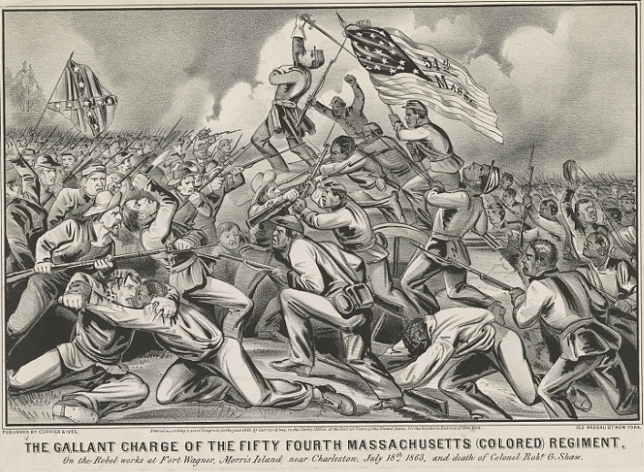
Here Was Indeed Revolution
Lincoln replied that he knew the suffering of the workingmen in Manchester and Europe in this crisis, and appreciated the action of the English workingmen as an example of "sublime Christian heroism," which "has not been surpassed in any age or in any country." He declared that the Civil War was "the attempt to overthrow this government, which was built upon a foundation of human rights, and to substitute one which should rest exclusively on the basis of human slavery." In the North, the Emancipation Proclamation meant the Negro soldier, and the Negro soldier meant the end of the war. "We have come to set you free!" cried the black cavalrymen who rode at the head of the Union Army as it entered Richmond in 1864.
Here was indeed revolution. At first, this was to be a white man's war. First, because the North did not want to affront the South, and the war was going to be short, very short; and secondly, if Negroes fought in the war, how could it help being a war for their emancipation? And for this the North would not fight. Yet scarcely a year after hostilities started, the Negroes were fighting, although unrecognized as soldiers; in two years they were free and enrolling in the army.
The Gallant Charge of the 54th Massachusetts (Colored) Regiment - 1863

Slide 49
Discussion & Wrap Up

Slide 50
Announcements
PCUSA Cell Chairs need to call members of their cells to remind them about attendance.
The next issue of New Masses (2026) has begun production. If you have art you want us to feature, email it to info@partyofcommunistsusa.net.

Slide 51
Volunteers Needed!
We are in need of volunteers for the staff of the People’s School! Here’s a few roles we need filled:
People to help manage posting on our social media and podcast platforms
Video Editors, Audio Editors, Graphic Designers, Artists, Narrators
Web Controls, Moderators
Email info@peoplesschool.us if you’re interested and try to attend our next staff meeting if possible.

Slide 52

View From Left Field
https://viewfromleftfield.libsyn.com
The Old PSMLS Youtube is now the Youtube of View From Left Field, a podcast of analysis and discussion of current events from a progressive perspective.
Like the Youtube videos and subscribe with 5 star ratings on your podcast platforms.

Slide 53

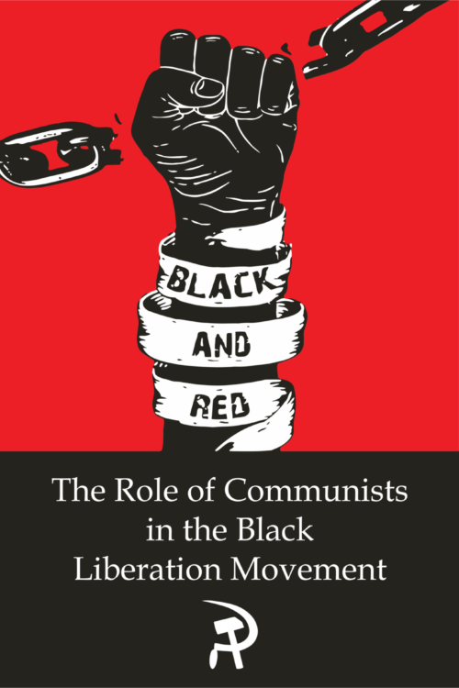
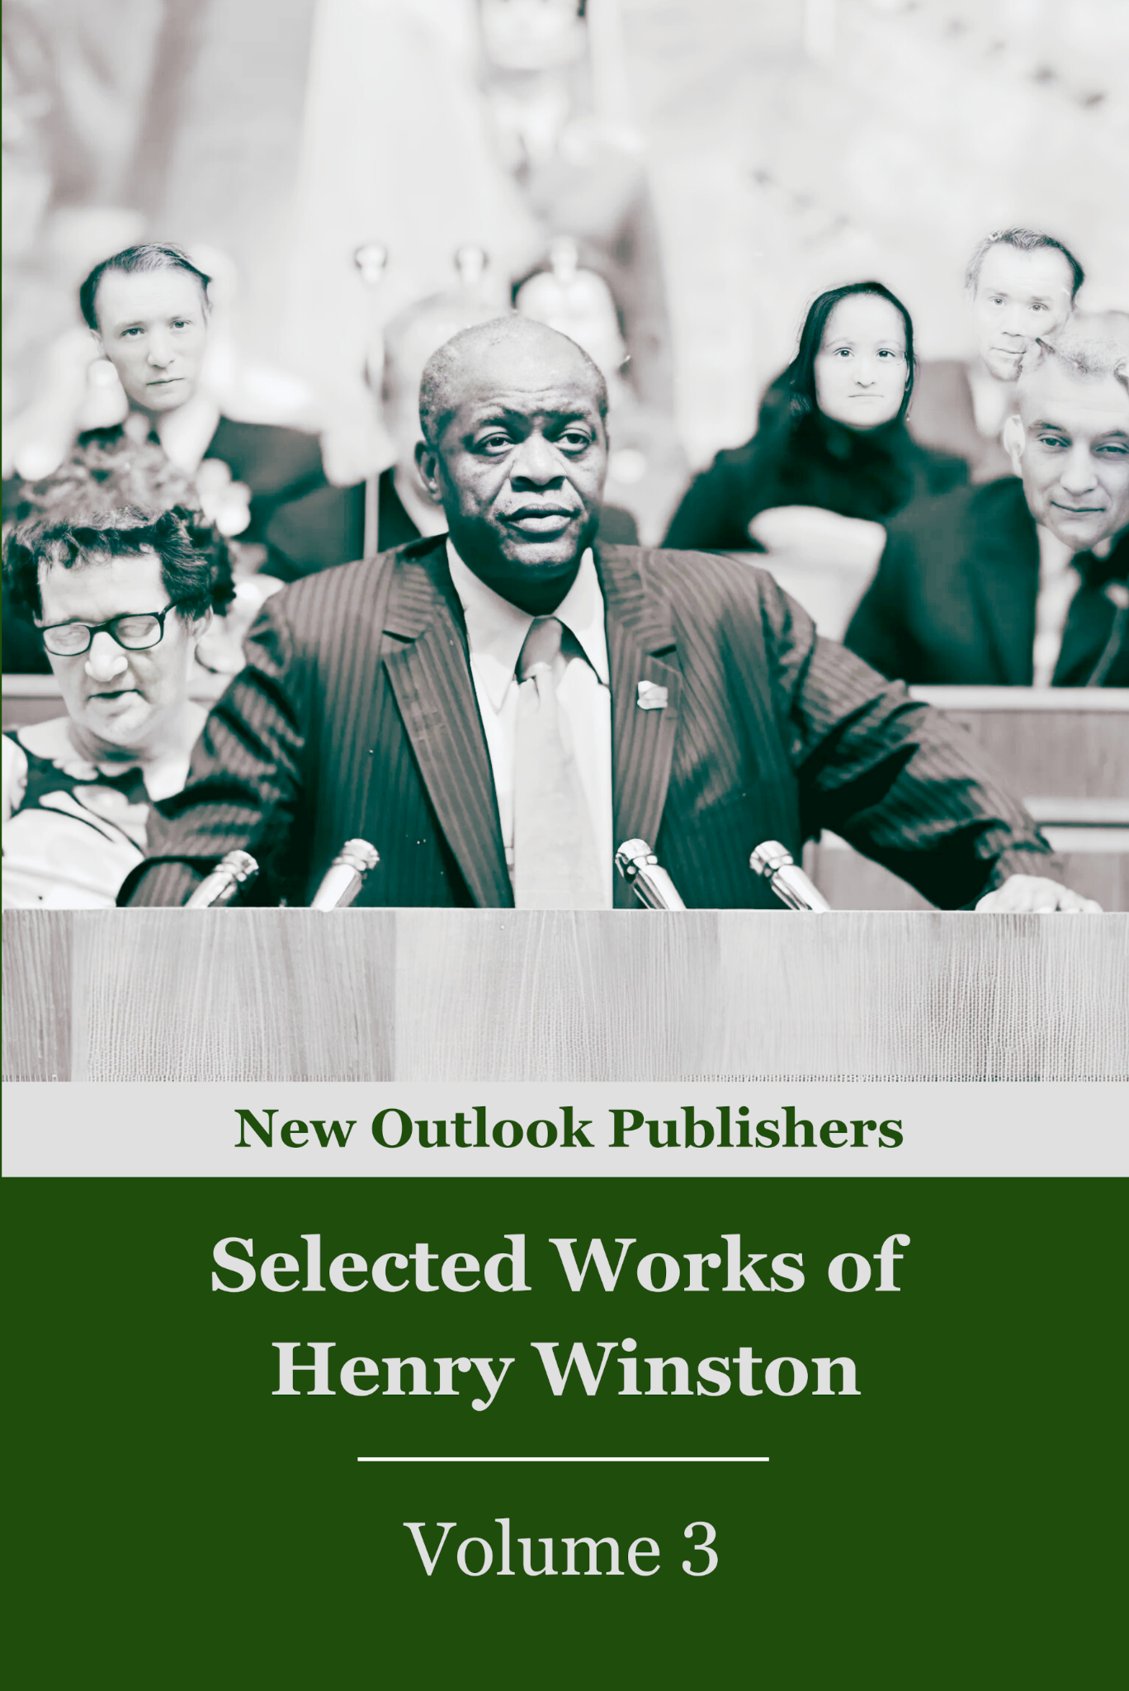
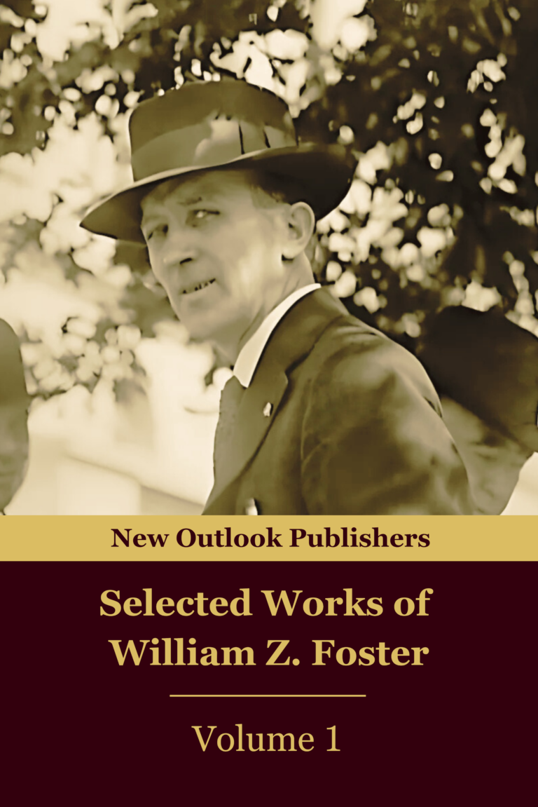
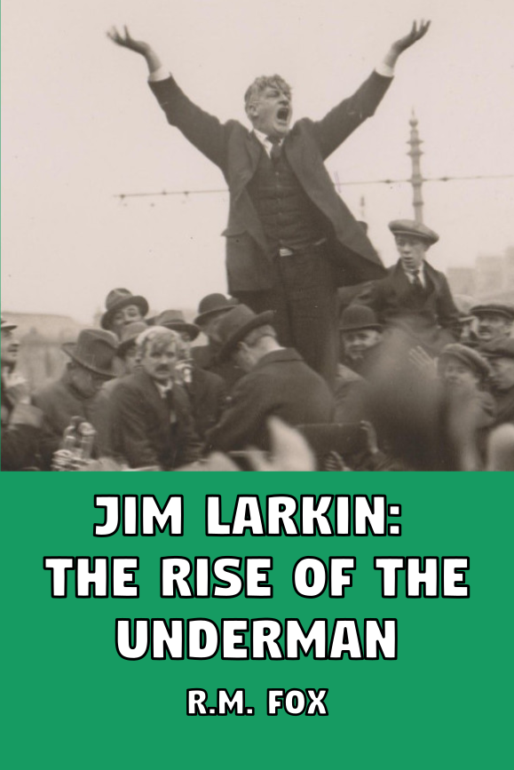
New Outlook Publishers
newoutlookpublishers.store
Relevant and Latest Releases

Slide 54



Harry Bridges School of Labor
luel.us/laborschool/
The Harry Bridges School of Labor is a monthly class covering a variety of topics aimed at building class consciousness among union members. For class schedule and other information, please visit the website at luel.us/laborschool.

Slide 55
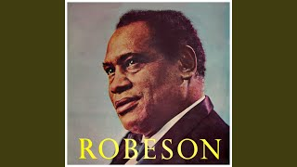
John Brown’s Body - Paul Robeson

