Slide 1

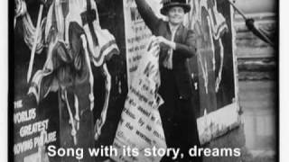
The March of the Women - Dame Ethel Smyth

Slide 2
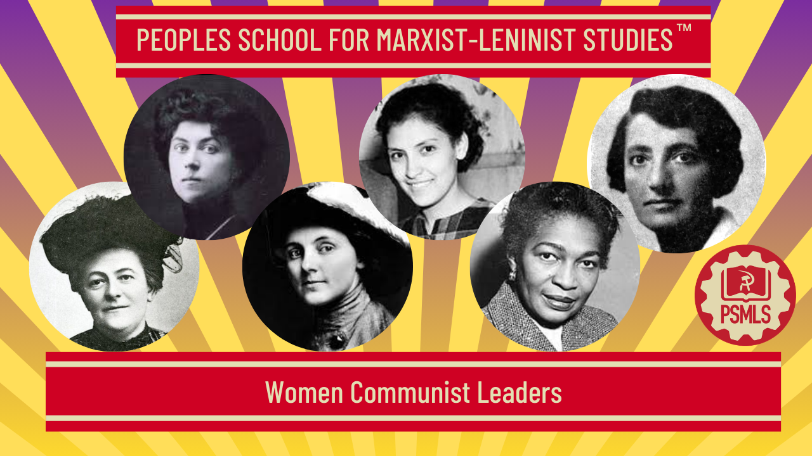
PSMLS 3/8/26

Slide 3
What we’ll be learning today:
Famous Female Communist Figures and their Contributions to the Movement
Soviet Women & their Role in the Revolution
Claudia Jones - An End to the Neglect of the Problems of the Negro Woman!

Slide 4
Famous Female Communist Figures and their Contributions to the Movement

Slide 5
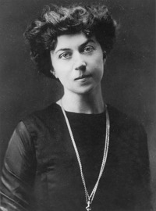
International Communists: Alexandra Kollontai
Alexandra Mikhailovna Kollontai (1872–1952) was a Russian revolutionary and Communist organizer. Educated in the democratic traditions of Russian progressive literature, Kollontai rebelled against Russian tsarist autocracy and became a Marxist, leading the life of a professional revolutionary.
Kollontai joined the Russian Social Democratic Labor Party in 1899 but did not formally side with either of the most prominent factions, the Mensheviks or the Bolsheviks. She joined the Mensheviks in 1906. During this time, she attended international socialist conferences representing the Russian socialist movement. In 1908, she published “Finland and Socialism” which called for Finnish people to resist their oppression under the Russian Empire. The Tsar’s government charged Kollontai with sedition and she was forced into exile where she became acquainted with other notable figures of the time including Zetkin, Luxemburg, Liebknecht, and Karl Kautsky. During her exile, she became an important connecting point between thought leaders transmitting ideology and theory across Europe.
In 1915, while still in exile, she became an opponent of the Great War (WWI). She broke with the Mensheviks to join the Bolshevik party after being influenced by Lenin’s position on World War I. She went on a tour of the USA to deliver speeches opposing US involvement in the War. She returned to Russia in 1917, after the February Revolution and served on the Bolshevik’s Central Committee that led the October Revolution. Kollontai was a prominent figure and one of the most visible women in the early Communist Party of the Soviet Union (CPSU). Notably, she became the world’s first female government minister when she served as the first People’s Commissar of Social Welfare of the Russian SFSR from Nov. 11, 1917 - Feb. 23, 1918.
Notes:
https://leninists.org/index.php?title=Selected_Articles_and_Speeches

Slide 6
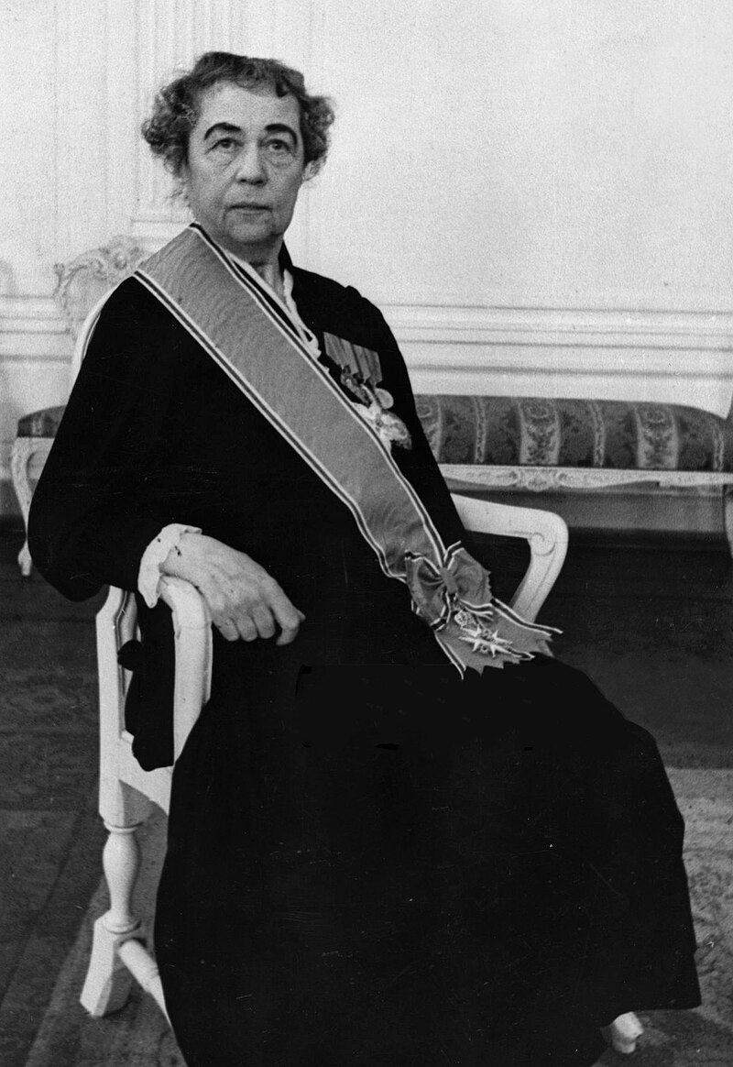
International Communists: Alexandra Kollontai
In 1918, Kollontai worked alongside Inessa Armand, Nadezhda Krupskaya and others to establish the Zhenotdel (Women’s Department) which worked to improve living conditions for women in the Soviet Union and enable women’s full participation in Soviet society. The Women’s Department worked across a broad spectrum of activities including establishing public laundries, kindergartens, nurseries and canteens, creating factory inspection systems, organizing delegate meetings for women, and recruiting women to workplaces on the basis of gender equality. The work of the Women’s Department markedly improved life for tens of thousands of women across the Soviet Union.
In 1921 she began to publicly support a left-wing oppositionist movement against the CPSU and gave a speech to the Third Congress of the Comintern opposing Lenin’s New Economic Policy. Kollontai’s left-wing factionalism led to her being mostly sidelined from domestic politics. After this she requested a diplomatic assignment and went on to begin a notable diplomatic career as an international representative of the Soviet Union.
From 1922-1945 Kollontai built a reputation as a well-known diplomat who made major contributions in improving relations between the Soviet Union and Nordic countries, including playing a key role in negotiating the end of the Soviet-Finnish Winter War.

Slide 7
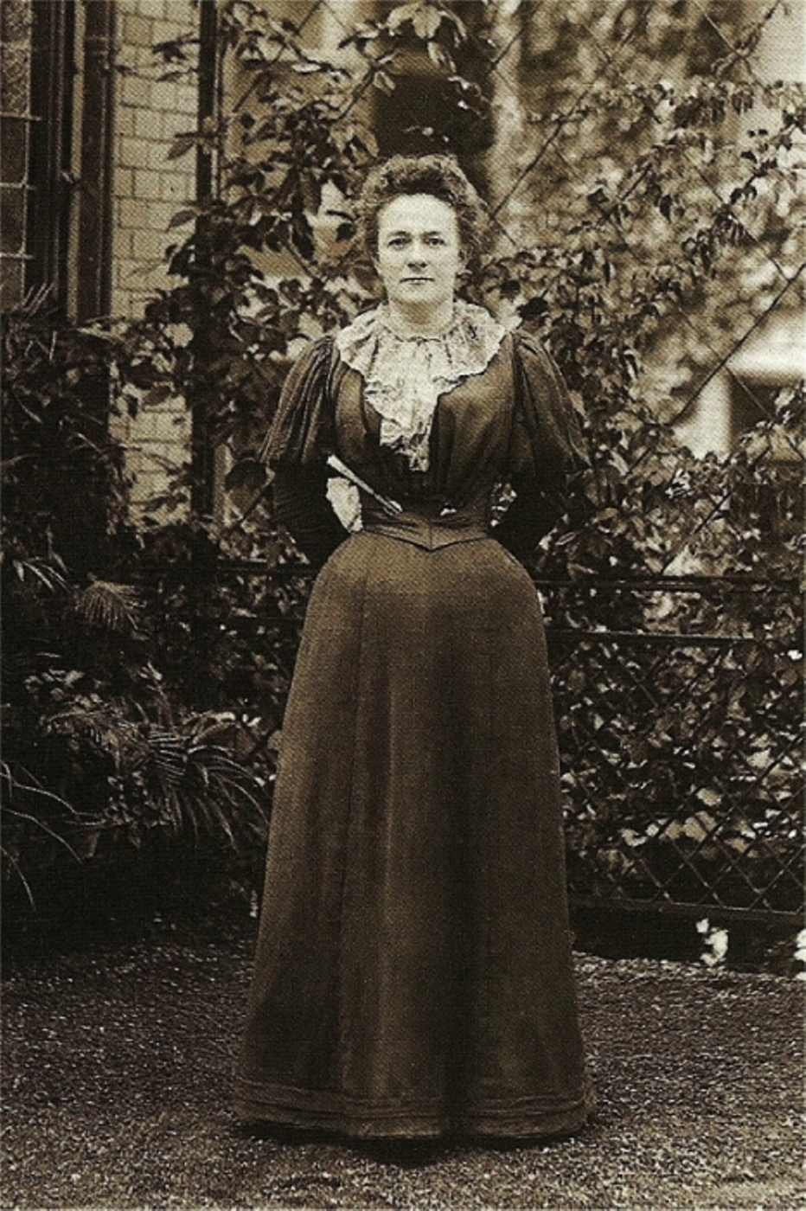
International Communists: Clara Zetkin
Clara Zetkin (1857-1933) was a seminal figure of the early international Communist movement. Over the course of her life Zetkin served as a member of the Social Democratic Party, a founding member of the Spartacist League which merged into the Communist Party of Germany (KPD), a representative to the Reichstag, and member of the Communist International’s executive committee.
Zetkin spent 1882 to 1890 in self-imposed exile from Germany in Zurich and Paris, fleeing the Anti-Socialist Law enacted by Otto von Bismarck. During this time she continued her work writing, distributing literature, and meeting with other figures in the Communist movement. She served as a representative of the KPD in the Reichstag from 1920 until the Reichstag fire in February 1933 when she again went into exile from her home country. She spent her last days in Moscow, passing in June of the same year.
Throughout her works, she argued that the fight for the rights and equality of women and the struggle against capitalism were deeply intertwined. In Zetkin’s eyes, the true emancipation of women could only come from socialist revolution, and women of the proletariat must reject bourgeois feminism.

Slide 8
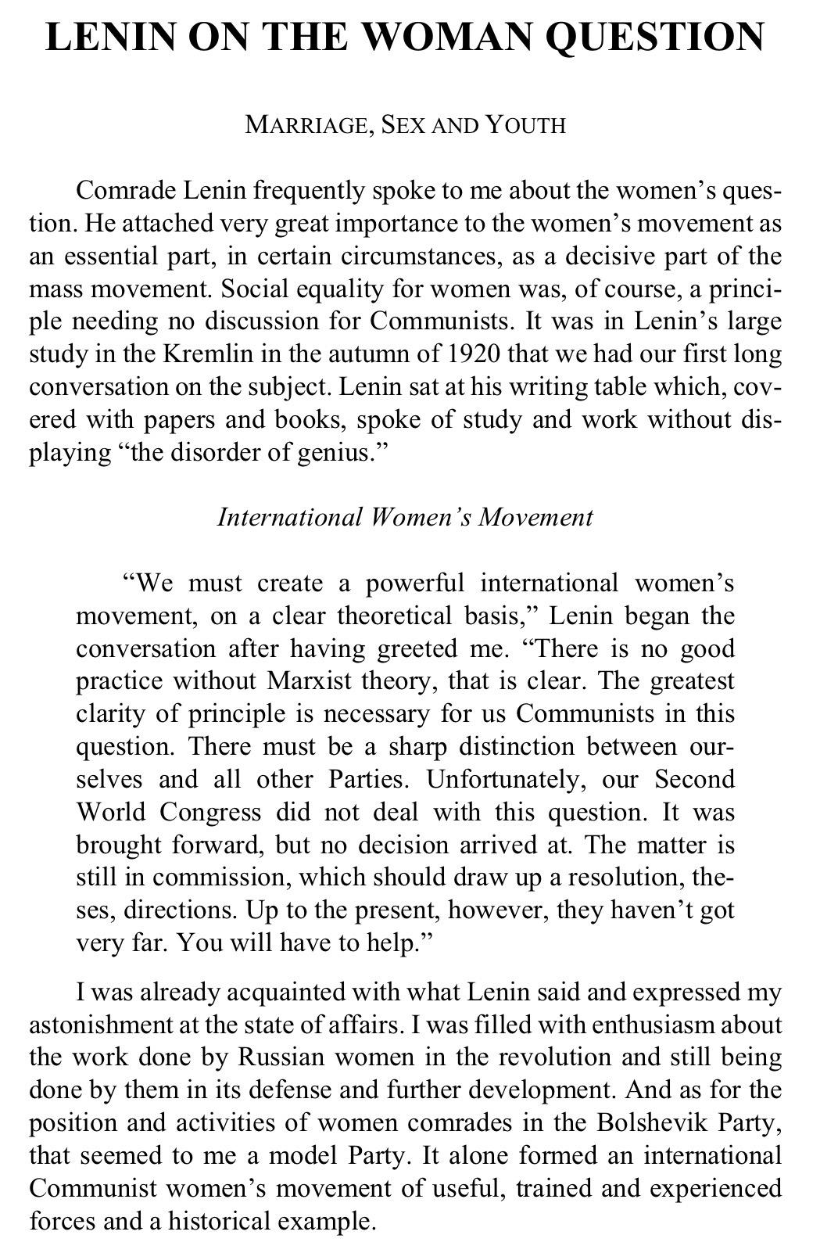
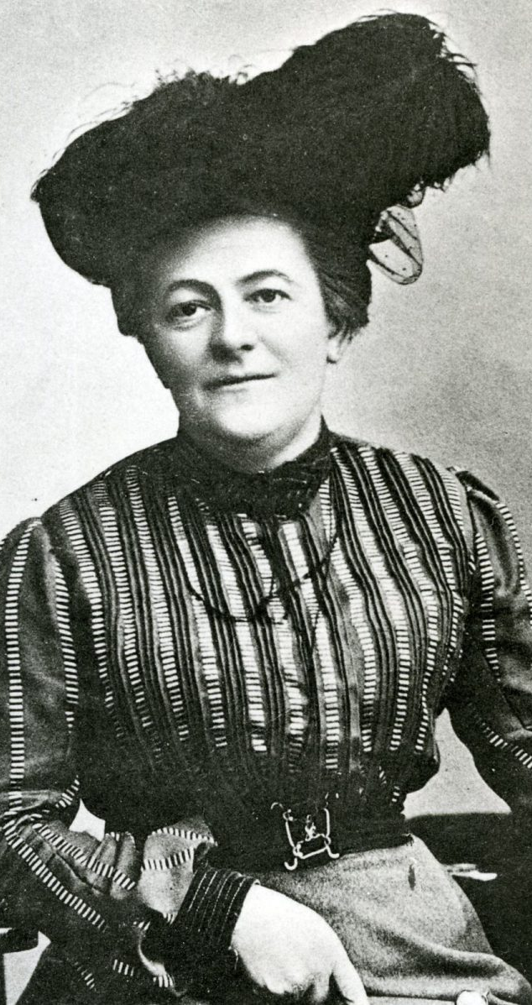
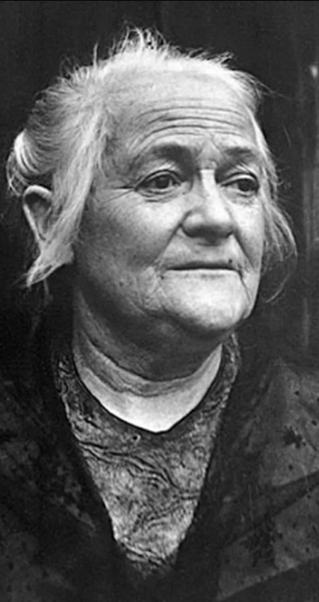
International Communists: Clara Zetkin
Clara Zetkin is remembered as a revolutionary thinker, organizer of women, friend of Vladimir Lenin, comrade of Rosa Luxemburg and Karl Liebknecht, and the principal architect of International Women’s Day.
American women who successfully organized Women’s Day demonstrations in 1909 proposed an annual international Socialist Women’s Day to the Second International Conference of Socialist Women held in Copenhagen in 1910. Zetkin’s draft resolution to the conference read:
“In agreement with the class-conscious political and trade union organizations of the proletariat, socialist women in all countries shall organize an annual Women’s Day, the primary purpose of which shall be agitation for women’s suffrage. This demand must be seen in the context of the socialist conception. Women’s Day must have an international character and be carefully prepared.”
From Lenin on the Woman Question, Clara Zetkin (1934)

Slide 9
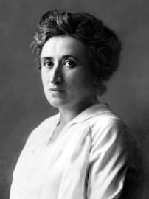
International Communists: Rosa Luxemburg
Rosa Luxemburg (1871–1919) was a Polish-German Marxist theorist and revolutionary. Luxemburg played a pivotal role in founding the anti-war Spartacist League from a faction of the Social Democratic Party and later the Communist Party of Germany (KPD).
Luxemburg was another key figure in the developing international Communist movement of the late 19th & early 20th century. She rejected reformism and advocated for spontaneity and mass action. In her work The Accumulation of Capital, she argued that capitalism requires the existence of non-capitalist markets, such as peasant economies or colonies, to generate surplus value.
Lenin and Luxemburg were contemporaries and had stark disagreements about the best path to achieve social revolution. While Lenin proved to have the more developed and ultimately successful theory, he respected Luxemburg as a devoted organizer and important contributor to the communist movement. Lenin famously defended her legacy even amid her mistakes in 1922’s Notes of a Publicist “by quoting two lines from a good old Russian fable: ‘Eagles may at times fly lower than hens, but hens can never rise to the height of eagles.’”
Even while imprisoned for anti-war activism during WWI she continued writing. In January 1919, she and Karl Liebknecht were brutally murdered by counter-revolutionary forces, making her a martyr and intellectual pillar of the communist movement.

Slide 10
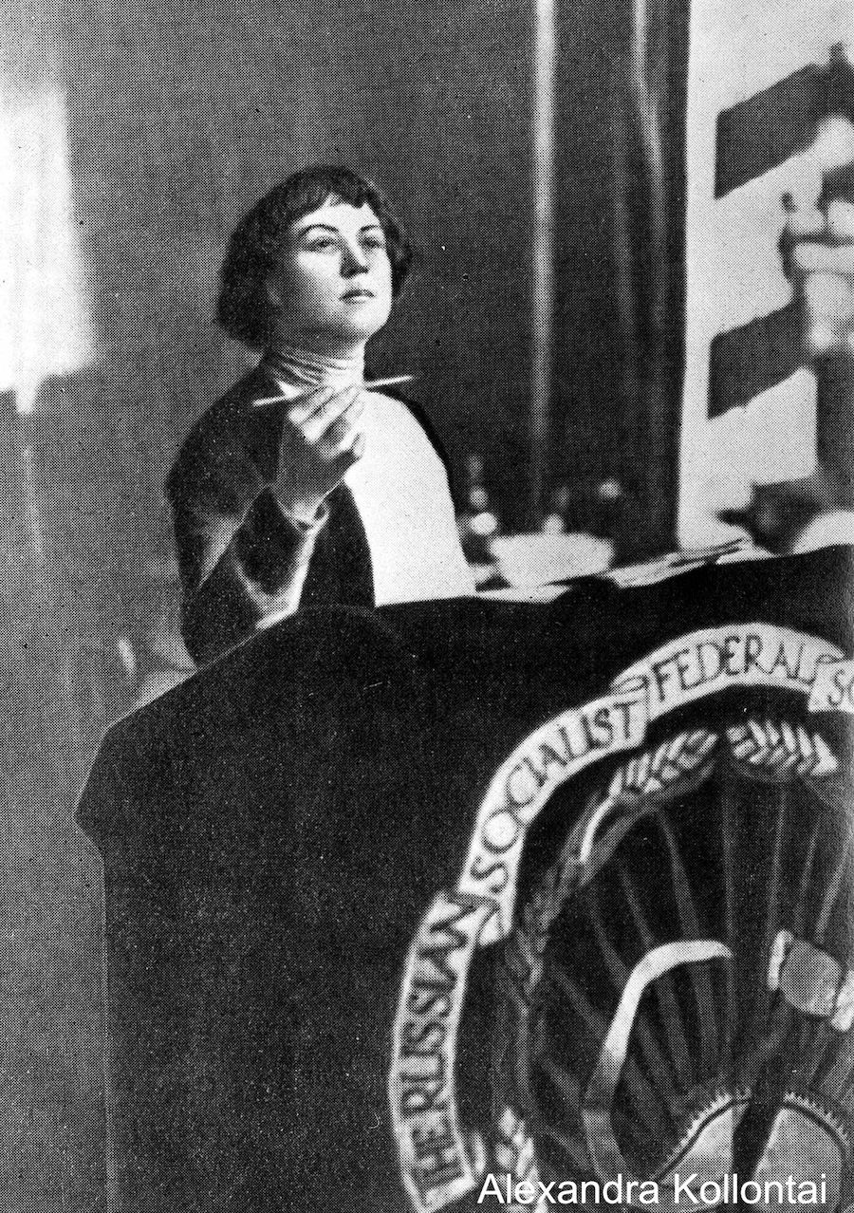
Kollontai’s Speech to the Women Workers (1917)
“Comrades women workers!
“For many centuries woman was oppressed and had no rights. For many centuries she was just an appendage to the man, his shadow. The husband provided for his wife, so long as she obeyed her husband’s will, meekly endured her own powerlessness, her own domestic and family slavery.
“The October Revolution liberated women. Now the peasant woman has the same rights as the peasant man, the worker woman has the same rights as male worker has. Everywhere the woman can vote and everywhere she can became a member of a Soviet or a commissar or even a People’s Commissar. But while according to law a woman has the same rights as a man do, life hasn’t liberated woman. The worker woman, the peasant woman are still in the clutch of a household, still a slave in their own land. The task of the workers now is to adjust life so as to relieve the burden of child care from a woman’s shoulders, to make household easier. The working class is interested in the liberation of women in these fields.

Slide 11
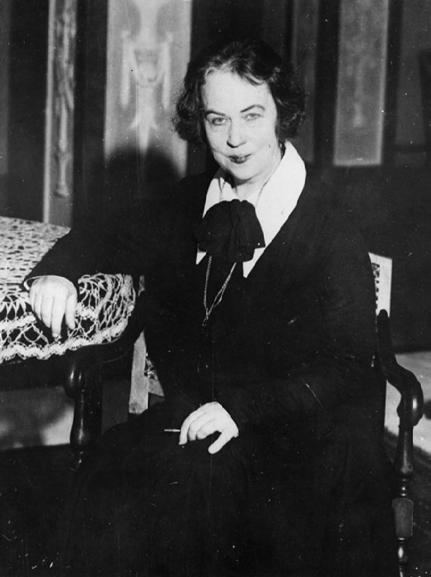
Kollontai’s Speech to the Women Workers (1917)
“The working class should understand that the woman is a member of the same proletarian family as the man, because the woman is working as well as the man. One third of the wealth on the Earth is created by women. There are 70,000,000 women workers in Europe and America. In communist society, a woman and a man must be equal. Without equality of women and men there is no communism.
Go to work, comrades working women! Liberate yourselves! Build nurseries, maternity houses, help the Soviets set up public canteens, help the Communist Party build a new happy life. Your place is amongst those who are fighting for the emancipation of working people, for equality, for freedom, for the happiness of your children! Your place, working women and peasant women, under the red revolutionary banner of worldly victorious communism!”

Slide 12

Excerpt from the Speech

Slide 13
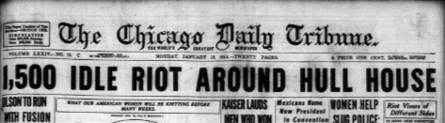
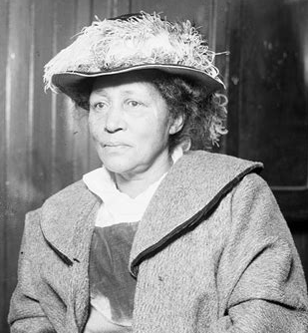
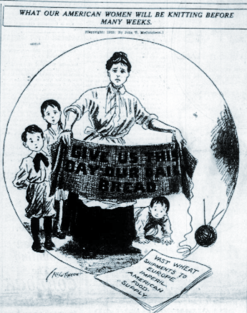
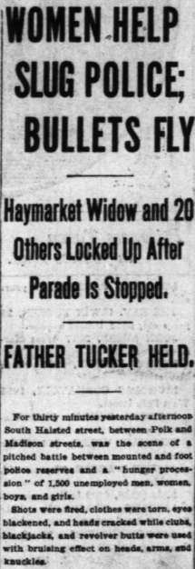
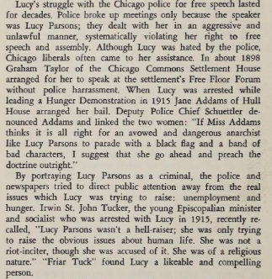
American Communists: Lucy Parsons
Lucy Parsons (c. 1851–1942) was a leading American radical labor organizer and writer of African American, Native American, and Mexican descent. Born into slavery, she became active with the Anarchist movement and was the only woman to address the founding convention of the Industrial Workers of the World (IWW) in 1905. Parsons spent decades organizing for workers' rights, free speech, and racial justice. She led the first May Day parade in Chicago in 1886. In 1915, Parsons led demonstrations of unemployed and hungry protesters.
After the Haymarket bombing, Parsons launched an international campaign to save her husband and the other condemned men from execution. Following their deaths on November 11, 1887, she dedicated the rest of her life to preserving their memory and continuing the struggle which they had given their lives for. Her contributions to the Communist movement came later in life, working with the communist-led International Labor Defense to defend the Scottsboro Boys and reportedly joining the Communist Party USA (CPUSA) around 1939. The Chicago Police Department famously described her as "more dangerous than a thousand rioters."
After her death in 1942, the FBI seized her entire library (by some accounts, as many as 1500 books) and all of her personal papers. These items were never returned, now apparently lost to history. She was buried in the same cemetery as the Haymarket Martyrs’ monument.
Excerpt from the Preface to Lucy Parsons: American revolutionary, Carolyn Ashbaugh (1976)
Newspaper clippings from the front page of the Chicago Daily Tribune, Jan. 18, 1915
Notes:
https://archive.org/details/per_chicago-daily-tribune_1915-01-18_74_15

Slide 14
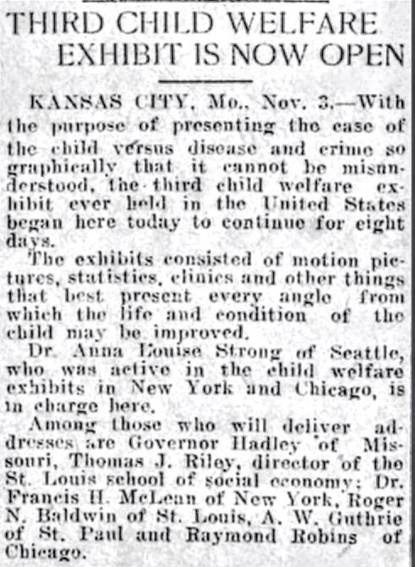
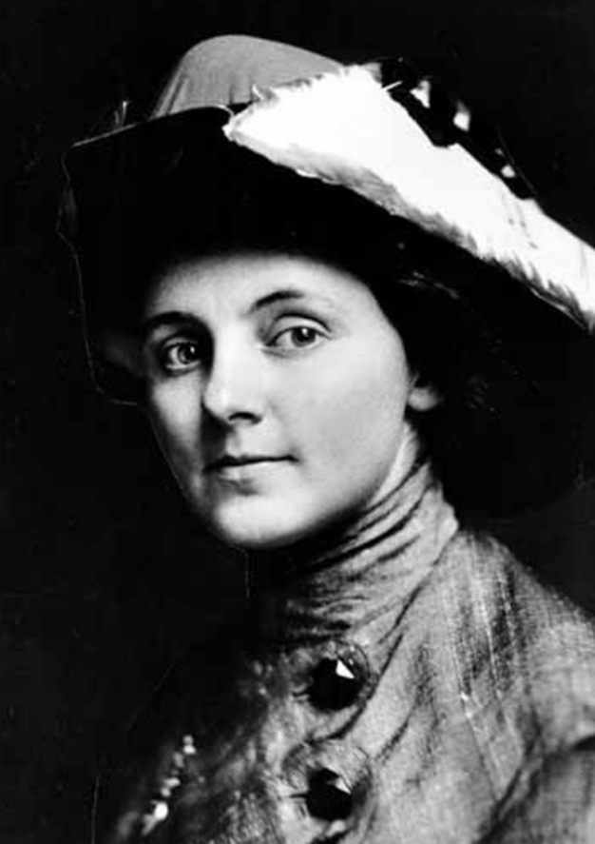
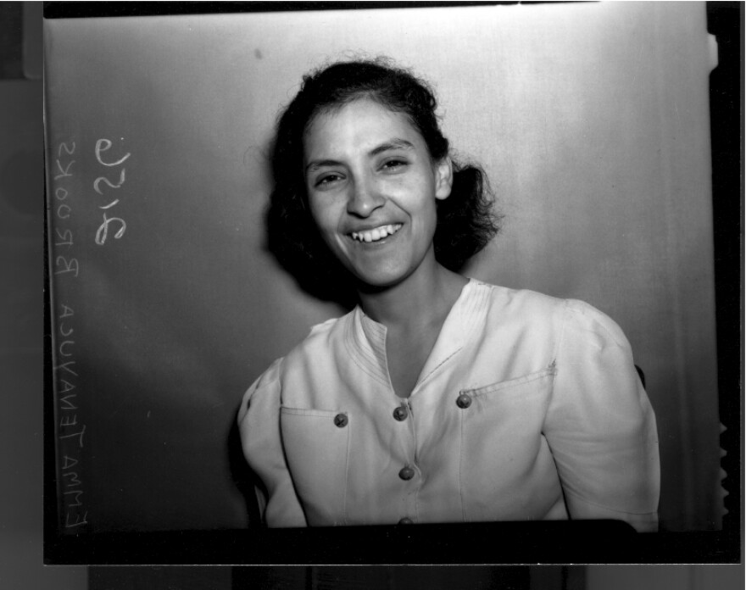
American Communists: Rose Wortis & Emma Tenayuca
Anna Louise Strong
Anna Louise Strong (1885–1970) was an American journalist who excelled academically from a young age, becoming the youngest woman to earn a PhD at the University of Chicago at the age of 23. She rose to public attention as an advocate for child welfare, touring an exhibition exposing child poverty throughout the US and overseas.
In 1916, Strong was a journalist for the New York Evening Post reporting on the Everett Massacre, a conflict which the IWW was involved in. After this event, Strong became a socialist and a dedicated advocate for labor. She opposed US participation in the First World War as a pacifist.
In the late ‘20s and into the early ‘30s Strong traveled throughout the Soviet Union, as well as China, North Vietnam, and Laos interviewing ordinary workers and people in the street. She also interviewed senior officials from the Communist Party of China and the CPSU, including Mao Zedong. She visited Spain in 1937, accompanied the Red Army into Poland and Berlin in 1945, and visited China during the latter stages of the war of liberation.
During the McCarthy period, Strong was arrested on espionage charges. She returned to the USSR in 1955, but settled in China until her death in 1970, where she was on close terms with Zhou Enlai and Mao Zedong.
Emma Tenayuca
Emma Tenayuca (1916–1999) was a fierce Mexican-American labor activist and Communist known as "La Pasionaria" for her fiery oration. She led the 1938 Pecan-Shellers' Strike in San Antonio, uniting nearly 12,000 predominantly Mexican workers against brutal wage cuts.
A member of the Communist Party, her contributions to the movement centered on bridging labor rights with Mexican-American civil rights. She organized workers across racial lines, fought against police brutality, and articulated a class-based analysis of the exploitation faced by Mexican communities. Her visibility made her a target of reactionary forces. After a 1939 attack on party headquarters and red-baiting campaigns, she was effectively forced from public life. Though her party affiliation was brief, her legacy endures in Chicano and labor history.
Salt Lake Tribune, Nov. 4, 1911

Slide 15
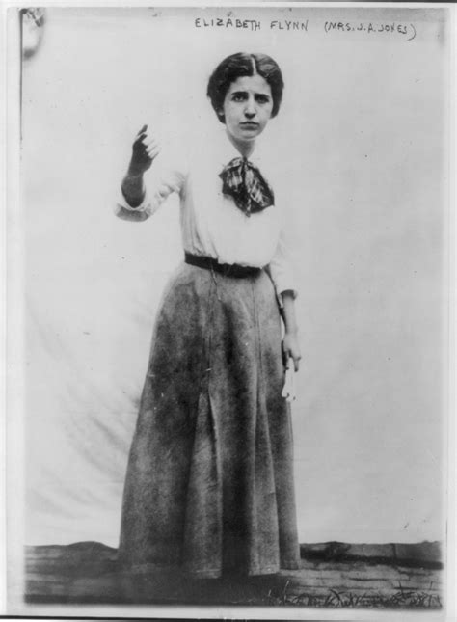
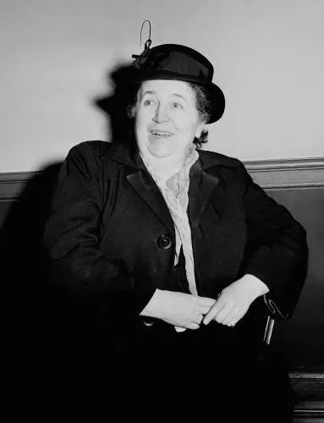
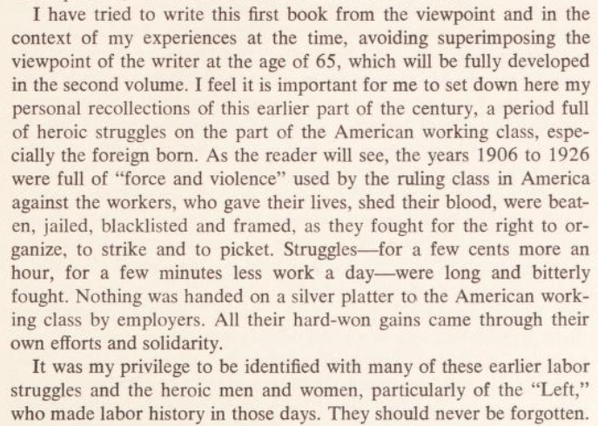
American Communists: Elizabeth Gurley Flynn
Elizabeth Gurley Flynn (1890–1964) was a fiery American labor organizer, feminist, and communist activist. She was given the moniker "The Rebel Girl" in a song written about her by Joe Hill while he awaited execution. A founder of the ACLU and key organizer for the Industrial Workers of the World (IWW), she led major strikes including the Lawrence textile strike (1912), which involved 30,000 workers and the Paterson silk strike (1913), which lasted five months. During her time as an IWW organizer, she was arrested ten times but never convicted.
She joined the Communist Party USA in 1936 during the Popular Front period, becoming a columnist for the Daily Worker and championing women's rights and racial justice. She was close friends with Claudia Jones and supported access to birth control for women. Flynn excoriated the trade unionist movement for being male-dominated. Expelled from the ACLU in 1940 for her Party membership, she was later convicted under the Smith Act (1951) and imprisoned for two years .
In 1961, she became the first woman elected chair of the CPUSA, a position she held until her death during a visit to Moscow in 1964, where she received a state funeral in Red Square. Her remains were laid to rest in Chicago’s Waldheim Cemetery, the same cemetery where Lucy Parsons lies.
Excerpt from the Preface to The Rebel Girl; an autobiography, my first life, Elizabeth Gurley Flynn (1973)

Slide 16
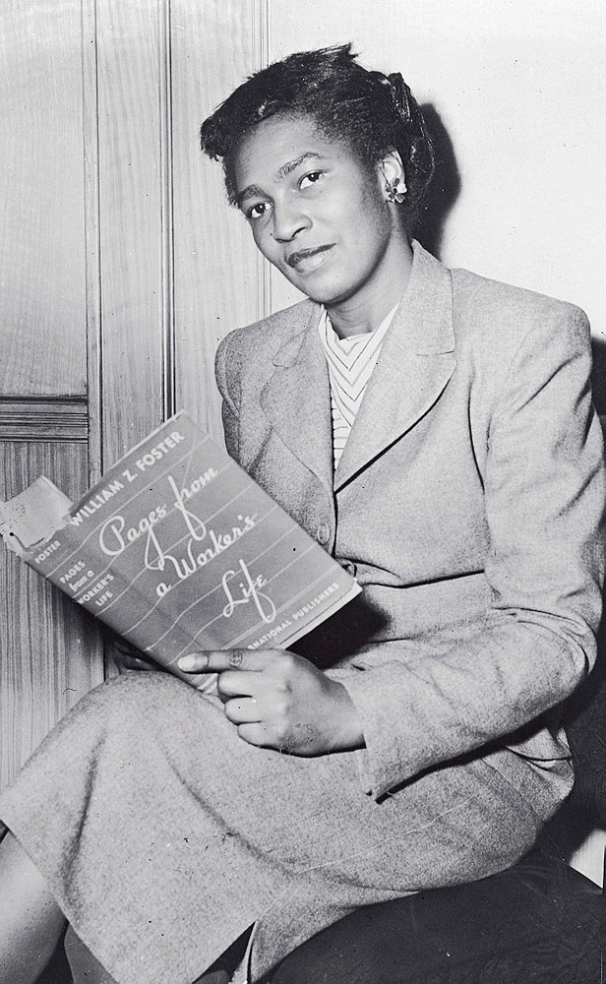
American Communists: Claudia Jones
Claudia Jones (1915–1964) was a Trinidadian-born Marxist intellectual and Communist activist who became a leading Black feminist voice in the CPUSA. Claudia and her sisters left Trinidad with their aunt to join her parents in New York City when she was nine years old. At the time she left, her family saw America as a land of opportunity, expecting to find a more prosperous life. Jones and her family were instead met with the crushing reality of American oppression of women and Black people. She experienced firsthand poverty, racism, and watched her mother die from overwork in the garment industry.
In 1936, after she graduated from high school, Jones joined the Young Communist League (YCL) and the CPUSA. At this time she also became involved in the movement to defend the Scottsboro Boys, including writing in their defense as a journalist for the Weekly Review, the YCL journal.
Her major achievement was developing a groundbreaking theoretical framework that analyzed the "triple oppression" of race, class, and gender. Jones argued that Black women's liberation was central to the working-class struggle because of the unique intersection at which they existed amid the triple oppression. Over the course of her career, she was a prolific writer and editor of multiple papers and columns. She founded the first major Black newspaper in Britain, the West Indian Gazette. Jones also served as the Secretary of the Executive Committee of the YCL in Harlem, as well as the Secretary of the Women’s Commission of the CPUSA. For her activism, she was arrested multiple times. Among these was her arrest and imprisonment under the Smith Act alongside Elizabeth Gurley Flynn and other American Communist leaders.¹
Her key contributions included integrating anti-imperialism with domestic civil rights, challenging both white chauvinism within the party and male dominance in leftist theory. Because of her public affiliation with the communist movement, she was never granted U.S. Citizenship despite qualifying and applying for it. American authorities deemed her “Undesirable” under the McCarran-Walter act. As a result, she was successfully deported from the U.S. during the McCarthy period. She relocated to Britain, where she connected with Caribbean community organizers as well as joining the Communist Party of Great Britain. Through her work, Jones laid intellectual groundwork for intersectional socialist feminism. In 1965, she was laid to rest next to Karl Marx in Highgate Cemetery in London.
Timeline from Left of Karl Marx, Carole Boyce Davies (2007)

Slide 17
Discussion & New Members Introductions

Slide 18
New Member Introductions
What is your name, pronouns and state (or country/territory)?
Where do you work? Is it unionized?
How did you find out about the People’s School?
What do you think about tonight's class?

Slide 19
Soviet Women & their Role in the Revolution

Slide 20
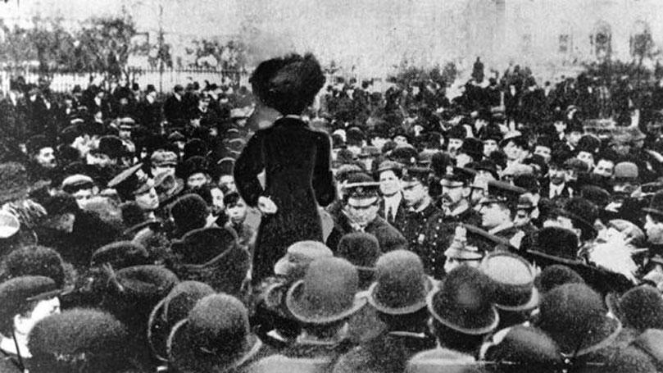
International Women’s Day and the Road to Revolution
Within the last 10-15 years many thousands of women worldwide have begun to recognize and to celebrate International Women’s Day (IWD). It is, however, unfortunate that its origins are not more widely known given that its foundation almost 100 years ago and subsequent history is truly inspirational. The motivation for IWD came from two sources: the struggle of working class women to form trade unions and the fight for women’s franchise. These two issues united European women with their sisters in the USA. In 1908 hundreds of women workers in the New York needle trades demonstrated in Rutgers Square in Manhattan’s Lower East Side to form their own union and to demand the right to vote. This historic demonstration took place on March 8th. It led, in the following year to the ‘uprising’ of 30,000 women shirtwaist makers which resulted in the first permanent trade unions for women workers in the USA.
1908 Mass Demonstration in Rutgers Square

Slide 21
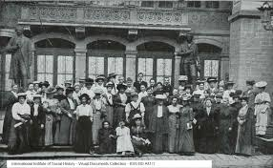
The Entire Women’s Question According to Socialist Precepts
Meanwhile news of the heroic fight of US women workers reached Europe – in particular it inspired European socialist women who had established, on the initiative of the German socialist feminist, Clara Zetkin (1857-1933), the International Socialist Women’s Conference. This latter body met for the first time in 1907 in Stuttgart alongside one of the periodic conferences of the Second International (1889-1914). Three years later in 1910 the Copenhagen Conference of the Second International, Clara Zetkin proposed the following motion:
“…..the Socialist women of all countries will hold each year a Women’s Day, whose foremost purpose it must be to aid the attainment of women’s suffrage. This demand must be handled in conjunction with the entire women’s question according to Socialist precepts. The Women’s Day must have an international character and is to be prepared carefully.”
Delegates to the First International Conference of Socialist Women - Stuttgart 1907

Slide 22
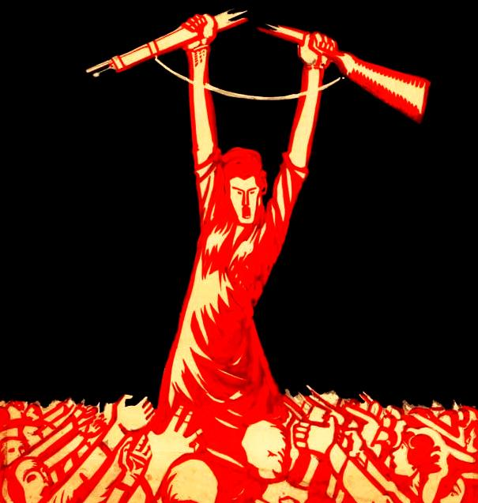
Socialist-Feminist Origins
In 1917 in Russia, International Women’s Day acquired great significance – it was the flash-point for the Russian Revolution. On March 8th (Western calendar) women workers in Petrograd held a mass strike and demonstration demanding Peace and Bread. The strike movement spread from factory to factory and effectively became an insurrection. In 1922, in honor of the women’s role on IWD in 1917, Lenin declared that March 8th should be designated officially as Women’s Day. Much later it was a national holiday in the Soviet Union and most of the former socialist countries. The cold war may explain why it was that a public holiday celebrated by communists, was largely ignored in the West, despite the fact that in 1975 (International Women’s Year), the United Nations recognized March 8th as International Women’s Day. Today we acknowledge that IWD gives us an opportunity to draw attention to our own struggles for women’s rights, to link this with women’s struggles worldwide and to demonstrate international sisterly solidarity with working women everywhere. However, the socialist feminist origins of IWD should never be forgotten.

Slide 23
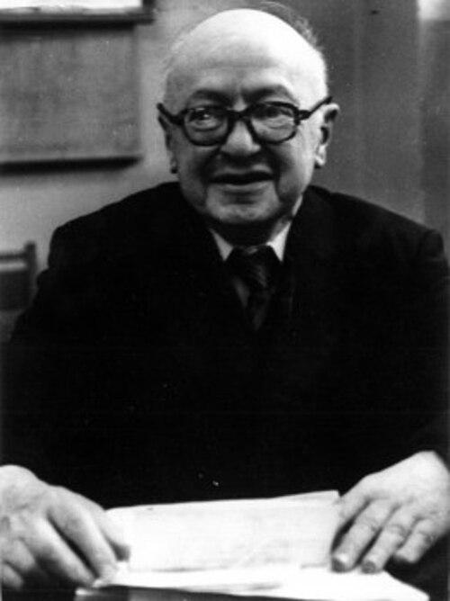
The Final Straw for Women Workers Sets Off the Revolution
On International Working Women’s Day in 1917, women workers from both home and factory took to the streets of St Petersburg. After two and half years of war the final straw for the women workers had come with the breakdown in the supply of bread, which began at the start of February when only half the food ordered for Petrograd arrived. The historian Burdzhalov tells that:
"Long lines stretched in front of shops and bakeries. A winter unprecedented in severity had set in, filling the streets with ice and piling snowdrifts on the roofs of homes, sidewalks and bridges of the city. Shivering from cold, poorly dressed young people, women and old men waited hours for bread and often went home empty-handed. Food shortages provoked an even greater ferment among the masses … the queues had the same force as revolutionary meetings and tens of thousands of revolutionary leaflets. The street had become a political club."
It was the women who initiated the action in most cases, primarily working women from the textile mills, and they did not confine their slogans to the food question. “Down with the War” and “Down with the Tsar” competed with the cry of “Bread”.
Eduard Nikolaevich Burdzhalov

Slide 24
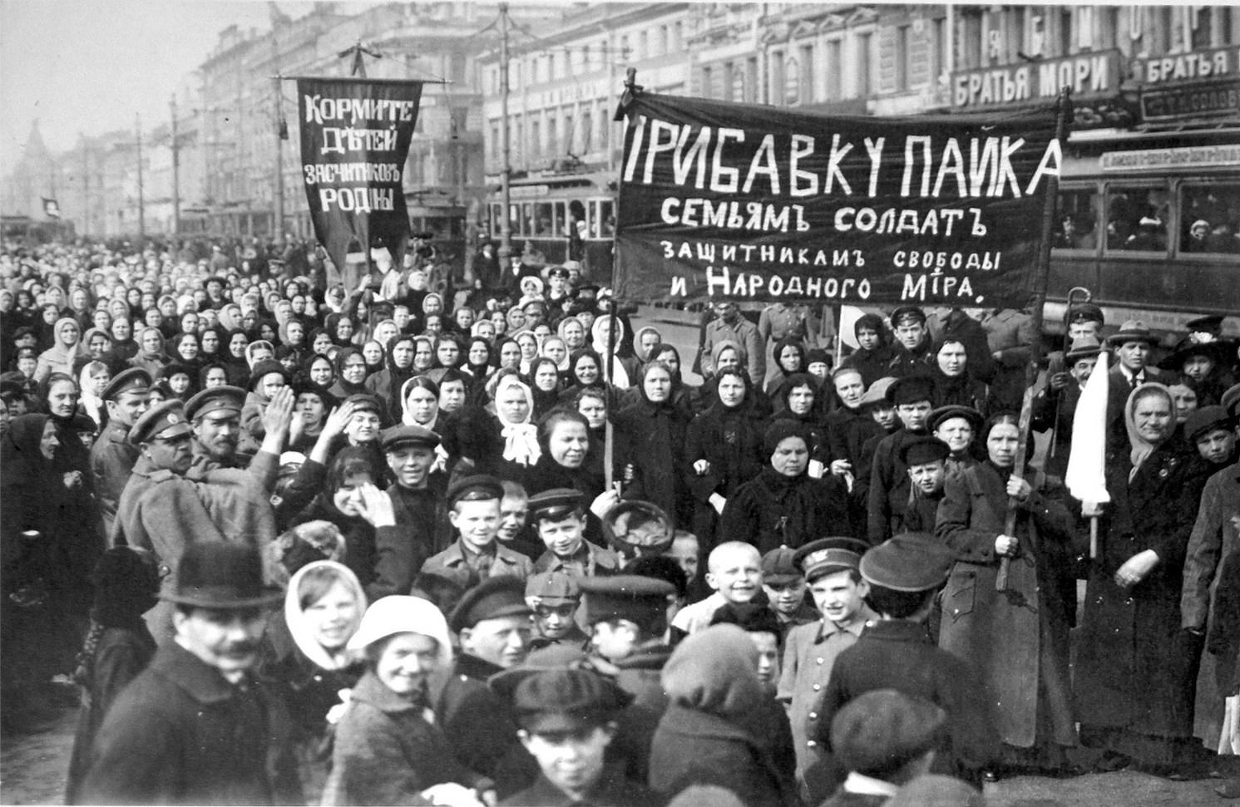
The Women of Petrograd Go On Strike
Since 1914 the First World War had brought 250,000 more women into the Petrograd workforce making the total about a million, or 40% of the factory proletariat. Conditions were particularly exacting for women. Many had to work long hours in war industries after their men were conscripted for the front, as well as look after children, and spend what little free time they had in long lines queuing for bread and kerosene. In the days before International Working Women’s Day, bakeries had been sacked and bread shops stoned but what now transformed these bread riots into something more was that women (plus some men) workers held “stormy” mass meetings which wanted to go beyond the traditional demonstration. Having decided to down tools in one factory they then went round others, sometimes throwing snowballs (sometimes nuts and bolts!) at windows to attract workers’ attention. Men and women poured out of factories to take part in demonstrations.
The Women of Petrograd - March 8, 1917

Slide 25
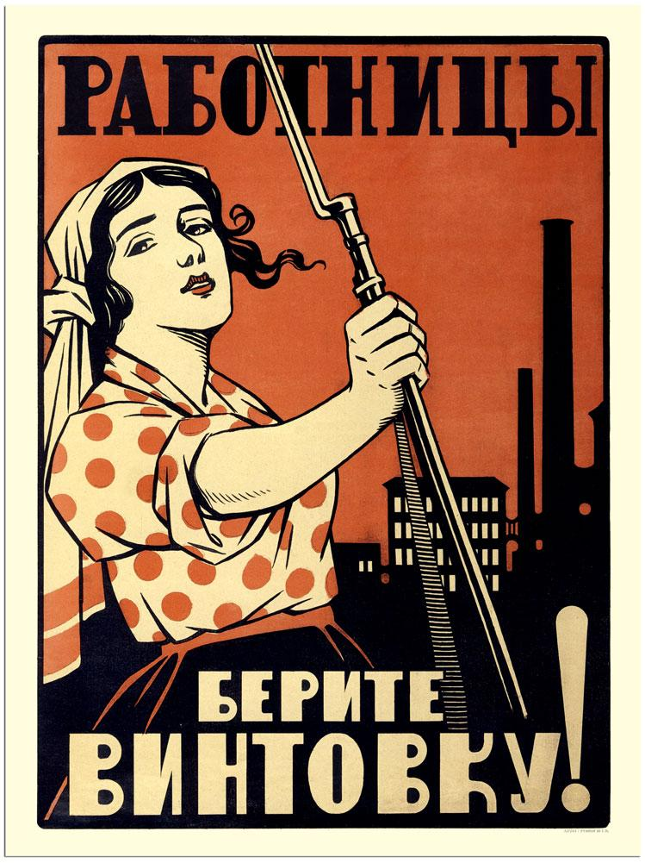
Bread, Peace, and an End to Tsarism
All told that day somewhere between 80,000 and 120,000 workers, the vast majority of them women, went out on strike demanding bread, peace, and an end to Tsarism. Five days of strikes, demonstrations, and over 1,300 deaths later, Tsarism had crumbled. Women continued to play an important role in those five days. They knew from their experience of the 1905 revolution that the key task was to win over the garrison. The softening-up process began in earnest on 9 March. Although most of the mounted Cossacks initially followed orders, there were one or two places where there were some signs of sympathy for the workers. It was, again, mainly women who went up to groups of soldiers taking hold of their bayonets, telling them about their lack of bread, explaining that their men were at the front, etc. Their aim was to shame the troops over the role they were playing. It often worked and the bulk of the soldiers gradually came over to the revolution.
Left - "Female workers, take the rifle!"

Slide 26
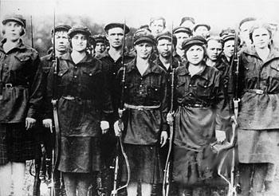
Alexandra Kollontai: Women Fighters in the Days of the Great October Revolution
The women who took part in the Great October Revolution – who were they? Isolated individuals? No, there were hosts of them; tens, hundreds of thousands of nameless heroines who, marching side by side with the workers and peasants behind the Red Flag and the slogan of the Soviets, passed over the ruins of tsarist theocracy into a new future…
If one looks back into the past, one can see them, these masses of nameless heroines whom October found living in starving cities, in impoverished villages plundered by war... A scarf on their head (very rarely, as yet, a red kerchief), a worn skirt, a patched winter jacket... Young and old, women workers and soldiers' wives, peasant women and housewives from among the city poor.
Russian Revolutionary Women in 1905

Slide 27
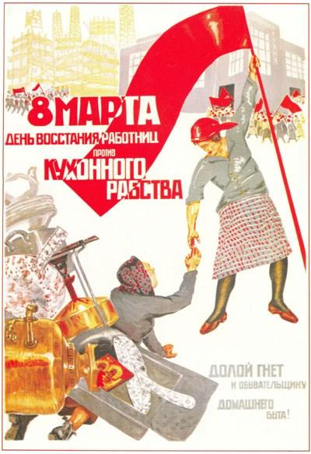
Alexandra Kollontai: Women Fighters in the Days of the Great October Revolution Cont.
More rarely, much more rarely in those days, office workers and women in the professions, educated and cultured women. But there were also women from the intelligentsia among those who carried the Red Flag to the October victory – teachers, office employees, young students at high schools and universities, women doctors. They marched cheerfully, selflessly, purposefully. They went wherever they were sent. To the front? They put on a soldier's cap and became fighters in the Red Army. If they put on red arm-bands, then they were hurrying off to the first-aid stations to help the Red front against Kerensky at Gatchina. They worked in army communications. They worked cheerfully, filled with the belief that something momentous was happening, and that we are all small cogs in the one class of revolution.
Right - 1932 Soviet poster reading: 8 March is the day of the rebellion of working women against kitchen slavery

Slide 28
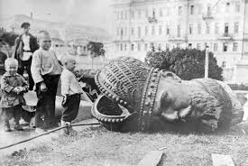
Alexandra Kollontai: Women Fighters in the Days of the Great October Revolution Cont.
In the villages, the peasant women (their husbands had been sent off to the front) took the land from the landowners and chased the aristocracy out of the nests they had roosted in for centuries. When one recalls the events of October, one sees not individual faces but masses. Masses without number, like waves of humanity. But wherever one looks one sees women – at meetings, gatherings, demonstrations...
They are still not sure what exactly it is they want, what they are striving for, but they know one thing: they will put up with war no longer. Nor do they want the landowners and the wealthy... In the year of 1917, the great ocean of humanity heaves and sways, and a large part of that ocean is made up of women...
Some day the historian will write about the deeds of these nameless heroines of the revolution who died at the front, were shot by the Whites and bore the countless deprivations of the first years following the revolution, but who continued to bear aloft the Red Banner of Soviet power and communism. It is to these nameless heroines, who died to win a new life for working people during the Great October Revolution, to whom the young republic now bows in recognition as its young people, cheerful and enthusiastic, set about building the basis of socialism.
Toppled Statue of Tsar Alexander III

Slide 29
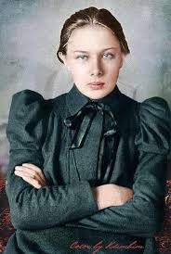
Alexandra Kollontai: Women Fighters in the Days of the Great October Revolution Cont.
However, out of this sea of women's heads in scarves and worn caps there inevitably emerge the figures of those to whom the historian will devote particular attention when, many years from now, he writes about the Great October Revolution and its leader, Lenin. The first figure to emerge is that of Lenin's faithful companion, Nadezhda Konstantinovna Krupskaya, wearing her plain grey dress and always striving to remain in the background. She would slip unnoticed into a meeting and place herself behind a pillar, but she saw and heard everything, observing all that happened so that she could then give a full account to Vladimir Ilyich, add her own apt comments and light upon a sensible, suitable and useful idea. In those days Nadezhda Konstantinovna did not speak at the numerous stormy meetings at which the people argued over the great question: would the Soviets win power or not? But she worked tirelessly as Vladimir Ilyich's right hand, occasionally making a brief but telling comment at party meetings. In moments of greatest difficulty and danger, when many stronger comrades lost heart and succumbed to doubt, Nadezhda Konstantinovna remained always the same, totally convinced of the rightness of the cause and of its certain victory. She radiated unshakable faith, and this staunchness of spirit, concealed behind a rare modesty, always had a cheering effect upon all who came into contact with the companion of the great leader of the October Revolution
Nadezhda Krupskaya, Vladimir Lenins wife c. 1890s

Slide 30
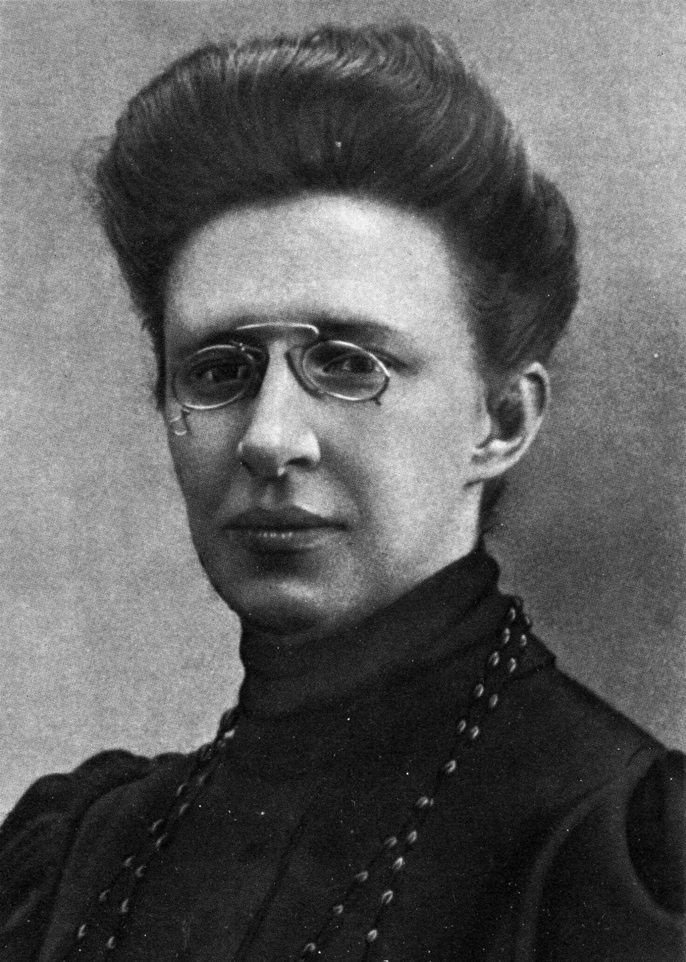
Alexandra Kollontai: Women Fighters in the Days of the Great October Revolution Cont.
Another figure emerges – that of yet another faithful companion of Vladimir Ilyich, a comrade-in-arms during the difficult years of underground work, secretary of the Party Central Committee, Yelena Dmitriyevna Stassova. A clear, high brow, a rare precision in, and an exceptional capacity for work, a rare ability to 'spot' the right person for the job. Her tall, statuesque figure could be seen first at the Soviet at the Tavrichesky palace, then at the house of Kshesinskaya, and finally at Smolny. In her hands she holds a notebook, while around her press comrades from the front, workers, Red Guards, women workers, members of the party and of the Soviets, seeking a quick, clear answer or order.
Stassova carried responsibility for many important matters, but if a comrade faced need or distress in those stormy days, she would always respond, providing a brief, seemingly curt answer, and herself doing anything she could. She was overwhelmed with work, and always at her post. Always at her post, yet never pushing forward to the front row, to prominence. She did not like to be the center of attention. Her concern was not for herself, but for the cause.
Yelena Dmitriyevna Stassova

Slide 31
Alexandra Kollontai: Women Fighters in the Days of the Great October Revolution Cont.
Klavdia Nikolayeva was a working woman of very humble origins. She had joined the Bolsheviks as early as 1908, in the years of reaction, and had endured exile and imprisonment... In 1917 she returned to Leningrad and became the heart of the first magazine for working women, Kommunistka. She was still young, full of fire and impatience. But she held the banner firmly, and boldly declared that women workers, soldiers' wives and peasant women must be drawn into the party. To work, women! To the defense of the Soviets and communism! She spoke at meetings, still nervous and unsure of herself, yet attracting others to follow. She was one of those who bore on her shoulders all the difficulties involved in preparing the way for the broad, mass involvement of women in the revolution, one of those who fought on two fronts – for the Soviets and communism, and at the same time for the emancipation of women. The names of Klavdia Nikolayeva and Konkordia Samoilova, who died at her revolutionary post in 1921 (from cholera), are indissolubly linked with the first and most difficult steps taken by the working women's movement, particularly in Leningrad. Konkordia Samoilova was a party worker of unparalleled selflessness, a fine, business-like speaker who knew how to win the hearts of working women. Those who worked alongside her will long remember Konkordia Samoilova. She was simple in manner, simple in dress, demanding in the execution of decisions, strict both with herself and others.

Slide 32
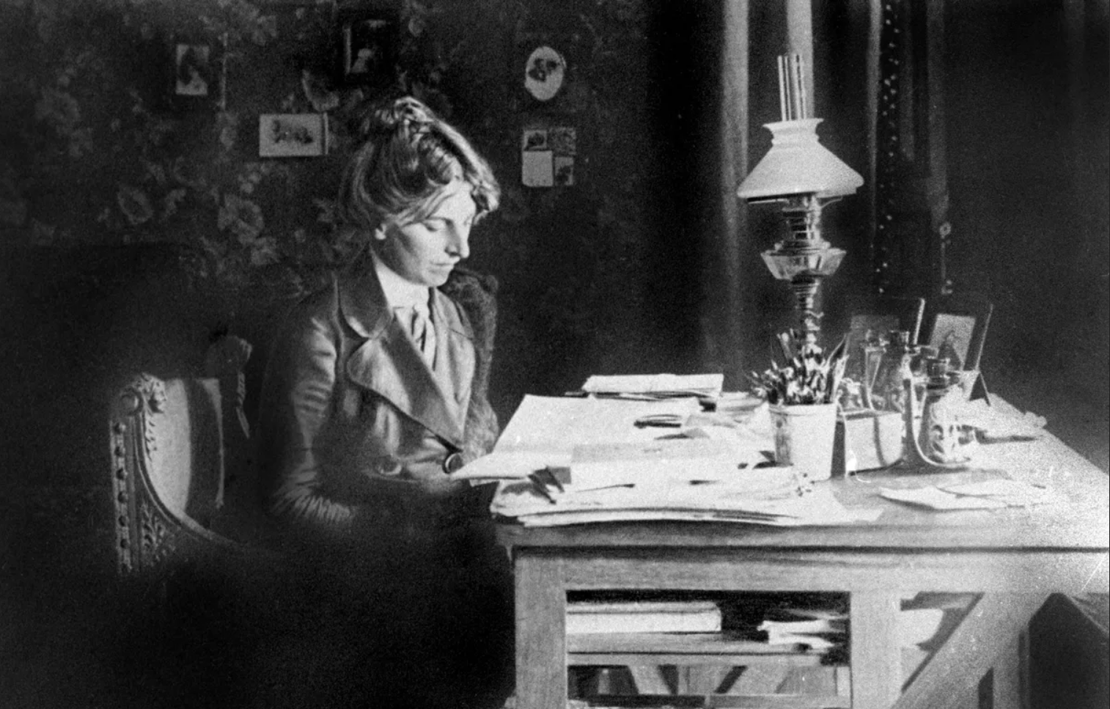
Alexandra Kollontai: Women Fighters in the Days of the Great October Revolution Cont.
Particularly striking is the gentle and charming figure of Inessa Armand, who was charged with very important party work in preparation for the October Revolution, and who thereafter contributed many creative ideas to the work conducted among women. With all her femininity and gentleness of manner, Inessa Armand was unshakable in her convictions and able to defend what she believed to be right, even when faced with redoubtable opponents. After the revolution, Inessa Armand devoted herself to organizing the broad movement of working women, and the delegate conference is her creation.
Enormous work was done by Varvara Nikolayevna Yakovleva during the difficult and decisive days of the October Revolution in Moscow. On the battleground of the barricades she showed a resolution worthy of a leader of party headquarters... Many comrades said then that her resolution and unshakable courage gave heart to the wavering and inspired those who had lost heart. 'Forward!' – to victory.
Inessa Armand

Slide 33
Alexandra Kollontai: Women Fighters in the Days of the Great October Revolution Cont.
As one recalls the women who took part in the Great October Revolution, more and more names and faces rise up as if by magic from the memory. Could we fail to honour today the memory of Vera Slutskaya, who worked selflessly in preparation for the revolution and who was shot down by Cossaks on the first Red front near Petrograd?
Could we forget Yevgenia Bosh, with her fiery temperament, always eager for battle? She also died at her revolutionary post.
Could we omit to mention here two names closely connected with the life and activity of V.I. Lenin – his two sisters and comrades-in-arms, Anna Ilyinichna Yelizarova and Maria Ilyinichna Ulyanova?
...And comrade Varya, from the railway workshops in Moscow, always lively, always in a hurry? And Fyodorova, the textile worker in Leningrad, with her pleasant, smiling face and her fearlessness when it came to fighting at the barricades?

Slide 34
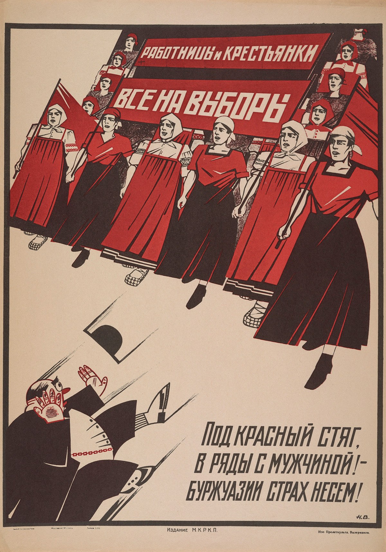
Alexandra Kollontai: Women Fighters in the Days of the Great October Revolution Cont.
It is impossible to list them all, and how many remain nameless? The heroines of the October Revolution were a whole army, and although their names may be forgotten, their selflessness lives on in the very victory of that revolution, in all the gains and achievements now enjoyed by working women in the Soviet Union.
It is a clear and indisputable fact that, without the participation of women, the October Revolution could not have brought the Red Flag to victory. Glory to the working women who marched under that Red Banner during the October Revolution. Glory to the October Revolution that liberated women!
Nikolai Valerianov, 1925 - “Women workers and peasant women. All to the polls. Gather under the red banner alongside the men - we bring fear to the bourgeoisie!”

Slide 35
Discussion

Slide 36
Putilov Strike of 1917
On February 18, 1917, workers at the Putilov Mill in Petrograd demanded higher wages because of the rising prices of food and goods. When the disgruntled workers began to dispute with the authorities at the mill over the denial of their pay increase, some 20,000 workers were locked out sparking an outrage among other factories in Petrograd. By February 22, in retaliation of the lockout, over 100,000 workers were actively protesting. The next day, on International Women’s Day, women joined the strikes and protests, demanding equal rights as well as other strikers protesting the rationing of bread. By this time, well over 500,000 people were protesting Petrograd for several different reasons. General Khabalov, as ordered by the Tsar, was told to order the troops to fire onto the crowds of protestors, but the soldiers refused. The soldiers instead sided with and joined the protestors as a result of their harsh treatment during the war. As more and more citizens joined the strikes, they became more about economics and politics. The protestors began to express their opposition of the Tsarist regime as well as the war. The majority of the businesses in Petrograd had been closed, ceasing mobilization and daily operations within the city. The strikes, though spontaneous and popular among the citizens, came to a halt on March 4. This series of economic and political strikes lasting from February 22 until March 4, 1917, became known as the February Revolution.

Slide 37
Women’s Role in the Revolution
While the October Revolution was a planned insurrection, it was made possible by the mass unrest of the February Revolution, which women ignited.
On International Women's Day (February 23, 1917), women textile workers in Petrograd took the initiative to halt work and pour into the streets, demanding "bread and an end to the war.”
This was not a wholly "spontaneous bread riot" as sometimes portrayed; evidence shows planning and organization behind these demonstrations, with crowds forming at specific locations, including near the offices of the League for Women's Equal Rights . These women encouraged their male counterparts to join them, transforming a protest into a general strike.
The February Revolution toppled the Tsar, established the Provisional Government, and created the dual power dynamic with the Petrograd Soviet that would ultimately lead to the Bolshevik takeover in October.

Slide 38
From the selected works of Alexandra Kollontai
On February 18, 1917, workers at the Putilov Mill in Petrograd demanded higher wages because of the rising prices of food and goods. When the disgruntled workers began to dispute with the authorities at the mill over the denial of their pay increase, some 20,000 workers were locked out sparking an outrage among other factories in Petrograd. By February 22, in retaliation of the lockout, over 100,000 workers were actively protesting. The next day, on International Women’s Day, women joined the strikes and protests, demanding equal rights as well as other strikers protesting the rationing of bread. By this time, well over 500,000 people were protesting Petrograd for several different reasons. General Khabalov, as ordered by the Tsar, was told to order the troops to fire onto the crowds of protestors, but the soldiers refused. The soldiers instead sided with and joined the protestors as a result of their harsh treatment during the war. As more and more citizens joined the strikes, they became more about economics and politics. The protestors began to express their opposition of the Tsarist regime as well as the war. The majority of the businesses in Petrograd had been closed, ceasing mobilization and daily operations within the city. The strikes, though spontaneous and popular among the citizens, came to a halt on March 4. This series of economic and political strikes lasting from February 22 until March 4, 1917, became known as the February Revolution.

Slide 39
Claudia Jones - An End to the Neglect of the Problems of the Negro Woman!

Slide 40
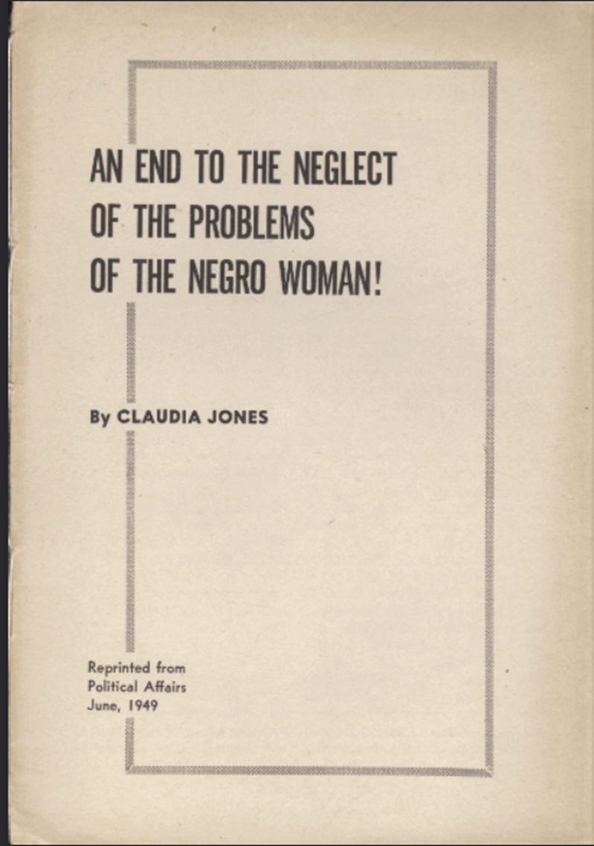
An End to the Neglect of the Problems of the Negro Woman!
Claudia Jones’ 1949 work, An End to the Neglect of the Problems of the Negro Woman! relates the term “super-exploitation” to systems of oppression of negro women. She describes the overlapping roles and mechanisms of race, class, gender, family, religion, and the state.
Course material primary sources
available in complete, free pdf format:
An End to the Neglect of The Problems of the Negro Woman!
By Claudia Jones
https://palmm.isle.flvc.org/node/114016

Slide 41
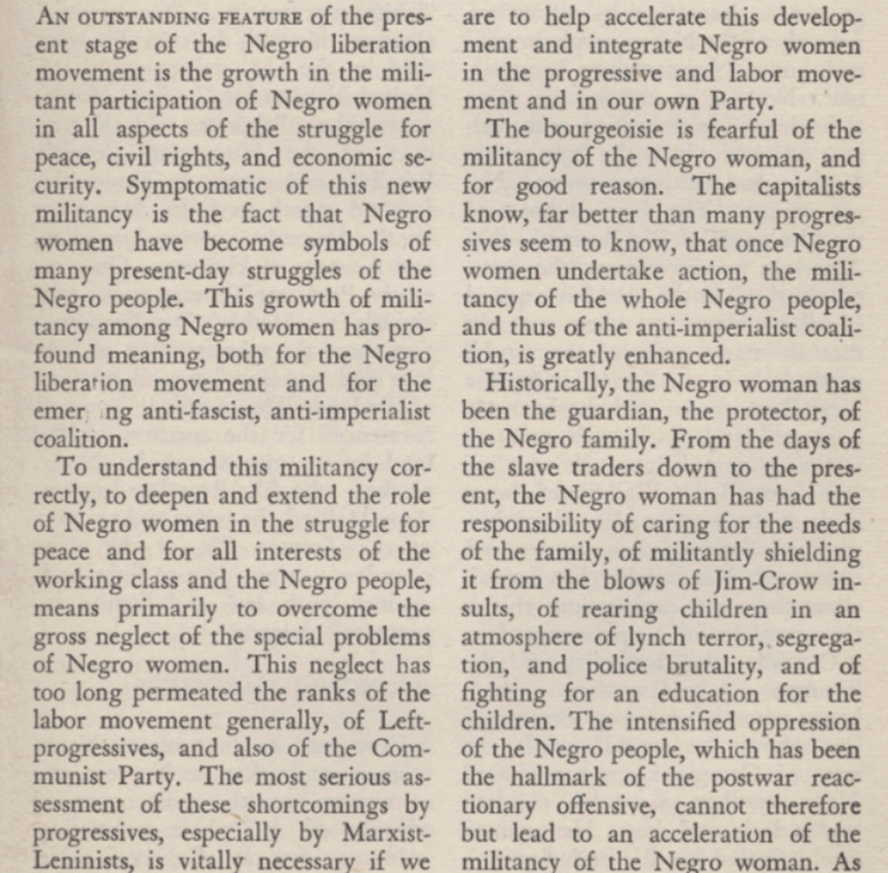
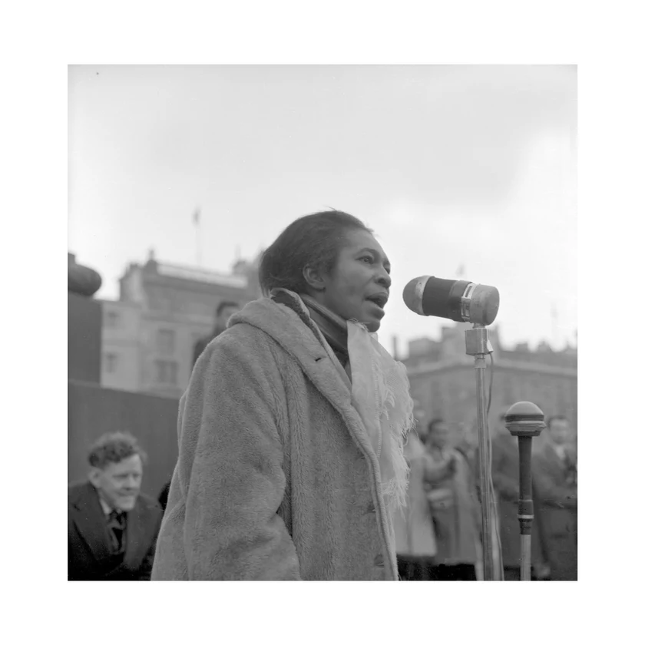
An End to the Neglect of the Problems of the Negro Woman!
Claudia Jones begins by telling us the Negro women’s movement underpins the “emerging anti-fascist, anti imperialist coalition”, of 1949.
She identifies the problem as “the gross neglect of the special problems of Negro women.”

Slide 42
Super-Exploitation or Intersectionality?
Angela Davis’ Connects the Dots of Intersectionality but Misses the Point
From the Davis Text:
“In terms of Palestine, again in the US, how are the narratives similar or different from the antiapartheid days? There are a lot of similarities, precisely because BDS has chosen to follow the root of the antiapartheid struggle toward a hopefully more global sense of solidarity by using the method of mass boycott.
I guess what is different is the existence of a powerful Zionist lobby. Certainly there was a powerful apartheid lobby, but it did not have nearly the influence as the Zionist lobby, which can be seen in terms of Black religion; its tentacles reach into the Black church, there have been direct efforts to, on the part of the state of Israel, to recruit significant Black figures. And I don’t know whether we experienced that level of sophistication during the antiapartheid era.”
Davis asserts that racial apartheid in the U.S can be considered intersectional and global as evidenced by boycotts used to protest against it globally, against transnational corporations.
Her argument alludes to intersectionality by discussing the responses to it, but then merely glancing at the cause. She avoids holding capitalism to scrutiny as the origin of inequality, referring to it as a system of response, rather than the primary causal factor of injustice.
Davis described the zionist political lobby influences on U.S. policy through corruption and notes its relationship with Christian institutions. Penetration of the Black church is made by the same means, proceeding to influence black cultural figures and therefore, black communities.
These layers of relationships between institutions appears “sophisticated” to Davis, but not to Jones. Instead, Jones openly compared the racial and economic equity of the Soviet Union to its absence in the United States. Jones lays the contradictions bare, while Davis points her analysis away from a critique of Capital.
Davis is certainly aware of this contradiction. The sophistication she alludes to, is that found in her avoidance of holding capitalism accountable.

Slide 43
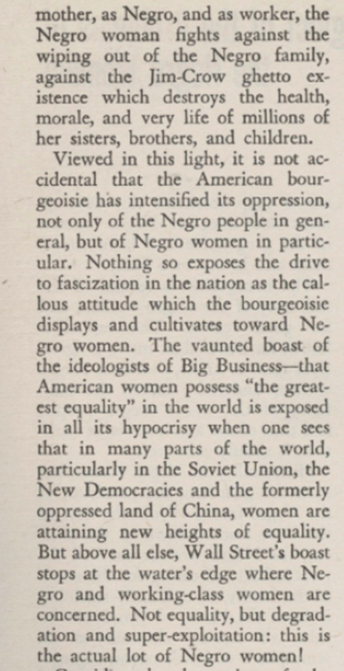

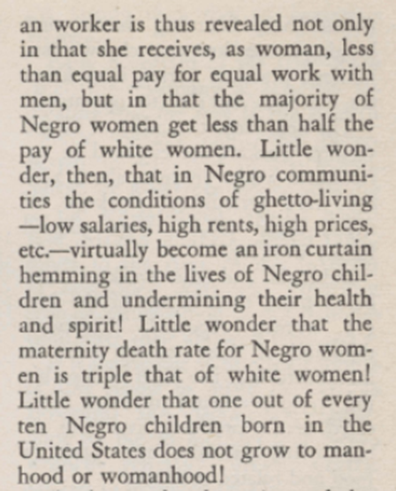
Super-Exploitation or Intersectionality?
Jone’s analysis goes immediately into specific experience of the Negro woman in defense of family the fundamental basic need of healthcare.
She correctly identifies the American Bourgeoise as the oppressor of all women, but Negro women especially, and in particular.
Her specificity sounds astonishing to modern ears.
Going further, Jones points to her time’s most current progress on a solution; the racial and gender equality found only in the Soviet Union and the New Democracies.
Jone’s concludes that Wall-street is the oppressor and it’s weapon is “super-exploitation” which she describes in the facing passage.

Slide 44
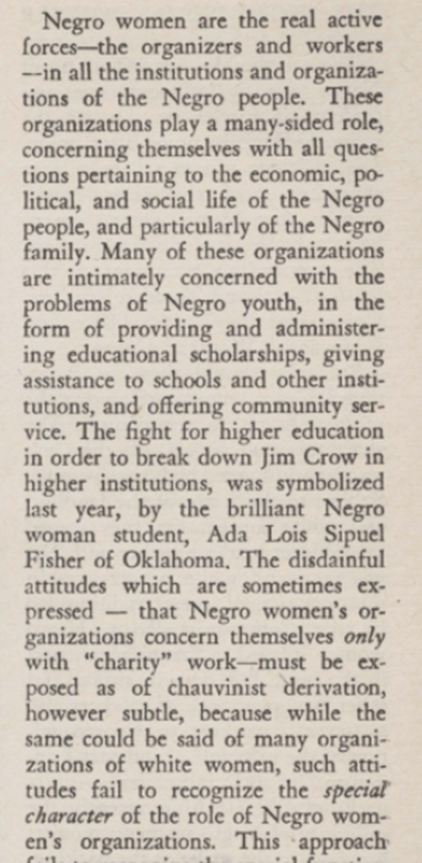
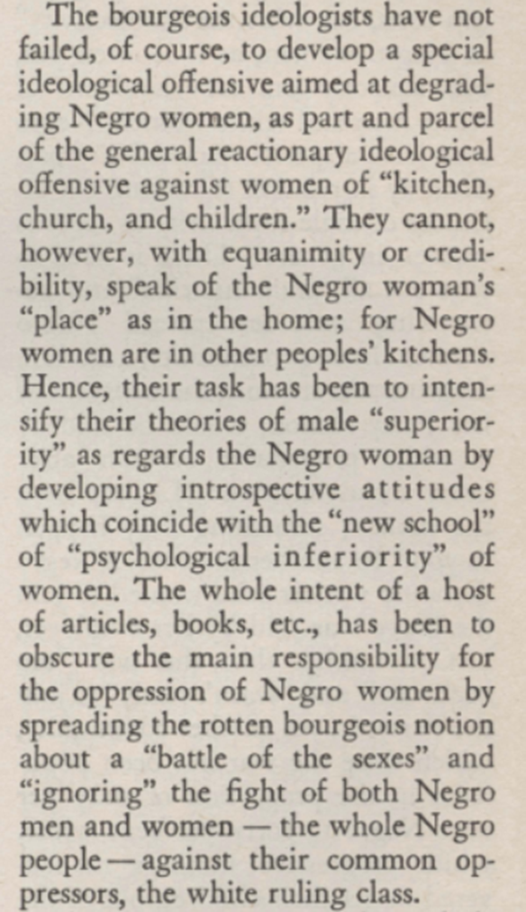
Claudia Jones’ Analysis
Negro women are the real active forces- the organizers and workers- in all the institutions of the Negro people.
These institutions found an economic, political, social and family core within the negro community and address the struggle intersectionally.
Many are youth focused and fight for higher education
Characterizing the negro women’s roles as “charity” work is chauvanist and divisive.
Bourgeoise Ideology degrades negro women specifically.
The bourgeoise attack reduces the negro women’s role in the movement in terms of merely gender, masking their place at the center of all negro movements which intersectionally underpin ALL people’s movements for democracy, equality and socialism.

Slide 45
Discussion & Wrap Up

Slide 46
Announcements
PCUSA Cell Chairs need to call members of their cells to remind them about attendance.
The next issue of New Masses (2026) has begun production. If you have art you want us to feature, email it to info@partyofcommunistsusa.net.

Slide 47
Volunteers Needed!
We are in need of volunteers for the staff of the People’s School! Here’s a few roles we need filled:
People to help manage posting on our social media and podcast platforms
Video Editors, Audio Editors, Graphic Designers, Artists, Narrators
Web Controls, Moderators
Email info@peoplesschool.us if you’re interested and try to attend our next staff meeting if possible.

Slide 48

View From Left Field
https://viewfromleftfield.libsyn.com
The Old PSMLS Youtube is now the Youtube of View From Left Field, a podcast of analysis and discussion of current events from a progressive perspective.
Like the Youtube videos and subscribe with 5 star ratings on your podcast platforms.

Slide 49


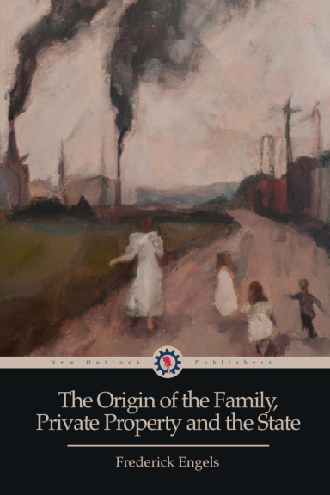
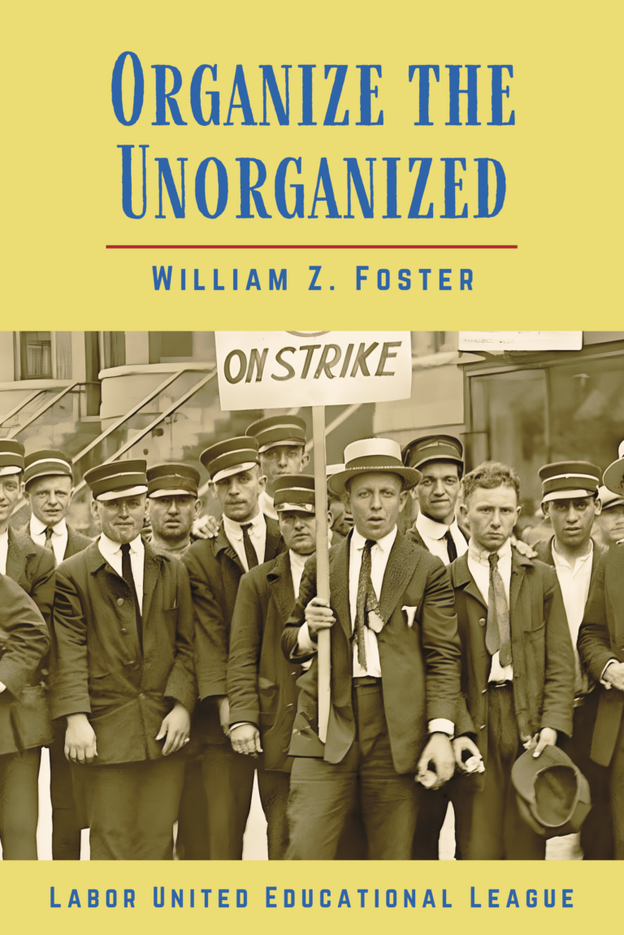

New Outlook Publishers
newoutlookpublishers.store
Relevant and Latest Releases

Slide 50



Harry Bridges School of Labor
luel.us/laborschool/
The Harry Bridges School of Labor is a monthly class covering a variety of topics aimed at building class consciousness among union members. For class schedule and other information, please visit the website at luel.us/laborschool.

Slide 51
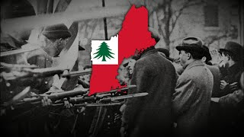
Bread & Roses - New England Women’s Labor Song

