Slide 1

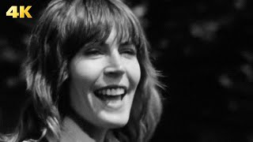
I am Woman by Helen Reddy

Slide 2
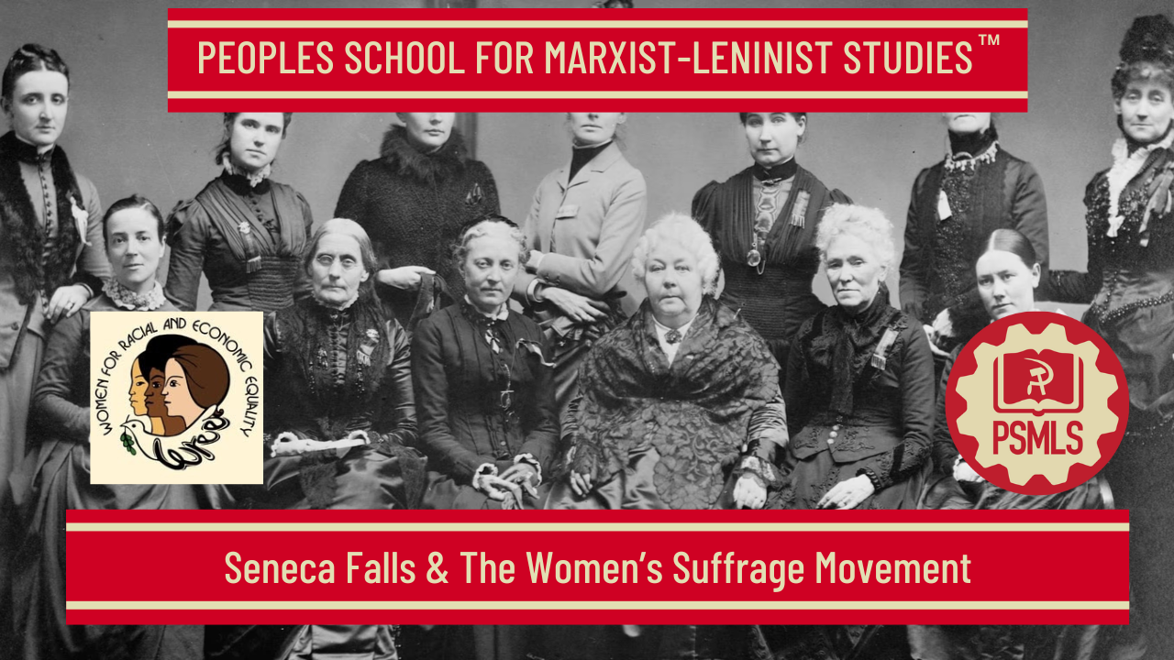
PSMLS 3/3/26

Slide 3
What we’ll be learning today:
History of the women’s suffrage movement
Seneca Falls Convention
Modern day attacks on women’s rights

Slide 4
History of the Woman Suffrage Movement

Slide 5
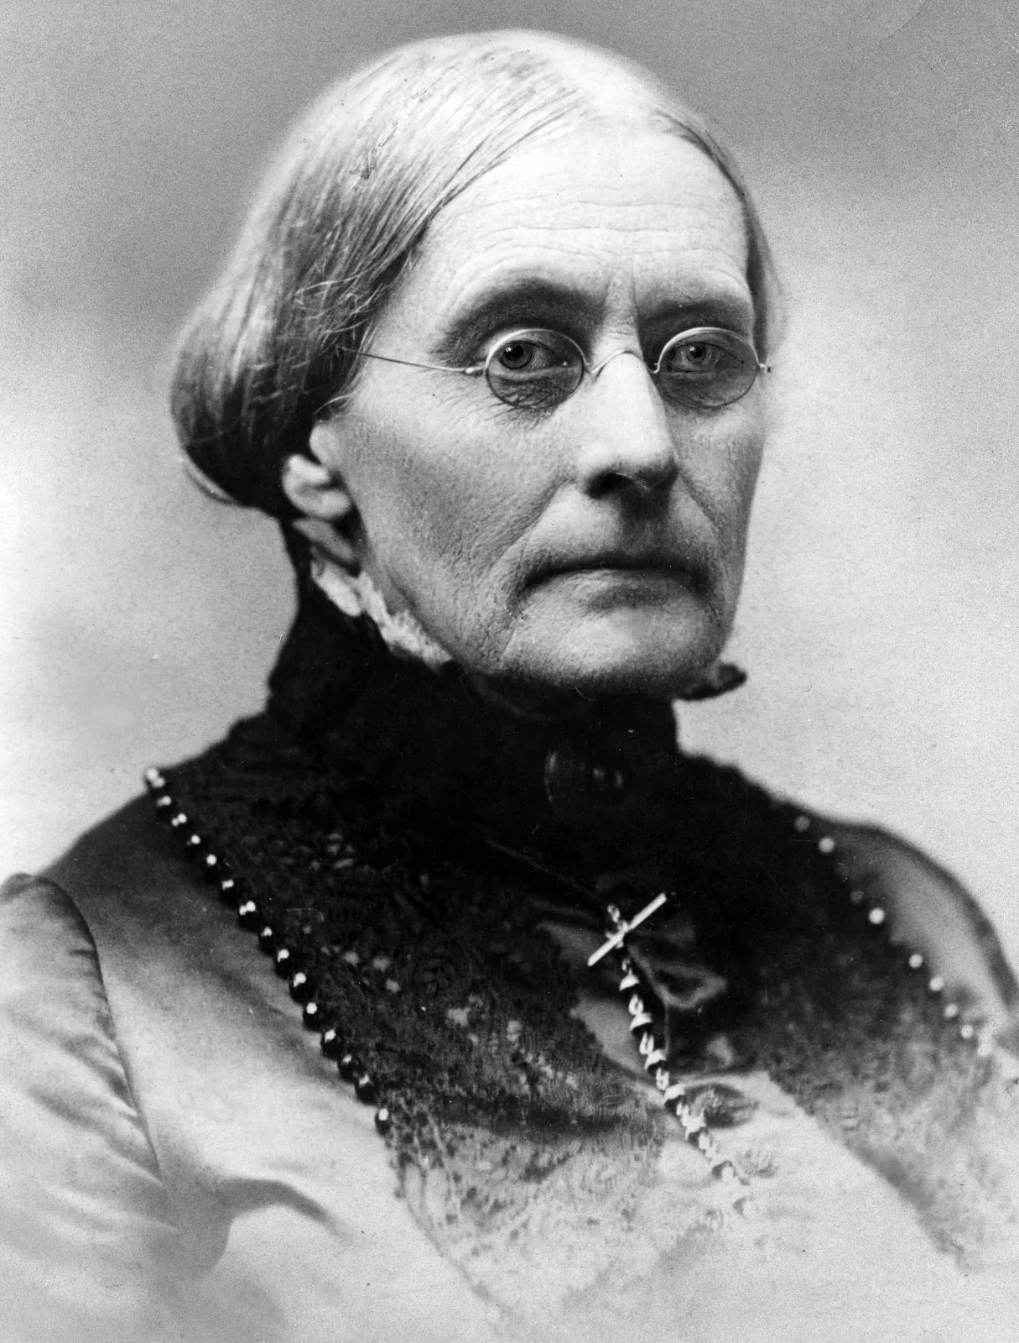
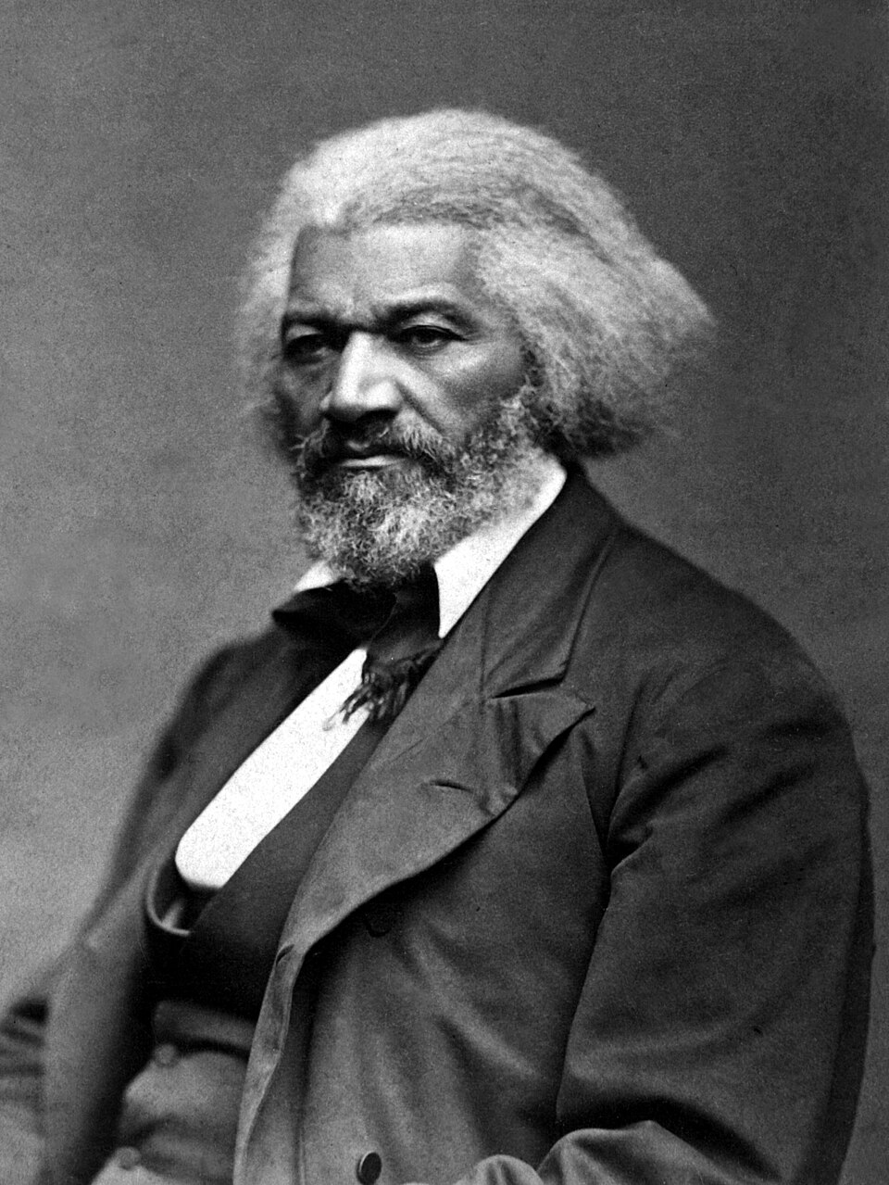
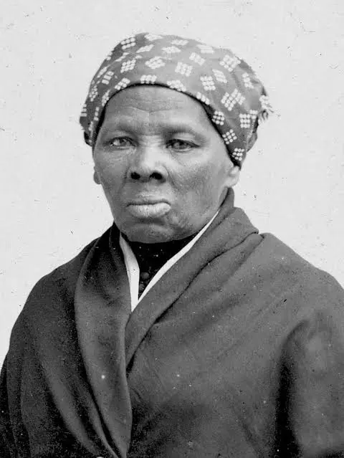
The Women’s Suffrage Movement in the United States
There were multiple important people in the Women’s Suffrage Movement in the United States.
Susan B. Anthony (1820-1906) was an American social reformer and women's rights activist who played a major role in women's’ fight for equality. Since her youth she was committed to social justice starting her political career as staunch abolitionist.
Harriet Tubman (1822-1913) was African American escaped former slave and leading guides of the Underground Railroad and a proud feminist who regularly collaborated with other activist such as Susan B. Anthony in the fight for women’s liberation and equality.
Some men even joined the fight such as, Frederick Douglas (1818-1895) who, similar to Harriet Tubman was an escaped former slave who strongly opposed slavery and strong supporter for women's suffrage stating, “Right is of no sex, truth is of no color.”
From Left to Right: Susan B. Anthony, Harriet Tubman, and Frederick Douglas

Slide 6
Women’s Rights in the U.S.S.R. (C.C.C.P.)
After the October Revolution of 1917 many vast and progressive social changes occurred in Russia one of the major ones being equal rights given to women.
Women were given the right to vote and take part in politics. (Suffrage)
Women were given equal employment and pay compared to their men comrades.
Women were also given equal access to education.
During the reign of the Tsars this was unheard of and was not put into place until the Bolsheviks came to power.
Compared to the United States women did not receive the bare minimum of suffrage until 1920 which was still heavily restricted by race.

Slide 7
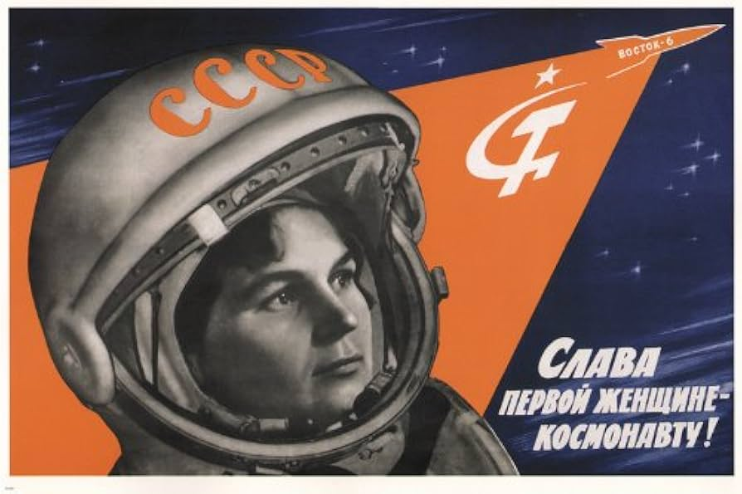
Soviet engineer, politician, and Soviet Cosmonaut, Valentina Tereshkova, the First Woman in Space.

Slide 8
International Workingmen's Association (I.W.A.)/First International Women’s Section
The International Workingmen's Association (I.W.A.)/First International (1864-1876) was an organization founded to unite leftist (such as Socialists/Communists) and trade union groups striving for working-class unity and solidarity.
It pushed for economic struggles and international cooperation.
It is especially known for influencing the fight and idea for an 8 hour workday.
On September 19th, 1871 Karl Marx drove the I.W.A. to create a section of the group that focused on women of the proletariat.
He noticed that industries had began to hire multiple women and saw them as essential members for the socialist/communist movement.
The section main purpose was to bring women into to the class struggle for liberation and equality.
A prominent example is, the Geneva Women's Section (1864-1876) which was a pioneering group whose main purpose was to integrate the demands of women workers with those of the male workers. This section as well as other regularly debated feminism and socialism.

Slide 9
The Communist Suffragettes: The Fight for Equality and the October Revolution
In 1916, Sylvia Pankhurst and her East London Federation of Suffragettes hosted a Christmas party for local children. Pankhurst described the scenes at her headquarters on 400 Old Ford Road in her 1932 memoir of the war years The Home Front. Fellow suffragette Norah Smyth disguised herself as Father Christmas and greeted a crowd of more than 900 children. Meanwhile, children wearing ‘red caps of liberty’ led a procession of young suffragettes adorned with flowers. Among these parading suffrage activists, Pankhurst wrote, were ‘the two pretty Cohens, one as slender as the lily she represented and the other, Nellie, my secretary, glowing ripe as a peach’.
Three years before this pageant, Pankhurst had established a branch of the Women’s Social and Political Union (WSPU) in London’s East End that proved, to the extreme consternation of Sylvia’s mother Emmeline and sister Christabel, a ceaseless font of radical politics. Sylvia’s creation of ties with socialist organisations such as the Herald League brought her into conflict with the Women’s Social and Political Union (WSPU) leadership. In 1913, her appearance on a platform in support of Irish workers active in that year’s famous Dublin lock-out – a large scale industrial dispute in the Irish capital – acted as the final catalyst that lead Christabel to break the formal tie between the main body of the WSPU and Sylvia’s East London branch. Expelled from the parent organisation in 1914 and thus free to pursue an independent path, the East London Federation of Suffragettes argued that women's suffrage was just one step in a road towards emancipation that necessarily entailed socialist transformation.

Slide 10
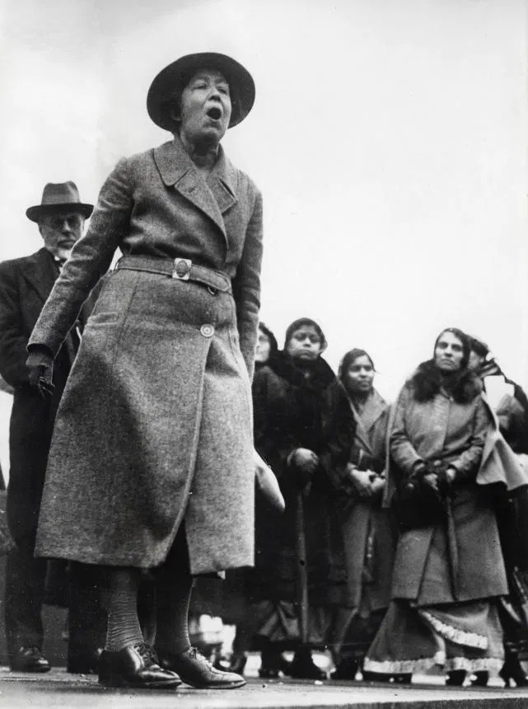
An International Movement
Considering the sprawling slums which lined the streets patrolled by the East London suffragettes, it is easy to understand how a revolution might have seemed the only solution. In cramped conditions, East End families survived the everyday indignities of capitalism alongside groups of social revolutionaries who were plotting its downfall. One group which provided a prolific stream of radicals was the local Jewish community, produced by the exodus of families fleeing antisemitic pogroms in the late 19th century Russian Empire. It was into one such refugee family that the ‘two pretty Cohens’ of Pankhurst’s 1916 pageant, Nellie, and her younger sister Rose, were born. Lifelong renegades, the Cohen sisters shared a path that began in East London with the movement for women’s suffrage and led to the international communist networks that developed in the tremors spreading outward from the October Revolution.
Sylvia Pankhurst protesting in Trafalgar Square, London, 1932.

Slide 11
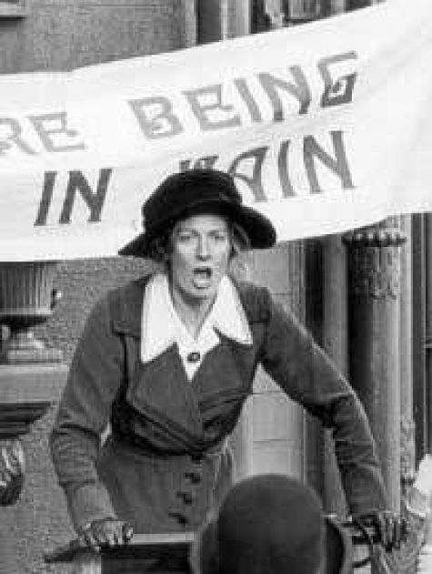
The “Lenin Revolution”
In 1917, news of the Russian monarchy’s demise entered this East End revolutionary ‘nest’ with all the force of a Special Branch raid. In March, Pankhurst addressed a meeting organised by representatives of the East London Jewish community to welcome the overthrow of the Tsar. Attendees swayed with enthusiasm as though intoxicated by the political moment. Following several more months of political tumult in Revolutionary Russia, the stage was set for Lenin’s seizure of power. During the period between the February and October Revolutions, Pankhurst steered her organisation and the Dreadnought towards solidarity with Bolshevik aims. Pankhurst responded to the October Revolution with an editorial heralding the ‘Lenin revolution’ as the harbinger of an authentically democratic power. She was not the only suffrage agitator in Britain to call for ‘all power to the soviets’. Charlotte Despard, the founder of the Women’s Freedom League, joined a committee tasked with establishing a Soviet-style system in Britain during the summer of 1917. Dora Montefiore, the English-Australian suffrage campaigner, described in her 1927 memoir how, though she never personally met Lenin, she ‘felt his spiritual presence on every side’. Indeed, Montefiore joined the Scottish suffragette Helen Crawfurd in the nascent Communist Party of Great Britain.
Sylvia Pankhurst, a Central Figure in the Historical Intersection of Struggles Against Class, Gender and Racial Discrimination.

Slide 12
Bolshevik Aims as a Program for Gender Emancipation
In broader British society, the rise of the Labour Party ensured that popular desires for social transformation were funnelled through parliamentary- rather than revolutionary-style politics. Conservative opinion, of course, quaked at the portent of a Bolshevik-style revolution taking place in Britain, a threat exaggerated by paranoid government reports and sensationalist media coverage. In contrast to these fears of insurrection, Sylvia Pankhurst believed that support for Bolshevik aims provided an expansive program promising not only gender emancipation but the building of a new world. Nellie and Rose, through their work for Pankhurst, were flung into the race to establish a British Communist Party that would receive the graces of Lenin and the Comintern, the international organisation for world revolutionary parties headquartered in Moscow and Berlin.
Sylvia Pankhurst protesting in Trafalgar Square, London, 1932.

Slide 13
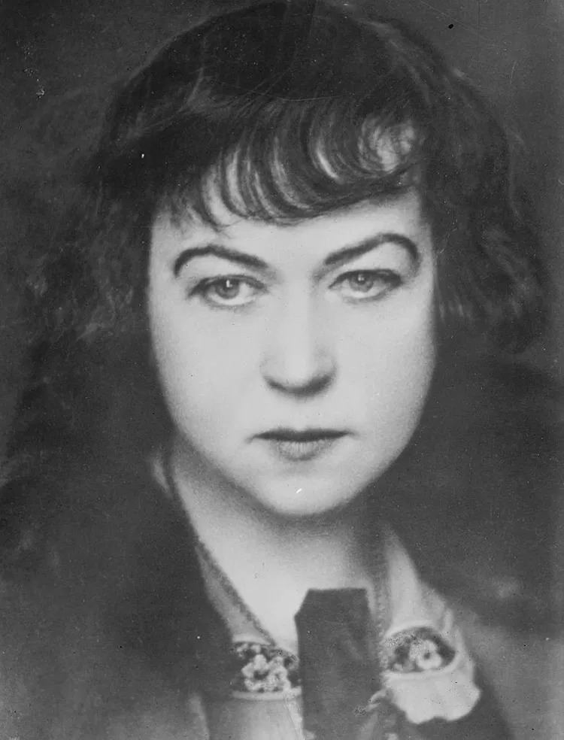
The Only Viable Route to Human Emancipation.
Early Bolshevik success in reshaping the role of women in society had a magnetic draw for many international feminists. For Alexandra Kollontai, a Bolshevik and the first woman to hold a ministerial post, communism heralded the collapse of the traditional family and prophesied that in its place would rise a new gender dynamic built on comradeship. The reforms introduced by Kollontai’s Commissariat for Social Welfare in the early years of the Soviet state included access to birth control and the legalisation of abortion. To enter into international communist networks was to act as a defender of these progressive reforms and to assert your belief that Marxist-Leninist theory provided the only viable route to human emancipation.
Alexandra Kollontai (1872-1952).

Slide 14
Discussion & New Members Introductions

Slide 15
New Member Introductions
What is your name, pronouns and state (or country/territory)?
Where do you work? Is it unionized?
How did you find out about the People’s School?
What do you think about tonight's class?

Slide 16
Seneca Falls Convention

Slide 17
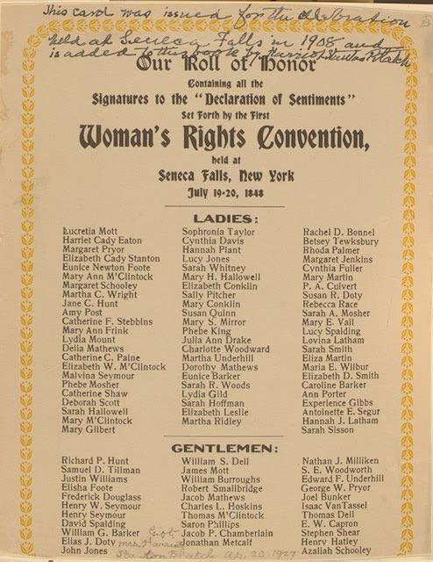
Seneca Falls Convention
The Seneca Falls convention was the first woman's rights convention held in Seneca Falls, New York, it spanned two days over July 19–20, 1848.
It was described by organizers as "a convention to discuss the social, civil, and religious condition and rights of woman"
Female Quakers local to the area organized the meeting along with Elizabeth Cady Stanton
Quakers were a progressive sect of Christians who believed in the spiritual equality of men and women. This conviction led to early, radical inclusion of women as public ministers, leaders, and organizers in business meetings.

Slide 18
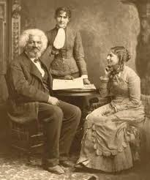
Seneca Falls Convention
The meeting comprised six sessions including a lecture on law, a humorous presentation, and multiple discussions about the role of women in society.
Stanton and the Quaker women presented two prepared documents, the Declaration of Sentiments and an accompanying list of resolutions, to be debated and modified before being put forward for signatures.
A heated debate sprang up regarding women's right to vote, with many urging the removal of this concept, but Frederick Douglass, who was the convention's sole African American attendee, argued eloquently for its inclusion, and the suffrage resolution was retained.

Slide 19
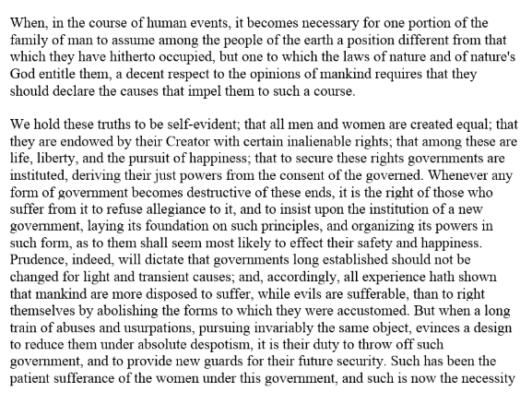
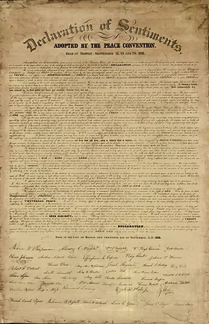
Declaration of Sentiments
The Declaration of Sentiments was modeled after the Declaration of Independence.

Slide 20
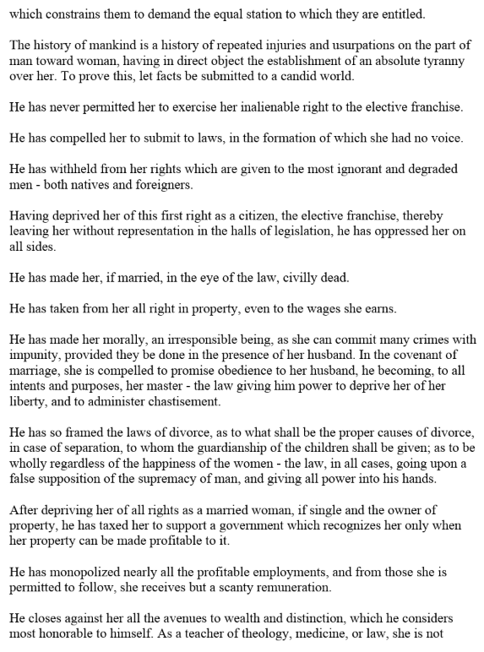
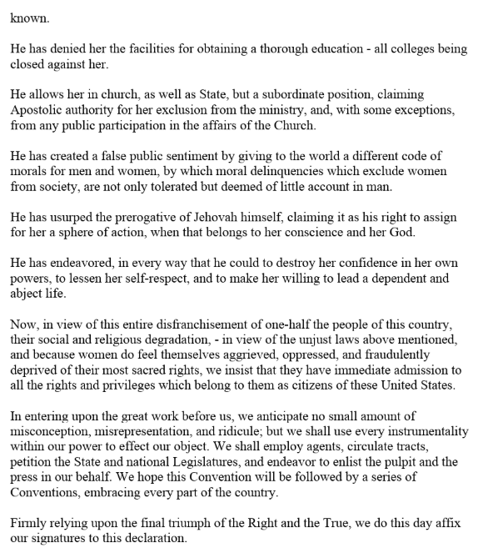
Declaration of Sentiments

Slide 21
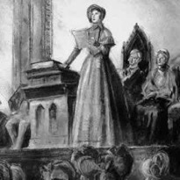
Seneca Falls Convention Continued
Exactly 100 of approximately 300 attendees signed the Declaration of Sentiments and the accompanying resolutions, mostly women.
The convention was seen by some of its contemporaries as one important step among many others in the continuing effort by women to gain for themselves a greater proportion of social, civil and moral rights, while it was viewed by others as a revolutionary beginning to the struggle by women for complete equality with men.
Stanton considered the Seneca Falls Convention to be the beginning of the women's rights movement.

Slide 22
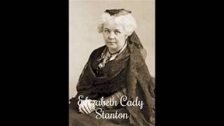
Elizabeth Cady Stanton’s Address at Seneca Falls 1848

Slide 23
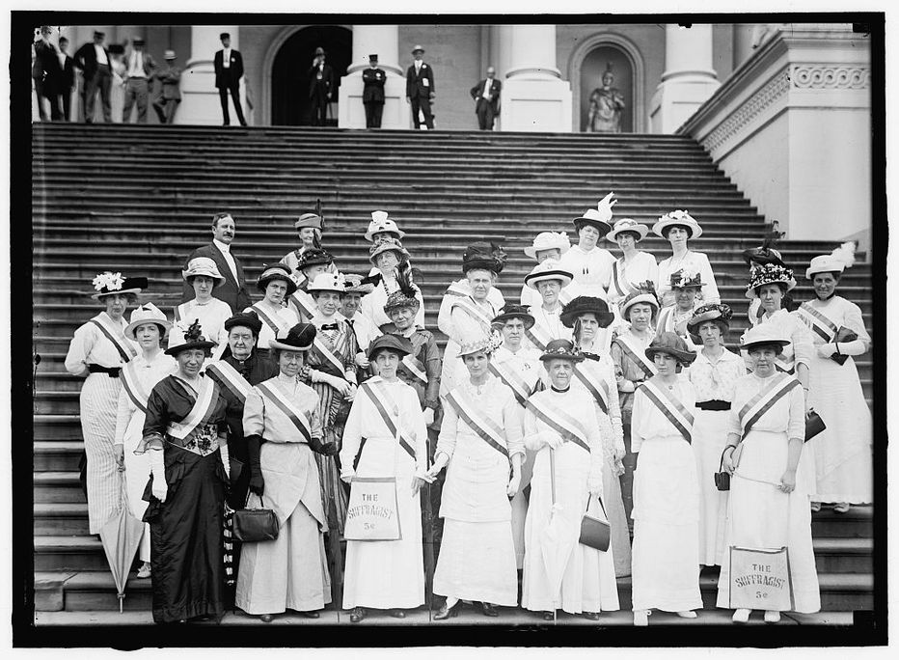
Seneca Falls Convention Legacy
On April 7, 1848, in response to a citizen's petition, the New York State Assembly passed the Married Woman's Property Act, giving women the right to retain the property they brought into a marriage, as well as property they acquired during the marriage. Other women’s rights conventions formed soon after, including the Rochester Women's Rights Convention in Rochester, New York, two weeks later. In 1850 the first in a series of annual National Women's Rights Conventions met in Worcester, Massachusetts.
By the time of the National Women's Rights Convention of 1851, the issue of women's right to vote had become a central tenet of the United States women's rights movement

Slide 24
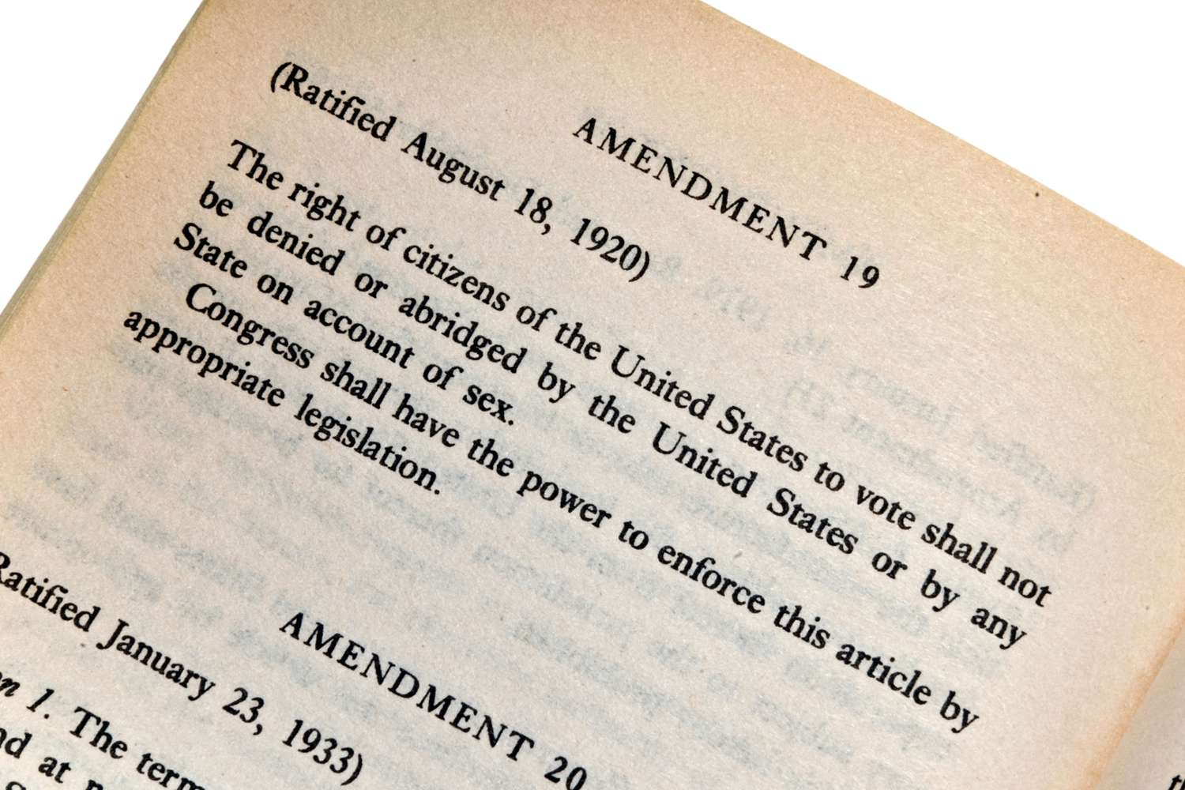
Seneca Falls Convention Legacy
The convention highlighted the necessity for women's autonomy in education, property, and professional opportunities, rather than just voting rights.
The movement spurred by the convention lead to the 1920 ratification of the 19th Amendment, cementing women’s right to vote

Slide 25
Discussion

Slide 26
Modern Day Attacks on Women’s Rights

Slide 27
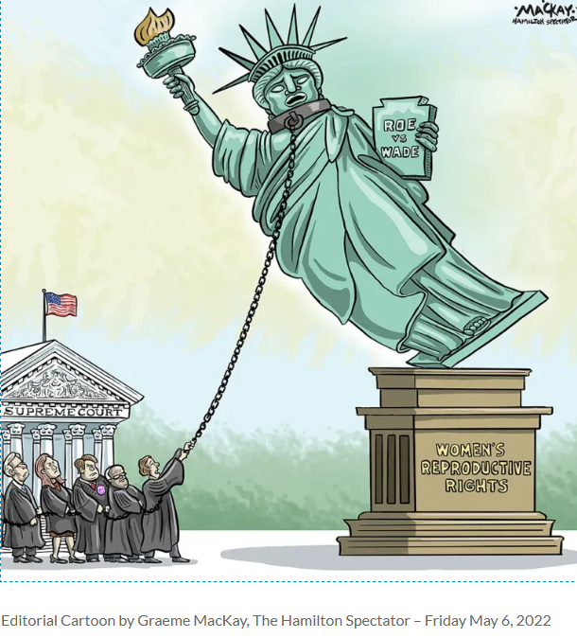
Section III Women’s Rights Attacked and Defended
Dobbs v. Jackson (2022)
Restrictions of Women’s Rights
Project 2025
Values Platform for Oppression of Women
Women for Racial and Economic Equality (WREE)
Organizing the defense of Women’s Rights

Slide 28
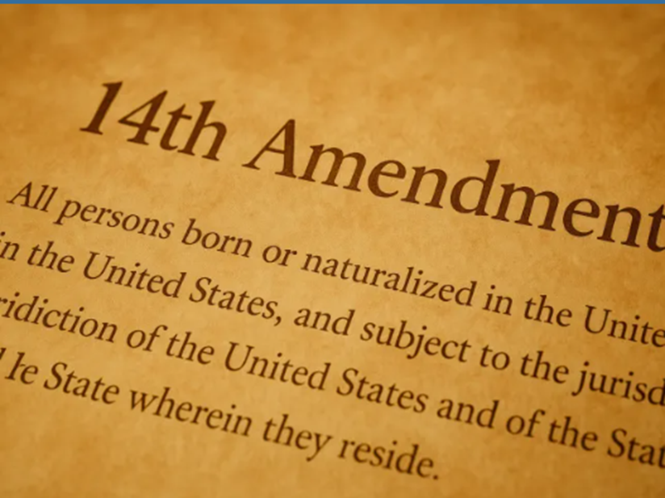
Dobbs v. Jackson Women's Health Organization (2022)
Dobbs v. Jackson Women’s Health Organization is the 2022 Supreme Court case that reversed Roe v. Wade and Planned Parenthood of Southeastern Pennsylvania v. Casey, the decisions that originally asserted the fundamental right to an abortion prior to the viability of the fetus.
Dobbs v. Jackson states that the Constitution does not confer a right to abortion; and, the authority to regulate abortion is “returned to the people and their elected representatives.”
The State of Mississippi, through Dobbs, argued that the Constitution does not provide a right to abortion and therefore, states can freely ban abortions if it is rationally related to legitimate government interests.

Slide 29
The Arguments
Mississippi Arguments for Banning Women’s Rights:
Leaned cited the Tenth Amendment, that denies states powers like making treaties, but does not directly deny the power to restrict abortion.
Additionally, Mississippi argued that “liberty” as written in the Fourteenth Amendment only implicates fundamental rights that are “deeply rooted in U.S history and tradition.”
Mississippi further argued that abortion is not a fundamental right since many states at the time of the Fourteenth Amendment’s ratification had bans on abortions.
Additionally, Mississippi contended that the “viability line” prevented a state from protecting its interest and was too arbitrary or subjective.
Women’s Health’s Defense of Women’s rights argued:
That abortion is grounded in the Fourteenth Amendment.
The concept of physical autonomy and body integrity are “essential elements of liberty protected by the Due Process Clause.” For example, contraception is included in the word “liberty.”
That abortion, or the right of a person to have possession of their own body is important in the common law tradition. Furthermore, Women’s Health pointed out that federal courts have uniformly applied the viability line.

Slide 30
Decision- To Overturn Roe v. Wade
Justice Alito wrote the majority opinion, joined by Justices Thomas, Gorsuch, Kavanaugh, and Barrett.
The Court explained that the critical question was whether the Constitution “properly understood” confers a right to obtain an abortion.
The Court first stated that the Constitution makes no express references to abortion.
The Court noted that the history of abortion in the U.S is “as a crime”-- that at the time the Fourteenth Amendment was adopted, three-quarters of the States had made abortion a crime at any stage of pregnancy.
The Court explained that this was true until Roe v. Wade—and thus, “liberty” would not recognize abortion as a fundamental right rooted in the nature, history, or traditions of the nation. Indeed, the Court stated that “Roe either ignored or misstated this history.”
The Court also explained that “the people of various states” may evaluate the interests between “potential life” and a “woman who wants an abortion” differently than the Court. Finally, the Court concluded
Abortion is not part of a broader entrenched right—that justifying this premise “proves too much.” The Court said that linking abortion to a right to autonomy or to “define one’s concept of existence” would also license fundamental rights to “illicit drug use, [or] prostitution.”

Slide 31
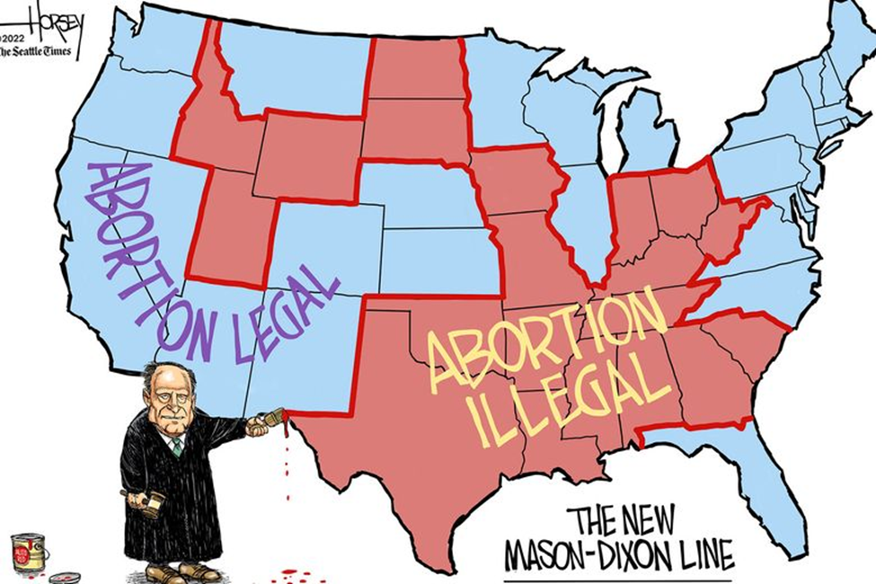
Implications for Women’s Health and Rights
States may regulate abortion “for legitimate reasons” and if those laws are challenged under the Constitution, they are entitled to “a strong presumption of validity.”
From outright bans to bills targeting medication abortion and bolstering the ability of far-right activists to lie to those seeking care about available options (such as requiring counseling on medication abortion “reversal”), states across the country have accelerated their efforts to limit access to abortion.
By the 100th day after the Dobbs decision, nearly 22 million women of reproductive age—almost 1 in 3 women—found themselves living in states where abortion was unavailable or severely restricted.
In 2022 alone, state legislators introduced 563 provisions to restrict access to abortion, and 50 of those restrictions were signed into law the same year.

Slide 32
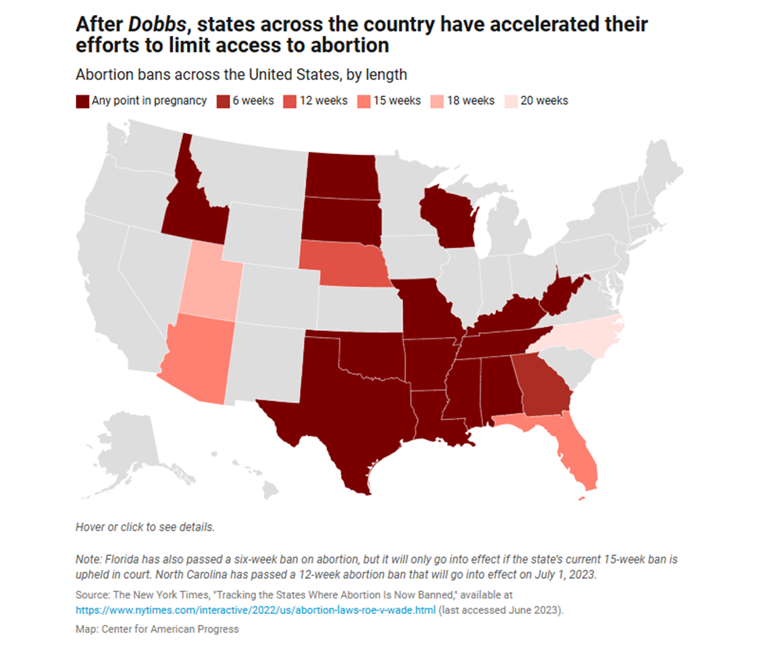
The States’ Response to the Dobbs Ruling
14 states have near-total abortion bans during any point in pregnancy in effect: Alabama, Arkansas, Idaho, Kentucky, Louisiana, Mississippi, Missouri, North Dakota, Oklahoma, South Dakota, Tennessee, Texas, West Virginia, and Wisconsin.
Several other states have similar abortion bans that have been temporarily blocked by the courts, including Arizona, Indiana, Utah, and Wyoming.

Slide 33
Extreme Penalties for Women and Healthcare Providers
Enforcement mechanisms include criminal penalties, bounty hunter provisions, and fear and confusion
Overwhelmingly, state bans on abortion at any point in pregnancy contain criminal penalties for those who perform or attempt to perform an abortion.
The majority of these criminal penalties include jail time, which typically ranges from 1 to 20 years, although the bans in Alabama and Texas can lead to life in prison.
Some states have also passed bounty hunter laws, which allow individuals to sue abortion providers and, in some cases, those who “aid” or “abet” an abortion.

Slide 34
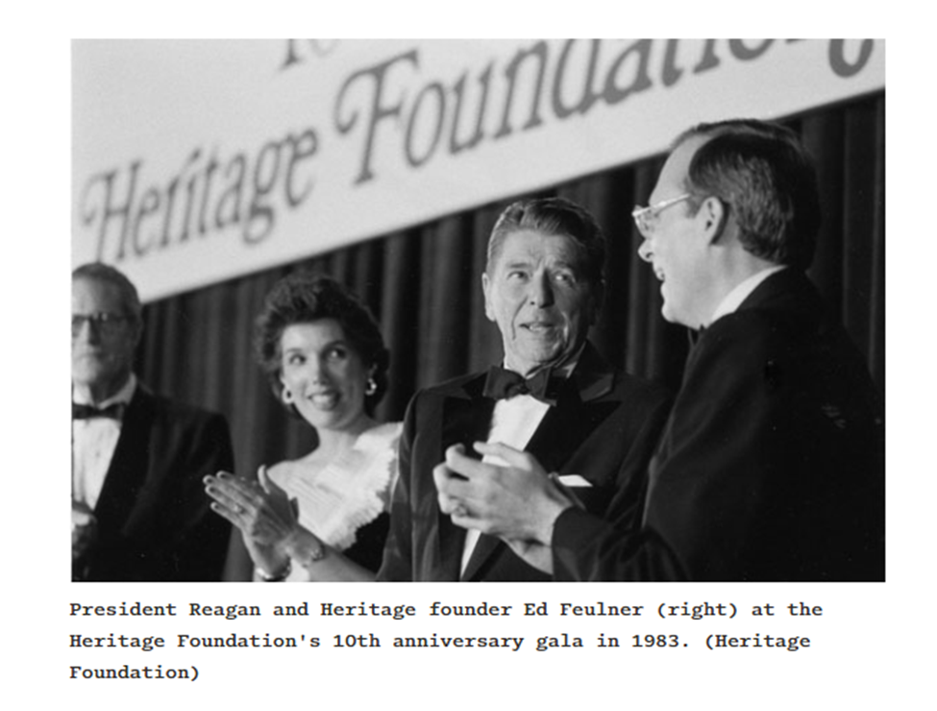
Project 2025- The Trump Regime’s Values Strategy
Project 2025 is a 900-plus–page handbook assembled by the Heritage Foundation, a leading conservative think tank, with at least 140 former Trump administration officials involved in its drafting.
It offers a step-by-step guide for how to quickly implement an extreme agenda across the federal government from day one of a conservative presidential administration. The Project 2025 agenda offers sweeping policy proposals that would dramatically overhaul how our federal government, including departments, agencies, sub-agencies, and personnel, would function, all geared toward implementing and institutionalizing extremist policy priorities and power.
Project 2025 seeks to impose a hierarchical, gendered, patriarchal vision of society. It is particularly focused on enforcing a vision of the family that relies on fixed and narrowly defined gender roles and in undermining protections that enable women and LGBTQI+ people to thrive outside of a male-dominated, heterosexual family.
Neoconservative Ronald Reagan in partnership with the Heritage Foundation 1983

Slide 35
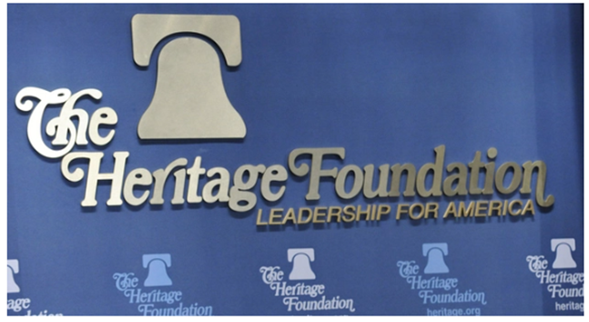
Project 2025
Project 2025 on Gender, Race, Religion and Family
“It takes one fertile man and one fertile woman to reproduce,
The family is the foundation of civilization, and marriage—the committed union of one man and one woman—is its cornerstone. It is the seedbed of self-government.”
“When the Moynihan report, The Negro Family: The Case for National Action, was published in 1965, Daniel Patrick Moynihan—then Assistant Secretary of Labor under President Lyndon Johnson—was so concerned about a 25 percent nonmarital birth rate for black women that he called for national action from the federal government.”
“In the decades since the report was published, that rate has nearly tripled.Underlying this view is a deep sense of gratitude in knowing that human beings are here by God’s grace and that children are divine gifts.”
“The welfare state kick-started the current crisis by punishing work and marriage. The welfare system has made marriage economically irrational for many low-income couples. Nearly all of the cash, food, and housing programs focus on subsidizing non-married single-parent families with the greatest benefits aimed at families that do not work.”

Slide 36

Project 2025
Project 2025 Incentivises “Traditional” Families
First, Congress should build on the President’s innovative Trump Accounts by supporting marriage with a $2,500 initial deposit into a new investment account
Second, Congress should apply the current $17,670 adoption tax credit to married parents for each of their own newborns.
To end America’s family crisis, policymakers and civic leaders should treat restoring the family home as a matter of justice, driven by two truths.
The first is that all children have a right to the affection and protection of the man and woman who created them.
The second is that the ideal environment in which to exercise this right is in a loving and stable home with their married biological parents. In contrast, the default in American culture today is to put the desires of adults over the needs of children. Children are too often called to sacrifice what is due to them—the presence of their mom and dad under the same roof for the entirety of their childhood.

Slide 37
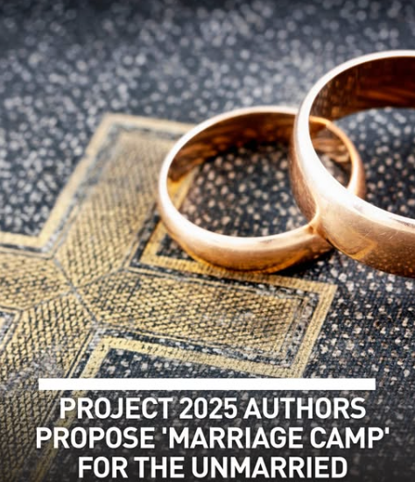
Project 2025
According to the Heritage Foundation’s framework, called “Saving America by Saving the Family,” Marriage Boot Camps would serve as reeducation centers for unmarried couples.
“Successful completion of the program would mean that couples are ready to walk down the aisle at a communal wedding by the end of the bootcamp,” the organization’s screed declares. “The bride and groom would also be matched with a mentor couple to help them to navigate the highs and lows of early married life.”
Each couple that completes the program could receive a ‘wedding bonus’ of up to $5,000 on their wedding day to be paid through foundations or private donors, not government funds.”

Slide 38
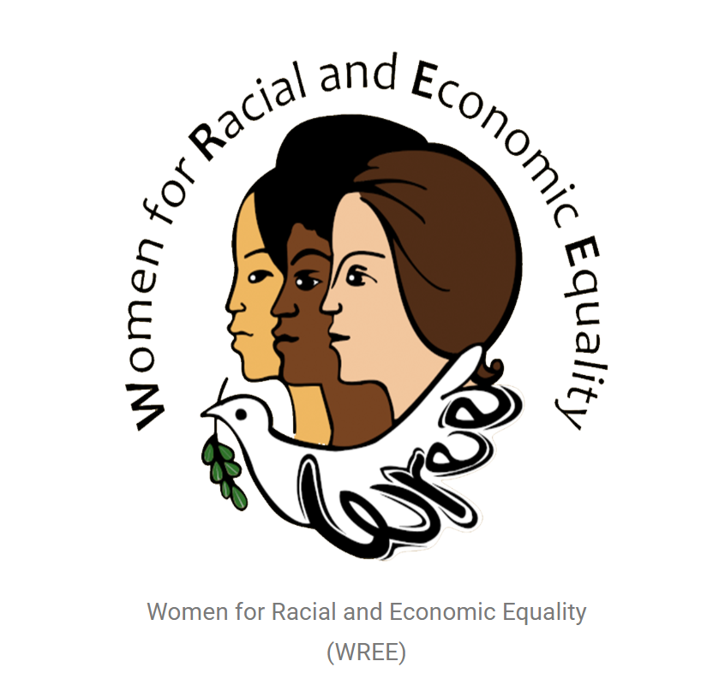
Women for Racial and Economic Equality (WREE)
WREE’s History
Women for Racial and Economic Equality, WREE, was established in 1974 as a successor to the CAW, Congress of American Women, and as an affiliate of WIDF, Women’s International Democratic Federation, a UN-recognized NGO. doing much of what progressive women’s organizations did in the 1960s and 1970s in helping women gain greater equality.
WREE was reconstituted on March 7, 2018, by a group of women. We have contacted some members in the previous generation of WREE, as well as leaders of its international affiliate, WIDF. We are growing, and looking for new members to join us in our struggle for Racial and Economic Equality.

Slide 39
WREE
From the program of their 3rd National Convention in May of 1984:
“We are Black, white, Chicano, Puerto Rican, Asian and Native American women. We are workers, trade unionists, unemployed, housewives, welfare recipients, professionals, students and senior citizens.
We are women witnessing a daily deterioration of our living standards as the economic crisis in our country grows deeper.
We are women who see banks and giant corporations grow richer and increasingly in direct control of city, state and national government, as our children and families suffer greater hardships.
We are women who see corporate monopoly reap huge profits from women workers by fostering divisions between men and women.
We are women demanding a say in the future of our country and an end to all forms of male supremacy.
We are women whose experiences have shown that racism is the major obstacle to bettering our living conditions in any real or meaningful way. Our organization strives for unity of all women based on a principled program of struggle to end racism in all its forms.
We are women who are united with our sisters throughout the world under the banner of world peace and equality for women.”

Slide 40
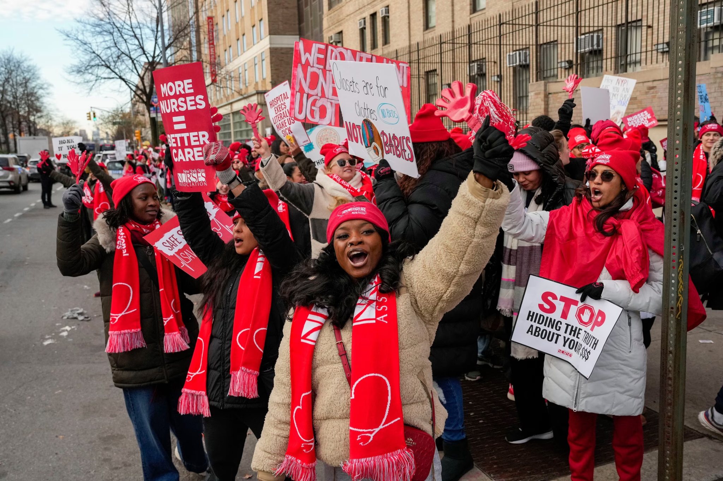
WREE
Current Projects
Defending Women’s reproductive rights
Opposing restrictions of women’s rights
Calling for military spending cuts to increase funding for education
Defending rights of transgender and LGBTQ+ women
Supporting and organizing women workers and unions
Women were at the forefront of the historic New York State Nurses Association strike which lasted 41 days, ending with a win for the nurses in Feb 2026

Slide 41
WREE
Get Involved!
https://wreeusa.org/contact-wree/

Slide 42
Discussion & Wrap Up

Slide 43
Announcements
PCUSA Cell Chairs need to call members of their cells to remind them about attendance.
The next issue of New Masses (2026) has begun production. If you have art you want us to feature, email it to info@partyofcommunistsusa.net.

Slide 44
Volunteers Needed!
We are in need of volunteers for the staff of the People’s School! Here’s a few roles we need filled:
People to help manage posting on our social media and podcast platforms
Video Editors, Audio Editors, Graphic Designers, Artists, Narrators
Web Controls, Moderators
Email info@peoplesschool.us if you’re interested and try to attend our next staff meeting if possible.

Slide 45

View From Left Field
https://viewfromleftfield.libsyn.com
The Old PSMLS Youtube is now the Youtube of View From Left Field, a podcast of analysis and discussion of current events from a progressive perspective.
Like the Youtube videos and subscribe with 5 star ratings on your podcast platforms.

Slide 46

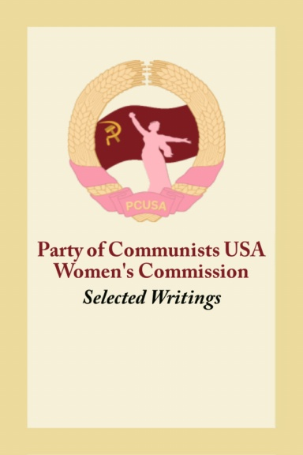
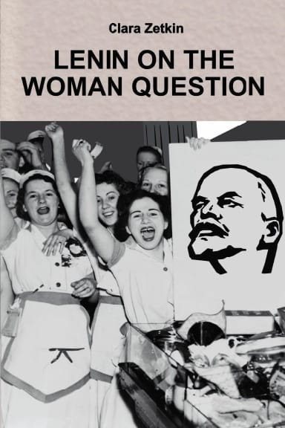


New Outlook Publishers
newoutlookpublishers.store
Relevant and Latest Releases

Slide 47



Harry Bridges School of Labor
luel.us/laborschool/
The Harry Bridges School of Labor is a monthly class covering a variety of topics aimed at building class consciousness among union members. For class schedule and other information, please visit the website at luel.us/laborschool.

Slide 48

9 to 5 by Dolly Parton

