Slide 1

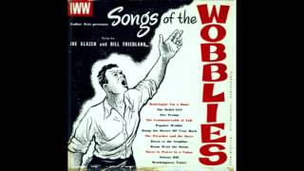
Rebel Girl by Joe Hill

Slide 2
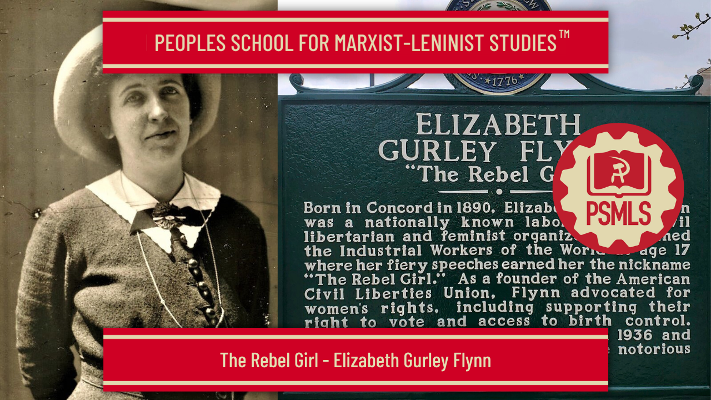
PSMLS 03/31/26

Slide 3
What we’ll be learning today:
Section I: Elizabeth Gurley Flynn - Daughter of Immigrants and Revolutionists, Socialist and IWW Agitator
Section II: Founding / Involvement with ACLU, Involvement in Irish Republican Movements, Prison Years
Section III: Clara Zetkin and Lenin on the Women’s Question.

Slide 4
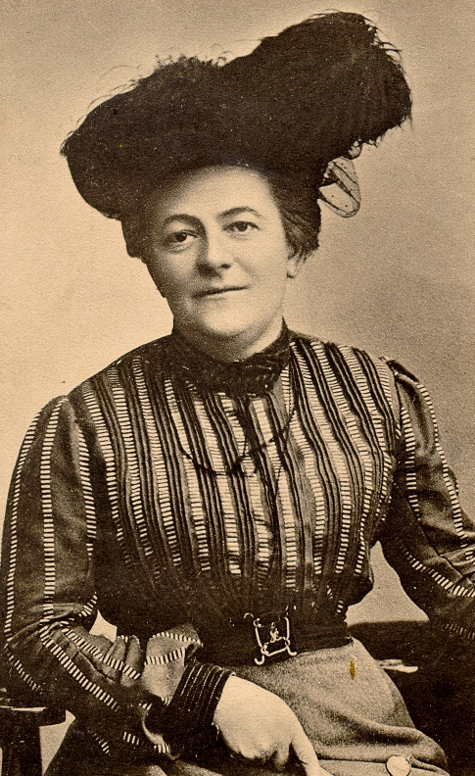
Clara Zetkin July 5 1857 – June 20 1933
German Marxist theorist,Communist activist and Women's Rights Advocate
Only in Conjunction With the Proletarian Woman Will Socialism Be Victorious
(1896)
“As far as the proletarian woman is concerned, it is capitalism’s need to exploit and to search incessantly for a cheap labor force that has created the women’s question. It is for this reason, too, that the proletarian woman has become enmeshed in the mechanism of the economic life of our period and has been driven into the workshop and to the machines. She went out into the economic life in order to aid her husband in making a living, but the capitalist mode of production transformed her into on unfair competitor. She wanted to bring prosperity to her family, but instead misery descended upon it. The proletarian woman obtained her own employment because she wanted to create a more sunny and pleasant life for her children, but instead she became almost entirely separated from them. She became an equal of the man as a worker; the machine rendered muscular force superfluous and everywhere women’s work showed the same results in production as men’s work. And since women constitute a cheap labor force and above all a submissive one that only in the rarest of cases dares to kick against the thorns of capitalist exploitation, the capitalists multiply the possibilities of women’s work in industry. As a result of all this, the proletarian woman has achieved her independence. But verily, the price was very high and for the moment they have gained very little.”
Source: Speech at the Party Congress of the Social Democratic Party of Germany, Gotha, October 16th, 1896. Berlin.

Slide 5
Elizabeth Gurley Flynn - Daughter of Immigrants and Revolutionists, Socialist and IWW Agitator

Slide 6
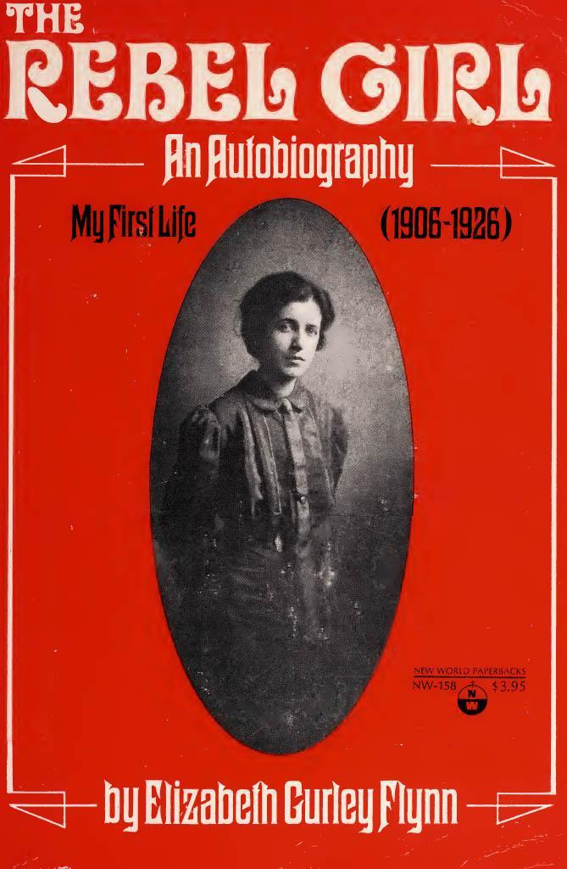
The Rebel Girl by Elizabeth “Gurley” Flynn
The Rebel Girl is Elizabeth “Gurley” Flynn’s autobiography. It is split into two volumes to emphasize her life before and after she became a communist: “My First Life (1906-1926)” and “My Second Life.”She wrote her biography by hand over many years. Because of political persecution under the Smith Act, she prepared the manuscript in very trying times, and Flynn died before ever finishing her biography. The following slides of this section are excerpts—including the images—from the first volume, of the second edition of her autobiography, published by International Publishers, digitized on the Internet Archive, and further archived on the American Marxist-Leninist Archive.
Volume one cover

Slide 7
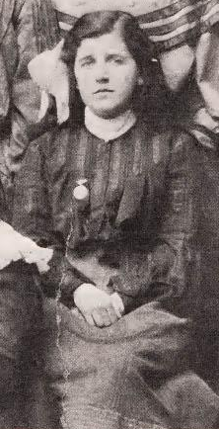
The Daughter of Immigrants and Revolutionists
Elizabeth Gurley Flynn was born in 1890 in Concord, NH. Her family were early Irish immigrants to America,with her grandfather arriving sometime in the 1840s. Life was hard for these early Irish immigrants who worked in lumber camps, building railroads and in the granite quarries, among other dangerous and difficult jobs. Her parents, Thomas Flynn, and Annie Gurley, along with her brother Thomas Gurley Flynn, and her two sister’s Lucy Sabina Flynn and Anna Katherine Flynn were forced to travel the country in her earliest years as her father struggled to find steady work.
Elizabeth Gurley Flynn’s family were “conditioned…to accept socialist thinking long before we came in contact with Socialism as an organized movement. My father had voted for Eugene V. Debs as the Socialist Party Candidate for President in 1900. (p. 44)” In Harlem New York, in 1906 her family were attending meetings at the Harlem Socialist Club where she gave her first speech at the age of 16, to a “gathering…extremely popular with radicals of all descriptions,” called the Unity Congregation.
Flynn at age 12 or 13

Slide 8
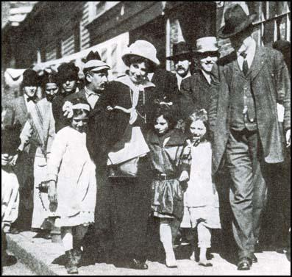
The Daughter of Immigrants and Revolutionists
In that summer she began speaking in the streets of Harlem, at mass meetings, which eventually resulted in her first arrest with her Father and several others for “speaking without a permit” and “blocking traffic in the heart of the theatrical district.”
Quote: : ”I had begun to feel very strongly, that in a rich and fertile country like ours, there was no excuse for poverty, unemployment, child labor, and long strikes.” Elizabeth Gurley Flynn (Flynn, Elizabeth. The Rebel Girl - An Autobiography: My First Life 1906 - 1926 p.45, 1973.)

Slide 9
Socialist and IWW Agitator
Shortly, after joining the IWW in 1906, Elizabeth Gurley Flynn participated in her first strike action, with the Tube Mill Workers of Bridgeport CT, where she participated in strike committee meetings, mass picketing, and daily meetings in two languages.
In 1907, at the age of 17 she was elected delegate of her IWW local to the IWW convention in Chicago. Her “family and friends were hesitant about letting [her] go but [she] was determined.” The local had no funds, but the Unity Club were able to raise the 18 dollar fare for her to travel by coach.
Following her first cross-country trip as an IWW organizer she would continue to travel the nation, giving “particularly inflammatory (p.85)” speeches at socialist and IWW branches and on the streets about the local labor issues and the worker’s grievances. For this activity she was arrested numerous times and devoted a large amount of her focus towards defending those unjustly arrested for their involvement in labor organizing.
During this time she also married her husband, Jack A. Jones, an ore miner and IWW local organizer, had a miscarriage and gave birth to her only son Fred Flynn, on May 19th, 1910.

Slide 10
Lead-up to World War I and the Founding of the ACLU
Quote: “How I got by the strict qualification that one must be an actual wage worker, I cannot recall, possible it was due to my extreme youth and the fact that all the work I did was for the movement, sometimes paid for and often not.” (Flynn, Elizabeth. The Rebel Girl - An Autobiography: My First Life 1906 - 1926 p.77, 1973.)
Throughout the years 1912 - 1916 Elizabeth Gurley Flynn was involved in several of the largest strikes in American history until that time. The first of these being the Lawrence Textile strike of 1912, where she helped lead the strike alongside “Big” Bill Haywood, holding “special meetings for women (p.132)” and struggling against the “old world attitude” of the men who voiced considerable opposition to women going to meetings and marching on the picket lines
(Flynn, Elizabeth. The Rebel Girl - An Autobiography: My First Life 1906 - 1926, 1973.

Slide 11
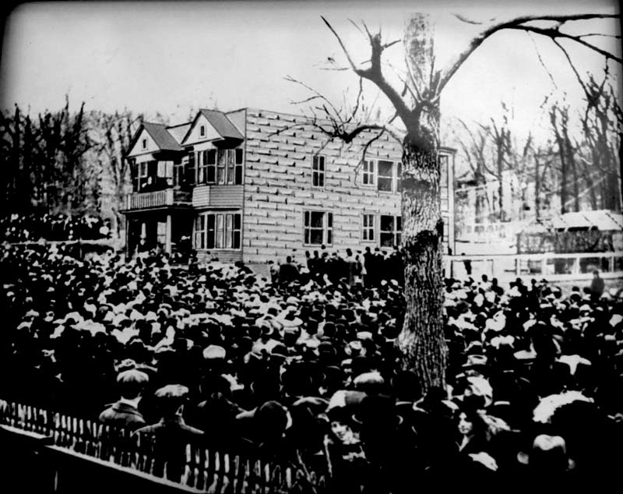
Lead-up to World War I and the Founding of the ACLU
She was then called to Paterson, NJ, the silk-weaving center of America, where she “found herself involved at once, in a major battle of the class struggle of 1913 - a long, hard, and brutal strike (p.154)” She and her comrades were attacked by the city authorities with “vicious fury” as “outside agitators” and ordered to leave town. They were then arrested at their first appearance at a mass meeting. After making bail she continued agitating for the striking workers and was involved in the defense of convicted strikers Quinlan and Boyd, even following the resolution of the strike.
Over the next few years, in the lead up to World War I, Elizabeth Gurley Flynn was kept busy by her organizing for the IWW and was frequently called to locations across the country engaged in labor struggles and the fight for free speech. She also continued to participate actively in the defense of innocent strikers and labor leaders who were being persecuted by the state.
(Flynn, Elizabeth. The Rebel Girl - An Autobiography: My First Life 1906 - 1926, 1973.

Slide 12
Discussion & New Members Introductions

Slide 13
New Member Introductions
What is your name, pronouns and state (or country/territory)?
Where do you work? Is it unionized?
How did you find out about the People’s School?
What do you think about tonight's class?

Slide 14
Involvement with ACLU and Irish Republican Movements

Slide 15
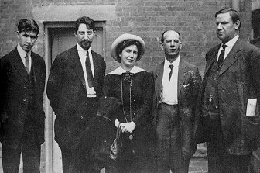
Joining the Communist Party USA (CPUSA)
The Communist Party was the largest at this time in its U.S. history, having doubled its membership between 1936 and 1938 to just over 80,000.
Elizabeth Gurley Flynn joined the Communist Party USA in 1936 during the Popular Front period and became one of its most recognized and beloved leaders.

Slide 16
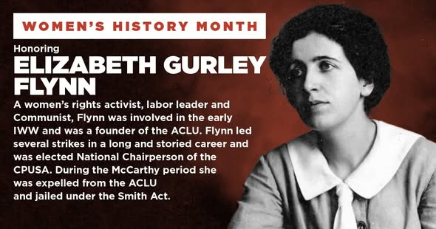
Involvement with the ACLU
A founding member of the American Civil Liberties Union (ACLU) in 1920, Flynn played a leading role in the campaign against the conviction of Sacco and Vanzetti.
Flynn was particularly concerned with women's rights, supporting birth control and women's suffrage.
Flynn also criticized the leadership of trade unions for being male-dominated and not reflecting the needs of women.
Though Flynn was in poor health most of her time in Portland, she was an active and vocal supporter of the 1934 West Coast Longshore Strike.

Slide 17
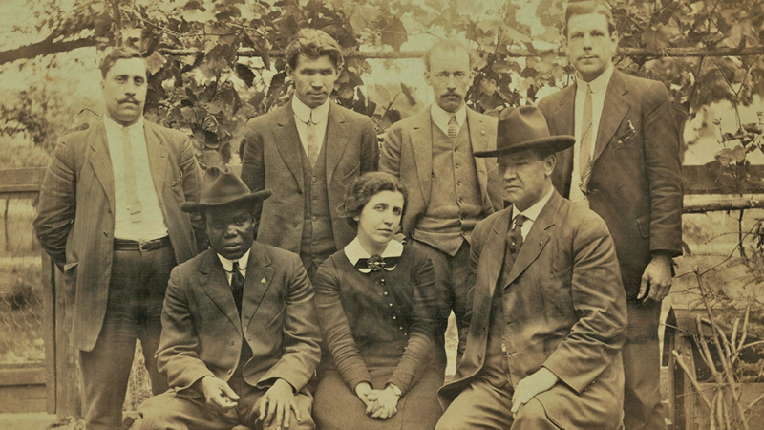
Involvement with the ACLU pt.2
In 1939, Flynn was re-elected to the ACLU board; however, when Adolf Hitler and Josef Stalin signed a nonaggression pact in 1939, the ACLU expelled all Communist Party members from its ranks in 1940, including Flynn.
Flynn alone refused and defended her position. Refused a hearing, she was expelled.
In l976, they repudiated their ouster on grounds that it was inconsistent with their basic principles.
When the ACLU betrayed
Elizabeth Gurley Flynn and the Left

Slide 18
Involvement in Irish Republican Movements
The strike against the Dublin Tramway Company was precipitated by the discharge of 200 men for membership in the “Irish Transport Workers Union.” The union responded by a general strike demanding the reinstatement of their fellow workers.
Discrimination was a last resort after all other means of smashing the union had failed.
William Murphy, president of the company is one of the biggest capitalists in Ireland.
Posing as an Irish patriot, he nevertheless accepted a knighthood from the English King.
The strike has produced intense police persecution.
The police rushed to disperse the cheering crowd and a wild fight followed. Men and women were beaten and trampled on, blood dyed the streets, five hundred were so badly hurt they had to receive hospital treatment, one man was mortally wounded and has since died, and another man killed outright.

Slide 19
Discussion

Slide 20
Imprisonment Years

Slide 21
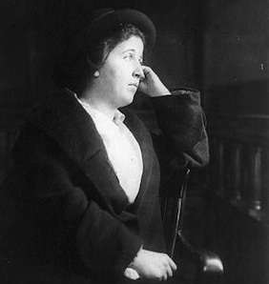
Prisoner Number 11710
Elizabeth Gurley Flynn spent twenty-eight months in the Alderson Federal Women’s Reformatory from 1954 to 1957. Elizabeth was also known as Prisoner Number 11710, now a heavy-set, gray-haired, elderly woman.
In 1951, at the age of sixty-one, Flynn was one of 132 “second tier” Party leaders indicted under the Smith Act for allegedly advocating the overthrow of the government by force and violence. She was found guilty and sentenced to three years’ imprisonment.

Slide 22
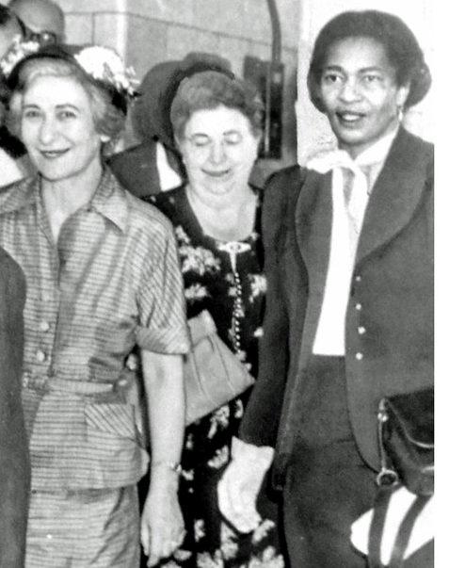
Prisoner Number 11710 cont’d
Other women convicted along with her and sent to prison included:
Claudia Jones, a Trinidad-born journalist, feminist, Black nationalist, and member of the National Committee of the Communist Party,
and Polish immigrant Betty Gannett, a teacher, writer, and National Education Director for the Party.

Slide 23
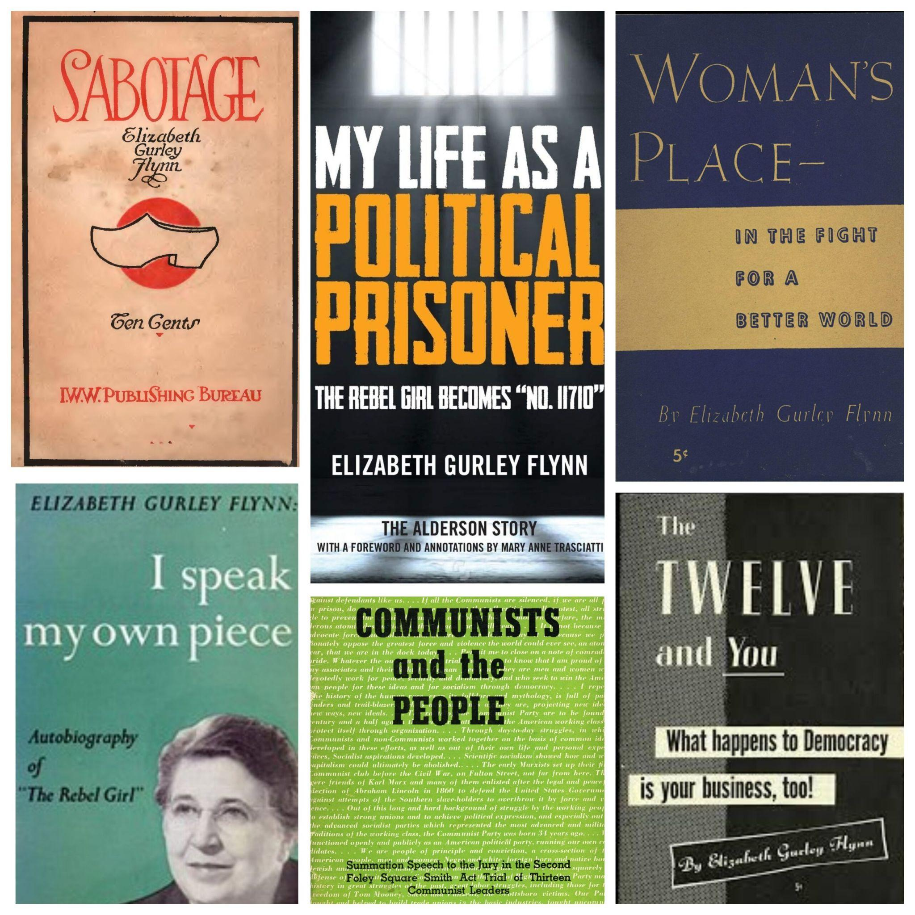
The Alderson story: my life as a political prisoner
by Flynn, Elizabeth Gurley
The narrative begins with Flynn’s arrest at the hands of three FBI agents who stormed into her family’s New York City apartment “on a hot morning in June 1951”.
But the book is not about the excesses of Cold War anti-Communism or the Smith Act. The trial and appeals process are addressed in two very short chapters, and by the beginning of Chapter 3 we have arrived at Alderson, along with Flynn, Jones, and Gannett.

Slide 24
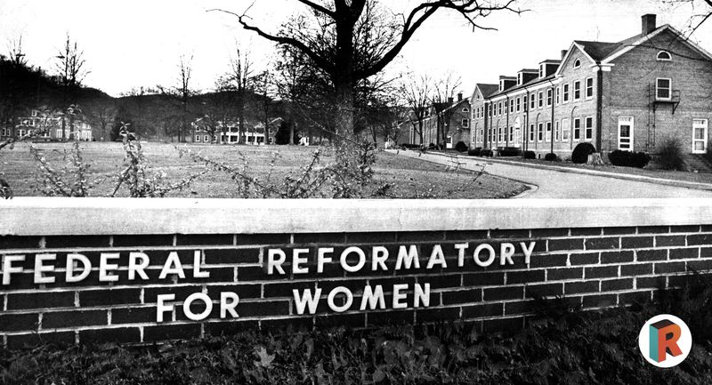
The Alderson Story - cont’d
The first federal women’s prison in the United States, Alderson was founded in West Virginia in 1927. It was intended to be a place of regulation and reform, by the time Flynn got to Alderson the reformatory spirit had waned considerably.
Confidence in the women, which had brought out the best in even the worst of them, was now replaced by distrust and suspicion, an atmosphere in which the inmate was always wrong. All forms of initiative were discouraged.

Slide 25
Subjects Covered in The Alderson Story
First, a strip search, followed by an enema and a search of all bodily cavities. Then, a shower, after which the new inmates were handed a rayon nightgown and a brown housecoat “of rough,nondescript material” (25), photographed and fingerprinted, and quarantined for three days.
“...no rich women were to be found in Alderson” —the majority were black and Spanish-speaking, many from abusive backgrounds, some mentally ill or suffering from drug addiction. Inmates and guards were racially segregated when the prison was founded, and the situation had not changed by the time Flynn arrived. Claudia Jones was assigned to a segregated “colored cottage.”

Slide 26
Subjects Covered in The Alderson Story
After the Supreme Court declared segregation unconstitutional in its 1954 decision in Brown v. Board of Education, Flynn, Jones, and other Communists were called upon by prison officials to help integrate the prison houses. Flynn clearly revelled in the irony of Communists being asked to enforce a civil rights edict issued by an arm of the US federal government.
Flynn’s solidarity with the oppressed and unwavering commitment to social, political, and economic justice reverberate throughout the pages of her prison memoir. Never one to waste an opportunity for activism, she used her time at Alderson to get to know the women around her, understand how and why they ended up in prison, and use this knowledge to advocate on their behalf. She presents fellow inmates as complex individuals whose crimes more often than not were the consequence of struggling with limited resources against forces beyond their control.

Slide 27
CONCLUSION
Flynn’s commitment to internationalism and the solidarity of workers around the globe was matched by a strong affinity for the country in which she was born. Like her friend and mentor James Connolly, she saw no contradiction between love of country and revolutionary working-class politics. In a letter to her sister Kathie, days before her release from Alderson, she wrote:
“Nothing and nobody can take my country away from me. I sit in prison, thinking of its beauty, its breadth, its people. It is ever in my heart, my thoughts, my eyes—its growth, its vastness, its richness. Sitting in the twilight, watching the sun sinking in the West, I remember my country clear out to the Pacific Ocean.
Last three slides, source: https://www.cpusa.org/article/on-flynns-my-life-as-a-political-prisoner/

Slide 28
Discussion

Slide 29
The Rebel Girl: My First Life

Slide 30
Childhood & Early Youth
By birth I am a New Englander, though not of Mayflower stock. My ancestors were immigrants and revolutionists from Ireland. I was born in 1890 in Concord, New Hampshire. The awareness of being Irish came to us as small children through plaintive song and heroic story. As children, we drew in a burning hatred of British rule with our mother’s milk. My great-grandfathers joined the French in 1798 to help free Ireland. My grandfather, Tom Flynn, came to America in the 1840s. We moved to New York City in 1900. I hated poverty. Socialism became a flame within me. In 1906, at fifteen, I made my first public speech: “What Socialism Will Do For Women.”
Flynn at age 12 or 13

Slide 31
Socialist and IWW Agitator, 1906-1912
Carlo Tresca moved his paper to New York City in 1913. Almost immediately we became involved in a spectacular strike of hotel workers in midtown New York. Paterson, called the “Lyons of America,” is the seat of Passaic County. Coming as we did with the aura of the Lawrence victories and the publicity of the hotel workers strike, we were very welcome to the workers. During the strike, the IWW was again plagued, as it had been in Lawrence, with the appearance of volunteer speakers on the strike platform over whom it could exercise no control. The Socialist Party repudiated [Frederick Summer Boyd] and his speeches right at the start. [He incited destruction of property.] The life of a strike depends upon
constant activities. In spite of the unpleasant episode of Boyd’s anti-flag speech, the attempt to use the American flag to lure the people back to work boomeranged completely. As the strike began to drag through the summer months, the IWW leadership was hard put to keep up the drooping spirits and the waning interest of the strikers. As usual in IWW strikes, we arranged mass funerals and, as usual, the police were conspicuous by their absence. When the strike ended in 1913, the authorities of many towns and cities in New Jersey made a determined effort to prevent prominent IWW organizers from speaking. Then I was called to trial on the indictment of two and a half years earlier.

Slide 32
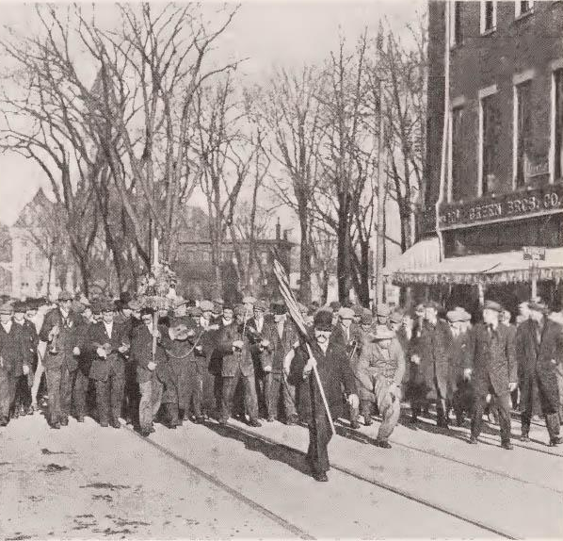
The Lawrence Textile Strike
In 1912 textile mills stretched along many miles of the Merrimac River—in Manchester and Nashua, New Hampshire, and in Lowell and Lawrence, Massachusetts. When Haywood came to Lawrence in February 1912 to assume the leadership of the textile strike it created a national sensation. Nobody knew or cared before the IWW came to lead the strike what happened to these ill-fed, ill-clothed, ill-housed foreign workers. The children’s meetings, at which Haywood and I spoke, showed us mainly that there were two groups of workers’ children in Lawrence, those who went to school and those who worked in the mills. The IWW textile strike in Lawrence was followed shortly afterwards by strikes in Lowell of 16,000 workers in its cotton mills and 25,000 in New Bedford. On May 1, 1912, we held IWW mass meetings everywhere. [T]hose of us who had been in Lawrence during the strike became very uneasy and conscience-stricken about the fate of the three men in jail. The Ettor-Giovannitti victory of 1912 paradoxically was like a swan song for the IWW in Lawrence.
The Lowell strikers march in 1912

Slide 33
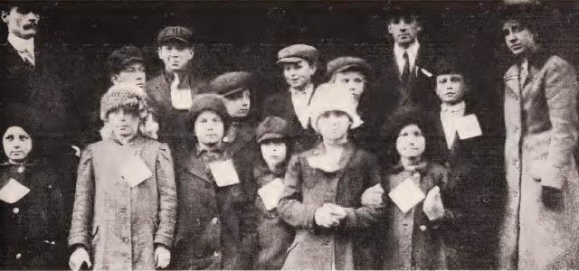
The Lawrence Textile Strike
During the 1912 Lawrence Textile Strike, Flynn leads a group of strikers’ children to New York were they were cared for in workers’ homes

Slide 34
The Paterson Silk Strike
Carlo Tresca moved his paper to New York City in 1913. Almost immediately we became involved in a spectacular strike of hotel workers in midtown New York. Coming as we did with the aura of the Lawrence victories and the publicity of the hotel workers strike, we were very welcome to the workers. But we were set upon by the city authorities with vicious fury. The bosses’ ads said that “the entire fabric of the city’s business interests and the Commonwealth itself is menaced to a point that should cause widespread alarm.”The strikers were harrassed continually by police brutality, arrests and trials. During the strike [the Silk strike, not the hotel workers], the IWW was again plagued, as it had been in Lawrence
with the appearance of volunteer speakers on the strike platform over whom it could exercise no control. The particular issue [Boyd’s] speech injected into the strike was“sabotage.” The life of a strike depends upon constant activities. In spite of the unpleasant episode of Boyd’s anti-flag speech, the attempt to use the American flag to lure the people back to work boomeranged completely. As the strike began to drag through the summer months, the IWW leadership was hard put to keep up the drooping spirits and the waning interest of the strikers. When the strike ended in 1913, the authorities of many towns and cities in New Jersey made a determined effort to prevent prominent IWW organizers from speaking.

Slide 35
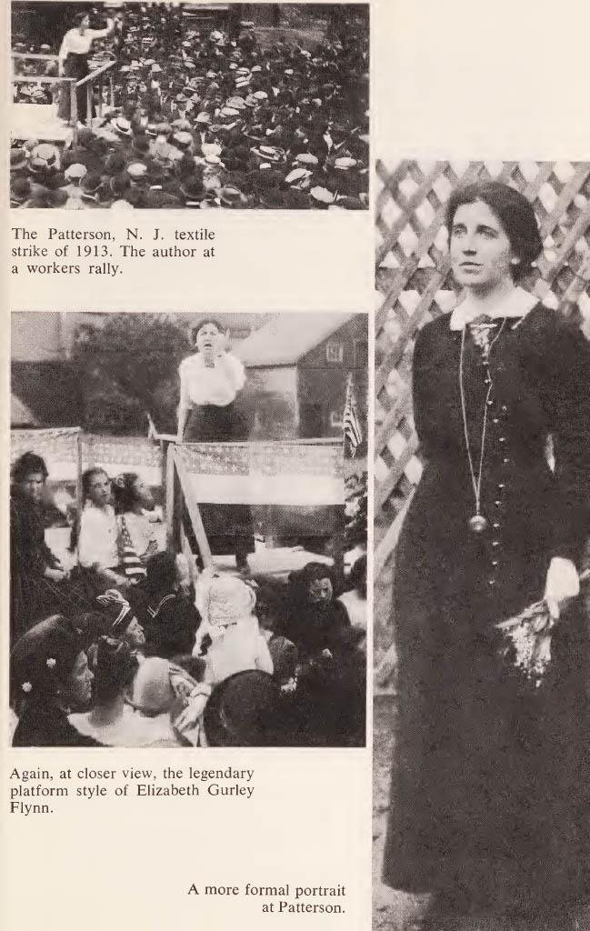
The Paterson Silk Strike
Flynn at a workers rally
Another view of the previous image

Slide 36
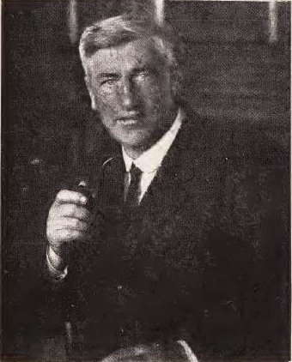
The IWW, 1912-1914
Foster had showed such exceptional organizational ability and skill in negotiations in the Spokane free speech fight that it attracted the attention of Vincent St. John. In 1910, with $100 for expenses and the Saint’s blessing. While the two great IWW textile strikes were taking place in Lawrence and Paterson, and we were involved in the aftermath defense of strike leaders in both places, the IWW was busy elsewhere. I was in Seattle in 1943, to speak on May Day. In 1913, a tense struggle developed over the right of Mexican and American workers to join the Mexican revolution. American troops patrolled the border to prevent Mexicans from escaping as political refugees or getting any aid from here. Hundreds were turned back to Mexico and certain persecution or death. The winter of 1913-1914 was a long one. Unemployment had struck America. After the Paterson strike I had a long siege with chronic bronchitis, which I could not shake off. One day in the Spring of 1914 a knock [from the visiting Jim Larrkin] came on our door at 511 East 134th Street in the Bronx.
Jim Larkin, the Irish revolutionary leader, 1924

Slide 37
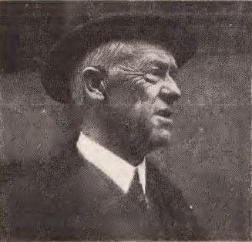
The IWW, 1912-1914
When Spring came in 1913 the army of the unemployed melted with the snows. By 1914 I had been in daily contact with workers and their struggles for eight years. The outstanding event on [one trip] was my visit to Joe Hill in the County Jail in Salt Lake City. At the time that war was declared in Europe in 1914 there was a strong anti-war feeling in this country which grew during the next three years. In 1915, ten years after the IWW came into existence, there began to develop a self-critical attitude in the organization. Articles appeared on “Why doesn’t the IWW Grow?” There was criticism of the German Socialists who had capitulated to their country’s war program. Vincent St. John came to Chicago in 1907 after he had been shot in Goldfield. He felt frustrated and dissatisfied because permanent organization failed to materialize from all of these heroic efforts. No strike passed in those days without bloodshed, caused by vicious attacks on strikers. Haywood refused to come to the Range to discuss our problems or to speak to the strikers.
Judge O. N. Hilton, courageous defender of Joe Hill, 1914

Slide 38
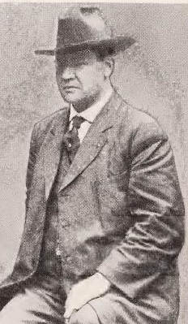
The IWW, 1912-1914
From the extreme of anarchistic decentralization, from which the IWW had long suffered, Haywood began now to develop a degree of bureaucratic centralism that was equally dangerous. I stuck for a while longer, determined to prove to my fellow-workers that my loyalty and devotion could not be shaken by my relations with Haywood. But it wasn’t easy, and became increasingly difficult in the next few years after 1916.
Haywood

Slide 39
Clara Zetkin and Lenin on the Woman Question by Clara Zetkin

Slide 40
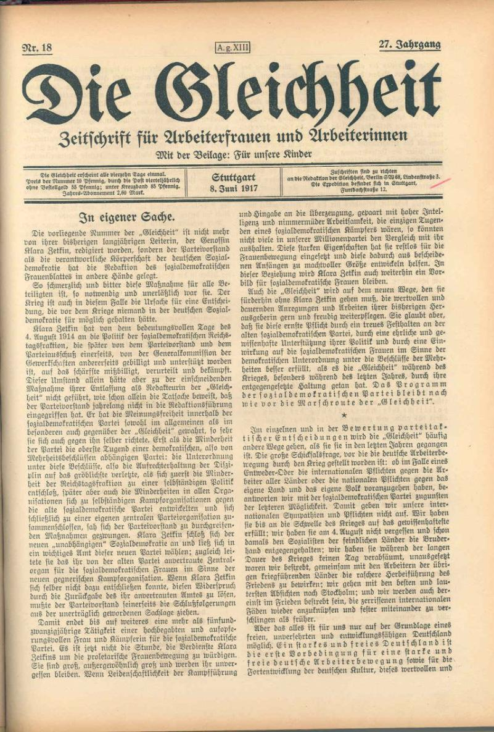
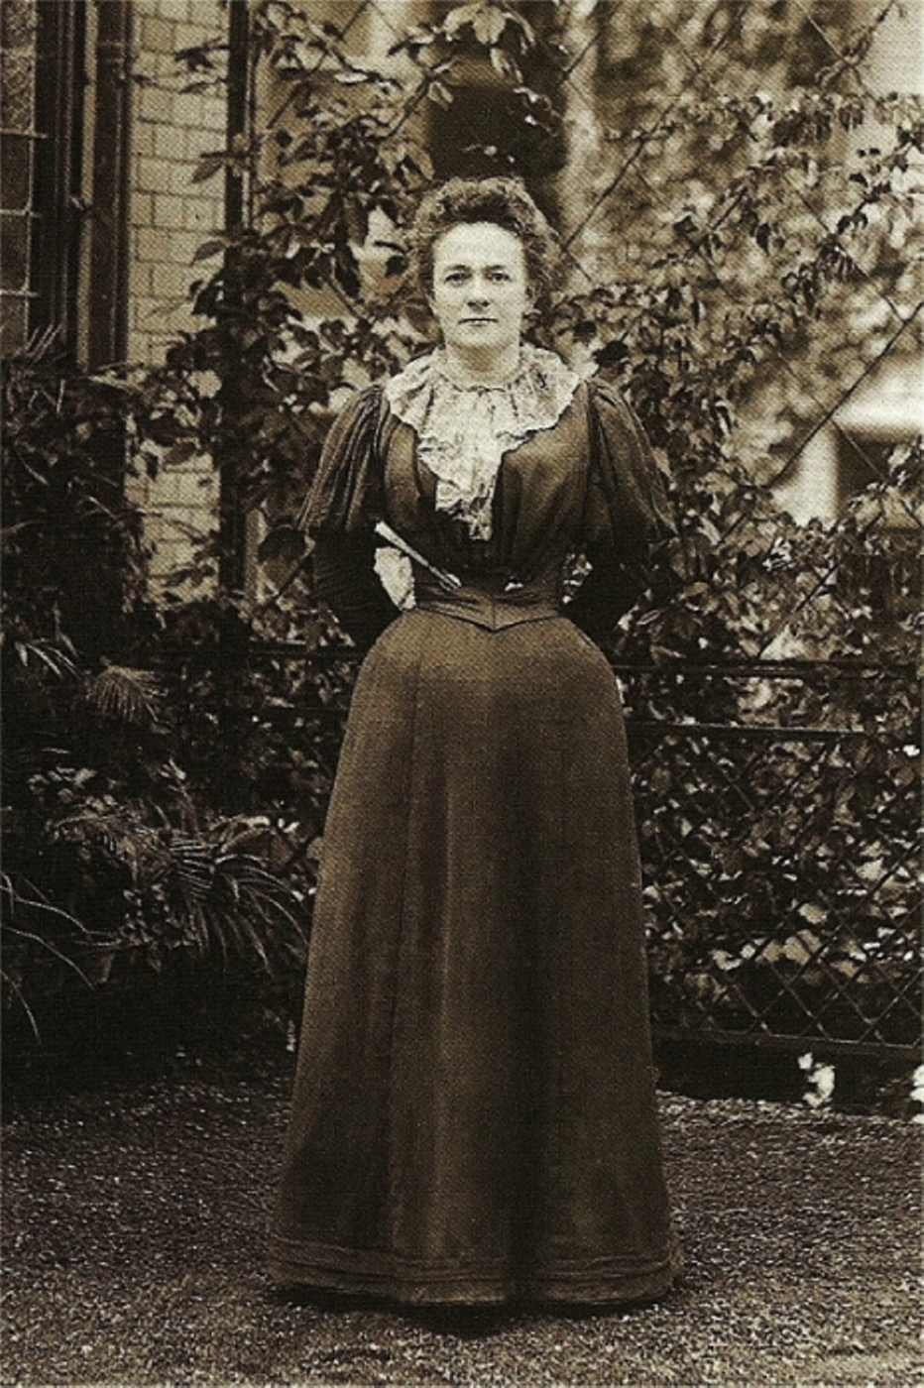
Clara Zetkin July 5 1857 – June 20 1933
German Marxist theorist, Communist activist and Women's Rights Advocate
Zetkin developed connections with the women's movement and the labour movement in Germany from 1874. In 1878 she joined the Socialist Workers' Party (Sozialistische Arbeiterpartei, SAP)
Around 1880, due to the political climate in Germany, Zetkin went into exile in Switzerland and later in France. After returning to Germany a decade later, she became the editor of the Social Democratic Party of Germany's newspaper for women, Die Gleichheit (Equality), a post that she occupied for 25 years.
Zetkin was deeply opposed to the concept of "bourgeois feminism," which she claimed was a tool to divide the unity of the working classes.

Slide 41
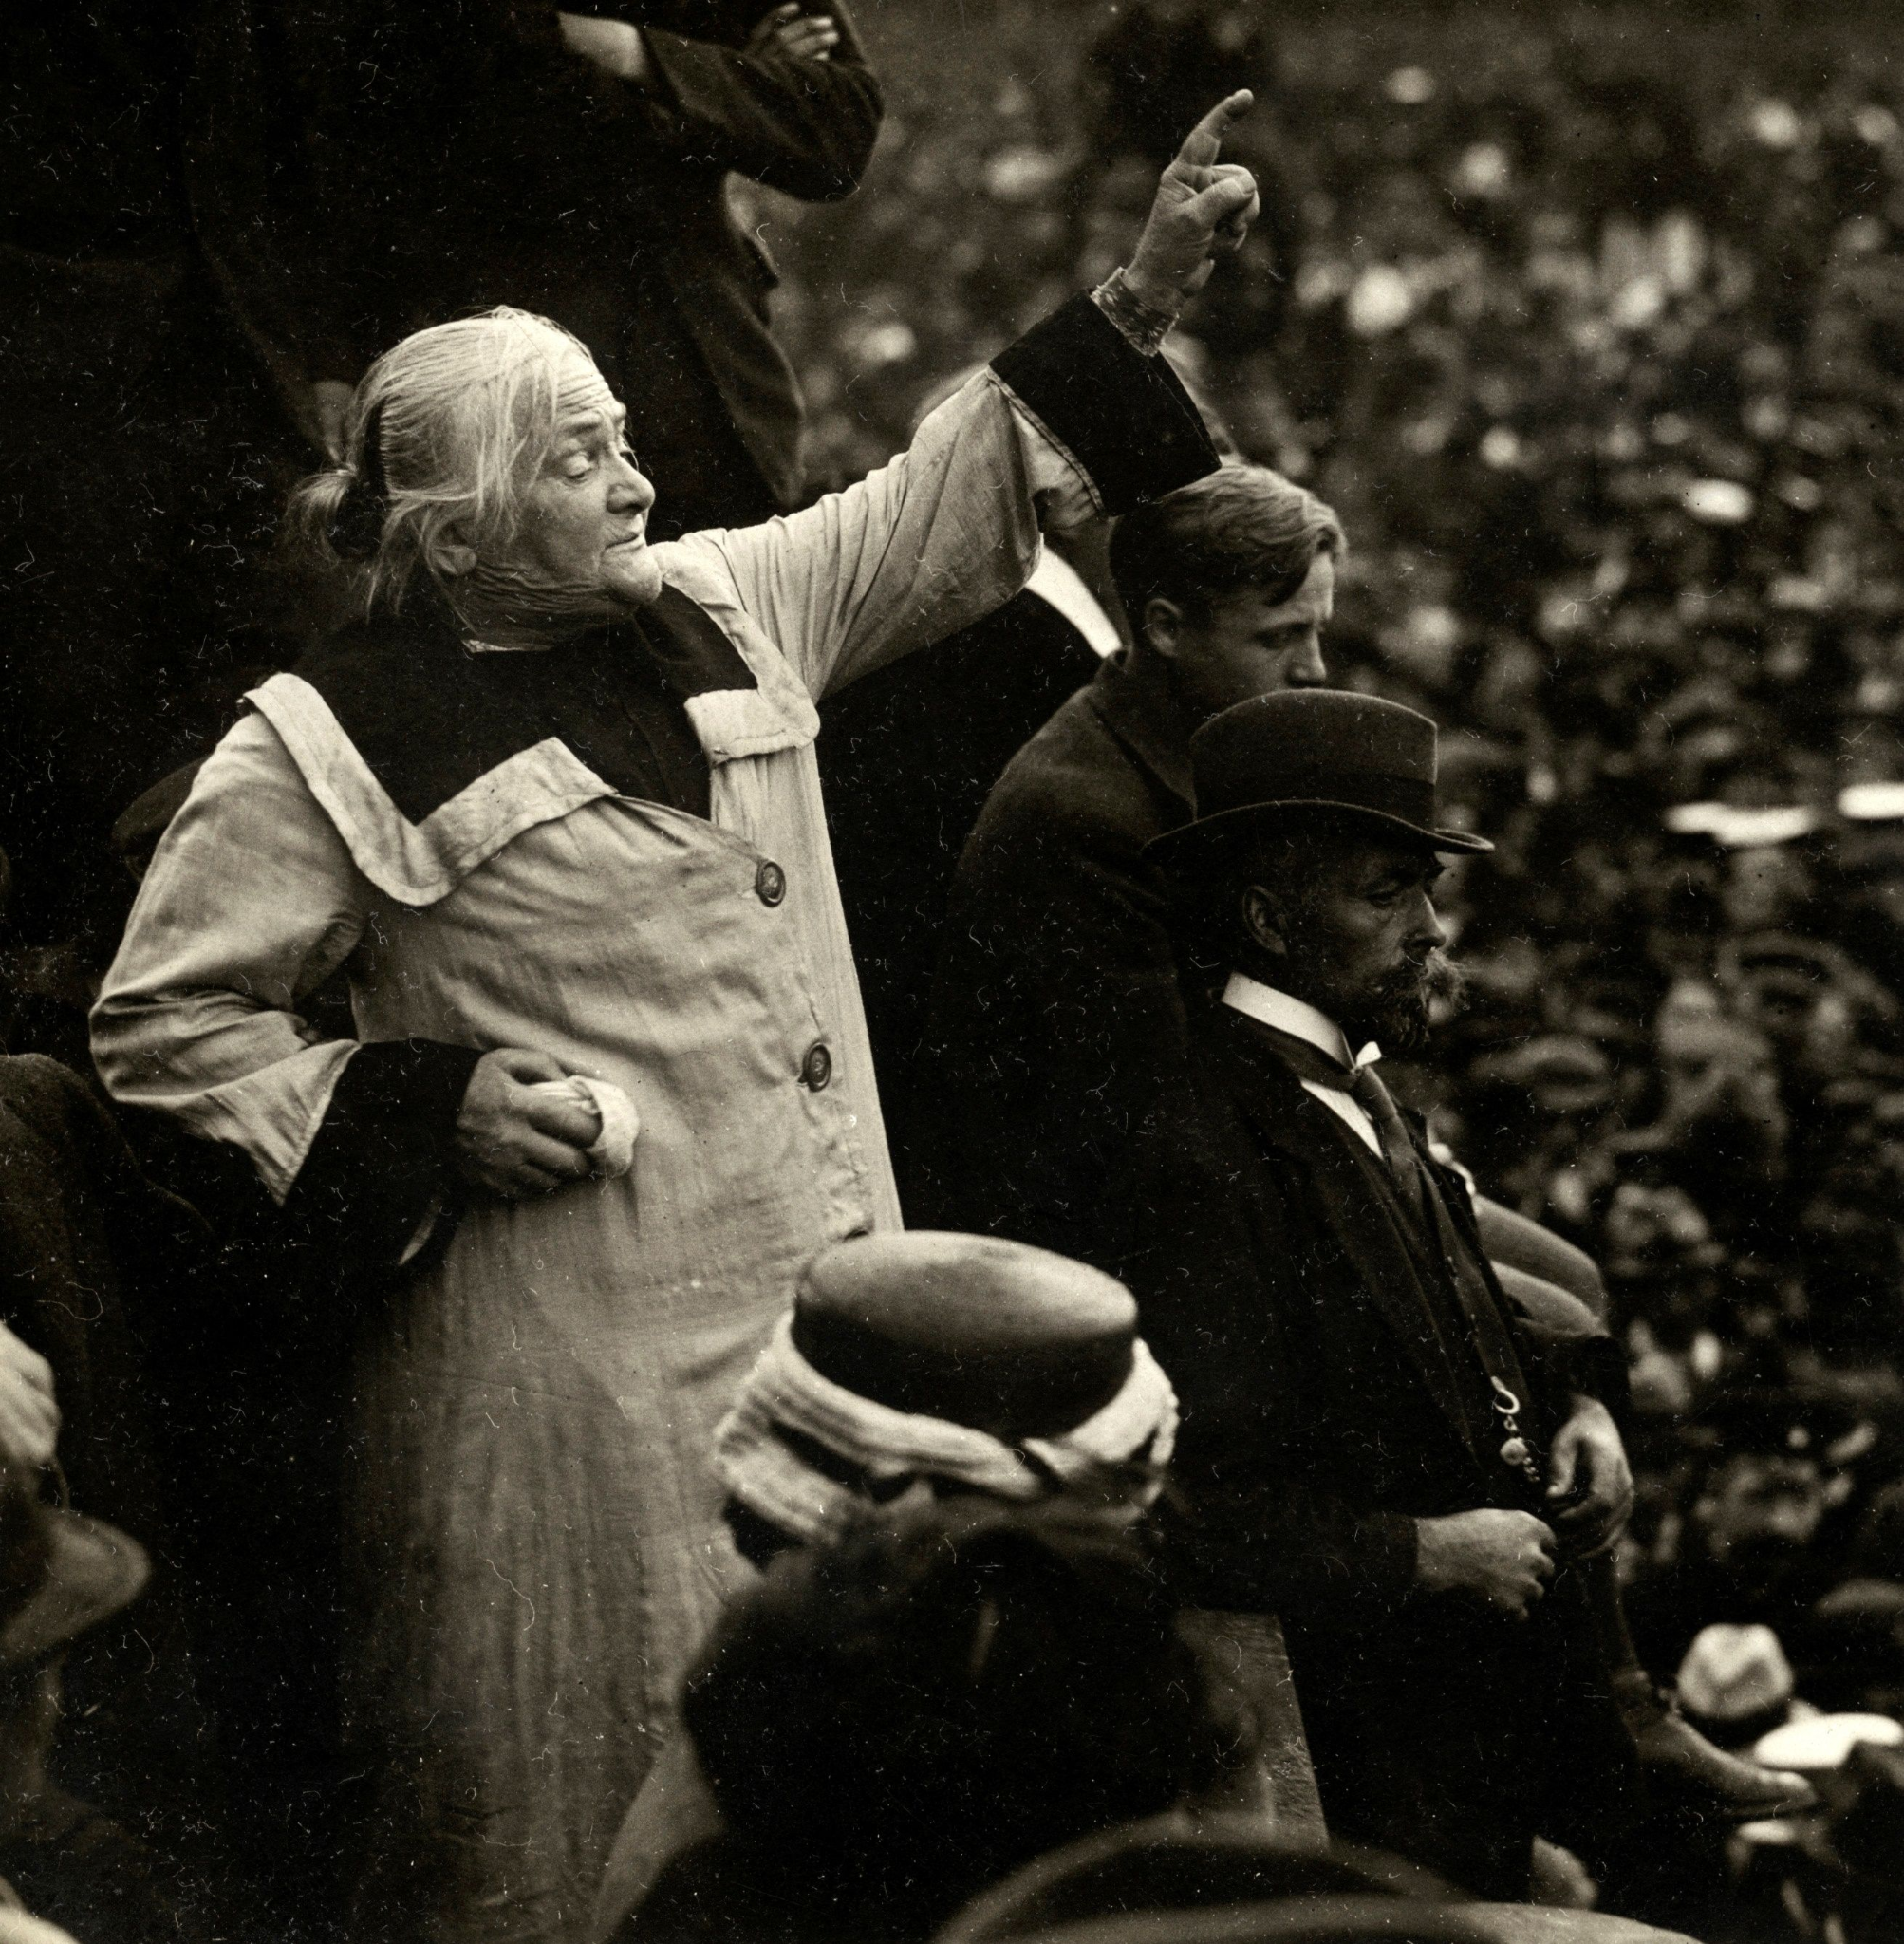
Clara Zetkin July 5 1857 – June 20 1933
German Marxist theorist,Communist activist and Women's Rights Advocate
In a speech that she delivered to the Second International in 1889, she stated:
“The working women, who aspire to social equality, expect nothing for their emancipation from the bourgeois women's movement, which allegedly fights for the rights of women. That edifice is built on sand and has no real basis. Working women are absolutely convinced that the question of the emancipation of women is not an isolated question which exists in itself, but part of the great social question. They realize perfectly clear that this question can never be solved in contemporary society, but only after a complete social transformation.”
Zetkin’s critique of the feminist movement was that it lacked class-consciousness, being primarily composed of upper and middle-class women whose own class interests were incompatible with the interests of
working-class women. Thus, feminism and the socialist fight for women's rights were incompatible.
For Zetkin, socialism was the only way to truly end the oppression of women. She advocated to get women out of the house and into work to participate in trade unions.
She interviewed Vladimir Lenin on "The Women's Question" in 1920

Slide 42
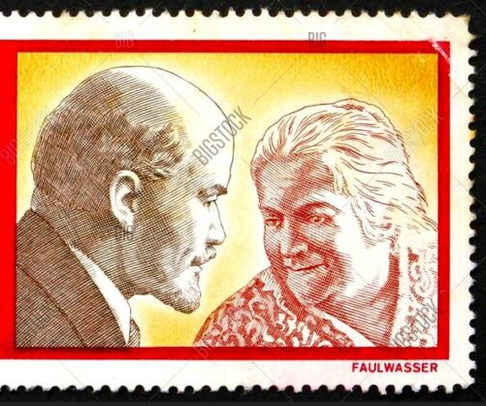
A Historic Meeting of the Minds
Clara Zetkin met with Lenin in the autumn of 1920 and recorded their discussion. Lenin’s remarks show that he respected Zetkin and treated her as a comrade and not an inferior. He spoke with the familiarity of a friend and mentor. It is clear that he valued her efforts regarding women’s place in society while offering his opinion on how that work should proceed and her role in that work. Of the conversations, Zetkin wrote: “Comrade Lenin repeatedly discussed with me the problem of women’s rights. He obviously attached great importance to the women’s movement, which was to him an essential component of the mass movement that in certain circumstances might become decisive. Needless to say, he saw full social equality of women as a principle which no Communist could dispute.”
Vladimir Lenin and Clara Zetkin Depicted On German Stamp.

Slide 43
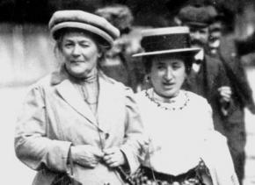
Excerpts from Lenin On the Women’s Question
It was in Lenin’s large study in the Kremlin in the autumn of 1920 that we had our first long conversation on the subject.
“We must create a powerful international women’s movement, on a clear theoretical basis”, Lenin began. “There is no good practice without Marxist theory, that is clear. The greatest clarity of principle is necessary for us communists in this question. There must be a sharp distinction between ourselves and all other Parties. Unfortunately, our Second World Congress did not deal with this question. It was brought forward, but no decision arrived at. The matter is still in commission, which should draw up a resolution, theses, directions. Up to the present, however, they haven’t got very far. You will have to help.”
I was already acquainted with what Lenin said and expressed my astonishment at the state of affairs. I was filled with enthusiasm about the work done by Russian women in the revolution and still being done by them in its defence and further development. And as for the position and activities of women comrades in the Bolshevik Party, that seemed to me a model Party. It alone formed an international communist women’s movement of useful, trained and experienced forces and a historical example.
Clara Zetkin (left) alongside Rosa Luxemburg

Slide 44
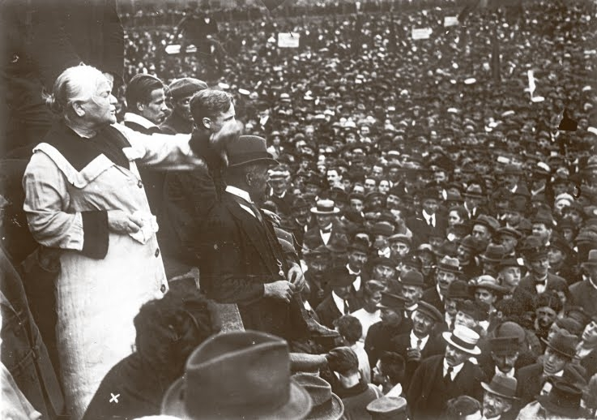
Movement of Working Women
“That is right, that is all very true and fine”, said Lenin, with a quiet smile. “In Petrograd, here in Moscow, in other towns and industrial centres the women workers acted splendidly during the revolution. Without them we should not have been victorious. Or scarcely so. That is my opinion. How brave they were, how brave they still are! Think of all the suffering and deprivations they bore. And they are carrying on because they want freedom, want communism. Yes, our proletarian women are excellent class fighters. They deserve admiration and love. We have in the Party reliable, capable and untiringly active women comrades. We can assign them to many important posts in the Soviet and Executive Committees, in the People’s Commissariats and public services of every kind.
Clara Zetkin with Wilhelm Pieck, speaking at a political rally, November 1918
Many of them work day and night in the Party or among the masses of the proletariat, the peasants, the Red Army. That is of very great value to us. It is also important for women all over the world. It shows the capacity of women, the great value their work has in society. The first proletarian dictatorship is a real pioneer in establishing social equality for women. It is clearing away more prejudices than could volumes of feminist literature.”

Slide 45
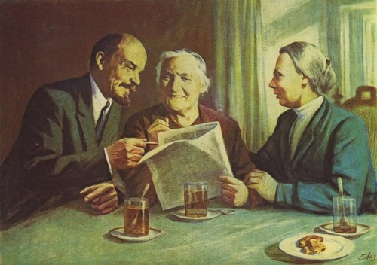
Sex and Marriage
Before I could answer, Lenin continued: “Your list of sins, Clara, is still longer. I was told that questions of sex and marriage are the main subjects dealt with in the reading and discussion evenings of women comrades. They are the chief subject of interest, of political instruction and education. I could scarcely believe my ears when I heard it. The first country of proletarian dictatorship surrounded by the counter-revolutionaries of the whole world, the situation in Germany itself requires the greatest possible concentration of all proletarian, revolutionary forces to defeat the ever-growing and ever-increasing counter-revolution. But working women comrades discuss sexual problems and the question of forms of marriage in the past, present and future. They think it their most important duty to enlighten proletarian women on these subjects.
Vladimir Lenin and Clara Zetkin
The extension of Freudian hypotheses seems ‘educated’, even scientific, but it is ignorant, bungling. Freudian theory is the modern fashion. I mistrust the sexual theories of the articles, dissertations, pamphlets, etc., in short, of that particular kind of literature which flourishes luxuriantly in the dirty soil of bourgeois society. However wild and revolutionary the behaviour may be, it is still really quite bourgeois. It is, mainly, a hobby of the intellectuals and of the sections nearest them. There is no place for it in the Party, in the class-conscious, fighting proletariat.”

Slide 46
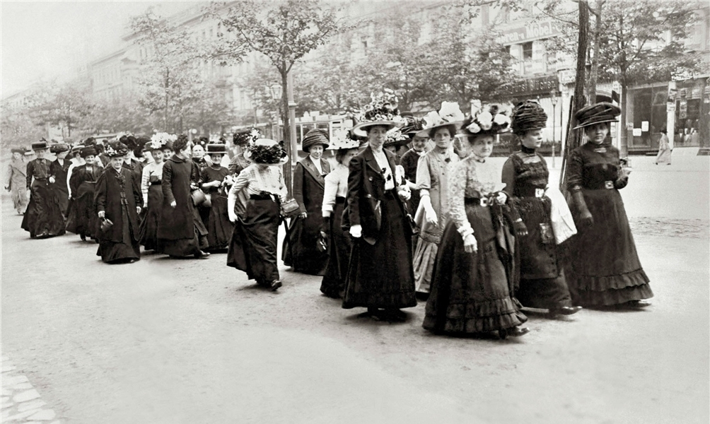
Sex and Marriage Cont.
I interrupted here, saying that the questions of sex and marriage, in a bourgeois society of private property, involve many problems, conflicts and much suffering for women of all social classes and ranks. The war and its consequences had greatly accentuated the conflicts and sufferings of women in sexual matters, had brought to light problems which were formerly hidden from them. To that were added the effects of the revolution. The old world of feeling and thought had begun to totter. Old social ties are entangling and breaking, there are the tendencies towards new ideological relationships between man and woman. The interest shown in these questions is an expression of the need for enlightenment and reorientation. It also indicates a reaction against the falseness and hypocrisy of bourgeois society.
The first International Women's Day was celebrated in March 1911 in Denmark, Germany, Austria-Hungary and Switzerland
Forms of marriage and of the family, in their historical development and dependence upon economic life, are calculated to destroy the superstition existing in the minds of working women concerning the eternal character of bourgeois society. A critical, historical attitude to those problems must lead to a ruthless examination of bourgeois society, to a disclosure of its real nature and effects, including condemnation of its sexual morality and falseness. Every real Marxist analysis of any important section of the ideological superstructure of society, must lead to an analysis of bourgeois society and of its property basis, must end in the realisation, “this must be destroyed”.

Slide 47
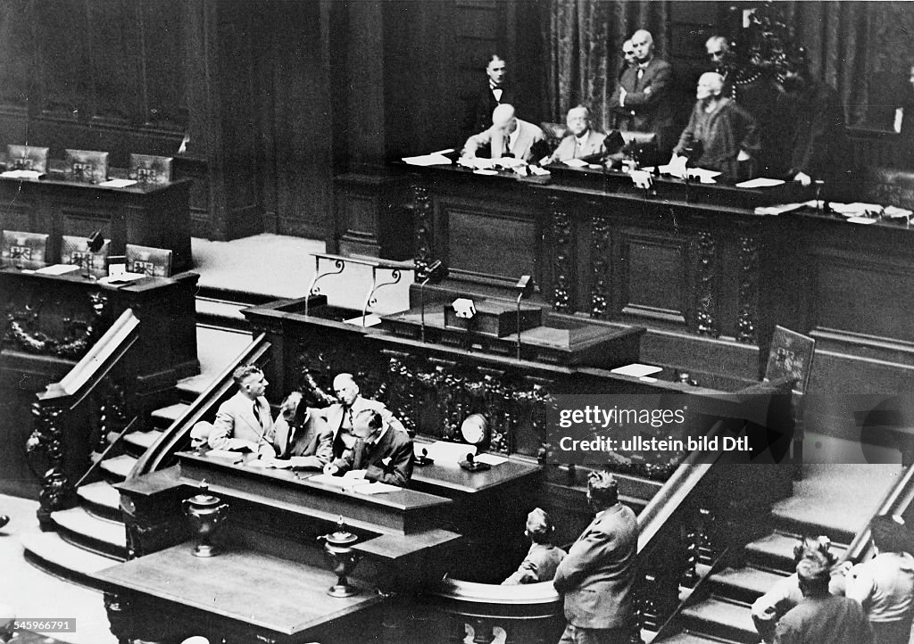
Sex and Marriage Cont
Lenin nodded laughingly. “There we have it! You are defending counsel for your women comrades and your Party. Of course, what you say is right. But it only excuses the mistakes made in Germany; it does not justify them. They are, and remain, mistakes. Can you really seriously assure me that the questions of sex and marriage were discussed from the standpoint of a mature, living, historical materialism? Deep and many-sided knowledge is necessary for that, the dearest Marxist mastery of a great amount of material. Where can you get the forces for that now? If they existed, then pamphlets like the one I mentioned would not be used as material for study in the reading and discussion circles. They are distributed and recommended, instead of being criticised. And what is the result of this futile, un-Marxist dealing with the question? That questions of sex and marriage are understood not as part of the large social question? No, worse! The great social question appears as an adjunct, a part, of sexual problems. The main thing becomes a subsidiary matter. That not only endangers clarity on that question itself, it muddles the thoughts, the class-consciousness of proletarian women generally.
Clara Zetkin first entered the Reichstag as a KPD representative on June 24, 1920

Slide 48
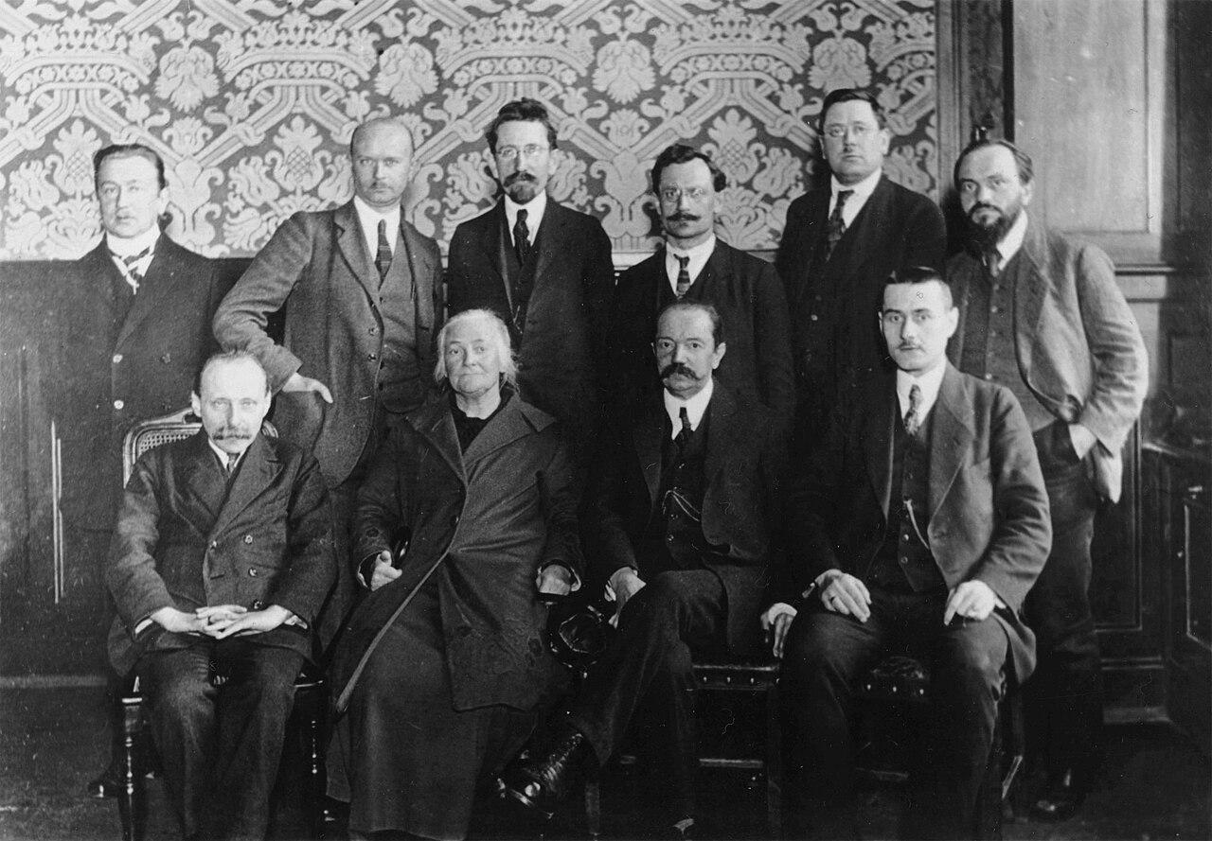
Sexual Morality
I have not failed to criticise and remonstrate with leading women comrades in the separate districts, I told him. By my criticism I had laid myself open to the charge of “strong survivals of social democratic ideology and old-fashioned philistinism.”
“I know, I know”, he said. “I have also been accused by many people of philistinism in this matter, although that is repulsive to me. There is so much hypocrisy and narrow-mindedness in it. Well, I’m bearing it calmly! The little yellow-beaked birds who have just broken from the egg of bourgeois ideas are always frightfully clever. We shall have to let that go. The youth movement, too, is attacked with the disease of modernity in its attitude towards sexual questions and in being exaggeratedly concerned with them.”
Members of the Reichstag faction of the KPD c. 1921
Lenin gave an ironic emphasis to the word modernity and grimaced as he did so. “I have been told that sexual questions are the favourite study of your youth organisations, too. There is supposed to be a lack of sufficient speakers on the subject. Such misconceptions are particularly harmful, particularly dangerous in the youth movement. They can very easily contribute towards over-excitement and exaggeration in the sexual life of some of them, to a waste of youthful health and strength. You must fight against that, too. There are not a few points of contact between the women’s and youth movements. Our women comrades must work together systematically with the youth.

Slide 49
Sexual Morality Cont.
“With us, too, a large part of the youth is keen on ‘revising bourgeois conceptions and morality’ concerning sexual questions. What you said before is true. In the conditions created by the war and the revolution the old ideological values disappeared or lost their binding force. The new values are crystallising slowly, in struggle. In relations between man and man, between man and woman, feelings and thoughts are becoming revolutionised. New boundaries are being set up between the rights of the individual and the rights of the whole, in the duties of individuals. It is a slow and often a very painful process of decay and growth. And particularly in the sphere of sexual relationships, of marriage and the family. The decay, the corruption, the filth of bourgeois marriage, with its difficult divorce, its freedom for the man, its enslavement for the woman, the repulsive hypocrisy of sexual morality and relations fill the most active minded and best people with deep disgust. People are beginning to protest against the prevailing rottenness and falseness, and the feelings of an individual change rapidly. The desire and urge to enjoyment easily attain unbridled force at a time when powerful empires are tottering, old forms of rule breaking down, when a whole social world is beginning to disappear. Sex and marriage forms, in their bourgeois sense, are unsatisfactory. A revolution in sex and marriage is approaching, corresponding to the proletarian revolution. The changed attitude of the young people to questions of sexual life is of course based on a ‘principle’ and a theory. Many of them call their attitude ‘revolutionary’ and ‘communist’. That does not impress us old people. The so-called ‘new sexual life’ of the youth – and sometimes of the old – often seems to me to be purely bourgeois, an extension of bourgeois brothels. That has nothing whatever in common with freedom of love as we communists understand it

Slide 50
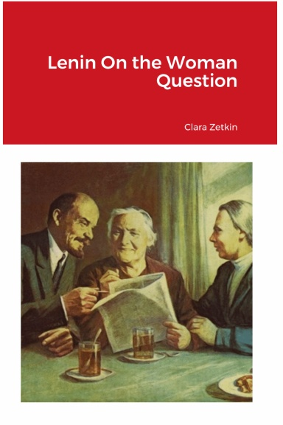
Principles of Organisation
Lenin glanced at the clock. “You have drawn up proposals for communist work among women What sort of proposals have you in mind?”
I gave a concise account of them. Lenin nodded repeatedly in agreement without interrupting me.
“Agreed”, said he. “I only want to dwell on a few main points, in which I fully share your attitude. The thesis must clearly point out that real freedom for women is possible only through communism. The inseparable connection between the social and human position of the woman, and private property in the means of production, must be strongly brought out. That will draw a clear and ineradicable line of distinction between our policy and feminism. And it will also supply the basis for regarding the woman question as a part of the social question, of the workers’ problem, and so bind it firmly to the proletarian class struggle and the revolution.

Slide 51
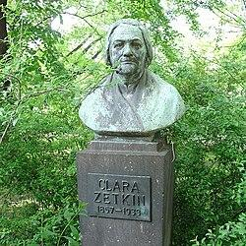
There can be no difference of opinion
The communist women’s movement must itself be a mass movement, a part of the general mass movement. Not only of the proletariat, but of all the exploited and oppressed, all the victims of capitalism or any other mastery. In that lies its significance for the class struggles of the proletariat and for its historical creation, communist society. We can rightly be proud of the fact that in the Party, in the Communist International, we have the flower of revolutionary woman kind. But that is not enough. We must win over to our side the millions of working women in the towns and villages. Win them for our struggles and in particular for the communist transformation of society. There can be no real mass movement without women. Our ideological conceptions give rise to principles of organisation. No special organisations for women.
Memorial bust of Clara Zetkin in Dresden
A woman communist is a member of the Party just as a man communist, with equal rights and duties. There can be no difference of opinion on that score. Nevertheless, we must not close our eyes to the fact that the Party must have bodies, working groups, commissions, committees, bureaus or whatever you like, whose particular duty it is to arouse the masses of women workers, to bring them into contact with the Party, and to keep them under Its influence. That involves systematic work among them. We must train those whom we arouse and win, and equip them for the proletarian class struggle under the leadership of the Party.

Slide 52
Discussion & Wrap Up

Slide 53
Announcements
PCUSA Cell Chairs need to call members of their cells to remind them about attendance.
The next issue of New Masses (2026) has begun production. If you have art you want us to feature, email it to info@partyofcommunistsusa.net.

Slide 54
Volunteers Needed!
We are in need of volunteers for the staff of the People’s School! Here’s a few roles we need filled:
People to help manage posting on our social media and podcast platforms
Video Editors, Audio Editors, Graphic Designers, Artists, Narrators
Facilitators, Web Controls, Moderators
Email info@peoplesschool.us if you’re interested and try to attend our next staff meeting April 5, 2026 if possible.

Slide 55

View From Left Field
https://viewfromleftfield.libsyn.com
The Old PSMLS Youtube is now the Youtube of View From Left Field, a podcast of analysis and discussion of current events from a progressive perspective.
Like the Youtube videos and subscribe with 5 star ratings on your podcast platforms.

Slide 56

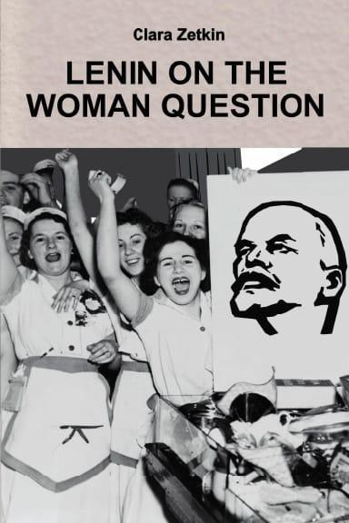


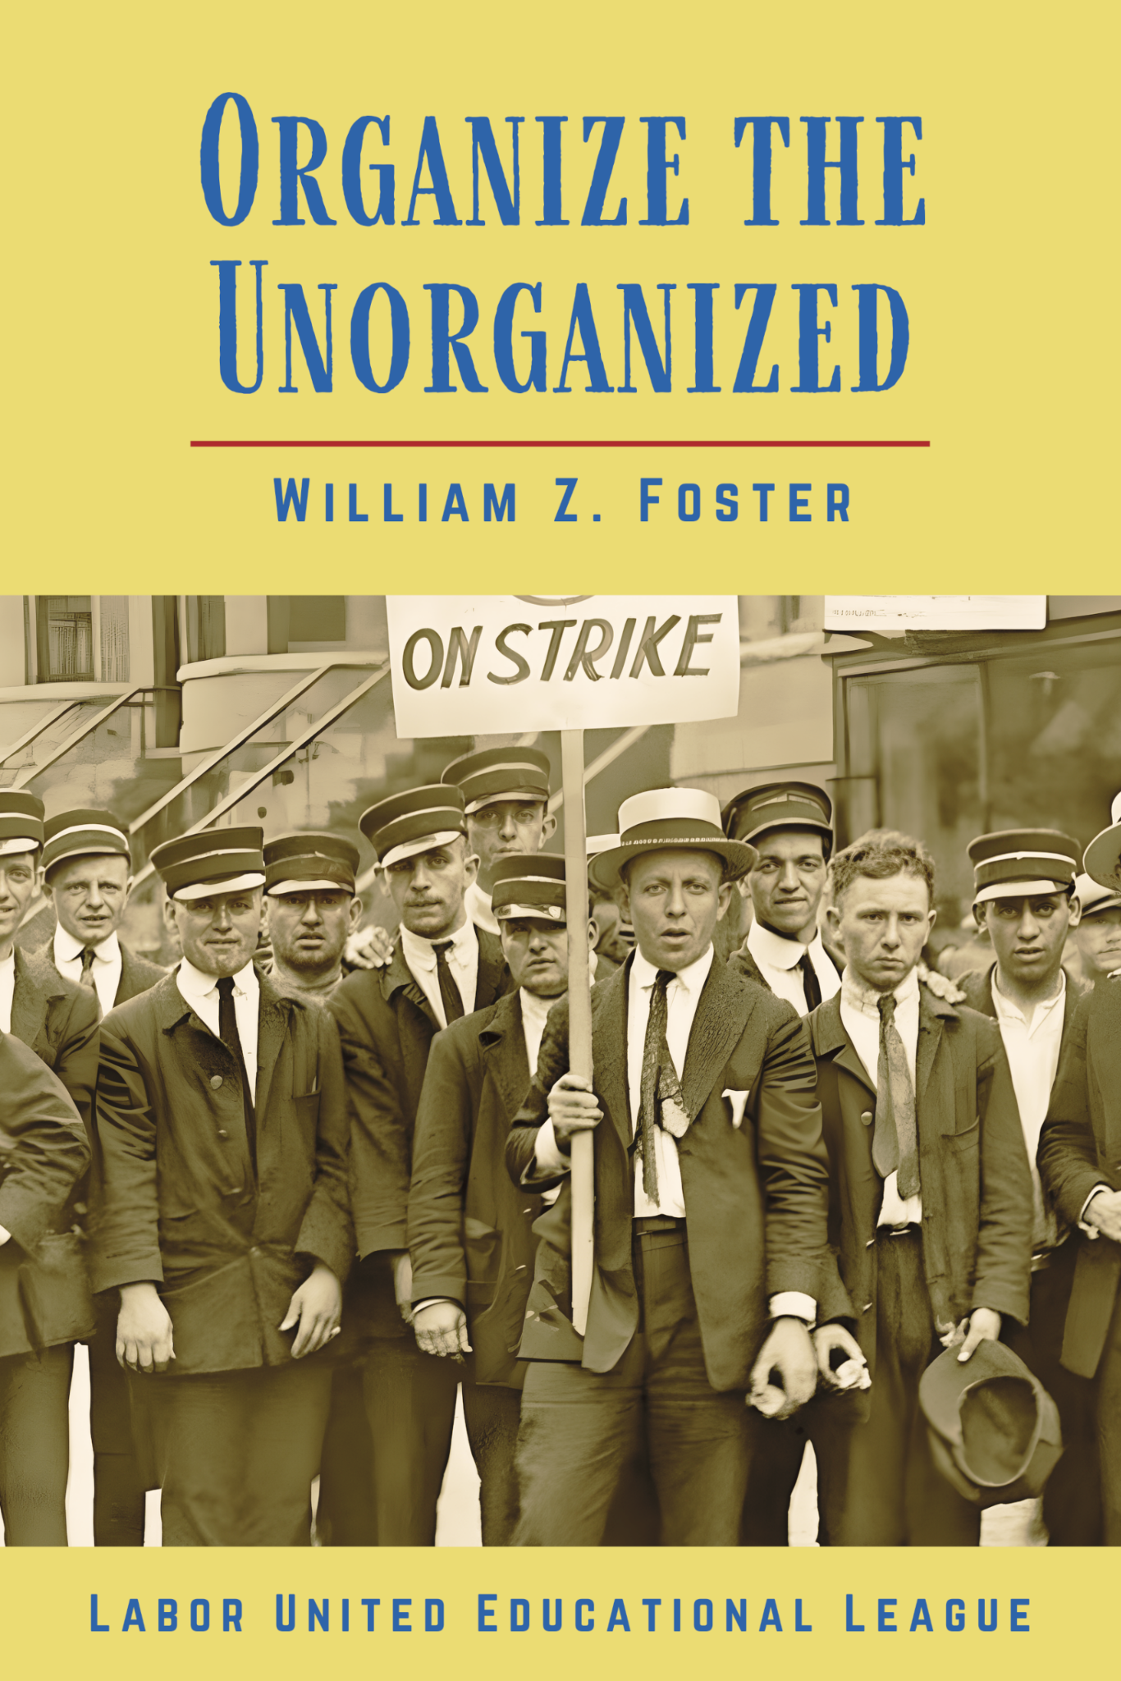
New Outlook Publishers
newoutlookpublishers.store
Relevant and Latest Releases

Slide 57


Harry Bridges School of Labor
luel.us/laborschool/
The Harry Bridges School of Labor is a monthly class held 2x per month. Classes cover a variety of topics aimed at building class conscious among union members.
Please visit luel.us/laborschool/ for the current class list.

Slide 58
Rebel Girl by Joe Hill

