Slide 1
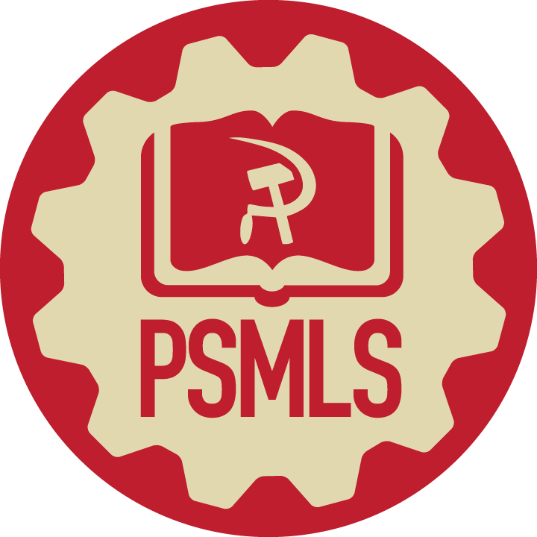

"US Embassy" - American Anti-Imperialist Song by David Rovics

Slide 2
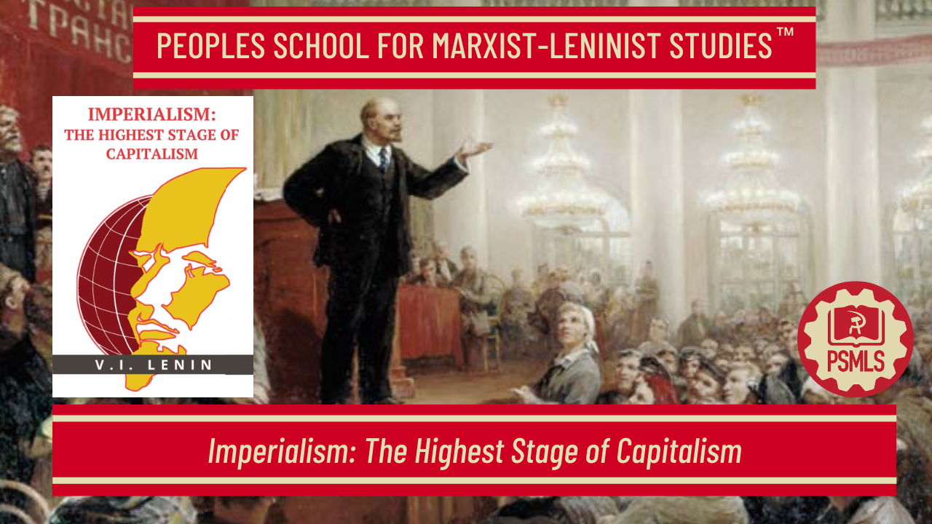
PSMLS 4/14/2026

Slide 3
What we’ll be learning today:
Chapters I – IV
Chapters V – X
Imperialism Today (1972) by Gus Hall

Slide 4
Section 1 - Chapters I – IV

Slide 5
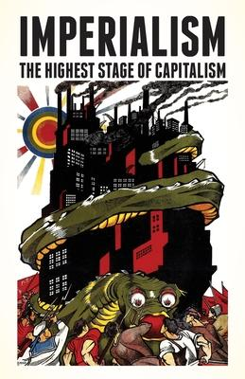
Capitalism as a World System of Colonial Oppression
The building of railways seems to be a simple, natural, democratic, cultural and civilising enterprise; that is what it is in the opinion of the bourgeois professors who are paid to depict capitalist slavery in bright colors, and in the opinion of petty-bourgeois philistines. But as a matter of fact the capitalist threads, which in thousands of different intercrossings bind these enterprises with private property in the means of production in general, have converted this railway construction into an instrument for oppressing a billion people in the colonies and semi colonies, that is, more than half the population of the globe that inhabits the dependent countries, as well as the wage-slaves of capital in the “civilized” countries. Private property based on the labour of the small proprietor, free competition, democracy, all the catchwords with which the capitalists and their press deceive the workers and the peasants are things of the distant past. Capitalism has grown into a world system of colonial oppression and of the financial strangulation of the overwhelming majority of the population of the world by a handful of “advanced” countries. And this “booty” is shared between two or three powerful world plunderers armed to the teeth (America, Great Britain, Japan), who are drawing the whole world into their war over the division of their booty.

Slide 6
What is the Labor Aristocracy?
As this pamphlet shows, capitalism has now singled out a handful of exceptionally rich and powerful states which plunder the whole world simply by “clipping coupons”. As a result of their enormous superprofits (since they are obtained over and above the profits which capitalists squeeze out of the workers of their “own” country) it is possible to bribe the labour leaders and the upper stratum of the labour aristocracy. And that is just what the capitalists of the “advanced” countries are doing: they are bribing them in a thousand different ways, direct and indirect, overt and covert. This stratum of workers-turned-bourgeois, or the labour aristocracy, who are quite philistine in their mode of life, in the size of their earnings and in their entire outlook, is the principal prop of the Second International, and in our days, the principal social (not military) prop of the bourgeoisie. For they are the real agents of the bourgeoisie in the working-class movement, the labour lieutenants of the capitalist class, real vehicles of reformism and chauvinism. In the civil war between the proletariat and the bourgeoisie they inevitably, and in no small numbers, take the side of the bourgeoisie. Unless the economic roots of this phenomenon are understood and its political and social significance is appreciated, not a step can be taken toward the solution of the practical problem of the communist movement and of the impending social revolution.

Slide 7
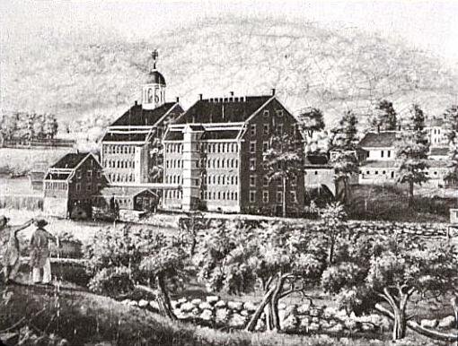
The Law of Concentration of Capital
American statistics speak of 3,000 giant enterprises in 250 branches of industry, as if there were only a dozen enterprises of the largest scale for each branch of industry. But this is not the case. Not in every branch of industry are there large-scale enterprises; and moreover, a very important feature of capitalism in its highest stage of development is so-called combination of production, that is to say, the grouping in a single enterprise of different branches of industry, which either represent the consecutive stages in the processing of raw materials (for example, the smelting of iron ore into pig-iron, the conversion of pig-iron into steel, and then, perhaps, the manufacture of steel goods)—or are auxiliary to one another (for example, the utilisation of scrap, or of by-products, the manufacture of packing materials, etc.). “Combination,” writes a bourgeois economist, “first of all, levels out the fluctuations of trade and therefore assures to the combined enterprises a more stable rate of profit. Secondly, combination has the effect of eliminating trade. Thirdly, it has the effect of rendering possible technical improvements, and, consequently, the acquisition of superprofits over and above those obtained by the ‘pure’ (i.e, non-combined) enterprises.”
The Waltham Textile Mill illustrates an early use of a “vertically integrated system” -Spinning, weaving, dyeing, and cutting were completed in a single plant

Slide 8
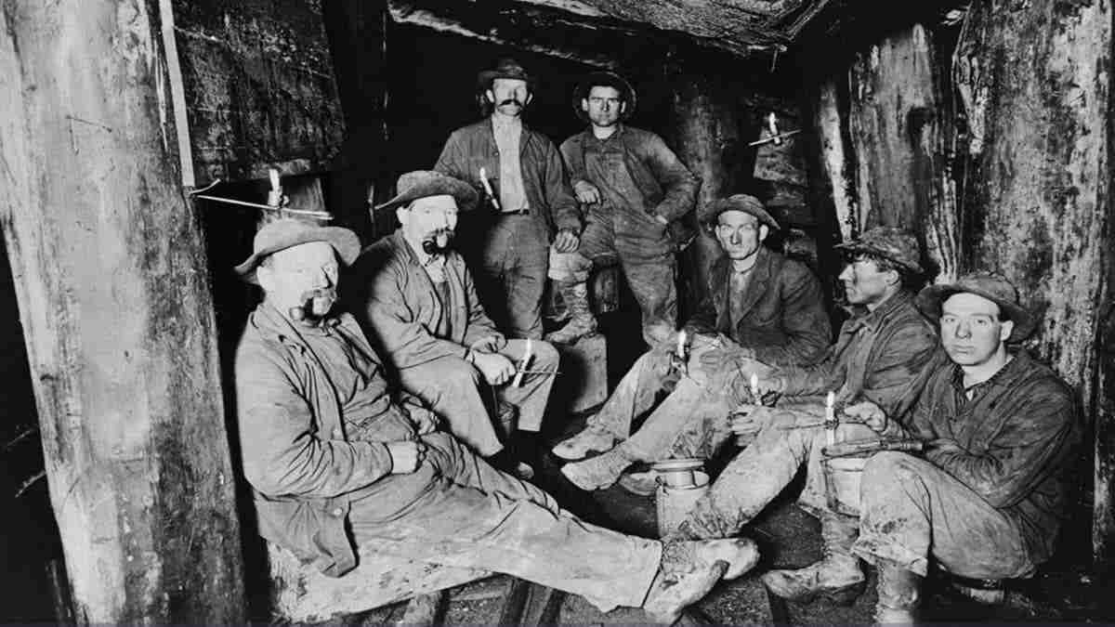
Concentration Goes on Further and Further
Concentration strengthens the position of the combined enterprises relative to the ‘pure’ enterprises. It strengthens them in the competitive struggle in periods of serious depression, when the fall in prices of raw materials does not keep pace with the fall in prices of manufactured goods.” In the words of another bourgeois Economist: “Pure enterprises perish, they are crushed between the high price of raw material and the low price of the finished product.” Thus we get the following picture: “There remain, on the one hand, the big coal companies, producing millions of tons yearly, strongly organized in their coal syndicate, and on the other, the big steel plants, closely allied to the coal mines, having their own steel syndicate. And concentration goes on further and further. Individual enterprises are becoming larger and larger. An ever-increasing number of enterprises in one, or in several different industries, join together in giant enterprises, backed up and directed by half a dozen big banks. In relation to the German mining industry, the truth of the teachings of Karl Marx on concentration is definitely proved; true, this applies even to a country where industry is protected by tariffs and freight rates.

Slide 9
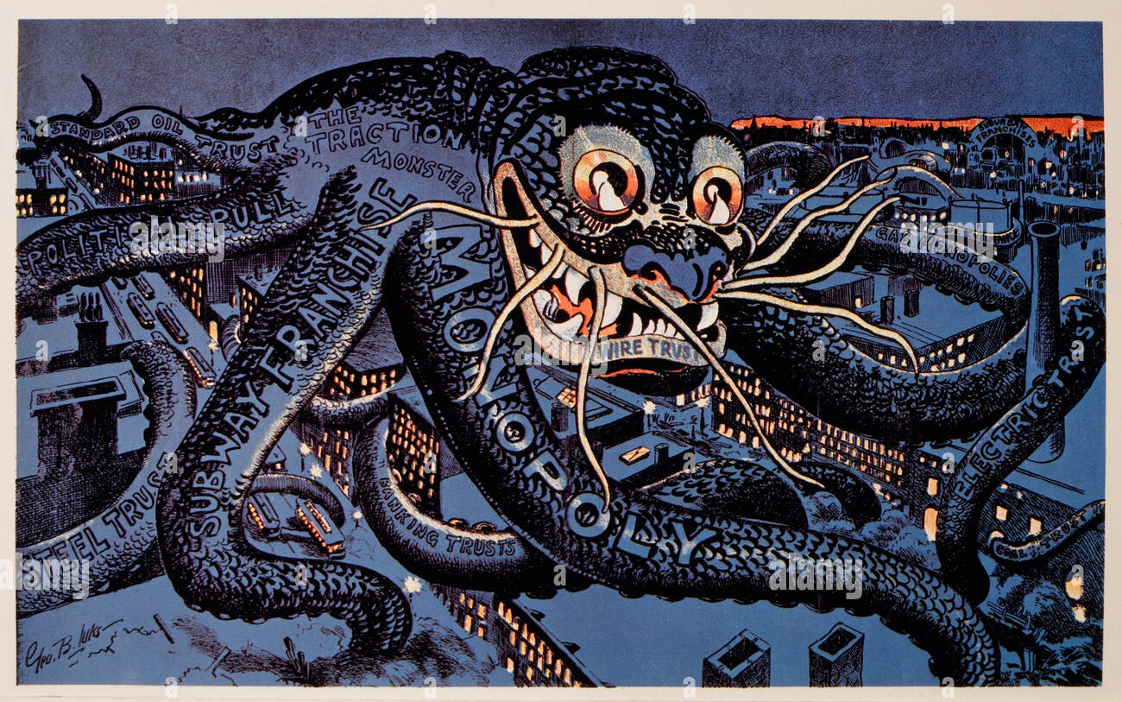
Capitalism Leads to Socialized Production
Competition becomes transformed into monopoly. The result is immense progress in the socialization of production. In particular, the process of technical invention and improvement becomes socialized. This is something quite different from the old free competition between manufacturers, scattered and out of touch with one another, and producing for an unknown market. Concentration has reached the point at which it is possible to make an approximate estimate of all sources of raw materials (for example, the iron ore deposits) of a country and even, as we shall see, of several countries, or of the whole world. Not only are such estimates made, but these sources are captured by gigantic monopolist associations. An approximate estimate of the capacity of markets is also made, and the associations “divide” them up amongst themselves by agreement.

Slide 10
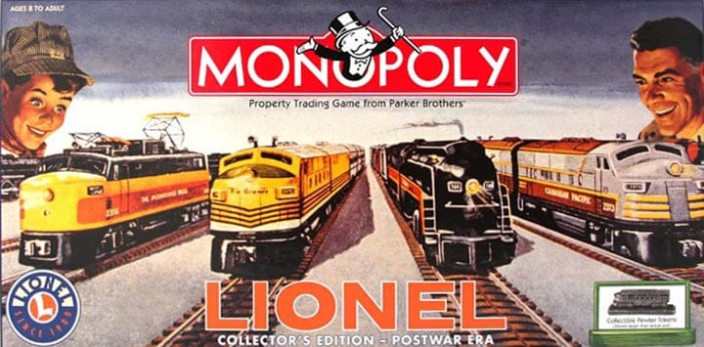
Production Becomes Social, but Appropriation Remains Private.
Skilled labor is monopolized, the best engineers are engaged; the means of transport are captured—railways in America, shipping companies in Europe and America. Capitalism in its imperialist stage leads directly to the most comprehensive socialization of production; it, so to speak, drags the capitalists, against their will and consciousness, into some sort of a new social order, a transitional one from complete free competition to complete socialization. Production becomes social, but appropriation remains private. The social means of production remain the private property of a few. The general framework of formally recognized free competition remains, and the yoke of a few monopolists on the rest of the population becomes a hundred times heavier, more burdensome and intolerable.”

Slide 11

Banks Command Almost the Whole of Money Capital
The principal and primary function of banks is to serve as middlemen in the making of payments. In so doing they transform inactive money capital into active, that is, into capital yielding a profit; they collect all kinds of money revenues and place them at the disposal of the capitalist class. As banking develops and becomes concentrated in a small number of establishments, the banks grow from modest middlemen into powerful monopolies having at their command almost the whole of the money capital of all the capitalists and small businessmen and also the larger part of the means of production and sources of raw materials in any one country and in a number of countries. This transformation of numerous modest middlemen into a handful of monopolists is one of the fundamental processes in the growth of capitalism into capitalist imperialism

Slide 12
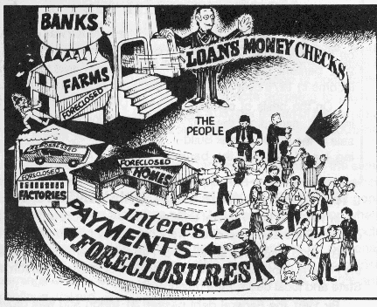
The Means By Which to Control the Economy
The concentration of capital and the growth of bank turnover are radically changing the significance of the banks. Scattered capitalists are transformed into a single collective capitalist. When carrying the current accounts of a few capitalists, a bank, as it were, transacts a purely technical and exclusively auxiliary operation. When, however, this operation grows to enormous dimensions we find that a handful of monopolists subordinate to their will all the operations, both commercial and industrial, of the whole of capitalist society; for they are enabled-by means of their banking connections, their current accounts and other financial operations—first, to ascertain exactly the financial position of the various capitalists, then to control them, to influence them by restricting or enlarging, facilitating or hindering credits, and finally to entirely determine their fate, determine their income, deprive them of capital, or permit them to increase their capital rapidly and to enormous dimensions.
Billions for the Bankers - Debts for the People

Slide 13

It is Possible with One Million Dollars, to Control Sixteen Million, Thirty-Two Million, etc.
Paramount importance attaches to the “(share) holding system”, already briefly referred to above. A German economist, said it in this way: “The head of the concern controls the principal company; the (Principal) reigns over the subsidiary companies which in their turn control still other subsidiaries, etc. In this way, it is possible with a comparatively small capital to dominate immense spheres of production. Indeed, if holding 50 per cent of the capital is always sufficient to control a company, the head of the concern needs only one million to control eight million in the second subsidiaries. And if this ‘interlocking’ is extended, it is possible with one million to control sixteen million, thirty-two million, etc.” As a matter of fact, experience shows that it is sufficient to own 40% of the shares of a company in order to direct its affairs, since in practice a certain number of small, scattered shareholders find it impossible to attend general meetings, etc. The “democratisation” of the ownership of shares, from which the bourgeois sophists and opportunist so-called “Social-Democrats” expect the “democratisation of capital”, the strengthening of the role and significance of small scale production, etc., is, in fact, one of the ways of increasing the power of the financial oligarchy. Incidentally, this is why, in the more advanced, or in the older and more “experienced” capitalist countries, the law allows the issue of shares of smaller denomination (ie. Penny Stocks).
The Charging Bull Statue on Wall St. in Front of the US Stock Exchange

Slide 14
Discussion

Slide 15
Discussion & New Members Introductions

Slide 16
New Member Introductions
What is your name, pronouns and state (or country/territory)?
Where do you work? Is it unionized?
How did you find out about the People’s School?
What do you think about tonight's class?

Slide 17
Section 2 - Chapters V – X

Slide 18
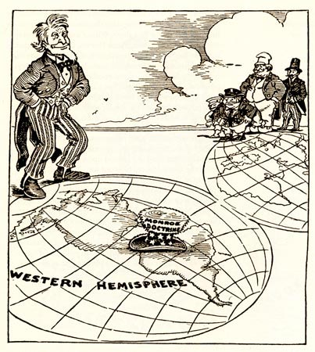
Ch. 5 - Division of the World Among Capitalist Associations
As the export of capital increased, and as the foreign and colonial connections and “spheres of influence” of the big monopolist associations expanded in all ways, things “naturally” gravitated towards an international agreement among these associations, and towards the formation of international cartels.

Slide 19
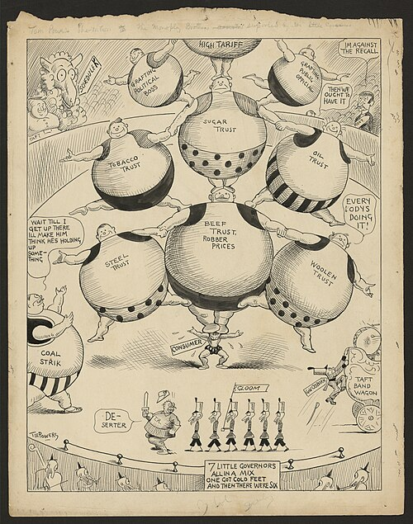
Division of the World Among Capitalist Associations
But the division of the world between two powerful trusts does not preclude redivision if the relation of forces changes as a result of uneven development, war, bankruptcy, etc.
The monopolies have never pursued the aim, nor have they had the result, of benefiting the consumer, or even of handing over to the state part of the promoter’s profits; they have served only to facilitate, at the expense of the state, the recovery of private industries which were on the verge of bankruptcy.

Slide 20
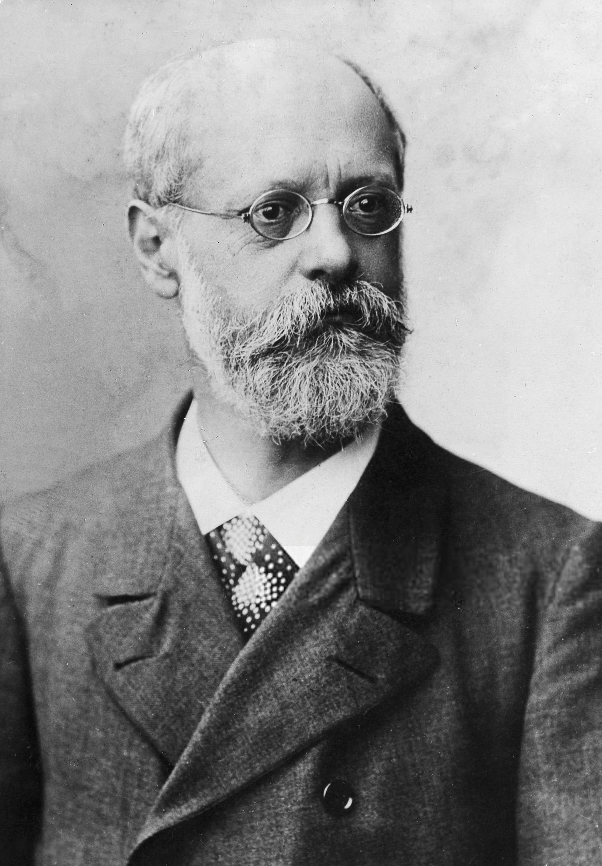
Division of the World Among Capitalist Associations
Certain bourgeois writers (now joined by Karl Kautsky, who has completely abandoned the Marxist position he had held, for example, in 1909) have expressed the opinion that international cartels, being one of the most striking expressions of the internationalisation of capital, give the hope of peace among nations under capitalism.
Theoretically, this opinion is absolutely absurd, while in practice it is sophistry and a dishonest defence of the worst opportunism.

Slide 21
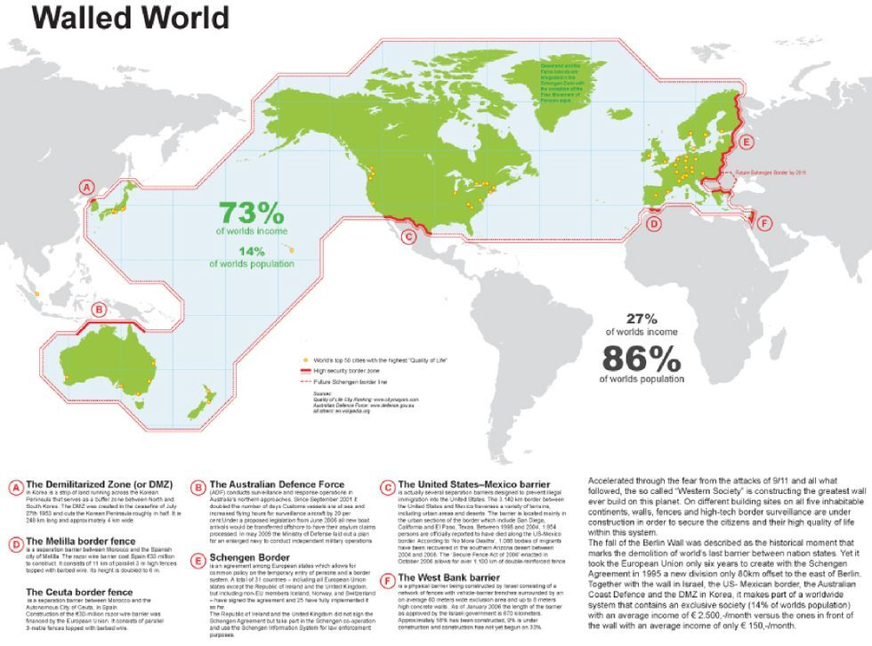
Division of the World Among Capitalist Associations
The capitalists divide the world, not out of any particular malice, but because the degree of concentration which has been reached forces them to adopt this method in order to obtain profits.
And they divide it “in proportion to capital”, “in proportion to strength,” because there cannot be any other method of division under commodity production and capitalism.

Slide 22
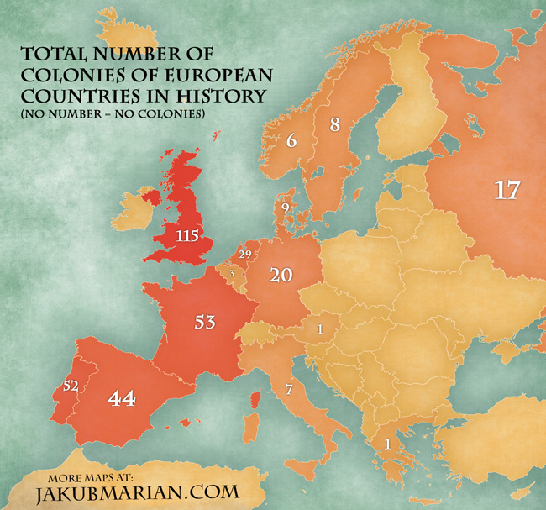
Ch. 6 - Division of the World Among the Great Powers
Alongside the colonial possessions of the Great Powers, we have placed the small colonies of the small states, which are, so to speak, the next objects of a possible and probable “redivision” of colonies.
These small states mostly retain their colonies only because the big powers are torn by conflicting interests, friction, etc., which prevent them from coming to an agreement on the division of the spoils.

Slide 23
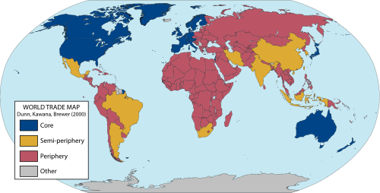
Division of the World Among the Great Powers
As to the “semi-colonial” states, they provide an example of the transitional forms which are to be found in all spheres of nature and society.
Finance capital is such a great, such a decisive, you might say, force in all economic and in all international relations, that it is capable of subjecting, and actually does subject, to itself even states enjoying the fullest political independence

Slide 24
Division of the World Among the Great Powers
The semi-colonial countries provide a typical example of the “middle stage.”
It is natural that the struggle for these semi dependent countries should have become particularly bitter in the epoch of finance capital, when the rest of the world has already been divided up.

Slide 25
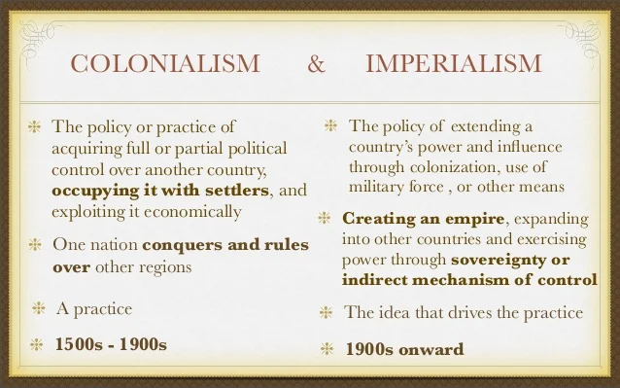
Division of the World Among the Great Powers
Colonial policy and imperialism existed before the latest stage of capitalism, and even before capitalism.
Rome, founded on slavery, pursued a colonial policy and practised imperialism.
However, the capitalist colonial policy of previous stages of capitalism is essentially different from the colonial policy of finance capital.

Slide 26
Division of the World Among the Great Powers
The principal feature of the latest stage of capitalism is the domination of monopolist associations of big employers. These monopolies are most firmly established when all the sources of raw materials are captured by one group, and we have seen with what zeal the international capitalist associations exert every effort to deprive their rivals of all opportunity of competing, to buy up, for example, ironfields, oilfields, etc.
Colonial possession alone gives the monopolies complete guarantee against all contingencies in the struggle against competitors, including the case of the adversary wanting to be protected by a law establishing a state monopoly. The more capitalism is developed, the more strongly the shortage of raw materials is felt, the more intense the competition and the hunt for sources of raw materials throughout the whole world, the more desperate the struggle for the acquisition of colonies.

Slide 27
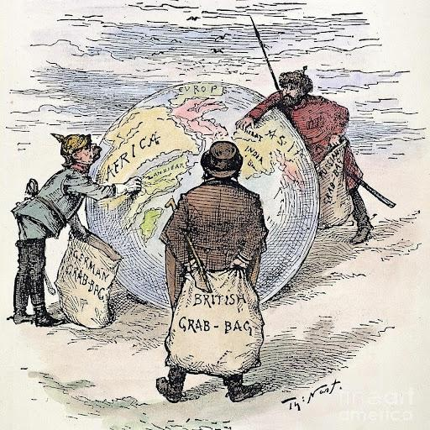
Ch. 7 -Imperialism as a Special Stage of Capitalism
If it were necessary to give the briefest possible definition of imperialism we should have to say that imperialism is the monopoly stage of capitalism.
Such a definition would include what is most important, for, on the one hand, finance capital is the bank capital of a few very big monopolist banks, merged with the capital of the monopolist associations of industrialists; and, on the other hand, the division of the world is the transition from a colonial policy which has extended without hindrance to territories unseized by any capitalist power, to a colonial policy of monopolist possession of the territory of the world, which has been completely divided up. It will include the following five of its basic features:

Slide 28
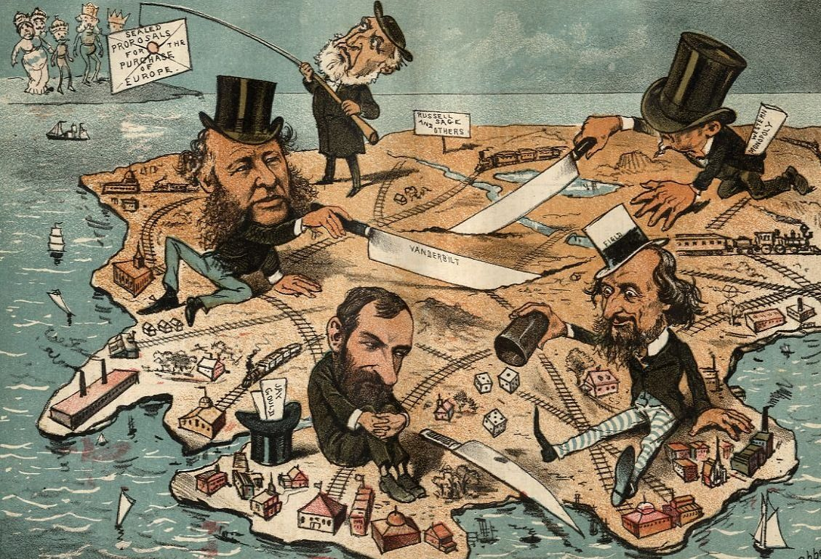
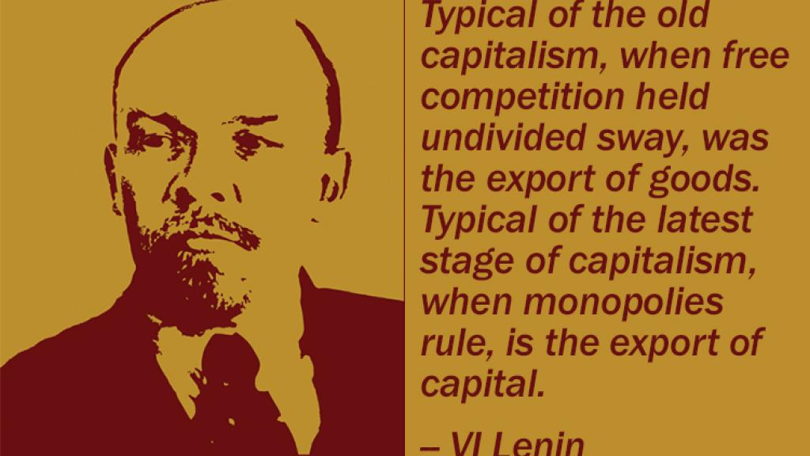
Imperialism as a Special Stage of Capitalism
the concentration of production and capital has developed to such a high stage that it has created monopolies which play a decisive role in economic life;
the merging of bank capital with industrial capital, and the creation, on the basis of this “finance capital,” of a financial oligarchy;
the export of capital as distinguished from the export of commodities acquires exceptional importance;

Slide 29
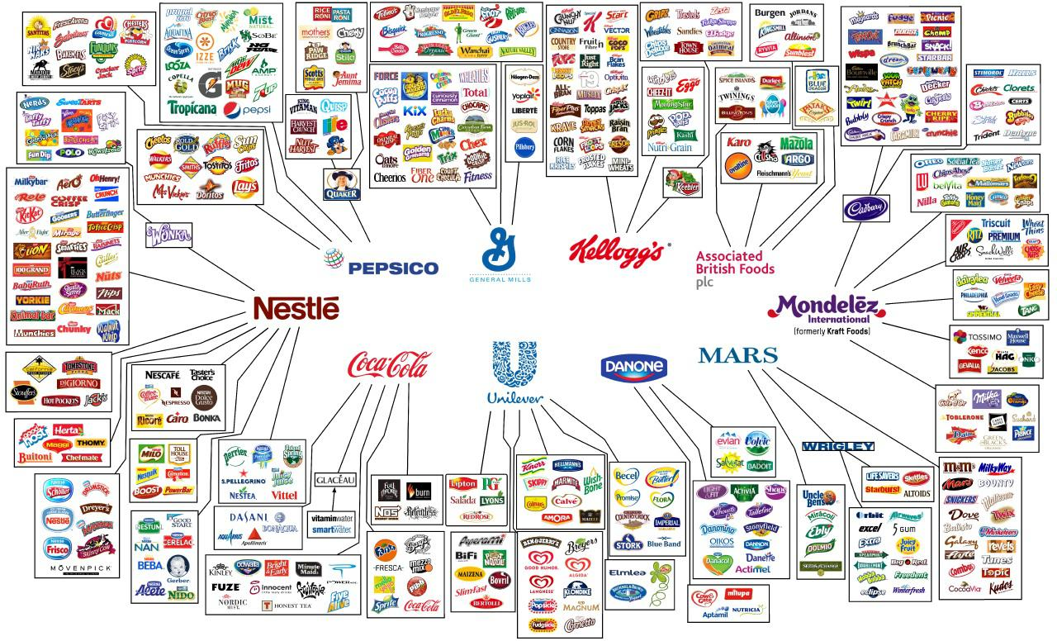
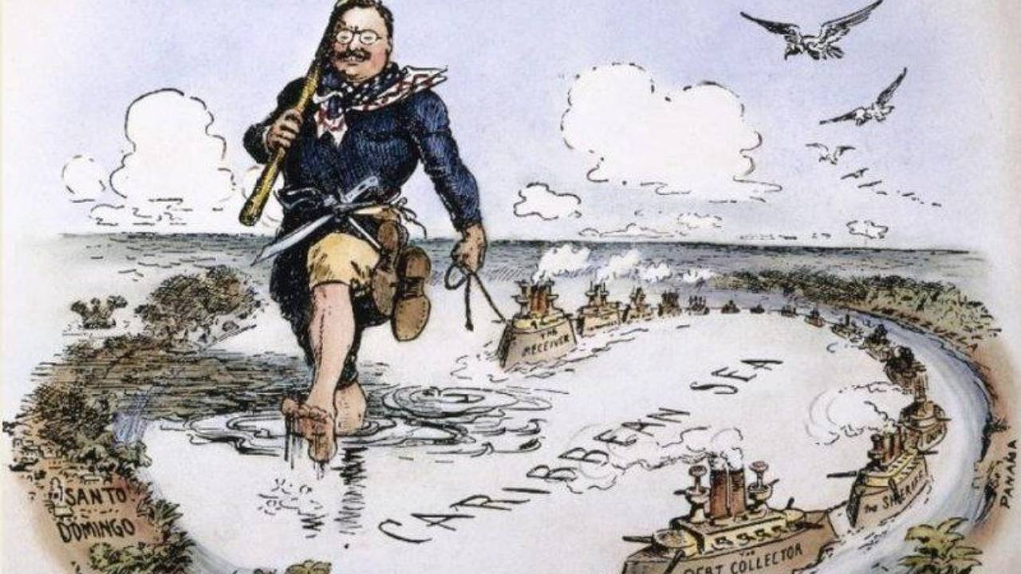
Imperialism as a Special Stage of Capitalism
4. the formation of international monopolist capitalist associations which share the world among themselves and
5. the territorial division of the whole world among the biggest capitalist powers is completed. Imperialism is capitalism at that stage of development at which the dominance of monopolies and finance capital is established; in which the export of capital has acquired pronounced importance;

Slide 30
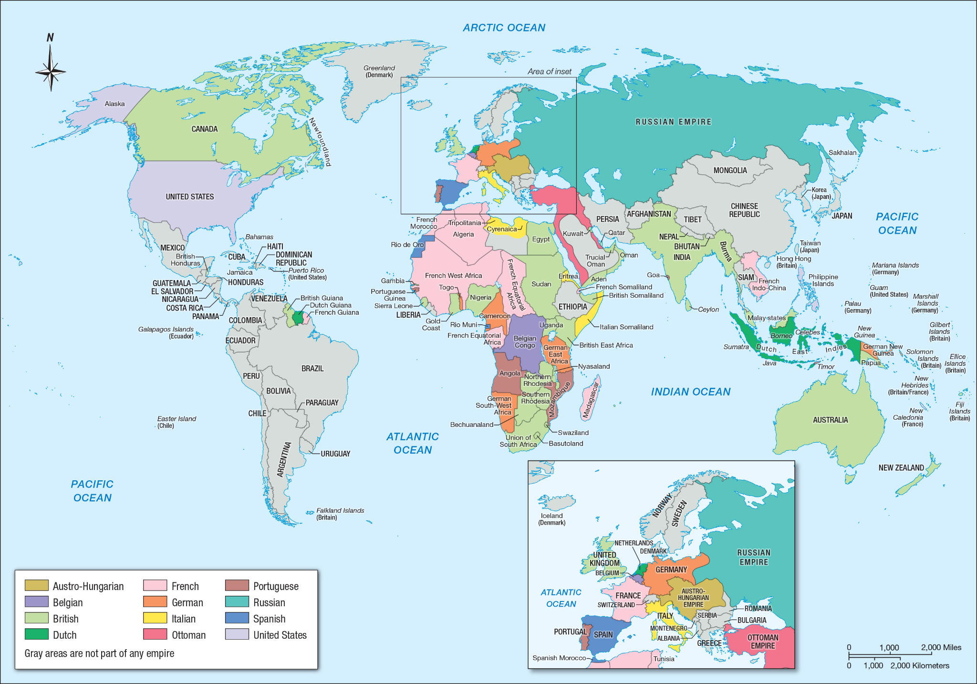
Imperialism as a Special Stage of Capitalism
The question is: what means other than war could there be under capitalism to overcome the disparity between the development of productive forces and the accumulation of capital on the one side, and the division of colonies and spheres of influence for finance capital on the other?

Slide 31
Ch. 8 - Parasitism and Decay of Capitalism
As we have seen, the deepest economic foundation of imperialism is monopoly. This is capitalist monopoly, i.e., monopoly which has grown out of capitalism and which exists in the general environment of capitalism, commodity production and competition, in permanent and insoluble contradiction to this general environment.
Nevertheless, like all monopoly, it inevitably engenders a tendency of stagnation and decay. Since monopoly prices are established, even temporarily, the motive cause of technical and, consequently, of all other progress disappears to a certain extent and, further, the economic possibility arises of deliberately retarding technical progress.

Slide 32
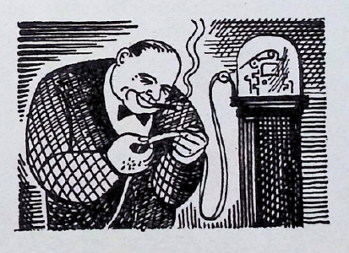
Parasitism and Decay of Capitalism
Certainly, the possibility of reducing the cost of production and increasing profits by introducing technical improvements operates in the direction of change. But the tendency to stagnation and decay, which is characteristic of monopoly, continues to operate, and in some branches of industry, in some countries, for certain periods of time, it gains the upper hand.

Slide 33
Ch. 9 - Critique of Imperialism
By the critique of Imperialism, in the broad sense of the term, we mean the attitude of the different classes of society towards imperialist policy in connection with their general ideology.
The enormous dimensions of finance capital concentrated in a few hands and creating an extraordinarily dense and widespread network of relationships and connections which subordinates not only the small and medium, but also the very small capitalists and small masters, on the one hand, and the increasingly intense struggle waged against other national state groups of financiers for the division of the world and domination over other countries, on the other hand, cause the propertied classes to go over entirely to the side of imperialism.

Slide 34
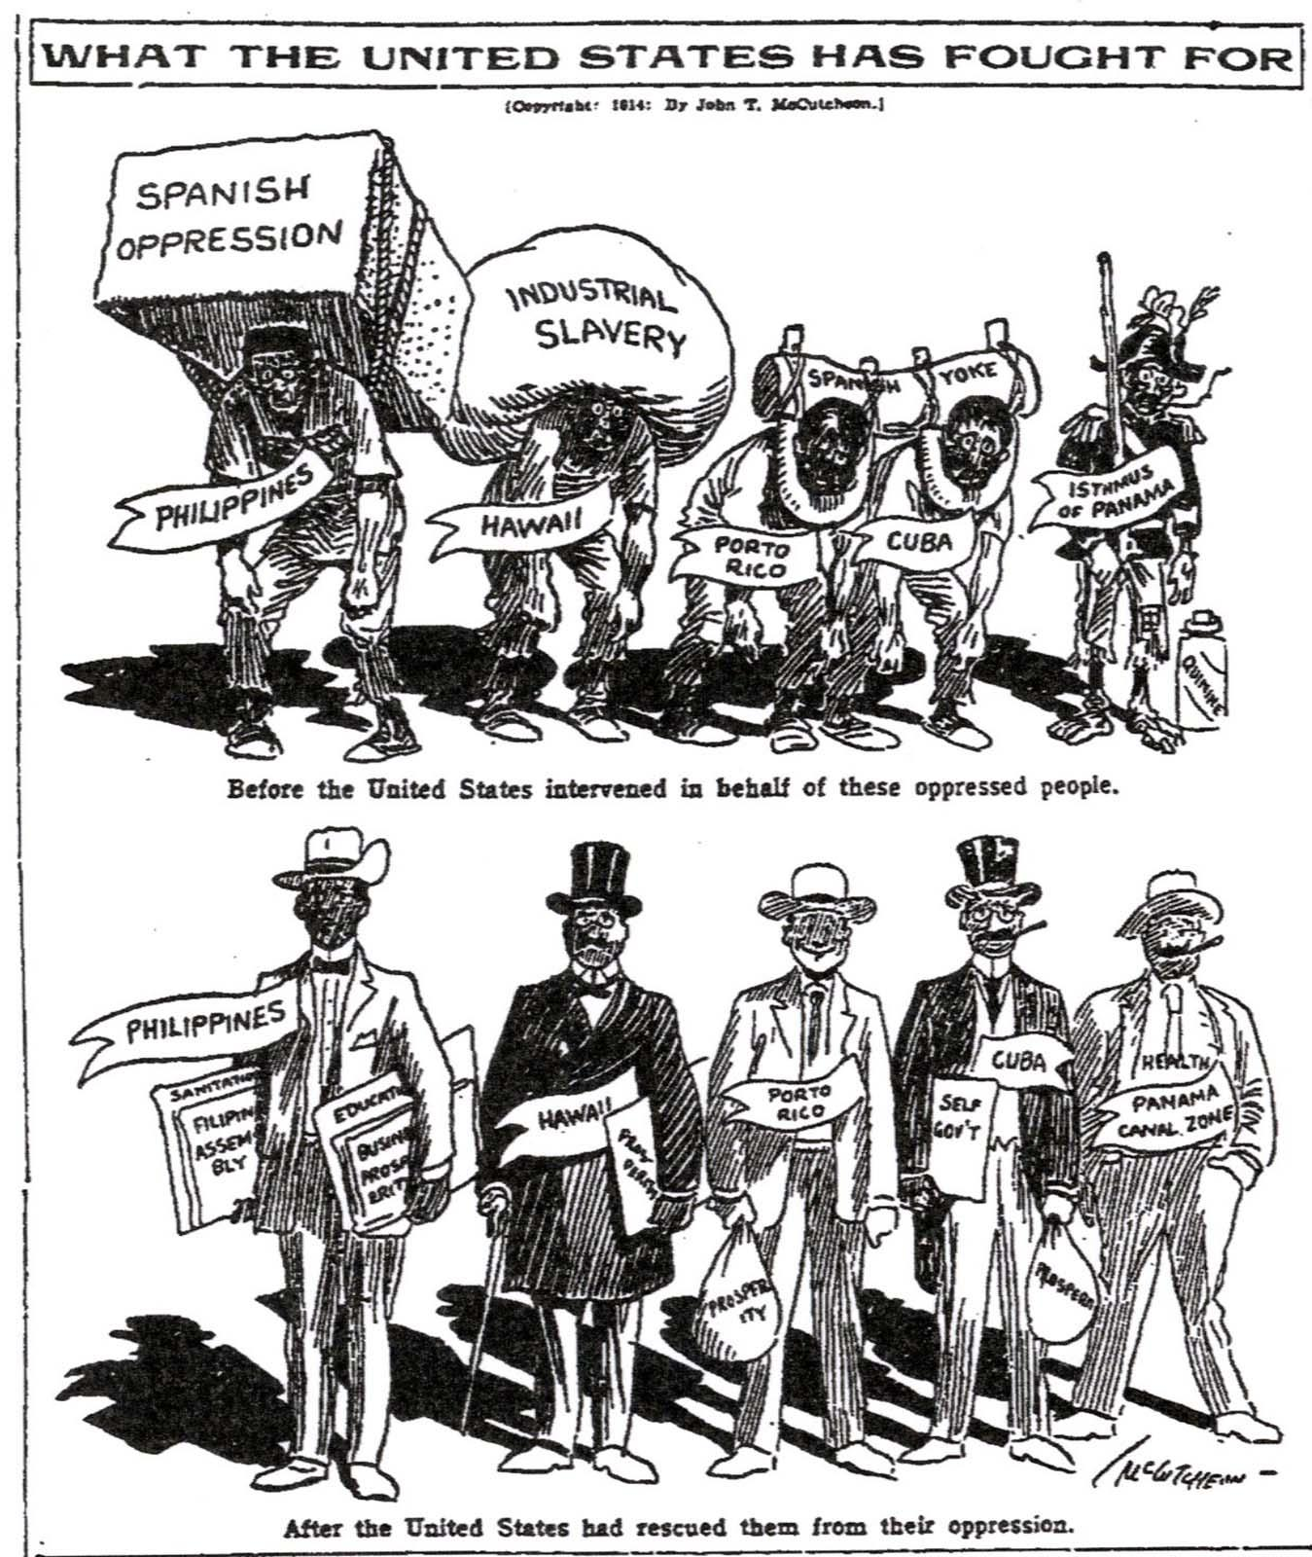
Critique of Imperialism
“General” enthusiasm over the prospects of imperialism, furious defense of it and painting it in the brightest colors — such are the signs of the times. Imperialist ideology also penetrates the working class. No wall separates it from the other classes.
A pro-Imperialist newspaper cartoon via the Chicago Tribune, 1914

Slide 35
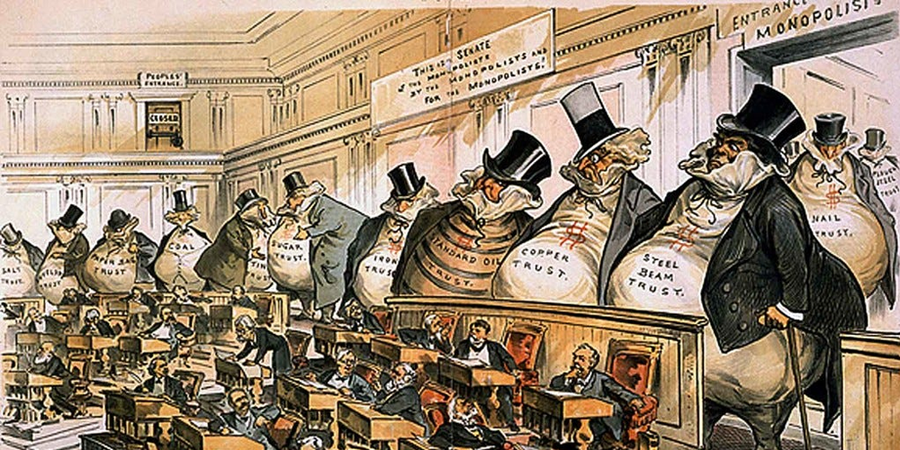
Critique of Imperialism
Bourgeois scholars and publicists usually come out in defense of imperialism in a somewhat veiled form; they obscure its complete domination and its deep-going roots, strive to push specific and secondary details into the forefront and do their very best to distract attention from essentials by means of absolutely ridiculous schemes for “reform”, such as police supervision of the trusts or banks, etc.

Slide 36
Critique of Imperialism
The questions as to whether it is possible to reform the basis of imperialism, whether to go forward to the further intensification and deepening of the antagonisms which it engenders, or backwards, towards allaying these antagonisms, are fundamental questions in the critique of imperialism.
Since the specific political features of imperialism are reaction everywhere and increased national oppression due to the oppression of the financial oligarchy and the elimination of free competition, a petty-bourgeois-democratic opposition to imperialism arose in the beginning of the 20th century in nearly all imperialist countries.

Slide 37
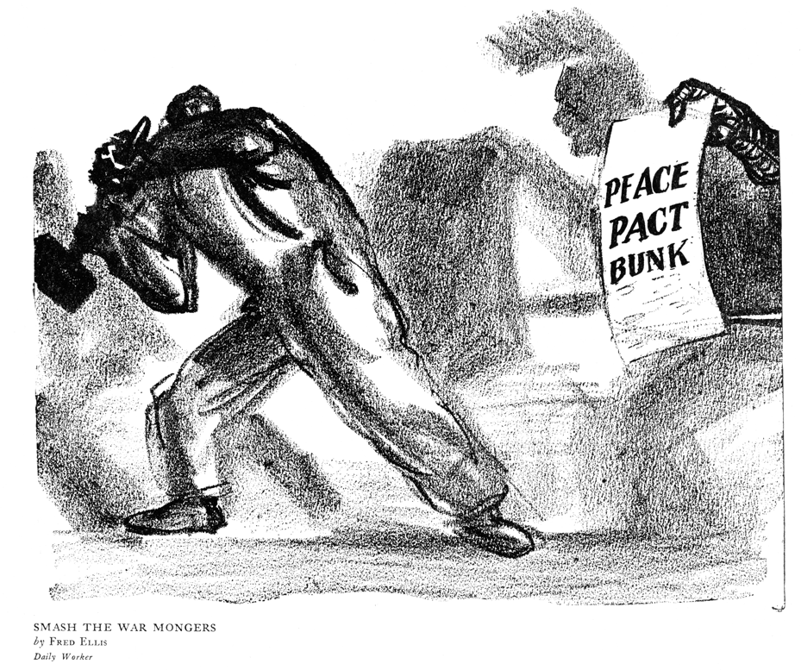
Critique of Imperialism
Such simple-mindedness on the part of the bourgeois economists is not surprising; moreover, it is in their interest to pretend to be so naive and to talk “seriously” about peace under imperialism. Instead of an analysis of imperialism and an exposure of the depths of its contradictions, we have nothing but a reformist “pious wish” to wave them aside, to evade them.

Slide 38
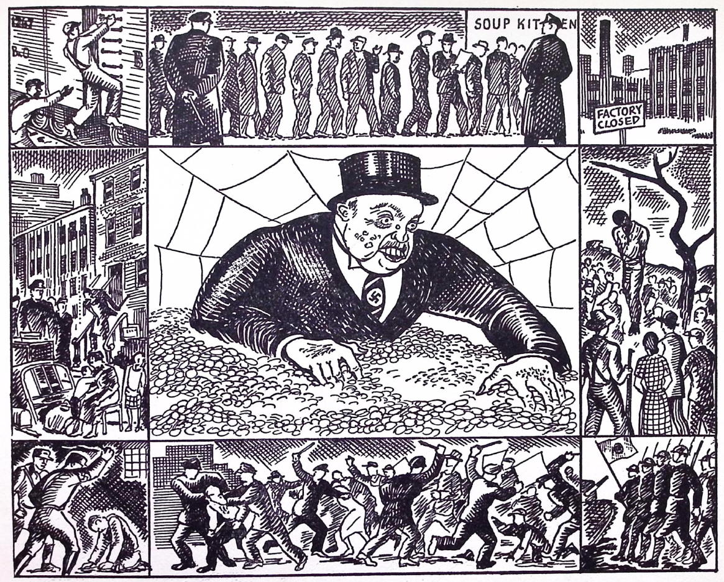
Ch. 10 - The Place of Imperialism in History
In its economic essence imperialism is monopoly capitalism.
This in itself determines its place in history, for monopoly that grows out of the soil of free competition, and precisely out of free competition, is the transition from the capitalist system to a higher socio-economic order. We must take special note of the four principal types of monopoly, or principal manifestations of monopoly capitalism, which are characteristic of the epoch we are examining.

Slide 39
The Place of Imperialism in History
Firstly, monopoly arose out of the concentration of production at a very high stage.
This refers to the monopolist capitalist associations, cartels, syndicates and trusts. We have seen the important part these play in present-day economic life.
Secondly, monopolies have stimulated the seizure of the most important sources of raw materials, especially for the basic and most highly cartelised industries in capitalist society: the coal and iron industries. The monopoly of the most important sources of raw materials has enormously increased the power of big capital, and has sharpened the antagonism between cartelised and non-cartelised industry.

Slide 40
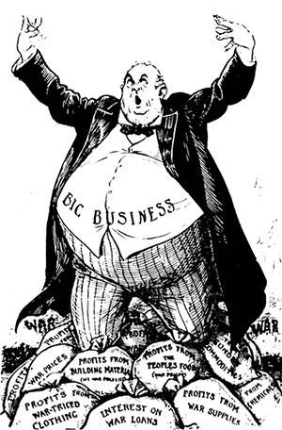
The Place of Imperialism in History
Thirdly, monopoly has sprung from the banks. The banks have developed from
humble middleman enterprises into the monopolists of finance capital.
A financial oligarchy, which throws a close network of dependence relationships over all the economic and political institutions of present-day bourgeois society without exception — such is the most striking manifestation of this monopoly.

Slide 41
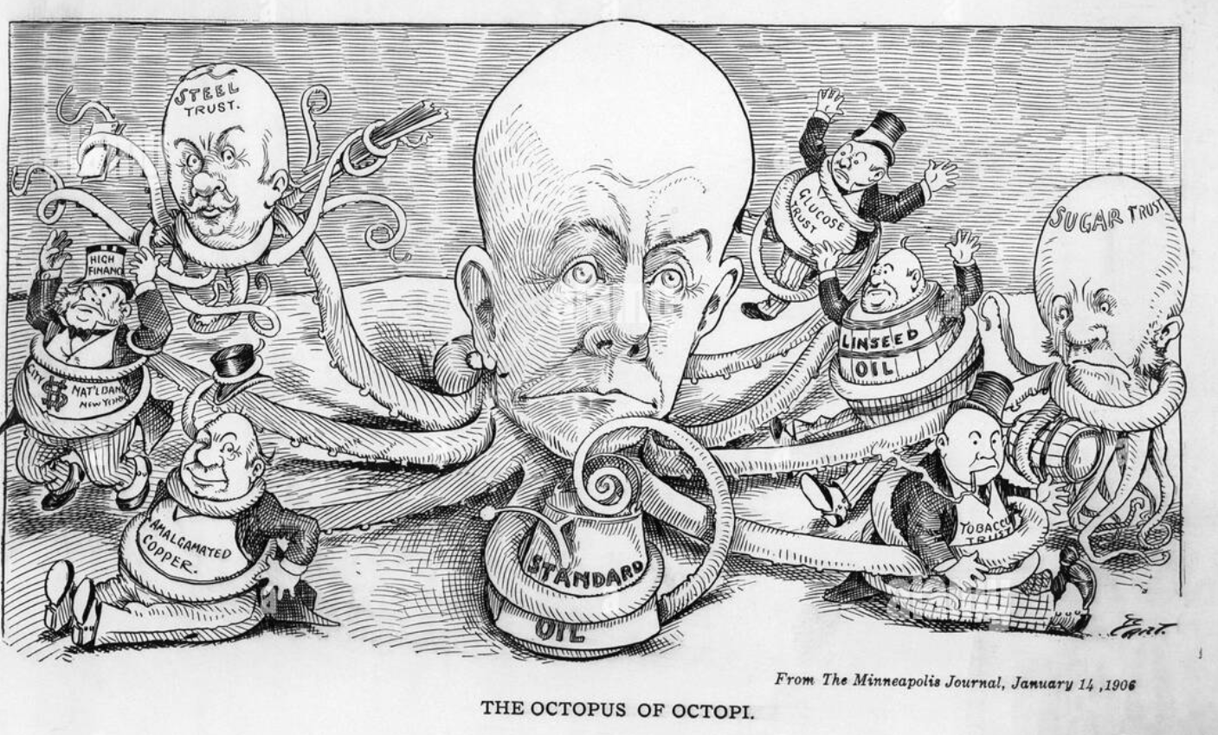
The Place of Imperialism in History
Fourthly, monopoly has grown out of colonial policy. To the numerous “old” motives of colonial policy, finance capital has added the struggle for the sources of raw materials, for the export of capital, for “spheres of influence”, i.e., for spheres for profitable deals, concessions, monopoly profits and so on, economic territory in general.

Slide 42
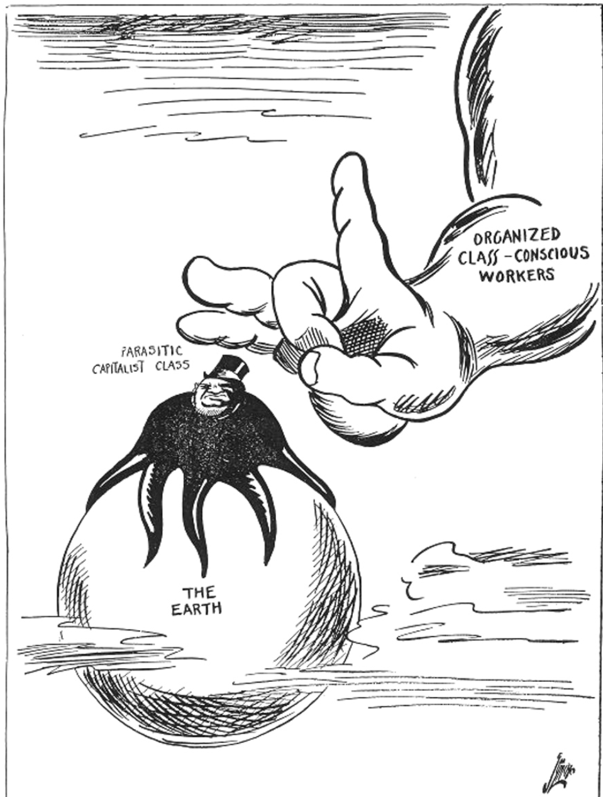
The Place of Imperialism in History
Monopolies, oligarchy, the striving for domination and not for liberty, the exploitation of an increasing number of small or weak nations by a handful of the richest or most powerful nations — all these have given birth to those distinctive characteristics of imperialism which compel us to define it as parasitic or decaying capitalism.

Slide 43
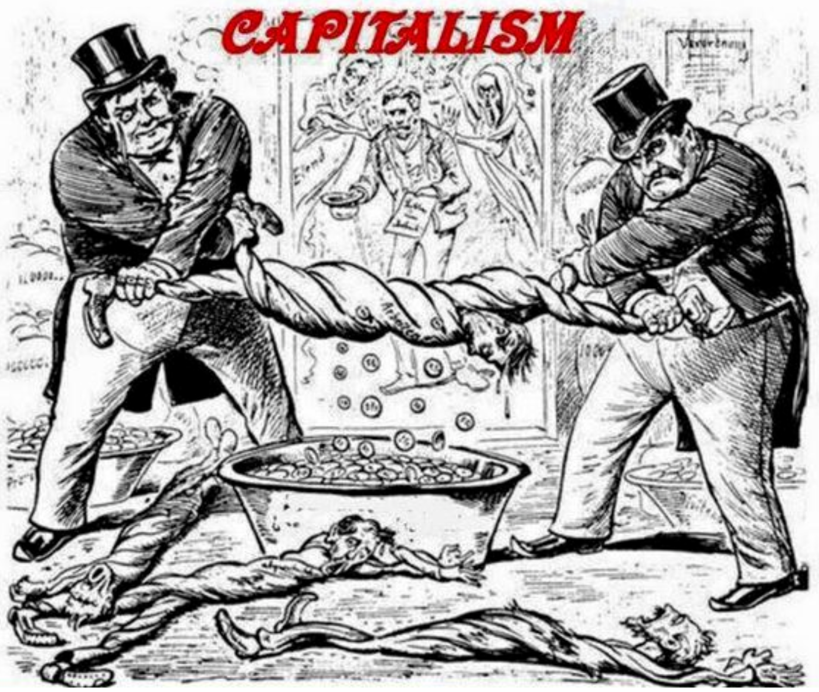
The Place of Imperialism in History
On the whole, capitalism is growing far more rapidly than before; but this growth is not only becoming more and more uneven in general, its unevenness also manifests itself, in particular, in the decay of the countries which are richest in capital (Britain then, America now)

Slide 44
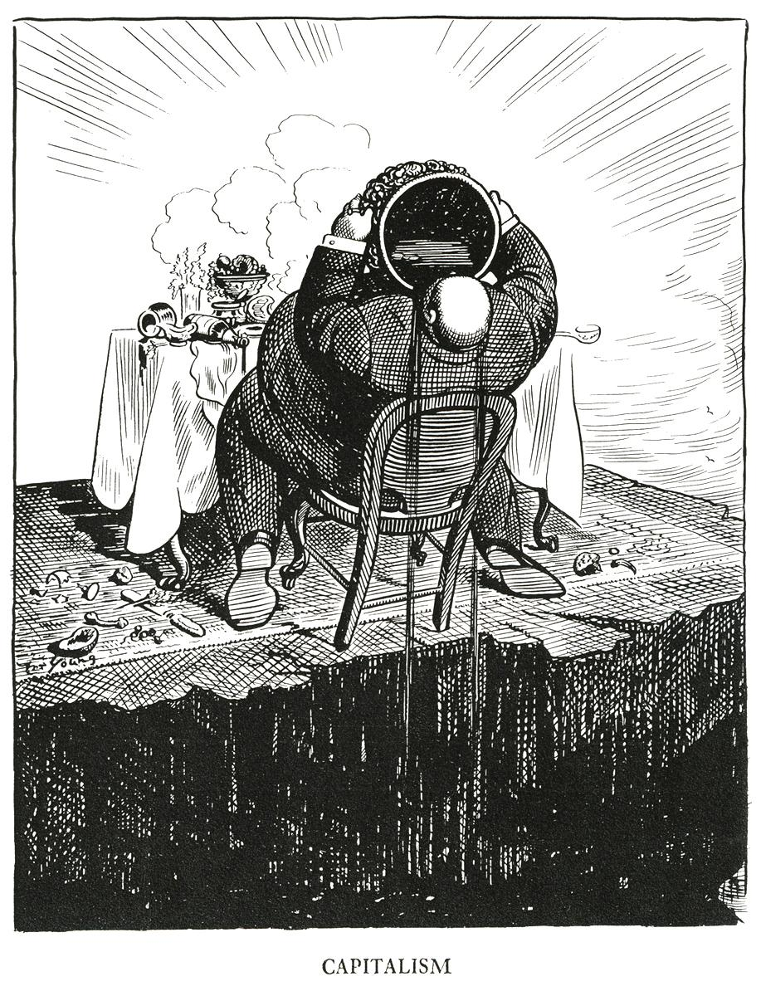
The Place of Imperialism in History
In its turn, this finance capital which has grown with such extraordinary rapidity is not unwilling, precisely because it has grown so quickly, to pass on to a more “tranquil” possession of colonies which have to be seized — and not only by peaceful methods — from richer nations. (See the conflicts of today).
From all that has been said in this book on the economic essence of imperialism, it follows that we must define it as capitalism in transition, or, more precisely, as moribund capitalism.

Slide 45
Discussion

Slide 46
Section 3 - Imperialism Today (1972)

Slide 47
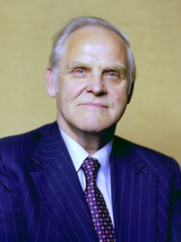
Imperialism Today (1972)
This Section is a summary of Imperialism Today: An Evaluation of Major Issues and Events of our Time by Gus Hall, Part 4: An Historical Necessity, i.e. pages 351 to 378. The source material was published by International Publishers and can be found on the Internet Archive.
Gus Hall, 1980

Slide 48
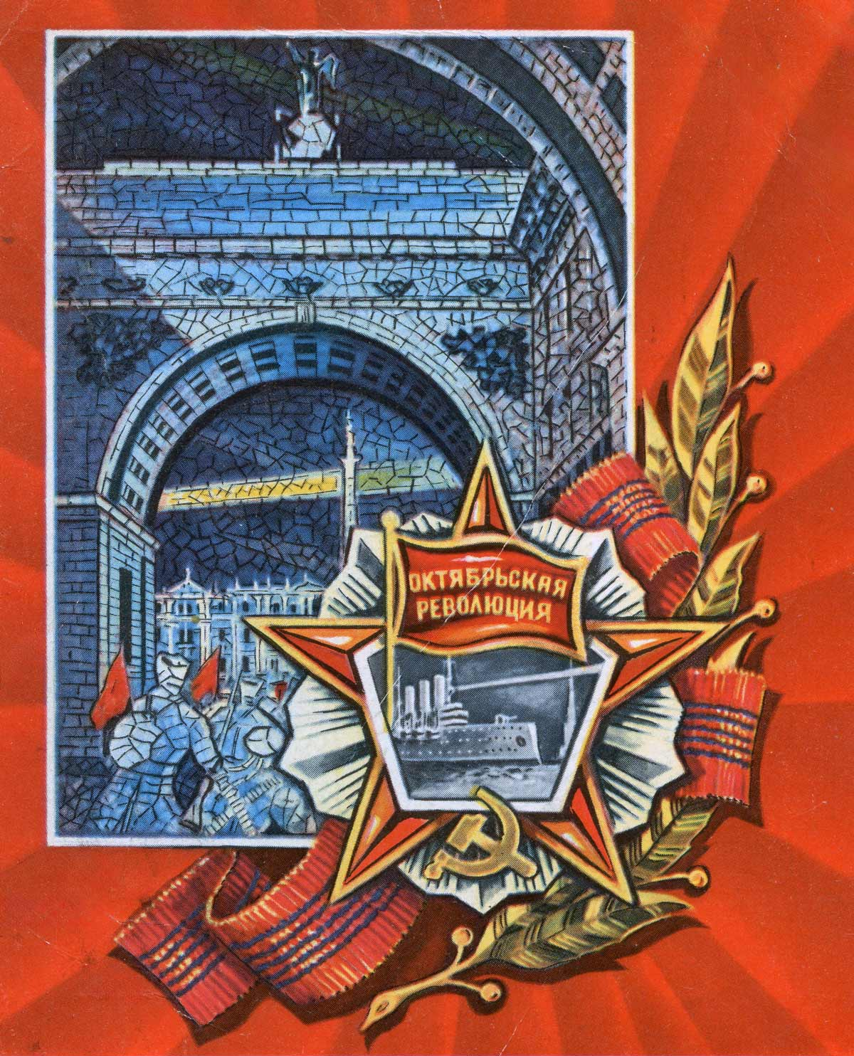
Revolutions: Explosions of Historical Necessities
Revolutions are not accidents. They are the explosions of historical necessities born from the laws of capitalist development. The old dominant class becomes reactionary, clinging to the status quo, while a new class emerges as the propellant of human progress. Each forward thrust is prepared within the old order. Today, the new momentum in science and technology has broken through old patterns, placing new contradictions on the table. Capitalism cannot achieve the unlimited possibilities it has unleashed. It has become a brake on social development. The world revolutionary process—the socialist one-third of the world, the working class, and the national liberation movements—is the explosion. U.S. imperialism is the pivot of world imperialism, so a special responsibility falls on the people of the United States. We must mold an anti-imperialist unity rooted in concrete problems: wages, taxes, racism, the war in Vietnam. The historical necessity is clear: destroy capitalism and build socialism.
“October Revolution”

Slide 49
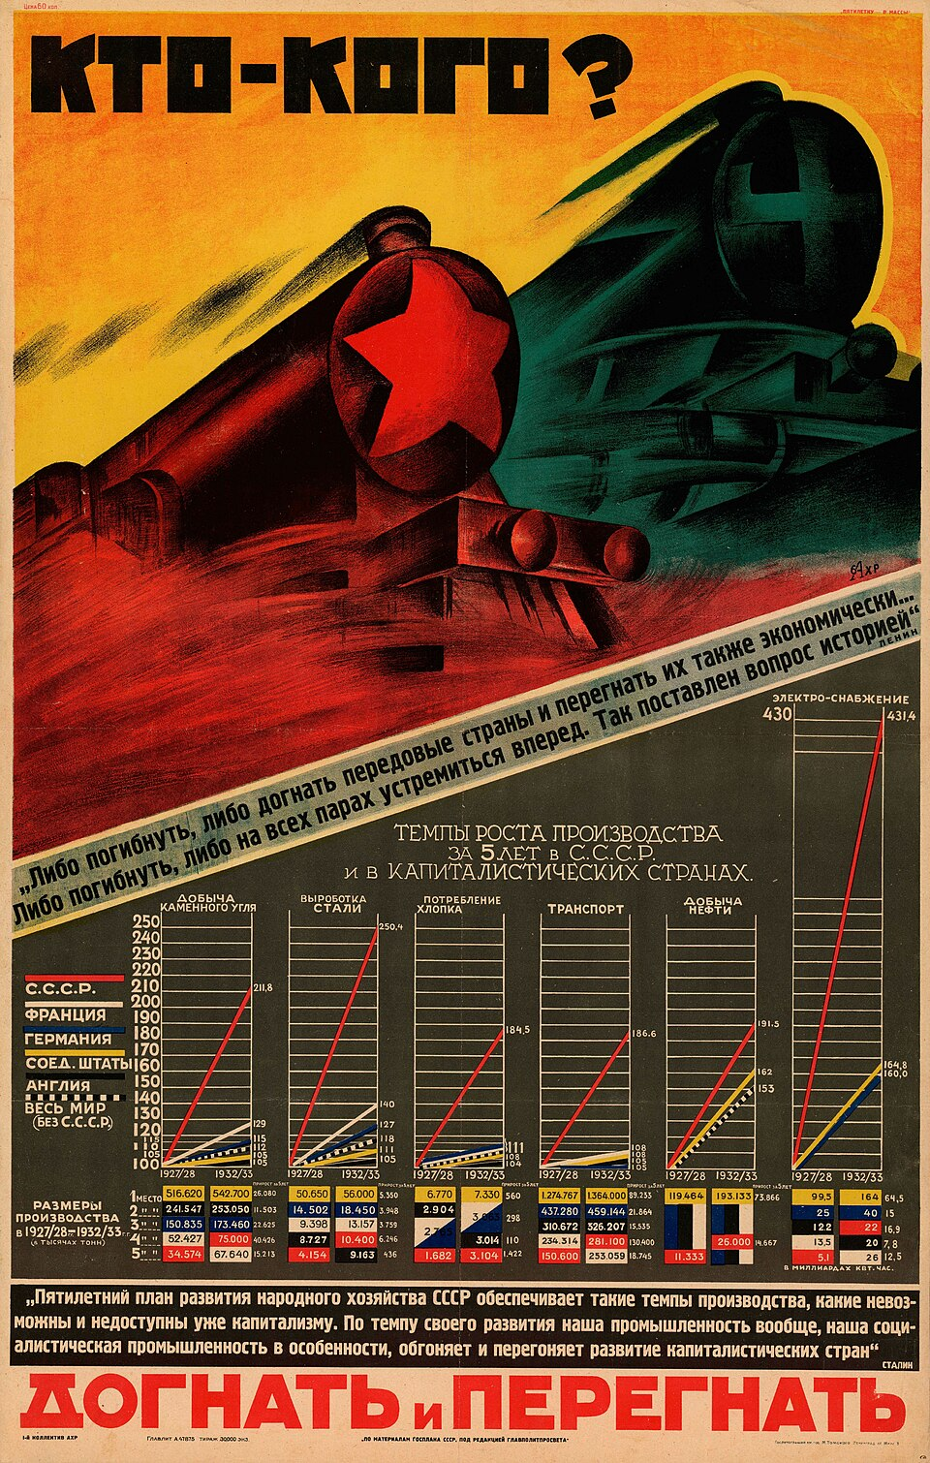
Today's Epoch-Making World Changes
We are living in a new epoch. Imperialism has lost its historical initiative. The overall direction of world developments is now determined by the forces propelling the world revolutionary process. Some ask whether we overstate the strength of the working class or the socialist sector. But look at the Soviet Union: in 50 years it has surpassed what capitalism produced in 250. The gap in industrial production has narrowed from 39 years to six. This is a competition between two socio-economic systems. Setbacks in Ghana or Indonesia do not reverse the tide. The national liberation sweep continues. A key conclusion of this epoch is that world wars are not inevitable. The shift in the balance of forces makes peace a real possibility. Imperialism can be corralled and destroyed before it destroys civilization. This is the epoch of transition from capitalism to socialism, and socialism cannot be imported—it will be molded by our own experiences and traditions.
"Catch up and overtake [the capitalist nations]," 1929

Slide 50
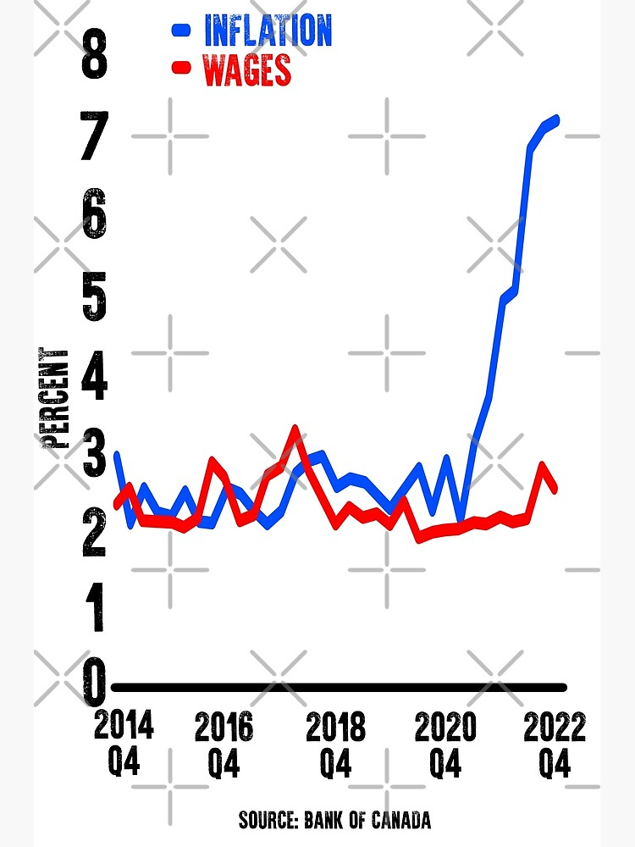
Events that Determine an Epoch
You cannot pin a new epoch on a calendar date. The birth of the Soviet Union shattered the shell of world capitalism but did not end it. Processes intermingle and overlap. Today, we are in the eye of the storm—mankind’s most explosive qualitative leap. The aggressive beast of imperialism is no longer master of the forest. It has been forced to shift tactics, but its predatory character remains the same. The root cause of every crisis—inflation, housing, education—is the unending drive for maximum profits. The rate of exploitation has gone up 30 percent in ten years. Unheard-of profits are drawn from 80 million workers and the oppression of 40 million Black, Brown, and Indigenous people. The economy is manipulated by giant monopolies and the government acting on their behalf. But they cannot indefinitely ward off economic laws. The crisis deepens, their options disappear, and the verdict of history moves closer.
Canadian inflation v.s. wages

Slide 51
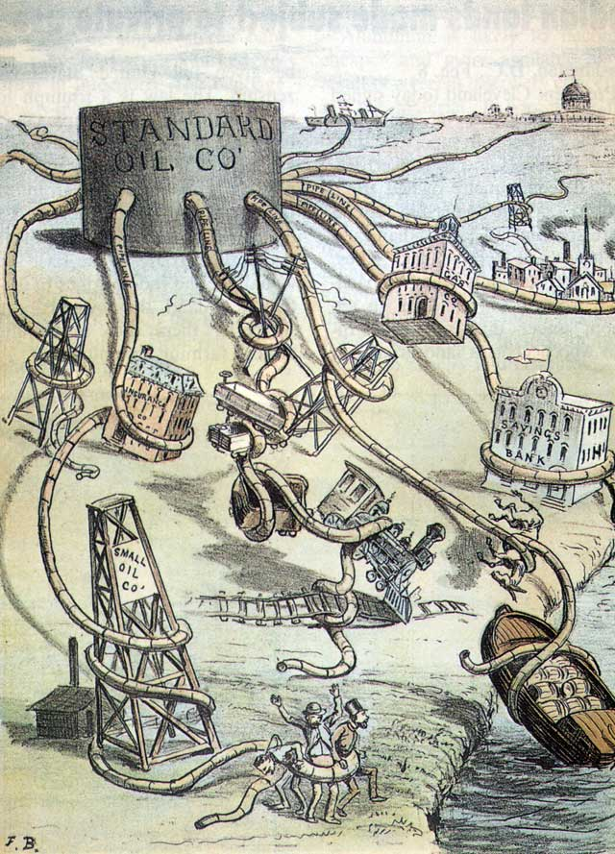
The Struggle to Break the Grip of Monopoly
Search any sector of life and you touch a tentacle of monopoly capital. The industrial worker meets it on the production line. The small farmer, the small businessman, Black Americans, Chicanos, women, students—all are victims of this monster. To “turn the country around” means to turn it against monopoly capitalism. An anti-monopoly coalition is an inevitable political development. Some say, ignore it—focus only on overthrowing capitalism. But that is a recipe for isolation. The anti-monopoly struggle is where masses wet their socialist feet. They may not yet be for socialism, but they are anti-capitalist. The path to socialism is lined with people fighting the issues that pain them most. Anti-monopoly struggles will lead to nationalization of banks and industries, to democratic controls, to a new political party independent of the twin parties of capitalism. The aim: anti-monopoly state power. That is the inevitable path of struggle.
1884 Print: Monster Monopoly Standard Oil Cartoon

Slide 52
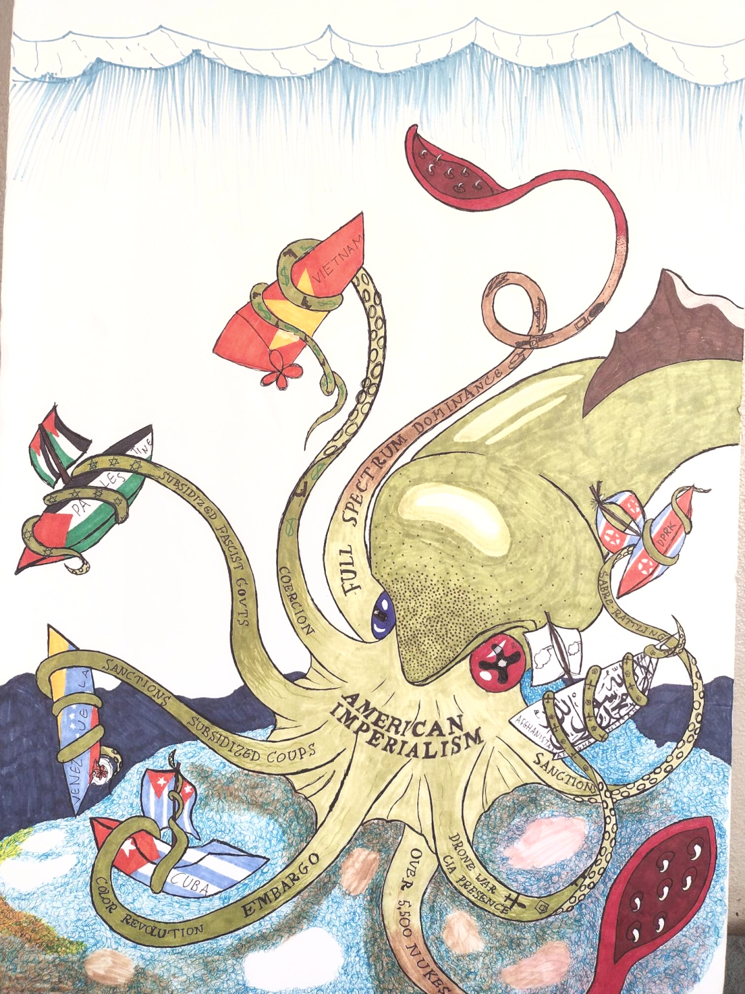
The Ever-Changing Balance of World Forces
Nothing stands still in the balance between imperialism and anti-imperialism. U.S. imperialism remains the most aggressive, warlike force on earth, but it is in ever deeper crisis. The annual price of its aggression is reaching $100 billion. At home, that means runaway inflation, declining real wages, and a total debt of more than one trillion dollars. The rate of exploitation of labor has been forced up 30 percent. Yet capitalism has also created its own gravediggers: a militant working class, a Black liberation movement, a massive youth revolt, and a peace campaign that reaches into the armed forces themselves. More than 53,000 desertions took place in one year. Rank-and-file caucuses are overthrowing old union bureaucracies. Young workers are free of ingrained prejudices, open to socialist ideas. The petty bourgeois theoreticians who say revolution can be made without the working class are wrong and are being rejected by the very youth they try to deceive.
Tentacles of imperialism

Slide 53
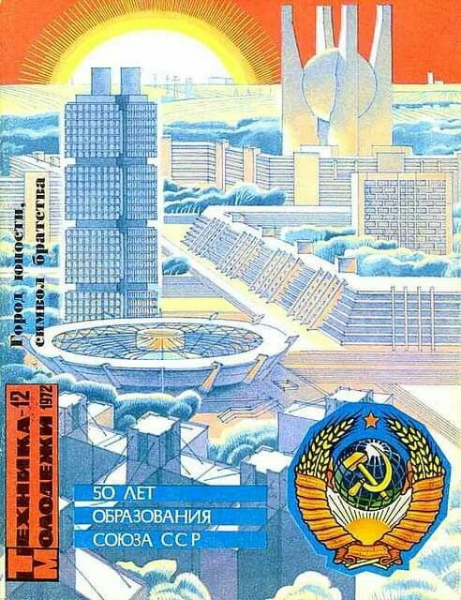
Conclusion
Capitalism is outmoded—marked for extinction like the prehistoric animals that could not keep up with changing reality. Imperialism is in its period of decay, suffering from a crisis of incompatibility. The new technology demands computerized planning, socialized investment, a system of abundance. For this task, capitalism is primitive. Socialism is the new species taking the field. Imperialism will never change. It will be the socio-economic dinosaur to its last day. But the verdict of history is unalterable: you have had it. We in the United States inhabit the nesting grounds of the dinosaur. Every blow we strike for our own freedom is a blow against world imperialism. The postwar capitalist structure designed by U.S. imperialism is coming apart—cracks in the dollar, in NATO, in military alliances. The Soviet Union became the world’s No. 1 steel producer in 1971. The balance has tipped. The main direction of mankind’s development is now determined by the socialist system, the working class, and all revolutionary forces.
“Technology for Youth; City of Youth, Symbol of Brotherhood”

Slide 54
Discussion & Wrap Up

Slide 55
Announcements
PCUSA Cell Chairs need to call members of their cells to remind them about attendance.
The next issue of New Masses (2026) has begun production. If you have art you want us to feature, email it to info@partyofcommunistsusa.net.
New Masses Movie Night returns May 30, 2026! We will show The Diary of Anne Frank in collaboration with the United Jewish People’s Fraternal Society!

Slide 56
Volunteers Needed!
We are in need of volunteers for the staff of the People’s School! Here’s a few roles we need filled:
People to help manage posting on our social media and podcast platforms
Video Editors, Audio Editors, Graphic Designers, Artists, Narrators
Web Controls, Moderators
Email info@peoplesschool.us if you’re interested and try to attend our next staff meeting if possible.

Slide 57


Slide 58

View From Left Field
https://viewfromleftfield.libsyn.com
The Old PSMLS Youtube is now the Youtube of View From Left Field, a podcast of analysis and discussion of current events from a progressive perspective.
Like the Youtube videos and subscribe with 5 star ratings on your podcast platforms.

Slide 59

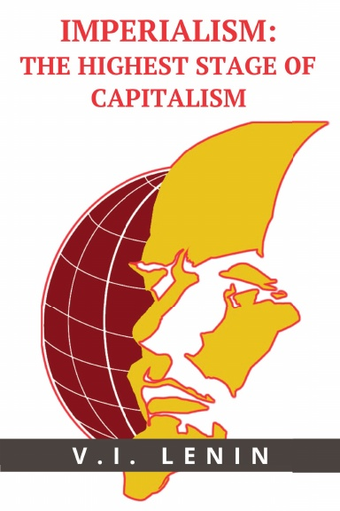
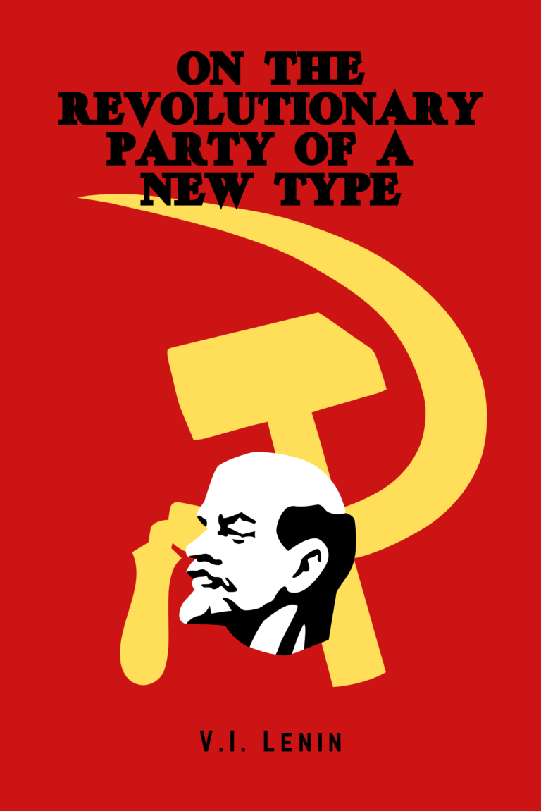

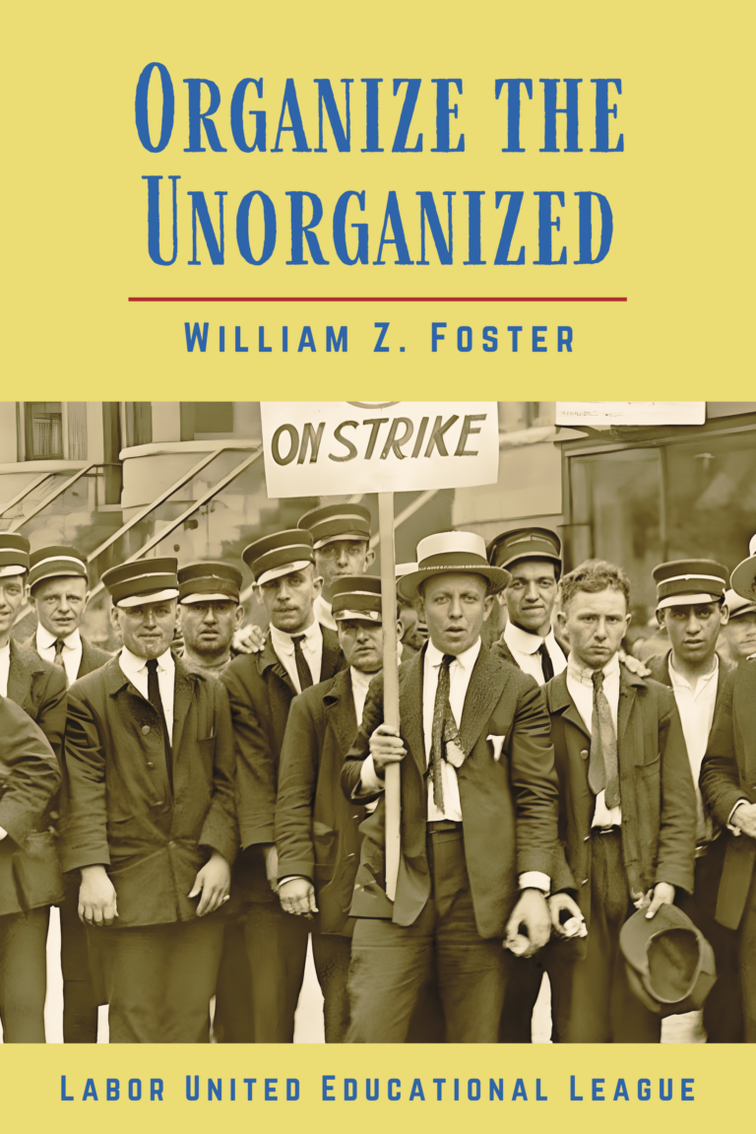
New Outlook Publishers
newoutlookpublishers.store
Relevant and Latest Releases

Slide 60



Harry Bridges School of Labor
luel.us/laborschool/
The Harry Bridges School of Labor is a monthly class covering a variety of topics aimed at building class consciousness among union members. For class schedule and other information, please visit the website at luel.us/laborschool.

Slide 61

¡Yankee go home! (Venezuela Anti-Imperialist Song)

