Slide 1

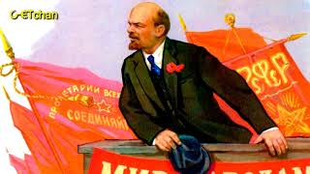
Партия Ленина - Party of Lenin

Slide 2

PSMLS 4/21/2026

Slide 3
What we’ll be learning today:
Background, context and historical significance
April Theses
Effects of the Theses on Russian politics

Slide 4
Background, Context and Historical Significance

Slide 5
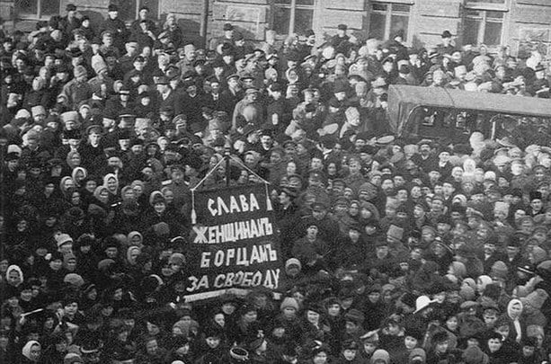
The Tsar is Overthrown
On February 23rd 1917, a spontaneous strike of women textile workers in Petrograd initiated a wave of revolt. This would result in the overthrow of the detested Tsar Nicholas II within five days. Protesting against the disastrous war campaign, the high cost of living, and terrible working conditions, the proletarian women of Petrograd mobilized the factory workers at a speed that surprised even the social democratic (which at the time meant Marxist) activists. This was accompanied by mass meetings and demonstrations. By February 27th, most of the city was in the hands of workers and soldiers. The masses, having learned from their experience of the 1905 revolution, immediately set up soviets: councils of workers and peasants. In reality, the soviets held power in their hands. The leadership of the soviets, however, was in the hands of the Mensheviks and Social Revolutionaries, who had no intention of taking power on behalf of the masses.
The 1917 Strike in Petrograd

Slide 6
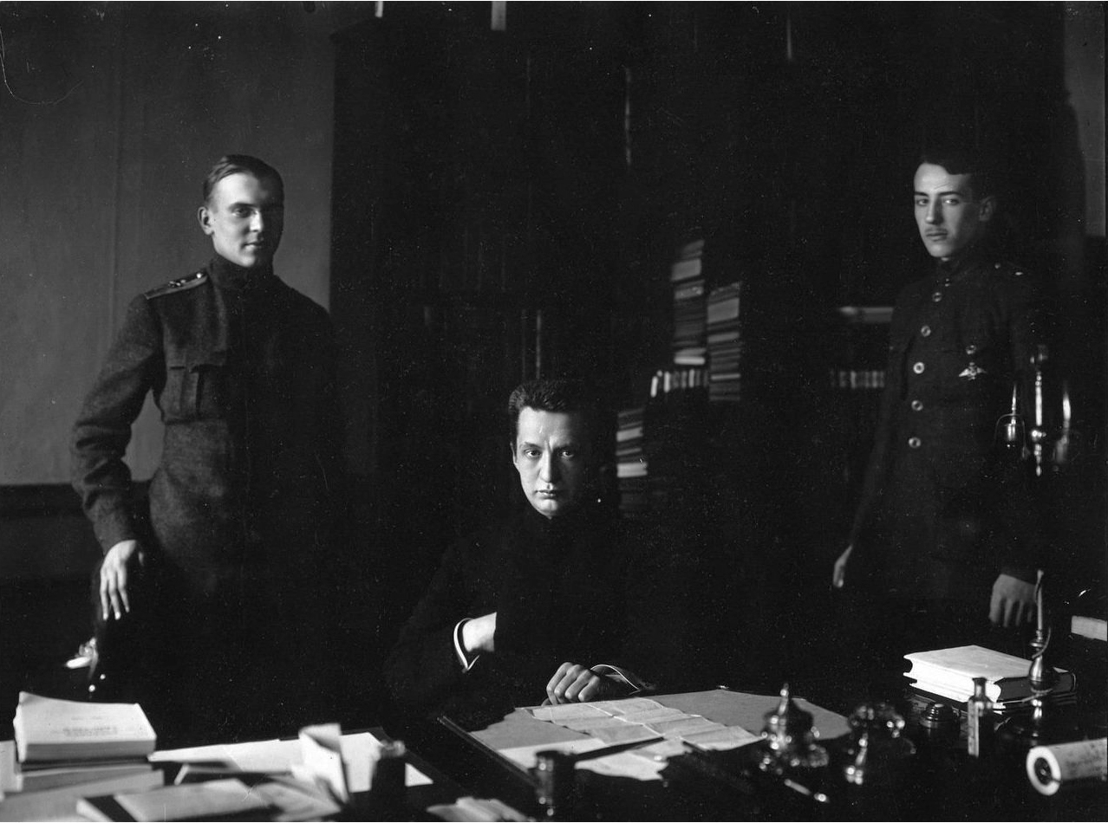
Kerensky Becomes Chairman of the New Government
Instead, these leaders handed power to the bourgeois provisional government, consisting of liberals who ultimately represented the old regime of landlords and capitalists. The intention of the Provisional Government from the start was to shipwreck the revolution. They merely made cosmetic changes at the top, without fundamentally changing society. At one point, it was even revealed that the Provisional Government intended to re-invite the recently deposed Tsar back into power. The lawyer and vice chairman of the Petrograd Soviet, Alexander Kerensky, was appointed as chairman of the new Provisional Government. Ironically, Kerensky would have been considered far too radical for the Tsarist government in the preceding period. But as is often the case during revolutionary movements, out of desperation, the Russian bourgeoisie sought to incorporate this leader into their ranks, in order to restrain and placate the masses.
Alexander Kerensky and his Adjutants in 1917

Slide 7
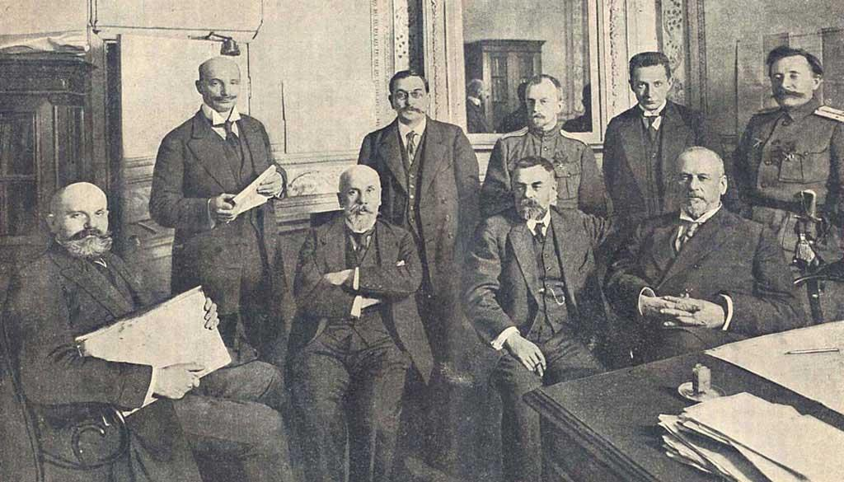
A Situation of “Dual Power”
The Provisional Government made all the same arguments that reformist leaders do today. They used their authority to hold back the masses, in the name of ‘unity’ and ‘defence of democracy’. They argued that it would be impossible for the working class to change society on its own, and that ‘pressure’ must be put on the bourgeois to make it act in the interests of workers. A contradictory situation known as ‘dual power’ emerged in Russia. Two diametrically-opposed forms of government existed simultaneously: one representing the workers; one representing the capitalists. Such a situation could not – and cannot – last indefinitely. Dual power is unstable and transitory, by its very nature, and can only ever be resolved by the complete victory of one of the mutually antagonistic classes over the other. The longer this situation continued, therefore, the graver the threat to the revolution.
Members of the Provisional Committee of the State Duma. Photo by Karl Bulla (1917)

Slide 8
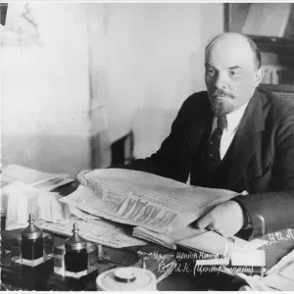
Lenin Intervenes From Afar
It was in March 1917 that Lenin sent his letters from afar: the opening salvo in the struggle to re-arm the Bolsheviks, and the prelude to the April Theses. In his letters to Pravda at the time, Lenin tried to bring the comrades to their senses as to the real situation that lay behind the euphoria over the Tsar’s overthrow. He hammered home that the imperialist war could not be ended by the bourgeois Provisional Government, since the bourgeoisie were themselves tied by a thousand threads to the British and French imperialists, and had their own imperialist designs. A lasting democratic peace – and not an imperialist, unjust one, which would merely pave the way for another war – could only be achieved with proletarian revolution. The Provisional Government was working towards the restoration of bourgeois power, he stated. No support should be given to it or the liberals. No unification should take place with opposing political parties like the Mensheviks.

Slide 9
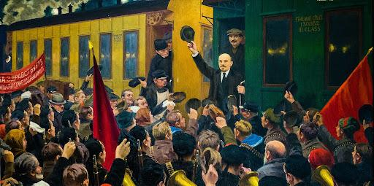
The Russian Masses Welcome Lenin Home
The soviets represented the embryo of workers’ power, Lenin explained. But the majority of workers and peasants had to be united under a concrete program, in order to carry out the practical tasks of the Russian Revolution, such as the nationalization of the land and the banks. And power would have to be transferred from the old state machinery, which was to be smashed, and handed to a new proletarian state. After many negotiations, and a long journey back to Russia via Germany, Lenin finally arrived at the Finland station in Petrograd, where he was received with an enormous welcome by the Russian masses. Upon his arrival, Lenin immediately turned from the soviet leaders, who had turned up with flowers for him, and launched into a thunderous tirade against the Provisional Government.
Lenin’s arrival at the Finland Station, as depicted by MG Sokolov (1875-1953)

Slide 10
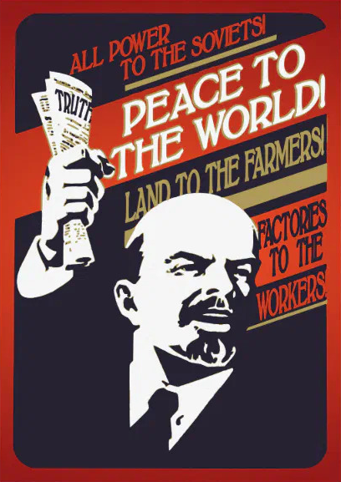
All Power to the Soviets
From here, Lenin began a struggle to prepare the Bolsheviks for power, under the famous slogan ‘all power to the soviets.’ The soviets were under the control of the Mensheviks and Social Revolutionaries at this point. The Bolsheviks were a minority. None of the leaders of those early soviets believed that the working class should be in power. Even the left Mensheviks, like Sukhanov, were of the same opinion. The role of these leaders was to prop up the Provisional Government, behind which the forces of reaction were gathering strength and preparing for an offensive against the working class. The essence of Lenin’s slogan was to argue that the liberal soviet leaders should in fact take power on behalf of the working class, despite the Bolsheviks’ minority position. Lenin knew, however, that this was the last thing that the soviet leaders were prepared to do.

Slide 11
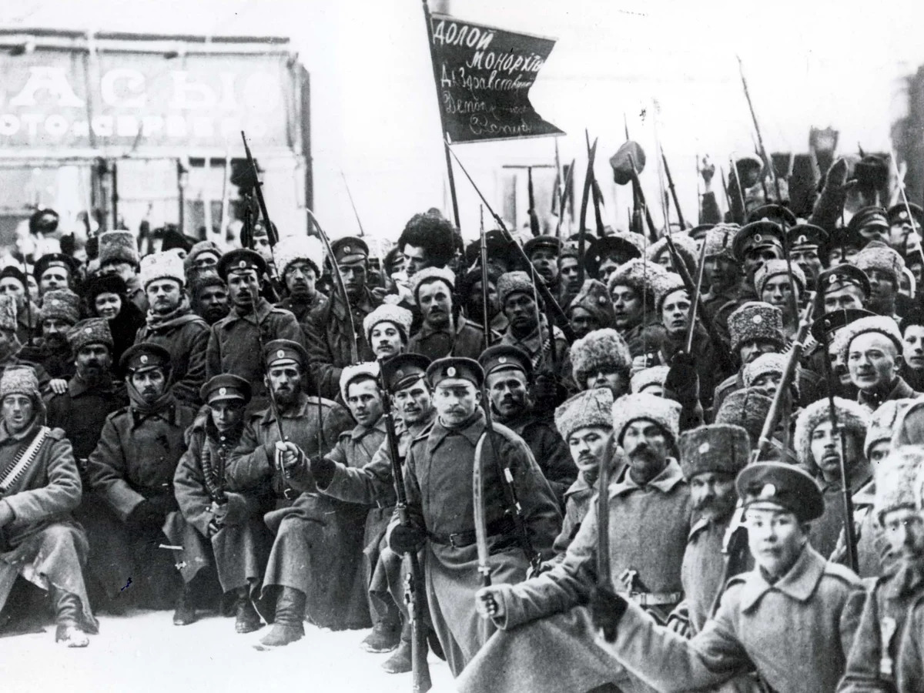
The Question of State Power
The slogan was therefore intended to help win the masses over to the Bolshevik position – not by simply denouncing the leaders, who many workers still looked towards, but by showing the workers what their leaders could do – but were refusing to do – with the power of the soviets. This both exposed these leaders, and showed to the workers that supported them that the Bolsheviks were not sectarian and only wanted the workers to have power. As Lenin explained: “The basic question of every revolution is that of state power.” Lenin knew from the moment of its inception that the bourgeois Provisional Government was incapable of completing the Russian Revolution. It therefore had to be overthrown.
Bolshevik Soldiers Demonstrate in the Streets of Petrograd, November 1917. Photograph: ENA/Popperfoto

Slide 12
In the Words of J. V. Stalin
Upon returning to Petrograd from exile, Stalin, along with Lev Kamenev, had taken over the editorial board of Pravda and had initially argued that the Bolsheviks should support the Provisional Government insofar as it fought against counter-revolutionary forces, a position often called "revolutionary defencism." However, following Lenin's return to Russia in April and the subsequent April Party Conference, Stalin was convinced. In a speech delivered on April 18th he gives a strong case for an immediate transition to socialist revolution:
“We are told that there must be confidence in the Provisional Government, that this confidence is essential. But what confidence can there be in a government which itself has no confidence in the people on the cardinal and basic issue? We are in the midst of a war. It is being waged on the basis of treaties concluded by the tsar with Britain and France behind the back of the people and now sanctified by the Provisional Government without the consent of the people. The people are entitled to know the contents of these treaties; the workers and soldiers are entitled to know what they are shedding their blood for. To the demand of the workers and soldiers that the treaties be made public, what did the Provisional Government reply?
“It declared that the treaties remained in force.”
“And it did not publish the treaties, and doesn't intend to publish them!”

Slide 13
In the Words of J. V. Stalin Cont.
“...Can we, in a period of revolution, support a government which has been hindering the revolution from its very inception? So far, the situation has been one in which the revolutionary initiative and democratic measures emanated from the Soviet of Workers' and Soldiers' Deputies, and from it alone. The Provisional Government held back and resisted and only afterwards agreed with the Soviet, and then only partially and verbally, while in practice creating obstacles. Such has been the situation so far. But how is it possible, at the height of revolution, to support a government which gets in the way of the revolution and pulls it back? Would it not be better to demand that the Provisional Government should not hinder the Soviet of Workers' and Soldiers' Deputies in the work of further democratizing the country?...”
“An agrarian movement has begun in Russia. The peasants are seeking on their own authority to plough the land left untilled by the landlords. If that is not done, the country may find itself on the verge of famine. In compliance with the wishes of the peasants, the All-Russian Conference of Soviets resolved to "support" the peasant movement for the confiscation of the landed estates. But what does the Provisional Government do? It characterizes the peasant movement as "usurpation," forbids the peasants to plough up the landed estates, and issues instructions "accordingly" to its commissars. Why, then, should we support the Provisional Government?”

Slide 14
In the Words of J. V. Stalin Cont.
“We are told that lack of confidence in the Provisional Government will undermine the unity of the revolution, repel the capitalists and landlords from it. But who will venture to assert that the capitalists and landlords really are supporting, or can support, the revolution of the masses?”
“Did not the Soviet of Workers' and Soldiers' Deputies, when it introduced the eight-hour working day, repel the capitalists, and at the same time rally the broad mass of the workers around the revolution? Who would venture to assert that the dubious friendship of a handful of manufacturers is more valuable to the revolution than the real friendship of millions of workers which has been cemented with blood?”
“Or again, did not the All-Russian Conference of Soviets, when it decided to support the peasants, repel the landlords and at the same time link the peasant masses to the revolution? Who would venture to assert that the dubious friendship of a handful of landlords is more valuable to the revolution than the real friendship of the many millions of poor peasants now clad in soldier's uniform?”
“The revolution cannot satisfy everyone and everybody. One of its sides always satisfies the toiling masses, while the other strikes at the overt and covert enemies of the masses. It is therefore necessary to choose: either with the workers and poor peasants for the revolution, or with the capitalists and landlords against the revolution. Clearly, the workers and soldiers can support only the Soviet of Workers' and Soldiers' Deputies which they themselves elected.”

Slide 15
Discussion & New Members Introductions

Slide 16
New Member Introductions
What is your name, pronouns and state (or country/territory)?
Where do you work? Is it unionized?
How did you find out about the People’s School?
What do you think about tonight's class?

Slide 17
April Theses

Slide 18
Thesis 1
1) In our attitude towards the war, which under the new [provisional] government of Lvov and Co. unquestionably remains on Russia’s part a predatory imperialist war owing to the capitalist nature of that government, not the slightest concession to “revolutionary defencism” is permissible.
The class-conscious proletariat can give its consent to a revolutionary war, which would really justify revolutionary defencism, only on condition: (a) that the power pass to the proletariat and the poorest sections of the peasants aligned with the proletariat; (b) that all annexations be renounced in deed and not in word; (c) that a complete break be effected in actual fact with all capitalist interests.

Slide 19
Thesis 1
In view of the undoubted honesty of those broad sections of the mass believers in revolutionary defencism who accept the war only as a necessity, and not as a means of conquest, in view of the fact that they are being deceived by the bourgeoisie, it is necessary with particular thoroughness, persistence and patience to explain their error to them, to explain the inseparable connection existing between capital and the imperialist war, and to prove that without overthrowing capital it is impossible to end the war by a truly democratic peace, a peace not imposed by violence.
The most widespread campaign for this view must be organised in the army at the front.
Fraternisation.

Slide 20
Thesis 2
2) The specific feature of the present situation in Russia is that the country is passing from the first stage of the revolution—which, owing to the insufficient class-consciousness and organisation of the proletariat, placed power in the hands of the bourgeoisie—to its second stage, which must place power in the hands of the proletariat and the poorest sections of the peasants.
This transition is characterised, on the one hand, by a maximum of legally recognised rights (Russia is now the freest of all the belligerent countries in the world); on the other, by the absence of violence towards the masses, and, finally, by their unreasoning trust in the government of capitalists, those worst enemies of peace and socialism.

Slide 21
Thesis 2
2) The specific feature of the present situation in Russia is that the country is passing from the first stage of the revolution—which, owing to the insufficient class-consciousness and organisation of the proletariat, placed power in the hands of the bourgeoisie—to its second stage, which must place power in the hands of the proletariat and the poorest sections of the peasants.
This transition is characterised, on the one hand, by a maximum of legally recognised rights (Russia is now the freest of all the belligerent countries in the world); on the other, by the absence of violence towards the masses, and, finally, by their unreasoning trust in the government of capitalists, those worst enemies of peace and socialism.

Slide 22
Thesis 2
This peculiar situation demands of us an ability to adapt ourselves to the special conditions of Party work among unprecedentedly large masses of proletarians who have just awakened to political life.

Slide 23
Thesis 3
3) No support for the Provisional Government; the utter falsity of all its promises should be made clear, particularly of those relating to the renunciation of annexations. Exposure in place of the impermissible, illusion-breeding “demand” that this government, a government of capitalists, should cease to be an imperialist government.

Slide 24
Thesis 4
4) Recognition of the fact that in most of the Soviets of Workers’ Deputies our Party is in a minority, so far a small minority, as against a bloc of all the petty-bourgeois opportunist elements, from the Popular Socialists and the Socialist-Revolutionaries down to the Organising Committee (Chkheidze, Tsereteli, etc.), Steklov, etc., etc., who have yielded to the influence of the bourgeoisie and spread that influence among the proletariat.

Slide 25
Thesis 4
The masses must be made to see that the Soviets of Workers’ Deputies are the only possible form of revolutionary government, and that therefore our task is, as long as this government yields to the influence of the bourgeoisie, to present a patient, systematic, and persistent explanation of the errors of their tactics, an explanation especially adapted to the practical needs of the masses.
As long as we are in the minority we carry on the work of criticising and exposing errors and at the same time we preach the necessity of transferring the entire state power to the Soviets of Workers’ Deputies, so that the people may overcome their mistakes by experience.

Slide 26
Thesis 5
5) Not a parliamentary republic—to return to a parliamentary republic from the Soviets of Workers’ Deputies would be a retrograde step—but a republic of Soviets of Workers’, Agricultural Labourers’ and Peasants’ Deputies throughout the country, from top to bottom.
Abolition of the police, the army and the bureaucracy.^{[1]}
The salaries of all officials, all of whom are elective and displaceable at any time, not to exceed the average wage of a competent worker.

Slide 27
Thesis 6
6) The weight of emphasis in the agrarian programme to be shifted to the Soviets of Agricultural Labourers’ Deputies.
Confiscation of all landed estates.
Nationalisation of all lands in the country, the land to be disposed of by the local Soviets of Agricultural Labourers’ and Peasants’ Deputies. The organisation of separate Soviets of Deputies of Poor Peasants. The setting up of a model farm on each of the large estates (ranging in size from 100 to 300 dessiatines, according to local and other conditions, and to the decisions of the local bodies) under the control of the Soviets of Agricultural Labourers’ Deputies and for the public account.

Slide 28
Thesis 7
7) The immediate union of all banks in the country into a single national bank, and the institution of control over it by the Soviet of Workers’ Deputies.

Slide 29
Thesis 8
8) It is not our immediate task to “introduce” socialism, but only to bring social production and the distribution of products at once under the control of the Soviets of Workers’ Deputies.

Slide 30
Thesis 9
9) Party tasks:
  (a) Immediate convocation of a Party congress;
  (b) Alteration of the Party Programme, mainly:
    (1) On the question of imperialism and the imperialist war,
    (2) On our attitude towards the state and our demand for a “commune state”;
    (3) Amendment of our out-of-date minimum programme;
  (c) Change of the Party’s name.

Slide 31
Thesis 10
10. A new International.
We must take the initiative in creating a revolutionary International, an International against the social-chauvinists and against the “Centre”.^{[4]}
In order that the reader may understand why I had especially to emphasise as a rare exception the “case” of honest opponents, I invite him to compare the above theses with the following objection by Mr. Goldenberg: Lenin, he said, “has planted the banner of civil war in the midst of revolutionary democracy” (quoted in No. 5 of Mr. Plekhanov’s Yedinstvo).
Isn’t it a gem?

Slide 32
Thesis 10
I write, announce and elaborately explain: “In view of the undoubted honesty of those broad sections of the mass believers in revolutionary defencism ... in view of the fact that they are being deceived by the bourgeoisie, it is necessary with particular thoroughness, persistence and patience to explain their error to them....”
Yet the bourgeois gentlemen who call themselves Social-Democrats, who do not belong either to the broad sections or to the mass believers in defencism, with serene brow present my views thus: “The banner[!] of civil war” (of which there is not a word in the theses and not a word in my speech!) has been planted(!) “in the midst [!!] of revolutionary democracy...”.

Slide 33
Thesis 10
I write, announce and elaborately explain: “The Soviets of Workers’ Deputies are the only possible form of revolutionary government, and therefore our task is to present a patient, systematic, and persistent explanation of the errors of their tactics, an explanation especially adapted to the practical needs of the masses.”
Yet opponents of a certain brand present my views as a call to “civil war in the midst of revolutionary democracy”!
I attacked the Provisional Government for not having appointed an early date or any date at all, for the convocation of the Constituent Assembly, and for confining itself to promises. I argued that without the Soviets of Workers’ and Soldiers’ Deputies the convocation of the Constituent Assembly is not guaranteed and its success is impossible.

Slide 34
Thesis 10
And the view is attributed to me that I am opposed to the speedy convocation of the Constituent Assembly!
I would call this “raving”, had not decades of political struggle taught me to regard honesty in opponents as a rare exception.
Mr. Plekhanov in his paper called my speech “raving”. Very good, Mr. Plekhanov! But look how awkward, uncouth and slow-witted you are in your polemics. If I delivered a raving speech for two hours, how is it that an audience of hundreds tolerated this “raving”? Further, why does your paper devote a whole column to an account of the “raving”? Inconsistent, highly inconsistent!

Slide 35
Thesis 10
It is, of course, much easier to shout, abuse, and howl than to attempt to relate, to explain, to recall what Marx and Engels said in 1871, 1872 and 1875 about the experience of the Paris Commune and about the kind of state the proletariat needs. [See: The Civil War in France and Critique of the Gotha Programme]
Ex-Marxist Mr. Plekhanov evidently does not care to recall Marxism.
I quoted the words of Rosa Luxemburg, who on August 4, 1914, called German Social-Democracy a “stinking corpse”. And the Plekhanovs, Goldenbergs and Co. feel “offended”. On whose behalf? On behalf of the German chauvinists, because they were called chauvinists!

Slide 36
Thesis 10
They have got themselves in a mess, these poor Russian social-chauvinists—socialists in word and chauvinists in deed.

Slide 37
Discussion

Slide 38
Effects of the Theses on Russian Politics

Slide 39
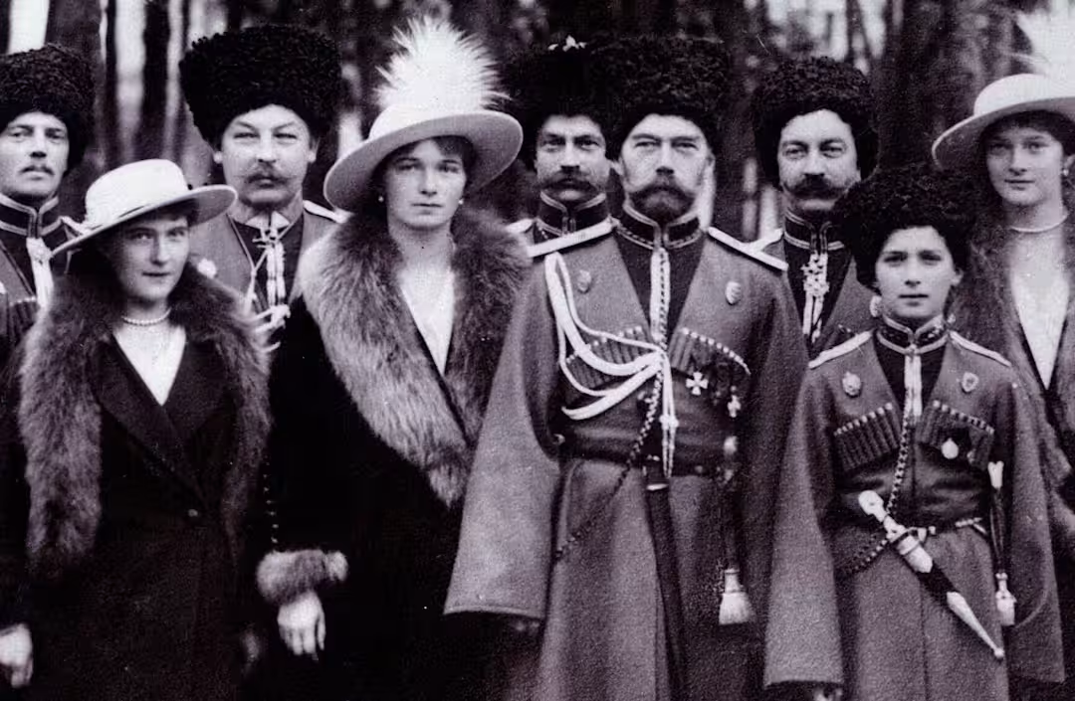
Ending the War-Czarist Russia’s Weaknesses Exposed
Unstable Regime At the Outset:
The Czarist regime faced plenty of threats to stability, from dire urban working conditions to labor strife that the Czar’s soldiers tried to put down by massacring gold miners in Siberia in 1912. To make matters worse, Nicholas II was starting to roll back the limited democratic reforms that he had agreed to in 1905. (Steven Miner, Ohio University)
Lagging War Production Unable to compete:
Russia remained vulnerable because its factories simply couldn’t produce enough arms and ammunition to equip the Czar’s 1.4 million-man army.The antiquated czarist regime’s determination to hang onto power hindered modernization efforts, as a result, “the Russian Empire trailed behind the rest of Europe in terms of economic and industrial strength,” (Lynne Hartnett Villanova University)
Russian Military Loses Confidence in Monarch:
An untrained, incapable Nicholas II led the Russian military. “He fancied himself a military strategist, but he was not,” (Mayhill Fowler, Russian Studies-Stetson University)
The Romanovs visiting a regiment during World War I, c. 1917. L-R: Grand Duchess Anastasia, Grand Duchess Olga, Tsar Nicholas II, Tsarevich Alexei, Grand Duchess Tatiana, and Grand Duchess Maria, along with Kuban Cossacks. World History Archive/UIG/Getty images

Slide 40
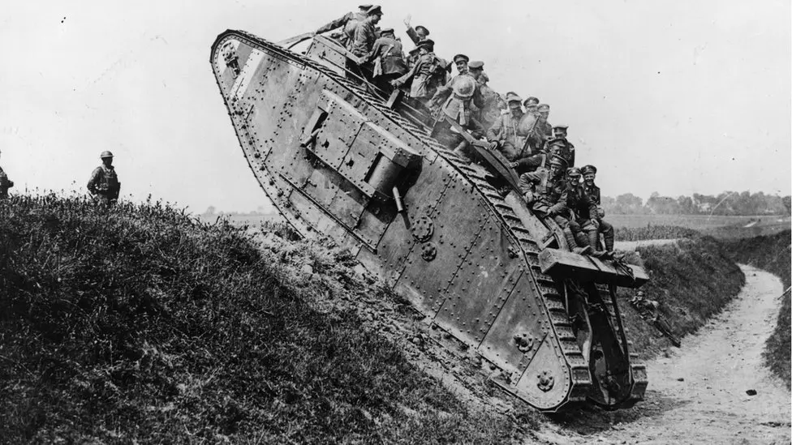
Ending the War- The Soviets Oppose Capitalism
Capitalism Goes to War
War Capitalism: A system where economic growth is driven by violence, coercion, and imperial control rather than free markets. It relies on the strategic use of military force, enslaved labor, and state power to create profit opportunities. Unlike classical capitalism, it doesn’t depend on voluntary exchange or competition but instead on conquest and domination. Private actors—merchants, investors, and companies—collaborated with states to extract wealth from colonized territories. This system was foundational to the rise of Western empires, creating global supply chains based on force. War capitalism laid the groundwork for modern global inequality by institutionalizing exploitation and concentrating wealth in imperial centers.

Slide 41
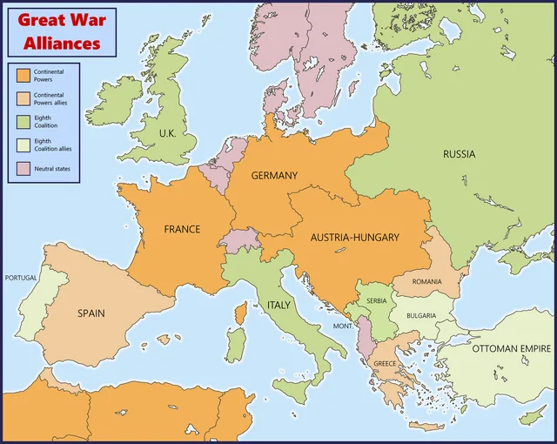
Ending the War- The Soviets Oppose Imperialism
“France and Germany did not go to war over Morocco,” “What happened, though, was that they were conditioned to think of each other as competitors, and to think of the world as this zero-sum game in which the French pursuit of empire could only come at the expense of the German pursuit of empire.” Great Britain was also concerned about Germany’s attempt to build a navy that might challenge its own.
“Although Germany was nowhere close to achieving this, Fogarty says, “the British couldn’t even tolerate the idea of a threat to their naval supremacy, because they had an empire to secure. And so that made them hypersensitive to any competition.”
French and British fears about Germany’s empire-building are part of what drove European nations to form alliances and informal agreements in the decades leading up to World War I, dividing Europe into roughly two opposing camps.”
From Richard Fogarty,University at Albany,co-editor of Empires in World War I: Shifting Frontiers and Imperial Dynamics in a Global Conflict.

Slide 42
Ending the War- The Contradictions Become Unbearable
The Duma, Russia’s elected legislature, couldn't do much about Nicholas’ mismanagement of the country, since he had the power to dissolve it if members dared to disagree with him. Even so, “prominent members wondered aloud if the recent decisions made by the czar’s government were the consequence of stupidity or treason,”
By early 1917, Russia was in throes of a crisis so severe that Nicholas could no longer ignore it.
“Breadlines grew in many cities and most notably in the capital of Petrograd. At the massive Putilov factory in Petrograd, workers went on strike in the early days of March, demanding higher wages to compensate for the high price of food. Rather than meeting the workers’ demands, he says, the factors responded with a lockout, prompting thousands of workers to continue the strike.”
A few days later, on International Women’s Day, tens of thousands of people marched in the streets of Petrograd, with striking factory workers joining forces with mothers who demanded food for their children.
(From Lynne Hartnett, Villanova University)

Slide 43
Land to the Peasantry-The Agrarian program
Lenin’s Agrarian Plan
Nationalization of all lands in the country.
Disposal of the land to be put in charge of the local Soviets of Agricultural Laborers' and Peasants' Deputies.
Organization of separate Soviets of Deputies of Poor Peasants.
Create model farms on each of the large estates... under the control of the Agricultural Laborers' Deputies and for the public account.
To build socialism it is necessary not only to industrialise a country but also to transform agriculture on socialist lines.
Socialism is a system of social economy which combines industry and agriculture on the basis of socialist ownership of the means of production and collective labour.
The socialist transformation of agriculture is the most difficult task of the revolution after the conquest of power by the working class. In contrast to industry, where the socialist revolution finds large-scale and highly-concentrated production, agriculture in the capitalist countries has not reached such a degree of capitalist socialisation of production. Small-scale scattered peasant households numerically predominate in it. So long as small-scale individual farming is the predominant form of agriculture, the basis of the bourgeois economic order continues to exist in the countryside, and the exploitation of the poor and a considerable section of the middle peasantry by the rural bourgeoisie, remains. The system of small-scale commodity production is unable to save the peasant masses from poverty and oppression.
(Lenin "On Cooperation", Selected Works, 1950, English edition, vol. II, Pt. 2, p. 719.)

Slide 44
Land to the Peasantry- Only Socialism Will Save The Working Peasantry
Only the socialist road can save the working masses of the peasantry from every kind of exploitation, poverty and ruin. Marxism-Leninism rejects as senseless and criminal the road of expropriation of the small- and middle-scale producers and the conversion of their means of production into State property. Such a course would undermine any possibility of the victory of the proletarian revolution and would drive the peasantry for a long time into the camp of the enemies of the proletariat. F. Engels wrote:
"When we are in possession of State power we shall not even think of forcibly expropriating the small peasants (regardless of whether with or without compensation) as we shall have to do in the case of the big landowners. Our task relative to the small peasant consists, in the first place, in effecting a transition of his private enterprise and private possession to co-operative ones, not forcibly but by dint of example and the offer of social assistance for this purpose." (Engels "The Peasant Question in France and Germany", Marx and Engels, Selected Works, 1951, English edition, vol. II, p. 393.)
Lenin, in his plan for building socialist society, was guided by the principle that the working class must build socialism in alliance with the peasantry. The plan worked out by Lenin, for the transition of the peasantry from small-scale private property farming to large-scale socialist farming through co-operation, is an essential element of the general plan for building socialism.
Lenin's co-operative plan was based on the fact that, in the conditions of the dictatorship of the proletariat, co-operation is the easiest, most understandable and advantageous path for millions of peasants to use in passing from scattered individual farming to large-scale productive units--the collective farms. The most important economic prerequisite for productive co­operation by the bulk of the peasantry is the all-round development of a large-scale socialist industry, capable of re-organising agriculture too on a modern technical basis. The peasantry are drawn into the channels of socialist construction through the development in the first instance of the most simple forms of co-operation in the sphere of sale, supply and credit, and the gradual transition to co-operation in production, collective farms. Peasant co-operation must proceed with the most careful observance of the voluntary principle. Organisation of the peasant farms into co-operatives proved to be the only correct form of combining the personal interests of the peasants with the interests of the State as a whole, of drawing the main mass of the peasantry into the building of socialism under the leadership of the working class.
In bourgeois society, where the means of production belong to the exploiters, co-operation is a capitalist form of economy. In agricultural co­operation under capitalism the bourgeoisie are economically predominant and exploit the masses of the peasantry. In a social system where political power is in the hands of the working people themselves, and the basic means of production are the property of the proletarian State, co-operation is a Socialist form of economy. "A system of civilised co-operators, given the social ownership of the means of production, with the class victory of the proletariat over the bourgeoisie, is the system of Socialism." (Lenin "On Cooperation", Selected Works, 1950, English edition, vol. II, Pt. 2, p. 719.)

Slide 45
Nationalize The Banks- A Plan for Finance Serving the Proletariat
Communists would “nationalize” or cede to democratic state authority, the currency, means of loaning, borrowing, and accumulating money.
The state would eventually create a single national bank, to eliminate competition between them, as was the case under capitalism.
Workers would control all withdrawals.
Deposits would be secured for depositors.
Convenience, security and access for workers would be prioritized.
Transitioning to the national bank would be gradual and utilize the capitalist systems specialized labor to ensure function.

Slide 46

Nationalize The Banks- How it Benefits the Worker
Government banking presents opportunities for a host of public policy options, serving as a stimulus for potential government solutions to existing social problems. Objections on financial grounds frequently halt proposals for new and expanded public services and projects. The pool of funds in government banks would loosen this restraint. In this way, government banking could combat public resignation to the status quo.
While it would remain necessary to set policy priorities, ideas once dismissed as unrealistic would be deemed worthy of further consideration. Proposals that previously appeared unrealizable would look more attainable. It would become easier to imagine viable social change. The basis of political life would move toward possibilities.
During the first half of the twentieth century, millions of Americans supported government control of banking in a nation where socialist principles supposedly lacked appeal. They wanted the economy to operate in the service of the workers and farmers whose labor underwrote national prosperity, and they believed that realizing this populist vision required a banking system oriented toward public service instead of private profit. Although most advocates of government banking did not identify as socialists, they were sympathetic to the socialist ideal of democratizing the economy.
(Republished from Catalyst: A Journal of Theory and Strategy. By Christopher W. Shaw)

Slide 47
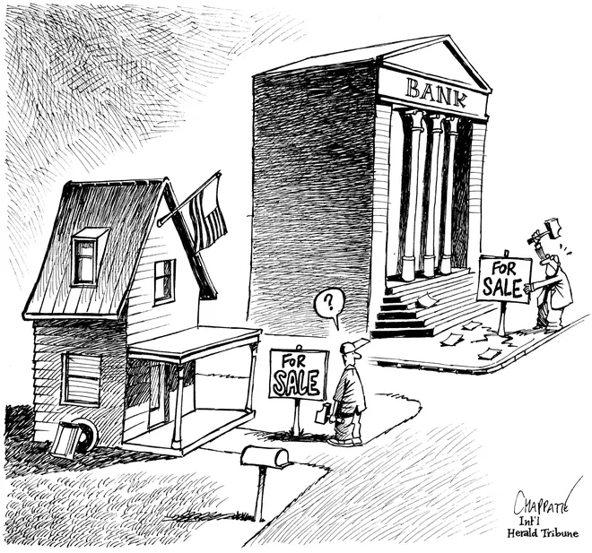
Nationalize The Banks
Jobs
Using the financial power of government banks to save jobs would forge a critical connection between these institutions and the lives of workers. In response to the deindustrialization that devastated numerous communities during the 1970s and 1980s, a movement emerged among workers to acquire and operate discarded manufacturing facilities.
Housing
Affordable housing is a pressing issue throughout the nation. Increasing numbers of working-class residents of both major cities and rural areas are finding it difficult to maintain a stable housing situation. Fiscal constraints are an obstacle to otherwise workable government-owned and rent-regulated solutions. While private investors avoid housing projects that don’t promise high returns, government banks could fill that void by financing social housing programs, ones that need not repeat the mistake of mid-twentieth-century public housing projects of limiting eligibility to lower-income residents. Shoddily constructed, poorly maintained, loosely managed projects intended only for very low-income residents were a recipe for failure. This unfortunate precedent supports not being so exclusive in the future. Many people in middle-income brackets would welcome the opportunity to participate in quality, well-managed social housing programs.
(Republished from Catalyst: A Journal of Theory and Strategy. By Christopher W. Shaw)

Slide 48
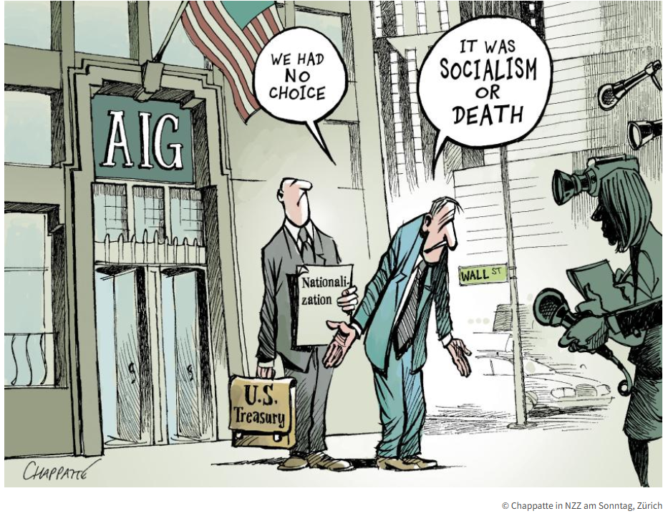
Nationalize The Banks
Schools
Educational facilities such as schools and libraries, in addition to more specialized structures like museums and planetariums, could be constructed and renovated using financing provided by government banks. Buildings that serve the public, from municipal hospitals and clinics to community centers and post offices, could be transformed from blueprints into bricks and mortar. New and improved recreational spaces, including parks, playgrounds, swimming pools, tracks, baseball and softball diamonds, and basketball and tennis courts, could be another outcome of such financing. Cash-strapped public transit and other infrastructure systems struggling to make needed improvements and repairs could also benefit.
Banking Services
Instead of commodifying personal financial information, public banks could offer privacy protections. Credit unions represent a notably successful example of cooperative enterprise in the United States because they provide their members an attractive alternative to for-profit banks. Government banking would attract patronage and win public support for the same reason.
(Republished from Catalyst: A Journal of Theory and Strategy. By Christopher W. Shaw)

Slide 49
Discussion & Wrap Up

Slide 50
Announcements
PCUSA Cell Chairs need to call members of their cells to remind them about attendance.
The next issue of New Masses (2026) has begun production. If you have art you want us to feature, email it to info@partyofcommunistsusa.net.

Slide 51
Volunteers Needed!
We are in need of volunteers for the staff of the People’s School! Here’s a few roles we need filled:
People to help manage posting on our social media and podcast platforms
Video Editors, Audio Editors, Graphic Designers, Artists, Narrators
Web Controls, Moderators
Email info@peoplesschool.us if you’re interested and try to attend our next staff meeting if possible.

Slide 52


Slide 53

View From Left Field
https://viewfromleftfield.libsyn.com
The Old PSMLS Youtube is now the Youtube of View From Left Field, a podcast of analysis and discussion of current events from a progressive perspective.
Like the Youtube videos and subscribe with 5 star ratings on your podcast platforms.

Slide 54

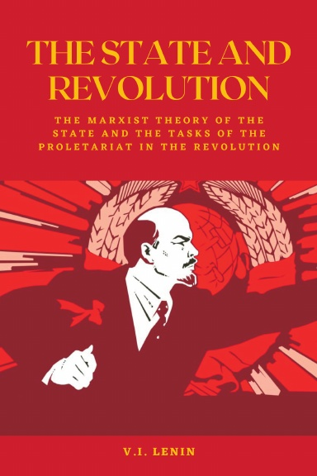
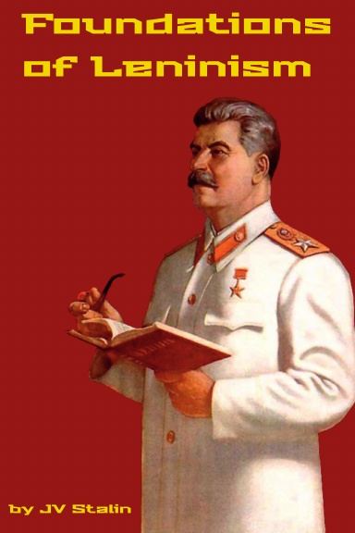

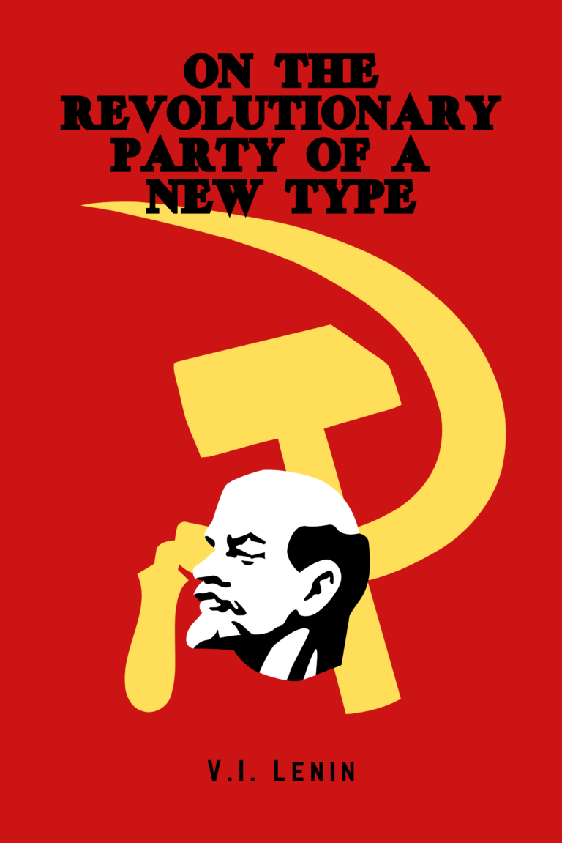
New Outlook Publishers
newoutlookpublishers.store
Relevant and Latest Releases

Slide 55



Harry Bridges School of Labor
luel.us/laborschool/
The Harry Bridges School of Labor is a monthly class covering a variety of topics aimed at building class consciousness among union members. For class schedule and other information, please visit the website at luel.us/laborschool.

Slide 56
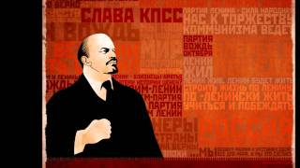
Песня о Ленине - Song about Lenin

