Slide 1

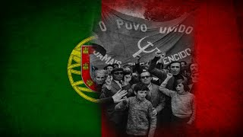
Who’s Afraid of Communism? - Portuguese Song

Slide 2
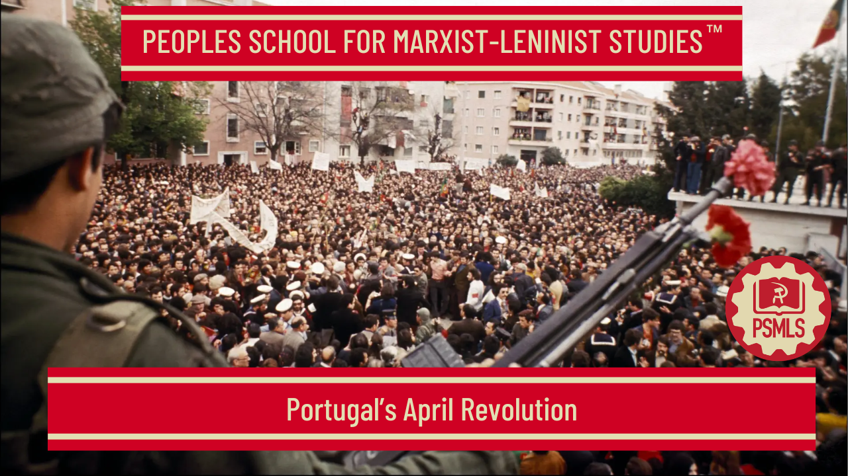
PSMLS 4/28/26

Slide 3
What we’ll be learning today:
Background of Portugal’s History
How did the Revolution Transpire?
Significance of the Revolution

Slide 4
Background of Portugal’s History

Slide 5
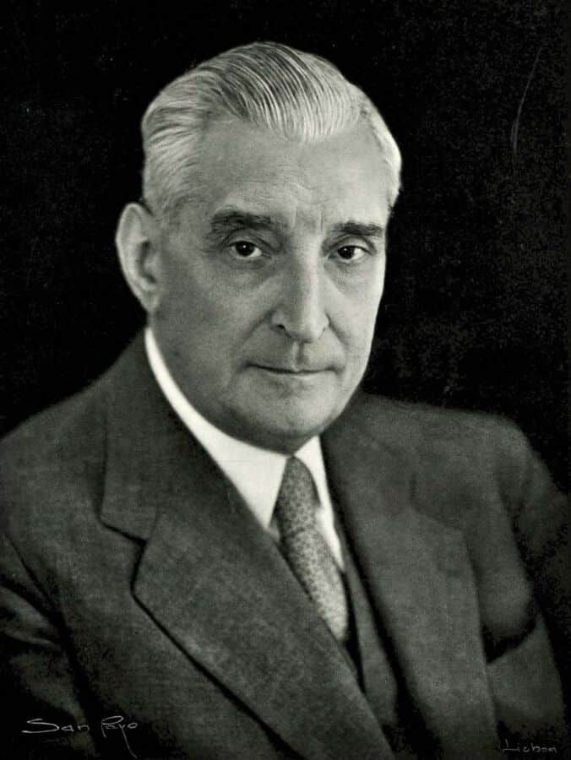
Salazar Comes to Power
In 1932, President of the Republic General Óscar Carmona appointed Salazar to head the government of Portugal after he had been in successful charge of the Finance Ministry for four years. Salazar became President of the Council of Ministers, the equivalent of Prime Minister. Thus began a 19-year collaboration between Salazar and President Carmona.

Slide 6
Salazar Comes to Power
In December 1932, two decrees introduced the punishment for “crimes of rebellion”—exile and imprisonment in the place of exile. Although the new regime permitted liberty of thought, further laws restricted this right.
Censorship became stricter, and Salazar reformed and gave greater power to the secret police (PVDE, later PIDE), and inaugurated the special military tribunal in Lisbon and the propaganda secretariat.
Salazar’s major objective was to neutralise or eliminate his political enemies: anarchists; opposition republicans both civilian and military, many of whom were freemasons; Catholic, liberal and conservative republicans; and monarchists.

Slide 7
The Principal Enemy
All these opposed the new government, but for Salazar the principal enemy was communism, which he named “a grande heresia da nossa idade” (the great heresy of our age).
Worker unions were both socialist and communist, and their General Strike of January 1934 was ruthlessly suppressed. Free trades unions were banned, and Salazar introduced legislation to promote corporativism, giving employers and the state greater control over labour relations.
State employees now had to swear to repudiate “communism and all subversive ideas” including freemasonry. At the same time, Salazar dismantled the fascist blueshirt organisation of Rolão Preto, which lasted only two years (1932-34).

Slide 8
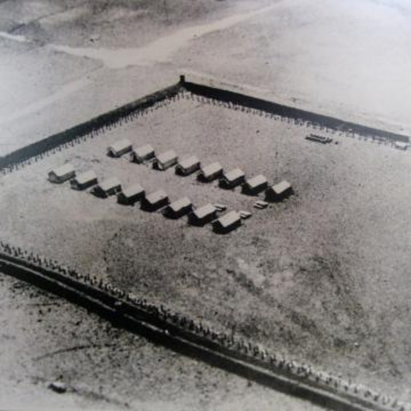
Salazar Comes to Power
As the Nationalist rising in Spain began in July 1936, Portugal soon aligned itself with Franco’s rebels. On September 8 in Lisbon, a communist-led naval revolt in support of Spain’s socialist government was defeated – 10 sailors were killed and 82 were arrested, of whom 34 were sent to the new concentration camp at Tarrafal.

Slide 9
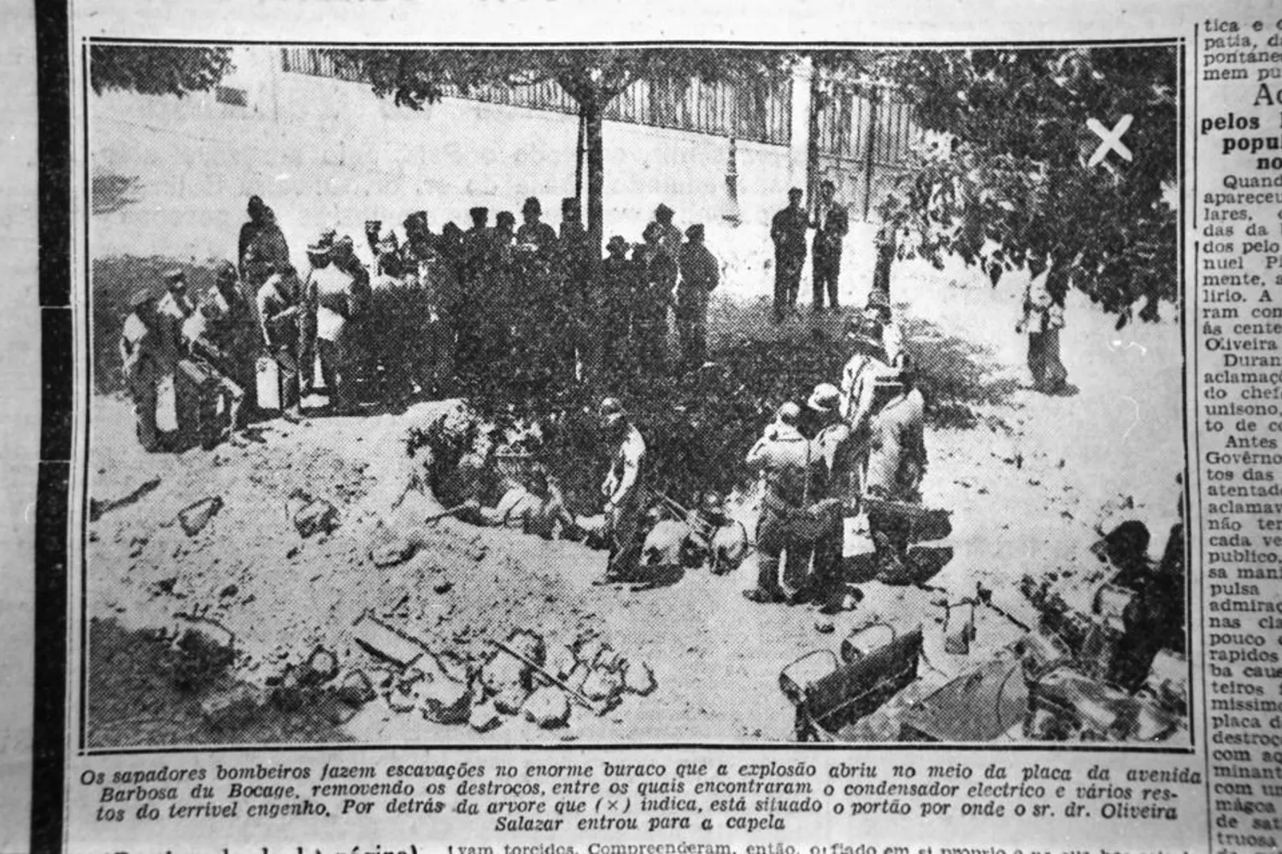
Portugal’s Reichstag Burning
The Frente Popular Portuguesa combined various opposition groups, and on a night in January 1937, members set off bombs in various places in Lisbon.
On Sunday, July 4, a bomb exploded close to Salazar’s car as he was about to attend Mass. Covered in dust, Salazar calmly entered the chapel. The usual suspects were communists, and five reds were apprehended, even though they had played no part in the outrage.

Slide 10
Democratic Reform Defeated
Like the Franco government in Spain, the right-wing Salazar government outlived the defeat of the Nazis, mainly because it was fanatically anti-communist.
After 1945, Salazar was forced to fake some democratic changes to keep up a good image in the eyes of the Allies, and in October of that year, the democratic resistance was authorised to form the Movimento de Unidade Democrática (MUD). Salazar promised free elections, “as free as in free England”.

Slide 11
Democratic Reform Defeated
Initially, MUD was controlled by moderates, but the party soon became strongly influenced by the PCP (Partido Comunista Português), and the leadership of the youth wing was served by several communists, including Mário Soares, Otávio Pato and Salgado Zenha.
Government manipulation of the electoral process persuaded credulous MUD officials to submit the party membership list, after which many people on the list were dismissed from their employment.
Communist influence led to the MUD being outlawed by the government in 1946. Political repression intensified in 1949 and many Communist leaders were arrested, including Álvaro Cunhal, later Secretary-General to the PCP.

Slide 12
Democratic Reform Defeated
The presidential elections of 1949 ranged the 80-year-old government candidate Marshal Carmona against General Norton de Matos, aged 82, representing the opposition. The PCP recommended abstention from the election, and Carmona was re-elected with 14.6% of registered voters.
Salazar’s regime took advantage of the Cold War to score a significant diplomatic victory when in 1949, as an opponent of Soviet foreign policy, Portugal became a founder member of NATO.

Slide 13
Democratic Reform Defeated
During the 1940s, opposition figures hoped for a change of regime, but the hardening of repression during the 1950s brought disillusion. An original supporter of the military coup of 1926, Henrique Galvão fell out of favour with the regime and found himself imprisoned, only to escape into exile in 1959.
Opposition figures seeking regime change through legitimate processes came together again only in 1958, after presidential candidate General Humberto Delgado entered a collision course with the Salazar regime.

Slide 14
Democratic Reform Defeated
On May 10, 1958, Delgado became a hero of the electorate in Portugal with one phrase, memorably spoken in an election meeting in Porto. Asked how he would deal with Salazar if he won the election, Delgado declared: “Obviously, I shall dismiss him.” A wave of hope and expectation flooded the country.
Supported by the secret police and the armed forces, Salazar’s candidate Admiral Américo Tomás cruised to victory with 75% of the vote, amid widespread certainty that the outcome was fraudulent. Threatened with dismissal from the air force, Delgado sought asylum in the Brazilian embassy and went into exile.

Slide 15
Democratic Reform Defeated
Salazar’s main enemies were still the PCP, the socialists, old republicans and liberals, and he now added the liberal wing of the Catholic church. The Catholic Frente Nacional had always supported Salazar, but now Catholics raised the voice of dissent through the Bishop of Porto, D António Ferreira Gomes, who criticised the regime for its neglect of the poorest in society. The bishop was encouraged to make a visit to Rome, after which he was denied re-entry to Portugal, and he spent the next 10 years in exile.
In March 1959, Salazar and PIDE defeated the Cathedral Coup (a plot by army officers who stored weapons in the cathedral), but in January 1960, they were embarrassed by the escape of 10 top communist leaders from the prison in the fortress of Peniche.

Slide 16
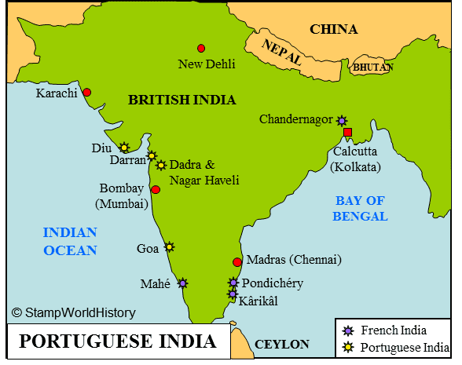
The Great Year of 1961
Salazar’s regime also had to deal with the independence movements in Portugal’s colonies. In 1953, India had already occupied the enclaves of Dadra and Nagar-Haveli, and independence movements formed in Angola (UPA and FNLA) seeking discussions about the peaceful transfer of power.
An incursion into northern Angola from neighbouring Zaire left many Portuguese dead, which inspired a murderous response by the Portuguese army.

Slide 17
The Great Year of 1961
The Portuguese cruise liner ‘Santa Maria’ was hijacked by escaped prisoner Henrique Galvão, and in continental Portugal, a group of 62 prominent figures published on January 31, 1961, a political manifesto calling for greater political transparency. All were soon detained by PIDE.
On February 4, a failed Angolan nationalist raid on the prisons in Luanda provoked a vengeful repression by the white population on the Africans. In March, another uprising in northern Angola left a tally of 800 dead Portuguese, and 6,000 dead Africans.

Slide 18
The Great Year of 1961
The beginning of the Colonial War in Angola soon spread to Guinea-Bissau (1962) and Mozambique (1964). By the end of 1964, there were 52,000 Portuguese soldiers in Angola, 15,000 in Guinea-Bissau and 18,000 in Mozambique.
Opposition to the colonial wars eventually provided the main motive for those officers who eventually overthrew the regime.
In April, the United Nations condemned Portugal’s colonial policy, and in July, Dahomey suddenly occupied the enclave fortress of São João Baptista de AjudáIn
December, India invaded the remaining Portuguese possessions on the sub-continent, Goa, Daman and Diu.

Slide 19
Many Secret Oppositions
Meanwhile, in Portugal itself, another plot, this time by the Minister of Defence Botelho Moniz, was foiled; a TAP airliner was hijacked; and a mutiny at the barracks of Beja left one government minister dead.
In mainland Portugal, between February and June 1962, the regime confronted an intense student opposition in both Lisbon and Coimbra. These young people were the children of the Portuguese elite. Uniting communists, supporters of Humberto Delgado, and radical socialists under the same banner, the Frente Patriótica de Libertação Nacional (FPLN) was founded in Rome in December 1962 and in Geneva in 1964, Mário Soares became a founder member of Ação Socialista Portuguesa. Other splinter marxist and maoist parties also appeared.

Slide 20
Many Secret Oppositions
In 1965, agents of PIDE attracted Humberto Delgado to a secret meeting just over the border in Spain, where he and his secretary were assassinated. Since PIDE was never independent, but always loyal to the dictator, it is certain that Salazar approved both this barbarity and more torture by PIDE.
In the same year, Republic President Américo Tomás was re-elected. He was nicknamed “Senhor Corta-fitas” (Mr Ribbon-cutter) because his main duty seemed to be cutting ribbons at opening ceremonies.
Many Catholics began to oppose the government’s colonial policies. But Salazar scored a diplomatic triumph in 1967, when Pope Paul VI visited the shrine at Fátima on the 50th anniversary of the apparition of the Blessed Virgin.

Slide 21
Many Secret Oppositions
After 1967, the Liga de Unidade e Ação Revolucionária began to use arms in their opposition activities. They raided a branch of the Bank of Portugal, attacked the HQ of the Évora military district and attempted to occupy the town of Covilhã.
Well before Salazar left the political stage, a new type of opposition began to emerge. This was strike action, the most notable of which was the “greve da mala” in Lisbon in 1968, when conductors on public transport refused to take money for tickets.

Slide 22
Why did the Dictatorship Survive for so Long?
To maintain his grip on power, Salazar was skilful in managing three lieutenants. First, his friend Cardinal Cerejeira managed the church; second, Captain Santos Costa managed the Armed Forces; and third, Captain Agostinho Lourenço was in charge of the secret police.
The longevity of the regime depended on two decisive factors. First, in moments of crisis (1945, 1958 and 1961), it retained the support of the whole of the Armed Forces; and second, it succeeded in dismantling opposition groups by intimidation and repression through the police, who “politically cleansed” national and local administrations.

Slide 23
Why did the Dictatorship Survive for so Long?
Few dictatorships rely solely on instruments of repression, and in Portugal the regime used censorship to create an atmosphere of consensus, and consequently a significant number of Portuguese refused to become involved in politics.
With the passing of the years, it seemed that the regime would never fall, and Salazar managed to persuade his political opponents that any attempt was doomed to failure.
With courage, but with little success, many opponents sacrificed their employment, their wealth, their liberty and even their lives as they took part in the struggle against the dictatorship.

Slide 24
Why did the Dictatorship Survive for so Long?
Yet, opposition groups had one outstanding characteristic. They, not the government, seemed to embody social and intellectual leadership as well as a superior political morality. Even though they were unable to unseat the regime, opposition groups were never completely repressed, and ultimately became indispensable to the success of the Armed Forces in defeating the regime on April 25, 1974, the Carnation Revolution.

Slide 25
Discussion & New Members Introductions

Slide 26
New Member Introductions
What is your name, pronouns and state (or country/territory)?
Where do you work? Is it unionized?
How did you find out about the People’s School?
What do you think about tonight's class?

Slide 27
How did the Revolution Transpire?

Slide 28
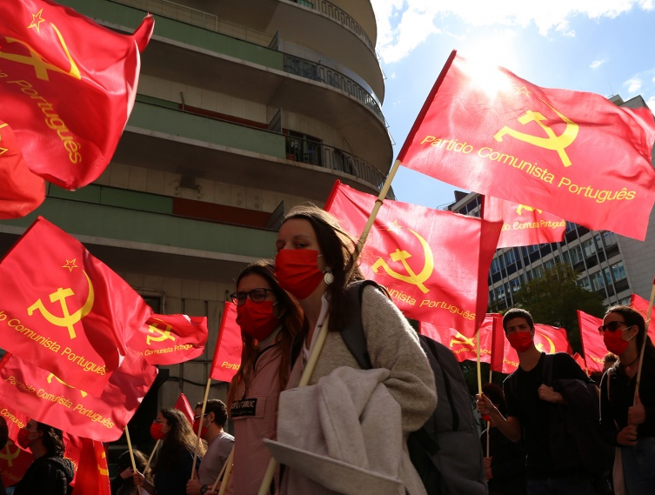
An Insider’s View of the April Revolution
Presentation by Albano Nunes at the Portuguese Communist Party Conference “100 years of the PCP”: The Portuguese Communist Party and the General and Particular in the Portuguese Revolution
The Portuguese Communist Party was the only party to organize itself underground and to resist the violence of repression (and hence it was simply called “the Party”), having asserted itself as the great driving force of the popular and anti-fascist struggle. This was the result of the Party’s working-class origin and its founding ideals; the inspiring impact of the October Revolution; the ideological maturity and the methods of organization and struggle adopted with Bento Gonçalves, General Secretary from 1929; the Party's connection to the working class and the popular masses, deepened with the 1940-41 reorganization; the dedication and heroism of Communist militants, who paid with prison, torture and their lives, their love for the cause of freedom, democracy and socialism. And it was, above all, the result of the correct analysis by the Party, particularly regarding the characteristics of Portuguese capitalism and the class nature of fascism.
“100 years of the PCP” at the Municipal Library of Alcântara in Lisbon - November 2021

Slide 29
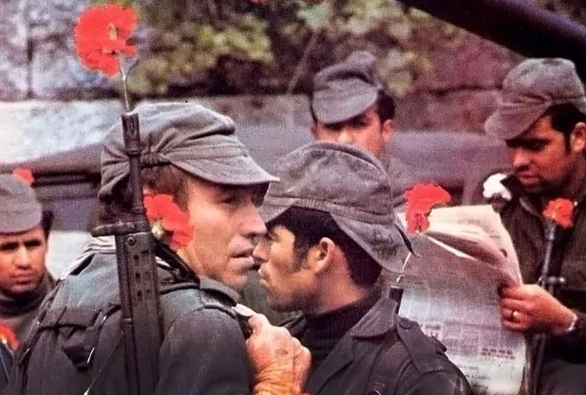
An Insider’s View of the April Revolution
When considering the one hundred years of the PCP's history, it is essential to point out that in its permanent confrontation of ideas within the field of democratic forces and in its struggle for a consistent anti-fascist unity, life has proved the PCP right in fundamental questions related, not only to the specificities of the situation and of the Portuguese Revolution, but in key questions of the theory and practice of revolution, considered according to Marxist criteria. Among them, are highlighted four: 1) “Revolutionary crisis”, a necessary condition for a social revolution; 2) “The necessary intervention of the popular masses”, without which a vanguard, however advanced it may be, is doomed to defeat; 3) “The question of the State”, implying the destruction of the old and the construction of a new revolutionary power representative of the victorious classes; 4) “A people that oppresses other peoples cannot be free” and the intrinsic link between the liquidation of colonialism and the liberation from the domination of imperialism over Portugal. A revolution is not a simple act of will. It does not happen just because more or less important and courageous political forces want to carry it out. It requires that the necessary objective and subjective conditions be met, commonly summarised in the expression “when those below no longer want, and those above no longer can”
Soldiers of the Carnation Revolution

Slide 30
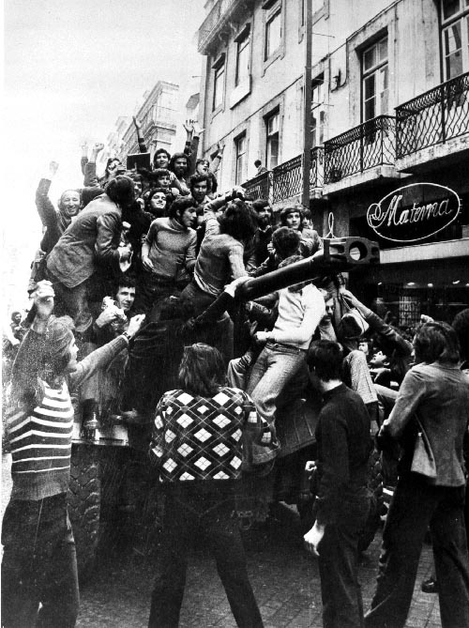
An Insider’s View of the April Revolution
Some, to the right within the democratic opposition, conceived the end of the dictatorship as a result of a simple “disintegration of the regime” or a “peaceful transition”, as happened in neighbouring Spain with the so-called “democratic transition”. For others, like the putschists and also the verbalists of the ‘left’, the conditions were always there, with the ‘spark’ ignited by a courageous ‘vanguard’ being sufficient to ‘set fire to the prairie’, with some even accusing the PCP of being an obstacle to the revolution.
Practice has answered this question by proving the PCP right. The 25th of April took place under the conditions of a deep crisis of the regime, accelerated and deepened by an upsurge in the popular struggle, by the liberation struggle of the peoples of the Portuguese colonies and by international isolation. And also because the sharpening of the class struggle forged the organized forces capable of undertaking the overthrow of the fascist government (the Armed Forces Movement-MFA) and of leading the popular uprising that immediately followed the military uprising (the PCP, other anti-fascist forces, the democratic movement and, above all, the labor and trade union movement), transforming the liberating action of April 25th into a revolution.
A crowd celebrates on a Panhard EBR armoured car in Lisbon, 25 April 1974

Slide 31
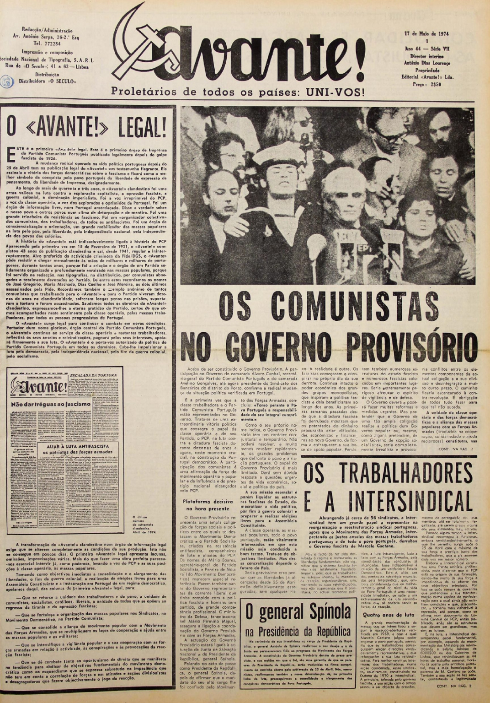
An Insider’s View of the April Revolution
No authentic revolution can develop without the conscious, organized and creative intervention of the popular masses.
As the PCP has always defended, countering viewpoints that feared or devalued mass actions, the April Revolution was the work of an intense and diversified popular struggle, with the working class at the forefront. On the eve of the 25th of April, the struggle was in full upsurge and, significantly, the last clandestine issue of the Avante! (April/1974) headlined on the front page: “No truce to fascism” and “Ally the anti-fascist struggle with the patriots of the armed forces”.
It was the eruption in force, from the very first day, of popular participation and the resulting revolutionary dynamics that enabled the defeat of [General] Spínola's aims to preserve the essentials of the fascist repression apparatus, imposing the immediate establishment of fundamental freedoms and profound democratic transformations, which exceeded the MFA [Armed Forces’ Movement] Programme’s initially limited goals.
This Historical First Legal Issue of Avante! brought Attention to the Presence of Communists in the 1st Provisional Government

Slide 32
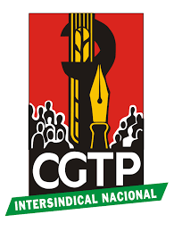
An Insider’s View of the April Revolution
Faced with the military uprising of April 25th that overthrew the fascist government, the Portuguese people did not limit themselves to supporting and demanding. They took the initiative and intervened with joy and enthusiasm in the transformation of society itself and played a decisive role in the defeat of successive counter-revolutionary attempts unleashed by forces lodged at the highest levels of political and military power.
In this process, the working class played a prominent role, both from the city and the countryside, with its class-oriented trade union movement led by the CGTP-Intersindical Nacional trade union central, whose unitary construction, was the result of the PCP’s guidelines for the organization of Unity Committees on the shop floors and for the intervention within the National Fascist Unions themselves (in the framework of the orientations of the 7th Congress of the Communist International, which was held in 1935) and of the tireless work of the communist militants in the companies and workplaces.

Slide 33
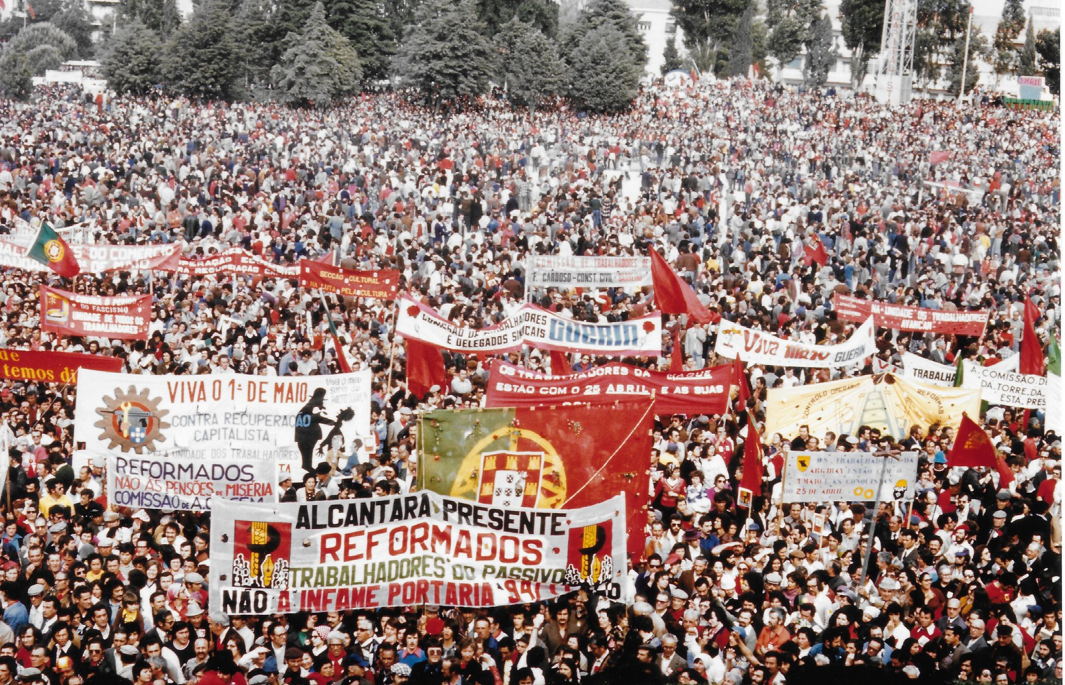
An Insider’s View of the April Revolution
The gigantic 1974 May Day has a profound historical significance, as it confirms a reality that the powerful strikes of the 1940s had already highlighted: the hegemony in the fight against the dictatorship passed from the liberal bourgeoisie to the working class, giving the anti-fascist revolution a strong class character. The fact that it was precisely against the unity of the trade union movement that the reactionary and social democratic forces most openly allied themselves (the ‘Open Letter’ and its surrogates) only confirms the decisive role of the unity and struggle of the working masses in the process of the Portuguese Revolution. It was the strength of the popular movement – which, even after the 25th November [1975] coup, with the resulting defeat of the military and divisions in the democratic field, took to the streets in defence of the revolution’s achievements – that made it possible to adopt the Constitution of the Portuguese Republic, which enshrines the values and the great achievements of the April Revolution. Only the strength of the popular movement explains why it took so many years to destroy the great achievements of the revolution and restore the power of the big economic groups.
May Day in Lisbon, 1974 (Photo: John Green)

Slide 34
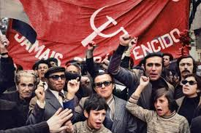
An Insider’s View of the April Revolution
In the PCP’s analysis, the fact that it was not possible to completely cut ties to imperialism (despite the fact that the revolution in itself was a powerful assertion of national sovereignty), nor materialize the alliance of the working class with the peasantry of the Center and North of the country (where the weight of half a century of obscurantism was most felt) were also important shortcomings of the revolution. But the main shortcoming lies in the question of political power.
It is important to remember that, according to the Party Programme, the establishment of democratic freedoms, the destruction of the fascist State and its replacement by a democratic State constituted a central objective of the democratic and national revolution and "a first and indispensable condition for the implementation of its other objectives”.
The process of the Portuguese revolution and counter-revolution confirmed the Marxist thesis according to which the State is the central question of the revolution
Communists Participate in the Carnation Revolution in Portugal

Slide 35
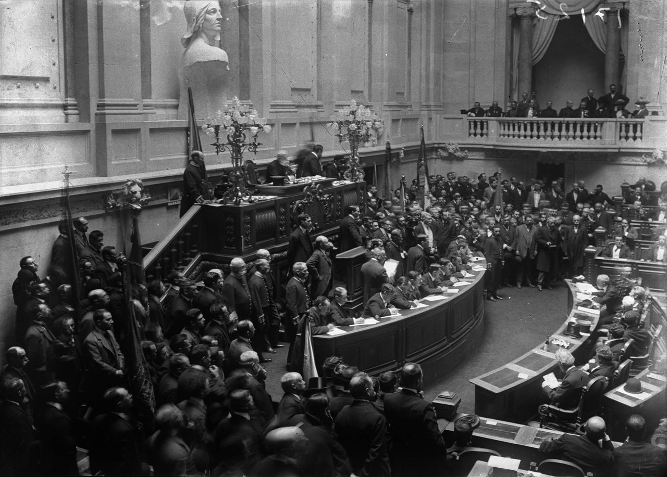
An Insider’s View of the April Revolution
Portugal was both a colonialist country and a colonized country. The struggle of the Portuguese people against colonialism and against the colonial war was simultaneously a struggle against the domination of Portugal by imperialism. The Portuguese people and the peoples of the former Portuguese colonies in their struggle for liberation became allies in the struggle against a common enemy, Portuguese fascism and colonialism. Regarding the colonial question, there were irreconcilable differences in the opposition movement to the fascist regime. The liberal sectors and the 'socialists' advocated colonialist or neo-colonial solutions and, when it became unavoidable for the democratic movement to take a clear position, they preferred to break unity, as happened in the 'elections' for the fascist National Assembly of 1969, in the face of CDE's courageous anti-colonial position. For many years, only the PCP took a principled anti-colonial position and defended the self-determination and independence of peoples subjected to Portuguese colonial rule. “Recognizing and assuring the peoples of the Portuguese colonies the right to immediate independence” is one of the eight fundamental points inscribed in its Programme.
The National Constituent Assembly of the First Portuguese Republic

Slide 36
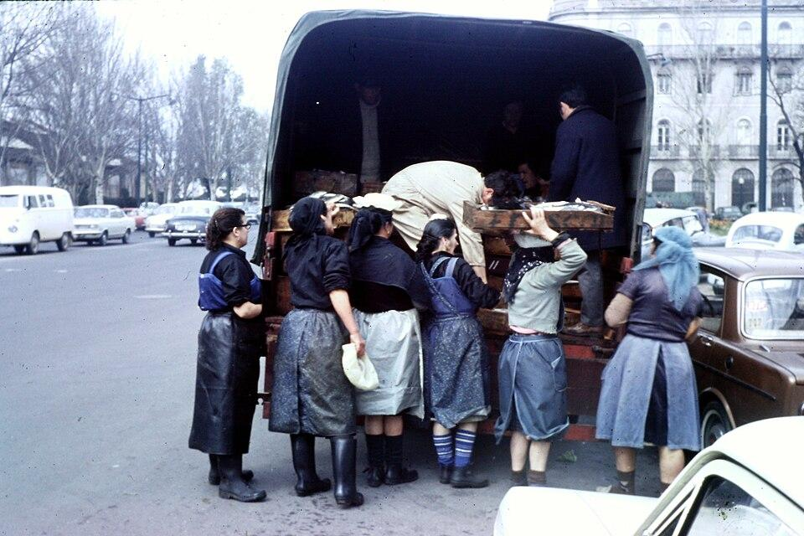
An Insider’s View of the April Revolution
The PCP is the offshoot of a historical epoch. A creation of the Portuguese working class, the birth of the PCP was hastened by the international repercussion of the October Revolution and its remarkable achievements, and its definition and programmatic goals, were initially very marked by the experiences of the first victorious proletarian revolution. But its political line and its Programme evolved with its ideological maturity, its growing roots in the working class and in the people in general, the deepening of its knowledge of Portuguese society and its mastery of the instruments of Marxist-Leninist analysis for the correct definition of the different phases and stages of the struggle for socialism in Portugal. This is the explanation for what will go down in History as an extraordinary merit of the Portuguese communists: the April Revolution basically confirmed what was included in the PCP’s Programme. The April Revolution was a unique revolution (as, by the way, are all true revolutions), because unique was the concrete reality of the country. In the case of Portugal, the capitalism of the 1960s and 1970s was marked by a set of traits that distinguished it from the prevailing reality in other European capitalist countries.
An Early 1970s Lisbon Fish Market

Slide 37
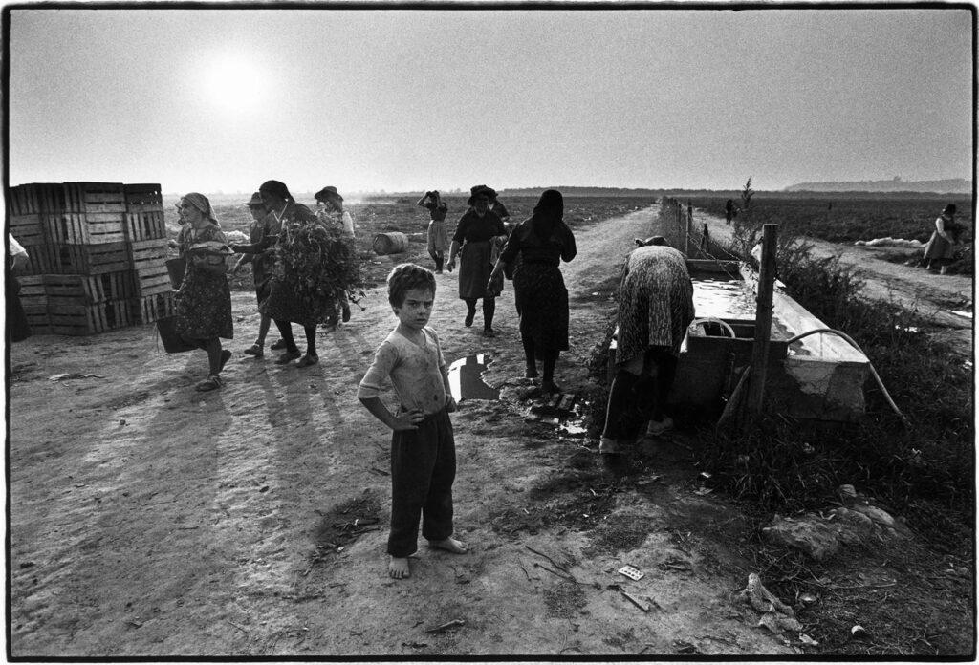
An Insider’s View of the April Revolution
A backward capitalist country, but with a very high degree of monopolistic concentration, in such a way that only seven economic groups dominated the economy and political power; a colonizing country, with the oldest colonial empire in the world, but, at the same time, a country colonized by the great imperialist powers; a country dominated by a fascist dictatorship with a highly centralized and purged apparatus, thus calling for the use of the force of guns to overthrow it; a country with a combative working class, both industrial and agricultural (which in the southern countryside represented over 80% of the active population); a country where the only real party was the PCP, which played a decisive role in the social and political struggle against fascism.
As Lenin said, “the concrete analysis of the concrete situation is the soul of Marxism.” The PCP studied Portuguese society in depth and, based on this concrete reality, drew its Programme, clearly defining the character and path of the anti-fascist revolution and its articulation with the struggle in Portugal for a socialist society, the PCP's ultimate objective.
In 1975, landless farmworkers, supported by the PCP, occupied some 1.2 million hectares of agricultural land - These lands were owned by often absentee large landowners and were now turned into 449 agricultural co-operatives with more than 71,000 regularly and non-regularly workers

Slide 38
Discussion

Slide 39
Significance of the Revolution

Slide 40
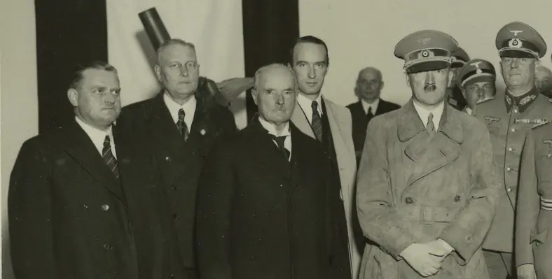
Why it Matters to Communists
People wanted - desperately needed - a better life. Fascism, it should be remembered, is not just a certain style of government suited to the need of personal dictators. It is a form of rule imposed by the big-moneyed interests when democratic liberties impede their ability to super-exploit the common people.
The moneyed interests then opt for a type of government that will crush popular resistance by brute force. Such is fascism, and such was the heavy yoke borne by the Portuguese people for nearly five decades.
Hitler with German industrial magnates. Fascism always works to the benefit of the monopoly-capitalists.

Slide 41
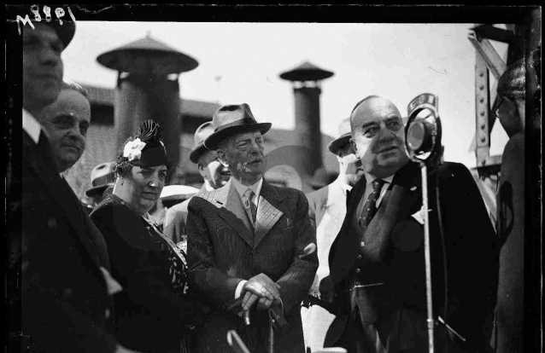
Why it Matters to Communists
A handful powerful monopoly groupings controlled ⅘ of the nation’s wealth. The Melos, Champalimaud and Espirito Santos families, often interlocked through marriage and financial ties, completely dominated economic life. The Melo dynasty alone, through its control of the conglomerate, CUF - since nationalized - controlled 250 firms, including
a leading bank and three of the leading insurance companies. Champalimaud controlled 150 foreign and domestic firms. And many of the small enterprises were also under the heels of the big monopolies through contracting and control of bank credit, raw materials and energy.
Alfredo Silva Melo-CUF Founder

Slide 42
Why it Matters to Communists
It was the combination of economic backwardness, monopolistic control, and economic dependence that led the PCP to challenge the view of the Portuguese Socialist Party leadership that the revolution can be halted at some half-way street of a bourgeois, social-democracy such as exists in West Germany and the Scandinavian countries.
The low level of Portuguese industrial development, the backwards nature of agriculture, the characteristics of its economy all demanded a high rate of exploitation on workers and dependence on western imperialism.
Hence in Portugal it was either a course which leads to socialism, or a course back to fascism. There was no middle choice.

Slide 43
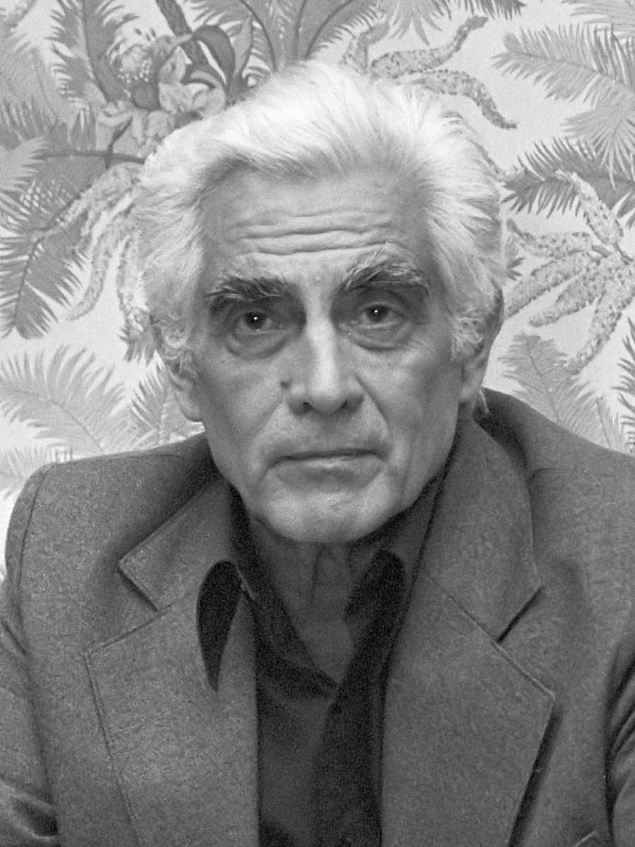
Why it Matters to Communists
This is why Alvaro Cunhal, the General-Secretary of the Portuguese Communist Party told his Party’s Congress in October, 1974, that economic power was still wielded by the monopolists and latifundia owners.
This situation, he said, could not last. “Either the monopolists and large landowners will regain political power and restore dictatorship, or the revolution will end their power in the interests of building a democratic Portugal.”

Slide 44
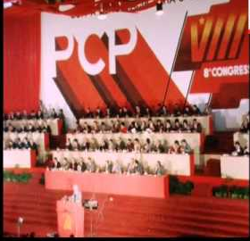
Why it Matters to Communists
“Our principal enemies are reactionaries, the big capitalists, and big agrarians. It is against and these enemies that we fight, and against them we are always ready to make fraternal union with those who are interested in doing so. All workers suffer from exploitation and have the same interests, no matter what their ways of thinking or the political party they may support. Whether communist or socialist…the workers are class brothers in the common fight for a better future, in the fight for agrarian reform, and for the liberation from capitalist exploitation.

Slide 45
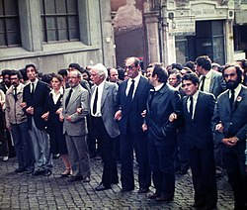
Why it Matters to Communists
“Despite the constant divisionist activities of certain parties, the Communist Party calls upon its militants to establish in their respective sectors the unity of action of democrats of all tendiences, either of the Left parties or the Socialist Party, or any other party. In our policy of unity and cooperation we make no distinction and we do not impose any conditions but one–that the cooperation be based on concrete action for the construction of the new democratic Portugal, moving toward socialism” - Alvaro Cunhal as address in Montemore-o-Novo.

Slide 46
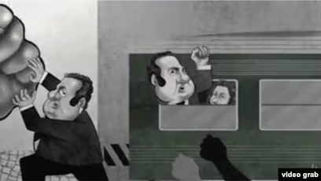
Why it Matters to Communists
One of the charges made against the PCP by Mario Soares and other leaders of the Socialist Party is that it aims to impose one-party rule in Portugal through means of an armed coup. This is quite the opposite of the real position of the PCP.
At its 7th Party Congress held in October 1974, five months after the fascist overthrow, the PCP defined both the present stage of the revolution and how it envisioned the revolution proceeding to the second stage, that of socialism.
Cartoon depicting Mario Soares and preaching revolutionary rhetoric while holding back revolutionary action.

Slide 47
Why it Matters to Communists
It saw the first stage as being “democratic and national” in character. Democratic, in that the revolution was putting an end to fascism, installing political liberty, ending the domination of the financial oligarchy, defending the interests of the people, and realizing a series of profound radical reforms in behalf of the nation and the great majority of people. It was “national” in the that it was putting an end to imperialist domination over Portugal and Portugal’s domination over colonial peoples.
If these objectives are achieved, said the Program of the 1974 Party Congress, a “peaceful passage to socialism” can be attained.

Slide 48
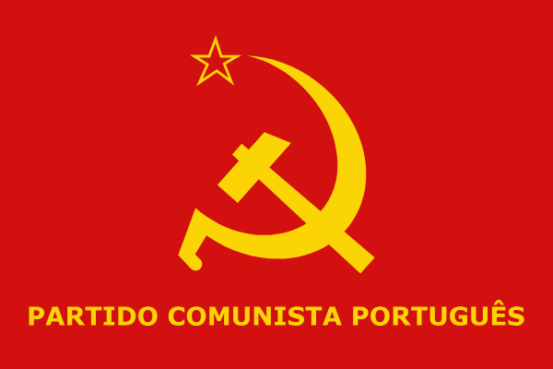
Why it Matters to Communists
The Program then went on to say:
  The working class and the toiling masses are interested in such a peaceful path and the PCP will use all its influence to help make such a path possible. The April 25 victory and the consequent destruction of the fascist state increase the possibilities of attaining that goal.
Thus, the objectives of the Party are not an armed seizure of power but a peaceful transition from one stage of revolution to the next.

Slide 49
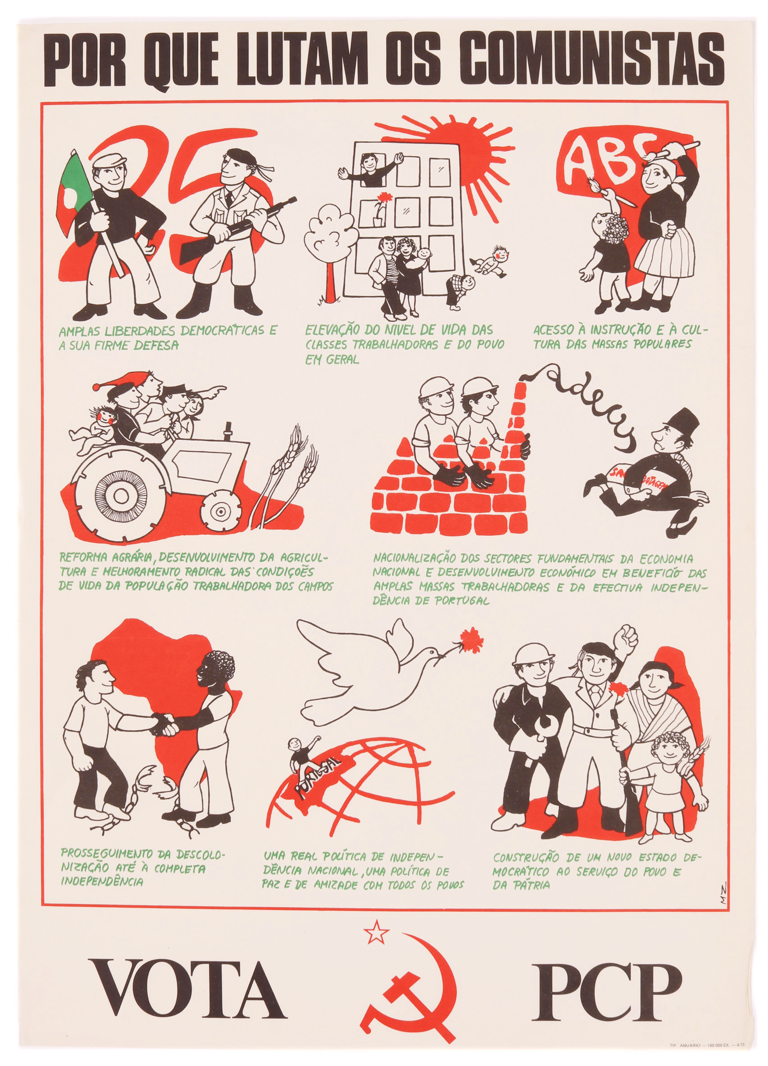
Why it Matters to Communists
The 1974 program also discusses the kind of government possible under Portuguese socialism. History has shown, it declared, that socialist rule assumes varied forms depending upon the concrete situation in each country.
If the unity of multiple political organizations and groups can be maintained, then it should be possible for a socialist government to function through a multi–party system in which there is an agreed upon program of common socialist action.

Slide 50
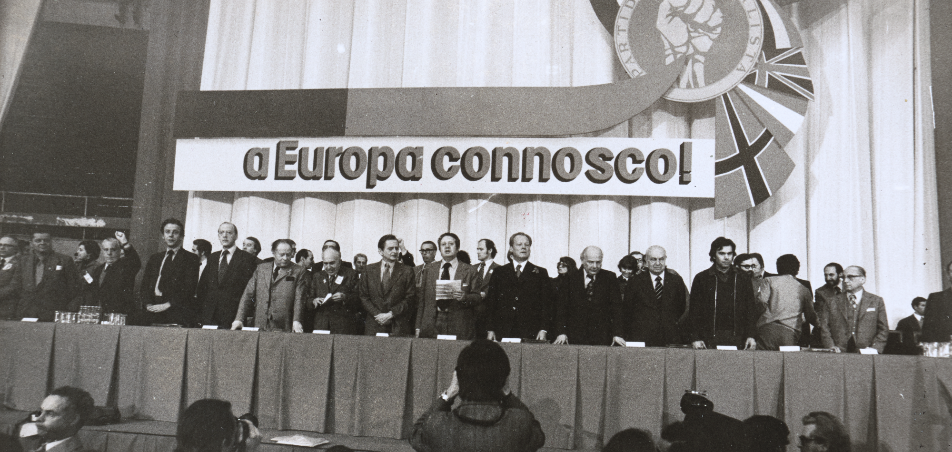
Why it Matters to Communists - Right Opportunists
This is a “pluralism” quite different than favored by Socialist Party leadership, which sees “pluralism” as meaning unity with the Right, with the representatives of Monopoly capitalism. Such is the “pluralism” of the German Social-Democratic Party and others.
But the PCP does not believe in unity with the monopolists. Thus, the 1974 PCP Program stresses, “The PCP’s policy of unity with other progressive forces is for today and for the future.”
“A Europa connoscol” “Europe with us,” Campaign of Europe social-democrat parties mostly in West Europe for connections.

Slide 51
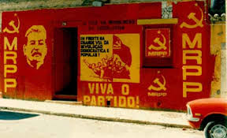
Why it Matters to Communists - Ultraleft distortions
Two Maoist groups, the Movement for the Reorganization of the Party of the Proletariat (MRPP) and the Portuguese Communist Party-Marxist Leninist (PCP-ML) went ultraleft with slogans like “Nem Kissinger Nem Brezhnev”, placing the USSR on the level of US capitalist imperialism.
They saw “social fascists” as the enemy and label both the USSR and PCP with this label. This in turn allied them with the Portuguese Socialist Party who allied themselves with the rightist Popular Democratic Party.

Slide 52
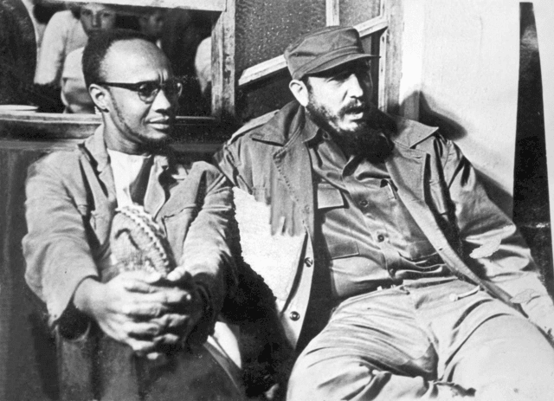
Instrumental to the National Liberation movement in African countries
But to most workers, peasants, and middle class-people whose sons were being drafted year after year to fight and die in a war that was not theirs, and especially to the soldiers doing the fighting and dying, the answer was not some vague promise of self- determination, but immediate and unconditional independence (for Africa).
This, of course, was the demand of the peoples of Angola, Mozambique, Guinea-Bissau, and the other colonies.
Amilcar Cabral, Guinea- Bissau freedom fighter with Fidel Castro

Slide 53

Instrumental to the National Liberation movement in African countries
“We are not fighting just to become black Portuguese,” declared the Mozambique Liberation Front. “We are fighting to affirm ourselves as Mozambiquans without showing any disrespect for the Portuguese People or any other peoples.” This was the firm, clear and dignified stand of the other colonial peoples as well.
Logo of Frente de Libertação de Moçambique (or MLA in English)

Slide 54

Instrumental to the National Liberation movement in African countries
When the fascist regime in Portugal was overthrown, it soon became clear independence could not be avoided. Holden Roberto was “activated” by the CIA and his specific job was to foment tribal strife and civil war in order to prevent unification of Angola under the leadership of the Popular Movement for the Liberation of Angola (MPLA), headed by Dr. Agostinho Neto, a Marxist.
The CIA also gave assistance to groups like the National Liberation Front of Angola (FNLA) and UNITA.

Slide 55
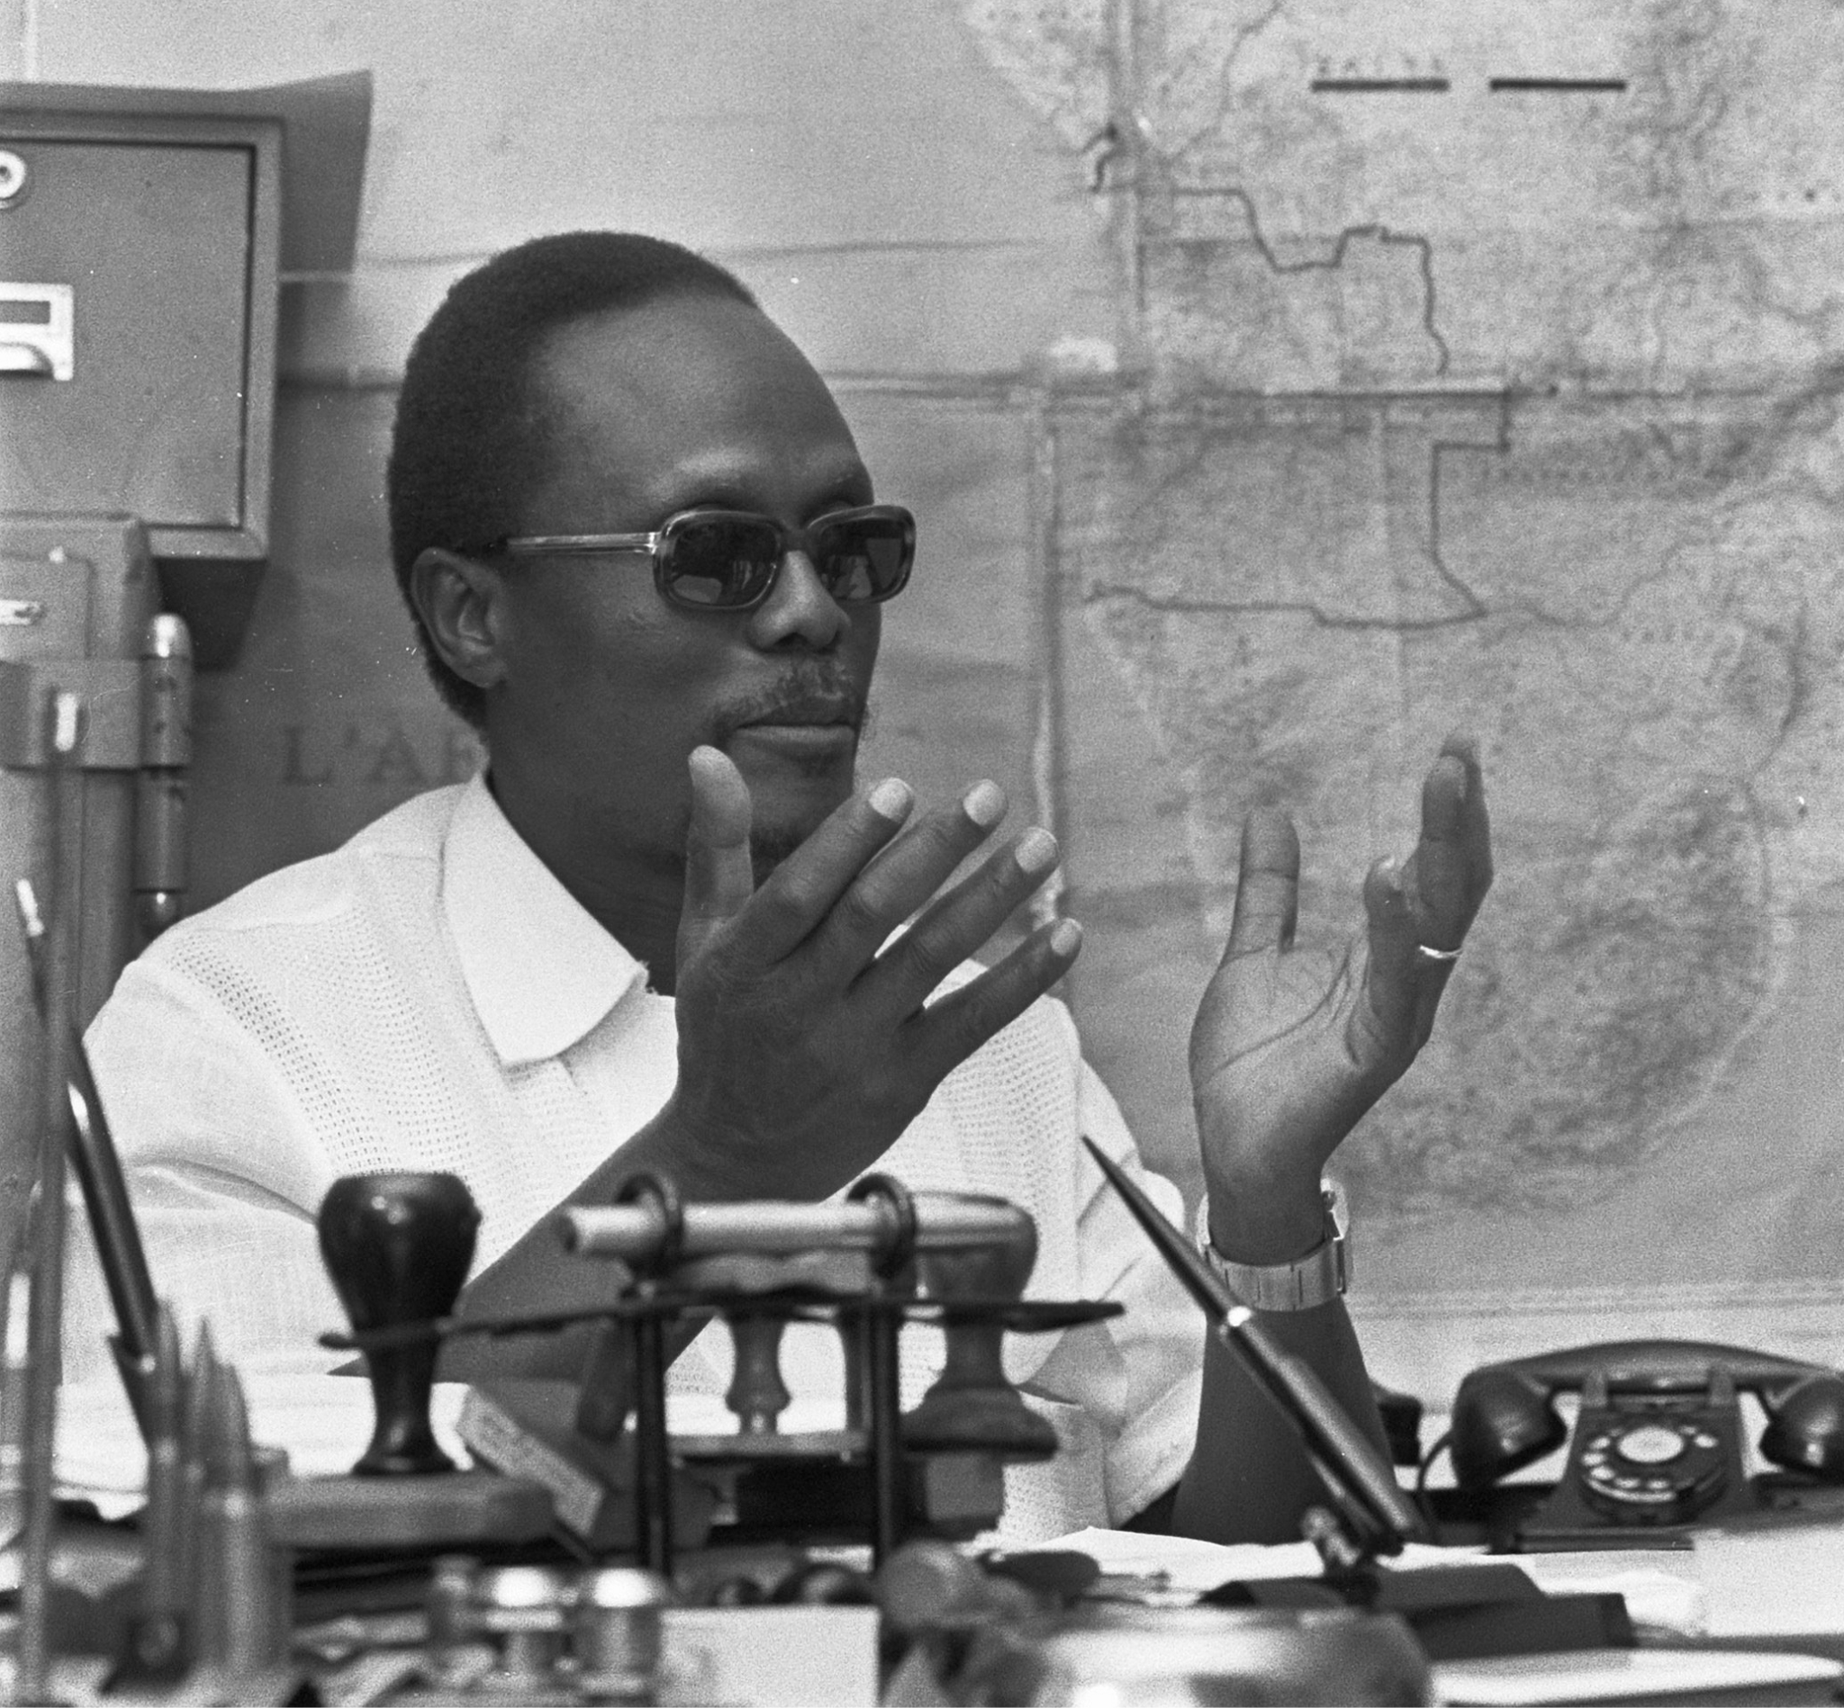
Instrumental to the National Liberation movement in African countries
The FNLA operated in the north, close to the border of Zaire (now Democratic Republic of the Congo Kinshasa). At stake in the north is its rich oil region, Cabinda. Here, Gulf Oil and other multinationals have large investments.
The appeal of the FNLA is primarily to the Bakongo tribal group of which Holden Roberto is a member. It uses tribalism as a major ideological and emotional weapon. As opposed to the internationalism of the MPLA.
Holden Roberto, FNLA Leader

Slide 56
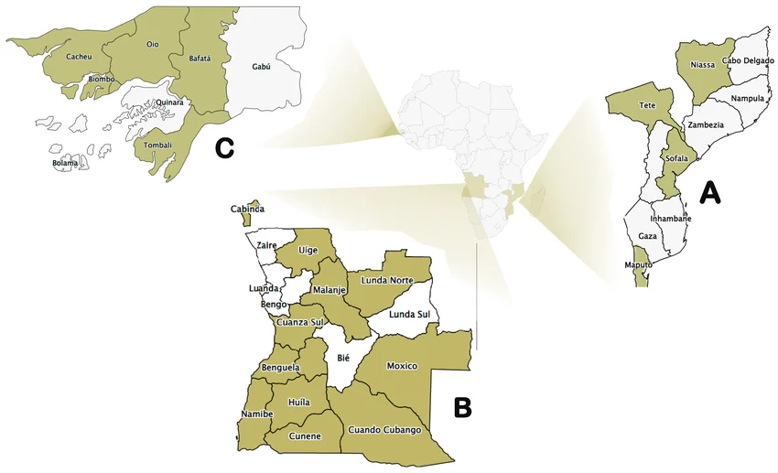
Instrumental to the National Liberation movement in African countries
While Mozambique and Guinea-Bissau have won their independence as well, it should not be taken for granted that US imperialism and the CIA will accept it as a finality. Both countries are rich in natural resources and Mozambique is as large as Texas.

Slide 57
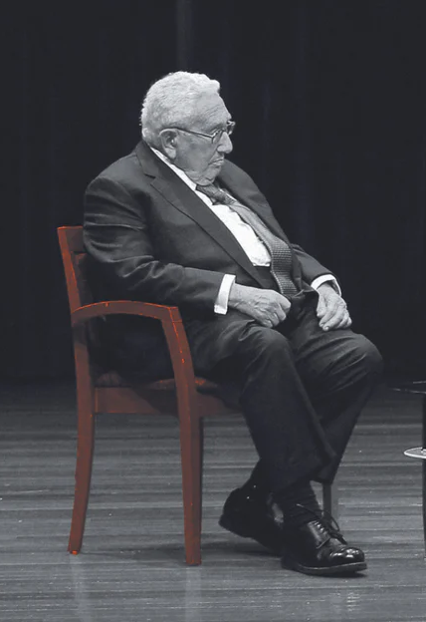
Instrumental to the National Liberation movement in African countries
At the time of the revolution, there was evidence that in addition to US military and financial aid to the FNLA, South African mercenary troops were being employed against liberation forces in Angola, and Zaire at the time had recently murdered Patrice Lumumba.
The government of Zaire at time was on the bankroll of US imperialism and then Secretary of State at the time Henry Kissinger made an additional plea to Congress of $60 million in “aid” to Zaire for its role in the strife in Angola.

Slide 58
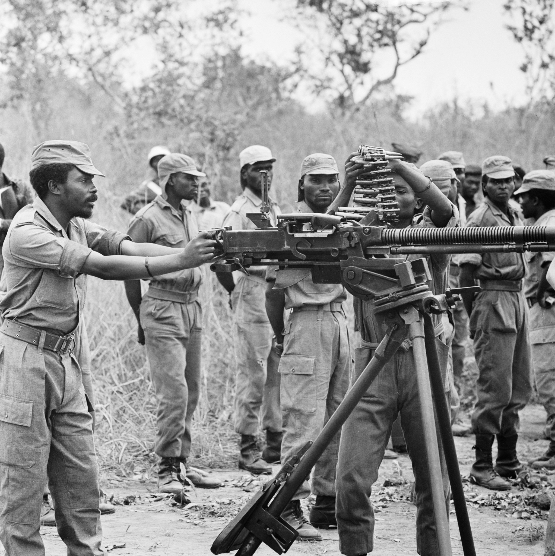
Instrumental to the National Liberation movement in African countries
Another shameful aspect of the situation in Angola was the situation of the role of the Beijing government in 1974-75.
Overwhelming evidence indicates the Chinese government was giving military aid in the form of 450 tons of arms to the FNLA and it was reported about 200 Chinese military advisors, operating from bases in Zaire, were training FNLA troops in guerilla warfare.
FNLA in Zaire training

Slide 59
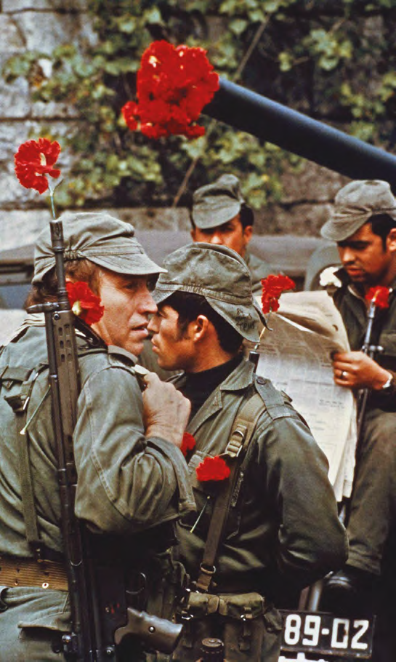
Analyzing Role of Military - When time to act?
The Communist Party and some of the other Left groups had influence in the armed forces and encouraged meetings and assemblies of soldiers, and the formation of a rank and file soldiers revolutionary organization, Soldiers United Will Win.

Slide 60

Analyzing Role of Military - When time to act?
May 1, 1974 was historic. What many had seen as solely a military uprising only five days earlier was transformed on May Day into a mighty peoples’ movement. In a city of about one million, half came out in joyous celebration of the international workers’ holiday. Red flags were proudly on
display, and the slogans, “A people united can never be defeated,” and “Long live the unity of the armed forces and the people,” predominated. This display of workers’ consciousness, unity, and might had two effects. In the first, it strengthened the hand of those in the armed forces movement who wanted basic revolutionary change.

Slide 61
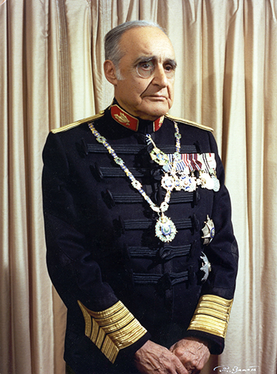
Analyzing Role of Military - When time to act?
The military leaders, at least those in power like General Antonio de Spinola, appointed Premier after the revolution, wanted to lull the revolutionary fervor of the armed forces. Spinola also happened to be on the Board of Directors of a steel company controlled by the Chapalimaud conglomerate.
Spinola wanted to end the overseas wars but form a neocolonial setup that would protect economic interests of western capitalism and postpone independence for the colonies in Africa

Slide 62
Resources cited and questions in this section:
Portugal’s Revolution by Gil Green - Source cited.
Question to consider: In many revolution movement, it appears the material conditions get so bad for the common people and those in the armed forces that revolutionary situations appear to arise. Is this similar to 1917 Russia?
Is there similarities to today?
What lessons can be taken from the Portuguese revolution and applied to today?
What lessons can we take from what happened after in Portugal? Especially on issues of unity and dealing with ultra-left and right opportunists?

Slide 63
Discussion & Wrap Up

Slide 64
Announcements
PCUSA Cell Chairs need to call members of their cells to remind them about attendance.
The next issue of New Masses (2026) has begun production. If you have art you want us to feature, email it to info@partyofcommunistsusa.net.
New Masses will be hosting a movie night on May 30th with the UJPFO for a showing of The Diary of Anne Frank.

Slide 65
Volunteers Needed!
We are in need of volunteers for the staff of the People’s School! Here’s a few roles we need filled:
People to help manage posting on our social media and podcast platforms
Video Editors, Audio Editors, Graphic Designers, Artists, Narrators
Web Controls, Moderators
Email info@peoplesschool.us if you’re interested and try to attend our next staff meeting if possible.

Slide 66

View From Left Field
https://viewfromleftfield.libsyn.com
The Old PSMLS Youtube is now the Youtube of View From Left Field, a podcast of analysis and discussion of current events from a progressive perspective.
Like the Youtube videos and subscribe with 5 star ratings on your podcast platforms.

Slide 67

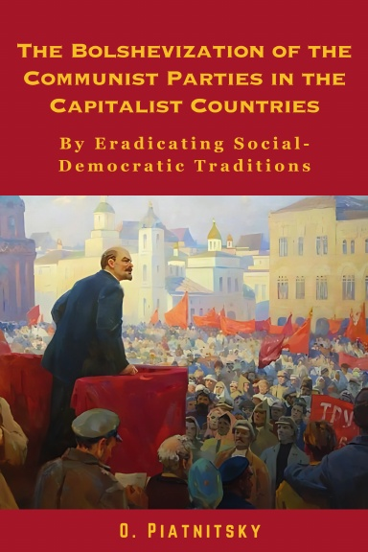
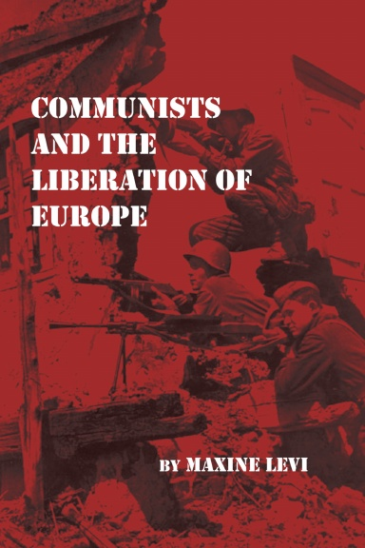
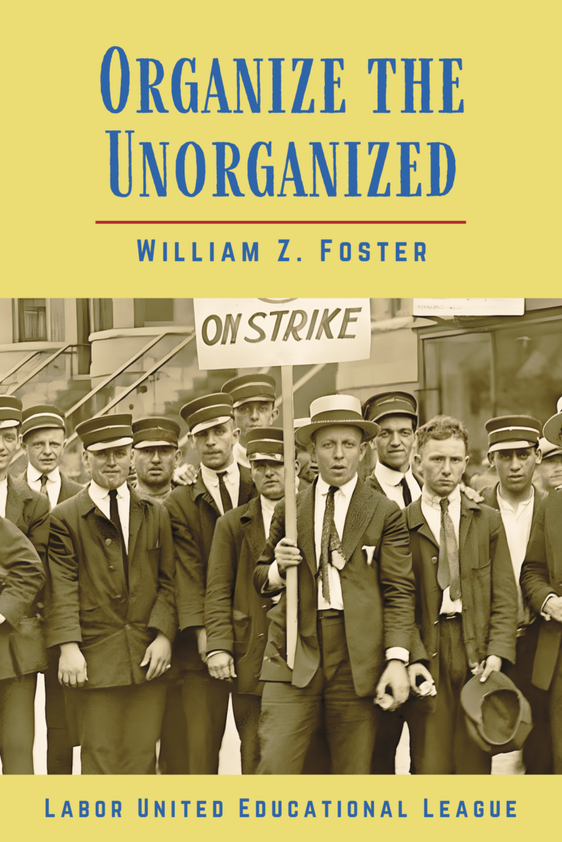

New Outlook Publishers
newoutlookpublishers.store
Relevant and Latest Releases

Slide 68


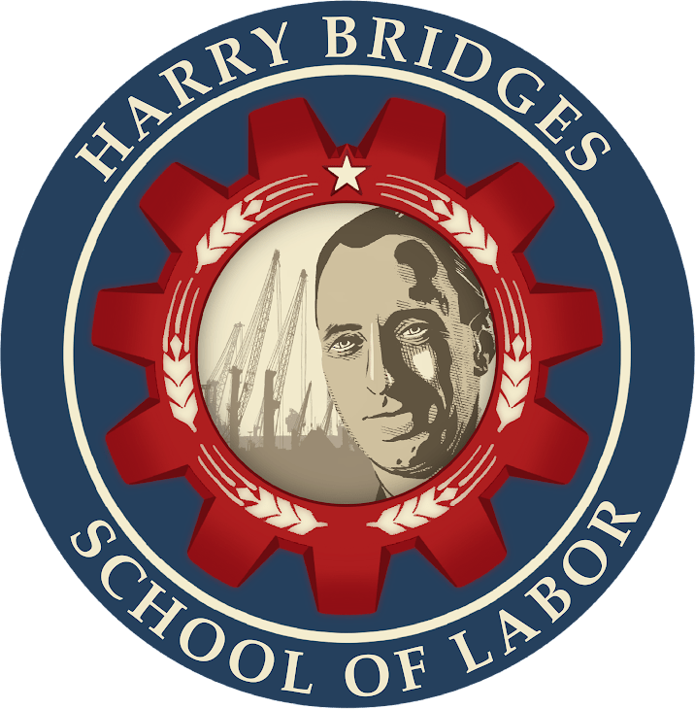
Harry Bridges School of Labor
luel.us/laborschool/
The Harry Bridges School of Labor is a monthly class covering a variety of topics aimed at building class consciousness among union members. For class schedule and other information, please visit the website at luel.us/laborschool.

Slide 69
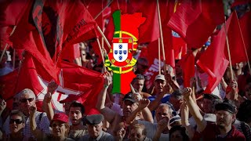
The Internationale in Portuguese

