Slide 1

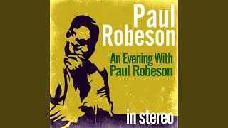
Land of my Fathers by Paul Robeson

Slide 2
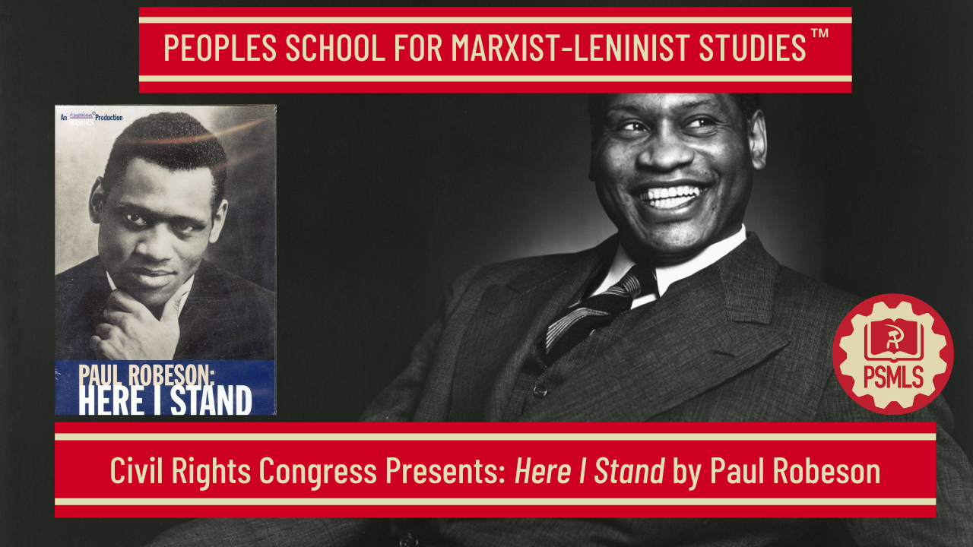
PSMLS 4/7/26

Slide 3
What we’ll be learning today:
Clips from the Tallest Tree in our Forest
Excerpts from Here I Stand
HUAC Testimony

Slide 4
Clips from the Tallest Tree in our Forest

Slide 5

Clips from the Tallest Tree in our Forest

Slide 6
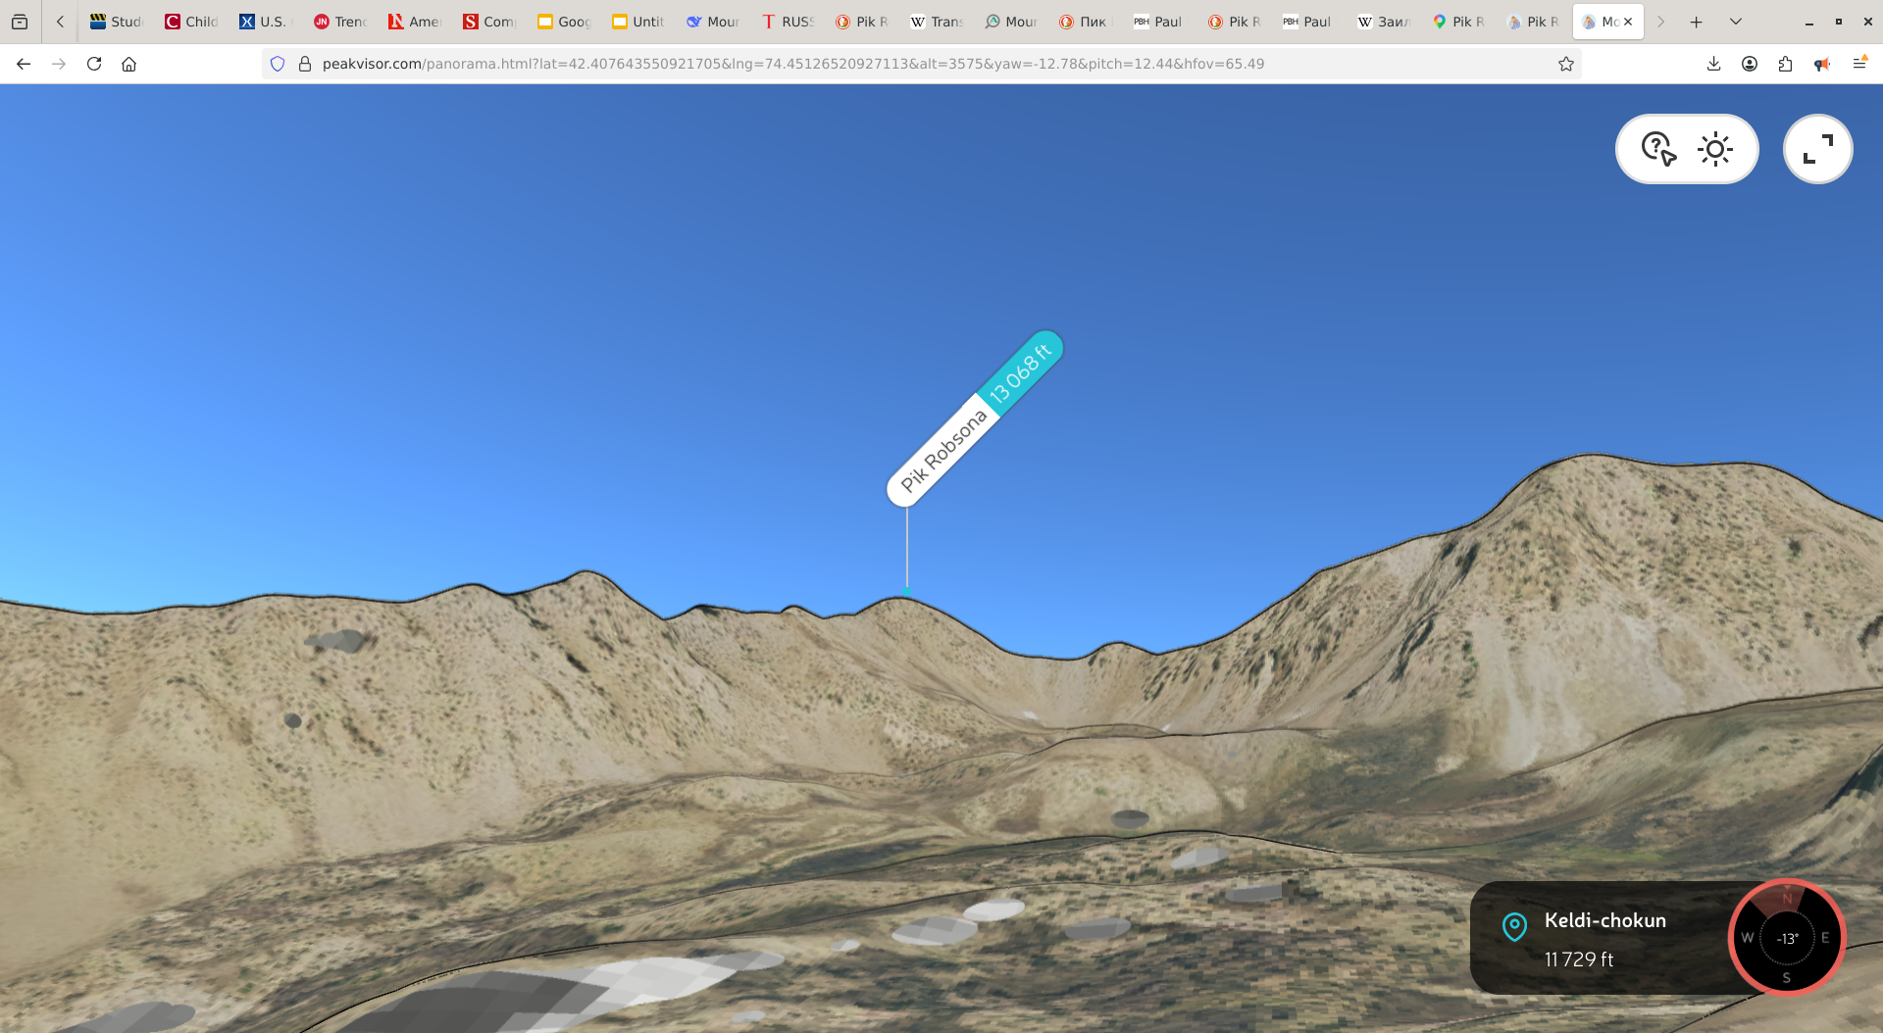
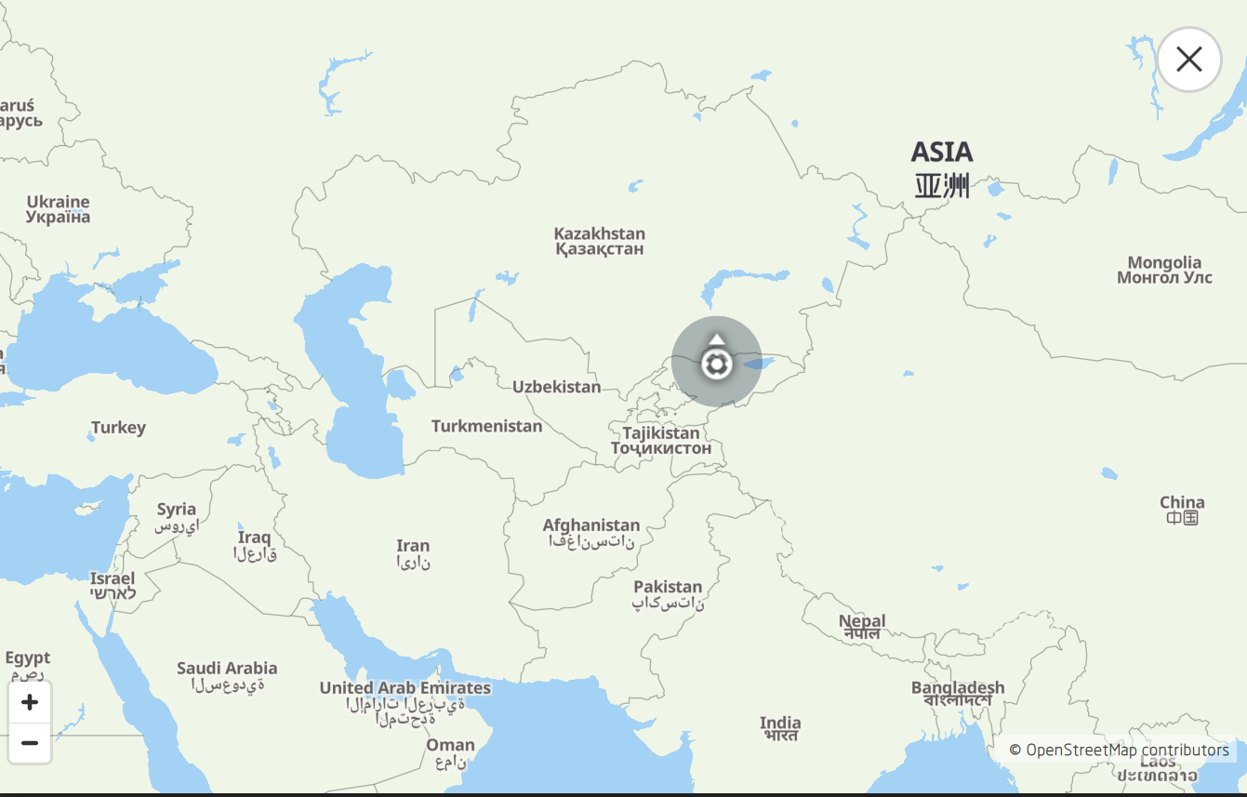
Peak Robeson, Kyrgyzstan
Peak Robeson viewed from the peakvisor terrain simulator
Peak Robeson as viewed on a peakvisor map

Slide 7
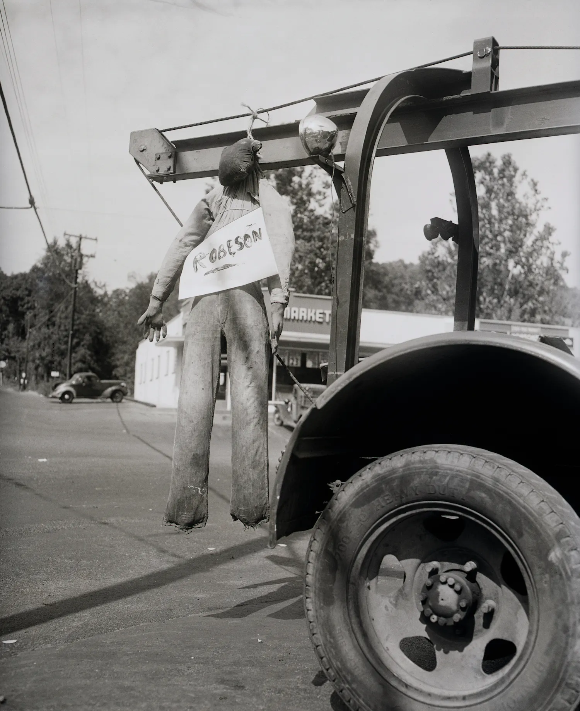
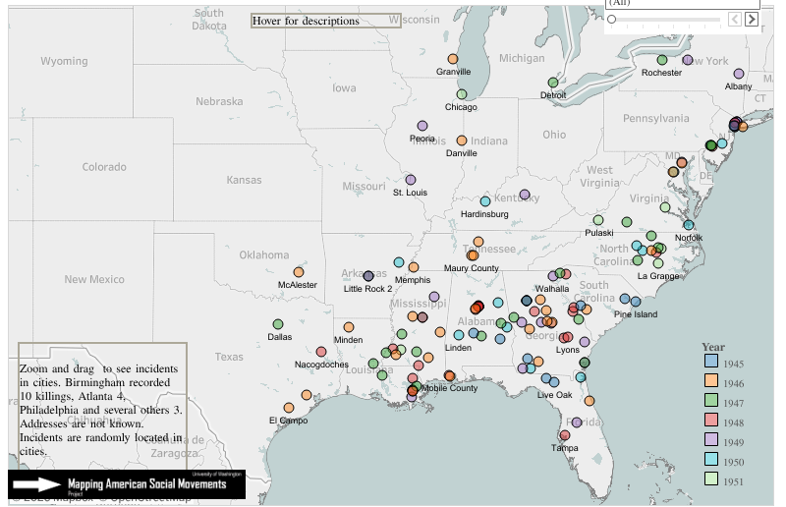
Genocide against Negros
A lynched effigy of Robeson, likely meant to intimidate him, New York State, September 4, 1949
Killings by police and lynch mobs 1945-1951 mentioned in We Charge Genocide (1951)

Slide 8
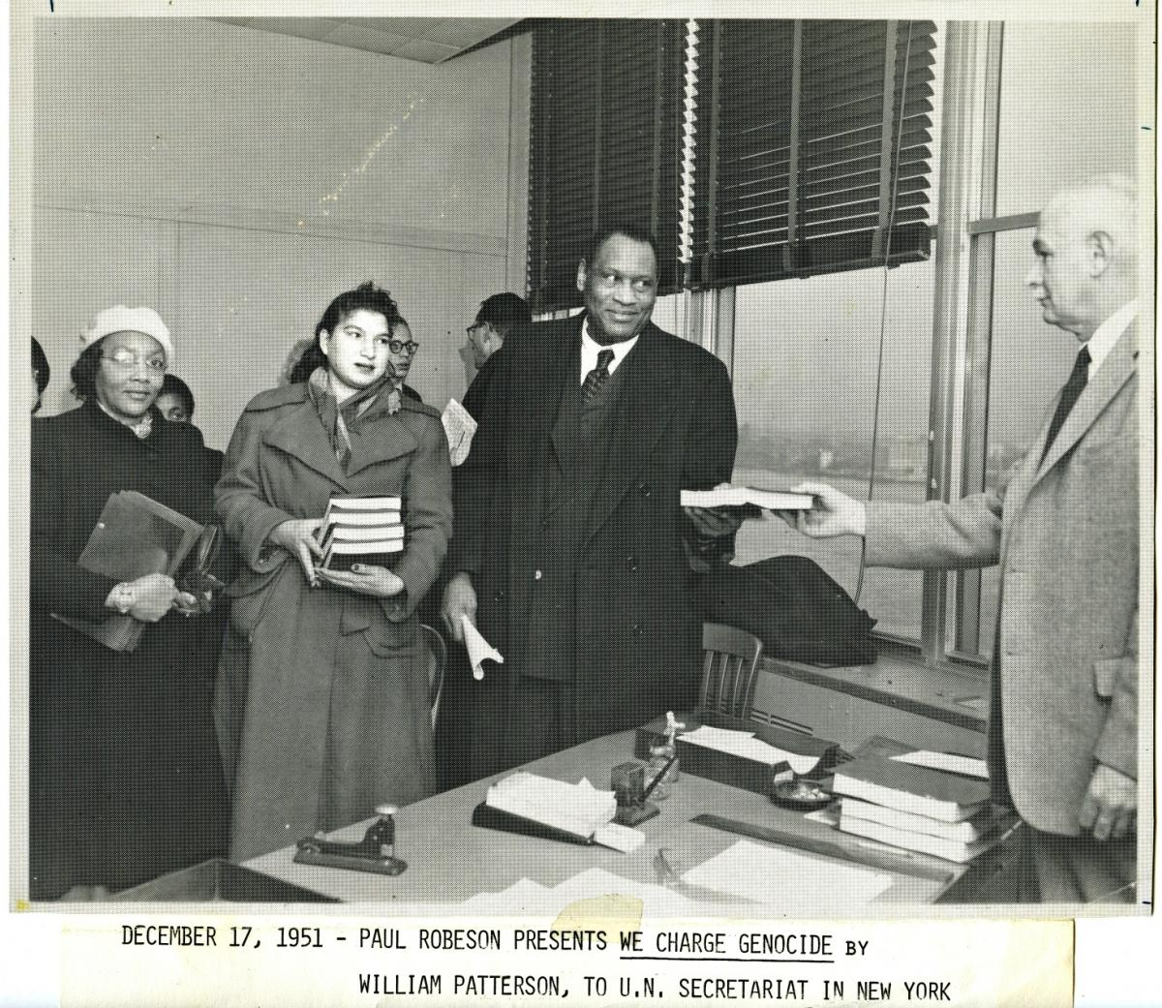
We Charge Genocide
Robeson “really felt in the struggle against fascism,” abroad and at home. After WWII, against the effort to brutally suppress black people, Paul Robeson submitted a petition from the Civil Rights Congress (CRC) to the United Nations, titled “We Charge Genocide: The Crime of Government Against the Negro People,” citing the the U.N.’s definition of genocide, but agents of the U.S. government suppressed the petition, preventing it from ever being discussed by any U.N. body.
December 17, 1951—Robeson presents We Charge Genocide by Wiliam Patterson to U.N. Secretariat in New York

Slide 9
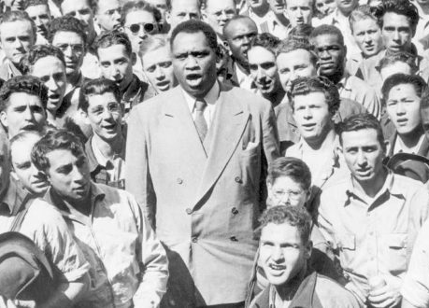
Involvement in the Labor Movement
Robeson had a long association with the labor movement in the United States and internationally. Mark Naison, professor of African American history and studies at Fordham University has referred to Robeson's involvement with the Labor movement as being ”One of the least known, but most significant dimensions of his political activism.” Like Woody Guthrie, Robeson completely identified with the fate of American and international labor. In Robeson’s own words, he spoke of two major influences—the hardships of his youth in facing racism and the class system and the transforming effects of interacting with the British working class. Robeson seemed to understand that ”the emancipation of the working classes must be conquered by the working classes themselves,” as said by Marx.
Robeson singing the “Star Spangled Banner” amidst a sea of black and white union workers, 1942

Slide 10
Discussion

Slide 11
Discussion & New Members Introductions

Slide 12
New Member Introductions
What is your name, pronouns and state (or country/territory)?
Where do you work? Is it unionized?
How did you find out about the People’s School?
What do you think about tonight's class?

Slide 13
Excerpts from Here I Stand

Slide 14
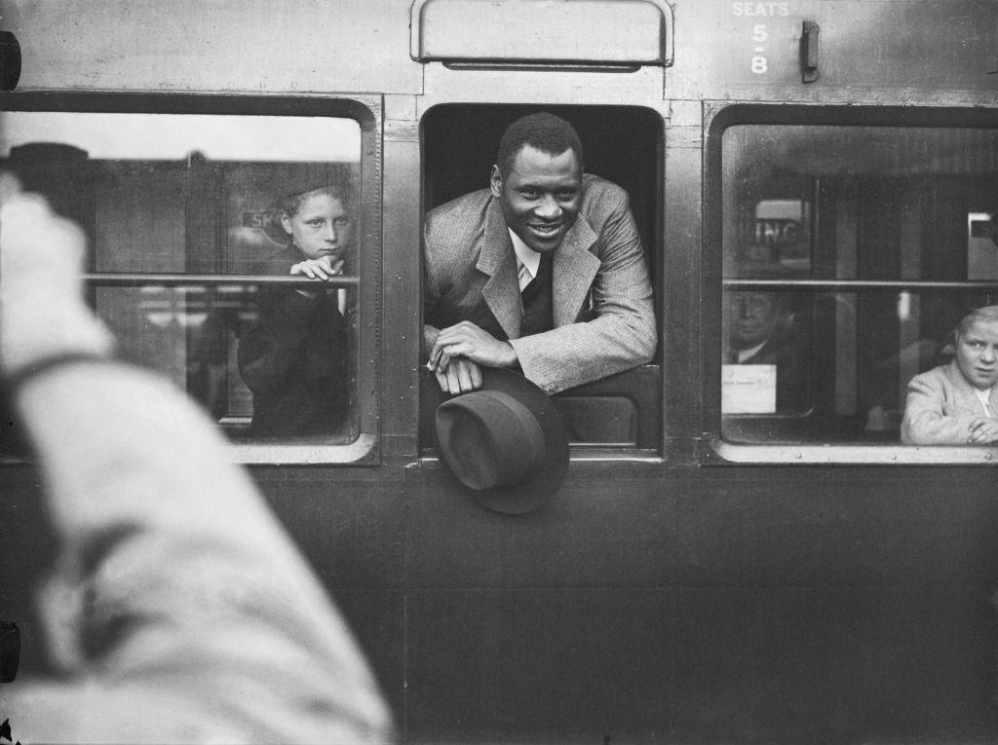
The Right to Travel
What concerns me here is the question of the right to travel in relation to the subject of Negro rights. The State Department will tell you that the fact that I am an advocate of Negro rights has nothing to do with their...[cancellation of my passport and denial of my right to travel], and to some people this might seem to be true since white persons as well as Negroes have been denied passports in this “cold-war” period. Nevertheless, there are facts—indisputable facts— which indicate that my concern for Negro rights is indeed at the heart of the case in which I am involved. When my passport was revoked in 1950 (I had held one since 1922), 1 took the matter to court; and from the outset it was apparent that the Negro question was the crux of the matter. The State Department’s brief, submitted to the Court of Appeals hearing in February, 1952, contained the following revealing statement in opposition to my claim of the right to travel:
“...Furthermore, even if the complaint had alleged, which it does not, that the passport was cancelled solely because of the applicant's recognized status as spokesman for large sections of Negro Americans, we submit that this would not amount to an abuse of discretion in view of appellant’s frank admission that he has been for years extremely active politically in behalf of independence of the colonial people of Africa.”
Paul Robeson leaves Waterloo Station in London, to catch the 'Majestic' boat train, 25th September 1935

Slide 15
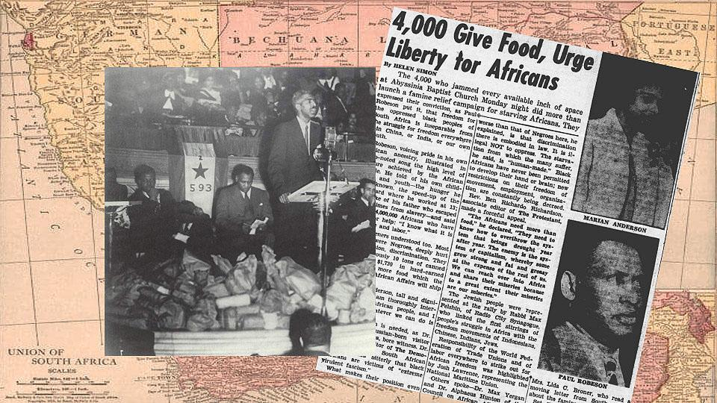
The Verdict of History
This attitude of the State Department should outrage every decent American, because the tradition of our country (which was itself born in a great revolution of colonies against alien rule) has always favored the concept that just government can exist only with the consent of the governed. For Negroes, the State Department’s viewpoint must have even greater significance. When I, as a Negro American, was restricted and charged with having acted against the “best interests of the United States" by working in behalf of African liberation, some very important questions arise: What are the best interests of Negro Americans in this matter? Can we oppose White Supremacy in South Carolina and not oppose that same vicious system in South Africa? No matter what any Washington officials may "decide,” the verdict of history, which we are reading in the stormy events of our day, is unmistakably clear: Those forces which stand against the freedom of nations are not only wrong—they are doomed to utter defeat and dishonor! Our country is strong and mighty among the nations of the world, but America cannot survive if she insists upon bearing the burden of the crumbling system of Imperialism. The colonial peoples—the colored peoples of the world—are going to be free and equal no matter whose “best interests" are in the way.
Food is piled up on the front of a stage as Alphaeus Hunton addresses 4,000 people at Abyssinian Baptist Church to open the South African famine relief campaign in 1946. Josh Lawrence, Paul Robeson, Rev. Shelton Bishop, and Adam C. Powell Sr. are seated behind the cans and bags of food.

Slide 16
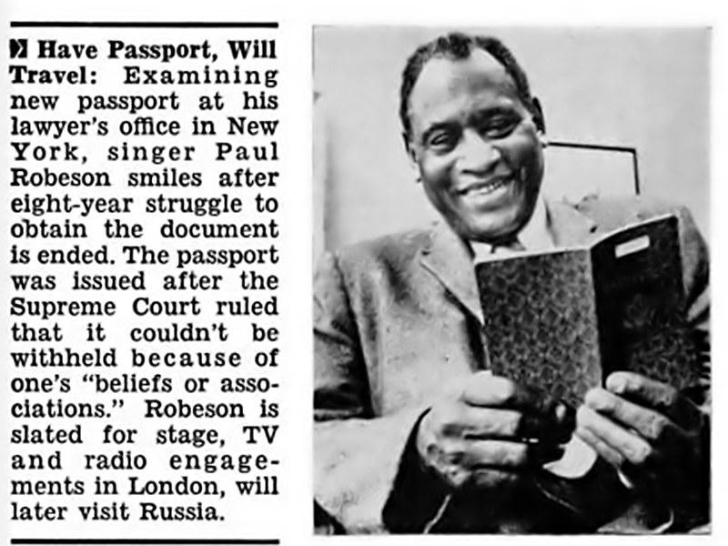
Criticism Until Change
But it simply is not true that the real interests of our country are opposed to colonial independence, and most Americans, white and Negro, are aware of that truth. Indeed, the fact that the men who direct our government feel it necessary to present their support of Imperialism in terms of defending the “Free World” is proof that the American people generally have a democratic outlook and believe in the independence of nations. In presenting the State Department’s position to a Federal court hearing in my passport case, in 1955, a U.S. Attorney said that Paul Robeson “during his concert tours abroad had repeatedly criticized the conditions of Negroes in the United States.” I say: So what? I have criticized those conditions abroad as I have at home, and I shall continue to do so until those conditions are changed. What is the Negro traveler supposed to do—keep silent or lie about what is happening to his people back home? Not I. Furthermore, as long as other Americans are not required to be silent or false in reference to their interests, I shall insist that to impose such restrictions on Negroes is unjust, discriminatory and intolerable.

Slide 17
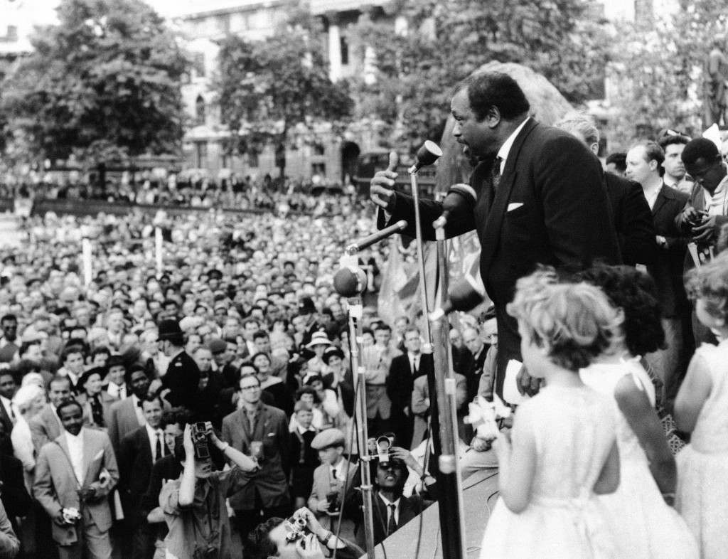
Devotion to the People's Interests
People who go abroad as private citizens are not servants of the State Department: on the contrary, the State Department is supposed to be the servant of the people. Hence, no job-holder in Washington has the legal or moral right to demand that any American traveler advocate the viewpoint of that official in order to get a passport. Patriotism—love of one’s country and devotion to its people's interests—cannot be equated with the outlook of some Wall Street corporation lawyer who is appointed Secretary of State or with the views of some political office-seeker who is rewarded with the job of issuing passports. He who upholds the democratic principles of the Declaration of Independence and the Bill of Rights is no less a patriot when he does so abroad, and if such conduct is “embarrassing" to anyone at home—well, shame on him!
Paul Robeson speaks to crowd gathered in Trafalgar Square in London, June 28, 1959 to demonstrate against the H-bomb and nuclear weapons

Slide 18
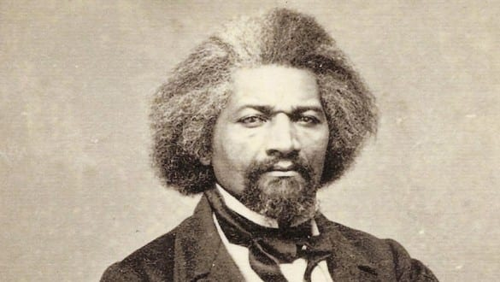
The Restoration of Long-Lost Rights
Negroes who spoke the truth abroad in the years of the Abolitionist struggle were bitterly denounced by the Big White Folks back home, and the U.S. newspapers called Frederick Douglass a "glib-tongued scoundrel” and said he was “running out against the institutions and people of America” when he traveled around Europe arousing anti-slavery sentiment. Defiantly, Douglass retorted:
“I deny the charge that I am saying a word against the institutions of America, or the people as such. What I have to say is against slavery and the slaveholders. I want the slaveholder to feel he has no sympathy in England, Scotland or Ireland; that he has none in Canada, none in Mexico, none among the poor wild Indians; that the voice of the civilized, aye, and the savage world is against him. I would have condemnation blaze down upon him in every direction, till, stunned and overwhelmed with shame and confusion, he is compelled to let go the grasp he holds upon the persons of his victims and restores them to their long-lost rights."
Frederick Augustus Washington Bailey, was born into slavery in Talbot County, Maryland, in 1818, escaped from slavery and arrived in New York City on Sept. 4, 1838. He changed his last name to Douglass soon after his arrival

Slide 19
Glory in Conflict
Douglass, a runaway slave, the greatest of these Negro Abolitionist leaders, was offered a home, land, and the means for a good life for himself and his family in England; but he gratefully declined. In his famous farewell speech to the British people, he told why he was going back to America:
“I do not go back to America to sit still, remain quiet, and enjoy ease and comfort.... I glory in the conflict, that I may thereafter exult in the victory. I know that victory is certain. I go, turning my back upon the ease, comfort and respectability which I might maintain even here....Still I will go back for the sake of my brethren. I go to suffer with them; to toil with them; to endure insult with them; to undergo outrage with them; to lift up my voice in their behalf; to speak and write in their vindication; and struggle in their ranks for the emancipation which shall yet be achieved.”
To achieve the right of full citizenship which is our just demand, we must ever speak and act like free men. When we criticize the treatment of Negroes in America and tell our fellow citizens at home and the peoples abroad what is wrong with our country, each of us can say with Frederick Douglass:
“In doing this, I shall feel myself discharging the duty of a true patriot; for he is a lover of his country who rebukes and does not excuse its sins.”

Slide 20
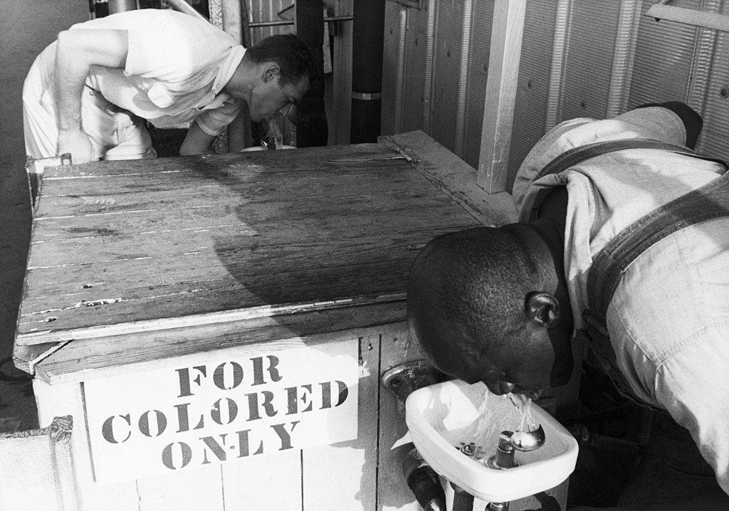
THE POWER OF NEGRO ACTION
“How long, O Lord, how long?”— that ancient cry of the oppressed is often voiced these days in editorials in the Negro newspapers whose pages are filled with word-and-picture reports of outrages against our people. A photograph of a Negro being kicked by a white mobster brings the vicious blow crashing against the breast of the reader, and there are all the other horrible pictures—burning cross, beaten minister, bombed school, threatened children, mutilated man, imprisoned mother, barricaded family—which show what is going on.
How long? The answer is: As long as we permit it. I say that Negro action can be decisive. I say that we ourselves have the power to end the terror and to win for ourselves peace and security throughout the land. The recognition of this fact will bring new vigor, boldness and determination in planning our program of action and new militancy in winning its goals.

Slide 21
Strengthening the Base of Democracy for All
The denials and doubts about this idea—the second part of the challenge which confronts us today—are even more evident than those I noted in regard to the first. The diehard racists who shout “Never” to equal rights, and the gradualists who mumble “Not now,” are quite convinced that the Negro is powerless to bring about a different decision. Unfortunately, it is also true that to a large extent the Negro people do not know their own strength and do not see how they can achieve the goals they so urgently desire. We are a minority, a tenth of the population of our country. In all the terms in which power is reckoned in America—economic wealth, political office, social privilege—we are in a weak position; and from this the conclusion is drawn that the Negio can do little or nothing to compel a change. It must be seen, however, that this is not a case of a minority pitting itself against a majority. If it were, if we wanted to gain something for ourselves by taking it away from the more powerful majority, the effort would plainly be hopeless. But that is not the case with our demand. Affirming that we are indeed created equal, we seek the equal rights to which we are entitled under the law. The granting of our demand would not lessen the democratic rights of the white people: on the contrary, it would enormously strengthen the base of democracy for all Americans. We ask for nothing that is not ours by right, and herein lies the great moral power of our demand. It is the admitted rightness of our claim which has earned for us the moral support of the majority of white Americans.

Slide 22
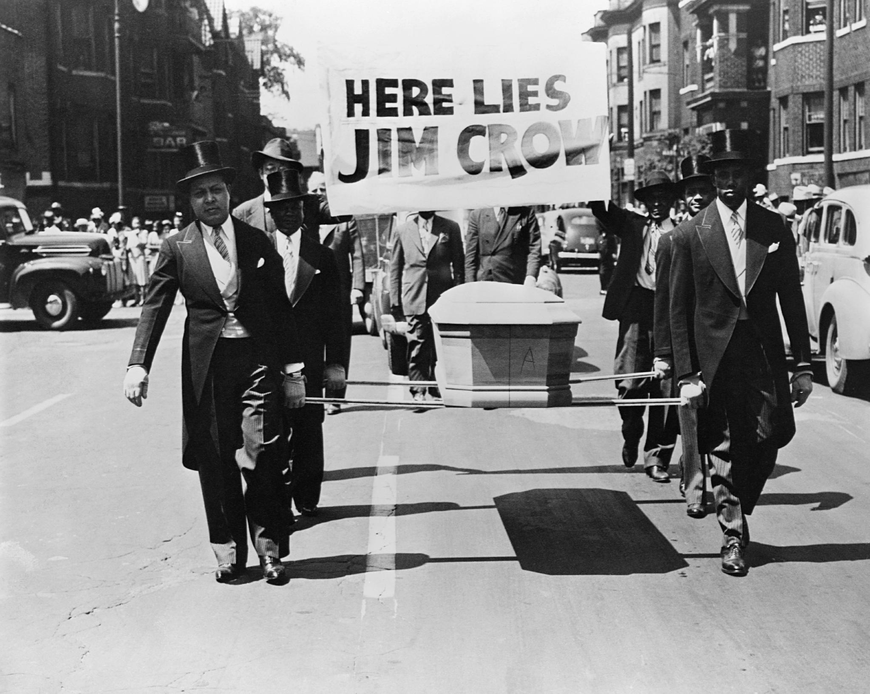
A Minimum Necessity
The granting of our demand for first-class citizenship, on a par with all others, would not in itself put us in a position of equality. Oppression has kept us on the bottom rungs of the ladder, and even with the removal of all barriers we will still have a long way to climb in order to catch up with the general standard of living. But the equal place to which we aspire cannot be reached without the equal rights we demand, and so the winning of those rights is not a maximum fulfillment but a minimum necessity and we cannot settle for less. Our viewpoint on this matter is not a minority opinion in our country. Though the most rabid champions of “white superiority” are unwilling to lest their belief by giving the Negro an equal opportunity, I believe that most white Americans are fair-minded enough to concede that we should be given that chance. The moral support of the American majority is largely passive today, but what must be recognized—and here we see the decisive power of Negro action—is this: “Wherever and whenever we, the Negro people, claim our lawful rights with all of the earnestness, dignity and determination that we can demonstrate, the moral support of the American people will become an active force on our side.”

Slide 23
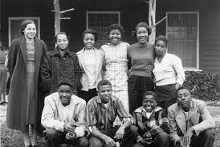
Liberation from Mob Violence
We have the right and, above all, we have the duty, to bring the strength and support of our entire community to defend the lives and property of each individual family. Indeed, the law itself will move a hundred times quicker whenever it is apparent that the power of our numbers has been called forth. The time has come for the great Negro communities throughout the land - Chicago, Detroit, New York, Birmingham and all the rest—to demonstrate that they will no longer tolerate mob violence against one of their own. In listing the inalienable rights of man, Thomas Jefferson put life before liberty, and the pursuit of happiness; and it must be dear that for Negro Americans today the issue of personal security must be put first, and resolved first, before all other matters are attended to. When the Negro is told that he must "stay in his place," there is always the implicit threat that unless he does so mob violence will be used against him. Hence, as I see it, nothing is more important than to establish the fact that we will no longer suffer the use of mobs against us. Let the Negro people of but a single city respond in an all-out manner at the first sign of a mob—in mass demonstrations, by going on strike, by organizing boycotts—and the lesson will be taught in one bold stroke to people everywhere.
The Clinton 12, the first Black students to attend Clinton High School, registered and attended school for one day without incident in late August of 1956

Slide 24
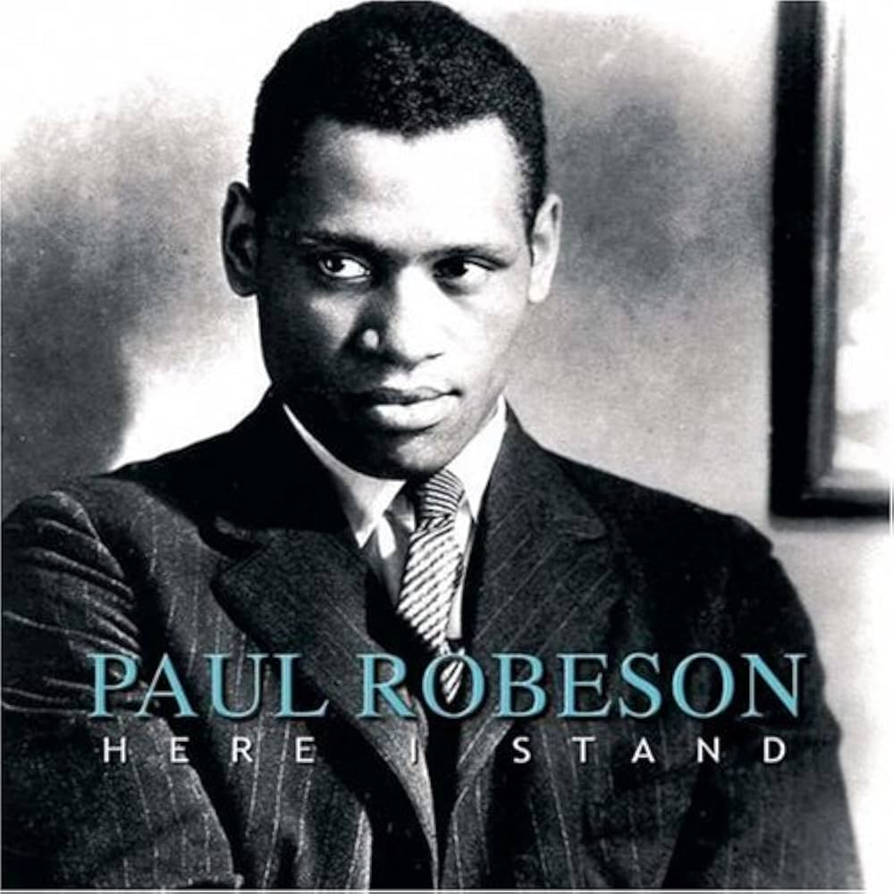
A Twofold Challenge
To our men and women of organized labor I would say: A twofold challenge confronts you. The Negro trade unionists must increasingly exert their influence in every aspect of our peoples community life. No church, no fraternal, civic or social organization in our communities must be permitted to continue without the benefit of the knowledge and experience that you have gained through your struggles in the great American labor movement. You are called upon to provide the spirit, the determination, the organizational skill, the firm steel of unyielding militancy to the age-old strivings of our people for equality and freedom. Secondly, on your shoulders there is the responsibility to rally the strength of the whole trade union movement, white and black, to the battle for liberation of our people. Though you are still largely unrepresented in the top levels of labor leadership, you must use your power of numbers to see to it that the leadership of the A.F.L.-C.I.O., shall not continue to be silent and unmoving in our crusade for freedom at home. You must rally your white fellow workers to support full equality for Negro workers; for their right to work at any job; to receive equal pay for equal work; for the election of qualified Negroes to positions of union leadership; for fair employment practices in every industry; for trade union educational programs to eliminate the notions of “white superiority” which the employers use to poison the minds of the white workers in order to pit them against you.

Slide 25
Discussion

Slide 26
HUAC Testimony

Slide 27
The Testimony
Paul Robeson was wrongly persecuted by the House of Un-American Activities Committee (HUAC) on June 12, 1956 for his support of the Communist Movement, especially regarding his deep love and respect for the Soviet Union/U.S.S.R. and Civil Rights Movement. Throughout the testimony Paul Robeson consistently used his fifth amendment right to combat badgering accusations, while staunchly speaking out against the hypocrisy and bigotry of the United States and the HUAC, in support of the U.S.S.R. and African Americans.

Slide 28
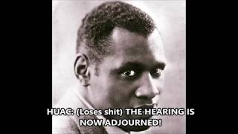
The HUAC Testimony

Slide 29
Discussion & Wrap Up

Slide 30

The Civil Rights Congress (CRC) is a growing, national, non-partisan organization, founded in 1946, which has been re-established to struggle for justice, and defend civil liberties and civil rights, as outlined in our Bill of Rights.
The CRC seeks to:
Conduct campaigns on local and national civil rights issues
Help to provide legal assistance to fight civil rights cases in the courts
Work in partnership with legal professionals who are sympathetic to the cause of social justice
Maintain a bail fund and prisoner relief fund for victims of injustice
Establish chapters across the country
Guarantee fair trials by taking the facts to the people

Slide 31
“The Civil Rights Congress is a defender of constitutional liberties, human rights, and peace.
It is the implacable enemy of every creed, philosophy, social system, or way of life that denies democratic rights or one iota of human dignity to any human being because of race, creed, nationality, political belief, sex, or gender.” – From We Charge Genocide, by the Civil Rights Congress in 1951.

Slide 32
Announcements
PCUSA Cell Chairs need to call members of their cells to remind them about attendance.
The next issue of New Masses (2026) has begun production. If you have art you want us to feature, email it to info@partyofcommunistsusa.net.

Slide 33
Volunteers Needed!
We are in need of volunteers for the staff of the People’s School! Here’s a few roles we need filled:
People to help manage posting on our social media and podcast platforms
Video Editors, Audio Editors, Graphic Designers, Artists, Narrators
Web Controls, Moderators
Email info@peoplesschool.us if you’re interested and try to attend our next staff meeting if possible.

Slide 34

View From Left Field
https://viewfromleftfield.libsyn.com
The Old PSMLS Youtube is now the Youtube of View From Left Field, a podcast of analysis and discussion of current events from a progressive perspective.
Like the Youtube videos and subscribe with 5 star ratings on your podcast platforms.

Slide 35

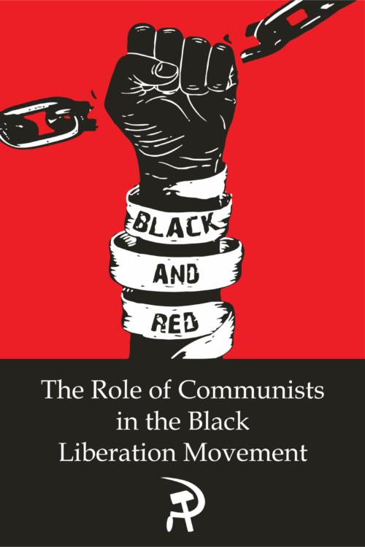
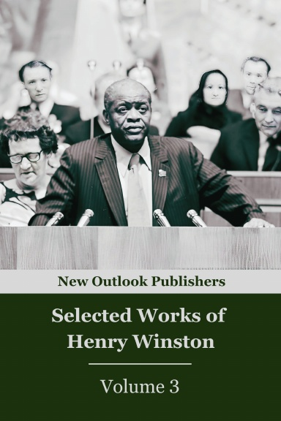
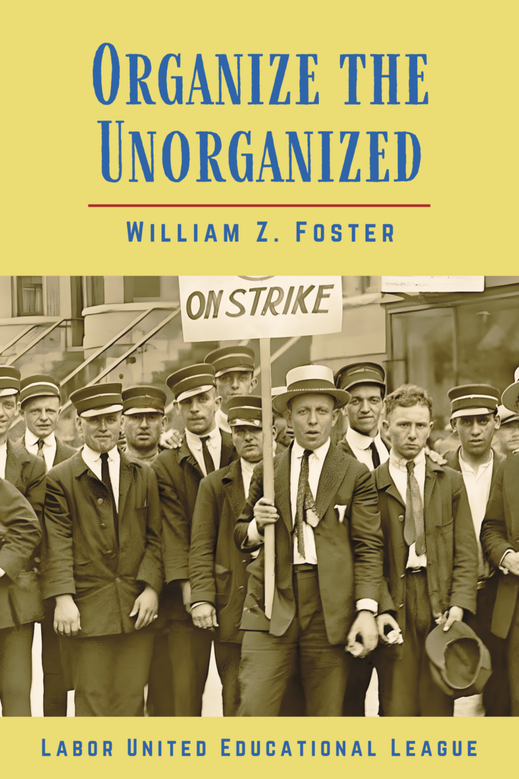

New Outlook Publishers
newoutlookpublishers.store
Relevant and Latest Releases

Slide 36


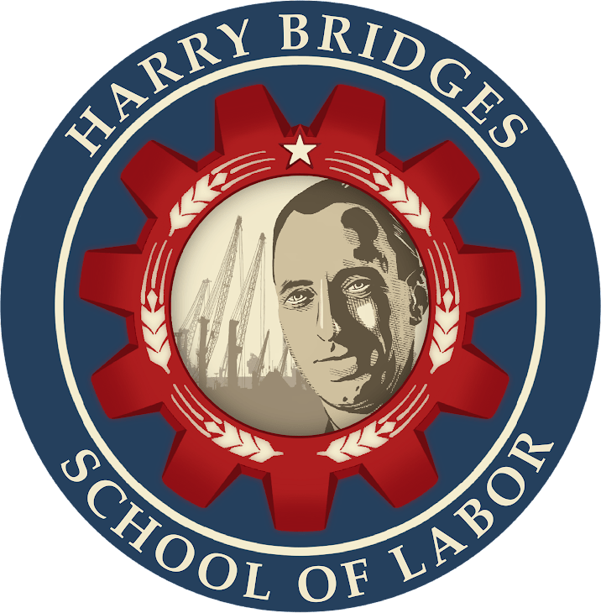
Harry Bridges School of Labor
luel.us/laborschool/
The Harry Bridges School of Labor is a monthly class covering a variety of topics aimed at building class consciousness among union members. For class schedule and other information, please visit the website at luel.us/laborschool.

Slide 37
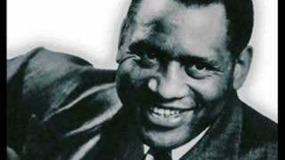
The House I Live In by Paul Robeson

