Slide 1

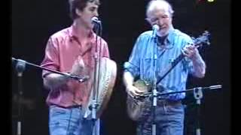
Pete Seeger - Viva la Quince Brigada

Slide 2
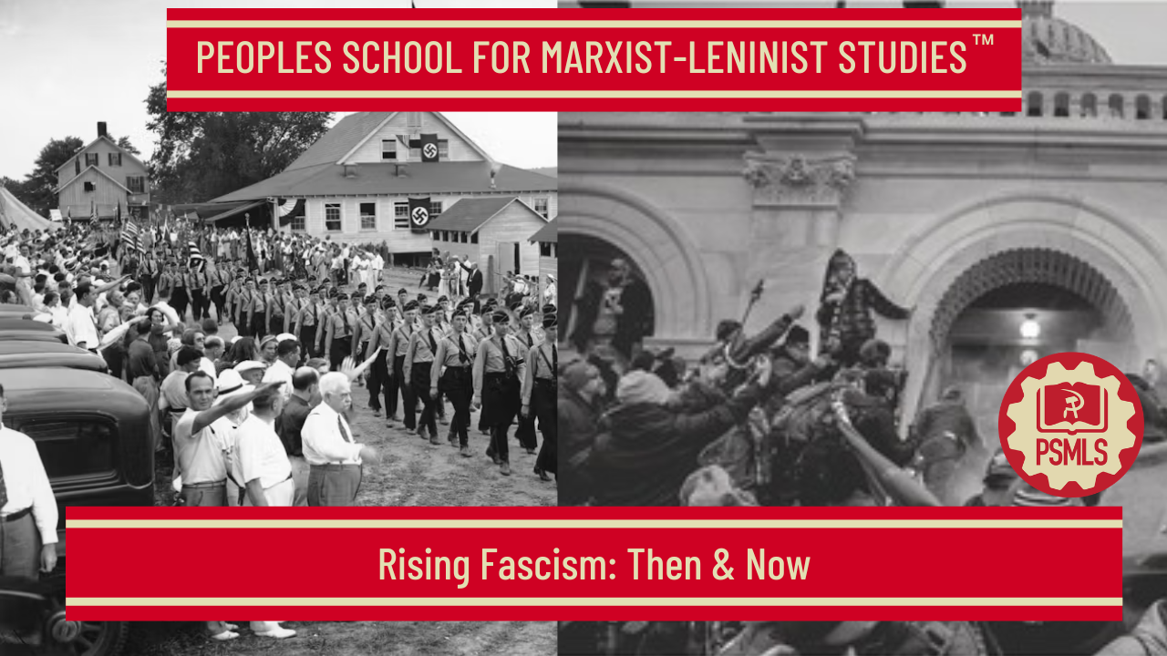
PSMLS 5/12/26

Slide 3
What we’ll be learning today:
History, context behind rise of fascism in the 1930s & 1940s
Fascism Today: Same Wolf, Different Sheep Skin
What can be done to combat fascism?

Slide 4
Rise of Fascism in the 1930s & 1940s

Slide 5
“Comrades, fascism in power was correctly described by the Thirteenth Plenum of the Executive Committee of the Communist International as the open terrorist dictatorship of the most reactionary, most chauvinistic and most imperialist elements of finance capital.”
Georgi Dimitrov, The Fascist Offensive and the Tasks of the Communist International in the Struggle of the Working Class against Fascism (Main Report delivered at the Seventh World Congress of the Communist International)

Slide 6
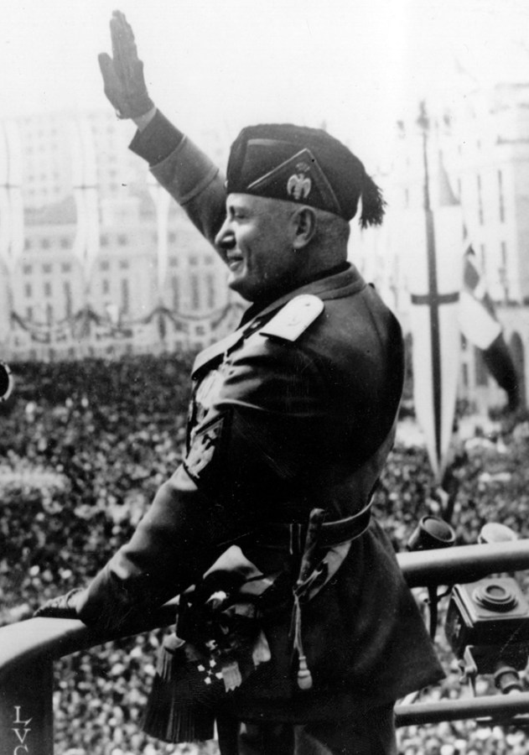
How did fascism come about in Italy?
The main method of the bosses was liberalism and concessions, as long as their forces were unprepared.
Even in the face of outright Fascism, social democracy looked to parliamentary means for defense. The revolution in Italy was defeated by reformism.
Fascism came when workers were disillusioned and disorganized already.
The transition to fascism was no sudden, abrupt break, but of a continuation of the same old bosses using new means.

Slide 7
How did fascism come about in Germany and Austria?
In 1918, after a workers revolution in Germany, reformists led workers back into the hands of the bosses. Fascism grew to power under the protection of reformists who refused to carry through the revolution, who refused to smash the state. They chose capitalism over communism.
Fascism requires a mass base which comes when the people are disgusted with reformism. Fascists then dogmatically preach about "national" socialism.
Social democracy, even under Fascism, unites with the bosses, rather than with the reds, as a lesser evil. Thus the line of lesser evils means the passive acceptance of every date of development to complete Fascism. Reformists, not Fascists, paralyzed workers will to resist. Opposition to Fascism came from communists alone. The German cp, however, had few industrial workers. Though it was large in numbers.
In Austria, Reformists supported one fascist over another in an election. In 1918-19 the reformists halted and sold out a revolution. When the present policy is class collaboration. It determines future action.

Slide 8
Economic & Social Analysis of Fascism
Economically, fascism strangles the powers of production, slow technical development, destroy material and human forces, crush innovation and development of thought, and focus the entirety of society on organizing for war, just for capitalists to maintain their domination.
R. Palme Dutt analyzes works written by Mussolini and the Imperial Fascist League, pointing out that their abstract conceptions have no distinctive character and are common to many schools of bourgeois political philosophy.
He regards the ideology as a vulgarization of Hegelianism and argues that there is no ideological theory that defines fascism; that it was developed as a counter-revolutionary mass movement supported by the bourgeoisie in practice.
He argues the specific character of fascism can only be defined by exposing the system of class relations within which it develops and functions and the class role it performs.

Slide 9
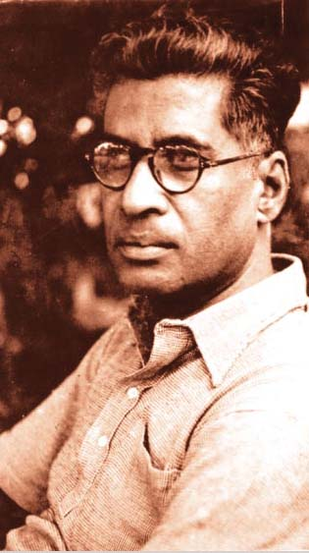
Fascism: M.N. Roy’s Analysis
In Fascism: Its Philosophy, Professions & Practice, M.N. Roy argues that “if Fascism is a socio-political reaction, its ideological foundation must have been laid by philosophical reaction,” and that it is erroneous to think that it has no philosophy.
Just as socialism grew and developed as a result of modern scientific philosophy, fascism grew as well over a long period of time from idealism and pseudo-science.

Slide 10
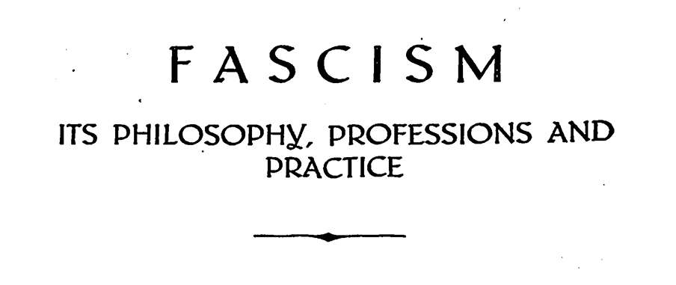
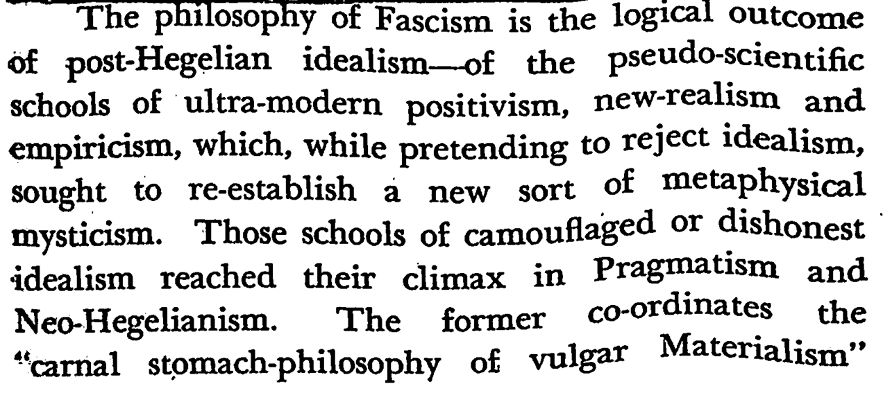
Fascism: M.N. Roy’s Analysis

Slide 11
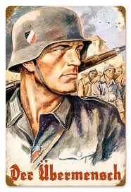
Fascism: M.N. Roy’s Analysis
To justify taking away civil liberties and political freedom, the philosophy of fascism rejects the Enlightenment ideals, developed during the Renaissance age, which emphasized reason, scientific empiricism and social/political reform.
To justify acts of violence and barbarism, these acts are framed as having a “divine purpose.”
“God takes decayed and distressed capitalism under his protection, and each fanatical defender of this worn- out system of vulgar materialism becomes an inspired, divine instrument.”
The fascist regards himself a “superman,” having unrestricted freedom of will which is denied to others.
The Nazi conception of a fascistic “superman” is based on Nietzsche’s idea of an “Übermensch,” an ideal, self-actualized human who creates their own morals and values.

Slide 12
Discussion & New Members Introductions

Slide 13
New Member Introductions
What is your name, pronouns and state (or country/territory)?
Where do you work? Is it unionized?
How did you find out about the People’s School?
What do you think about tonight's class?

Slide 14
Fascism Today: Same Wolf, Different Sheep Skin

Slide 15
Ukraine, parts of Eastern Europe
Throughout the former socialist states, a fascistic campaign against the left and all forms of progress has taken place. Trade union halls have been scorched; activists have been imprisoned, tortured, and killed; and state-sponsored scapegoating of once fraternal ethnic groups has taken place.

Slide 16
Ukraine
On May 2, 2014, heavily-armed fascist militia forces attacked the House of Trade Unions in Odessa, Ukraine. Trapped inside were demonstrators opposed to the right-wing government in Kiev that had been put in place in a U.S.-orchestrated coup just weeks earlier.
The new government had been established in the wake of the February 2014 “Euromaidan” protests that overthrew the corrupt albeit democratically-elected administration of President Viktor Yanukovych. Trying to play Russia and the EU off one another to get the best economic deal for Ukraine when he was in charge, Yanukovych became the target of Western-backed business interests in Ukraine and ultra-nationalist groups. The latter joined together, with U.S. support, to carry out a coup and sent Yanukovych running for Moscow.

Slide 17
Ukraine
In the wake of that coup, labor unions and left-wing parties were severely repressed in Ukraine, and activists of the Communist Party of Ukraine and other groups were forced underground. Across the country, a campaign of ethnic erasure was launched against Russian-speaking Ukrainians, with the Russian language being banned from public life.
In the mostly Russian regions of eastern Ukraine, a violent war ensued between the Kiev government and separatists. By the end of 2021, it had taken over 15,000 lives. Commanders from openly neo-Nazi and fascist groups like the Azov Battalion were integrated to become brigades of the official Ukrainian Armed Forces and given free rein in the Donbass.

Slide 18
Ukraine
So, by the time that Russian President Vladimir Putin ordered his military to invade Ukraine in February 2022, war had already been raging for years in eastern Ukraine. Chances for peace—both before and after the invasion—were repeatedly scuttled, often at the insistence of Kiev’s allies in Washington.
The Odessa trade union massacre was one of the earliest of many atrocities committed in the war in Ukraine. The Right Sector militia celebrated the mass murder that happened that day, calling it “yet another bright page in our fatherland’s history.” None of the perpetrators were ever brought to justice, and some of the massacre’s coordinators even ended up as members of parliament.

Slide 19
Parts of Eastern Europe
Though Ukraine stands out as the most blatant example of fascism, i.e. the sabotage of labor unions, banning of communists, and scapegoating of minorities, others clearly stand.
Here are just a few examples of fascistic practices:
  Many of the communist parties, following the dismantling of socialism in Europe and Asia, were outlawed, and this outlawing has continued ever since.
  Since April 19, 2022, Belarusian security forces have raided the offices and apartments of leaders and activists of independent Belarusian trade unions. Many detained leaders and activists still remain in custody.

Slide 20
Parts of Eastern Europe
Many minority groups, especially Russians, across the former socialist world have attempted to protect themselves by forming new, separate People’s Republics, to escape the dangers of scapegoating attempts. These republics have been systematically sabotaged in Ukraine, Estonia, Kazakhstan, etc. Russia is labeled as the enemy, alongside all Russians, whose existence is said to be a threat to national security, and the land they live on is said to be “Ukrainian land.” “Moldovan land.” etc., ignoring who actually lives there, the people. Instead, the reactionaries and fascists focus on national borders, which they seek to preserve at any human costs. All languages, except one national language, are labeled foreign. Speaking these “foreign”languages is projected as unpatriotic and, again, a threat to “national security.”

Slide 21
Project 2025
And this fascistic phenomena is not limited to Eastern Europe. Its embryo is forming in the U.S., and it is also headed by American monopoly capital, just like it is in Europe. Fascism’s vanguard in the U.S., the Heritage Foundation, have put out a detailed plan: Projet 2025.
Project 2025, a sprawling right-wing plan to provide policy and staffing to a future Republican president, proposes an extreme anti-worker agenda that would severely curtail unions’ ability to collectively bargain on behalf of their members and reverse gains organized labor has made in recent years. It would also weaken overtime regulations, give corporations wider latitude in misclassifying workers as independent contractors, and dismantle safety regulations that prohibit young people from working dangerous jobs.

Slide 22
Project 2025
The initiative’s policy book, Mandate for Leadership, is an attempt to roll back New Deal-era, working class victories by allowing state-level exemptions from the National Labor Relations Act and the Fair Labor Standards Act, and by creating nonunion “employee involvement organizations” to undermine unions’ negotiating power. It additionally calls for sharp reductions in the budgets of the National Labor Relations Board and the Department of Labor and a freeze on new hires.

Slide 23
Project 2025
Project 2025 is organized by The Heritage Foundation and includes more than 100 reactionary groups on its advisory board, which have collectively received more than $55 million from groups tied to conservative megadonors Leonard Leo and Charles Koch. Leo has been pushing the Supreme Court to further erode the power of organized labor, and the Koch family has waged a war on unions for more than 60 years.
The Project lays out a clear scapegoat: Immigrants:
  Mass Deportation: Project 2025 calls for sweeping raids to arrest, detain, and deport undocumented immigrants, with plans to use the U.S. military for domestic law enforcement and hold detainees in internment camps 12.

Slide 24
Project 2025
  Border Security: The plan proposes increased funding for border walls and the creation of a new immigration agency to replace DHS 13.
  Military Use in Domestic Affairs: The proposal to use the U.S. military for domestic law enforcement, including mass deportations, is a violation of American’s civil liberties and a step towards fascism. This would allow the president to act as a dictator, like Hitler or the Emperors of Rome.

Slide 25
Discussion

Slide 26
What Can be Done to Combat Fascism?

Slide 27
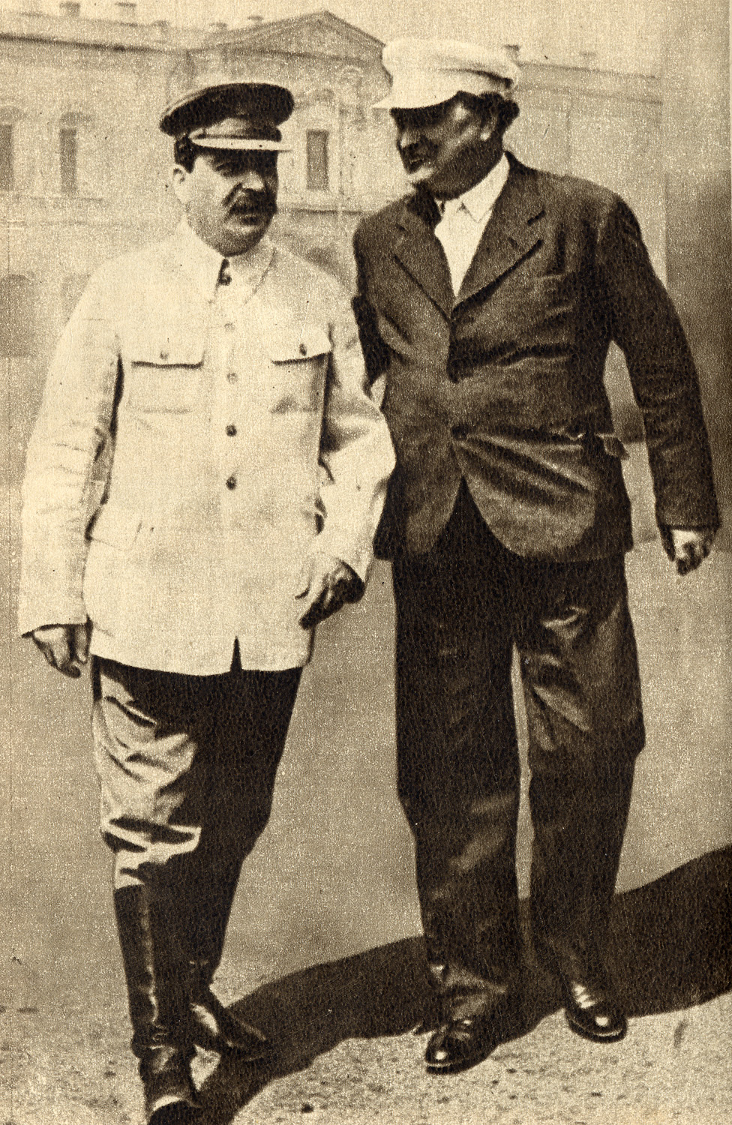
A Founding Father of the Fight Against Fascism
Georgi Dimitrov led the Communist International from 1934 to 1943. During that time, he contributed to the Communist understanding of fascism, more so than any other Marxist theorist. Dimitrov outlined the origins and purpose of fascism as well as the strategy the Communist movement had to adopt in order to defeat it.
Dimitrov gave a class analysis of fascism. After the crisis of capitalism that began in 1929, capitalism faced the dilemma of a weakened capitalist system coinciding with a Soviet Union, which was then constructing socialism. The rise of Communist Parties across the world, especially in advanced industrial countries, with a fighting workers’ movement, meant that the capitalist way of ruling had to adapt in order to survive. The bourgeoisie substituted their state form – from a bourgeois-democratic to a more open, terroristic dictatorship - to protect capital and crush the growing workers’ power. Pinochet’s Chile, as well as the current Venezuelan opposition, can be said to also fall into this category.
Joseph Stalin & Georgi Dimitrov-1936

Slide 28
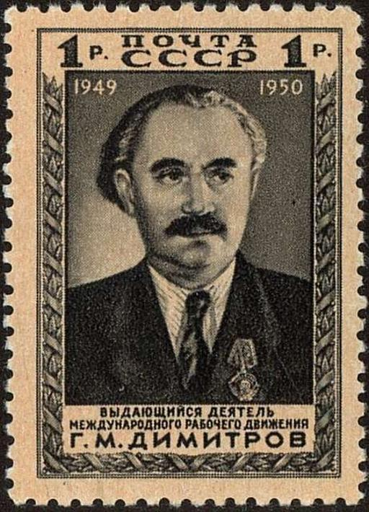
The Policy of the United Front
Dimitrov showed how in order to defeat Fascism, the Communist Parties must become more connected with the broad masses of workers and the people. Rather than ignoring the people's’ concerns, Communists have to understand them and work with the people towards solving them. If the left does not do that, then the far-right will step into the void. The Communist International, under the leadership of Dimitrov, proposed the policy of the united front to combat fascism. This was a policy of uniting all anti-fascist forces into one movement, not just working class forces, but women and youth, as well as sections of the petit-bourgeoisie. This included the radical sections of social democracy, who understood that the policy of class-collaboration or struggling for a better capitalism was no way to defeat fascism. The united front was not, it should be said, intended to struggle for socialism, it’s objective was to defeat fascism, even if the working class and other strata were not prepared for the struggle for socialism, they could be convinced to defend their interests in the democratic struggle. It should be pointed out some Communists in the post-war environment, especially in Western Europe, adopted this policy as a means of struggling for socialism, abandoning revolutionary strategy.
The Soviet Union 1950 CPA 1531 Stamp - Georgi Dimitrov (1882-1949), First Communist Leader of Bulgaria

Slide 29
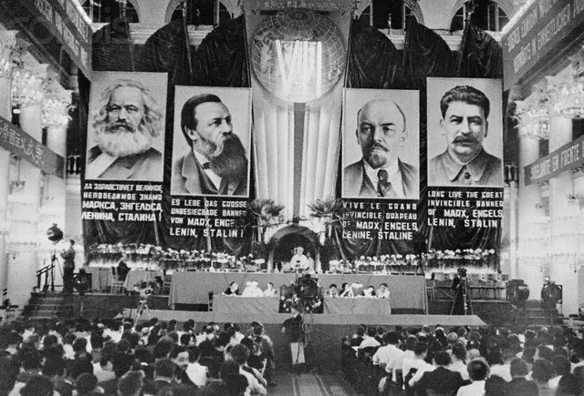
A Practical Strategy for Fighting Fascism
The following are excerpts from a speech which Dimitrov gave that was intended to help provide a blueprint for the struggle against the rising tides of fascism.
From Unity of the Working Class against Fascism: The concluding speech of the Seventh World Congress of the Communist International delivered by Comrade Georgi Dimitrov on August 13, 1935:
“…unanimity may, undoubtedly, be regarded as one of the most important conditions for success in solving the paramount immediate problem of the international proletarian movement, namely, establishing unity of action of all sections of the working class in the struggle against fascism.
The successful solution of this problem requires, first, that Communists, skilfully wield the weapon of Marxist-Leninist analysis, while carefully studying the actual situation and the alignment of class forces as these develop and that they plan their activity and struggle accordingly.”
Photo of The Seventh World Congress of the Communist International - December 1935

Slide 30

The Necessity for a Concrete Marxist Analysis of Current Conditions
“We must mercilessly root out the weakness not infrequently observed among our comrades, for cut-and-dried schemes, lifeless formulas and ready-made patterns. We must put an end to the state of affairs in which Communists, when lacking the knowledge or ability for Marxist-Leninist analysis substitute for it general phrases and slogans such as 'the revolutionary way out of the crisis,' without making the slightest serious attempt to explain what must be the conditions, the relationship of class forces, the degree of revolutionary maturity of the proletariat and mass of working people, and the level of influence of the Communist Party for making possible such a revolutionary way out of the crisis. Without such an analysis all these catchwords become dud shells, empty phrases which only obscure out tasks of the day. Without a concrete Marxist-Leninist analysis we shall never be able correctly to present and solve the problem of fascism, the problems of the proletarian united front and the Popular Front, the problem of our attitude to bourgeois democracy, the problem of a united front government, the problem of the processes going on - within the working class, particularly among the Social Democratic workers, or any of the numerous other new and complex problems with which life itself and the development of the class struggle confront us now and will confront us in the future.”

Slide 31
Real People, Equipped with Marxism-Leninism, and Fully Organized
“Second, we need live people - people who have grown up from the masses of the workers, have sprung from their everyday struggle, people of militant action, wholeheartedly devoted to the cause of the proletariat people whose brains and hands will give effect to the decisions of our Congress. Without Bolshevik, Leninist cadres we shall be unable to solve the enormous problems that confront the working people in the fight against fascism.”
“Third, we need people equipped with the compass of Marxist-Leninist theory, without the skilful use of which they turn into narrow-minded and shortsighted practicians, unable to look ahead, who take decisions only from case to case, and lose the broad perspective of the struggle which shows the masses where we are going and we are leading the working people.”
“Fourth, we need the organization of the masses in order to put our decisions into practice. Our ideological and political influence alone is not enough. We must put a stop to reliance on the hope that the movement will develop of its own accord, which is one of our fundamental weaknesses. We must remember that without persistent, prolonged, patient, and sometimes seemingly thankless organizational work on our part the masses will never make for the Communist shore. In order to be able to organize the masses we must acquire the Leninist art of making our decisions the property not only of the Communists but also of the widest masses of working people. We must learn to talk to the masses, not in the language of book formulas, but in the language of fighters for the cause of the masses, whose every word and every idea reflect the innermost thoughts and sentiments of millions.”

Slide 32
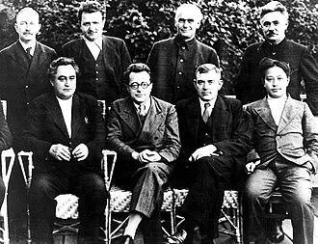
The Struggle Against Fascism Must be Concrete
“No general characterization of fascism, however correct in itself, can relieve us of the need to study and take into account the special features of the development of fascism and the various forms of fascist dictatorship in the individual countries and at its various stages. It is necessary in each country to investigate, study and ascertain the national peculiar ties, the specific national features of fascism and to map out accordingly effective methods and forms of struggle against fascism. Lenin persistently warned us against such 'stereotyped methods, such mechanical levelling and identification of tactical rules, of rules of struggle.' This warning is particularly to the point when it is a question of fighting an enemy, who so subtly and Jesuitically exploits the national sentiments and prejudices of the masses and the anti-capitalist inclinations in the interests of big capital. Such an enemy must be known to perfection, from every angle. We must, without any delay whatever, react to his various maneuvers, discover his hidden moves, be prepared to repel him in any arena and at any moment. We must not hesitate even to learn from the enemy if that will help us more quickly and more effectively to wring his neck.”
Members of the Executive Committee of the Comintern at the 7th World Congress, 1935.
Seated (L-R): Georgi Dimitrov, Palmiro Togliatti, Wilhelm Florin, Wang Ming; Standing: Otto Kuusinen, Dmitry Manuilsky, Klement Gottwald, Wilhelm Pieck

Slide 33
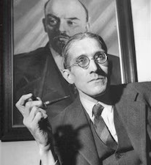
The Danger of Illusions Regarding the “Weakness” of Fascism
“It would be a gross mistake to lay down any sort of universal scheme of the development of fascism, valid for all countries and all peoples. Such a scheme would not help but would hamper us in carrying on a real struggle. Apart from everything else, it would result in indiscriminately thrusting into the camp of fascism those sections of the population which, if properly approached, could at a certain stage of development be brought into the struggle against fascism or could at least be neutralized. It would likewise be dangerous to cherish illusions regarding the weakness of fascism in other countries where it does not have a broad mass base. We have the example of such countries as Bulgaria, Yugoslavia and Finland, where fascism, although it had no broad base, came to power, relying on the armed forces of the state, and then sought to broaden its base by making use of the state apparatus.”
“Comrade Dutt was right in his contention that there has been a tendency among us to contemplate fascism in general, without taking into account the specific features of the fascist movement in the various countries, erroneously classifying all reactionary measures of the bourgeoisie as fascism and going so far as calling the entire non-Communist camp fascist. The struggle against fascism was not strengthened but rather weakened in consequence.”
Rajani Palme-Dutt, the father of Indian Marxist historiography (Getty Images)

Slide 34
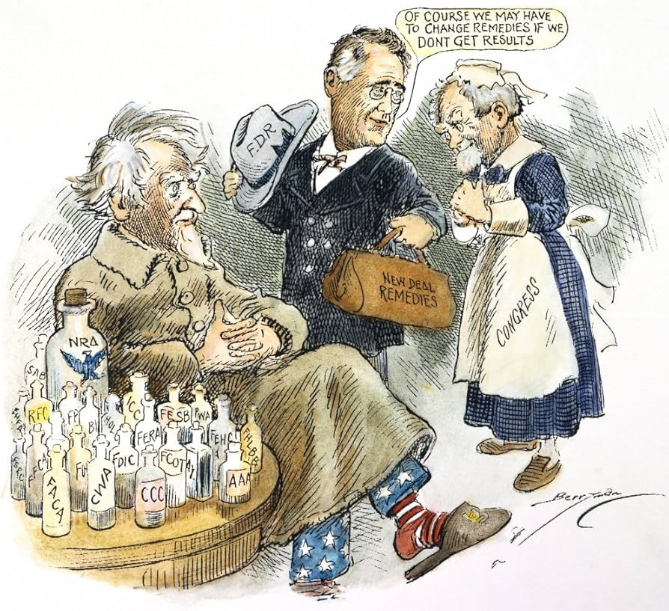
Fascism Assumes Peculiar Forms
“Even now we still have survivals of a stereotyped approach to the question of fascism. When some comrades assert that Roosevelt's 'New Deal' represents an even clearer and more pronounced form of the development of the bourgeoisie toward fascism than the 'National Government' in Great Britain, for example, is this not a manifestation of such a stereotyped approach to the question? One must be very partial to hackneyed schemes not to see that the most partial to reactionary circles of American finance capital, which are attacking Roosevelt, are above all the very force which is stimulating and organizing the fascist movement in the United States. Not to see the beginnings of real fascism in the United States behind the hypocritical outpourings of these circles 'in defence of the democratic rights of the American citizen' is tantamount to misleading the working class in the struggle against its worst enemy. In the colonial and semi-colonial countries also, certain fascist groups are developing, but of course there can be no question of the kind of fascism that we are accustomed to see in Germany, Italy and other capitalist countries. Here we must study and take into account the quite special economic, political and historical conditions, in accordance with which fascism is assuming and will continue to assume peculiar forms of its own.”
New Deal Cartoon of President Franklin D Roosevelt Trying To Heal A Depression-Stricken United States With An Ever-Growing Assortment Of New Deal Agencies & Programs - C1935 By Clifford B

Slide 35
United Proletarian Front or Anti-Fascist Popular Front
“Some comrades are quite needlessly racking their brains over the problem of what to begin with - the united proletarian front or the anti-fascist Popular Front.”
“Some say that we cannot start forming the anti-fascist Popular Front until we have organized a solid united front of the proletariat.”
“Others argue that, since the establishment of the united proletarian front meets in a number of countries with the resistance of the reactionary part of Social Democracy, it is better to start at once with building up the Popular Front, and then develop the united working class front on this basis.”
“Evidently, both groups fail to understand that the united proletarian front and the anti-fascist Popular Front are connected by the living dialectics of struggle; that they are interwoven, the one passing into the other in the process of the practical struggle against fascism, and that there is certainly no Chinese wall to keep them apart.”
“For it cannot be seriously supposed that it is possible to establish a genuine anti-fascist Popular Front without securing the unity of action of the working class itself, the leading force of this anti-fascist Popular Front. At the same time, the further development of the united proletarian front depends, to a considerable degree, upon its transformation into a Popular Front against fascism.”

Slide 36

The Masses Must Shift Toward Class Struggle to Guarantee Success in the Offensive Against Fascism
How does the matter really stand? Of course, we must strive everywhere for a wide Popular Front of struggle against fascism. But in a number of countries we shall not get beyond general talk about the Popular Front unless we succeed in mobilizing the masses of the workers for the purpose of breaking down the resistance of the reactionary section of Social Democracy to the proletarian united front of struggle. In these countries the Communists would commit a very serious political mistake if they shirked the struggle to establish a united proletarian front, under cover of general talk about the Popular Front, which cannot be formed without the participation of the mass working class organizations.
Dimitrov on Fascism- “the power of finance capital itself….It is the organization of terrorist vengeance against the working class.” Here, the face of Donald Trump is projected on a screen above the trading floor at the New York Stock Exchange (AP)
In order to bring about a genuine Popular Front in these countries, the Communists must carry out an enormous amount of political and organizational work among the masses of the workers. They must overcome the preconceived ideas of these masses, who regard their large reformist organizations as already the embodiment of proletarian unity. They must convince these masses that the establishment of a united front with the Communists means a shift on the part of those masses to the position of the class struggle, and that only this shift guarantees success in the struggle against the offensive of capital and fascism. We shall not overcome our difficulties by setting ourselves much wider tasks here. On the contrary, in fighting to remove these difficulties we shall, in fact and not in words alone, prepare the ground for the creation of a genuine Popular Front of struggle against fascism, against the capitalist offensive and against the threat of imperialist war.

Slide 37
Discussion & Wrap Up

Slide 38
Announcements
PCUSA Cell Chairs need to call members of their cells to remind them about attendance.
The next issue of New Masses (2026) has begun production. If you have art you want us to feature, email it to info@partyofcommunistsusa.net.

Slide 39
Volunteers Needed!
We are in need of volunteers for the staff of the People’s School! Here’s a few roles we need filled:
People to help manage posting on our social media and podcast platforms
Video Editors, Audio Editors, Graphic Designers, Artists, Narrators
Web Controls, Moderators
Email info@peoplesschool.us if you’re interested and try to attend our next staff meeting if possible.

Slide 40


Slide 41

View From Left Field
https://viewfromleftfield.libsyn.com
The Old PSMLS Youtube is now the Youtube of View From Left Field, a podcast of analysis and discussion of current events from a progressive perspective.
Like the Youtube videos and subscribe with 5 star ratings on your podcast platforms.

Slide 42

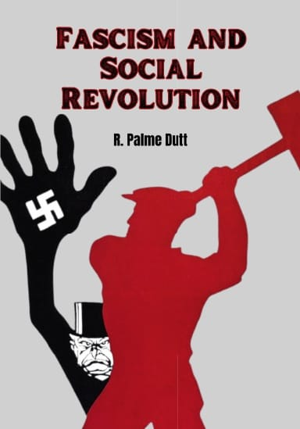



New Outlook Publishers
newoutlookpublishers.store
Relevant and Latest Releases

Slide 43



Harry Bridges School of Labor
luel.us/laborschool/
The Harry Bridges School of Labor is a monthly class covering a variety of topics aimed at building class consciousness among union members. For class schedule and other information, please visit the website at luel.us/laborschool.

Slide 44
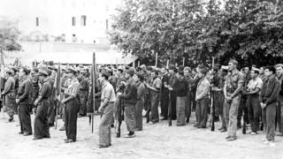
Paul Robeson - The Four Insurgent Generals

