Slide 1

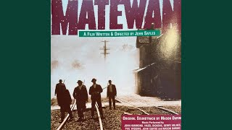
Fire in the Hole (feat. Hazel Dickens) - Matewan Soundtrack

Slide 2
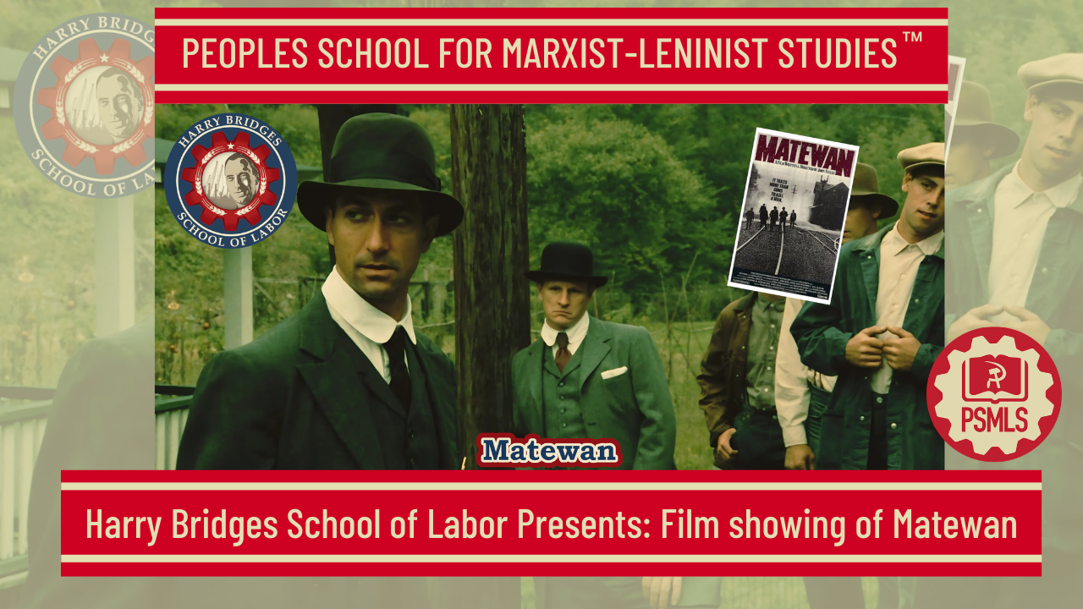
PSMLS 5/19/26

Slide 3
What we’ll be learning today:
History of Matewan
Lessons of Matewan
Communist Perspective

Slide 4
A History of Bitter Struggle: The Build-up Toward Matewan

Slide 5
Class War in West Virginia
It is important not to regard the miners’ struggle in West Virginia as some sort of backwoods conflict that, no matter how terrible the circumstances, had no direct relevance to the American capitalist class or to the American labour movement. This was not the case. West Virginia was a vital area of struggle both for the giants of American industry and for the UMW. The UMW had been established in 1890 by a merger of the Knights of Labour District Assembly No. 135 and the National Union of Miners and Mine Labourers. Previous attempts at union organisation had ended in often bloody defeat, but in July 1897 the UMW with only 10,000 members called a strike in the bituminous or soft coal mines across America that brought out 150,000 miners. This resulted in January 1898 in the establishment of the Central Competitive Field. The soft coal mine companies in Indiana, Illinois, Ohio and Pennsylvania were forced to accept a ‘landmark’ agreement that conceded ‘the eight-hour day, a standard wage for men who worked on a daily basis, and a standard tonnage rate with local wage differentials’. The Central Competitive Field agreement was ‘the foundation of the UMWA’s accomplishments’, but, ‘almost from the day the 1898 trade agreement was signed it suffered erosion at the geographic frontiers of the CCF. Non-union coal was available from Colorado and Alabama and above all from West Virginia.’

Slide 6
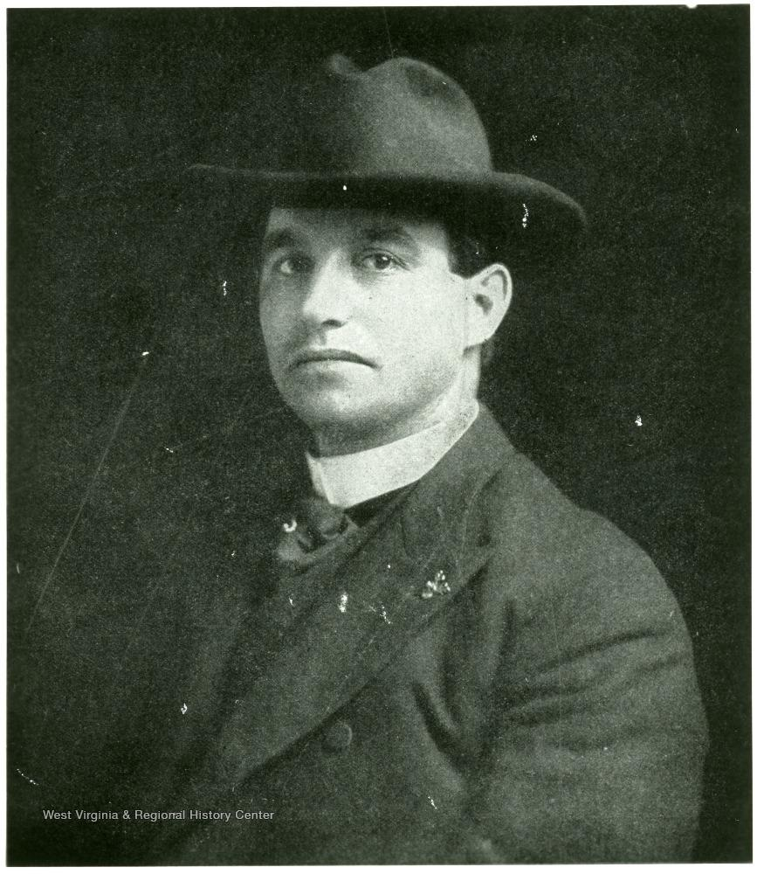
The Strength of Your Union is Not the Best Organised Districts
At the end of the 1890s the Morgan Trust built a new rail network to open up the West Virginia coalfield. This led to a massive expansion of the industry: in 1867 West Virginia produced 489,000 tons of coal, in 1887 it produced 4,882,000 tons and in 1917 it produced 89,384,000 tons. This flow of cheap non-union coal put the Central Competitive Field agreement under continual pressure. As the UMW president, John Mitchell, pointed out to his members:
“The strength of your union is not the best organised districts. Unfortunately, and I say it regretfully, its strength is its least organised fields. You cannot be permanently safe, you cannot rest in security until West Virginia, the Irwin field, the Connellsville and Meyersdale regions of Pennsylvania, are organised.”
A portrait of John Mitchell, President of the United Mine Workers during the Anthracite Strike, 1902

Slide 7
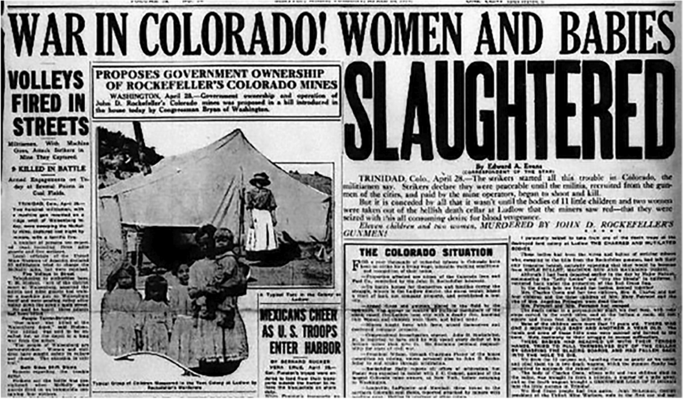
Another Massacre of Men, Women, and Children
Mitchell’s solution was not an organising drive to carry the union into the non-union fields, but a strategy of class collaboration, accepting wage cuts, deteriorating conditions and fragmenting agreements in the Central Competitive Field. This provoked a rank and file revolt that led to the political radicalisation of the union: at the 1908 UMW convention over 400 of the 1,000 delegates were members of the Socialist Party. The union determined to resist further encroachments on the Central Competitive Field agreement and also to make a determined effort to organise the non-union fields. The attempt to break into the non-union fields produced bloody conflicts in both Colorado and West Virginia. In both states the UMW met with the most fierce resistance. Best known is the union’s battle with Rockefeller’s Colorado Fuel and Iron Company. On 20 April 1914 company guards and state militia attacked a union tent colony at Ludlow, killing three strikers and 13 women and children. One of the dead miners was the union organiser, Louis Tikas, who was captured by the militia, beaten and summarily executed. By the time the union admitted defeat, nearly 70 people had been killed in this conflict.

Slide 8
Fightback
Equally bloody was the conflict in West Virginia. Here the UMW had already achieved a foothold in Kanawha County but in April 1912 this came under attack when the mine companies refused to renew agreements. After a two month strike most gave in, but in Paint Creek and Cabin Creek where nearly 100 pits employed 7,500 miners the employers continued to resist. Here the mine companies employed the Baldwin-Felts agency to break the strike and precipitated a small scale war. According to David Corbin in his classic study of the West Virginia miners, Life, Work and Rebellion in the Coal Fields:
Armed and organised, the striking miners unleashed their rage upon the Baldwin-Felts guards. They hid in the hills and sniped at individual guards, and squads of miners attacked companies of Baldwin-Felts men. In one instance, miners surrounded a camp of guards during the night, cleared away the underbrush, and silently waited till dawn. When the guards awoke and began preparing breakfast, the miners opened fire, killing 13 to 15 of them ... The miners blew up the tipples of operating mines and the trains carrying coal that had been mined by scabs. They met trains that were bringing strikebreakers to the strike zone and forced the potential scabs to evacuate – an action that often pitted black strikers against black strikebreakers and immigrant strikers against immigrant strikebreakers. The solidarity of black and white, Protestant and Catholic, immigrant and native miners was unbreakable.

Slide 9
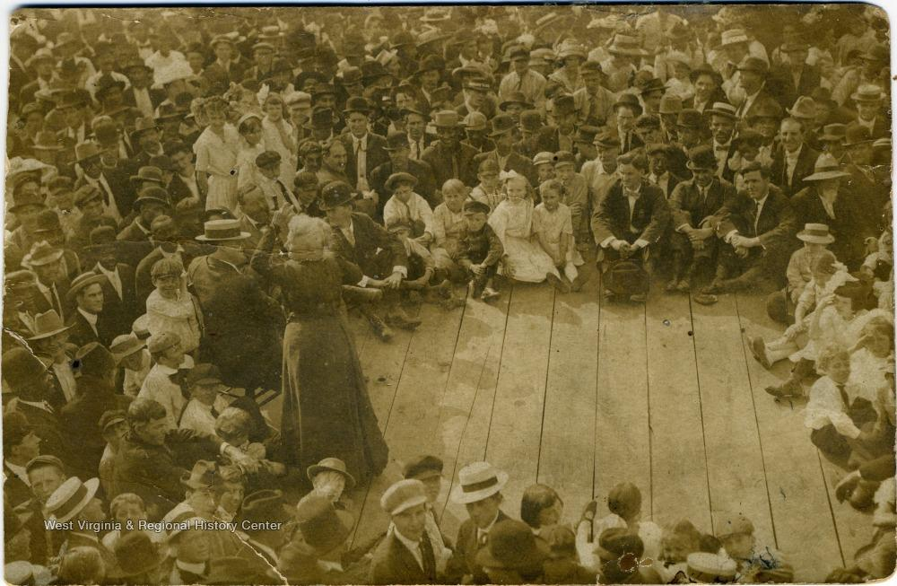
Gone to Hell…More to Go
Hatred of the company guards and private detectives was ferocious. The coffin of one Baldwin-Felts man was decorated with the sign: ‘GONE TO HELL. MORE TO GO. DAMNED THUGS’. And on another occasion Mother Jones, a powerful agitator in the union cause, held up a company guard’s bloodstained jacket and told the assembled miners that this was ‘the first time I ever saw a goddamned mine guard’s coat decorated to suit me’. Despite blanket court injunctions that made union activity illegal, the murderous activities of the Baldwin-Felts agents, the proclamation of martial law, intervention by the National Guard, mass arrests, the suppression of the socialist press and an attempted sell out by UMW officials, the miners emerged victorious. It was this tremendous struggle against all the odds that inspired a Wobbly, Ralph Chaplin, to write the union song Solidarity Forever. As he wrote at the time, ‘Solidarity is something more than a word in Kanawha County; it is a tremendous and spontaneous force – a force born in the hot heart of the class struggle.’
Photograph postcard of labor organizer Mother Jones on August 4th speaking at the Montgomery ballpark in West Virginia - 1912

Slide 10
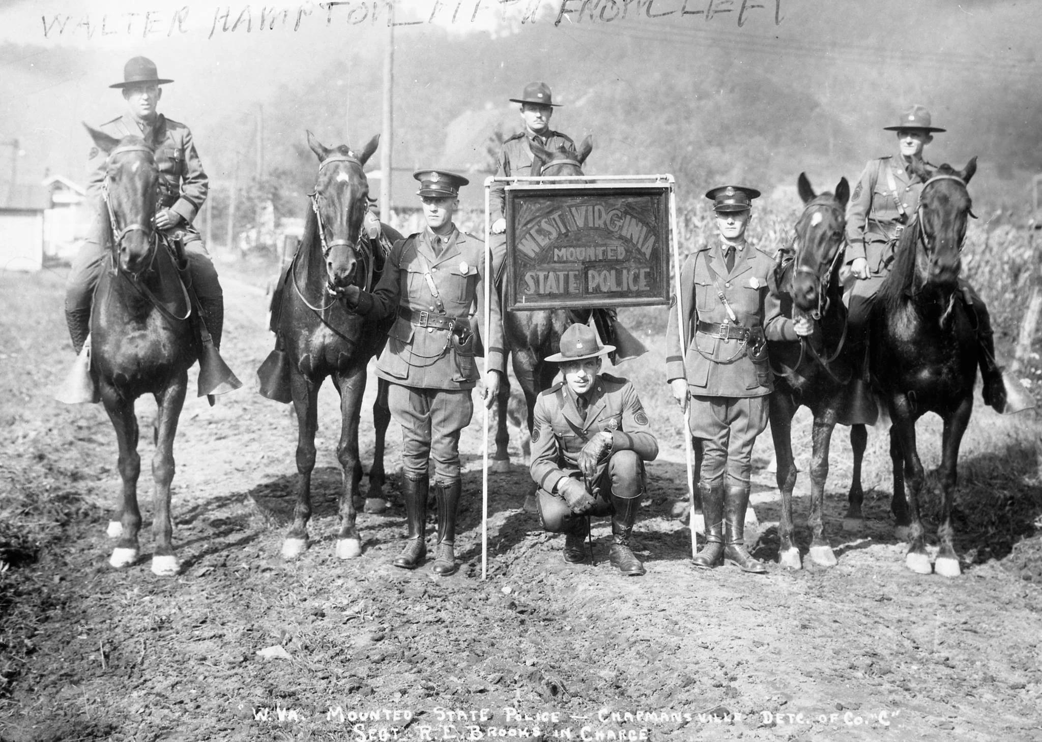
A Dagger Aimed at the Union’s Heart
But while the union succeeded in consolidating its position in Kanawha County with 16,000 members, southern West Virginia – the counties of Mingo, Logan and McDowell – remained non-union, controlled by company guards, Baldwin-Felts agents and sheriff Don Chafin.
Clearly West Virginia was of crucial importance to the UMW. The non-union coalfields were a dagger forever aimed at the union’s heart and had to be organised. What this involved, however, was not a confrontation with backwoods mine companies, petty local tyrants who had never heard of industrial relations, but with corporate interests at the heart of American capitalism. Over 90 percent of the land in Mingo and Logan Counties was owned by outside interests. The powerful Mellon family owned mines in the area, but the dominant interest was the fiercely anti-union corporation, US Steel, that owned over 32,000 acres in Mingo and Logan and another 50,000 acres in McDowell. British companies also had extensive holdings. The fact was that southern West Virginia was not owned and controlled by local capitalists but by capitalists resident in New York, Philadelphia, Boston, Baltimore and London. The decision to wage murderous war on the union was taken by these men.
West Virginia Mounted State Police in Logan County

Slide 11
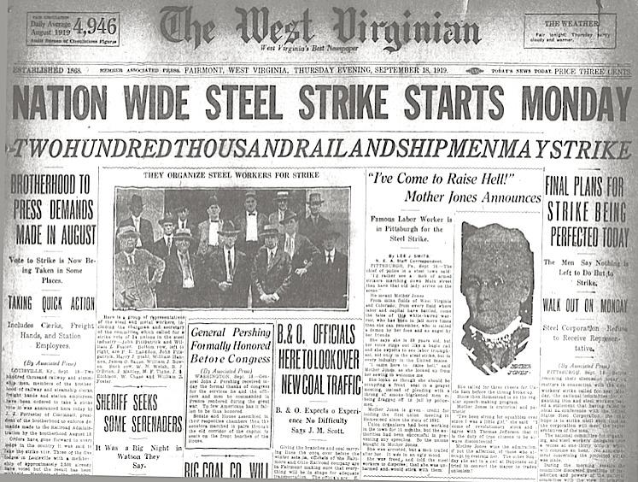
Ebbs and Tides
The year 1919 saw a dramatic explosion of industrial unrest throughout the United States. Over 4 million workers were involved in 3,630 strikes. In February there was a general strike in Seattle. Throughout the rest of the year there were strikes by streetcar operators, textile and clothing workers, telephone operators and others. Then in September the Boston police went on strike. The decisive struggles, however, were the great steel strike that began in September and the great miners’ strike that began in November. The American ruling class responded to this explosion with a ‘red scare’ campaign and a drive for the ‘open’ or non-union shop. The American Federation of Labour reluctantly sponsored a National Committee for Organising Iron and Steel which co-ordinated a union recruitment campaign. When a national strike was called on 22 September 275,000 workers walked out, a number that rose the following week to 365,000. The employers, dominated by US Steel stood firm, refused to recognise the unions and resolved to starve and intimidate the strikers back to work. The strike began to crumble. By mid-December the number of workers still out had fallen to 100,000 and the strike was finally called off on 8 January 1920. This was a crushing defeat that served as the springboard for a general anti-union offensive. Between 1920 and 1923 union membership in the United States was to fall by 1.5 million.
Hellraisers Journal: Steel Strike Begins Monday; Mother Jones Back in Pittsburgh: “I CAME HERE TO RAISE HELL!” - The West Virginian 1919

Slide 12
The Threat of Non-Union Coal
Discontent was also building up among the miners with a rash of unofficial strikes in the summer of 1919 and demands for a general strike to secure the release of Tom Mooney, a revolutionary socialist framed for a bombing in San Francisco in 1916. This unrest came to a head at the UMW convention in September when delegates voted to demand a six hour day, five day week (at that time miners worked an eight hour day and a six day week, so this would have required an 18 hour reduction) and a 60 percent wage increase. Failure to concede would result in a national strike on 1 November. Inevitably the Democrat president, Woodrow Wilson, sided with the employers and his attorney general, A. Mitchell Palmer, secured a court injunction preventing the UMW from implementing the strike decision. The union president, John L. Lewis, complied but on 1 November 394,000 soft coal miners walked out on strike regardless. On 8 November the court ordered the union to secure a return to work. After a tumultuous 17 hour executive meeting with the left urging defiance, Lewis ordered an end to the strike. The strike continued and it was not until the end of December that a general return to work had taken place. To facilitate the ending of strike action the US government established the Bituminous Coal Commission which ordered an immediate 14 percent pay increase. When the commission made its final award in March 1920 the average pay rise was 27 percent, but nothing was conceded on hours. Still, what of the threat of the non-union fields? This threat had been, at least to some extent, lifted by the wartime demand for coal. It now returned with a vengeance. In Alabama the mine owners refused to implement the commission awards and instead imposed wage cuts. Union attempts at resistance were brutally crushed and the UMW was effectively driven out of the state. What of West Virginia?

Slide 13
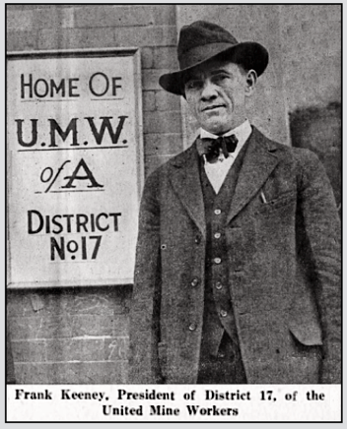
UMW District 17 Forms the Tip of the Spear
West Virginia UMW District 17, under the leadership of Frank Keeney and Fred Mooney, both socialists, had successfully consolidated its hold in the northern and western districts. By the end of 1918 they claimed a union membership of 22,000 out of a mine workforce of 100,000, uniting black and white, native and immigrant, in the face of the most brutal repression. Racial barriers between black and white workers were broken down by the severity of their common exploitation and oppression. Black miners were elected onto District 17’s executive, appointed as organisers and served as officers of union locals (one local had a black president, vice-president and secretary). They were in the forefront of the fight against the mine owners. As early as November 1919 reports that union organisers were being murdered in Logan County led to some 5,000 armed miners assembling outside Charleston, the West Virginia state capitol. They intended to liberate Logan, drive out the company guards and establish union control. District 17’s president, Frank Keeney, persuaded them to disperse. Nevertheless, the UMW was determined to establish itself throughout the state.

Slide 14
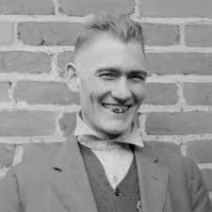
Forced to Become and Armed Insurgency
Early in 1920 the UMW began organising in Mingo County, using the independent town of Matewan, with its union mayor and chief of police, as a centre of operations. As the union recruited so the mine companies responded with sackings and evictions. What transformed the situation, however, was the unsuccessful attempt by Baldwin-Felts agents to take over Matewan. First Sid Hatfield was offered bribes to allow the agency to establish a guard post equipped with machine guns in the town and then on 19 May the attempt was made to kill him. Hatfield’s devastating victory ended the climate of fear maintained by the Baldwin-Felts agents and thousands of miners flooded into the union. By the end of June over 90 percent of the county’s miners were enrolled in 34 locals and the union’s state wide membership had risen to over 50,000. On 1 July the UMW called its members in Mingo County out on strike. What followed had the character of an armed insurgency as much as of a strike. Throughout the county armed miners fought it out with company guards and state police, enforcing the closure of the mines.
1 August 1921, Sid Hatfield, the pro-union chief of police of Matewan, West Virginia

Slide 15
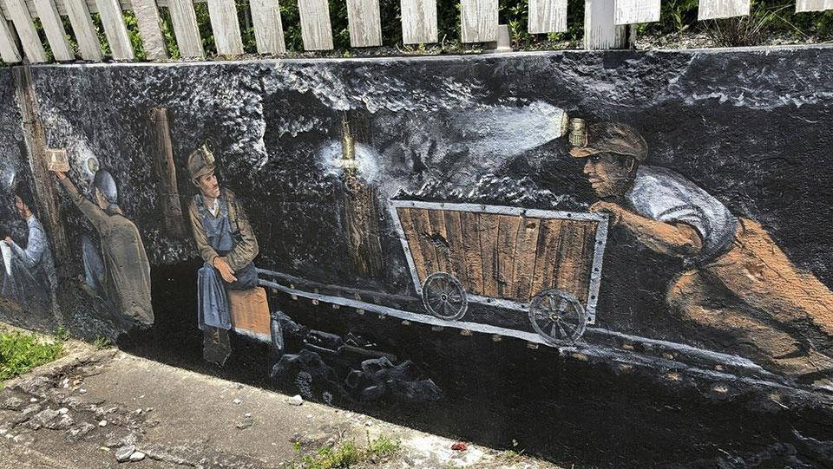
A Film Which Stands in Monument
John Sayles’s film Matewan is a celebration of working class solidarity and courage in the face of the most brutal employers. It focuses on the rank and file experience of the 1920 strike with the intention of inspiring similar solidarity and courage among the working class today. This is to be wholeheartedly welcomed. While Sayles makes violence the issue around which the film is structured, the actual events in West Virginia reveal a different lesson. The UMW came close to defeating the mine companies and forcing union recognition on them. This was despite the murderous activities of the company guards and private detectives. What turned the tide was the intervention of the federal government and the arrival of troops and bomber aircraft to crush the miners’ army at Blair Mountain. Victory was still possible. National action by the UMW and solidarity action from other unions could still have won the day. Instead the struggle remained localised and despite all their courage, sacrifice and endurance, the miners went down to defeat in West Virginia.
A mural depicting miners working in coal mines in Matewan, W.Va. On May 19, 1920, a group of miners, who were led by a local police chief, and detectives hired by a coal company to evict unionizing miners from their homes were involved in a gun battle on the street. Ten people died in the Matewan Massacre. John Raby | AP

Slide 16
Discussion & New Members Introductions

Slide 17
New Member Introductions
What is your name, pronouns and state (or country/territory)?
Where do you work? Is it unionized?
How did you find out about the People’s School?
What do you think about tonight's class?

Slide 18
Lessons of Matewan

Slide 19
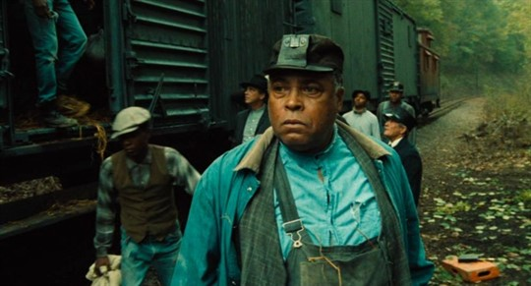
TITLE
Throughout the movie, a central theme is overcoming racial and national barriers to organize
The Baldwin-Felts Company, in the service of the monopolistic Stone Mountain Coal Company, utilizes divide and conquer methods.
On one hand, Stone Mountain Coal Company brought in black workers to act as scabs. While on the other, Baldwin-Felts Agent Charles Everett Lively, infiltrated the union organizing meetings and galvanized racial tensions between the black and white workers.
Lively and the Baldwin-Felts union busters were preventing the unity of labor.
Black workers being transported by Stone Mountain Coal Company to act as scabs. These miners who were unknowingly being used were then attacked by white workers who were manipulated into racist violence.

Slide 20
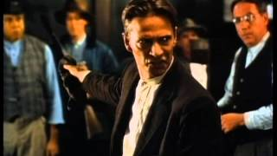
Racism Has No Place in the Union

Slide 21
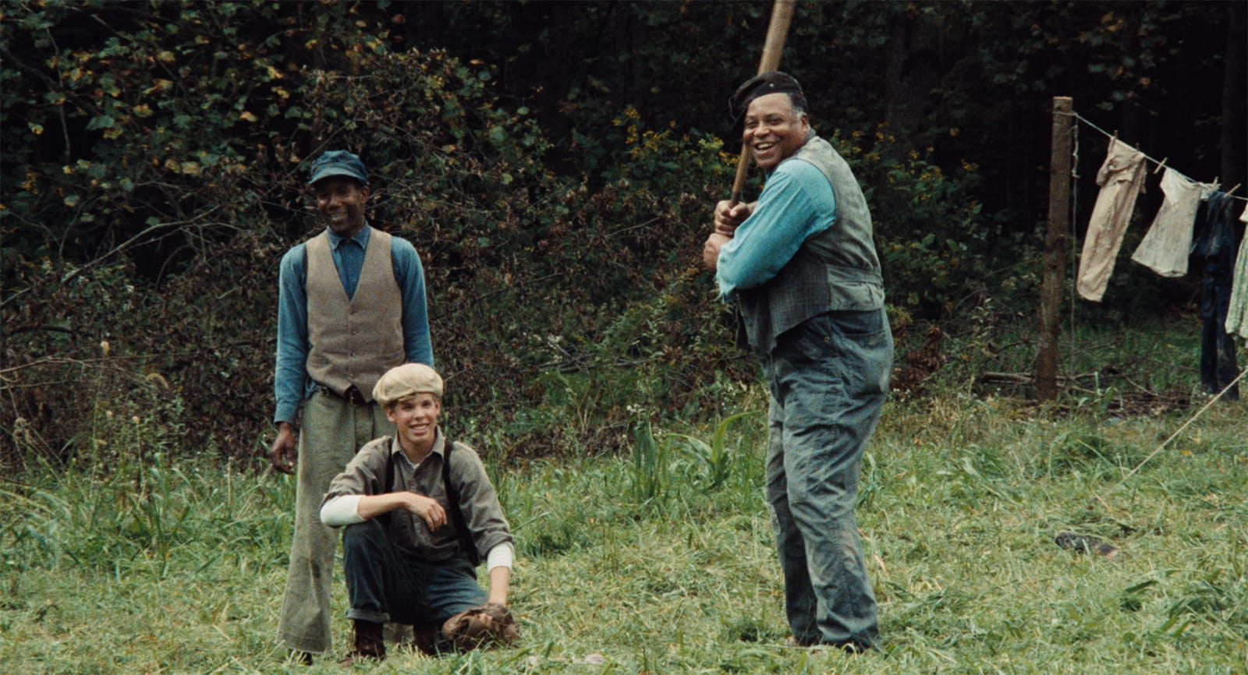
Workers Unite Through Shared Strike Culture
Despite all the efforts by the Baldwin-Felts Company to disrupt unity between black and white workers, the miners stuck together in their strike and continued to recruit anyone who was brought in by the company or Baldwin-Felts to scab into the union campaign.
Through this unity, the miners were able to defend themselves against the Baldwin-Felts reign of terror.
Black and white miners playing baseball together which builds solidarity among the workers of different races.

Slide 22
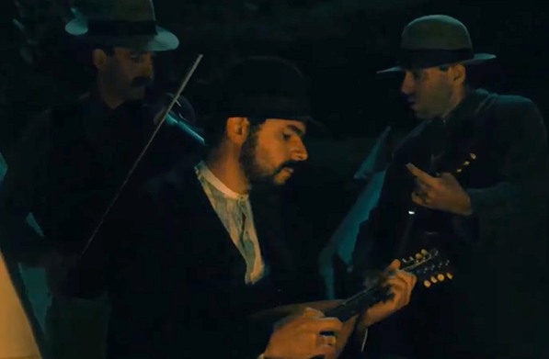
Workers Unite Through Shared Strike Culture
When racism between the black and white American miners did not succeed, Stone Mountain Coal company and their Baldwin-Felts lackeys tried bringing in Italian immigrant miners in who had a limited ability speaking English.
In the camp, the miners black and white, American and foreign-born bonded over music and food. Again the agents of reaction failed in causing divisions.
All miners of all backgrounds unite through arts and culture (music and food)

Slide 23
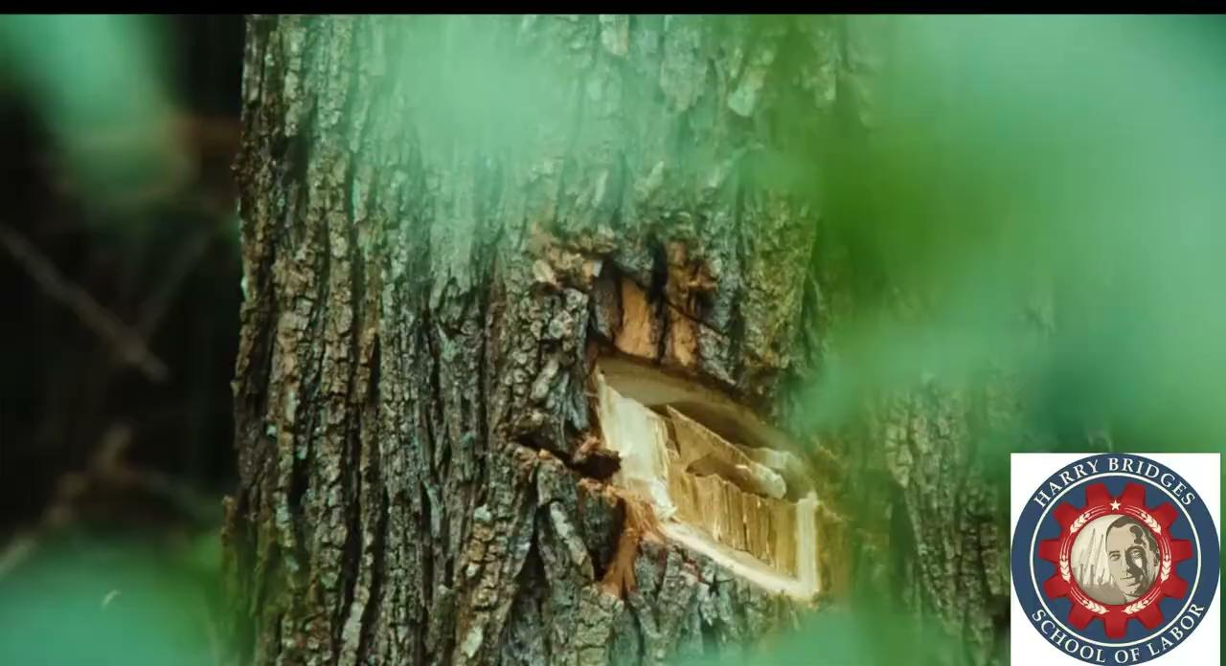
Mutual Aid During the Strike
The Baldwin-Felts Union Busters, in their brutal attempts at ending the strike, evicted the miners from their homes and cut off access to vital resources like food and water.
The mineworkers responded in a clever way. Instead of dispersing for narrow self-interests, the workers came together, built a camp, and worked together to defend each other against attacks, share food, clothing, and labor in the camps.
This mutual aid was not merely a charity but rather an organized and well rationed system in order to maintain the strike
Miners form a camp to mutually aid each other in order to ensure the strike is successful

Slide 24
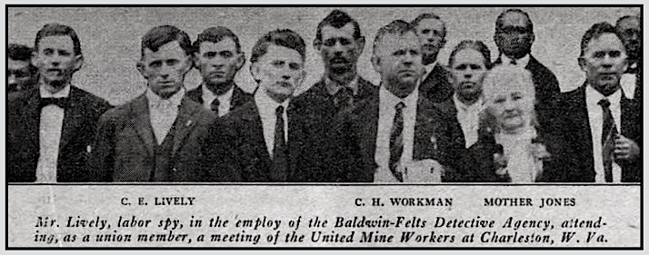
Beware the Pied Pipers
Throughout the movie, there is always a section of the striking workers that abandon the idea of forming a union and prefer to take up armed adventures against the bosses. Included in these individuals is Charles Lively himself.
It becomes apparent that moving away from labor organizing and proceeding directly to armed conflict is precisely the strategy that the bosses (Stone Mountain Coal) wanted.
A few dead Baldwin-Felts agents is nothing to Stone Mountain Coal if it can break up the organizing of a militant and united labor union.
Charles E. Lively with the Baldwin-Felts Detective Agency

Slide 25
Lessons From Matewan Summarized
For a successful struggle against monopoly, whether in a labor or civic setting, a definite struggle against divisions such as racism, sexism, national chauvinism, anti-LGBT+ bigotry, etc is an utmost necessity.
Organizing a mutual aid structure can and probably is vital for the prolonged struggle especially when said struggle is based on attrition.
Identifying disunifying forces and adventurism and struggling vigorously against these dangerous trends ensures that when pivotal opportunities take place, there is no doubt that there is unwavering solidarity.

Slide 26
Discussion

Slide 27
The Communist Perspective of Matewan

Slide 28
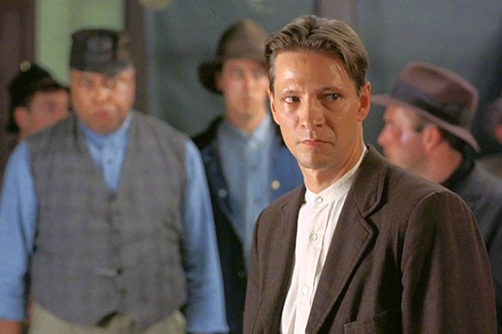
Matewan in it’s Time
Joe Kenehan showed the workers that there was them and the bosses.
The bosses had tried to have the workers fight each on the basis of race, but Joe Kenehan showed them that when they fight together they have a chance against the bosses who are united in their class solidarity.

Slide 29
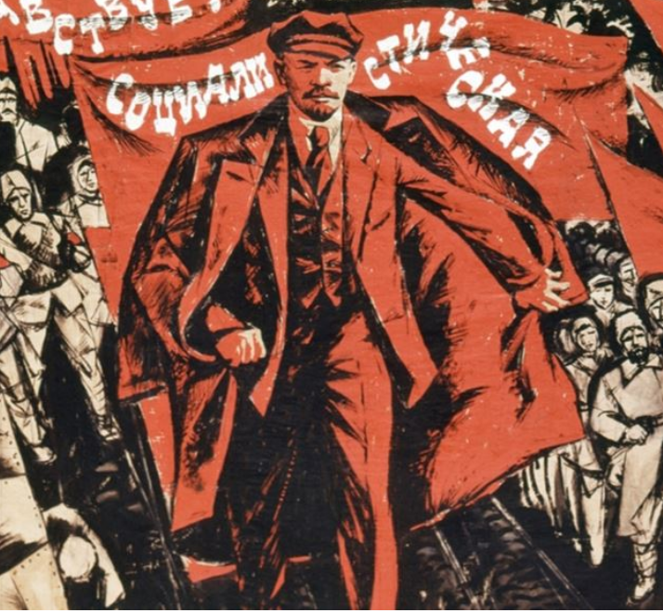
Fear of Communism in the Events and Movie
One point in the movie is the company scab informing the mine owners and the private detectives that Joe Kenehan was a “Red”, despite him being an ex-Wobbly, or IWW Anarcho-Syndicalist.
While in 1920 the Russian Revolution was only 3 years old, the power of the world’s first worker’s state had already spread fear in the capitalist ranks and led to the first Red Scare in the 1920s.

Slide 30
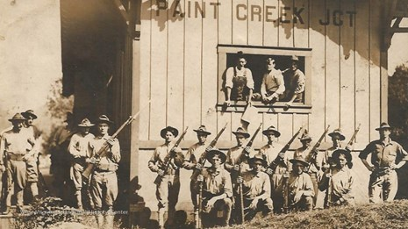
On Adventurism and Individualistic Actions
Though the union of workers succeeds in parrying the brutal tactics of the Baldwin-Felts paramilitary, ultimately the labor drive is forced into a bloody confrontation that leaves many dead due to the adventurism of certain workers who grow impatient with the mass organization methods of the union.
Lenin spoke extensively on adventurism and infatuation with violence and how it should be avoided in building the class struggle.

Slide 31
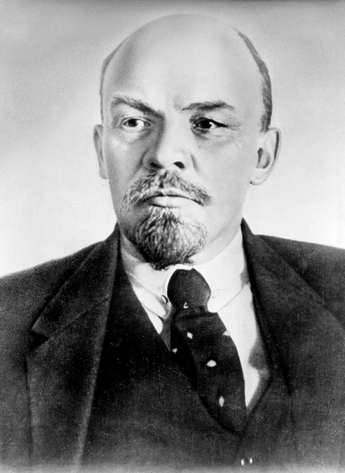
In the words of Lenin:
In their defence of terrorism, which the experience of the Russian revolutionary movement has so clearly proved to be ineffective, the Socialist-Revolutionaries are talking themselves blue in the face in asseverating that they recognise terrorism only in conjunction with work among the masses, and that therefore the arguments used by the Russian Social-Democrats to refute the efficacy of this method of struggle (and which have indeed been refuted for a long time to come) do not apply to them.

Slide 32
In the words of Lenin:
Here something very similar to their attitude towards “criticism” is repeating itself. We are not opportunists, cry the Socialist- Revolutionaries, and at the same time they are shelving the dogma of proletarian socialism, for reason of sheer opportunist criticism and no other.
We are not repeating the terrorists’ mistakes and are not diverting attention from work among the masses, the Socialist-Revolutionaries assure us, and at the same time enthusiastically recommend to the Party acts such as Balmashov’s assassination of Sipyagin, although everyone knows and sees perfectly well that this act was in no way connected with the masses and, moreover, could not have been by reason of the very way in which it was carried out—that the persons who committed this terrorist act neither counted on nor hoped for any definite action or support on the part of the masses.

Slide 33
In the words of Lenin:
Anyone who really carries on his revolutionary work in conjunction with the class struggle of the proletariat very well knows, sees and feels what vast numbers of immediate and direct demands of the proletariat (and of the sections of the people capable of supporting the latter) remain unsatisfied. He knows that in very many places, throughout vast areas, the working people are literally straining to go into action, and that their ardour runs to waste because of the scarcity of literature and leadership, the lack of forces and means in the revolutionary organisations. And we find ourselves—we see that we find our selves—in the same old vicious circle that has so long hemmed in the Russian revolution like an omen of evil. On the one hand, the revolutionary ardour of the insufficiently enlightened and unorganised crowd runs to waste. On the other hand, shots fired by the “elusive individuals” who are losing faith in the possibility of marching in formation and working hand in hand with the masses also end in smoke.
Lenin-On Revolutionary Adventurism, Collected Works Volume 6

Slide 34
Discussion & Wrap Up

Slide 35
Announcements
PCUSA Cell Chairs need to call members of their cells to remind them about attendance.
PCUSA Cell members are reminded attendance at the Continuing Education class of Jones-Foster every first Wednesday of the month is required.
The next issue of New Masses (2026) has begun production. If you have art you want us to feature, email it to info@partyofcommunistsusa.net.

Slide 36
Volunteers Needed!
We are in need of volunteers for the staff of the People’s School! Here’s a few roles we need filled:
People to help manage posting on our social media and podcast platforms
Video Editors, Audio Editors, Graphic Designers, Artists, Narrators
Web Controls, Moderators
Email info@peoplesschool.us if you’re interested and try to attend our next staff meeting if possible.

Slide 37


Slide 38

View From Left Field
https://viewfromleftfield.libsyn.com
The Old PSMLS Youtube is now the Youtube of View From Left Field, a podcast of analysis and discussion of current events from a progressive perspective.
Like the Youtube videos and subscribe with 5 star ratings on your podcast platforms.

Slide 39

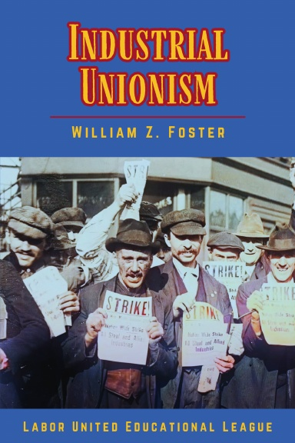
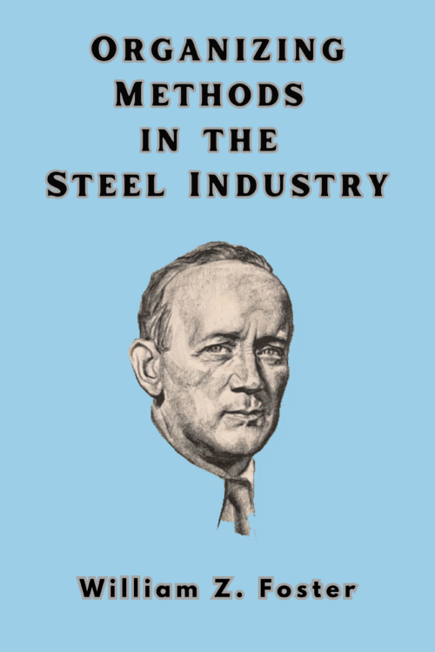
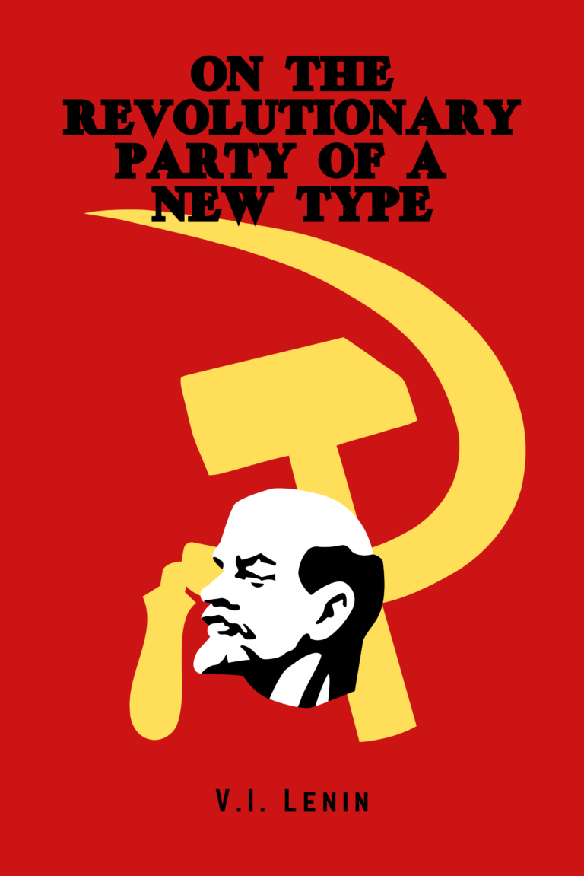

New Outlook Publishers
newoutlookpublishers.store
Relevant and Latest Releases

Slide 40


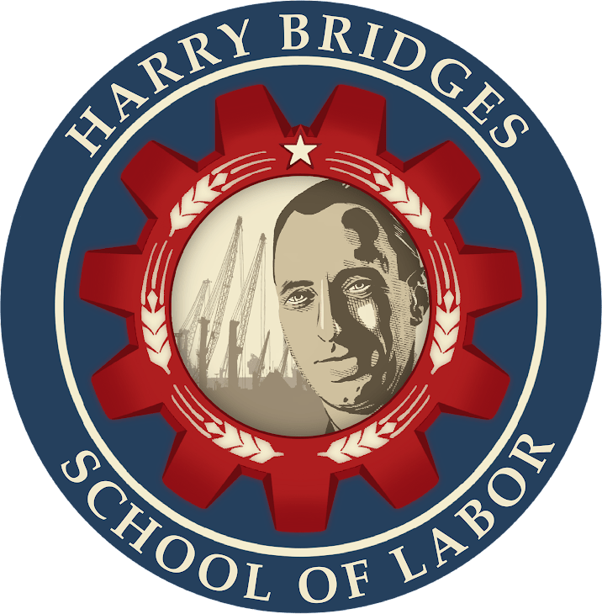
Harry Bridges School of Labor
luel.us/laborschool/
The Harry Bridges School of Labor is a monthly class covering a variety of topics aimed at building class consciousness among union members. For class schedule and other information, please visit the website at luel.us/laborschool.

Slide 41
Hills of Galilee (feat. Hazel Dickens) - Matewan Soundtrack

