Slide 1

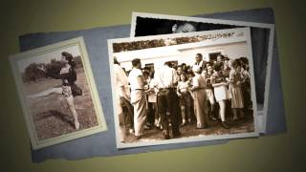
The House I Live In by Paul Robeson - Camp Wo-Chi-Ca

Slide 2
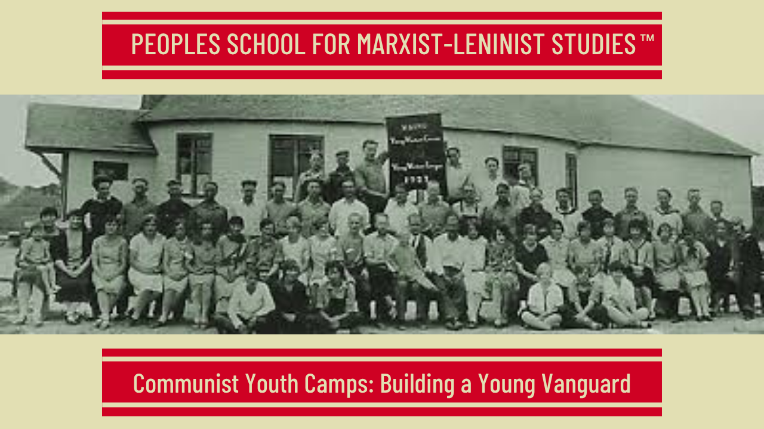
PSMLS 6/2/26

Slide 3
What we’ll be learning today:
Happy International Children’s Day!
History & legacy of Communist camps
The Aims and Methods of Young Workers Education by Oliver Carlson
Continuing the legacy of communist youth camps

Slide 4
History & Legacy of Communist Camps

Slide 5
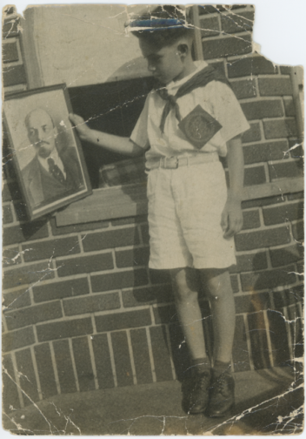
The Children’s Movements as Basis for Summer Camps
The Communist Children’s Movement attempted to develop a children’s political culture in which working-class consciousness and identification with the Communist movement would transcend ethnic or regional differences between children.
They sought a culture that would provide an alternative to the conservatism of U.S. society in general. The movement emphasized the ability of youngsters to develop an autonomous political consciousness in order separate children from the socializing influences of bourgeois society.
These influences, they held, included the working-class family as well as public schools, newspapers, churches, synagogues, and children’s and youth organizations such as the Boy Scouts.
The children’s organizations of the Communist Party were semi-autonomous sections of the Communist political movement.
Membership in the children’s sections was intended to be broader than that in the party; it was to include working-class children whose parents were not Communists.

Slide 6
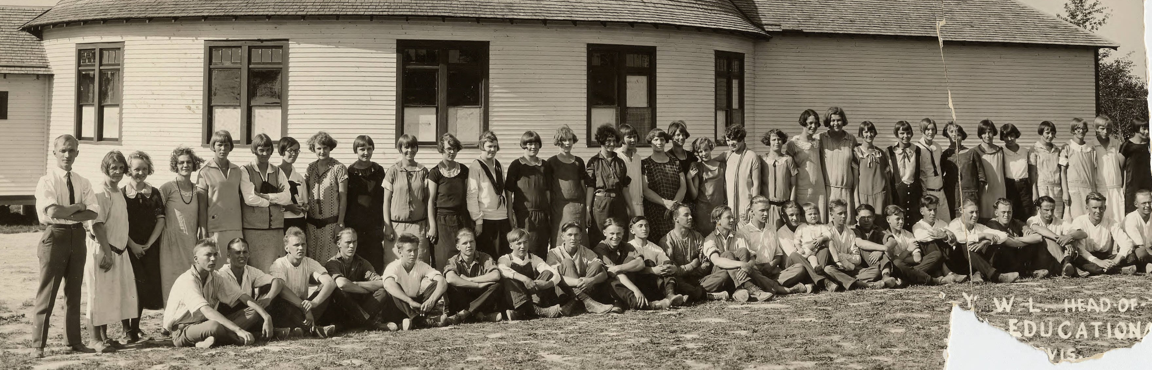
Camps as Communist Immersion
At the summer camps, the culture of the Communist movement and the Communist vision of political education for children could be realized in a context in which children were removed from the daily conservative influences of the larger society.
Troop leaders were members of the Young Communist League who had been specially selected to work with children. The meetings included discussions based on articles in the Pioneer magazines or of current events, a play activity or game, and planning for the political activities of the troop.
If a troop was running properly, the children themselves were to initiate and lead the organization of the activities. Children would chair the meetings and record the minutes, and all troop officers were elected from among the Pioneers.

Slide 7
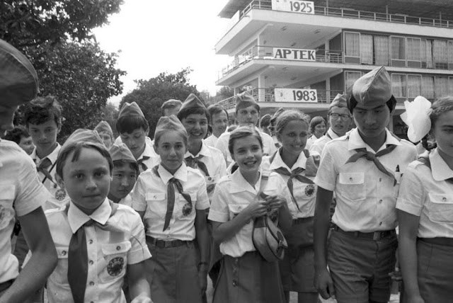
Socialism in One Summer Radical Summer Camps in the 1930’s and 1940’s
Summertime is a utopian season. Children are freed from the constraints of school, the weather is cooperative, and the world belongs to kids. In the industrialized world, this “free” time has been extended to adults, for whom summer vacations provide welcome respite from the year’s labor.
During the 1930s and 1940’s, in summer camps, bungalow communities, and resorts, radicals used this freedom to create temporary communities organized around their own culture and values. These communities, temporary as they might be, were an extension of the spirit that animated the intentional communal settlements that flourished around the reform and radical movements of the late nineteenth and early twentieth centuries. For postwar Marxists, they were a way of participating in the radical American communitarian tradition.
The radical movement of this period spawned dozens of these institutions that functioned as both vacation resorts and utopian experiments.
The Communist-oriented Left was not alone in organizing children’s camps. Left-wing organizations not affiliated to the CP, including those opposed to the Communists, also organized such institutions.

Slide 8
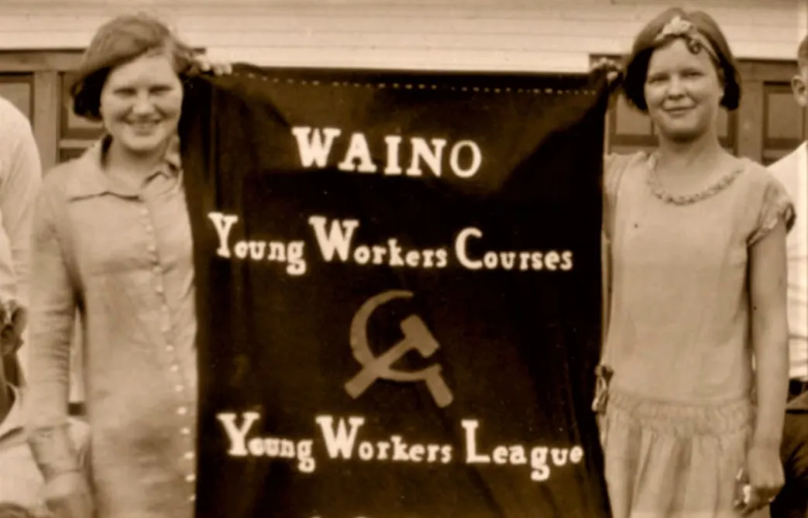
THE SOVIET OF CHILDREN: THE YOUNG PIONEER SUMMER CAMPS
The most popular activities of the Communist children’s movement were the Pioneer summer camps. These camps were the events most likely to reach beyond the children of Communists themselves. The organizing of children was effective during strikes, but there was often little holdover when the strikes ended.
The summer camps, which became a central feature of Communist children’s activities during the 1930s and 1940s, not only offered outdoor recreation to children who could not ordinarily afford it, but provided an institutional setting where a Communist political culture could be developed away from the hostility of the larger society, as mentioned earlier.
The structure of camp governance attempted to create a living model of socialism for both the children and the adults in the camp. Patterned on the Soviet political structure—indeed, in many camps, the assembly of child and adult representatives was known as the camp soviet—the structure reflected Communist views on the relationship between children and adults. The children were organized into squads, or collectives, that for the time camp was in session were supposed to function as political units. Squads at the camp at Iron River, Wisconsin, in 1932 were named Lenin, Octobrists, Tom Mooney, Red Sparks, Marx, and Stalin.

Slide 9
Camp life provides wrap around class consciousness
In the Communist view, children, like the proletariat under socialism, needed guidance coupled with autonomy and power.
Daily life at the camps was organized to express this perspective, which the Communists hoped would be carried over into political life after the camp.
That aspect of the Communist movement that tended to make of the movement a world unto itself reached its highest expression in the Pioneer summer camps. Everything about the life at the camps was directed toward the end of creating an identification between the children and the Communist movement.
Many of the songs the children sang came from the Pioneer Song Book, with words such as:
We’re marching towards the morning,
We’re struggling comrades all.
Our aims are set on victory,
Our enemies must fall.
With ordered step, red flag unfurled,
We'll make a new and better world.
We are the youthful guardsmen of the
proletariat.

Slide 10
Young Pioneers, not the Boy Scouts
Because the Young Pioneers saw organizations like the Boy Scouts as the voice of the capitalists among working-class children, they sought to compete with them, presenting themselves as the revolutionary alternative.
A leaflet issued in a New York high school giving their overall ideology illustrated their views on the Boys Scouts:
The Boy Scouts justify and glorify bosses’ wars. They boast of the fact
that Boy Scouts make the best soldiers and that Boy Scouts did service to
the bosses in the last World War, which was only a war for the bosses’
profits.
The Pioneers are against all bosses’ wars. We say to the workers’ children: Your real enemies are not the workers of any other country, but the
bosses right here at home—the American capitalist class. . . .
The Pioneers are fighting against the rotten conditions in the schools
in working-class neighborhoods—against the fire traps, against the overcrowding, against the part-time system. ... We’re fighting to spread
the truth about the workers and bosses among the children and to win
the workers’ children for the working class.

Slide 11
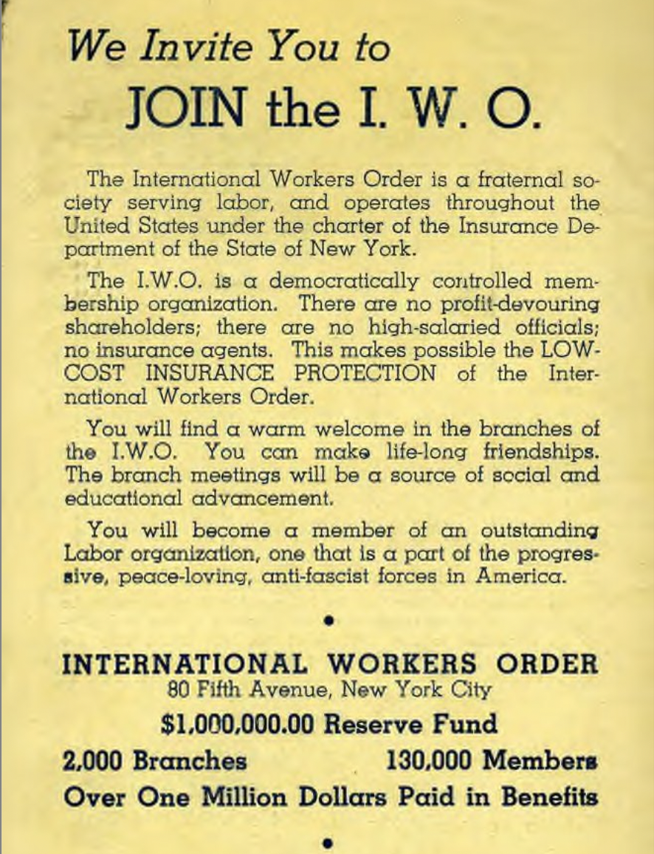
The I.W.O. as base for Popular Front Children’s Activities
As revolutionaries, Communists were opposed to much in American culture, seeing it only as the ideological expression of capitalist domination. Thus they tried to get the children’s organizations to involve children in outwardly directed political activities.
The high point in the development of the Young Pioneer movement occurred after the onset of the Great Depression.
By 1934, however, the Communist-oriented children’s activities began to change, developing the character they would have during the rest of the 1930s and into the 1940’s. These changes coincided with the general shift in Communist strategy to what was characterized as the Popular Front against Fascism. This policy was instituted in 1936, but changes in the children’s activities tending in this direction began earlier.
The Young Pioneers of America was dissolved in 1934. The political perspective it had evolved since the early 1920s no longer reflected the concerns either of the Communist Party or of Communist parents.
After 1934, the junior section of the International Workers Order, which had first been organized in 1930 when the IWO itself was first organized, became the primary organization for Communist children’s activities.

Slide 12
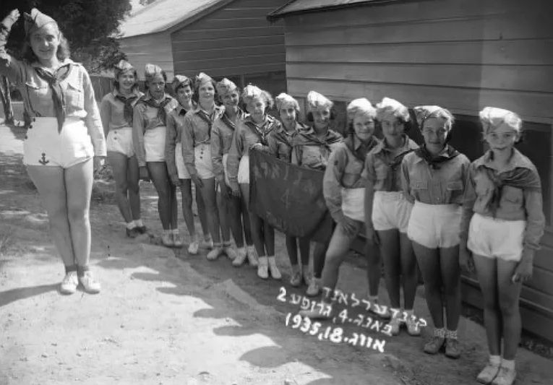
Camp Kinderland
Camp Kinderland, founded in 1925 by activists in the shules of the Workmen’s Circle, was located on Sylvan Lake in Dutchess County, New York.
An adult resort, Lakeland, was attached to the children’s camp during much of Kinderland’s history.
The relationship between the camp and the shules in the city was always central to the organizers’ conception of Kinderland. The principle “Foon shule in kemp, foon kemp in shule” (from shule to camp, from camp to shule) expressed the continuity between the Yiddish cultural activities in the city and the activities
The next year, when the Workmen’s Circle opened Camp Kinder Ring across Sylvan Lake, the two camps engaged in much verbal rivalry, but also some cooperation, over the course of their histories.
Kinderland was an independent institution operating within the milieu of the Communist-allied Jewish working-class movement in New York. After the formation of the IWO, it was formally sponsored by the Jewish People’s Fraternal Order of the IWO.

Slide 13
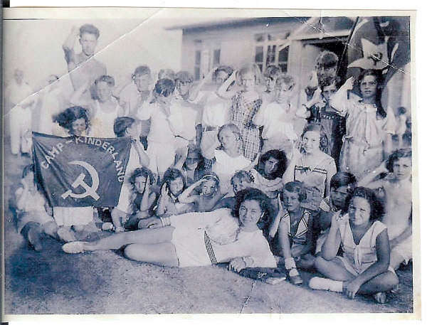
Camp Kinderland
Daily life for campers at Kinderland was organized around activities that were a combination of structured and unstructured time. In the morning, after breakfast and the clean-up of the bunks, there was often an early assembly.
The days were divided into a typical summer camp program of swimming, sports, and play, plus educational and cultural activities directed toward the camp’s political goals. Yiddish classes were mandatory through the 1930s and much of the cultural life was organized around the teaching of Yiddish culture and the history of Eastern European and U.S. working-class Jews. What might seem to be normal activity for a child’s summer camp was politicized by its context in the educational and cultural programs. These were integral to the camp. Classes and formal discussions were conscientiously carried out by the camp organizers.
But equally important were the celebrations and rituals marking special events and holidays.
Singer/activist Paul Robeson had equal importance in that he represented the American culture, of which the Jewish radicals were attempting to become a part.
Robeson’s visits were of particular importance. He was greeted in a fashion similar to that accorded to the others.

Slide 14
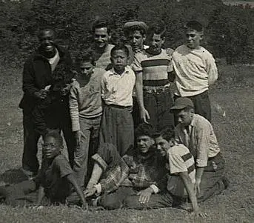
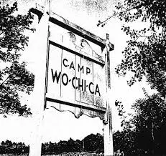
Camp Wo-Chi-Ca
Wo-Chi-Ca, founded in 1936, grew in the same soil as Kinderland, but its focus was less on the culture created by immigrants and more on a Popular Front—era Communist conception of American democracy. Although many of the children who attended Wo-Chi-Ca came from New York Jewish families similar to those of children at Kinderland, the organizers of Wo-Chi-Ca did not attempt to keep the Yiddish language of the parents alive at the camp.
Instead, they attempted to translate the experiences of the Communist culture in New York—predominantly Jewish though it was—into an American socialist vision that would reflect the concerns of a multiethnic and multiracial working class.
Interracialism was, thus, a central theme at Wo-Chi-Ca. Camp organizers hoped that by creating an institution where Black and white children would interact on a daily basis, racism could be confronted openly and overcome.
Wo-Chi-Ca was founded by people who had been active in the Young Pioneers, the IWO Juniors, and other sections of the radical children’s movement in New York.
The founding group included both members of the Communist Party and nonmembers In the 1930s and 1940s, the idea of interracial camping for children was daring. Most children’s camps were de facto segregated because of their sponsorship by all-white organizations such as churches and fraternal organizations, and in addition, the cost of sending a child to camp was prohibitive for most Black families. There was also constant opposition to interracial camping from conservatives in the state.

Slide 15
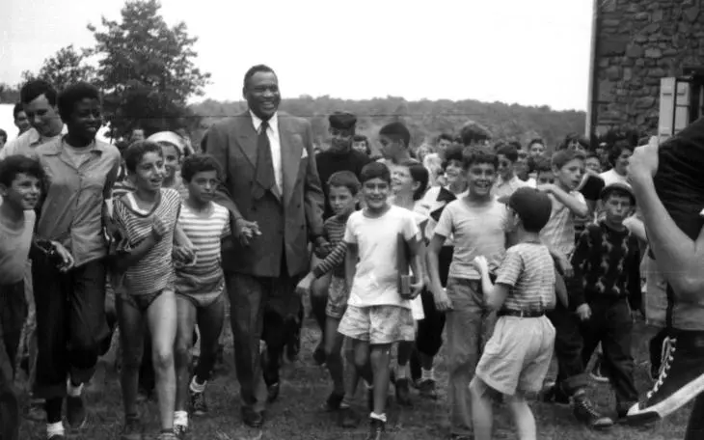
Camp Wo-Chi-Ca
The white families who sent their children to Wo-Chi-Ca were predominantly Jewish. However, by the 1940s children from other ethnic backgrounds also began to attend Wo-Chi-Ca in significant numbers. The camper list from 1949 includes many Latin American, Slovak, and Italian names, in addition to Jewish ones.That year, Congressman Vito Marcantonio sponsored four Puerto Rican children from his East Harlem district, including future Salsa musician Tito Puente.”
One way in which interracialism was practiced at Wo-Chi-Ca was to make African American culture representative of American culture in general. Songs from the Black tradition were sung and skits illustrating the experiences of Black people in the United States were performed.
At Wo-Chi-Ca, as at Kinderland, Paul Robeson was an important symbol of the effort to unite these two streams of American protest; the labor movement and the African American’s struggle. Not only were Robeson’s dignity and personal accomplishments enormous, he had pro-Soviet and anticolonialist sympathies. In addition, Paul Robeson Jr. attended Wo-Chi-Ca during the summers of 1941 and 1942.

Slide 16
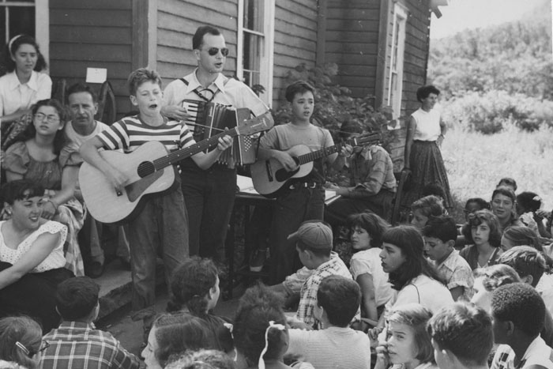
Camp Woodland- Folk Music Revival
Camp Woodland, founded in 1938 and closed in 1962, was run by people whose ties to the radical movement were not primarily with the associations and organizations of the Communist Left. Rather, they had worked within the left-wing of the Progressive Education movement.
Camp Woodland, in Phoenicia, New York, in the Catskill Mountains, drew on some of the experiences of other radical camps but forged a third alternative for the creation of a radical culture: it linked an urban based radicalism with the “naturally” democratic traditions of rural America.
In this interaction between urban and rural culture, by far the most important way in which Woodland attempted to create something new from it was in the area of folk music. The folk music of the Catskills offered Woodland organizers a cultural form that could be made the basis for a radical American culture. At Woodland, the new vision of folk music as popular, democratic culture was put into practice. It formed the framework for the cultural life of the camp. Pete Seeger’s visits to Woodland were special occasions for the camp, much in the way that the visits of prominent people to the other camps were.

Slide 17

Camp Woodland- Urban and Rural Integrated
Folk music was a vehicle for creating a culture at the camp during the summer, but it also could be taken back to the city during the school year.
By combining the musical heritage of the Left with that of the rural Catskills and the multiethnic camp population, Woodland helped to create an alternative, radical culture.
Like Wo-Chi-Ca’s it emphasized interracialism and manual labor; and it added a third component, the traditions of the rural community.

Slide 18
CONCLUSION
Although different, each of the three camps discussed developed a program for children that attempted to respond to the crucial cultural issue facing American radicals during the 1930s and 1940’s. Each camp chose different aspects of American life they could emphasize and in which they could make a socialist intervention.
During this period, the Communist Party was addressing the same issue on a political rather than a cultural basis. The slogan “Communism is Twentieth Century Americanism,” proclaimed by Communist leader Earl Browder, and the development of the policies of the Popular Front provided a political context for the organizers of the camps.
The culture or cultures created by Communists during the 1930s and 1940s were rooted in an attempt to join the Communist political perspective with the social and cultural concerns of the base of party members and sympathizers.
Kinderland, Wo-Chi-Ca, and Woodland inhabited a world separate from, yet a part of, the Communist political movement. Yet the camp experience was also a separate part of the radical world, even in the city. Workers and children from the camps maintained friendships over the winter, and some organized activities in the city were carried out by camp alumni. In this way the utopian aspect of camp life was continued.
Summer was a time during which children could leave the world of capitalism to live in a community that reflected the values of the radical movement, diverse though they were. The experience touched many of them profoundly and gave them a vision they could carry with them through their lives.

Slide 19
Discussion & New Members Introductions

Slide 20
New Member Introductions
What is your name, pronouns and state (or country/territory)?
Where do you work? Is it unionized?
How did you find out about the People’s School?
What do you think about tonight's class?

Slide 21
A Practical Primer on Workers’ Summer Camps

Slide 22
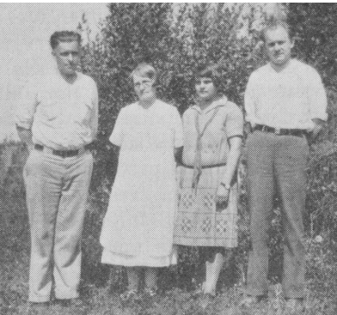
Teaching Proletarian Social Science
The following is the pamphlet entitled The Aims and Methods of Young Workers Education by Oliver Carlson.
Published in Red Dawn: Commencement Annual of the Northwest Young Workers Summer School held at Winlock, Washington, July 10th-August 20th, 1927. (Astoria, OR: Pacific Development Society, [1927]), pp. 6-7, 42-44.
This pamphlet aims to be a guide for those who intend to provide an educational camp experience for the purpose of developing the working class and teaching them the basics of marxism-leninism in a fun and fulfilling environment. That being said, much of the advice contained within is useful in general and can be applied by anyone who is engaged in the project of helping to educate the working masses to reach their full potential, both individually and as a class.
1927 Winlock, Washington YWL Summer School Staff: W.A. Harju (Technical Manager); Anna Oja (Cook); Vivian Miller (Instructor); and Oliver Carlson (Director).

Slide 23
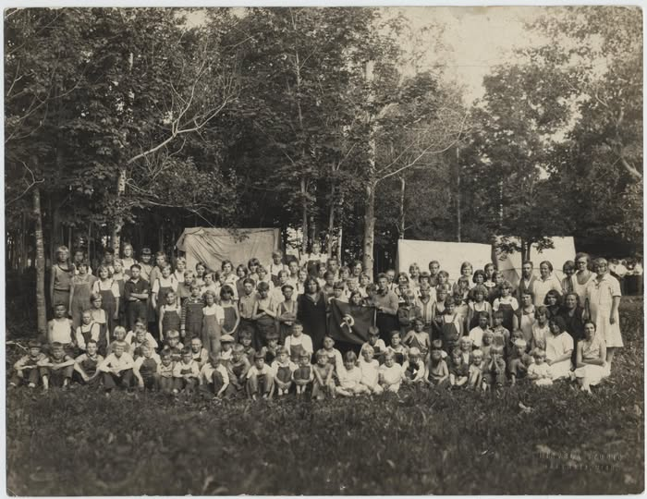
An Experienced View of Summer Schools
It is still too early to formulate a complete program of education for young workers. The methods of procedure are still experimental. The more ultimate aims have been quite clearly formulated — but there still remains much to be said as to the more concrete and immediate aims. In this article I shall give my point of view on these questions as based upon the specific experience of conducting and directing three young workers summer schools. These schools have been held in quite different parts of the country: Northern Wisconsin, Illinois, Southern Washington. The schools have varied in length of time: 4, 5, and 6 weeks. The number of students have also varied considerably in each case. The smallest attendance was 32; the largest 57, while the other had 42 students. The background for the students have also been quite distinct in each case; while they have ranged in age from 14 to 28 years. In education they have represented elements who were still attending public schools, high schools, and colleges. There have also been a few university graduates.
Finnish-American Communist Summer Camp in Wakefield, MI. - c. 1930

Slide 24
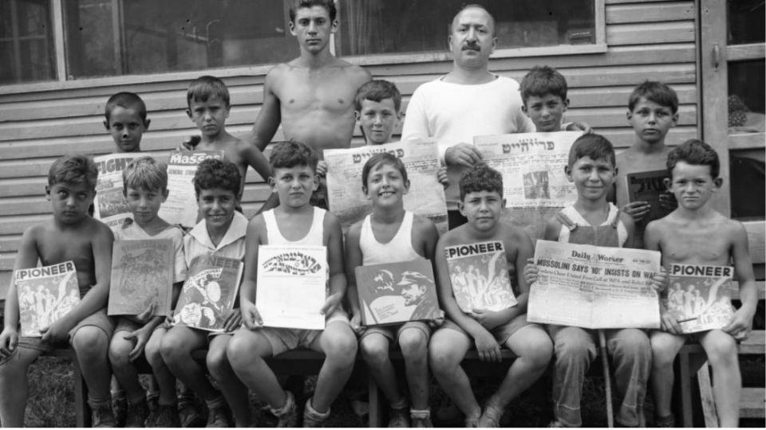
Workers and Students Both
In so far as occupation was concerned, the majority of all have been those who are still attending schools. However a wide diversity of occupations have also been included among those who were already workers. There have been machinists, coal miners, timber workers, loggers, needle trades workers, farmers, unskilled factory workers, clerks, clerical workers, domestic workers, etc., etc. It must also be mentioned that the method of study has been somewhat different in each school. The same applies to the curriculum and the textbooks used. It is upon this background of experience that I base my conclusions.
Camp Kinderland's Communist Sympathies on Proud Display - Photo Taken in August 1935

Slide 25
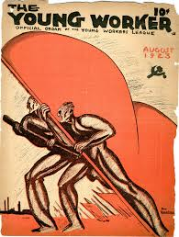
A Working Class Outlook Permeating Every Subject
From the very beginning we have been definite that these schools should in no way be considered as supplements to the ordinary public schools. We were not trying to give culture to the young. We were not interested in education for its own sake. The regularly accepted lines of education were neither accepted nor followed. Nearly all the material given to the students was such as is never obtained by them in ordinary schools. In fact, one of our first tasks of our educational program has been that of debunking the students, i.e. of freeing their minds from a confused mass of outright falsehoods and half-truths which they had consciously or unconsciously imbibed through the schools, movies, newspapers, and other agencies. We were determined that a definite working class outlook should permeate every subject studied. We openly admitted that all education is of necessity biased, especially that which deals with social, economic, and political problems. Ours was biased in favor of the proletariat.

Slide 26
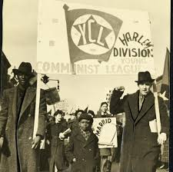
A Deeper and Wider Vision Than Bourgeois Science
For the benefit of those who demand “pure truth,” let me point out that the working class view on social sciences is far more correct than that “impartial” view which is dished out to the unsuspecting in the public educational institutions. These latter institutions are interested in the preservation of the existing social order. Their outlook is warped and made static for this reason. They become apologists for the system, not careful investigators. The working class, on the other hand, has no vested interest in the existing system. It can afford to look the facts in the face and admit the temporary and transitional nature of capitalism. It can and does take a dynamic attitude. Proletarian social science is superior to bourgeois social science “because it has a deeper and wider vision of the phenomena of social life, because it is capable of seeing further and observing facts that lie beyond the vision of bourgeois social science.”
The Young Communist League has taken part in and led some of the most important struggles of working-class youth — against poverty, unemployment and racism and for multiracial unity

Slide 27
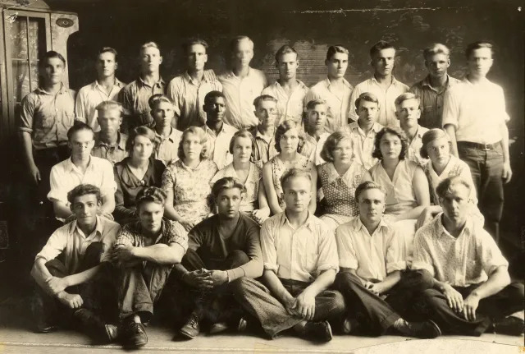
Theory Becomes the Greatest Force in the Labor Movement
The importance of theory, that is, of the synthesis or generalization of the accumulated facts, has been stressed throughout the schools. But at all times the theory has been closely connected with practice. The two are bound up, one with the other. Theory loses its reason for existence “if it is not connected with revolutionary practice, just as practice wanders off into darkness if it does not light its way with revolutionary theory. But the theory becomes the greatest force in the labor movement if it is insolubly bound up with revolutionary practice, for it alone can give to the movement confidence, guidance, understanding of the inner relations between events. It alone can help to make clear the process and direction of class movements in the present and the near future.” Insistence on being able to separate sentiment from fact has also been stressed. The importance of this cannot be overestimated for a working class movement that bases itself upon sloppy sentimentalities is easily mislead and swayed from one point of view to another.
Young Communists with the Young Workers League in the Summer of 1923

Slide 28
The Aim of the Schools
We may say that the more ultimate aim of the school has been to prepare intelligent workers who can take their place in the organized labor movement, economic, political, educational, etc., and give it guidance and direction to the end that capitalism may be abolished and replaced by a worldwide Union of Socialist Soviet Republics. The more immediate aim of the schools has been (1) To acquaint the students with their position as members of the working class to the rest of society; (2) To give them an understanding of the struggle of the oppressed classes since the dawn of history and the methods and means which both oppressor and oppressed have used; (3) To acquaint them with the economic working of the existing social system; (4) To teach them the relationship between economic and political theories and organizational forms, giving special attention to the theories and organizations existing within the worldwide labor movement at the present time. Special attention has been given to the creation of the model Young Workers League organization amongst the students, where they could discuss and consider tangible problems that face them in their respective localities. Nor must we forget the importance attached to getting the students to think for themselves. Discussion and criticism of all subjects and proposals made by the instructors to the students have been encouraged and welcomed.

Slide 29
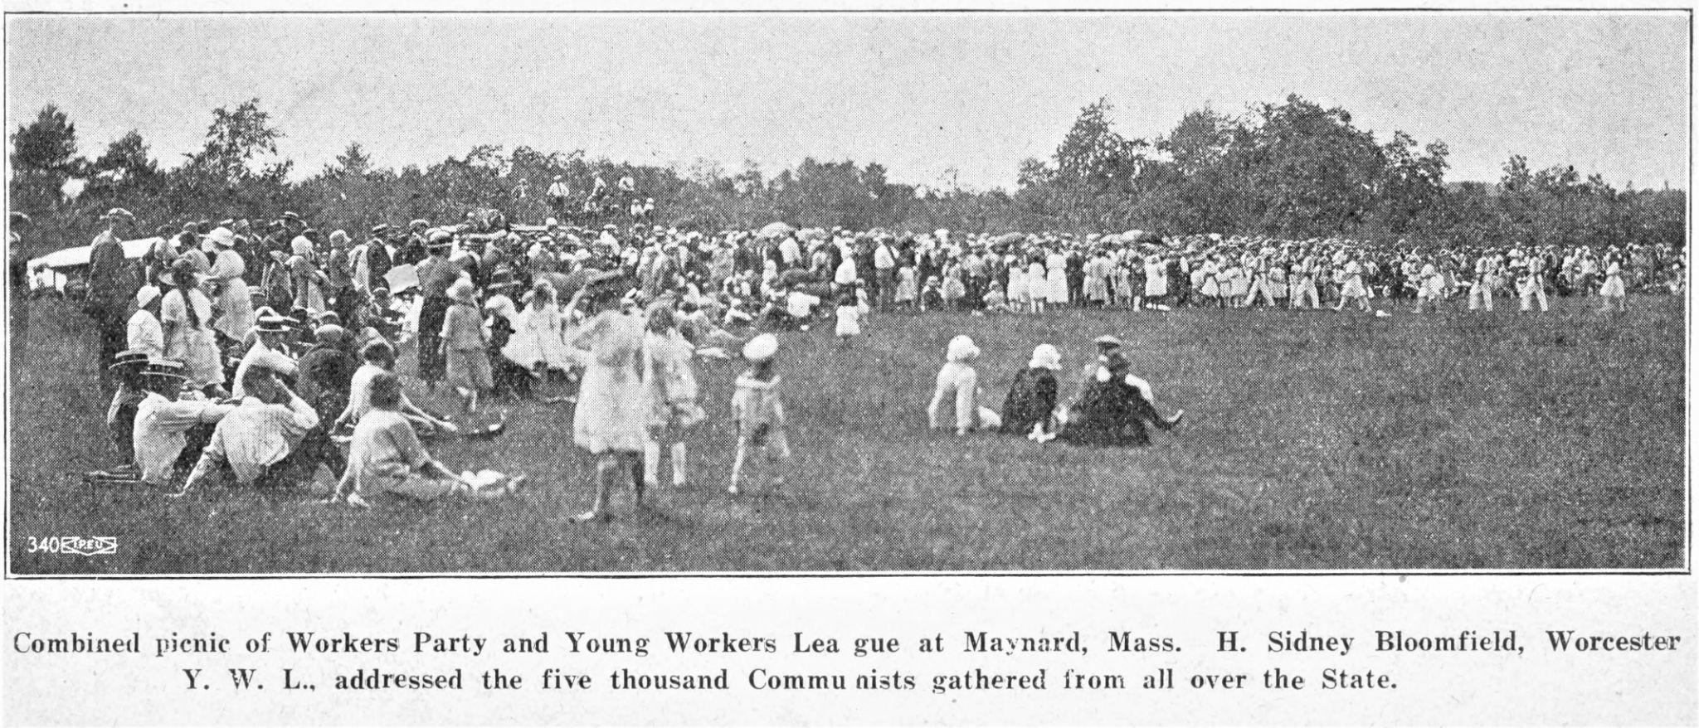
Lecture is More Suitable Than Circular Discussion
The lecture method of instruction has proved to be the best of the many methods tried. The circle discussion method is suitable where the students already have a fairly good background for the subjects that are being studied, but in most cases our experience has been that this background was altogether insufficient. The method of reading and reciting in class from certain texts has also proved itself rather a failure. One method which has been developed to a certain extent and that promises to yield excellent results in the future is that of the group-problem method. By this means two or more students are assigned a task of collecting material on a given problem and to prepare a written or a graphic report on the problem.
This system, however, demands that there be on hand at the school an extensive library together with an ample supply of the technical apparatus needed to make the charts and graphs and maps.

Slide 30
Without Life Experience One Cannot Yet Appreciate the Class War
The question may be rightfully asked what type of students are the best for such a school as this? In answering this question one must bear in mind the purpose of the school. Many times boys and girls of 15 and 16 years of age who are students are able to do the academic work of the school as well as those who are older; however, it is not merely the ability to give correct answers to the questions asked in the school which counts. Rather, it is the problems of making the students conscious of the fact that the subjects which they are studying have a direct bearing upon their lives and the organizations with which they are affiliated. The boy or girl of 14, 15, or 16 years who is still in school has not yet been forced to shift for himself, to make his own living, and to feel the pressure of the class struggle. To such a one the class war and all other theories relating to it cannot be duly appreciated. On the other hand the boy or girl who has been forced to make his own living, even though he may not always be as able to give the correct academic answer to the questions propounded by the instructor, will nevertheless understand the significance of the subjects taught and their relation to the organized movements of labor.

Slide 31
Discussion

Slide 32
Continuing the Legacy of Communist Youth Camps

Slide 33
League of Young Communists
The League of Young Communists (LYC) pulls from the traditions of past generations of communist youth, such as the Labor Youth League (LYL), W.E.B Du Bois Clubs of America, the Young Workers Liberation League (YWLL), and the Young Communist League.
The LYC aims to give direction to working class youth, and to inspire them in their class struggle war for economic, educational, and cultural advancement.
The primary purpose of the LYC is the education and communist development of young comrades in the science of Marxism-Leninism and the requisite organizational understanding to prepare them to take up leadership in the Party of Communists USA.

Slide 34
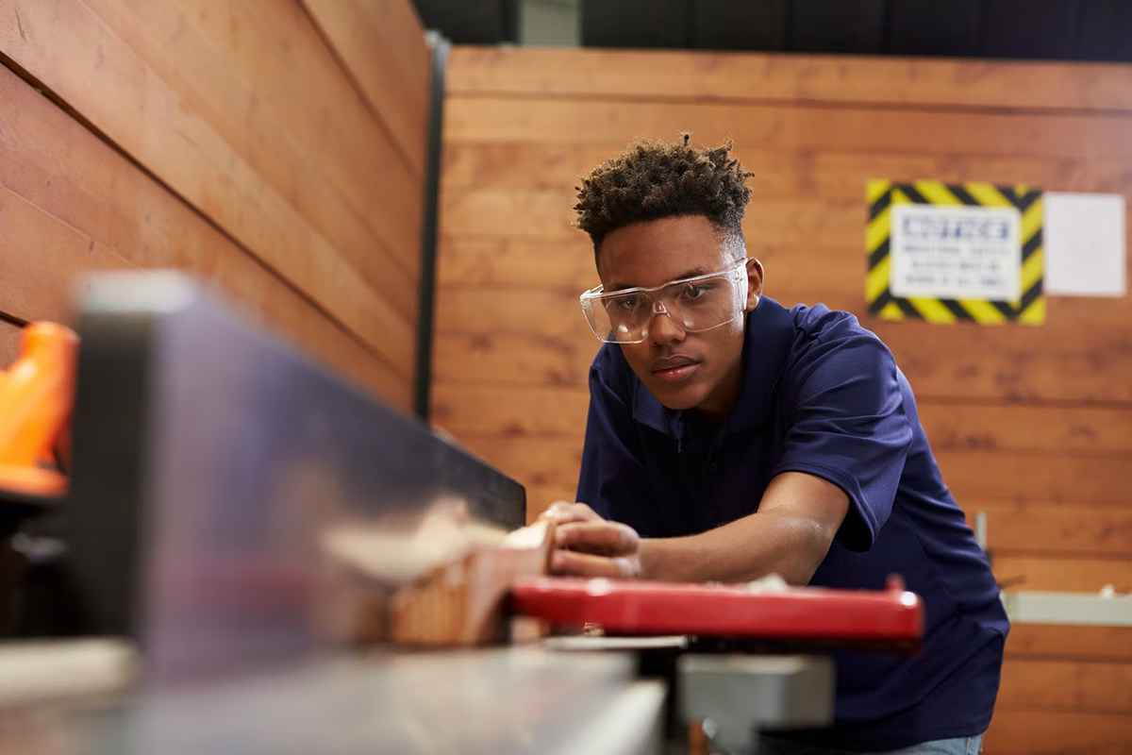
League of Young Communists
If corporate America can devour a worker after 30 years of loyalty, they can certainly devour a young worker who has been there for only a few years. Young workers are also the first casualty.
Individually, our voices are never heard and we often feel alienated from older generations and discriminated by social mores which have been imposed upon us.

Slide 35
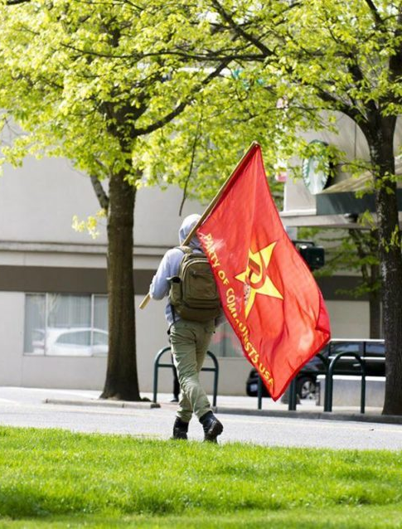
League of Young Communists
The job of the LYC is to equip the present generation of young workers with the ideological tools of Marxism-Leninism which are needed in the final conflict to make temporary advances permanent in a scientific socialist society.
Only through class oriented union representation can young workers begin to fight for better health benefits, injury-free workplaces, and better economic conditions.

Slide 36
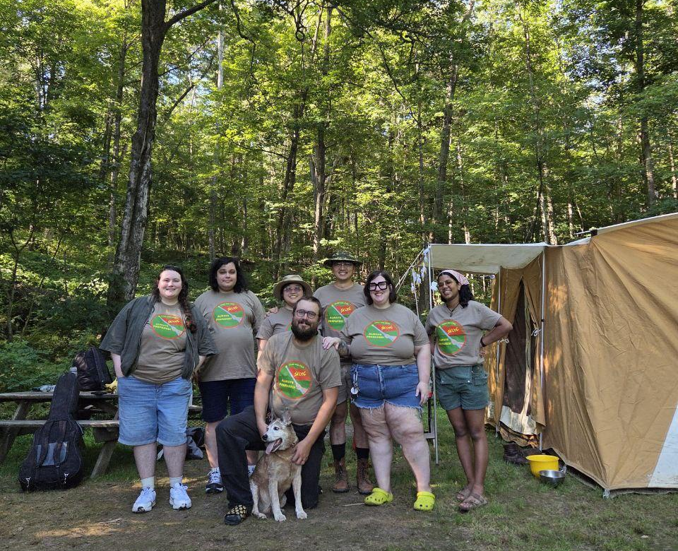
Camp Red Star
Continuing the tradition of past communist youth organizations, LYC runs its own youth camp.
Camp Red Star has been successfully running camps since 2023, this year marks the 4th year.
Camp is running from July 17th - 19th

Slide 37
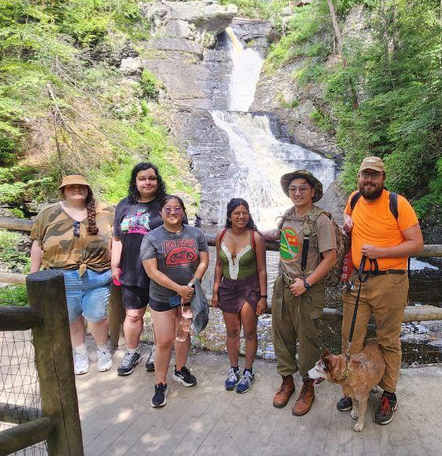
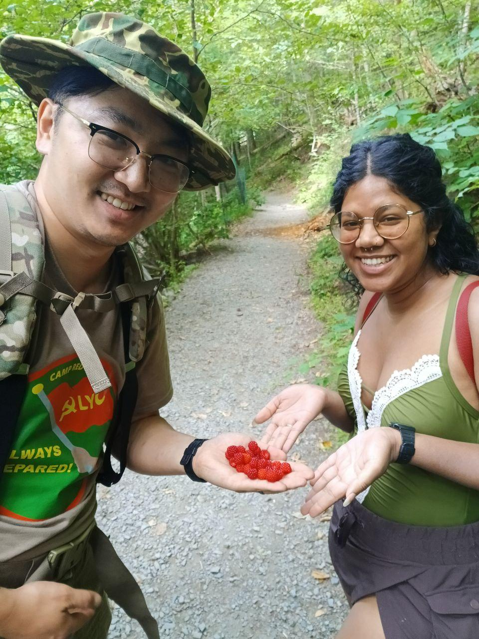
Camp Red Star
Activities are planned out in advance and include a mix of active, physical activities, routine activities and social activities.
Physical activities: hiking, swimming, foraging, building and maintaining the campsite

Slide 38
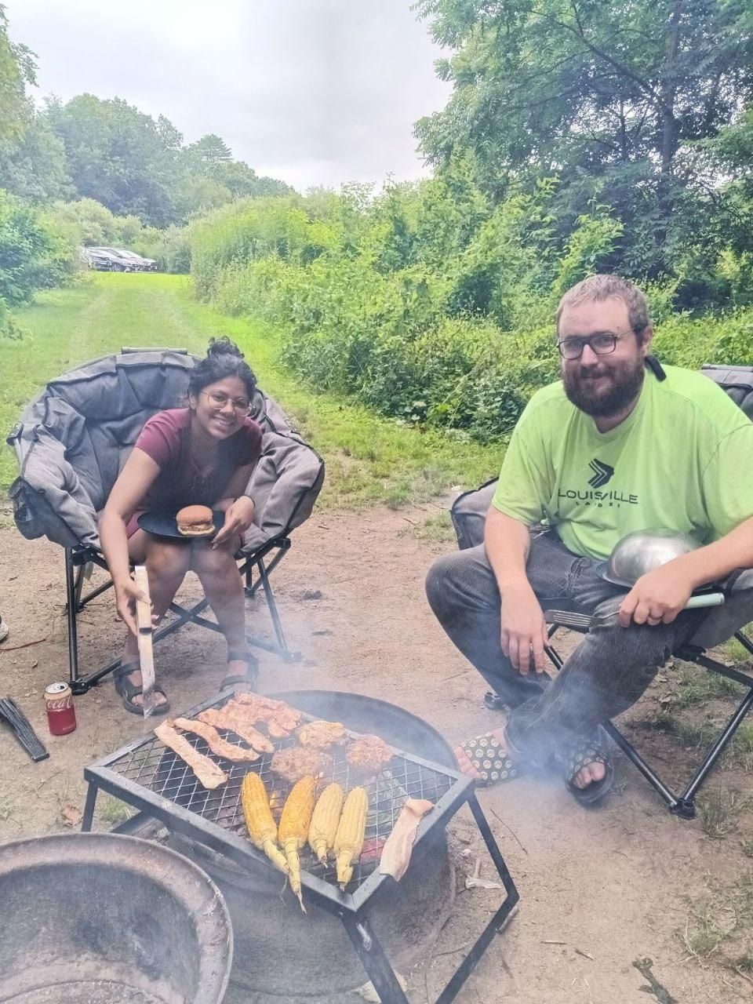
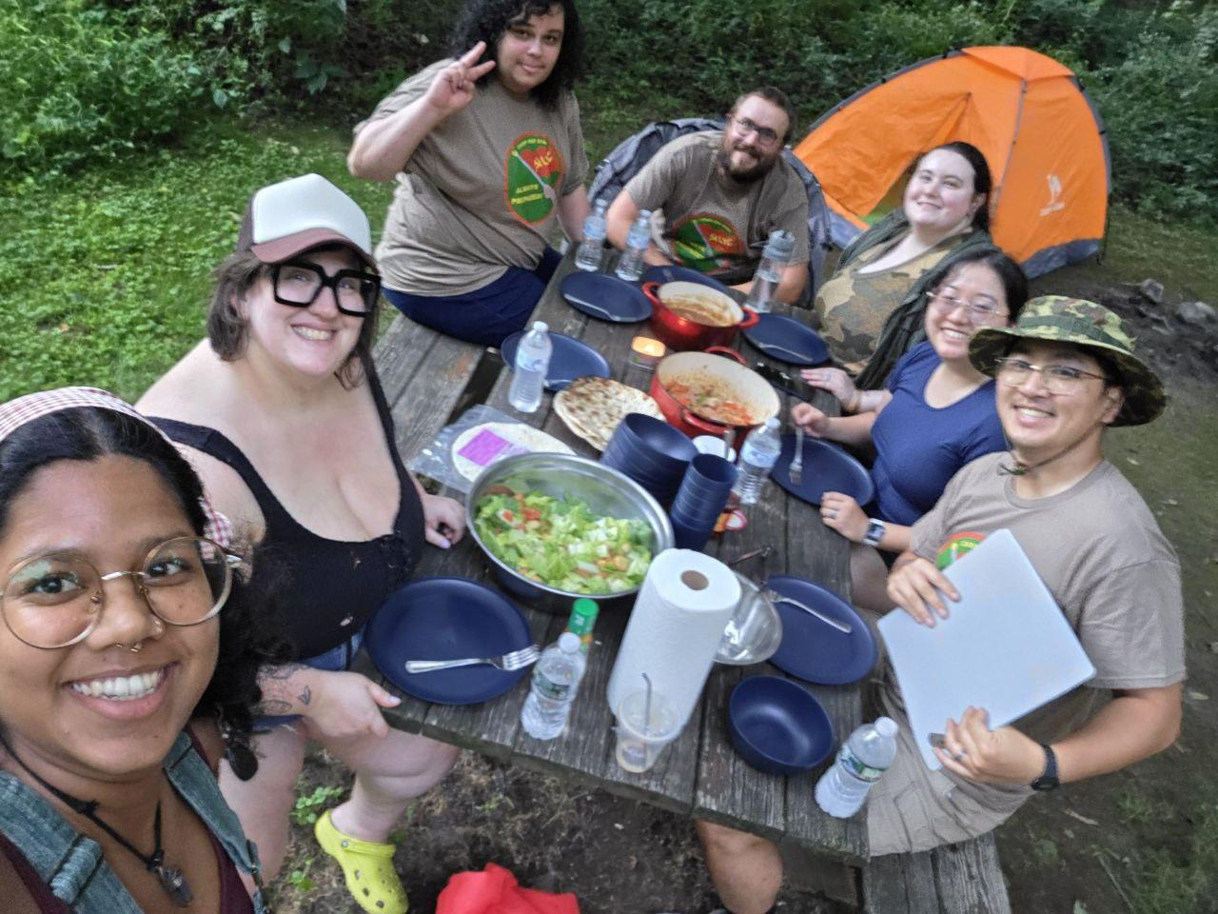
Camp Red Star
Routine activities: cooking, cleaning, building the campfire, collecting water

Slide 39
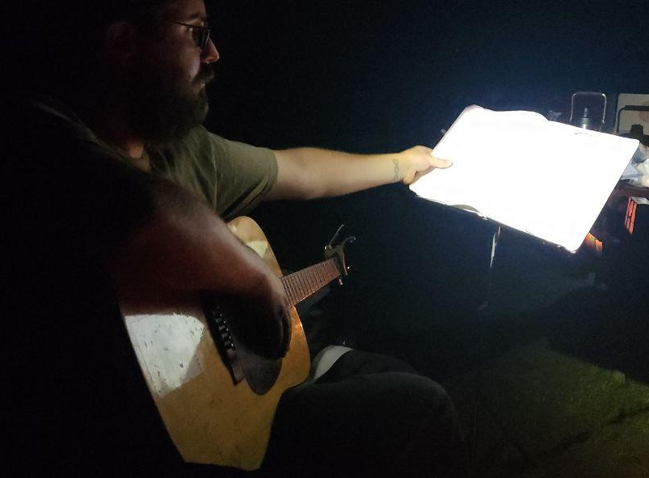
Camp Red Star
Social activities:
Singing communist and workers songs
Reading and discussing literature
Role playing scenarios to improve organizing skills
Playing team building or socialist - themed games

Slide 40
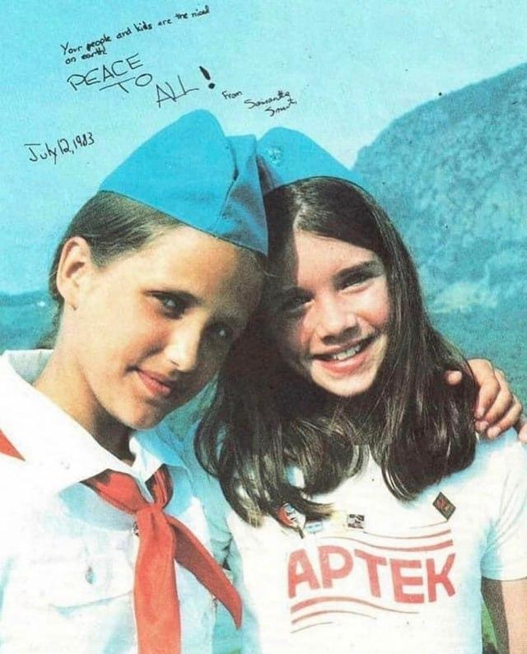
Camp Red Star
Each year, camp improves upon last year. This year, the camp will be running with a specific theme, goals and objectives in mind.
Theme: The purpose of communist youth camps is to advance the young party member’s knowledge and experience in organizing in a class-oriented collective.
Goals:
  Campers will leave camp with a better understanding of how to speak to others about organizing.
  Campers will have the opportunity to experience nature and participate in activities to build camaraderie and organizing skills.

Slide 41
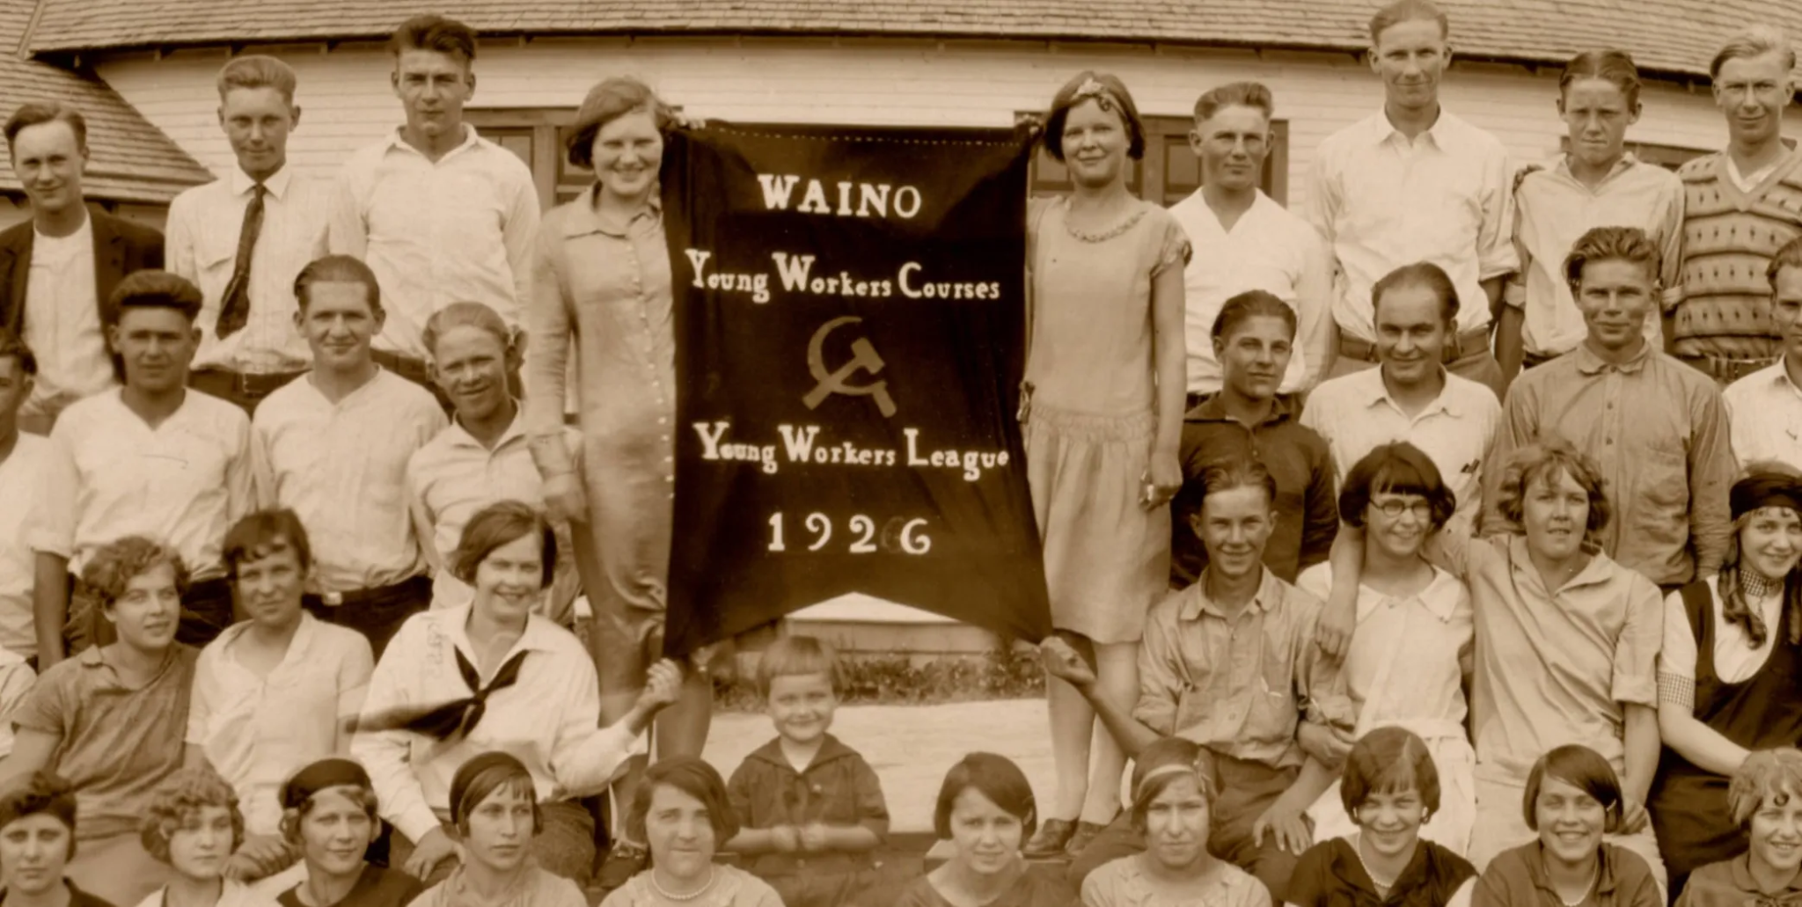
Camp Red Star
Just like any other educational camp, the curriculum and program of the camp is designed primarily for campers to gain certain skills and knowledge in an outdoor setting with their peers.
Fundamental skills we need to teach young comrades include discipline, following a collectively determined plan, working together effectively by each member taking initiative to contribute.

Slide 42

Camp Red Star
If campers diligently meet these expectations, the end result is a camp that runs like a well-oiled machine and unexpected hurdles can easily be weathered.
A level of trust and camaraderie is built that is rare to find.
The camp becomes fun, not because fun was the primary aim, but as a emergent property of the camp running smoothly as a collective.

Slide 43
Discussion & Wrap Up

Slide 44
Announcements
PCUSA Cell Chairs need to call members of their cells to remind them about attendance.
PCUSA Cell members are reminded attendance at the Continuing Education class of Jones-Foster every first Wednesday of the month is required.
The next issue of New Masses (2026) has begun production. If you have art you want us to feature, email it to info@partyofcommunistsusa.net.

Slide 45
Volunteers Needed!
We are in need of volunteers for the staff of the People’s School! Here’s a few roles we need filled:
People to help manage posting on our social media and podcast platforms
Video Editors, Audio Editors, Graphic Designers, Artists, Narrators
Web Controls, Moderators
Email info@peoplesschool.us if you’re interested and try to attend our next staff meeting if possible.

Slide 46
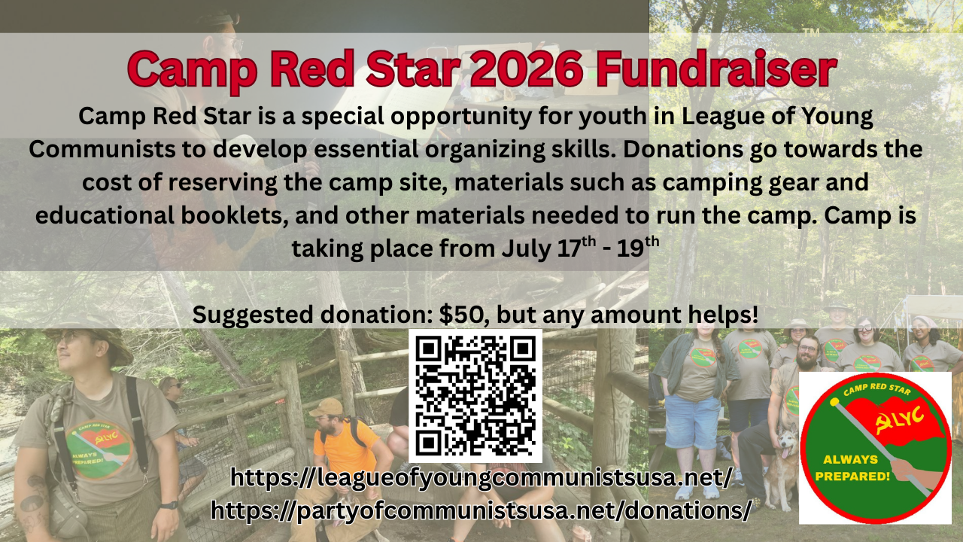

Slide 47

View From Left Field
https://viewfromleftfield.libsyn.com
The Old PSMLS Youtube is now the Youtube of View From Left Field, a podcast of analysis and discussion of current events from a progressive perspective.
Like the Youtube videos and subscribe with 5 star ratings on your podcast platforms.

Slide 48

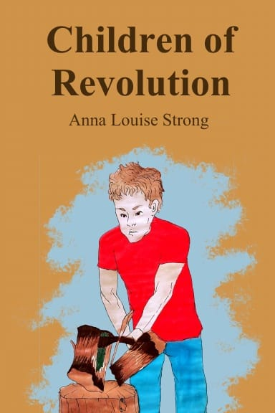
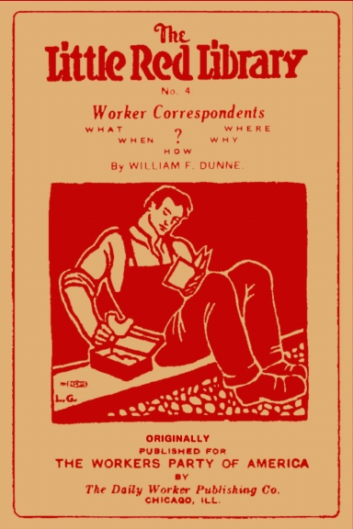


New Outlook Publishers
newoutlookpublishers.store
Relevant and Latest Releases

Slide 49



Harry Bridges School of Labor
luel.us/laborschool/
The Harry Bridges School of Labor is a monthly class covering a variety of topics aimed at building class consciousness among union members. For class schedule and other information, please visit the website at luel.us/laborschool.

Slide 50
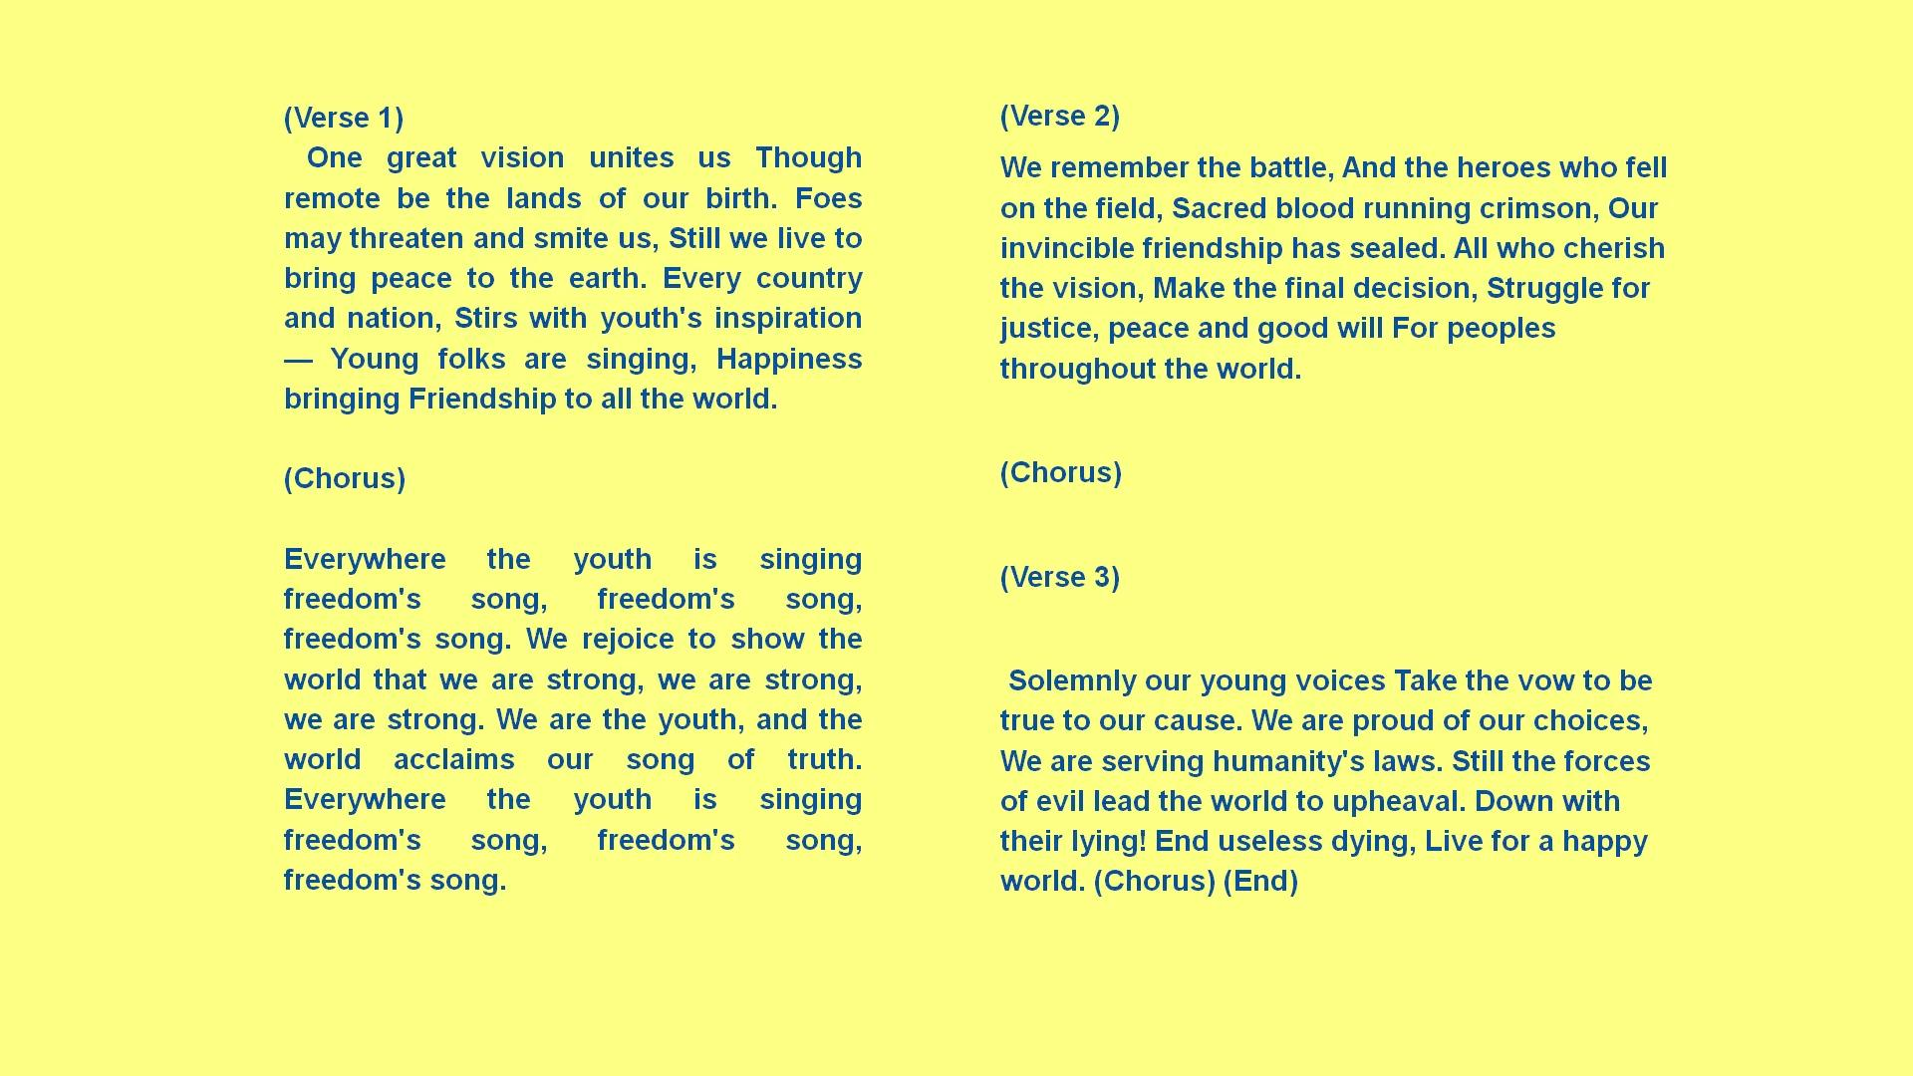
World Federation of Democratic Youth Instrumental with English Lyrics

