Slide 1

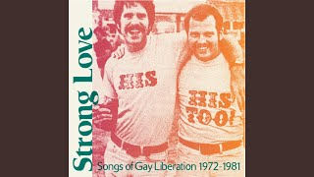
Stand Up For Your Rights by International Gay Society

Slide 2
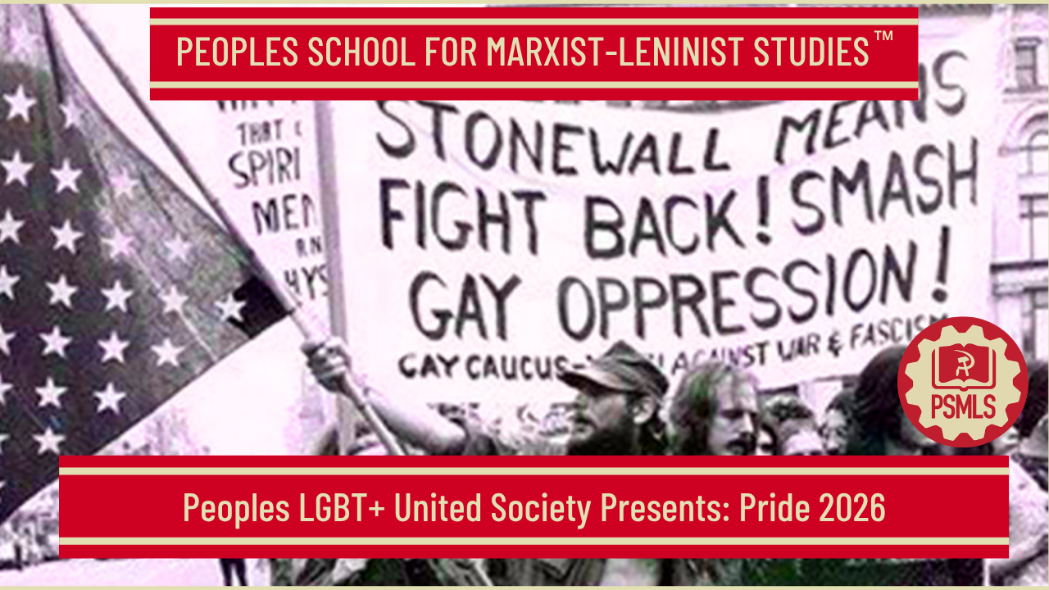
PSMLS 6/23/2025

Slide 3
What we’ll be learning today:
Advancements of LGBT+ Rights in the US
Recent Attacks on the LGBT+ Movement
Continuing the Struggle

Slide 4
Advancements of LGBT+ Rights in the US

Slide 5
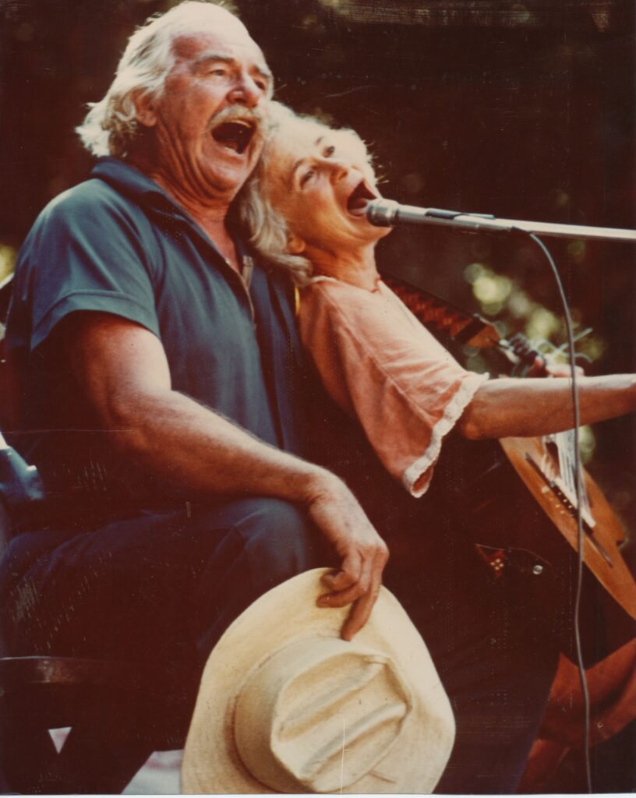
Will Geer
https://youtu.be/1W6xc_UePc8?si=Wk7N3M7DjPLxYvK0
During the 1930s, Geer became a dedicated activist touring government work camps of the Civilian Conservation Corps with folk singers like Burl Ives and Woody Guthrie, whom he introduced to the People's World and the Daily Worker.
In 1932, Geer met Harry Hay at the Tony Pastor Theatre where Geer was working as an actor. They soon became lovers. Geer was a committed communist; Hay later described him as his political mentor Geer introduced Hay to Los Angeles' communist community and together they were activists, joining demonstrations for laborers' rights and the unemployed.
Geer and Hay participated in a milk strike in Los Angeles. Later in the year, they performed in support of the 1934 West Coast waterfront strike, where they witnessed police firing on strikers and killing two.
Geer introduced Guthrie to Pete Seeger at the 'Grapes of Wrath' benefit, which he organized in 1940 for migrant farm workers.
Geer became a member of the Communist Party of the United States in 1934. After Hay was increasingly political, Geer introduced him to the party. Geer became a reader of the People's World, a West Coast Communist newspaper.

Slide 6
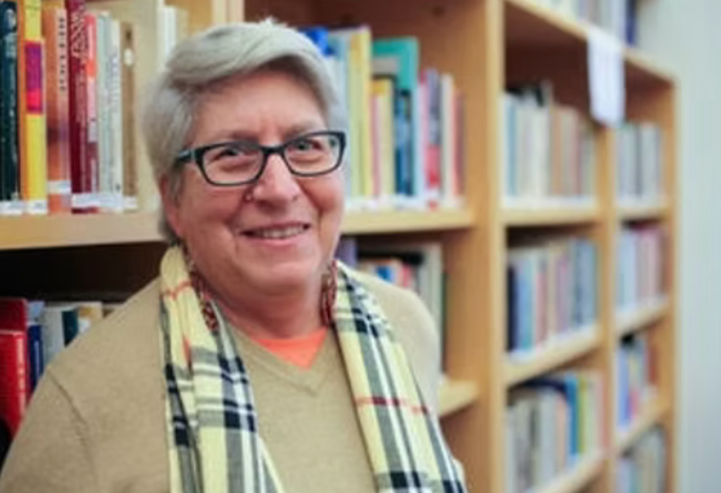
Bettina Aptheker
Activist in the W.E.B. Du Bois Club, a national youth organization sponsored by the Communist Party USA.
Part of the Berkeley Free Speech Movement in 1964.
1976 obtained her Master’s in communications at San José State University, and began teaching there.
A delegate to the June 1964 founding convention of the W.E.B. DuBois Clubs, a Communist Party-sponsored youth organization, held in San Francisco.
Worked for the defense in the high-profile trial of Angela Davis, a long-time friend and fellow Communist Party member.
Joined Women's Institute for Freedom of the Press (WIFP), in 1977. The WIFP is an American nonprofit publishing organization which works to increase communication between women and connect the public with forms of women-based media.

Slide 7
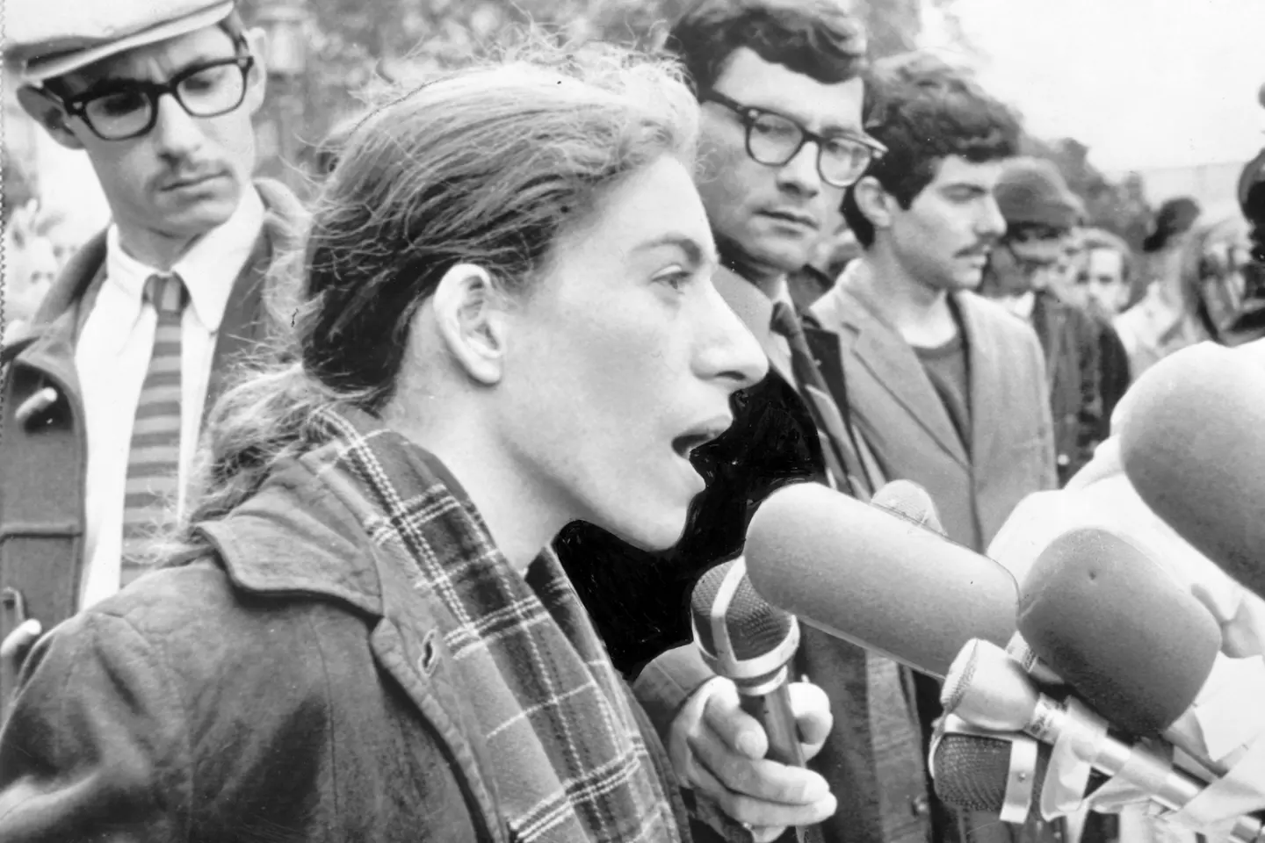
Bettina Aptheker
Q: “What’s the potential for ending capitalism?”
A: “Are human beings only propelled by profit and greed that capitalism feeds? Or is there another way to organize society and undermine our dependence on coal and oil?
We need to visualize socialism or some kind of system in which the welfare of people and the wealth of a country is distributed equally, where racism is overturned, misogyny is ended, homophobia no longer exists.
This is all tied in with the prison abolition movement,” states Aptheker.
“The recent union movement has some potential with its class-consciousness, to combine with movements for anti-racism and reproductive freedom. We need that kind of movement.”

Slide 8
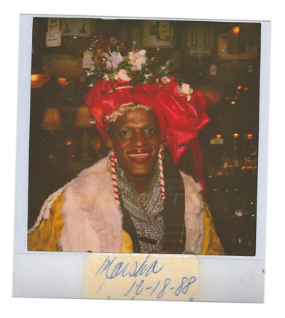
Marsha P. Johnson
Marsha P. Johnson was one of the most prominent figures of the gay rights movement of the 1960s and 1970s in New York City. Always sporting a smile, Johnson was an important advocate for homeless LGBTQ+ youth, those affected by H.I.V. and AIDS, and gay and transgender rights.
Johnson’s life changed when she found herself engaging with the resistance at The Stonewall Inn on June 28, 1969. Police raided the bar and began arresting the patrons, most of whom were gay men.
The raid on Stonewall galvanized the gay rights movement. The first Gay Pride Parade took place in 1970 and a series of gay rights groups—including the Gay Liberation Front, a more radical organization, and the Gay Activist Alliance, a more moderate and focused spin-off group—emerged.
Johnson was involved in the early days of both but grew frustrated by the exclusion of transgender and LGBTQ+ people of color from the movement. She actively spoke out about the transphobia in the early gay rights movement.
In 1970, Johnson co-founded the Street Transvestite Action Revolutionaries (STAR), “an organization dedicated to sheltering young transgender individuals who were shunned by their families.” She also co-founded the STAR House, a place where transgender youth could stay and feel safe.
Source: National Women’s History Museum

Slide 9
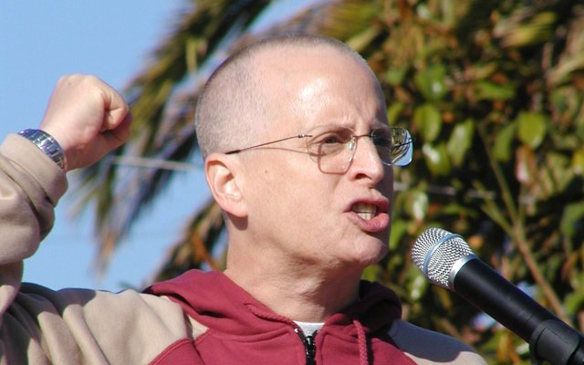
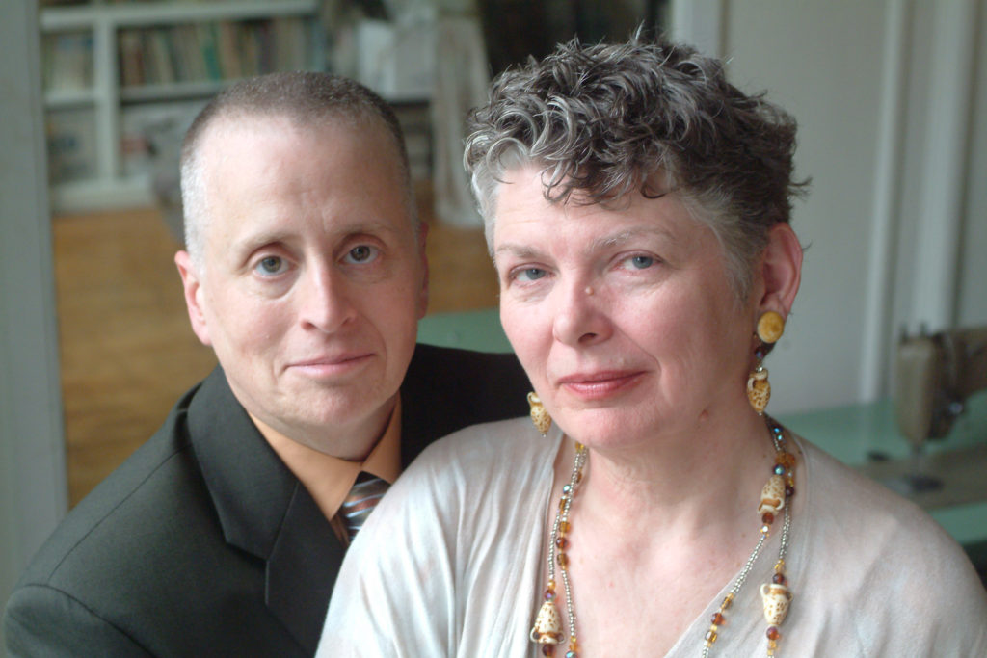
Leslie Feinburg
Feinberg was born in Kansas City, Missouri and raised in Buffalo, New York in a working-class, Jewish family.
When Feinberg was in her twenties, she met members of the Workers World Party at a demonstration for the land rights and self-determination of Palestinians and joined the Buffalo branch of the party. After moving to New York City, Feinberg took part in anti-war, anti-racist, and pro-labor demonstrations on behalf of the party for many years.
Feinberg began writing in the 1970s. As a member of the Workers World Party, she was the editor of the political prisoners’ page of the Workers World newspaper for fifteen years, and by 1995, she had become the managing editor.
Feinberg was outspoken about her support for Palestinians. In a 2007 speech given to the first public conference of Aswat, an organization for LGBT Palestinian women, in Haifa in 2007, Feinberg said, "I am with Palestinian liberation with every breath in my body; every muscle and every sinew."
Feinberg described herself as "an anti-racist white, working-class, secular Jewish, transgender, lesbian, female, revolutionary communist."

Slide 10
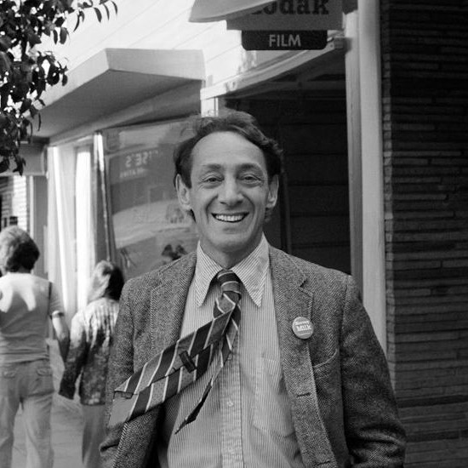
Harvey Milk
Harvey Bernard Milk (May 22, 1930 – November 27, 1978) was an American politician and the first openly gay man to be elected to public office in California, as a member of the San Francisco Board of Supervisors.Milk would lead the gay rights movement in battles against anti-gay initiatives.
During Milk's almost eleven months in office, he sponsored a bill banning discrimination based on sexual orientation in public accommodations, housing, and employment. The supervisors passed the bill by a vote of 11–1, and Mayor George Moscone signed it into law.
On November 27, 1978, Milk and Moscone were assassinated by Dan White, a disgruntled former city supervisor who cast the sole vote against Milk's bill.
“It takes no compromise to give people their rights...it takes no money to respect the individual. It takes no political deal to give people freedom. It takes no survey to remove repression.”
― Harvey Milk

Slide 11
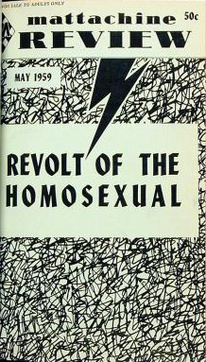
CPUSA on Gay Rights
“Now we come to a poignant and in its own way tragic moment in American political history. At a time when the CPUSA was facing unprecedented political persecution on all fronts and losing tens of thousands of members, Harry Hay was a dedicated and committed party member, an activist in the best sense.
Hay reluctantly left the CPUSA because the Party leadership was not yet ready to grasp the possibilities and significance of a homosexual liberation movement.
His situation reminds us in some ways of that of W.E.B. Du Bois who left the Socialist Party on the eve of World War I and debated the Communists for several decades before joining the Communist Party near the end of his life. With the defeat of fascism and the collapse of colonialism, Du Bois saw that the world was rapidly changing and that the future of liberation struggles by the “non-white” peoples of the world now rested with the Communist movement.
Harry Hay saw in the postwar world the possibility of applying what he had learned as a CPUSA activist. Hay took action in the autumn of 1950, as both the Korean War and Senator Joseph McCarthy raged on, and the right denounced “crooks, communists, and queers” in and outside of government. With gay friends and comrades he now formed the Mattachine Society. The name itself has an interesting history — one deeply connected with those who have had to hide their true identity. Hay took the name from a medieval French secret society of unmarried men who wore masks as part of their secret rituals.” Source: Norman Markowitz- CPUSA July 10, 2024

Slide 12
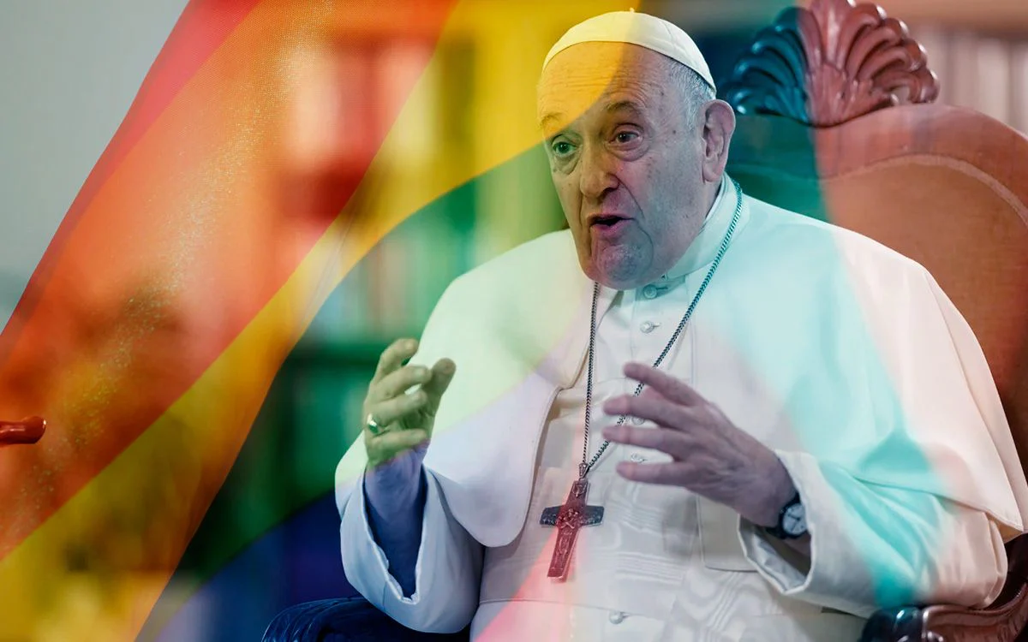
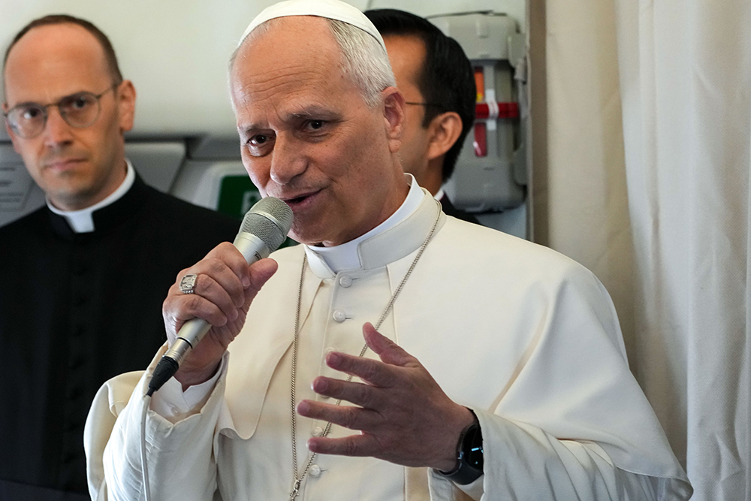
LGBTQ+ Catholics’ Rights
Globally, there are 1.4 billion Catholics. It is once of the world’s oldest, most powerful institutions. It is slow to change. It’s leadership and the changes they institute are widely held to by Catholics worldwide.
The Catholic Church campaigns against same-sex marriage, but the progressive, recently deceased Pope Francis expressed support for civil unions in different European and South American countries as an alternative. Catholic doctrine maintains that marriage can only be the union of a man and a woman.
Current Pope, Leo XIV, signaled that he supports the Vatican’s existing position allowing informal blessings for same-sex couples.
The Catholic Church is politically active on LGBTQ rights issues, and its relationship with the LGBTQ community has been particularly strained during critical moments, such as the height of the HIV/AIDS pandemic.
Some notable LGBT Catholics, including priests and bishops, have been openly gay or bisexual.
On 18 December 2023 the Catholic church issued a declaration allowing Catholic priests to bless people who are not considered to be married by the Church, including people in same-sex relationships.
In contrast, as an example of how the Catholic church balances contradictory values, the Church's opposition to condoms, despite their proven effectiveness in preventing the spread of HIV, has invited criticism from public health officials, anti-HIV activists, and the broader LGBT community.

Slide 13
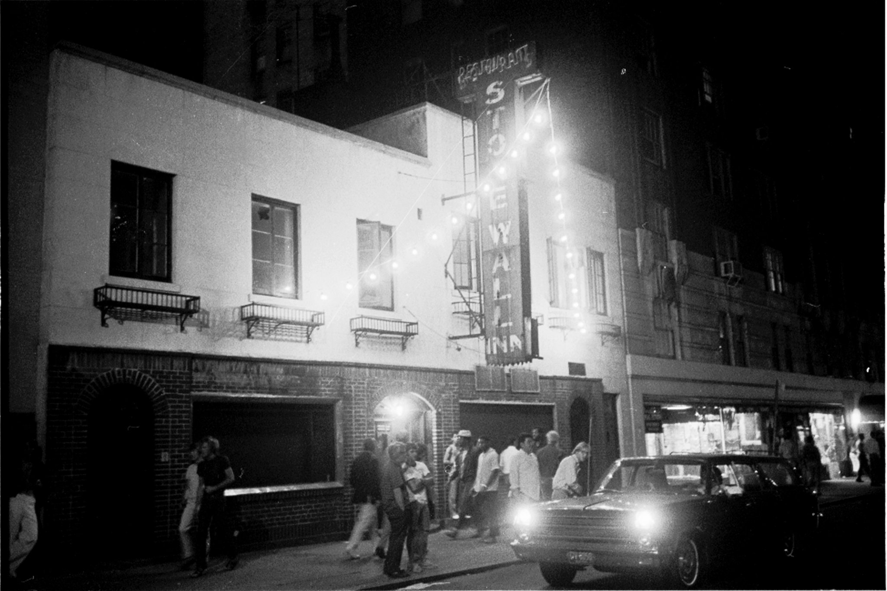
Brief History
The Stonewall Riots occurred June 28th, 1969. These were a series of riots and demonstrations that occurred at the Stonewall Inn in the Greenwich Village neighborhood of Lower Manhattan in New York City. This moment is commonly hailed as a new beginning for the LGBT rights movement in the United States.

Slide 14
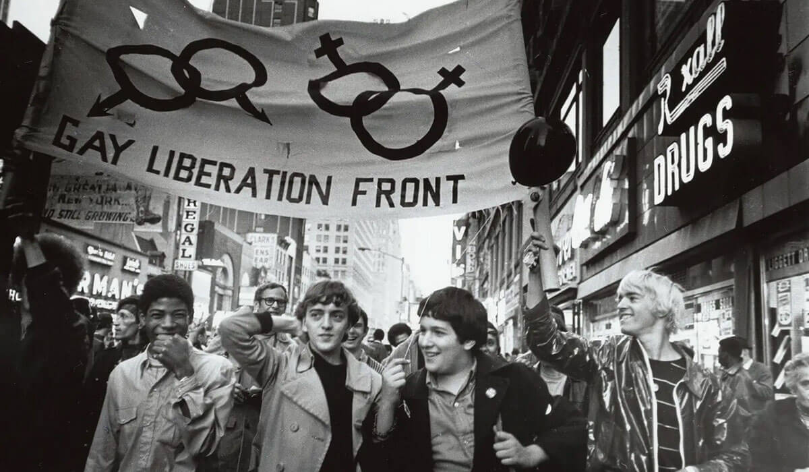
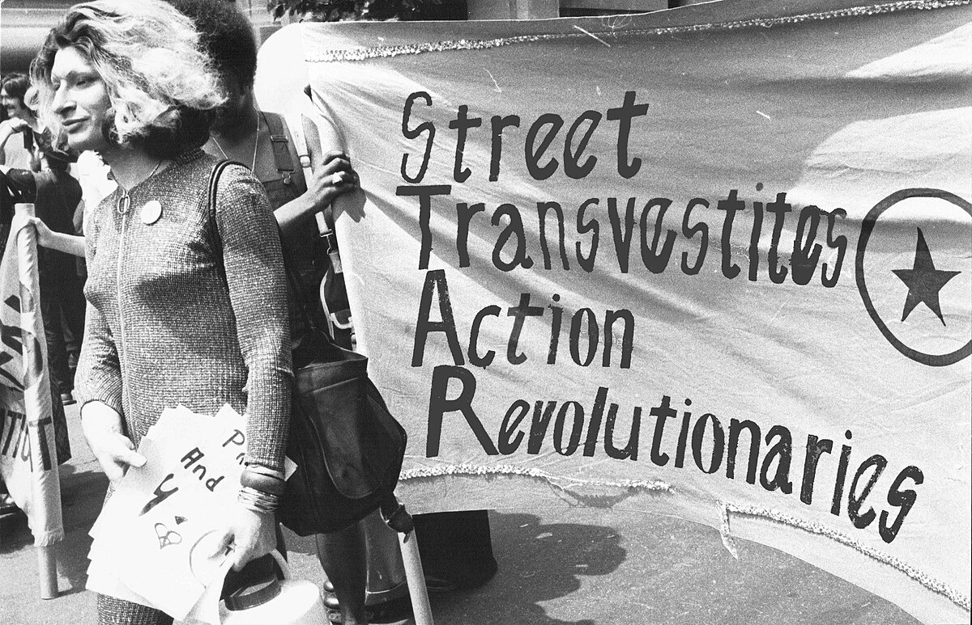
Brief History
The Gay Liberation Front formed on July 31st, 1969 by a group of radical pro-LGBT plus activists that met at Alternative U, a leftist meeting hall. In the following year, the group:
  protested at the Women’s House of Detention in Greenwich Village
  Organized a march protesting coverage of gay people in The Village Voice where they denounced racism and capitalism and declared support for the Black Panther Party
  Published their first periodical: Come Out!
  Had a drag queen caucus of the group that formed the Street Transvestite Action Revolutionaries (STAR) which focused on providing support for gay prisoners and homeless LGBT+ youth.
Harvey Milk became the first openly gay person elected to public office in California in 1977

Slide 15
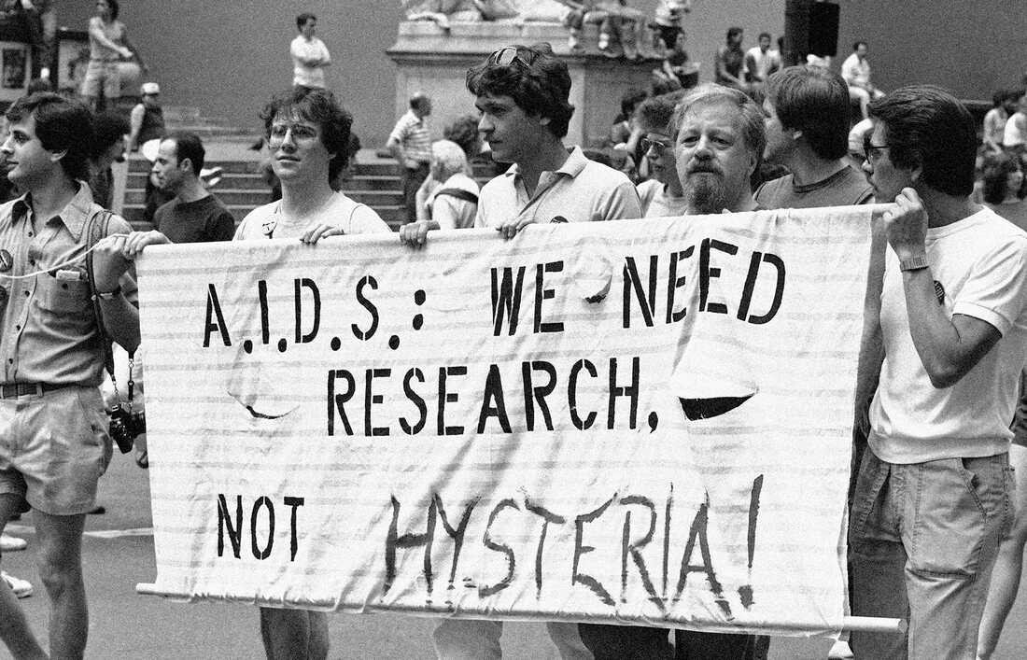
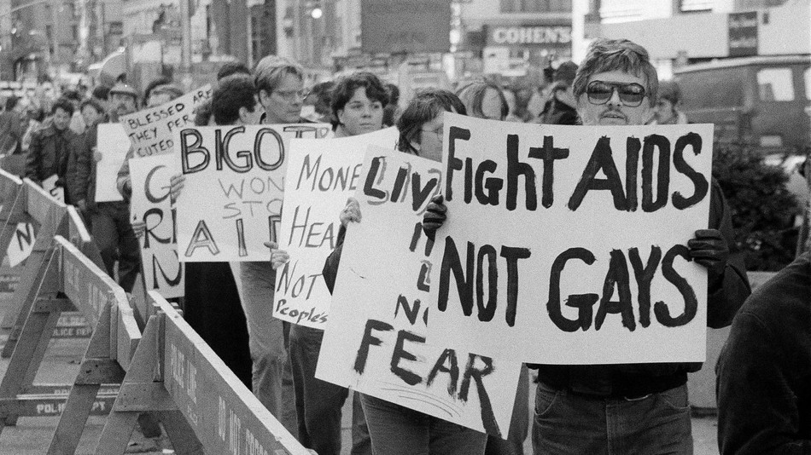
The HIV/AIDS Epidemic
The AIDS epidemic began June 5th, 1981 when the Center for Disease Control and Prevention reported a cluster of Pneumocystis pneumonia in five homosexual men in Los Angeles.
Over the next couple of years, increasingly more clusters of this pneumonia, as well as other diseases common in immunosuppressed patients, were discovered in typically healthy patients.
A June 1982 report suggested that due to the prevalence of a cases among gay men in Southern California, the disease may have a sexually transmitted infectious agent. Thus, the term was originally named “GRID”: gay-related immune deficiency.
Many terms for the disease arose. Some more-slanderous terms included “gay cancer”, “gay plague”, and “homosexual syndrome”.

Slide 16
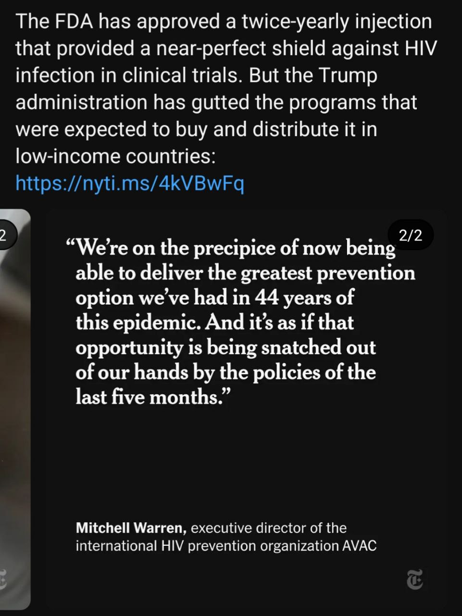
The HIV/AIDS Epidemic
There was a common misconception that AIDS mainly affect white, gay males. This meant black people were often neglected in terms of education on the issue and services. In 1989, this lead to the creation of the Black Coalition for AIDS Prevention and the Alliance for South Asian AIDS Prevention. You can read more and get involved with those groups here: blackcap.ca asaap.ca
In 1982, the gay activist group The Sisters of Perpetual Indulgence published Play Fair!, a sex educational manual discussing safe and healthy sex practices, including those related to AIDS. Play Fair! was distributed at San Francisco’s Gay Freedom Day on June 27th, 1982 and is credited a the first sex-education pamphlet.
It is estimated, based on current rates, that 1 in every 6 gay and bisexual men will be diagnosed with HIV in their lifetime. For Latino men, this rate rises to 1 in 4. For black men, this rate is 1 in 2.

Slide 17

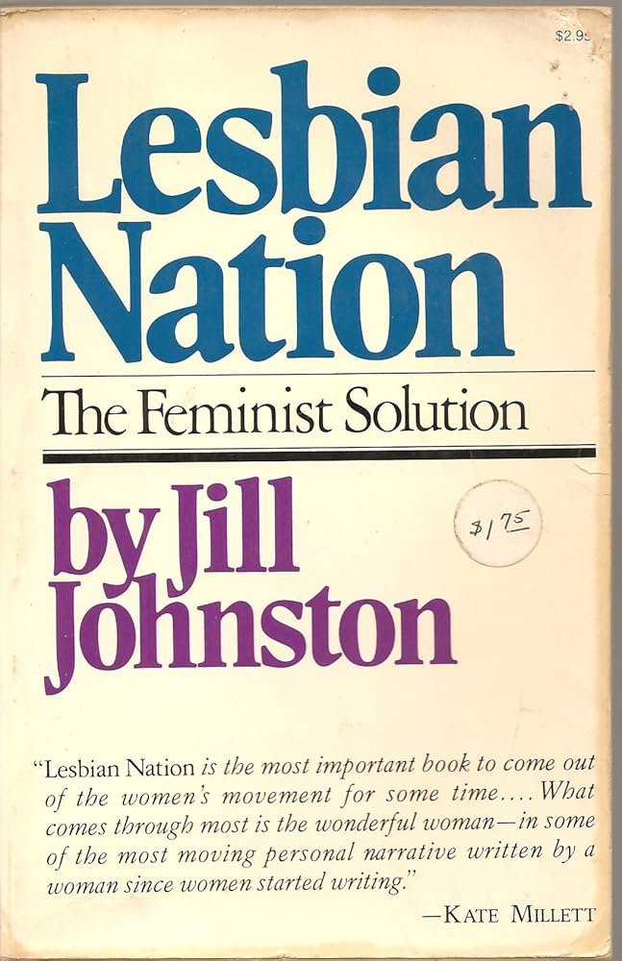
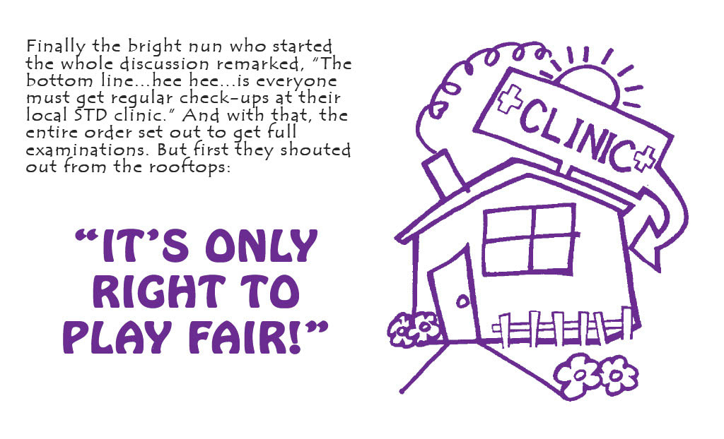
LGBT+ Media - Literature
In 1970, Del Martin and Phyllis Lyon published Lesbian/Woman, a text discussing what it means to be a lesbian woman.
Originally published as a series of essays in The Village Voice and as a book in 1973, Lesbian Nation: The Feminist Solution by Jill Johnston proposed lesbian separatism as a thesis. She argued that all female engagement with men, including female heterosexuality, was collaboration with the patriarchy.
In 1977, Charles Silverstein and Edmund White released the sex manual The Joy of Gay Sex.
In 1982, the Sisters of Perpetual Indulgence published Play Fair!, a brochure about safe sex for gay men.

Slide 18
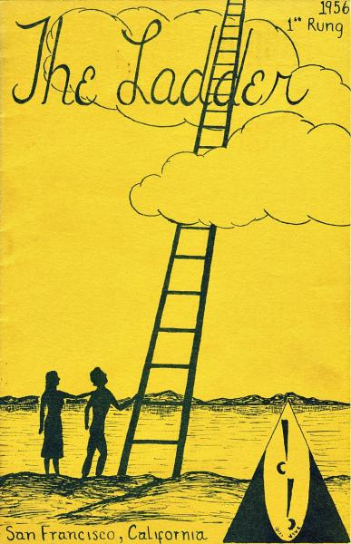
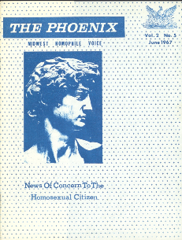
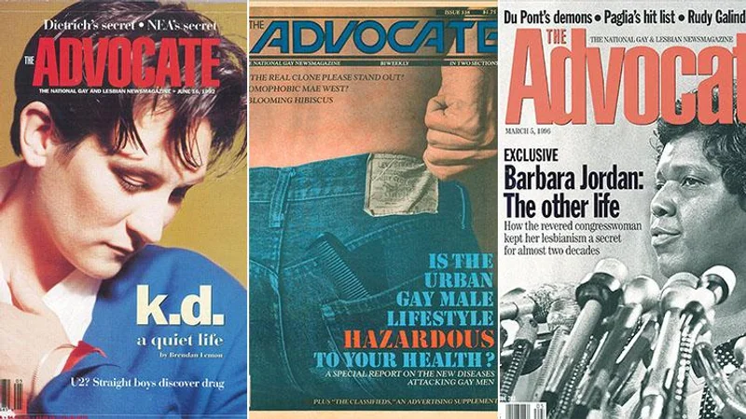
LGBT+ Media - Literature
Pre-Stonewall, the first nationally distributed Lesbian periodical was The Ladder (1956). This was followed by other LGBT magazines: Drum (Philadelphia,1964), The Advocate (Los Angeles, 1967), and The Phoenix: Midwest Homophile Voice (Kansas City, Missouri, 1966).
Post-Stonewall, LGBT+ publications include: Come Out! (New York City, 1969), The Gay Blade (Washington, D.C., 1969), Bay Area Reporter (San Francisco Bay Area, 1971), Fag Rag (Boston, 1971), Lavender Woman (Chicago, 1971), Chicago Gay Crusader (1973), Gay Community News (Boston, 1973), the San Francisco Sentinel (1974), Philadelphia Gay News (1976), Gaysweek (New York City, 1977), and San Francisco Bay Times (1978).

Slide 19
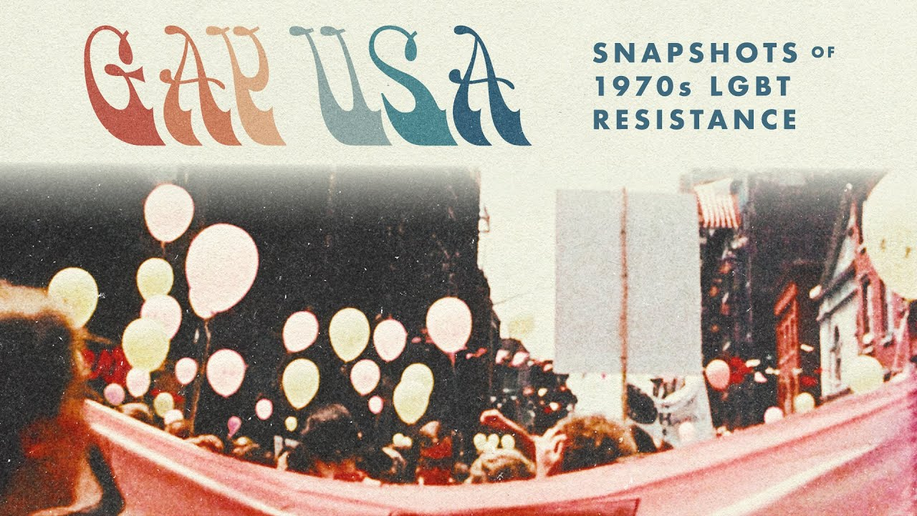
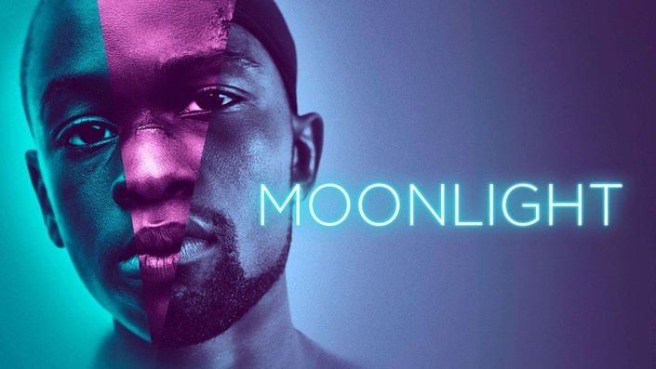
LGBT+ Media - Film
The Motion Picture Production Code, the motion picture industry guideline for film producers, called for censoring of LGBT+ representation in film between 1934 and 1968.
In 1977, American director Arthur J. Bressan Jr. released Gay USA, considered the first known documentary about LGBT+ people.
In 2005, Brokeback Mountain grossed over $178 million.
In 2017, Moonlight won three Academy Awards: Best Picture, Actor in a Supporting Role, and Adapted Screenplay (and was nominated for 5 other categories as well).

Slide 20


LGBT+ Media - Film
The Code of Practices for Television Broadcasters prohibited positive homosexual representation from 1952 to 1983, preventing both representation on screen as well as scaring actors and actresses into remaining in the closet.
Despite this, LGBT+ communities used public-access television to air inclusive programs such as The Emerald City (1977-1979), Gay Morning America (84-85), Candied Camera (1990s), and others.
In 1977, Ellen became the first show to have a gay main character. This opened the floodgates for gay television media and recurring gay characters including but not limited to shows such as: Will & Grace, Dawson's Creek, Spin City, ER, Buffy the Vampire Slayer, Nightline, Queer Eye for the Straight Guy, Queer as Folk, The Young and Restless, Ugly Betty, and Glee.

Slide 21
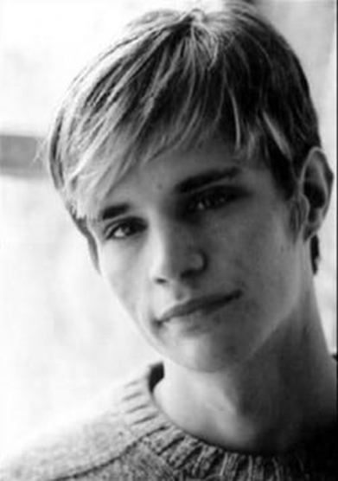
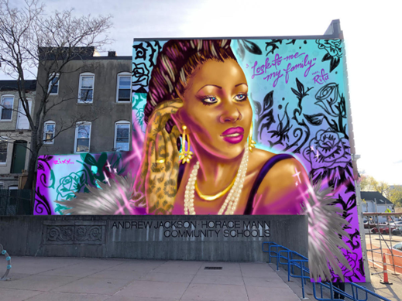
Violence Towards LGBT+ People
Matthew Sheppard, a gay American student at the University of Wyoming, was beaten, tortured, and left to die near Laramie, Wyoming on October 6th, 1998. Sheppard died 6 days later in the hospital. Both murderers were found guilty and each received two consecutive life sentences.
Rita Hester, a transgender African American woman was murdered in her home in Allston, Massachusetts on November 28th, 1998. The city of Boston commissioned a mural memorializing Hester. (photo from Boston.gov)

Slide 22

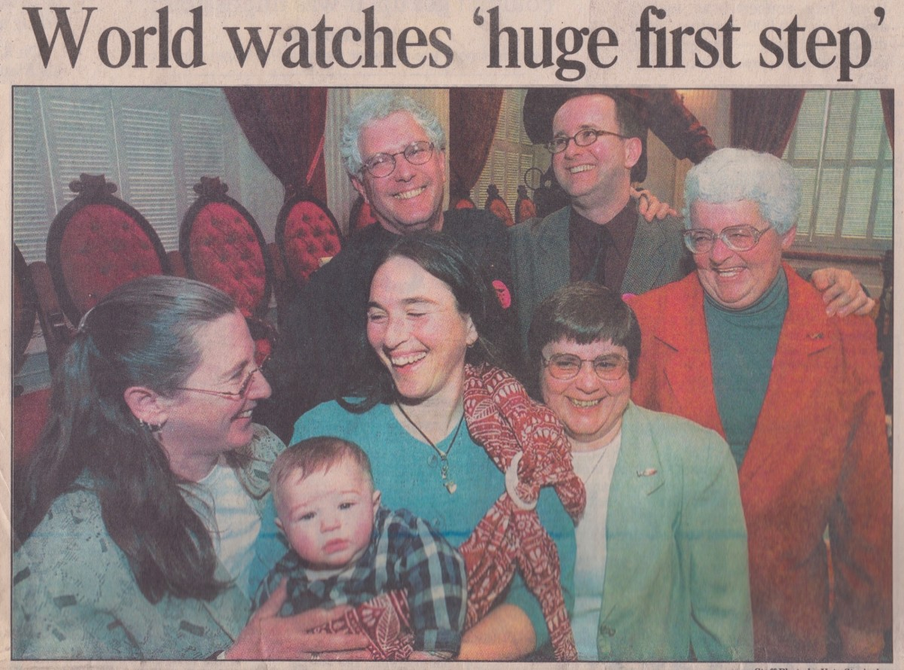
Notable Dates and Events
The transgender pride flag was created by Monica Helms in 1999 and first flown at a pride parade in Phoenix, Arizona in 2000.
Transgender Day of Remembrance was founded in 1999 by Gwendolyn Ann Smith, a transgender woman, to memorialize the murder of Rita Hester. This day is held annually on November 20th.
On December 20th, 1999, the Vermont Supreme Court holds in Baker v. Vermont that excluding same-sex couples from marriage violates the Vermont Constitution, granting civil union rights to same-sex couples for the first time in the US.
In 2003, The US Supreme Court rules 6-3 in Lawrence v. Texas against sodomy laws, making same-sex activity legal in the US.

Slide 23
Notable Dates and Events
On May 15th, 2008, the Supreme Court of California legalizes same-sex marriage. Several states follow in subsequent years.
On May 9th, 2012, Obama becomes the first sitting president to declare support for same sex marriage.
On June 26th, 2015, The Supreme Court of the United States rules in Obergefell v. Hodges that the fundamental right to marry is guaranteed to same-sex couples by both the Due Process Clause and the Equal Protection Clause of the Fourteenth Amendment to the United States Constitution. This legalized same-sex marriage in the United States with all rights and responsibilities.
On June 15th, 2020, The Supreme Court rules in Bostock v. Clayton County that Title VII of the Civil Rights Act of 1964 prohibits employment discrimination against LGBTQ people on the grounds that any such discrimination must be based on the sex of the victim which is expressly prohibited.

Slide 24
Discussion & New Members Introductions

Slide 25
New Member Introductions
What is your name, pronouns and state (or country/territory)?
Where do you work? Is it unionized?
How did you find out about the People’s School?
What do you think about tonight's class?

Slide 26
Recent Attacks on the LGBT+ Movement

Slide 27
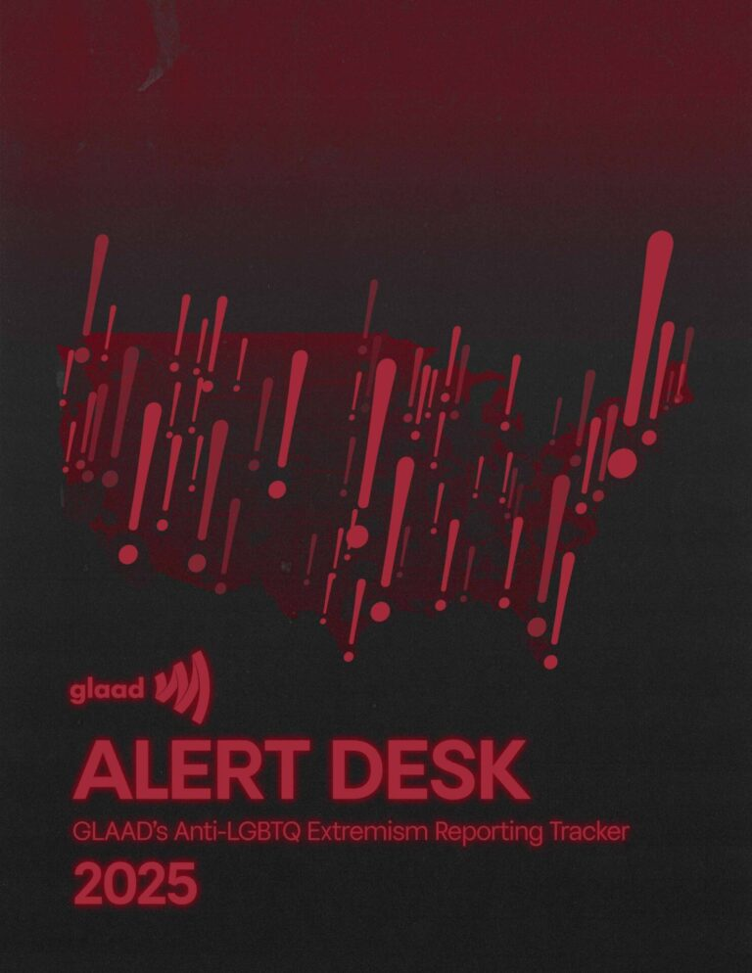
Violence and Targeting of LGBT+ People
In 2025, the ALERT Desk tracked 1,042 anti-LGBTQ incidents in 47 US states and the District of Columbia. These included 128 acts of hateful vandalism, 76 violent assaults, 22 threats of mass violence, and 15 arson attempts. This is up from 984 incidents tracked in 2024, a 5% increase in hate.
We remember and honor the lives of those taken by hate-fueled violence last year – Rodolfo Fernandez de Velasco, Chris Allen Villegas Fentress, Jonathan Joss, Christina Hayes, Dream Johnson, and Alvin Prasad – along with more than 70 others injured during anti-LGBTQ attacks.
Sadly, this trend has not shown any improvement. In 2026, the LGBTQ community is facing unprecedented challenges to our rights and safety.

Slide 28

Violence and Targeting of LGBT+ People
Notable Trends:
Incidents targeting transgender and gender non-conforming people are on the rise. Over half (532) of all tracked incidents in 2025 specifically targeted transgender and gender non-conforming people, a 10% increase from the 485 anti-trans incidents the ALERT Desk documented in 2024.
Pride 2025 saw a dramatic rise in incidents: 268 incidents occurred during June 2025, a nearly 400% increase from the 54 incidents tracked in June 2022 when GLAAD began its data collection.
In 2025, states at the center of political debates over the rights of LGBTQ people led the US in terms of number of incidents. States with the most incidents are: California (198), New Hampshire (72), Texas (66), Ohio (50), and Washington (50).

Slide 29
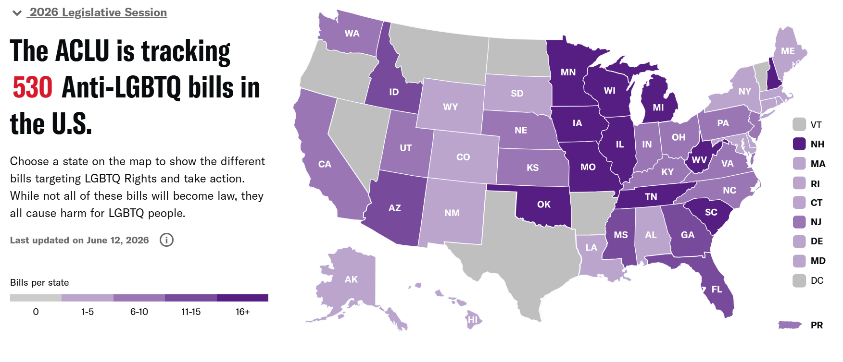
Violence and Targeting of LGBT+ People
https://www.aclu.org/legislative-attacks-on-lgbtq-rights-2026

Slide 30
Trump Administration’s Attacks on LGBT+ Rights
The vitriol and violence have intensified especially since the Trump administration began dismantling laws and measures protecting the rights of LGBT+ people. In a series of executive orders, the administration has mandated that federal departments only recognize male and female sexes, ceased funding for gender-affirming care, dismantled DEI measures and banned transgender individuals from serving in the military. Last year, Trump cut specialized suicide prevention services for LGBT+ youth.
Those who discriminate against the LGBT+ community are now emboldened to target them, as there are little to no repercussions. Even law enforcement in conservative areas does not care to stop this violence and in many cases, participate in the repression. LGBT+ youth are statistically much more likely to be targeted by bullies and be shunned by their own families, leading to higher rates of depression and suicide. Adults are more likely to be discriminated against at their workplace or by their own community and are much more at risk of facing homelessness and poverty.

Slide 31
Why are LGBT+ people and their rights under attack?
After years of mass movements and organizing throughout 20th century LGBT+ people in the USA were able to win many of their constitutional rights.
Under pressure from the LGBT+ mass movements and legislative action, we achieved protection in the workplace, gay marriage, civil rights, child adoption, military service, education and improved health services as part of a progressive agenda. Society is challenging the 'ruling' norms, and finance capital cannot survive if the ruling norms change.
These are not gifts, they are rights — and are never secure.
In crisis, finance capital seeks to restrict democracy — often facing resistance from liberals and bureaucrats from within, but who are not strong enough to resist the fascist encroachment.
In this period of capitalist crisis, the ruling class’s form of rule has become untenable. As the monopoly capitalist economy collapses, finance capital will increasingly use any tactics to maintain its position.

Slide 32

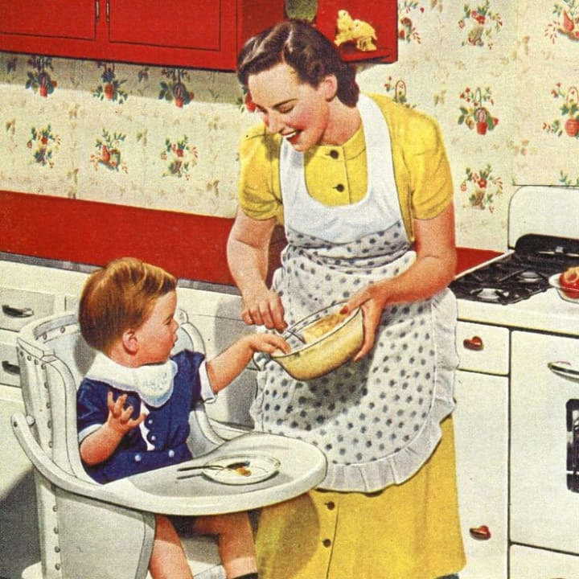
LGBT+ in a time of economic breakdown in the USA
With the global capitalist system in crisis, populations are losing faith in the old and outdated institutions which no longer reflect reality. This has sparked a legitimacy crisis for the Democratic and Republican parties. The existence of LGBT+ undermines the conservative gender norms that have been an integral part of the capitalist underpinnings. Wars, inflation, housing collapse, labor unrest.
In the U.S., LGBT+ people are being blamed for the social breakdown because it undermines the nuclear family which keeps the spouse in the kitchen, and producing more workers to continue the established social division of labor.

Slide 33
LGBT+ and reaction in Late-stage Capitalism
The capitalist ruling class, now threatened by social instability, is shifting back to open repression against vulnerable groups, such as LGBT+ and immigrants. We have recently seen a huge rise in legislation nationally and locally endangering, targeting, and persecuting LGBT+ people in our schools, hospitals, homes etc.
However, as corporations are celebrating Pride Month, our federal government is persecuting these same groups. This contradiction is what Marx warned as the epitome of the internal rot in capitalism that hastens the decay and eventual end to capitalism.
“The contradiction between the progressive aspect and the reactionary aspect of a thing determines its life and drives its development.”
— Mao Zedong, On Contradiction
“The development of things should be seen as their self-movement, their internal contradiction being the cause of their development.”
— Mao Zedong, On Contradiction

Slide 34
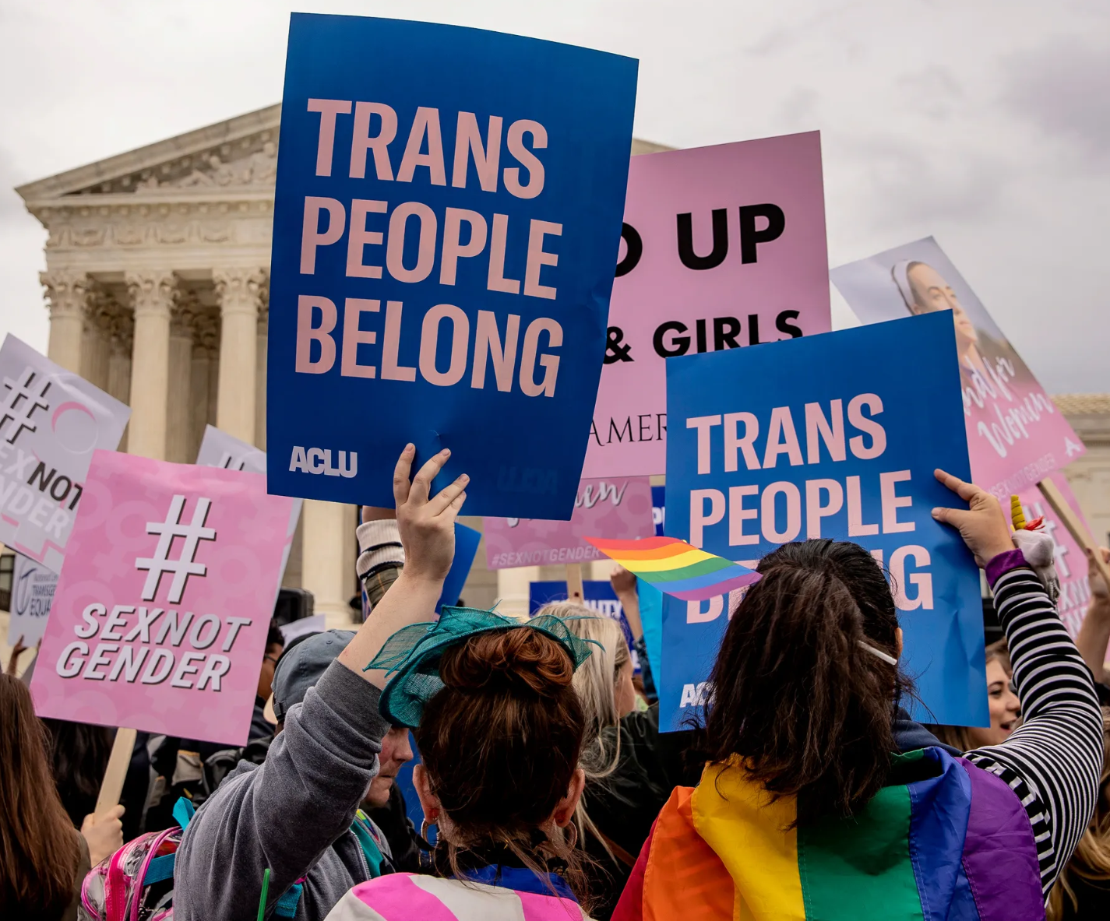
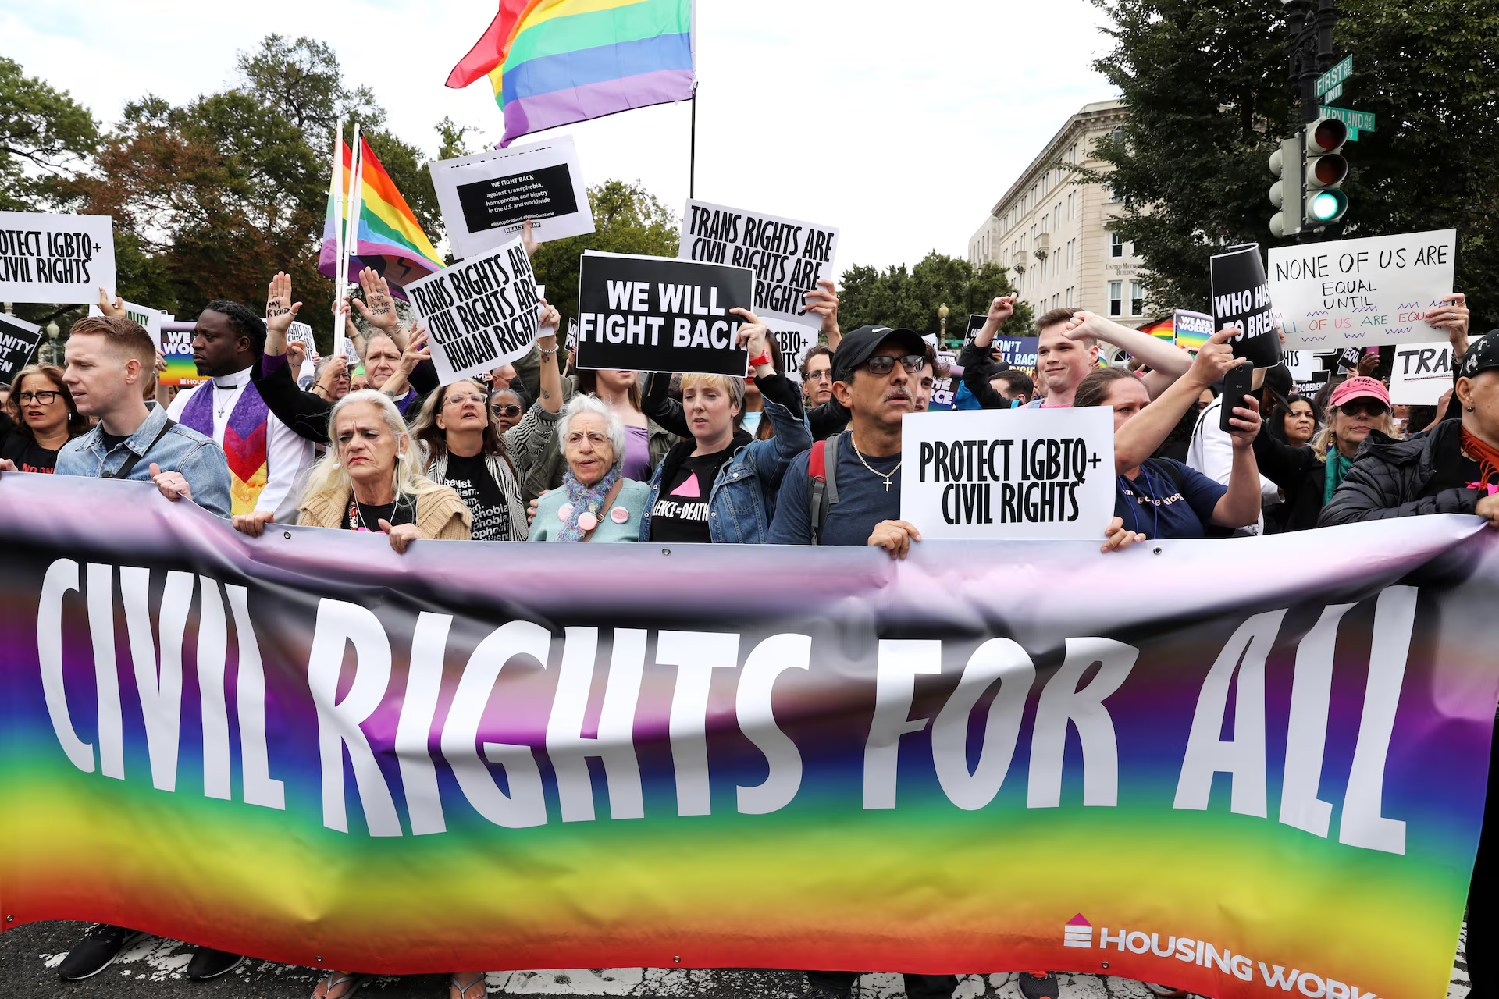
How do we combat this reactionary offensive?
We must defend every piece of democratic ground we have and continually push progressive legislation forward.
We are now being threatened at this moment by the fascist forces culminating around president Trump and his administration. We must mobilize to protect our hard won democratic and constitutional rights gained over centuries of struggle. This is a 'forever' battle, never allowing complacency to take root.
To combat these attacks requires working with an Anti-Monopoly Labor-Led Coalition. It’s important to remember the working class has to be the head and leader of this movement to successfully wipe out the oligarchs that have a stranglehold on our country.

Slide 35
Discussion

Slide 36
Continuing the Struggle

Slide 37
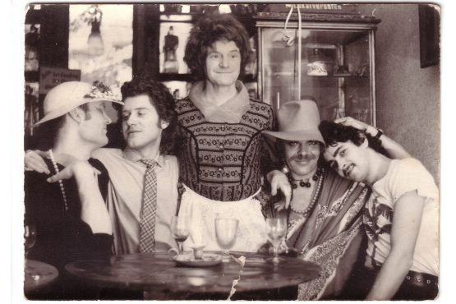
The GDR: Ahead of the West on Gay Rights
Soldiers, the directive read, should strive to “deconstruct traditional moral prejudices against homosexuality.” These words come from neither some long-suppressed Obama-era executive order nor the fantasies of a gay rights group. They constituted one of five “tenets” that communist East Germany’s military adopted in September 1988, around a year before the Berlin Wall was toppled.
The order made East Germany one of the first countries to allow gay men into its military, an achievement that the United States took twenty-three years to match. And if that were not striking enough, the policy was part of a larger suite of pro-gay reforms that the East German dictatorship promulgated between 1985 and 1989.
Several of East Germany’s gay activists, including well-known transgender woman Charlotte von Mahlsdorf, center, pose for a photo in the 1970s.

Slide 38
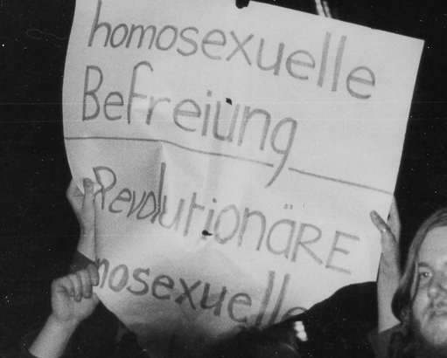
The GDR: Ahead of the West on Gay Rights
This story begins with two men in their early twenties, Peter Rausch and Michael Eggert, who met in an East Berlin public bath in the early 1970s. Rausch remembers that Eggert “rose out of the water like an Adonis,” and they soon became friends. It was a serendipitous meeting. Eggert had recently met with West German gay activists who had ventured behind the Berlin Wall. They had shared their aspirations with the young Eggert, who in turn began discussing them with Rausch. Of the significance of the moment, Rausch said, “It had never occurred to me that [homophobia] was wrong, rather that I was wrong.” It was the birth of gay political activism in East Germany.
A Rare Photo of a Protest for Gay Rights in the GDR.

Slide 39
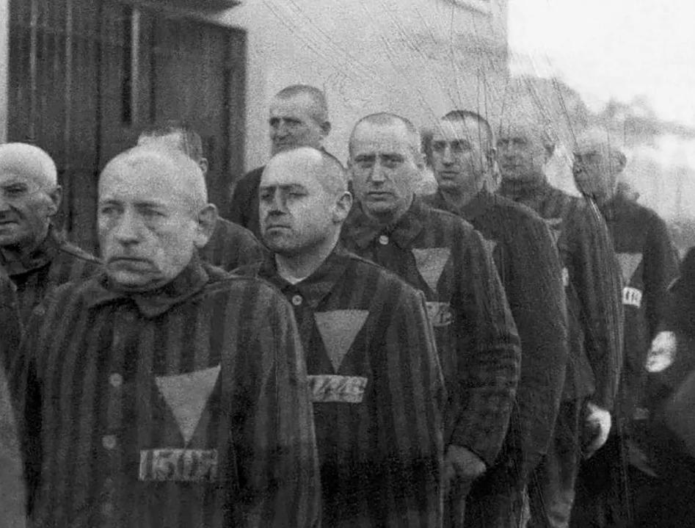
The GDR: Ahead of the West on Gay Rights
The East German state was never particularly hostile to homosexuality. German socialists had a grand tradition of fighting against homophobia that stretched back to socialist leader August Bebel’s 1898 address to the Reichstag, “On Homosexuality and the Penal Code,” in which he advocated for the repeal of Germany’s sodomy law, §175 of the penal code. By contrast, the Nazis had strengthened the law in 1935, criminalizing all homosexual acts, from holding hands to kissing, a change that led to the imprisonment of almost 50,000 men. Soon after the war, in 1950, only a year into its rule, the East German government shifted to a milder version of the sodomy law, which it repealed entirely in 1968 (the only holdover was a higher age of consent for homosexual sex). It did so not only because of German socialism’s legacy of fighting §175. The regime also hoped that by purging the country of fascist relics, it could draw a favorable contrast between itself and West Germany. Indeed, East Germany’s reform of the sodomy law stood in stark contrast to democratic West Germany, where the new regime, led by conservative chancellor Konrad Adenauer (who won a landslide reelection in 1957 running under the slogan “No Experiments!”) kept the Nazi version of §175 in place.
Homosexual prisoners at the concentration camp at Sachsenhausen, Germany, wearing pink triangles on their uniforms, are marched outdoors by Nazi guards on December 19, 1938.

Slide 40
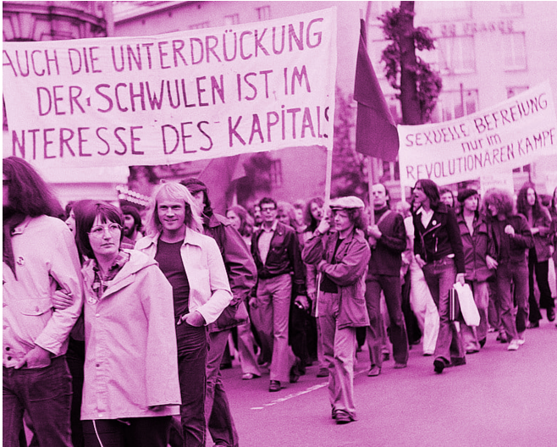
The GDR: Ahead of the West on Gay Rights
That difference meant that while East Germany convicted approximately 4,000 men under the statute between 1949 and 1968, West Germany convicted over 50,000 men between 1949 and 1969—a fivefold per capita difference. This does not mean that East Germany was a gay paradise. Only a handful of bars in its cities catered to gay male clientele. For the most part, gay men had to cruise in parks, train stations, public toilets, or baths such as the one at which Rausch and Eggert met. These could be dangerous locations, where thugs waited to beat and rob unsuspecting men. Lesbians, if anything, had it worse. There were no bars for them, no cruising spots, no opportunities to meet one another. Rausch, Eggert, and a few of their friends decided to do something. They believed the socialist government would help them carve out a gay-friendly space in society, if only they described for it the tribulations they faced. For the most part they seemed to believe in the socialist experiment. And so they began meeting regularly, planning social events and strategizing about how best to lobby the government.
Another Photo of a Protest for Gay Rights in the GDR.

Slide 41
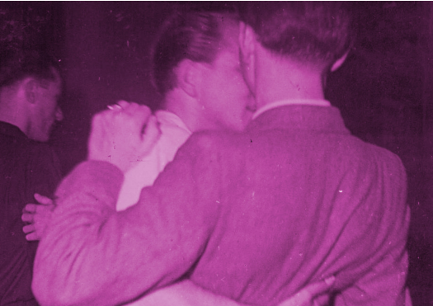
The GDR: Ahead of the West on Gay Rights
Under pressure to stem the tide of gay protest action, the police began debating new strategies. Departments exchanged flurries of memos debating what course of action the government should pursue. In 1985 the Stasi finally produced a new set of guidelines on how to prevent what it termed “the political misuse of homosexuals.” Some of its recommendations were unsurprising, such as ramping up surveillance of gay activist leaders. But its final recommendation was entirely novel. It insisted that the government find “resolution[s] to homosexuals’ humanitarian problems.” That is, the Stasi decided to actually address activists’ demands. Thus began a series of genuinely radical changes in East German society. The state-censored newspapers, which for decades had hardly ever mentioned homosexuality, suddenly started printing dozens of stories about gay men and lesbians. The government also freed periodicals to accept personal advertisements from gay men and lesbians looking for partners.
Two Men Dancing in a Gay Club in the GDR

Slide 42
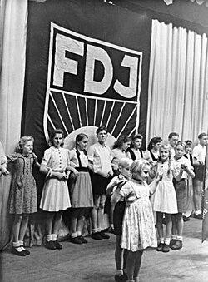
The GDR: Ahead of the West on Gay Rights
In addition, the state began granting official recognition to gay groups, such as the Sunday Club, a secular activist collective run by Sillge that had been meeting in East Berlin since the early 1980s. And it authorized East Germany’s first gay discos, such as Die Busche, a club that still exists today.
The government even allowed gay chapters within the Free German Youth (FDJ), the state’s official youth scouting organization, and mandated that all FDJ members attend educational sessions dealing with homosexuality. All of a sudden, East German youth were required to attend meetings of gay groups such as the Sunday Club. Remembering this moment, Rausch stated, “The joke was that suddenly everyone was standing in line to get into the Sunday Club,” only a couple years after it had been a target of state repression.
In 1987 the East German Supreme Court struck down the law that set a higher age of consent for gay men and lesbians. The following year, the military allowed gay soldiers, reversing a policy the government had instituted in the 1950s.
Foundation of the FDJ in Berlin, November 1947

Slide 43
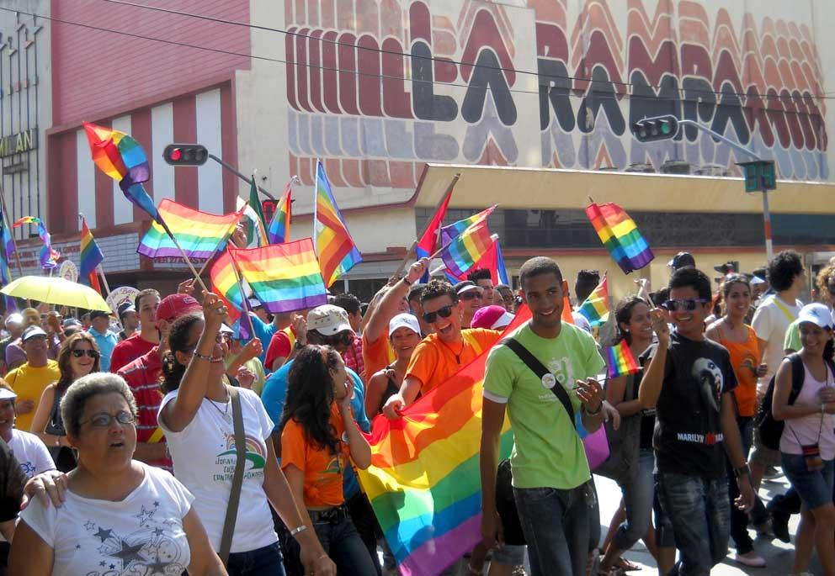
Cuban Evolution on the Issue of Gay Rights
Cuba has come a long way since the 1960s Cuban Revolution; the country today is considered one of the most open-minded Caribbean Islands and has implemented a handful of new laws, movements, and policies in support of the LGBTQ movement. Since 2008, the country has largely ended any state-sanctioned oppression of the LGBTQ community in a bid to progress towards equal rights. Underneath the guidance of Mariela Castro, daughter of former Cuban leader Raul Castro and Fidel’s niece, the government began fighting for change and made it illegal to discriminate against LGBTQ people. Shortly after, the Cuban health services announced they would begin offering free gender reassignment surgery to transgender citizens under a universal health care programme. A huge feat for the island country. As years passed restrictions eased on the use of the internet in Cuba, and so LGBT activists took to social media to organise the first visual display of gay pride via a march in Havana’s Parque Central on May 12, where individuals paraded down the El Prado boulevard waving rainbow flags. A move that’s helped to shape a new, more rosy-looking future for gay individuals here.
Havana, Cuba’s May 2011 LGBT Parade

Slide 44
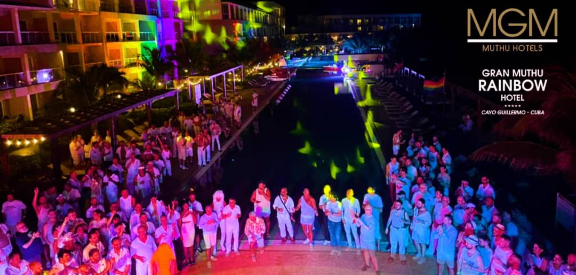
Cuban Evolution on the Issue of Gay Rights
Each of these events created a significant turning point for the LGBTQ community in Cuba who no longer wanted to suppress their beliefs, but instead celebrate them. The streets started to become a safe space for same-sex couples to walk hand in hand, and this new sense of freedom quickly developed into a vibrant social scene tailored specifically to the community. You could find a few LGBT-friendly bars in the city during pre-revolution Cuba, if you knew where to look for them, with St. Michel, The Dirty Duck and El Gato Tuerto in Havana being a few of the popular haunts. But there were always strict laws that criminalised homosexuality, meaning visiting such venues was always a risk. Today, not only will you find handfuls of LGBT bars dotted across Cuba’s major cities, but entire hotels tailored to the community, such as the grand re-opening and newly dedicated LGBT Hotel Telegrafo in Havana, and the five-star Gran Muthu Rainbow Hotel in Cayo Guillermo – which holds the official crown as the first LGBT hotel in Cuba.
Gran Muthu Rainbow Hotel in Cayo Guillermo Celebrates Diversity in 2024

Slide 45
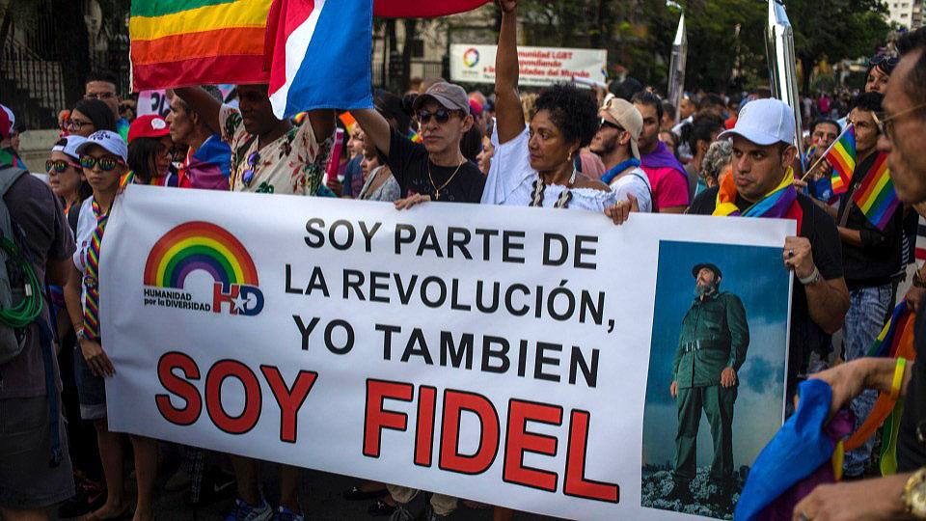
Cuban Evolution on the Issue of Gay Rights
Most recently of all, the Cuban government has revealed plans to legalise same-sex marriage (which remains prohibited on some Caribbean Isles) by publishing a draft of a new and long-awaited family code, which, if passed, proposes to also allow same-sex adoption. After decades of persecution, it’s apparent that social attitudes are finally changing, and the country’s ground-breaking laws and legislations have started waving their flags in support of a rainbow revolution. We can’t wait to see where this journey will take us…
People carry a banner with a message that reads in Spanish: "I am part of the revolution, I also am Fidel¨ during the annual LGBTQ pride parade in Havana, May 12, 2018

Slide 46

The Attack on Pride
It seems Pride is being systematically eliminated to reduce public support for the community and align with political motives. Several states have announced that Pride will not be celebrated this year. Tampa, Florida; Arlington, Texas; and Tucson, Arizona have enacted a hiatus due to “political tensions,” indicating that rising hostilities have created an environment in which celebrations are “not possible.”​
In addition to announcing that Pride will not be celebrated this year, Florida Governor Ron DeSantis has enacted legislation banning Diversity, Equity, and Inclusion (DEI) incentives, granting him the power to forcibly remove any local official found to support LGBTQ+ organizations within the state. This bill will go into effect on January 1, 2027, and has raised concerns among both residents and officials.​

Slide 47
Forming Coalitions
Various local and national organizations and LGBT+ centers exist currently that are fighting back against the attack on our civil liberties. Many offer resources to LGBT+ individuals who are struggling, such as legal aid, housing and medical care.
These groups are essential for many who face discrimination and are feeling the effects of the current administration’s crackdown on gay and trans rights.
However, for any mass movement to be effective, it must have its roots in labor.
This is where PLUS plays an integral role: we must seek out any effective pro-LBGT+ groups and form connections. This will help unite the movement and strengthen it, giving us a fighting chance at preserving and winning even more civil liberties.

Slide 48
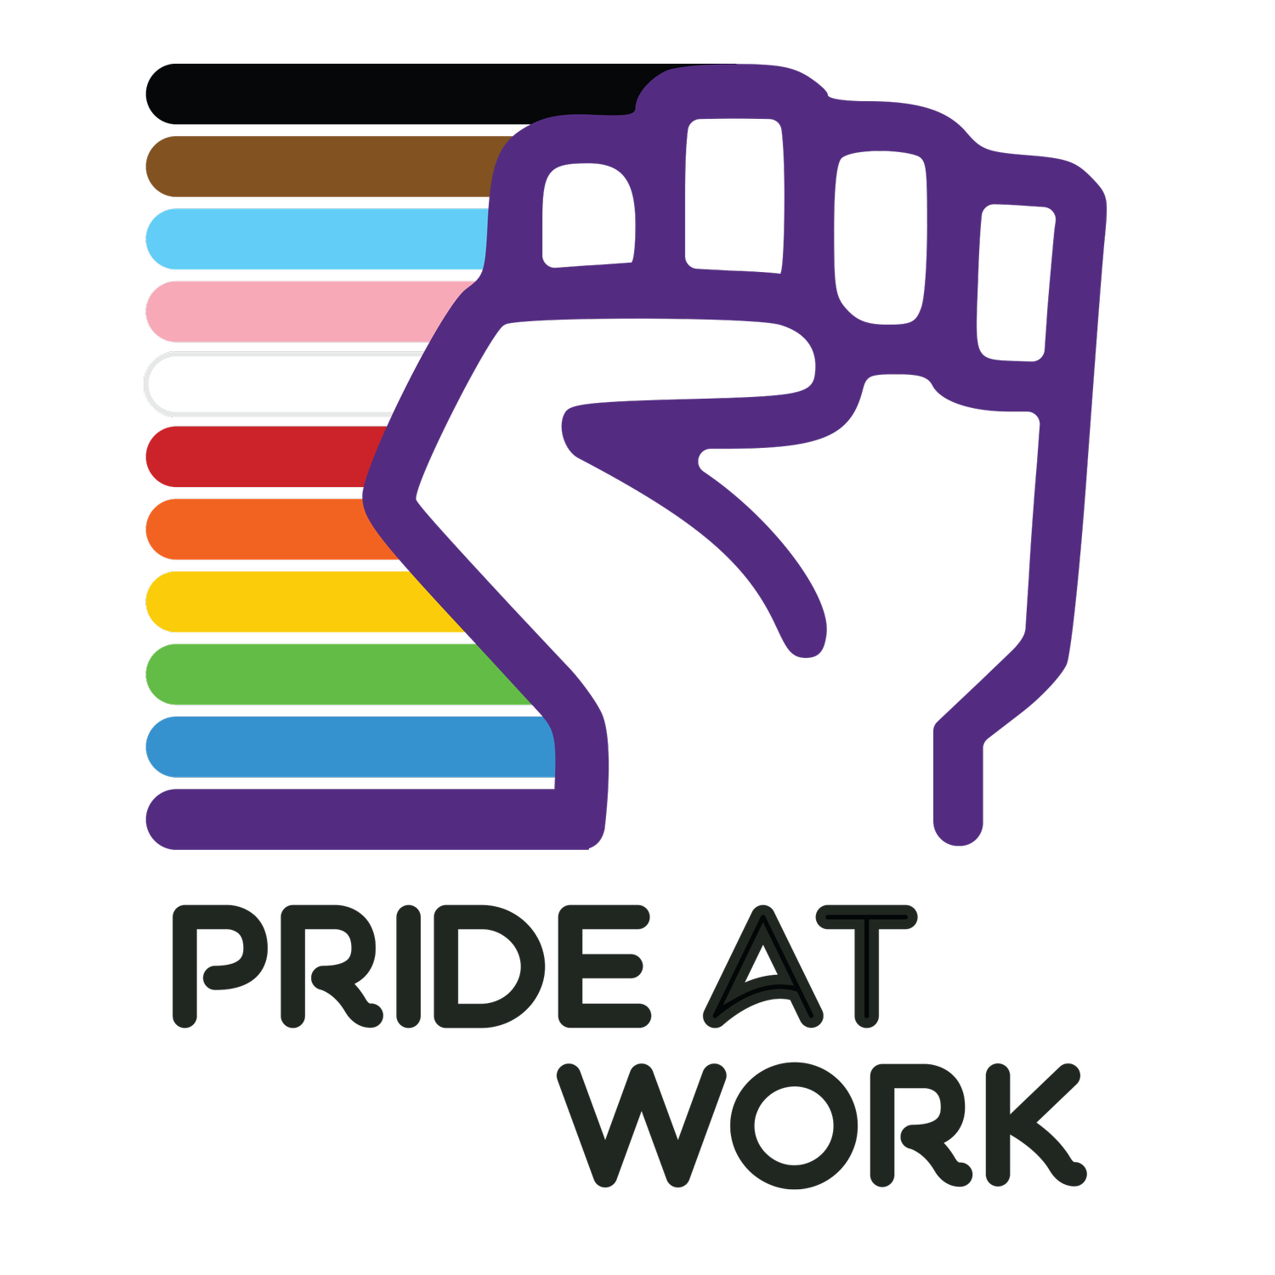
Pride at Work
A notable group is Pride at Work, a caucus within the AFL-CIO for any LGBT+ members and allies.
They aim to promote bargaining for LGBT+ justice. From their website:
“At a time of widespread backlash against LGBTQIA+ rights, it is especially important that we are leveraging our union power at the bargaining table to fight for LGBTQIA+ workplace justice. To assist in this effort, Pride at Work is putting together guidance on bargaining language to make our contracts as protective of LGBTQIA+ members as possible.”
Their guidelines identify some key issue areas important to LGBTQIA+ workplace justice. For each issue area, they have identified why it matters, provided legal context, recommended what language should be included or avoided, and where appropriate provided sample contract language that can be used or adapted.

Slide 49

Defending LGBT+ Rights
The LGBT+ community is currently on the defensive. This comes with particular challenges.
The administration targets our community because we are easy targets for scapegoating. Their aim is to de-class as many of us as they can so that we are fighting for survival rather than banding together.
Most of the movement at this time is mutual aid and spreading awareness, our goal is to further the struggle and galvanize the movement.
In order to do this, we need to get not just more of our own community involved, but also involve our straight allies.
Even if you do not identify as LGBT+, if you consider yourself a straight ally, the best way to be an ally is to get involved and fight alongside us, especially during this time when gay and trans people need their allies the most.

Slide 50
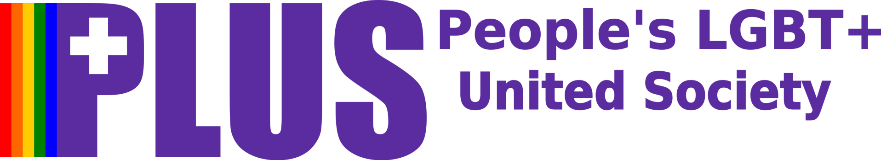
Defending LGBT+ Rights
Join PLUS today at https://peopleslgbt.org/
Dues are only $25
Follow us on Social Media, like and share our posts to give more exposure
https://x.com/PeoplesLGBT/
https://www.facebook.com/profile.php?id=61572375303487
Literature such as pamphlets and our Stonewall Lives Bulletin are available for download on our website
Find an LGBT+ center near you, introduce yourself, and drop off some literature
Pride month isn’t over yet! If there are anymore events near you as the month closes out, try to attend and distribute literature
Pride parades and events are also great for finding local and national organizations perfect for forming coalitions with.

Slide 51
Discussion & Wrap Up

Slide 52
Announcements
PCUSA Cell Chairs need to call members of their cells to remind them about attendance.
PCUSA Cell members are reminded attendance at the Continuing Education class of Jones-Foster every first Wednesday of the month is required.
The next issue of New Masses (2026) has begun production. If you have art you want us to feature, email it to info@partyofcommunistsusa.net.

Slide 53
Volunteers Needed!
We are in need of volunteers for the staff of the People’s School! Here’s a few roles we need filled:
People to help manage posting on our social media and podcast platforms
Video Editors, Audio Editors, Graphic Designers, Artists, Narrators
Web Controls, Moderators
Email info@peoplesschool.us if you’re interested and try to attend our next staff meeting if possible.

Slide 54

Happy Pride Month!
Happy Pride from People’s United LGBT+ Society!
During this pride month, attend a parade near you. Download our brochure and our Stonewall Lives Bulletin and distribute. https://peopleslgbt.org/
Literature can also be requested using the literature request form on the member’s portal.

Slide 55


Slide 56

View From Left Field
https://viewfromleftfield.libsyn.com
The Old PSMLS Youtube is now the Youtube of View From Left Field, a podcast of analysis and discussion of current events from a progressive perspective.
Like the Youtube videos and subscribe with 5 star ratings on your podcast platforms.

Slide 57

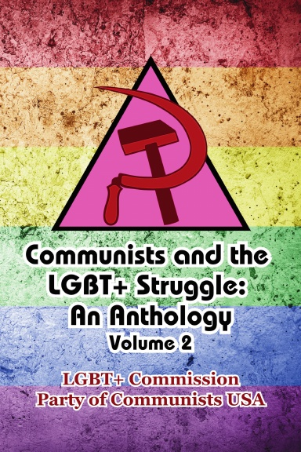
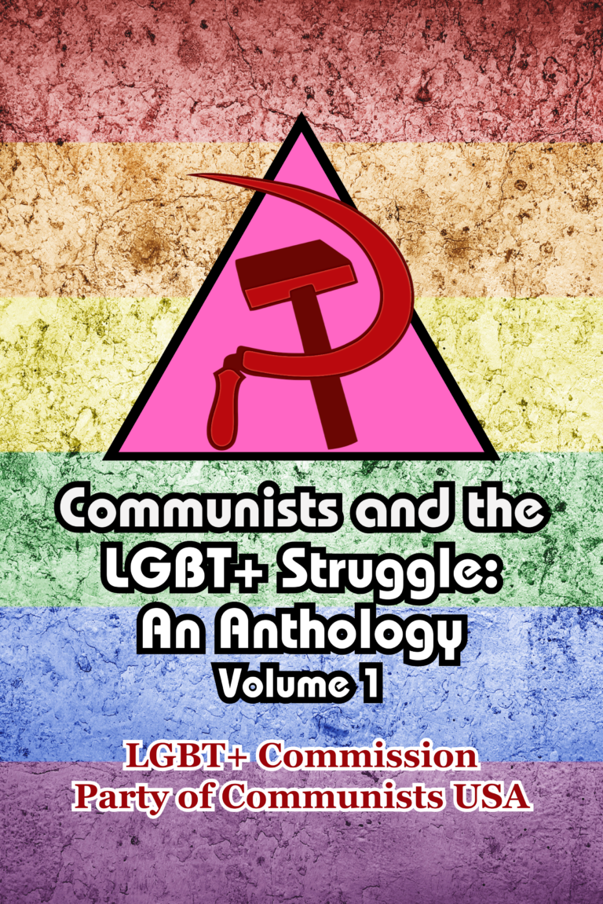
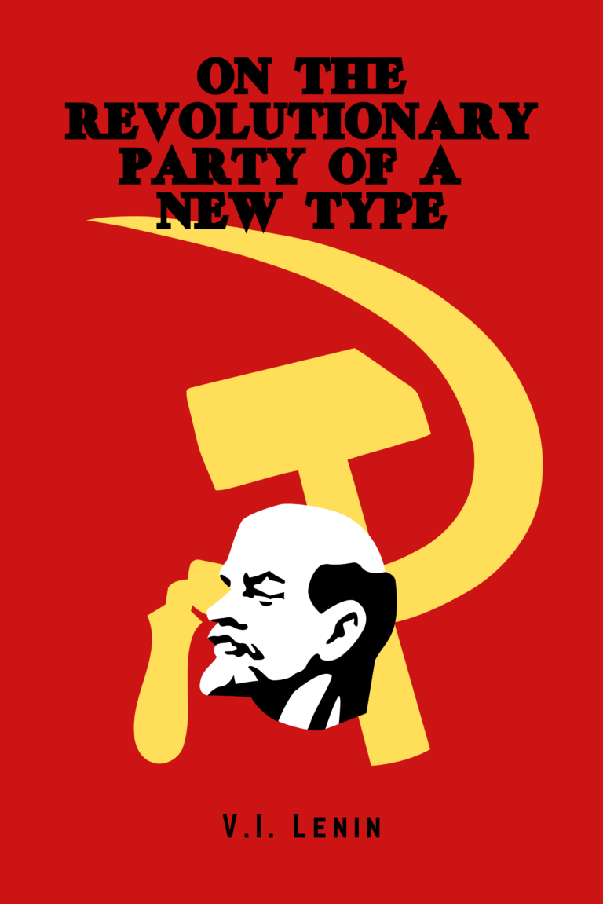

New Outlook Publishers
newoutlookpublishers.store
Latest Releases

Slide 58


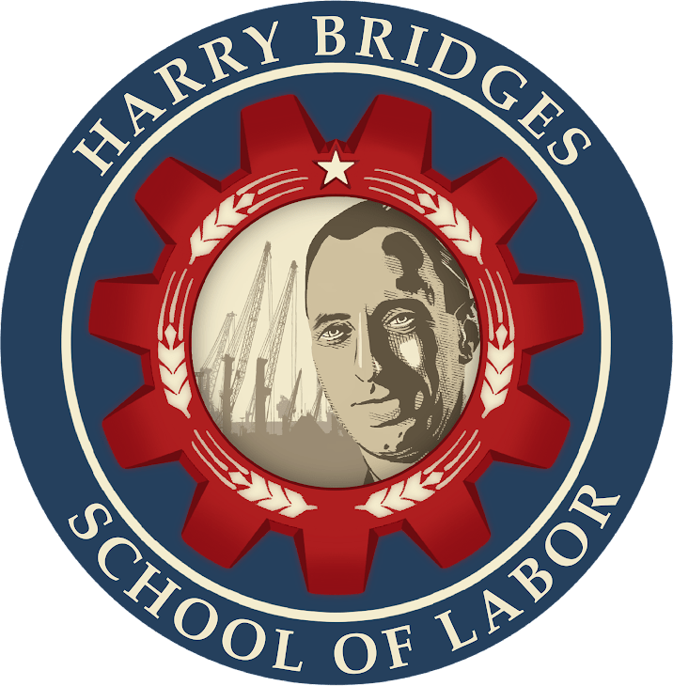
Harry Bridges School of Labor
luel.us/laborschool/
The Harry Bridges School of Labor is a monthly class covering a variety of topics aimed at building class consciousness among union members. For class schedule and other information, please visit the website at luel.us/laborschool.

Slide 59

I Want To Break Free by Queen

