Slide 1

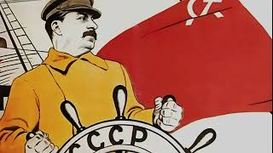
The Internationale

Slide 2
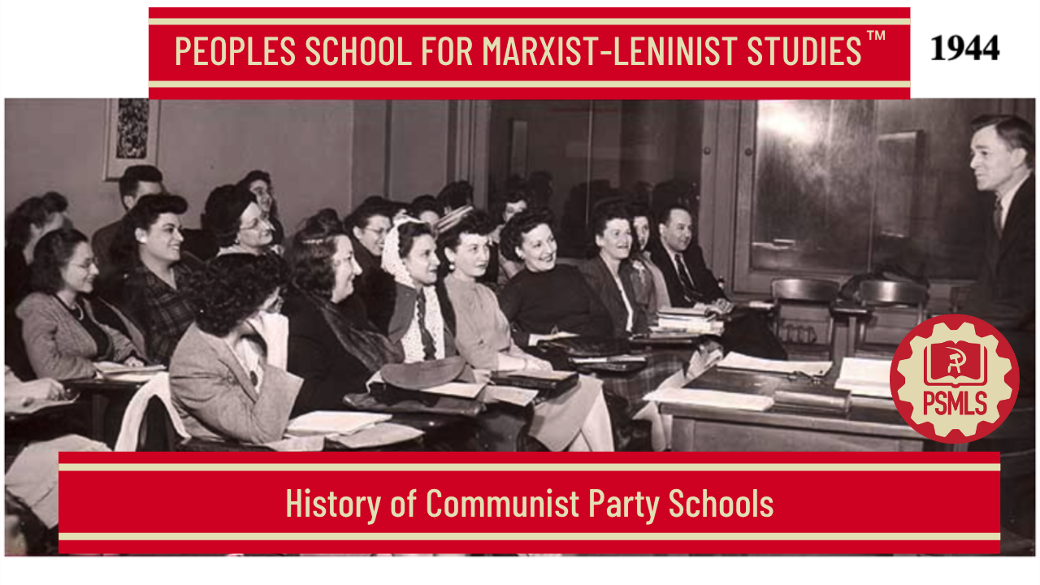
PSMLS 7/14/26

Slide 3
What we’ll be learning today:
Significance of communist party schools
What did party schools teach?
Current Communist Party Schools

Slide 4
The People’s University - A Short History of Party Schools

Slide 5
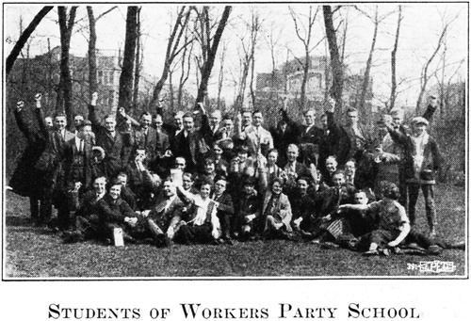
Schools for Workers
A much-overlooked part of the rise of the Communist Party as the leading Left organization in the mid twentieth century is that it produced a robust network of schools for workers. An overview of these schools conveys the effort to instill in workers a class-conscious education. These schools countered dominant pedagogy and traditional education. Early in its history the Party argued that traditional schools were agents of indoctrination, designed to instill quiescent, interchangeable workers. “The primary motive of the institutions of so-called free education is to turn out as large a number of obedient patriotic wage slaves…” the Daily Worker argued in 1925. To counter that trend, the Party established a network of “people’s universities”: workers’ schools that, as the Chicago’s Workers School announced, would, “equip the workers with the knowledge and understanding of Marxism-Leninism” so that worker-students could engage in “militant struggle … toward the decisive proletarian victory.” New York’s Jefferson School and Chicago’s Abraham Lincoln School taught some of the country’s first courses in African American history and labor and working-class history. They championed a humanistic form of adult education for “workers of hand and brain.”
“Workers’ Education Is Workers’ Power.” This Slogan-emblazoned atop the brochure announcing the courses for the Fall term of 1936-captured the political convictions of the Chicago Workers School

Slide 6
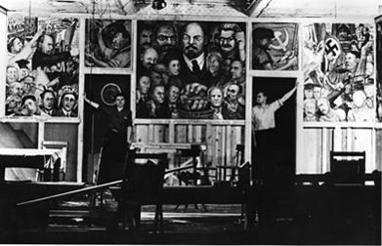
Bringing About a Bolshevik Result
The flagship was the New York Workers School, which offered courses in the Principles of Communism, Marxism-Leninism, and Historical Materialism, and saw its mission as preparing pupils for their role in bringing about the workers’ state. School Director Abraham Markoff, “emphasized the importance of bringing about a real Bolshevik result in the teaching of Marxism-Leninism in our schools.” General theory in courses, he stressed, “must be linked up with the immediate problems and developments of today.” Workers schools taught children and adults not just in large cities but in many smaller places as well. A weekly Daily Worker column, “What’s Doing in the Workers Schools of the U.S.” demonstrated the depth of offerings, pedagogical and geographical. Already by 1934, recent Communist Vice-President Candidate James Ford and James Allen were offering a course on “Problems of the Negro Liberation Movement,” which covered Black history from colonial times to the present, highlighting “the revolutionary traditions of the Negro people which have been buried by bourgeois and reformist historians.” The schools offered a mix of ethnic culture, training in public speaking and union organizing, and history lessons from America’s submerged ethno-racial and working-class past. The Harlem Workers’ School in 1934 offered a course on “History of the Negro in America,” with lectures on “What has Capitalism Done for the Negro?”
New Workers' School, NYC 1933 - Stephen Pope Dimitroff and Janitor - Photo by Lucienne Bloch, Mural by Diego Rivera

Slide 7
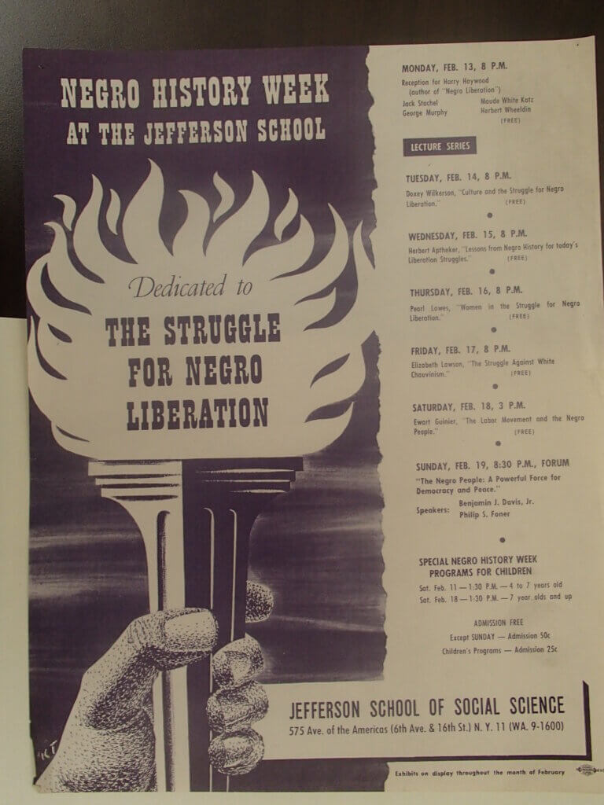
Prosser and Vesey, Alongside Douglass and Lincoln
As early as 1934, similar courses on Black history as well as anti-colonial history were taught at workers’ schools in Saint Louis; Brownsville, Brooklyn; Los Angeles; Detroit; Buffalo, even Newport, Illinois. The valorization of African American history continued in the schools as the Party swung into its Popular Front period. Workers’ Schools embraced Lincoln, as well as “that great liberationist son of the Negro people, Frederick Douglass,” as part of a progressive American genealogy. This emphasis on progressive Americanism led to some unintended ironies. Popular Front Communists at New York’s Jefferson School celebrated both Thomas Jefferson and “Negro slave revolts” as progressive history. What was unusual, though, was that schools offered courses by historian Herbert Aptheker on “Negro Slave Revolts” at all. Elizabeth Lawson’s 1939 course on the “History of the American Negro People” offered some of the first rejoinders to the dominant public-school canard on Reconstruction as “the Era of Negro Misrule.” Likewise, she presented Gabriel Prosser and Denmark Vesey, both of whom led major slave revolts as early as 1800, as heroes, surely a dissenting view in the 1930s.
The Jefferson School often held celebrations of interracial progressivism. The event culminated in a reception for Black Communist Harry Haywood.

Slide 8
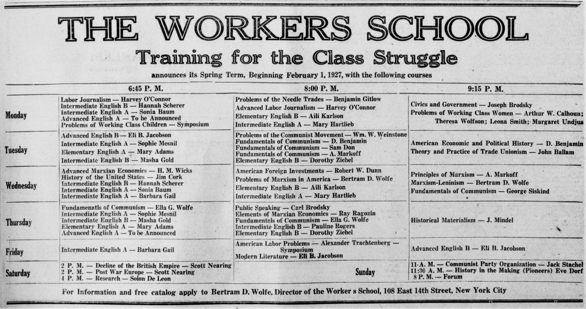
Expanded Horizons for Worker-Students
Other innovative humanities courses, while anchored in a Marxist perspective, expanded workers’ horizons. New York’s school in 1934 offered courses in “Social Forces in American History;” “History of Science and Technology;” “Origin of Man and Civilization;” “Colonial Questions,” and “Revolutionary Interpretation of Modern Literature.” Los Angeles students could take “Emancipation of Women,” taught by “a specialist in social medicine and women’s hygiene.” At Chicago’s Workers School, courses in art and literature were hosted in 1934; drawing and illustration and dramatics were already proving popular with children and adults enrolled in Cleveland, although that school also offered Russian History. Workers schools in Queens, Crown Heights, Brooklyn, Harlem, and Detroit had drama and art courses. At Cleveland’s Workers School, the library contained many novels such as Henry Fielding’s Tom Jones to enhance courses in literature. Some students evidently gravitated to workers schools for expanded horizons in literature, art, or the theater. The schools already offered a proto-course in adult education.
‘New York Workers’ School Readies 51 Courses’ - Headline from The Daily Worker. Vol. 4 No. 9. January 24, 1927

Slide 9
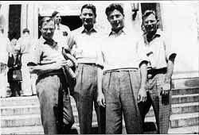
A People’s University
By World War II, the schools were part of a left-wing network, which served as “a people’s university,” as the Polish newspaper Głos Ludowy labeled Chicago’s Abraham Lincoln School. In 1942 more than 4,000 black, white and Hispanic men and women flocked to classes at Lincoln, taking courses in “The People’s War; Structure of Fascism; Propaganda Analysis; Spanish; Basic English; Russian; French; Economics; Philosophy; History; Psychology; Art; Music; Writing for Short Story; Newspaper and Radio; Public Speaking; Labor Problems; History and Culture of Racial and National Groups.” After 1944 the Jefferson School of Social Science in New York became the premier workers’ school. It offered courses in African American, Latin American, and U.S. labor history by scholars such as Aptheker, Lawson, and the Foner brothers, leftist professors fired from the City College of New York in 1941 for their political beliefs. Aptheker and Philip Foner’s emphasis on the salience of slave revolts and Frederick Douglass to America’s freedom story was certainly a counterhegemonic pedagogy at a time when public schools persistently cast abolitionists as unstable, dangerously violent extremists–and claimed slavery was a benign institution.
Philip and Jack Foner - Two of the four Foner brothers who were leaders in the American labor movement and progressive academic circles

Slide 10
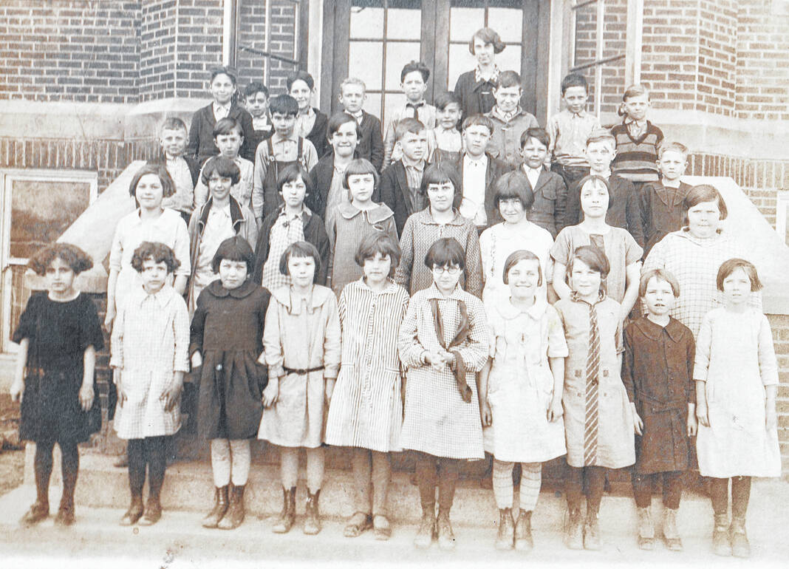
Ideas - When the People Take Hold of Them - Can Change the World!
These “People’s Universities,” as the Jefferson’s directors called the school, helped workers “achieve that education which can enable them to change their world through ever better understanding of it.” Three years later, the school reiterated its commitment to educate “workers of hand and brain – for it knows that these are not only the most numerous group in our society, but also that in their thought and struggles lies the promise of the future.” At a celebratory banquet on its fourth anniversary (attended by Paul Robeson, W.E.B. DuBois and others) the school proclaimed, “Ideas – when the people take hold of them – can change the world!” For a time, it seemed progressive pedagogy was a growth industry. The Jeff developed annexes in Brooklyn, the Bronx, and Queens, and made its course outlines in anti-colonialism, Black history, and labor available to Newark’s Walt Whitman School and White Plains’ Tom Paine School. The moderate Republican New York Herald Tribune in 1945 approvingly reported the Jefferson School had annually enrolled 14,000 students and that the “Leftist School [was] Copied in Seven Other Cities.” The “experiment in adult education” was, the paper noted, regarded by the Jeff’s directors as “a strong trend … toward realization of the dream of a ‘people’s university’ – an educational forum geared to the ‘needs of citizenship in a democracy,’ rather than to ‘self-development’ or ‘heightened individual awareness.’”
A Photo of Jefferson School Alumni to Celebrate the 103rd Anniversary in Westboro

Slide 11
The Scourge of McCarthyism
Within a few years, the paper had its answer. Progressive schools were targeted by the House Un-American Activities Committee and the Attorney General’s List of Subversive Organizations. Schools were stigmatized for preaching such heresy as anti-colonialism or scientific Marxism but also for teaching racial equality. The Jefferson School and other “people’s universities” faced declining enrollments and crushing legal bills. The school’s directors pleaded with the public, “Don’t Let McCarthyism Darken the Halls of Learning,” but it closed by the end of 1956. In announcing its demise, Jefferson’s board was “confident the understanding and inspiration provided by the School will live on in the minds of its many thousands of students, and will continue to be reflected in their daily lives.” Many school alumni indeed continued espousing civil rights, peace and other causes, and alternative schools rose again through the efforts of SDS (Students for a Democratic Society), the Mississippi Freedom Summer and other liberationist organizations such as New York’s 1965-68 Free University. The Workers’ Schools offer a liberating example of true Bolshevik education to counter the contemporary privatized, marketized education mania. In an era of ascendant imperialism where the profit motive has infested our education system at every level, we must look to an earlier era’s “people’s university” for instruction.

Slide 12
Discussion & New Members Introductions

Slide 13
New Member Introductions
What is your name, pronouns and state (or country/territory)?
Where do you work? Is it unionized?
How did you find out about the People’s School?
What do you think about tonight's class?

Slide 14
Teaching the Comrades: What and Why

Slide 15
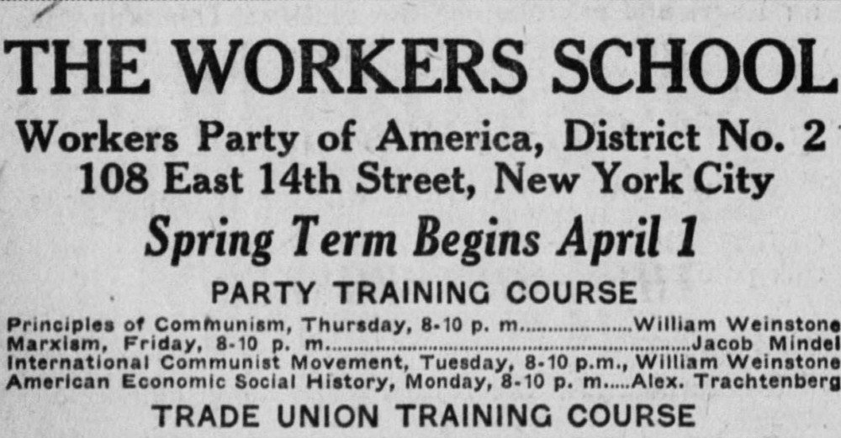
To“Equip the Workers”. That’s Why.
A much-overlooked part of the rise of the Communist Party as the leading Left organization in the mid twentieth century is that it produced a robust network of schools for workers. An overview of these schools conveys the effort to instill in workers a class-conscious education. These schools countered dominant pedagogy and traditional education.
Early in its history the Party argued that traditional schools were agents of indoctrination, designed to instill quiescent, interchangeable workers. “The primary motive of the institutions of so-called free education is to turn out as large a number of obedient patriotic wage slaves …” the Daily Worker argued in 1925.
To counter that trend, the Party established a network of “people’s universities”: workers’ schools that, as the Chicago’s Workers School announced, would, “equip the workers with the knowledge and understanding of Marxism-Leninism” so that worker-students could engage in “militant struggle … toward the decisive proletarian victory.”

Slide 16
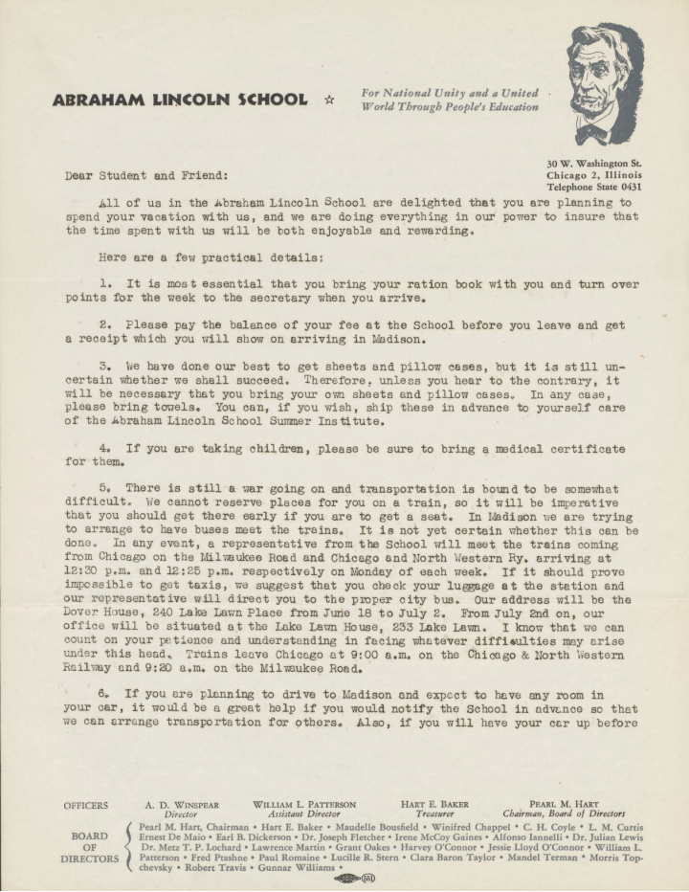
Party Schools: Pioneers of Public Education
New York’s Jefferson School and Chicago’s Abraham Lincoln School taught some of the country’s first courses in African American history and labor and working-class history. They championed a humanistic form of adult education for “workers of hand and brain.”
The flagship was the New York Workers School, which offered courses in the Principles of Communism, Marxism-Leninism, and Historical Materialism, and saw its mission as preparing pupils for their role in bringing about the workers’ state.
School Director Bertram Wolfe in 1925 declared his school was “a part of and subordinate to the political agitation and propaganda of the party, to be designed to definitively serve the party’s needs in its major campaigns. … This is the spirit in which we must approach our work.”
11 years later, the School’s new Director, Abraham Markoff, noted that Earl Browder “emphasized the importance of bringing about a real Bolshevik result in the teaching of Marxism-Leninism in our schools.” General theory in courses, he stressed, “must be linked up with the immediate problems and developments of today.”
Acceptance Letter (1945) from the Abraham Lincoln School of Social Science

Slide 17
Party Schools: Pioneers of Public Education
The Jefferson School often held celebrations of interracial progressivism, as when it sponsored events during “Negro History Week, dedicated to the struggle for Negro Liberation.” The week culminated in a reception for Black Communist Harry Haywood. (NYU, Tamiment-Wagner Library, Jefferson School of Social Science papers, Box 2, Folder 6)
Other innovative humanities courses, while anchored in a Marxist perspective, expanded workers’ horizons. New York’s school in 1934 offered courses in “Social Forces in American History;” “History of Science and Technology;” “Origin of Man and Civilization;” “Colonial Questions,” and “Revolutionary Interpretation of Modern Literature.” Los Angeles students could take “Emancipation of Women,” taught by “a specialist in social medicine and women’s hygiene.”
At Chicago’s Workers School, courses in art and literature were hosted in 1934; drawing and illustration and dramatics were already proving popular with children and adults enrolled in Cleveland, although that school also offered Russian History. Workers schools in Queens; Crown Heights, Brooklyn; Harlem, and Detroit had drama and art courses. At Cleveland’s Workers School, the library contained many novels such as Henry Fielding’s Tom Jones to enhance courses in literature, but no works, Markoff lamented, by Lenin or Engels. Some students evidently gravitated to workers schools for expanded horizons in literature, art, or the theater. The schools already offered a proto-course in adult education.

Slide 18
Party Schools: Pioneers of Public Education
A weekly Daily Worker column, “What’s Doing in the Workers Schools of the U.S.” demonstrated the depth of offerings, pedagogical and geographical. Already by 1934, recent Communist Vice-President Candidate James Ford and James Allen were offering a course on “Problems of the Negro Liberation Movement,” which covered “Negro” history from colonial times to the present, highlighting “the revolutionary traditions of the Negro people which have been buried by bourgeois and reformist historians.” The schools offered a mix of ethnic culture, training in public speaking and union organizing, and history lessons from America’s submerged ethno-racial and working-class past. The Harlem Workers’ School in 1934 offered a course on “History of the Negro in America,” with lectures on “What has Capitalism Done for the Negro?”
As early as 1934, similar courses on Black history as well as anti-colonial history were taught at workers’ schools in Saint Louis; Brownsville, Brooklyn; Los Angeles; Detroit; Buffalo, even Newport, Illinois. The valorization of African American history continued in the schools as the Party swung into its Popular Front period. Schools after 1935 claimed prominent historical figures as progressive icons; they were urged in 1936 to stress “the revolutionary historic role of Lincoln” and to “link up their present struggle with its revolutionary traditions and past” lest “fascist falsifiers” claim “all that is valuable in the historical past of the nation,” so “that the fascists may bamboozle the masses …” Workers’ Schools embraced Lincoln, as well as “that great liberationist son of the Negro people, Frederick Douglass,” as part of a progressive American genealogy.

Slide 19
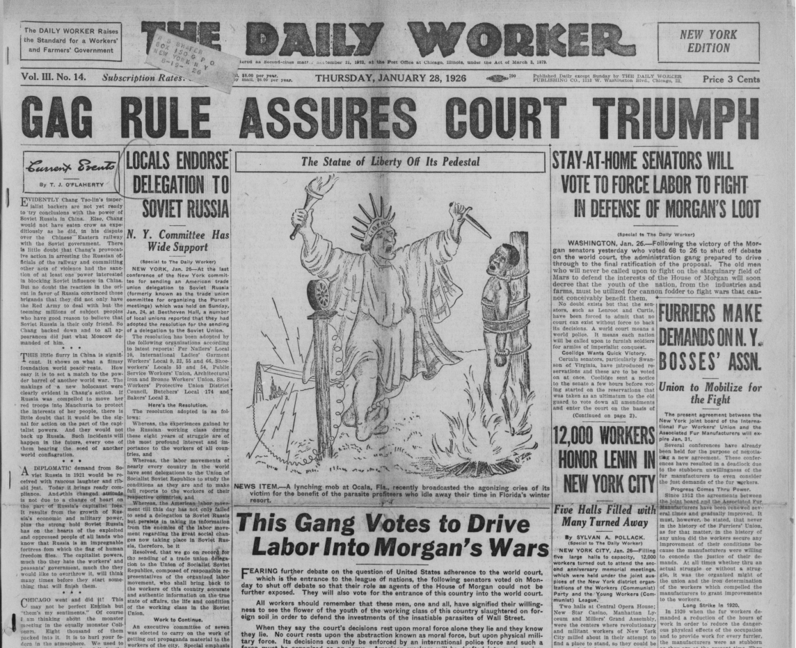
Original Source: The Workers School Curriculum
‘The New York Workers School’ by Joseph Freeman from The Daily Worker. Vol. 3 No. 14. January 28, 1926.
(The following is a report on the New York Workers’ School made by the well-known writer, Joseph Freeman, for the Russian news agency, Tass.)
NEW YORK. The largest Workers’ School in the United States is conducted by the Workers (Communist) Party. Since its establishment by the party in 1923 the school has grown steadily, until now over 1,000 workers attend its classes. The institution is known as the “Workers’ School.” Most of its classes–containing over 700 students–are held at the New York headquarters of the party. Branch classes, attended by about 300 workers, are held in other parts of the city and in nearby towns.
The students are drawn from all the important trades in and around New York, including clothing, fur, millinery, the metal trades, leather goods, textiles, teaching and clerical work. About 80 per cent of the students are members of trade unions.
Front page of The Daily Worker featuring this article

Slide 20
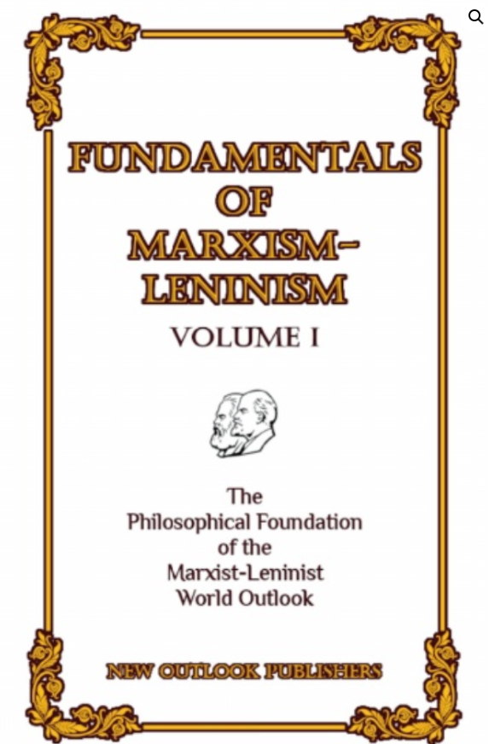

The Workers School Curriculum
The Central School.
The central school gives 21 courses. The most important of these are the party training courses, aiming to train active party members for capable leadership in trade union and other party work. One of these courses, known as the “Party Training Course,” runs for six months and is devoted to a study of Marxism, party history and problems, Leninism, and trade union work.
The Party Training Course.
This course seeks to familiarize the party membership with the origins and aims of the Communist movement, the left wing struggles in the American socialist movement, and the history of the Workers (Communist) Party The course is attended by about 150 students.

Slide 21
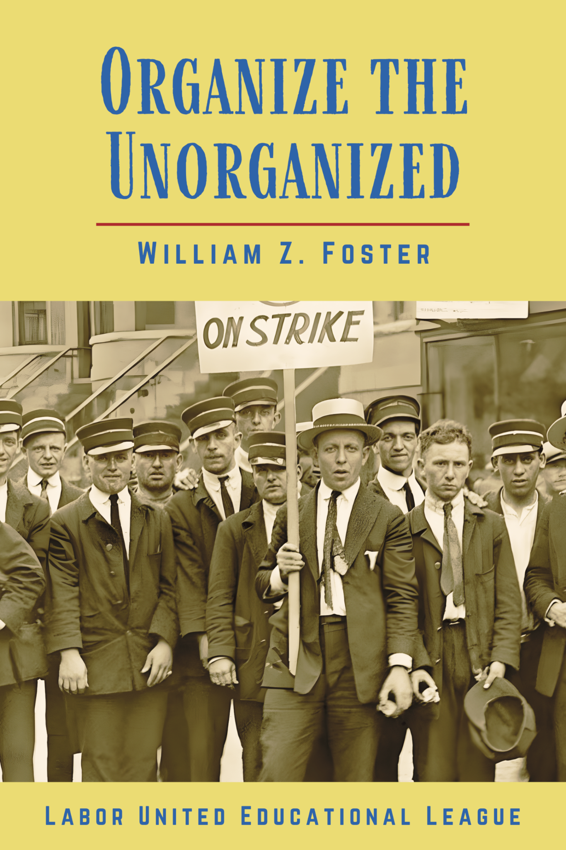
The Workers School Curriculum
The Shop Nucleus Training Course.
The “Shop Nucleus Training Course” combines a study of Leninism with a study of party problems, and is organized to draw the entire membership into the party’s educational work.
Every shop nucleus elects one member to attend the “Shop Nucleus Training Course” at the central school. The nucleus pays his fee and exacts attendance at classes. The delegates of the shop nuclei are taught the fundamentals of party theory and work.
Nuclei and Branch Classes.
The students then return to their respective shop nuclei and teach the membership what they have learned at the central school. Questions and problems raised by the membership are, in turn, brought back to the school, where they are discussed and explained. In this way contact and exchange of ideas are maintained between the central school and the membership. About 200 shop nuclei representatives are enrolled in the “Shop Nucleus Training Course.”

Slide 22
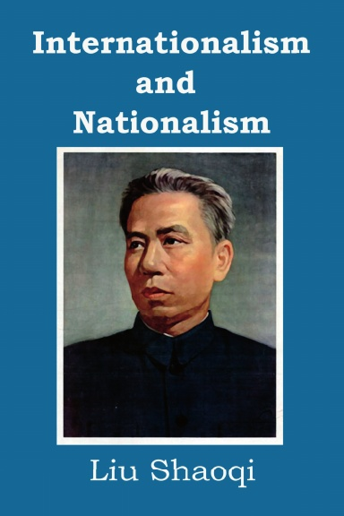

The Workers School Curriculum
Other Classes of the School.
Other courses at the school include classes in public speaking, research and a class for workers’ correspondents. There are also classes in English, and a class in Russian for party members who feel that they cannot advance in their study of Leninism without a knowledge of the Russian language.
Foreign Language Classes.
The central school conducts all its classes in English, except the Russian class. There are, however, a number of foreign-language courses given to branch classes. The Jewish members of the party give a number of courses in Yiddish. There are also courses in Finnish, German, Hungarian, Lithuanian, Italian, etc. In addition to the courses in their own language, these groups are taught English.
The Role of the English Classes.
The classes in English, both at the central school and the branch classes, are heavily attended. They are considered of the utmost importance in breaking down language barriers among the foreign-born workers. The party considers English essential to the liquidation of the foreign-language federations, with their autonomous tendencies, and the building-up of a unified, centralized party, based on shop nuclei and united by one language.

Slide 23
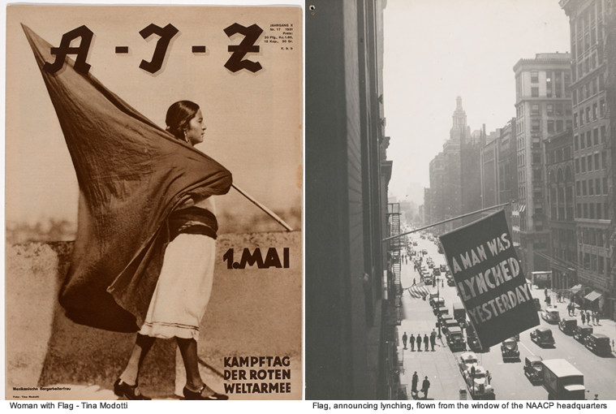
The Workers School Curriculum
The Workers School and the Agitprop Department.
The “Workers’ School” is one of the activities of the agitprop department of the Workers’ (Communist) Party. The agitprop director for New York is at the same time director of the school. All the teachers, are party members. There are 18 teachers at the central school and an average of two teachers in the branch classes.
Agitprop “Politically Engaged Art” examples

Slide 24
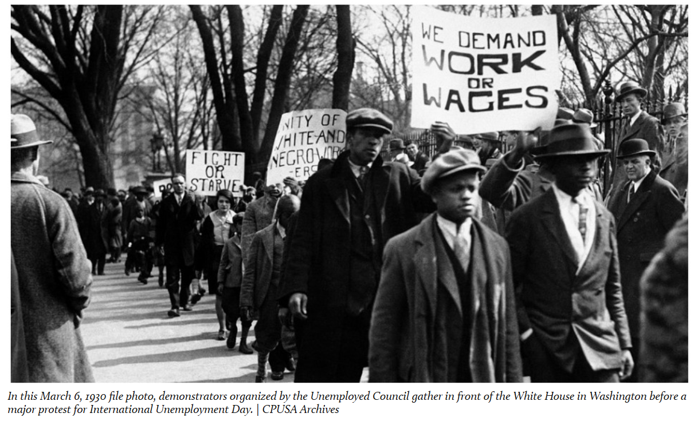
The Workers School Curriculum
The School Library.
The school has a library of several hundred books, and a research department which works together with the class in research work.
Open to All Workers.
All classes at the school, except the party training courses, are open to workers who are not members of the party, but are sympathetic to Communism. There are a number of such sympathizers in the various courses, drawn chiefly from the needle trades. The students are charged a small fee except when they are on strike or unemployed.

Slide 25
Workers Schools: Down, Not Out.
Progressive schools were targeted by the House Un-American Activities Committee and the Attorney General’s List of Subversive Organizations.
Schools were stigmatized for preaching such heresy as anti-colonialism or scientific Marxism but also for teaching racial equality. The Jefferson School and other “people’s universities” faced declining enrollments and crushing legal bills.
The school’s directors pleaded with the public, “Don’t Let McCarthyism Darken the Halls of Learning,” but it closed by the end of 1956. In announcing its demise, Jefferson’s board was “confident the understanding and inspiration provided by the School will live on in the minds of its many thousands of students, and will continue to be reflected in their daily lives.”
Many school alumni indeed continued espousing civil rights, peace and other causes, and alternative schools rose again through the efforts of SDS, the Mississippi Freedom Summer and other liberationist organizations such as New York’s 1965-68 Free University.
The PSMLS is a continuation of the Workers School Tradition…

Slide 26
Discussion

Slide 27
Current Communist Party Schools

Slide 28
Background
Our party started in 2011 as the National Council of Communists USA (NCCA) – a pre-party formation.
On May 1st 2014, we had our founding congress for the Party of Communists USA (PCUSA)
The People’s School for Marxist-Leninist Studies (PCUSA) was established during this congress
It started off as a conference call, eventually switching to Zoom by 2021.
The People’s School is not a party school, classes are available for the public and for anyone to join the discussion and learn about Marxism-Leninism.

Slide 29
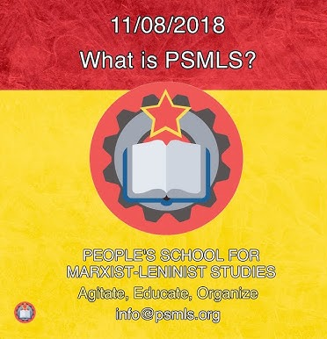
The People’s School
Throughout the years, the PSMLS has had many different leaders and was run in different ways
Each leader brought with them a different way of running the class, various ideas, methods and improvements to the class.
These changes have culminated in the current People’s School, which has carried forward the improvements and innovations of past iterations and shed any ineffective elements.

Slide 30

The Peoples School
The school has a detailed, planned out schedule of classes, with class committees meeting every Fridays to plan 2 weeks ahead.
The People’s School has become the PCUSA’s most successful mass organization and essentially has developed a task force of reliable comrades who consistently produce high quality content for classes.
This provides a good blueprint or guide for other mass organizations of the party to develop into successful, effective formations.

Slide 31
Jones-Foster Party School
The Jones-Foster Party School is the official party school of the PCUSA. It is only available to members of the PCUSA and is required for candidates to ascend to cadre level.
The school also requires party cadre to attend every 1st Wednesday of the month.
Jones-Foster differs from the People’s School in that the content is intended to develop political knowledge, leadership skills and Marxist-Leninist view of the world within aspiring cadre.
It is essential for cadre to continue their education so that they can be aware of what developments happen in the party and so they can continue to hone their skills and knowledge.

Slide 32
Jones-Foster Party School
Regarding content, the curriculum is much more rigorous and challenging, with topics such as political economy and theory, the basic foundations of Marxism-Leninism and training in the party’s Bolshevik method of leadership and organizing.
While the People’s School is developed with some involvement and feedback from the party’s Ideological Secretary, the Party School is directly created and run by the Educational Secretary and Ideological Secretary.
For cadre, the content is also a good way to keep up to date with developments in the party and thus to see the tangible effects of our collective work.

Slide 33
Discussion & Wrap Up

Slide 34
Announcements
PCUSA Cell Chairs need to call members of their cells to remind them about attendance.
PCUSA Cell members are reminded attendance at the Continuing Education class of Jones-Foster every first Wednesday of the month is required.
The next issue of New Masses (2026) has begun production. If you have art you want us to feature, email it to info@partyofcommunistsusa.net.

Slide 35
Volunteers Needed!
We are in need of volunteers for the staff of the People’s School! Here’s a few roles we need filled:
People to help manage posting on our social media and podcast platforms
Video Editors, Audio Editors, Graphic Designers, Artists, Narrators
Web Controls, Moderators
Email info@peoplesschool.us if you’re interested and try to attend our next staff meeting if possible.

Slide 36
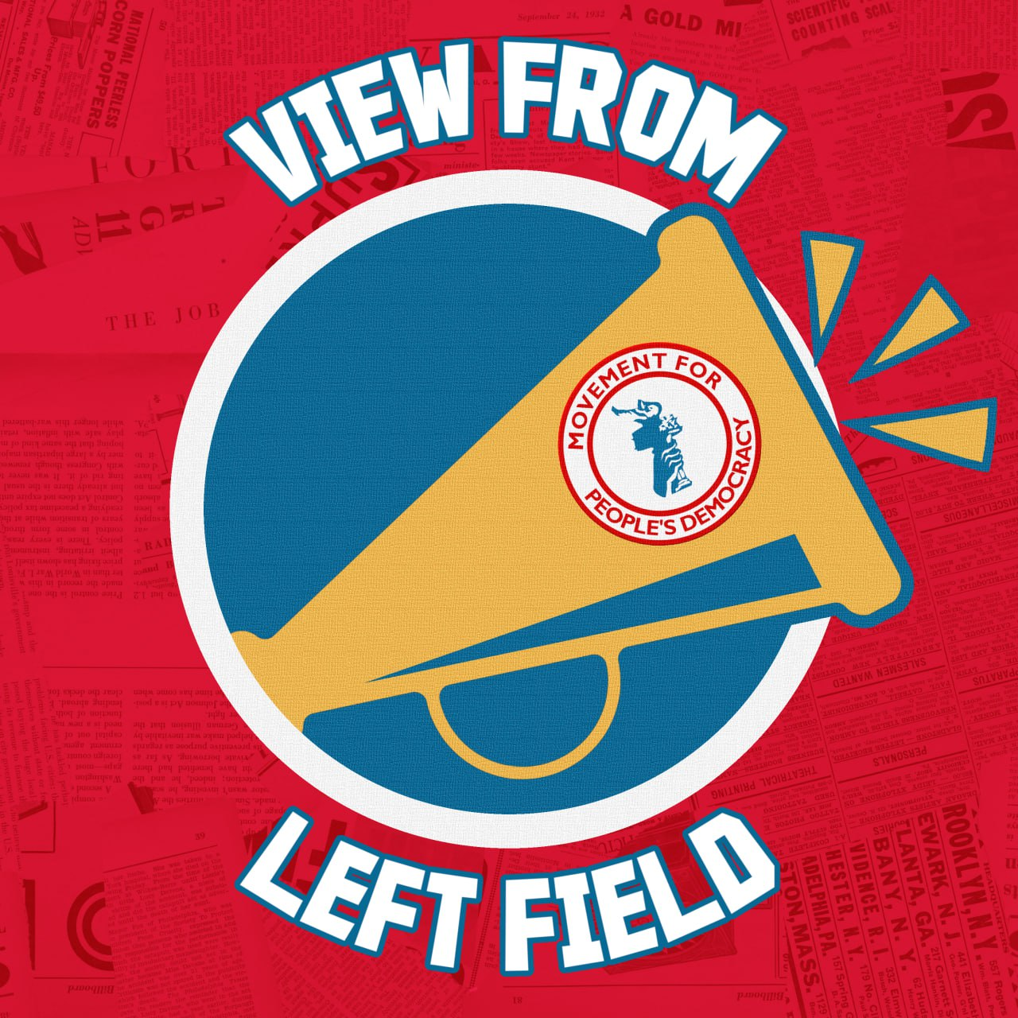
View From Left Field
https://viewfromleftfield.libsyn.com
The Old PSMLS Youtube is now the Youtube of View From Left Field, a podcast of analysis and discussion of current events from a progressive perspective.
Like the Youtube videos and subscribe with 5 star ratings on your podcast platforms.

Slide 37

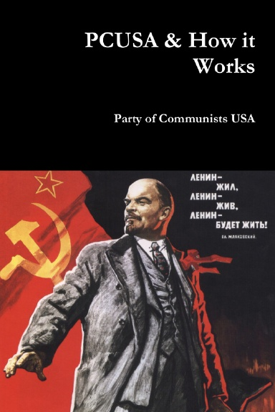
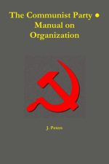


New Outlook Publishers
newoutlookpublishers.store
Relevant and Latest Releases

Slide 38


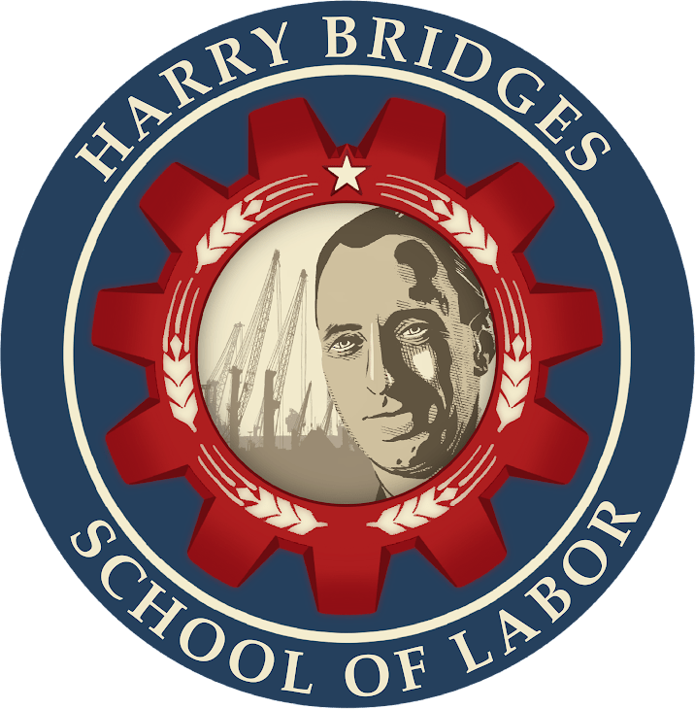
Harry Bridges School of Labor
luel.us/laborschool/
The Harry Bridges School of Labor is a monthly class covering a variety of topics aimed at building class consciousness among union members. For class schedule and other information, please visit the website at luel.us/laborschool.

Slide 39
