Slide 1

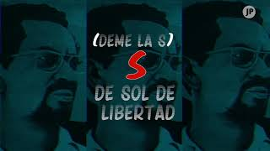
La Consigna - FSLN (Sandinista National Liberation Front)

Slide 2
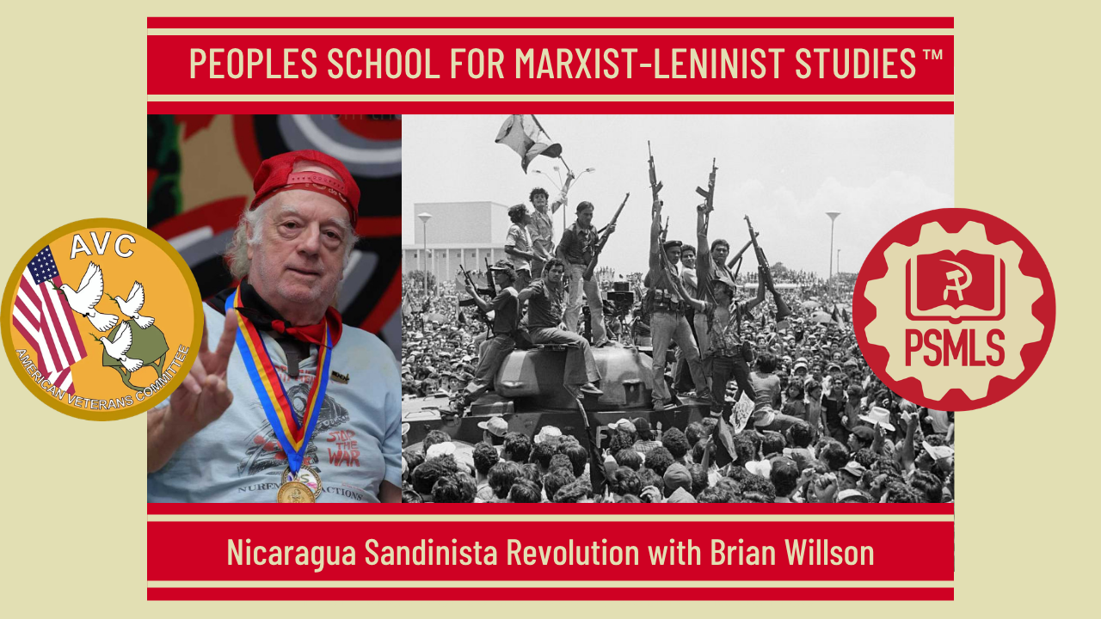
PSMLS 7/21/2026

Slide 3
What we’ll be learning today:
History of Nicaragua
US Support of Contras
Interview with Brian Willson

Slide 4
History of Nicaragua

Slide 5
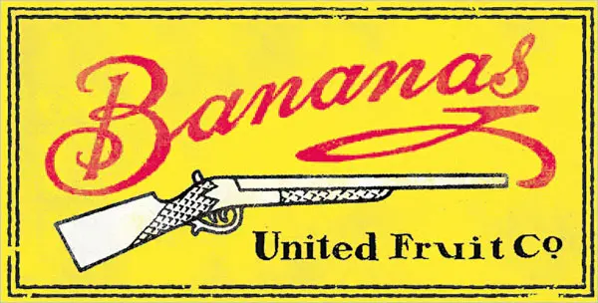
United Fruit & The Banana Republics
In the late 1800s, several fruit companies conglomerated to form United Fruit (now known as Chiquita Banana), operating banana plantations in various Central America, the Caribbean and some Southern American countries such as Guatemala, Honduras, Nicaragua,Costa Rica, Colombia, Panama, Cuba, and Jamaica
The company's deep economic footprint and extensive political power—often referred to as el pulpo (the octopus)—gave rise to the term "banana republics" in countries like Honduras, Guatemala, Costa Rica, and Nicaragua.
For the seasonal workers in the fields life is harsh. Working conditions are physically dangerous, work is seasonal and the toxic chemicals used in the crop are a permanent hazard.

Slide 6
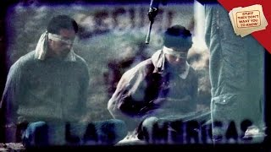
School of Americas/WINSEC
Contras and other terrorist groups were trained in the CIA-backed School of Americas/Western Institute of Security & Cooperation (WINSEC) in Somoza. The program was designed to disrupt any leftist movements in South America.
Questions for Brian Willson:
What was the School of Americas/WINSEC?
How did they prop up the Somoza Dictatorship?

Slide 7
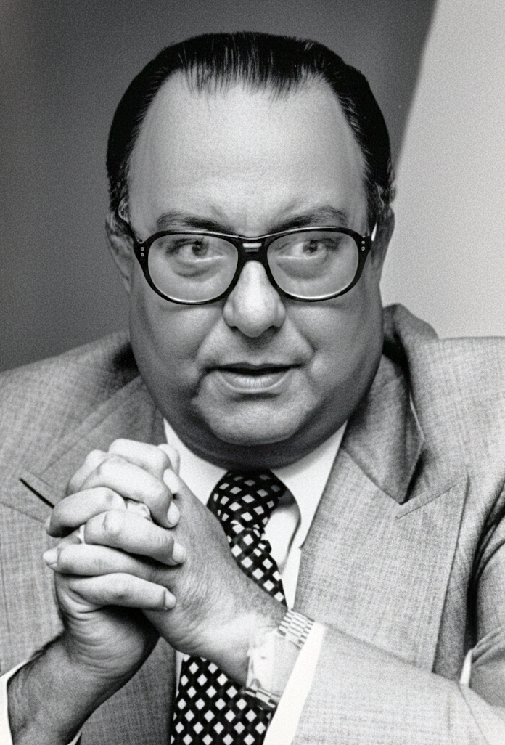
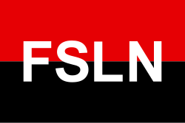
Somoza Dictatorship & the Sandinistas National Liberation Front
The Somoza regime, which had been in power in Nicaragua for over four decades, was characterized by widespread human rights violations and corruption, with Somoza and his associates amassing vast wealth at the expense of the populace.
Inspired by the Cuban Revolution, the Sandinistas National Liberation Front (FSLN) was founded in 1961, forcing Anastasio Somoza Debayle, the last Somoza dictator to flee into exile in 1979.
Daniel Ortega, an FSLN commander, became first a member of the 5-person junta of National Reconstruction, and later president from 1985 to 1990. At the time, he considered himself a Marxist-Leninist.
Reforms included the nationalization of over 2.000 properties owned by the Somozas, and ambitious social programs.

Slide 8
Discussion & New Members Introductions

Slide 9
New Member Introductions
What is your name, pronouns and state (or country/territory)?
Where do you work? Is it unionized?
How did you find out about the People’s School?
What do you think about tonight's class?

Slide 10
US-Backed Contras

Slide 11
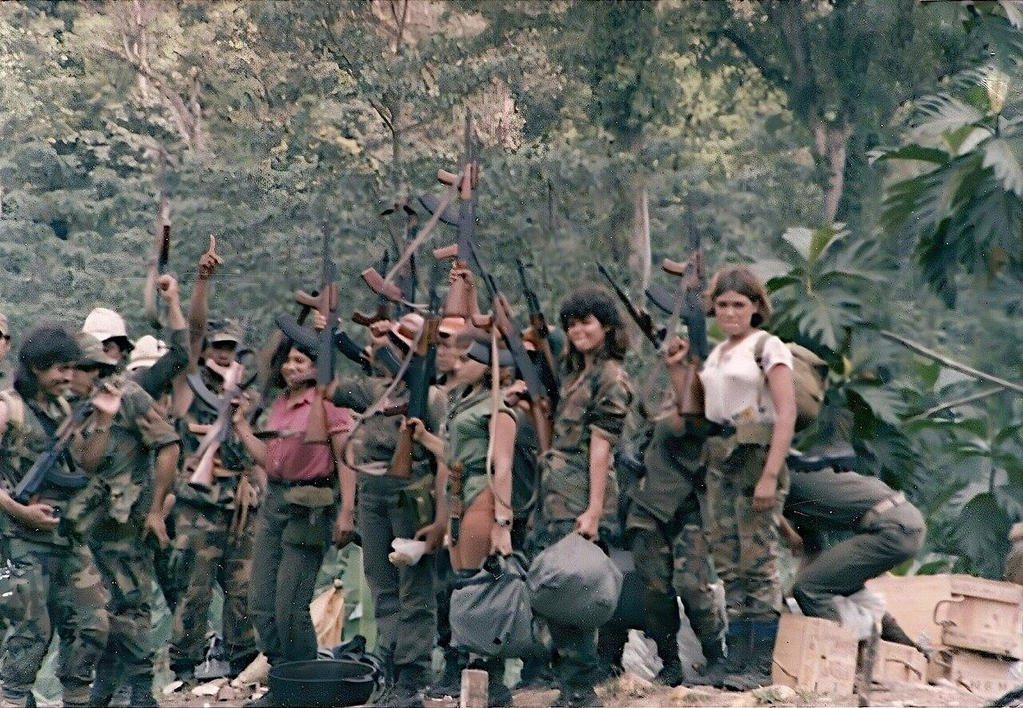
Creating the Contras (1981)
March 1981: Reagan authorized CIA to recruit, arm, and train anti-Sandinista forces. Two main groups emerged:
FDN (Nicaraguan Democratic Force): Largest group, led by former Somoza National Guard officers. Based in Honduras. Composed of:
  Ex-National Guard members (Somoza's brutal military/police)
  Displaced landowners who lost property to land reform.
  Some peasants recruited through coercion or payment
ARDE: Smaller southern front based in Costa Rica, led by Edén Pastora ("Commander Zero"), a disillusioned former Sandinista.
The Leadership Problem: The Contras were led by Somoza's former military officers—the same people who'd tortured and murdered Nicaraguans under the dictatorship. This made Reagan's "freedom fighter" rhetoric absurd.
Contra group from FDN and ARDE Frente Sur in the Nueva Guinea area in 1987

Slide 12
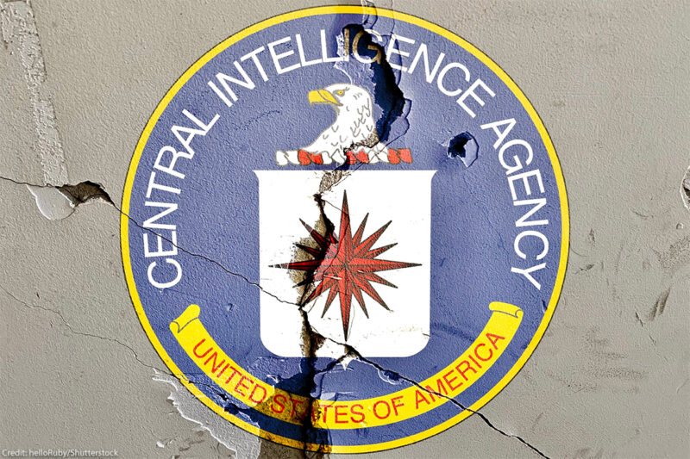
CIA Operations
Training: CIA established camps in Honduras and Florida teaching guerrilla warfare, sabotage, assassination, psychological operations.
Funding:
  1982: $19 million
  1983: $24 million
  1984: $24 million
  Eventually totaling $300+ million official funding
The CIA Manual (1983):
  Assassinate Sandinista officials
  "Neutralize" (kill) judges, police, state security
  Create "martyrs" by provoking government reprisals against civilians
  Blackmail and coerce civilians into cooperation
When exposed, this manual caused scandal—the CIA was teaching terrorism.
Mining Harbors (1984): CIA operatives mined Nicaragua's harbors, damaging commercial ships. The International Court of Justice ruled this violated international law. The U.S. rejected the ruling.

Slide 13
Contra Tactics: War Crimes
Human rights organizations (Americas Watch, Amnesty International) documented systematic atrocities:
Rape: Systematic sexual violence against women in Sandinista-sympathetic villages.
Torture: Mutilation, eye-gouging, castration, burning victims alive.
Civilian Targeting: Murdered teachers (literacy campaign workers), health workers, agricultural cooperative members—anyone associated with Sandinista programs.
Kidnapping: Forced recruitment, especially of teenagers. Contras press-ganged peasants into service.
Destruction: Burned schools, health clinics, agricultural cooperatives to sabotage Sandinista development programs.
Example: In 1984, Contras attacked Pantasma killing 16 civilians including children. They raped women, mutilated bodies, and destroyed the town's clinic.
The Pattern: Contras didn't fight Sandinista military; they terrorized civilians to make the country ungovernable.

Slide 14
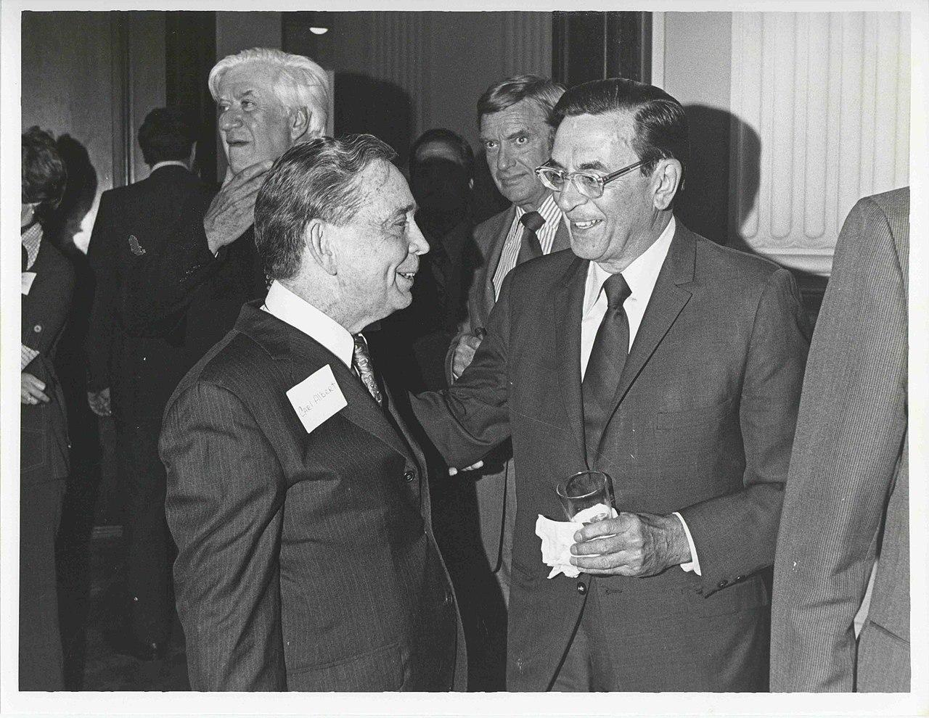
The Boland Amendments (1982-1984)
Congress grew uncomfortable funding Contras after atrocity reports and the harbor mining incident.
Boland I (December 1982): Prohibited funds for "overthrowing" Nicaragua's government (loophole: could fund "interdicting arms to El Salvador").
Boland II (October 1984): Banned all military aid to Contras—no loopholes.
Reagan faced a choice: obey the law or find illegal workarounds.
He chose illegal workarounds.
Edward Boland (right), author of the Boland Amendment

Slide 15
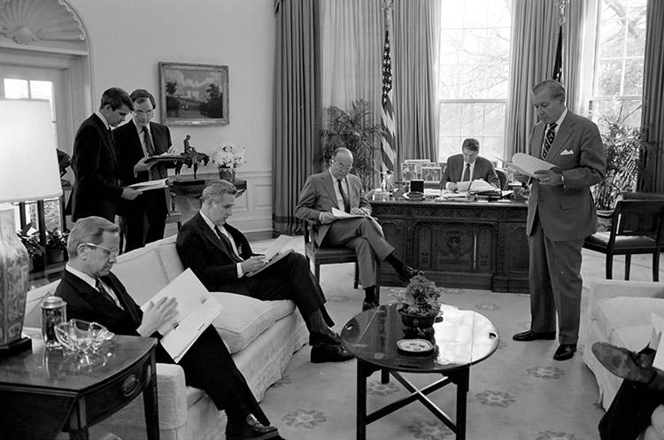
Iran-Contra: Breaking the Law
The Scheme: NSC staffers Oliver North and John Poindexter:
  Secretly sold weapons to Iran (America's enemy, holding hostages)
  Diverted $18 million in profits to Contras
  Solicited donations from Saudi Arabia ($32 million), Brunei ($10 million)
  Created front companies and Swiss bank accounts to launder money
Exposed (November 1986): Lebanese magazine revealed arms-for-hostages deal. Attorney General Ed Meese announced Contra diversion. Scandal exploded.
The Cover-Up: North shredded thousands of documents. Officials lied to Congress. Reagan claimed ignorance.
Prosecutions: 14 indicted, 11 convicted—then President George H.W. Bush pardoned six (December 1992), ending investigation.
President Reagan Meeting with Senior Staff regarding Nicaragua and the Central American Peace Proposal in the oval office with Robert McFarlane, Oliver North, Langhorne Motley, David Chew, John Poindexter and Donald Regan - 04/04/1985

Slide 16
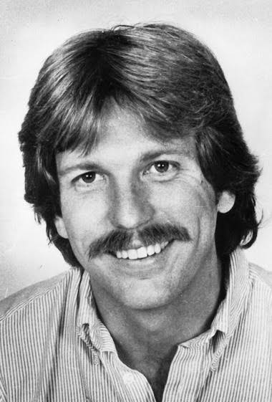
The Cocaine Connection
Gary Webb Investigation (1996): San Jose Mercury News reporter documented Contras trafficking cocaine into the U.S., with CIA knowledge, to fund operations.
The Allegations:
  Contra supporters sold cocaine in Los Angeles (fueling crack epidemic)
  Profits funded weapons purchases
  CIA turned blind eye because Contras were anti-communist allies
CIA Inspector General Report (1998): Confirmed CIA knew about Contra drug trafficking but didn't stop it. Admitted dozens of Contras trafficked drugs while receiving U.S. support.
The Tragedy: American taxpayers funded Contras officially; crack cocaine in American cities funded them unofficially—with CIA complicity.
The award-winning investigative reporter, Gary Webb (1955–2004)- best known for his Dark Alliance series that linked a Northern California drug ring with the CIA and the United States’ burgeoning crack epidemic

Slide 17
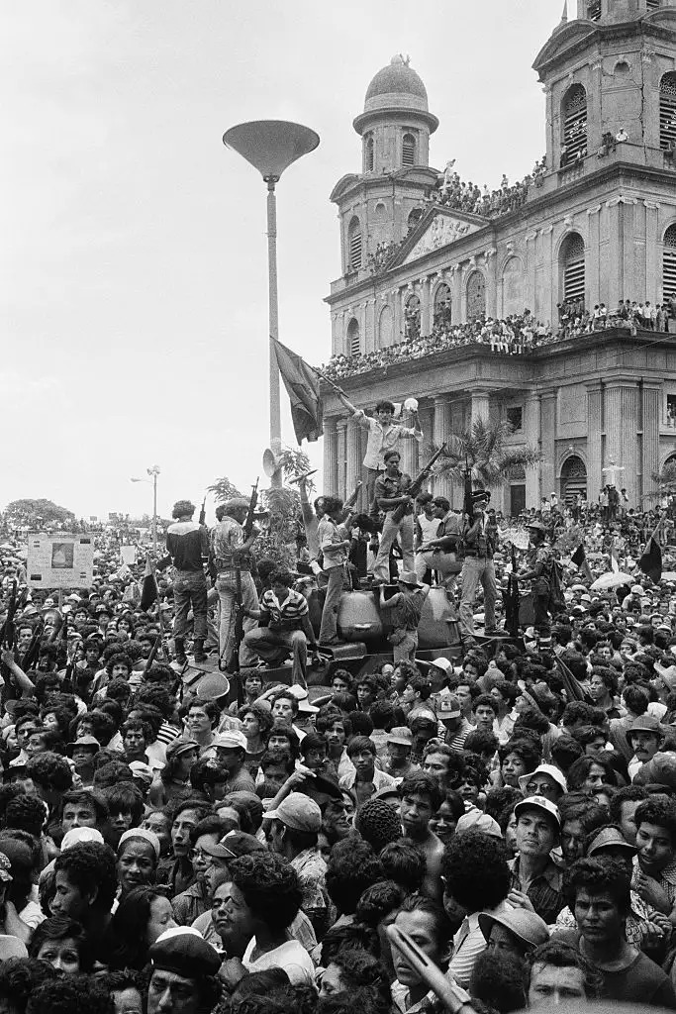
The War's Impact
Deaths: 30,000+ Nicaraguans killed (in country of 3 million—equivalent to 3 million Americans).
Refugees: Hundreds of thousands fled to Honduras, Costa Rica, United States.
Economic Devastation: War destroyed infrastructure, agriculture, economy. Nicaragua became Western Hemisphere's second-poorest country.
Prosecutions: 14 indicted, 11 convicted—then President George H.W. Bush pardoned six (December 1992), ending investigation.
(Left) Sandinista guerillas arrive triomphant in the Nicaraguan capital of Managua following the resignation and expropriation of Dictator Anastasio Somoza - Tony Comiti

Slide 18
The Soviets and the Sandinistas
The USSR developed great relations with the Sandinistas after the overthrow of the Somoza family as part of the 1979 Sandinista revolution in Nicaragua, to the point that Victor Volskii, president of the Soviet Association of Friendship with Latin American Countries, called the revolution a "model" for global armed revolution. During the 1980s, the Soviet Union provided full political, economic, military, and diplomatic support to the left wing government of Nicaragua. This was both a reaction to the right-wing Contra resistance movement and the Sandinista government working towards a full-fledged alliance with the Soviet Union. These efforts resulting in Nicaragua receiving free credit, economic subsidies, technological support, and heavy weapon grants. Soviet economic investments to Nicaragua consisted of both direct aid, economic/industrial investments, and trade. For example, in 1983, Nicaragua received between $200 million and $250 million from the Soviet bloc, with investments ranging from $100 million - $150 million from 1981 to 1984. As further relations with the US deteriorated due to foreign policy of the Reagan administration, Nicaragua relied heavier on Soviet trade. By May 1985, Nicaragua became the second largest importer of Soviet goods (after Cuba), with Soviet exports to Nicaragua growing three times from 1983 to 1984. Nicaragua voted consistently for Communist causes during the 1980s, shown especially with the 1984 Nicaraguan general elections where the Sandinistas garnered 66.78% of the total votes in the nation. While the Soviet Union rapidly withdrew both economic and military investments to various Latin American nations (including Nicaragua) in the beginning of the 1990s leading up to the dissolution of the USSR, Russia continued to invest in the economic, technological, and infrastructural success of Nicaragua.

Slide 19
Continued Support for Nicaragua
The Nicaraguan armed forces received a variety of Soviet equipment at no cost, including heavily armed Mi-24 attack helicopters (Hinds), and Mi-17 transport helicopters, along with T-55 main battle tanks, BM-21 "Grad" multiple launch rocket systems, trucks, and various forms of artillery (ranging from 152mm howitzers to anti-aircraft guns). Along with military equipment, the Sandinista government received various forms of support from allied leftists governments' militaries, with there being, as of 1985, "some 8,000 Cubans, 50 Soviets, 35 East Germans, 50 Palestine Liberation Organization and Libyan personnel," and an unknown number of North Korean and Bulgarian foreign advisors and support staff engaging in military, security, medical, and educational (both political and academical) matters to increase the readiness of the Nicaraguan military. Some further 1,000 construction workers also supported in infrastructure development in the country, building and maintaining airfields, radars, dams, bridges, and telecommunication companies.
After Sandinista leader Daniel Ortega returned to power in 2007, positive relations continued with Russia taking over the patron role for Nicaragua. Nicaragua was the second country after Russia to recognize the disputed territories of South Ossetia and Abkhazia. In September 2008, perhaps in response to Nicaragua's support over the breakaway Georgian territories, Russia offered to strengthen ties with Nicaragua and to provide aid to Nicaragua to help rebuild areas damaged by hurricanes.

Slide 20
Discussion

Slide 21
Interview With Brian Willson & Preston Harp

Slide 22
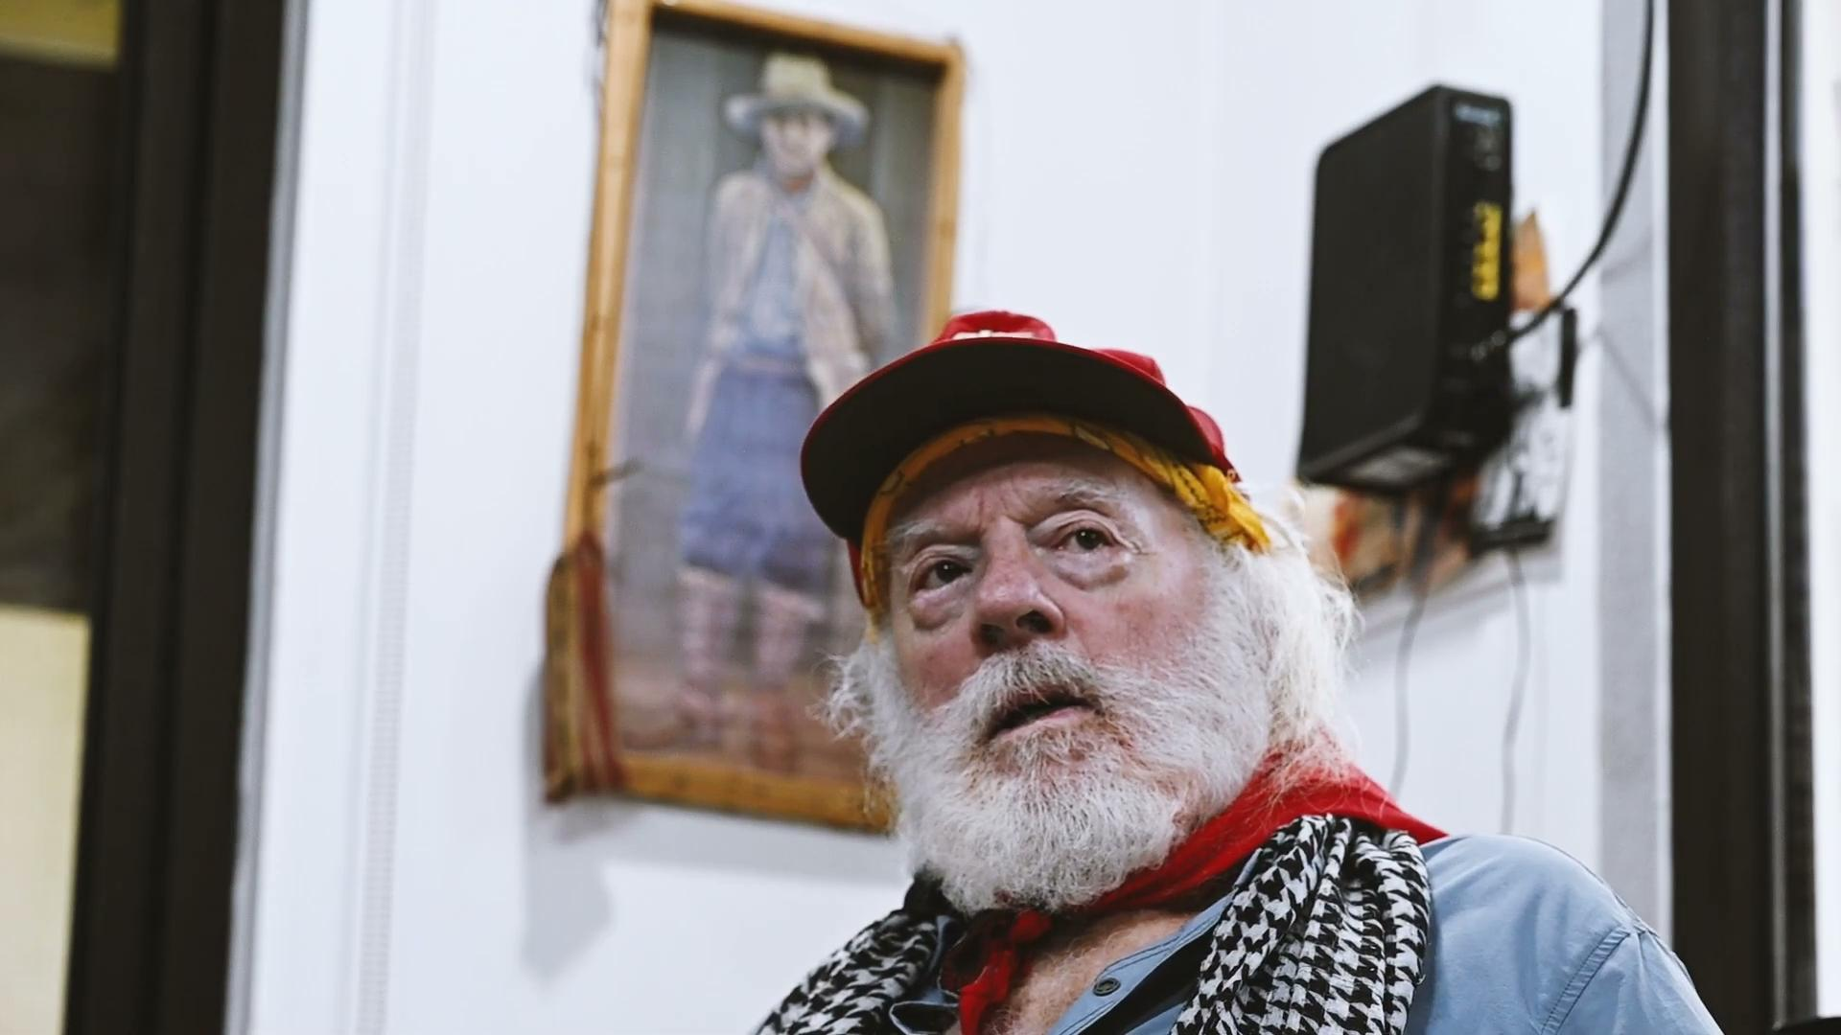
Interview With Brian Willson

Slide 23
Discussion & Wrap Up

Slide 24

The American Veterans Committee, founded in 1947, is a veterans organization that promotes networking opportunities for US veterans globally. The American Veterans Committee (AVC) aims to combat American intervention in other countries & military - industrial complex. It promotes re-directing the defense budget towards domestic products & services at home & opposing ROTC in our schools.
Promoting democracy & supporting our veterans through fraternal relationships with International and National Veterans Associations. We aim to make it easier for US veterans to connect with veterans from other countries, expand new employment, while also promoting a people’s diplomacy. We oppose discrimination of all forms in the military such as sexism, racism, LGBT+ discrimination, ethnic and national discrimination.
We aim to convert our National Guard to a domestic force for civil service and crisis relief by creating local AVC Chapters to survey the needs of local areas, providing mutual aid to the homeless veterans in need. We acknowledge that the United States military is the biggest polluter of the environment. Respond to Climate Change disasters by relying on the National Guard.

Slide 25
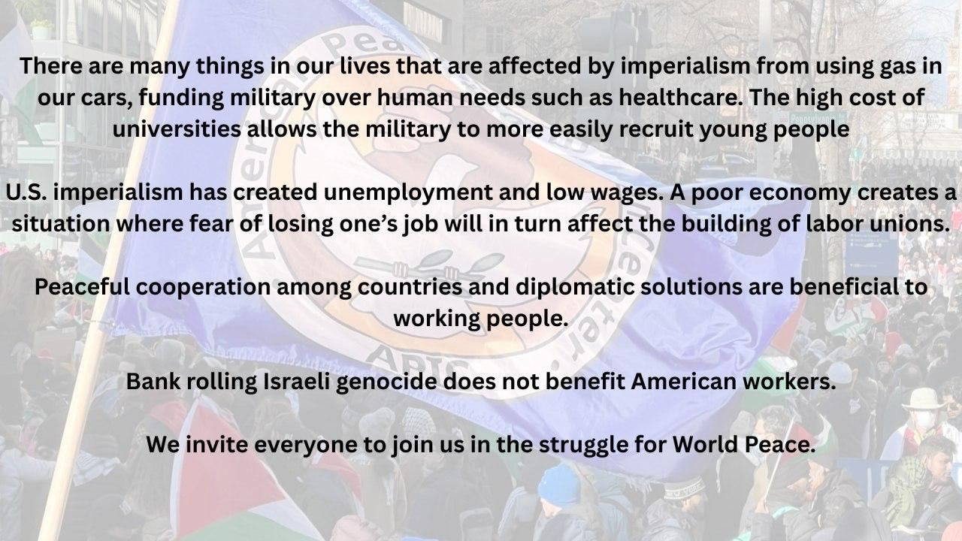

Slide 26
Announcements
Reminder that PCUSA Cadre attendance to Jones-Foster Continuing Education class on the first wednesday of every month is mandatory!
PCUSA Cell Chairs need to call members of their cells to remind them about attendance.
The next issue of New Masses (2026) has begun production. If you have art you want us to feature, email it to info@partyofcommunistsusa.net.

Slide 27
Volunteers Needed!
We are in need of volunteers for the staff of the People’s School! Here’s a few roles we need filled:
People to help manage posting on our social media and podcast platforms
Video Editors, Audio Editors, Graphic Designers, Artists, Narrators
Web Controls, Moderators
Email info@peoplesschool.us if you’re interested and try to attend our next staff meeting if possible.

Slide 28

View From Left Field
https://viewfromleftfield.libsyn.com
The Old PSMLS Youtube is now the Youtube of View From Left Field, a podcast of analysis and discussion of current events from a progressive perspective.
Like the Youtube videos and subscribe with 5 star ratings on your podcast platforms.

Slide 29

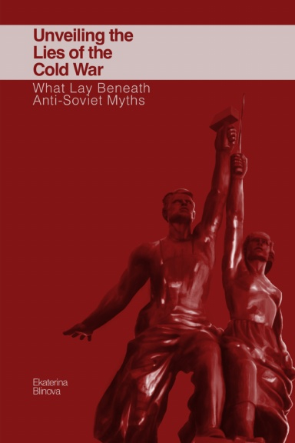
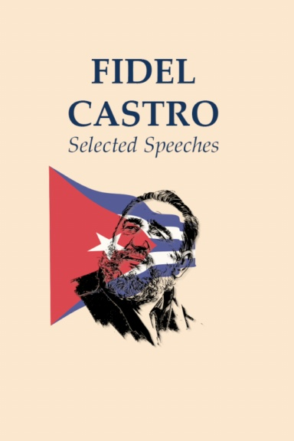
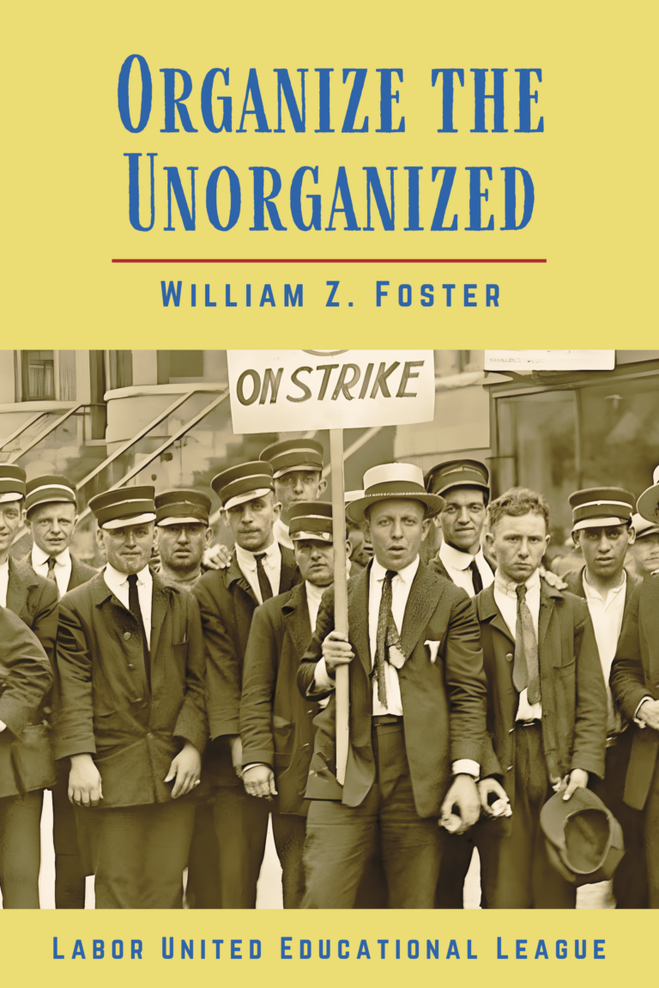

New Outlook Publishers
newoutlookpublishers.store
Relevant and Latest Releases

Slide 30



Harry Bridges School of Labor
luel.us/laborschool/
The Harry Bridges School of Labor is a monthly class covering a variety of topics aimed at building class consciousness among union members. For class schedule and other information, please visit the website at luel.us/laborschool.

Slide 31
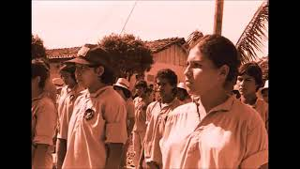
CORRIDO DEL BRIGADISTA - EL INDIO PAN DE ROSA

