Slide 1

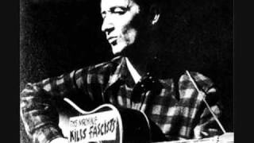
Woodie Guthrie - This Land Is Your Land

Slide 2
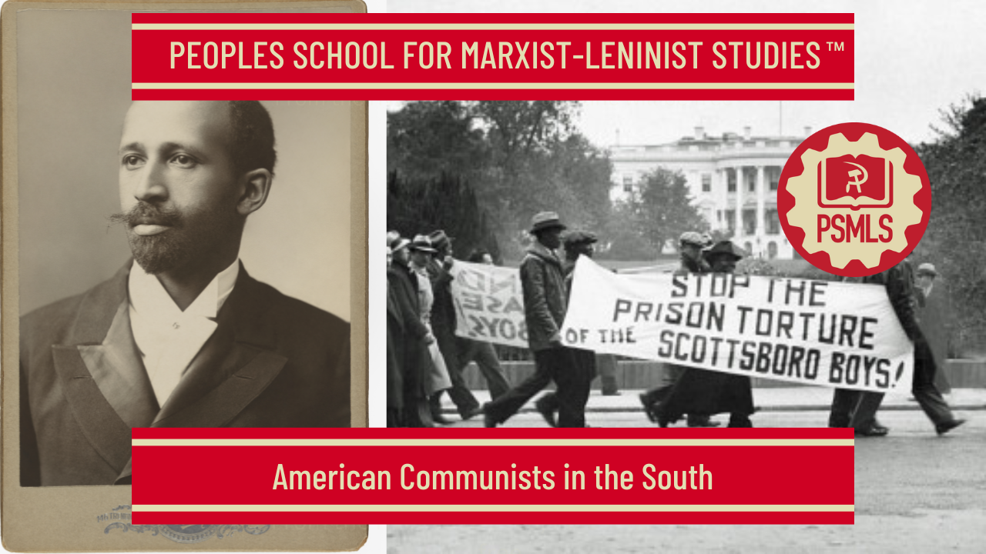
PSMLS 7/22/25

Slide 3
What we’ll be learning today:
Communist Party formation in the South to WWII
Brown V Board of Education of Topeka to Civil Rights Movement
Southern Solidarity and the Legacy of Communist Organizing in the South

Slide 4
Communist Party formation in the South to WWII

Slide 5
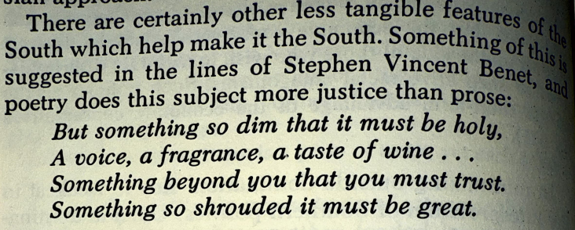
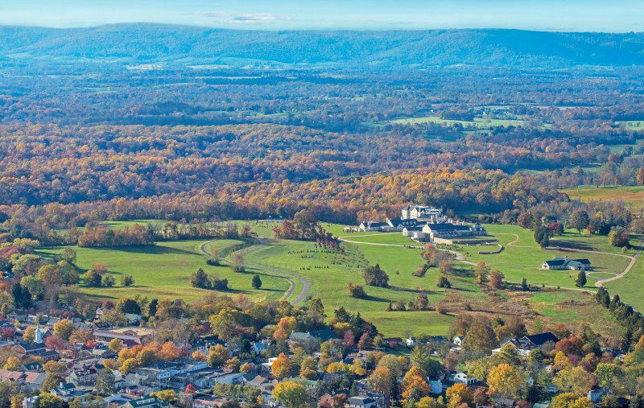

The Central Theme of Southern History - Herbert Aptheker

Slide 6
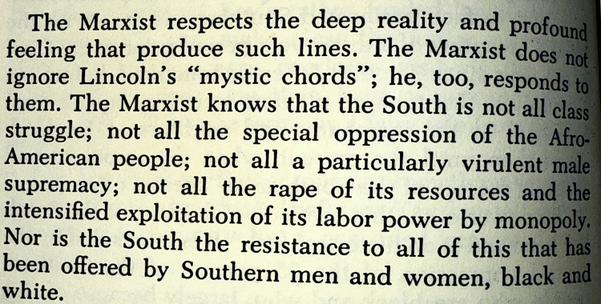
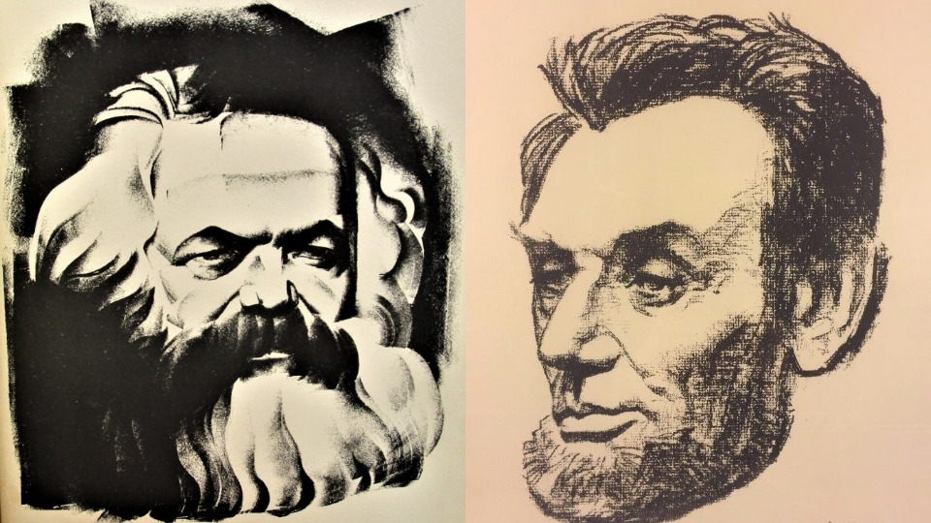
The Central Theme of Southern History - Herbert Aptheker

Slide 7
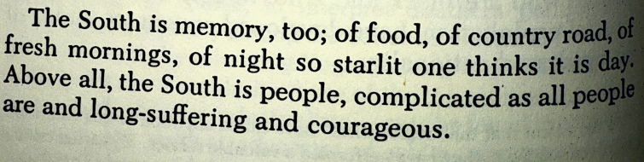
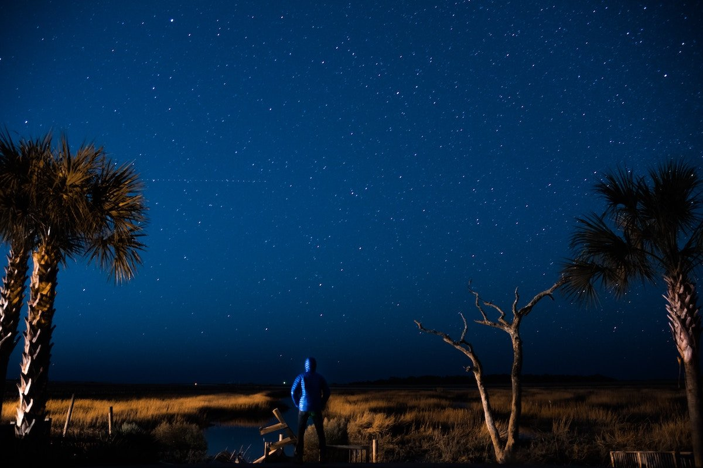
The Central Theme of Southern History - Herbert Aptheker

Slide 8
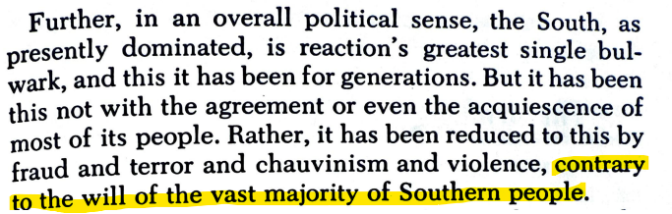
The Central Theme of Southern History - Herbert Aptheker

Slide 9
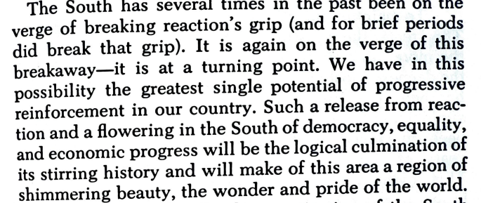
The Central Theme of Southern History - Herbert Aptheker

Slide 10
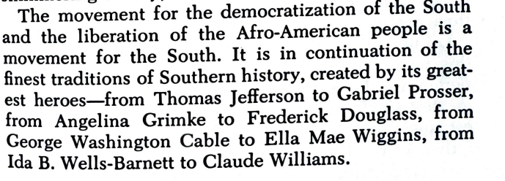
The Central Theme of Southern History - Herbert Aptheker

Slide 11
Legacy of Marxists in the South- From Black Reconstruction in America W.E.B DuBois
The trade unions were willing to admit that the Negroes ought to be free sometime; but at the present, self-preservation called for their slavery; and after all, whites were a different grade of workers from blacks. Even when the Marxian ideas arrived, there was a split; the earlier representatives of the Marxian philosophy in America agreed with the older Union movement in deprecating any entanglement. with the abolition controversy. After all, abolition represented capital. The whole movement was based on mawkish sentimentality, and not on the demands of the workers, at least of the white workers. And so the early American Marxists simply gave up the idea of intruding the black worker into the socialist commonwealth at that time.

Slide 12
Legacy of Marxists in the South- From Black Reconstruction in America W.E.B DuBois
In all this consideration, we have so far ignored the white workers of the South and we have done this because the labor movement ignored them and the abolitionists ignored them ; and above all, they were ignored by Northern capitalists and Southern planters. They were in many respects almost a forgotten mass of men. Cairnes describes the slave South, the period just before the war:
"It resolves itself into three classes, broadly distinguished from each other, and connected by no common interest-the slaves on whom devolves all the regular industry, the slaveholders who reap all its fruits, and an idle and lawless rabble who live dispersed over vast plains in a condition little removed from absolute barbarism."

Slide 13
Legacy of Marxists in the South- From Black Reconstruction in America W.E.B DuBois
This placed the white and black labor movement in a singularly
contradictory position. The alliance of the black labor movement with the Republican Party was simply the political side of an economic fact. The Republican Party had given the black man the right to vote. This right to vote he was going to use to better his economic and social position. To oppose the Republican Party, then, was to oppose his own economic enfranchisement.
Negro leaders, naturally, resented the attack made by white labor
organizations on the Republican Party. Nor did they understand how far this new Southern labor government was dependent on Northern industrial reaction and capitalistic oligarchy. Northern labor was equally ignorant and did not dream that in the South the Republican Party was par excellence the party of labors

Slide 14
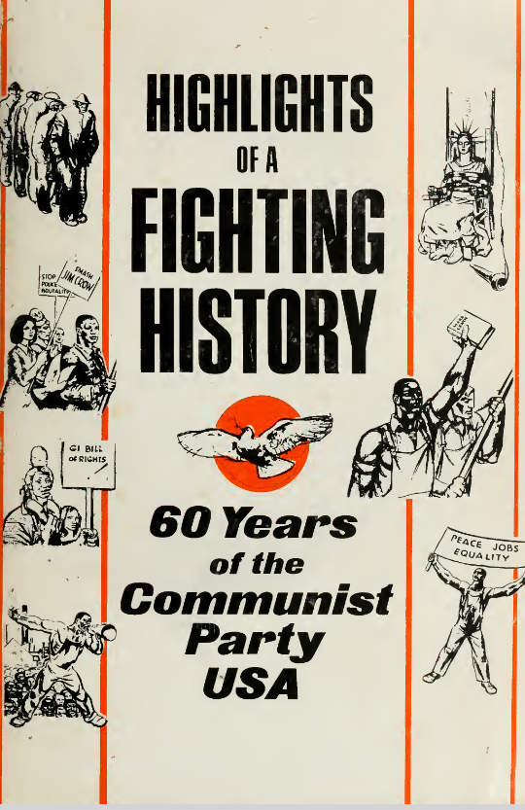
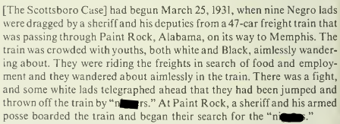
Scottsboro Boys Case

Slide 15
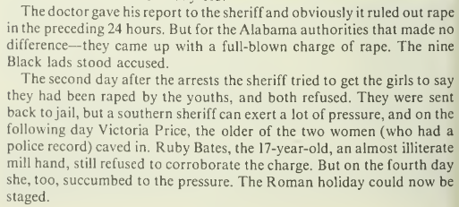
Scottsboro Boys Case

Slide 16
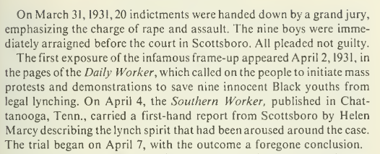
Scottsboro Boys Case

Slide 17
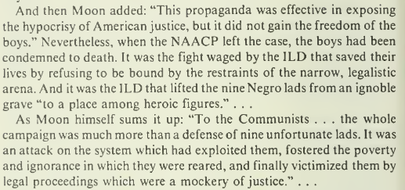
Scottsboro Boys Case

Slide 18
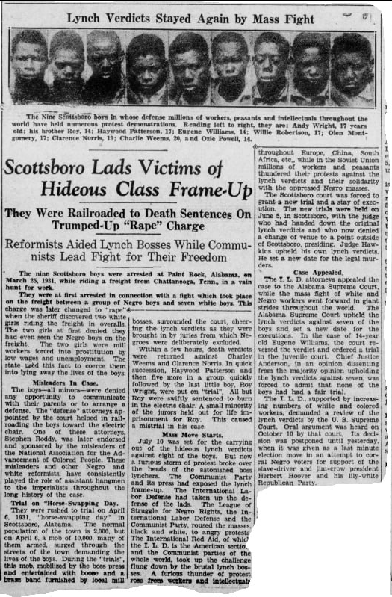
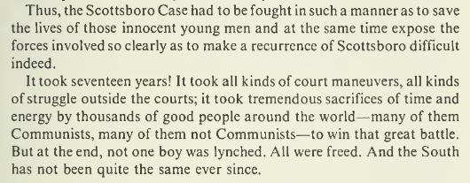
Scottsboro Boys Case

Slide 19
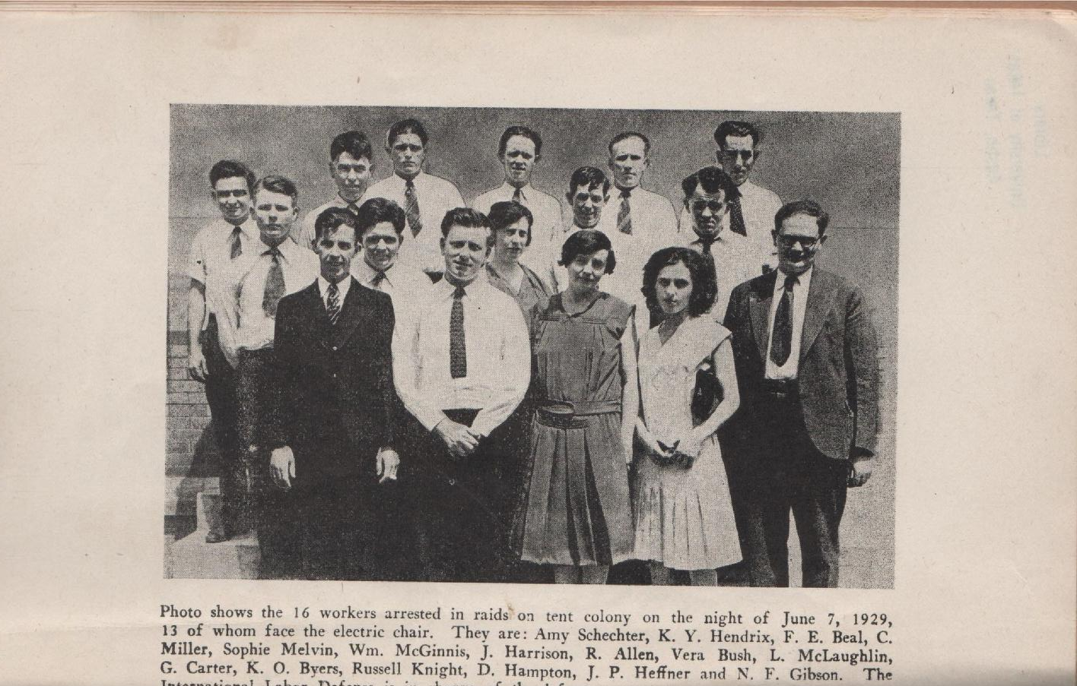
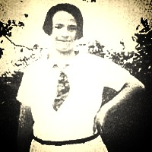
Loray Mill Strike

Slide 20
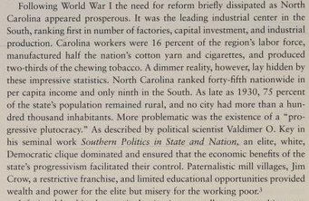
Why did the Party decide to organize North Carolina?
North Carolina was the 1st Southern State to be Organized by the Party.
North Carolina was the most industrialized state in the South after WWI. In the years leading up to the Loray Mill Strike of 1929 there were several strike actions taken by southern workers.
1921 Cannon Mill locations in Charlotte, Concord, and Kannapolis Durham 1926 @ Marvin Carr Silk Mill. 1943 Winston-Salem strike at R.J. Reynolds and the creation of Food, Tobacco, & Agricultural Workers Local 22 (C.I.O.)
The History of the North Carolina Communist Party by Gregory S. Taylor

Slide 21
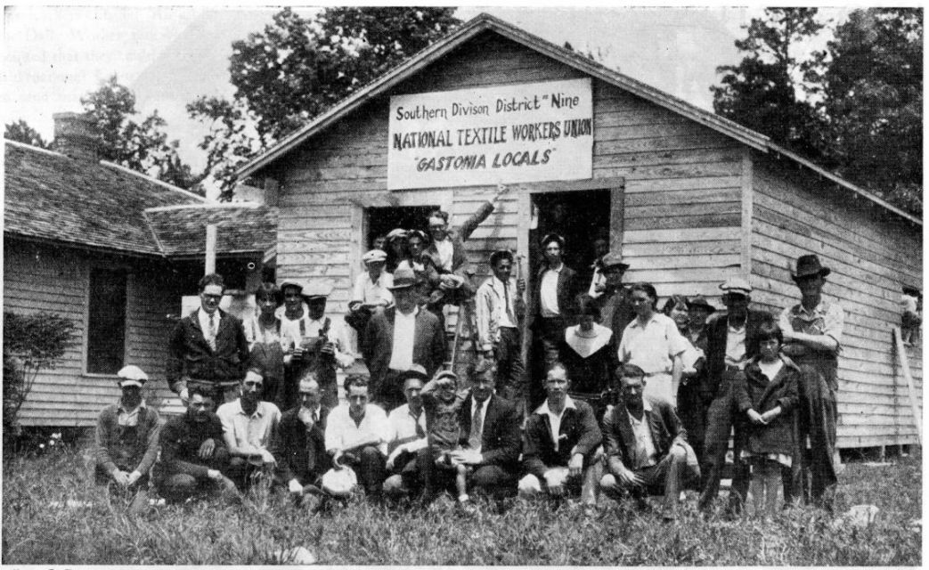
The Strike
The Loray Mill Strike was a 5.5 month long strike beginning on April 1st, 1929
1800 textile mill workers walked out of work
Led by CPUSA member Fred Beal and the Communist Party/ Trade Union Unity League founded National Textile Workers Union (NTWU)
The strike demanded an end to the speed-up conditions, 40 hour work week, and higher wages

Slide 22
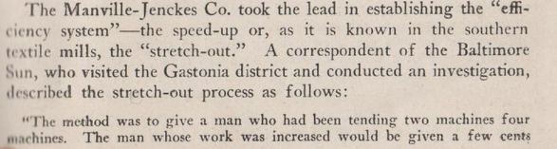
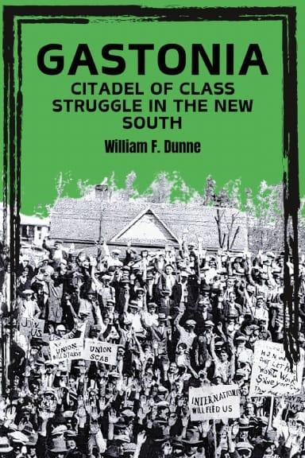
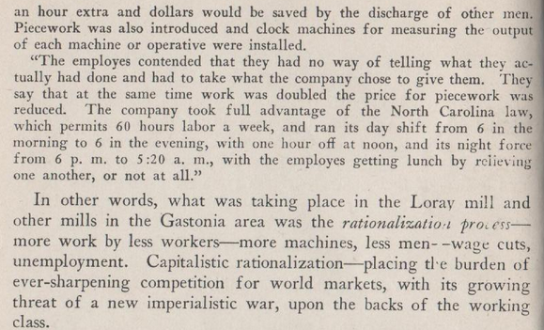
From Gastonia: Citadel of Class Struggle in the South by William F. Dunne
Can be purchased at newoutlookpublishers.store

Slide 23
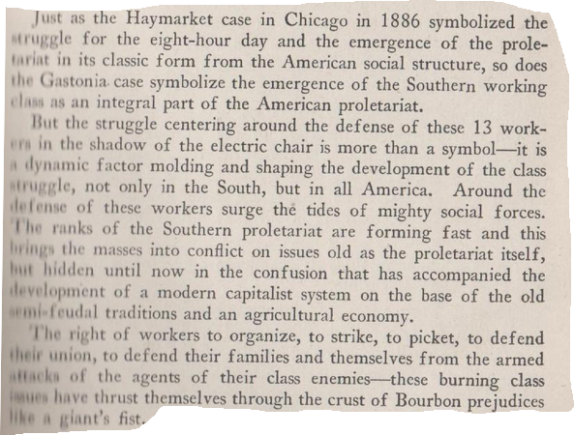
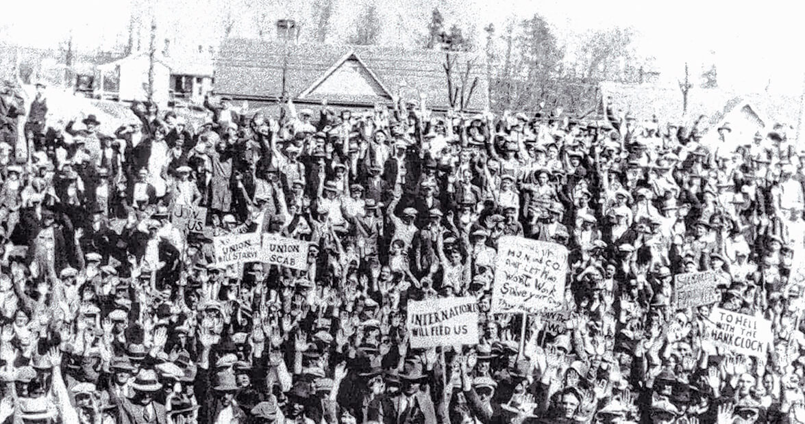
From Gastonia: Citadel of Class Struggle in the South by William F. Dunne

Slide 24
Discussion

Slide 25
Communists and the Civil Rights Struggle in the South Post-WWII

Slide 26
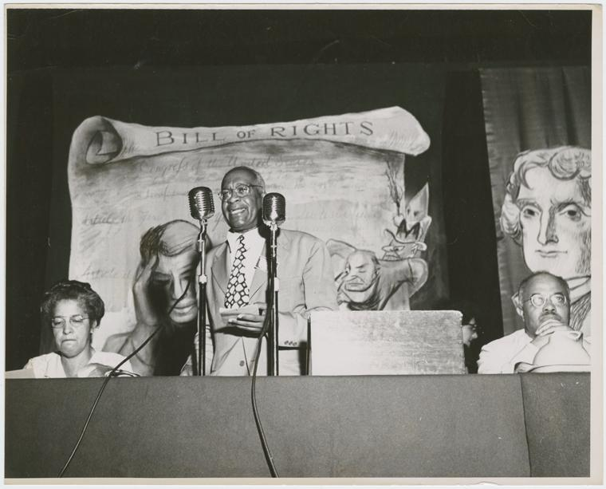
We Charge Genocide: The 1951 Black Lives Matter Campeign
In 1951, the Civil Rights Congress (affiliated with the Communist Party) engaged in a campaign to hold the United States accountable for genocide against African Americans. A massive petition (over 200 pages) was delivered to the United Nations in Paris in December 1951. The petition sought to demonstrate that the government of the United States was in violation of the U.N. Genocide Convention. The Convention on the Prevention and Punishment of Genocide had been adopted in 1948 in the aftermath of the Holocaust. The petition entitled, We Charge Genocide: The Historic Petition to the United Nations for Relief from a Crime of The United States against the Negro People, is as relevant today as it was in its own time. We Charge Genocide was produced by William Patterson and the Civil Rights Congress, charged that under the legal rubric laid out by the United Nations, the United States, which failed to enforce its own Constitution, must be punished under international law for its genocidal acts against African Americans.
William L. Patterson, executive director of the Civil Rights Congress

Slide 27
The relationship Between Hitler’s crimes and America’s Crimes
In his Introduction to the petition, Patterson emphasized the relationship between Hitler’s crimes against the Jews and America’s crimes against African Americans. “Out of the inhuman Black ghettos of American cities, out of the cotton plantations of the South, comes this record of mass slayings on the basis of race, of lives deliberately warped and distorted by the willful creation of conditions making for premature death, poverty and disease. It is a record that calls aloud for condemnation, for an end to these terrible injustices that constitute a daily and ever-increasing violation of the United Nations Convention on the Prevention and Punishment of the Crime of Genocide.”
"Once the classic method of lynching was the rope. Now it is the policeman’s bullet. To many an American the police are the government, certainly its most visible representative. We submit that the evidence suggests that the killing of Negroes has become police policy in the United States..." (pp.8-9)

Slide 28
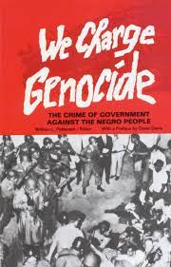
A “Dangerous” Document
We Charge Genocide documented 152 recent killings, and 344 other crimes of violence against African Americans and other human rights abuses committed in the United States against its own citizens from 1945-1951. Ninety-four individuals signed the petition.William Patterson flew to Paris in 1951 to personally deliver it to members of the United Nations Committee on Human Rights. The petition received favorable publicity overseas but was denounced in the United States and disavowed by other civil rights groups. When he returned to the U.S., Patterson had his passport revoked by the State Department and was banned from further travel abroad. Patterson was a Communist as were many other signatories to the petition and in the fierce Cold War climate of 1951 We Charge Genocide was considered a dangerous document.
We Charge Genocide can still be purchased widely as a re-print

Slide 29
The Beginning of Progress
Brown v. Board of Education (1954) is the case that outlawed school segregation and largely overturned Plessy v. Ferguson’s (1896) “separate but equal” precedent. In this case, the Court found that school segregation was unconstitutional under the Equal Protection Clause of the Fourteenth Amendment of the Constitution. The decision was the turning point in the country’s struggle for equal protection under the law for all of its citizens with particular application to education. It also gave encouragement to the Civil Rights Movement. Brown’s impact on segregation, however, was neither immediate in 1954 nor has it ended segregation. The struggle continues today. Brown clearly stated that “in the field of public education, ‘separate but equal’ has no place,” but gave no details about how to implement this. In practice, schools still had de facto segregation, including those in the North that legally desegregated schools long before Brown.

Slide 30
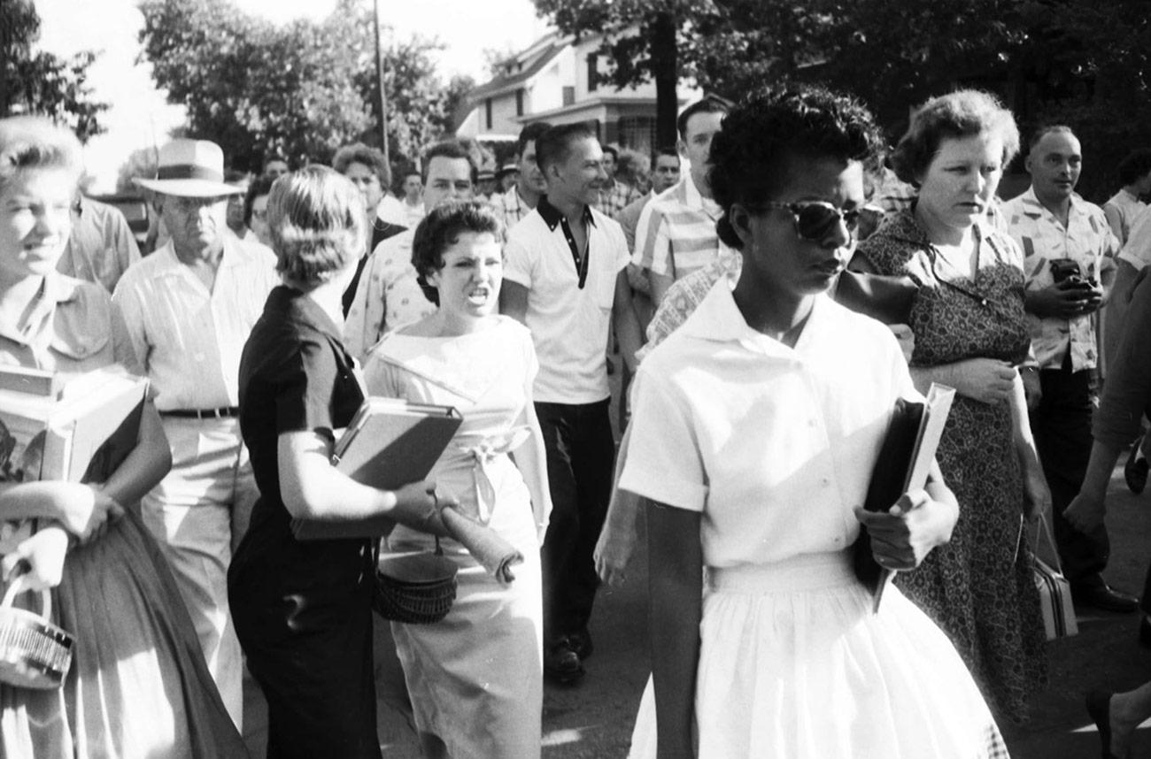
The Beginning of Progress
The decade following the Court’s unanimous opinion in Brown was filled with resistance. States in the South avoided implementation, and varying degrees of presidential support weakened its impact. Thus, Brown v. Board of Education did not immediately mark the end of school desegregation, but rather marked the beginning of progress both at the state and national levels. Brown was one of the first federal actions to target racial segregation since the end of Reconstruction, but it would take executive, legislative, and civic action to create the change that the decision sought to achieve.
Segregationist protestors surround Elizabeth Eckford, one of nine Black students to integrate Central High School in Little Rock, Arkansas, 1957.

Slide 31
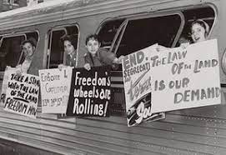
Civil Rights After Brown v. Board
Brown was one of the first federal actions to target racial segregation since the end of Reconstruction, but it would take executive, legislative, and civic action to create the change that the decision sought to achieve. The ineffectiveness of the Brown decisions contributed to the Civil Rights Movement’s use of direct action tactics in the 1960s. Dr. Martin Luther King Jr. believed that lawsuits were not the right strategy for the movement, stating that “whenever it is possible, we want to avoid court cases in the integration struggle.” Similarly, the major organizations of the Civil Rights Movement all rejected using lawsuits to create social change. Instead, Civil Rights activists used peaceful protest methods, such as marches, sit-ins and Freedom Rides.
Members of the Washington Freedom Riders Committee

Slide 32
Why the FBI Saw Martin Luther King Jr. as a Communist Threat
In early 1962, Attorney General Robert Kennedy approved a request from FBI Director J. Edgar Hoover to install wiretaps on the home and office of a New York City-based lawyer named Stanley David Levison. According to FBI informants, Levison had been an influential member of the Communist Party of the United States of America (CPUSA) as late as 1956. They believed he was now wielding influence in a different way—as a top adviser to the nation’s most prominent civil rights leader, Dr. Martin Luther King Jr. Because the CPUSA had supported greater civil rights for Black Americans as far back as the 1930s, Hoover was not alone in viewing the emerging civil rights movement of the 1950s as susceptible to communist influence. The FBI first took notice of King in 1955, when the young minister played a leading role in the Montgomery bus boycott. King and Levison met in 1956 through Bayard Rustin, another civil rights leader. Levinson ultimately became one of King’s closest advisers, helping the movement with fundraising, ghostwriting speeches and more, including editing and securing a publishing deal for King’s first book, Stride Toward Freedom.

Slide 33
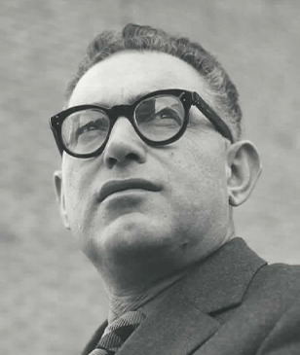
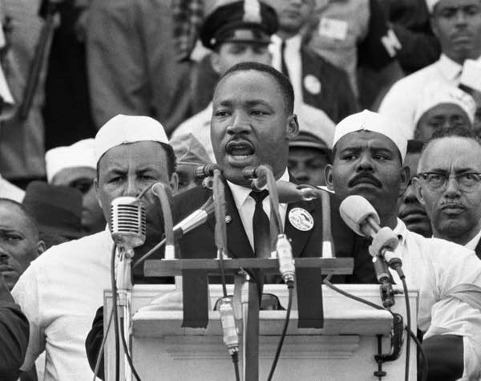
Production for the Whole of the People
As King biographer David Garrow wrote in his 1981 book, The FBI and Martin Luther King Jr., valued informants provided the FBI with credible reports about Levison’s role as a top CPUSA financier from the mid-1940s to 1956. Though Levison reportedly disappeared from party affairs around the time he met King, Hoover remained convinced he was still involved. His arguments were enough to convince Robert Kennedy to authorize wiretapping Levison’s home and office within weeks of learning of his connection with King.
(Left) MLK Jr. Speaking at the March on Washington
(Right) Stanley Levison was involved with the CPUSA in the 1940’s

Slide 34
Angela Davis: Changing the Things We Cannot Accept
Davis attended Carrie A. Tuggle School, a segregated black elementary school, and later, Parker Annex, a middle-school branch of Parker High School in Birmingham. During this time, Davis's mother, Sallye Bell Davis, was a national officer and leading organizer of the Southern Negro Youth Congress, an organization influenced by the Communist Party aimed at building alliances among African Americans in the South. Davis grew up surrounded by communist organizers and thinkers, who significantly influenced her intellectual development. Davis was involved in her church youth group as a child and attended Sunday school regularly. As a Girl Scout, she marched and picketed to protest racial segregation in Birmingham.
By her junior year of high school, Davis had been accepted by an American Friends Service Committee (Quaker) program that placed black students from the South in integrated schools in the North. She chose Elisabeth Irwin High School in Greenwich Village. There she was recruited by a communist youth group, Advance.

Slide 35
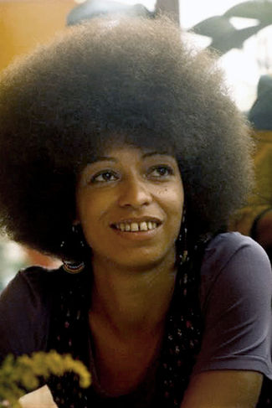
A Communist and A Black Panther
Beginning in 1969, Davis was an acting assistant professor in the philosophy department at the University of California, Los Angeles (UCLA). At that time she was known as a radical feminist and activist, a member of the Communist Party USA, and an affiliate of the Los Angeles chapter of the Black Panther Party. Davis had previously joined the Communist Party in 1968 and had become a member of the Black Panther Party, working with a branch of the Black Panther Party in Los Angeles where she directed political education. When Black Panther Party leadership determined that party members could not also be affiliated with other parties, Davis retained her Communist Party membership although continued to work with the Black Panther Party.
A Photo of Angela Davis

Slide 36
The "Free Angela Davis" campaign
Angela Davis is perhaps most famous for her involvement with the Soledad brothers, who were accused of killing a prison guard. During George Jackson’s trial in August 1970, an escape attempt was made at gunpoint and several people were killed. Davis was accused of taking part in the event and was charged with murder. Almost immediately a groundswell of support developed in favor of Davis' and Magee's release. Davis in particular, received widespread national and international support from the black community, liberals and the progressive left. The Communist Party mounted a major political campaign and held rallies in the United States and abroad, published articles, pamphlets and posters, issued petitions, distributed postcards, and requested that the public mail cards and letters on Davis' behalf. The National Council of Black Lawyers offered Davis assistance with her trial and the Presbyterian Church gave the Davis Defense Fund $10,000. A white farmer from Fresno County who sympathized with Davis gave her the money she needed for bail, and on February 23, 1972, five days before her trial, Davis was released on $102,000 bail after serving seventeen months in jail.

Slide 37
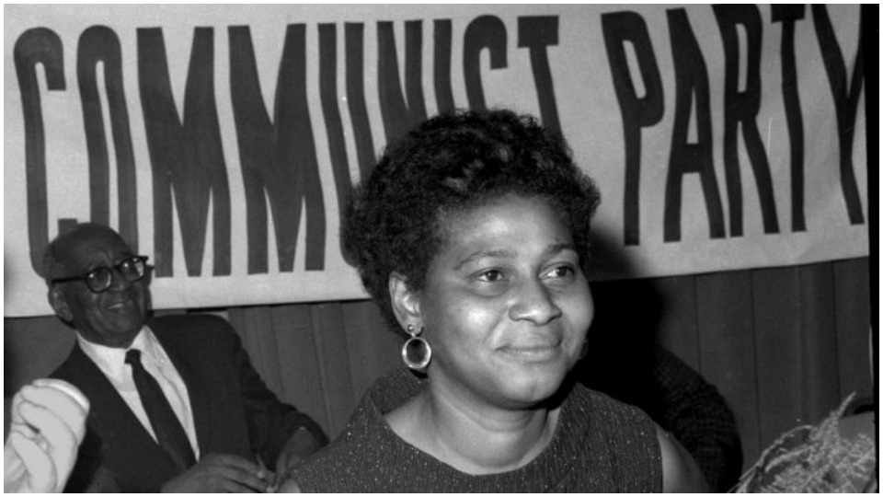
The NAARPR
In a December 1972 report to the CPUSA’s Central Committee, Charlene Mitchell outlined her experience as leader of the international campaign to free Davis. She told her comrades, “The major lesson we learned was that the legal and mass defense of political prisoners is an inseparable entity; that you cannot free a political prisoner in the courtroom alone, and you cannot, without a good, political legal defense in the courtroom, make a mass defense,” or create a mass movement. Importantly, she added, “we must discuss the role our Party can play” in forming a national defense organization, the genesis of which would come from the roughly 200 local Free Angela Davis Committees. Mitchell outlined a proposal for building a national defense organization, arguing “that it is very possible for us to be the leadership” of such an organization “and for that leadership to be completely accepted.”
A Photo of Charlene Mitchell

Slide 38
A National Apparatus to Organize Resistance
The call for the founding conference of what became the NAARPR proclaimed: “[F]orces of racism and repression can be defeated. We know that victory can be won. We can free political prisoners. We can free victims of racist and political repression. We can stop the increase of police aggression and the unbridled terrorism which pervades the prisons. We can only succeed in turning the tide of repression through a united, nationally coordinated effort…The repression of this period is calculated, organized and systematic. In its center is the seed of fascism, which, if allowed to sprout, would strangle us all. To successfully confront and bring a halt to this systematic, nationally organized repression, we need a national apparatus to organize our resistance.”
Of course, this was a sentiment the CPUSA – as well as the broad array of progressive forces then coalescing around Davis – agreed with. Over 800 civil rights leaders and organizers attended the NAARPR’s founding Conference in Chicago.

Slide 39
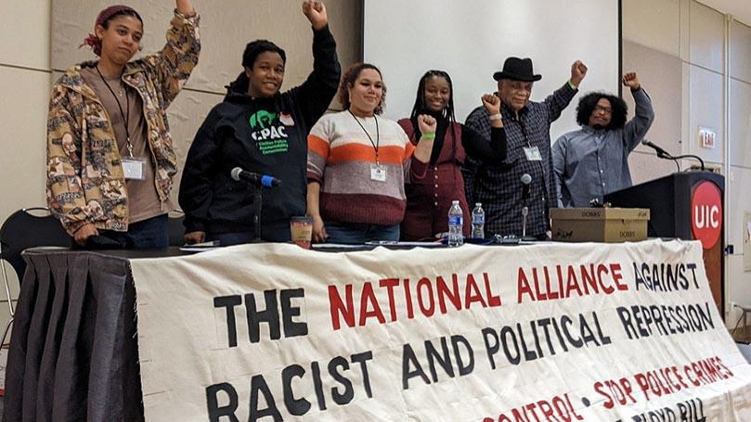
Continuing the Fight
The NAARPR continued to defend political prisoners throughout the 1970s and 1980’s, participating in a number of civil rights cases, and remains active to this day. The last NAARPR conference was held in 2021 during which Angela Davis gave the following statement:
“When we initially created the Alliance, we saw the era of the 1970s as unprecedented in the reach of its repression…. At that time…we clearly understood the interdependency of racist repression and political repression. Today, we have an even deeper appreciation of the centrality of structural racism and the violence it spawns, and the ways in which racism continually produces and extends and exacerbates crises in our society. “
The NAARPR in its Modern Incarnation

Slide 40
Discussion

Slide 41
Education & Cultural Development

Slide 42
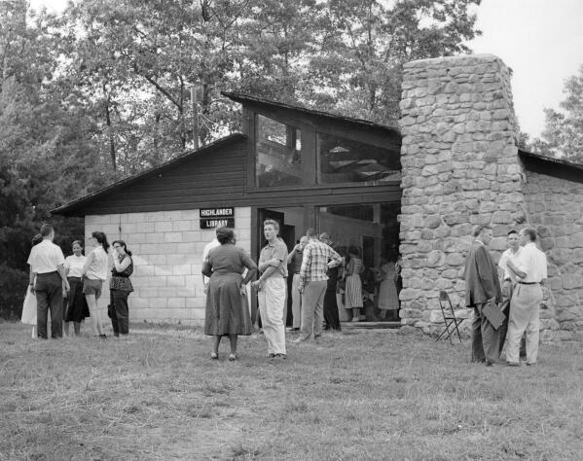
Highlander Folk School
The Highlander Folk School was a “Popular Education” school in Monteagle, Tennessee
Focused on labor organizing and Civil Rights in the South.
The CPUSA played a strong role in the school with famous CPUSA members and fellow travelers such as Abner Berry, Aubrey Williams, James Dombrowski, Pete Seeger, and Rosa Parks teaching at the school

Slide 43
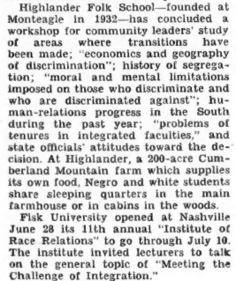
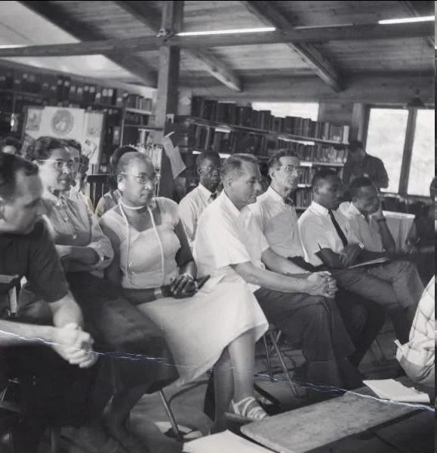
Highlander Folk School

Slide 44
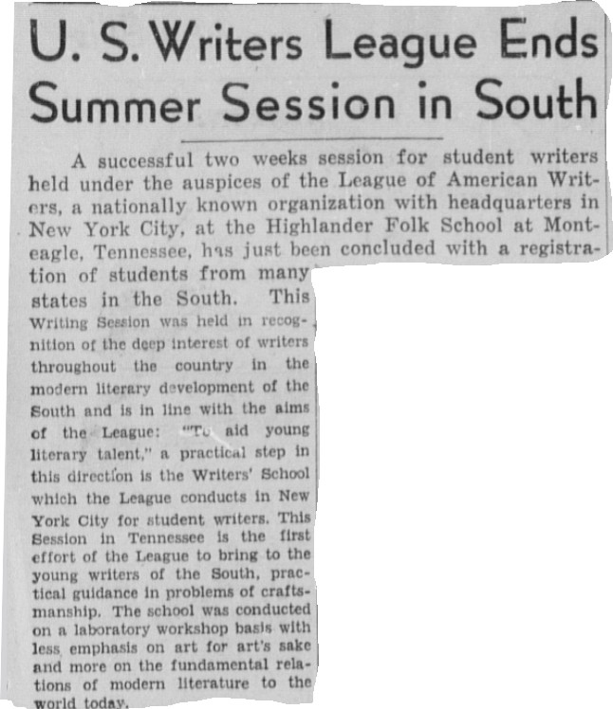
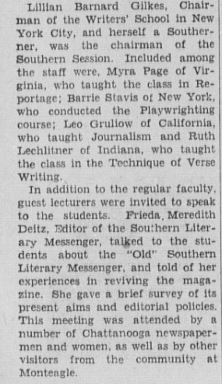
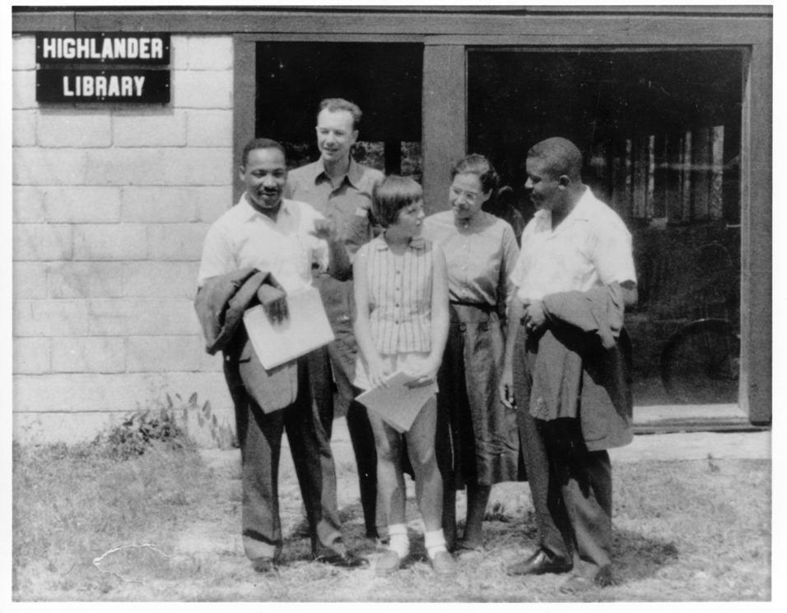
Highlander Folk School (From Daily Worker November 1932)
Famous figures such as MLK Jr. and Rosa Parks were students and teachers at the school.

Slide 45
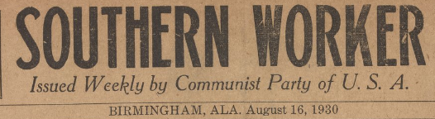
Southern Worker
The Southern Worker was a CPUSA newspaper founded in 1930. It focused on building up the Party and black membership which was acknowledged by General Secretary Earl Browder as being a shortcoming of the Party.

Slide 46
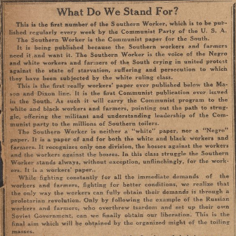
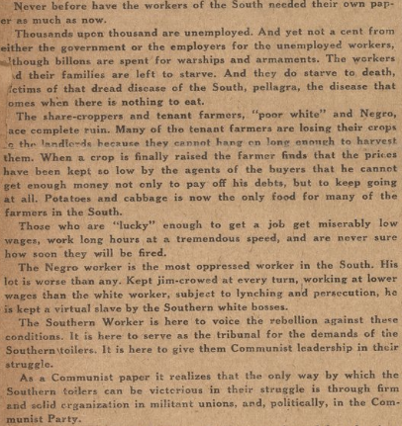
Southern Worker

Slide 47
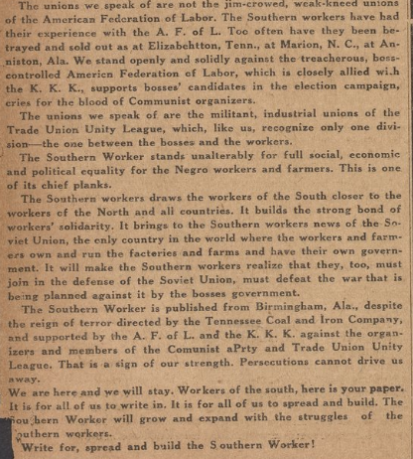
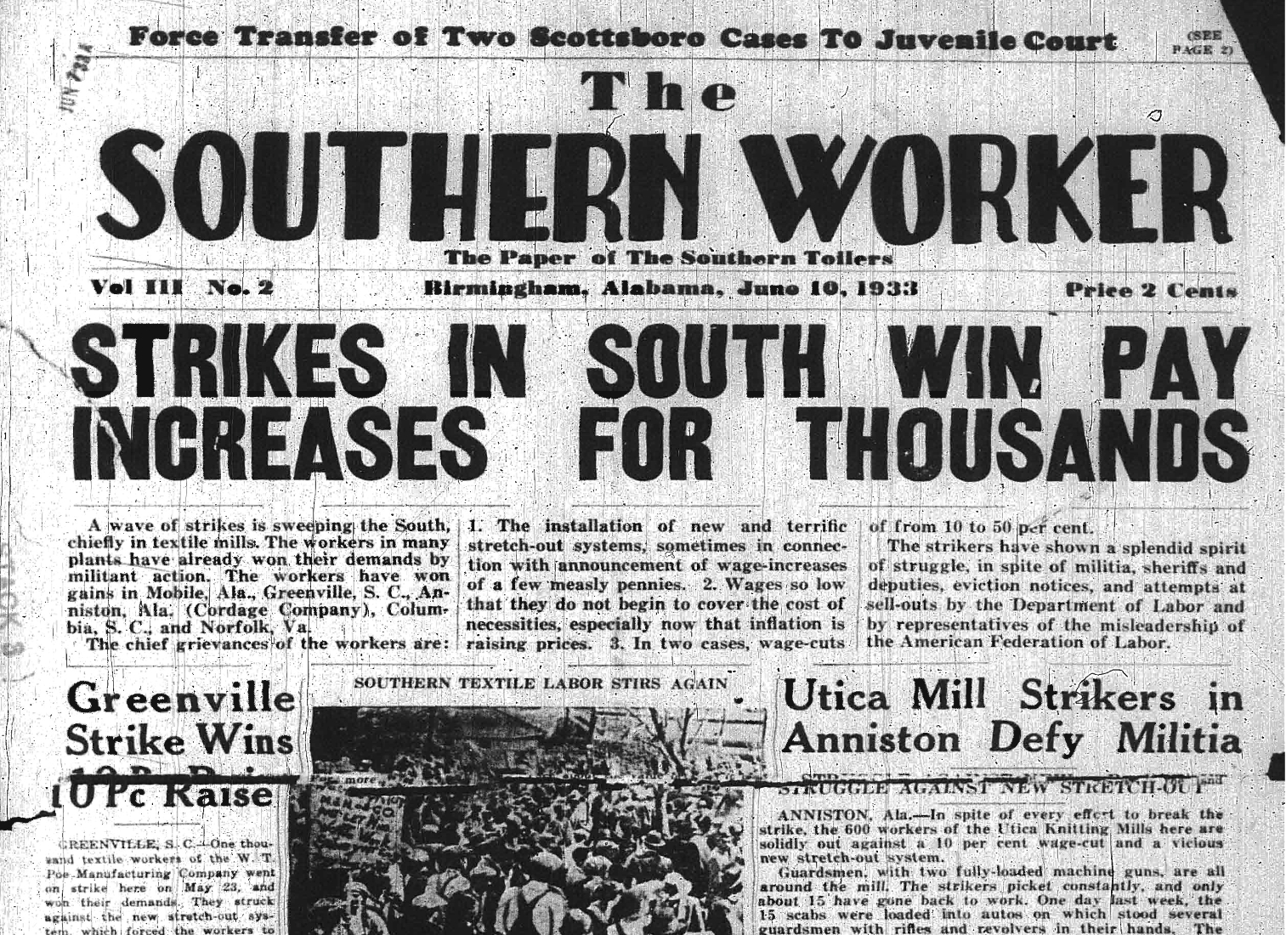
Southern Worker

Slide 48
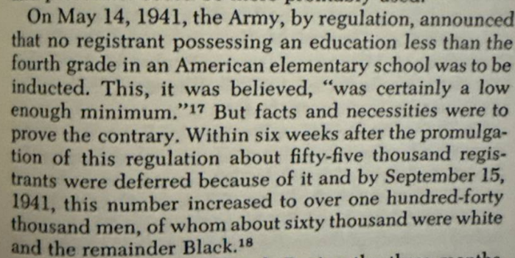
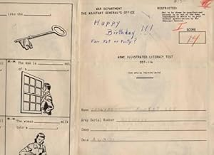
Literacy, the Afro-American and World War II - Afro American History - H. Aptheker
Army Illustrated Literacy Test DST-IIa (for Special Training units) 1943
About 150,000 (85% successfully completed training) (~86,600 were Black)

Slide 49
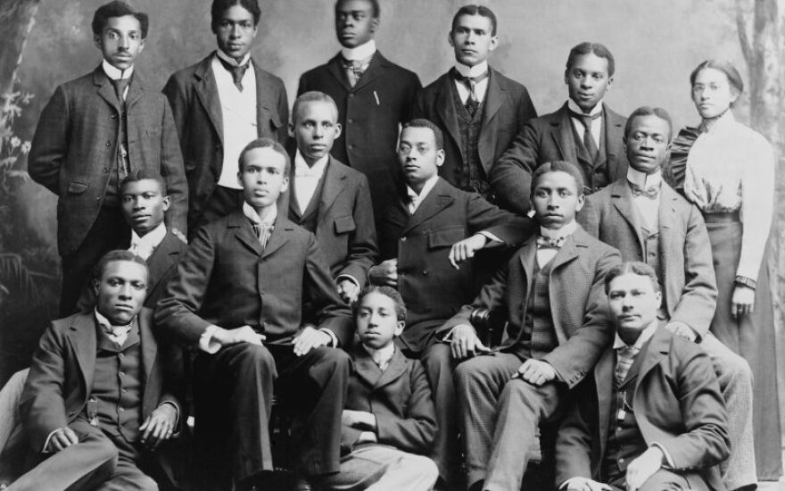

Literacy, the Afro-American and World War II - Afro American History - H. Aptheker
African-American students at Roger Williams University in Nashville, Tennessee, ca. 1899.

Slide 50



Literacy, the Afro-American and World War II - Afro American History - H. Aptheker
A teacher instructs a segregated class of black students at a poorly funded, one-room school in the backwoods of Georgia in 1941.

Slide 51


Literacy, the Afro-American and World War II - Afro American History - H. Aptheker
Ronald McNair NC A&T State graduate and astronaut who died on the Challenger Space Shuttle

Slide 52
Discussion & New Members Introductions

Slide 53
New Member Introductions
What is your name, pronouns and state (or country/territory)?
Where do you work? Is it unionized?
How did you find out about the People’s School?
What do you think about tonight's class?

Slide 54
Discussion & Wrap Up

Slide 55
Announcements
The PSMLS has recovered our old Youtube account we lost to wreckers in 2022 and we have re-uploaded all our old videos. Like, subscribe, and check out what subjects we covered prior and what we aware saying in the past.
PCUSA Cell Chairs need to call members of their cells to remind them about attendance.
The next issue of New Masses (2025) has begun production. If you have art you want us to feature, email it to info@partyofcommunistsusa.net.

Slide 56
Volunteers Needed!
We are in need of volunteers for the staff of the People’s School! Here’s a few roles we need filled:
People to help manage posting on our social media and podcast platforms
Video Editors, Audio Editors, Graphic Designers, Artists, Narrators
Facilitators, Web Controls, Moderators
Email info@peoplesschool.us if you’re interested and try to attend our next staff meeting if possible.

Slide 57

View From Left Field
https://viewfromleftfield.libsyn.com
The Old PSMLS Youtube is now the Youtube of View From Left Field, a podcast of analysis and discussion of current events from a progressive perspective.
Like the Youtube videos and subscribe with 5 star ratings on your podcast platforms.

Slide 58





New Outlook Publishers
newoutlookpublishers.store
Relevant & Latest Releases

Slide 59



Harry Bridges School of Labor
luel.us/laborschool/
The Harry Bridges School of Labor is a monthly class held 2x per month. Classes cover a variety of topics aimed at building class conscious among union members.
August’s class will be a viewing of “Salt of the Earth.” Class will be Wednesday August 6, 2025 at 8pm EST/6pm PST and Saturday August 9, 2025 at 7pm EST/4pm PST.

Slide 60

Mill Mother’s Lament - Originally Written by Loray Mill Striker Ella Mae Wiggins - Sung By Pete Seeger

