Slide 1

Intro Song

Slide 2
PSMLS 7/28/26

Slide 3
What we’ll be learning today:

Slide 4
Cuba and the USSR: Allies on the World Stage

Slide 5
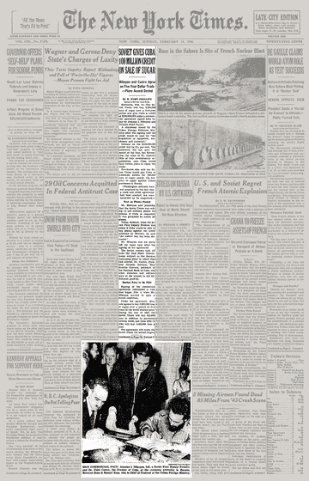
From the Soviet Union with Love
The Cuban Revolution of 1953-1959 is one of the most relevant events in the history of Latin America, or, at least, so it is perceived in the United States and in other countries in the Continent. For almost two decades Cuba represented the sole socialist country in the Americas and for that period, going from 1959 to the election of Allende in Chile in 1973, it was the sole Soviet ally in the region. The economic support the Soviet Union gave to Cuba began to increase after tensions between Washington and Cuba escalated in May 1960, and quickly became vital. By the mid-1960s the USSR had effectively taken the role of a major (and predominant) economic partner of the Caribbean nation. The most important aspect of this economic support was the subsidy to Cuban exports, in particular the country’s two main exports: sugar and nickel. In fact it is estimated that by the 1970s the USSR bought one half of all Cuban sugar at about three times its market price, along with more than half of all its nickel exports. This is noteworthy, if we consider that exports represented between 20% and 30% of total Cuban GDP and that sugar constituted between 74 and 90% of these exports, with nickel representing the rest.
An article in The New York Times (Feb. 14th, 1960) Stating that the Soviet Union will buy 5,000,000 tons of sugar over a five-year period and give Cuba a credit of $100,000,000 under a commercial agreement signed by Anastas I. Mikoyan and Premier Fidel Castro

Slide 6
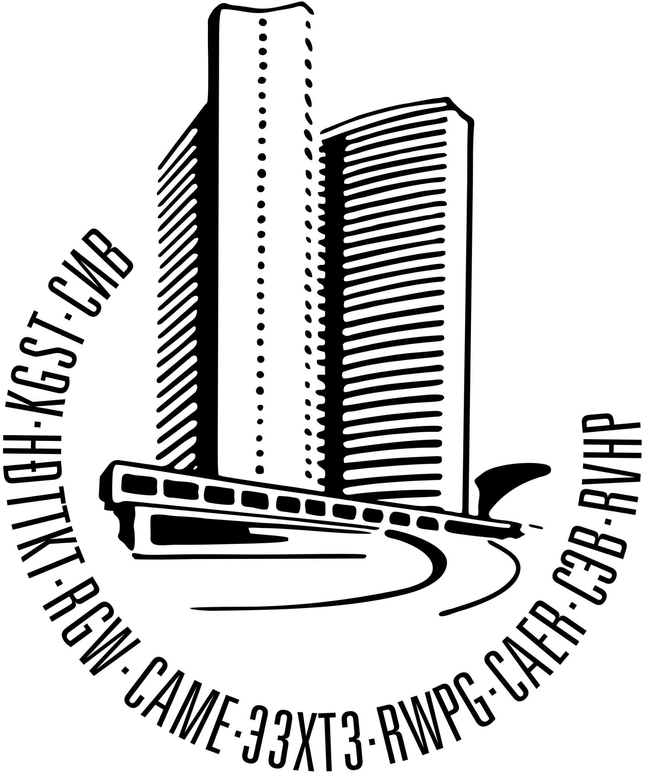
Subsidized Trade and Favorable Loans
By 1979 the Soviet Union provided Cuba with almost all the oil it needed, along with most of the food and about one third of all the intermediary goods that were consumed by the country. Moreover, Moscow helped Cuba in joining the COMECON, bolstering Cuban imports and exports even more: it has been estimated that between 1961 and 1976, 73% of all Cuban trade was with COMECON countries, of which 48.5% was with the USSR. From these numbers it can be seen that the Cuban economy could be kept afloat despite the American blockade and Western sanctions. However, trade was not the only way in which the USSR supported Cuba’s economy. Loans were another crucial aspect of support, already in 1960 the revolutionary government signed an agreement with the USSR for a $100 million loan. This was only the first of a series of loans and non-repayable credits: by 1976 the total amount of Soviet financial support was estimated around $10 billion, with only half as repayable loans; by 1979 the total financial aid reached $16.7 billion. Annually, Soviet economic aid corresponded to almost 25% of Cuba’s GDP. Moreover, in 1976 the Soviet government decided to freeze the repayment of $6.2 billion in loans, in order to help relieve some pressure on the Cuban people.
Logo of the Council for Mutual Economic Assistance - An economic organization (1949-1991) under the leadership of the USSR that comprised the countries of the Eastern Bloc along with a number of communist states elsewhere in the world

Slide 7

Soviet Support for Manufacturing, Development, and Military Defense
The Soviets supported Cuban economic reform, not only with millions of dollars spent in aiding development and diversification efforts, but also by sending economic advisors and qualified personnel to Cuba, to support efforts by the Castro administration to expand certain economic sectors. This sectoral aid effectively supported the modernization of harvesting techniques, especially in the sugar industry, but it also led to the modernization of other key sectors such as fishing and nickel extraction, as well as providing support for Cuba’s nascent manufacturing sector. The second crucial sector in which Cuba received vital assistance form the USSR was the military sector. Actually, after the end of the war with the army of Fulgencio Batista, Fidel Castro dissolved the army and created the Revolutionary Armed Forces (FAR), a new military organization built around the 26th of July guerrilla movement. However, that was not an army, it was a military organization prepared and armed for guerrilla tactics that was able to win as long as it pursued revolutionary goals under the foco theory elaborated by Ernesto “Che” Guevara.
Emblem of the Cuban Revolutionary Armed Forces

Slide 8
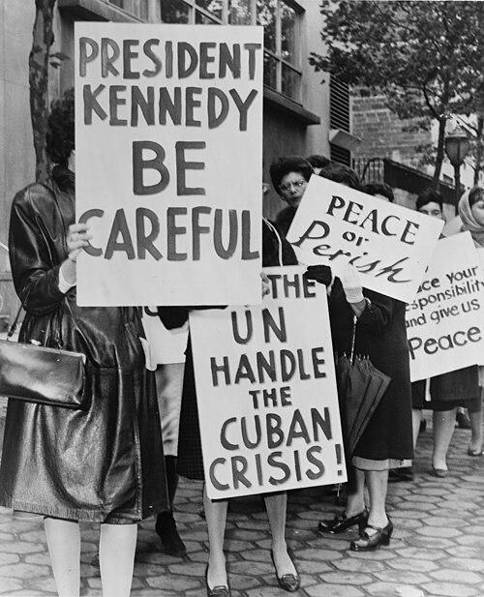
The Skills to Fight Modern Wars
By 1981 the FAR had 227,000 strong land forces, equipped with 650 tanks and 400 armored personnel carriers; the navy relied on 11,000 men and was equipped with dozens of vessels, including two submarines; the air force was equipped with 175 combat aircraft and other assets. Practically all this equipment came from the USSR. Moreover, the Soviet Union provided world-class training to the Cuban troops. The Cuban Defense Minister at the time, Raul Castro, stated that the Soviets were the first ones to really give the Cubans the skills to fight in contemporary wars. The Cuban Missile Crisis of 1961 underlines the relevance of this direct military aid, as it was the stationing of missiles and troops on the island which granted protection from a possible military invasion of the island. The USSR also provided military aid through the KGB in the form of training and equipping the General Directorate of Intelligence (DGI), transforming it into an effective intelligence agency. Moscow provided Havana with more than $ 20 million a year in military aid which was a major factor in Cuba progressing from a small, relatively untrained militia in 1960 to one of the largest and best equipped armies in Latin America.
A Group of 800 women from Women Strike for Peace - "Women Strike for Peace is a US women's peace activist group founded by Bella Abzug and Dagmar Wilson and was initially part of the movement for a ban on nuclear testing

Slide 9
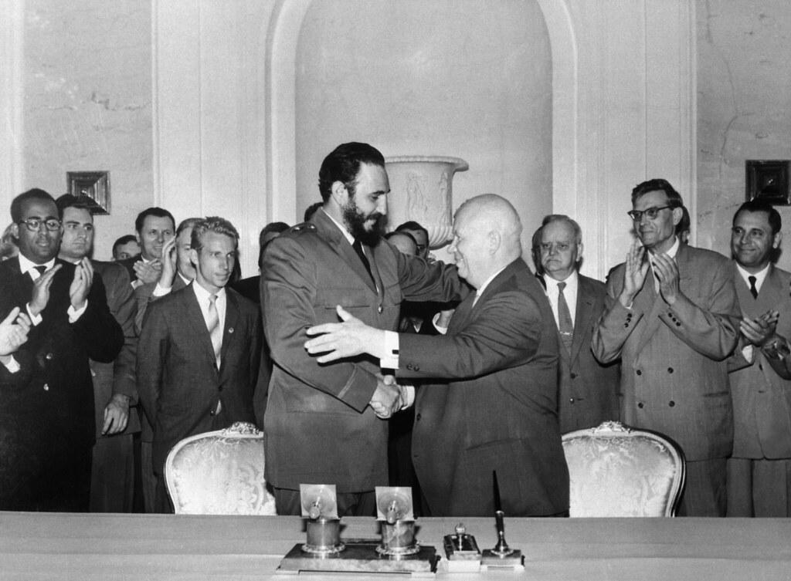
Soviet Support for Manufacturing, Development, and Military Defense
Soviet support for Cuba also took the form of diplomatic backing in front of the World: the USSR was the first country to recognize Castro’s revolutionary government in 1959 and it included Cuba in the family of socialist states through institutions such as the COMECON. The USSR actively supported Cuban bureaucracy reforms and institution building by providing advisors and guidance for these processes. When looking at economic data it is quite evident that, despite gaining influence in the region, the Soviet Union did not get any gains in purely economic terms. The USSR poured billions of dollars in economic support to Cuba through repayable loans, non-repayable credits, trade subsidies, aid to development, and military assistance grants. The total estimate of support to Cuba’s economy in the 1970s and the early 1980s can be said to have cost Moscow $1 million per day. Clearly the value the Soviets placed on their alliance with Cuba was about much more than the exploitative motives which we typically see in the relations between imperialist powers and their colonial interests.
Premiers Nikita Khrushchev of the Soviet Union and Fidel Castro of Cuba shake hands and start to embrace in Moscow - Castro made a state visit to the Soviet Union in 1963

Slide 10
The Anti-Colonial Weapon
Even after the tragic collapse of the USSR and the loss of their most valued ally, Marxism-Leninism lives on in Cuba. Alongside the ideas of José Martí, Marxism-Leninism constitutes the official governing ideology of the Communist Party of Cuba (PCC), the country’s ruling organisation. In Cuba, Marxism-Leninism is guiding the Revolution and the construction of socialism. This raises the question: why has Marxism-Leninism succeeded in Cuba?
First, and most importantly, Marxism is compatible with the Cuban revolutionary tradition, as exemplified in the legacy of José Martí.
Second, Marxism is a scientific theory, one that offers a truthful insight into the causes and solutions to Cuba’s social problems.
Third, Marxism has remained compatible with Cuba’s national conditions, even as they have changed over time.
Fourth, Cuba’s communist leaders have developed and enriched Marxism, thereby achieving its successful Cubanisation. Together, the success of the Cuban Revolution and the development of Cuban socialism demonstrate the contemporary vitality, achievements, and significance of Marxism-Leninism

Slide 11
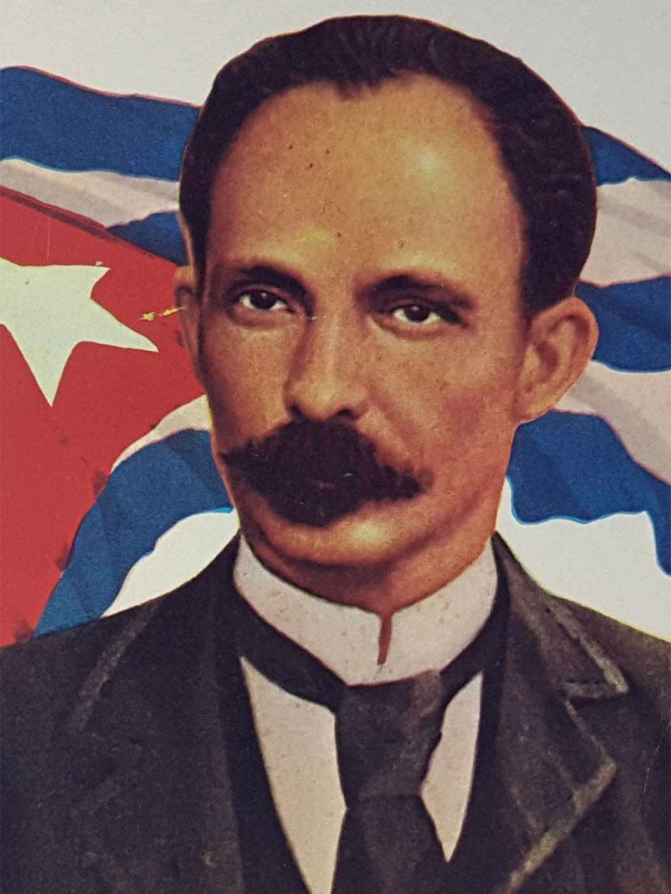
The Compatibility of Marxism with the Cuban Revolutionary Tradition
José Martí is Cuba’s national hero and the father of the nation. Fidel Castro, leader of the Cuban Revolution, said that:
“there is a continuity of thought between the ideas of Martí and Marxist-Leninist ideas … Today Martí would be a Marxist-Leninist, he would be a communist, there is not the slightest doubt” (Castro 2011: 265).
Likewise, Miguel Díaz-Canel (2022), First Secretary of the PCC, said that:
“in Cuba, Marxism merged with the best of the revolutionary national tradition … which had among its highest exponents José Martí …”
This is a major reason why the Cuban people understand and accept Marxism-Leninism. The continuity between Martí’s thought and Marxism-Leninism has furthered the integration and success of Marxism in Cuba. In 1975, on the 50th anniversary of the founding of Cuba’s first Marxist-Leninist Party in 1925, the Communist Party of Cuba held its first Congress and recognised that it was the heir of José Martí’s Cuban Revolutionary Party (CRP), which he formed in 1892.
José Julián Martí Pérez (January 28, 1853–May 19, 1895) a Cuban nationalist, poet, philosopher, essayist, journalist, translator, professor, and publisher, who is considered a Cuban national hero because of his role in the liberation of his country from Spain

Slide 12
A True Founding Father
In 1894 Martí outlined the fundamental elements of his political philosophy: a commitment to revolutionary change, social justice, anti-imperialism, and the development of a vanguard party, four Marxist-Leninist principles:
“How beautiful is the united action of the Cuban Revolutionary Party on behalf of dignity never marred by intrigues, flattery or pleas from its members and the authorities it has empowered; the equity of its expressed goals which do not foresee the country’s destiny in the domination of one class over another in a new country, without the poison and voluntary debasement involved in the ideas of classes, but rather with the full individual enjoyment of man’s legitimate rights which can only be diminished by the negligence or excess of those who exercise them; and on behalf of the opportunity, on the brink of being lost, of the enslaved Antilles to occupy their place as a nation in the Americas before the disproportionately developed, most powerful part of America turns those lands, which can still be gardens for their dwellers and scales of justice for the world into a theatre of universal greed. (Martí, 1975: 13)”

Slide 13
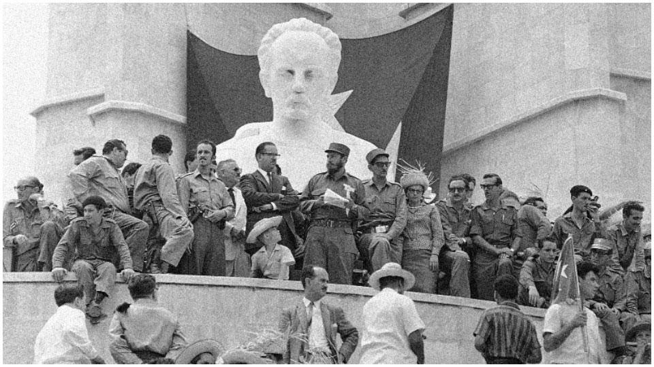
Sovereignty is the First Necessity
Although we cannot describe this as a fully Marxist ideology we can see, particularly in Martí’s understanding of the class struggle, that he was both consciously and unconsciously influenced by Marxist thinking. He begins by stressing the need for a disciplined vanguard party that is free of corruption and factionalism. He goes on to suggest that social equity cannot be achieved without eliminating the class system. And he ends by calling for Cuba to become a sovereign, independent nation, rather than a source of exploited wealth for American capitalists. This programme was not only a precursor to some of the aims of Lenin’s Bolshevik Party, but it also laid the foundations for the central tenets of the PCC. The CRP advocated armed struggle as the means to free Cuba from imperialist exploitation. As such it was an avowedly revolutionary party that, first and foremost, sought to prevent America from becoming the new dominant power, after its victory in the Spanish-American War of 1898: “The party was formed to achieve absolute independence for the Island of Cuba.” For Martí – and later Fidel Castro – anti-imperialism was the main driving force of this revolutionary party. Social justice could not be achieved until Cuba was a sovereign nation.
Fidel Castro, center, at the May Day 1960 parade in Havana at the Jose Marti Monument

Slide 14
Discussion & New Members Introductions

Slide 15
New Member Introductions
What is your name, pronouns and state (or country/territory)?
Where do you work? Is it unionized?
How did you find out about the People’s School?
What do you think about tonight's class?

Slide 16
Section 2

Slide 17
The US embargo on Cuba has cost the Cuban people hundreds of billions to trillions
  Nearly the amount of Saudi Arabia’s total annual GDP
Infant mortality rate doubled in 2025 to 9.9 babies per 1000 born as a result of the intensified military blockade imposed by the Trump regime

Slide 18
Discussion

Slide 19
Cuba solidarity today: How we can help the Cuban revolution

Slide 20
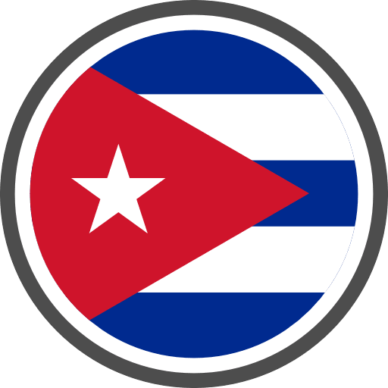
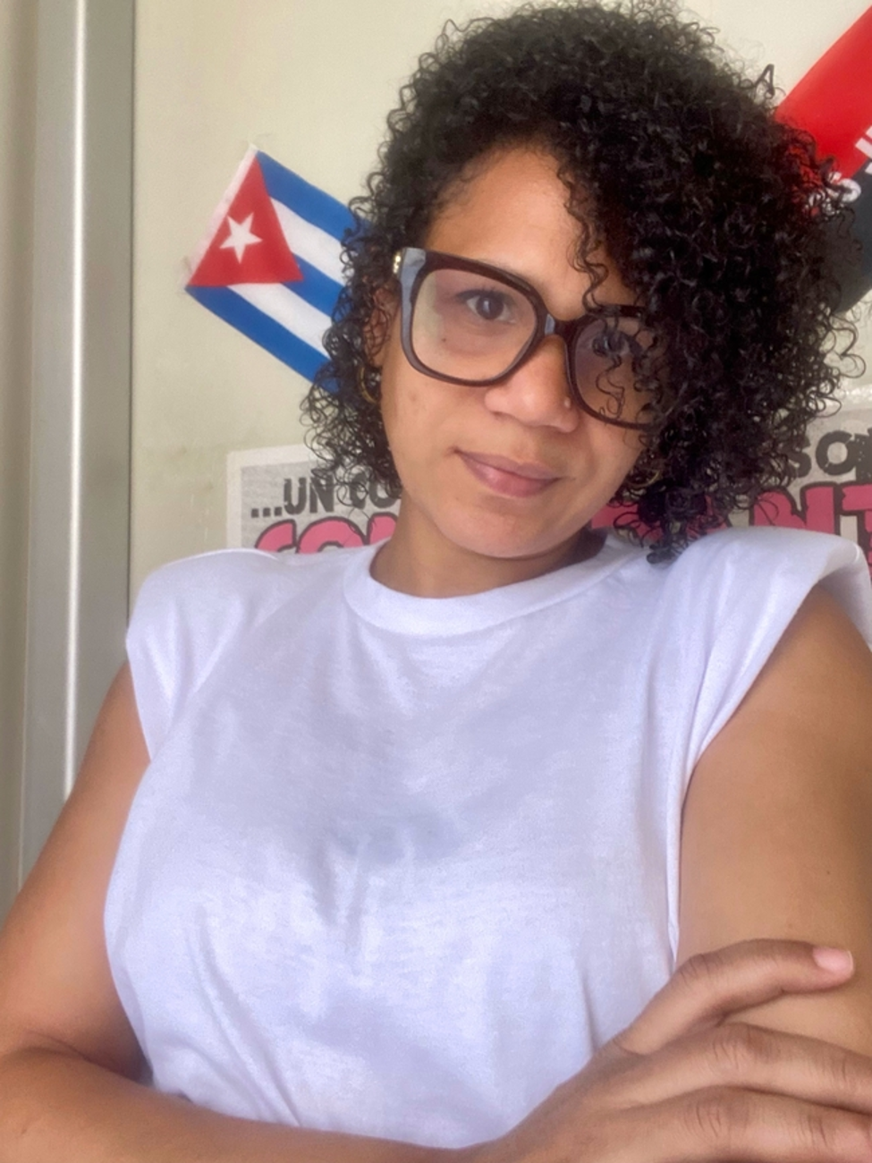
Elizabeth Ribalta from the Cuban Institute of Friendship with the Peoples (ICAP)
Liz is the Northern European Officer for the Instituto Cubano de Amistad con los Pueblos (ICAP, or the Cuban Friendship Institute)
She has a wealth of experience of international relations, having worked at ICAP since 2014. Her roles include United States group coordinator in the North America division, where she led international volunteer work brigades and worked with the Pastors for Peace Caravan which brings material aid and delegations from the US each year.
She also worked in the ICAP department that looks after foreign students, including working directly with young students studying at the Latin American School of Medicine.
SOURCE: https://socialistvoice.ie/2026/07/cuban-delegate-tells-left-to-maintain-faith-as-island-nation-announces-opening-up/

Slide 21
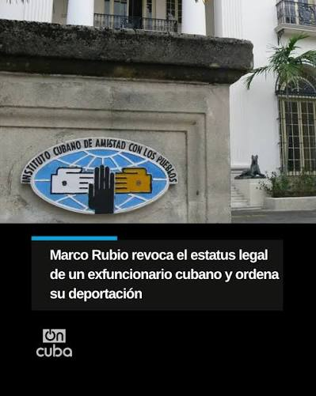
What is ICAP?
At the end of June, the Communist Party of Ireland had the privilege of hosting Elizabeth Ribalta from the Cuban Institute of Friendship with the Peoples (ICAP), during her travels around Ireland and the UK.
The event happened just days after Cuban president Miguel Díaz-Canel announced swathes of the economy would be opened up to foreign and private investment, as the state attempts to tackle the impacts of the tightening US blockade.
Question: First, what is ICAP, for people who aren’t familiar?
Elizabeth: The Cuban Institute of Friendship with the Peoples was founded in 1960, one year after the revolution. The US government started trying to isolate Cuba from the world, so our objective was to link people of other countries with Cuba. From the beginning we defended just causes around the world—independence processes in Africa, Asia, Latin America. We received refugees from the dictatorship in Chile. We started receiving solidarity brigades who came to participate in building the new society.

Slide 22
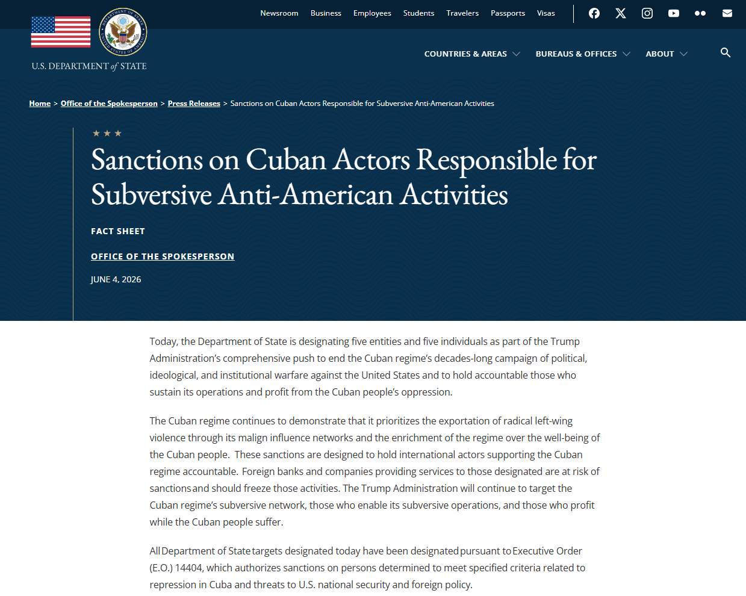
Trump Administration Sanctions ICAP
Office of the Spokesperson June 4, 2026
“All Department of State targets designated today have been designated pursuant to Executive Order (E.O.) 14404, which authorizes sanctions on persons determined to meet specified criteria related to repression in Cuba and threats to U.S. national security and foreign policy.”
Taking Action Against the Cuban Regime: The following entities associated with developing, implementing, and funding the Cuban regime’s violent revolutionary network are being designated:
Cuban Institute of Friendship with the Peoples (ICAP): ICAP is being designated pursuant to Sec. 2(a)(i)(F) of E.O. 14404 for being a political subdivision, agency, or instrumentality of the Government of Cuba. ICAP is a Cuban organization founded by Fidel Castro in 1960 that supports Cuban intelligence and counterintelligence activities.

Slide 23
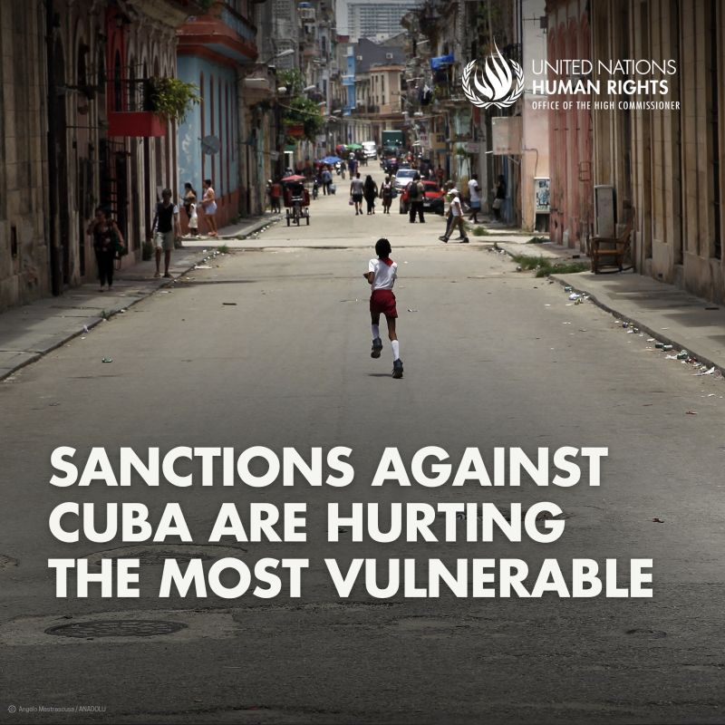
Current Conditions in Cuba
Q: What’s actually happening on the ground?
E: This is a very well-designed maneuver of US policy. They describe Cuba as a “state sponsor of terrorism”, inventing excuses like Chinese military bases or phantom drone attacks—all not true. They say Cuba is a failed state needing humanitarian intervention. Then they suffocate every source of income, cutting all opportunity to trade, to buy equipment, medicines, food, technology.
Since we don’t receive oil, power cuts are up to 20 hours daily. Imagine waking up with no electricity, no breakfast, walking long distances to work or school. Eighty percent of water pumping is [non-functional].
Hospitals operate on generators with minimal diesel. Surgical waiting lists exceed 100,000 patients, more than 11,000 are children.
Infant mortality has risen to 9.9 [per 1,000 live births], when years ago it was just 4.
This is something Cubans are suffering every day.

Slide 24
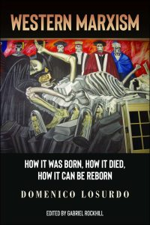
Change is a Process
Q: Some European leftists feel recent economic changes are a betrayal of the revolution. What do you say?
E: We know our friends sometimes idealize the revolution. They don’t see we are in a process of constructing a new society—you cannot cut yourself from the international system we live in.
We are making mistakes. We go two steps forward and one step back. We are not China, we are not Vietnam—it is a very different scenario.
People need to maintain faith with the Cuban revolution because its success is also the success of other peoples around the world.
“Western Marxism” by Domenico Losurdo. In it he refers to Western Marxism as a “product of defeat”.

Slide 25
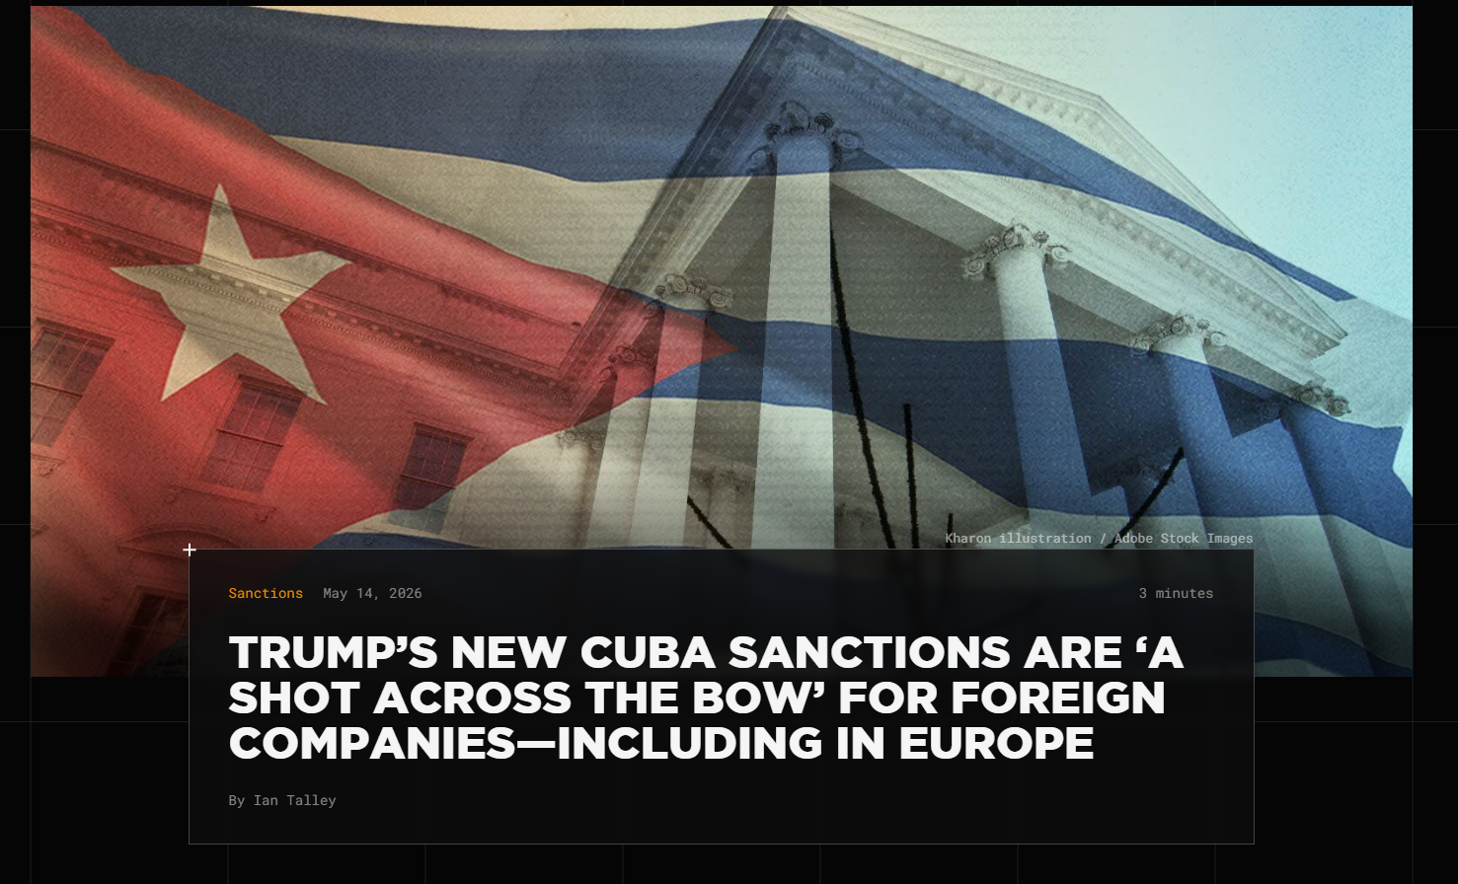
Europe Joins U.S. in Sanctioning Cuba
Q: The European Parliament recently passed a resolution calling for sanctions on Cuba. What’s happening there?
E: Now we are in a very adverse scenario in the EU because the majority of parliamentarians are from the right wing. The left are the minority.
That gives the counterrevolution spaces to give them all this misinformation about Cuba—just the point of view of mercenary people who go to the parliament to sabotage the dialogue between Cuba and the European Union.
It is very sad that European governments have pledged to US policy and what Trump says.
These countries have their own self-determination and sovereignty, but it seems like they don’t have it.

Slide 26
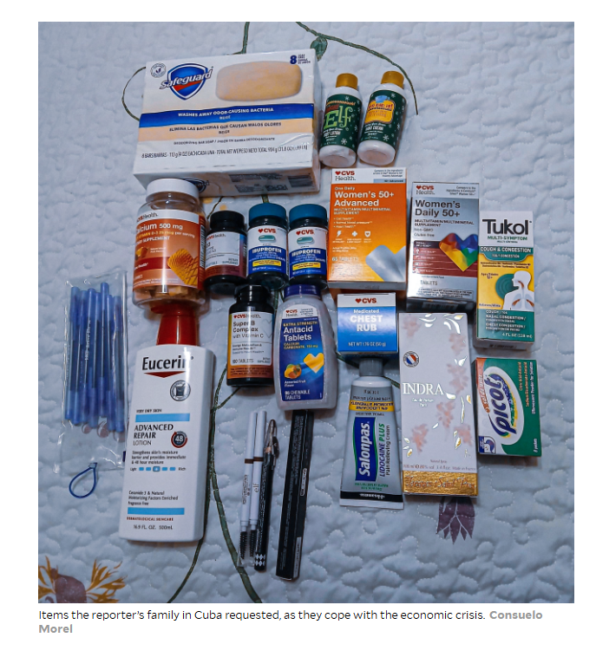
How to Support Cuba
Q: What should Irish (or other) activists prioritize?
E: The call for solidarity is urgent—this is a genocide.
They are not using bombs yet, but they could be.
The solidarity movement must be more active than ever: visible public manifestations, motions, declarations, letters to MPs and European parliamentarians.
We need you to keep denouncing this policy, because if it’s not visible, they will continue lying.
We really appreciate the aid—solar panels for polyclinics, maternity homes, schools. Food, powdered milk, beans, rice.
But also, go to Cuba. You need to see with your own eyes what is really happening, and this is a way to support Cuba economically. I know there are obstacles, but it is necessary to go.

Slide 27
Discussion & Wrap Up

Slide 28
Announcements
PCUSA Cell Chairs need to call members of their cells to remind them about attendance.
PCUSA Cell members are reminded attendance at the Continuing Education class of Jones-Foster every first Wednesday of the month is required.
The next issue of New Masses (2026) has begun production. If you have art you want us to feature, email it to info@partyofcommunistsusa.net.

Slide 29
Volunteers Needed!
We are in need of volunteers for the staff of the People’s School! Here’s a few roles we need filled:
People to help manage posting on our social media and podcast platforms
Video Editors, Audio Editors, Graphic Designers, Artists, Narrators
Web Controls, Moderators
Email info@peoplesschool.us if you’re interested and try to attend our next staff meeting if possible.

Slide 30


Slide 31

View From Left Field
https://viewfromleftfield.libsyn.com
The Old PSMLS Youtube is now the Youtube of View From Left Field, a podcast of analysis and discussion of current events from a progressive perspective.
Like the Youtube videos and subscribe with 5 star ratings on your podcast platforms.

Slide 32

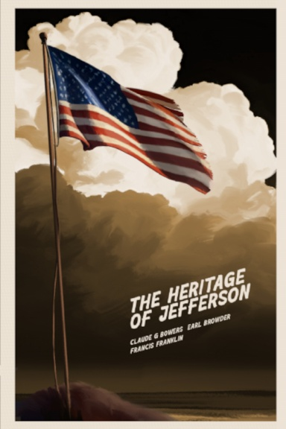
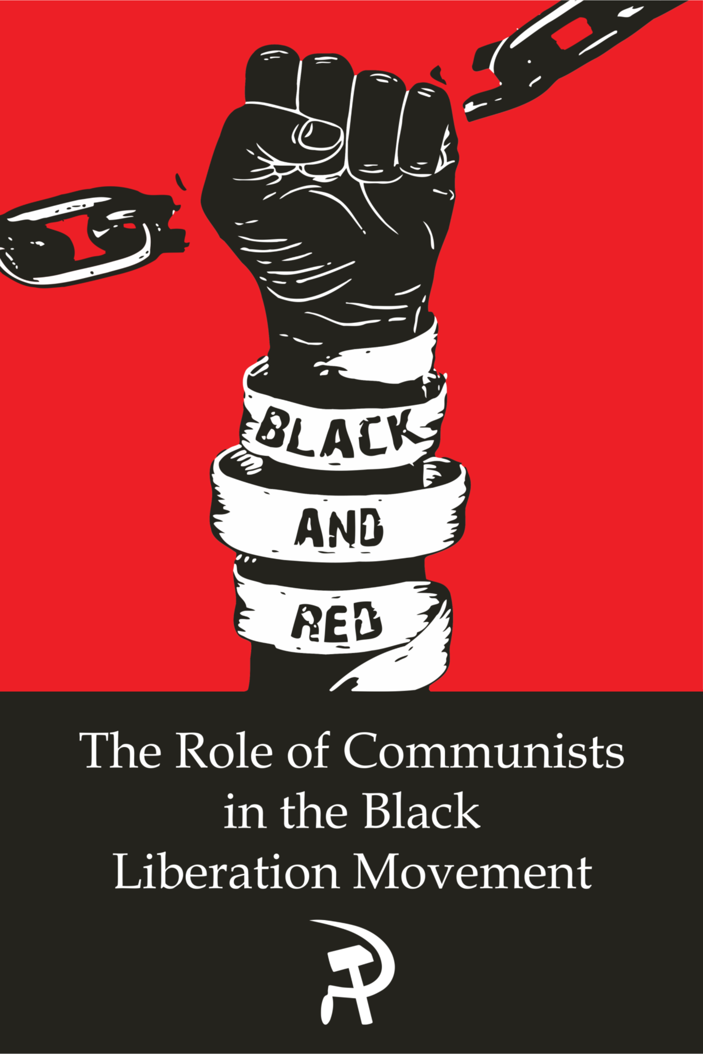
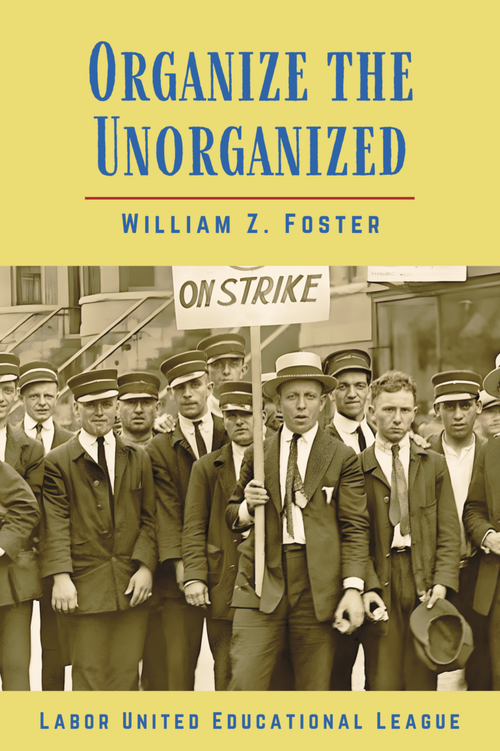

New Outlook Publishers
newoutlookpublishers.store
Relevant and Latest Releases

Slide 33


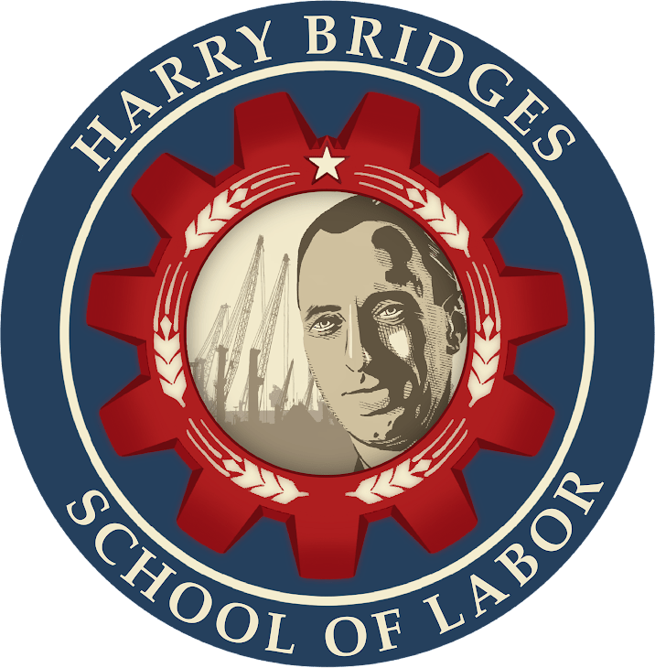
Harry Bridges School of Labor
luel.us/laborschool/
The Harry Bridges School of Labor is a monthly class covering a variety of topics aimed at building class consciousness among union members. For class schedule and other information, please visit the website at luel.us/laborschool.

Slide 34
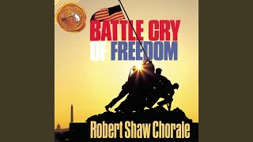
Yankee Doodle (Fife & Drum) - Revolutionary War Song

