Slide 1

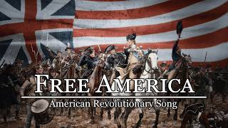
Free America - American Revolutionary Song

Slide 2
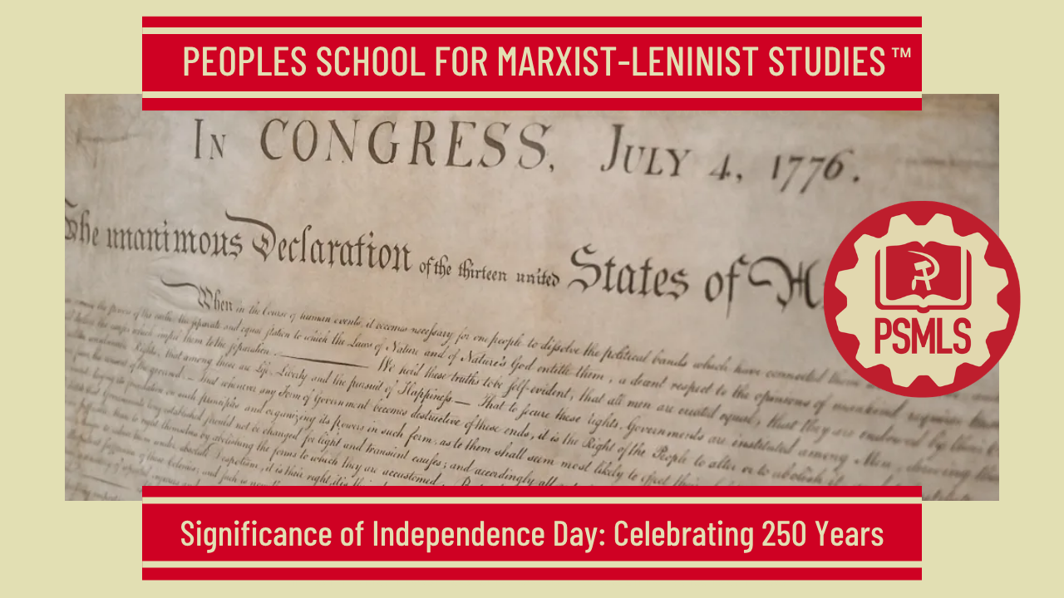
PSMLS 7/7/26

Slide 3
What we’ll be learning today:
The Revolutionary War: A Progressive & Justified War
Jefferson Vs. Hamilton: Should We Guard Against the Elites or the Masses
Who Are The Americans? By Earl Browder

Slide 4
The Revolutionary War: A Progressive & Justified War

Slide 5

A Major Blow to the British Empire
By the 1700s the British Empire was growing and spreading its influence in various countries and regions.
The British monarchy and practice of colonialism was brutal and oppressive.
The Revolutionary War put a toll on the empire’s resources and Britain's defeat marked a turning point in world history.

Slide 6
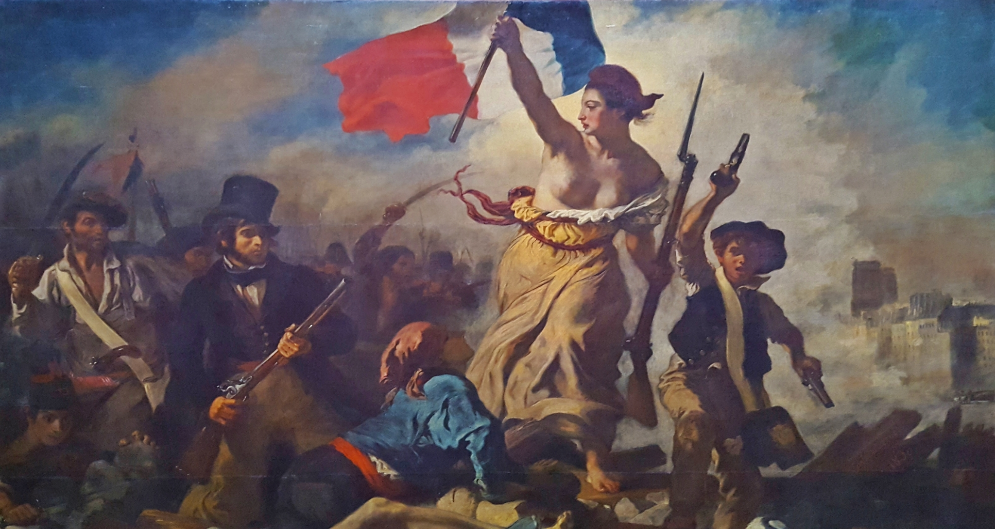
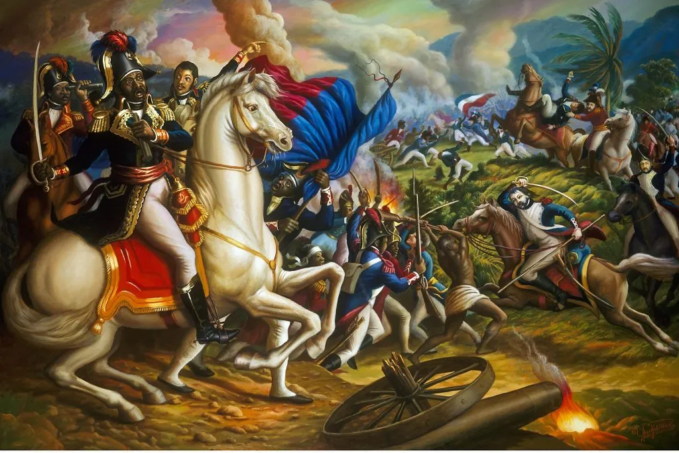
A Major Blow to the British Empire
Britain’s defeat not only undermined the empire, but also the idea of monarchy.
The Revolutionary War served as inspiration for other wars of liberation, such as a French Revolution and Haitian Revolution.
This led to a major change in the idea of what constitutes a state, from one being based on land to being based on the people and their government.
People called themselves “citizens.”

Slide 7
“Dual Power” in Colonial America
In the colonies there was always a longstanding constitutional tension between the internal, locally elected colonial assemblies and the British Crown & Parliament.
For over a century, Britain exercised a policy of “salutary neglect.” While the Crown held ultimate sovereignty through royal governors and judges, distance and administrative necessity forced a sharing of power. British government purposely relaxed the enforcement of strict trade laws and imperial regulations in its American colonies. This leniency was designed to ensure colonial loyalty and maximize economic output.
Thus, property-owning colonists elected their own assemblies. Since assemblies controlled the money, they frequently leveraged their power to force compromises with royal governors.

Slide 8
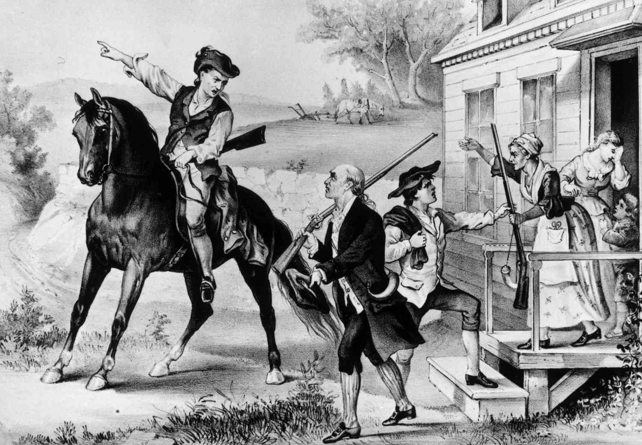
“Dual Power” in Colonial America
As tensions culminated, rebels built shadow governments to actively replace British rule.
Colonists formed their own grassroots governing networks, such as the Committees of Correspondence and Safety and Provincial Congresses.
These shadow institutions—backed by armed colonial militias—coexisted with, and rapidly usurped, the day-to-day administrative power of royal governors before ultimately declaring independence.

Slide 9
The Committees of Correspondence and Safety
Early on, Committees of Correspondence served as temporary formations to deal with specific disputes with an individual colony and Great Britain.
The first standing Committee of Correspondence was formed by Samuel Adams and twenty other leaders in 1772 in Boston in response to the Gaspée Affair.
Samuel Adams, Dr. Joseph Warren, James Otis, and other Patriot leaders in Boston recognized the importance of collective resistance, the power of correspondence, and the significance of town meetings. They recognized that in order to gain popular support they needed to split the strength of the towns away from British rule.
Their first step was to gain influence in town meetings throughout Massachusetts, which were primarily dominated by Loyalists, although at this time the number of Patriot supporters was growing rapidly.
The close mutual association of towns and the influence of town meetings, clergy, and later newspapers in colonial America created an atmosphere in which a cooperative spirit was nurtured.

Slide 10
The Committees of Correspondence and Safety
Thus, when the Committees of Correspondence were created they had a profound effect stirring the populace into collective action.
The majority of towns in Massachusetts took stock in the example set by the Boston Committee of Correspondence and established a network of Committees of Correspondence throughout the colony of Massachusetts. The name Committee of Correspondence helped garner support during this radical period. Rather than being singular in title, the word “committee” carries no authoritative ring and carried more moral power in the minds of the colonists than a request from a single representative or even a single town would have.
By February 1774, eleven of the Thirteen Colonies, excluding Pennsylvania and North Carolina, had established networks of Committees of Correspondence. In terms of power, by early 1774 the Committees of Correspondence had superseded the colonial legislature and royal officials in the Thirteen Colonies. The Committees of Correspondence were influential in revolutionizing the town meeting from discussions of local matters to far-reaching global politics.

Slide 11
Sons of Liberty
The majority of the members of the Committees of Correspondence were also members of their local chapters of the secret Patriot organization called the Sons of Liberty. They set up espionage networks to identify disloyal elements and disenfranchised royal officials.
The Sons of Liberty was a well-organized Patriot paramilitary political organization established to undermine British rule in colonial America and was influential in organizing and carrying out the Boston Tea Party.
The organization disbanded at the close of the American Revolution and as a political entity was replaced early in the Revolution by the more formal and qualified Committees of Safety.

Slide 12
The First Continental Congress
The Continental Congresses were a series of legislative bodies that served as the provisional government for the Thirteen Colonies and the early United States between 1774 and 1789. They directed the Revolutionary War effort, declared independence from Great Britain, and established the nation's first constitutional framework.
The Maryland Committee of Correspondence was influential in establishing the First Continental Congress, which was in response to the Intolerable Acts. This first congress produced a declaration of rights.

Slide 13
The Second Continental Congress
The Second Continental Congress convened just weeks after the Battles of Lexington and Concord, transitioning from a protest assembly into a de facto national government for the duration of the Revolutionary War.
It created the Continental Army (appointing George Washington as commander-in-chief), authorized the printing of money, established a postal service, and officially adopted the Declaration of Independence on July 4, 1776.
Following the ratification of the Articles of Confederation, the Second Continental Congress was reorganized into the Confederation Congress. It acted as the first official federal government of the United States.

Slide 14
What did Marx & Lenin Write About the Revolutionary War & Civil War?
Marx and Engels categorized it as a necessary and progressive bourgeois revolution. They viewed it as a pivotal step in destroying feudal ties and establishing the capitalist conditions necessary for the development of the modern world.
Marx frequently contrasted the American Revolution with the American Civil War. While the 1776 revolution established bourgeois liberty and capitalism, he viewed the Civil War (which he analyzed in depth through his journalism) as an equally—if not more—momentous struggle.
In Lenin's 1918 Letter To American Workers, he famously praised the American War of Independence as "one of those great, really liberating, really revolutionary wars".

Slide 15
Discussion & New Members Introductions

Slide 16
New Member Introductions
What is your name, pronouns and state (or country/territory)?
Where do you work? Is it unionized?
How did you find out about the People’s School?
What do you think about tonight's class?

Slide 17
Jefferson Vs. Hamilton: Should We Guard Against the Elites or the Masses

Slide 18
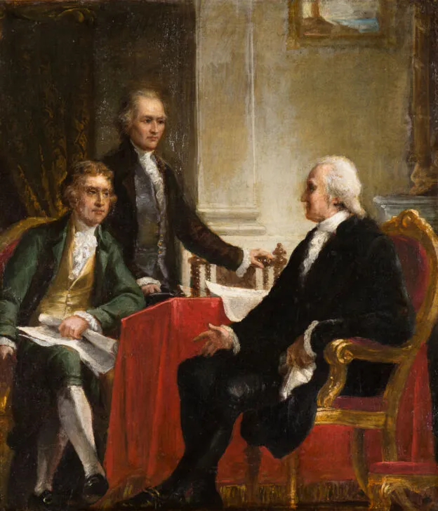
America’s Great Debate
George Washington's cabinet (which included only four men) was dominated by Alexander Hamilton, the Secretary of the Treasury, and Thomas Jefferson, the Secretary of State. Jefferson and Hamilton disagreed strongly regarding the powers of the central government, the proper interpretation of the Constitution, the economy, and foreign policy. Other political leaders quickly rallied around one side or the other. Hamilton favored a strong, active, and dominant central government, while Jefferson advocated for a limited federal government that would respect the rights of the states and individuals. John Adams sided with the Federalists, while Jefferson was joined by his close friend, James Madison. Madison's alignment with Jefferson is significant because it represented an end to the political alliance between Madison and Hamilton that produced The Federalist Papers. While nearly everyone who had opposed the ratification of the Constitution would have gravitated toward Jefferson's party, there were those who, like Madison, had advocated strongly for ratification, yet saw Hamilton's plans to further empower the central government as exceeding the powers delegated by the Constitution.
Jefferson and Hamilton meeting with Washington

Slide 19

Federalists vs. [Jeffersonian] Republicans
​Hamilton's party, which became known as the Federalist Party, retained the branding that Hamilton had used in his campaign to ratify the Constitution. The Jeffersonians began to refer to themselves as Republicans - a lowkey snub at the Hamiltonian Federalists. In calling themselves Republicans, members of Jefferson's faction claimed that theirs was the only party that favored a republican form of government. Jeffersonians frequently referred to their opponents as "monarchists" and "monocrats" who sought to overthrow the republican society that sprang from the American Revolution. To Jefferson, Hamilton was a counter-revolutionary who sought to mold the young United States in the image of Europe. It's important to distinguish Jefferson's Republican Party from the Republican Party that exists in the United States today. The present-day Republican Party was founded in the 1850s after the breakup of the Second Party System. In order to avoid confusion, historians have traditionally referred to Jefferson's party as the Jeffersonian Republican Party.
Cockade of the Federalist Party - Black cockades were worn by Federalist supporters during the 1790s as a sign of opposition to the French Republic

Slide 20
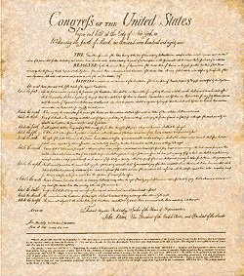
The Controversy of the Bill of Rights
The difference between the Federalists and the Republicans concerned the role of the central government. Although the Constitution was drafted and ratified in order to create a stronger central government than had existed under the Articles of Confederation, the Constitution still retained many features of federalism, which limited the power of the central government. In order to get the Constitution ratified, Federalists had agreed to adopt a Bill of Rights that would protect the rights of the people and the states - something which had been one of Jefferson’s highest priorities. Although Madison did not initially believe that a Bill of Rights was necessary, he guided the passage of these amendments through Congress. While Madison appears to have been acting in good faith with every intention of respecting the spirit of the Bill of Rights, Alexander Hamilton - who presented a plan at the Constitutional Convention to completely do away with state sovereignty and argued in Federalist No. 84 that a Bill of Rights was unnecessary - was determined to make sure that the central government had as much power as possible. This difference in approach was the source of the split between Hamilton and Madison in the 1790s.
Proposed following the 1787 debate over the ratification of the Constitution, The United States Bill of Rights contains the first ten amendments, written to address the objections raised by Anti-Federalists

Slide 21
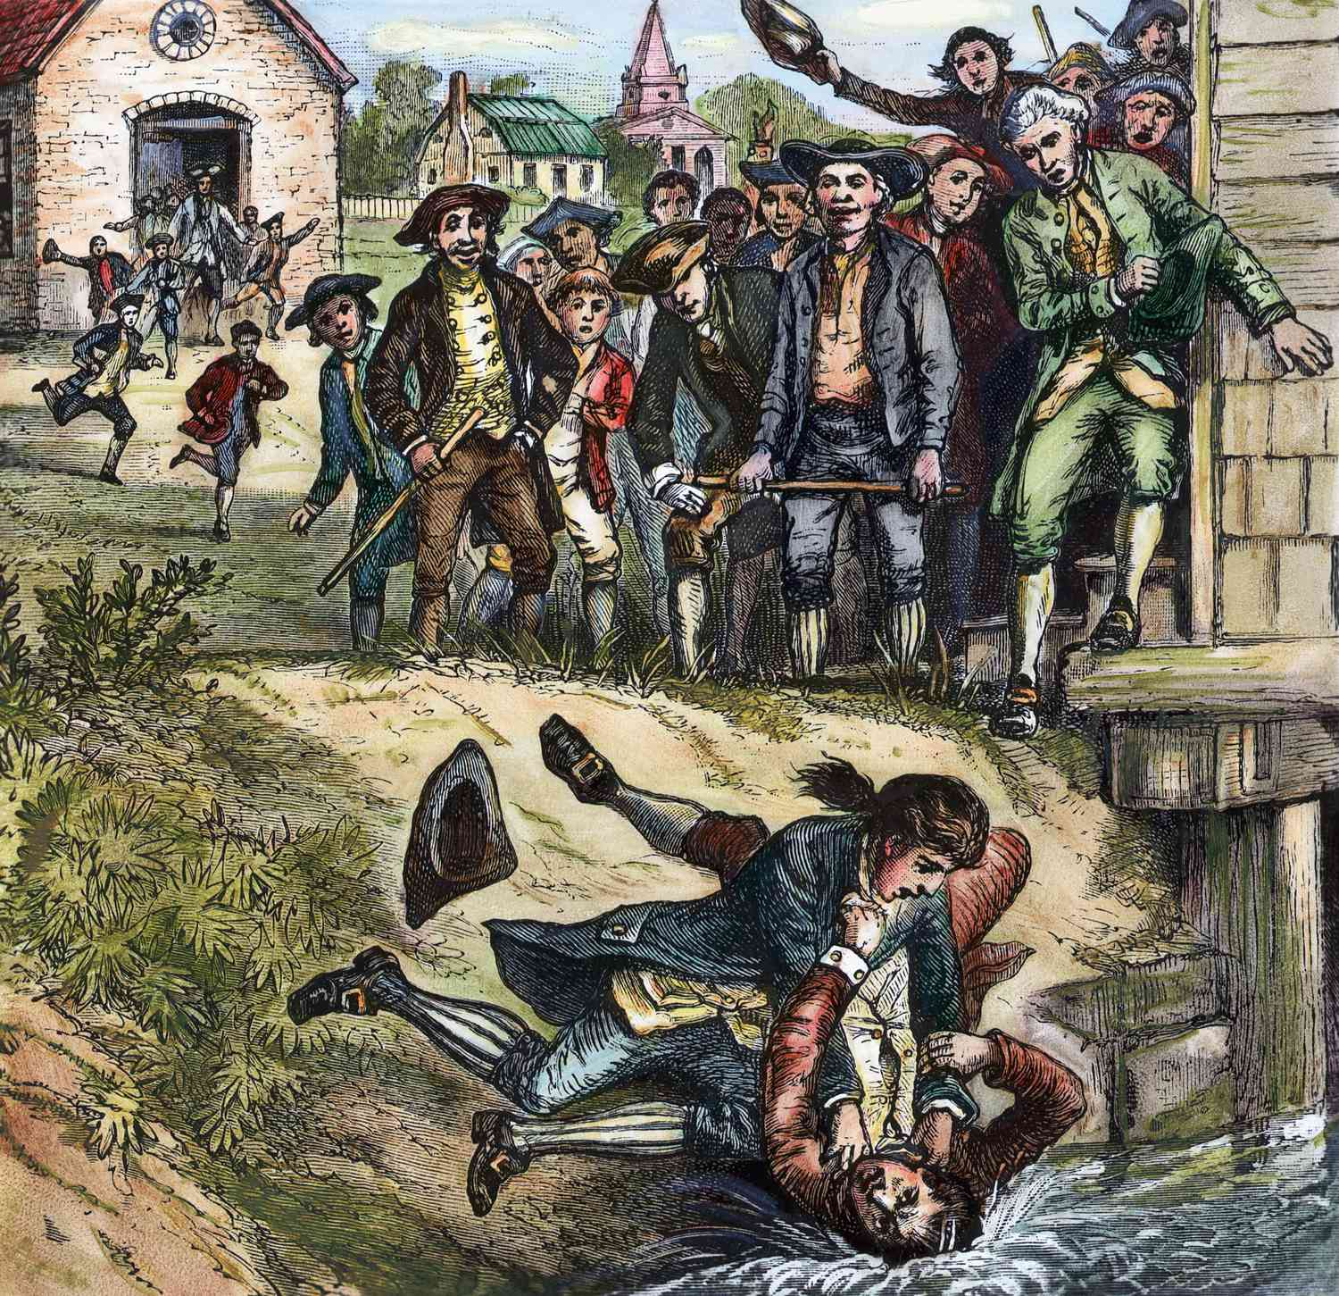
Two Conflicting Threats
​The political positions of the Federalists and the Republicans largely started with their fears. The Federalists feared the masses - the threat of a populace out of the control of the central government. Shays' Rebellion alarmed many elites, who saw in it the future of the United States without strong central control. This is reflected in the Constitution's empowerment of the federal government to "suppress insurrections" - a power not delegated to Congress under the Articles of Confederation. Jefferson and Madison were much more fearful of tyranny. During Shays' Rebellion, Jefferson wrote to Madison, "a little rebellion now and then is a good thing." Rationally, Jefferson did not see how one rebellion in a single state threatened the existence of the United States, but he feared that a strong central government could place the states at risk of having their rights stripped away as they had been at the outset of the American Revolution. "I am not a friend to a very energetic government," Jefferson wrote, "It is always oppressive." This view of government was behind all of Jefferson's efforts to keep the power of the central government as limited as possible, for fear of oppression.
Shays’ Rebellion was a series of violent protests staged during 1786 and 1787 by a group of American farmers who objected to the way state and local tax collections were being enforced and drew lawmakers’ attention to serious weaknesses in the Articles of Confederation

Slide 22
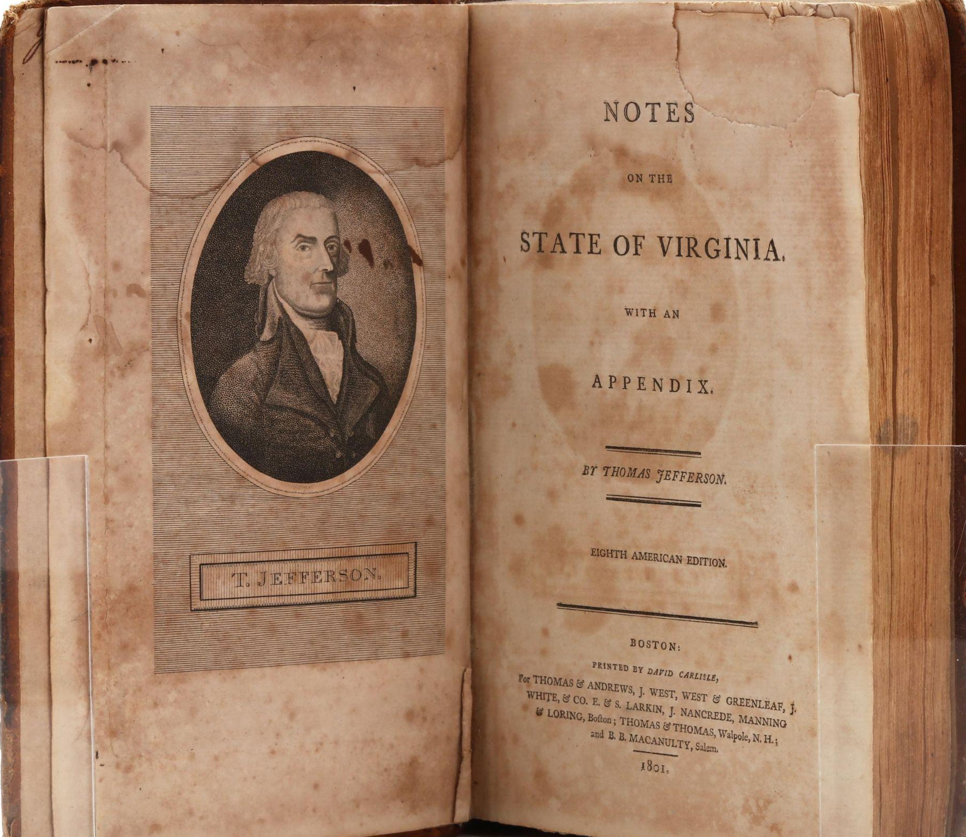
Jefferson’s View of Human Nature
Jefferson believed that every human person “was endowed with a sense of right and wrong” and that this moral sense was “as much a part of man as his leg or arm.” This interior moral sense could not be measured by scientific means because it was instinctual. Nor was it to be confused with reason. Still, it was obvious to Jefferson that “nature hath implanted in our breasts a love of others.” This moral sense could be strengthened or weakened. As he warned in 1781 in Notes on the State of Virginia, “Human nature is the same on every side of the Atlantic.” Those writing constitutions in the 1770s for the newly independent States, he counseled, should therefore learn from ancient and European history about the corruptibility of virtuous people with good intentions. “Nor should our assembly be deluded by the integrity of their own purposes, and conclude that these unlimited powers will never be abused, because they themselves are not disposed to abuse them.” As James Madison warned a few years later in Federalist No. 10, “Enlightened statesmen will not always be at the helm.” Thus, Americans “should look forward to a time, and that not a distant one, when corruption in this, as in the country from which we derive our origin, will have seized the heads of government, and be spread by them through the body of the people; when they will purchase the voices of the people, and make them pay the price.”
Eighth American Edition of Thomas Jefferson's Notes on the State of Virginia

Slide 23
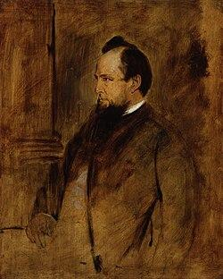
The Prime Determinants in Human Behavior
​For Jefferson, the rulers usually corrupt the people, not the other way around. There is a similarity here to Lord Acton’s famous dictum that “power tends to corrupt, and absolute power corrupts absolutely.” Jefferson believed that the human person was born neither good nor stained by Original Sin. Man’s moral sense could, however, be steered toward the good through long practice and education. Jefferson believed that environment, education, upbringing, and culture were the prime determinants in human behavior. Jefferson trusted most Americans to use their “moral sense” in their decision-making. He was confident that there were matters of right and wrong that all people could know regardless of their education. “State a moral case to a ploughman and a professor,” wrote Jefferson, and “the former will decide it as well, and often better than the latter, because he has not been led astray by artificial rules.” While all ought to submit their moral choices “to the guidance of reason,” most men would make the right choice due to their innate moral sense.
“John Acton, 1st Baron Acton” by Franz Seraph von Lenbach oil on mahogany panel, circa 1879

Slide 24
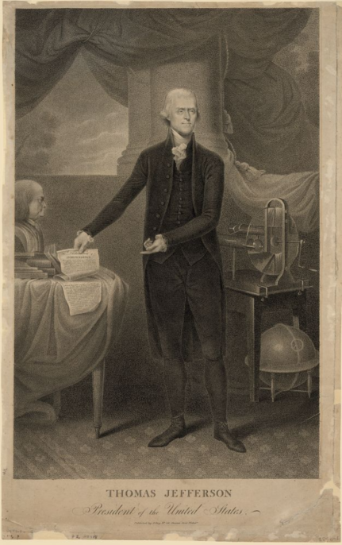
Destined for Society
Jefferson recognized that the human person also possesses a social nature. He put it clearly: “Man was destined for society.” Jefferson may have thought Aristotle outdated, but he nevertheless agreed that man is a political creature with an end to which he is ordered by his nature. Man could only flourish and achieve this end in society. For Jefferson, society meant both natural society, such as the family, and political society. Unlike John Locke, Jefferson did not think that a preexistent natural society had begotten its own replacement in political society. Rather, like Thomas Paine and heavily influenced by Scottish Enlightenment philosopher Lord Kames, Jefferson thought both had always been present and intertwined. Each was necessary for human flourishing. Where Jefferson parted ways with Paine is that the Virginian saw government not as a necessary evil but as an irreplaceable institution ordered to the good of human happiness. Government could only achieve its proper end, however, if it was kept limited. In 1801, in his first inaugural address as president, Jefferson recommended “a wise and frugal government, which shall restrain men from injuring one another, shall leave them otherwise free to regulate their own pursuits of industry and improvement.” Along with not taking “from the mouth of labor the bread it has earned.”
Thomas Jefferson, “First Inaugural Address” (4 March 1801) - Photo Courtesy of the Library of Congress

Slide 25
Discussion

Slide 26
Who are the Americans?

Slide 27
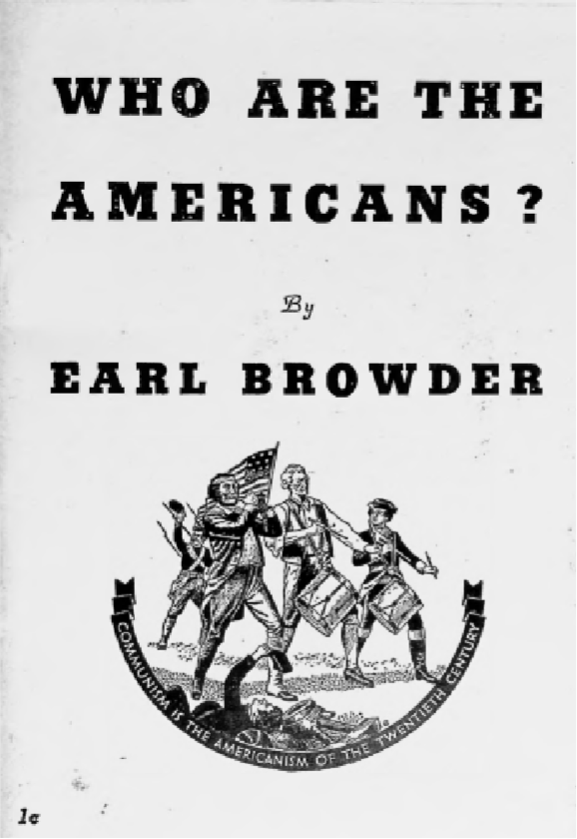
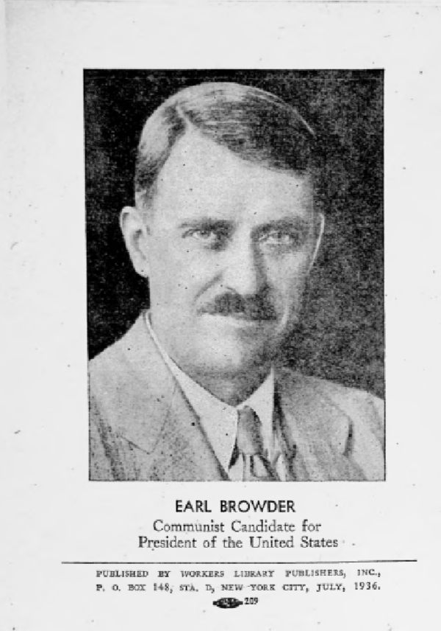
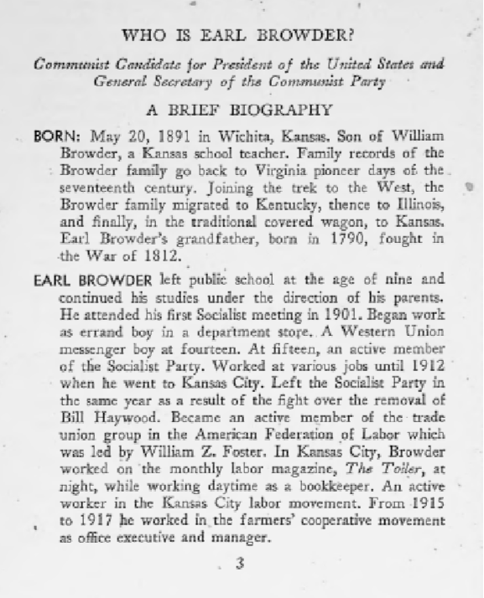
Who Are The Americans by Earl Browder 1936

Slide 28
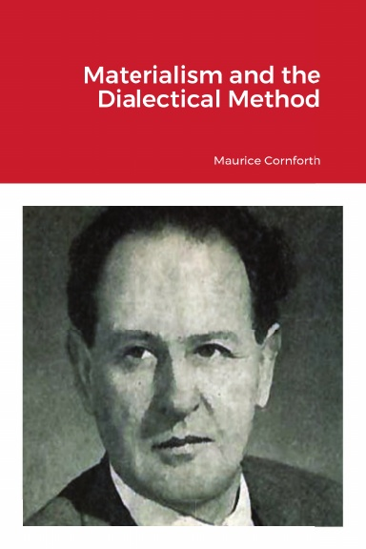
How the Working Class Interprets Original Sources: Interpreting “Who Are the Americans”
Workers can and must do history. The history given us, by other classes is a reflection of those classes biases and values, which are contradictory to the class consciousness of the workers. It serves those classes, not ours.
When approaching history, we must consider the way we analyze and communicate history; this is called Historiography. The working class adheres to Dialectical Materialism as the methodology of it's scientific research. History is, afterall, science. For an excellent and authoritative book on this topic, please see “Materialism and The Dialectical Method” by Maurice Cornforth, available at New Outlook Publishers.
Ask questions such as “Who benefitted?”, “What was substantially changed?” “What are the qualities of those changes?” “How can we tell?” “How were the events described and responded to in their own time?”.
In your findings, place emphasis on the function and purpose of the data objectively, which is to view social change as an ongoing process of ideas and social forces meeting, changing, and reforming in new ways to produce the next components of the following social changes.
Acknowledge that capitalist history is an established narrative created entirely in the service of one social class over the other.

Slide 29
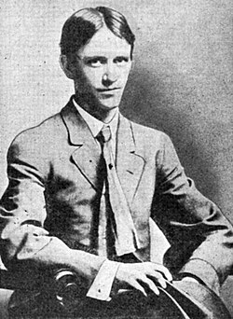
Applied Critical Thinking: Browder and Browderism
When considering Browder and Browderism, think critically and dialectically by considering his class biography, experiences and possible motivations. Correlate these with the times in which he lived.
Biography: Browder was a worker from a working class family, and a socialist at age 16. He ran for president twice, and lead the CPUSA during a time when communism was under direct attack abroad and significant suppression in the United States, only 20 years after the October Revolution. His commitment to Americanism was presumed to be motivated by his goal of empowering the CPUSA to join in a national effort to oppose fascism.
Conflicted Ideologies: Browder was an influential figure in CPUSA leadership during the Popular Front era of the early 1930’s. This era’s emphasis was placed on creating a united Left to oppose fascism. This emphasis changed as WWII gained momentum. Browder was imprisoned for passport fraud when Nazi Germany launched Operation Barbarossa,the invasion of the Soviet Union. Immediately, the political line of the global communist movement shifted from anti-intervention in the "imperialist war" to intense advocacy for anti-fascist intervention; the slogan was "Defend the Soviet Union".
Contradictions: Browder supposed that the cooperation between America and the Soviet Union would continue after the war. It did not. This expectation of cooperation between the Allied powers abroad and civil peace at home were the hallmarks of what was later known as "Browderism". The postwar era for the CPUSA is marked by the most damaging and lasting efforts to abolish the party. Arguably, fascism was never defeated, but rather streamlined and repackaged to resurface later. Communism was never defeated . It rises again to confront fascism.
Why do History? Because history will ask you which side you’re on. How will you answer?
Browder, Age 17

Slide 30
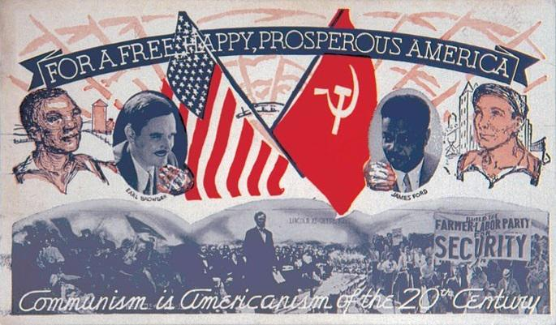
A Patriotism Incompatible with Exploitation
Browder asks us what we mean when we say we love America.
He suggests and rightly, we think that we mean to say we love the masses, or the working class when this affection for home and country are expressed.
This is different than what is advertised to us as what is meant, by those who deprive, harm and incarcerate us.
Our patriotism is incompatible with capitalism, and it’s bedfellows, national chauvinism and an Americanist exclusivity based on birthplace.

Slide 31
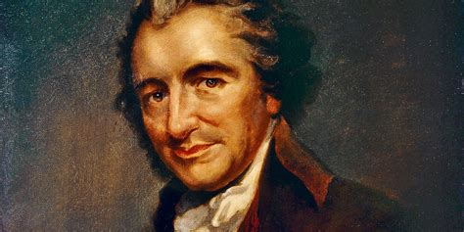
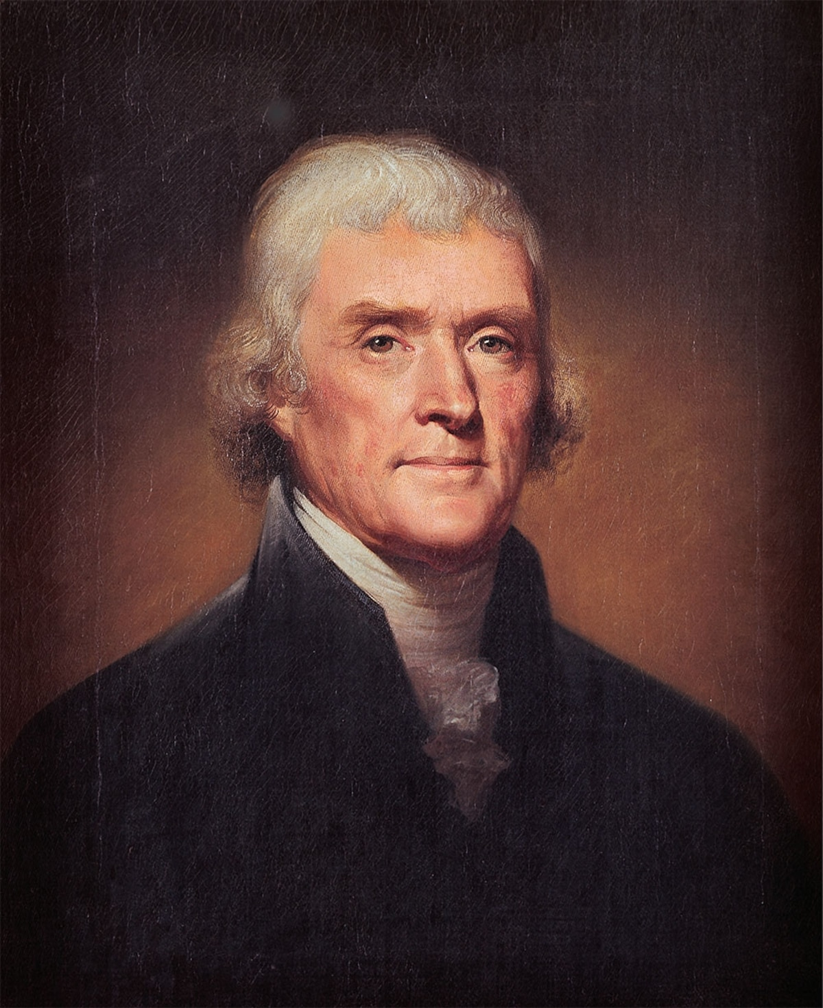
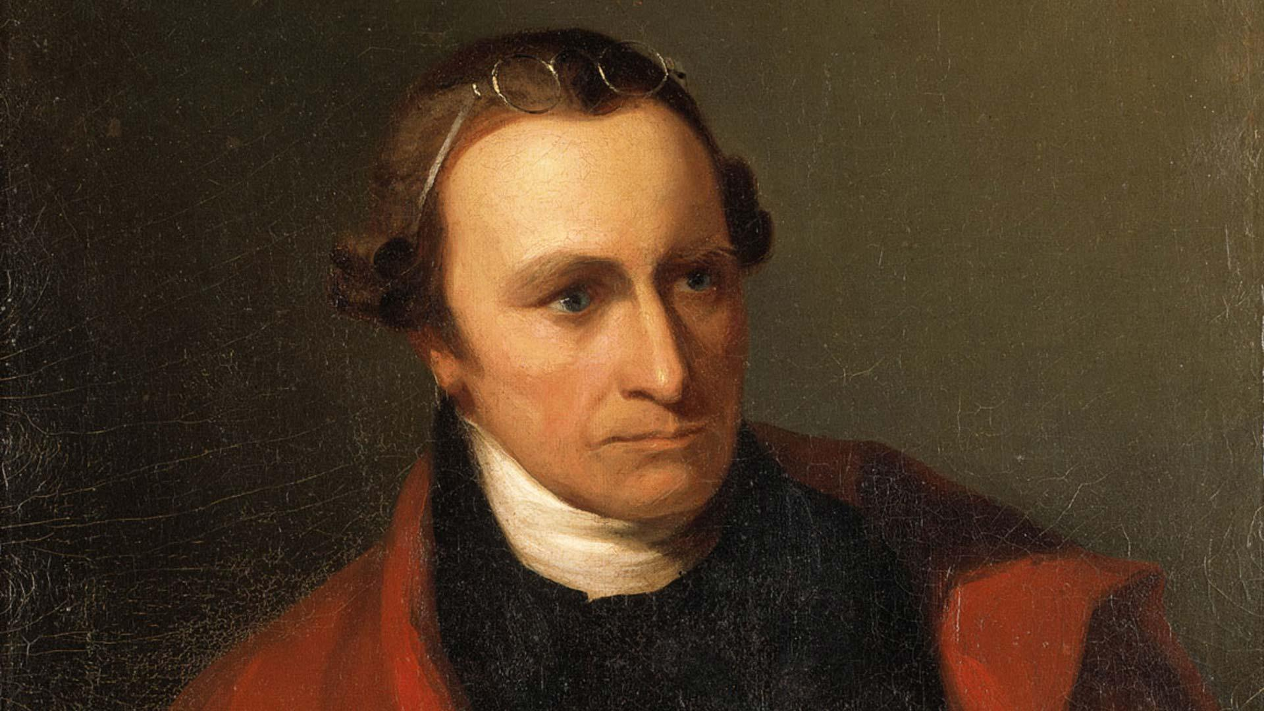
The Incendiary American Giants of Their Day
We draw on the words of Paine, Jefferson and Henry who’s outcry echoes across chasms of history saying, “give me liberty or give me death” as well as “And what country can preserve its liberties if their rulers are not warned from time to time that their people preserve the spirit of resistance? Let them take arms. The remedy is to set them right as to facts, pardon and pacify them. What signify a few lives lost in a century or two? The tree of liberty must be refreshed from time to time with the blood of patriots and tyrants”
They “in their own time, faced the issues of their day, cut through the red tape of precedent, legalism and constitutionalism with a sword, made a revolution, killed off a dying outworn system, and opened up a new chapter in world history.”
These “American giants were the international incendiaries of their day”, impelling the French Revolution. Browder states that The Declaration of Independence was for that time what the Communist Manifesto is for ours. The reactionary voices of our time speak of Lenin and Stalin the same way the European reactionaries spoke of Washington and Jefferson.
Thomas Paine (top left) Thomas Jefferson (right) and Patrick Henry (lower left)

Slide 32
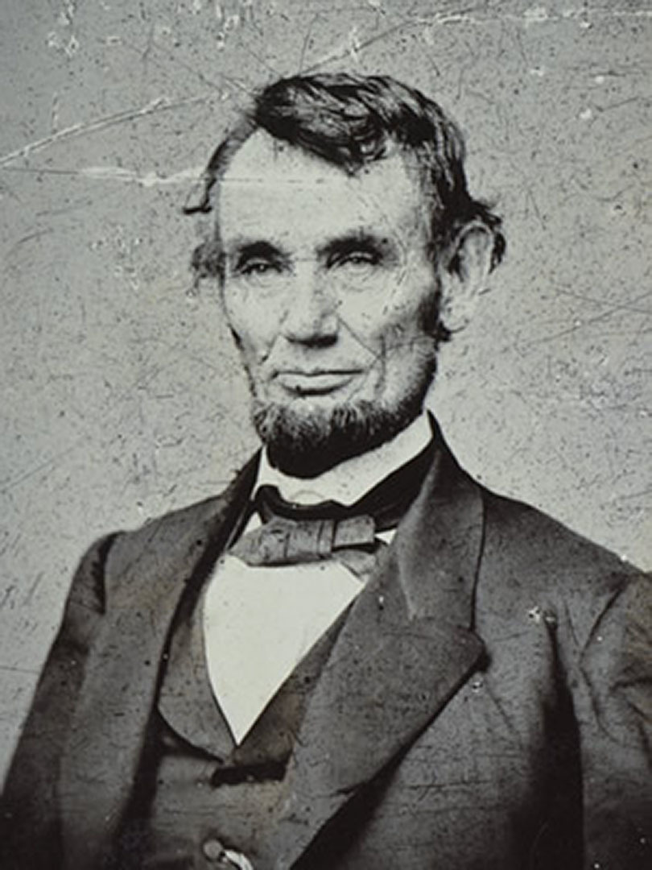
Lincoln the Revolutionary
The American revolutionaries were confronted and harried by counter-revolutionary victories, and these were codified in the Constitution of 1787 and in the “Alien and Sedition Laws”. But,the masses were not defeated. Abraham Lincoln made open war on chattel slavery and that specific flaw in hearts of men who would claim persons as property. Lincoln’s words on revolution were “This Country, with its institutions, belongs to the people who inhabit it. Whenever they shall grow weary of the existing government, they can exercise their constitutional right of amending it, or their revolutionary right to dismember and overthrow it.”
Lincoln's words paraphrased the Declaration of Independence, the document for which the national celebration of July 4th, stands in memorial. It states “Whenever any form of government becomes destructive of these ends (life, liberty and the pursuit of happiness) it is the right of the people to alter or abolish it and to institute a new government, laying its foundations on such principles and organizing its powers in such forms, as to them shall seem most likely to effect their safety and happiness… When long train of abuses and usurpations, pursuing invariably the same object evinces a design to reduce them (the masses) under absolute despotism, it is their right, it is their duty, to throw off such government and to provide new guards for their future security.”

Slide 33
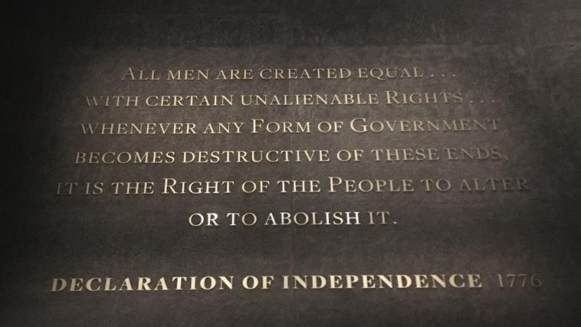
The Right of the People to Alter or to Abolish It
Lincoln's words paraphrased the Declaration of Independence, the document for which the national celebration of July 4th, stands in memorial. It states “Whenever any form of government becomes destructive of these ends (life, liberty and the pursuit of happiness) it is the right of the people to alter or abolish it and to institute a new government, laying its foundations on such principles and organizing its powers in such forms, as to them shall seem most likely to effect their safety and happiness… When long train of abuses and usurpations, pursuing invariably the same object evinces a design to reduce them (the masses) under absolute despotism, it is their right, it is their duty, to throw off such government and to provide new guards for their future security.”
Plaque on the wall of the first floor of the Museum of Museum of African-American History and Culture. The bottom level of which was designed to evoke the feeling of a slave ship. Washington D.C.

Slide 34
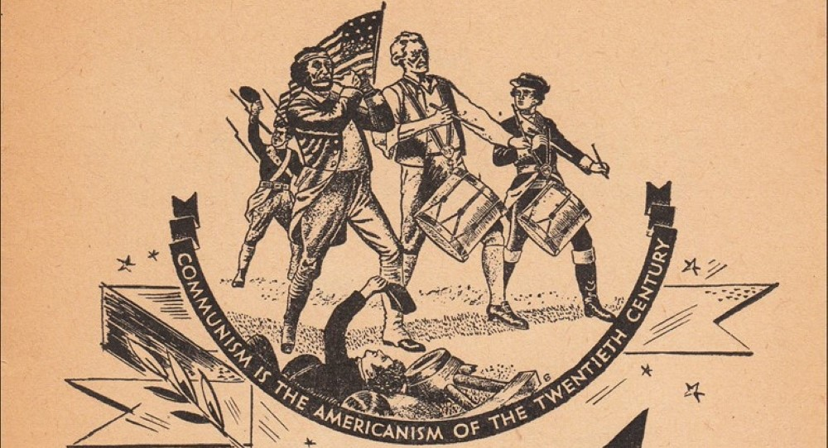
American Communists claim American Revolutionary Traditions
The American tradition is firmly rooted in the revolutionary ethic and without this to anchor it to its tradition of struggle to overcome great injustices, its devolution leaves behind a husk in whose shadow scoundrels find their last refuge.
Today’s popular notion of what is meant by “justice” and “revolution” bear no resemblance to what was meant by the American revolutionaries and Lincoln, because their premise is found only within the revolutionary rights belonging solely to the masses. The masses have long been misguided and ideologically divorced from a sense of identification with class . This class consciousness, the awareness of this identity, has suffered nearly complete obliteration. But all is not lost. A few who remember, do still remain.
Browder stated “We Communists claim the revolutionary traditions of Americanism. We are the only ones who consciously continue those traditions and apply them to the problems of today. We are the Americans and Communism is the Americanism of the twentieth century.”
Communists Are Inheritors of Revolutionary Traditions of ’76’ from the Daily Worker. Vol. 13 No. 160. July 4, 1936

Slide 35
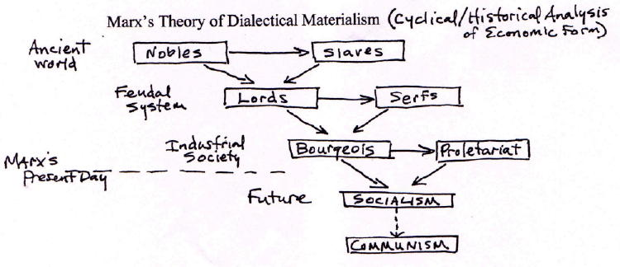
Communism Forges Liberty from Capitalism’s Chains
Browder explains that these claims are made dialectically. He is not suggesting a return to the late 18th century’s emerging capitalism being freed from feudalism as an economic standard.
Instead, and again, dialectically appreciating the emergence of responses to 20th century problems as a result of interactions between 20th century forces, Browder suggests that since 20th century capitalism’s expansive productive capacity has outgrown capitalism as ideology, the ideological hand on the tiller of modern modes of production must be replaced in order to use it justly for comprehensive benefit to humankind.
Liberty is the project for which Communism is purposed and for which Capitalism never was.
Diagram of Historical Materialism-Applied Dialectical Materialism as Social Science

Slide 36
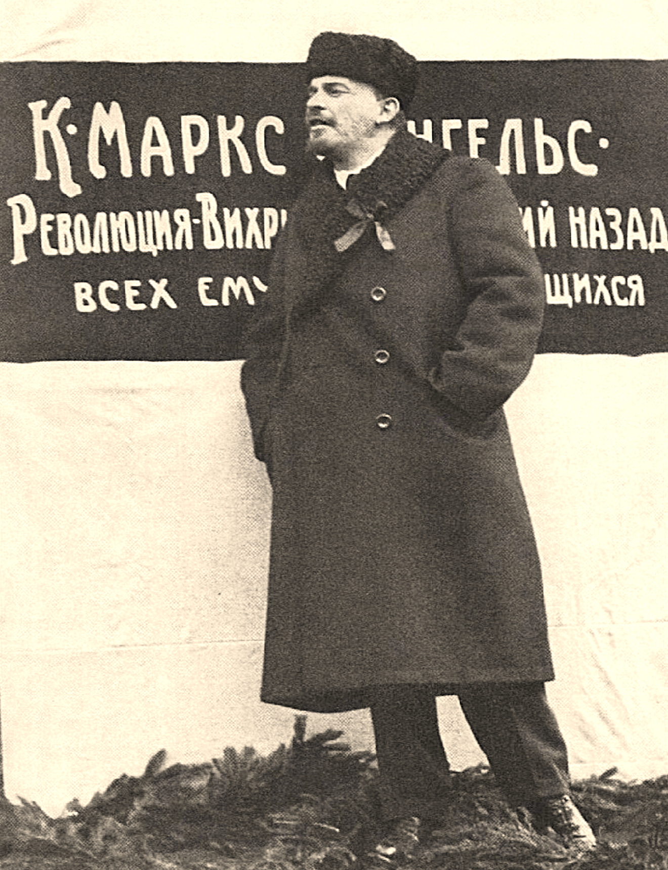
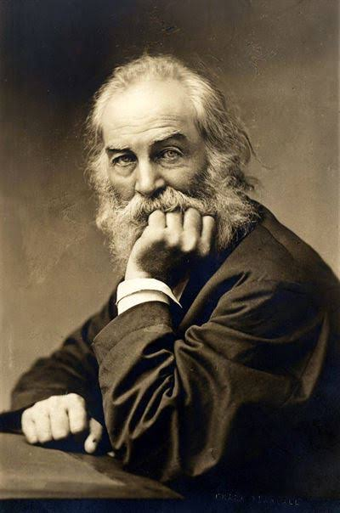
Browder’s Americanist Historiography
The modern Americanism’s revolutionary objective as Browder envisions, is to promote human progress. By human progress, Browder means the ongoing refining of processes to anticipate and meet the ever-changing needs of an expanding, advancing humanity. To retain the knowledge and advantages of previous progressive efforts but to constantly, intentionally and institutionally advance the quality of the relationship between the means of creating reality and the very product of these means; reality itself.
In this way, Browder asserts that “This is how we American Communists read the history of our country. This is what we mean by Americanism. This is how we love our country, with the same burning love Lenin bore for Russia, his native land Like Lenin, we will fight to free our land from the blood-sucking reactionaries, place it in the hands of the masses, bring it into the international brotherhood of World Union of Soviet Republics, and realize the prophetic lines of Walt Whitman: “We have adhered too long to petty limits…the time has come to enfold the world.”

Slide 37
Discussion & Wrap Up

Slide 38
Announcements
PCUSA Cell Chairs need to call members of their cells to remind them about attendance.
PCUSA Cell members are reminded attendance at the Continuing Education class of Jones-Foster every first Wednesday of the month is required.
The next issue of New Masses (2026) has begun production. If you have art you want us to feature, email it to info@partyofcommunistsusa.net.

Slide 39
Volunteers Needed!
We are in need of volunteers for the staff of the People’s School! Here’s a few roles we need filled:
People to help manage posting on our social media and podcast platforms
Video Editors, Audio Editors, Graphic Designers, Artists, Narrators
Web Controls, Moderators
Email info@peoplesschool.us if you’re interested and try to attend our next staff meeting if possible.

Slide 40


Slide 41

View From Left Field
https://viewfromleftfield.libsyn.com
The Old PSMLS Youtube is now the Youtube of View From Left Field, a podcast of analysis and discussion of current events from a progressive perspective.
Like the Youtube videos and subscribe with 5 star ratings on your podcast platforms.

Slide 42

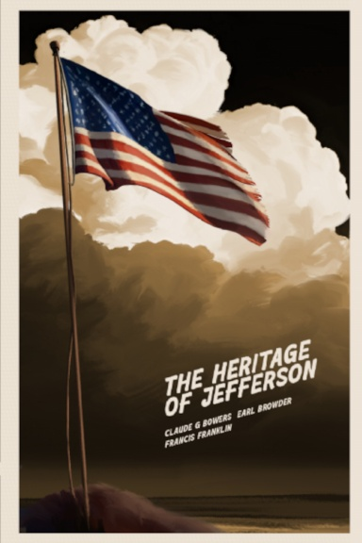
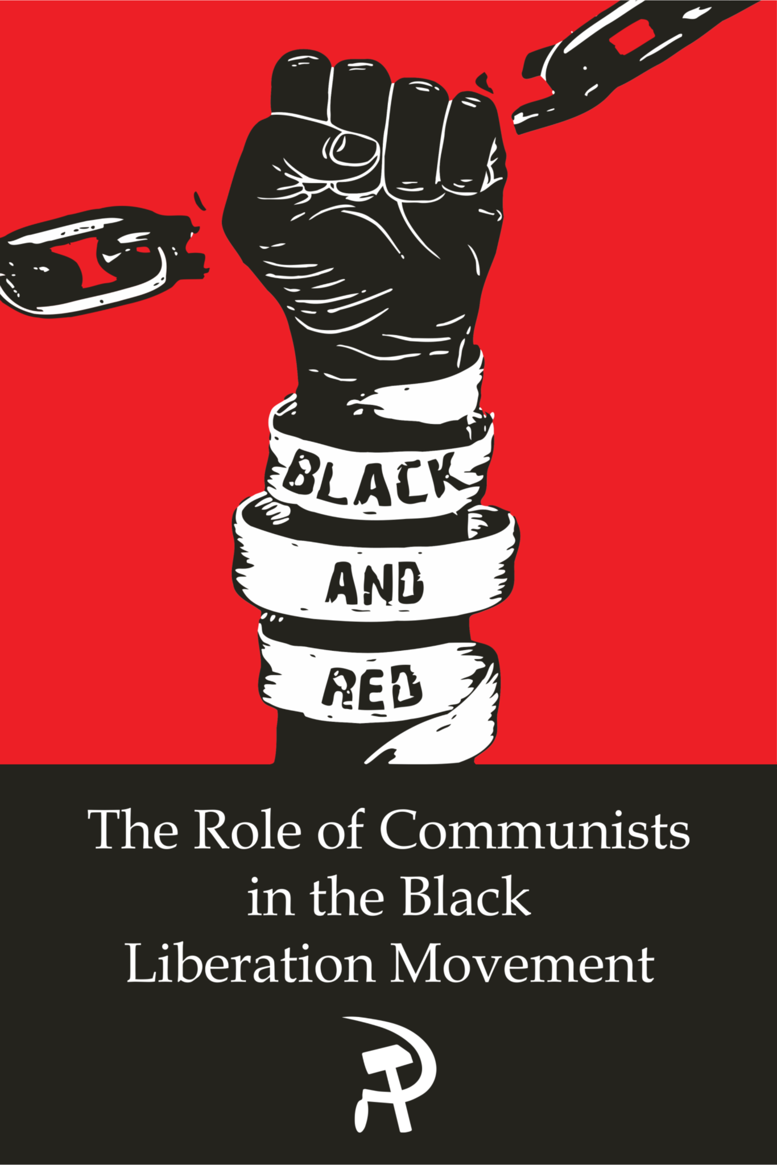
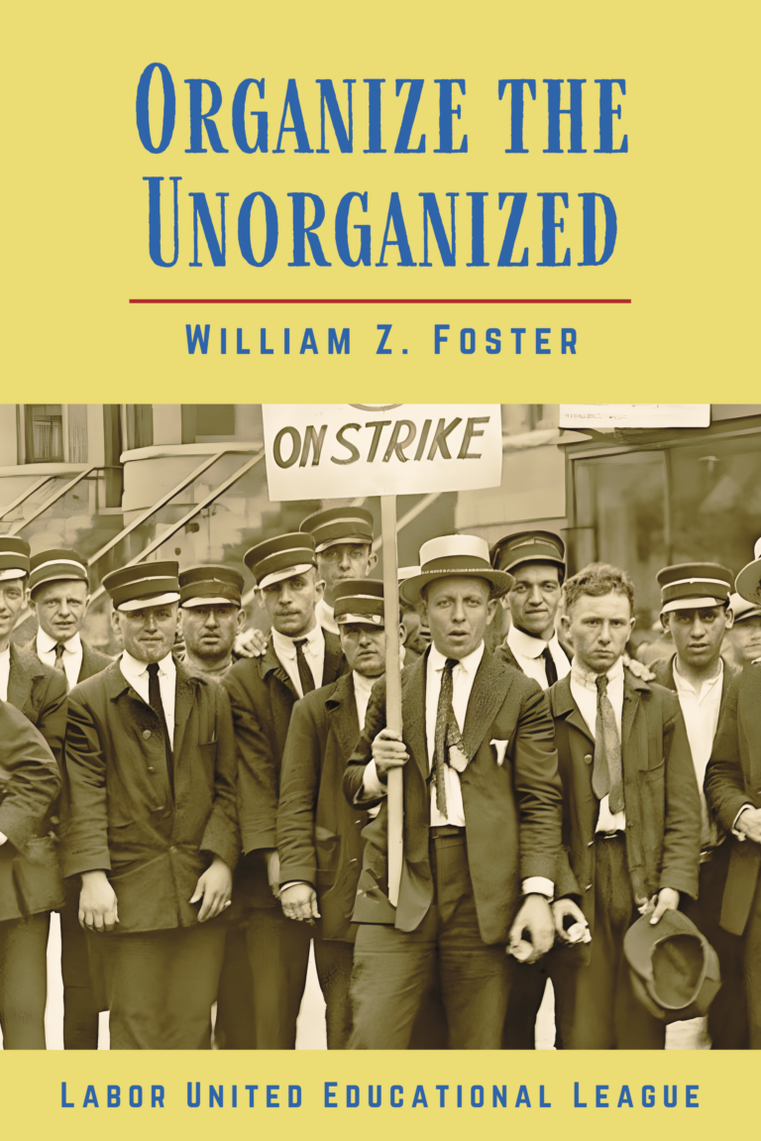

New Outlook Publishers
newoutlookpublishers.store
Relevant and Latest Releases

Slide 43



Harry Bridges School of Labor
luel.us/laborschool/
The Harry Bridges School of Labor is a monthly class covering a variety of topics aimed at building class consciousness among union members. For class schedule and other information, please visit the website at luel.us/laborschool.

Slide 44
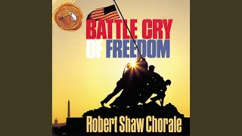
Yankee Doodle (Fife & Drum) - Revolutionary War Song

