Slide 1

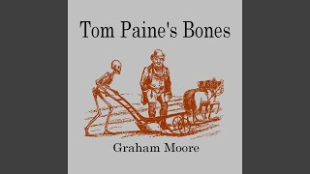
Tom Paine’s Bones by Graham Moore

Slide 2
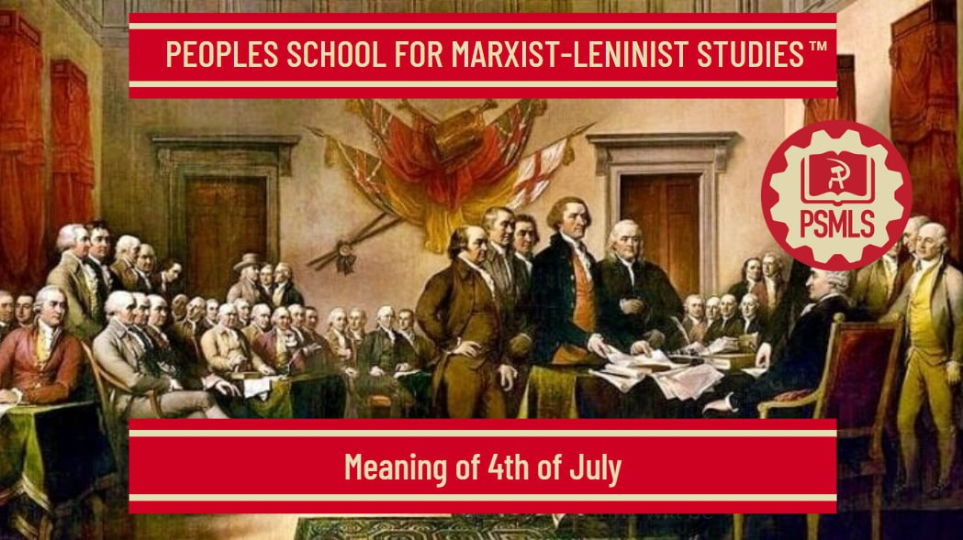
PSMLS 7/8/2025

Slide 3
What we’ll be learning today:
Section 1: Enlightenment Era ideal which inspired the American Revolution
Section 2: American Independence was Progressive
Section 3: Why Marxists defend American Independence

Slide 4
Enlightenment Era Ideals

Slide 5
Philosophy of the Enlightenment Era
In the 18th century, the philosophical movement of Enlightenment emerged.
It championed ideals such as reason, individual liberty, progress, tolerance and the separation of church and state.
  The Enlightenment placed great emphasis on the power of human reason to understand the world and solve problems, contrasting with reliance on tradition, superstition, and religious dogma.
  Enlightenment thinkers advocated for individual rights and freedoms, including freedom of thought, speech, and religion, as well as the right to participate in government.
  The Enlightenment fostered a belief in the possibility of human progress and societal improvement through reason and scientific advancement.
  Tolerance, particularly religious tolerance, was a central tenet, as thinkers believed that diverse perspectives and beliefs could coexist peacefully.

Slide 6
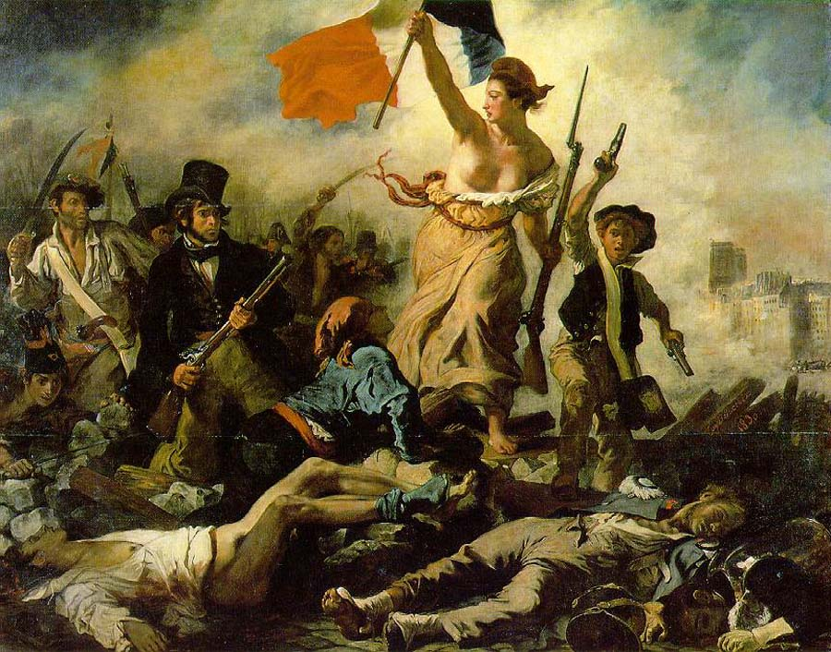
Philosophy of the Enlightenment Era
  Enlightenment thinkers argued for a clear distinction between religious institutions and the state, preventing religious authorities from interfering in government matters.
  The philosophy promoted the idea of constitutional government and the rule of law, with power derived from the consent of the governed rather than by divine right or hereditary privilege.
These ideas challenged traditional authority and emphasized the power of human reason to improve society and individual lives
Key thinkers include John Locke, Voltaire, Montesquieu, Rousseau, and Immanuel Kant, among others.

Slide 7
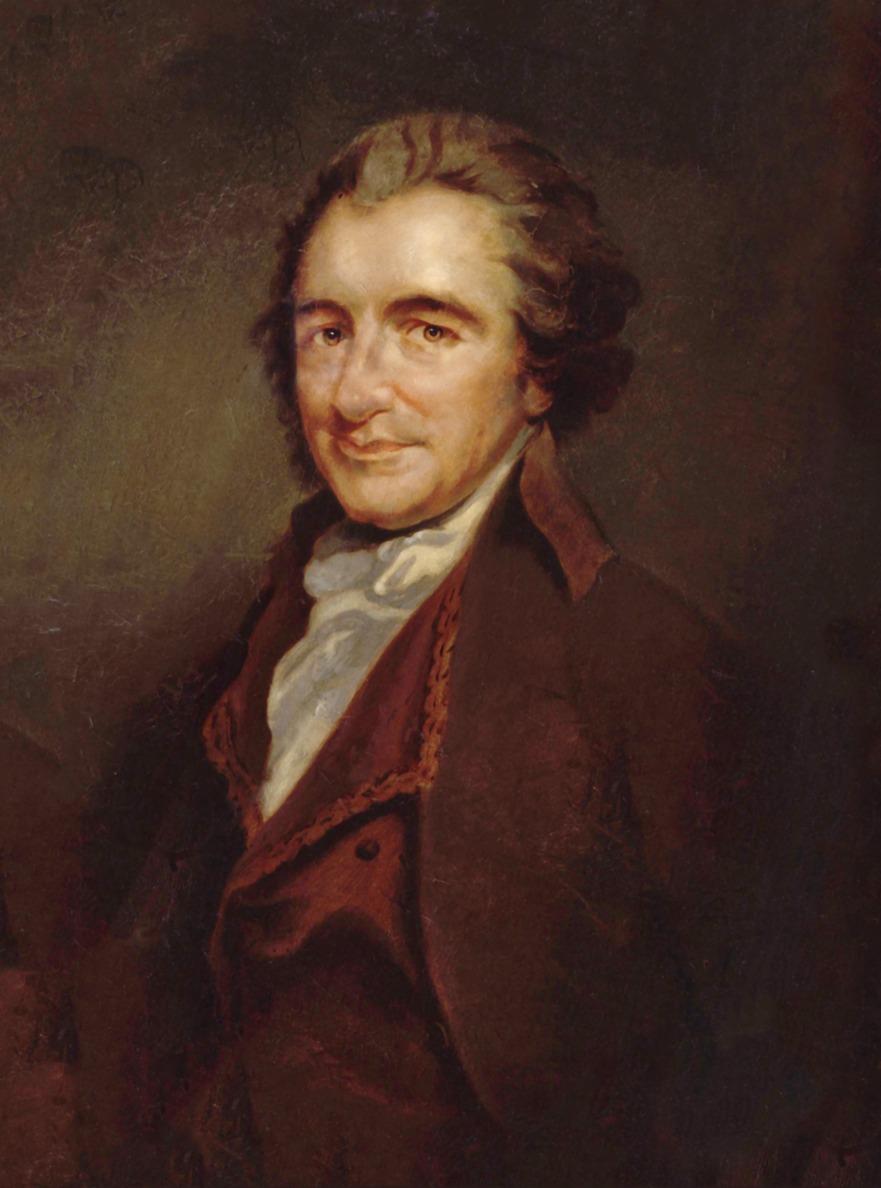
Common Sense by Thomas Paine
Common Sense is a pamphlet written by Thomas Paine in 1775 advocating independence from Great Britain to people in the Thirteen Colonies.
He argued for two main points:
  (1) independence from England and
  (2) the creation of a democratic republic. Paine avoided flowery prose. He wrote in the language of the people, often quoting the Bible in his arguments. Most people in America had a working knowledge of the Bible, so his arguments rang true.

Slide 8
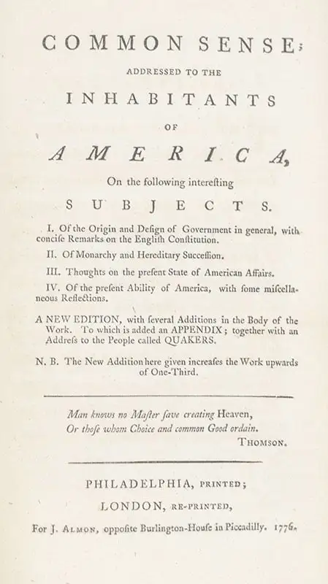
Common Sense by Thomas Paine
Paine's pamphlet significantly impacted the American Revolution by shifting public opinion towards independence from British rule. He provided a clear and compelling case for independence, moving many colonists away from reconciliation with Britain towards the idea of a separate nation.
The pamphlet's widespread popularity and accessible language helped unite diverse groups of colonists under the banner of independence. Paine's use of plain language made political arguments accessible to a larger audience, including those who might not have engaged with more scholarly or abstract texts.
It fueled the revolutionary spirit by articulating the colonists' grievances and aspirations for self-governance.

Slide 9
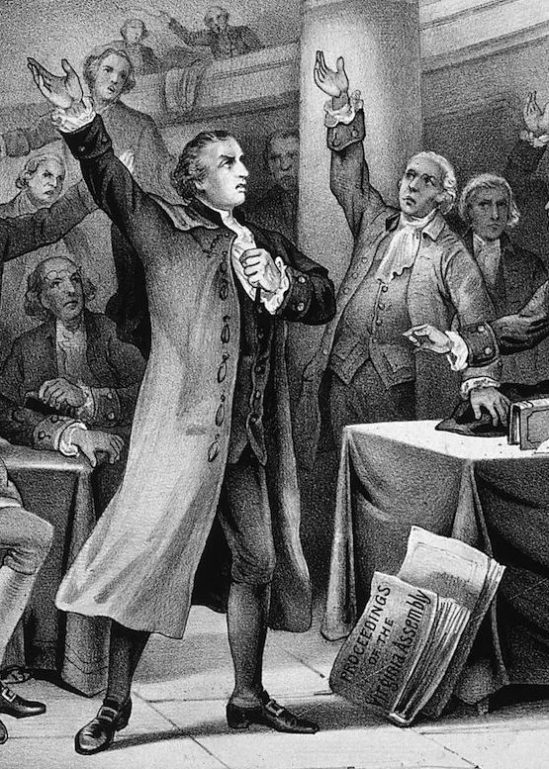
Give Me Liberty Or Give Me Death by Patrick Henry
The famous line comes from a speech Patrick Henry made to the Second Virginia Convention on March 23, 1775.
The goal of the convention was to decide how to handle Britain’s military threat. Henry believed in fighting for independence—the speech’s immediate goal was to convince Virginia to raise a militia—while others wanted to compromise with Britain.
Henry is credited with having swung the balance in convincing the convention to pass a resolution delivering Virginian troops for the Revolutionary War.

Slide 10
Give Me Liberty Or Give Me Death by Patrick Henry
In the speech, Henry acknowledges that the colonists’ hopes of peaceful resolution are normal; however, he urges them to consider that they may be ignoring Great Britain’s unjust treatment. He argues that they must open their ears and eyes and “know the whole truth,” no matter how much anguish it causes.
He explains that he is confident, based on previous experience with Britain’s behavior, that the British will continue to behave the same way. Henry suggests that the colonists have done everything they can to be civil to the British, but their requests have been met with violence and disregard “for the last ten years”. Having explored all nonviolent avenues, Henry says, the colonists cannot simply hope for peace any longer: If the colonists want freedom, then they need to fight for it.
Henry suggests that the current state of peace is an illusion: Britain’s actions signal that war has already begun. He ends by reiterating that he would rather die than continue to live in “chains,” saying, “I know not what course others may take; but as for me, give me liberty, or give me death!”

Slide 11
Discussion

Slide 12
American Independence was Progressive

Slide 13
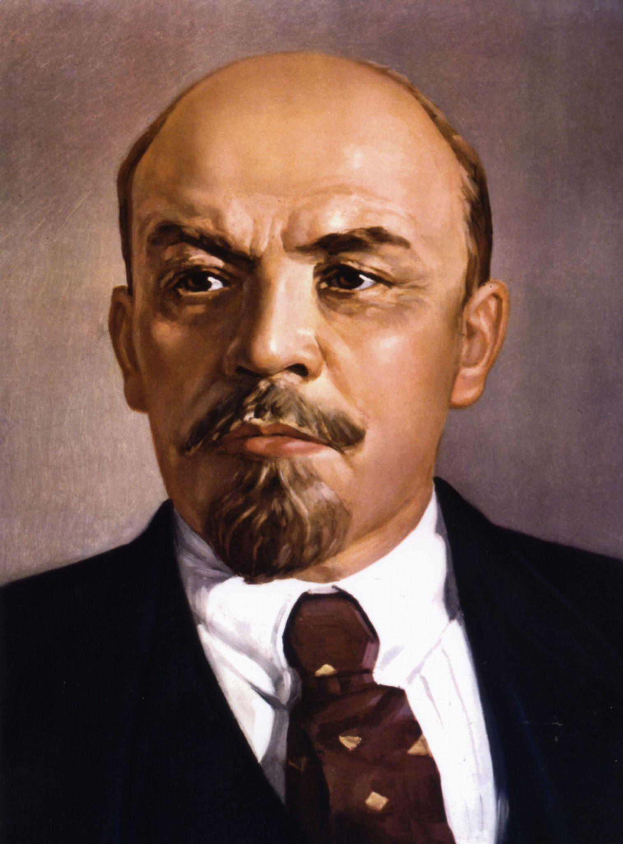
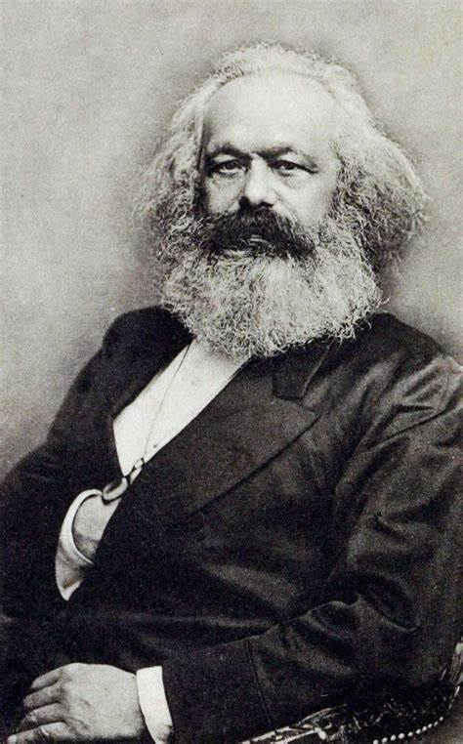
Lenin and Marx remarks on American Revolution
The history of modern, civilised America opened with one of those great, really liberating, really revolutionary wars of which there have been so few compared to the vast number of wars of conquest which, like the present imperialist war, were caused by squabbles among kings, landowners or capitalists over the division of usurped lands or ill-gotten gains. That was the war the American people waged against the British robbers who oppressed America and held her in colonial slavery, in the same way as these “civilised” bloodsuckers are still oppressing and holding in colonial slavery hundreds of millions of people in India, Egypt, and all parts of the world. - Lenin in Letter to the American Workers
The workingmen of Europe feel sure that, as the American War of Independence initiated a new era of ascendancy for the middle class, so the American Antislavery War will do for the working classes. They consider it an earnest of the epoch to come that it fell to the lot of Abraham Lincoln, the single-minded son of the working class, to lead his country through the matchless struggle for the rescue of an enchained race and the reconstruction of a social world. - Marx in Address of the International Working Men's Association to Abraham Lincoln, President of the United States of America (1865)

Slide 14
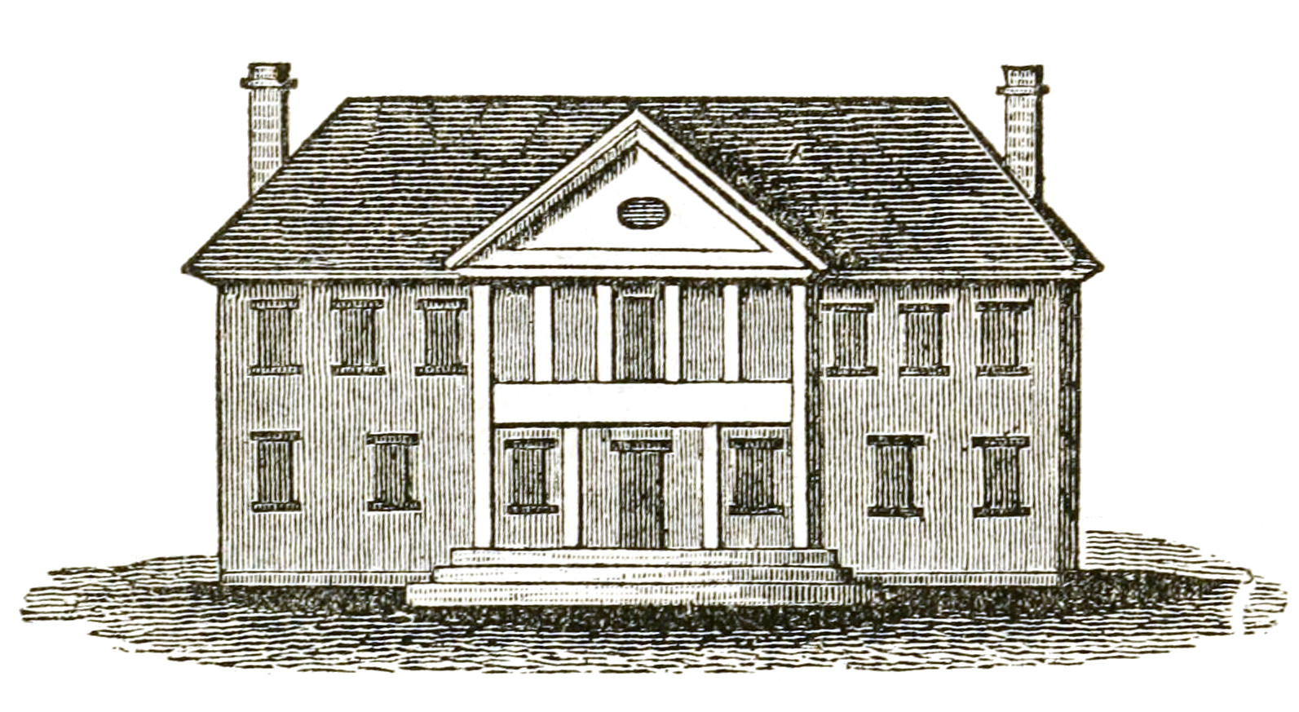
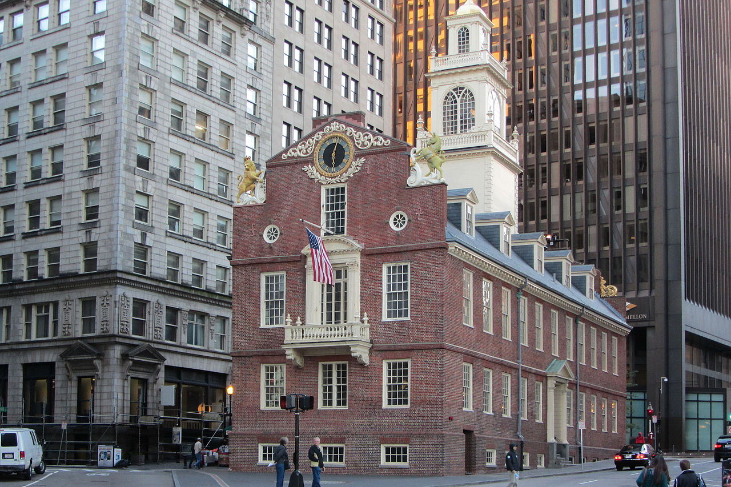
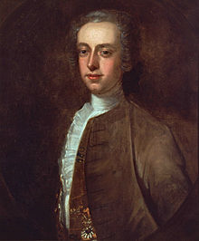
A summary of Colonial American governments
Each colony had limited self government modeled on the British model of government. With a unelected Governor appointed by the British monarch directly and answerable to them alone. They were responsible for upholding the monarch’s wishes in the colony and protect royal power. They could veto any legislation, send the assemblies home whenever they wished.
Below them was an elected assembly which often had different names but they functioned very similar. They only voters were white males who owned sufficient property to be “independent” this excluded laborers, small farmers, indentured servants, as well as African-Americans (free or enslaved), Native Americans (who were considered outside the colonies anyway) and women.
There was conflict between the unelected governor and the elected assembly but this was mostly based on each branch wanting more power rather than a genuine fight for democracy. But these conflicts would come to a head during the Revolution as the Royal governors fought against their subjects to defend their jobs and their monarch.

Slide 15
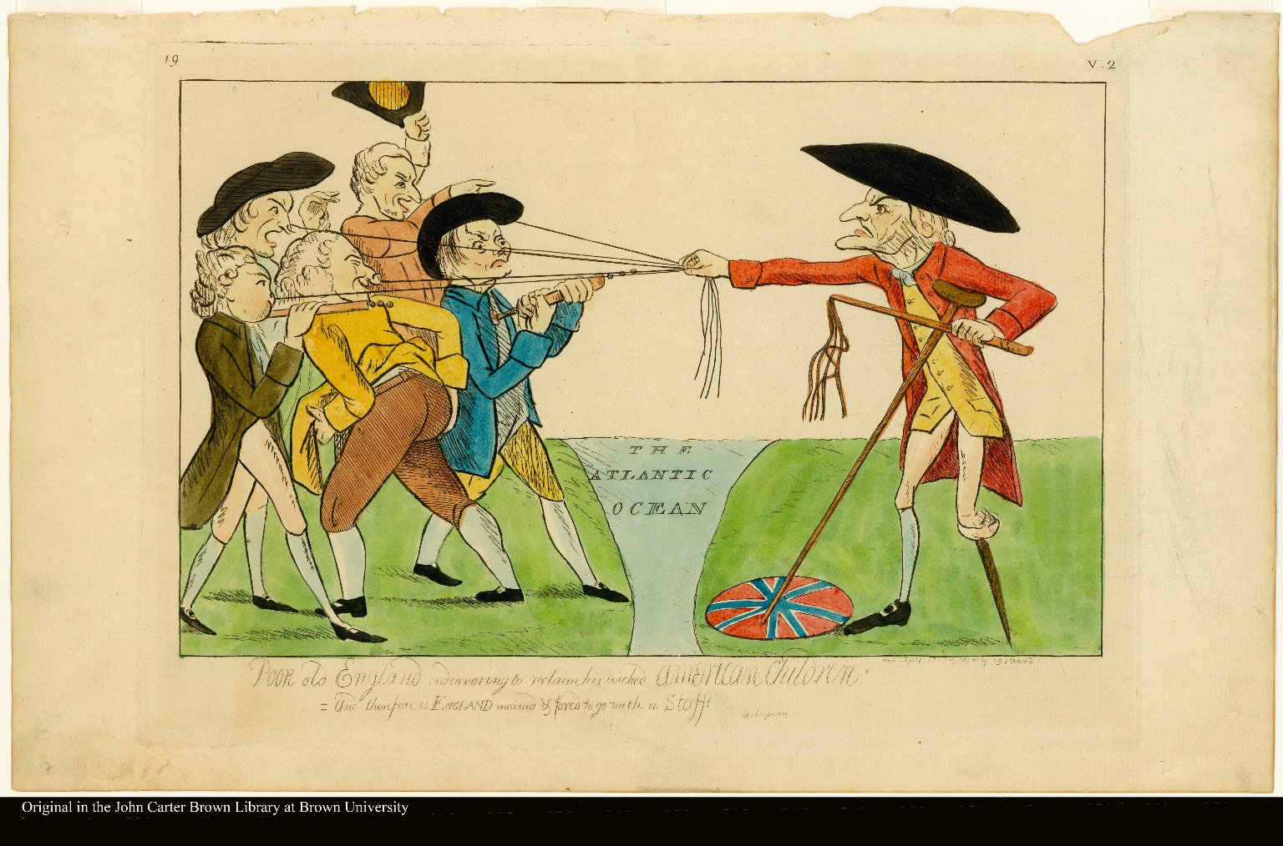
Effects of the Seven Years War cont.
Political and economic effects of the Seven Years War
“The sun never shined on a cause of greater worth. ’Tis not the affair of a city, a country, a province, or a kingdom, but of a continent of at least one eighth part of the habitable globe.” the removal of the French from the territory, the American colonists saw the true nature of the relationship with the British empire
  “The colonists felt the weight of British policy in very concrete and provoking ways. They saw increased centralization of administration; enhanced militarization of colonial life and the stationing of thousands of soldiers in America; increasing British restrictions upon established civil rights. They saw efforts to establish an Episcopate in America; whittle away the political democracy that had been established in certain of the colonies and inhibit its appearance elsewhere; make the judiciary in the colonies quite independent of the colonists or their legislatures; vitiate the powers of the colonial legislatures in additional ways, particularly by curbing their power over the purse; confine the colonists within a narrow strip of land hugging the seacoast; rigidly enforce the commercial and manufacturing restrictions. They saw an ever more prominent role being given to the British navy; trials without jury established in certain colonial cases; swarms of officeholders moving in from England to take over the American civil service; writs of assistance being issued and the sanctity of their homes violated; coveys of informers crowding the ports and being paid for bringing misery to others; new and burdensome systems of taxation concocted and levied; new restraints placed upon their economic development, and monopolies given to favored English companies or individualist summed itself up, in the opinion of Thomas Jefferson, expressed in 1774, as “a deliberate and systematical plan of reducing us to slavery.””
- Passage from the American Revolution by Herbert Aptheker

Slide 16

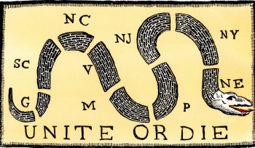
From American Revolution by Herbert Aptheker
The American Revolution was the result of the interpenetration of three currents: The fundamental conflict in interest between the rulers of the colonizing power and the vast majority of the colonists; the class stratification within the colonies themselves and the resulting class struggles that marked colonial history which almost always found the British imperial power as a bulwark of the reactionary or the conservative interests in such struggles; and the developing sense of American nationality. The Nature of the Revolution transcending class lines, which resulted from the varied origins of the colonies’ peoples, their physical separation from England, the different fauna and flora and climate of their surroundings, their different problems and interests, their own developing culture and psychology and even language, their own common history, and from their own experience of common hostility— varying in degree with place and time—towards the powers that-be in England.
Grand Union Flag adopted in December 1775 and made obsolete in June 1777 after the Flag Act of 1777 was passed. It represented the Unity of the 13 Colonies against Britain.
Unite or Die originally Join or Die was Political Cartoon by Benjamin Franklin originally for the Seven Years War but revived in the lead up to the American Revolution.

Slide 17
American Independence: Limited but still Revolutionary
History cannot be viewed with 21st Century glasses - Cde. Dr. Angelo D’Angelo
When viewing the results and contributions of American Independence, it is important not to overemphasize our level of consciousness today when viewing historical events and movements
That said, Communists have never ignored the limitations of the American revolution either. While we acknowledge the national liberation, we see that full access to democracy was limited to wealthy, landowning, white men.
This resulted in the revolution being cut short. This resulted in the continuing of slavery, native genocide, sexual discrimination, etc.
It is important to state these facts while keeping in mind that the inheritors of the American Revolution kept the tradition alive.
The American Revolution set in motion the rapid industrialization of the country which gave birth to a militant working class movement
The legacy of the Revolution also intensified the anti-slavery/abolitionist movement of the 19th Century to complete the bourgeois democratic revolution and end slavery.
The same revolutionary tradition gave rise to the Women’s Suffrage, Civil Rights, the anti-imperialist, and Socialist and Communist movements of United States.
The point is that with its limitations, the national liberation of the US from Britain helped differentiate the various classes of American society in which one, the working class and their allies, continued the progressive struggle against the reactionary big capitalists and slave-owning gentry that resisted forward movement.

Slide 18
Discussion

Slide 19
Why Marxists Defend American Independence

Slide 20

From Earl Browder’s Concerning America’s Revolutionary Traditions
One of the most serious contributions made by the Communist Party to the American people, first of all the working class, has been its leading role in the general rediscovery of American history, with the revitalization of the democratic and revolutionary traditions that followed. During the past three years the Party has proved the correctness of its claim to be the inheritor of the revolutionary traditions of America.

Slide 21
From Earl Browder’s Concerning America’s Revolutionary Traditions
The purpose of the present brief article is, from the above approach, to discuss the value and the limitations of the popular slogan: "Communism Is Twentieth Century Americanism."
It is unquestionable that this slogan has played a positive role and served to dissolve the remnants of the old sectarian and nihilistic approach to American national traditions which we inherited from the pre-war Socialist Party, and which the Socialists had taken over uncritically from the mechanical debunking school of historical study founded by Charles Beard.…but its meritorious desire to dig beneath the sonorous rhetoric of conventional history to the underlying realities was gradually transformed into the fixed, idea that historical analysis consists in reducing the rich pattern and colors of social development to a uniform gray monotone of human greed, unprincipledness, and lust for power, an undifferentiated mass of depravity from which the intelligent student finally turned in revulsion to an all-embracing skepticism or nihilism. No progress at all was possible until we broke out of this blind alley into which Beard had led progressive study of history in the United States. It was in the first stages of our offensive against Beardism, and against openly reactionary Red-baiting, that there arose (one might almost say spontaneously) the slogan: "Communism Is Twentieth Century Americanism”

Slide 22

From Earl Browder’s Concerning America’s Revolutionary Traditions
In the early summer of 1935, I wrote for the New Masses an article entitled "Who Are the Americans?", as one of a series later incorporated as the first chapter in the book What Is Communism. Answering the Red-baiters' challenge: "Why don't you go back where you came from?" and making a head-on assault against the cynical and skeptical attitude toward Americanism, I made the declaration: "We Are the Americans, and Communism Is the Americanism of the Twentieth
Century."

Slide 23
From Earl Browder’s Concerning America’s Revolutionary Traditions
In this question is involved the basic problem of the relation between communism (or socialism), which is international and worldwide, and nationality, which is specific and concrete to one part of the world. Here we should recall Stalin's famous definition of the new society as it arises concretely. The new society is the expression of principles universally valid, but its form is determined by the character of the nation in which it arises, by all the forces that have contributed to produce that nation in its specific and concrete peculiarities-in short, by its history and
traditions.
Thus, the critical re-examination of our slogan leads us to the study of the basic principles of Marxism-Leninism, of dialectical and historical materialism. It is the concrete application of these principles which led us to the rediscovery of the American revolutionary traditions, and to our general revaluation of American history. Our study of American history is, in turn,vitalizing and deepening our grasp of the principles of Marxism-Leninism. Where in the past we depended almost entirely upon the theoretical works which concretized these principles in the history of European countries, we are now facing the creative task of tracing out the working of these principles in our own national history.

Slide 24

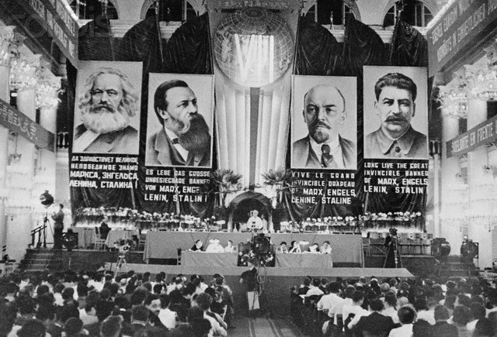
From Earl Browder’s July 4th, the American Tradition, and Socialism
We must address ourselves, however, to those friends and potential allies within the democratic camp, who in a different form entirely see a contradiction between the Communist support of the democratic program today and our aspirations for socialism tomorrow; who see in socialism itself–actual socialism, not the reactionary bogey-man–something alien to the democratic tradition of Americanism. We need to make clear to them, and to ourselves, the true relation between the preservation of democracy today and the achievement of socialism tomorrow.

Slide 25
Browder’s writings, which were written during Popular Front period of the 30s and 40s, clearly demonstrates the importance of understanding July 4th and the revolutionary tradition of the American people.
A mass movement that can push us towards socialism, can only be done if organically connected with the American masses. Browder’s analysis was as much a defense against red-baiting as it was a defense of the communist name from the sectarian ultra-left that adopts the stereotyped abstracts that the red-baiters defined. In this way, by connecting communism to American tradition, he denies the ultra-right and ultra-left attempts at preventing communists from immersing ourselves with our democratic allies.

Slide 26
Discussion & New Members Introductions

Slide 27
New Member Introductions
What is your name, pronouns and state (or country/territory)?
Where do you work? Is it unionized?
How did you find out about the People’s School?
What do you think about tonight's class?

Slide 28
Discussion & Wrap Up

Slide 29
Announcements
The PSMLS has recovered our old Youtube account we lost to wreckers in 2022 and we have re-uploaded all our old videos. Like, subscribe, and check out what subjects we covered prior and what we aware saying in the past.
PCUSA Cell Chairs need to call members of their cells to remind them about attendance.
The next issue of New Masses (2025) has begun production. If you have art you want us to feature, email it to info@partyofcommunistsusa.net.

Slide 30
Volunteers Needed!
We are in need of volunteers for the staff of the People’s School! Here’s a few roles we need filled:
People to help manage posting on our social media and podcast platforms
Video Editors, Audio Editors, Graphic Designers, Artists, Narrators
Web Controls, Moderators
Email info@peoplesschool.us if you’re interested and try to attend our next staff meeting if possible.

Slide 31










PSMLS Propaganda
peoplesschool.us/media & peoplesschool.us/store
Materials to help promote the school!

Slide 32

View From Left Field
https://viewfromleftfield.libsyn.com
The Old PSMLS Youtube is now the Youtube of View From Left Field, a podcast of analysis and discussion of current events from a progressive perspective.
Like the Youtube videos and subscribe with 5 star ratings on your podcast platforms.

Slide 33


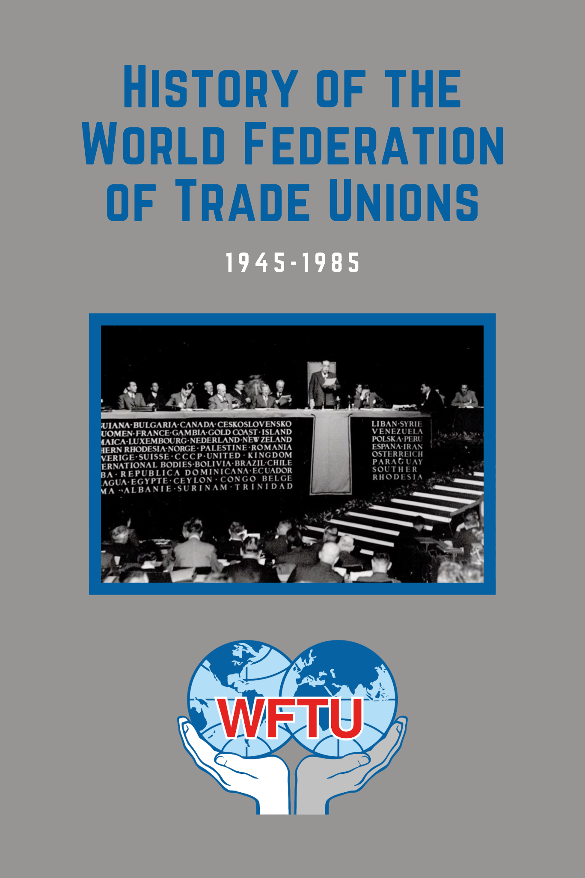
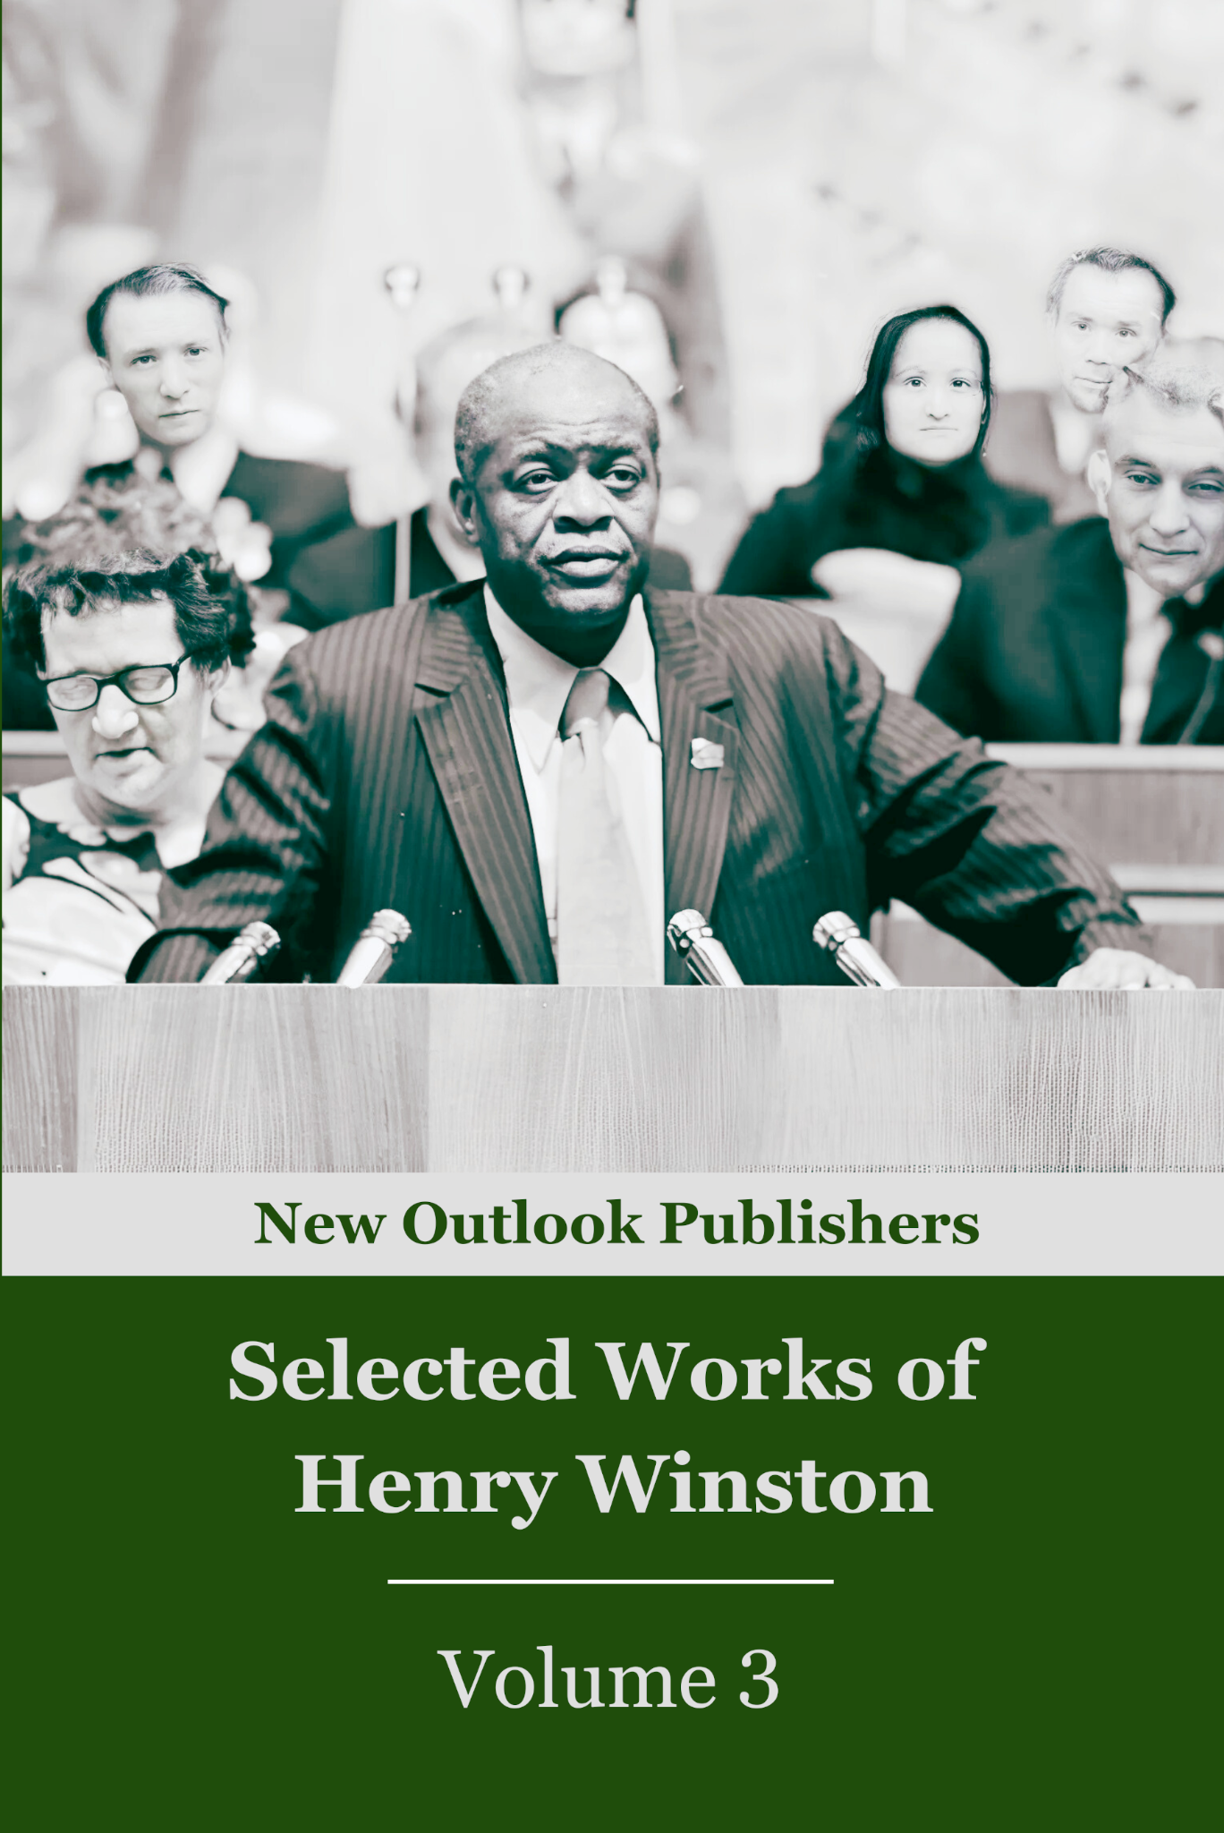

New Outlook Publishers
newoutlookpublishers.store
Relevant and Latest Releases

Slide 34



Harry Bridges School of Labor
luel.us/laborschool/
The Harry Bridges School of Labor is a monthly class held 2x per month. Classes cover a variety of topics aimed at building class conscious among union members.
August’s class will be a viewing of “Salt of the Earth.” Class will be Wednesday August 6, 2025 at 8pm EST/6pm PST and Saturday August 9, 2025 at 7pm EST/4pm PST.

Slide 35

American Revolutionary War Song: Ballad of the Green Mountain Boys

