Slide 1

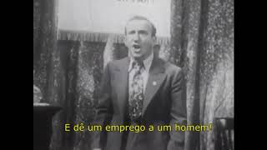
Give a man a job - American New Deal song

Slide 2
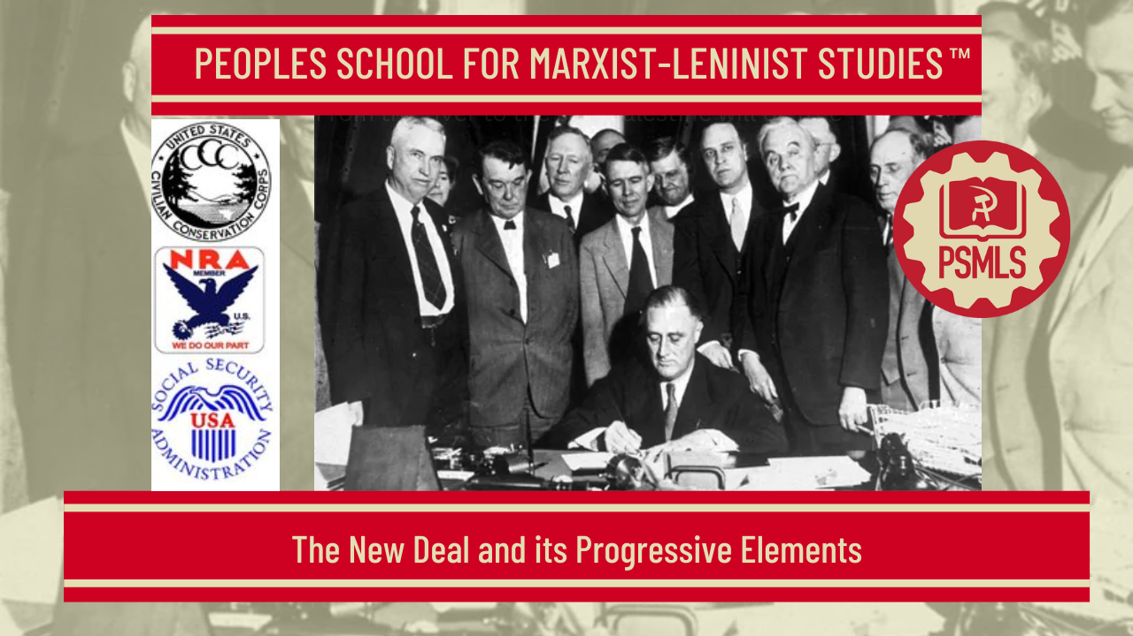
PSMLS 8/19/25

Slide 3
What we’ll be learning today:
Section 1: The New Deal and the Business Plot
Section 2: Benefits of New Deal Still Felt Today
Section 3: Left-Center Unity Today

Slide 4
The New Deal and the Business Plot

Slide 5
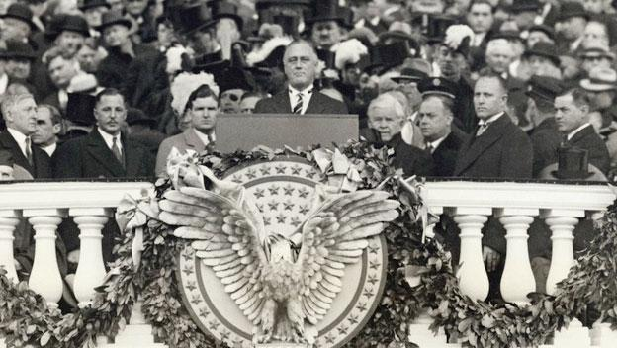
Confronting the Great Depression
FDR's mandate as a first-term President was clear and challenging: rescue the United States from the throes of its worst depression in history. Economic conditions had deteriorated in the four months between FDR's election and his inauguration. Unemployment grew to over twenty-five percent of the nation's workforce, with more than twelve million Americans out of work. A new wave of bank failures hit in February 1933. Upon accepting the Democratic nomination, FDR had promised a "New Deal" to help America out of the Depression, though the meaning of that program was far from clear. In trying to make sense of FDR's domestic policies, historians and political scientists have referred to a "First New Deal," which lasted from 1933 to 1935, and a "Second New Deal," which stretched from 1935 to 1938. Roosevelt himself never used them. The idea of a "first" and "second" New Deal is useful insofar as it reflects important shifts in the Roosevelt administration's approach to the nation's economic and social woes.
Franklin D. Roosevelt's First Inaugural Address

Slide 6
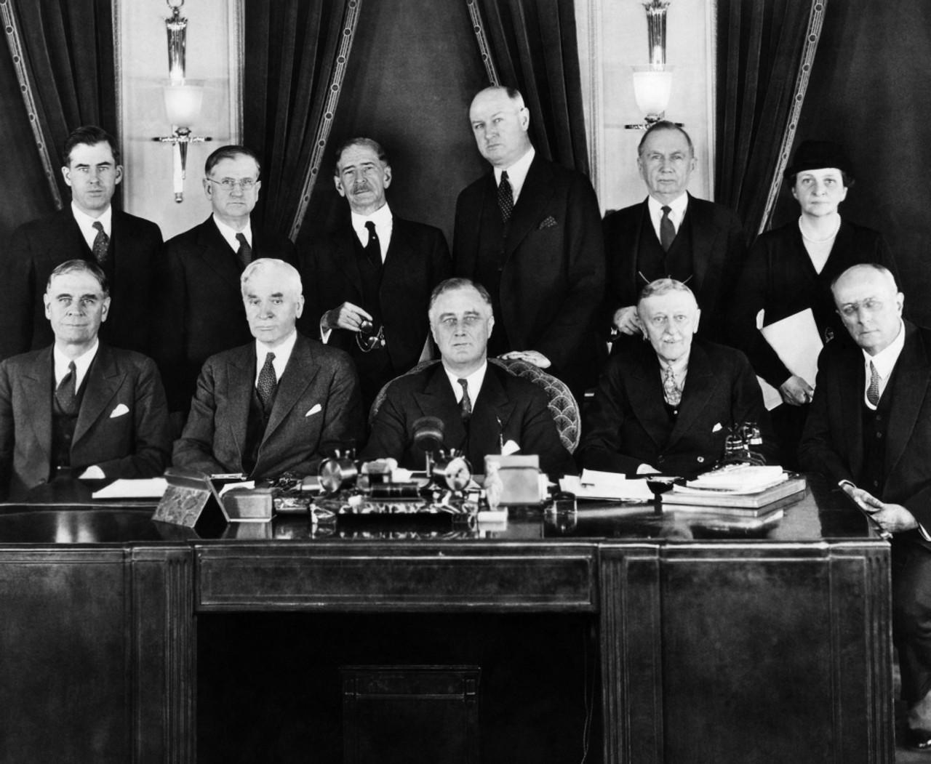
A Collection of Advisers
To help him, FDR depended on advisers to a degree unprecedented in the history of the presidency. FDR brought many veterans of his governorship to Washington. Raymond Moley, a professor of public law, joined the administration, as did Harry Hopkins, who ran New York's program for the unemployed. Francis Perkins, who had known FDR since their days in the state legislature, became the first woman ever to hold a cabinet office, taking charge at the Department of Labor. In the main, these advisers were political liberals. Instead of meting out individual tasks to his advisers, Roosevelt often charged them with similar duties. FDR would also appoint advisers of clashing temperaments and beliefs to the same policy issue, leading to internal confrontations and squabbling. This produced a degree of flexibility, which matched well with Roosevelt's often experimental approach to the New Deal. The main drawback to this type of governance was that the New Deal often appeared to be moving in several directions, many of them contradictory, all at once.
FDR's First Cabinet

Slide 7
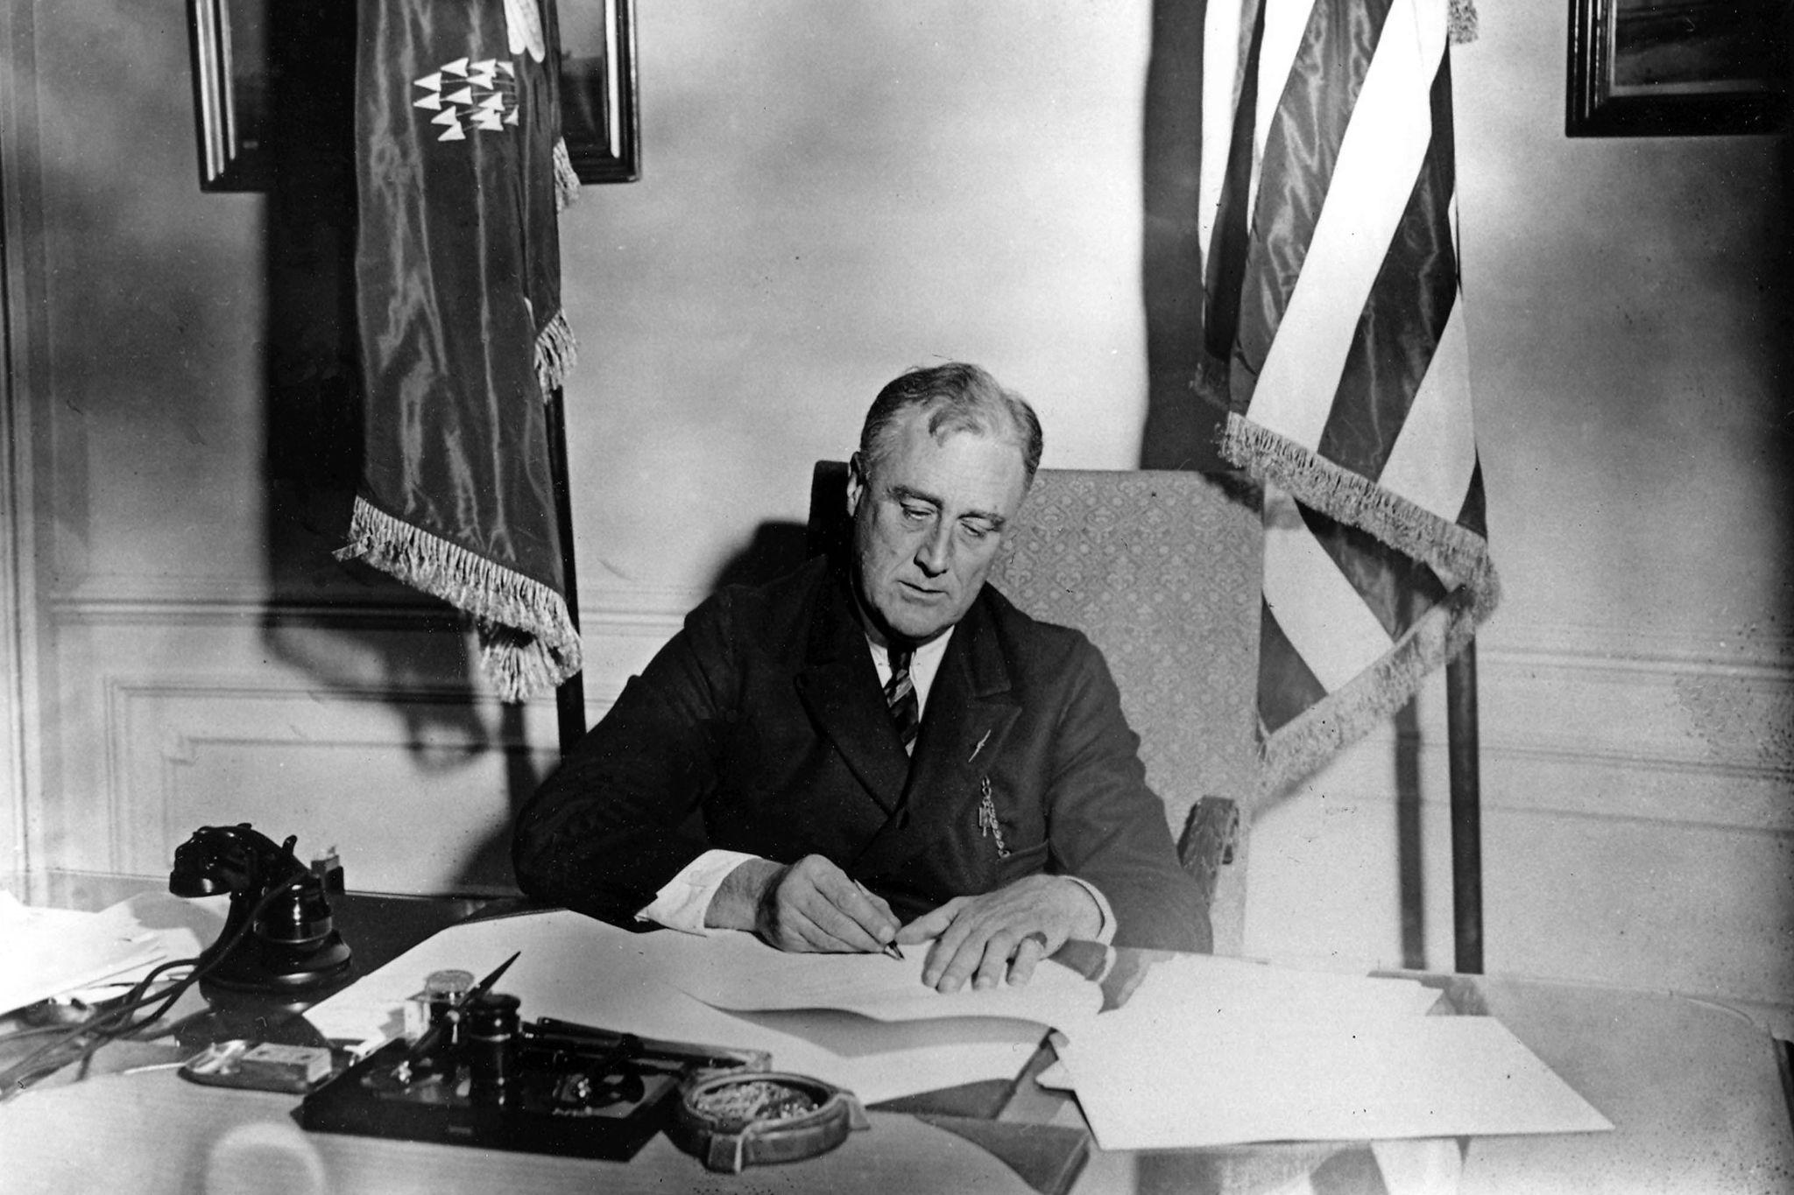
The First New Deal: Saving Capitalism
The First New Deal began almost immediately upon Roosevelt's assumption of the presidency. FDR spurred Congress towards a flurry of legislative activity that became known as the "Hundred Days"—from March to June 1933—in which numerous bills were passed which were designed to end the nation's economic troubles. In general, the First New Deal looked to stabilize the U.S. financial system, provide relief and jobs to the suffering, and reenergize America's capitalist economy.
FDR's immediate task upon his inauguration was to stabilize the nation's banking system. On March 6, Roosevelt declared a national "bank holiday" to end a run by depositors seeking to withdraw their money from faltering banks. Under this plan, the federal government would inspect all banks, re-open those that were sufficiently solvent, re-organize those that could be saved, and close those that were beyond repair.
President Franklin D. Roosevelt signs the Emergency Banking Act into law on March 9, 1933.

Slide 8
A Shift of Economic Power
FDR then implemented a significant number of reforms related to the nation's financial sector. In May 1933, he signed the Securities Act, which required corporations and stockbrokers to release accurate information about stocks to investors. In June 1933, he signed the Glass-Steagall Act, which created the Federal Deposit Insurance Corporation, guaranteeing the savings of average citizens, and prevented commercial banks from engaging in investment banking, which they had been carrying on in scandalous fashion. In 1934, the Securities and Exchange Act created the Securities and Exchange Commission (SEC), which was charged with regulating financial markets.
Roosevelt in 1933 took America off the gold standard, and the Banking Act of 1935 gave the country a central banking mechanism for the first time. A reorganized Reconstruction Finance Corporation (RFC) spun off subsidiaries such as the Federal National Mortgage Association ("Fannie Mae") that, along with the Federal Housing Administration (FHA) made it possible for millions of Americans to buy or renovate homes. Taken together these actions represented a shift of economic power from the lower part of Manhattan, where it had been for over a century, to Washington.

Slide 9
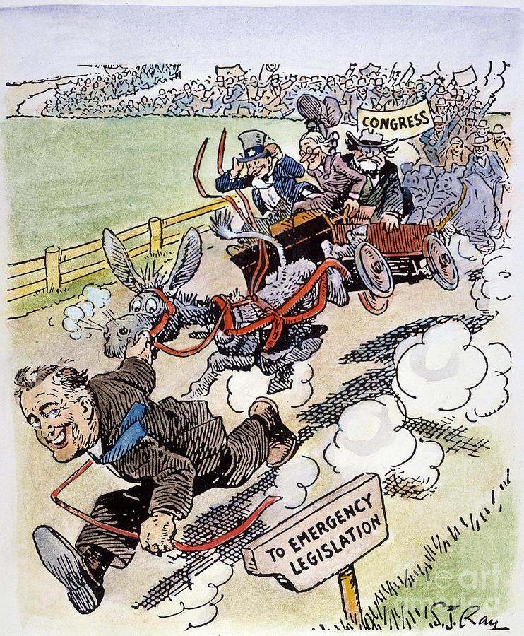
Challenges From Critics on All Sides
Left-wing critics of the new deal thought it did not do enough to solve the causes of America’s economic problems, especially the huge gap between the rich and the rest of the population. In addition, some agencies discriminated against African Americans. For example, the newly created Civilian Conservation Corps (CCC), segregated African Americans from white Americans by having separate CCC camps.
Industrialists and wealthy Americans led the right-wing attack against the FDR and his new deal policies. Most notably, the American Liberty League labeled FDR as a fascist and proclaimed New Deal programs to be key threats to the very nature of democracy. The National Association of Manufacturers, urged businessmen to outright ignore new laws that promoted collective bargaining, as well as subsequent labor protection legislation. Right-wing reaction to the first New Deal eventually culminated in the conspiracy to overthrow FDR and his government and end New Deal policies by force.
A Critical Cartoon Showing FDR Rushing Ahead of Congress

Slide 10
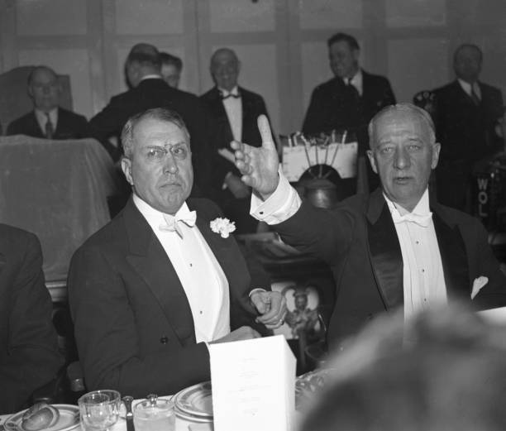
The White House Putsch
The White House Putsch, was a political conspiracy in 1933 in the United States to overthrow the government of President Franklin D. Roosevelt and install Smedley Butler as dictator. Butler, a retired Marine Corps major general, testified under oath that wealthy businessmen were plotting to create a fascist veterans' organization with him as its leader and use it in a coup d'état to overthrow Roosevelt. The coup was backed by the American Liberty League, and members included JP Morgan Jr, Irénée du Pont, Robert Sterling Clark of the Singer sewing machine fortune, and the chief executives of General Motors, Birds Eye and General Foods. The putsch called for a massive army of veterans – funded by $30m from Wall Street titans and with weapons supplied by Remington Arms – to march on Washington, oust Roosevelt and the entire line of succession, and establish a fascist dictatorship backed by a private army of 500,000 former soldiers.
Attendees at a 1936 Liberty League dinner in Washington, D.C. Former Governor Smith, the principal speaker, struck at the New Deal and called upon President Roosevelt to abandon "socialistic" trends.

Slide 11
“It Has Slaughtered the Little and Allowed the Big to Escape”
Retired General Smedley Butler was approached to lead the fascist coup attempt in August, 1934 but refused to take part. Instead, in the fall of 1934, he went to J. Edgar Hoover, head of what would become the FBI. Congressional hearings were launched to investigate the conspiracy. The committee never released a report, but it told Congress it “had received evidence that certain persons had made an attempt to establish a fascist organization in this country. There is no question that these attempts were discussed, were planned, and might have been placed in execution when and if the financial backers deemed it expedient.”
Butler — who later published a book, “War Is a Racket,” in which he lamented that all the military conflicts he had ever been involved in were fought to benefit “millionaires and billionaires” — was vindicated. But he claimed that he had named names, and those names had been removed from his testimony that was released to the public. “Like most committees, it has slaughtered the little and allowed the big to escape. The big shots weren’t even called to testify,” he said in a radio interview.
“(As a General) I spent most of my time being a high-class muscle man for big business, for Wall Street, and for the bankers, In short, I was a racketeer for capitalism.” Smedley Butler, one year after his congressional testimony.

Slide 12
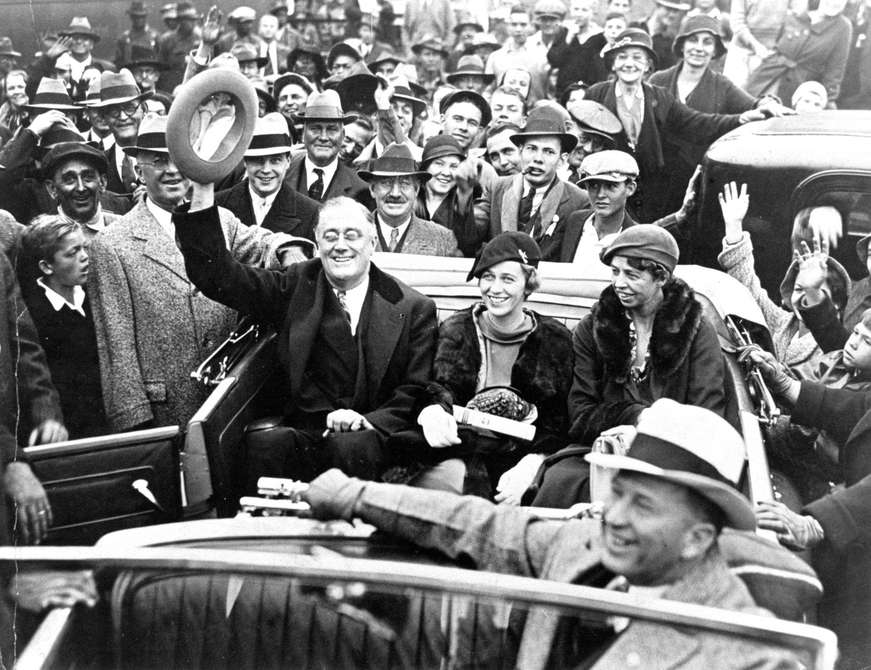
New Deal 2.0
Roosevelt recognized that some of the criticisms of the New Deal were valid and following the Supreme Court’s invalidation of some First New Deal statutes, he decided to face his re-election bid in 1936 by unveiling another wave of legislation later known as the Second New Deal. Following his reelection, Roosevelt called congressional leaders into the White House and gave them a list of “must-pass” legislation that he wanted before they adjourned for the summer.
The first of these priorities was the “Banking Act of 1935,” the most far-reaching revision of banking laws since the creation of the Federal Reserve System in 1914. Previously, regional reserve banks, particularly the New York Reserve Bank—controlled by the powerful Morgan and Rockefeller families—had dominated policy-making at the Federal Reserve. Under the new system, there would be a seven-member board of governors to oversee regional banks. This new board kept interest rates low, allowing the federal government to borrow billions of dollars to fund major relief and recovery programs.
Franklin D. Roosevelt Celebrating His Election Victory

Slide 13
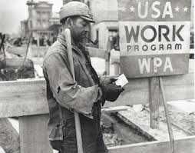
A Real Jobs Program for American Workers
In 1935, Congress also passed the Emergency Relief Appropriation Act, which authorized the single largest expenditure at that time in the country’s history: $4.8 billion. Almost one-third of those funds were invested in a new relief agency, the Works Progress Administration (WPA) which ran until 1943. In that time, the program provided employment relief to over eight million Americans, or approximately 20 percent of the country’s workforce. The WPA funded the construction of more than 2,500 hospitals, 5,900 schools, 570,000 miles of road, and more. The WPA also created the Federal One Project, which employed approximately forty thousand artists in theater, art, music, and writing. They produced state murals, guidebooks, concerts, and drama performances all around the country as well as funding the collection of oral histories, including those of former slaves. The WPA also included the National Youth Administration (NYA), which provided work-study jobs to over 500,000 college students and four million high school students.

Slide 14
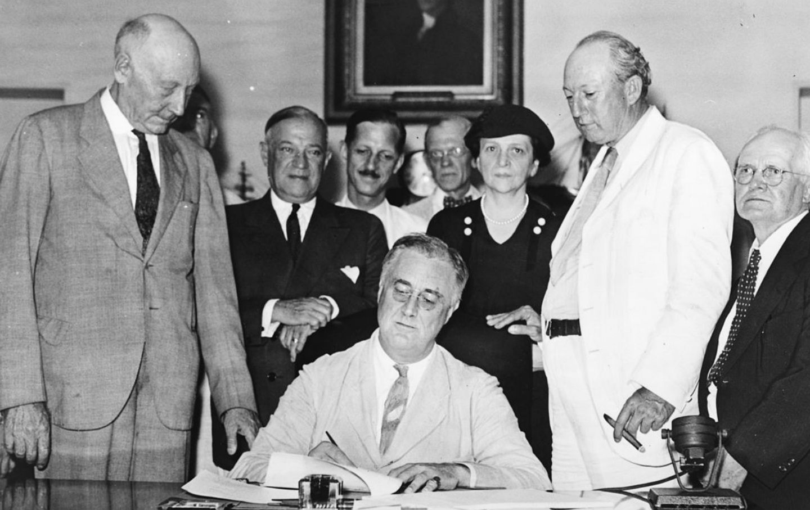
A Limited Social Safety Net
With the implementation of the Second New Deal, Roosevelt also passed The Social Security Act, establishing programs intended to help the most vulnerable: the elderly, the unemployed, the disabled, and the young. It included a pension fund for all retired people—except domestic workers and farmers, which therefore left many women and African Americans beyond the scope of its benefits—over the age of sixty-five, to be paid through a payroll tax on both employee and employer. Related to this act, Congress also passed a law on unemployment insurance, to be funded by a tax on employers, and programs for unwed mothers, as well as for those who were blind, deaf, or disabled. It is worth noting that some of these reforms were pulled from Roosevelt detractors such as Francis Townsend (ie. the Townsend Plan; an early attempt at a form of Social Security.) The popularity of these movements pushed FDR to include these progressive reforms among his priorities.
President Roosevelt Signing the National Security Act

Slide 15
The Wagner Act, The NLRB, and The CIO
Roosevelt also signed into law the Wagner Act, also known as the National Labor Relations Act. The act created the National Labor Relations Board (NLRB) for the stated purpose of protecting American workers’ right to unionize and bargain collectively, as well as to provide a federal vehicle for labor grievances to be heard. Although fiercely criticized by the Republican Party and factory owners, the Wagner Act withstood several legal challenges and eventually received constitutional sanction by the U.S. Supreme Court in 1937. The law received the support of John L. Lewis and the Congress of Industrial Organizations who had sought government protection of industrial unionism, from the time they split from the American Federation of Labor in 1935 over disputes on whether to organize workers along craft or industrial lines. Following passage of the law, Lewis began a widespread publicity campaign urging industrial workers to join “the president’s union.” The relationship was mutually beneficial to Roosevelt, who subsequently received the endorsement of Lewis’s United Mine Workers union in the 1936 presidential election, along with a sizeable $500,000 campaign contribution. The Wagner Act permanently established government-secured workers’ rights and protections from their employers, and it marked the beginning of labor’s political support for the Democratic Party.

Slide 16
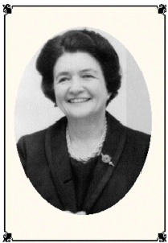
A Capitalist Program with Radical Elements
Many accounts of the New Deal, paint it as fundamentally pro-capitalist. The project’s architects sought to save capitalism from its excesses and reform the system so that more extreme alternatives — fascism on the Right, communism on the Left — did not take root. Once economic prosperity and political stability were restored post–World War II, New Dealers’ incentive for further reform disappeared.
But this story is partially accurate at best. In fact, many people who joined the Roosevelt administration at high levels in the 1930s were radicals who viewed the New Deal as a chance to empower labor, reorient the economy around democratic priorities rather than the profit motive, and advance the interconnected causes of racial, gender, and economic equality. In the 1930s, the massive New Deal expansion of the federal government attracted a generation of young leftists to Washington, DC.
Mary Dublin Keyserling - Socialist and New Deal Reformer

Slide 17
Socialist Influence on the New Deal Era
These reformers brought systemic critiques of capitalism, arguing that the federal government should promote economic democracy to combat the destructive tendencies that spawned the Great Depression and to foster greater equality along class, racial, and gender lines. Though quite a few were skeptical of Roosevelt’s administration, they all came to believe that New Deal programs could be a vehicle for their ambitious vision. Among them were Mary Dublin Keyserling and Leon Keyserling, two reformers whos exemplified the broader New Deal left. Mary was a member of the Socialist Party, trained in economics, and a leading figure in the consumers’ movement of the Depression era. She moved to Washington in 1940, where she began a career in federal government that lasted into the ’60s and married Leon Keyserling. Leon was a legislative aide to Senator Robert Wagner and was responsible for drafting several pivotal pieces of New Deal legislation, including the National Labor Relations Act (or Wagner Act) of 1935, which institutionalized collective bargaining rights for workers, and the 1937 US Housing Act. Leon went on to serve in the US Housing Authority and, like Mary, worked in federal government for decades. He was also a socialist, writing to his father in 1937 that New Deal reforms would create a “chain reaction” through which “the power of capitalism is going to be weakened to the point of extinction.”

Slide 18
Discussion

Slide 19
Benefits of New Deal Still Felt Today

Slide 20
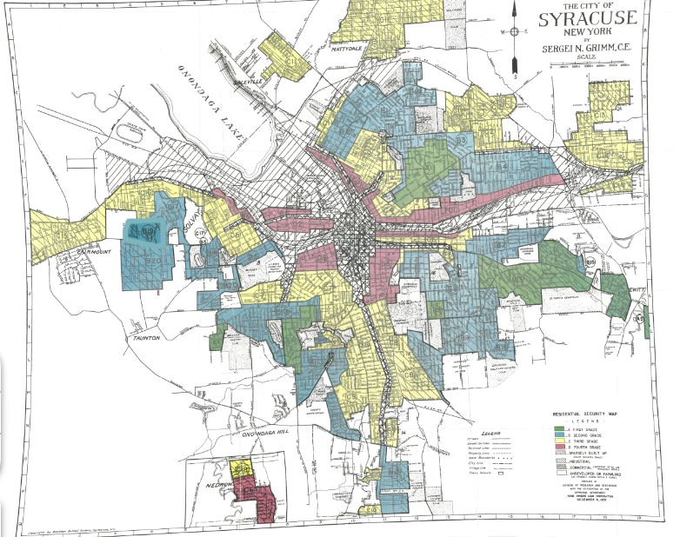
An Important Consideration Before Reviewing New Deal Programs
Before reviewing some influential projects of the New Deal, it must be kept in mind that the second and third phases of the New Deal were especially unfavorable to the banks and monopolies
While there was much mass support for New Deal relief programs, big industry and finance, along with their loyal reactionary servants fought tooth and nail to prevent or water down these programs.
For example, compromises to pass the National Housing Act of 1934 led to localized authority of allocation of federal funds which were abused by local financial and housing authorities to favor investment into wealthier white communities and underfunding racial minority dominated communities
Other New Deal Programs were not immune
The harmful results of monopoly influence in politics is exemplified by the notorious redlining maps which created racist federal funding allocation inequalities.
Source: Mapping Inequality

Slide 21
Housing Act of 1937
In his State of the Union Message of January 6, 1937, President Roosevelt spoke of the urgent need for the new Congress to address the housing situation:
“There are far-reaching problems still with us for which democracy must find solutions if it is to consider itself successful. For example, many millions of Americans still live in habitations which not only fail to provide the physical benefits of modern civilization but breed disease and impair the health of future generations. The menace exists not only in the slum areas of the very large cities, but in many smaller cities as well. It exists on tens of thousands of farms, in varying degrees, in every part of the country.”
On September 1, 1937, the Housing Act was enacted to improve the housing situation of low income workers and unemployed people

Slide 22
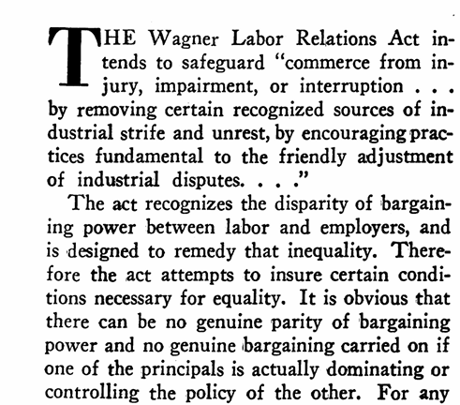
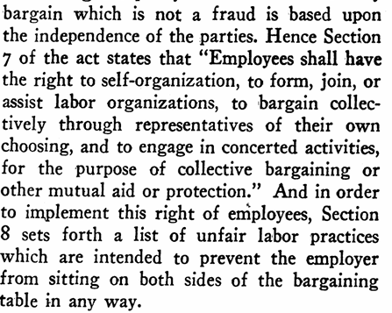
National Labor Relations Act (Wagner Act)
Excerpts from How the Wagner Act Works by Ben Golden published in New Masses May 1937

Slide 23
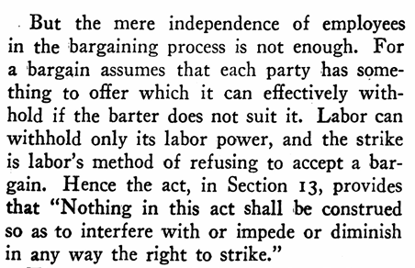
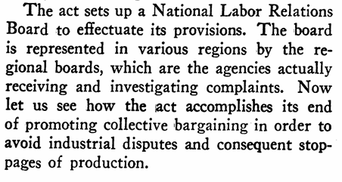
National Labor Relations Act Cont.

Slide 24
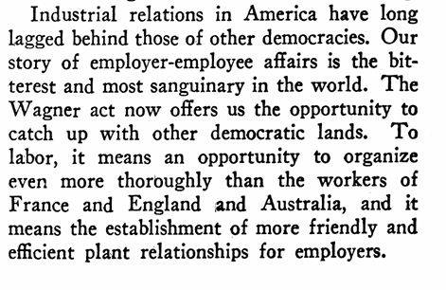
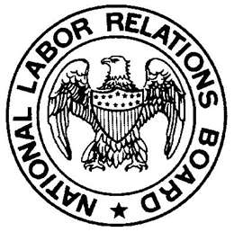
National Labor Relations Act Cont.

Slide 25
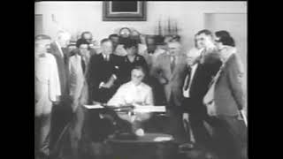
Social Security Act

Slide 26
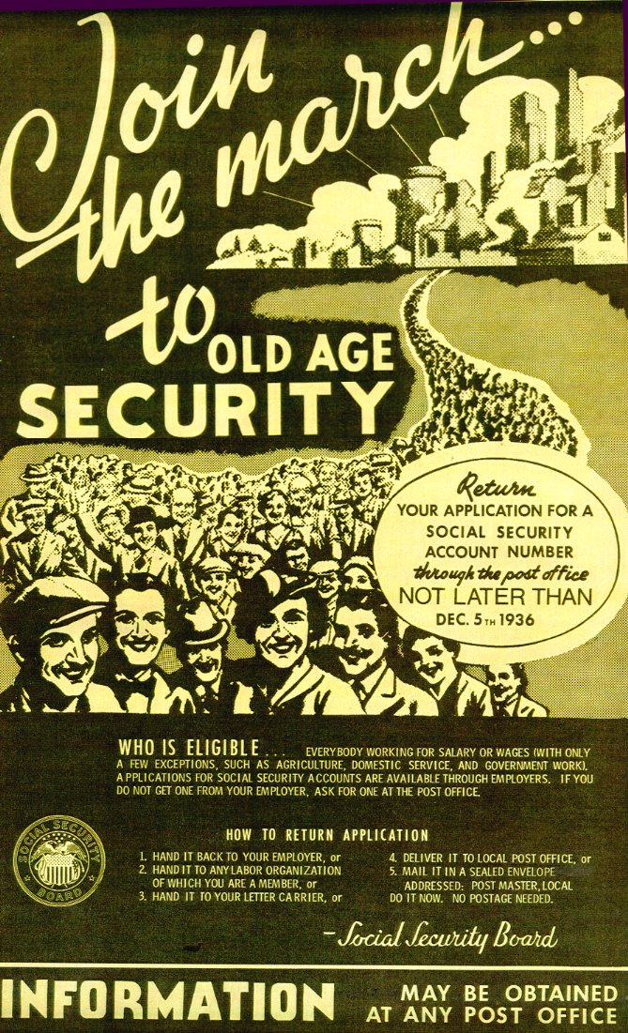
Benefits Under Social Security Act
Monthly Old Age/Retirement income
Disability Insurance/Income
Monthly income and supplements to family members and dependents
Monthly income to people with no or low income and benefits
Medicare and Medicaid were created from amendments to the Social Security Act in 1965 and were administered by the Social Security Administration

Slide 27
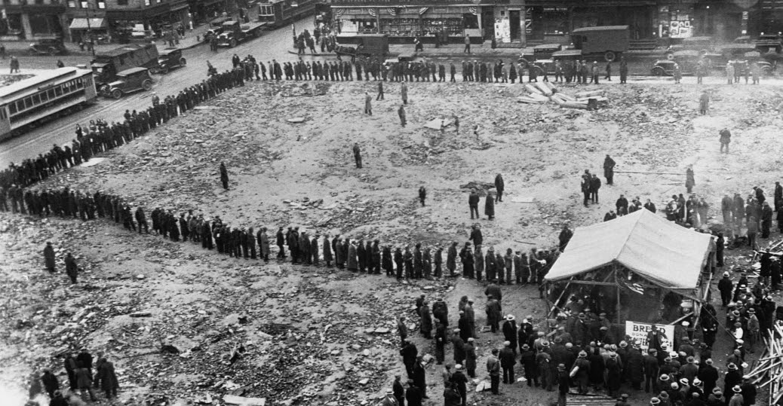
Communists Called for Social Security Years Before SSA
Excerpt from Anna Rochester’s Labor and Coal published by International Publishers in 1931
What happens to a mine worker and his family when illness, injury or death cut off the pay envelope? For the miner is not the only one to suffer from the hazards of the industry; at least three-fifths of the men have dependents for whose bread and shelter they are responsible. Average earnings are too low to provide a decent living when all goes well. They leave no reserve for carrying the worker’s family through a period when wages are cut off. And no coal mining state in the country provides any social insurance as a matter of right to the workers, beyond, a meager system of compensation for a worker and his family when a miner is killed or injured on the job.
Breadlines during the Great Depression highlight the instability in the life of a worker under Capitalism and the need for a basic social insurance

Slide 28
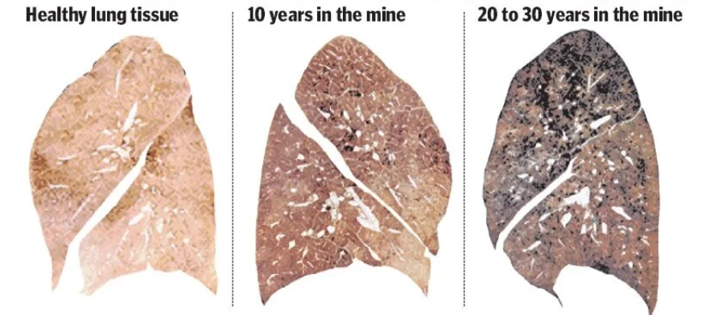
Communists Called for Social Security Years Before SSA
For other deaths and illnesses the miner and his family are thrown entirely on their own resources. This haunting insecurity of the worker’s family has been exploited to the full by the great industrial insurance companies. Thousands of miners are included in the mass of workers who squeeze out somehow from an inadequate wage the weekly payment for a small sickness and death-insurance policy. But many a policy has been forfeited when work is scarce and immediate hunger presses harder than the dread of illness or death.
Black Lung Disease caused by prolonged exposure to coal dust in mines led to thousands of deaths and injuries that threatened the stability of mining families

Slide 29
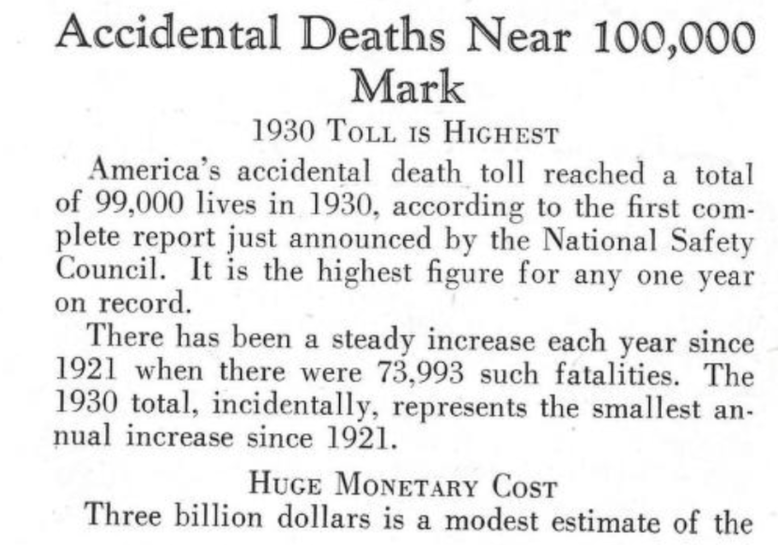
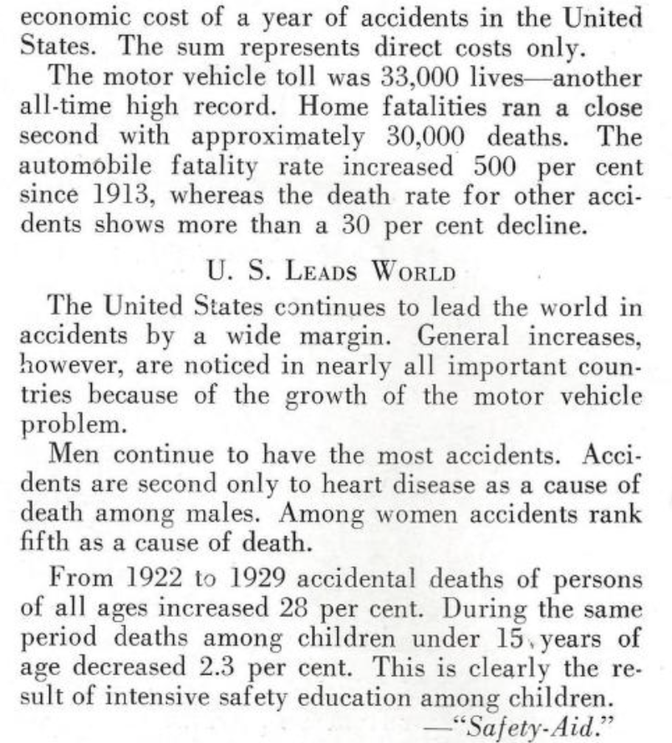
Why The US Needs Social Security
Clippings from Union Pacific Coal Company Employee Magazine 1931

Slide 30

Other Legacy Programs of the New Deal Today
Natural Resources Conservation Service (NRCS) was created to research solutions to environmental issues such as water and soil pollution and soil erosion. Originally formed as the Soil Conservation Service in 1935.
The Federally-owned Tennessee Valley Authority (TVA) which was tasked with modernizing the utilities, agricultural, and economic infrastructure of the region and land-use planning. The TVA has been attacked since its inception by reactionaries who view it as “creeping socialism” and “big government overreach”

Slide 31
Discussion

Slide 32
Left-Center Unity Today

Slide 33
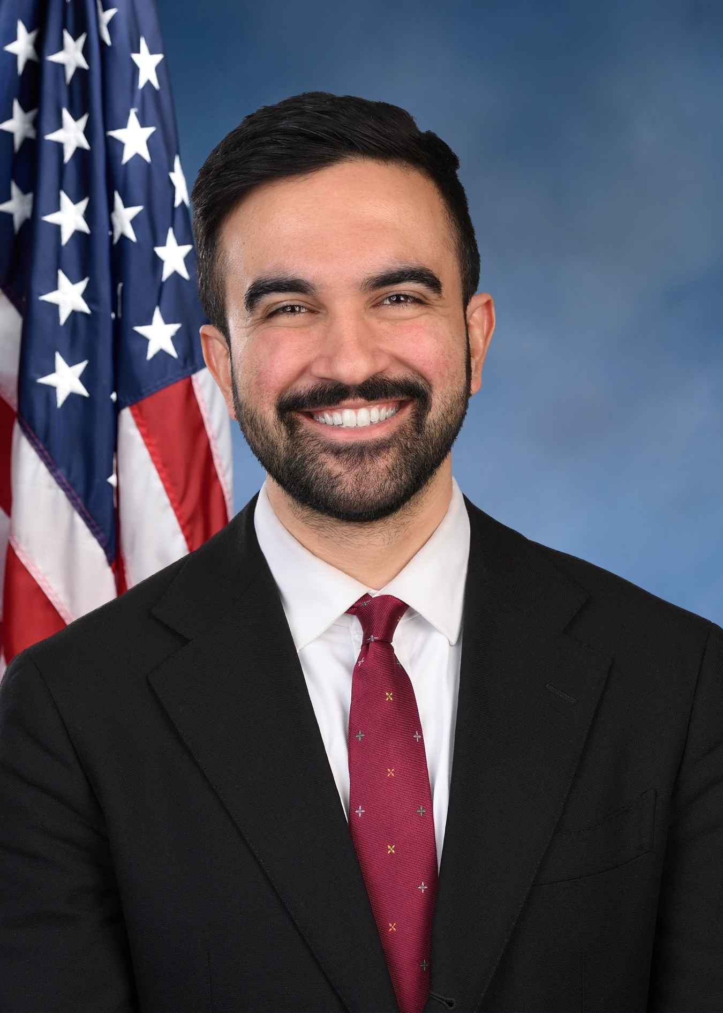
Progressive Politicians
Zohran Mamdani, a progressive Queens assemblyman and member of the DSA has fostered unity between many different leftist groups in NYC and even some in the center.
His proposed policies include free buses, free childcare, rent controls and city-owned grocery stores.
His policies reflect the needs of many New York City residents who struggle to get by due to the high cost of living.
He also expresses support for Palestine and calling an end to the genocide while acknowledging Israel’s right to exist, representing both Muslim and progressive Jewish New Yorkers
His recent landslide win in the primary election shows the importance of progressive candidates who can unite the left and center forces to counter reactionary forces.

Slide 34

Progressive Politicians
Mamdani also expresses support for Palestine and calling an end to the genocide while acknowledging Israel’s right to exist, representing both Muslim and progressive Jewish New Yorkers
His recent landslide win in the primary election shows the importance of progressive candidates who can unite the left and center forces to counter reactionary forces.
If Zohran wins the mayoral election, a ripple effect which has already begun will grow throughout the nation, inspiring and setting an example for other progressive politicians to emerge throughout the country.
Progressive politicians can orient us in the correct direction by advocating for policies that benefit workers and uniting different sections of the left and center.

Slide 35
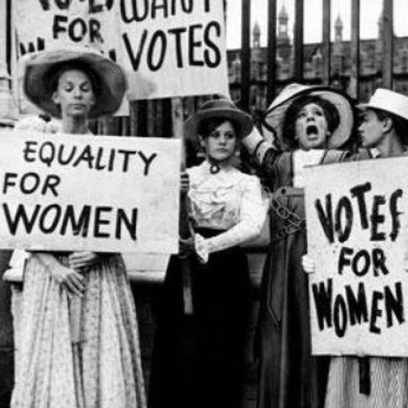
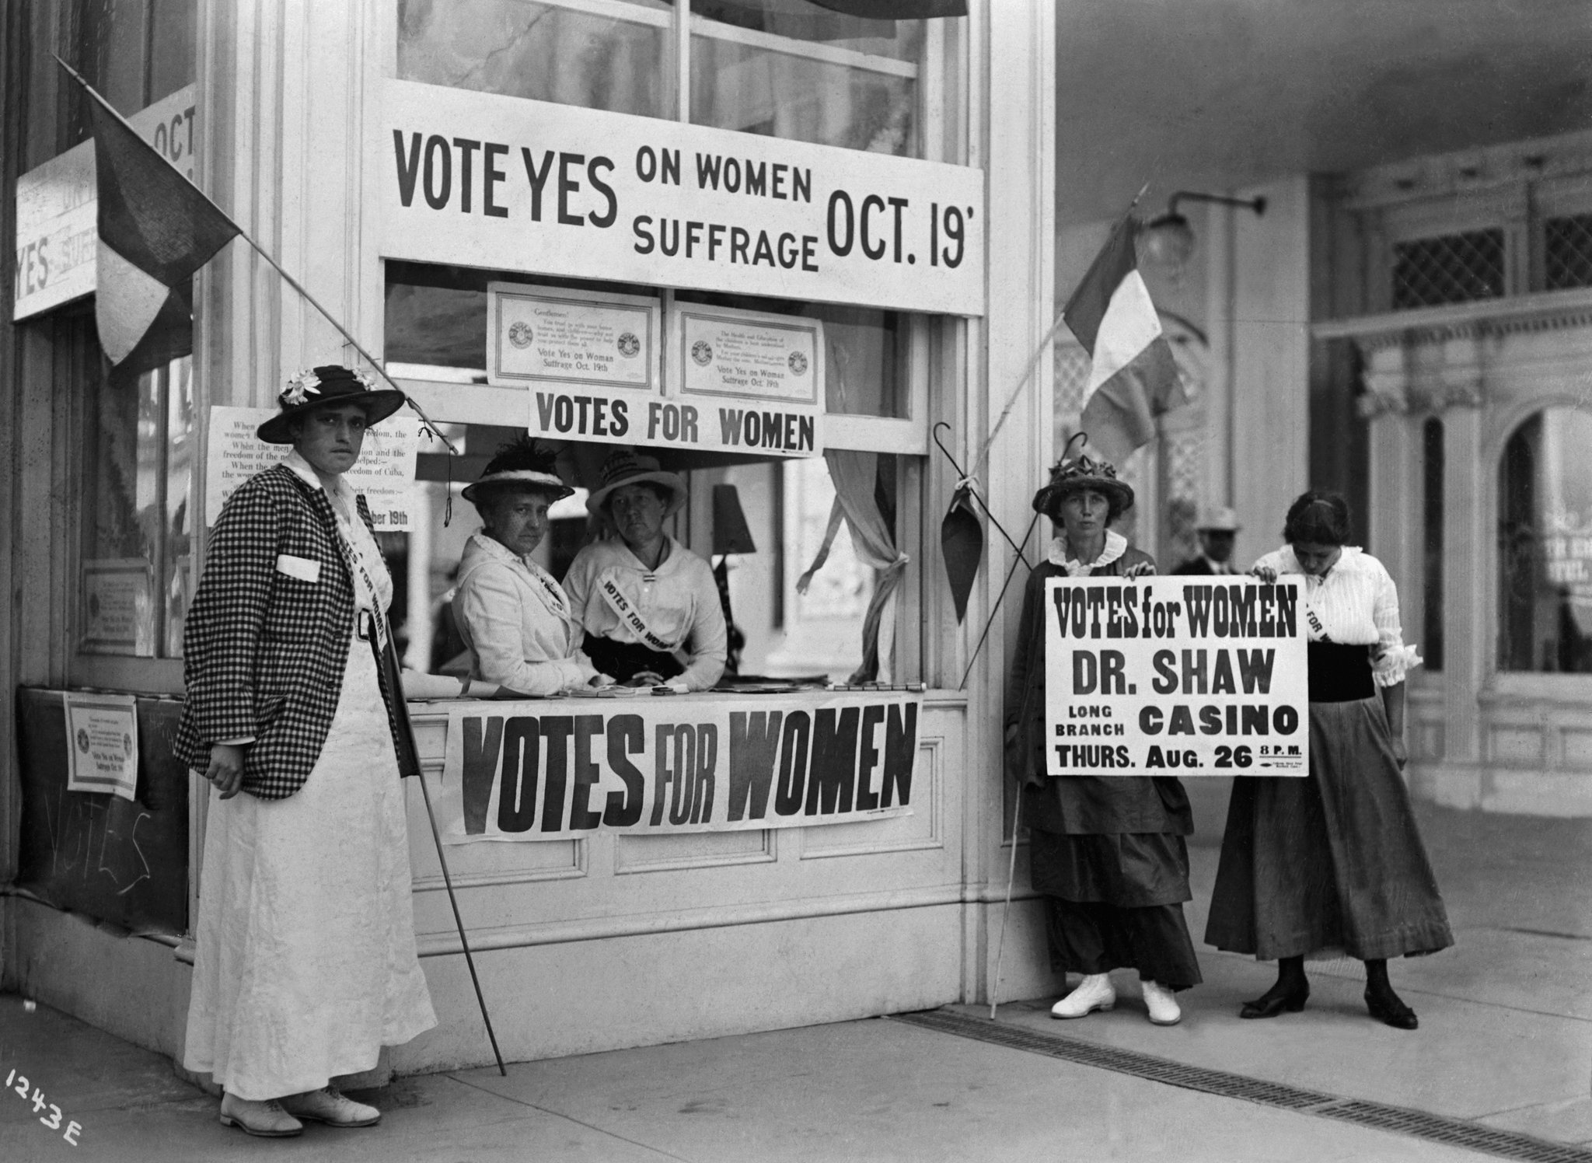
Progressive Movements
As communists, it is important for us to get involved with popular progressive movements and back progressive politicians.
However, it is not enough to simply get involved and show support.
Our job is to establish ourselves through dedicated efforts as trusted leaders in these movements so that we can prevent them from stagnating or dissipating, and maybe even push them further in the correct direction.
Our strategies should remain diverse, involving both progressive mass movements and pushing for legislation.
Even under authoritarian regimes, pro-democracy movements can still advance their goals by strategically engaging the courts, and at the same time, mass movements can gain legitimacy through court battles.

Slide 36
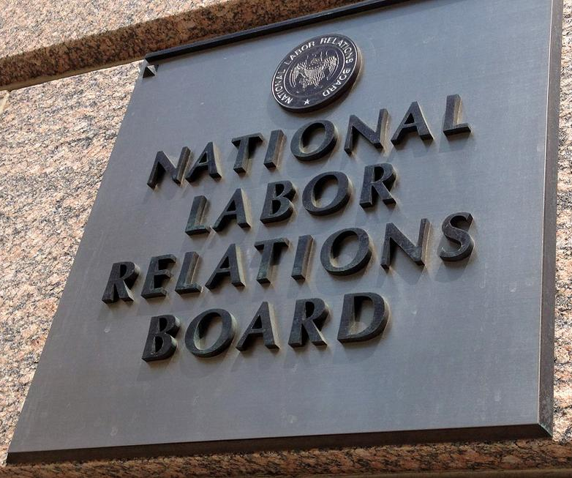
Attacks on NLRB & Labor Relations Board
An example of progressive legislation supported by communists is The Labor Relations Act. It was created in 1935 by fellow traveler Francis Perkins.
It guaranteed the right of private sector employees to organize into unions, bargain collectively with their employers, and engage in other protected activities like striking.
It also established the National Labor Relations Board (NLRB) to oversee and enforce these rights.
Progressive legislation and laws such as the Labor Relations Act benefit the working class, any efforts to eliminate these beneficial policies should be met with mass dissent and organized efforts to defend our rights.
Trump’s attack on the NLRB and Labor Relations Board are directed specifically at the working class movement in an effort to weaken unions.

Slide 37
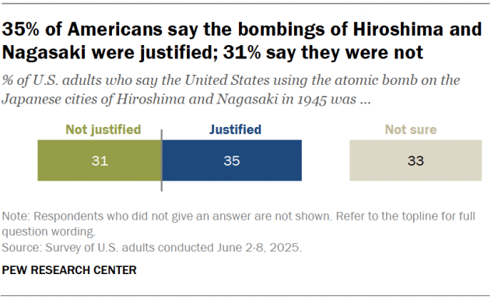
Defeating Reactionary Forces
When facing strong right-wing opposition, especially as reactionary forces rally around Donald Trump’s administration, it is crucial to establish unity between left and center forces.
In general, for many political issues, a third of society will be in support of the issue, another third will be critical of the issue, while the last third will have no strong opinion.
As capitalism progresses and democracy begins to unravel, the political center becomes radicalized and those who have no strong opinion are forced to pick a side.
An example of society being divided in thirds over the topic of the bombings of Hiroshima and Nagasaki. As the truth about the unjustified reasons for bombing Japan become more mainstream, a shift can be observed from previous years of polling on the same subject.

Slide 38
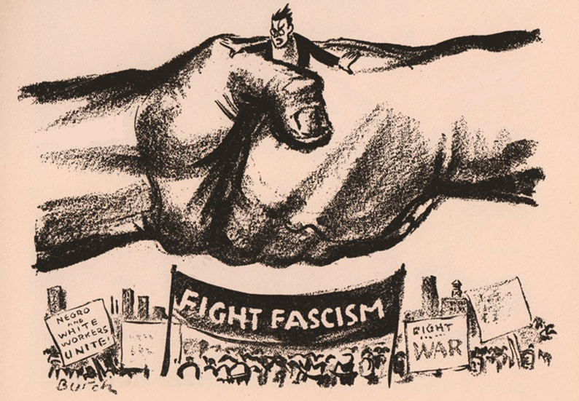
Challenges of Left-Center Unity
If left-center unity is established, more people from the center will join the left than the right, which can be a turning point in favor of the working class.
While this can be a powerful tool for achieving political goals, it can also be challenging to maintain unity and navigate the different perspectives within the coalition
When organizing with those who have differing perspectives, it’s important to respect the views of those who are genuinely willing to work with you and fight to preserve democracy.
The best way to do this is to keep the focus on the common goals which unite everyone in the coalition.

Slide 39
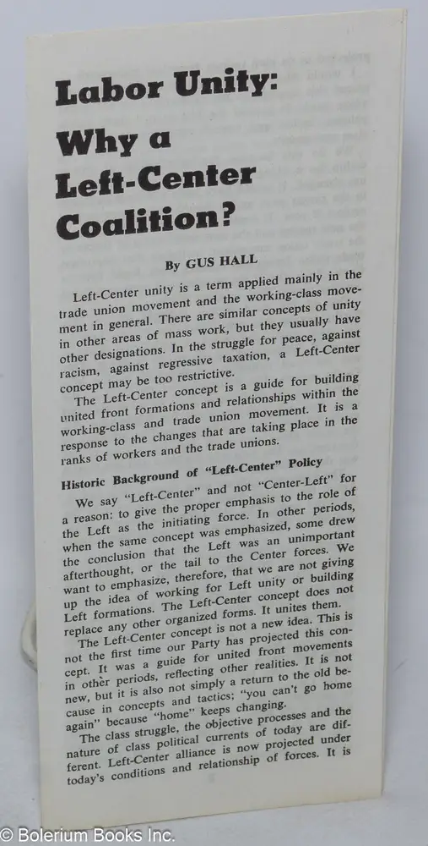
Challenges of Left-Center Unity
Sometimes, the majority of the group will not agree with you on a particular strategy.
It’s important to gauge when is the best time to engage in political struggle and how you choose to approach it. Often, it is not worth arguing or working against the majority if you want to maintain trust, especially if you aim to lead the coalition.
If their strategy fails, then the group should learn from any mistakes made and hopefully try a better strategy. Should you stick through this with them and lead them the correct direction, you will earn the trust of the people who may have previously doubted you and thus be more likely to end up leading the coalition.
If approached strategically, a left-center coalition can potentially mobilize a larger segment of the population against the capitalist class.

Slide 40
Discussion & New Members Introductions

Slide 41
New Member Introductions
What is your name, pronouns and state (or country/territory)?
Where do you work? Is it unionized?
How did you find out about the People’s School?
What do you think about tonight's class?

Slide 42
Discussion & Wrap Up

Slide 43
Announcements
PCUSA Cell Chairs need to call members of their cells to remind them about attendance.
The next issue of New Masses (2025) has begun production. If you have art you want us to feature, email it to info@partyofcommunistsusa.net.

Slide 44
Volunteers Needed!
We are in need of volunteers for the staff of the People’s School! Here’s a few roles we need filled:
People to help manage posting on our social media and podcast platforms
Video Editors, Audio Editors, Graphic Designers, Artists, Narrators
Web Controls, Moderators
Email info@peoplesschool.us if you’re interested and try to attend our next staff meeting if possible.

Slide 45

View From Left Field
https://viewfromleftfield.libsyn.com
The Old PSMLS Youtube is now the Youtube of View From Left Field, a podcast of analysis and discussion of current events from a progressive perspective.
Like the Youtube videos and subscribe with 5 star ratings on your podcast platforms.

Slide 46

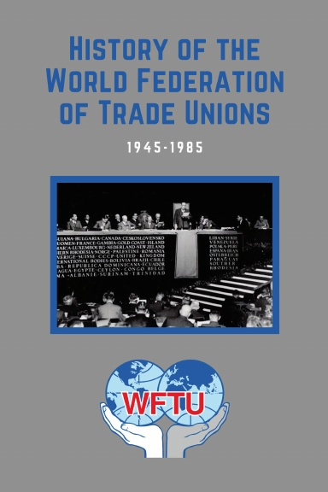
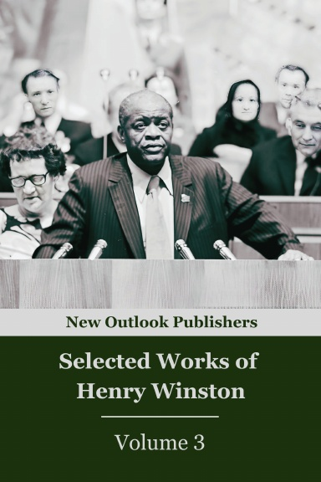
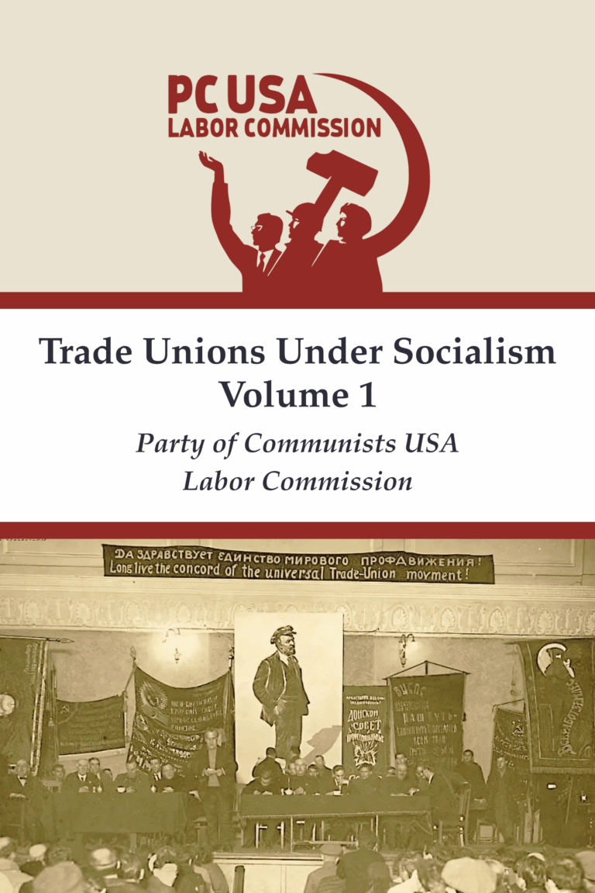
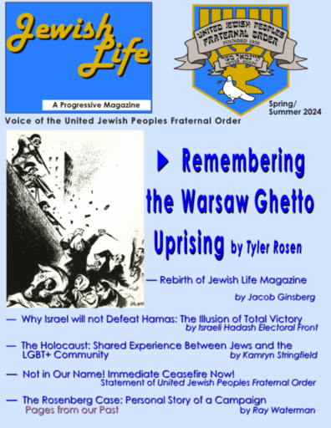
New Outlook Publishers
newoutlookpublishers.store
Latest Releases

Slide 47


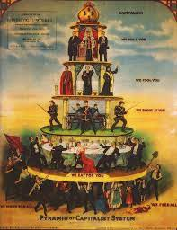
Harry Bridges School of Labor
luel.us/laborschool/
The Harry Bridges School of Labor is a monthly class held once per month starting September 2025. Classes cover a variety of topics aimed at building class consciousness among union members.
September’s class is “Class-Oriented Labor and Politics - Independent Political Action”. Class will be September 6, 2025 at 7pm EST/4pm PST.

Slide 48
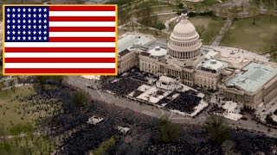
"The Road is Open Again" - American New Deal Song

