Slide 1

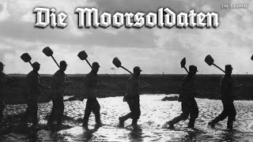
Peat Bog Soldiers (Die Moorsoldaten) - German Anti-Fascist Song

Slide 2
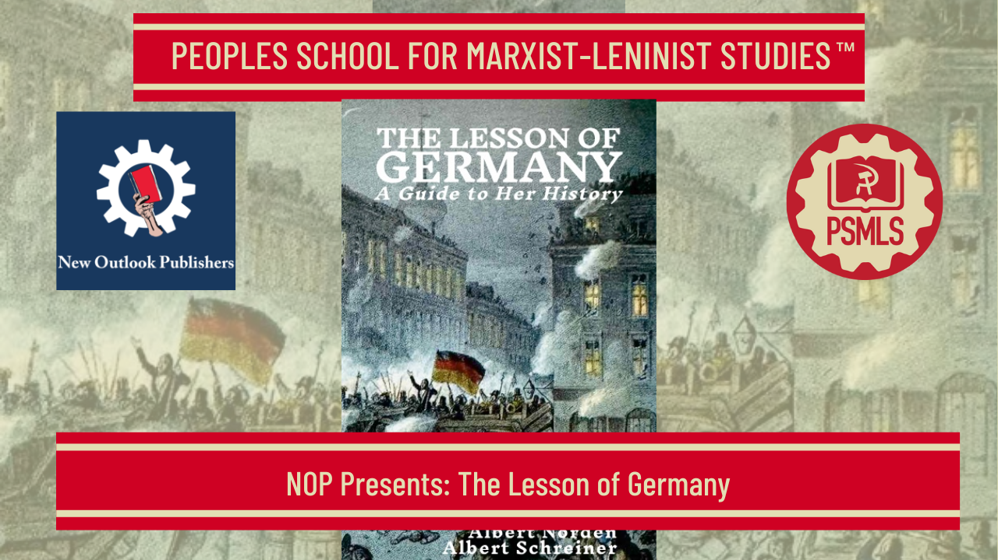
PSMLS 09/15/25

Slide 3
What we’ll be learning today:
The Defeat of the Revolution and the end of WWI
The Rise of Fascism
The Nazis Set Up Their Dictatorship

Slide 4
Introduction & Historical Context

Slide 5
Please Get Your Own Copy for Your Marxist Library
Tonight’s class gives a truncated look at the book Lesson of Germany by Gerhart Eisler, Albert Norden, and Albert Schreiner.
Unfortunately, an hour and a half course can hardly do the book justice. After attending the class, it is recommended that all attendees and viewers order a the book from New Outlook Publishers using this link: https://newoutlookpublishers.store/shop/history/the-lesson-of-germany/ to read the book in its entirety.

Slide 6
The Roman Catholic Church
Once a unifier of Europe, the Vatican would hinder the national unification of Germany
This led to the Reformation movement to break the German kingdoms away from the Papacy
The disorganized peasant uprisings which culminated in the Great Peasant War of 1525 led to its defeat
The break with the corrupt Vatican was achieved but the maintenance and strengthening of localized feudal despots which prevented a modern German national state
The struggle against the Catholic church would have a lasting imprint on Germany with the Prussians of the east developing an anti-Catholic nationalism and the Austrians and Southern Germans aligning closely with the Catholic Habsburgs.
These regional conflicts would culminate in the reactionary and anti-worker Prussification movement and Kulturkampf which led to repression against the Southern German Catholics

Slide 7
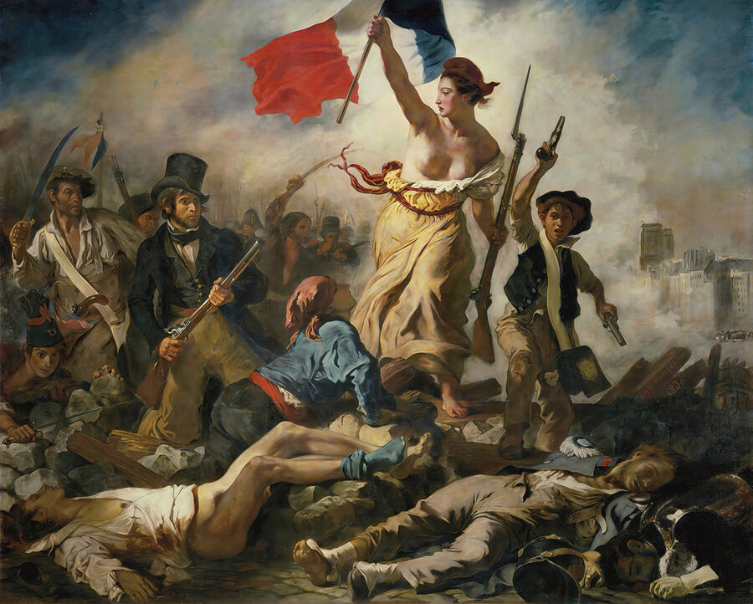
Effect of French Revolution of 1830 on Germany
Lesson of Germany (Pg. 29)
The first break in the general paralysis came with the Revolution of July, 1830, in Paris. This historic event, marking the emergence of the working class as an independent force, sent sparks of democratic and socialist ideas into neighboring Germany. Moreover, changed economic conditions gave the German middle class and newly arising industrial working class of the 1830’s solid ground on which to wage their fight.
This event also revived the German nationalist movement that began after the national liberation from Napoleon and was repressed by the ensuing reaction
Liberty Leading the People by Eugene Delacroix depicts the liberation of the French from King Charles X

Slide 8
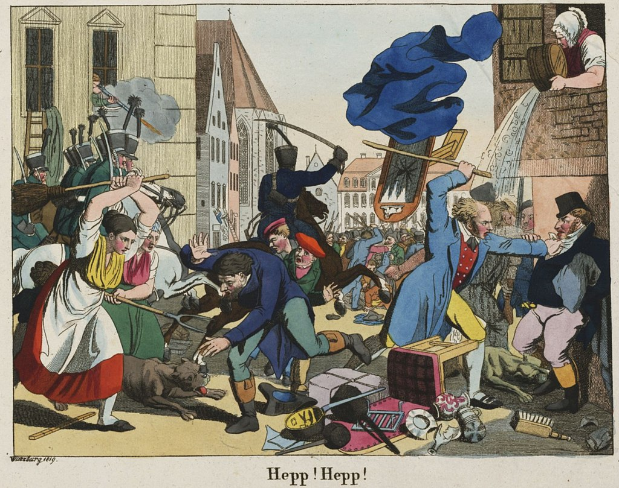
Anti-Semitism in Pre-Hitler Germany
After Napoleon Bonaparte’s conquest of Europe, he passed edicts guaranteeing Jewish people equal status to the French and peoples conquered
After the downfall of Napoleon, the edicts guaranteeing equal status was revoked in most German states
Pogroms against the Jewish people started to pick up in the 19th century such as the Hep-Hep Riots of 1819
Painting depicting Hep-Hep Riots

Slide 9
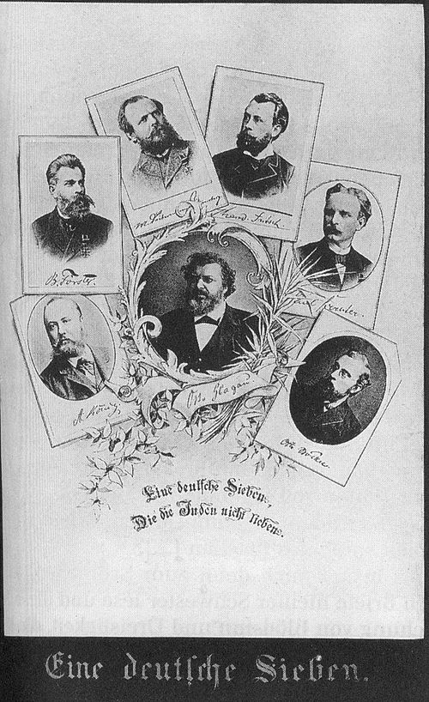
Anti-Semitism in Pre-Hitler Germany Cont.
In 1880 the Prussian Parliament drafted a petition to Otto Von Bismarck with the following:
“Your Excellency, may your mighty influence in Prussia and Germany urge:
1. that the immigration of alien Jews be at least limited, if not completely prevented;
2. that the Jews be excluded from all positions of authority; that their employment in the judiciary—namely as autonomous judges—receive appropriate limitation;
3. that the Christian character of the primary school—even when attended by Jewish pupils—be strictly protected; that only Christian teachers be allowed in these schools and that in all other schools Jewish teachers be placed only in special and exceptional cases;
4. that a special census of the Jewish population be reinstituted.”
Source: <https://germanhistorydocs.org/en/forging-an-empire-bismarckian-germany-1866-1890/ghdi:document-1801>
Poster titled “German Seven” depicting the men pushing anti-Semitic legislation in Bismarck’s Germany

Slide 10
Legacy of the Second Reich
While Bismarck succeeded in German Unification and setting in motion a modern capitalist Germany, Bismarck, a Junker (pronounced Yoonker; Prussian name for Gentry), maintained the rule of the Hohenzollern Dynasty
With a late start to capitalist development, the bourgeoisie and proletariat were weak which caused a weak liberal movement and capitulation of the bourgeoisie to the feudal aristocracy and monarchy
Bismarck’s anti-Socialist laws of 1878 which repressed the Socialist movement and banned the Social Democratic Workers Party of Germany (SAPD), gave the class-collaborationist, pro-German imperialist, anti-Marxist Lassallean General German Workers Association (ADAV) to dominate (Lasalle’s followers would later be colloquially referred to as Kaiser Socialists)

Slide 11
Defeat and Revolution

Slide 12
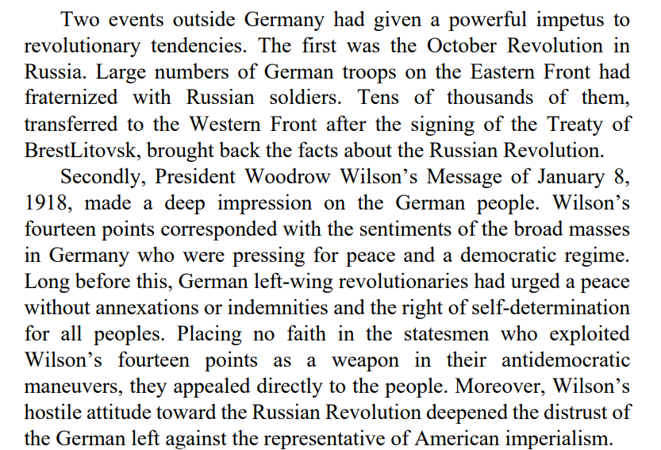
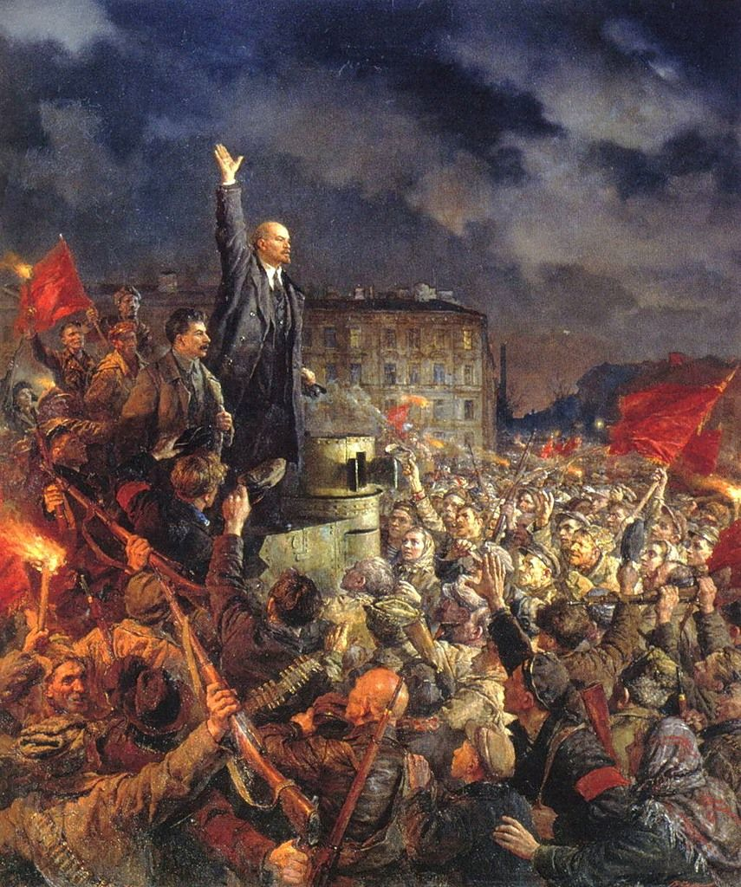
Revolutionary Fervor in Post-WWI Germany
Bolshevik Revolution of 1917

Slide 13
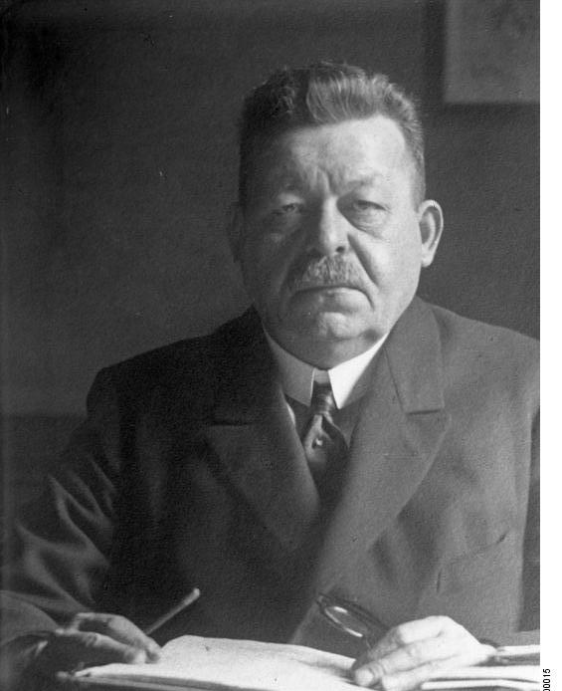
The Lasallean Social Democrats Conspire to Maintain the Prussian Monarchy
General Wilhelm Groener, held a conference in the Chancellor’s office with six leaders of the Social-Democrats and free trade unions. At this meeting Ebert made the following proposal: “Kaiser Wilhelm abdicate if we are to prevent the masses from staging a revolution. I therefore propose that today, or at the very latest tomorrow, the Kaiser abdicate of his own free will and entrust one of his sons, perhaps Eitel Fritz or Oskar, with the Regency.” Side by side with these secret negotiations to bolster the Hohenzollern regime went passionate appeals from the Social Democratic and trade union leaders to the workers not to strike or demonstrate, but to await the results of negotiations by Ebert, Scheidemann, and Karl Legien, head of the trade union movement.
Friedrich Ebert

Slide 14
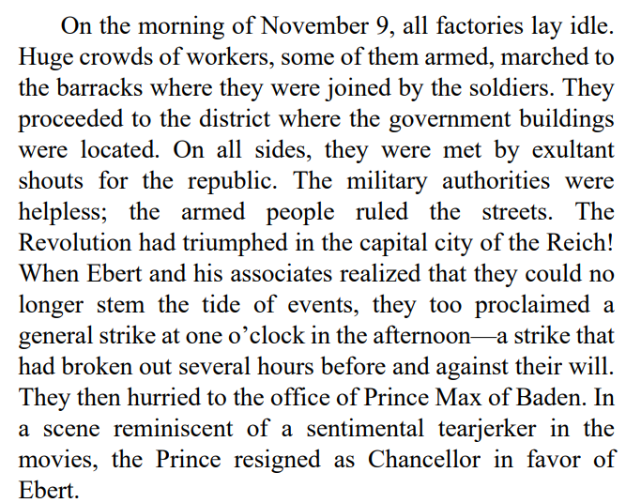
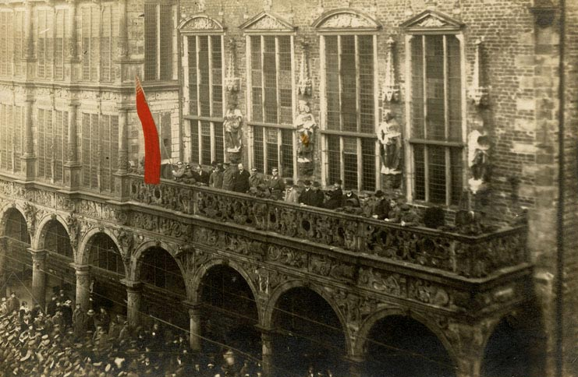
“But it was too late! The Revolution rode roughshod over all obstacles.”
Proclamation of the Bremen Soviet Republic outside the city hall on 15 November 1918

Slide 15
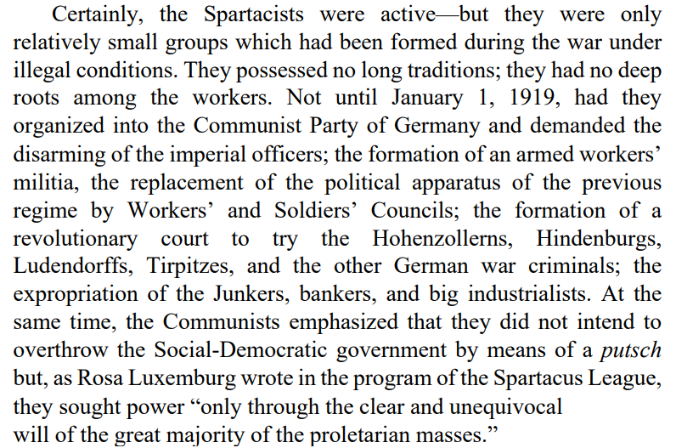
The Communists and the Revolution

Slide 16
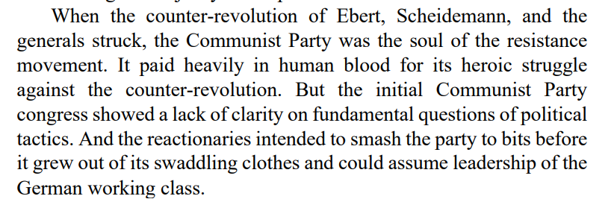
The Counter-Revolution Begins

Slide 17
Discussion

Slide 18
The Rise of Fascism

Slide 19
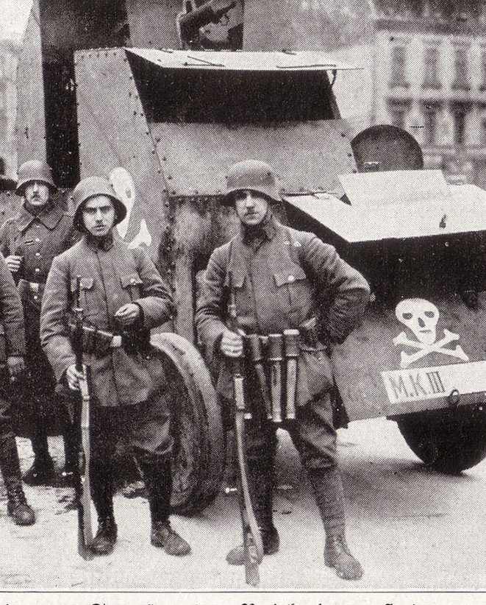
The Freikorps are Let Loose
During the first half of 1919, under the pretext of maintaining “law and order,” military detachments were sent to break up the Workers’ and Soldiers’ Councils. These troops struck at the workers with a savagery like that which, fifteen years later, characterized the S.A. and S.S. formations of Adolf Hitler. On February 11, General von Watter, acting under government orders, dissolved the General Soldiers’ Council. The Free Corps (freikorps) were let loose. In reply, a general strike was called. Coincident with the advance of the troops, the Social Democratic leaders formulated the slogan: “Socialization is already law,” and misled their own followers into abandoning the strike movement. The Free Corps ruffians shot and stabbed, clubbed and drowned workers, soldiers and sailors at will. They arrested left-wing leaders, and the commander of the People’s Marine Division was shot “while trying to escape.” The murderer, a Sergeant Tamschick, was rewarded by the Social-Democratic government with a promotion to lieutenant! On March 16 1919, the government peremptorily ordered the arrest of all Communists.
Freikorps paramilitaries in Berlin, 1919

Slide 20
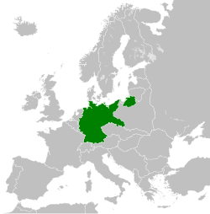
The Birth of the Weimar Republic
The revolutionary government fled with the National Assembly to Weimar. There, at the beginning of February 1919, the National Assembly elected Friedrich Ebert president of the republic and set up a cabinet of Social Democrats, Democrats, and Catholic Centrists. This coalition was to dominate the political scene in Germany for the next few years. The Republican Constitution went into effect on August 11, 1919. Its progressive articles were the fruit of the Revolution and the subsequent mass strikes. Freedom of opinion and association, equal and universal suffrage by secret ballot, and other democratic principles found legal expression in the document. At the same time, Article 48 provided for the abrogation of all these freedoms in case of emergency. This Article later became a favorite instrument of the governments of the Weimar Republic. The Constitution also sanctioned the establishment of workers’ councils which were, in fact, little more than agencies for settling disputes between employers and workers. The burning issue of socialization was ceremoniously buried in parliamentary committees.
The Weimar Republic in 1930

Slide 21
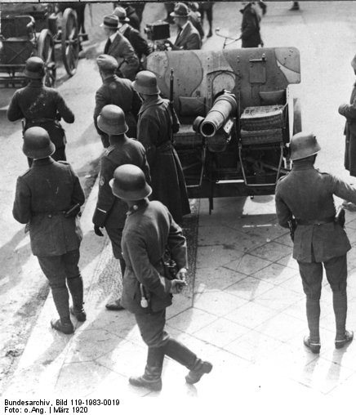
The Kapp Putsch
In March, 1920, the militarist clique felt that the left had been sufficiently weakened by the 1919 blood-letting, and that it could now proceed openly to institute its own monarchist dictatorship, which led to the attempted “Kapp putsch.” What decided the date of the uprising—known as the Kapp putsch—was the fact that the moment had come for disbanding the army in accordance with the Versailles Treaty. To the professional officers and non-coms, therefore, the putsch became a matter of their very livelihood. The Reichswehr generals were not willing to fire on units of their own army taking part in the anti-government putsch, and President Ebert and his government fled Berlin. The rebels occupied the government buildings. The legal government hid in Stuttgart. But the workers, salaried employees, and civil servants throughout Germany arose in a mammoth people’s strike which shut down every factory, mine, dock, and office. Kapp and Luettwitz operated in a vacuum. Their orders went unheeded; in many places their troops suffered defeat in armed conflicts with the workers. On March 17 they abdicated. The rescued government returned from Stuttgart.
Soldiers in Berlin Attempting to Overthrow the Revolutionary Government in the Kapp Putsch

Slide 22
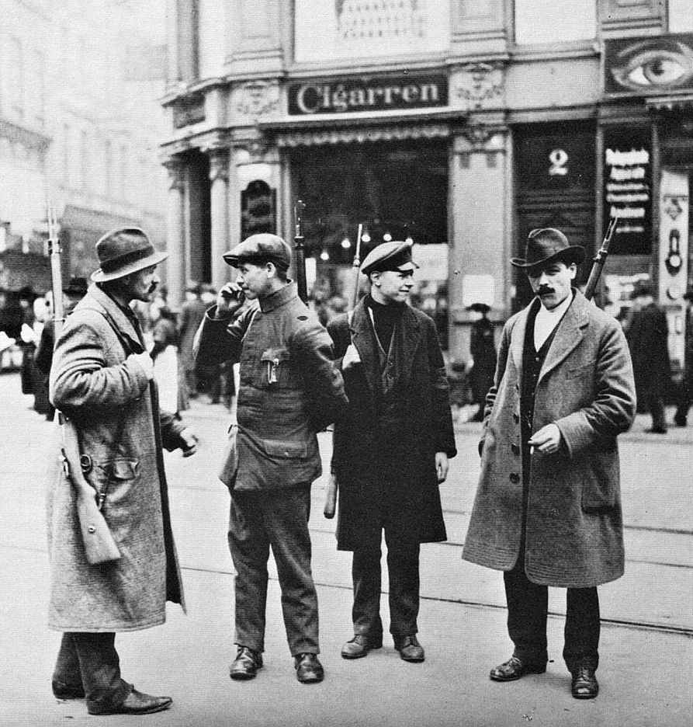
Forming a Popular Front
Members of the Red Ruhr Army. Dortmund, 1920
Now commanding general, von Watter’s troops marched into the industrial centers, bearing aloft the black-white-red imperial flag and shouting for the monarchy. On March 15, a joint appeal was issued, signed by the leaders of the Rhineland Westphalia Social Democrats, the Independent Socialists, and the Communists. Its aim was: “(1) gaining political power by means of the dictatorship of the proletariat; (2) immediate socialization of branches of industry ripe for it.” The workers fought and expelled the Kapp militarists from one city after another. On March 19, Essen fell to the workers.

Slide 23
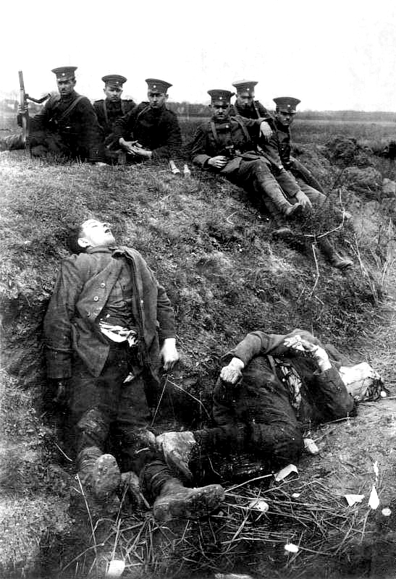
A People’s Army
Members of the Reichswehr sitting above the bodies of Red Ruhr Army fighters who had been shot, 2 April 1920
A central military committee organized the workers into a Red Army, which by March 21 had entirely cleared that vital industrial region of Germany of reactionary troops. The Ebert government began negotiations with a view to smashing the Ruhr workers’ united front, and utilized the time gained to assemble troop transports from the whole Reich against Western Germany. In the name of the government, a pact was signed that allowed the workers to form local defense groups and pledged that the Reichswehr would not occupy the Ruhr region.

Slide 24
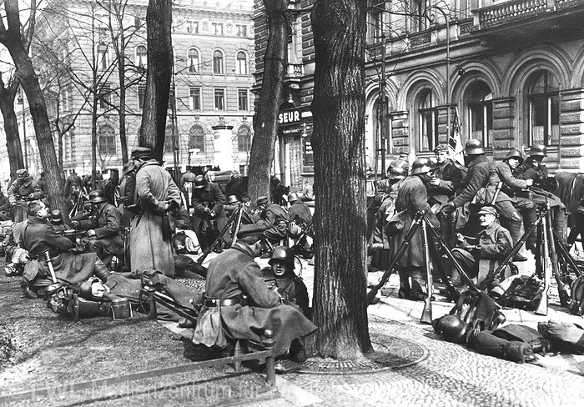
The Nazi Party Program
Why did the Government sign this accord? No sooner had a large section of the workers, trusting the agreement, laid down their arms than the Social Democratic Chancellor Hermann Mueller and General von Watter set an impossible time limit for the immediate dissolution of all people’s defense groups and the surrender of their weapons. With the demobilization in full swing, the Kapp putschists of yesterday, reinstated as “loyal” government troops, struck with unbridled ferocity. Invading the Ruhr, these military bands turned it into a veritable inferno. The Kapp putschists who had lost their jobs received substantial yearly pensions. Proceedings against 540 putschists of the Reichswehr were suspended. But the workers who had resisted the uprising received an aggregate total of more than one thousand years’ imprisonment. With the defeat of those who bore the main burden in smashing the Kapp putsch, the revolutionary period of 1918-1920 came to an end.
A Group of Kapp Putschists in Military Uniform

Slide 25
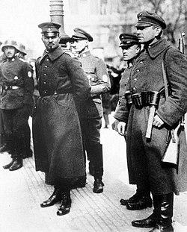
Disappointed and Embittered
The elections of June 6, 1920, were for deputies to the first Reichstag, which succeeded the Constitutional National Assembly. The election results should have been a warning to the government which had enlisted the aid of the reactionaries to defeat the people. Some of those who had formerly voted for the Weimar coalition, disappointed and embittered, moved to the Left; others, especially among the city and rural middle classes, returned to the Rightist camp which they had left in 1918 in the hour of military defeat. These results were bound to encourage the Right. The same Captain Erhardt who had organized the Kapp putsch now formed the O.C. (Organization Consul), the members of which attacked and murdered people holding high posts in the republic.
Ehrhardt in Berlin during the Kapp Putsch.

Slide 26
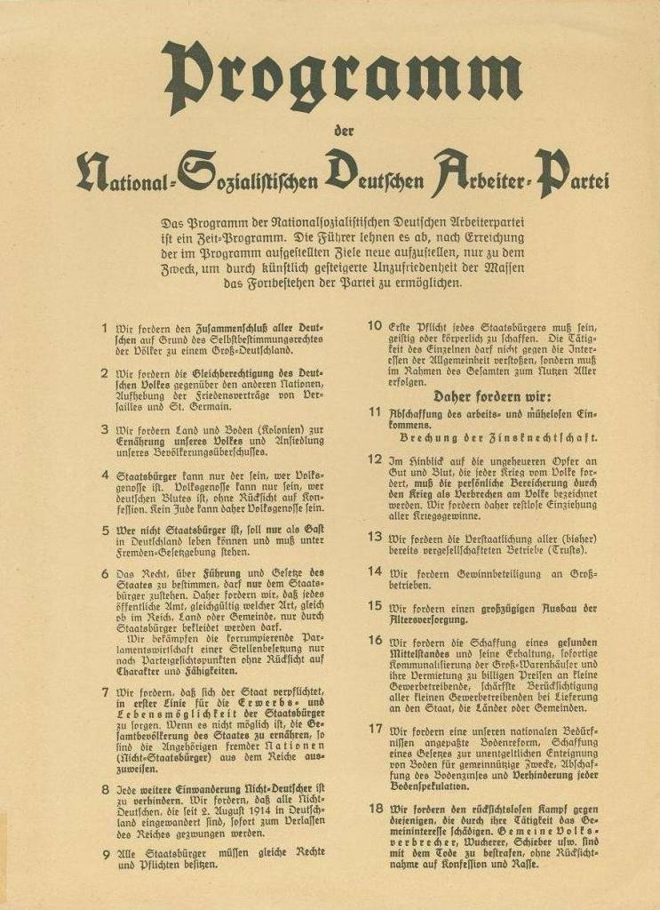
The Nazi Party Program
Appealing to the despairing middle-class professionals and intellectuals who were facing ruin in the inflation, the reactionaries prepared their coup. In the foreground of the movement was the German Workers' Party of Adolf Hitler, founded in Munich in 1919. In February, 1920, Hitler provided the party with a program that promised to “abrogate unearned income, break the Foreign Policy of the Weimar Republic, destroy the bonds of interest-slavery, confiscate all war profits, turn over all trusts to the state, introduce profit-sharing in all big enterprises, create a healthy middle class, divide department stores into a number of small shops leased by small storekeepers at low rentals, give maximum consideration to small merchants in furnishing supplies to the state, and punish usurers and speculators with death.” Known as the 25-Point Program, it outlined the ideology of the German Workers' Party (DAP), which was renamed the National Socialist German Workers' Party (NSDAP), or Nazi Party, on the same day
The 25 Point Program

Slide 27
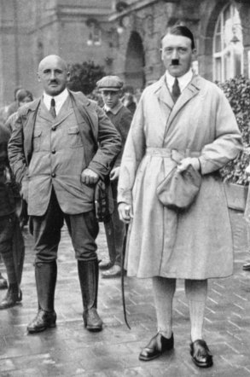
Hoping to Win the Masses by Wearing a Socialist Mask
The name and program of the party was proof that the German reactionaries could hope to win the masses only if they wore a socialist mask. The politically unstable middle classes, who had supported the republic only to find themselves draining the cup of their misery, were particularly receptive to Hitler’s unbridled chauvinism: “All people of German blood, whether they live under Danish, Polish, Czech, Italian, or French rule, must be united in the German Reich....”
Almost immediately after his failed November 9, 1923 putsch Hitler’s party completely disintegrated. However, Hitler had powerful supporters and had to serve only a few months of his five-year sentence, in a comfortably furnished fortress. After this none-too-arduous sojourn, he was set free to rebuild his party and spread his Nazi propaganda. The leaders of Social-Democracy wanted no cooperation with the Communists. They saw in the economic upturn which set in after 1924, and which was aided by foreign loans, the beginning of a long period of capitalist prosperity. Powerful trusts arose in Germany during these years: for example, the I. G. Farben combine, formed from the merger of a number of chemical enterprises, and the Vereinigte Stahlwerke, which fused the coal mines, iron and steel works into a single giant undertaking.
Adolf Hitler and Julius Streicher at Nuremberg, Sept. 2nd 1923

Slide 28
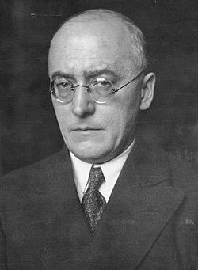
Signing the Death Warrant of the Republic
The German industrialists began working through Chancellor Dr. Heinrich Bruening after he came to power in the spring of 1930 and the first act of the Bruening cabinet was to reduce social expenditures and to increase taxes on the low-income groups. When Bruening feared that the Reichstag might reject his harsh economic decrees, he invoked Article 48 of the constitution and had Hindenburg enact his “emergency decrees” into law. This article gave the President the right to govern dictatorially without consulting parliament, in the event of serious unrest in the country. There was no such unrest. When on October 18, 1930, a majority of the Reichstag, including the Social-Democratic deputies, voted for this authoritarian course, the Weimar politicians signed the death warrant of their own parties and of the republic.
Heinrich Brüning c. 1930

Slide 29
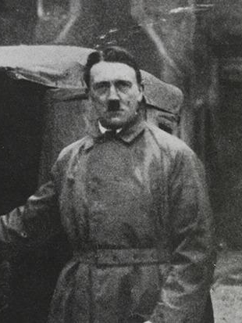
Diverting the Wrath of the Masses
The party of Adolf Hitler was again in the public eye. With the failure of the beer hall putsch of 1923, it had sunk into obscurity. Now it rose rapidly. Hitler’s party became therefore the center of attraction for the great mass of the politically vacillating who were desperately seeking a way out of their misery. Its far-flung apparatus offered many well paid jobs for jobless intellectuals, ruined storekeepers, and former officers who had originally been active in forming the “storm-troop units.” Many of these S.A. headquarters were crowded with unemployed men, deprived of unemployment insurance by the Bruening decrees.
Hitler’s main propaganda weapon was his attack on the Versailles Treaty and on those parties he held responsible for having signed the Diktat. Hitler hid the fact that the real authors of German poverty were the big capitalists who were his paymasters. To prevent a social explosion within Germany, the Nazis diverted the wrath of millions of Germans into chauvinist and anti-Semitic channels.
Hitler Leaving Prison in Dec. 1924 Having Served Only A Fraction of His Sentence for the Beer Hall Putsch

Slide 30
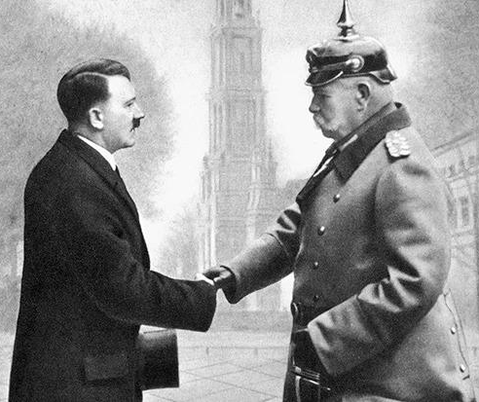
Voting for the “Lesser Evil”
The 1930 elections showed that the Nazis had not succeeded in penetrating the ranks of the politically conscious workers. Both workers’ parties, with the pendulum of influence swinging slowly in favor of the Communists, had stood their ground in the face of the Nazis’ head-on assault. But to halt the rising tide of Nazism demanded that they unite their efforts. Instead, the Social-Democratic leaders declared that Bruening was “the lesser evil” and had to be tolerated, against the greater evil, Hitler. But Bruening’s policies as chancellor hastened, not hindered, the victory of Hitler. By his emergency decrees, Bruening dug the grave of the Weimar Republic. Hindenburg’s seven-year term of office as President expired at the beginning of 1932. To illustrate how low the ruling parties of the republic had fallen, the only candidate they could find to oppose Hitler was Hindenburg, who would run once again. In 1925, the Germans had voted for Wilhelm Marx who later made common cause with Hindenburg. Now they voted for Hindenburg, who less than a year later made Hitler Chancellor of Germany.
President von Hindenburg shakes hands with Hitler, 1933.

Slide 31
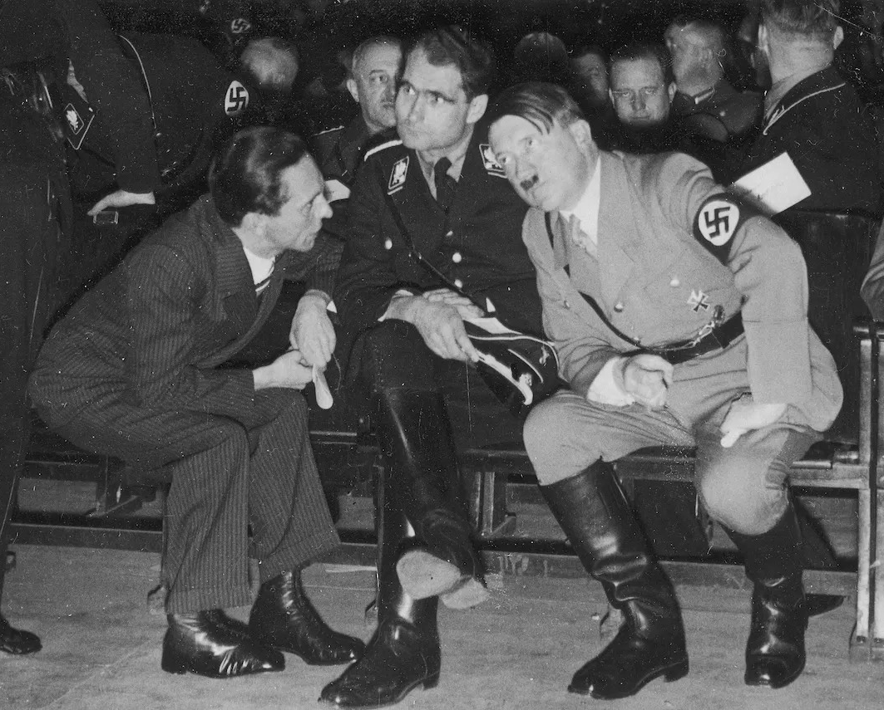
The Future Looks Dark and Gloomy
The Nazi movement did not come to power in Germany because it had won over the majority of the people to its policies, or because the Germans are “by nature” Nazis. Even under the most advantageous conditions, despite fraudulent elections, terror, and the pro-Nazi sympathies of many government officials, the National Socialists never won a clear majority of the voters in anything like a normal election. Three months after their most resounding electoral victory, in the Reichstag elections of November 6, 1932, they lost 2,000,000 votes. Describing the mood of the Nazi Party, Goebbels wrote in his diary for December, 1932: “Deep depression throughout the organization. One feels so worn out; one longs for nothing but a few weeks’ escape from the whole business....” “Phone call from Dr. Ley: The situation in the party is getting worse from hour to hour.” “The year 1932 has brought us eternal ill luck.... The past was sad, and the future looks dark and gloomy; all chances and hopes have quite disappeared.” “For hours, the leader (Hitler) paces up and down the room in the hotel. It is obvious that he is thinking very hard.... Suddenly he stops and says: ‘If the party once falls to pieces, I shall shoot myself without more ado.’ A dreadful threat, and most depressing.”
Hitler, Goebbels, and Hess Engaged in Conversation

Slide 32
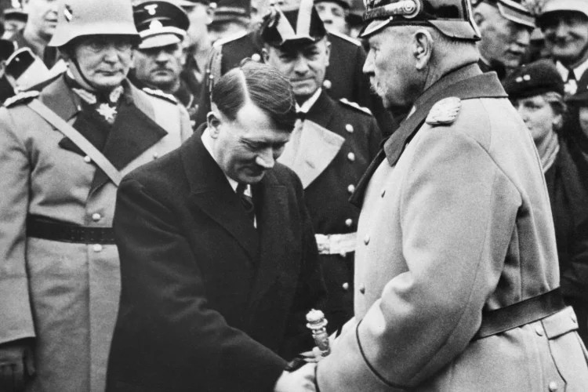
Hitler Becomes Chancellor
But Hitler did not have to shoot himself, nor did his party fall to pieces. The parties and classes opposed to his assumption of power did not take advantage of this favorable situation. They failed to act. But the reactionaries needed him and his party in order to set up a dictatorship. On January 4, 1933, in the presence of Franz von Papen, Hitler negotiated with the Cologne banker, Kurt von Schroeder, a financial intimate of the big industrialists and a man who had excellent international connections with British and American financial interests. As a result, Hitler obtained all the money he needed to finance his campaigns and his terrorist gangs. And he received much more. On January 30, 1933, Hitler was named Chancellor of Germany by von Hindenburg, the very man whom the middle-class democrats and Social-Democratic voters had elected President in order to defend the Weimar Republic against Hitler
Newly appointed Chancellor Adolf Hitler greets President von Hindenburg at a memorial service. Berlin, 1933

Slide 33
Discussion

Slide 34
The Nazis Set Up Their Dictatorship

Slide 35
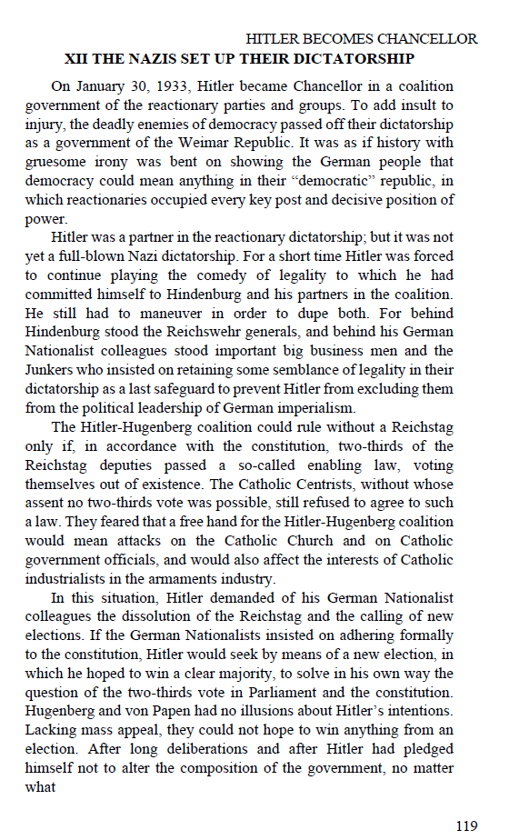
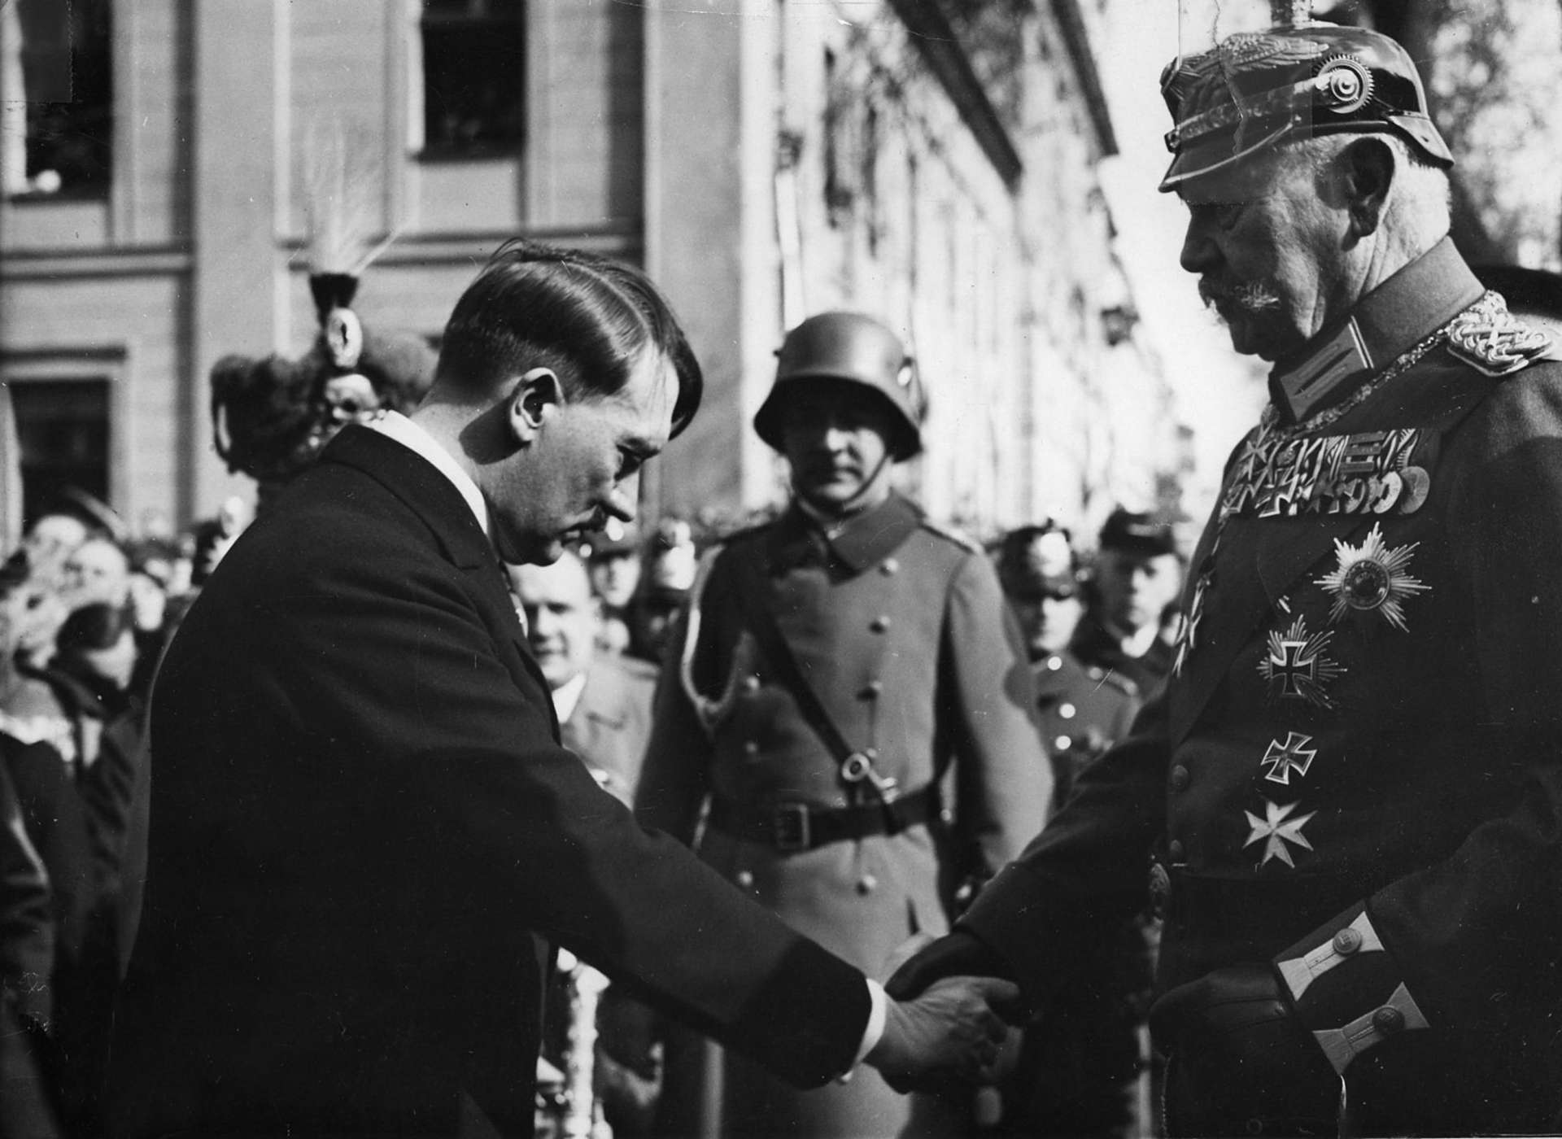
Ch. 12
Hitler is sworn in as Chancellor

Slide 36
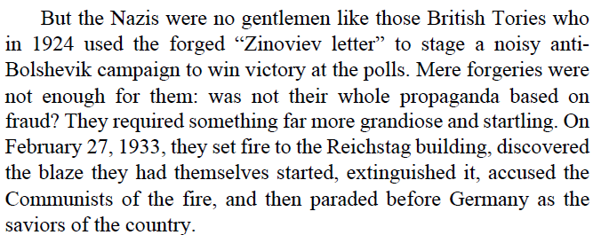
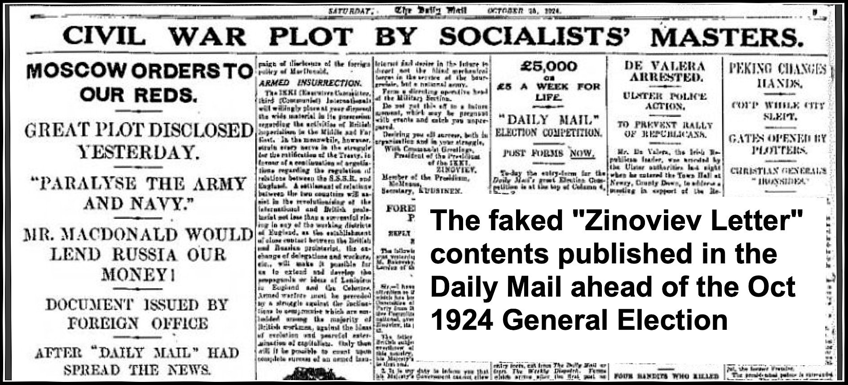
Newspaper Article on the “Zinoviev Letter”

Slide 37
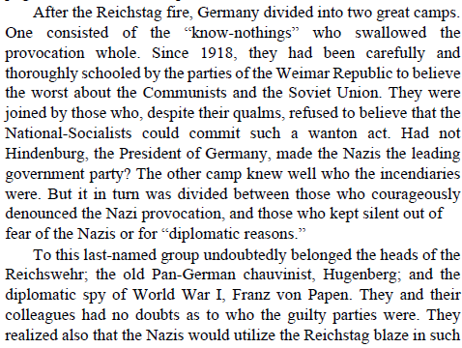
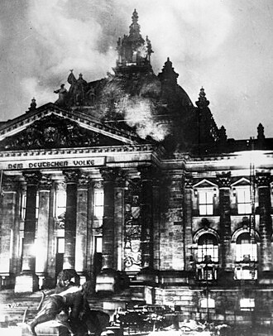
The burning of the Reichstag

Slide 38
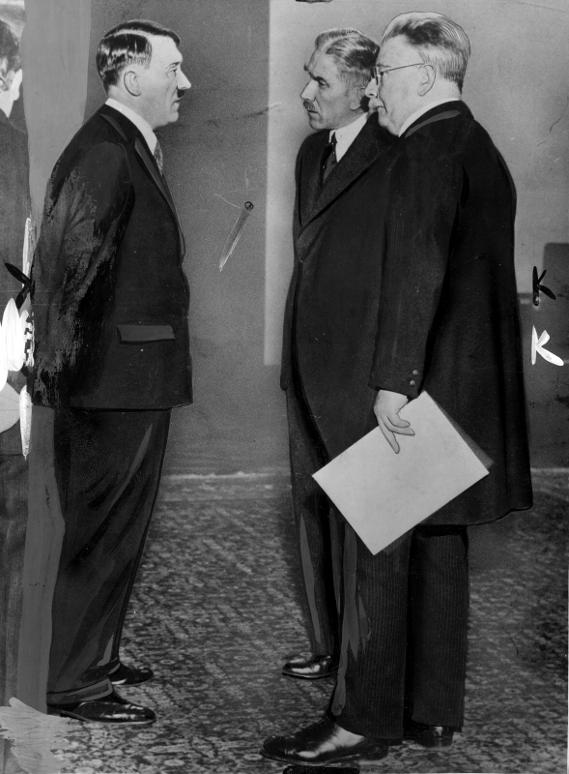
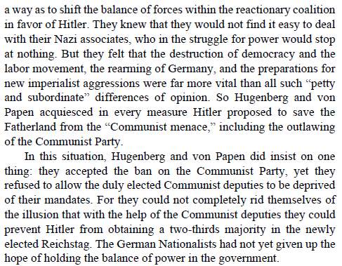
Hugenberg and von Papen (right)

Slide 39
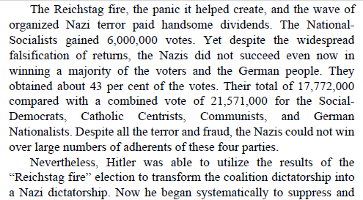
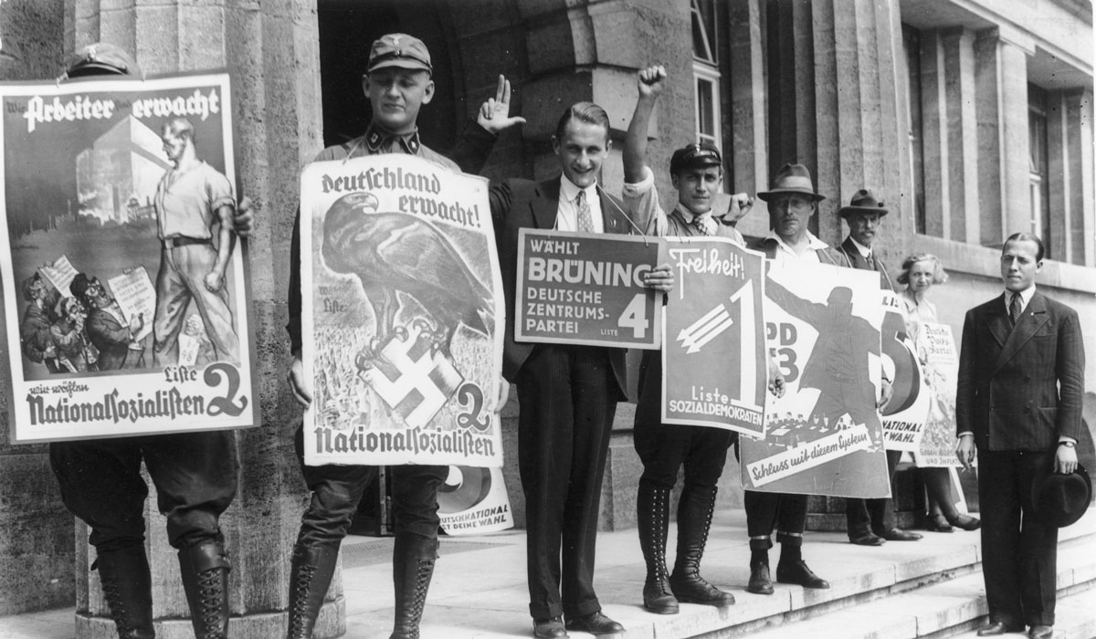
Two Nazi SA men (left), along with representatives of the (Catholic) Center, Social Democratic, Communist, and other parties, campaign in Berlin

Slide 40
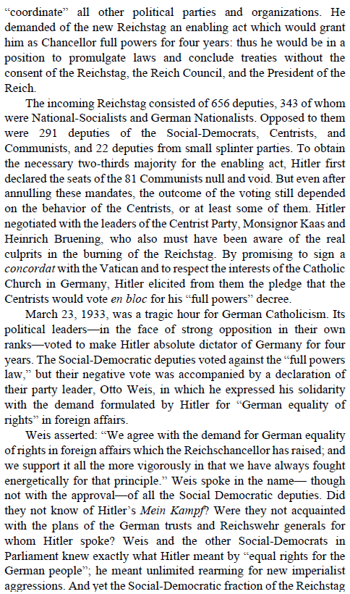
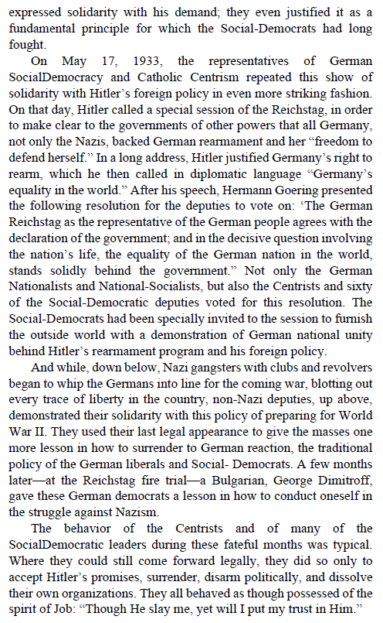

Slide 41
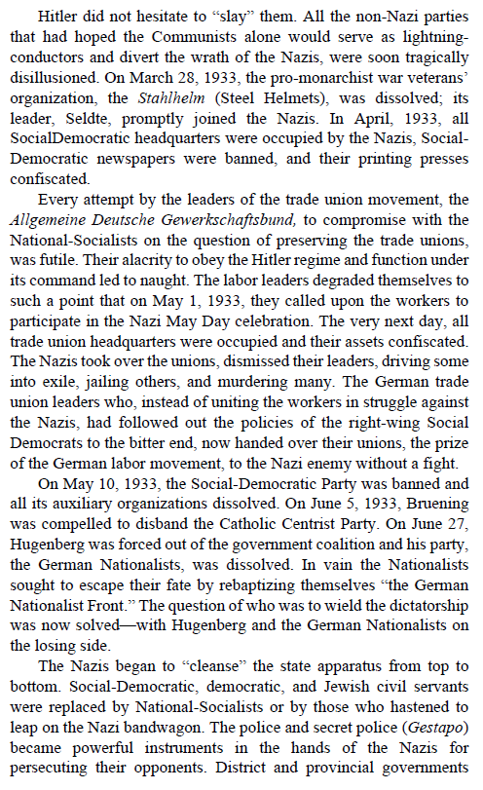
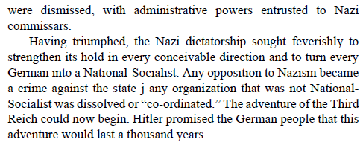

Slide 42
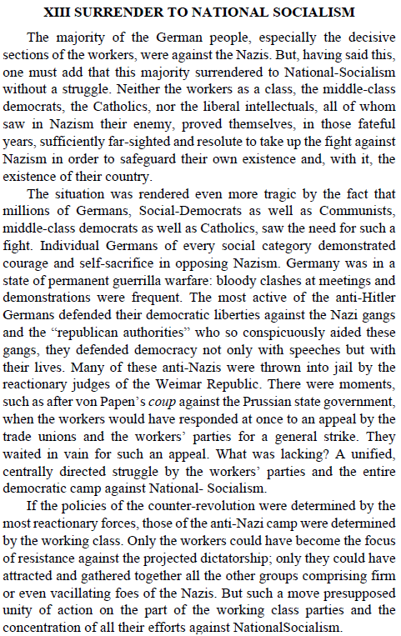
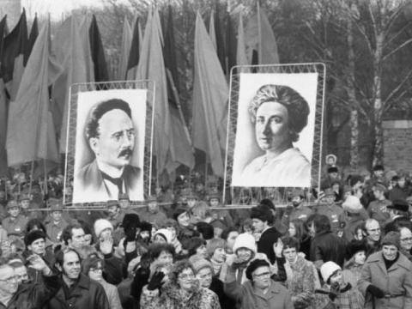
Efforts to lead the discontent masses towards victory were unsuccessful due to a lack of unity in leadership

Slide 43
Comparison with Current Events
In the present day we see terroristic individual acts of violence as discontent grows amongst the masses.
When there is no strong communist movement to guide the frustration of the masses into collective action, individuals turn to desperate acts of violence.
Though the individuals targeted are not martyrs by any means, killing individuals who are mere figureheads of a larger oppressive system does not bring us any closer to democracy. On the contrary, it exacerbates the problem, as the reactionaries in power blame these actions on the left to justify expanding their power and use of the military against civilians.
Now that we’ve learned the mistakes of Germany and German left, we are better equipped to build a popular front in time.
Fascism couldn’t take root in the US in the 1940s, and we continue the struggle to ensure it doesn’t this time.

Slide 44
On the Recent Act of Political Terrorism
Statement by Politburo of Party of Communists USA
The assassination of right-wing Christian nationalist Charlie Kirk is an individual act of political terrorism. The Party of Communists USA condemns such acts of political violence, which are driven by the lack of a working-class-oriented consciousness.
“We believe that even a hundred regicides can never produce so stimulating and educational an effect as this participation of tens of thousands of working people in meetings where their vital interests and the links between politics and these interests are discussed, and as this participation in a struggle, which really rouses ever new and “untapped” sections of the proletariat to greater political consciousness, to a broader revolutionary struggle.” Vladimir Lenin, "New Events and Old Questions," Iskra.
President Trump has decried radical left political violence. What about radical right political violence? We see 1920s Germany and Italy being repeated. The contradictions of capitalism come to a head and lead to the rise of fascism.
Unity between the left and center is necessary as this individual act of terrorism has led to calls for political repression and violence against progressives and Democrats. This left-center unity will work to uproot the conditions that produce the reactionary acts by dispossessed people; namely: destitution and decaying society.
The utility that together we can affect change which is better than what we can do alone.

Slide 45
Discussion & New Members Introductions

Slide 46
New Member Introductions
What is your name, pronouns and state (or country/territory)?
Where do you work? Is it unionized?
How did you find out about the People’s School?
What do you think about tonight's class?

Slide 47
Discussion & Wrap Up

Slide 48
Announcements
PCUSA Cell Chairs need to call members of their cells to remind them about attendance.
The next issue of New Masses (2025) has begun production. If you have art you want us to feature, email it to info@partyofcommunistsusa.net.

Slide 49
Volunteers Needed!
We are in need of volunteers for the staff of the People’s School! Here’s a few roles we need filled:
People to help manage posting on our social media and podcast platforms
Video Editors, Audio Editors, Graphic Designers, Artists, Narrators
Web Controls, Moderators
Email info@peoplesschool.us if you’re interested and try to attend our next staff meeting if possible.

Slide 50

View From Left Field
https://viewfromleftfield.libsyn.com
The Old PSMLS Youtube is now the Youtube of View From Left Field, a podcast of analysis and discussion of current events from a progressive perspective.
Like the Youtube videos and subscribe with 5 star ratings on your podcast platforms.

Slide 51

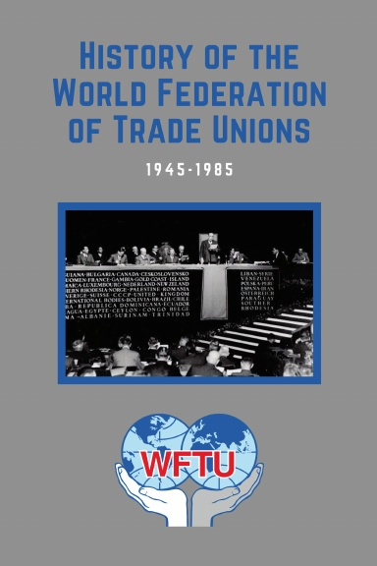
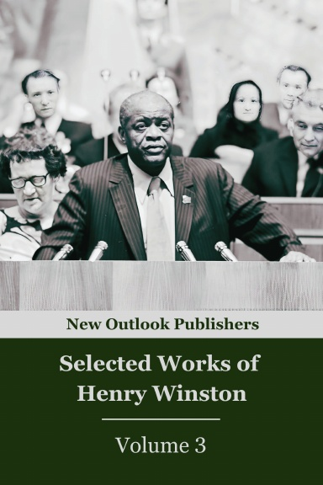

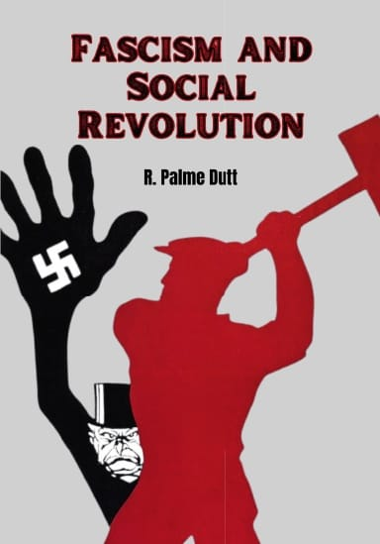
New Outlook Publishers
newoutlookpublishers.store
Latest & Relevant Releases

Slide 52

Jewish
Peoples Schule
The Jewish Peoples Schule educates in fraternity along secular, progressive lines to our Jewish and non-Jewish friends to share and relate the historical struggles of the Jewish peoples to other peoples’ struggles against oppression.
During the Days of Awe, let us reflect and learn together about Jewish-American Working Class Heroes. September 27th, 2025
6:00 PM to 7:30 PM EASTERN

Slide 53



Harry Bridges School of Labor
luel.us/laborschool/
The Harry Bridges School of Labor is a monthly class held 2x per month. Classes cover a variety of topics aimed at building class conscious among union members.
October’s class is Part 2 of History of the World Federation of Trade Unions (WFTU). Class will be October 4, 2025 at 7pm EST/4pm PST.

Slide 54
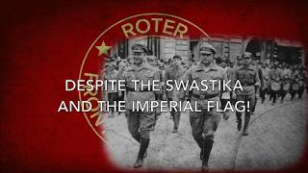
Marching Song of the Red Front (Die Rote Front Marschiert)

