Slide 1

PSMLS 9/2/2025

Slide 2

Context for today’s film:
Released in 1943, the film stars Ginger Rogers, Robert Ryan, Ruth Hussey, and Kim Hunter and was directed by Edward Dmytryk.
Filmed during WWII, the movie portrays women on the home front living communally while their husbands are away at war.
The film has an anti-fascist message and advocates for collectivism and democracy. It also shows the viewpoint of the women during the war, who had to work in the factories to aid the war effort and financially support themselves.
The film was later used by the HUAC as evidence of Dalton Trumbo spreading communist propaganda. Trumbo was subsequently blacklisted.

Slide 3
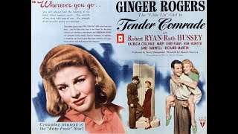

Slide 5
Discussion

Slide 8
Discussion

Slide 11
Discussion & New Members Introductions

Slide 12
New Member Introductions
What is your name, pronouns and state (or country/territory)?
Where do you work? Is it unionized?
How did you find out about the People’s School?
What do you think about tonight's class?

Slide 13
Discussion & Wrap Up

Slide 14
Announcements
PSUSA Cell Chairs need to call members of their cells to remind them about attendance.
2025 of New Masses is in production. If you have any art or literary work you wish to submit, please email it to info@partyofcommunistsusa.net

Slide 15

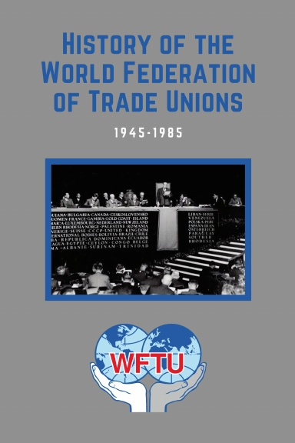
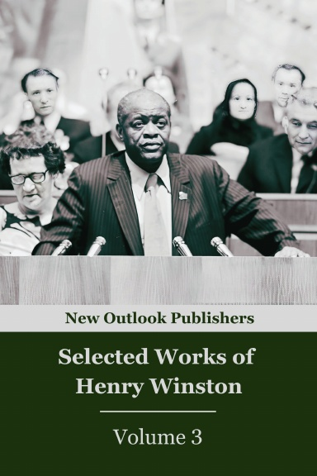
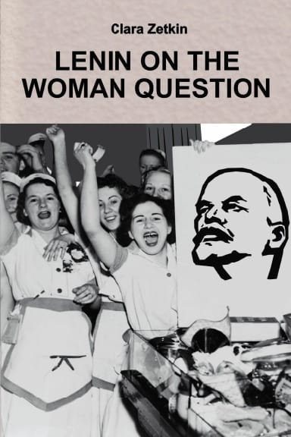
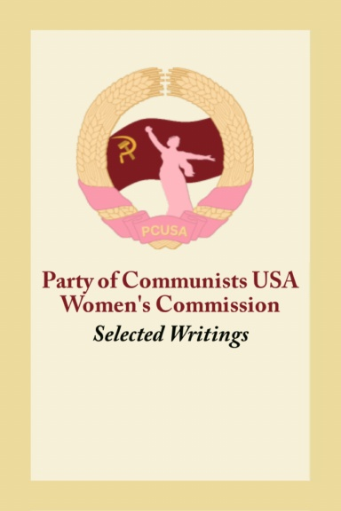
New Outlook Publishers
newoutlookpublishers.store
Latest & Relevant Releases

Slide 16


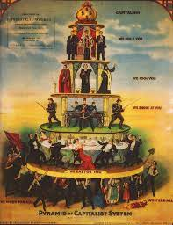
Harry Bridges School of Labor
luel.us/laborschool/
The Harry Bridges School of Labor is a monthly class held once per month starting September 2025. Classes cover a variety of topics aimed at building class consciousness among union members.
October’s class is “Class-Oriented Labor and Politics - Independent Political Action”. Class will be September 6, 2025 at 7pm EST/4pm PST.

