Slide 1

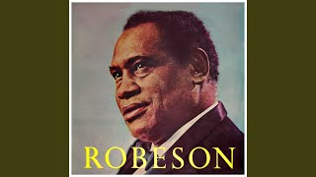
Paul Robeson - John Brown’s Body

Slide 2
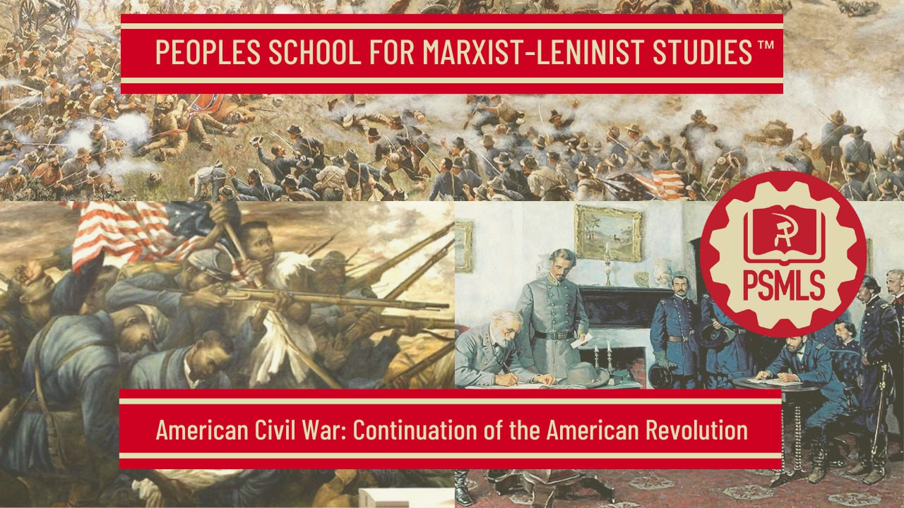

PSMLS 04/15/2025

Slide 3
What we’ll be learning today:
From Revolution to Civil War
Fight Against Slavery
Outcome of the Civil War

Slide 4
From Revolution to Civil War

Slide 5
Immense, World-historic, Progressive and Revolutionary
Lenin in his “Letter to American Workers”
“The history of modern, civilised America opened with one of those great, really liberating, really revolutionary wars of which there have been so few compared to the vast number of wars of conquest which, were caused by squabbles among kings, landowners or capitalists over the division of usurped lands or ill-gotten gains. That was the war the American people waged against the British robbers who oppressed America and held her in colonial slavery, in the same way as these “civilised” bloodsuckers are still oppressing and holding in colonial slavery hundreds of millions of people in India, Egypt, and all parts of the world.
When they waged their great war of liberation against the British oppressors, they had also against them the French and the Spanish oppressors who owned a part of what is now the United States of North America. In their arduous war for freedom, the American people also entered into “agreements” with some oppressors against others for the purpose of weakening the oppressors and strengthening those who were fighting in a revolutionary manner against oppression, for the purpose of serving the interests of the oppressed people. The American people took advantage of the strife between the French, the Spanish and the British; sometimes they even fought side by side with the forces of the French and Spanish oppressors against the British oppressors; first they defeated the British and then freed themselves (partly by ransom) from the French and the Spanish.

Slide 6
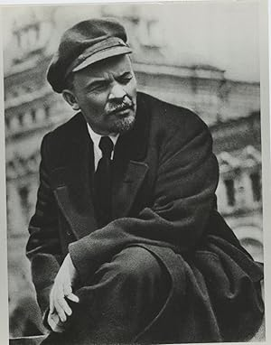
The American people have a revolutionary tradition which has been adopted by the best representatives of the American proletariat, who have repeatedly expressed their complete solidarity with us Bolsheviks. That tradition is the war of liberation against the British in the eighteenth century and the Civil War in the nineteenth century. In some respects, if we only take into consideration the “destruction” of some branches of industry and of the national economy, America in 1870 was behind 1860. But what a pedant, what an idiot would anyone be to deny on these grounds the immense, world-historic, progressive and revolutionary significance of the American Civil War of 1863-65!
The representatives of the bourgeoisie understand that for the sake of overthrowing Negro slavery, of overthrowing the rule of the slaveowners, it was worth letting the country go through long years of civil war, through the abysmal ruin, destruction and terror that accompany every war. But now, when we are confronted with the vastly greater task of overthrowing capitalist wage-slavery, of overthrowing the rule of the bourgeoisie—now, the representatives and defenders of the bourgeoisie, and also the reformist socialists who have been frightened by the bourgeoisie and are shunning the revolution, cannot and do not want to understand that civil war is necessary and legitimate.

Slide 7
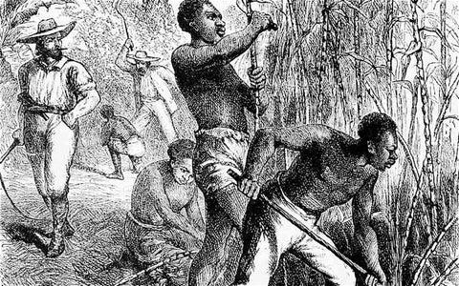
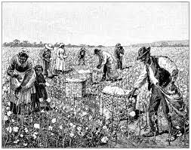
Marx On Slavery
Marx to Engels, January 11, 1860:
“In my opinion, the biggest things that are happening in the world today are on the one hand the movement of the slaves in America started by the death of John Brown, and on the other the movement of the serfs in Russia…”
Marx in Capital Vol. 1:
”Labor cannot emancipate itself in the white skin, wherein the black it is branded.”
Slaves on a Haitian Sugar Plantation
Marx in Theories of Surplus Value, Part 2:
“In the second type of colonies - plantations - where commercial speculations figure from the start and production is intended for the world market, the capitalist mode of production exists, although only in a formal sense, since the slavery of Negroes precludes free wage-labour, which is the basis for capitalist production [as a whole]. But the business in which slaves are used is conducted by capitalists. The method of production which they introduce has not arisen out out of slavery but is grafted on it. In this case, the same person is capitalist and landowner.”
Slaves on an American Cotton Plantation

Slide 8
The System of Slavery or the System of Free Labor
Karl Marx and Frederick Engels in The Civil War in the United States:
“What would in fact take place (ed. Should the south win the Civil War) would be not a dissolution of the Union, but a reorganisation of it, a reorganisation on the basis of slavery, under the recognised control of the slaveholding oligarchy. The plan of such a reorganisation has been openly proclaimed by the principal speakers of the South at the Congress of Montgomery and explains the paragraph of the new Constitution which leaves it open to every state of the old Union to join the new Confederacy. The slave system would infect the whole Union. In the Northern states, where Negro slavery is in practice impossible, the white working class would gradually be forced down to the level of helotry. This would fully accord with the loudly proclaimed principle that only certain races are capable of freedom, and as the actual labour is the lot of the Negro in the South, so in the North it is the lot of the German and the Irishman, or their direct descendants.
The present struggle between the South and North is, therefore, nothing but a struggle between two social systems, the system of slavery and the system of free labour. The struggle has broken out because the two systems can no longer live peacefully side by side on the North American continent. It can only be ended by the victory of one system or the other.

Slide 9
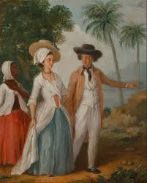
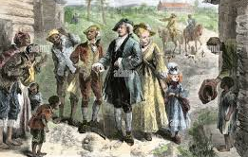
If the border states, the disputed areas in which the two systems have hitherto contended for domination, are a thorn in the flesh of the South, there can, on the other hand, be no mistake that, in the course of the war up to now, they have constituted the chief weakness of the North. One section of the slaveholders in these districts simulated loyalty to the North at the bidding of the conspirators in the South; another section found that in fact it was in accordance with their real interests and traditional ideas to go with the Union. The two sections have equally crippled the North. Anxiety to keep the "loyal" slaveholders of the border states in good humour; fear of throwing them into the arms of secession, in a word, tender regard for the interests, prejudices and sensibilities of these ambiguous allies, has smitten the Union government with incurable weakness since the beginning of the war, driven it to half measures, forced it to dissemble away the principle of the war, and to spare the foe's most vulnerable spot, the root of the evil—slavery itself.

Slide 10
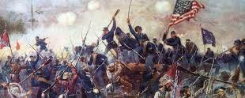
It is believed that the issue for the slaveholders' party is merely one of uniting the territories it has hitherto dominated into an independent group of states and withdrawing them from the supreme authority of the Union. Nothing could be more false. " The South needs its entire territory. It will and must have it." With this battle-cry the secessionists fell upon Kentucky. By their "entire territory" they understand in the first place all the so-called border states'"— Delaware, Maryland, Virginia, North Carolina, Kentucky, Tennessee, Missouri and Arkansas. Besides, they lay claim to the entire territory south of the line that runs from the northwest corner of Missouri to the Pacific Ocean. What the slaveholders, therefore, call the South, embraces more than three-quarters of the territory hitherto comprised by the Union. A large part of the territory thus claimed is still in the possession of the Union and would first have to be conquered from it. None of the so-called border states, however, not even those in the possession of the Confederacy, were ever actual slave states. Rather, they constitute the area of the United States in which the system of slavery and the system of free labour exist side by side and contend for mastery, the actual field of battle between South and North, between slavery and freedom. The war of the Southern Confederacy is, therefore, not a war of defence, but a war of conquest, a war of conquest for the spread and perpetuation of slavery.”

Slide 11
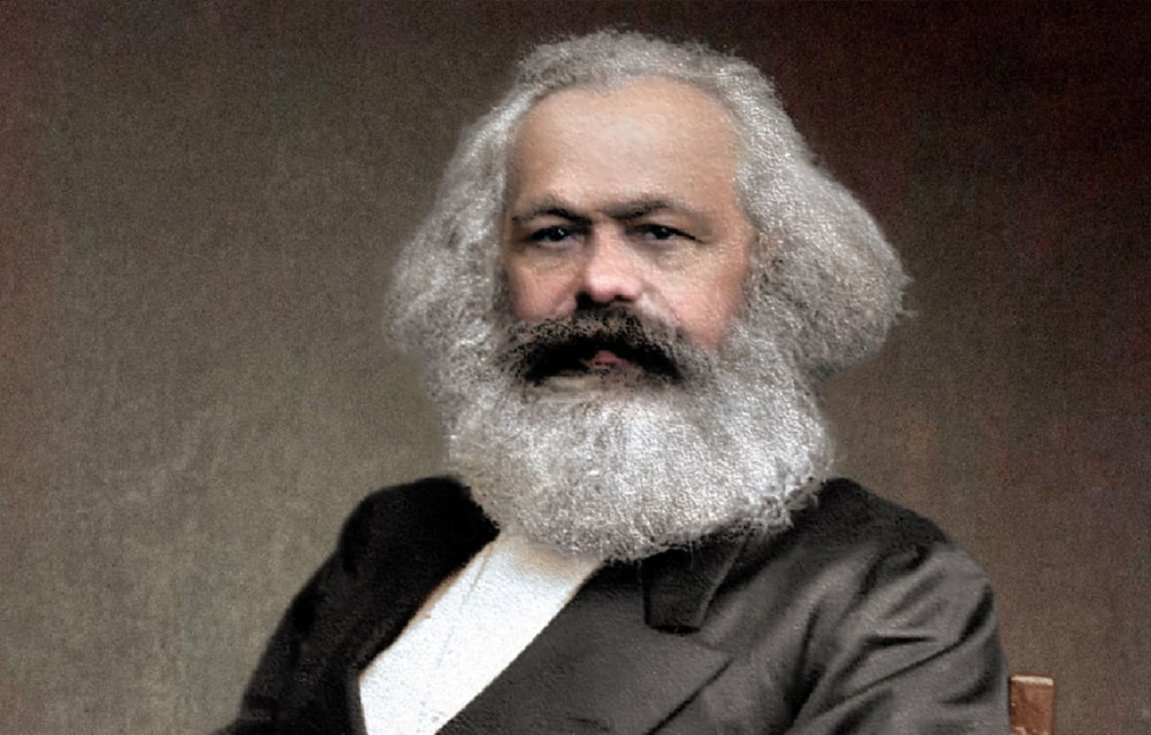
Why the Confederacy Was Condemned to Lose
NOWHERE was Karl Marx’ genius more dramatically demonstrated than in his grasp of the real nature of the Civil War and in his comprehension of the unpopular character of the Confederacy. The military experts of the world were agreed that the North would not be able to defeat the South; at best they saw a long and drawn-out war exhausting both sides with some kind of military draw resulting and a negotiated settlement concluding the conflict. Marx disagreed; he held that the North would defeat the South and do so rather quickly and accomplish it utterly. And Marx insisted on this exactly because he knew it was not the North versus the South, but rather the United States versus a slaveholding oligarchy. Marx, of course, paid careful attention to the class forces involved in the struggle; he followed with close attention the procedure of secession; he noted that no plebiscite on this was permitted. He insisted upon the oligarchic and non-popular character of the Confederacy.
From Herbert Aptheker’s American Civil War

Slide 12
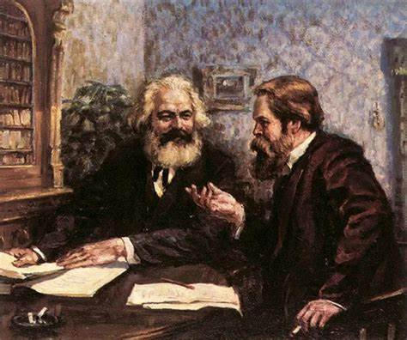
Why the Confederacy Was Condemned to Lose
Indeed, even Frederick Engels seriously doubted the outcome of the war, and as late as September, 1862, asked Marx:
“Do you still believe that the gentlemen in the North will crush the rebellion’?”
Marx replied that he “would wager his head” on that belief. It was based, he wrote, not only on Lincoln’s supremacy in resources and men (for this alone need not be decisive — witness the American colonies versus Great Britain, Holland versus Spain, etc.), but also on the fact that the South was not in rebellion, but that rather an oligarchy of some 300,000 slaveholders had engineered a counter-revolutionary coup d'etat.
From Herbert Aptheker’s American Civil War

Slide 13
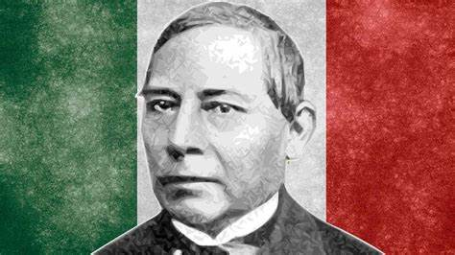
International Progressive Forces Aid the Union and Abolitionist Cause
In the result of the War, the sympathy for the cause of the Union felt by the common people of all Europe, of Canada and of Mexico was important. The role of the First International, under the personal leadership of Karl Marx, in helping to organize and focus this popular opposition, especially in Great Britain, is well-known. Less well known is the important contribution to the Union cause made by the Mexican revolutionary masses, led by the great Benito Juarez, in resisting the efforts of France to conquer Mexico. Had this conquest been complete and not seriously contested, the Confederacy would have had a long land border with a friendly French power, and this would have added difficulties to the imposition of an effective blockade of the Confederacy. It is somewhat ironic that the Mexican masses helped preserve the integrity of the United States, less than twenty years after the United States had stolen from Mexico, through war, one-third of its own territory.
Benito Juarez - President of Mexico from 1858 to 1872
From Herbert Aptheker’s American Civil War

Slide 14
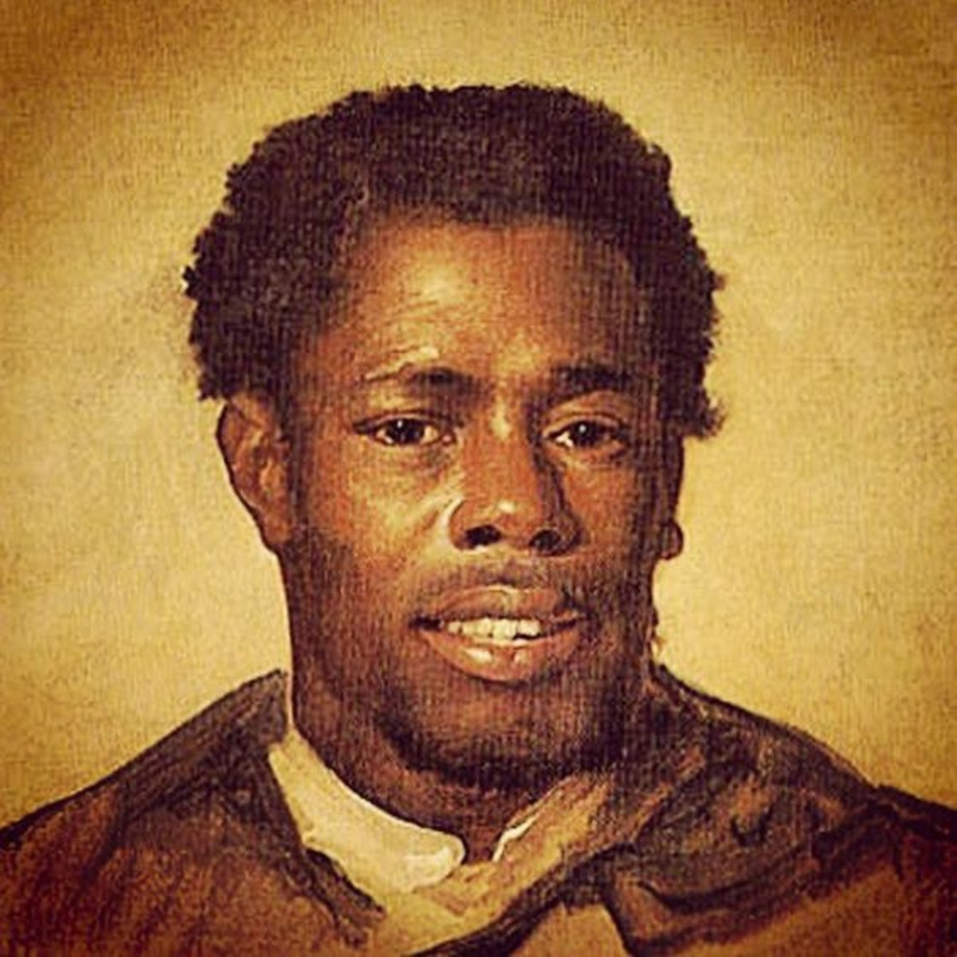
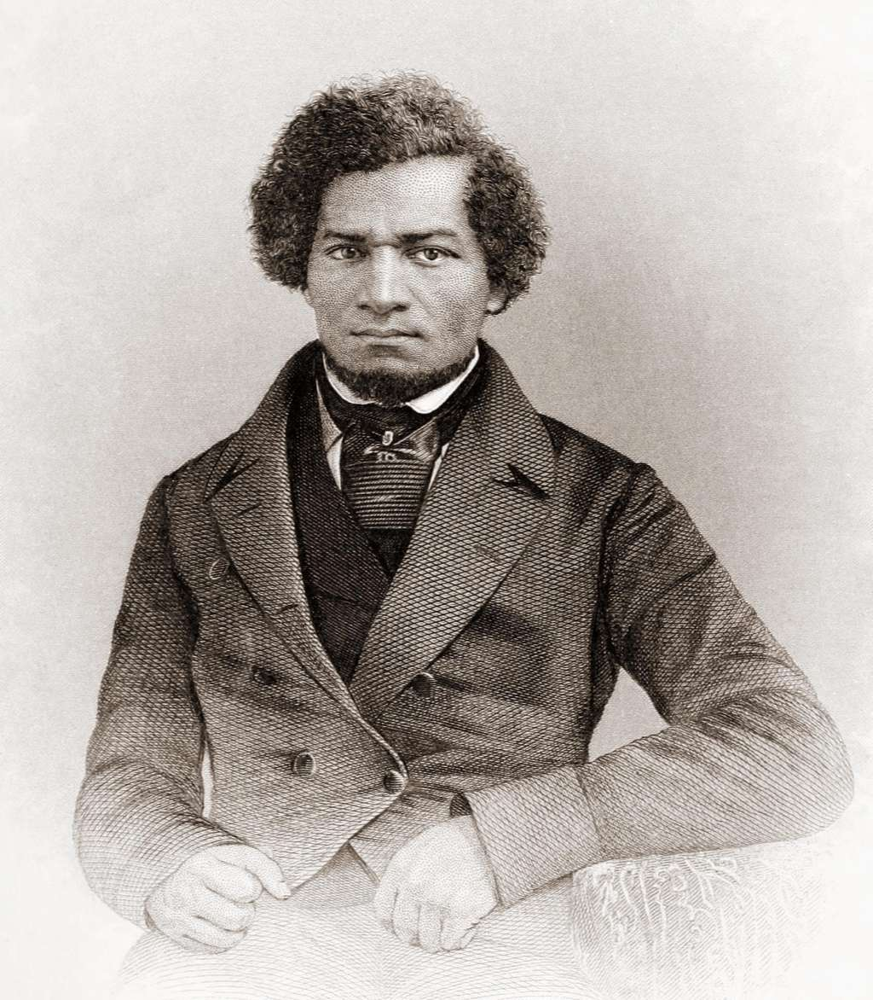
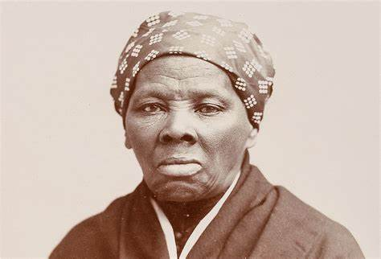
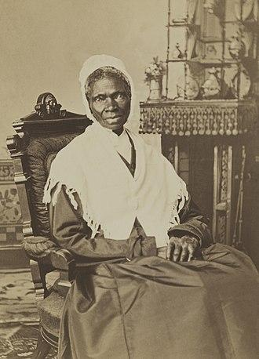
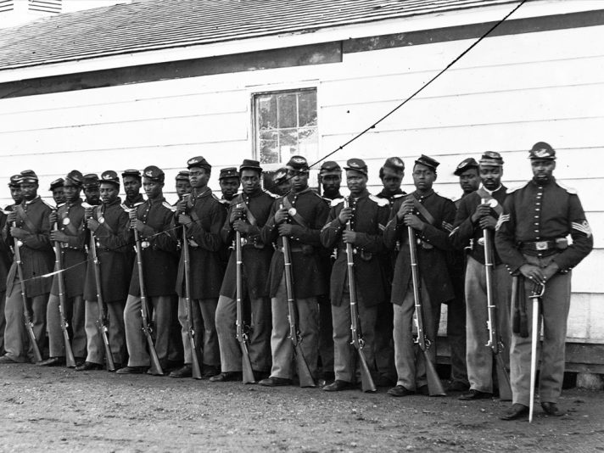
African-Americans Were Instrumental in the Defeat of the Confederacy and the Slave Institution
The African-American leadership was in the forefront of the effort to make clear the decisive nature of the slave system to the power of the Confederacy; it therefore led in advancing the necessity to revolutionize the conduct of the war. The war, if conducted passively, defensively, if conducted only to "defend the Union” with an insistence that the institution of slavery was irrelevant to the conflict, would not terminate happily for the Union No, to defend the Union it was necessary to destroy the power base of those who attacked it; to defend the Union it was necessary to add to its resources the mighty power and passion of the African-American millions. To defend the Union it was necessary to destroy slavery. The salvation of the Union required the emancipation of the slaves; the emancipation of the slaves required the salvation of the Union. Thus did the dialectics of history manifest itself in specific form in the great Civil War.
African American Abolitionist Leaders: Nat Turner, Frederick Douglass, Harriet Tubman, and Sojourner Truth
54th Massachusetts Regiment
From Herbert Aptheker’s American Civil War

Slide 15
Discussion

Slide 16
Section 2 Title

Slide 17
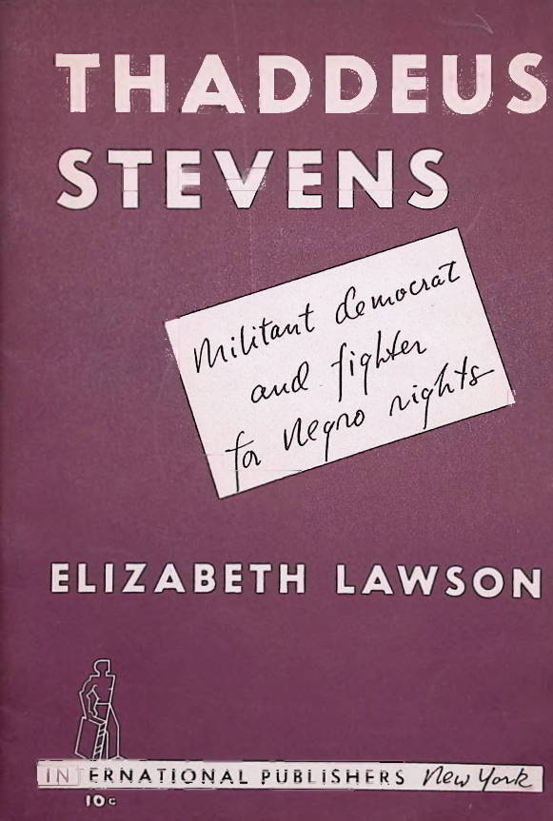
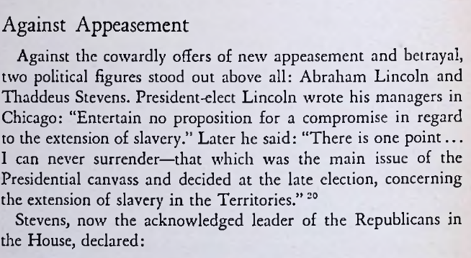
Thaddeus Stevens - Against Appeasemen

Slide 18
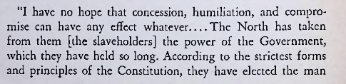
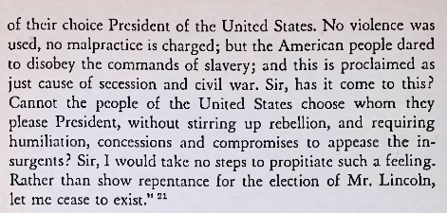
Thaddeus Stevens - Against Appeasemen

Slide 19
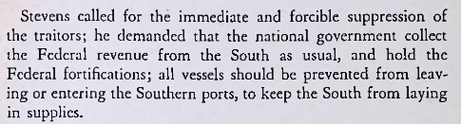
Thaddeus Stevens - Against Appeasemen

Slide 20
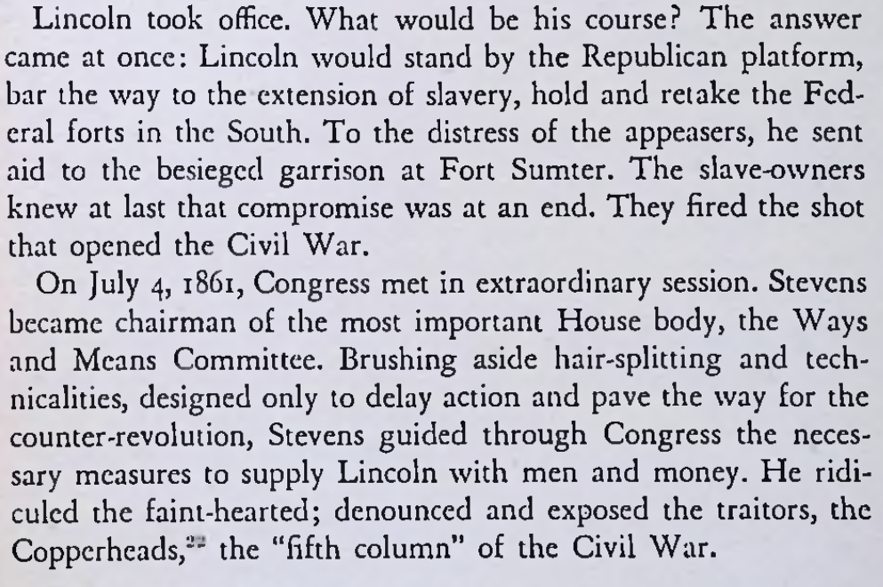
Thaddeus Stevens - Against Appeasemen

Slide 21
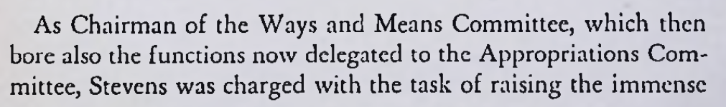
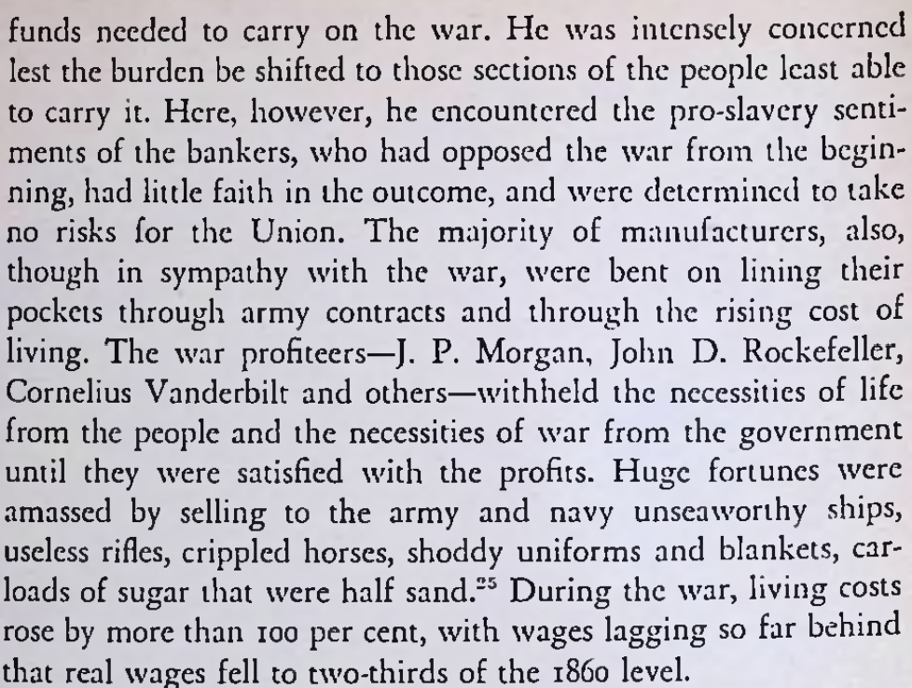
Thaddeus Stevens - Fighting the Profiteers

Slide 22
Thaddeus Stevens - Fighting the Profiteers

Slide 23
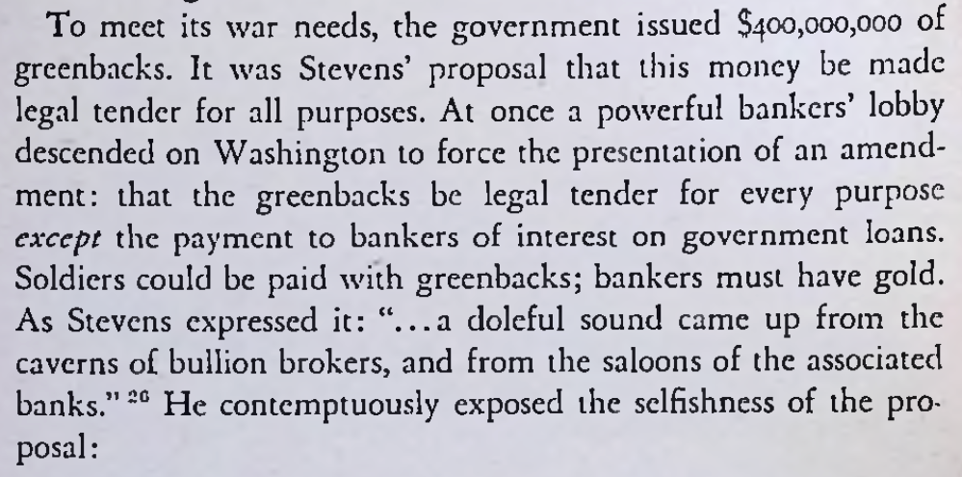
Thaddeus Stevens - Fighting the Profiteers

Slide 24
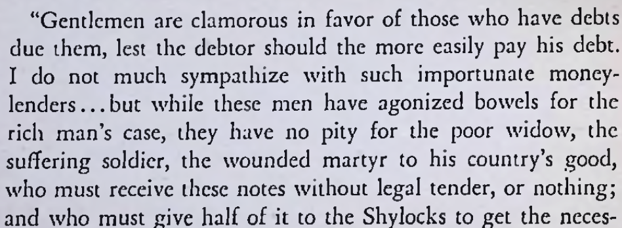
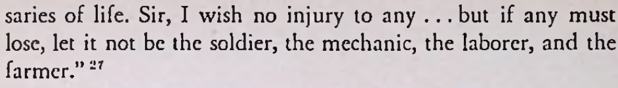
Thaddeus Stevens - Fighting the Profiteers

Slide 25
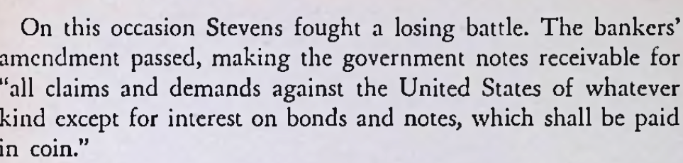
Thaddeus Stevens - Fighting the Profiteers

Slide 27
Discussion

Slide 28
Outcome of the Civil War

Slide 29
Victory for the Union, but now what?
With the Surrender of the Confederate States the United States had a new task how to rebuild the rebellious states, and what to do with the former enslaved population. The federal government would struggle to deal with the contradiction between the former plantation class and the newly freed persons. There were 3 key amendments to the constitution that would establish the freedom of all citizens.
Thirteenth Amendment (1865)
Section 1
Neither slavery nor involuntary servitude, except as a punishment for crime whereof the party shall have been duly convicted, shall exist within the United States, or any place subject to their jurisdiction.
Section 2
Congress shall have power to enforce this article by appropriate legislation.

Slide 30
14th Amendment (1868)
Section 1
All persons born or naturalized in the United States, and subject to the jurisdiction thereof, are citizens of the United States and of the State wherein they reside. No State shall make or enforce any law which shall abridge the privileges or immunities of citizens of the United States; nor shall any State deprive any person of life, liberty, or property, without due process of law; nor deny to any person within its jurisdiction the equal protection of the laws.
Section 2
Representatives shall be apportioned among the several States according to their respective numbers, counting the whole number of persons in each State, excluding Indians not taxed. But when the right to vote at any election for the choice of electors for President and Vice-President of the United States, Representatives in Congress, the Executive and Judicial officers of a State, or the members of the Legislature thereof, is denied to any of the male inhabitants of such State, being twenty-one years of age, and citizens of the United States, or in any way abridged, except for participation in rebellion, or other crime, the basis of representation therein shall be reduced in the proportion which the number of such male citizens shall bear to the whole number of male citizens twenty-one years of age in such State.

Slide 31
14th Amendment (1868)
Section 3
No person shall be a Senator or Representative in Congress, or elector of President and Vice-President, or hold any office, civil or military, under the United States, or under any State, who, having previously taken an oath, as a member of Congress, or as an officer of the United States, or as a member of any State legislature, or as an executive or judicial officer of any State, to support the Constitution of the United States, shall have engaged in insurrection or rebellion against the same, or given aid or comfort to the enemies thereof. But Congress may by a vote of two-thirds of each House, remove such disability.
Section 4
The validity of the public debt of the United States, authorized by law, including debts incurred for payment of pensions and bounties for services in suppressing insurrection or rebellion, shall not be questioned. But neither the United States nor any State shall assume or pay any debt or obligation incurred in aid of insurrection or rebellion against the United States, or any claim for the loss or emancipation of any slave; but all such debts, obligations and claims shall be held illegal and void.
Section 5
The Congress shall have power to enforce, by appropriate legislation, the provisions of this article.

Slide 32
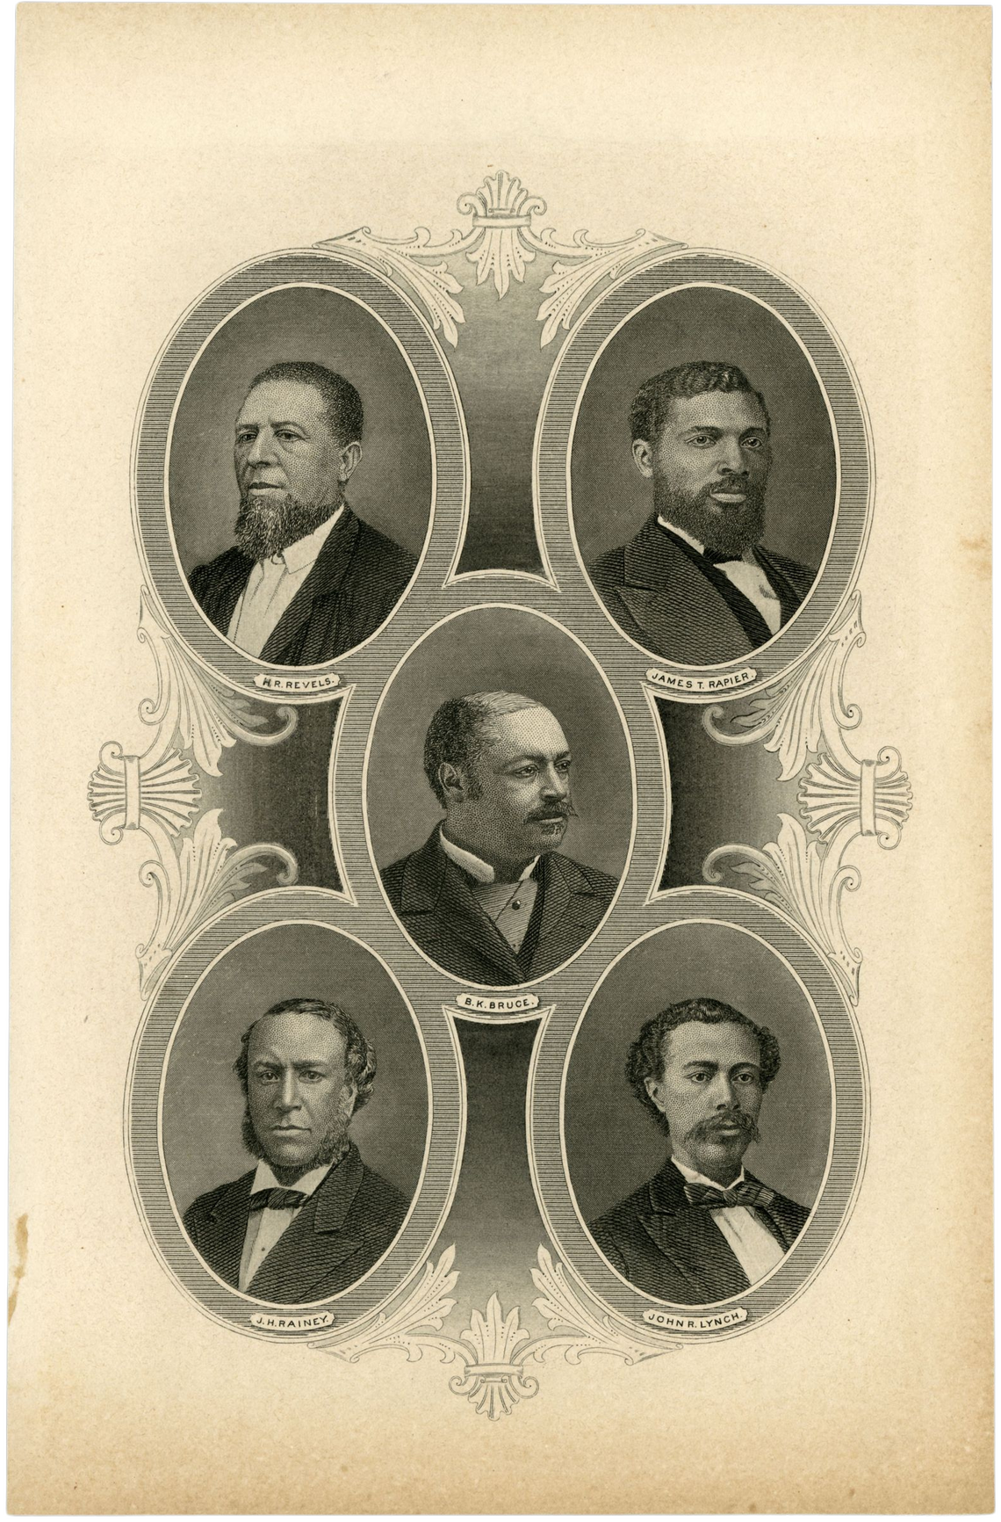
15th Amendment (1870)
Section 1
The right of citizens of the United States to vote shall not be denied or abridged by the United States or by any State on account of race, color, or previous condition of servitude–
Section 2
The Congress shall have power to enforce this article by appropriate legislation.
This engraving of five African American members of Congress dates from about 1884. The congressmen featured are Hiram R. Revels of Mississippi, James T. Rapier of Alabama, Blanche Kelso Bruce of Mississippi, Joseph Hayne Rainey of South Carolina, and John R. Lynch of Mississippi. They were all elected to Congress between 1870 and 1874.

Slide 33
Differing views on Reconstruction
The cause of the war was slavery. We have liberated the slaves. It is our duty to protect them, and provide for them while they are unable to provide for themselves.
None will deny the right to confiscate the property of the Southern states, as they all made war as the Confederate States of America.
The bill provides that each freed slave who is a male adult, or the head of a family, will receive forty acres of land, (with $100 to build a house). Homesteads are far more valuable than the immediate right of suffrage, though they should receive both.
Four million people have just been freed from slavery. They have no education, have never worked for money, and don’t know about their rights. We must make the freed slaves independent of their old masters, so that they may not be compelled to work for them upon unfair terms, which can only be done by giving them a small tract of land to farm.
Source: Thaddeus Stevens, speech to Congress, March 19, 1867.
Before the Civil War there were 4,000,000 black people held as slaves by about 340,000 people living in the South. That is, 340,000 slave owners paid all the living expenses of the slaves.
Then, the war began and the slaves were freed . . . Now to the Freedmen’s Bureau bill. What was it? Four million slaves were emancipated and given an equal chance and fair start to work and produce . . .
But the Freedmen's Bureau comes and says we must take charge of these 4,000,000 slaves. The bureau comes along and proposes, at a cost of $12,000,000 a year, to take charge of these slaves. You had already spent $3,000,000,000 to set them free and give them a fair opportunity to take care of themselves - then these [Radical Republicans], who are such great friends of the people, tell us they must be taxed $12,000,000 to sustain the Freedmen's Bureau.
Source: Andrew Johnson, campaign speech, September 3, 1866.

Slide 34
Freedmen’s Bureau Bill, “An Act to establish a Bureau for the Relief of Freedmen and Refugees” (1865)
An Act to establish a Bureau for the Relief of Freedmen and Refugees. March 3, 1865
Be it enacted by the Senate and House of Representatives of the United States of America in Congress assembled, That there is hereby established in the War Department, to continue during the present war of rebellion, and for one year thereafter, a bureau of refugees, freedmen, and abandoned lands, to which shall be committed, as hereinafter provided, the supervision and management of all abandoned lands, and the control of all subjects relating to refugees and freedmen from rebel states, or from any district of country within the territory embraced in the operations of the army, under such rules and regulations as may be prescribed by the head of the bureau and approved by the President…
Section 4…And be it further enacted, That the commissioner, under the direction of the President, shall have authority to set apart, for the use of loyal refugees and freedmen, such tracts of land within the insurrectionary states as shall have been abandoned, or to which the United States shall have acquired title by confiscation or sale, or otherwise, and to every male citizen, whether refugee or freedman, as aforesaid, there shall be assigned not more than forty acres of such land, and the person to whom it was so assigned shall be protected in the use and enjoyment of the land for the term of three years at an annual rent not exceeding six per centum upon the value of such land….
At the end of said term, or at any time during said term, the occupants of any parcels so assigned may purchase the land and receive such title thereto as the United States can convey, upon paying therefor the value of the land, as ascertained and fixed for the purpose of determining the annual rent aforesaid.

Slide 35


Success during Reconstruction
The Freedmen’s Bureau and the American Missionary Association helped to set up schools for freedpeople
“Many of the negroes . . . common plantation negroes, and day laborers in the towns and villages, were supporting little schools themselves. Everywhere I found them hoping to get their children into schools. I often noticed that workers in stores and men working in warehouses, and cart drivers on the streets, had spelling books with them, and were studying them during the time they were not working. Go outside any large town in the South, and walk among the negro housing, and you will see childrenand in many cases grown negroes, sitting in the sun alongside their cabins studying.”
Source: Sidney Andrews quoted in the Joint Report on Reconstruction,1866. The document above is an excerpt from a report by a Northern white man to the United States government in 1866.
The Freedmen's Bureau did help get some land to freedmen and freedwomen, however it was mostly island lands off the coast of the Carolinas, Georgia, and Florida. These communities of freedpeople have continued to exist.
When it was funded by Congress Bureau agents would help process legal cases to extend rights and opportunities.
Colleges and Universities were set up and continue to thrive. They are known as Historically Black Colleges and Universities (HBCU)

Slide 36
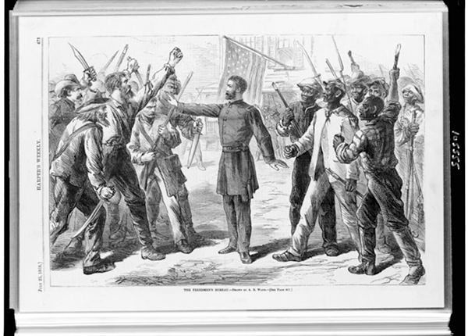
Issues with the Freedmen's Bureau
CIRCULAR No. 8. (1866)
1. Numerous well authenticated reports from officers and Agents of the Bureau in different parts of the State have been received at this office, setting forth that now the crops are nearly ready to lay by, and the immediate demand for labor has, to some extent ceased, planters in some instances, are driving off freed-people employed by them and refusing to pay for their labor. Sometimes this is done openly, but generally by purposely quarreling with the freed-people—threatening them with violence if they remain, and then because of their leaving the plantation, claiming that they have violated their contracts and forfeited their wages. If this unjust and dishonest conduct is persisted in, the State will be filled with unemployed freed-people, without means of subsistence, who must live by theft or be supported by the Government. Therefore persons employing freed-people are forbidden to discharge them without payment, unless they shall first show sufficient cause, and obtain the consent of an officer or Agent of this Bureau.
2. Military commanders in this State will assist the officers and Agents of the Bureau to enforce the provisions of this Circular.
DAVIS TILLSON,
Bt. Maj. Gen’l Vols. Com’dg
and Asst. Commissioner.
Approved:
O.O. HOWARD,
Major Gen’l, Commissioner, &c.

Slide 37
Black Codes: Restricting Freedom
SECTION 1. No negro shall be allowed to come within the limits of the town of Opelousas without special permission from his employers.
SECTION 3. No negro shall be permitted to rent or keep a house within the limits of the town under any circumstances.
SECTION 4. No negro shall reside within the limits of the town of Opelousas who is not in the regular service of some white person or former owner.
SECTION 5. No public meetings of negroes shall be allowed within the limits of the town of Opelousas under any circumstances without the permission of the mayor or president of the board of police. This, however, does not prevent the freedmen from attending the usual church services.
SECTION 11. All the foregoing provisions apply to freedmen and freedwomen.
Source: Black Code from Opelousas, Louisiana, July 3, 1865.

Slide 38
The End of Reconstruction
The Radical Republicans supported Reconstruction policies such as land distribution and enforcing the amendments. However the economy entered a crash in 1872 and this turned the voters against them.
In 1876 the Presidential election was too close to call, There was a commission that met to decide who received the necessary electoral votes decided in favor of Republican Rutherford B. Hayes, in order to keep the Democrats happy the Republicans agreed to end Reconstruction. Compromise of 1877.
Institutionalizing Black Disenfranchisement
“With federal intervention effectively eliminated, Southern states systematically stripped African Americans of civil, economic, and social rights. Mississippi led the way with its 1890 state constitution, instituting grandfather clauses, literacy tests, poll taxes, and restrictive residency provisions to bar blacks from voting or even registering to vote. It also barred blacks from owning or possessing guns, aiming to cut their ability to protect themselves against rampant white violence.
The Terror of Lynching and Racial Violence
Mississippi also led the surge of lynchings that brutally symbolized black repression. Crusading investigative journalist Ida B. Wells (1862–1931) exposed the horror of lynching in her 1892 publication Southern Horrors: Lynch Law in All Its Phases. Between 1882 and 1890, white mobs in the South lynched 534 blacks; in the 1890s, they lynched another 1,111 blacks.
Other Southern states quickly adopted Mississippi’s measures, and the US Supreme Court confirmed the white supremacists’ successes in the 1896 Plessy v. Ferguson decision and the 1898 Williams v. Mississippi decision. The first cemented so-called separate-but-equal practices that formed the basis of expanding racist segregation; the second eliminated black challenges to states restricting voting rights.”
“The Betrayal of Emancipation: Black Civil Rights Denied,” by Thomas J. Davis (2025)

Slide 39
Discussion & New Members Introductions

Slide 40
New Member Introductions
What is your name, pronouns and state (or country/territory)?
Where do you work? Is it unionized?
How did you find out about the People’s School?
What do you think about tonight's class?

Slide 41
Discussion & Wrap Up

Slide 42
Announcements
The PSMLS has recovered our old Youtube account we lost to wreckers in 2022 and we have re-uploaded all our old videos. Like, subscribe, and check out what subjects we covered prior and what we aware saying in the past.
PCUSA Cell Chairs need to call members of their cells to remind them about attendance.
The next issue of New Masses (2025) has begun production. If you have art you want us to feature, email it to info@partyofcommunistsusa.net.

Slide 43
Volunteers Needed!
We are in need of volunteers for the staff of the People’s School! Here’s a few roles we need filled:
People to help manage posting on our social media and podcast platforms
Video Editors, Audio Editors, Graphic Designers, Artists, Narrators
Facilitators, Web Controls, Moderators
Email info@peoplesschool.us if you’re interested and try to attend our next staff meeting if possible.

Slide 44










PSMLS Propaganda
peoplesschool.us/media & peoplesschool.us/store
Materials to help promote the school!

Slide 45

View From Left Field
https://viewfromleftfield.libsyn.com
The Old PSMLS Youtube is now the Youtube of View From Left Field, a podcast of analysis and discussion of current events from a progressive perspective.
Like the Youtube videos and subscribe with 5 star ratings on your podcast platforms.

Slide 46

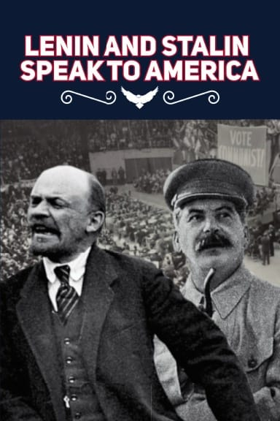
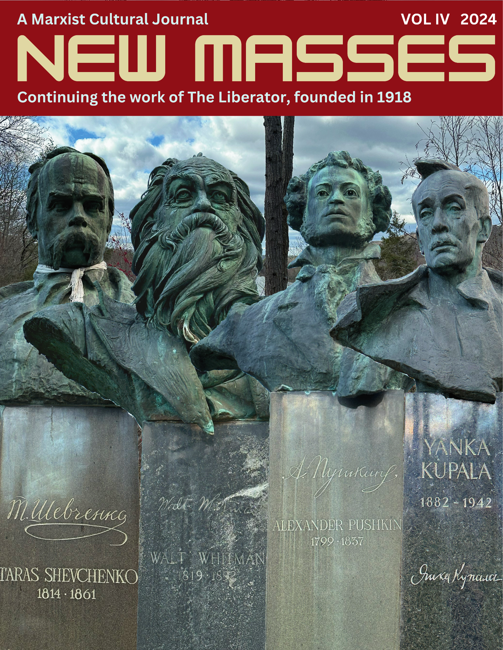
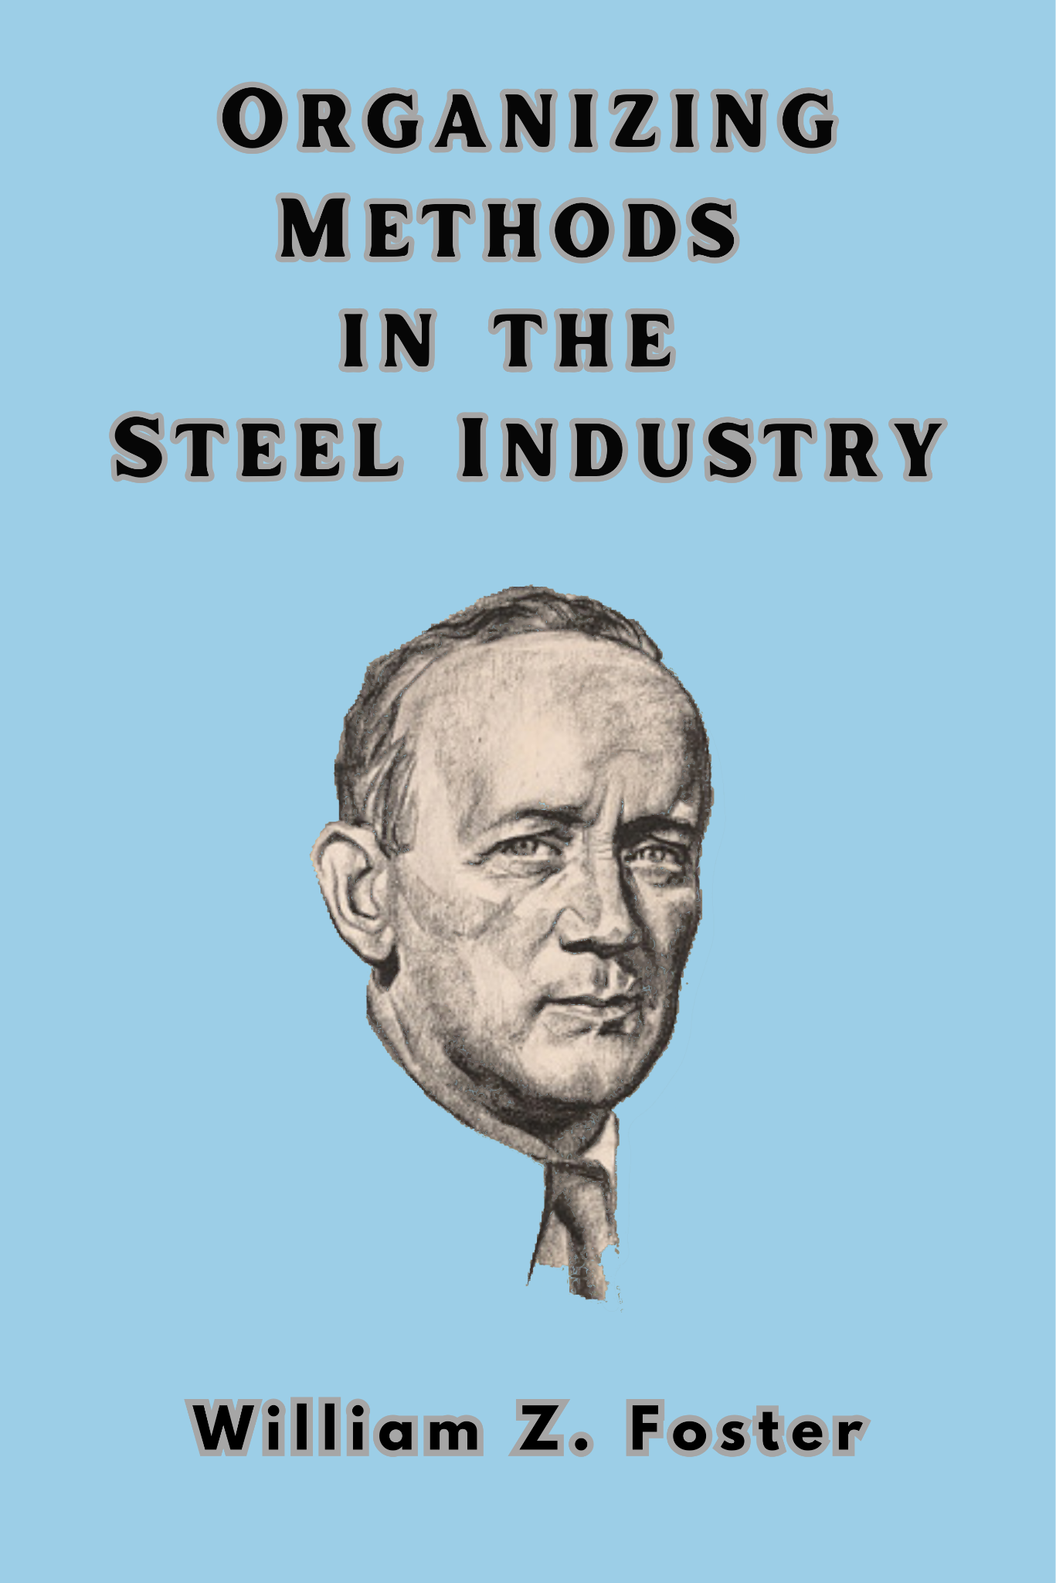

New Outlook Publishers
newoutlookpublishers.store
Relevant and Latest Releases

Slide 47


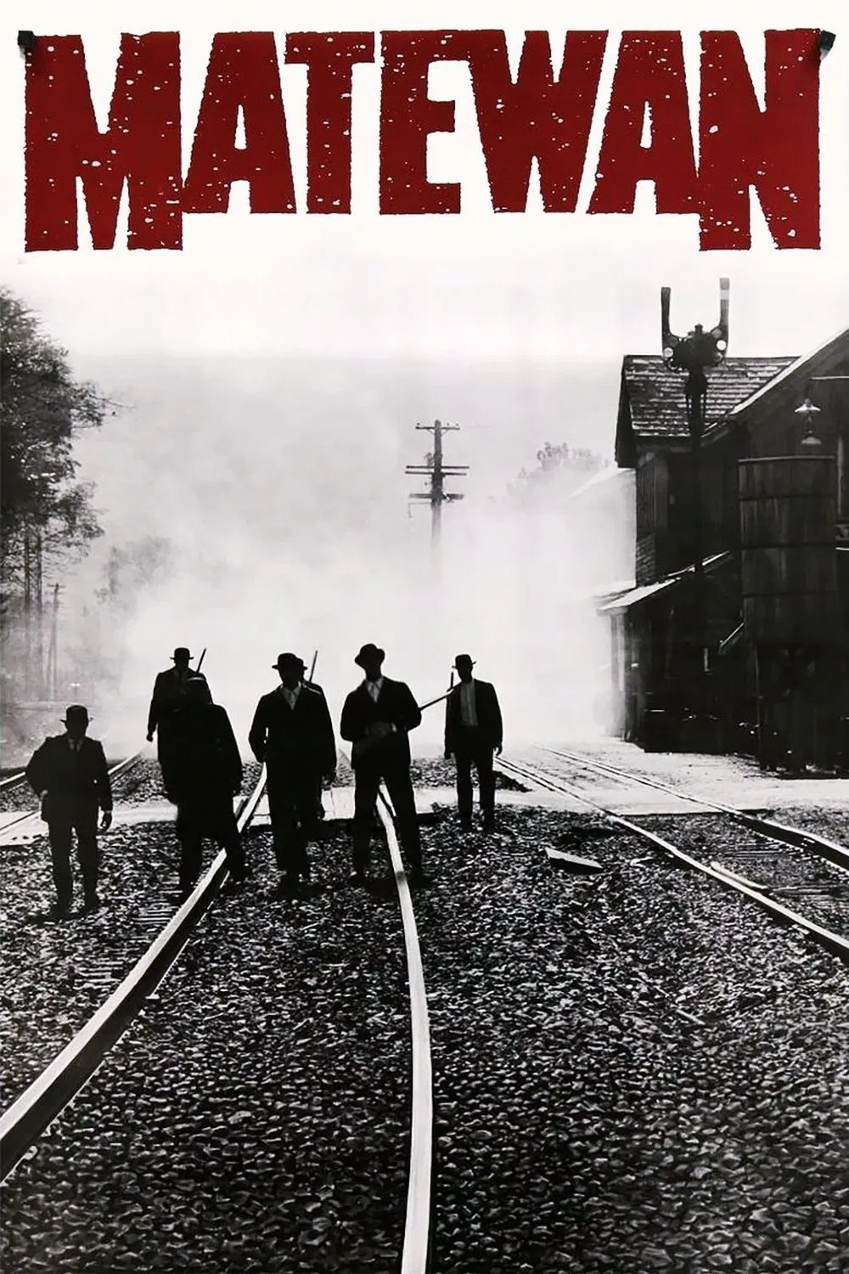
Harry Bridges School of Labor
luel.us/laborschool/
The Harry Bridges School of Labor is a monthly class held 2x per month. Classes cover a variety of topics aimed at building class conscious among union members.
May’s class is a showing of “Matewan” and Part 1 will be shown on May 7, 2025 at 8pm EST/5pm PST and Part 2 on Saturday May 10, 2025 at 7pm EST/4pm PST.

Slide 48
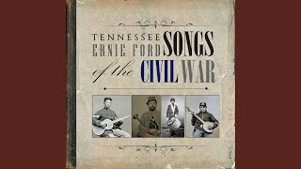
Tennessee Ernie Ford - Union Dixie

