Slide 1

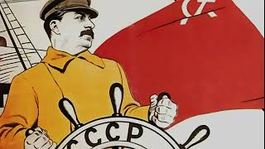
The Internationale

Slide 2


PSMLS mm/dd/yy - mm/dd/yy

Slide 3
What we’ll be learning today:
The Meaning of San Rafael
Strategy for a Black Agenda
The Moynihan-Kissinger Doctrine

Slide 4
The Meaning of San Rafael

Slide 5
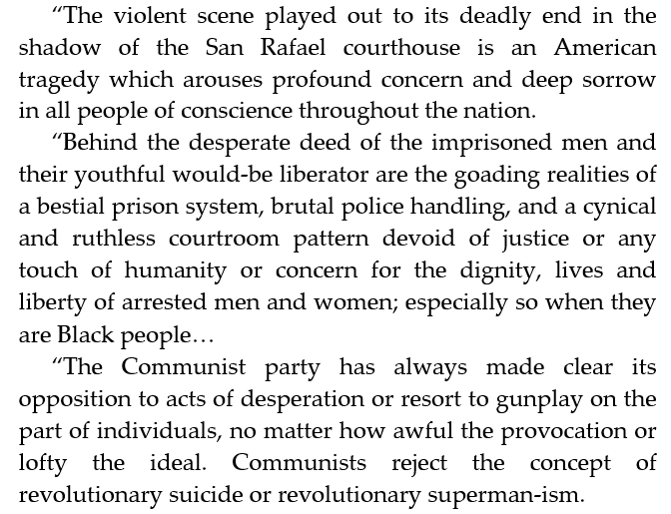
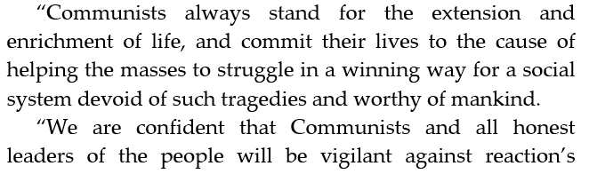

Statement of the Political Committee of the Communist Party USA after San Rafael:

Slide 6
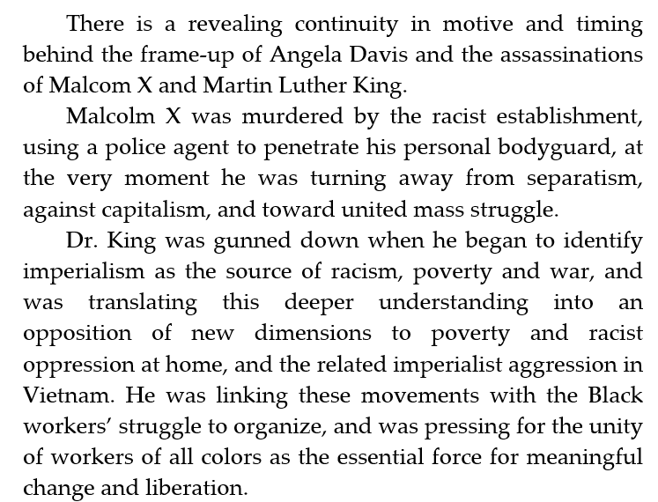
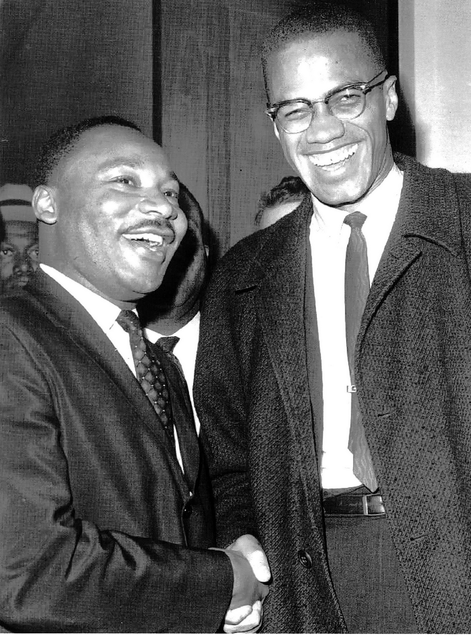
The Meaning of San Rafael

Slide 7
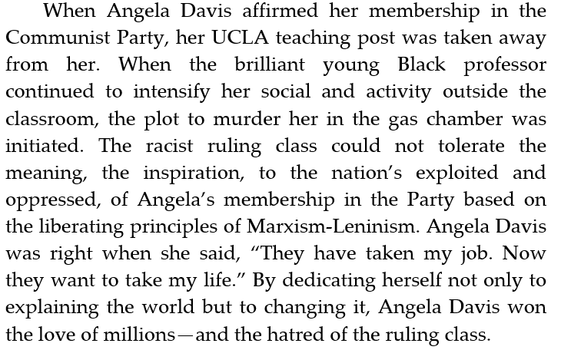
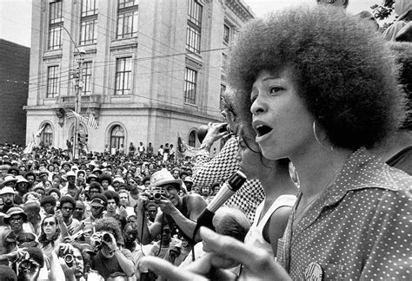
The Meaning of San Rafael

Slide 8
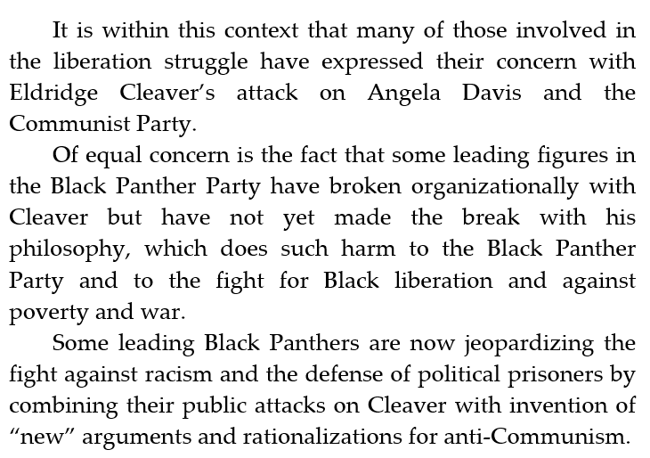
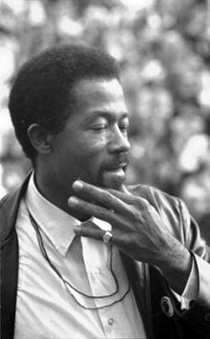
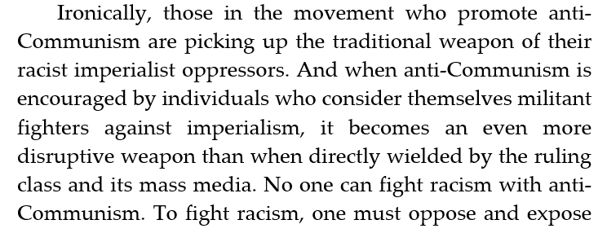
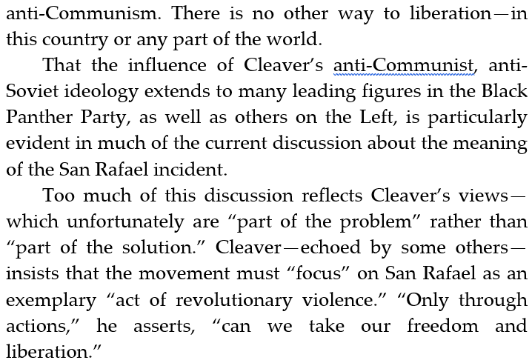
The Meaning of San Rafael
Eldridge Cleaver

Slide 9
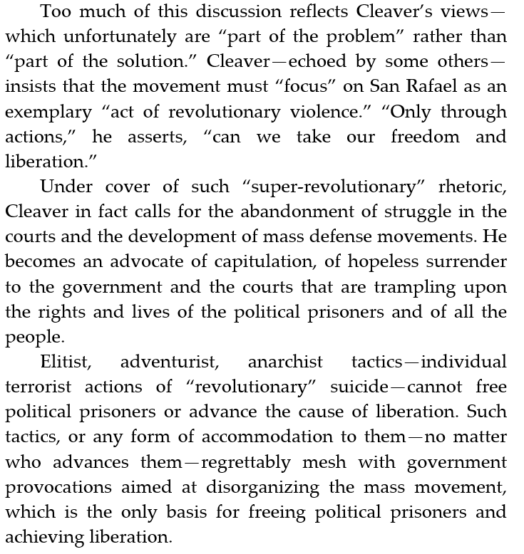
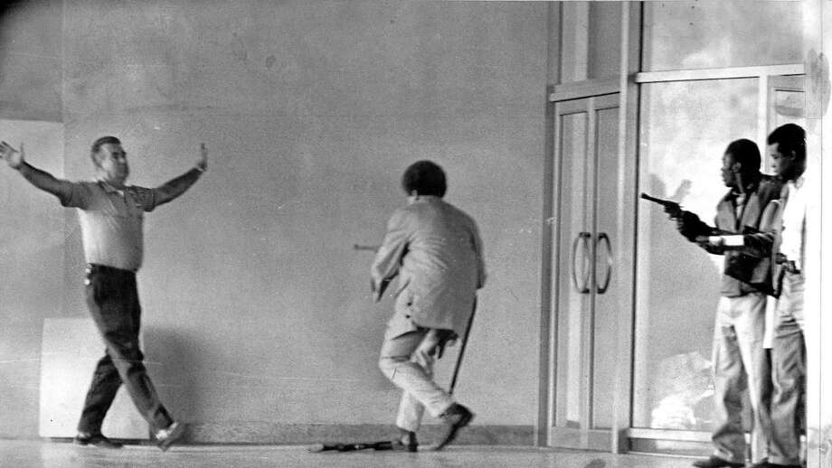
The Meaning of San Rafael

Slide 10
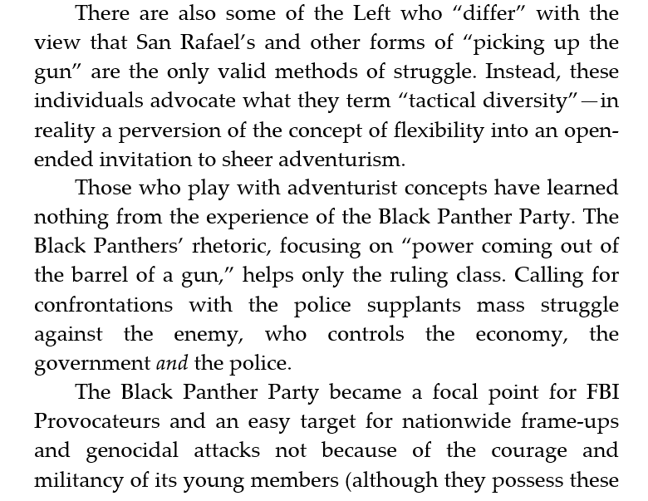
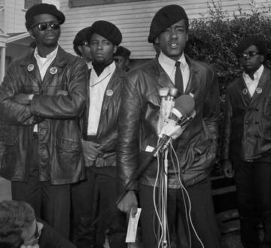
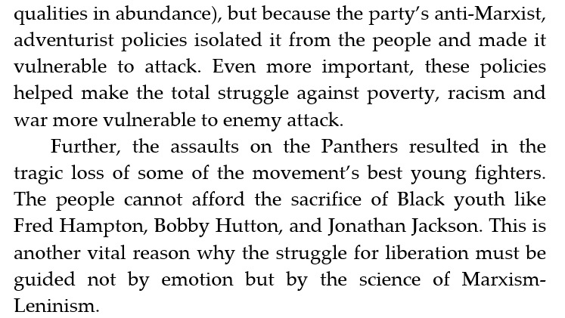
The Meaning of San Rafael

Slide 11
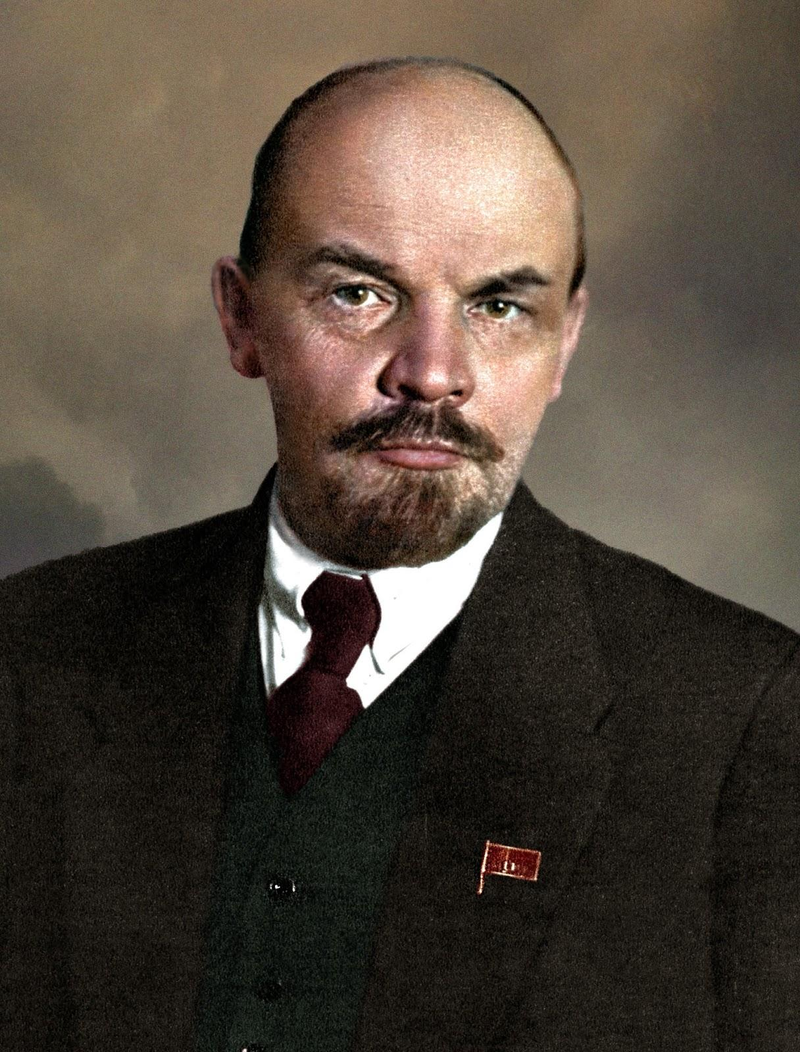
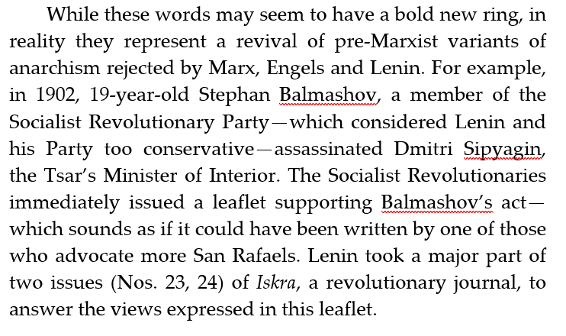
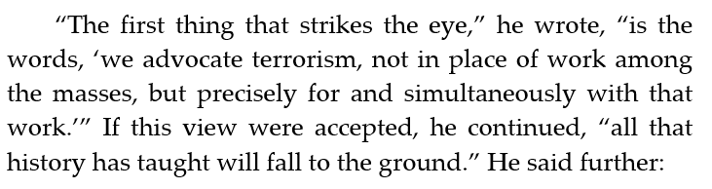
The Meaning of San Rafael

Slide 12
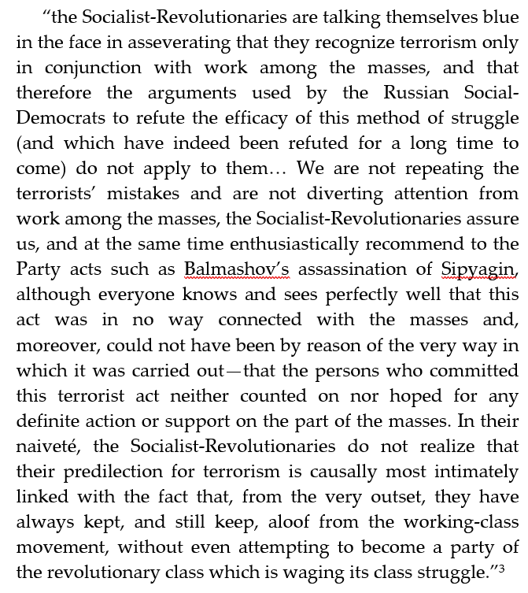
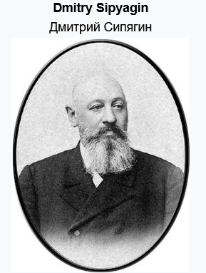
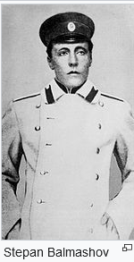
The Meaning of San Rafael

Slide 13
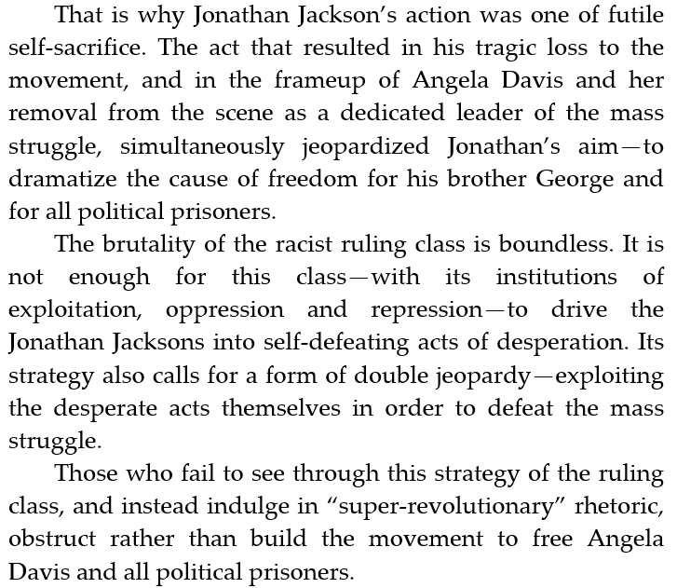
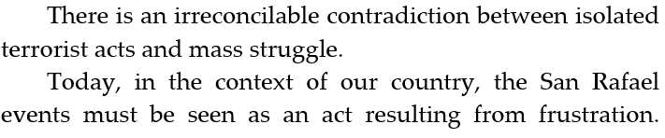
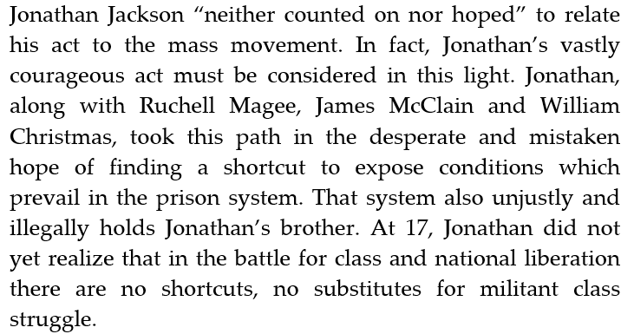
The Meaning of San Rafael

Slide 14
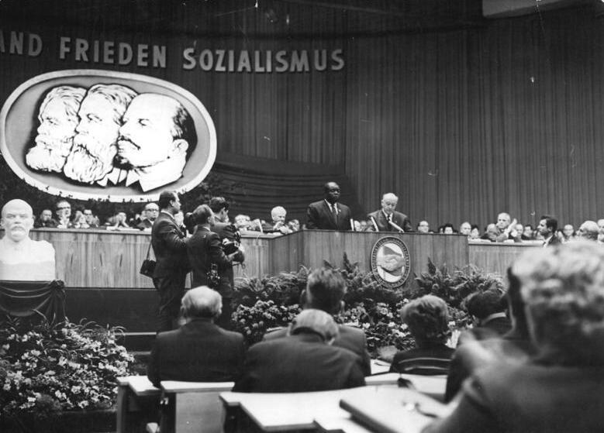
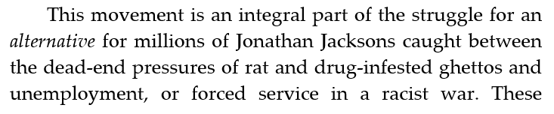
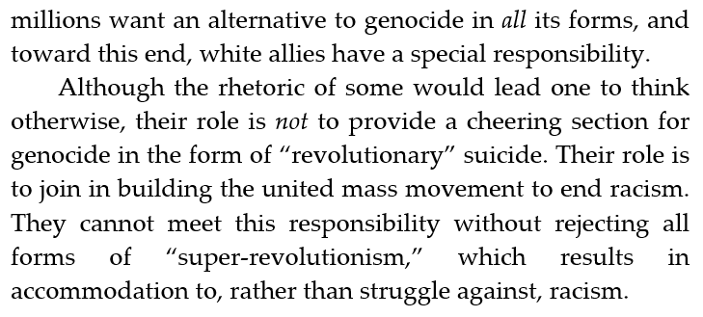
The Meaning of San Rafael

Slide 15
Discussion

Slide 16
Strategy for a Black Agenda

Slide 17
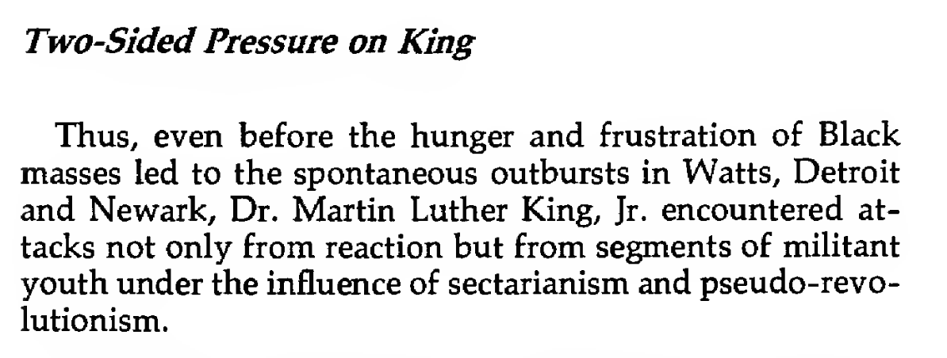
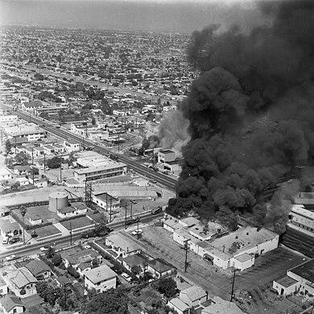
Chapter 15: Strategy for a Black Agenda - Strategy for a Black Agenda
The Watts riots, sometimes referred to as the Watts Rebellion or Watts Uprising, took place in the Watts neighborhood and its surrounding areas of Los Angeles from August 11 to 16, 1965.

Slide 18
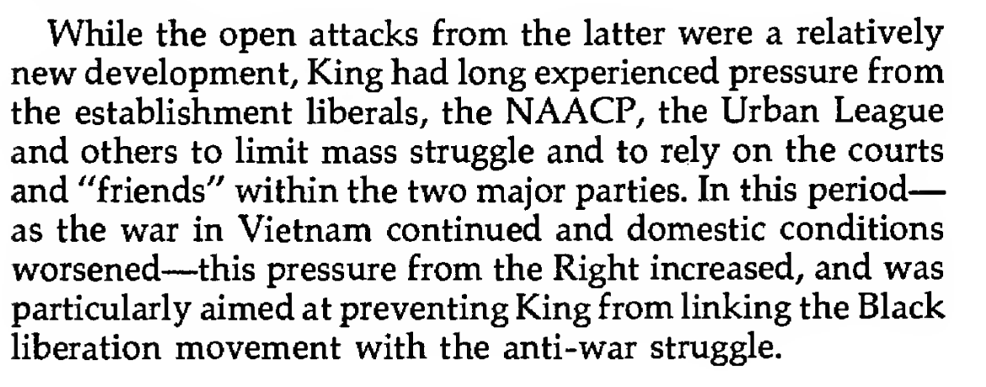
Chapter 15: Strategy for a Black Agenda - Strategy for a Black Agenda

Slide 19
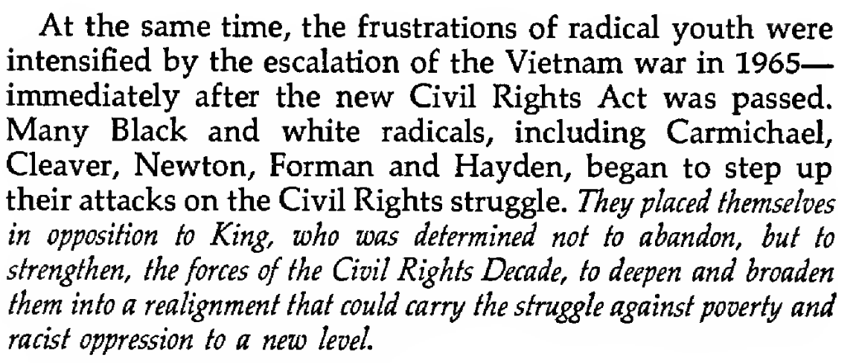
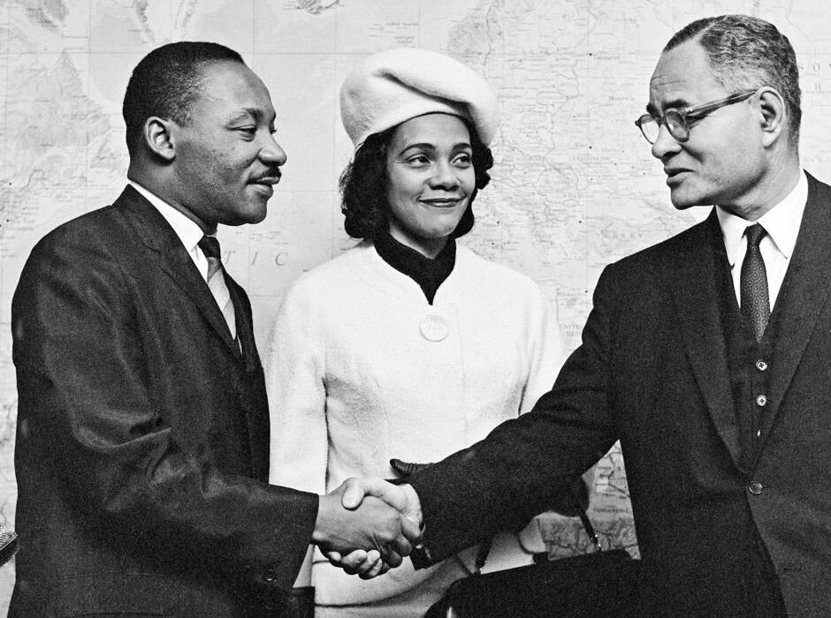
Chapter 15: Strategy for a Black Agenda - Strategy for a Black Agenda
During their visit to the United Nations, in 1964, Dr. Martin Luther King and his wife Coretta Scott King are greeted by Mr. Ralph J. Bunche, UN Under-Secretary for Special Political Affairs.
Photo: © UN Photo/Yutaka Nagata

Slide 20
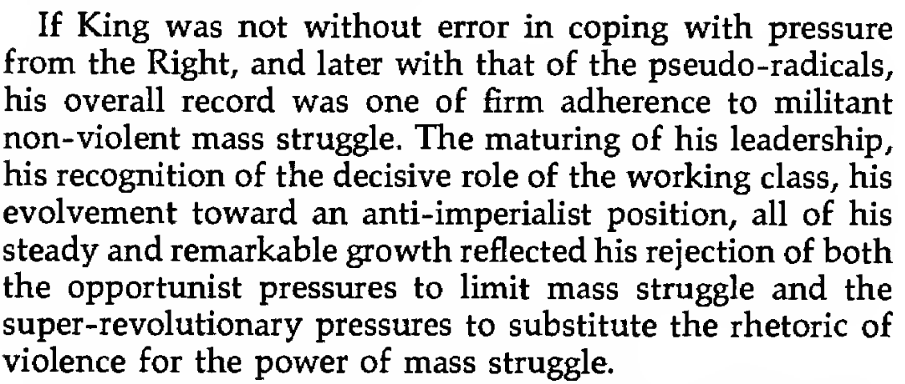
Chapter 15: Strategy for a Black Agenda - Strategy for a Black Agenda

Slide 21
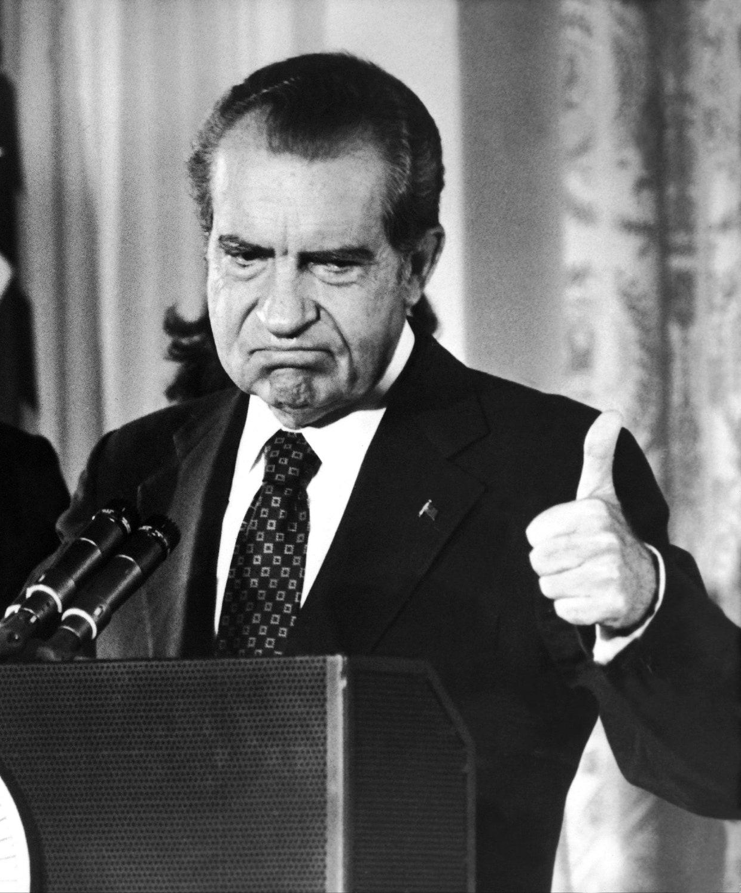
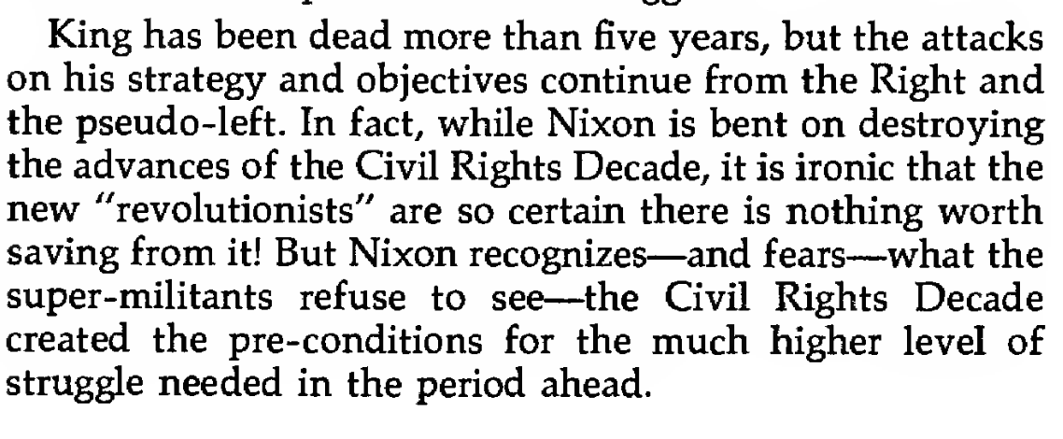
Chapter 15: Strategy for a Black Agenda - Strategy for a Black Agenda

Slide 22
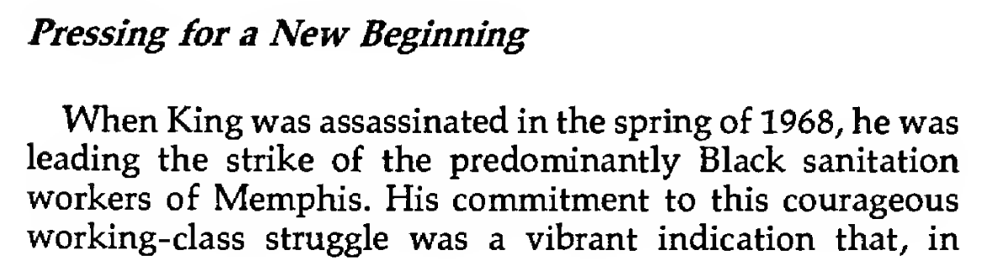
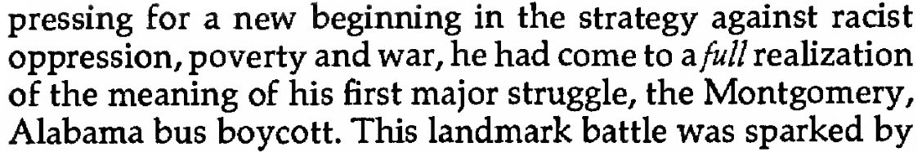
Chapter 15: Strategy for a Black Agenda - Strategy for a Black Agenda

Slide 23
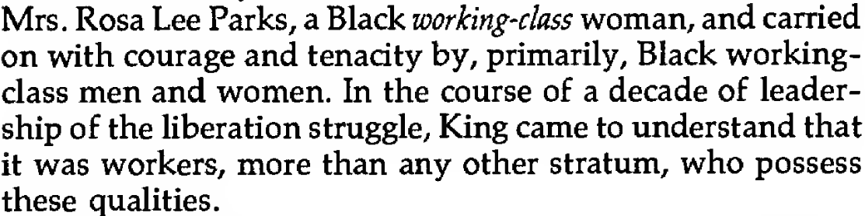
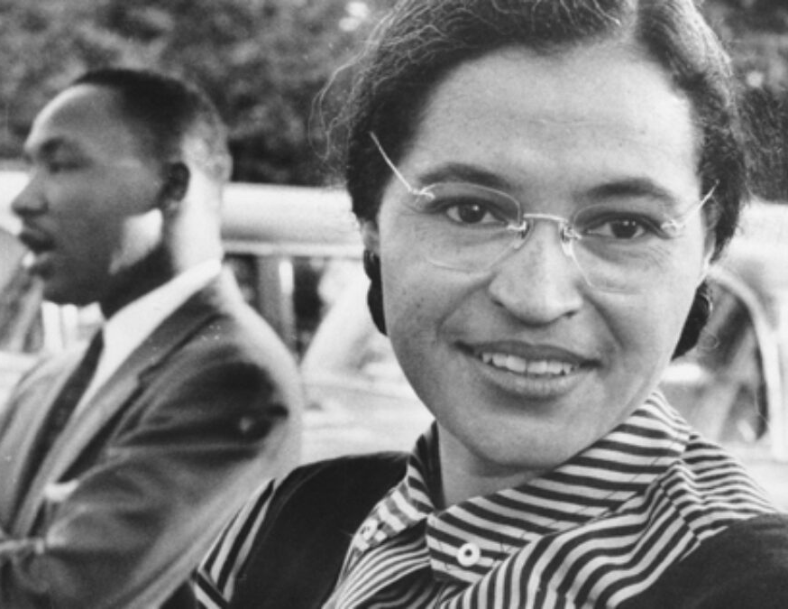
Chapter 15: Strategy for a Black Agenda - Strategy for a Black Agenda

Slide 24
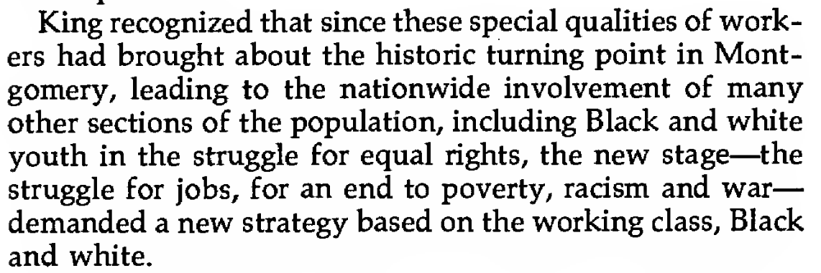
Chapter 15: Strategy for a Black Agenda - Strategy for a Black Agenda

Slide 25
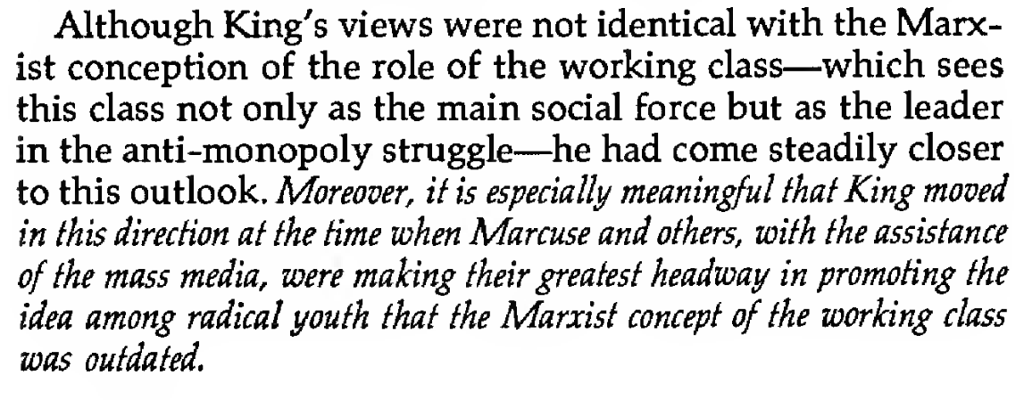
Chapter 15: Strategy for a Black Agenda - Strategy for a Black Agenda

Slide 26
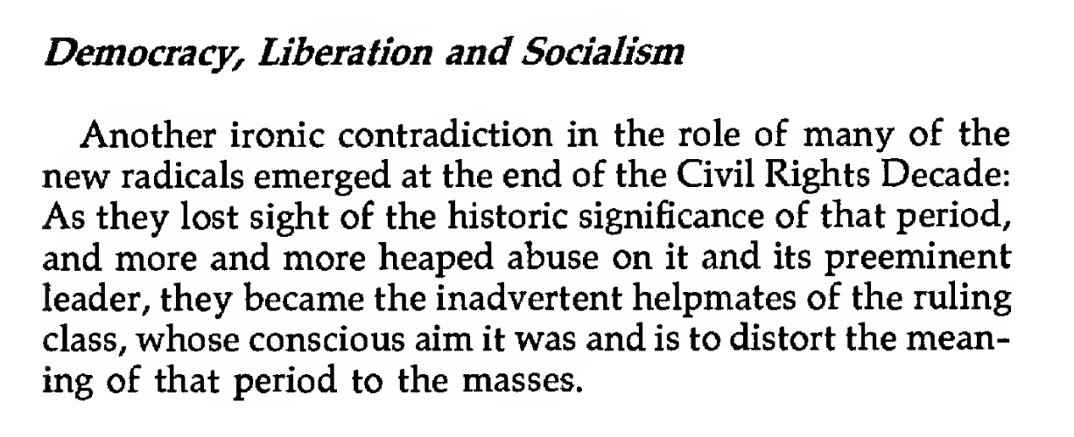
Chapter 15: Strategy for a Black Agenda - Strategy for a Black Agenda

Slide 27
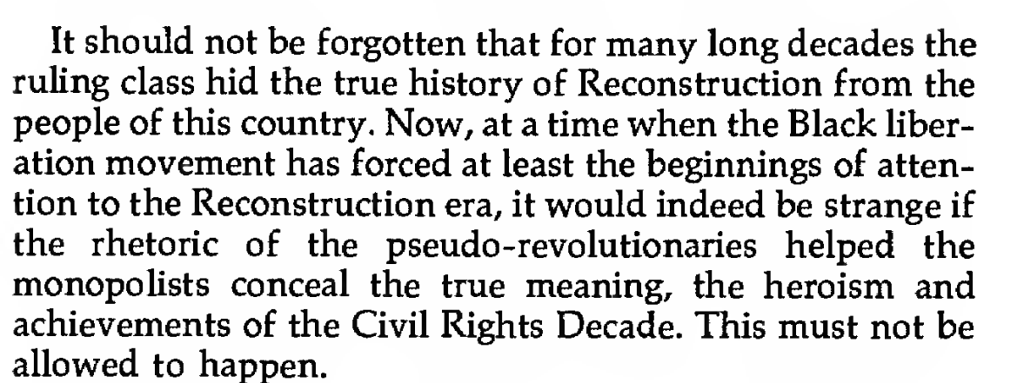
Chapter 15: Strategy for a Black Agenda - Strategy for a Black Agenda

Slide 28
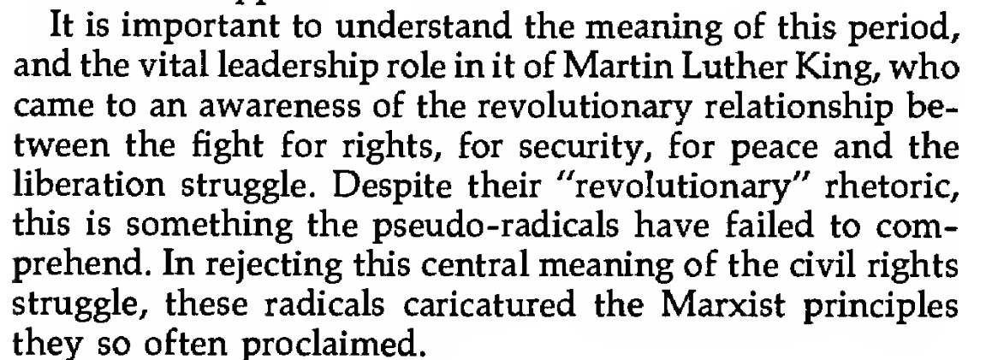
Chapter 15: Strategy for a Black Agenda - Strategy for a Black Agenda

Slide 29
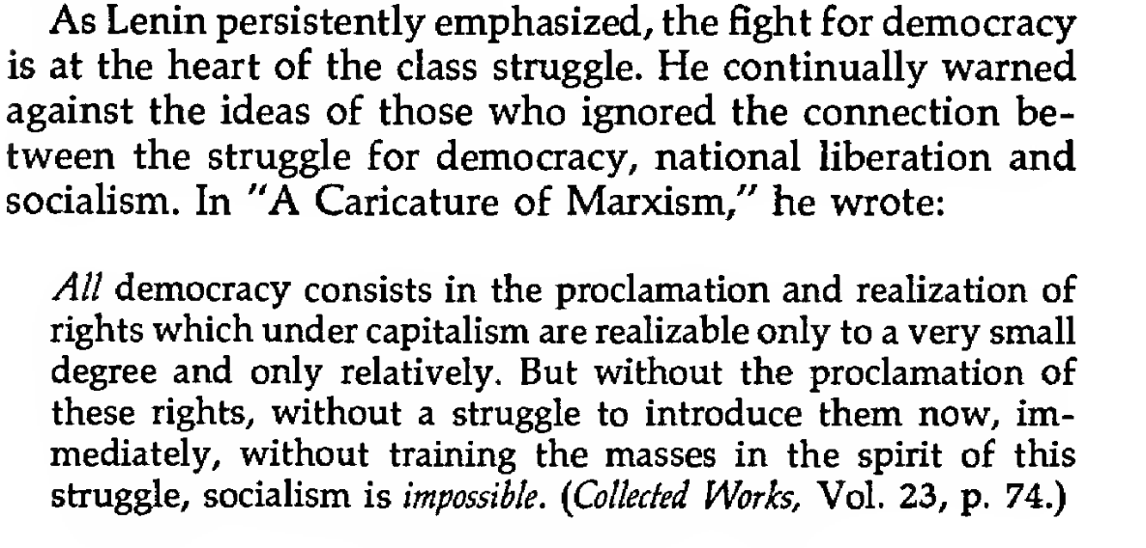
Chapter 15: Strategy for a Black Agenda - Strategy for a Black Agenda

Slide 30
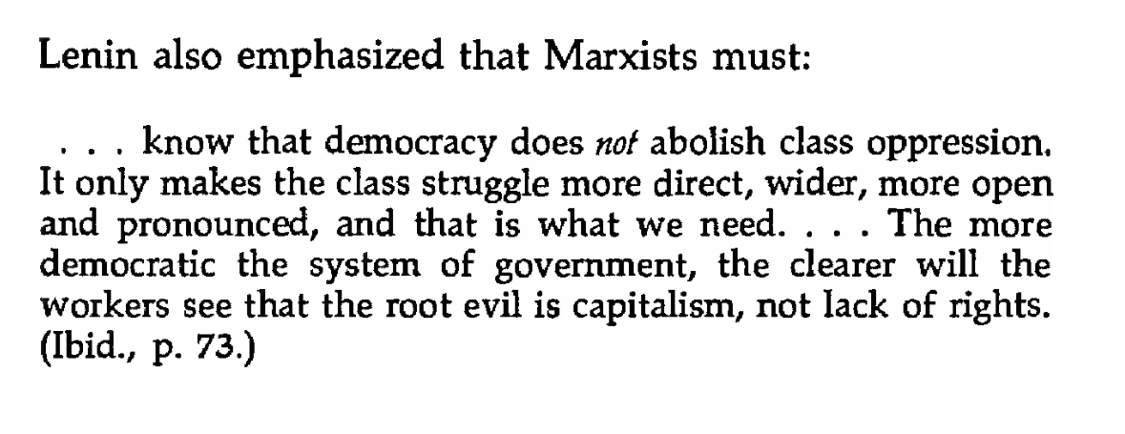
Chapter 15: Strategy for a Black Agenda - Strategy for a Black Agenda

Slide 31
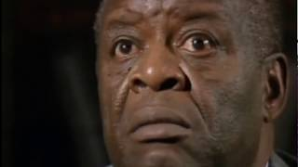
Henry Winston on the Self-Determination, Black Belt Thesis and the National Question.

Slide 32
Discussion

Slide 33
Moynihan-Kissinger Doctrine and the “Third World”

Slide 34
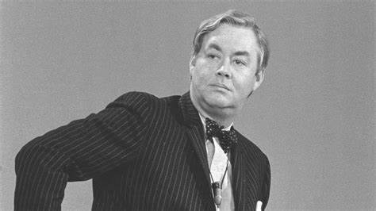
Who was Daniel Moynihan and why is he important?
Moynihan served as Assistant to the Labor Secretary under JFK and Lyndon B. Johnson and as Assistant to President for Domestic Affairs
He was later made the US Ambassador to the UN
In 1965, he published a report that sought to take blame for poverty in the black communities away from corporate America and placed the blame on family structures within the black community
Daniel Moynihan

Slide 35
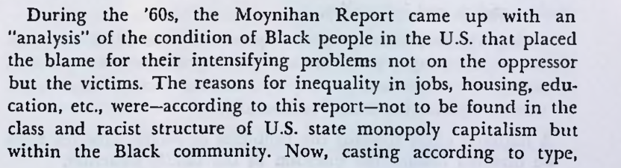
Moynihan Report Briefly

Slide 36

Moynihan Report Briefly

Slide 37


Slide 38

Moynihan Report Briefly

Slide 39

Daniel Bell’s “Revolution of Rising Entitlements”

Slide 40


Daniel Bell’s “Revolution of Rising Entitlements”
We see that inflation is generally directly proportional with unemployment and inversely proportional to economic growth

Slide 41

The Anti-Monopoly Coalition is Needed to Halt the Crisis in Capitalism

Slide 42


The Anti-Monopoly Coalition is Needed to Halt the Crisis in Capitalism

Slide 43

The Anti-Monopoly Coalition is Needed to Halt the Crisis in Capitalism

Slide 44
Discussion & New Members Introductions

Slide 45
New Member Introductions
What is your name, pronouns and state (or country/territory)?
Where do you work? Is it unionized?
How did you find out about the People’s School?
What do you think about tonight's class?

Slide 46
Discussion & Wrap Up

Slide 47
Announcements
The PSMLS has recovered our old Youtube account we lost to wreckers in 2022 and we have re-uploaded all our old videos. Like, subscribe, and check out what subjects we covered prior and what we aware saying in the past.
PCUSA Cell Chairs need to call members of their cells to remind them about attendance.
The next issue of New Masses (2025) has begun production. If you have art you want us to feature, email it to info@partyofcommunistsusa.net.

Slide 48
Volunteers Needed!
We are in need of volunteers for the staff of the People’s School! Here’s a few roles we need filled:
People to help manage posting on our social media and podcast platforms
Video Editors, Audio Editors, Graphic Designers, Artists, Narrators
Facilitators, Web Controls, Moderators
Email info@peoplesschool.us if you’re interested and try to attend our next staff meeting if possible.

Slide 49










PSMLS Propaganda
peoplesschool.us/media & peoplesschool.us/store
Materials to help promote the school!

Slide 50

View From Left Field
https://viewfromleftfield.libsyn.com
The Old PSMLS Youtube is now the Youtube of View From Left Field, a podcast of analysis and discussion of current events from a progressive perspective.
Like the Youtube videos and subscribe with 5 star ratings on your podcast platforms.

Slide 51





New Outlook Publishers
newoutlookpublishers.store
Relevant and Latest Releases

Slide 52



Harry Bridges School of Labor
luel.us/laborschool/
The Harry Bridges School of Labor is a monthly class held 2x per month. Classes cover a variety of topics aimed at building class conscious among union members.
March’s class is on “Triangle Waistshirt Factory Fire” Class will be March 5, 2024 at 9pm EST/6pm PST and Saturday March 8, 2024 at 7pm EST/4pm PST.

Slide 53

The Internationale

