Slide 1

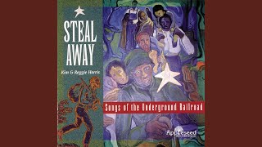
Wade in the Water - Songs of the Underground Railroad

Slide 2
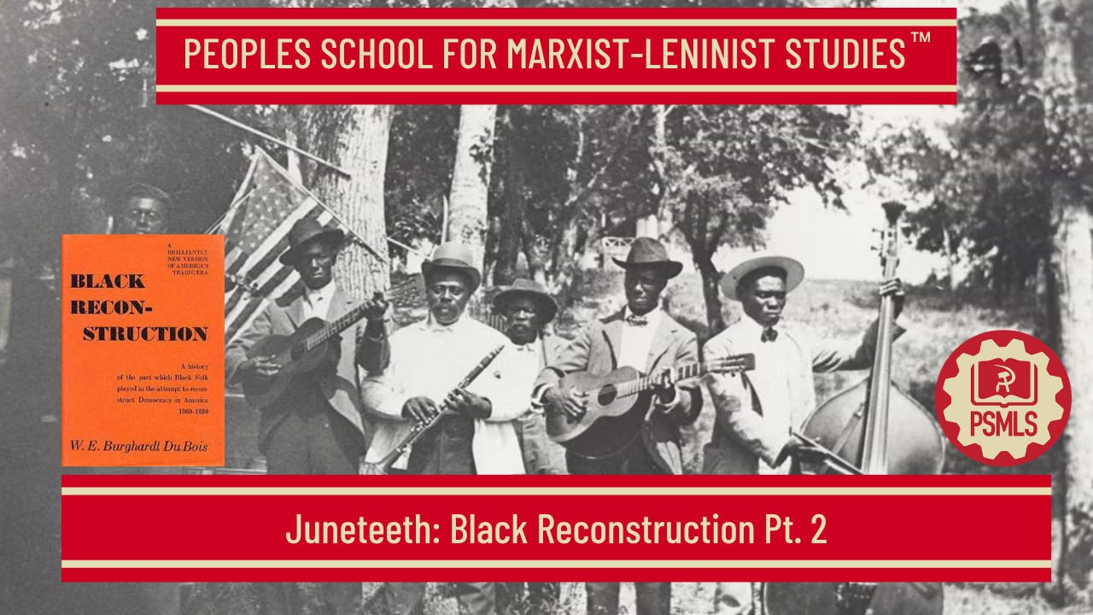
PSMLS 6/16/26

Slide 3
What we’ll be learning today:
Covering Black Reconstruction by W. E. B. DuBois
Section 1 - Chapters 6 and 7
Section 2 - Chapters 8 and 9
Section 3 - Chapter 10

Slide 4
Section 1 - Looking Backward, Looking Forward (Ch. 6 & 7)

Slide 5
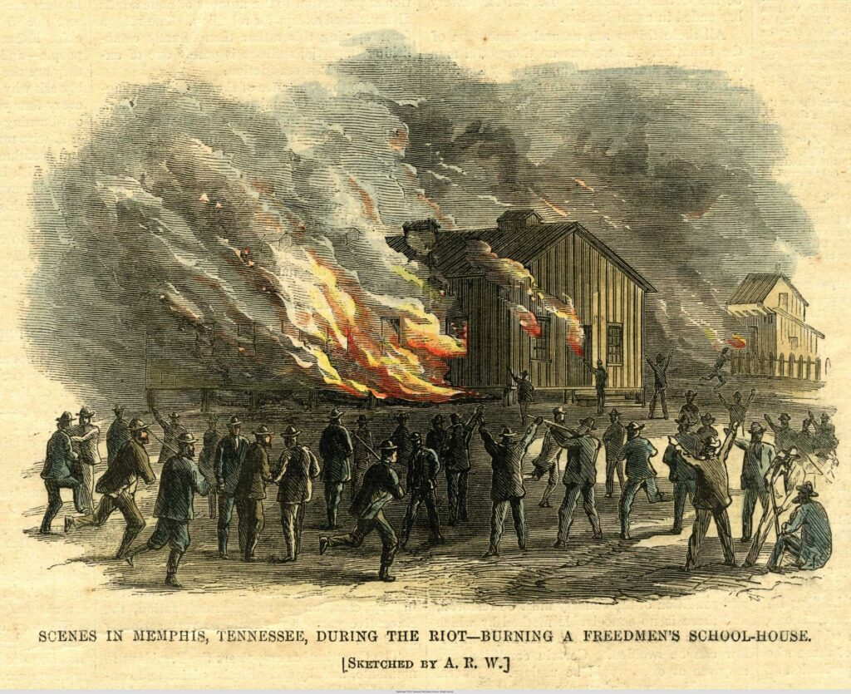
The South Fought and Lost the Civil War to protect slavery
Yet the most pitiable victims of the war were not the rich planters, but the poor workers; not the white race, but the black. Naturally, the mass of the planters were bitterly opposed to the abolition of slavery. First, they based their opposition upon a life-long conviction that free Negro labor could not be made profitable.
The schism in the South.
The white planter endeavored to keep the Negro at work for his own profit on terms that amounted to slavery and which were hardly distinguishable from it.
This was the plain voice of the slave codes. On the other hand, the only conceivable ambition of a poor white was to become a planter. Meantime the poor white did not want the Negro put to profitable work. He wanted the Negro beneath the feet of the white worker.

Slide 6
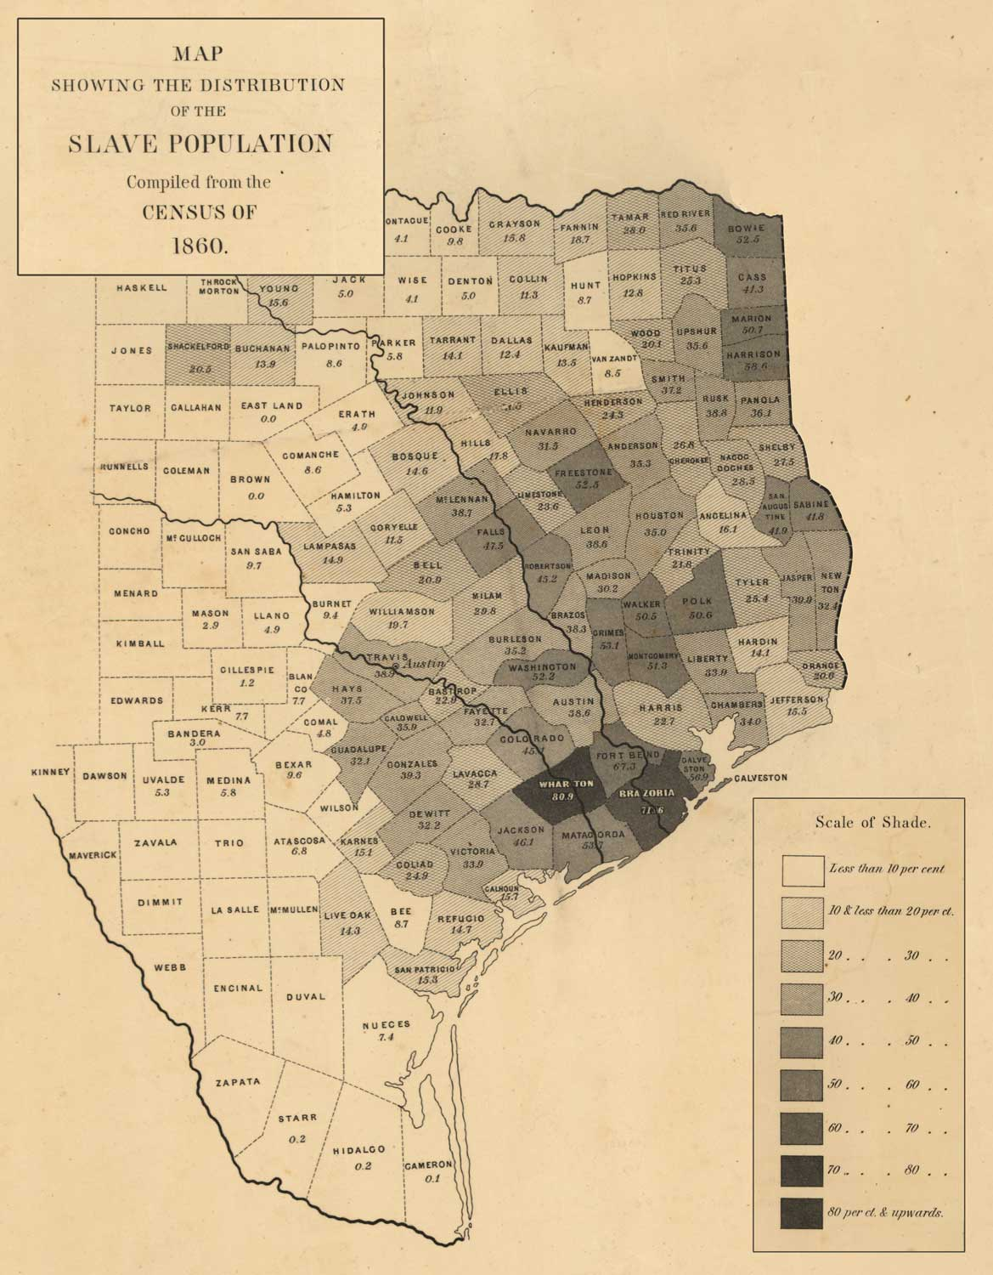
No Freedom in Texas
There was no inconsiderable number of Southerners who stoutly maintained that Negroes were not free.
Slavery remained intact within the Federal lines except as to the return of fugitives, and might be reinstated everywhere at the close of hostilities; or, in any case, compensation might be obtained by loyal citizens through the decision of the Supreme Court.
The situation in Texas was peculiar. During the war, Texan produce had been sent to Europe by the way of Mexico, and a steady stream of cash came in which made slavery all the more valuable.
At the end of the war slavery was essentially unimpaired.

Slide 7
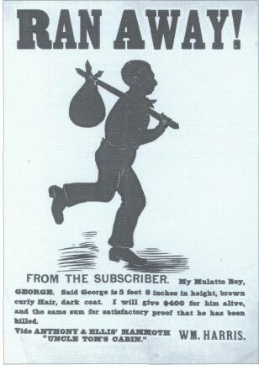
The Black Codes
The original codes favored by the Southern legislatures were an astonishing affront to emancipation and dealt with vagrancy, apprenticeship, labor contracts, migration, civil and legal rights.
In all cases, there was plain and indisputable attempt on the part of the Southern states to make Negroes slaves in everything but name.
They were given certain civil rights : the right to hold property, to sue and be sued. The family relations for the first time were legally recognized.
Negroes were no longer real estate. Yet, in the face of this, the Black Codes were deliberately designed to take advantage of every misfortune of the Negro.

Slide 8
The Black Codes
Negroes were liable to a slave trade under the guise of vagrancy and apprenticeship laws; to make the best labor contracts, Negroes must leave the old plantations and seek better terms; but if caught wandering in search of work, and thus unemployed and without a home, this was vagrancy, and the victim could be whipped and sold into slavery.
The Negro's access to the land was hindered and limited ; his right to work was curtailed ; his right of self-defense was taken away, when his right to bear arms was stopped; and his employment was virtually reduced to contract labor with penal servitude as a punishment for leaving his job.
And in all cases, the judges of the Negro's guilt or innocence, rights and obligations were men who believed firmly, for the most part, that he had "no rights which a white man was bound to respect."
As to other civil rights, the marriage of Negroes was for the first time recognized in the Southern states and slave marriages legalized.
Negroes were no longer real estate. Yet, in the face of this, the Black Codes were deliberately designed to take advantage of every misfortune of the Negro.

Slide 9
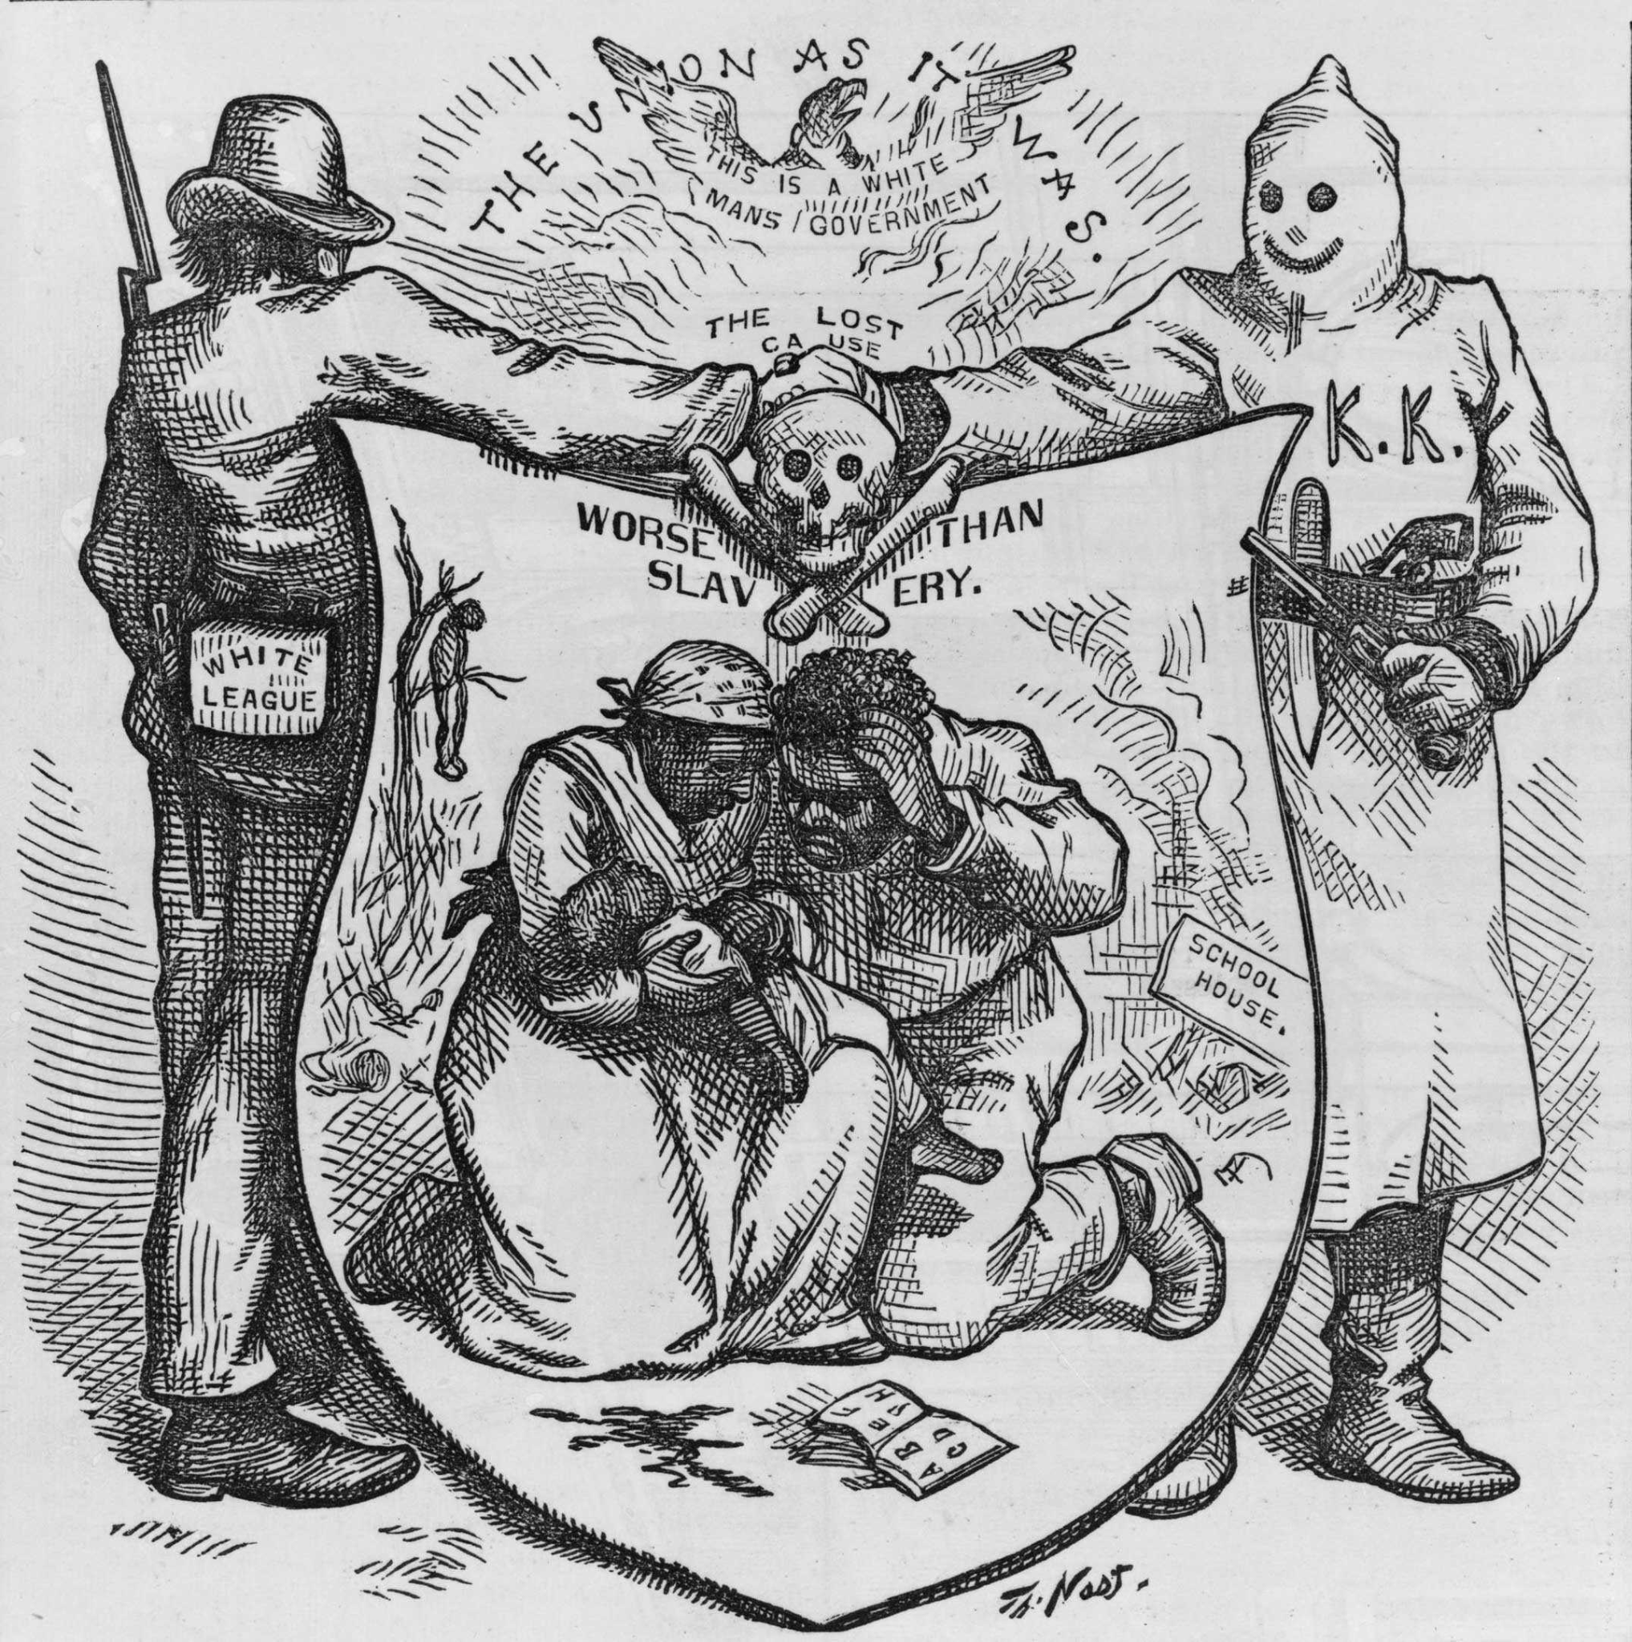
Looking Backwards
These slave laws have been defended in various ways. They were passed in the midst of bitterness and fear and with great haste; they were worded somewhat like similar vagrancy laws in Northern States ; they would have been modified in time; they said more than they really meant. All of this may be partly true, but it remains perfectly evident that the black codes looked backward toward slavery.
Here, then, was the dominant thought of that South with which Reconstruction must deal. Arising with aching head and palsied hands it deliberately looked backwards.

Slide 10
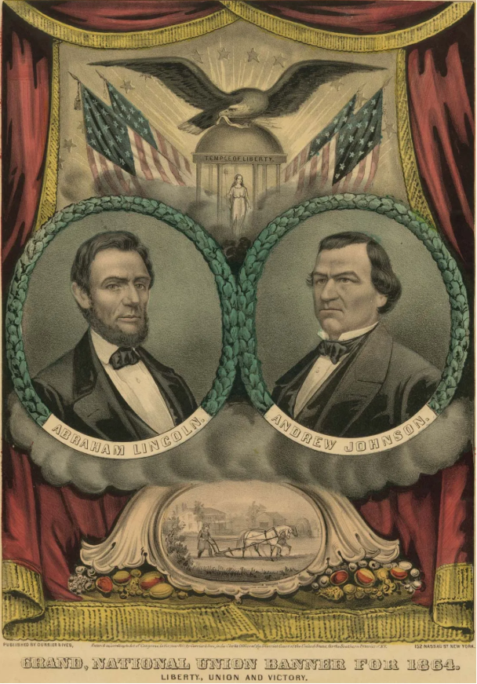
Looking Forwards
How two theories of the future of America clashed and blended just after the Civil War :
the one was abolition-democracy based on freedom, intelligence and power for all men;
the other was industry for private profit directed by an autocracy determined at any price to amass wealth and power.
The uncomprehending resistance of the South, and the pressure of black folk, made these two thoughts uneasy and temporary allies
This was the development of industry in America and of a new industrial philosophy.
The new industry had a vision not of work but of wealth ; not of planned accomplishment, but of power. It became the most conscienceless, unmoral system of industry which the world has experienced.

Slide 11
The American Assumption, Labor and Capital
Behind this extraordinary industrial development, as justification in the minds of men, lay what we may call the great American Assumption, which up to the time of the Civil War, was held more or less explicitly by practically all Americans. The American Assumption was that wealth is mainly the result of its owner's effort and that any average worker can by thrift become a capitalist.
The American labor movement, founded in the spirit that regarded America as a refuge from oppression and free for individual development according to conscience and ability, grew and expanded in America, basing itself frankly upon the American Assumption.
Its object was rule by the people, the wide education of people so that they could rule intelligently, and economic opportunity of wealth free for thrift. It found itself hindered by slavery in the South : directly, because of the growing belief of the influential planter class in oligarchy and the degradation of labor; and indirectly by the competition of slave labor and the spread of the slave psychology.
It became, therefore, at first more and more opposed to slavery as ethically wrong, politically dangerous, and economically unprofitable.

Slide 12
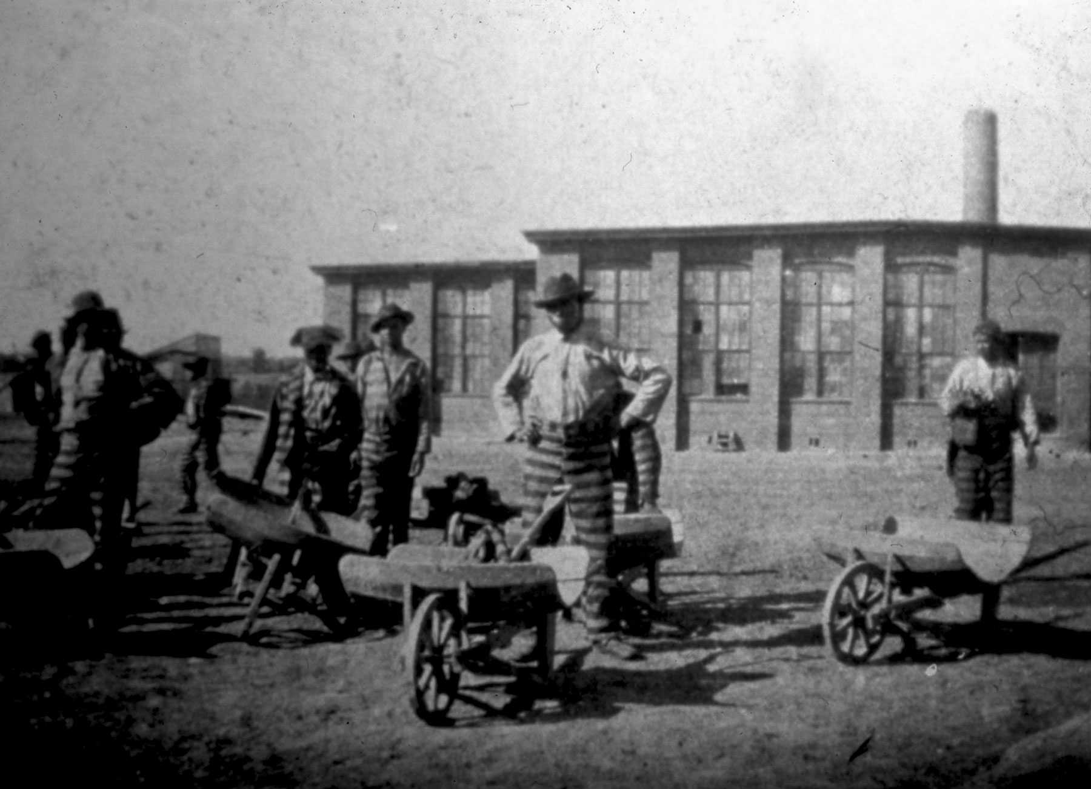
Capital
Capital, on the other hand, accepted widespread suffrage as a fact forced on the world by revolution and the growing intelligence of the working class. But since the new industry called for intelligence in its workers, capitalists not only accepted universal suffrage but early discovered that high wages in America made even higher profits possible; and that this high standard of living was itself a protection for capital in that it made the more intelligent and best paid of workers allies of capital and left its ultimate dictatorship undisturbed.
Nevertheless, industry took pains to protect itself wherever possible. It excluded illiterate foreign voters from the ballot and advocated a reservoir of non-voting common labor; and it stood ready at any time by direct bribery or the use of its power to hire and discharge labor, to manipulate the labor vote.

Slide 13
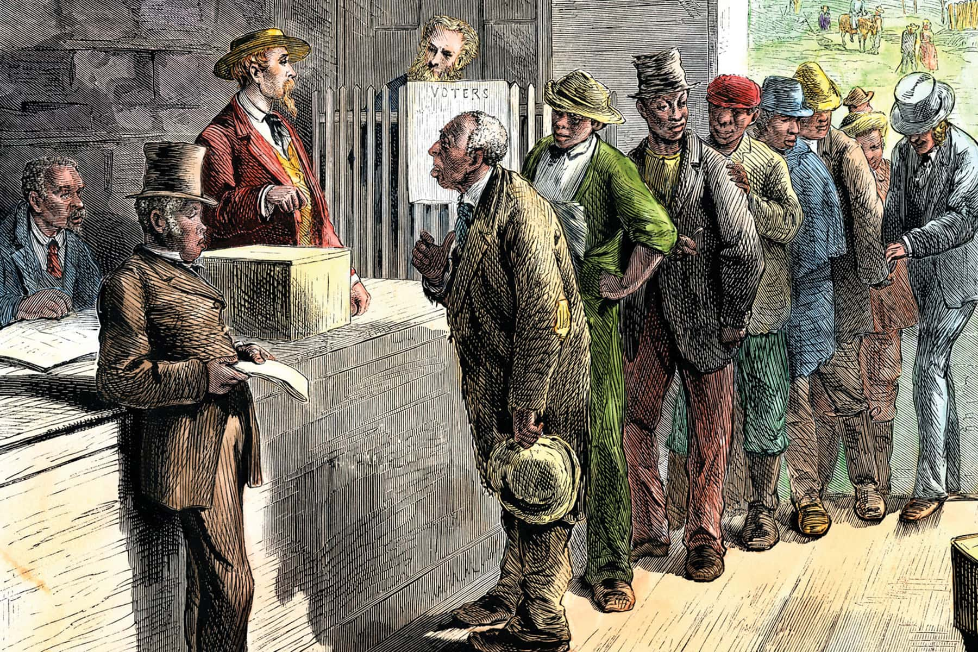
Slaves’ Relationship to Democracy
The true significance of slavery in the United States to the whole social development of America, lay in the ultimate relation of slaves to democracy.
What were to be the limits of democratic control in the United States? If all labor, black as well as white, became free, were given schools and the right to vote, what control could or should be set to the power and action of these laborers?
Was the rule of the mass of Americans to be unlimited, and the right to rule extended to all men, regardless of race and color, or if not, what power of dictatorship would rule, and how would property and privilege be protected ?
This was the great and primary question which was in the minds of the men who wrote the Constitution of the United States and continued in the minds of thinkers down through the slavery controversy.
It still remains with the world as the problem of democracy expands and touches all races and nations.

Slide 14
The Abolition-Democracy
The abolition-democracy was the liberal movement among both laborers and small capitalists, who united in the American Assumption, but saw the danger of slavery to both capital and labor. It began its moral fight against slavery in the thirties and forties and, gradually transformed by economic elements, concluded it during the war.
The object and only real object of the Civil War in its eyes was the abolition of slavery, and it was convinced that this could be thoroughly accomplished only if the emancipated Negroes became free citizens and voters.
For the first time in the classic democracy in the United States, it was made aware that the American Assumption was not and could not be universally true. Thus abolition-democracy was pushed towards the conception of a dictatorship of labor, although few of its advocates wholly grasped the fact that this necessarily involved dictatorship by labor over capital and industry.
On the other hand, industrialists after the war expected the South to seize upon the opportunity to make increased profit by a more intelligent exploitation of labor than was possible under the slave system.
They looked upon free Negro labor as a source of profit, and considered freedom, that is, a legal doing away with individual physical control, all that the Negroes or their friends could ask. They expected some popular education and a gradual granting of the right to vote, which would be straitly curtailed in its power for mischief by the far larger power of capital.

Slide 15
Democracies Eternal Paradox
Democracy, that inevitable end of all government, faces eternal paradox. In all ages, the vast majority of men have been ignorant and poor, and any attempt to arm such classes with political power brings the question : Can Ignorance and Poverty rule? If they try to rule, their success in the nature of things must be halting and spasmodic, if not absolutely nil; and it must incur the criticism and raillery of the wise and the well-to-do.
On the other hand, if the poor, unlettered toilers are given no political power, and are kept by exploitation in poverty, they will remain submerged unless rescued by revolution ; and a philosophy will prevail, teaching that the submergence of the mass is inevitable and is on the whole best, not only for them, but for the ruling classes. In all this argument there is seldom a consideration of the possibility that the great mass of people may become intelligent, with incomes that insure a decent standard of living. In such case, no one could deny the right and inevitableness of democracy. And in the meantime, in bridging the road from ignorance and poverty to intelligence and an income sufficient for civilization, the real power must be in someone's hands. Shall this power be a dictatorship for the benefit of the rich, the cultured and the fortunate?
This is the basic problem of democracy and it was discussed before the people of the United States in unusual form directly after the Civil War. It was a test of the nation's real belief in democratic institutions. And the fact that the ideal of abolition-democracy carried the nation as far as it did in the matter of Negro suffrage must always be a source of intense gratification for those who believe in humanity and justice.

Slide 16
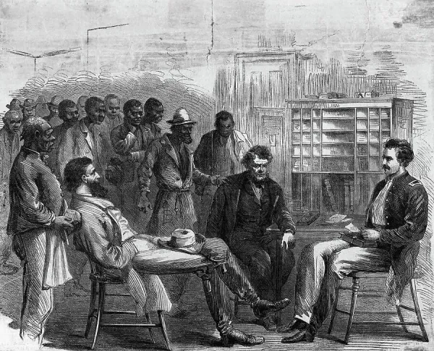
The Freedmen’s Bureau
The Freedmen's Bureau was the most extraordinary and far-reaching institution of social uplift that America has ever attempted. It had to do, not simply with emancipated slaves and poor whites, but also with the property of Southern planters. It was a government guardianship for the relief and guidance of white and black labor from a feudal agrarianism to modern farming and industry.
"It made laws, executed them and interpreted them; it laid and collected taxes, defined and punished crimes, maintained and used military force, and dictated such measures as it thought necessary and proper for the accomplishment of its varied ends. Naturally, all these powers were not exercised continuously nor to their fullest extent”
Thus the Freedmen's Bureau, which rose automatically as a result of the slaves' general strike during the war, and came directly out of the consolidation of the various army departments of Negro affairs, now loomed as the greatest plan of reasoned emancipation yet proposed.
It was finally emasculated and abolished by those in the North who grudge its inevitable cost, and by that Southern sentiment which passed the black codes.

Slide 17
Discussion

Slide 18
Discussion & New Members Introductions

Slide 19
New Member Introductions
What is your name, pronouns and state (or country/territory)?
Where do you work? Is it unionized?
How did you find out about the People’s School?
What do you think about tonight's class?

Slide 20
Section 2 - Transubstantiation of a Poor White and The Price of Disaster (Chapter 8 & 9)

Slide 21
Offense to All Right-Thinking Men
The final report of the Committee of Fifteen was made June 18. It made an eight hundred page book and 100,000 copies were distributed. Its majority and minority sections summed up the strongest arguments available for and against the proposed methods of Reconstruction. The part of the majority report that touched the Negro said: "Slavery had been abolished by constitutional amendment. A large proportion of the population had become, instead of mere chattels, free men and citizens. Through all the past struggle these had re-mained true and loyal, and had, in large numbers, fought on the side of the Union. It was impossible to abandon them without securing them their rights as free men and citizens. The whole civilized world would have cried out against such base ingratitude, and the bare idea is offensive to all right-thinking men. Hence, it became important to inquire what could be done to secure their rights, civil and political. It was evident to your committee that adequate security could only be found in appropriate constitutional provisions…. The increase of representation necessarily resulting from the abolition of slavery was considered the most important element in the questions arising out of the changed condition of affairs, and the necessity for some fundamental action in this regard seemed imperative.

Slide 22
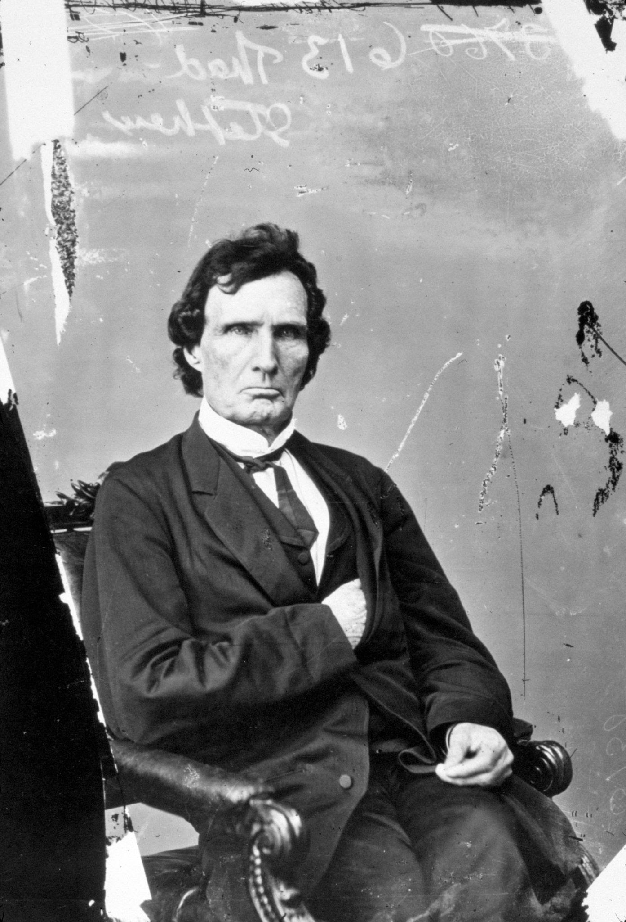
The Eternal Labor Of Sisyphus
Neither Sumner nor Stevens was satisfied with the Fourteenth Amendment. On the last day of the session, July 28, 1866, Thaddeus Stevens made his last defense of Negro suffrage. He was at the time worn out; his health was precarious; he was seventy-three years of age, and he hardly expected to return to his seat in the House. With deep solemnity, he sought " 'to make one more—perhaps an expiring effort to do something which shall be useful to my fellow men; something to elevate and enlighten the poor, the oppressed, and the ignorant in this great crisis of human affairs.' The black man, he declared, must have the ballot or he would continue to be a slave. There was some alleviation to the lot of a bondman, but 'a freeman deprived of every human right, is the most degraded of human beings.' Without the protection of the ballot-box the freedmen were 'the mere serfs,' and would become 'the victims of their former masters.' He declared that what he had done he had done for humanity. 'I know it is easy,' he said, 'to protect the interests of the rich and powerful; but it is a great labor to guard the rights of the poor and downtrodden—it is the eternal labor of Sisyphus, forever to be renewed. In this, perhaps my final action on this great question, I can see nothing in my political course, especially in regard to human freedom, which I could wish to have expunged or changed.
Republican Congressman Thaddeus Stevens supported abolition and criticised
President Lincoln on his attitude
towards this subject.

Slide 23
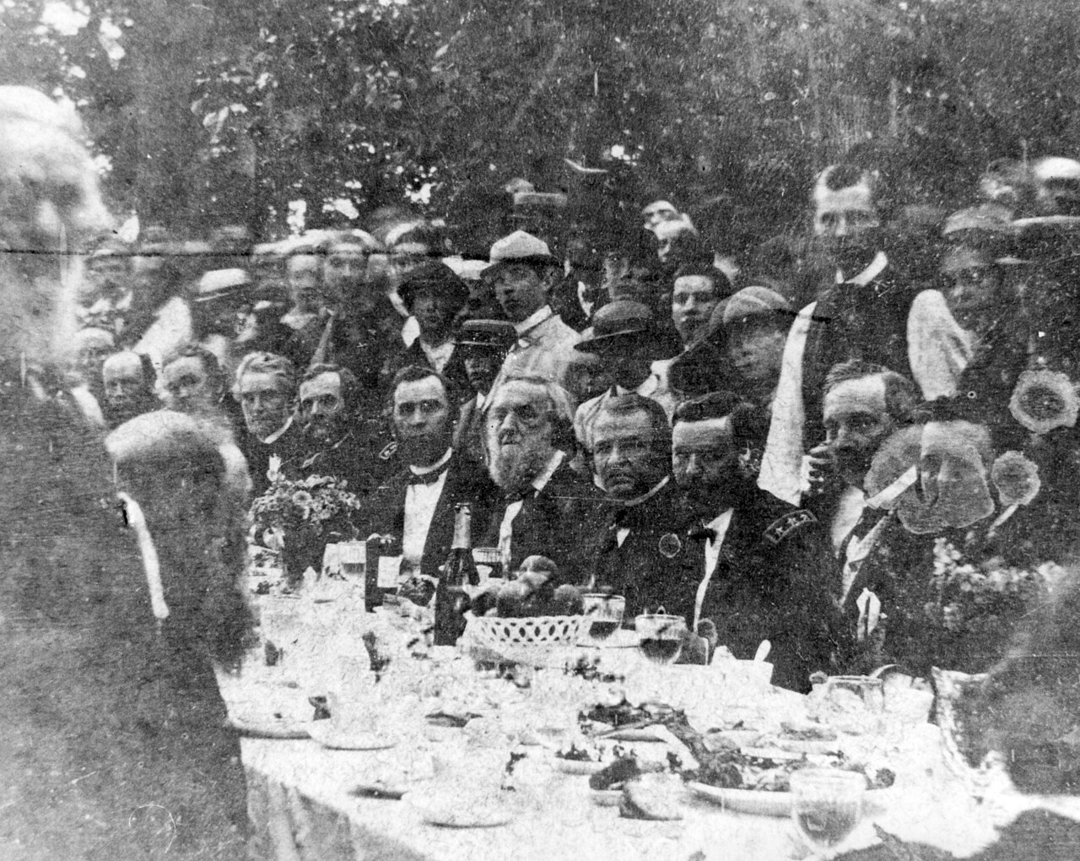
Altogether Human
For a brief period—for the seven mystic years that stretched between Johnson's "Swing round the Circle" to the Panic of 1873, the majority of thinking Americans of the North believed in the equal manhood of Negroes. They acted accordingly with a thoroughness and clean-cut decision that no age which does not share that faith can in the slightest comprehend. They did not free draft animals, nor enfranchise gorillas, nor welcome morons to Congress. They simply recognized black folk as men. "The South called for war," said James Russell Lowell, "and we have given it to her. We will fix the terms of peace ourselves and we will teach the South that Christ is disguised in a dusky race."Then came in 1873-76 sudden and complete disillusion, not at Negroes but at the world—at business, at work, at religion, at art. A bitter protest of Southern property reinforced Northern reaction; and while after long years the American world recovered in most matters,it has never yet quite understood why it could ever have thought that black men were altogether human.
Photograph of U.S. President Andrew Johnson at a banquet in his honor during the Swing Around the Circle speaking tour.

Slide 24
Andrew Johnson Surrenders Reconstruction
"As a result of the measures instituted by the Executive, with the view of inducing a resumption of the functions of the States comprehended in the inquiry of the Senate, the people of North Carolina,South Carolina, Georgia, Alabama, Mississippi, Louisiana, Arkansas,and Tennessee, have reorganized their respective State governments,and are yielding obedience to the laws and government of the United States with more willingness and greater promptitude than under the circumstances could reasonably have been anticipated. The proposed amendment to the Constitution, providing for the abolition of slavery forever within the limits of the country, has been ratified by each one of those states, with the exception of Mississippi, from which no official information has yet been received; and in nearly all of them measures have been adopted or are now pending, to confer upon freedmen rights and privileges which are essential to their comfort, protection, and security. In Florida and Texas, the people are making commendable progress in restoring their State governments, and no doubt it is entertained that they will, at an early period be in a condition to resume all of their practical relations to the Federal Government. It is true that in some of the States the demoralizing effects of the war are to be seen in occasional disorders; but these are local in character, not frequent in occurrence, and are rapidly disappearing as the authority of civil law is extended and sustained. Perplexing questions were naturally to be expected from the great and sudden change in the relations between the two races; but systems are gradually developing themselves under which the freedman will receive the protection to which he is justly entitled, and by means of his labor make himself a useful and independent member of the community in which he has his home."

Slide 25
The Most Pitiful Figure of American History
The transubstantiation of Andrew Johnson was complete. He had begun as the champion of the poor laborer, demanding that the land monopoly of the Southern oligarchy be broken up, so as to give access to the soil, South and West, to the free laborer. He had demanded the punishment of those Southerners who by slavery and war had made such an economic program impossible. Suddenly thrust into the Presidency, he had retreated from this attitude. He had not only given up extravagant ideas of punishment, but he dropped his demand for dividing up plantations when he realized that Negroes would largely be beneficiaries. Because he could not conceive of Negroes as men, he refused to advocate universal democracy, of which, in his young manhood, he had been the fiercest advocate, and made strong alliance with those who would restore slavery under another name. This change did not come by deliberate thought or conscious desire to hurt—it was rather the tragedy of American prejudice made flesh; so that the man born to narrow circumstances, a rebel against economic privilege, died with the conventional ambition of a poor white to be the associate and benefactor of monopolists, planters and slave drivers. In some respects, Andrew Johnson is the most pitiful figure of American history. A man who, despite great power and great ideas, became a puppet, played upon by mighty fingers and selfish, subtle minds; groping, self-made, unlettered and alone; drunk, not so much with liquor, as with the heady wine of sudden and accidental success.

Slide 26
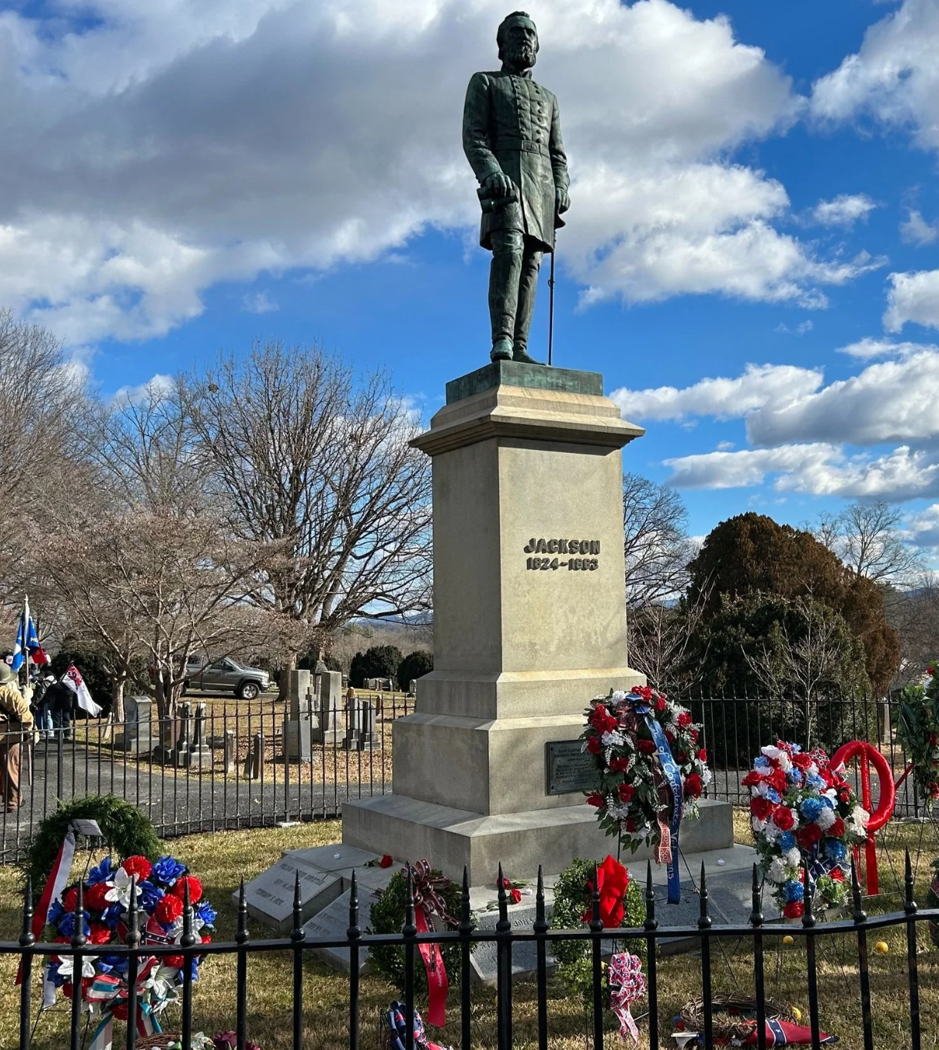
Who will Control Reconstruction?
The elections of 1867 made it clear that if the Democrats won in 1868, the entire system of Reconstruction would be changed. The business elements of the North, therefore, while not willing to follow abolition-democracy to the extreme, were even less willing to put Reconstruction entirely in the hands of Southerners. Congress, therefore, prepared to clinch its political hold on the South, and reconstruct Southern states on a basis of Negro suffrage. Conservative and commercial elements in the North went into the Republican Party, on the other hand, former Democrats began to return to the Democratic Party, where they were received with more or less suspicion. Meetings began to be held by Democratic leaders to determine candidates and procedure. On Jackson Day, January 8, 1868, a meeting was held in Washington, at which President Johnson spoke and many Democratic leaders. This meeting was dominated by the War Democrats, rather than by Copperheads, and emphasis was laid upon cooperation between the War Democrats and the Johnson administration, on the one hand, and the Democratic organization on the other. New measures and new men were sought. August Belmont, the banker, was chairman of the National Committee. New York was chosen as the seat of the convention, and a general invitation was issued to former Democrats.
Lee–Jackson Day was a state holiday in Virginia, commemorating, Robert E. Lee and Stonewall Jackson. It was Shamefully Celebrated the Week Before MLK Day Until 2020

Slide 27
Stupid, Causeless, Aimless Hatred
The New York Herald enumerated the elements of the new democracy: merchants who opposed the protective tariff, the unemployed, the foreign born, the Catholics, the women opposed to Negro suffrage, the opponents of military control in the South. Many papers warned the pro-Southern elements in the Democratic Party not to oppose the loyal sentiment in the nation. The Springfield Republican, July 1, mentioned "the mere stupid, causeless, aimless hatred of the Negro" in the Democratic Party. The opposition of the Democrats to Negro suffrage was not clearly expressed. Evidently, the tide in favor of democracy had risen so high in the country that as a party the Democrats did not dare oppose it. The party, therefore, would not come out flatly in opposition to Negro suffrage but simply declared that suffrage was a question to be settled by the states. Twenty-two state Democratic conventions were held in 1868. Eleven of these opposed Negro suffrage anywhere. Only the convention of South Carolina in April approved it. Ten other conventions either were silent on the subject or announced their belief that this was a matter of state control. The various state platforms illustrated local Northern thought. California Democrats declared that they "now and always confide in the intelligence, patriotism, and discriminating justice of the white people of the country to administer and control their Government, without the aid of either Negroes or Chinese.

Slide 28
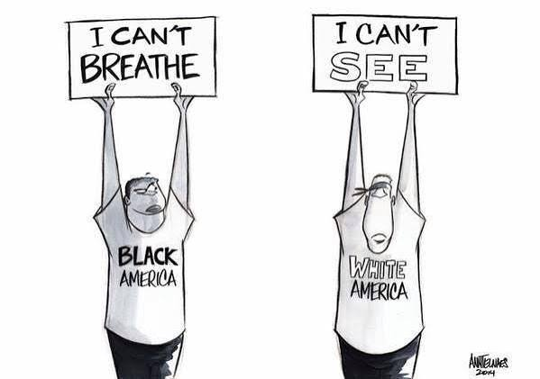
The Dictatorship of Labor under Reconstruction
At Christmas, 1868, President Johnson proclaimed general amnesty, pardoning every person engaged directly or indirectly in the rebellion. His last presidential message was an interesting and rather curious argument. He declared, in effect, that the dictatorship of labor, attempted in the South under the Reconstruction acts, had led to corruption and bloodshed and, therefore, prevented the rise of industry in the South, which was the real solution of the race problem. He believed that the bondholders had already received an amount larger than the principal which they owed and that, hereafter, the interest paid should be applied to the reduction of that principal. Johnson thus illustrated again the way in which the color problem became the Blindspot of American political and social development and made logical argument almost impossible. The only power to curtail the rising empire of finance in the United States was industrial democracy—votes and intelligence in the hands of the laboring class, black and white, North and South.
The American Blindspot

Slide 29
The Right to Vote Shall Not be Denied
The chief act of the third session of the 40th Congress was the Fifteenth Amendment. The House Committee on the Judiciary reported June 11, 1869, a proposed Fifteenth Amendment. This caused long debate in the House and many proposed modifications. Among the propositions was that no educational attainment or possession of property should be made the test of any citizen's right to vote. Eight other amendments were offered, and some fifteen substitute propositions. Finally, a substitute suggested by Wilson was adopted by a vote of 31-27. It read: "No discrimination shall be made in any State among the citizens of the United States in the exercise of the elective franchise or in the right to hold office in any State, on account of race, color, nativity, property, education or religious creed." This was amended so as to insure Congress power to direct the manner in which the election should be conducted, and thus the Senate agreed to the House proposition with amendments. The House refused to concur. The Senate declined to recede and the measure failed. Finally, the Fifteenth Amendment was passed 35-1 1, in its present form, except that the words "to hold office" were added after"the right to vote." February 20, the House considered this proposal and there were five attempts to amend it, of which one was successful and added "nativity, property and creed," to the other qualifications. It then passed the House 140-37. The Senate rejected the House amendment and asked for conference. Finally, the present Fifteenth Amendment was agreed upon, and it passed the House 145-44, and the Senate 39-13.It was thus recommended to the states February 26, 1869.

Slide 30
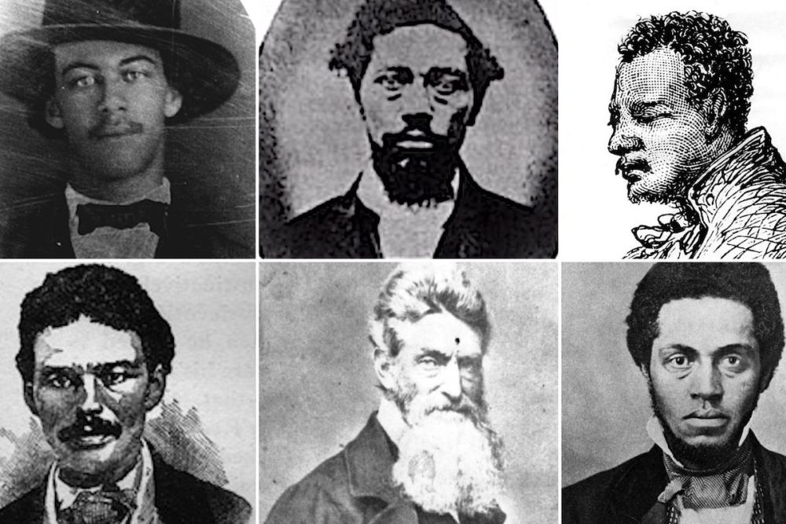
Prophets, Martyrs, and an ugly Dialectic
Some Americans think and say that the nation freed the black slave and gave him a vote and that, unable to use it intelligently, he lost it. That is not so. To win the war America freed the slave and armed him; and the threat to arm the mass of the black workers of the Confederacy stopped the war. Nor does this fact for a moment deny that some prophets and martyrs demanded first and last the abolition of slavery as the sole object of the war and at any cost of life and wealth. So, too, some Americans demanded not simply physical freedom but votes, land, and education for blacks, not only in order to compass the economic emancipation of labor, but also as the only fulfillment of American democratic ideals; but most Americans used the Negro to defend their own economic interests and, refusing him adequate land and real education and even common justice, deserted him shamelessly as soon as their selfish interests were safe. Nor does this for a moment deny that unselfish and far-seeing Americans, poor as well as rich, by supplying public schools when the Negroes demanded them and establishing higher schools to train teachers, saved the Negro from being entirely reenslaved or exterminated in an unequal and cowardly renewal of war.
The Martyrs of John Brown’s Raid on Harpers Ferry. Like a Modern Spartacus, John Brown Earned the Lifelong Admiration of Marx, Who Correctly Saw Brown’s Attack as the Only Moral Response to the World-Historical Evil of American Chattel Slavery

Slide 31
Discussion

Slide 32
Section 3 - The Black Proletariat in South Carolina - Ch. 10

Slide 33
Thoughts by W E B DuBois
All men know that by sheer weight of physical force, the mass of men must in the last resort become the arbiters of human action. But reason, skill, wealth, machines and power may for long periods enable the few to control the many. But to what end? The current theory of democracy is that dictatorship is a stopgap pending the work of universal education, equitable income, and strong character. But always the temptation is to use the stopgap for narrower ends, because intelligence, thrift and goodness seem so impossibly distant for most men.We rule by junta ; we turn Fascist, because we do not believe in men ; yet the basis of fact in this disbelief is incredibly narrow. We know perfectly well that most human beings have never had a decent human chance to be full men. Most of us may be convinced that even with opportunity the number of utter human failures would be vast ; and yet remember that this assumption kept the ancestors of present white America long in slavery and degradation.

Slide 34
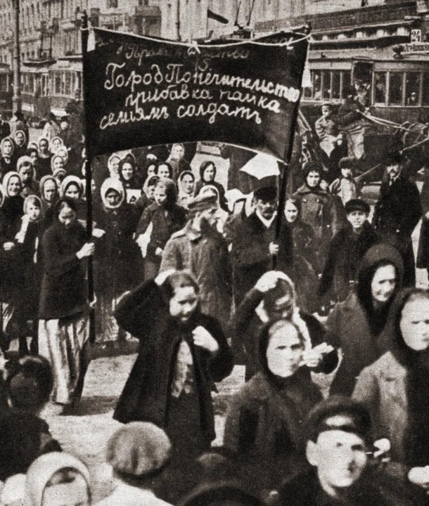
Thoughts continued
It is then one's moral duty to see that every human being, to the extent of his capacity, escapes ignorance, poverty and crime. With this high ideal held unswervingly in view, monarchy, oligarchy, dictatorships may rule ; but the end will be the rule of All, if mayhap All or Most qualify. The only unforgivable sin is dictatorship for the benefit of Fools, Voluptuaries, gilded Satraps, Prostitutes and Idiots. The rule of the famished, unlettered, stinking mob is better than this and the only inevitable, logical and justifiable return. To escape from ultimate democracy is as impossible as it is for ignorant poverty and crime to rule forever

Slide 35
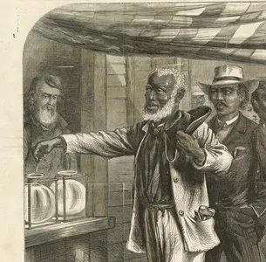
South Carolina
The military commanders, under the Reconstruction legislation, did much to abolish discrimination. One captain of a vessel was fined who refused to allow a colored woman to ride as a first-class passenger, and General Canby, a Kentuckian, whom Johnson appointed in March, 1867, ordered that Negroes serve on juries. This led to excitement and protests.
Northern capitalists began to appear in the state. They were, at first, welcomed : "Men of capital are coming from the North by every steamer in view of investing in cotton and rice. · We are glad to see such a lively trade in South Carolina ; it benefits everyone."

Slide 36
South Carolina
Later, and especially when they began to take part in politics, they were loaded with every accusation. Some of them were army officers; others, employees of the Freedmen's Bureau ; some were farmers, and some religious and educational leaders. The Negroes, naturally, turned to them for leadership and received it. They helped organize the Negroes in Union Leagues in order to teach them citizenship and united action. Northern visitors continued to come. Senator Henry Wilson of Massachusetts spoke at Charleston : "After four bloody years, Liberty triumphed and slavery has died to rise no more . . . . The creed of equal rights, equal privileges and equal immunities for all men in America is hereafter to be the practical policy of the Republic . . . . Never vote unless you vote for the country which made you free. Register your names. Vote for a united country. Vote for the old flag. Vote for a change in the constitution of the state that your liberties may be consummated."

Slide 37
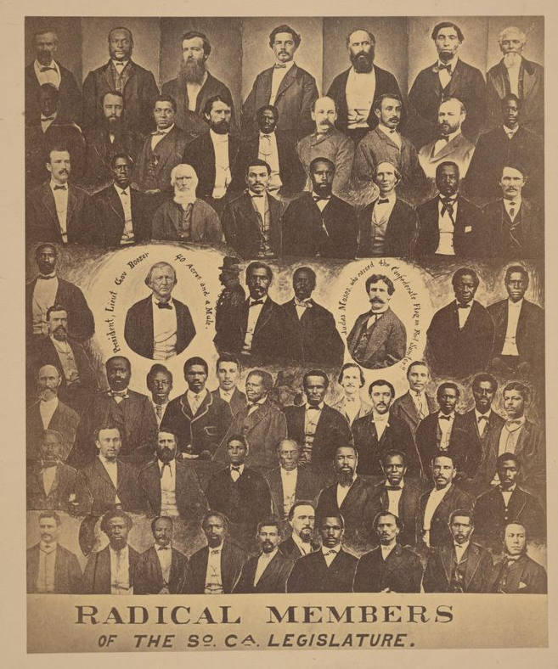
South Carolina
The state convention, when it met, had Negro members for the first time in the history of the state. Seventy-six of the one hundred and twenty-four delegates were colored. As in Mississippi and elsewhere, a number of the planter class had early contemplated an effort to control the Negro vote, and thus quickly to get rid of military rule. On the other hand, the Negroes, because of the educated free Negro element, some considerable talent among the slaves, and the influx of Negroes from the North, showed unusual foresight and modesty. The convention was earnest, and on the whole, well-conducted. Of the seventy-six colored men, it is said, fifty-seven had been slaves.

Slide 38
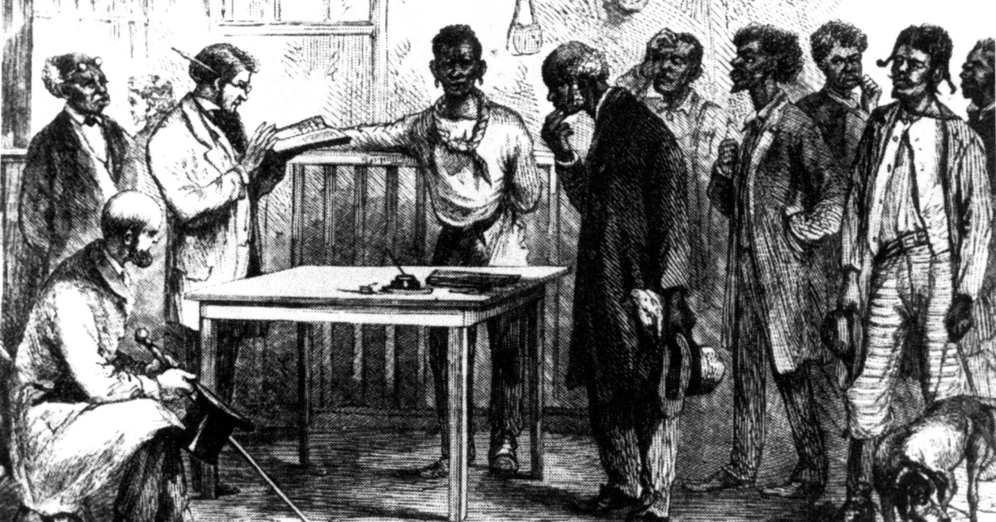
South Carolina
The real basis of opposition to the new regime was economic. Nothing showed this clearer than one fact, and that is that the chief and repeated accusations against the convention and succeeding legislatures was that they were composed of poor men, white and black.
The white 47 delegates were said to have paid all together $761 in annual taxes, of which one conservative paid $5o8. The total taxes paid by the 74 Negroes were $ 117, of which a Charleston Negro paid $85. Twenty-three of the whites and fifty-nine of the colored paid no taxes whatever.

Slide 39
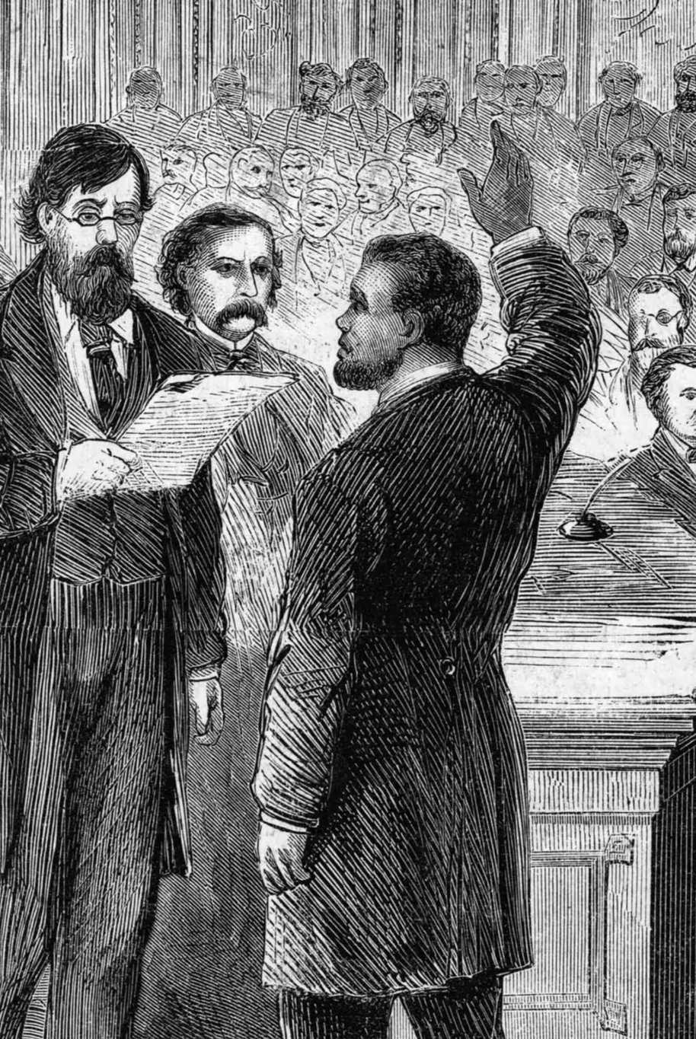
South Carolina
In a day when property was sacred no matter how secured, and in a state where it had been politically supreme, this attitude was understandable. Yet one wonders just what was expected. Since the great majority of the white people of the state had been kept in ignorance and poverty, and practically all of the Negroes were slaves, whose education was a penal offense, one would hardly expect universal suffrage to put rich men in the legislature.
It was singularly to the credit of these voters that poverty was so well represented ; it showed certain tendencies toward a dictatorship of the proletariat. The taxpayers' convention of 1871 frankly proposed to restore the power of property by giving 60,000 taxpayers voting power equal to 90,000 non-taxpayers!

Slide 40
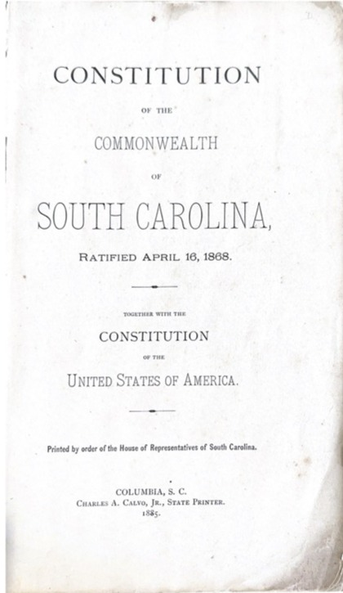
South Carolina
Discriminations of race and color were abolished by the constitution, and practical application was attempted in the case of the public schools, and the militia.
The convention framed the most liberal provisions for the right of suffrage that any of the Southern constitutions provided. They did not attempt, as in Virginia, Alabama, and Mississippi, to restrict the voting of whites further than was provided by the Reconstruction acts.

Slide 41
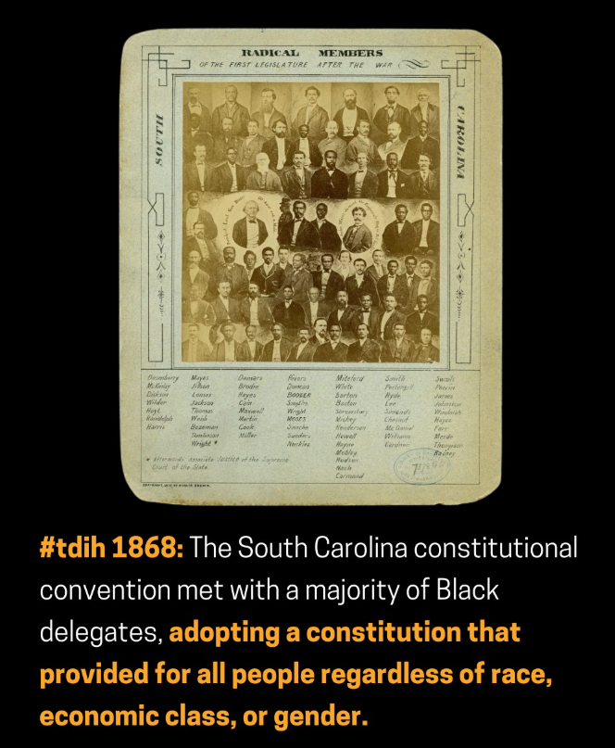
South Carolina
Indeed, Whipper, a colored delegate, wished to petition Congress to remove all political disabilities from the white citizens. In this Cardozo and Nash agreed, and the motion was passed.
Of course, they made no distinction in race and color. The rights of women were enlarged. The property of married women could not be sold for their husbands' debts, and for the first time in its history, the state was given a divorce law.
Education was discussed at length, and a free common school system voted for.

Slide 42
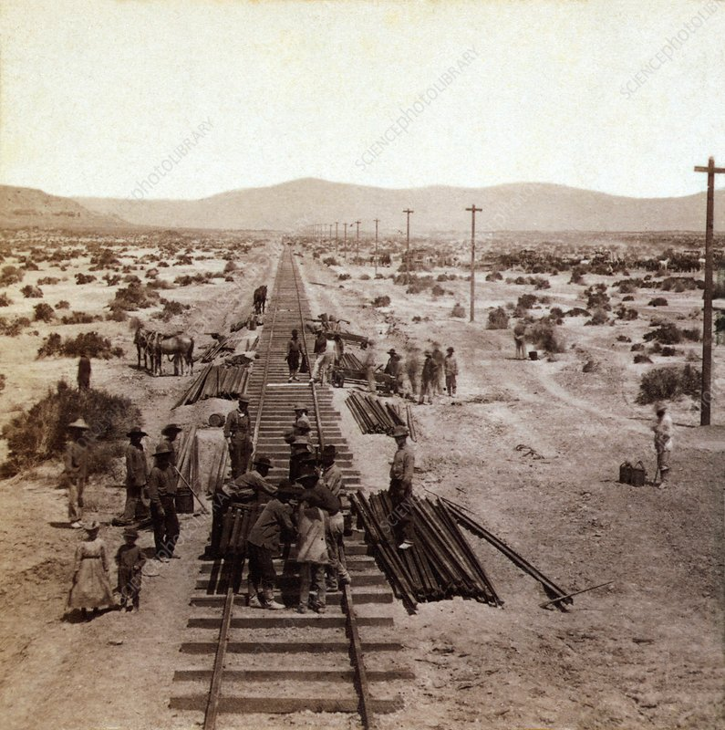
On Railroads and Public Services privatized
One of the chief sources of corruption in nearly all the reconstructed states was railroad building. And the reasons for this are easily misconceived because of the changed economic status of railroads today.
It must be remembered that at the beginning throughout the country and the world, the railroad was a public highway, and for this reason a public enterprise toward whose building and maintenance the public rightly contributed. It was only after the railroad was built and established by public funds, that private interests monopolized it and sequestered its income to make individual millionaires.

Slide 43
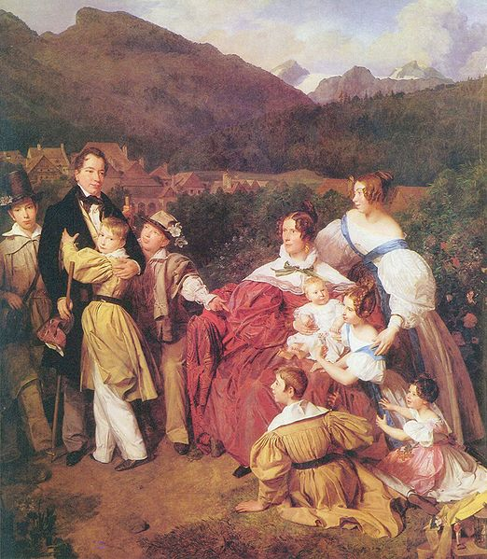
South Carolina
The appropriations to meet the new expenses had to grow. The fact is that South Carolina had been a state absolutely dominated by landed property. It is said that the ante-bellum state was ruled by 180 great landlords. They had made the functions of the state just as few as possible, and did by private law and on private plantations most of the things which in other states were carried on by the local and state governments. The economic revolution, therefore, which universal suffrage envisaged for this state, was perhaps greater than in any other Southern state. It was for this reason that the right of the masses to vote was so bitterly assailed, and expenditures for the new functions of the state denounced as waste and extravagance.

Slide 44
Closing
Beneath the race issue, and unconsciously of more fundamental weight, was the economic issue. Men were seeking again to reestablish the domination of property in Southern politics. By getting rid of the black labor vote, they would take their first and substantial step. By raising the race issue, they would secure domination over the white labor vote, and thus the oligarchy that ruled the South before the war would be in part restored to power. It would, of course, lack capital.
But the North stood ready to furnish capital if profit could be obtained, and it was being made more and more clear that this furnishing of capital, far from being contingent upon universal suffrage in the South, could be made more available even if the black labor vote was disfranchised completely, and white labor directed in the South by the same methods that were dominating it in the North.

Slide 45
Discussion & Wrap Up

Slide 46
Announcements
PCUSA Cell Chairs need to call members of their cells to remind them about attendance.
PCUSA Cell members are reminded attendance at the Continuing Education class of Jones-Foster every first Wednesday of the month is required.
The next issue of New Masses (2026) has begun production. If you have art you want us to feature, email it to info@partyofcommunistsusa.net.

Slide 47
Volunteers Needed!
We are in need of volunteers for the staff of the People’s School! Here’s a few roles we need filled:
People to help manage posting on our social media and podcast platforms
Video Editors, Audio Editors, Graphic Designers, Artists, Narrators
Web Controls, Moderators
Email info@peoplesschool.us if you’re interested and try to attend our next staff meeting if possible.

Slide 48


Slide 49

View From Left Field
https://viewfromleftfield.libsyn.com
The Old PSMLS Youtube is now the Youtube of View From Left Field, a podcast of analysis and discussion of current events from a progressive perspective.
Like the Youtube videos and subscribe with 5 star ratings on your podcast platforms.

Slide 50

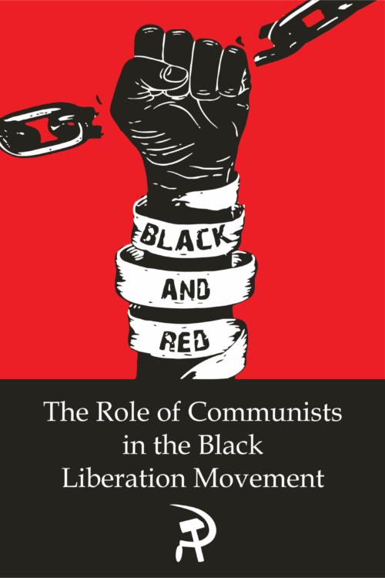
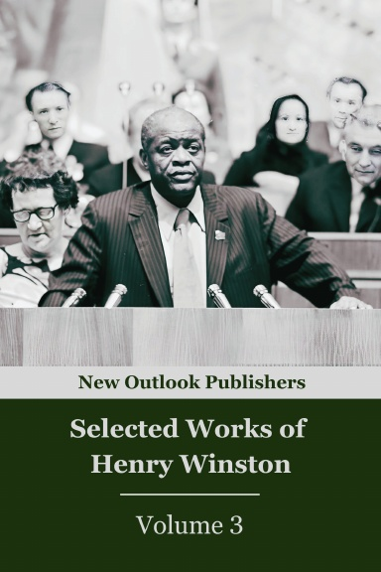
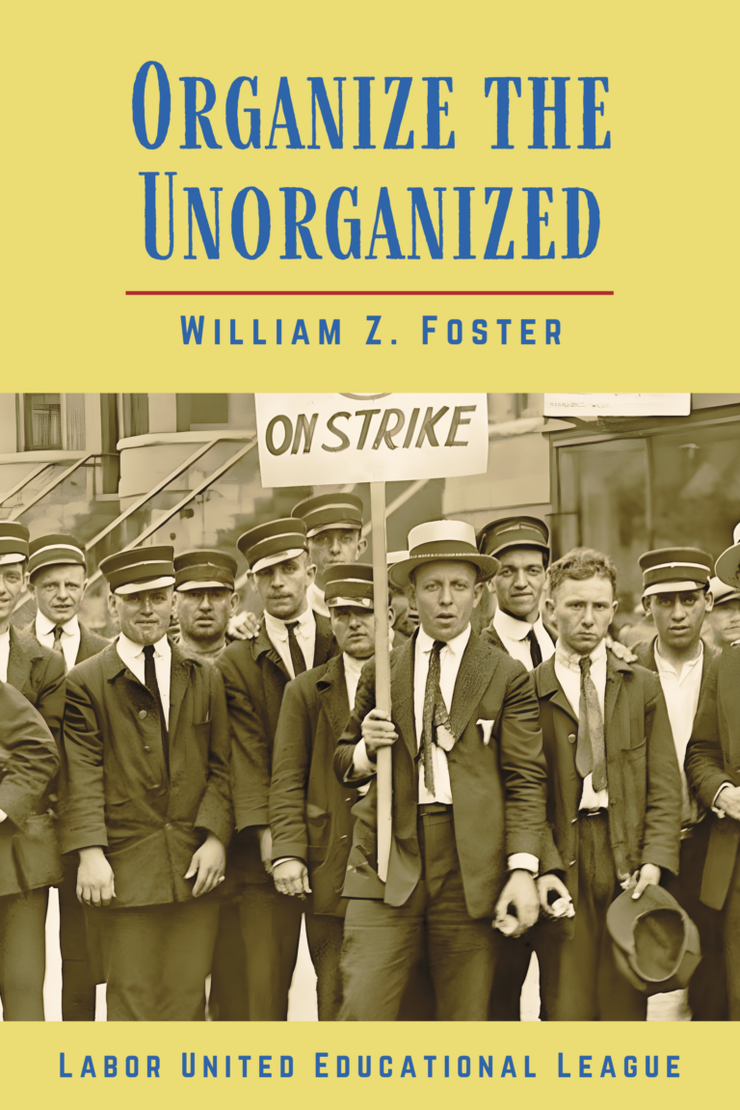

New Outlook Publishers
newoutlookpublishers.store
Relevant and Latest Releases

Slide 51



Harry Bridges School of Labor
luel.us/laborschool/
The Harry Bridges School of Labor is a monthly class covering a variety of topics aimed at building class consciousness among union members. For class schedule and other information, please visit the website at luel.us/laborschool.

Slide 52
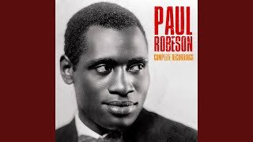
Go Down Moses - Paul Robeson

