Slide 1

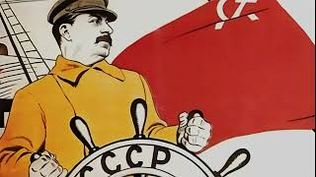
The Internationale

Slide 2
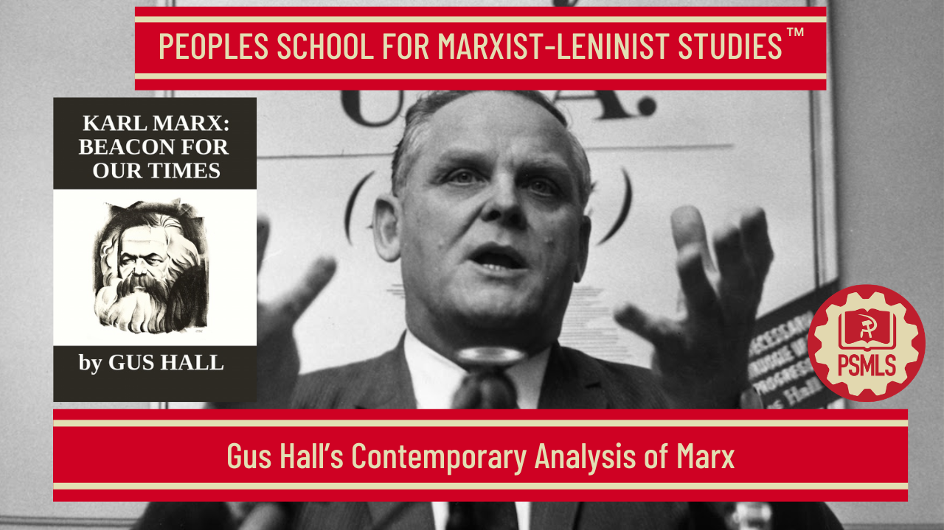
PSMLS 5/5/26

Slide 3
What we’ll be learning today:
One Hundred (and counting) years after: Marx Right on Target
The Revolutionary Legacy of Karl Marx
Karl Marx in Our Time

Slide 4
One Hundred (and counting) years after: Marx Right on Target

Slide 5
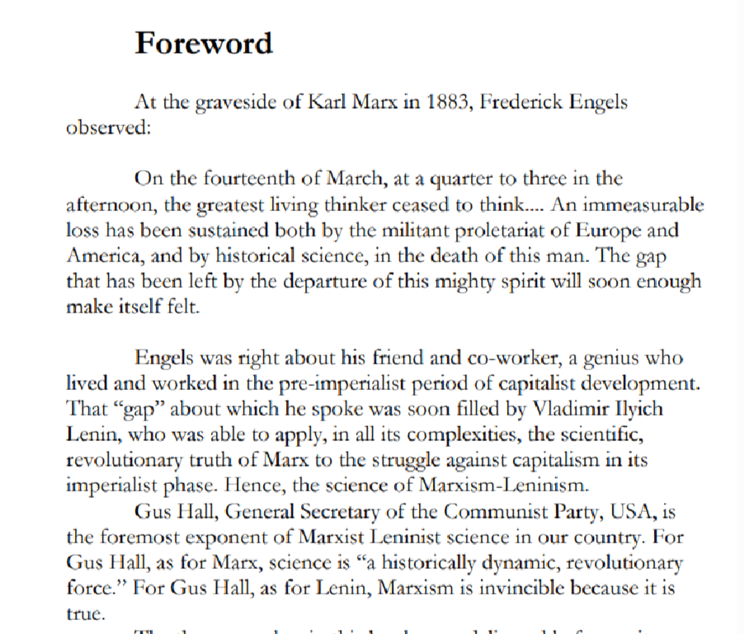
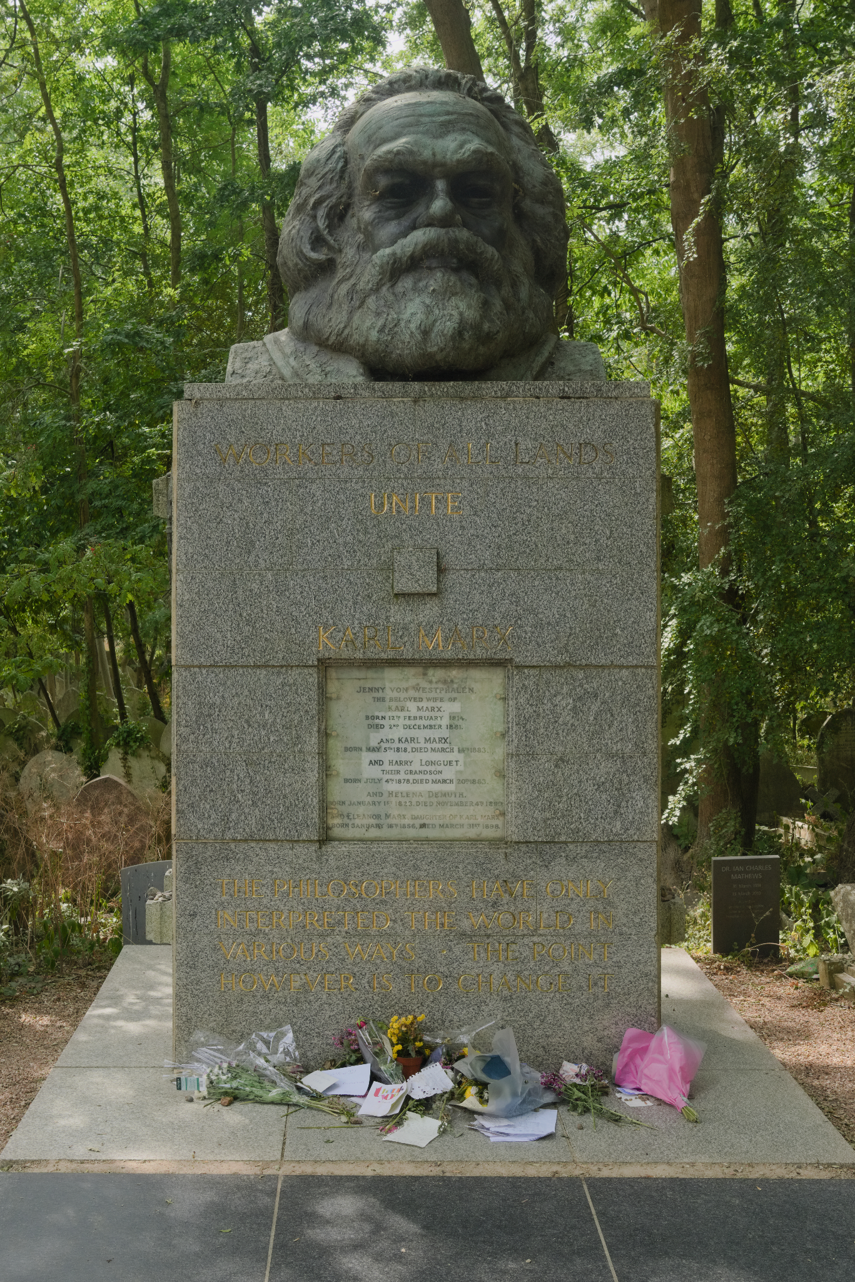
MARCH 14, 1883 2:45 P.M

Slide 6
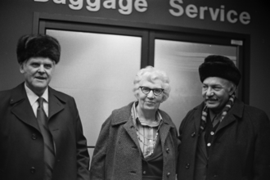
Foreword by Henry Winston National Chairman, CPUSA
On these occasions, Gus Hall demonstrates (as he has at numerous other events) that revolutionary science is consistent, is applicable and explainable to any audience which is concerned with solutions to our common problems. The objective laws of social development don’t change with the political winds or windbags of the moment. The source of capitalist profits and the inner contradictions of the system cannot be wished away, or washed away in a foaming tide of Reaganomics.
Most of all, a bright future of peace and socialism awaits us, too, if only the imperialist nuclear fanatics are curbed and defeated. Gus Hall emphasizes how the legacy of Marx is alive and at work today on the side of the working class, of the racially and nationally oppressed, of all movements in struggle for social progress and freedom from nuclear disaster.
He pointedly warns of the dire consequences that can 6 result from playing the anti-Soviet game of the warhawks, and of the danger of opportunism whether in the class struggle at home or in the struggle for peace in the world arena.
In fact, the decisive contribution of the Soviet Union to the defeat of the fascist Rome-Berlin-Tokyo Axis in World War II cannot be denied by any honest person.

Slide 7
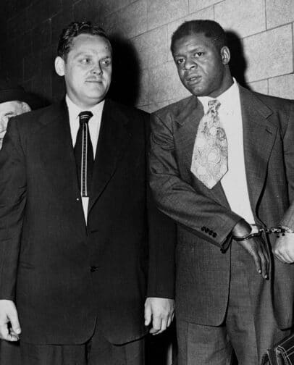
Foreword by Henry Winston National Chairman, CPUSA
Even the arch reactionary, General Douglas MacArthur, declared in February, 1942: “The world situation at the present time indicates that the hopes of civilization rest upon the worthy banners of the courageous Russian Army.” The vital interests of the Soviet people, then as now, coincided with the vital interests of all peoples fighting for greater democracy and against the fascist menace.
At the present time, President Reagan and his ilk strive mightily to make their anti-Communist crusade appear as a “defense” of democracy. But in the early post-World War II years, the U.S.-Soviet British agreements unequivocally included Communists within the democratic forces, and just as clearly excluded fascists.
Not able to deny this fact, the Reagan-Thatcher circles try to cover it up with “new” slanders against the Soviet Union and its leaders. As Gus Hall so ably affirms, the “two superpowers” concept is designed to take the heat off the real threat to peace, U.S. imperialism, and to continue the arms buildup. In regard to this true source of the war danger, it is useful to take a look at a few pages from our own history in which Karl Marx himself played an important role.

Slide 8
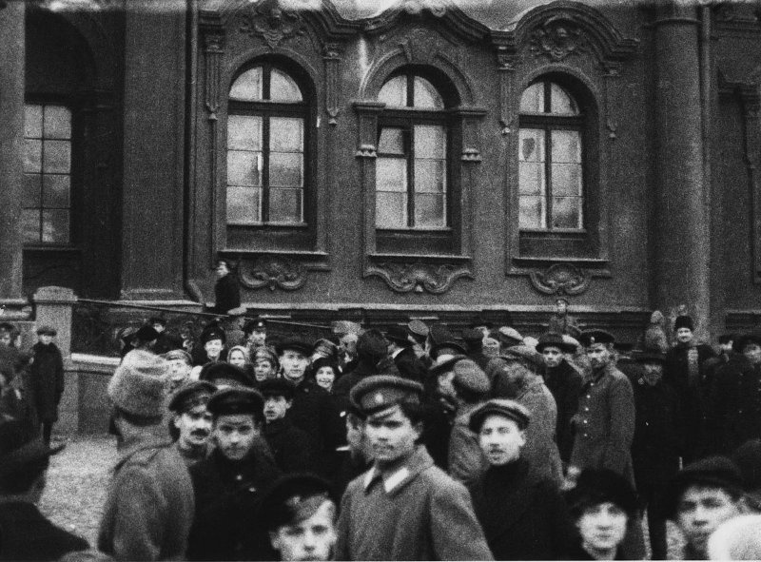
Foreword by Henry Winston National Chairman, CPUSA
Another new epoch in the annals of the working class was opened up by the October Revolution. The emergence of the first socialist state offered proof of Marx’s observation that while the capitalist class cannot do without the working class, the working class can do without the Capitalist class. The first socialist state offered further proof.
The October Revolution liberated the nations that were oppressed by czarist imperialism; thus, the peoples of Africa, Asia and Latin America had evidence that while imperialism cannot live without the profits from neo-colonialist oppression, the oppressed nations can live without imperialism.
Today’s historic reality is that the peoples of these continents are struggling against the neo-colonialism of the transnational corporations. They add new strength to the global struggle to—as Marx put it “command peace where our would-be masters shout war.” The struggle for peace must become a victorious mass crusade in our country!
There is a peace majority in the United States. It has the potential to reverse the nuclear insanity of the monopoly forces allied with the Pentagon and the Reagan administration. How aptly Marx’s analysis applies to President Reagan, who is shouting for war against what he calls a “Soviet-Cuban-Nicaraguan axis.”

Slide 9

Foreword by Henry Winston National Chairman, CPUSA
When he spoke in Miami on May 20th to an audience of CubanAmericans, Reagan called Fidel Castro a fascist. Reagan has never called General Pinochet of Chile a fascist, nor will he ever do so. The Pinochet dictatorship is included in Reagan’s concept of democracy. The Cuban newspaper, Granma, responded truly to the Reagan demagogy: “Never before the arrival in the White House of the ex-Hollywood actor have lies been institutionalized so meticulously as official policy.” The people of Nicaragua and of El Salvador also refuse to submit to the dictates of U.S. imperialism. This is the situation to one degree or another throughout Latin America. The science of Marxism-Leninism, of the Communist Party of the United States, always seeks to unite the vital interests of our people—beginning with the working class—with that of all people oppressed by imperialism. Today the cause of the people of Central America must become the cause of every trade union, every church, every campus, and must ring out in every legislative hall!

Slide 10
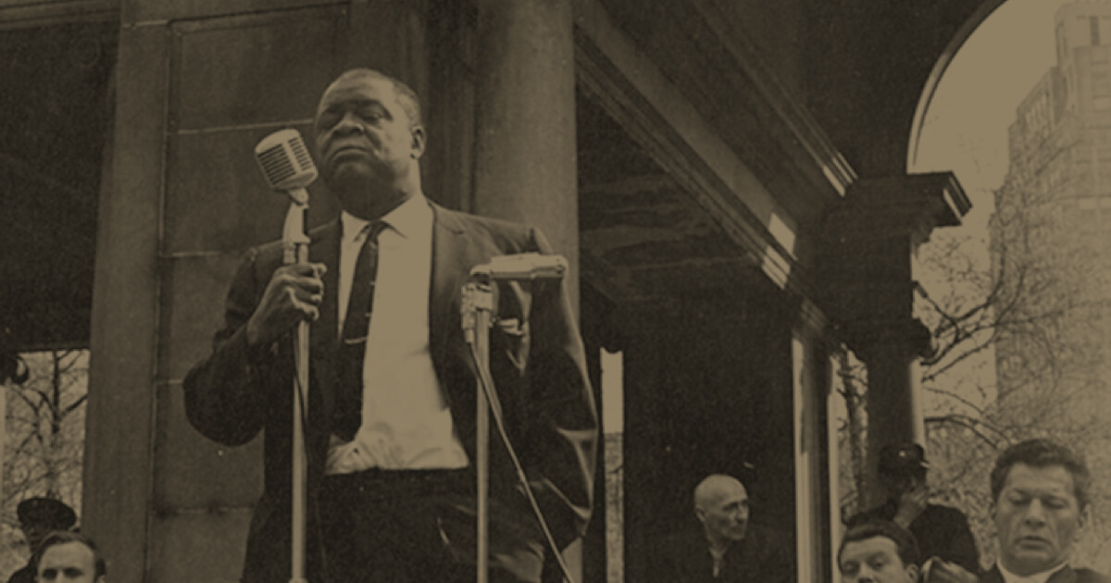
Foreword by Henry Winston National Chairman, CPUSA
This fight, linked with the broad movement for genuine disarmament negotiations on the basis of equality and mutual security as repeatedly proposed by the Soviet Union, is the guarantee of our future of humanity’s future— for peace, social progress and socialism.
Gus Hall’s remarks in celebration of the Marx Centenary outline the essence of the obstacles, and the path to victories with exceptional clarity, humanism and revolutionary optimism.
I am confident that you will find Gus Hall a worthy friend and ally, and that you will be pleased, through him, to better understand how Karl Marx, too, is on your side. I think that many of you will want to join more firmly and actively with their program, our program, as well.
Henry Winston National Chairman, CPUSA

Slide 11

Marxism on Religion
In that same speech Reagan declared that Marxism-Leninism is the epitome of “sin, evil and ungodliness.” For a President to declare a holy war against a so-called “evil empire,” as Reagan did in Orlando, is itself the greatest evil, and to say the very least, irrational. Karl Marx would have been somewhat astonished and puzzled to hear a 20th century President declare that the capitalist world can meet the present day challenge “only if it has as much faith in God as the Communists have faith in man,” In a sense, accusing Communists of faith in man is really a backhanded compliment!
Because of the wide publicity Reagan’s speech received and because of its provocative hysteria, for a brief moment I wondered whether your invitation to speak would be withdrawn. Knowing Marx’s keen dialectical method of observing things— not statically, but in the process of growth and change, seeing things in the framework of specific time, place and circumstance-—-I am sure that in today’s world he would formulate the question differently. Were he alive today, most likely Marx would be somewhat surprised at the progressive role so many churches and religious institutions are playing.

Slide 12

Marxism Lives and Grows
….today, more than 100 years after Marx’s death, Marxism has become the basis for the most far-reaching, most influential ideological current in the entire history of human societies. Why this is so is one of the most perplexing questions for non-Marxists today, because Marxism has been cussed, castigated and crucified for over one hundred years. More Marxist books and pamphlets have been burned than any other body of literature—book burnings from Hitler Germany to the one I witnessed in the Leavenworth penitentiary, where I was serving an eight-year prison sentence for the crime of “thinking Marxist thoughts.” To this day, only one U.S. University, the University of Minnesota, has an accredited course in Marxism-Leninism. Marxism has been and still is vilified, illegalized, falsified and revised. Yet Marx’s “spectre” still haunts the entire non-socialist world. The question is—why? Why does Marxism grow in influence, prestige and popularity despite the decades of campaigns and crusades to destroy it?

Slide 13

Marxism Lives and Grows
Why does Marxism grow in influence, prestige and popularity despite the decades of campaigns and crusades to destroy it? Why are more than one-half of the world’s peoples either building a new socialist society or moving in the direction of socialism?
Why are there no developing countries anywhere in the world moving toward capitalism? Why is Marxism-Leninism the main ideological current influencing the direction of human society?
Why is Marxism considered enemy number one to the U.S. establishment, the government, the Pentagon and big business?
Why is it that the FBI, CIA, and military intelligence spend most of their time harassing those who believe Marx made some important contributions to the bank of human thought? Why does Marx, dead over a hundred years, “still speaketh”?
Looking through the eyes of Mother Nature the answer is obvious. Trees and flowers do not grow on concrete pavements or dry deserts. Seeds and acorns take root only when there is a suitable soil and water to nourish them. Similarly, Marxism prevails as a viable, powerful force because its roots are sunk deep in the reality of life and therefore nourished by the people.

Slide 14
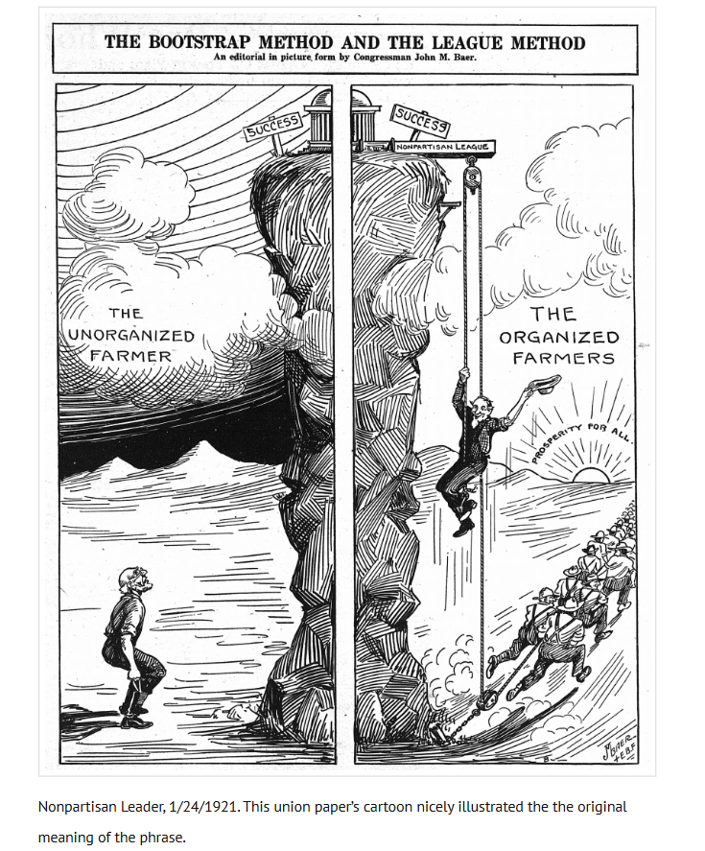
A Science For Social Change
Marxism explains and deals with real life. It is a science that reveals life’s real processes—the social, economic processes as well as the laws of nature. Marxism is a science that is specifically at the service of people, especially the working people. Marxism is a science of thought, but it is also a science for social change.
It helps people in their daily struggles for a better life. The people of the world react to Karl Marx in two Opposing ways, each reflecting the side of the class struggle upon which one makes a living. On the one hand, the number of Marxism’s defenders, advocates and followers keeps growing by leaps and bounds. While on the other hand, its antagonists and enemies become ever more vehement, desperate, extreme and hysterically fanatic.
Their slanders, falsehoods and outright lies keep moving ever further away from truth, from any semblance of intellectual integrity. These reactions, both pro and con, are almost inevitable in our world of two opposing classes, reflected in the two main Socio-economic systems, Those who are exploited—the have-nots—see Marxism as the science and philosophy of liberation, the science that explains to them how and why they are exploited. Why, generation after generation, the millions are poor or just about making ends meet. Why a small minority, generation after generation, keeps accumulating greater and greater wealth. Contrary to popular myths, hard work as a rule does not make one rich.
The secret to getting rich is to have a lot of people working hard for you. The so-called captains of industry and banking amass huge fortunes without ever setting foot on the production line or picking up a tool.

Slide 15

Monopoly capitalism
One hundred twenty years ago, on the basis of a thorough study of the laws of capitalism, Marx made a number of scientific projections. He accurately predicted that the small manufacturing concerns which dominated industry in his time would be devoured by the bigger ones till finally there would be a few big corporate monopolies left that would rule over the economy. Who can deny the accuracy of that projection today? IBM, GM and U.S. Steel all prove how well Marx knew the inner soul of capitalist development. Marx said that as the corporations grew, they would become less and less socially responsible and less and less patriotic.
One need only mention dioxin and the EPA and the transfer of jobs and capital to low wage, low-tax areas to see where today’s corporate social responsibility and patriotism lie. Who can deny that the U.S. multinational corporations are irresponsible and perfectly willing to sacrifice national interest on the altar of profits? Marx said that old profits flow to wherever the new profits are the highest.

Slide 16
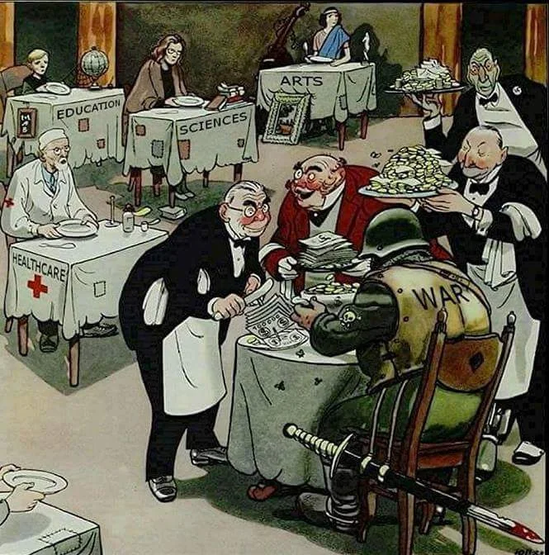
The class struggle
Based on economic laws, one hundred twenty years ago Marx forecast that because capitalism pushes for ever-increasing production of goods, while restricting the market for them by keeping wages low, the system would develop gluts of unsold goods that would bring on recurring economic crises.
Today, out of a working day of 8 hours, the average worker works 2 hours and 9 minutes for himself and 5 hours and 51 minutes for the boss. That's corporate profits.
Or, to put it another way, for the rest of this year the working class (those who are working, that is) will work only for the profits of the corporations and to pay taxes.
The rest of this year the workers will produce goods they cannot buy. In fact, this is precisely what the corporate publicity material says to lure industries to their areas.

Slide 17

The class struggle
In the now famous Communist Manifesto, Marx asserted that the capitalist system during its rule of scarce one hundred years, had created more massive and more colossal productive forces than had all preceding generations together.
In a sense, it is precisely because of the big monopolies and the vast expansion of the productive forces under capitalism, that it has outgrown itself.
Capitalism, because of private ownership and lack of planning in production, has now become an obstacle to the further development and progress of society. Capitalism was an advance over slavery and feudalism. It was able to use the technology of its day. But now capitalism is increasingly out of step with modern times.

Slide 18
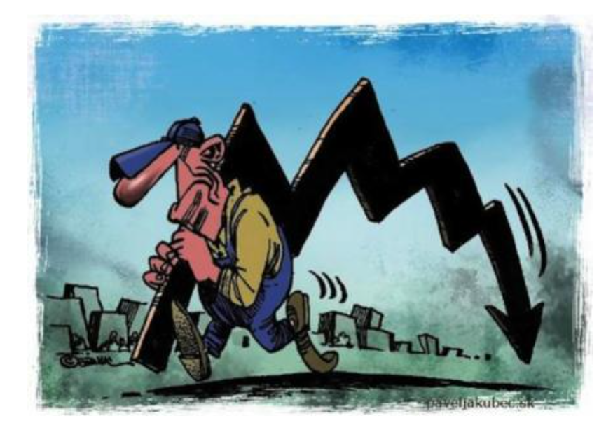
A system of anarchy
The scientific and technological revolution is passing it by. The problems of today’s world are too complex for a socio-economic system that is at the mercy of individual corporations without concern for people or society.
Capitalism is a system of anarchy. As the process of the bigger corporations swallowing up the smaller ones accelerates (far beyond even Marx’s predictions), big business becomes even less concerned about human life and society. As capitalism develops into monopoly capitalism, the anarchy increases on an even bigger scale and the crises and disasters become more frequent and intense.
Today capitalism in the U.S. careens from one crisis to another, because it is unplanned, chaotic, and anarchistic. Its credo is, each dog for himself, and dog-eat-dog. The new advances in science and 16 technology become entangled in the monopolies’ single minded determination to milk all the benefits of production for their private profits. The new technology needs a system that can plan and develop its use and distribute its benefits to society as a whole. All the talk about “hi-tech” replacing mass production industries, about our society becoming a post-industrial system, is totally unrealistic.

Slide 19
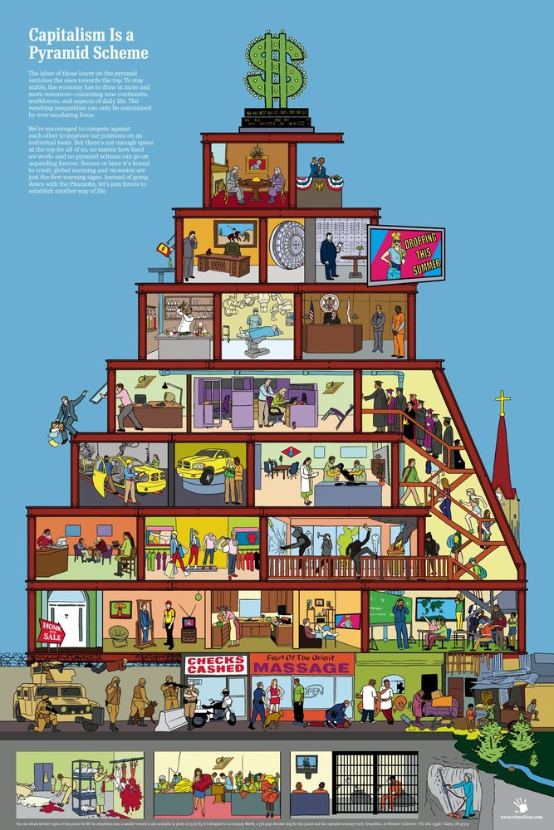
A system of anarchy
The scientific and technological revolution is passing it by. The problems of today’s world are too complex for a socio-economic system that is at the mercy of individual corporations without concern for people or society.
Capitalism is a system of anarchy. As the process of the bigger corporations swallowing up the smaller ones accelerates (far beyond even Marx’s predictions), big business becomes even less concerned about human life and society.
As capitalism develops into monopoly capitalism, the anarchy increases on an even bigger scale and the crises and disasters become more frequent and intense.
Today capitalism in the U.S. careens from one crisis to another, because it is unplanned, chaotic, and anarchistic. Its credo is, each dog for himself, and dog-eat-dog.

Slide 20

A system of anarchy
The invasion of the robot army will drive new millions out of the industrial plants and onto the unemployment lines. It is estimated that in the next ten years, for every three thousand jobs “high tech” industries will create, fifty thousand jobs will be lost.
It is one of those ironies of history that U.S. capitalism daily provides proof that Karl Marx was right absolutely right, and right on target. Our President, Ronald Reagan, a lifelong anti. communist fanatic, personally does more to prove Marx was on target than hundreds of paid thinktanks combined.
More than anyone else, Ronald Reagan and Reaganomics is forcing people to search seriously for a viable alternative, to consider the socialist solution.

Slide 21
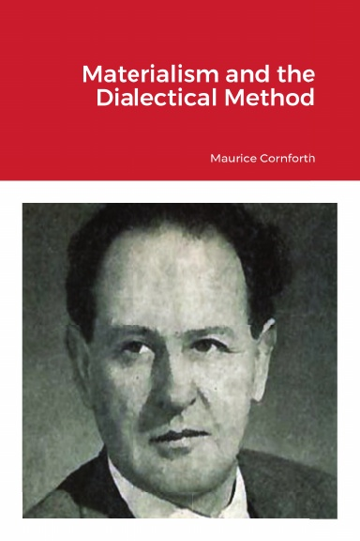
Marxism has the answers
The burning question is: WHY? Why does the Reagan Administration and most of Congress relentlessly pursue these cold-blooded, anti-people policies that cause hunger, unemployment, sickness, misery and death—with the constant threat of nuclear war? Is it that they completely lack human compassion and social conscience?
Why cut funds for the immunization of children to protect them from dis ease, knowing many will be struck with crippling and killing diseases that were conquered by medica science years ago? Why are the oil and chemical monopolies permitted to lace our gas, heating and fuel oil with lead and toxic chemicals?
Why are they permitted to dump toxic wastes in areas where people live, knowing full well these actions will poison and kill people—especially children—for the next ten, twenty, even one hundred years? Engels, co-worker of Marx, wrote about capitalism and ecology a century ago, and today Reagan calls popular concern about this issue “environmental extremism.” Is he not concerned about human life, about our future generations? Why the deliberate gutting of social security that cuts the only lifelines of the elderly, ill and disabled? Have they no concern for our older generation?
Why do these planned (with malice aforethought) inhuman policies continue without letup? Is the United States really slipping so far from what used to be the richest country in the world? Is the United States becoming a nation that can no longer afford to provide even a minimum standard of living, a minimum safety net, for its people? Has the United States really run out of resources and money?
From a Marxist viewpoint, that’s unadulterated hogwash! Or, are U.S. products uncompetitive on the world market because U.S. workers are unproductive and lazy? Or live too high off the hog? Such ideas, we believe, are more hogwash! The real answers to all these questions lie deep in the very heart of the capitalist system itself.

Slide 22
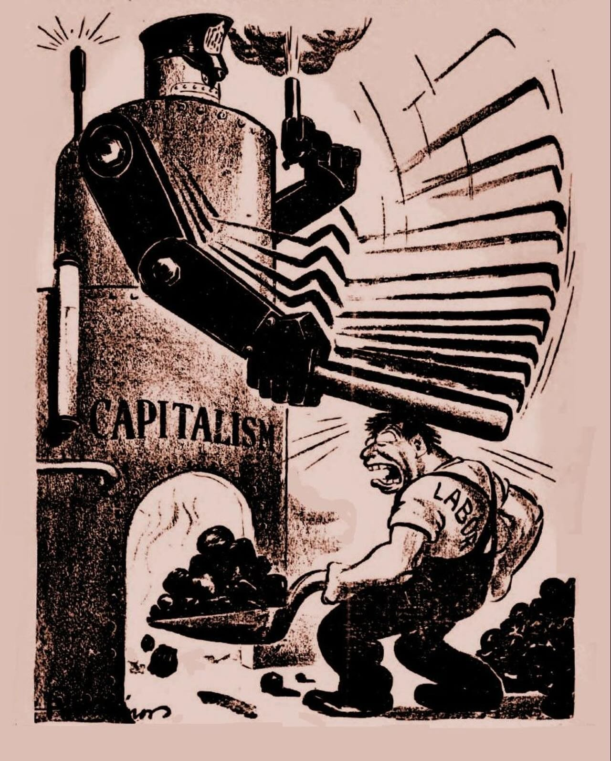
Marxism has the answers
It is a system that places corporate profits before the interests of the people. The double-barreled, Reagan-big business offensive against the people has a serious negative cause and effect impact on the economy.
Cutting paychecks, unemployment checks, social security checks and food stamps means less money for buying consumer goods. Therefore, less sales in the marketplace; And less sales mean less production and less jobs.
The bottom-line cause for the economic mess our country is in is the capitalist system itself. Capitalism is timeworn and worn out. It is overtired, but refuses to give up. Capitalism is deep in the process of decay and decline. As with all phenomena in life, it is the victim of old age and the aging process.
The ever-deepening economic, political, social and moral crises we are going through are not momentary. The decline and contraction of capitalism is the product of an inborn, fixed and law-governed process, In a sense, it is ironic that U.S. developments have followed the classical model Karl Marx projected, including high unemployment, widespread poverty, the emergence and rise of the huge industrial monopolies, the financial galaxies and conglomerates that now dominate, exploit and control every phase of life in the United States.

Slide 23
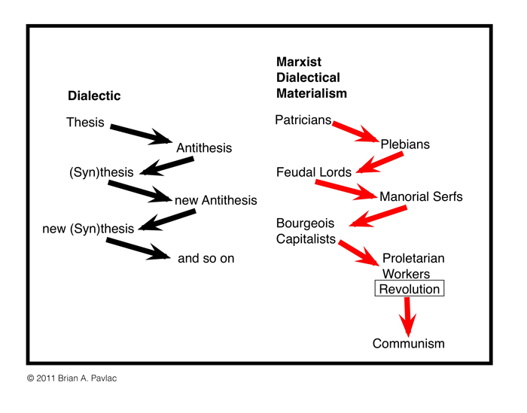
Dialectical laws of development
Much is known and written about the laws of economic and social development, as well as scientific socialism. Much less is known and appreciated about how much Marx and Engels added to our understanding of the Laws of nature—to natural science.
However, natural scientists are discovering that the more they probe the ways of nature the more they are learning about the dialectical laws that determine and explain all phenomena—nature, society and consciousness.
Revolutions cannot be imported or exported. In each country, revolutions are the explosions resulting from a combustion of accumulated frustrations and anger because of exploitation, injustice and oppression.
You can transplant a rubber tree to Alaska, but it will not take root. You can transplant revolutionary ideas, but unless the political and economic soil is prepared and ready, they will not take root and grow. This historic moment is so explosive because there are two interrelated worldwide revolutionary processes.

Slide 24
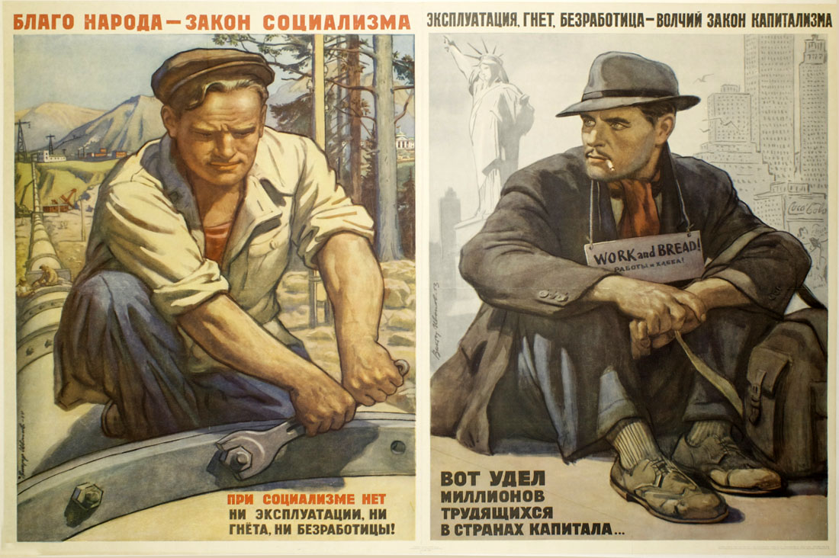
Dialectical laws of development
Socialism is a society that (once and for all) will do away with all forms of human exploitation through which a very small, privileged minority became richer and richer by exploiting the labor of the many, the great majority, who became poorer and poorer.
Under socialism, for the first time, the people will truly “inherit the earth.” The fact is that this revolutionary process is inevitable.
It is propelled and dictated by the inner laws of social development.

Slide 25

Dialectical laws of development
Karl Marx was a keen observer of our country. He learned much from our American revolutionary traditions. In fact, there were times when Karl Marx sounded very much like Thomas Jefferson. And, when Thomas Jefferson sounded much like Karl Marx.
“Whenever any form of government becomes destructive of these ends [the inalienable rights to life, liberty and the pursuit of happiness] it is the right of the people to alter or abolish it, and to institute a new government, laying its foundation on such principles, and organizing its powers in such form, as to them shall seem most likely to affect their safety and happiness.” Jefferson also said that it is also “the duty” of the people to so act when necessary (The Declaration of Independence).
Those were written by Thomas Jefferson. Now, one more quote: When a great social revolution shall have mastered the results of the bourgeois epoch then only will human progress cease to resemble that hideous, pagan idol, who would not drink the nectar but from the skulls of the Slain. (1979 C. W. 12:222).
That is from Karl Marx. It was Karl Marx who showed that rebellion and revolution are law-governed, inevitable processes. ' He was therefore able to explain the factors and forces that motivate and drive the law-governed forward process of history. That’s why Karl Marx, one hundred years after his death, still “speaketh” today—right on target. So, 1f you want to ride the wave of the future, you should consider jumping aboard the revolutionary bandwagon.

Slide 26
Discussion

Slide 27
Discussion & New Members Introductions

Slide 28
New Member Introductions
What is your name, pronouns and state (or country/territory)?
Where do you work? Is it unionized?
How did you find out about the People’s School?
What do you think about tonight's class?

Slide 29
The Revolutionary Legacy of Karl Marx

Slide 30
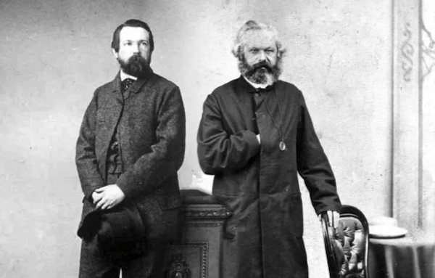
The "Locomotive of History"
Marxism-Leninism is the theory and method of socialist revolution. And revolution is the "locomotive of history." It has become a law of social development that the further humanity progresses from the age of Marx, the closer it moves toward Marxism-Leninism. Today there is not a country in the world that does not have an active Marxist-Leninist movement. And, there is nothing the New York Times fears more than this. Yes, the "spectre" hangs ever heavier over the capitalist world. As the sun was setting on the day Karl Marx died, Frederick Engels, his closest co-worker and dearest friend, penned a most perceptive epitaph: "Man-kind is shorter by a head, and the greatest head of our times, at that" (Foner, 1973, 28). With keen dialectical insight Engels reflected on the effects Marx's passing would have on the class struggle: "The final victory is certain, but circuitous paths, temporary and local errors-things which even now are so unavoidable - will become more common than ever." Engels premonition was right on target. As we know, there have been deviations and aberrations, both "temporary and local."
Friedrich Engels (left) and Karl Marx (right)

Slide 31

Rebellion, High Ideals and Struggle
To illustrate the profound impact of Marx's death in 1883, let me quote some typical reactions: On his passing, the New York Central Labor Council passed a resolution: “The world of workers has lost one of its greatest teachers, one of its warmest friends. . . . Karl Marx was the one who over 30 years ago called upon all working men of all countries to unite and organize for the purpose of establishing justice upon this earth. . . . Let us all unite in honoring his memory.” The present leaders of the New York Central Labor Council would do well to take a new look at what its "greatest teacher" and "warmest friend" advocated.
A leading Boston daily newspaper editorialized: "Karl Marx . . . was one of the most remarkable men of our time, . . . A great student and remarkable organizer.”
After one-hundred years we should add, remarkable for ALL times. A week after Marx’s death, Jose Marti, the great Cuban revolutionary wrote: “Marx . . . showed great insight into the causes of human misery . . . [He was] a man driven by a burning desire to do good. He saw in everyone what he carried in himself: rebellion, highest ideals, struggle.”
Standing atop a 19-foot-tall pedestal, the equestrian monument to the Cuban patriot José Martí depicts the moment when he was mortally wounded in a battle against the Spanish royalist army

Slide 32
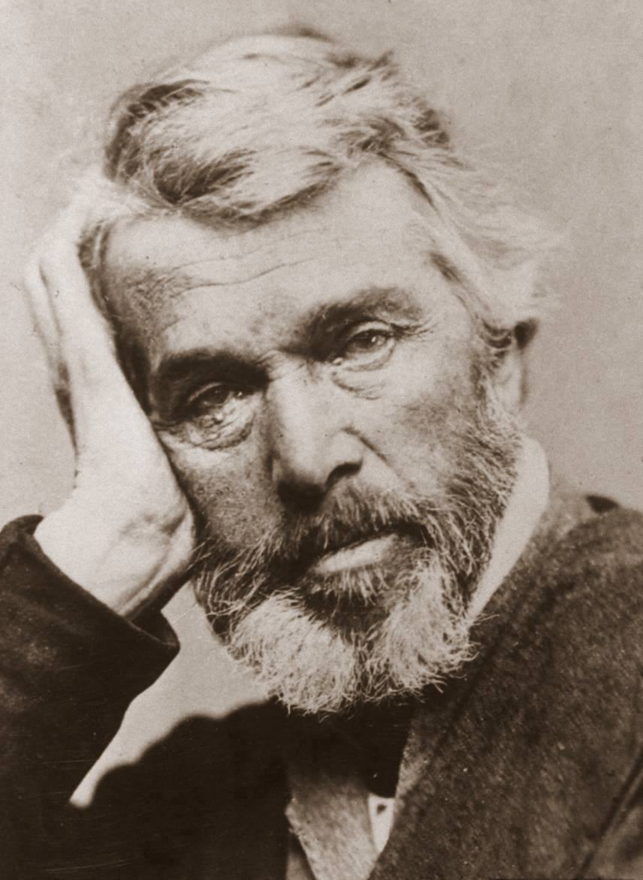
The Fallacy of the Great Man Theory
Who would argue today that Karl Marx has not earned these honors, tributes, and bouquets to his life and work? Well, the one person who would have objected to all the praise and honors is Karl Marx himself. Marx would have expressed caution and reservation about such personalized praise - even from his colleague and co-thinker, Frederick Engels. Marx revealed that in the past the accepted view was that the primary cause for all historic changes was to be found in changing ideas. From this followed the view that individuals - monarchs, feudal lords, statesmen, philosophers, thinkers, politicians - somehow create ideas and then put them into practice. In other words, motivated by personal ambition or desire, love of God and country, etc., great men perform great deeds and thereby make and change history. Marx, of course, was the first to disprove scientifically the concept that history is the product of the whims of individuals. He viewed ideas and thoughts as reflections of the real world -the substance of life's realities- and not the other way around. He said: “With me, on the contrary, the ideal is nothing else than the material world reflected by the human mind, and translated into forms of thought.”
The Great Man Theory is primarily attributed to the Scottish essayist, historian and philosopher Thomas Carlyle

Slide 33
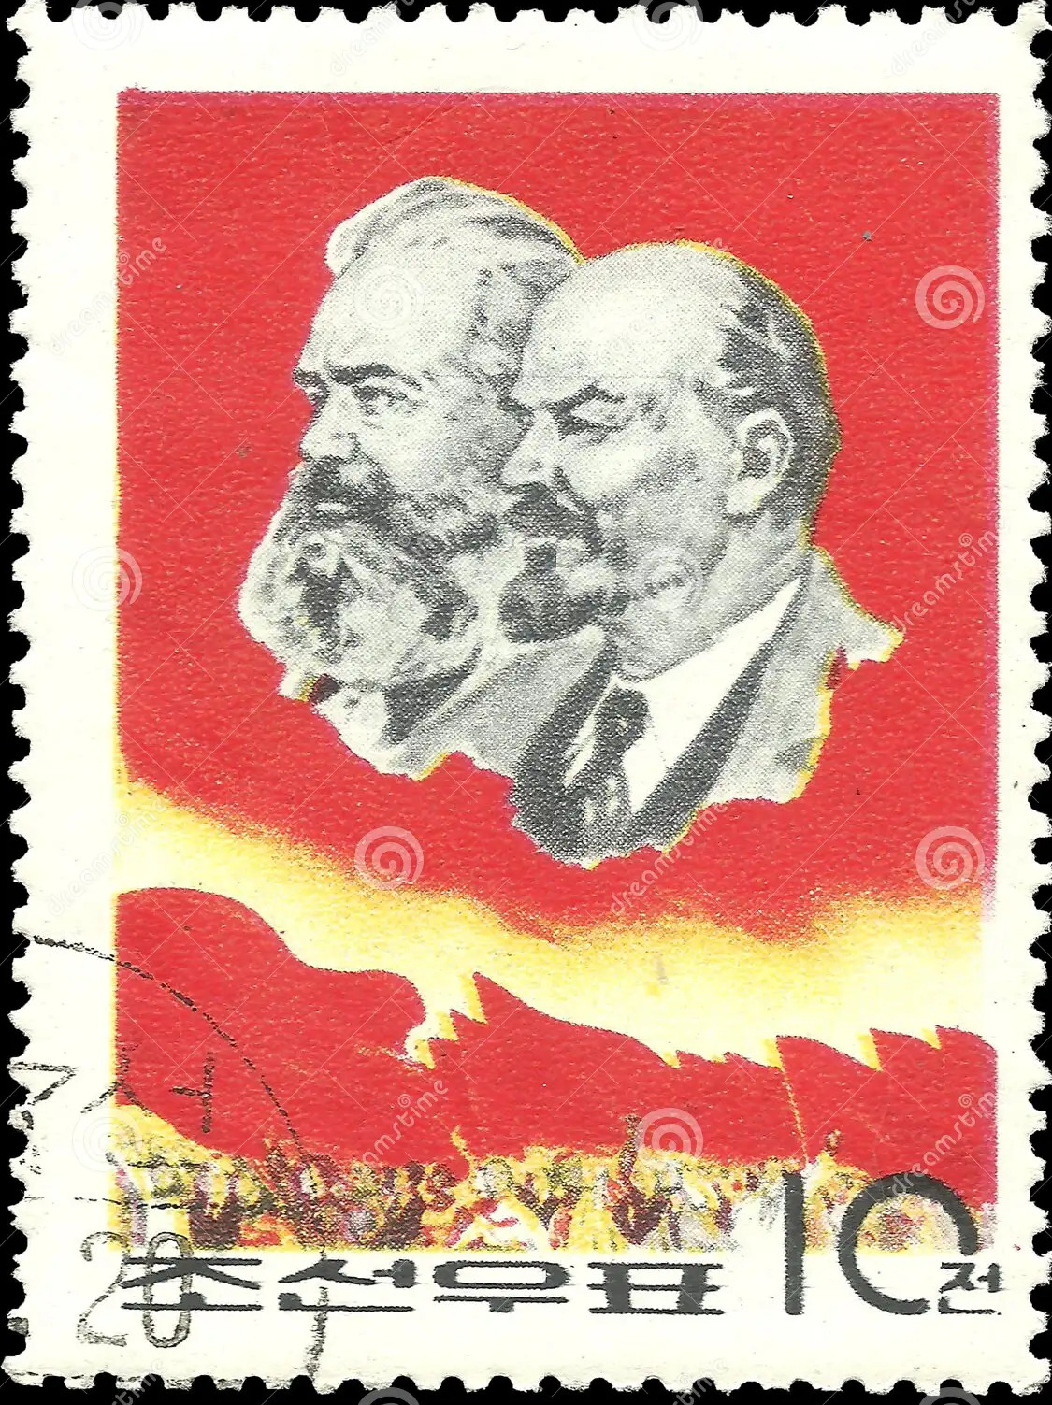
A Guide to Action
Before Marx, all of life, the world and the history of the world were viewed as a big mishmash of events, as incidents and happenings without rhyme or reason. Things happened, events occurred, but there was no sensible explanation for them. Marx made sense out of human society and history. He revealed the orderly, working principles of change. He revealed the inner laws of motion of society and history; that objective laws and order operate in social life, that people can understand and utilize these laws of social development in their own interests. Most important, Marx proved that there is a direction in which history is irrevocably moving and that by knowing the laws of its motions people can act to advance, influence and accelerate the direction. Armed with Marxism-Leninism, the working class influences advances and accelerates the direction of history. Marxism is a guide to action; it charts the course of the working class and peoples of the world. Applying Marx’s conception of society and history, Lenin wrote: “The chaos and arbitrariness that had previously reigned in views on history and politics were replaced by a strikingly integral and harmonious scientific theory, which shows how, in consequence of the growth of productive forces, outofone system of social life another and higher system develops-how capitalism, for instance, grows out of feudalism.”

Slide 34
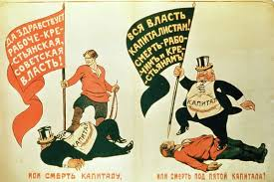
Socialism - “Another and Higher System”
Of course, the capitalist class rejects all concepts of law-governed processes because they expose the brutal, anti-human nature of capitalism and show
that just as capitalism grew out of feudalism, capitalism is now on its way off the stage of history to make way for "another and higher system"-socialism. So you see, Marx’s caution about praising individuals would have come directly from his own work. Marx would have argued that no matter how brilliant his thoughts and contributions, they were not byproducts of his instincts, insights, intuitions, or revelations. They were solid, scientific conclusions based on an intense, exhaustive study of accurate, in-depth observations of reality, society, and the accumulated knowledge of all humanity. His theories, concepts and conclusions were based on the study of the laws – the inner, objective workings present in all things. To find the essence in society one must look for the class and economic interests behind all actions, politics, principles, institutions and policies. Here Marxism comes to a very fundamental question. In order to study the essence of things, in depth and in general, it is necessary to know the laws of motion.
Soviet propaganda poster from 1919, “Either Death to Capitalism, or Death Under the Foot of Capitalism by Deni, Viktor Nikolaevich (1893-1946)

Slide 35
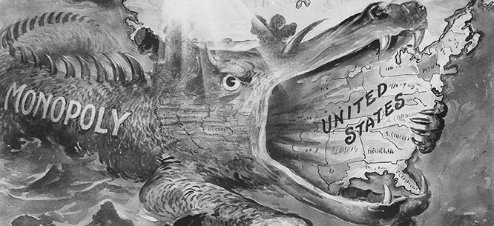
The Advantage of Knowledge and Understanding
A study of the essence, the substance, the essential qualities of things is a study of the laws, a study of how and why all processes develop and change. This is necessary because one cannot really comprehend the essence of anything without some knowledge of its inner laws. To know the laws is to know the present. But even more important, the only way one can gain knowledge about what is coming in the future is to know about the laws that bring about all change. This enables one to predict scientifically. Over one-hundred years ago, based on his knowledge of the laws of capitalist development, Marx saw the inevitable development of big monopolies. And, if you know in advance what's coming, including what your opponent is going to do, you have a big advantage. Today for instance, based on the inner laws of imperialism and monopolies (as revealed by Lenin), we know how U.S. capitalism must operate, must fall into and out of constant crises, must maximize profits, and must ultimately be replaced by socialism. Thus we also know the role of the class that will bring about the revolutionary change to socialism and we have the tools to develop tactics toward this inevitable change. All this knowledge is based on our understanding of the objective laws of motion and social development
(Bettmann / Getty Images)

Slide 36

A Burning Exposé
“Driven by a burning desire to do good,” to struggle against injustice and exploitation, Marx, Engels and Lenin focused their penetrating studies, energies and organizing skills on the human society on the stage of history-capitalism. The three volumes of Capital by Marx and Engels and the volumes by Lenin lay bare the inner, inherent laws, the ugly essence, of capitalism. Capital is a burning exposé of an anti-human, brutal social system based on exploitation of the working class. It is a searing indictment of the law of the drive for maximum private corporate profits. The three volumes of Capital make up a comprehensive handbook on how to fight the inhumanity and injustices of a system motivated solely by the greed of a small capitalist minority. It is Marx and Engels' great gift and legacy to the workers of the world. Because it is absolutely indispensable to the working class, the law of surplus value (or the law of corporate profits) is worth taking a closer look at. Because it exposes the source of corporate profits, thousands of volumes have been written in an attempt to complicate, to distort, to cover up this law.
Karl Marx Antique Das Kapital First Edition

Slide 37
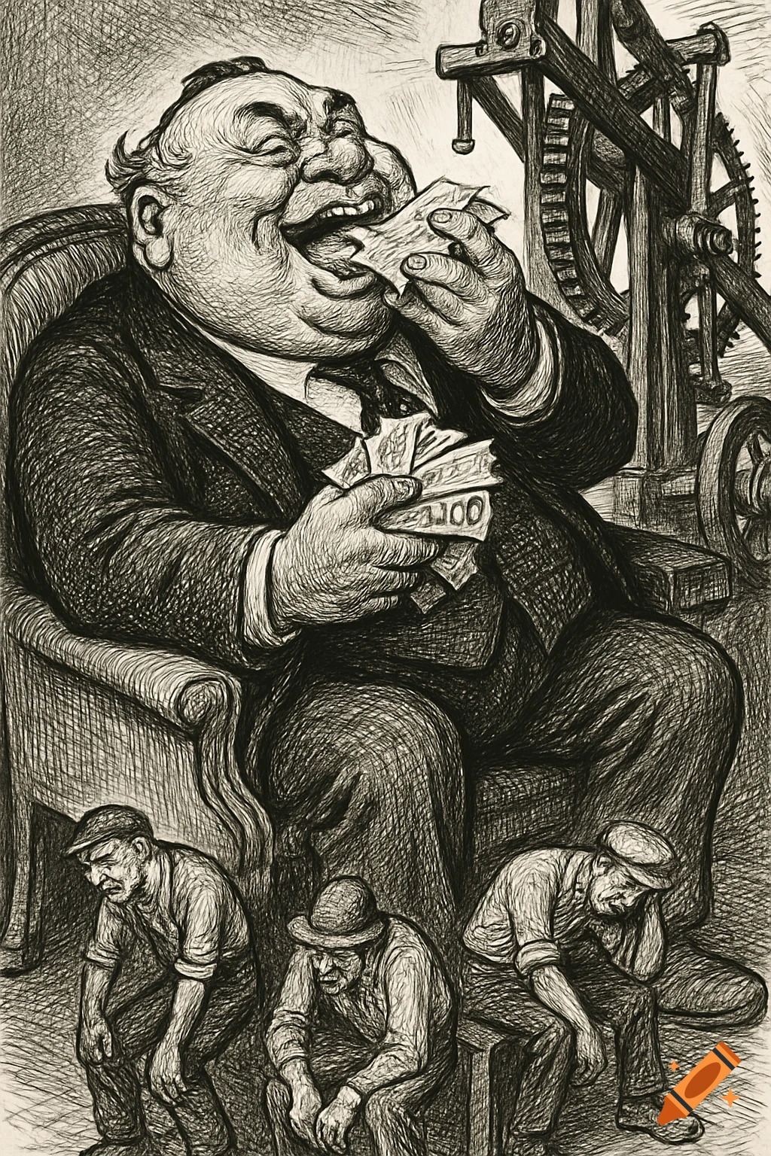
Exposing the Sacred Secret of the Ruling Class
When Marx proved that nothing is added to the value of products in the process of buying and selling and this, therefore, cannot be the source of profits, the question sharply emerged: what then is the source of corporate profits? The exploiting ruling class has never forgiven Marx for exposing forever their most guarded and sacred secret -the source of their ill-begotten wealth. Marx pointed out and scientifically proved that the profits of the capitalists can come only from the labor of the workers they hire to work in their plants and factories. The law of surplus value operates very simply. The corporation pays the workers just enough so that they can continue living and working. The workers never get rich. Their savings are very small. But the workers produce much more than the value of the wages they get. This is the source of all profits. That is how the rich get richer and the workers get poorer. The workers produce all the wealth and the capitalists get wealthy. Well, let us say it requires four hours of labor for the worker to produce what he needs to live and work. However, in most cases the worker works an eight-hour day. Thus, the capitalist uses the worker's labor power (ability to work) for the full eight hours, which means he gets four hours clear profit
from the labor of the worker.

Slide 38
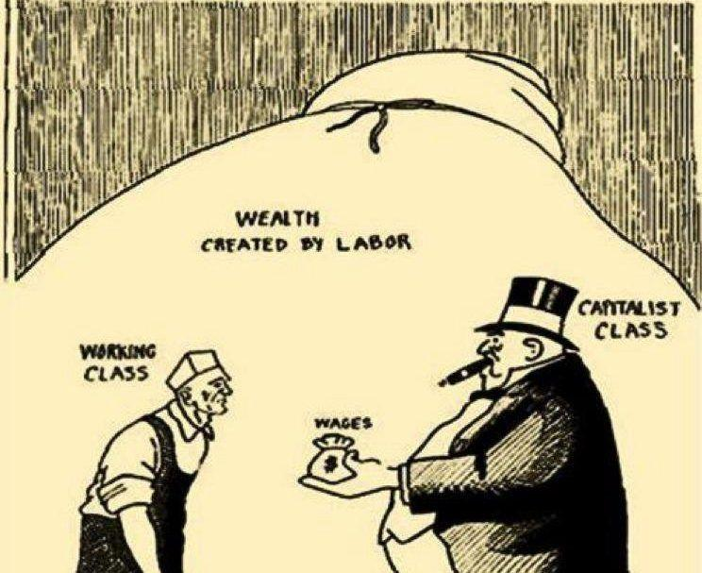
The Power of The Labor Theory of Value
“We can see how important this law is when we translate hours into dollars to measure surplus value or profit. If a worker produces $24 worth of goods in an hour, the value of an hour of labor is $24. If The worker is paid only $8 per hour, the extra going to the boss is $16 and the rate of surplus value or profit is 200%. In terms of hours, if the worker is working 9 hours, he/she is working 3 hours for himself/herself and 6 hours for the boss. Surplus value is, therefore, the gross profit of the capitalist class. It is profit before dividing it up among the stockholders, the banks, landlords and corporate brass. Understanding this key law of where corporate profits come from is critical because U.S. monopoly capitalists have surpassed all other exploiting classes in history in raising the rate of surplus value -in increasing, brutally, the rate of exploitation of labor. As marx said, labor power is a commodity that is “a source not only of value, but of more value than it has itself.”
A Cartoon Depicting the Labor Theory of Value with the Capitalist Class Shown Handing a Worker his Pitiful Wages while the Wealth of Labor is Grandly Depicted in the Background

Slide 39

The Epoch-Making Role of the Working Class
The soaring rate of surplus value in the U.S. and in the countries U.S. imperialism is plundering is the basic cause of declining real wages, declining living standards of the masses of U.S. workers as well as workers laboring under the heel of U.S. Imperialism. They are living proof of the correctness of Marx's statement of the irreconcilability of the interests of capital and labor and the law that "profit rises in the same degree in which wages fall; it falls in the same degree in which wages rise." In uncovering the law of surplus value, Marx also helped to reveal the law of class struggle between the capitalists and the workers, which gives the ultimate lie to all class-collaboration concepts. The ultimate truth inherent in these laws made it possible for Marx and Engels to develop the theory of scientific socialism. They proved that far from being utopian or a fantasy, socialism is the natural
outcome of the development of capitalist society. They showed that as capitalism develops, it digs its own grave. They brought to light the epoch-making role of the working class and drew the logical conclusion that the road to the new society lies in overthrowing capitalism.
May 1st vintage propaganda poster Soviet Union 1921

Slide 40
Discussion

Slide 41
Karl Marx in Our Time

Slide 42
Karl Marx in Our Time
Today, in 2026, Marx is just as relevant as he was in the nineteenth century. As example of this, the following slides of this section will be the entirety of Gus Hall’s The American way to Bill of Rights socialism, a Marxist view of the Bill of Rights.

Slide 43
The American way to Bill of Rights socialism
We Communists believe that socialism is the very best replacement for a capitalist system that has served its purpose but no longer meets the needs and requirements of the great majority of our people.
We believe that Socialism USA will be built according to the traditions, history, culture and conditions of the United States. Thus, it will be different than any other socialist society in the world. It will be uniquely American.
What will be the goals of our socialist society?
  A life free of exploitation, insecurity, deprivation; an end to unemployment, hunger and homelessness.

Slide 44
The American way to Bill of Rights socialism
What will be the goals of our socialist society?
  An end to racism, national oppression, anti-Semitism; of all forms of discrimination, prejudice and bigotry. An end to the unequal status of women.
  Renewal and extension of democracy; an end to the rule of corporate America and the private ownership of the wealth of our nation. Creation of a truly humane and rationally-planned society that will stimulate the fullest flowering of the personality, creativity and talent of the individual.
The advocates and ideologues of capitalism hold that such goals are utopian; that human beings are inherently greedy and selfish. Others argue that these goals can be fully realized under capitalism.

Slide 45
Why socialism?
We are confident, however, that such goals can be realized — but only in a socialist society.
Since its inception capitalism has been fatally flawed. Its inherent laws — to maximize profit on the backs of the working class — gives rise to the class struggle.
History is a continuous story of people rising up against those who exploit and oppress them to demand what is theirs. Our country’s historic beginning was revolutionary. The ideals of justice and equality have inspired people for centuries.

Slide 46
Why socialism?
Up until the time of Karl Marx, those who advocated socialism were “utopians,” that is, motivated by ideals only. It was Marx and his friend and collaborator, Frederick Engels, who uncovered the inner laws of capitalism — where profit comes from and how societies develop. Marx and Engels transformed wishful thinking for socialism into socialism with a scientific, materialist basis.
Communists say that capitalism won’t be around forever, just like previous societies weren’t around forever either. Slavery gave rise to feudalism and feudalism to capitalism. So, too, capitalism gives rise to socialism.

Slide 47
Why socialism?
A socialist government draws up plans covering the entire economy. They are drawn up with maximum participation of the people, from the shop level on up. Such plans harmonize the interests of all, because there are no conflicts arising from exploitation of workers and the dog-eat-dog competition of capitalism.
A socialist government is based on all-around democracy, starting with economic democracy. The more people participate in running their own economy, the more firmly people’s power is established, the more successful a socialist America will be.

Slide 48
Why socialism?
Trade unions in a socialist USA will insure a fair balance between what workers produce and what they receive. They will have decisive power to enforce safety and health provisions, prevent speedup, guarantee good transportation, working conditions and plant facilities.
Public services — schools, hospitals, utilities, transit, hospitals, parks, roads — are crumbling under capitalism. Under socialism public services will be updated and vastly expanded. They will be broadened in their scope beyond anything dreamed of under capitalism.
The U.S. will become a vast construction site. Homes, schools, hospitals, places of recreation will be built to end shortages, replace substandard infrastructures and public facilities.

Slide 49
Why socialism?
Full employment will be quickly achieved as production is expanded to satisfy the needs of people. Automation at the service of the working people will lead to both reduced hours of work and higher living standards. There will be no danger of overproduction since production will be planned and people’s incomes will increase in line with the rising output of consumer goods and services.
Poverty will be ended quickly, with the recovery of the vast resources now wasted in war production, advertising and the extravagant lifestyles of the filthy rich.
All education will be tuition-free. Every person will have access to medical and health care without charge. These rights will be realized as rapidly as facilities can be built and the personnel trained.

Slide 50
Why socialism?
With capitalism gone, organized crime will also go, for it is the vicious profit system that corrupts people and breeds crime.
Some ask whether guaranteeing basic necessities, free education and health care will encourage people to avoid working, or doing one’s best. The principle of socialism is: From each according to his/her ability, to each according to his/her work.
Socialism provides incentives for working better, producing more and higher quality goods, acquiring advanced skill. It does not equalize wages. Wages vary according to occupation and efficiency, although everyone is guaranteed a livable wage.

Slide 51
Why socialism?
Under capitalism, improvements in skill, organization and technology are rightly feared by workers because they threaten jobs. Under socialism, they offer the chance to make the job more interesting and rewarding, as well as to improve the living standard.
Socialism provides moral incentives because the fruits of labor benefit all. No person robs others of the fruits of their labor. When social goals are adopted by the majority, people will want to work for these goals. Work will be less a burden, more and more a creative activity, where everyone is his or her neighbor’s helper, instead of rival.

Slide 52
Why socialism?
It is true socialism will nationalize or socialize all large-scale production, property and real estate. But socialism does not require abolition of all privately owned businesses. It does not require nationalization of those small businesses owned by people who work for themselves and do not hire others to make a profit. Personal property — private homes and automobiles — will remain just that, personal property.
In highly mechanized U.S. agriculture there will still be a place for the family farmer. But the farm family will be relieved of the pressure of trying to compete with agribusiness monopolies.

Slide 53
Socialism USA
There will be rapid elimination of racial and national oppression. Socialism will bring complete equality for all racially and nationally oppressed. There will be no compromise with racism, for there will no longer exist a capitalist class which profits from it. Racism, national oppression, anti-Semitism, sexism, anti-immigrant discrimination and all forms of prejudice and bigotry will be banned by law, with strict measures of enforcement.
Affirmative action will be greatly expanded immediately to begin to undo — to make up for — hundreds of years of the ravages of racism. Full equality will be one of the main priorities of the new society.
The only privileged sectors will be the children, our future, and seniors, who have earned the right to a healthy, carefree and secure retirement.

Slide 54
Socialism USA
Socialism provides the economic foundation for effective democracy for the masses of people. To carry through the economic and social transformation requires political rule by the working class — a government of, by and for the working people.
Socialism USA will benefit from the experiences, the mistakes and successes of the countries who built and are building socialism. But mainly it will reflect the distinctive features of U.S. development and our specific environment.
Unique historical advantages, like the unequaled natural resources, fertile soil and perfect weather, coupled with the contributions of generations of working people, enabled U.S. capitalism to achieve higher productive levels and living standards than capitalism in other countries.

Slide 55
Socialism USA
The development of socialism here will have some other distinct advantages:
Free from the threat of foreign intervention, Socialism USA will not have to divert human and economic resources to defend itself.
Socialism USA will avoid the terrible problems of extreme poverty, illiteracy, civil wars, wars of intervention and world wars that the Soviet Union had to deal with.
Socialism USA will extend democracy to its fullest, taking as its starting point the democratic traditions and institutions of the American people.

Slide 56
Path to socialism
We say that it may be possible in the U.S. to bring socialism through peaceful means. Perhaps through the ballot box. One thing is clear: there won’t be socialism in the U.S. until the majority of the American people want it.
I like to say that when workers enter the corporate boardrooms to take over and the ruling class says something like: “Okay, you’re right, we made a mess of things and now you should run it all.” Well, then there won’t be any trouble.
But if the ruling class says: “Forget it!” and calls out the army, the police and the National Guard, that is how revolutions become violent. It starts with the ruling class. Workers and their allies have to defend themselves to fight for what is rightfully theirs.

Slide 57
Path to socialism
We believe and advocate a socialist society in our country that will guarantee all the liberties defined in the Bill of Rights, but have never been fully realized. These include the right of people to express themselves fully and freely through organizations of their choice and competing candidates who respect and are guided by the concept of building socialism.
Indeed, the freedoms in the Bill of Rights will take on far greater meaning for the great majority, who will then own the meeting halls, press, radio and TV, and will be able to exercise that freedom effectively.

Slide 58
Path to socialism
That’s why we call ours “Bill of Rights Socialism USA.” Socialism is our vision for America’s future. It is a vision we are winning more and more people to because it is the logical – really a great – replacement for capitalism. And, because it is the next inevitable step up the ladder of human civilization.

Slide 59
Discussion & Wrap Up

Slide 60
Announcements
PCUSA Cell Chairs need to call members of their cells to remind them about attendance.
The next issue of New Masses (2026) has begun production. If you have art you want us to feature, email it to info@partyofcommunistsusa.net.

Slide 61
Volunteers Needed!
We are in need of volunteers for the staff of the People’s School! Here’s a few roles we need filled:
People to help manage posting on our social media and podcast platforms
Video Editors, Audio Editors, Graphic Designers, Artists, Narrators
Web Controls, Moderators
Email info@peoplesschool.us if you’re interested and try to attend our next staff meeting if possible.

Slide 62

View From Left Field
https://viewfromleftfield.libsyn.com
The Old PSMLS Youtube is now the Youtube of View From Left Field, a podcast of analysis and discussion of current events from a progressive perspective.
Like the Youtube videos and subscribe with 5 star ratings on your podcast platforms.

Slide 63

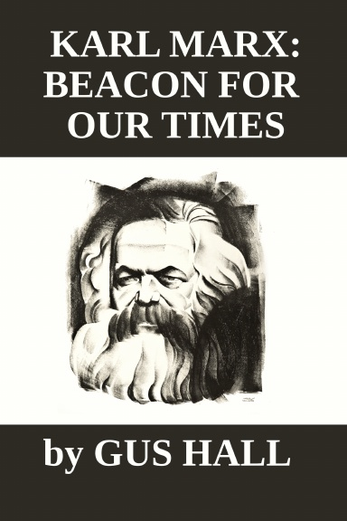



New Outlook Publishers
newoutlookpublishers.store
Relevant and Latest Releases

Slide 64



Harry Bridges School of Labor
luel.us/laborschool/
The Harry Bridges School of Labor is a monthly class covering a variety of topics aimed at building class consciousness among union members. For class schedule and other information, please visit the website at luel.us/laborschool.

Slide 65


