Slide 1

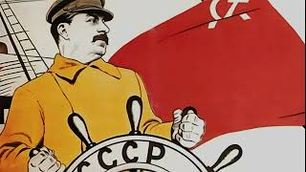
The Internationale

Slide 2
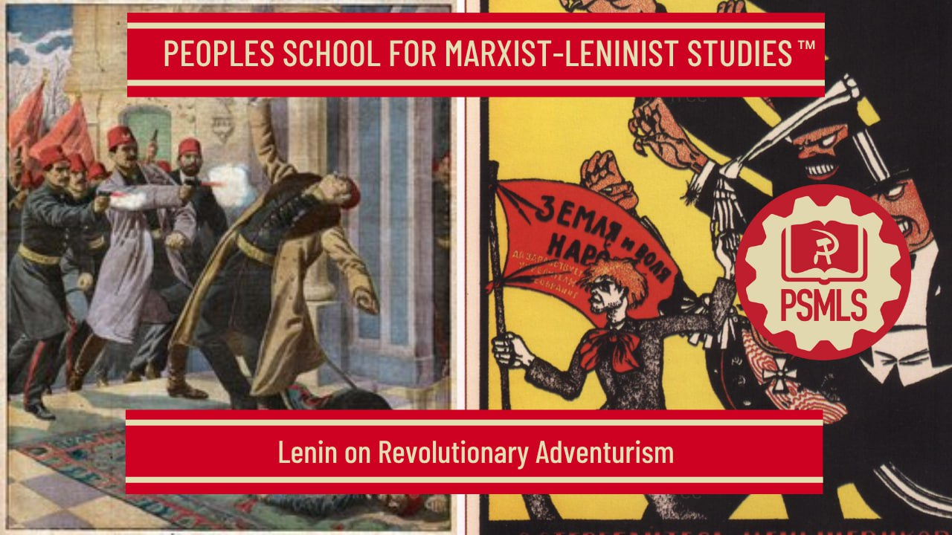

PSMLS 6/2/2025

Slide 3
What we’ll be learning today:
Lenin on Revolutionary Adventurism
How the Socialist-Revolutionaries Sum Up the Revolution
Revolutionary Adventurism Today

Slide 4
Lenin on Revolutionary Adventurism

Slide 5
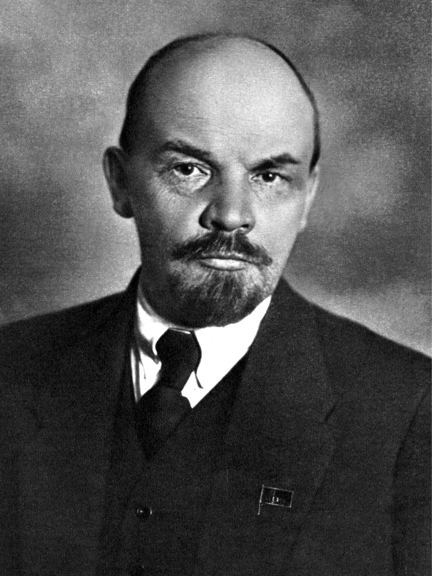
Lenin on Times and Trends
We are living in stormy times, when Russia (and the US today)’s history is marching on with seven-league strides, and every year sometimes signifies more than decades of tranquillity. Results of the half-century of the post-Reform period are being summed up, and the corner-stone is being laid for social and political edifices which will determine the fate of the entire country for many, many years to come. The revolutionary movement continues to grow with amazing rapidity—and “our trends” are ripening (and withering) uncommonly fast. Trends firmly rooted in the class system of such a rapidly developing capitalist country as Russia almost immediately reach their own level and feel their way to the classes they are related to.

Slide 6
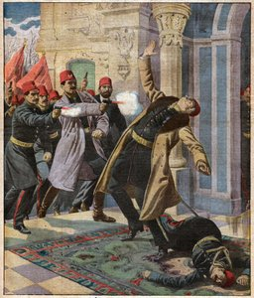
The True Face of the SRs (ultra-left)
Three circumstances have served most to disclose the true face of the Socialist-Revolutionaries. These are, first, the split between the revolutionary Social-Democrats and the opportunists, who are raising their heads under the banner of the “criticism of Marxism.” Secondly, Balmashov’s assassination of Sipyagin (or more recent events) and the new swing towards terrorism in the sentiments of some revolutionaries. Thirdly and mainly, the latest movement among the peasantry, which has compelled such that are accustomed to sit between two stools and have no programme whatever to come out post factum with some semblance of a programme.
Depiction of Assassination of Sipyagin

Slide 7
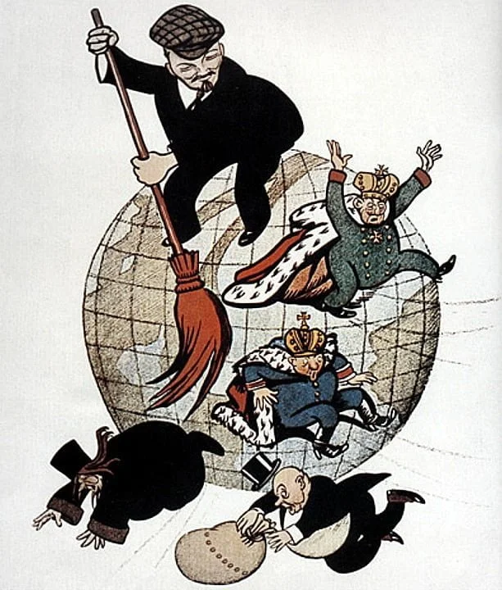
Lenin on the SRs
In our opinion, the crisis of socialism makes it incumbent upon any in the least serious socialists to devote redoubled attention to theory—to adopt more resolutely a strictly definite stand, to draw a sharper line of demarcation between themselves and wavering and unreliable elements. In the opinion of the Socialist-Revolutionaries, however, if such things as confusion and splits are possible “even among Germans,” then it is God’s will that we, Russians, should pride ourselves on our ignorance of whither we are drifting. In our opinion, the absence of theory deprives a revolutionary trend of the right to existence and inevitably condemns it, sooner or later, to political bankruptcy. In the opinion of the Socialist-Revolutionaries, however, the absence of theory is a most excellent thing, most favourable “for unity.”

Slide 8
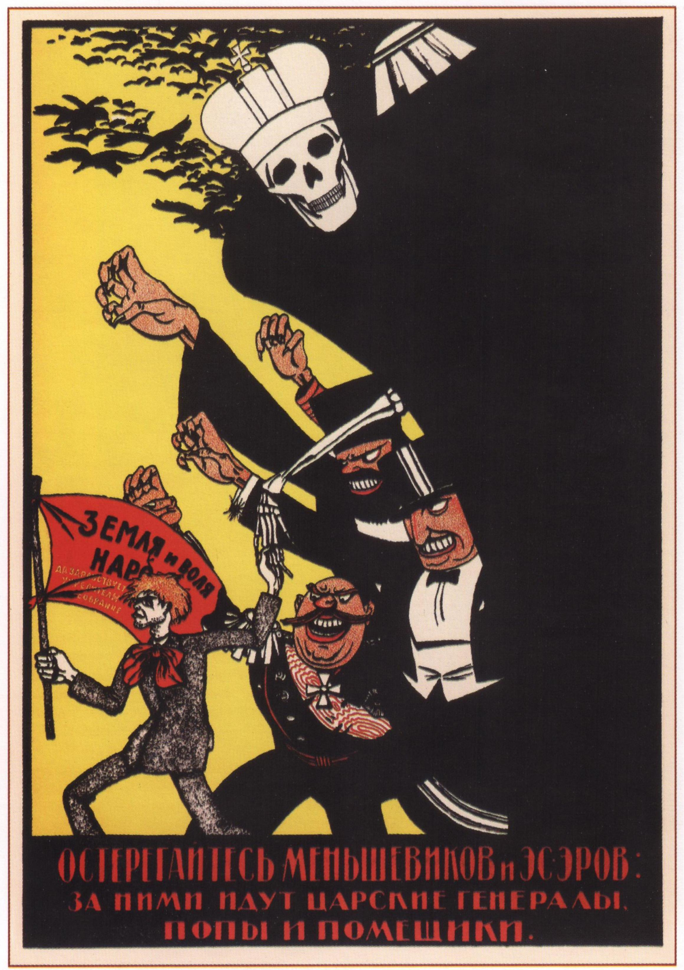
On Socialist-Revolutionaries and Terrorism
In their defence of terrorism, which the experience of the Russian revolutionary movement has so clearly proved to be ineffective, the Socialist-Revolutionaries are talking themselves blue in the face in asseverating that they recognise terrorism only in conjunction with work among the masses, and that therefore the arguments used by the Russian Social-Democrats to refute the efficacy of this method of struggle (and which have indeed been refuted for a long time to come) do not apply to them. Here something very similar to their attitude towards “criticism” is repeating itself.
Bolshevik Poster Depicting SRs as proxies of Counter-Revolution.

Slide 9
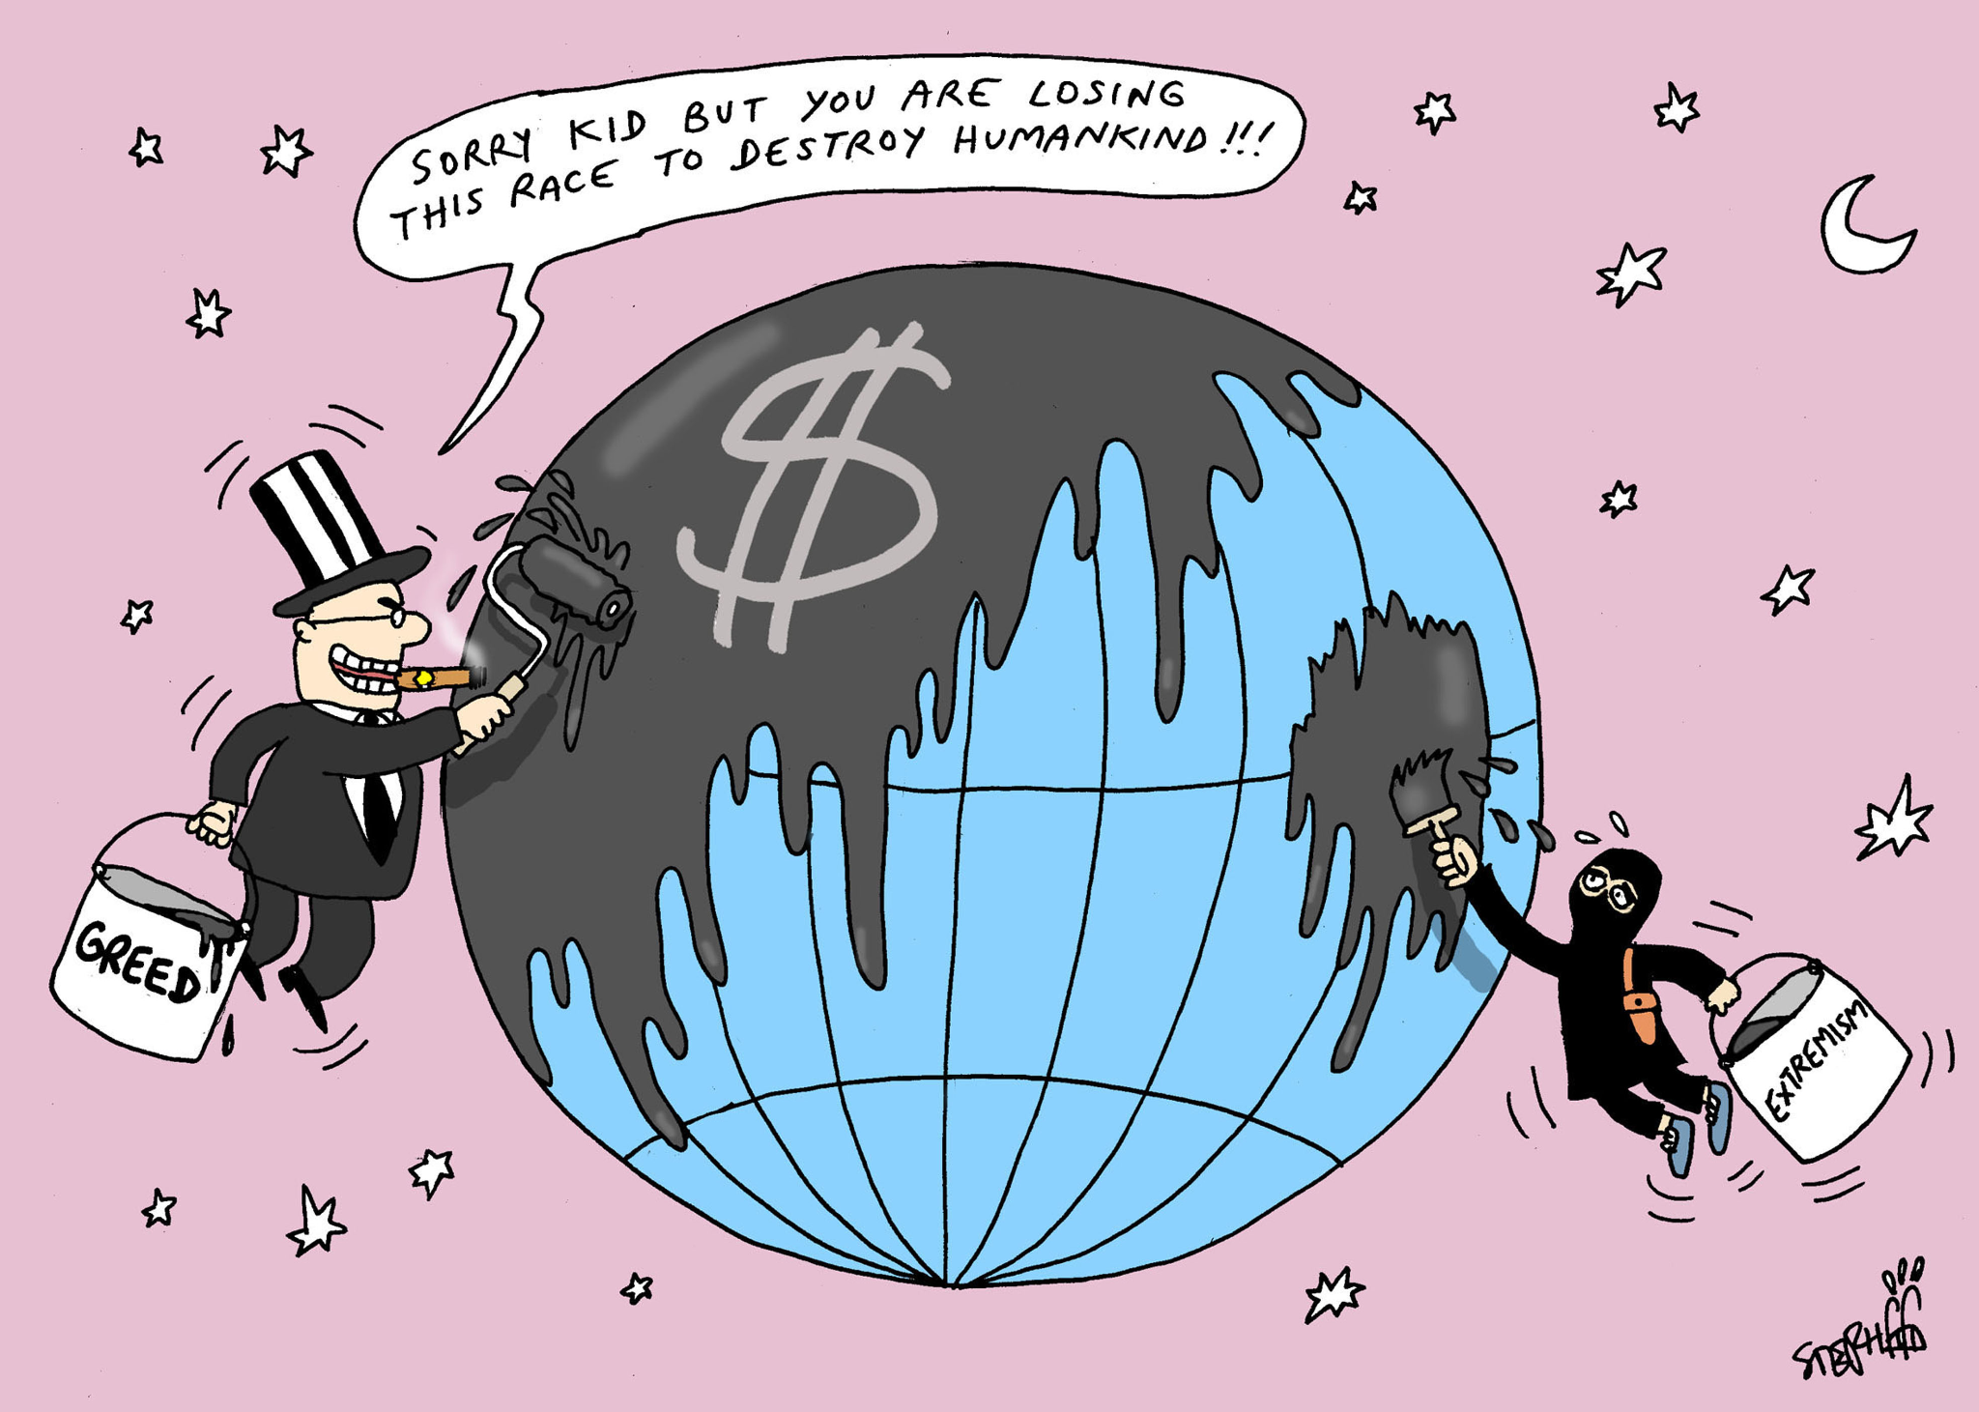
The Socialist-Revolutionaries and Opportunism
We are not opportunists, cry the Socialist-Revolutionaries, and at the same time they are shelving the dogma of proletarian socialism, for reason of sheer opportunist criticism and no other. We are not repeating the terrorists’ mistakes and are not diverting attention from work among the masses, the Socialist-Revolutionaries assure us, and at the same time enthusiastically recommend to the Party acts such as Balmashov’s assassination of Sipyagin, although everyone knows and sees perfectly well that this act was in no way connected with the masses and, moreover, could not have been by reason of the very way in which it was carried out—that the persons who committed this terrorist act neither counted on nor hoped for any definite action or support on the part of the masses.

Slide 10
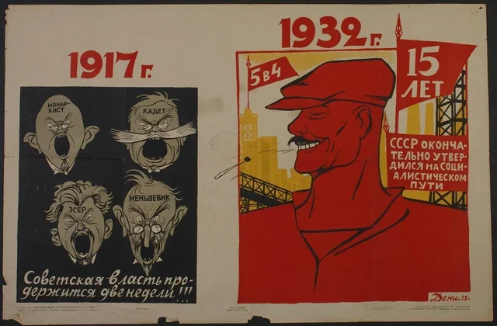
Terrorism vs. Work among the Masses
In their naïveté, the Socialist-Revolutionaries do not realise that their predilection for terrorism is causally most intimately linked with the fact that, from the very outset, they have always kept, and still keep, aloof from the working-class movement, without even attempting to become a party of the revolutionary class which is waging its class struggle. Over-ardent protestations very often lead one to doubt and suspect the worth of whatever it is that requires such strong seasoning. Do not these protestations weary them?—I often think of these words, when I read assurances by the Socialist-Revolutionaries: “by terrorism we are not relegating work among the masses into the background.”After all, these assurances come from the very people who have already drifted away from the Social-Democratic labour movement, which really rouses the masses; they come from people who are continuing to drift away from this movement, clutching at fragments of any kind of theory.
Celebrating success of the 5 year plan and 15 years with Mensheviks, monarchists, Cadets, and SRs on the left.

Slide 11

Terrorism vs. Work in the Masses
The first thing that strikes the eye is the words: “we advocate terrorism, not in place of work among the masses, but precisely for and simultaneously with that work.” They strike the eye particularly because these words are printed in letters three times as large as the rest of the text (a device that is of course repeated by Revolutsionnaya Rossiya). It is all really so simple! One has only to set “not in place of, but together with” in bold type—and all the arguments of the Social-Democrats, all that history has taught, will fall to the ground.

Slide 12
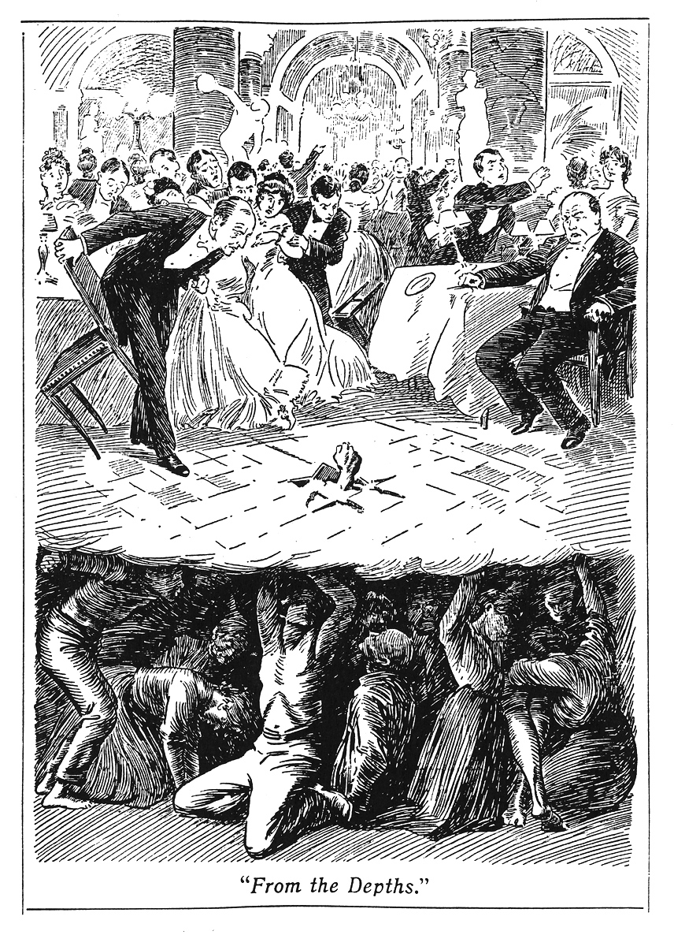
Alas, alas!
But just read the whole leaflet and you will see that the protestation in bold type takes the name of the masses in vain. The day “when the working people will emerge from the shadows” and “the mighty popular wave will shatter the iron gates to smithereens”—“alas!” (literally, “alas!”) “is still a long way off, and it is frightful to think of the future toll of victims!” Do not these words “alas, still a long way off” reflect an utter failure to understand the mass movement and a lack of faith in it? Is not this argument meant as a deliberate sneer at the fact that the working people are already beginning to rise?

Slide 13
Who to strike down??
The real thing is yet to come. “Whom are we to strike down?” asks the party of the Socialist-Revolutionaries, and replies: the ministers, and not the tsar, for “the tsar will not allow matters to go to extremes” (!! How did they find that out??), and besides “it is also easier” (this is literally what they say!): “No minister can ensconce himself in a palace as in a fortress.” And this argument concludes with the following piece of reasoning, which deserves to be immortalised as a model of the “theory” of the Socialist-Revolutionaries. “Against the crowd the autocracy has its soldiers; against the revolutionary organisations its secret and uniformed police; but what will save it…” (what kind of “it” is this? The autocracy? The author has unwittingly identified the autocracy with a target in the person of a minister whom it is easier to strike down!) “… from individuals or small groups that are ceaselessly, and even in ignorance of one another [!!], preparing for attack, and are attacking?”

Slide 14
SRs lag behind the masses and tail them.
Because of the extremely rapid growth of the movement, the leaders lagged behind the masses, the revolutionary organisations did not come up to the level of the revolutionary activity of the proletariat, were incapable of marching on in front and leading the masses. That a discrepancy of this sort exists cannot be doubted by any conscientious person who has even the slightest acquaintance with the movement. And if that is so, it is evident that the present-day terrorists are really “economists” turned inside out, going to the equally foolish but opposite extreme. At a time when the revolutionaries are short of the forces and means to lead the masses, who are already rising, an appeal to resort to such terrorist acts as the organisation of attempts on the lives of ministers by individuals and groups that are not known to one another means, not only thereby breaking off work among the masses, but also introducing downright disorganisation into that work.

Slide 15
The work of the Socialist-Revolutionaries
Nor does the leaflet eschew the theory of excitative terrorism. “Each time a hero engages in single combat, this arouses in us all a spirit of struggle and courage,” we are told. But we know from the past and see in the present that only new forms of the mass movement or the awakening of new sections of the masses to independent struggle really rouses a spirit of struggle and courage in all. Single combat however, inasmuch as it remains single combat waged by the Balmashovs, has the immediate effect of simply creating a short-lived sensation, while indirectly it even leads to apathy and passive waiting for the next bout. We are further assured that “every flash of terrorism lights up the mind,” which, unfortunately, we have not noticed to be the case with the terrorism-preaching party of the Socialist-Revolutionaries. We are presented with the theory of big work and petty work. “Let not those who have greater strength, greater opportunities and resolution rest content with petty [!] work; let them find and devote themselves to a big cause—the propaganda of terrorism among the masses [!l, the preparation of the intricate… [the theory of elusiveness is already forgotten!]… terrorist ventures.” How amazingly clever this is in all truth: to sacrifice the Life of a revolutionary for the sake of wreaking vengeance on the scoundrel Sipyagin, who is then replaced by the scoundrel Plehve—that is big work.

Slide 16
What Must be Done
The Social-Democrats will always warn against adventurism and ruthlessly expose illusions which inevitably end in complete disappointment. We must bear in mind that a revolutionary party is worthy of its name only when it guides [sic.] in deed the movement of a revolutionary class. We must bear in mind that any popular movement assumes an infinite variety of forms, is constantly developing new forms and discarding the old, and effecting modifications or new combinations of old and new forms. It is our duty to participate actively in this process of working out means and methods of struggle. When the students’ movement became sharper, we began to call on the workers to come to the aid of the students without taking it upon ourselves to forecast the forms of the demonstrations, without promising that they would result in an immediate transference of strength, in lighting up the mind, or a special elusiveness.

Slide 17
Discussion

Slide 18
Lenin on Revolutionary Adventurism Part 2

Slide 19
Marxism or Vulgar Socialism
We begin this section with a summarization of part 2 of the pamphlet covered in the first section of this class: Revolutionary Adventurism by V. I. Lenin
The Socialist-Revolutionaries’ attitude to the peasant movement is of particular interest. It is precisely in the agrarian question that representatives of the old Russian socialism, their liberal-Narodnik descendants, and also adherents of opportunist criticism who are so numerous in Russia and so vociferously pass assurances that on this score Marxism has already been conclusively disproved by the “critics,” have always considered themselves especially strong. Our Socialist-Revolutionaries too are tearing Marxism to shreds, so to speak: “dogmatic prejudices... outlived dogmas long since refuted by life... the revolutionary intelligentsia has shut its eyes to the countryside, revolutionary work among the peasantry was forbidden by orthodoxy,” and much else in this vein. It is the current fashion to kick out at orthodoxy.

Slide 20
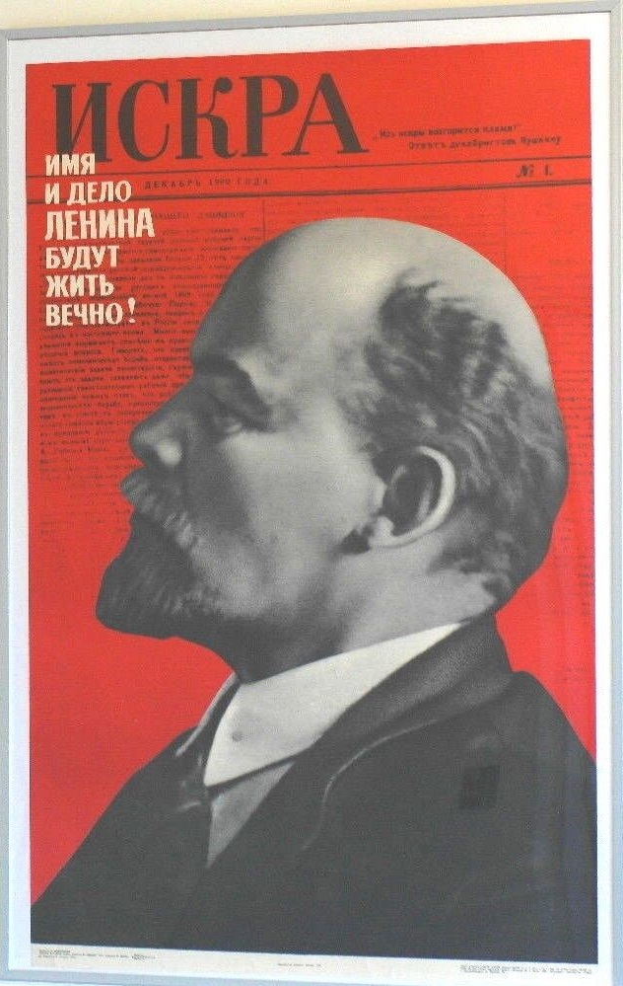
Empty Rhetoric and Freedom From Theory
We have seen that the Socialist-Revolutionaries’ greatest “advantage” lies in their freedom from theory; their greatest skill consists in their ability to speak without saying anything. But in order to present a programme, one must nevertheless say something. It is necessary, for instance, to throw overboard the “dogma of the Russian Social-Democrats of the late eighties and early nineties to the effect that there is no revolutionary force save the urban proletariat.” What a handy little word “dogma” is! One need only slightly twist an opposing theory, cover up this twist with the bogy of “dogma”—and there you are!
Notes:
A poster of the Newspaper "Iskra" Nr. 1 with a photo of Lenin and the words "The Word and the work of Lenin will last forever." This pamphlet was published in Iskra no.23 and no.24 in 1902.

Slide 21
A Hopeless Confusion of Concepts
Beginning with the Communist Manifesto, all modern socialism rests on the indisputable truth that the proletariat alone is a really revolutionary class in capitalist society. The other classes may and do become revolutionary only in part and only under certain conditions. What, then, must one think of people who have “transformed” this truth into a dogma of the Russian Social-Democrats of a definite period and who try to convince the naive reader that this dogma was “based entirely on the belief that open political struggle lay far in the future”? To counter Marx’s doctrine that there is only one really revolutionary class in modern society, the Socialist-Revolutionaries advance the trinity: “the intelligentsia, the proletariat, and the peasantry,” thereby revealing a hopeless confusion of concepts. If one sets the intelligentsia against the proletariat and the peasantry it means that one considers the former a definite social stratum, a group of persons occupying just as definite a social position as is occupied by the wage-workers and the peasants. But as such a stratum the Russian intelligentsia is precisely a bourgeois and petty-bourgeois intelligentsia.

Slide 22
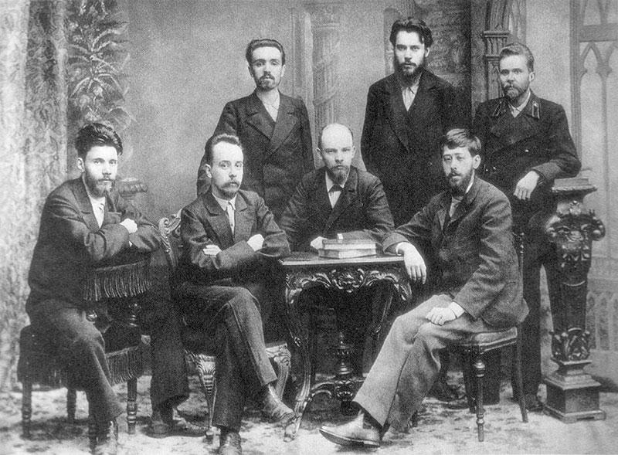
Adventurous Intellectuals or Proletarian-Aligned Intelligentsia
However, if one is referring to those intellectuals who have not yet taken any definite social stand, or have already been thrown off their normal stand by the facts of life, and are passing over to the side of the proletariat, then it is altogether absurd to contrapose this intelligentsia to the proletariat. Like any other class in modern society, the proletariat is not only advancing intellectuals from its own midst, but also accepts into its ranks supporters from the midst of all and sundry educated people. The campaign of the Socialist-Revolutionaries against the basic “dogma” of Marxism is merely additional proof that the entire strength of this party is represented by the handful of Russian intellectuals who have broken away from the old, but have not yet adhered to the new.
A Photograph of a young Lenin (Center), Martov (to Lenin’s left), and other intellectuals taken after a meeting of the League of Struggle for the Emancipation of the Working Class

Slide 23
The Good Old Methods of Vulgar Socialism
The Socialist-Revolutionaries have kept themselves pure of the baneful influence of modern socialist doctrines. They have fully preserved the good old methods of vulgar socialism. We are confronted by a new historical fact, a new movement among a certain section of the people. They do not examine the condition of this section or set themselves the aim of explaining its movement by the nature of that section and its relation to the developing economic structure of society as a whole. To them, all this is an empty dogma, outlived orthodoxy. They do things more simply: what is it that the representatives of the rising section themselves are speaking about? Land, additional allotments, redistribution of the land. There it is in a nutshell. You have a “semi-socialist programme,” “a thoroughly correct principle,” “a bright idea,” “an ideal which already lives in the peasant’s mind in embryo form,” etc. All that is necessary is to “brush up and elaborate this ideal,” bring out the “pure idea of socialism.” You find this hard to believe, reader? It seems incredible to you that this Narodnik junk should again be dragged into the light of day by people who so glibly repeat whatever the latest book may tell them? And yet this is a fact.

Slide 24

The Ultimate Aim
Let the agrarian programme of the Socialist-Revolutionaries serve as a lesson and a warning to all socialists, a glaring example of what results from an absence of ideology and principles, which some unthinking people call freedom from dogma. When it came to action, the Socialist-Revolutionaries did not reveal even a single of the three conditions essential for the elaboration of a consistent socialist programme: a clear idea of the ultimate aim; a correct understanding of the path leading to that aim; an accurate conception of the true state of affairs at the given moment or of the immediate tasks of that moment. Compare this with Iskra’s programme, which indicates to the entire militant proletariat one ultimate aim, without reducing it to a “minimum,” without debasing it so as to adapt it to the ideas of certain backward sections of the proletariat or of the small producers.

Slide 25
The Characteristics of Adventurism: Continued
In this segment of our presentation we will read Lenin’s article Adventurism published in Rabochy (The Worker) No. 7, June 9, 1914.
When Marxists say that certain groups, are adventurist, they have in mind the very definite and specific social and historical features of a phenomenon, one that every class-conscious worker should be familiar with.
The history of Russian Social-Democracy teems with tiny groups, which sprang up for an hour, for several months, with no roots whatever among the masses (and politics without the masses are adventurist politics), and with no serious and stable principles. In a petty-bourgeois country, which is passing through a historical period of bourgeois reconstruction, it is inevitable that a motley assortment of intellectuals should join the workers, and that these intellectuals should attempt to form all kinds of groups, adventurist in character in the sense referred to above.

Slide 26
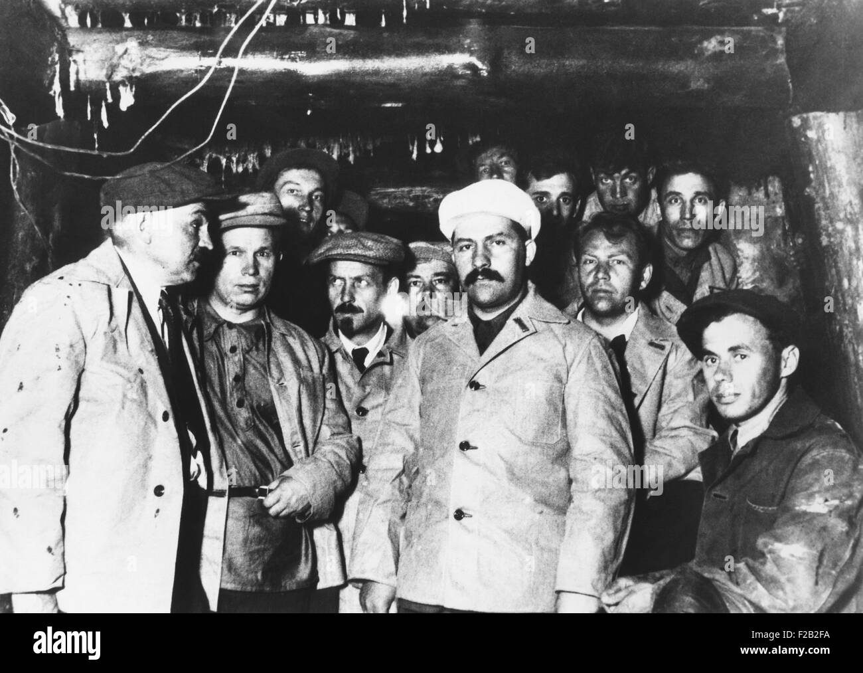
Put No Faith in Words
Workers who do not wish to be fooled should subject every group to the closest scrutiny and ascertain how serious its principles are, and what roots it has in the masses. Put no faith in words; subject everything to the closest scrutiny—such is the motto of the Marxist workers. Let us recall the struggle between Iskrism and Economism in 1895–1902. These were two trends of Social-Democratic thought. One of them was proletarian and Marxist, which had stood the test of the three years’ campaign conducted by Iskra, and been tested by all advanced workers, who recognised as their own the precisely and clearly formulated decisions on Iskrist tactics and organisation. The other, Economism, was a bourgeois, opportunist trend, which strove to subordinate the workers to the liberals.
Soviet workers building the Moscow subway are visited by Communist Party leaders. March 26, 1934

Slide 27
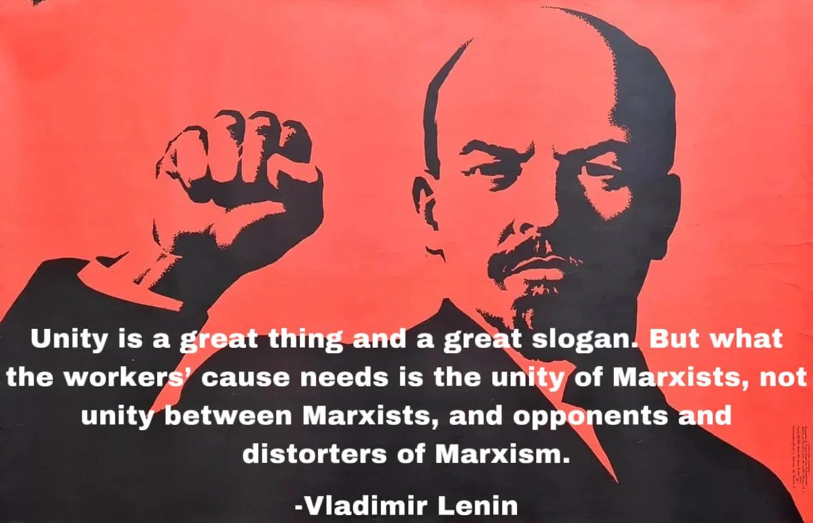
Putting Phrases to the Test of Facts
Besides these two important trends, there were a host of small and rootless groups. These have long been forgotten. Though there were no few honest and conscientious Social-Democrats in these groups, they proved adventurist in the sense that they had no stable or serious principles, programme, tactics, organisation, and no roots among the masses.
It is thus, and only thus—by studying the history of the movement, by pondering over the ideological significance of definite theories, and by putting phrases to the test of facts—that serious people should appraise present-day trends and groups.
Only simpletons put faith in words.
A Quote from Lenin in his Article Entitled Unity published in Put Pravdy (The Way of Truth) No. 59, April 12, 1914

Slide 28
Pravdism: The Marxist, Proletarian Trend
Pravdism is a trend which has given precise Marxist answers and resolutions on all questions of tactics, organisation and programme. The continuity of these decisions since the time of the old Iskra (1901–03), let alone the London (1907) Congress, has been of the strictest. The correctness of these decisions has been proved by the five or six years’ (1908–14) experience of all the advanced workers, who have accepted these decisions as their own. Pravdism has united four-fifths of the class-conscious workers of Russia.
Liquidationism is a trend with a history that goes back almost twenty years, for it is the direct continuation of Economism (1895–1902) and the offspring of Menshevism (1903–08). The liberal-bourgeois roots and the liberal-bourgeois content of this trend have been recognised in official decisions (1908 and 1910; small wonder that the liquidators are afraid even to publish them in full!). The liquidators’ liberal ideas are all linked up and of a piece: down with the “underground”, down with the “pillars”, for an open party, against the “strike craze”, against the higher forms of the struggle, and so forth. In liberal-bourgeois “society” the liquidators have long enjoyed the strong sympathy of the Cadets and of the non-Party (and near-Party) intellectuals. Liquidationism is a serious trend, only not a Marxist, not a proletarian trend, but a liberal-bourgeois one. Only witless people can talk about “peace” with the liquidators.

Slide 29

Helpless, Pitiful, and Vacillating
In the past, we have enumerated many groups mentioned in the Russian press. In Russia and abroad they have stated that they want to be separate “trends” and groups.
All these groups, without exception, represent sheer adventurism.
“Why? Where is the proof?” the reader will ask.
Proof is provided by the history of the last decade (1904–14), which is most eventful and significant. During these ten years members of these groups have displayed the most helpless, most pitiful, most ludicrous vacillation on serious questions of tactics and organisation, and have shown their utter inability to create trends with roots among the masses.

Slide 30
Condemning the “Unity of All Trends”
Take Plekhanov, the best of them. The services he rendered in the past were immense. During the twenty years between 1883 and 1903 he wrote a large number of splendid essays, especially those against the opportunists, Machists and Narodniks.
But since 1903 Plekhanov has been vacillating in the most ludicrous manner on questions of tactics and organisation: After a decade of such experience we can safely say that Plekhanov is capable of producing ripples, but he has not produced, nor will he ever produce, a “trend”.
We quite understand the Pravdists, who willingly published Plekhanov’s articles against the liquidators. They could not very well reject articles which, in full accord with the decisions of 1908–10, were directed against the liquidators. Now Plekhanov has begun to repeat—with the liquidators, with Bogdanov and the rest—phrases about the unity of “all trends”. We emphatically condemn this line, which should be relentlessly combated.

Slide 31
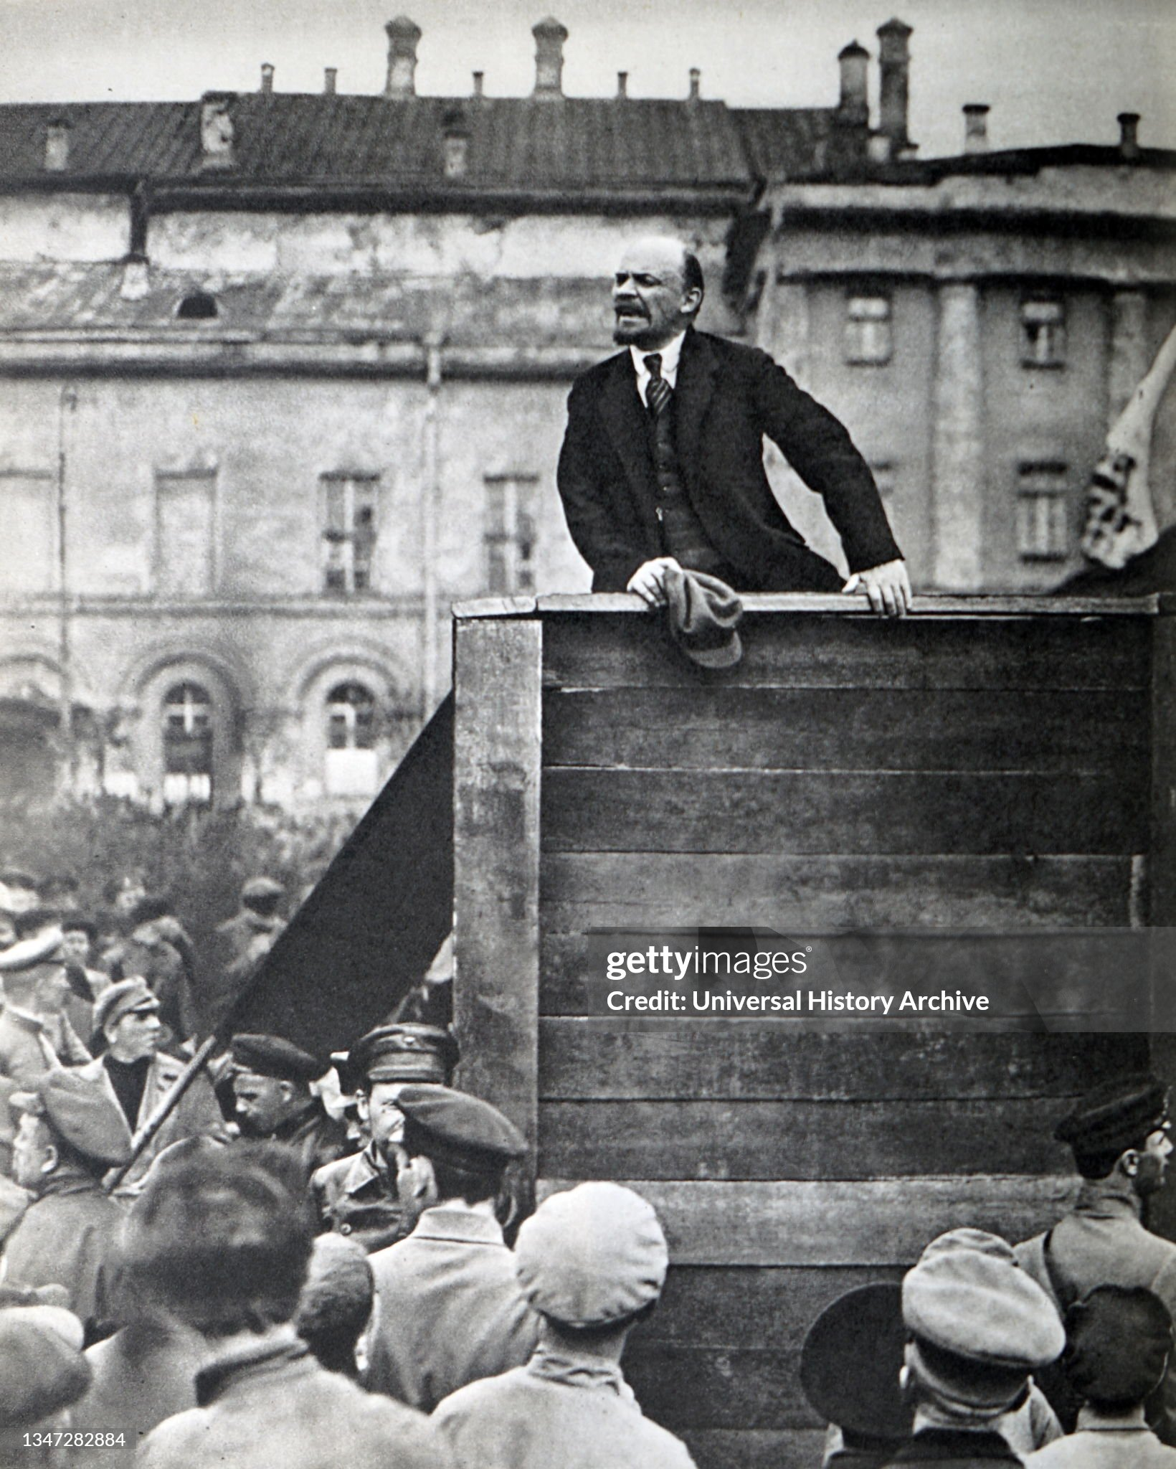
Condemning the “Unity of All Trends”
Nowhere in the world do the workers’ parties unite groups of intellectuals and “trends”; they unite workers on the following terms: (1) recognition and application of definite Marxist decisions on questions of tactics and organisation; (2) submission of the minority of class-conscious workers to the majority.
Plekhanov now threatens to destroy this unity of the majority. We calmly and firmly say to the workers: put no faith in words. Put them to the test of facts, and you will see that every step taken by every one of the above-mentioned adventurist groups more and more glaringly reveals their helpless and pitiful vacillation.

Slide 32
Discussion

Slide 33
Revolutionary Adventurism Today

Slide 34

The Heritage Foundation and Project Esther
Published on the Heritage Foundation’s website and titled Project Esther: A National Strategy to Combat Antisemitism, the Heritage Foundation claims that the pro-Palestine movement is part of a global “Hamas Support Network.”
The project derives its name from The Book of Esther, and proposes a solution to antisemitism inspired by the book. In the book, Haman, who plots to kill all the Jews in Persia, is ultimately hanged.

Slide 35
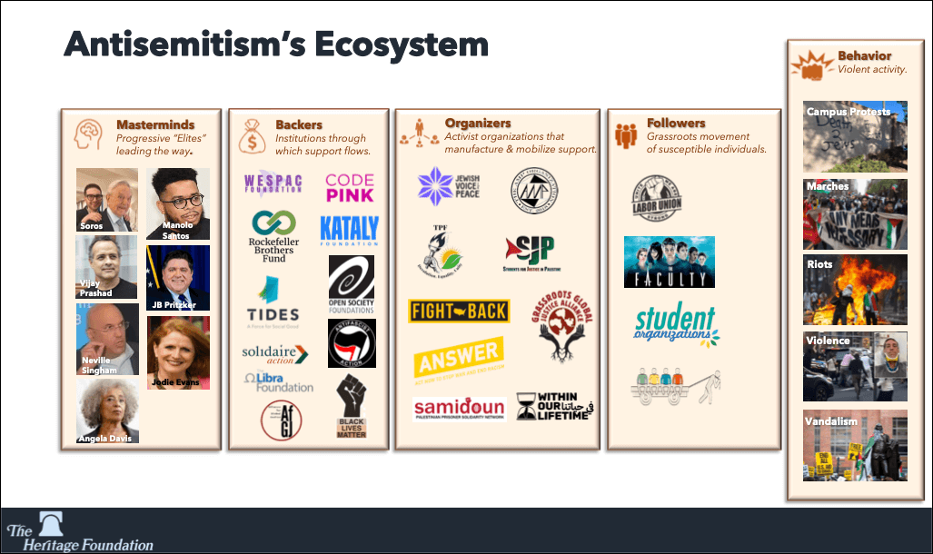
The Heritage Foundation and Project Esther
In other words, the Heritage Foundation’s plan is to dismantle any organization they deem to be “pro Hamas.”
Those on the left who support Hamas are supporting their adventurous tactics and only giving ammunition to the far-right to dismantle any pro-Palestine organizations.

Slide 36

Warfare Against the Working Class: Pincer Movement
In warfare, a pincer movement involves flanking the opposition from both sides.
Those on the ultraleft who glorify and defend desperate acts of terrorism committed by individuals unknowingly give ammo to capitalists.
Under the guise of countering terrorism and violence, the capitalist class can enact even more repressive measures and curb our civil liberties, making it much more difficult to politically organize.

Slide 37
Recent Instances of Revolutionary Adventurism
On May 21, 2025, two staff members of the Israeli Embassy in Washington, D.C., Yaron Lischinsky and Sarah Milgrim, were fatally shot outside the Capital Jewish Museum while leaving an event. The suspect, Elias Rodriguez, was apprehended and charged with murder and other federal crimes. He allegedly shouted "Free Palestine" during his arrest.
This senseless act of violence contributed nothing positive to the Free Palestine movement and took the lives of two people who were not in high positions of power in the Israeli government.
While some on the left condemned this act of violence, some went as far as to defend it. While the vast majority of the pro-Palestine movement is peaceful, the loud minority backing acts of terrorism will now be associated with the movement.

Slide 38

Recent Instances of Revolutionary Adventurism
Similarly, the shooting of the United Healthcare CEO was an act of revolutionary adventurism which could have had the potential of galvanizing the healthcare reform movement. Instead, the ruling class shifted the narrative to focus on the individual who committed the act.
More alarmingly, NYC Governor Kathy Hochul proposed a deal after several CEOs brought up concerns over their personal safety, to collaborate with the Department of Defense in providing them personal protection.
Hochul also announced the deployment of 250 additional National Guard members to the NYC subway system, bringing the total to 1,000 soldiers stationed at subway entrances. This increase was part of a larger initiative to bolster subway safety and provide a visible deterrent to crime.

Slide 39
Discussion & New Members Introductions

Slide 40
New Member Introductions
What is your name, pronouns and state (or country/territory)?
Where do you work? Is it unionized?
How did you find out about the People’s School?
What do you think about tonight's class?

Slide 41
Discussion & Wrap Up

Slide 42
Announcements
Missed any previous classes? Can’t wait for next week’s class to learn more? Check out our PSMLS YouTube Channel where we upload all of our past classes: https://www.youtube.com/@PSMLS
PCUSA Cell Chairs need to call members of their cells to remind them about attendance.
The next issue of New Masses (2025) has begun production. If you have art you want us to feature, email it to info@partyofcommunistsusa.net.

Slide 43


“No Kings” Rallies Across the Country
Find an Event Near You and RSVP!
3rd iteration of the Indivisible organized events such as 50501 and Hands Off
https://www.nokings.org/#map
June 14th

Slide 44

Happy Pride Month!
Happy Pride from People’s United LGBT+ Society!
During this pride month, attend a parade near you. Download our brochure and our Stonewall Lives Bulletin and distribute. https://peopleslgbt.org/
Literature can also be requested using the literature request form on the member’s portal.

Slide 45

Please Help Comrades Attend Camp Red Star!
Camp Red Star is an opportunity for our young comrades to build camaraderie and learn skills that will help them build up the Party of Communists USA and its youth league, the League of Young Communists USA.
With financial hardship plaguing the country, we request that those with the means to help spare what they can to help our comrades attend. Any amount is greatly appreciated!
Donate at: https://partyofcommunistsusa.net/donations/
Choose “one-time donation”
under donation reasons click “other”
in the following text box labelled “donation reason” type in “LYC Summer Camp Subsidy”

Slide 46
Volunteers Needed!
We are in need of volunteers for the staff of the People’s School! Here’s a few roles we need filled:
People to help manage posting on our social media and podcast platforms
Video Editors, Audio Editors, Graphic Designers, Artists, Narrators
Web Controls and Moderators
Email info@peoplesschool.us if you’re interested and try to attend our next staff meeting if possible.

Slide 47

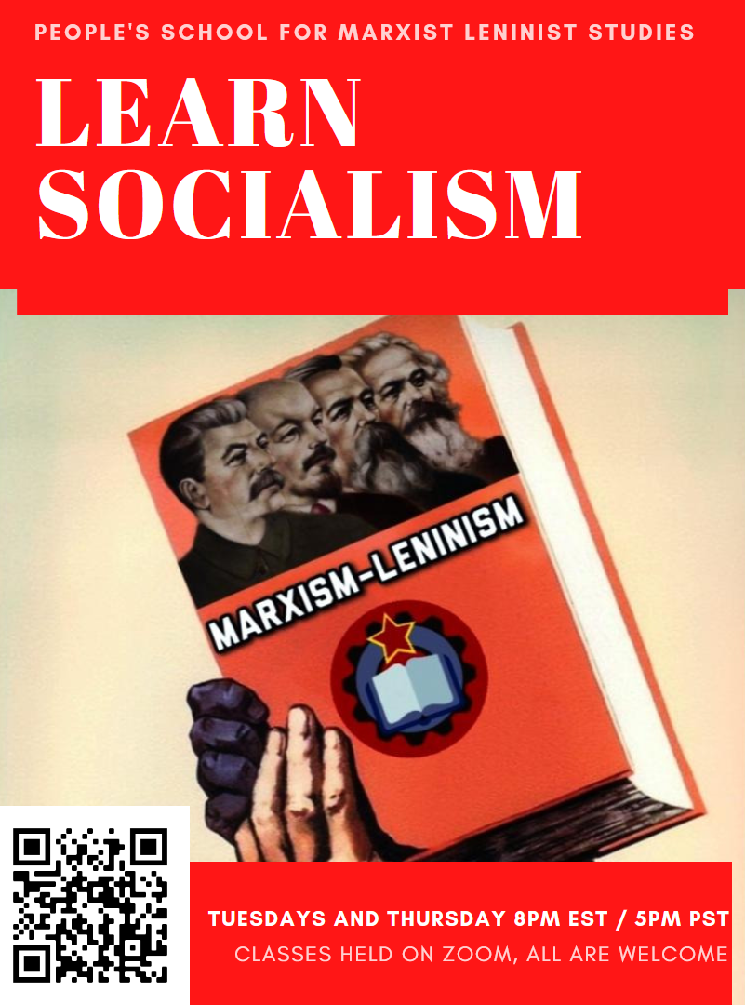








PSMLS Propaganda
peoplesschool.us/media & peoplesschool.us/store
Materials to help promote the school!

Slide 48

View From Left Field
https://viewfromleftfield.libsyn.com
The Old PSMLS Youtube is now the Youtube of View From Left Field, a podcast of analysis and discussion of current events from a progressive perspective.
Like the Youtube videos and subscribe with 5 star ratings on your podcast platforms.

Slide 49

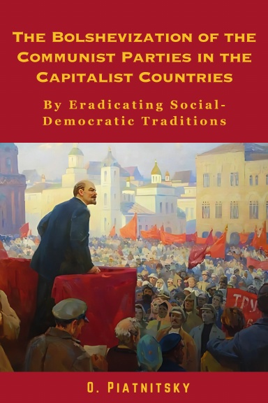



New Outlook Publishers
newoutlookpublishers.store
Latest Releases

Slide 50



Harry Bridges School of Labor
luel.us/laborschool/
The Harry Bridges School of Labor is a monthly class held 2x per month. Classes cover a variety of topics aimed at building class conscious among union members.
June’s class is on Trade Unions in the Fight Against Fascism. Class will be Wednesday June 4, 2025 at 8pm EST/6pm PST and Saturday June 7, 2025 at 7pm EST/4pm PST.

Slide 51

The Internationale

