Slide 1

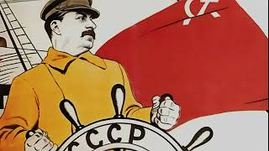
The Internationale

Slide 2
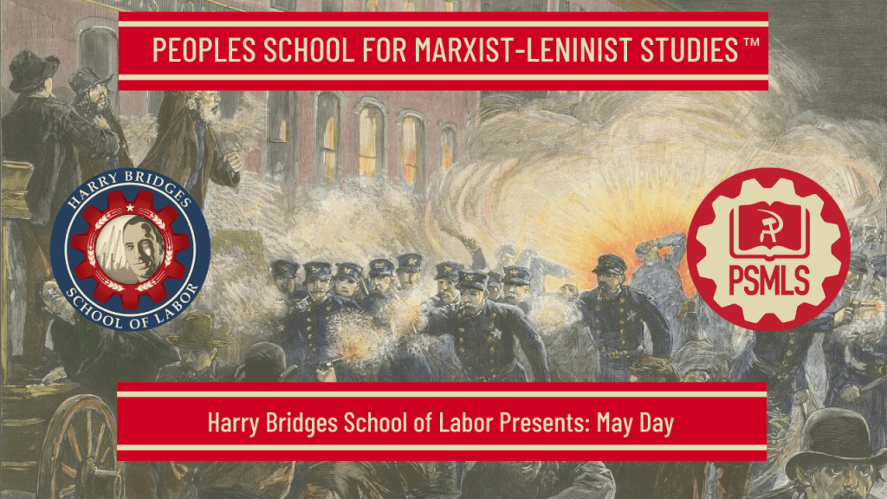
PSMLS 04/29/2025

Slide 3
What we’ll be learning today:
Struggles for a Shorter Workday
A Day of Revolt
Modern Celebrations & Actions

Slide 4
Struggles for a Shorter Workday

Slide 5
10 Hour Movement
The origin of May Day is indissolubly bound up with the struggle for the shorter workday—a demand of major political significance for the working class. This struggle is manifest almost from the beginning of the factory system in the United States.
Although the demand for higher wages appears to be the most prevalent cause for the early strikes in this country, the question of shorter hours and the right to organize were always kept in the foreground when workers formulated their demands against the bosses and the government. As exploitation was becoming intensified and workers were feeling more and more the strain of inhumanly long working hours, the demand for an appreciable reduction of hours became more pronounced.

Slide 6
10 Hour Movement
Already at the opening of the 19th century workers in the United States made known their grievances against working from “sunrise to sunset,” the then prevailing workday. Fourteen, sixteen and even eighteen hours a day were not uncommon. During the conspiracy trial against the leaders of striking cordwainers in 1806, it was brought out that workers were employed as long as nineteen and twenty hours a day.
The twenties and thirties are replete with strikes for reduction of hours of work and definite demands for a 10-hour day were put forward in many industrial centers. The organization of what is considered as the first trade union in the world, the Mechanics’ Union of Philadelphia, preceding by two years the one formed by workers in England, can be definitely ascribed to a strike of building trade workers in Philadelphia in 1827 for the 10-hour day. During the bakers’ strike in New York in 1834 the Workingmen’s Advocate reported that “journeymen employed in the loaf bread business have for years been suffering worse than Egyptian bondage. They have had to labor on an average of eighteen to twenty hours out of the twenty-four.”

Slide 7
10 Hour Movement
The struggle for a shorter working day is as old as the country itself.
First strike for a 10 hour day, 1791 Philadelphia Carpenters’ Strike
Unsuccessful strikes in Boston & Philadelphia in 1827
Circular from the Boston strike:
“We have been too long subjected to the odious, cruel, unjust and tyrannical system which compels the operative mechanic to exhaust his physical and mental powers. We have rights and duties to perform as American citizens and members of society, which forbid us to dispose of more than ten hours for a day’s work.”
This circular would go on to inspire the 1835 Philadelphia General Strike.

Slide 8
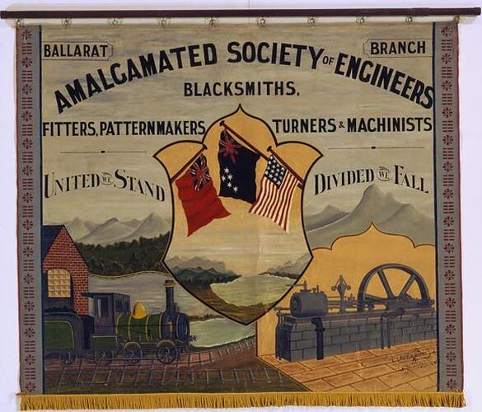
10 Hour Movement
The struggle for a shorter working day is as old as the country itself.
1835 Philadelphia General Strike won workers the 10 hour day and an advance in wages.
Gains were reversed due to depression from 1837-1841
Movement continued, 10-Hours laws were passed in many states, though they were largely ineffectual.
The struggle for a shorter work day would turn into an 8-Hour movement in 1863 when the Machinists’ & Blacksmiths’ Union endorsed the 8-Hour day at their Convention.

Slide 9
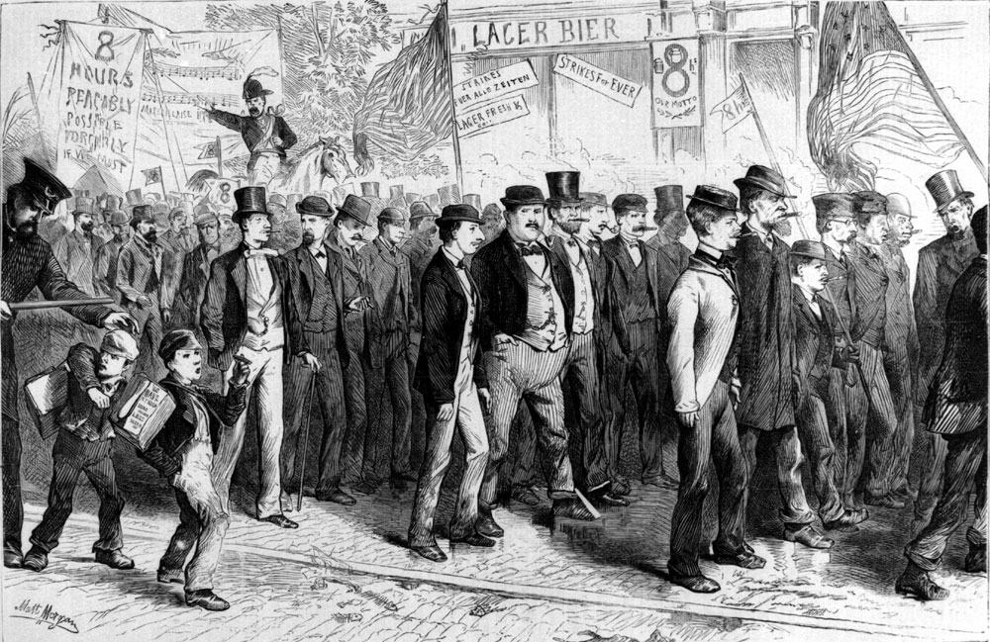
Transition to the 8 Hour Movement
Ira Steward, member of the Machinists’ & Blacksmiths’ Union, developed the main ideas for the 8-hour Movement. He contended “Labor’s demands were small, because long hours gave the workers little chance to realize that they needed more. A worker who labored 14 hours a day had neither the imagination nor the energy to demand higher wages. He was so debased by excessive toil that he could think only of food and sleep.”
“Out of the death of slavery, a new life at once arose. The first fruit of the Civil War was the eight hours’ agitation, that ran with the seven-leagued boots of the locomotive from the Atlantic to the Pacific, from New England to California.”

Slide 10
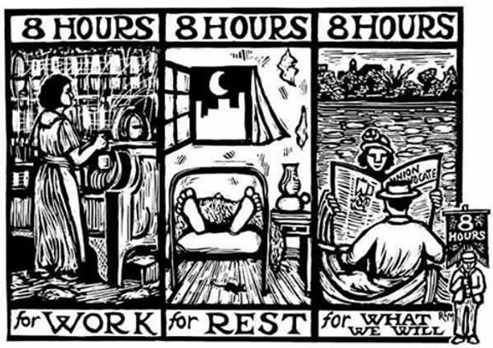
Transition to the 8 Hour Movement
National Labor Union resolution, “The first and great necessity of the present to free the labor of this country from capitalistic slavery is the passing of a law by which eight hours shall be the normal working day in all states of the American Union.”
International Workingmen’s Association Resolution Adopted at Geneva Congress: “ As this limitation represents the general demand of the workers of the North-American United States, the Congress transforms this demand into the general platform of the Workers of the World.

Slide 11
Passage of Toothless 8 Hour Laws
8-Hour laws were enacted in 6 states by 1868, all of them included loopholes that allowed for contracts stipulating longer working days.
In 1868, a federal 8-Hour law was passed.
In many cases wages were reduced with the shortened day.
US Attorney General ruled the 8-Hour law didn’t apply to government contracts.
In 1877, SCOTUS unanimously upheld AG’s decision.
By the 1880s, House Committee on Education & Labor declared the law a “dead-end”.

Slide 12
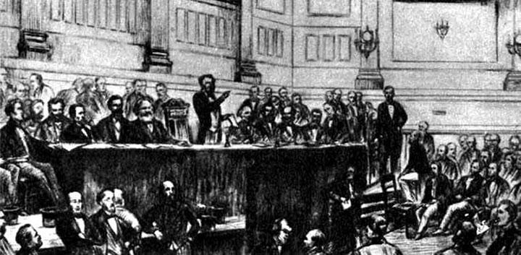
First International Adopts 8-hr Day
The decision for the 8-hour day was made by the National Labor Union in August 1866. In September of the same year the Geneva Congress of the First International went on record for the same demand in the following words:
“The legal limitation of the working day is a preliminary condition without which all further attempts at improvements and emancipation of the working class must prove abortive. ... The Congress proposes 8 hours as the legal limit of the working day.”
Painting Depicting meeting of the International Workingmen’s Association, better known as the First International

Slide 13
Marx on the 8-Hour Day
In the chapter on “The Working Day” in the first volume of Capital, published in 1867, Marx calls attention to the inauguration of the 8-hour movement by the National Labor Union. In the passage, famous especially because it contains Marx’s telling reference to the solidarity of class interests between the Negro and white workers, he wrote:
“In the United States of North America, every independent movement of the workers was paralyzed so long as slavery disfigured a part of the Republic. Labor cannot emancipate itself in the white skin where in the black it is branded. But out of the death of slavery a new life at once arose. The first fruit of the Civil War was the eight hours’ agitation, that ran with the seven-leagued boots of the locomotive from the Atlantic to the Pacific, from New England to California.”
Marx calls attention to how almost simultaneously, in fact within two weeks of each other, a workers’ convention meeting in Baltimore voted for the 8-hour day, and an international congress meeting in Geneva, Switzerland, adopted a similar decision. “Thus, the movement of the working-class on both sides of the Atlantic, that had grown instinctively out of the conditions of production themselves,” endorse the same movement of the limitation of hours of labor and concretize it in the demand for the 8-hour day.

Slide 14
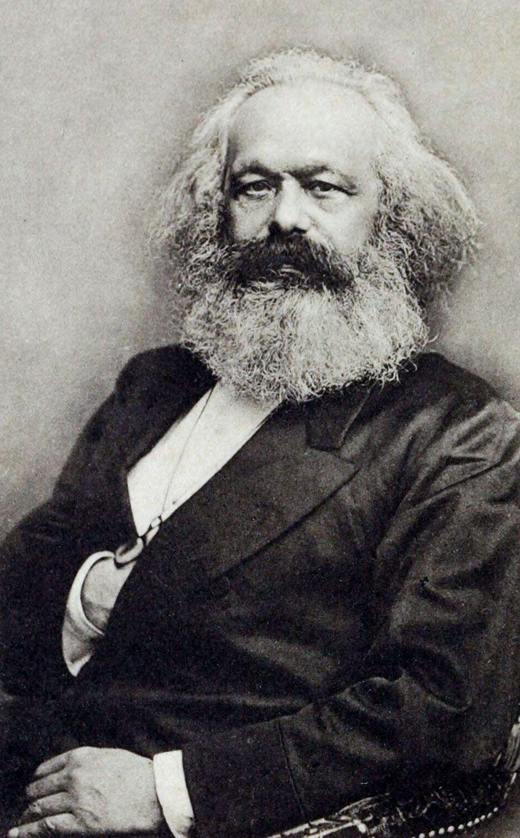
Marx on the 8-Hour Day
That the decision of the Geneva Congress was prompted by the American decision can be seen from the following portion of the resolution:
“As this limitation represents the general demand of the workers of the North-American United States, the Congress transforms this demand into the general platform of the workers of the whole world.”
A similar influence of the American labor movement upon an international congress and in behalf of the same cause was exerted more profoundly 23 years later.

Slide 15

Union Maid

Slide 16
Discussion

Slide 17
A Day of Revolt!

Slide 18
A Day of Revolt!
Federation of Organized Trades & Labor Unions 1884 Resolution on 8-Hour Day: “Resolved ... that eight hours shall constitute a legal day’s labor from and after May 1, 1886, and that we recommend to labor organizations throughout this district that they so direct their laws as to conform to this resolution by the time named.”
The Federation made several attempts to join forces with the Knights of Labor to build a coalition on establishing the 8-Hour day, but KOL was vehemently anti-strike. KOL Grandmaster Workman, Terrence Powderly, instead called on KOL members to write essays on the working day.
While National leadership was against the campaign, many local assemblies signed on in support.
Powderly issues a March circular demanding KOL assemblies don’t strike.
Divided membership of the KOL.

Slide 19
A Day of Revolt!
While the KOL ranks were dividing over the movement, THE majority of FOTLU member unions supported the strike movement.
Called on unions not striking to support those who were.
Drafted an agreement framework for 8-Hour Agreements with employers.
Strikes would only take place as a backup plan.
Union continued agitation and organizing for a May 1 strike.
“Arouse, ye toilers of America! Lay down your tools on May 1, 1886, cease your labor, close the factories, mills and mines—for one day in the year. One day of revolt—not of rest! A day not ordained by the bragging spokesmen of institutions holding the world of labor in bondage. A day on which labor makes its own laws and has the power to execute them! All without the consent or approval of those who oppress and rule. A day on which in tremendous force the unity of the army of toilers is arrayed against the powers that today hold sway over the destinies of the people of all nations. A day of protest against oppression and tyranny, against ignorance and war of any kind. A day on which to begin to enjoy ‘eight hours for work, eight hours for rest, eight hours for what we will.’ ”

Slide 20
A Day of Revolt!
Planning and coordination of was largely lead by local coalitions, as FOTLU did not yet have the ability to lead a National Campaign.
Over 250,000 workers had joined the struggle by April.
Pressure was mounting on employers & approx. 30,000 workers has gained a shortened work day by then.
Cities started granting 8-Hour days to Municipal workers.
Still not all unions supported the movement, Grand Chief of the Brotherhood of Locomotive Engineers (BLET) detested the 8-Hour Movement, : “two hours less work means two hours more loafing about the corners and two hours claiming more for drink.”
Boston Carpenters’ Union rallying cry: “That this is the workingman’s hour, and affrighted capital begins to understand that labor has rights which it is bound to respect—giving promise that the hour is at hand when the producer of wealth shall claim his own, and freely share in the gains and honors of advanced civilization.”

Slide 21
A Day of Revolt!
May 1, 1886 saw a massive strike wave throughout the US.
At least 400,000 workers struck for the 8-Hour Day
Large cities had big turnouts such as New York, Baltimore, Washington, Milwaukee, Cincinnati, St. Louis, Pittsburgh, Detroit, and the largest being Chicago.
In addition many smaller cities and rural towns held significant strikes & demonstrations: Montclair, NJ; Duluth, MN; Argentine, KS; South Gardiner, ME; Mobile, AL; Galveston, TX and many others.
One notable town was Troy, NY which had 5,000 workers on strike.
Many strikes continued past May 1

Slide 22
Tragedies of the Movement
Chicago: May 3, McCormick Harvester & May 4, Haymarket Affair
Chicago saw tragedy on May 3 as police open fire on striking workers at the McCormick Harvester Plant killing 4 workers.
In response, a rally was called for the following day in Haymarket Square to protest the police brutality.
The rally was mostly uneventful. Bomb thrown as Police moved to disperse crowd during the final speech.
7 policeman were killed, 70 wounded, Police opened fire on crowd killing at least 1, wounding many others.

Slide 23
Tragedies of the Movement
Milwaukee: May 5, North Chicago Rolling Mill
Strikers had been striking for 4 days, successfully closing all factories, except the North Chicago Rolling Mill.
Striking workers marched, as they had in the days before, to close down the factories.
As workers neared the factory, a single inaudible order to stop was issued, when the workers continued police open fire filling 9 workers.
No charges were levied against the police, but nearly 50 workers were charged with “riot and conspiracy” or “riot and unlawful assembly” and served 6 to 9 month sentences.

Slide 24
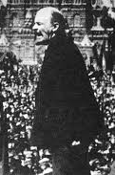
Lenin on May Day
Early in his activity in the Russian revolutionary movement Lenin contributed to making May Day known to the Russian workers as a day of demonstration and struggle. While in prison, in 1896, Lenin wrote a May Day leaflet for the St. Petersburg Union of Struggle for the Liberation of the Working Class, one of the first Marxist political groups in Russia. The leaflet was smuggled out of prison and 2,000 mimeographed copies distributed among workers in 40 factories. It was very short and written in Lenin’s characteristically simple and direct style, so that the least developed among the workers could understand it. “When a month after the famous textile strikes of 1896 broke out, workers were telling us that the first impetus was given by the little modest May Day leaflet,” wrote a contemporary who helped to issue it.

Slide 25
Lenin on May Day
After telling the workers how they are exploited for the benefit of the owners of the factories in which they work, and how the government persecutes those who demand improvement in their conditions, Lenin proceeds to write about the significance of May Day:
“In France, England, Germany and other countries where workers have already been united in powerful unions and have won for themselves many rights, they organized on April 19 (May 1) [the Russian calendar was then 13 days behind the West-European] a general holiday of Labor. Leaving the stifling factories they march with unfurled banners, to the strains of music, along the main streets of the cities, demonstrating to the bosses their continuously growing power. They assemble at great mass demonstrations where speeches are made recounting the victories over the bosses during the preceding year and lay plans for struggle in the future. Under the threat of strike the bosses do not dare to fine the workers for not appearing at the factories on that day. On this day the workers also remind the bosses of their main demand: 8 hours work, 8 hours rest, and 8 hours recreation. This is what the workers of other countries are demanding now.”

Slide 26
Lenin on May Day
The Russian revolutionary movement utilized May Day to great advantage. In the preface to a pamphlet, May Days in Kharkov, published in November 1900, Lenin wrote:
“In another six months, the Russian workers will celebrate the First of May of the first year of the new century, and it is time we set to work organizing the celebrations in as large a number of centres as possible, and on a scale as imposing as possible. They must be imposing, not only in the numbers of participants, but in the organized character and the class-consciousness the participants will display, in their determination to launch a resolute struggle for the political liberation of the Russian people and, consequently, for a free opportunity for the class development of the proletariat and its open struggle for socialism.”
It can be seen how important Lenin considered the May Day demonstrations, since he called attention to them six months ahead of time. To him May Day was a rallying point for “the irrepressible struggle for the political liberation of the Russian people,” for “the class development of the proletariat and its open struggle for Socialism.”

Slide 27
Lenin on May Day
Speaking of how May Day celebrations “can become great political demonstrations,” Lenin asked why the Kharkov May Day celebration in 1900 was “an event of outstanding importance,” and answered, “the mass participation of the workers in the strike, the huge mass meetings in the streets, the unfurling of red flags, the presentation of demands indicated in leaflets and the revolutionary character of these demands—eight-hour day and political liberty.”
Lenin upbraids the Kharkov Party leaders for joining the demands for the 8-hour day with other minor and purely economic demands, for he does not want the political character of May Day in any way be clouded. He writes in this preface:
“The first of these demands [8-hour day] is the general demand put forward by the proletariat in all countries. The fact that this demand was put forward indicates that the advanced workers of Kharkov realize their solidarity with the international Socialist labor movement. But precisely for this reason a demand like this should not have been included among minor demands like better treatment by foremen, or a ten percent increase in wages. The demand for an eight-hour day, however, is the demand of the whole proletariat, presented, not to individual employers, but to the government as the representative of the whole of the present-day social and political system, to the capitalist class as a whole, the owners of all the means of production.”

Slide 28

Which Side Are You On?

Slide 29
Discussion

Slide 30
May Day in 2025

Slide 31
WFTU Declaration for May Day 2025
The International Class-oriented Trade Union Movement, the workers, and the militant unions all over the globe honor with struggles the 139th anniversary of the workers’ struggle in Chicago in 1886. The World Federation of Trade Unions, the most historic international trade union organisation, representing more than 105 million workers all the length and breadth of the world, sends a cordial and militant message to all the workers and farmers, to the ordinary people of toil and labour, on the occasion of International Workers Day, which constitutes a lasting and bright milestone of struggle.
This year’s May Day coincides with the 80th Anniversary of the WFTU, which was born in the ashes of the most destructive war in the history of humanity in the revolutionary fresh air of the great anti-fascist victory of the peoples with the Soviet Union at the forefront, and completes 8 decades of continuous and uninterrupted struggle for the rights of workers, for justice and social progress, against all forms of discrimination, against wars and imperialist interventions, against man by man exploitation.

Slide 32
WFTU Declaration for May Day 2025
Both the messages and demands of the Chicago pioneers of 1886 and the needs that inevitably led to the establishment of the WFTU remain relevant and necessary today. The crisis of capitalism deepens and is generalized. Social inequalities are widening dramatically. Democratic freedoms and trade union rights are under attack all over the world, and the imperialist wars and interventions are on the daily agenda.
The genocide of the Palestinians in Gaza and in the West Bank, the bombing in Lebanon and other countries of the wider Middle East region, with the support and encouragement of the USA, the EU, and their allies, continues, revealing in all its grandeur the hypocrisy, cynicism, and inhumane nature of imperialism.

Slide 33
WFTU Declaration for May Day 2025
At the same time, global defence spending rose to 2.46 trillion USD last year, with big budget increases in countries of Asia, the Middle East, North Africa, and Europe. Notably, there are examples of countries that are almost doubling their defence spending. At the same time, the USA President Trump calls for a minimum spending of 5% of GDP among NATO members, and the EU Commission Summit decided to finance 800 billion euros for military armament within the ReArm EUROPE project.
The shift towards a war economy is clearly a priority for the ruling circles of capitalism, as it incites profitability for multinational monopolies and the expansion of the geopolitical power of developed imperialist states.
These new massive increases in military spending, apart from being a threat to global peace and security, also mean even harsher austerity policies and widening social inequality. The resources that would be destined for families, workers, and ordinary people are cut and diverted to rearmament, and civil and social rights and liberties are placed under guardianship, because in the preparation for war, different opinions are not allowed.

Slide 34
WFTU Declaration for May Day 2025
The WFTU and the class-oriented trade unions strongly condemn the war preparations of the bourgeoisie. The popular strata have nothing to expect from a new widespread and generalized war but death, poverty, destruction, refugees, and hardship. We demand spending for the contemporary needs of the workers and the peoples. We demand adequate education and healthcare and not weapons. We demand dignified working and living conditions and not ammunition and missiles. We demand spending on culture, sport, and recreation, and not fighter aircraft and naval vessels.
We demand measures against rising inflation and living costs that erode living standards. We oppose privatization, outsourcing, and flexible forms of work that intensify the precarious employment and exploitation, alongside extended retirement ages.

Slide 35
WFTU Declaration for May Day 2025
The Workers and social achievements are under relentless attacks and challenges undermining labor rights, collective agreements, and democratic freedoms. Workplace safety remains neglected, causing daily injuries and fatalities. Despite global challenges, workers do not passively accept the anti-labor offensive on their rights and freedoms. Millions mobilize worldwide for dignified work and the protection of trade union and social rights with the WFTU members to be firmly at the forefront of these struggles. The response of bourgeois governments to the just popular demands is the sharpening of state repression and authoritarianism. At the same time, employers and governments are attempting to manipulate labor struggles, betting on the role of yellow unions and compromised trade union leaders.
In our era it is obvious that the prerequisites for truly dignified working and social living conditions for all workers exist in abundance. The class-oriented trade union movement fights so that the huge productive capabilities are not utilized to increase the profits of capitalists and create unimaginable wealth for a few, but to ensure dignified living and working conditions for those who create and produce the wealth.

Slide 36
WFTU Declaration for May Day 2025
Organization and struggle is the only path that can overturn the existing realities of misery, exploitation, and social injustice. The weapon of workers everywhere is solidarity and internationalism. The WFTU remains firmly committed to these principles. It continues its 80-year path with the same vision that inspired its founding: for a world without wars and imperialist interventions, without exploitation and discrimination. A world where work will be permanent, stable, regulated, and safe.
On the occasion of May Day 2025, the WFTU calls upon the class and militant trade unions around the world to take initiatives and organize this year’s campaign and activities under the slogan:
Their profits or Our lives – Hope lies in peoples’ struggle
ΝΟ to war economies
YES to the class struggles:
against the imperialist wars and interventions,
against capitalist exploitation,
for the satisfaction of the workers’ contemporary needs.

Slide 37
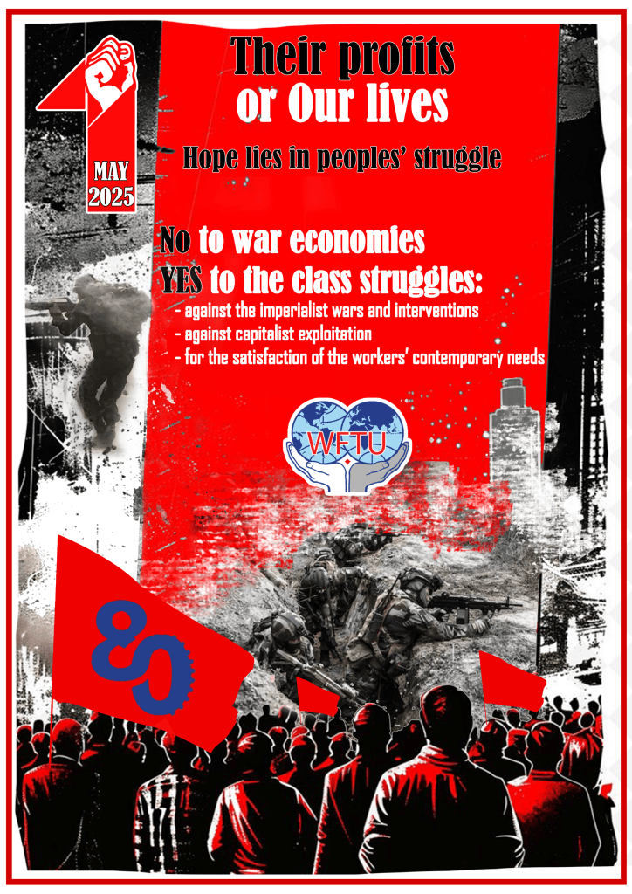
WFTU Declaration for May Day 2025
Let the WFTU flag proudly wave along with the flags of the militant trade unions in the uninterrupted class struggle for stable work with rights, social security, free public, and universal health and education, a dignified life. This will be the highest and proper celebration of the glorious 80-year course of struggles, sacrifices, and dignity of the international class-oriented trade union movement.
LONG LIVE MAY DAY!
LONG LIVE INTERNATIONALIST SOLIDARITY!
LONG LIVE 80TH ANNIVERSARY OF THE WFTU!

Slide 38
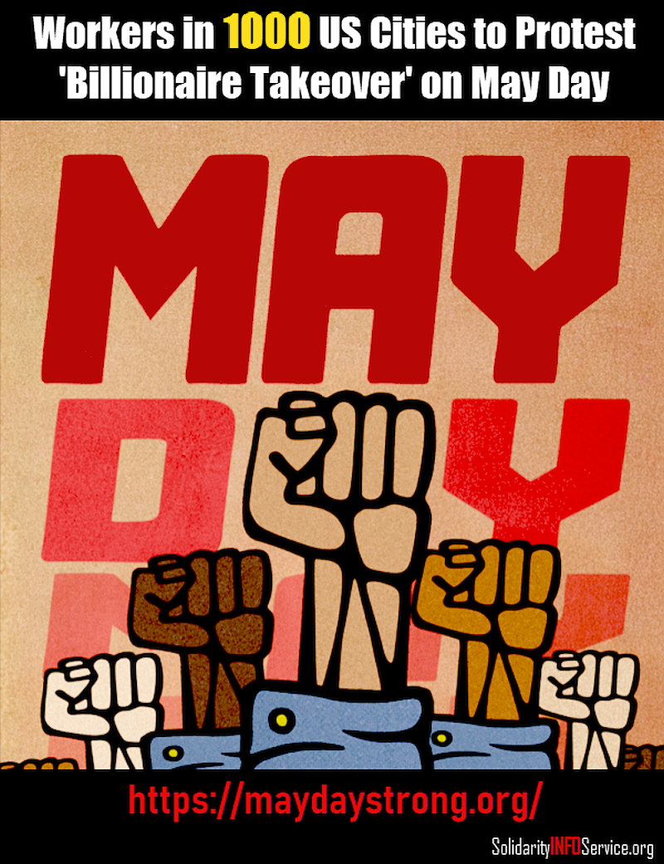
May Day Events 2025
This years’ May Day is poised to be one the most active Mat Day in decades. There are currently over 1000 actions planned across the country. There are actions planned in most major cities with the attacks on immigrants and federal workers leading the rallying cry this year.
Check out maydaystrong.org for events in your area!

Slide 39
Discussion & New Members Introductions

Slide 40
New Member Introductions
What is your name, pronouns and state (or country/territory)?
Where do you work? Is it unionized?
How did you find out about the People’s School?
What do you think about tonight's class?

Slide 41
Discussion & Wrap Up

Slide 42
Announcements
The PSMLS has recovered our old Youtube account we lost to wreckers in 2022 and we have re-uploaded all our old videos. Like, subscribe, and check out what subjects we covered prior and what we aware saying in the past.
PCUSA Cell Chairs need to call members of their cells to remind them about attendance.
The next issue of New Masses (2025) has begun production. If you have art you want us to feature, email it to info@partyofcommunistsusa.net.

Slide 43
Volunteers Needed!
We are in need of volunteers for the staff of the People’s School! Here’s a few roles we need filled:
People to help manage posting on our social media and podcast platforms
Video Editors, Audio Editors, Graphic Designers, Artists, Narrators
Facilitators, Web Controls, Moderators
Email info@peoplesschool.us if you’re interested and try to attend our next staff meeting if possible.

Slide 44










PSMLS Propaganda
peoplesschool.us/media & peoplesschool.us/store
Materials to help promote the school!

Slide 45

View From Left Field
https://viewfromleftfield.libsyn.com
The Old PSMLS Youtube is now the Youtube of View From Left Field, a podcast of analysis and discussion of current events from a progressive perspective.
Like the Youtube videos and subscribe with 5 star ratings on your podcast platforms.

Slide 46

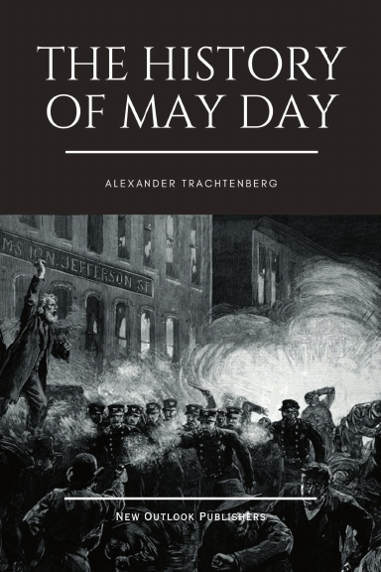
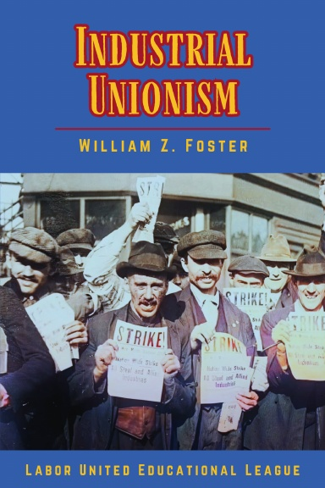
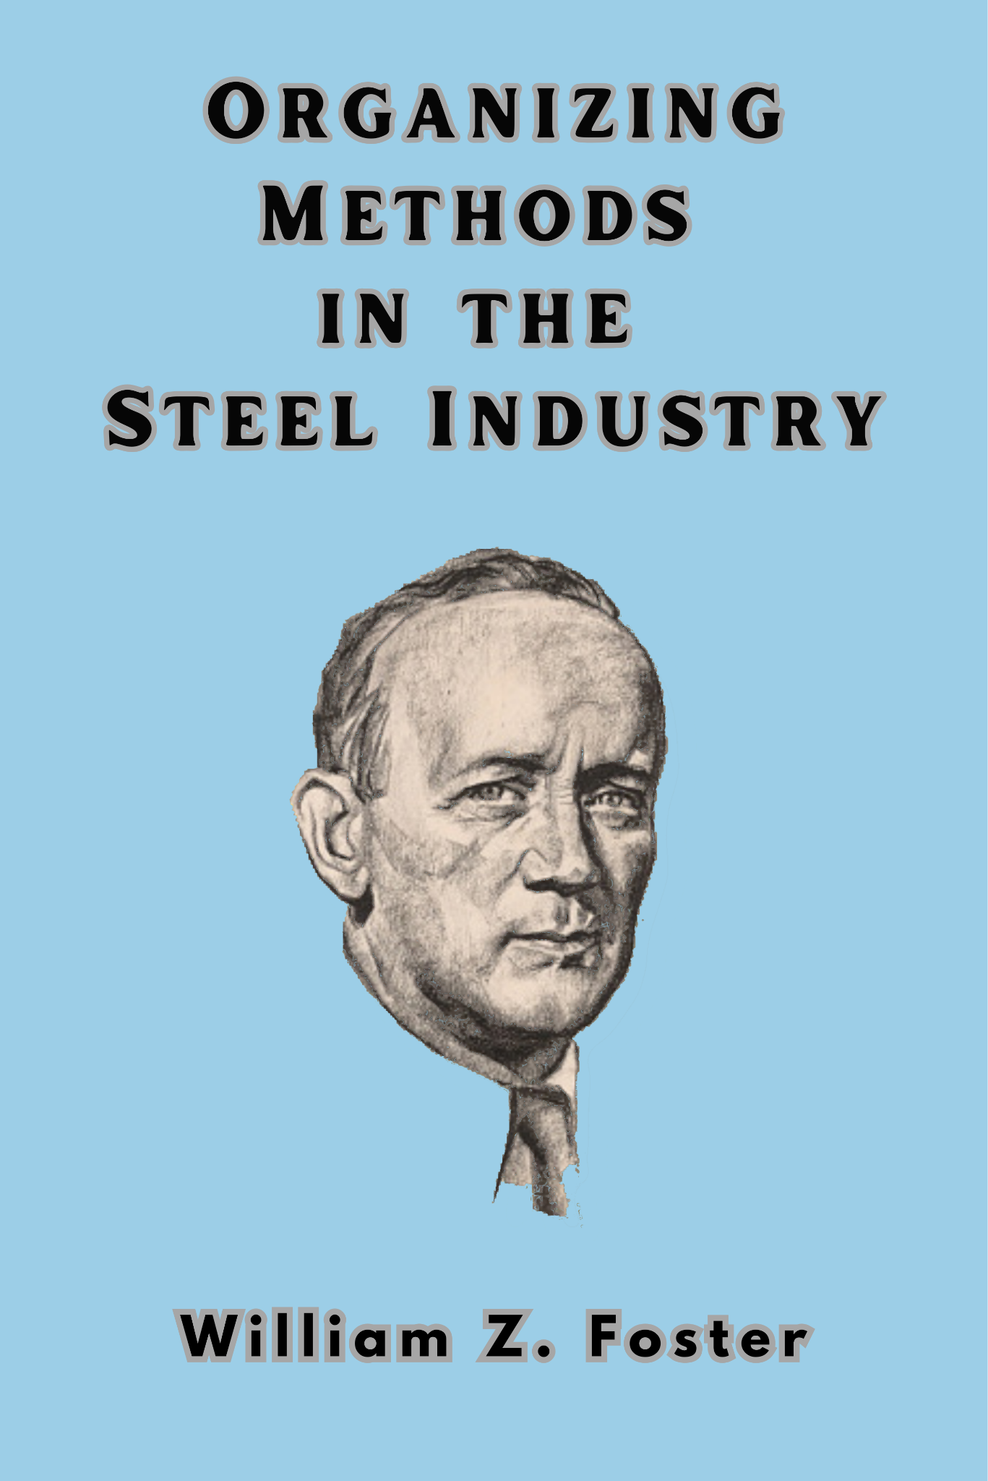

New Outlook Publishers
newoutlookpublishers.store
Relevant Releases

Slide 47



Harry Bridges School of Labor
luel.us/laborschool/
The Harry Bridges School of Labor is a monthly class held 2x per month. Classes cover a variety of topics aimed at building class conscious among union members.
May’s class is a showing of the movie Matewan will be May 7, 2024 at 8pm EDT/6pm PDT and Saturday May 10, 2024 at 7pm EDT/4pm PDT.

Slide 48

Solidarity Forever

