Slide 1

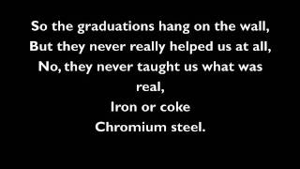
Allentown by Billy Joel

Slide 2
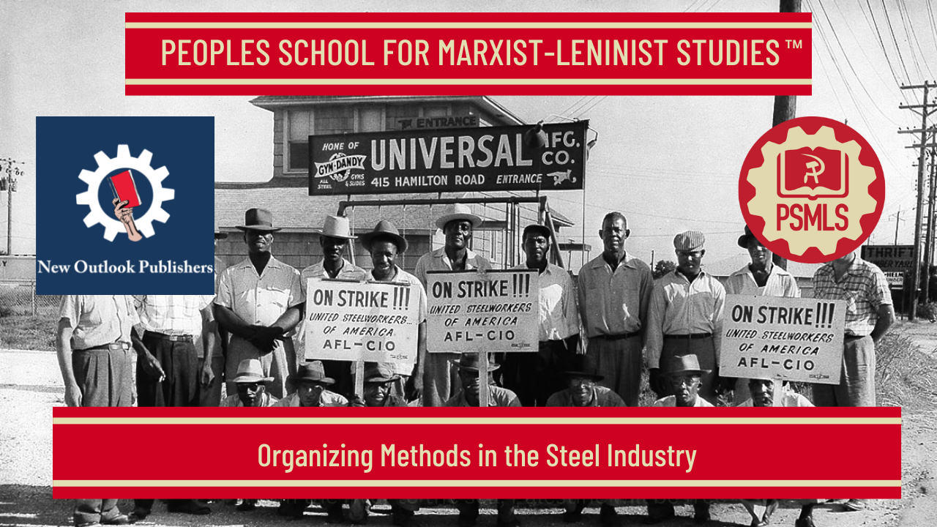
PSMLS 8/12/2025

Slide 3
What we’ll be learning today:
Organization Forms and Functions and Mass Agitation
Mass Organizations
Company Unions and Special Organization Work

Slide 4
Organization Forms and Functions and Mass Agitation

Slide 5
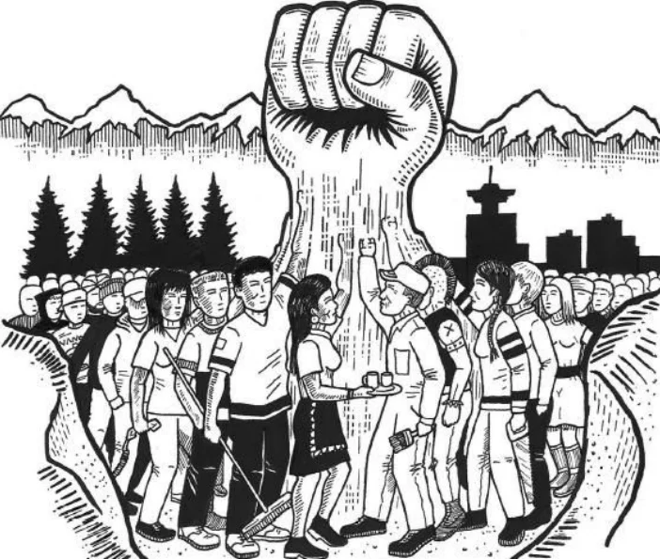
Section 2 - Organizational Forms and Functions
The organizing force of the steel campaign should be formed on the following general basis:
(a) The full-time and part-time organizers in the localities and districts should be formed into definitie committees, each with a secretary and with sub-committees for publicity, Negro, youth, women and defense. They should hold regular weekly meetings at definite times and places.
(b) A corps of volunteer organizers should be created, carefully selected to avoid unreliable elements. Each paid organizer should be commissioned as a captain of a crew of volunteer organizers and made immediately responsible for their work
(c) Each local of the Amalgamated Association should appoint an organizing committee of several members.
(d) In the company unions informal organizing committees should be set up to bring the company union membership systematically into the Amalgamated Association.

Slide 6
Organizational Forms and Functions
(e) Organizing committees should be set up in the various steel mills and in their departments, functioning either openly or privately, as conditions dictate. These should become the basis for future local unions.
(f) The Central Labor Unions and other unions (especially the railroad organizations) should set up local committees to support the steel drive and to organize their own trades. The steel drive should aim at 100 percent organization of all workers in the steel towns.
(g) Similar supporting committees should also be formed among fraternal organizations, churches and elsewhere, where active sympathizers be found for the steel campaign.
(h) These local union, mill and other organizing committees should meet together weekly (so far as is practical) jointly with the paid and volunteer organizers.
(i) One or more national conferences of all the local unions and organizing forces should be held to coordinate the whole campaign of organization.
(j) Periodic meetings of organizers should be held to study concrete methods of mass agitation and organization.

Slide 7
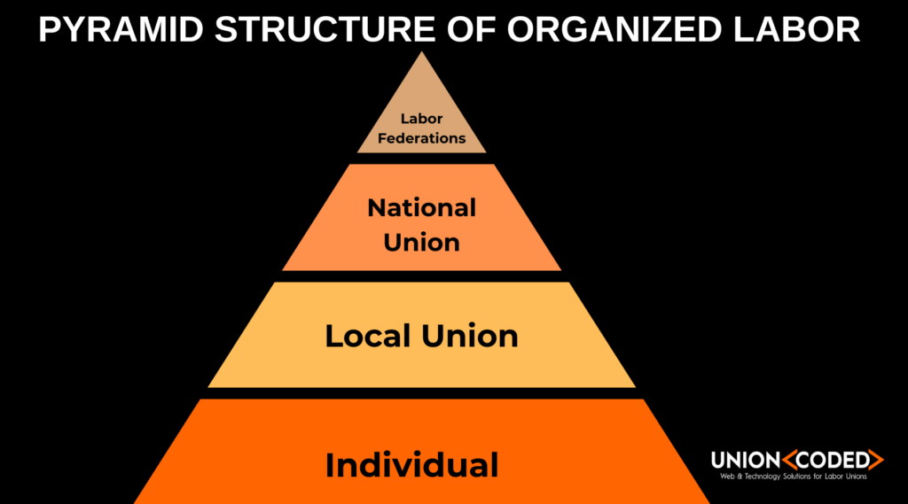
Structure of the Union
(a) Local unions should be formed on the principle of one mill, one union. In large mills the local union should be sub-divided into branches according to main departments, but the local union branches should be kept linked together by a broad representative committee.
(b) In the localities and districts the local steel unions in the several mills should be joined together into Steel Councils based upon a broad rank-and-file representation.
(c) The obsolete constitution of the Amalgamated Association should be adapted in practice to permit of this form of departmentalized industrial union.

Slide 8
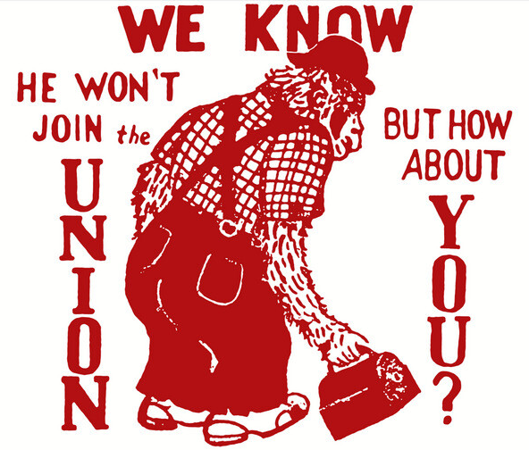
Functions and Tasks
(a) Organizers should not work haphazardly. They should each be given very specific tasks and held responsible for their fulfillment, specified individuals being charged with the work in certain mills, language groups, company unions, etc.
(b) The principles of socialist competition should be introduced to stimulate the work of the organizers, to create friendly organizing rivalry between worker and worker, department and department, mill and mill, town and town
(c) The greatest care should be taken to guard against spies and provocateurs entrenching themselves in the organizing crew and official leadership of the union but the organizers should avoid starting a “spy scare”. Spies that are uncovered should be exposed to the workers.
(d) Care should be taken to protect all lists of members. Loss of such lists and other important documents to company sources is highly demoralizing to the workers, and careless organizers should be disciplined.

Slide 9
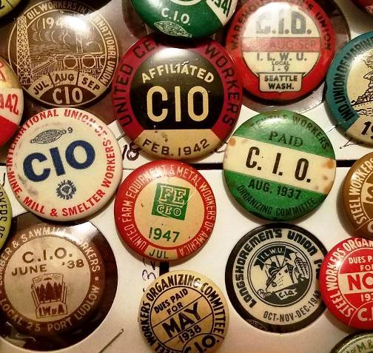
Functions and Tasks
(e) An absolutely strict control should be maintained over the finances, as loose financial methods always constitute a grave danger in large campaigns.
(f) The headquarters of the organizing committee and the union should be located conveniently to the mills, but not directly under the eyes of the mill officials.
(g) Organized protection of organizers, officers, local headquarters, etc., should be provided for in local situations of acute struggle.
(h) All organizers should submit detailed weekly reports on their activities.
(i) Organizers and other union officials handling funds should be regularly bonded with a bonding company.

Slide 10
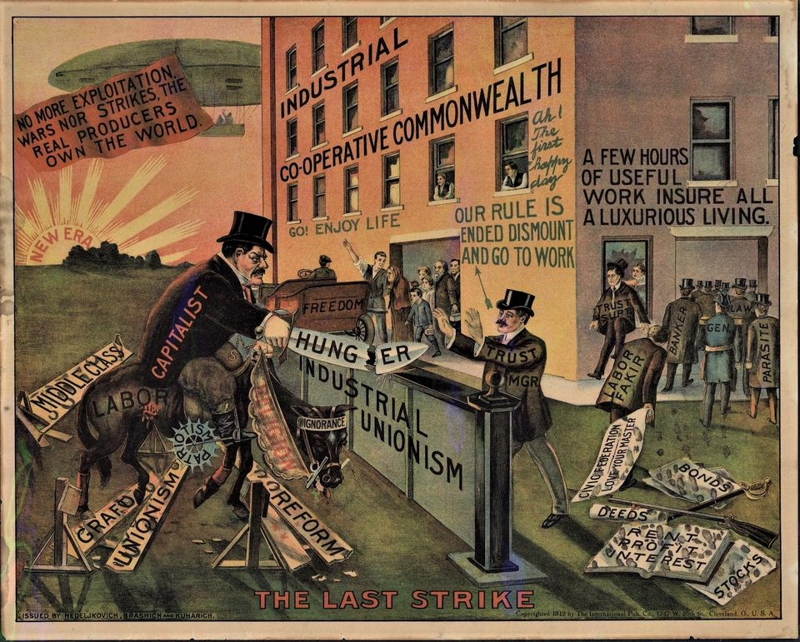
Section 3 - Mass Agitation
The main objectives of the educational work should be to liquidate fear and pessimistic moods among the workers ; to convince them of the necessity for trade unionism to win their demands and the possibility for success in the present campaign ; to rouse the enthusiasm, confidence and fighting spirit of the workers ; to win public sentiment behind the campaign.

Slide 11
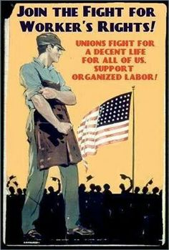
Slogans
The mass of workers support the drive and join the union in order to improve their conditions by securing the satisfaction of their most urgent economic demands. This elementary fact should never be lost sight of. The whole campaign of agitation must be based upon the popularization of the sloganized major demands of the workers, together with their local demands. The whole steel industry should be saturated with these slogans.
The economic demands of the union should be put forth immediately, but finally formulated and adopted at a broad national rank-and-file conference and then ratified by huge local mass meetings, pledge voted, etc., everywhere in the steel areas.

Slide 12
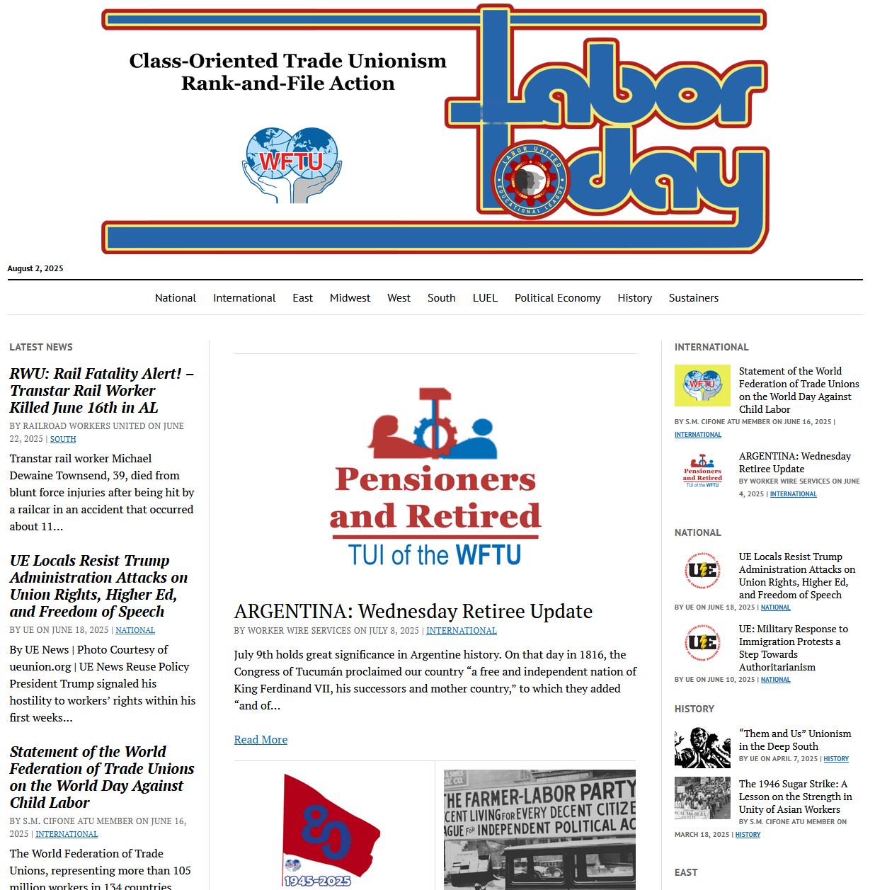
Publicity and Printed Matter
The publicity material should be short and concrete, with concise facts about conditions in the industry and arguments for organization. Occasionally it should be printed in the most important foreign languages, the foreign-born workers liking to read their native languages even when they speak and understand english.
  (a) Handbills should be issued regularly by the local organizing committees and upon occasion by the various local steel unions.
  (b) Bulletins should be issued regularly by the local organizing committees giving local news of the movement, and especially stressing the progress of the campaign in other localities.
  (c) House-to-house distribution on a mass scale should be organized for handbills, bulletins and other literature.
  (d) A circulation as extensive as possible should be secured for the weekly paper, Steel Labor.

Slide 13
Publicity and Printed Matter
(e) Shop papers should be issued wherever practicable by A.A. local unions.
(f) Advertisements in the local papers are valuable and should be used regularly for important announcements to the steel workers.
(g) Every means should be exercised to secure systematically favorable write-ups in the local press on the campaign.
(h) Stickers are effective, but care must be exercised that they do not become a nuisance and antagonize public opinion, by being stuck up indiscriminately.
(i) The wearing of union buttons in the plants is a very important organizing force, but care must be taken that it be not introduced until there is sufficient mass support and that the proper time is seized upon for its introduction, in order to prevent discharges of workers.
(j) Advertisements in movies in small towns are often practical and effective.
(k) Posters and window-cards should also be utilized on special occasions

Slide 14
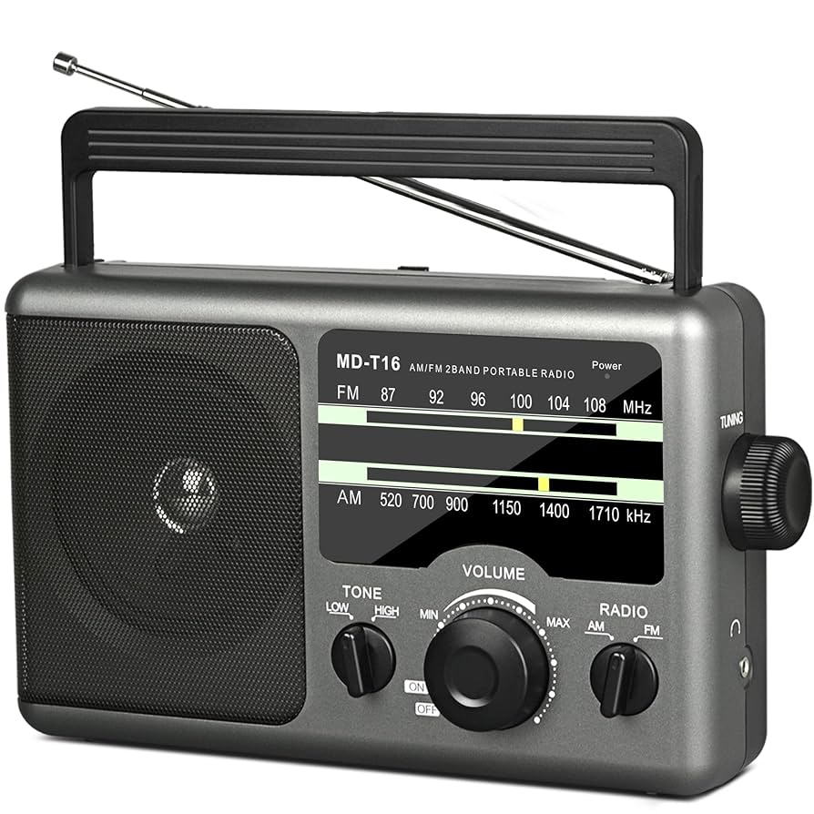
Radio
The radio is an extremely important means for organizing workers in an industry such as steel where the company maintains terrorism to prevent workers from attending open meetings. The radio takes the union message directly into the workers’ homes, thus avoiding the censorship of the bosses’ spies.
  (a) Local broadcasts should be organized weekly or semi-weekly in all important steel towns as one of the basic means of mass agitation.
  (b) Where radio time cannot be secured in the given steel localities, often the objective can be gained by using the radio in nearby towns.
  (c) Radio listeners’ clubs should be systematically organized on a wide scale, as many steel workers have no radios.
  (d) Radio speeches should be carefully prepared and should always give a direct stimulus to joining the union.

Slide 15
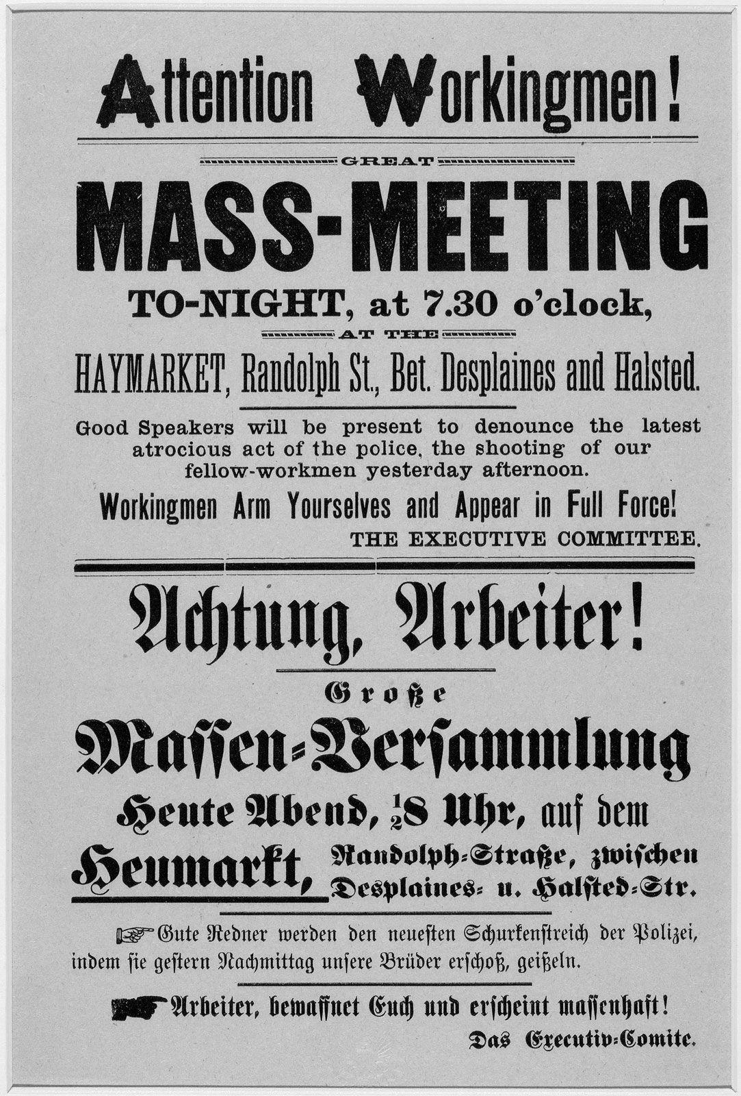
Mass Meetings, Demonstrations, etc.
The actual gathering together of workers in mass meetings and demonstrations is fundamental to the carrying on of a successful organization campaign. It gives the workers a confidence bred of their own numbers, and it enables the organizers to reach them personally with their educational appeal and organization methods. But such meetings, to achieve the best success, must be of the broadest mass character. This means that they have to be thoroughly prepared, and all the batteries of publicity, organizers, etc., should be coordinated and stimulated for their organization. The entire agitation among the workers should aim directly to culminate in the holding of such mass meetings. One good mass meeting is better than two dozen indifferent ones.

Slide 16
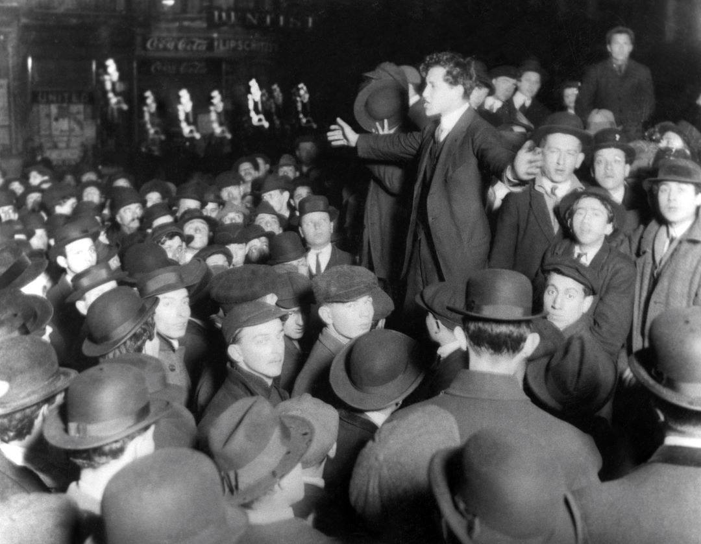
Mass Meetings, Demonstrations, etc.
(a) The general mass meetings should be called not only under the auspices of the local organizing committees but also on a mill or department scale by the local steel unions and in special cases also by the Central Labor Unions and other sympathetic organizations.
(b) Meetings should be held especially in popular neighborhood halls, where the workers’ fraternal lodges meet, where the workers dance, where their weddings take place, and where they are generally accustomed to going.
(c) Every effort should be made to bring the maximum number of women and children to the steel mass meetings.
(d) The question of mass meetings in company towns and in localities where the right of assembly is curtailed presents special problems. The danger of discharge of the workers makes it necessary that if mass meetings are held in such localities they must first have a broad basis of organization among the workers, and a wide preliminary publicity.

Slide 17
Mass Meetings, Demonstrations, etc.
e) At mass meetings it is important to get prominent out-of-town speakers to address the workers.
(f) Mill gate meetings should be held regularly at noon-time and at change-shifts where local conditions permit.
(g) Very effective are small delegations of steel workers form one town or district to another and large mass delegations of workers from organized mills to unorganized mills.
(h) Parades in steel towns are very effective in stimulating the workers, provided the parades are well organized and have real mass support. Auto demonstrations are easily organized and are effective agitational means.
(i) Music is important in a mass organizing campaign. Sound trucks should be freely employed in the mill gate and meetings. An extensive use should be made of bands in mass meetings and street demonstrations. Platform singing should also be employed and mass singing wherever possible.
(j) Social affairs such as smokers, boxing matches, card parties, dances, picnics, various sports, etc., should be organized to establish contacts with the workers, especially in localities where more open mass work is difficult.

Slide 18
Discussion

Slide 19
Mass Organizations

Slide 20
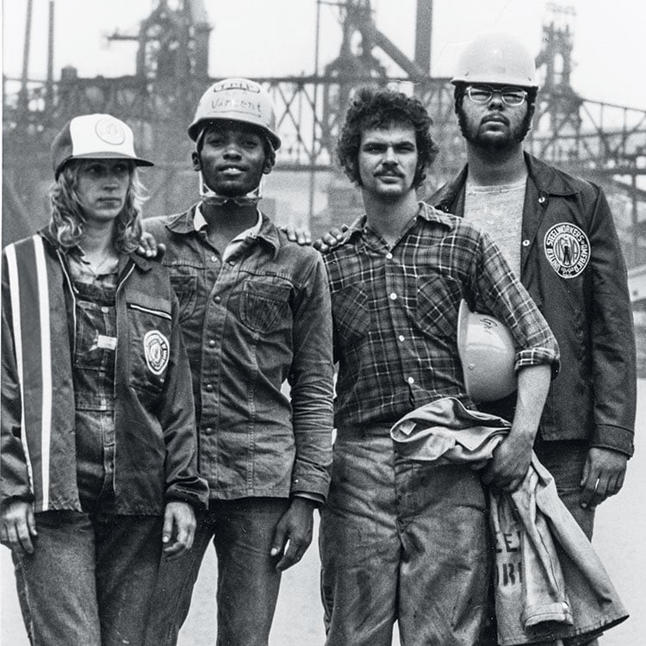
Individual Recruitment
“Individual [one-on-one] recruiting is the base of all organizational work in the steel industry.”
“It is important for every steel center and may be the only way to recruit in company union towns, where terroristic conditions prevail.” Secret methods of organization work are often imperative to prevent demoralizing discharge cases. Exposure of the workers to discharge must be strictly avoided.

Slide 21
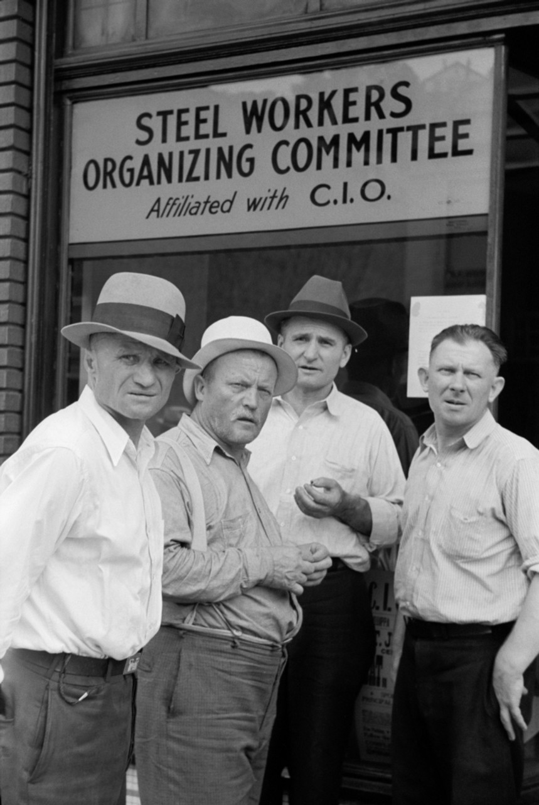
Recruitment work cannot be done by organizers alone
The main task is to organize the most active workers to do the recruiting and then to closely check-up on all activity.
Recruitment can only succeed if the workers help directly in the enrollment of new members.
What is needed, is to activate the workers to do the individual button-hole work, and to be given the ability to sign up new members.

Slide 22
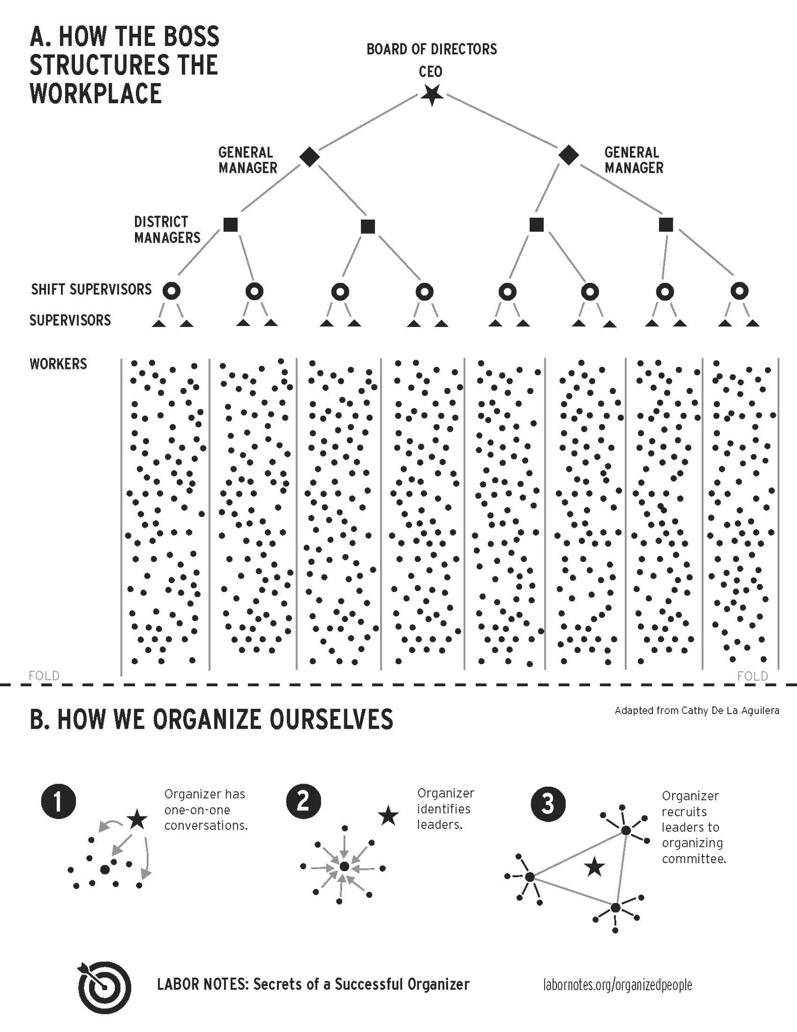
The Chain System (Networking)
One of the best means of individual recruitments is the “chain system” (referrals) such as:
Active workers undertake personally to organize their friends or to furnish their names to organizers.
One on one Personal Referrals
Lists given to trusted workers for contacting
Active workers recognize key persons for recruitment
Campaigns for Recruitment organized by department, mill, etc.
Create Sign-ups at public events, fraternal, social events, home meetings, etc.

Slide 23
Open Recruitment
Offer recruitment opportunities at all mass meetings, events, etc, when there is no danger to jobs. Active workers should be on hand to sign up new members, issuing receipts on the spot. Often large numbers of potential members are lost through neglecting these elementary preparations for their enrollment. Often workers will join at small meetings when they will not sign up at large, open mass meetings.
It is very important from an organizational standpoint that the local unions and their branches be set up as soon as practical and a regular dues system established. This impresses the workers with seriousness and stability of the movement. Merely signing up a worker does not organize him. He must be brought into a local union, given a union card, got to paying dues, attending union meetings, etc.

Slide 24

Recruitment Struggles
EMPHASIZE OUTCOMES:
Use successful results from campaigns, from new members, etc, to facilitate organization work. Potential members want to belong to a successful organization.
If on the other hand the campaigns are defeated, the resultant anger among potential members can also be utilized readily for organization building.

Slide 25
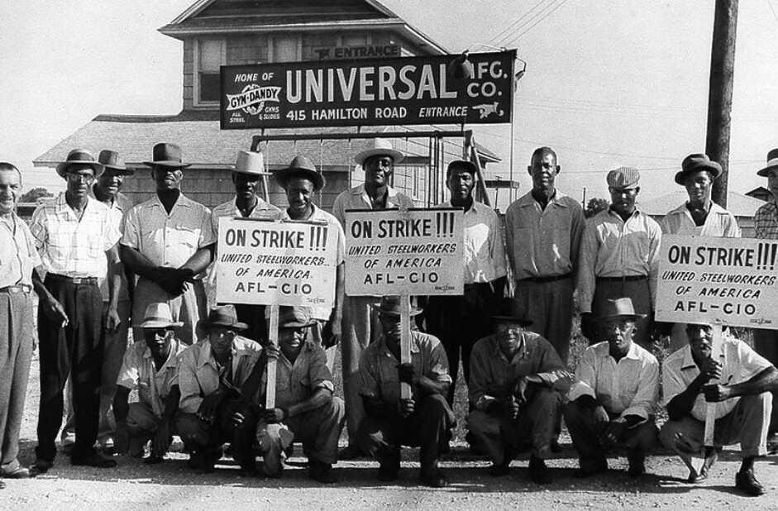
Know Your Audience - Minorities
Special efforts should be made to fight against employer-cultivated craft union, company union, anti-foreigner, anti-black and anti-Native American tendencies among workers. Active work should be carried on in many organizations such as various fraternal orders, etc.
There should also be immediately developed an active campaign against the prevalent jim-crow practices in the steel towns and steel industry. Local organizations of African-Americans should be enlisted in support of the campaigns.

Slide 26
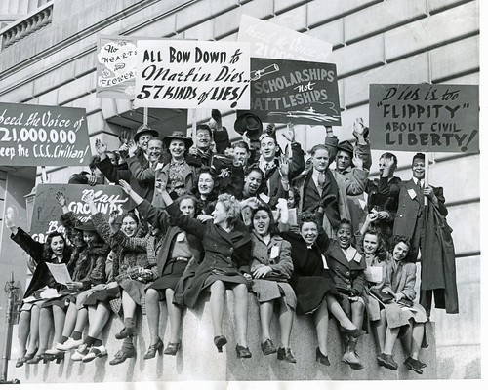
Know Your Audience - Youth
Youth committees should be set up in the organization. It is necessary to use certain special methods in addition to the system of the general campaign.
Youth demands should be formulated and widely popularized.
A corps of youth organizers should be developed. Special meetings and mass delegate conferences of the youth should be held and attention given to cultivating sports activities of various kinds among the youth. Systematic organizational campaigns should be directed to the youth members of the Y.M.C.A. and such organizations.
The connections of the American Youth Congress should be utilized to organize the youth.

Slide 27


Know Your Audience - Immigrants
There should be organizers speaking the principal foreign languages of the foreign-born workers. Literature must be issued in these main languages to enroll the militants among the foreign-born workers. Systematic recruitment work must be conducted in the many fraternal and other organizations that exist among this group of workers.

Slide 28
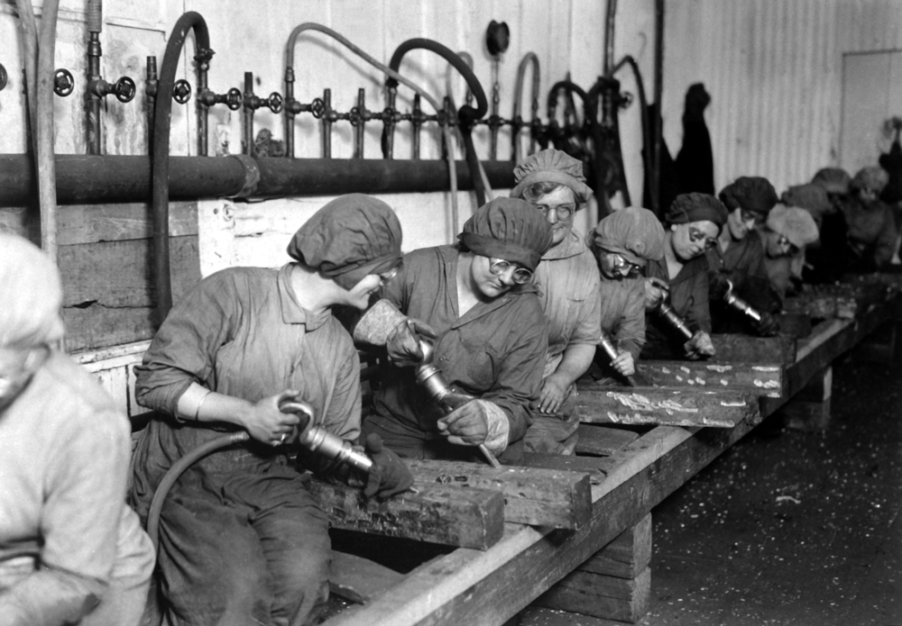
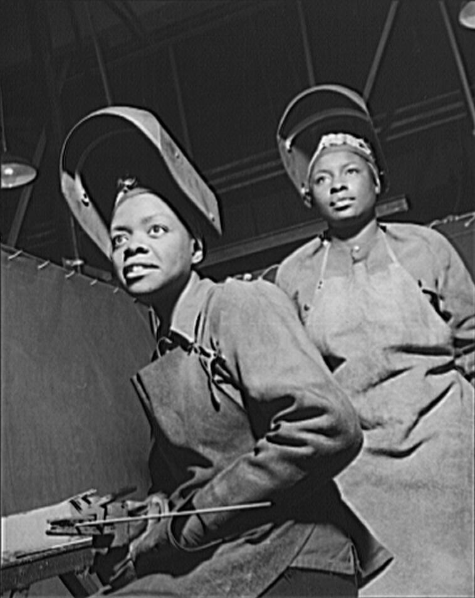
Know Your Audience - Women
The women relatives of workers are a vital factor. The most militant among them should be drawn into all the activities of the general organizing force.
Special meetings and mass delegate conferences of women should be held with prominent speakers, and special literature dealing with women’s problems, etc.
There should be a corps of women organizers in the field, and the women’s clubs and other organizations should be stirred into constructive activity in the campaign.

Slide 29
“Keep the question of the economic demands
And the need for a solid trade union aggressively in the forefront”
“The steel corporations will make every effort to destroy the solidarity between the various groups of workers in the steel industry and thus to defeat them all by attempting to divide them upon political, racial, religious and national lines.
In order to combat this campaign the essential thing is to keep the question of the economic demands and the need for a solid trade union aggressively in the forefront.
Under no circumstances should the campaign leadership allow itself to be dragged from this main line and into abstract racial, religious, national and other questions. “

Slide 30
Discussion

Slide 31
Company Unions and Special Organization Work

Slide 32
VI. Company Unions
The company unions can with proper methods be developed into a strong force for building the (the Amalgamated Association) A.A. In this respect the work should be based upon the following general principles:
(a) The organizing crew and A.A. must develop a strong initiative in the industry by an intense advocacy of its slogans and by very active organization work. In this manner the union must be made the center of all movements of the workers against the employers. To develop such an initiative by the union forces is fundamental.
(b) All activities within the company unions should be undertaken with flexible tactics in the sense of utilizing the company unions as an auxiliary force to the building of the trade union with the aim of eventually incorporating the company union membership into the A.A. In many cases the structure of the company unions can be readily transformed into trade union organizations.

Slide 33
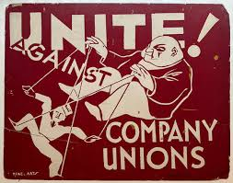
Company Unions C0nt.
(c) The general policy in the company unions should be directed towards bringing the masses into conflict with the bosses in order to awaken the workers’ fighting spirit, to demonstrate to even the most backward workers the insufficiency of company unionism, and thus to give a stimulus to the campaign to organize the A.A. and thus to lay the basis for the maximum permanent advantages for the workers.
(d) In submitting major demands to the companies, therefore, the company union should put forward the main union demands and stand by them firmly, thus identifying themselves with the union organizing campaign and making clear to all the need of the trade union to back up these elementary demands. So far as possible all important concessions from the company should be won directly by the trade union or under its immediate leadership.

Slide 34
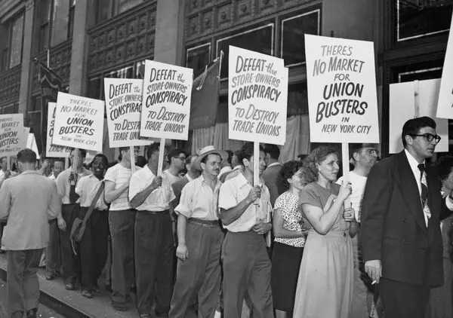
Company Unions C0nt.
(e) Minor shop demands should be freely submitted by the company unions, efforts being made at the same time to develop the local company union forces into shop grievance committees of a trade union character working in close cooperation with the A.A. Local strikes over these demands should be avoided, especially in the early stages of the campaign and in the major factories, warehouses, etc.
(f) The organizing crew and the A.A. should give active support to all the major and minor demands submitted by the company unions to the employers. Only in this manner can the workers be made to understand that whatever concessions they may secure through the company union are due primarily to the activity and strength of the trade union organizing campaign.
(g) In case of company union elections tickets should be put up of workers supporting the A.A. and the organizing campaign.

Slide 35
Company Unions C0nt.
(h) Efforts should be constantly made to have the company unions in practice break with their narrow constitutions by holding mass local and district conferences, by issuing independent papers and bulletins, by meeting off company property, etc.
(i) In cases where such a step is possible and practical, trade union speakers should be invited to company union meetings and vice-versa. Joint trade union-company union conferences should eventually become possible and necessary.
(j) In all this work in the company unions the basic conditions for success are, first, for the organizing forces to maintain in the company union an active campaign of education, exposing the maneuvers of the companies and stressing the need for trade unionism and, secondly, to prosecute in the company unions an aggressive campaign of organization by recruiting key men, setting up of organizing committees in shops, activizing of company union members, drawing in of company union representatives into trade union conferences, meetings, etc.

Slide 36
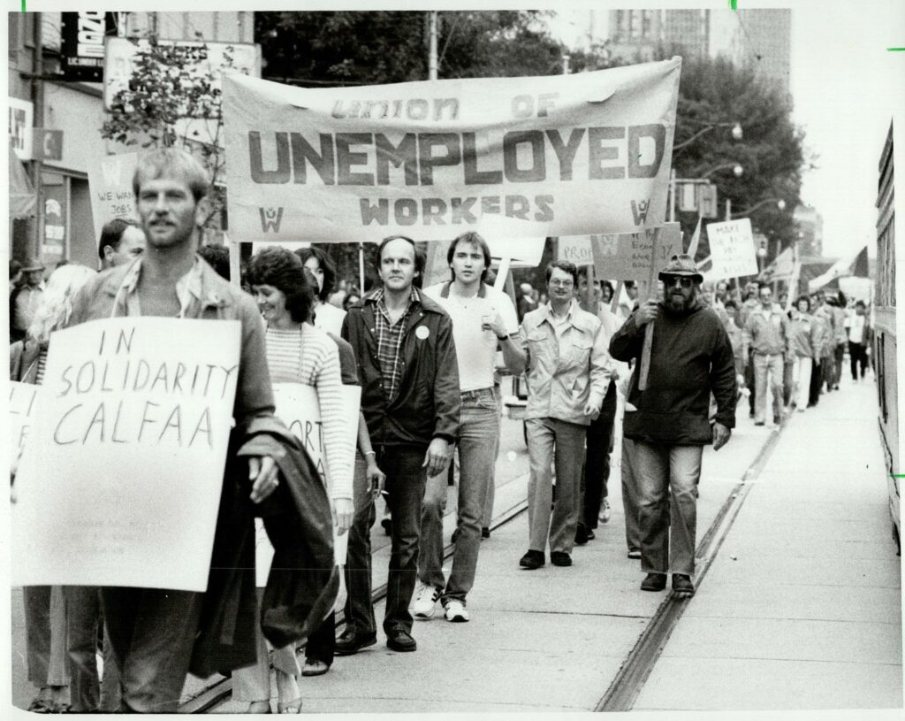
VII. Special Organization Work: Part 1
The Unemployed
It is important that the strongest bond of solidarity be developed between the employed and unemployed workers in the given industry. This is necessary in order to help the organization work at the present stage of the campaign and also to establish a complete unity in the eventuality of a strike.
(a) The organizing forces and the A.A. should give active support to the demands of the unemployed workers, and should extend support in building the Workers Alliance and other organizations of the unemployed.
Union of Unemployed Workers marching in the 1982 Labor Day Parade.

Slide 37
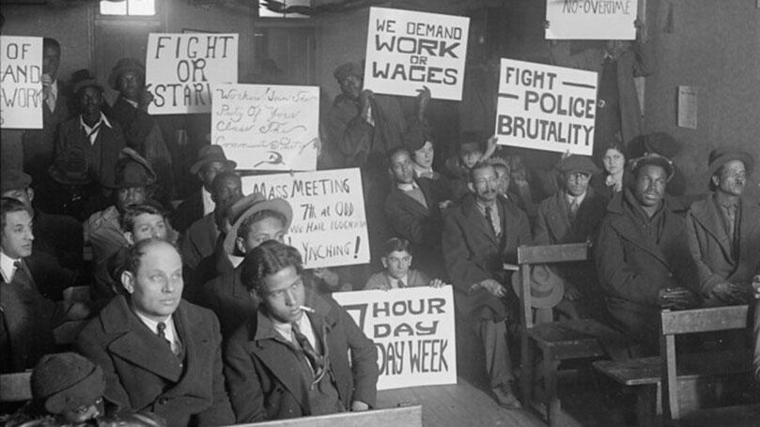
Special Organization Work: Part 1 Cont.
(b) Representative unemployed workers should be engaged as union organizers and brought into all the trade union organizing committees. Volunteer organizers should also be recruited from among the unemployed and relief workers.
(c) Mass conferences, demonstrations, etc., of the unemployed should be stimulated to popularize and organize the trade union campaign.
(d) Representatives of the organizing crew should visit all organizations and meetings of the unemployed in order to make direct connections in behalf of the organizing campaign.
The National Unemployed Council, made up of workers of all political affiliations, was organized in Chicago, on July 4, 1930. It was fully backed by the C.P., T.U.U.L., and Y.C.L.

Slide 38

VII. Special Organization Work: Part 2
Fraternal Organizations
These organizations play a vital role in the local community, especially among the foreign-born workers. It is very important to develop a strong educational and organizational campaign among them. Among the measures necessary are the following:
(a) There should be national and local mass conferences held in which these organizations should recruit members for themselves as well as for the A.A.
(b) There should be committees set up in the local organizations of these fraternal bodies in order systematically to recruit their worker members into the A.A.
The Ancient Order of United Workmen (AOUW) was a fraternal organization in the United States providing social and financial support after the American Civil War.

Slide 39
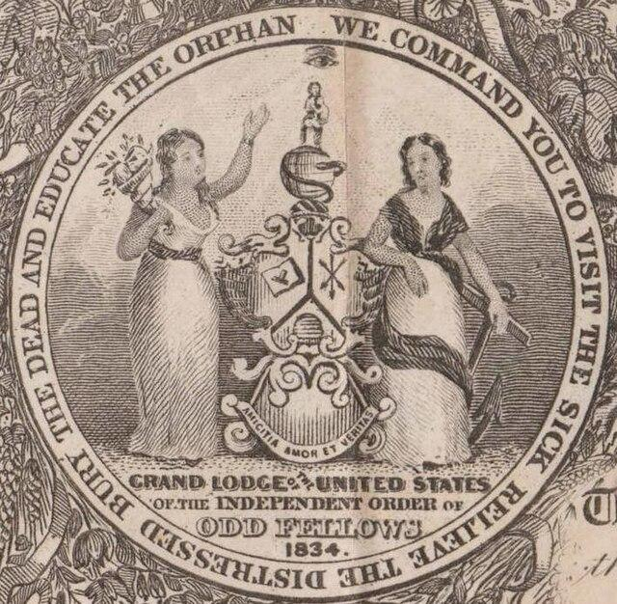
Special Organization Work: Part 2 Cont.
(c) There should be an exchange of speakers between the meetings of the fraternal organizations and of the union. They should also send fraternal delegates to each other’s conferences and gatherings.
(d) The fraternal organizations should assign organizers to the organizing campaign.
(e) The organization campaign should make free use of the halls of the fraternal organizations and, in cases of suppression of civil rights, these may be the only halls available.
(f) Educational material on the union drive should be systematically furnished to the press of the fraternal organizations.
The Independent Order of Odd Fellows (IOOF) is a non-political, non-sectarian international fraternal order of Odd Fellowship.

Slide 40
Special Organization Work: Part 3
Churches
In many instances strongly favorable sentiment to the organization campaign will be found among the churches in the local area. This should be carefully systematized and utilized.
(a) Organizers should be sent to the churches to speak from the pulpits. If possible, Labor Sundays should be organized, with organizers speaking in many churches simultaneously throughout the whole community.
(b) Sympathetic priests and preachers should be invited to speak at meetings in the organization campaign.
(c) Active work of recruitment should be developed in the local religious organizations, articles should be prepared for publication in the religious press, etc.
(d) In case of suppression of civil rights, meetings may sometimes be held in church premises.

Slide 41
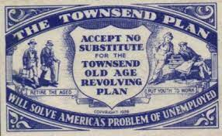
Special Organization Work: Part 4
Other Organizations
Organizing work along similar lines to the above can and should be carried on effectively in local branches of such organizations as the American Legion, the National Union for Social Justice, the Townsend movement, farmers’ organizations, cooperatives, etc.
In the local towns the organizing crew should pay special attention to sending speakers into all organizations and meetings of professional and business men, in order to break down so far as possible the opposition of these elements to the organization of the workers.
The Townsend Plan was a September 1933 proposal by California physician Francis Townsend for an old-age pension in response to the Great Depression, leading to a social and political movement. At its peak, the OARP advocacy group claimed more than 750,000 members

Slide 42
Discussion & New Members Introductions

Slide 43
New Member Introductions
What is your name, pronouns and state (or country/territory)?
Where do you work? Is it unionized?
How did you find out about the People’s School?
What do you think about tonight's class?

Slide 44
Discussion & Wrap Up

Slide 45
Announcements
PSUSA Cell Chairs need to call members of their cells to remind them about attendance.
2025 of New Masses is in production. If you have any art or literary work you wish to submit, please email it to info@partyofcommunistsusa.net

Slide 46

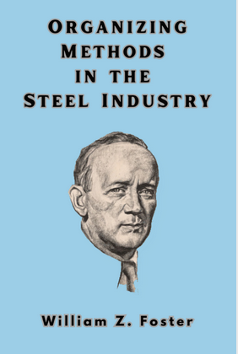
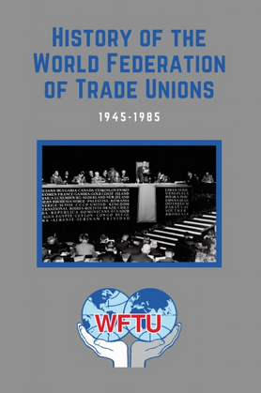

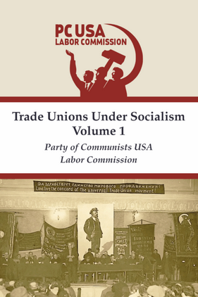
New Outlook Publishers
newoutlookpublishers.store
Relevant and Latest Releases

Slide 47


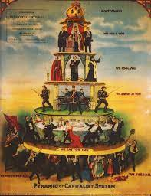
Harry Bridges School of Labor
luel.us/laborschool/
The Harry Bridges School of Labor is a monthly class held once per month starting September 2025. Classes cover a variety of topics aimed at building class consciousness among union members.
September’s class is “Class-Oriented Labor and Politics - Independent Political Action”. Class will be September 6, 2025 at 7pm EST/4pm PST.

Slide 48
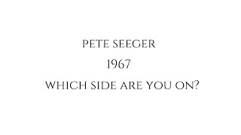
Which Side Are You On? By Pete Seeger

