Slide 1


I Don’t Want Your Millions, Mister by Pete Seeger

Slide 2
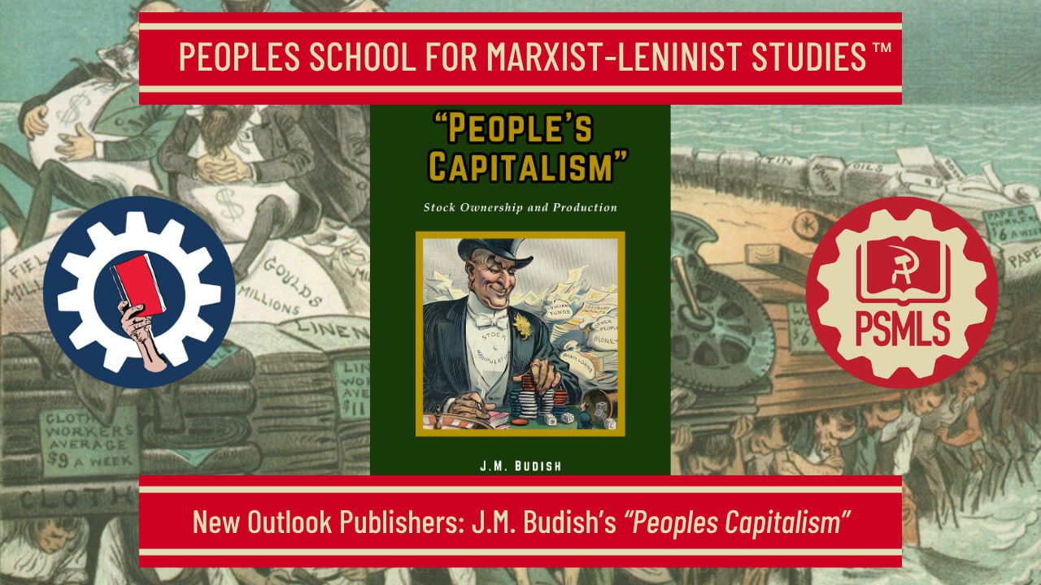
PSMLS May 27th, 2025

Slide 3
What we’ll be learning today:
US Corporations and how they present the idea of “People’s Capitalism”
Economic growth under capitalism
Comparison to the USSR

Slide 4
US Corporations & the Myth of “People’s Capitalism”

Slide 5
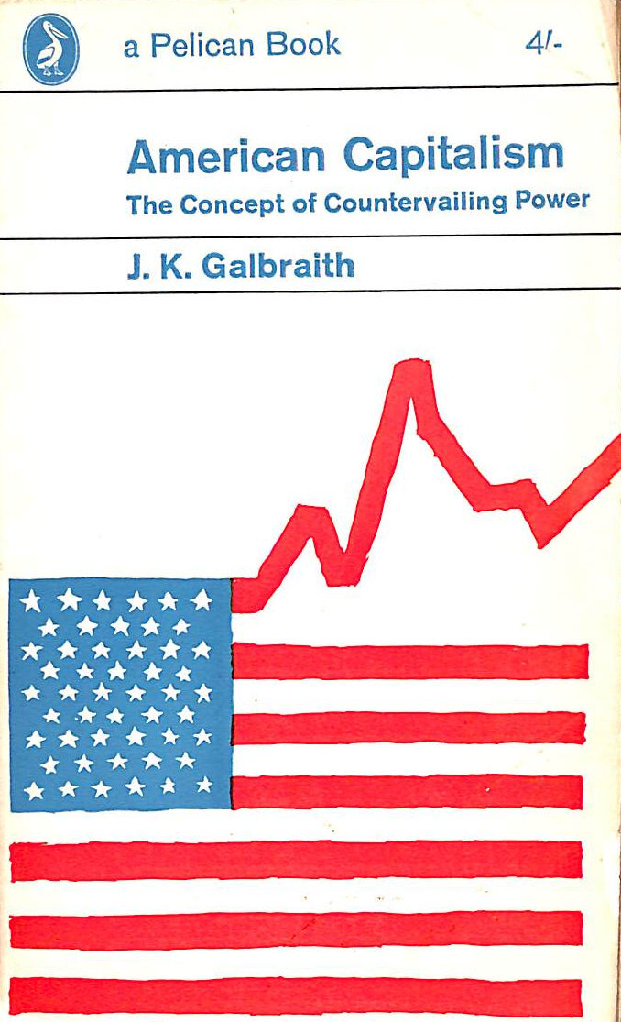
“People’s Capitalism”
After 2 world wars, the Great Depression and many lesser economic crises and recessions, all within the span of one generation, the capitalist economy has become so discredited that even its spokesmen have come up with a new label for it: “People’s Capitalism.”
This mythical idea was elaborated in the pamphlet “American Capitalism,” published by the Ethyl Corporation, a conglomerate of General Motors and Standard Oil Co. The ideas are taken from lectures of Professors Salvadori of Smith College.
Salvadori explains that while “old-style European capitalism” represents crises, instability, unemployment, war and imperialism, that American capitalism is not the same.

Slide 6
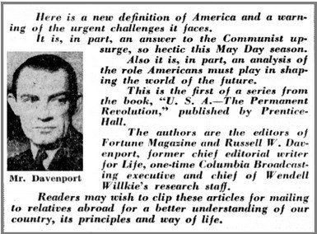
“People’s Capitalism”
This rebranding of capitalism is nothing new. In the Fortune Magazine’s first chapter, “U.S.A., The Permanent Revolution” (1951), they advanced the claim of U.S. capitalism to a unique and beneficent nature:
“U.S. capitalism has been in the process of transformation, with the result that it now bears little resemblance to the classical brand (against which, for example, Karl Marx launched his
attack more than a hundred years ago). ... When Europeans talk of capitalism they are referring to something that no longer exists in America… More goods at lower cost (and prices) is the basic principle of American industry.”
Image from Fortune Magazine's "USA: The Permanent Revolution."

Slide 7
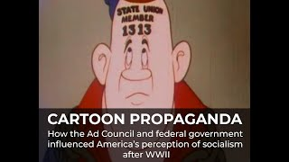
“People’s Capitalism”
The Advertising Council and the U.S. Information Agency (a federal propaganda organization operating in foreign countries) in their campaign to promote “the understanding of the effectiveness of the American economic system,” published a pamphlet, People’s Capitalism, for distribution abroad.
They admit with disarming modesty that: “Capitalism in the United States went through a period when the general welfare was often neglected, when great fortunes were amassed while the workers were overworked and underpaid.” But, we are told, “This belongs in the historical past. Today's picture is a different one.”

Slide 8
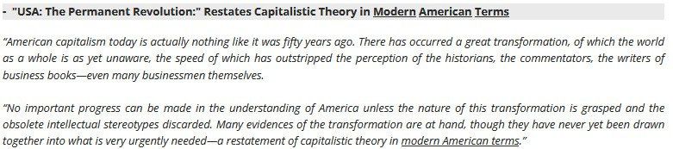
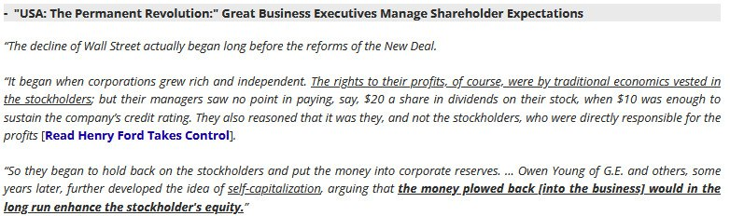
Excerpts from People’s Capitalism

Slide 9
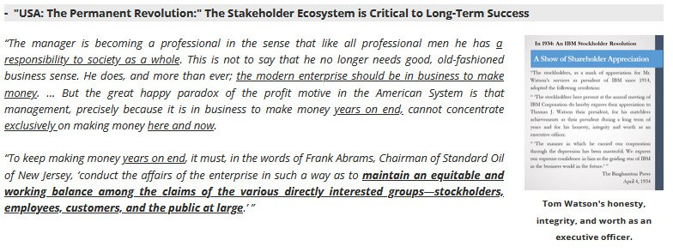
Excerpts from People’s Capitalism

Slide 10

The New York Stock Exchange
The visitor center at the New York Stock Exchange boasts signs such as:
NEW YORK STOCK EXCHANGE—CORNERSTONE OF A PEOPLE’S CAPITALISM.
“Two Significant Developments Sparked Our Democratic Capitalism—Division of Corporate Ownership Into Shares and Stock Exchanges Where These Shares Can Be Traded.”
“Our National Corporations Are Owned by Millions of People.”
“Share Owners Are Increasing at the Rate of 500,000 a Year.”
Propaganda to convince the average worker into buying corporate stocks through brokers on the NY Stock Exchange

Slide 11
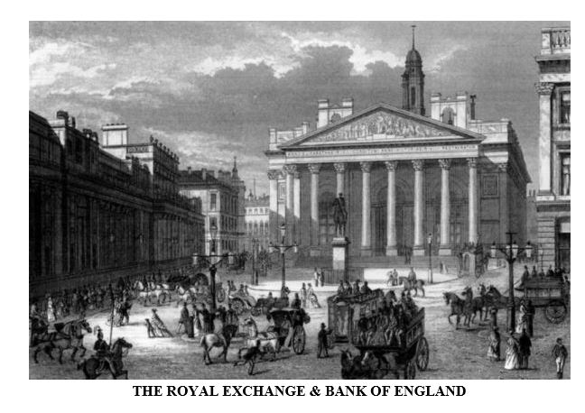
The New York Stock Exchange
People’s Capitalism claims that the change from the old form of rapacious European capitalism to an alleged benevolent capitalism of the US comes from 1. the division of the capital of industrial and other corporate enterprises into shares and 2. the functioning of stock exchanges where these stocks can be bought and sold. These changes, according to
the chairman of U.S. Steel Corp., have produced a situation where “businesses—especially our biggest businesses ... are now owned by millions of people in all walks of life.”
However, any claim that the New York Exchange represents the cornerstone of a unique “People’s Capitalism,” peculiar only to postwar United States, clearly has no validity, considering the existence of stock markets since the 1700s in various European countries. The American stock exchange itself originated in 1792.

Slide 12

The New York Stock Exchange
President Keith Funston of the New York Stock Exchange claimed that “we have moved closer to a true “People’s Capitalism” in which millions of people everywhere—the great bulk of them in the middle income ranges—own the voting shares of American business. What’s more, the trend of share ownership continues to expand.”
The same line is taken by Professor Marcus Nadler in People’s Capitalism, “The economy of the United States is rapidly assuming the character of what may be termed
‘People’s Capitalism,’ under which the productive facilities of the nation—notably manufacturing have come to be increasingly owned by people in the lower and middle income brackets or indirectly by mutual institutions which manage their savings.”

Slide 13
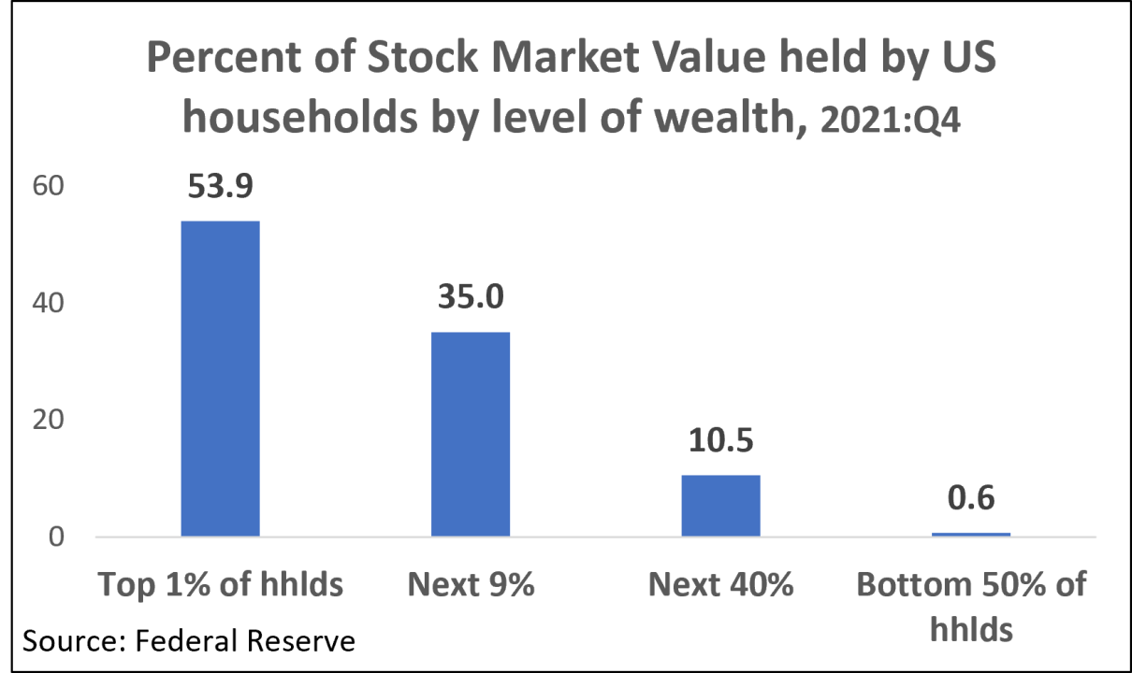
The New York Stock Exchange
How widespread is the ownership of the means of production in the US? A survey conducted by the New York Stock Exchange early in 1956 reported that 5% of individuals in the U.S. population owned shares, and this is likely a generous overestimate. Only 0.2 percent of the unskilled workers, 1.4 percent of the semi-skilled workers, and 4.4 percent of the skilled workers and foremen owned any stocks at all.

Slide 14
The New York Stock Exchange
What is even more significant, only 2.3% of all stockholders in manufacturing corporations owned 57% of the total number of those corporations’ shares. In finance and investment companies 3% of their shareholders controlled 53% of all their shares. In transportation 1.5% of shareholders held 56% of the stock.Finally, in the field of public utilities (telephone, gas, electricity, etc.) only 1% of the shareholders owned 46% of all shares.
Only slightly over 6% of all adult Americans owned any shares, and the mass of these shares was controlled by 1% to 3% of the shareholders, or by 0.06% to 0.18% of the adult population. Thus, the effective shareholding control of the U.S. economy is concentrated in the hands of a tiny monopolistic class ranging, for the various branches, from two persons in every thousand to one person in every two thousand adults. The other millions of shareholders own an average of approximately four shares per stockholder, the Brookings study showed. This, of course, gives them no voice whatever in the control of the economy. The market value of Rockefeller holdings in a single corporation, Standard Oil of New Jersey, was twice the market value of all the holdings of all American wage earners.

Slide 15
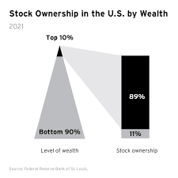
The New York Stock Exchange
In summary, some 90% of the American people own no stocks at all and the shareholdings of the majority the other 10% are limited to an insignificant number of shares. Neither directly nor
indirectly through so-called mutual financial institutions (savings banks, insurance companies, etc.) do the overwhelming majority of the people have any effective share in the ownership or control of American business or capitalism.
Employee stock ownership plans and the intensive campaigns for consumer stock ownership are merely schemes designed to induce the workers and the public to believe that monopolistic enterprises are owned by the people.The richly supported propaganda seeks to implant in the public mind a misleading image of “People’s Capitalism.” Actually it aims to undermine the collective bargaining power of employees and impair their capacity to implement the gains they had won in former hard struggles.

Slide 16
The New York Stock Exchange
It aims also to weaken the resistance of customers to increases in the prices of goods and in the charges for telephone, light, gas, transportation, and other services. Any benefits the little stockholders (whether employees or consumers) may receive in the form of dividends or increased market value of the few shares they own, is extremely slight, very rarely exceeding the amount of straight interest they might have received from insured savings institutions on the original cost of their shares.
Such insignificant benefits are more than offset by the loss of earnings and the increased cost of living as a result of impaired bargaining power and weakened resistance to inflated prices and rates, not to speak of the risks connected with stock market fluctuations and the rapid decline of the market value of stocks in periods of business recession. The effective ownership and control of the big companies and the entire U.S. capitalist economy is concentrated in the hands of a tiny but powerful class of super-capitalists that comprises less than one fifth of 1% of the total adult population of the United States.The package labeled “People’s Capitalism” is in reality nothing else but monopoly capitalism.

Slide 17
Discussion

Slide 18
Economic Growth Under Capitalism

Slide 19
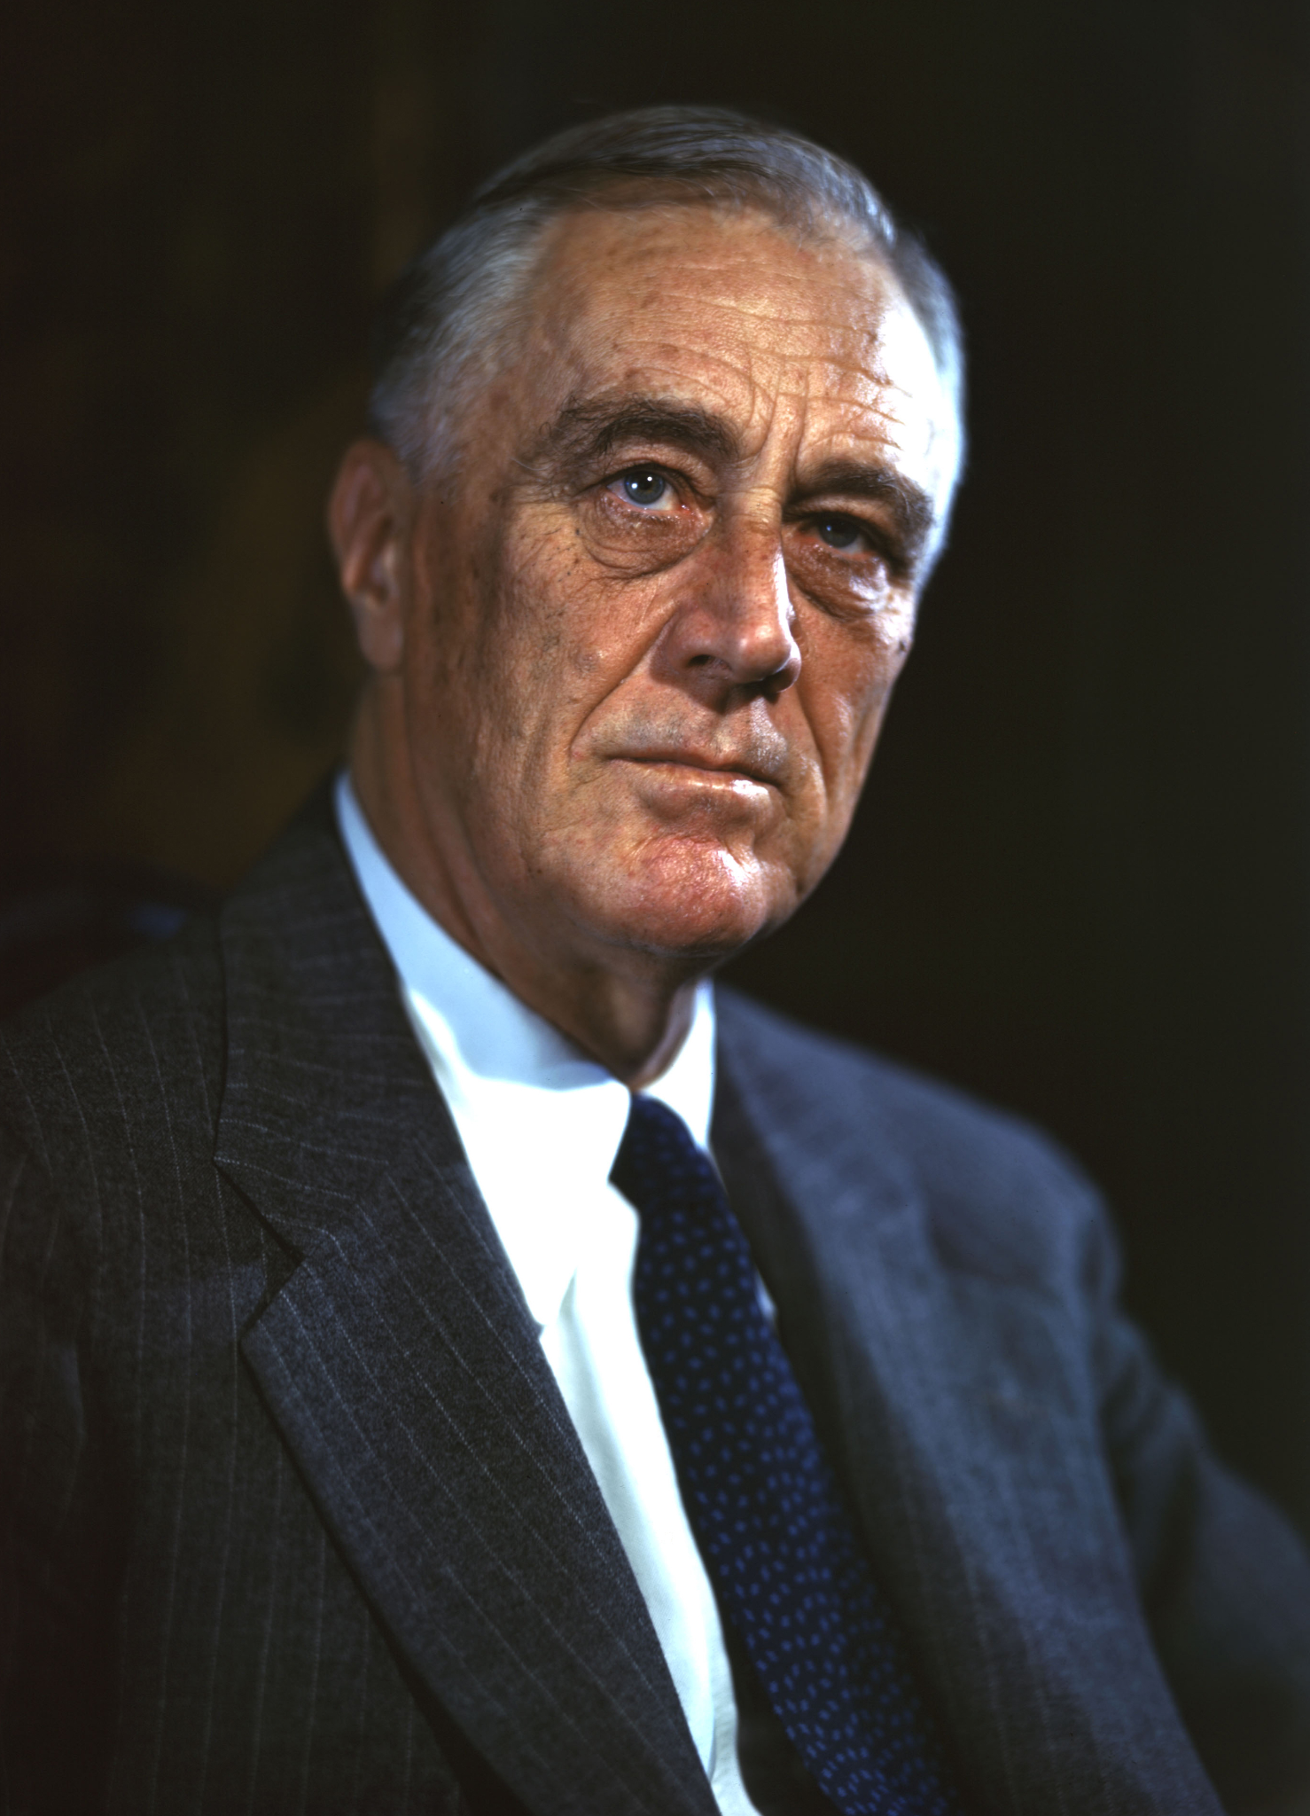
FDR’s Message to Congress
It is now nearly a century since Franklin D. Roosevelt, in a message to Congress in 1938, warned the American people that, “Private enterprise is ceasing to be free enterprise and is becoming a cluster of private collectivisms; masking itself as a system of free enterprise after the American model it is in fact becoming a concealed cartel system after the European model.” (A cartel is a combination of big private enterprisers, the largest business corporations, to eliminate competition by a formal agreement for control of output, markets and prices.)

Slide 20
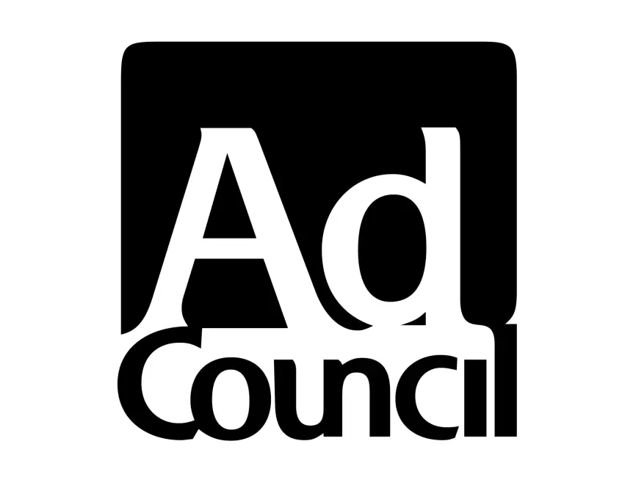
“Experts” Weigh in on People’s Capitalism
On November 16 and 17, 1956, a panel for the discussion of People’s Capitalism was held in New Haven, Conn., under the sponsorship of Yale University and the Advertising Council. The purpose, as announced in the American Round Table report called People's Capitalism, which gave a digest of the discussion, was to help make clear “the new, unique and vital economic system which has evolved in America.” It attempted also to reach conclusions on “the manner in which the American form of capitalism differs from older (and less enlightened) forms.”

Slide 21
“Experts” Weigh in on People’s Capitalism
The “experts” went so far as to admit that “widespread ownership of capital, though significant, is not an essential feature” of People’s Capitalism.
The slowed growth of the U.S. economy has not just happened. It has not been due to any special adversities. It has come about as an inescapable result of the inherent characteristics of capitalism in the course of its progressive concentration and monopolization.
Dean Sinnott, at the Yale-American Round Table conference had described the current U.S. economic system as follows: “Clearly it is a capitalistic system, characterized by free enterprise, competition and the profit motive, and not operated by the workers or the government.”
In addition to the fact that the features of “free enterprise” and competition no longer fully fit the present matured stage of monopoly capitalism. Prof. Sinnott’s definition also violates the laws of logic by being partly negative. It tells us who does not operate the American economic system, but fails to say who does operate it.

Slide 22
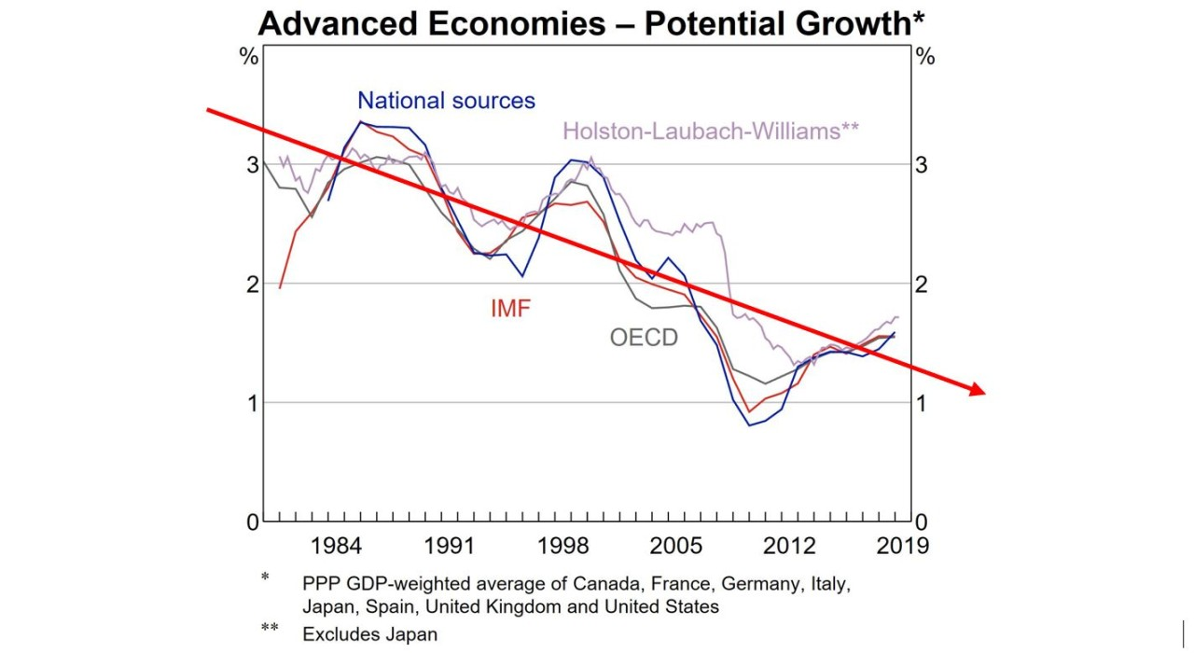
“Experts” Weigh in on People’s Capitalism
This exposes the inherent deficiency of U.S. capitalism, namely, private ownership of the Means of production and their operation for private profit. As We shall see, such ownership and operation for profit inevitably generates fluctuations of expansion and contraction, boom and bust, and also an increasing gap between the capacity to produce and effective consumer demand. Hence the slackening of rate of economic growth.

Slide 23
“Economic Growth” Under Capitalism
It is true that in the present advanced monopoly stage of U.S. capitalism the most important industries are controlled each by a few giant enterprises. These monopolies may, and frequently do, act in concert with a view to the elimination of some phases of competition among themselves (by informal agreement to maintain more or less uniform prices, distribute markets, etc.). But these giant companies, even when acting together, are still groping blindly. For they cannot possibly predetermine the aggregate effective market demand at the time their finished goods will be offered for sale, nor can they foresee how the demand for their particular goods would be affected hy unpredictable changes in consumer preferences, or by technological changes and innovations in other industries producing interchangeable materials, equipment or consumer goods.

Slide 24
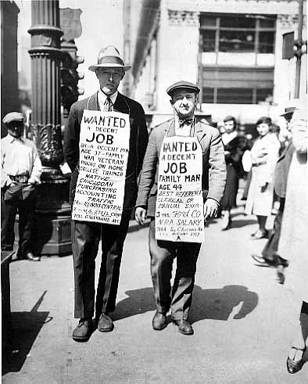
“Economic Growth” Under Capitalism
Upholders of the capitalist system have claimed that since the Great Depression “a revolutionary change” has taken place in the American economy. It is contended that a remodeled “People’s Capitalism” has been supplied with so-called built-in stabilizers, such as unemployment benefits, social security, price supports for farmers, as well as plans for deficit spending.

Slide 25
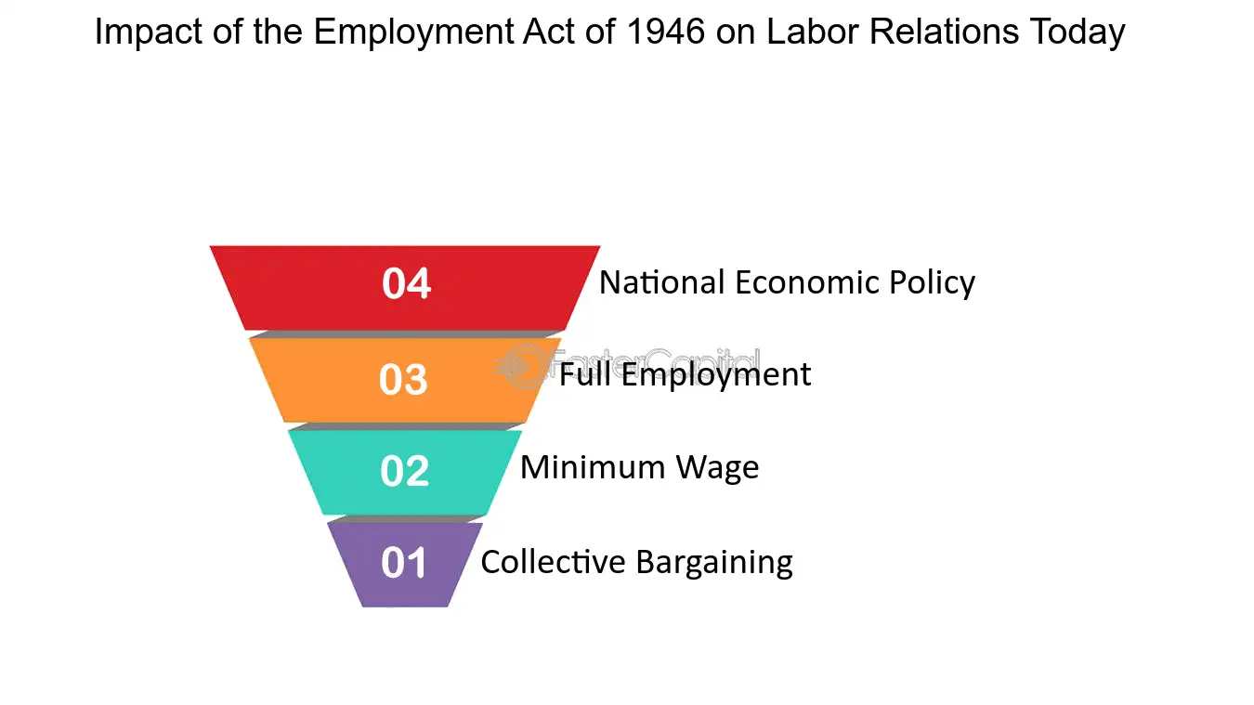
“Economic Growth” Under Capitalism
Special significance is ascribed to the passage of the Employment Act of 1946 that makes it the responsibility of the federal government “to promote maximum employment, production and purchasing power.” Government monetary and fiscal (credit control and taxation) policies plus various welfare programs have allegedly insured the U.S. economy
against violent business fluctuations and have practically eliminated the danger of another serious economic crisis or depression.

Slide 26
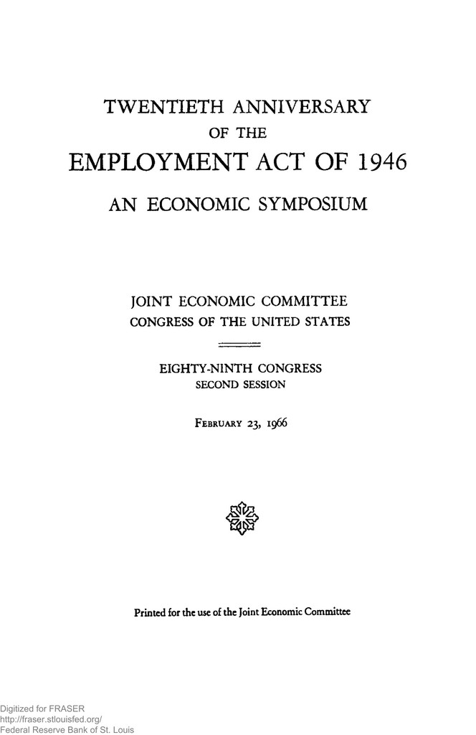
“Economic Growth” Under Capitalism
But whatever their merits in temporarily relieving distress, these “stabilizers” cannot be considered something either new or peculiar to U.S. capitalism. Also, actual developments show that such measures and programs have not provided any greater stability to U.S. capitalism.

Slide 27
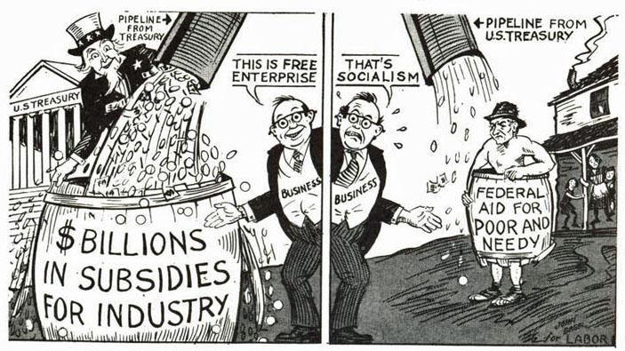
“Economic Growth” Under Capitalism
The spokesmen of capitalism, even while making every effort to sell it under the label of ‘People’s Capitalism,” tell us that profit is “the one thing our economy must have to live and grow on.” In the early stages of U.S. capitalism, profit was a significant factor of economic growth. So long as free enterprise and ruthless competition were still effective realities, the profit motive did provide an incentive for innovation and technological improvement, making possible cost reduction and increased profit, but requiring mass production on an ever larger scale.

Slide 28

“Economic Growth” Under Capitalism
The Brookings Institution economists prefer to call the present stage of capitalism not monopoly but oligopoly capitalism, in which a few giant corporations control the greater part of the assets, output and sales of the nation. But monopoly by any other name still exercises the same control over the market and still has the same incentive for producing at less than capacity in order to maximize profits.

Slide 29
“Economic Growth” Under Capitalism
Under present monopoly conditions the profit motive has become a major restraining and retarding factor sharing the responsibility for the decline of our ability to multiply, as well as for the decline of the rate of increase in U.S. industrial production.
In view of these facts one must agree with the conclusion of the Congressional Select Committee on Small Business: “But whatever the explanation [for the monopolistic policies of Big Business]—cartelization or spontaneous recognition of the joint advantages of monopolistic behavior—the results are about the same. In either case the results are high price and low production policies. These policies tend to an economy of restriction and scarcity—not to an economy of progress and abundance. A monopolized economy may operate at full employment levels for a while—particularly in periods of huge government expenditures, but much logic supports the view that ultimately such an economy results in unemployment and collapse.

Slide 30
Discussion

Slide 31
U.S. and Soviet Economic Growth: A Comparison

Slide 32
The Economic Challenge of the Soviet Union
Let us see how the rate of economic growth under U.S. capitalism compares with that of the socialist economy of the Soviet Union. For years all government and economic authorities, as well as all media, cultivated the illusion that the socialist economic system of the Soviet Union, from which profit motivated private enterprise was eliminated, went basically against human nature, and would never be able to increase production substantially. But soon the spokesmen of U.S. capitalism were sounding the alarm against the economic challenge of the same Soviet Union.

Slide 33
The Economic Challenge of the Soviet Union
Soviet economic growth proceeded at a rapid rate putting it in the front rank of all highly industrialized countries, second only to the United States. As early as 1955 the Joint Economic Committee of the U.S. Congress prepared a study, Trends in Economic Growth: A Comparison of the Western Powers and the Soviet Bloc. Later, in 1957, the same committee prepared another study titled Soviet Economic Growth: A Comparison with the United States. The study for the Congressional Joint Economic Committee was prepared by a staff of expert economists with the advice of specialists of the Departments of Agriculture, Commerce, Defense, Labor and State, and the Library of Congress.

Slide 34
A Tale of Two Economic Systems
The Congressional study chose two periods for comparing U.S. and Soviet growth. The rates of Soviet economic growth during (1) 1928 to 1955, and (2) 1950-55 are compared with the rate of U.S. economic growth in earlier periods; when the level of industrial development in the US and the distribution of labor force between agriculture and industry were presumably similar to those in the USSR. The Congressional committee’s study selected the periods, 1867-1907, and 1922-27 in the U.S. as the most satisfactory for comparison with the Soviet periods 1928-55 and 1950-55 “in order to shed the most light on the relative ability of the two systems to expand production most.”

Slide 35
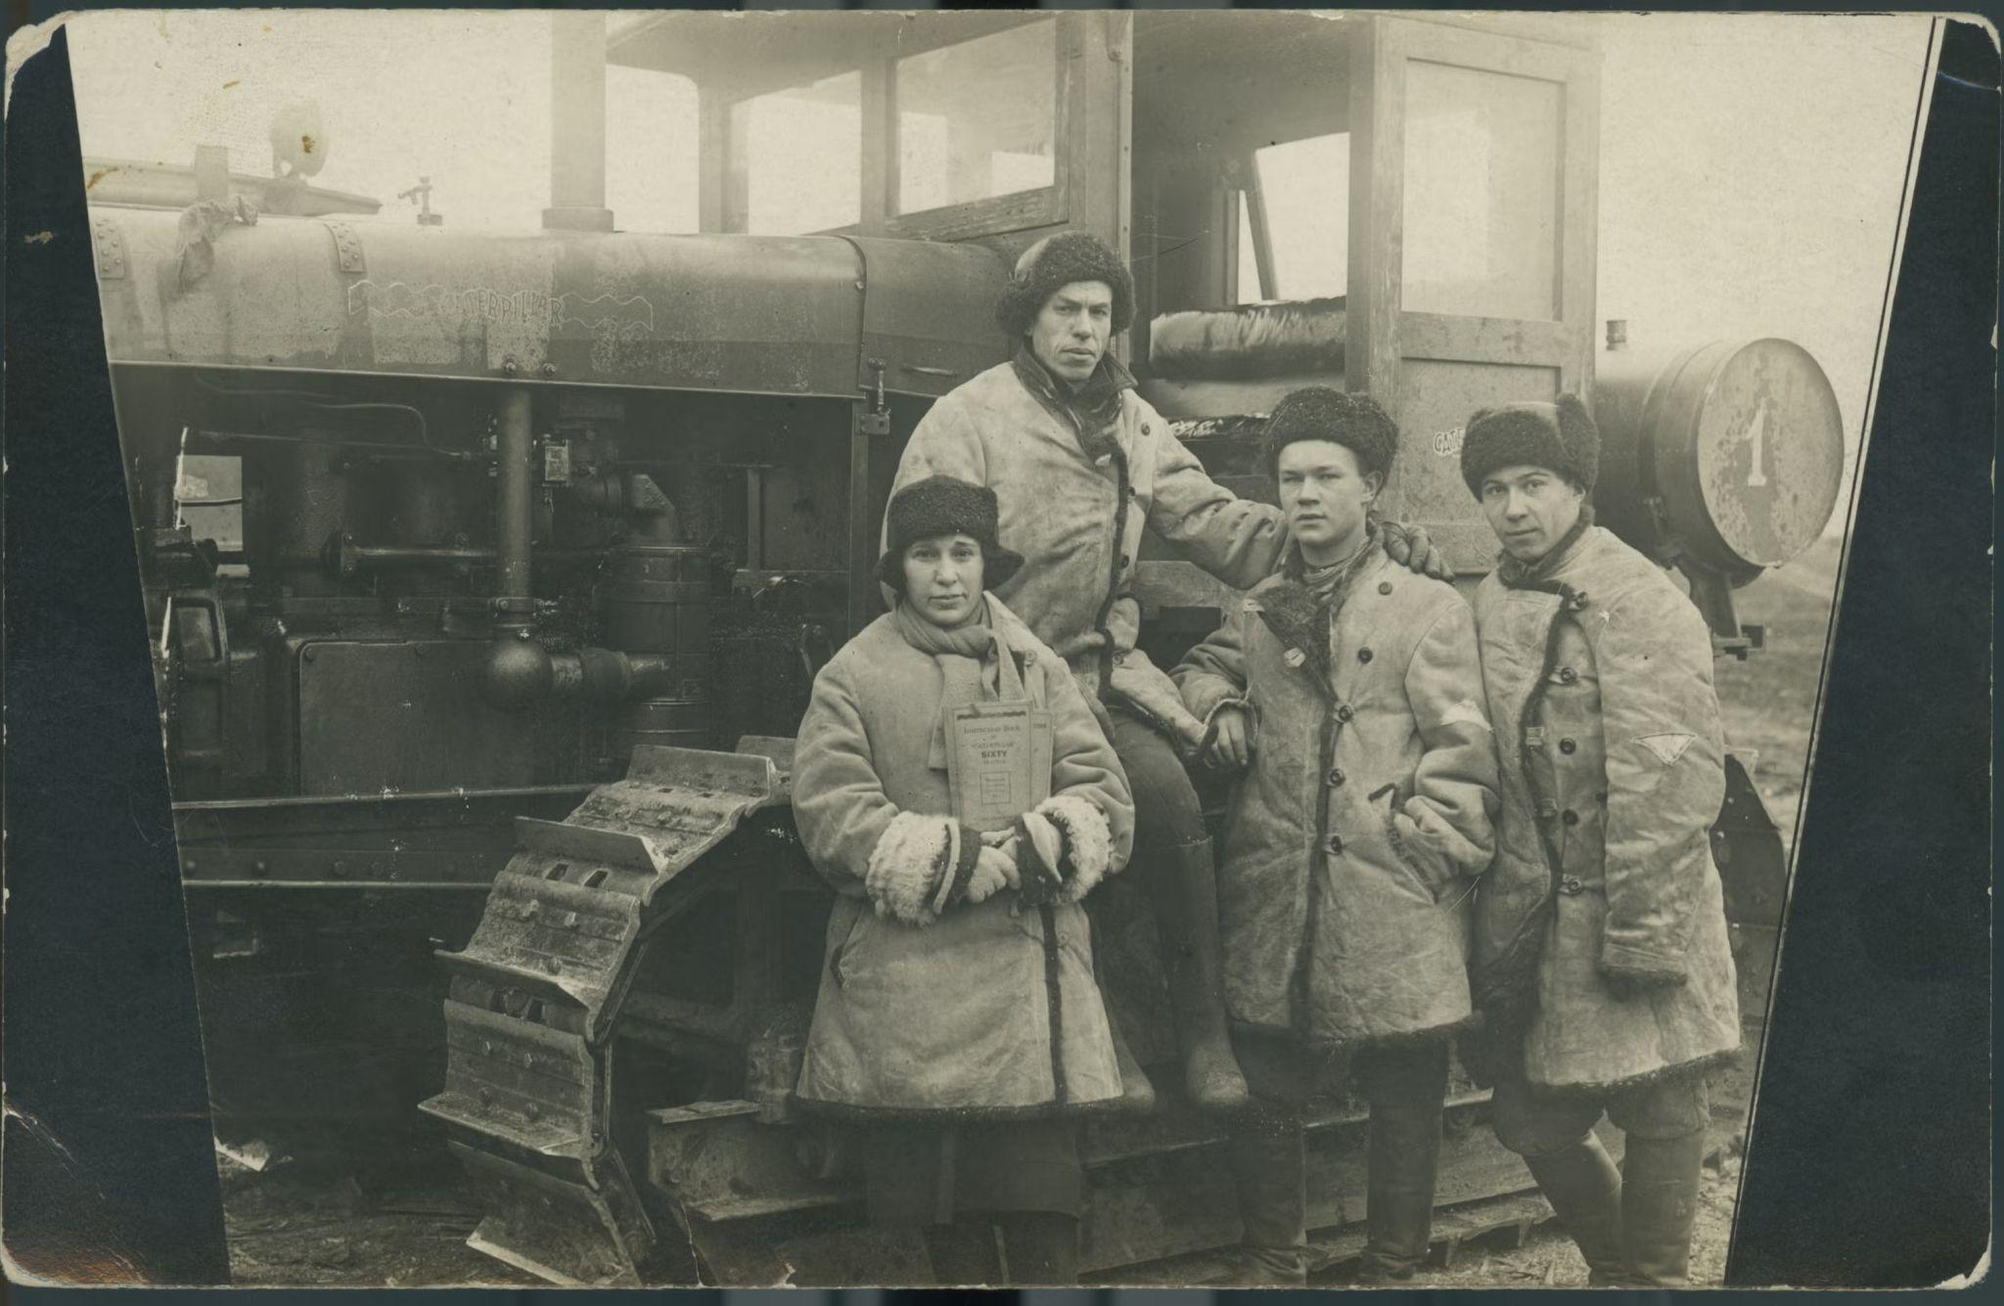
Notes:
The first five year plan (1928 - 1932) was created in order to initiate rapid and large-scale industrialization across the Union of Soviet Socialist Republics (USSR). In order to become an industrial powerhouse, modern machinery was adopted across the country to maximize production efficiency and output. Many qualified and experienced tractor instructors were hired to teach Soviets the operation of large machinery. In the photo above, an instructor can be seen posing with colleagues or students in front of a tractor in the USSR.

Slide 36
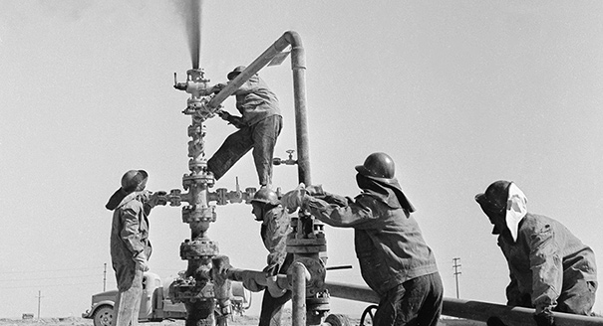
Notes:
Between the end of World War II and the mid-1960s, the Soviet Union’s economy was one of the most vibrant in the world. The country had successfully launched the first man into space and was competing with the United States in developing cutting-edge military technology.

Slide 37
An Unfair Comparison
The committee chose a method of comparison that weights the scale strongly against the USSR. To illustrate, we may consider just two decisive factors of economic growth: labor force and capital investment. In both these respects—labor force and capital investment—the Soviet Union did not get any help from foreign countries. The Soviet economy had to raise itself, so to say, by its own bootstraps. Predominantly a peasant country, it had to create and train a large working class, and from the development of its own resources and skills accumulate the capital for rapid expansion. Not only was foreign capital and credit denied to the Soviet Union; it was continually hampered by boycotts and trade restrictions, and its best and most skilled labor force was literally decimated by World War II.

Slide 38
An Unfair Comparison
The comparing of the Soviet 1928-55 period with the U.S. 1867-1907 period is, therefore, definitely slanted in favor of the United States. However, even after a further arbitrary reduction of the average rate of growth by failing to eliminate the war years, the committee study still arrives at the conclusion that, if the trends in the two countries are compared for the same years, Soviet industry appears to have expanded at rates about double those in the United States. In its report the committee states, “if we eliminate the war years, it appears that during the 1928-55 period Soviet industry expanded at rates about triple those in the U.S. In the latest 1950-55 period industrial expansion, on the same basis, was two to three times faster than in the U.S.”

Slide 39
Capitalism: Atomized and Anarchic
Why was there a significant slowdown and lagging behind of U.S. economic growth in comparison to the Soviet Union? And how could the rapid expansion of the Soviet economy be explained? Private ownership of the means of production and operation exclusively for private profit (and not for any socially useful end) is characteristic of capitalism. It involves also atomized or anarchic control of enterprises without any overall planning and regulation, though they are engaged in a closely interdependent social process of production.

Slide 40
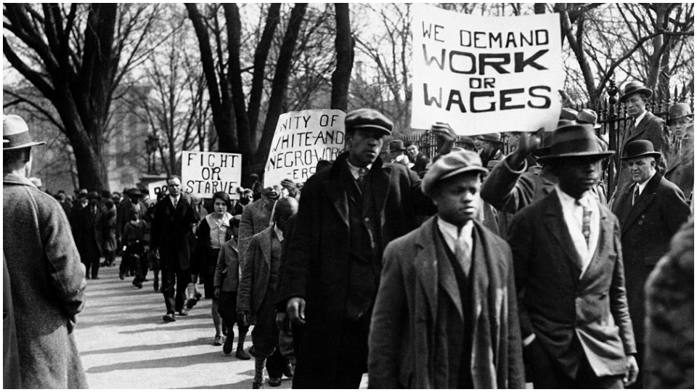
Notes:
In this March 6, 1930 photo, demonstrators organized by the Unemployed Council gather in front of the White House in Washington before a major protest for International Unemployment Day. Photo from the CPUSA Archives

Slide 41
Cyclical Crises and Depressions
It leads to monopolization and squeezing out of free enterprise, and results in business fluctuations, instability, recurrent economic recessions and crises, in the increasing gap between capacity and output and between output and effective demand. It means that unemployment is continuous and chronic and rises to intolerable proportions in times of cyclical crises and depressions. All these characteristics of capitalism have the effect of braking and immobilizing the resources of the economy and slowing down the rate of its economic growth.

Slide 42

Notes:
People from a coalition of housing justice groups hold signs protesting evictions during a news conference outside the Statehouse, Friday, July 30, 2021, in Boston following the expiration of the nationwide eviction moratorium.

Slide 43
The Soviet Socialist Economic System
By contrast, the Soviet economic system ended the private ownership of the means of production and the pursuit of private profit, thus making possible the mobilization of the resources and energies of the nation for socially useful ends (in the order of their relative urgency) with overall collective planning. The Socialist system thus enabled the Soviet people in but slightly more than two decades of peacetime progress (eliminating the years of civil war after the revolution and two world wars) to transform a backward, stagnant, nearly illiterate country into a dynamic advanced one with universal secondary education, and an extensive system of higher education, which had the highest standards in the fields of science, technology and culture, and an economy that challenged that of the United States.

Slide 44
A Socialist System of Human Institutions
Thus we see that the crucial factor is the socialist system of human institutions, and that they cannot be isolated and applied only to one field of activity. The ability to make correct decisions about what is important to achieve and then to motivate and organize the effort to achieve it, once it is based on socialism, cannot but be universally applied to all important endeavors. It is not a question of greater ingenuity or wisdom. What may be a perfectly correct decision by capitalists from the viewpoint of maximizing profits is often a totally wrong decision from the standpoint of national welfare, including economic growth and national security. The socialist system and its human institutions are obviously responsible for the rapid rate of expansion of Soviet industrial production and economic growth.

Slide 45
The Myth of “People’s Capitalism”
Statements that present-day U.S. capitalism has learned better how to increase production have been shown to have no foundation in fact. The rate of increase in US output grew substantially below the rate of the challenging Soviet Socialist system in the time periods we examined. We arrive at the conclusion that the claims concerning the widespread ownership of US industries (in which millions of middle-income people everywhere own the voting shares of American business) are nothing but a deliberately cultivated myth. The package misleadingly labeled “People’s Capitalism” is proved to be nothing but the advanced stage of monopoly capitalism.

Slide 46
Discussion & New Members Introductions

Slide 47
New Member Introductions
What is your name, pronouns and state (or country/territory)?
Where do you work? Is it unionized?
How did you find out about the People’s School?
What do you think about tonight's class?

Slide 48
Discussion & Wrap Up

Slide 49
Announcements
Please like, subscribe to, and share our youtube channel to your personal social media: https://www.youtube.com/@PSMLS
PCUSA Cell Chairs need to call members of their cells to remind them about attendance.
The next issue of New Masses (2025) has begun production. If you have art you want us to feature, email it to info@partyofcommunistsusa.net.

Slide 50

Please Help Comrades Attend Camp Red Star!
Camp Red Star is an opportunity for our young comrades to build camaraderie and learn skills that will help them build up the Party of Communists USA and its youth league, the League of Young Communists USA.
With financial hardship plaguing the country, we request that those with the means to help spare what they can to help our comrades attend. Any amount is greatly appreciated!
Donate at: https://partyofcommunistsusa.net/donations/
Choose “one-time donation”
under donation reasons click “other”
in the following text box labelled “donation reason” type in “LYC Summer Camp Subsidy”

Slide 51
Volunteers Needed!
We are in need of volunteers for the staff of the People’s School! Here’s a few roles we need filled:
People to help manage posting on our social media and podcast platforms
Video Editors, Audio Editors, Graphic Designers, Artists, Narrators
Facilitators, Web Controls, Moderators
Email info@peoplesschool.us if you’re interested and try to attend our next staff meeting if possible.

Slide 52










PSMLS Propaganda
peoplesschool.us/media & peoplesschool.us/store
Materials to help promote the school!

Slide 53

View From Left Field
https://viewfromleftfield.libsyn.com
The Old PSMLS Youtube is now the Youtube of View From Left Field, a podcast of analysis and discussion of current events from a progressive perspective.
Like the Youtube videos and subscribe with 5 star ratings on your podcast platforms.

Slide 54


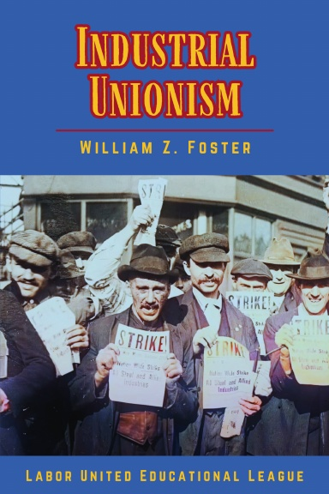
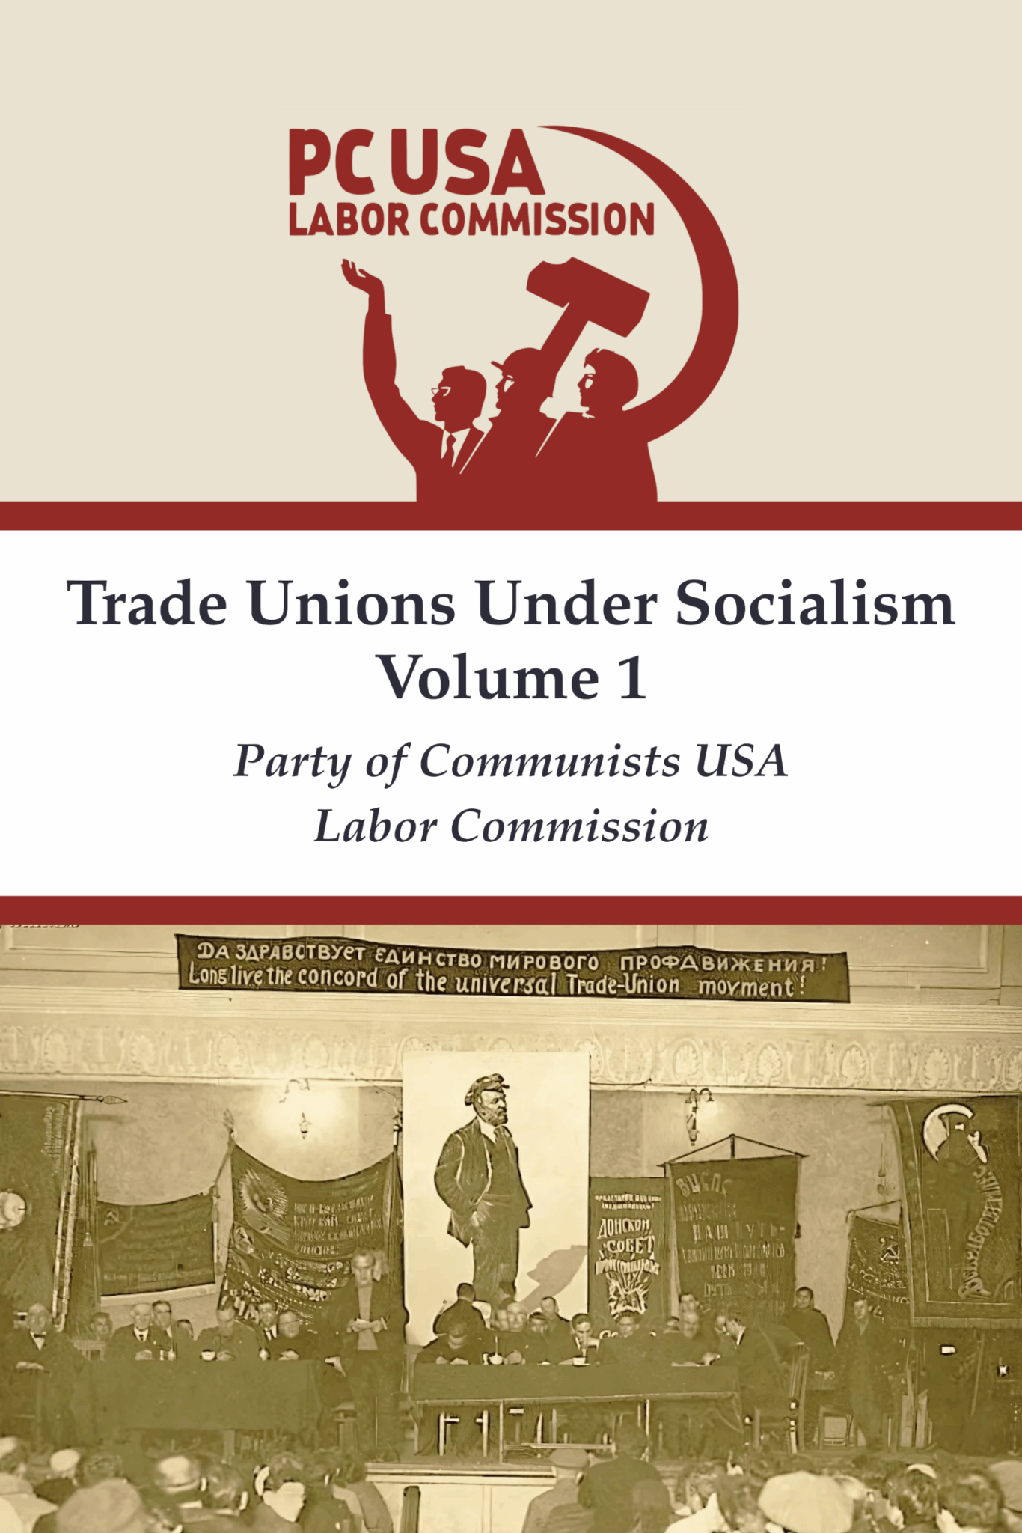

New Outlook Publishers
newoutlookpublishers.store
Latest Releases

Slide 55



Harry Bridges School of Labor
luel.us/laborschool/
The Harry Bridges School of Labor is a monthly class held 2x per month. Classes cover a variety of topics aimed at building class conscious among union members.
June’s class is on Trade Unions in the Fight Against Fascism. Class will be Wednesday June 4, 2025 at 8pm EST/6pm PST and Saturday June 7, 2025 at 7pm EST/4pm PST.

Slide 56
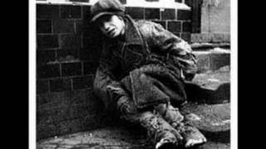
Brother, Can You Spare a Dime? Sung by Bing Crosby, song of the Great Depression

