Slide 1

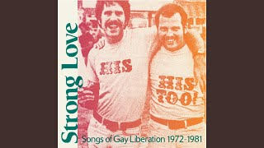
Stand Up For Your Rights by International Gay Society

Slide 2
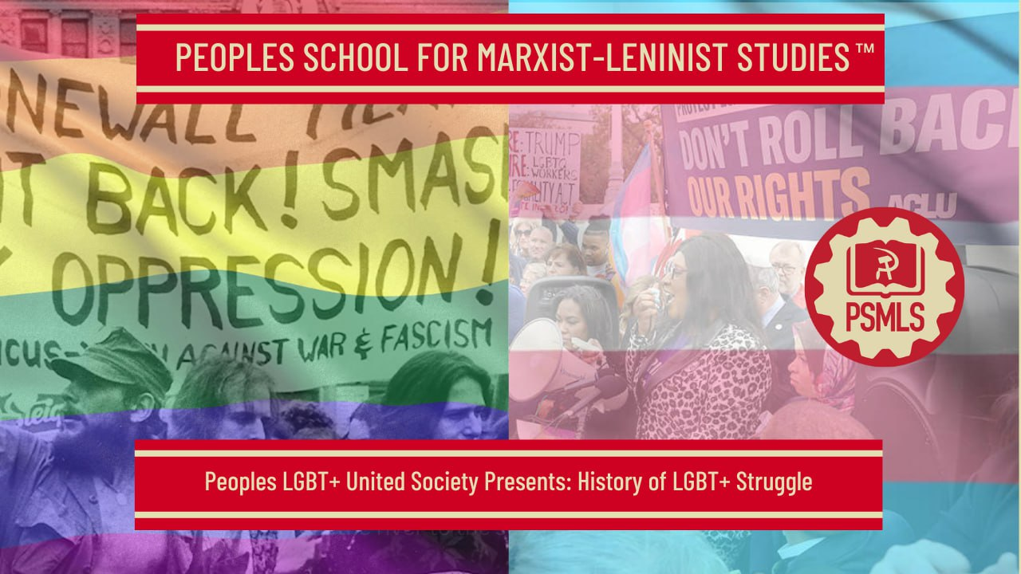
PSMLS 6/23/2025

Slide 3
What we’ll be learning today:
Advancements of LGBT+ Rights in the US
Recent Attacks on the LGBT+ Movement
Continuing the Struggle

Slide 4
Advancements of LGBT+ Rights in the US

Slide 5
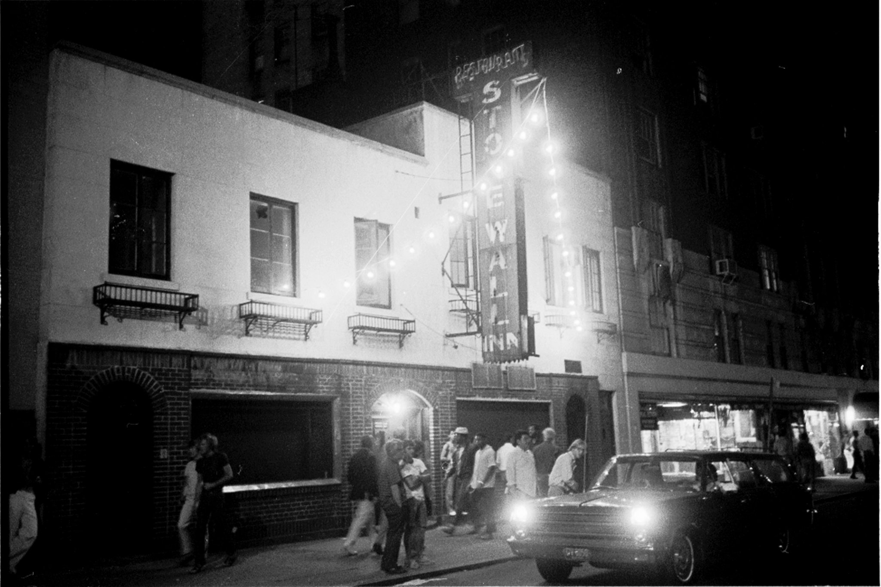
Brief History
The Stonewall Riots occurred June 28th, 1969. These were a series of riots and demonstrations that occurred at the Stonewall Inn in the Greenwich Village neighborhood of Lower Manhattan in New York City. This moment is commonly hailed as a new beginning for the LGBT rights movement in the United States.

Slide 6
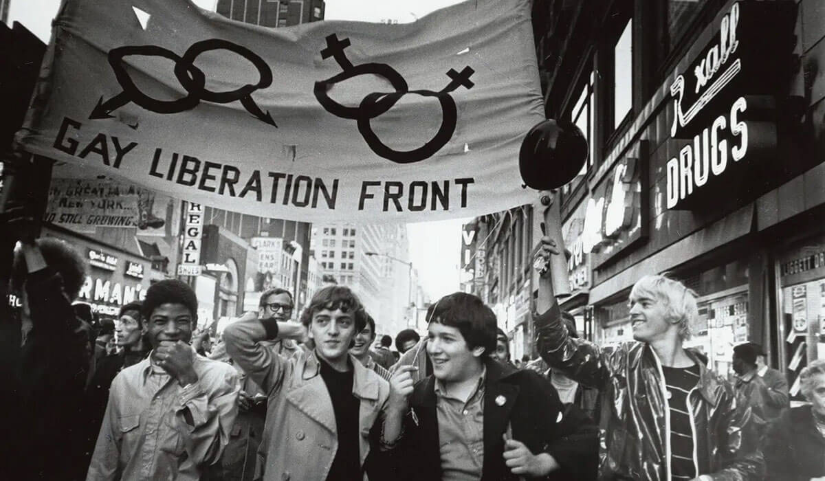
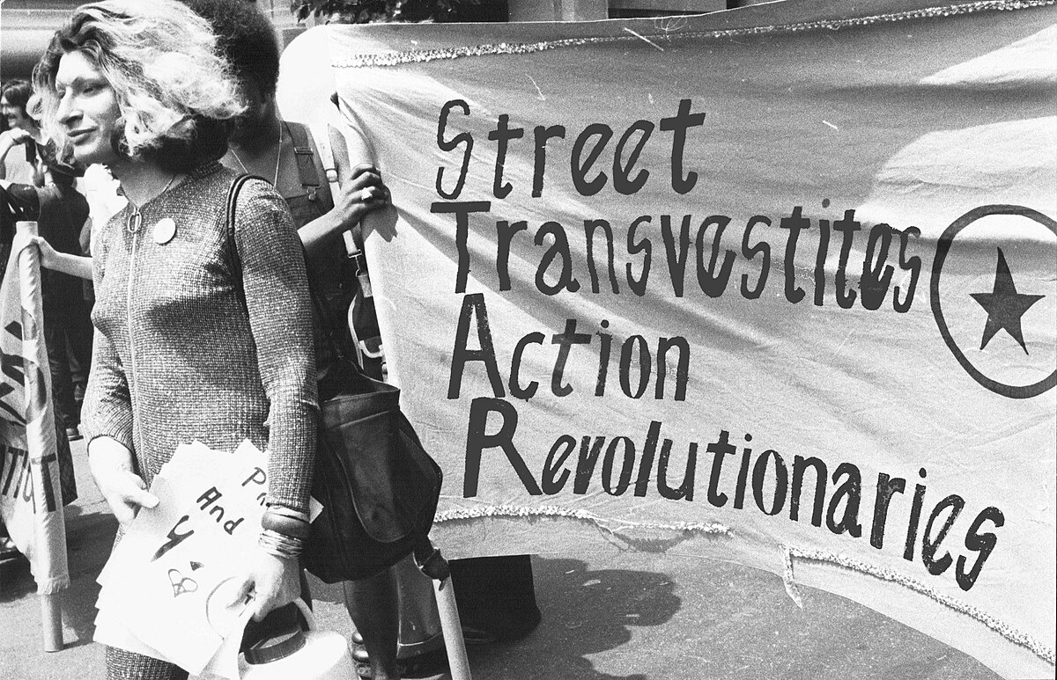
Brief History
The Gay Liberation Front formed on July 31st, 1969 by a group of radical pro-LGBT plus activists that met at Alternative U, a leftist meeting hall. In the following year, the group:
  protested at the Women’s House of Detention in Greenwich Village
  Organized a march protesting coverage of gay people in The Village Voice where they denounced racism and capitalism and declared support for the Black Panther Party
  Published their first periodical: Come Out!
  Had a drag queen caucus of the group that formed the Street Transvestite Action Revolutionaries (STAR) which focused on providing support for gay prisoners and homeless LGBT+ youth.
Harvey Milk became the first openly gay person elected to public office in California in 1977

Slide 7
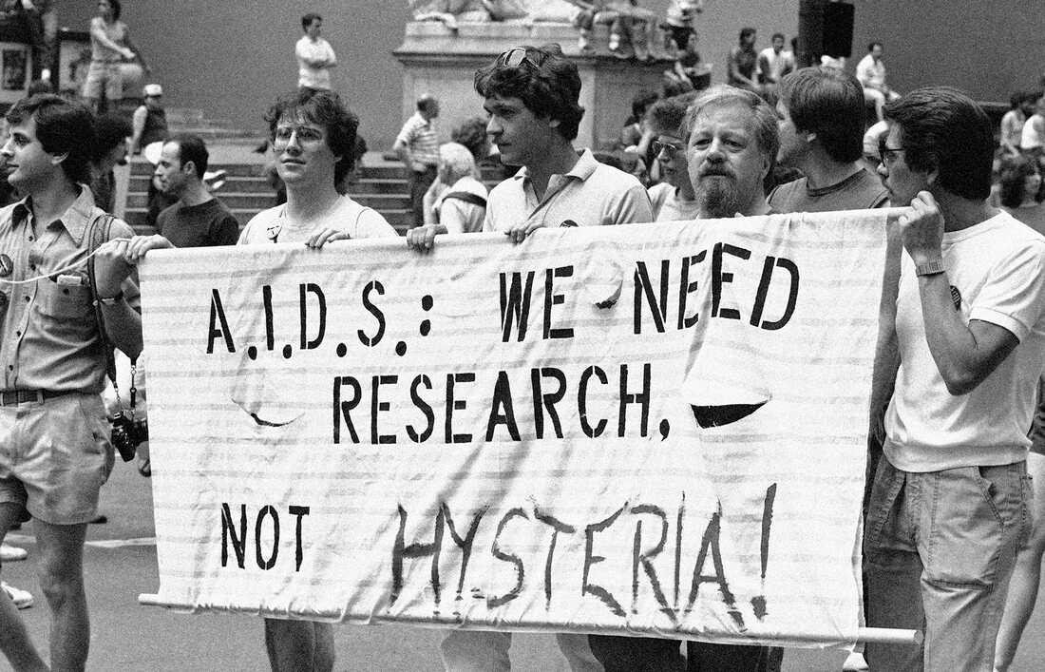
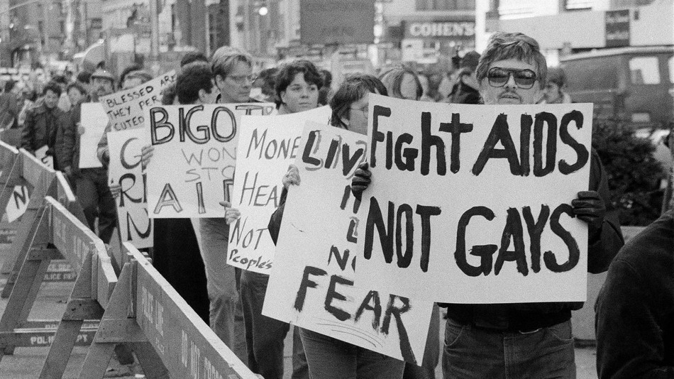
The HIV/AIDS Epidemic
The AIDS epidemic began June 5th, 1981 when the Center for Disease Control and Prevention reported a cluster of Pneumocystis pneumonia in five homosexual men in Los Angeles.
Over the next couple of years, increasingly more clusters of this pneumonia, as well as other diseases common in immunosuppressed patients, were discovered in typically healthy patients.
A June 1982 report suggested that due to the prevalence of a cases among gay men in Southern California, the disease may have a sexually transmitted infectious agent. Thus, the term was originally named “GRID”: gay-related immune deficiency.
Many terms for the disease arose. Some more-slanderous terms included “gay cancer”, “gay plague”, and “homosexual syndrome”.

Slide 8
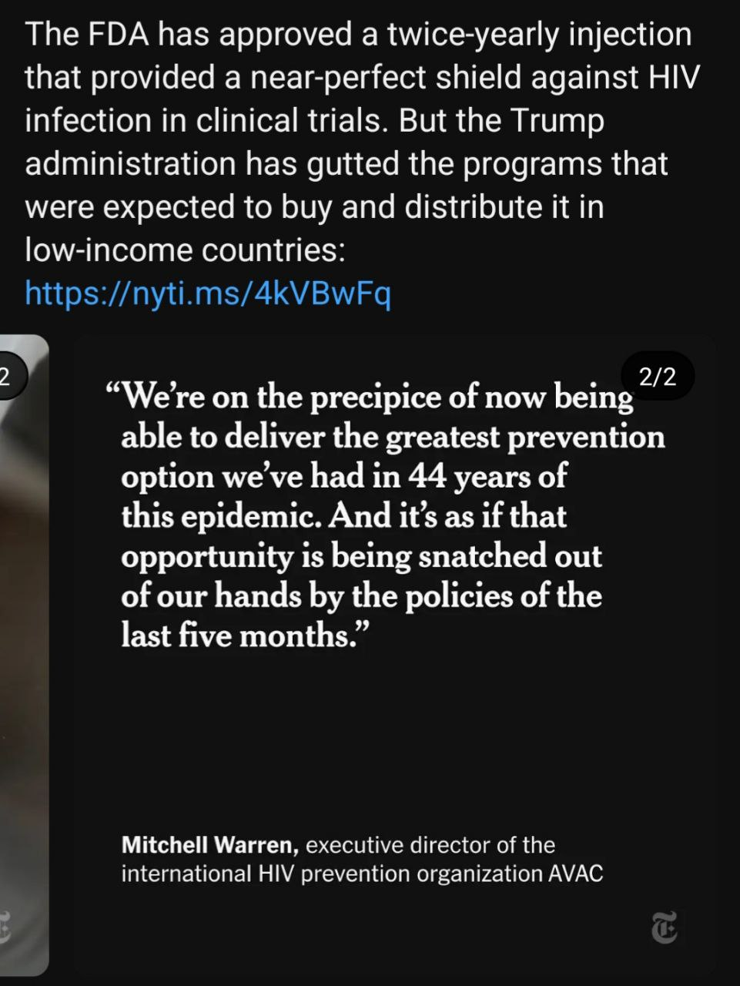
The HIV/AIDS Epidemic
There was a common misconception that AIDS mainly affect white, gay males. This meant black people were often neglected in terms of education on the issue and services. In 1989, this lead to the creation of the Black Coalition for AIDS Prevention and the Alliance for South Asian AIDS Prevention. You can read more and get involved with those groups here: blackcap.ca asaap.ca
In 1982, the gay activist group The Sisters of Perpetual Indulgence published Play Fair!, a sex educational manual discussing safe and healthy sex practices, including those related to AIDS. Play Fair! was distributed at San Francisco’s Gay Freedom Day on June 27th, 1982 and is credited a the first sex-education pamphlet.
It is estimated, based on current rates, that 1 in every 6 gay and bisexual men will be diagnosed with HIV in their lifetime. For Latino men, this rate rises to 1 in 4. For black men, this rate is 1 in 2.

Slide 9

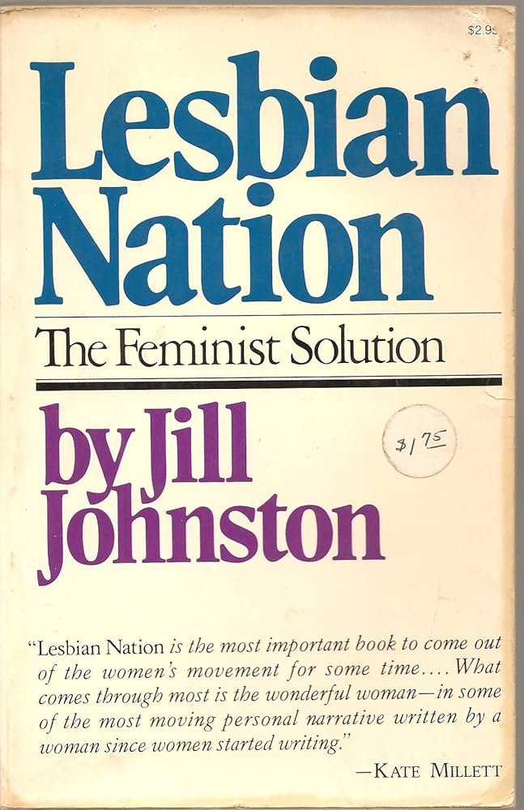
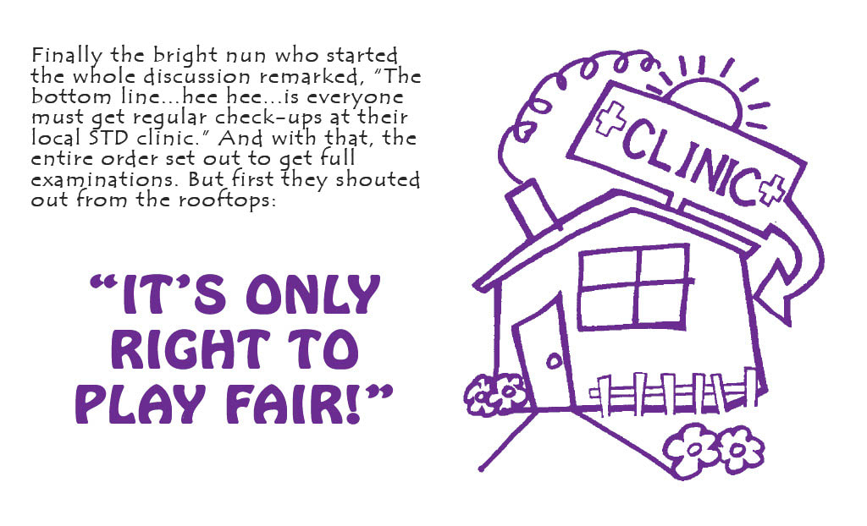
LGBT+ Media - Literature
In 1970, Del Martin and Phyllis Lyon published Lesbian/Woman, a text discussing what it means to be a lesbian woman.
Originally published as a series of essays in The Village Voice and as a book in 1973, Lesbian Nation: The Feminist Solution by Jill Johnston proposed lesbian separatism as a thesis. She argued that all female engagement with men, including female heterosexuality, was collaboration with the patriarchy.
In 1977, Charles Silverstein and Edmund White released the sex manual The Joy of Gay Sex.
In 1982, the Sisters of Perpetual Indulgence published Play Fair!, a brochure about safe sex for gay men.

Slide 10
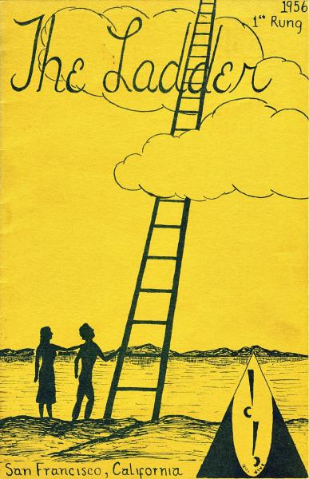
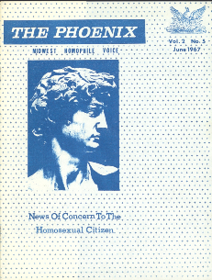
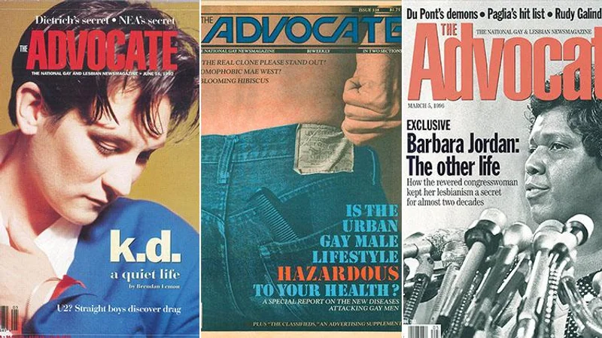
LGBT+ Media - Literature
Pre-Stonewall, the first nationally distributed Lesbian periodical was The Ladder (1956). This was followed by other LGBT magazines: Drum (Philadelphia,1964), The Advocate (Los Angeles, 1967), and The Phoenix: Midwest Homophile Voice (Kansas City, Missouri, 1966).
Post-Stonewall, LGBT+ publications include: Come Out! (New York City, 1969), The Gay Blade (Washington, D.C., 1969), Bay Area Reporter (San Francisco Bay Area, 1971), Fag Rag (Boston, 1971), Lavender Woman (Chicago, 1971), Chicago Gay Crusader (1973), Gay Community News (Boston, 1973), the San Francisco Sentinel (1974), Philadelphia Gay News (1976), Gaysweek (New York City, 1977), and San Francisco Bay Times (1978).

Slide 11
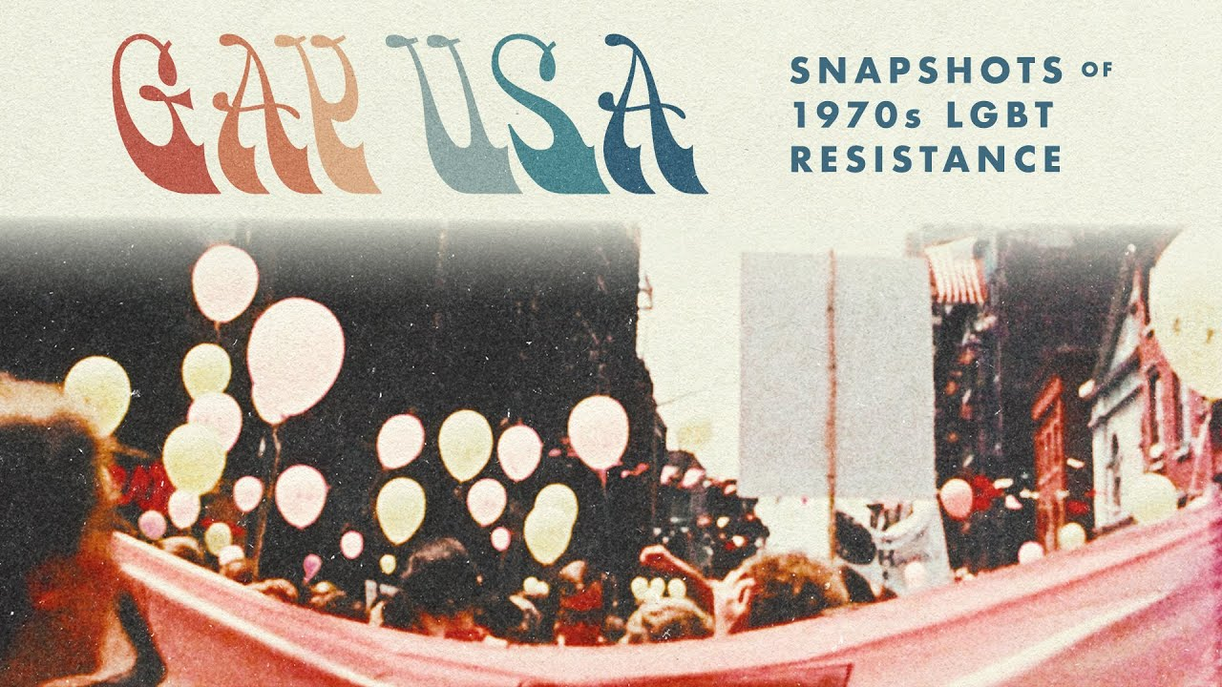
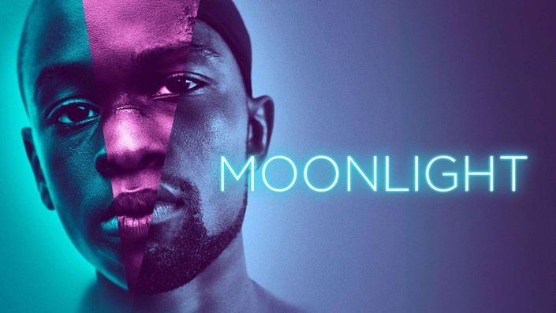
LGBT+ Media - Film
The Motion Picture Production Code, the motion picture industry guideline for film producers, called for censoring of LGBT+ representation in film between 1934 and 1968.
In 1977, American director Arthur J. Bressan Jr. released Gay USA, considered the first known documentary about LGBT+ people.
In 2005, Brokeback Mountain grossed over $178 million.
In 2017, Moonlight won three Academy Awards: Best Picture, Actor in a Supporting Role, and Adapted Screenplay (and was nominated for 5 other categories as well).

Slide 12
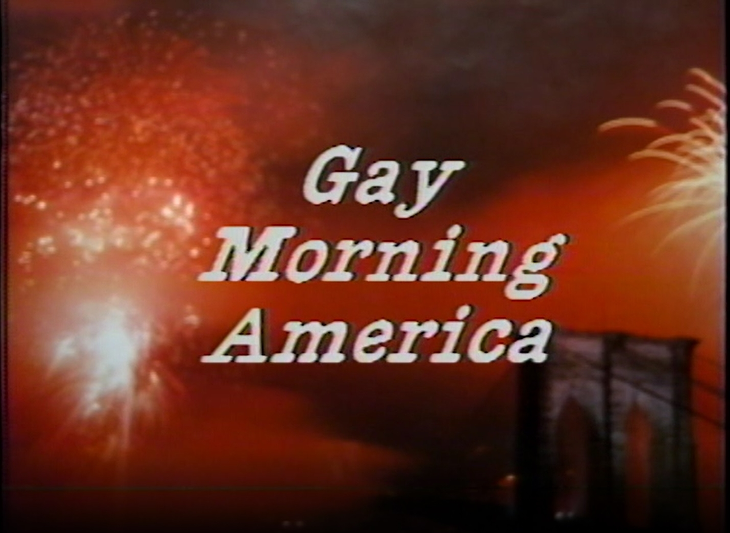

LGBT+ Media - Film
The Code of Practices for Television Broadcasters prohibited positive homosexual representation from 1952 to 1983, preventing both representation on screen as well as scaring actors and actresses into remaining in the closet.
Despite this, LGBT+ communities used public-access television to air inclusive programs such as The Emerald City (1977-1979), Gay Morning America (84-85), Candied Camera (1990s), and others.
In 1977, Ellen became the first show to have a gay main character. This opened the floodgates for gay television media and recurring gay characters including but not limited to shows such as: Will & Grace, Dawson's Creek, Spin City, ER, Buffy the Vampire Slayer, Nightline, Queer Eye for the Straight Guy, Queer as Folk, The Young and Restless, Ugly Betty, and Glee.

Slide 13
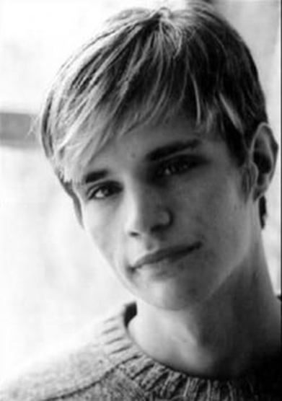
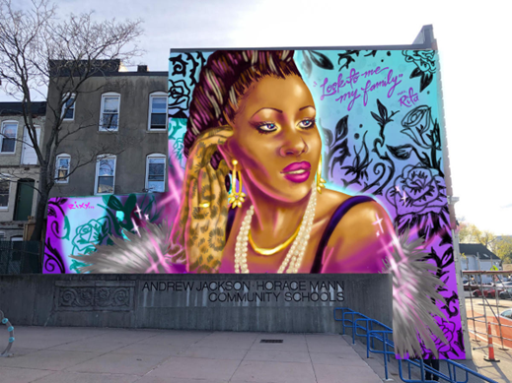
Violence Towards LGBT+ People
Matthew Sheppard, a gay American student at the University of Wyoming, was beaten, tortured, and left to die near Laramie, Wyoming on October 6th, 1998. Sheppard died 6 days later in the hospital. Both murderers were found guilty and each received two consecutive life sentences.
Rita Hester, a transgender African American woman was murdered in her home in Allston, Massachusetts on November 28th, 1998. The city of Boston commissioned a mural memorializing Hester. (photo from Boston.gov)

Slide 14

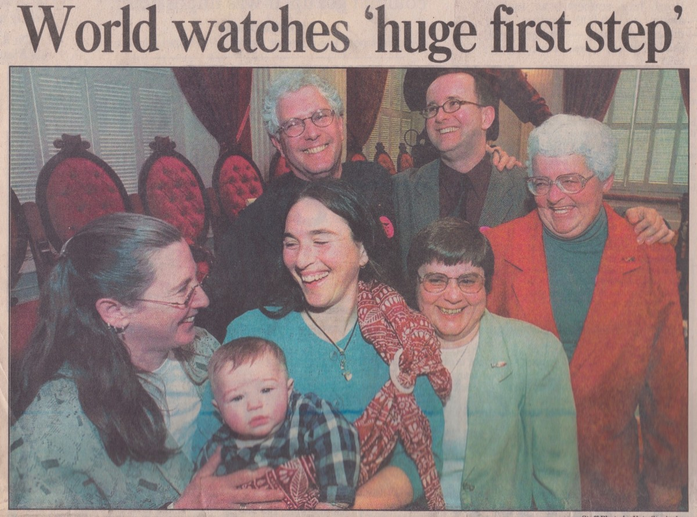
Notable Dates and Events
The transgender pride flag was created by Monica Helms in 1999 and first flown at a pride parade in Phoenix, Arizona in 2000.
Transgender Day of Remembrance was founded in 1999 by Gwendolyn Ann Smith, a transgender woman, to memorialize the murder of Rita Hester. This day is held annually on November 20th.
On December 20th, 1999, the Vermont Supreme Court holds in Baker v. Vermont that excluding same-sex couples from marriage violates the Vermont Constitution, granting civil union rights to same-sex couples for the first time in the US.
In 2003, The US Supreme Court rules 6-3 in Lawrence v. Texas against sodomy laws, making same-sex activity legal in the US.

Slide 15
Notable Dates and Events
On May 15th, 2008, the Supreme Court of California legalizes same-sex marriage. Several states follow in subsequent years.
On May 9th, 2012, Obama becomes the first sitting president to declare support for same sex marriage.
On June 26th, 2015, The Supreme Court of the United States rules in Obergefell v. Hodges that the fundamental right to marry is guaranteed to same-sex couples by both the Due Process Clause and the Equal Protection Clause of the Fourteenth Amendment to the United States Constitution. This legalized same-sex marriage in the United States with all rights and responsibilities.
On June 15th, 2020, The Supreme Court rules in Bostock v. Clayton County that Title VII of the Civil Rights Act of 1964 prohibits employment discrimination against LGBTQ people on the grounds that any such discrimination must be based on the sex of the victim which is expressly prohibited.

Slide 16
Discussion

Slide 17
Recent Attacks on the LGBT+ Movement

Slide 18
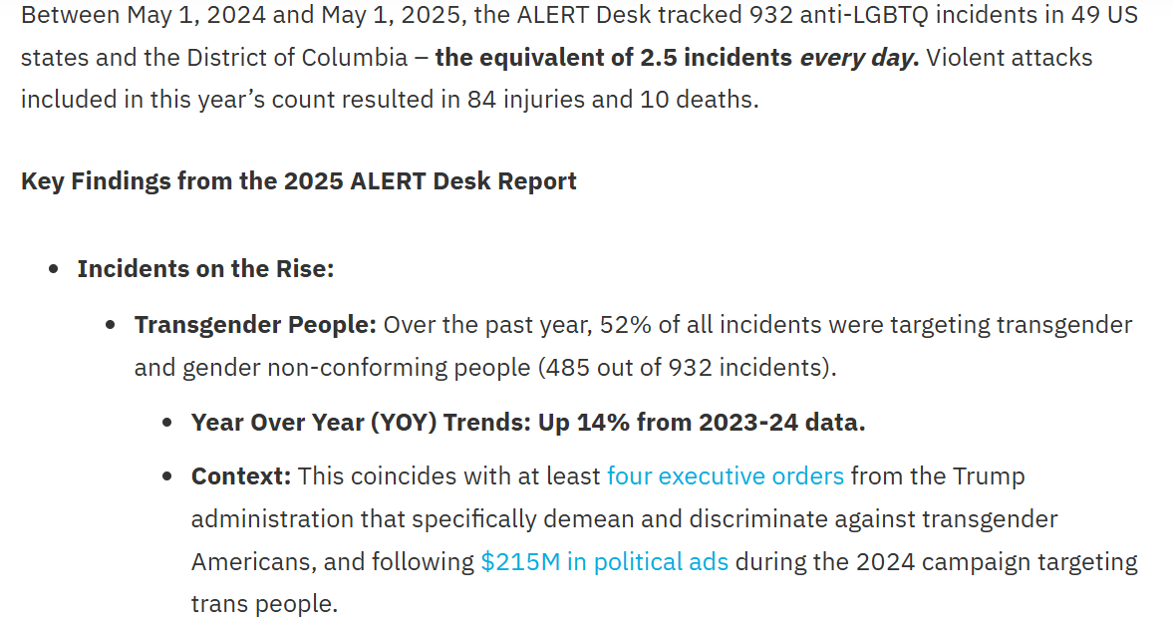
Violence and Targeting of LGBT+ People
This pride month, we have seen a disturbing uptick in violence against the LGBT+ community. The month began with the tragic death of Jonathon Joss, a Native American musician and voice actor. Joss and his husband were targeted by one of their neighbors, who allegedly burned their house down and shot Joss in the head.
In another case, a transgender man from South Carolina, Luca Strobel, was violently arrested after asking permission to use an empty woman’s restroom. In Seattle, an evangelical Christian group held an anti-trans rally which ended in violence clashes with counter protestors.
Sadly, this rise in hatred against the LGBT+ community is not new. Statistics show that hate crimes and discrimination based on sexual orientation and gender identity have risen these past few years.
https://glaad.org/2025-alert-desk/

Slide 19
Trump Administration’s Attacks on LGBT+ Rights
The vitriol and violence have intensified especially since the Trump administration began dismantling laws and measures protecting the rights of LGBT+ people. In a series of executive orders, the administration has mandated that federal departments only recognize male and female sexes, ceased funding for gender-affirming care, dismantled DEI measures and banned transgender individuals from serving in the military. Most recently, Trump has cut specialized suicide prevention services for LGBT+ youth.
Those who discriminate against the LGBT+ community are now emboldened to target them, as there are little to no repercussions. Even law enforcement in conservative areas does not care to stop this violence and in many cases, participate in the repression. LGBT+ youth are statistically much more likely to be targeted by bullies and be shunned by their own families, leading to higher rates of depression and suicide. Adults are more likely to be discriminated against at their workplace or by their own community and are much more at risk of facing homelessness and poverty.

Slide 20
Why are LGBT+ people and their rights under attack?
After years of mass movements and organizing throughout 20th century LGBT+ people in the USA were able to win many of their constitutional rights.
Under pressure from the LGBT+ mass movements and legislative action, we achieved protection in the workplace, gay marriage, civil rights, child adoption, military service, education and improved health services as part of a progressive agenda. Society is challenging the 'ruling' norms, and finance capital cannot survive if the ruling norms change.
These are not gifts, they are rights — and are never secure.
In crisis, finance capital seeks to restrict democracy — often facing resistance from liberals and bureaucrats from within, but who are not strong enough to resist the fascist encroachment.
In this period of capitalist crisis, the ruling class’s form of rule has become untenable. As the monopoly capitalist economy collapses, finance capital will increasingly use any tactics to maintain its position.

Slide 21

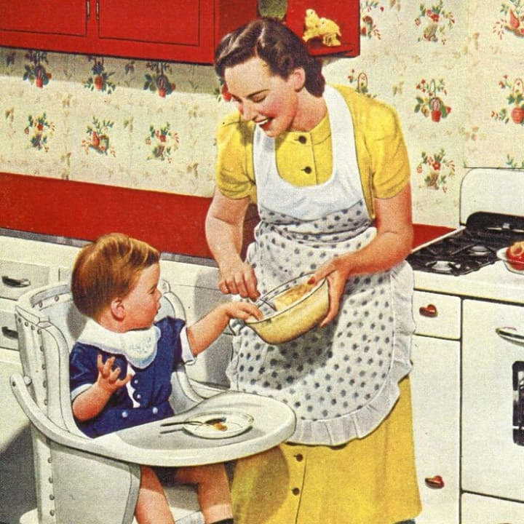
LGBT+ in a time of economic breakdown in the USA
With the global capitalist system in crisis, populations are losing faith in the old and outdated institutions which no longer reflect reality. This has sparked a legitimacy crisis for the Democratic and Republican parties. The existence of LGBT+ undermines the conservative gender norms that have been an integral part of the capitalist underpinnings. Wars, inflation, housing collapse, labor unrest.
In the U.S., LGBT+ people are being blamed for the social breakdown because it undermines the nuclear family which keeps the spouse in the kitchen, and producing more workers to continue the established social division of labor.

Slide 22
LGBT+ and reaction in Late-stage Capitalism
The capitalist ruling class, now threatened by social instability, is shifting back to open repression against vulnerable groups, such as LGBT+ and immigrants. We have recently seen a huge rise in legislation nationally and locally endangering, targeting, and persecuting LGBT+ people in our schools, hospitals, homes etc.
However, as corporations are celebrating Pride Month, our federal government is persecuting these same groups. This contradiction is what Marx warned as the epitome of the internal rot in capitalism that hastens the decay and eventual end to capitalism.
“The contradiction between the progressive aspect and the reactionary aspect of a thing determines its life and drives its development.”
— Mao Zedong, On Contradiction
“The development of things should be seen as their self-movement, their internal contradiction being the cause of their development.”
— Mao Zedong, On Contradiction

Slide 23
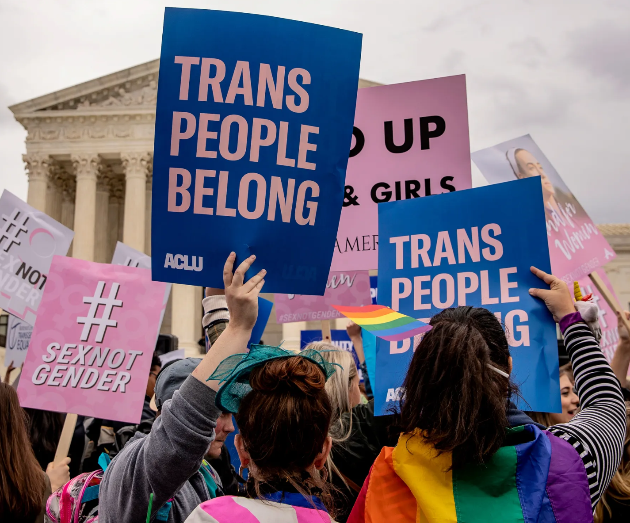
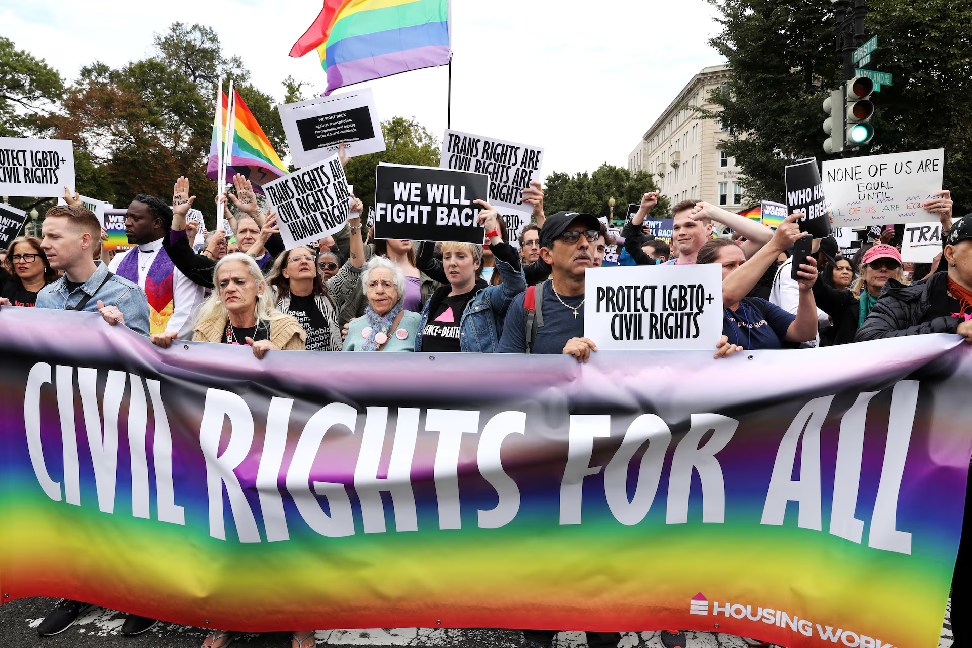
How do we combat this reactionary offensive?
We must defend every piece of democratic ground we have and continually push progressive legislation forward.
We are now being threatened at this moment by the fascist forces culminating around president Trump and his administration. We must mobilize to protect our hard won democratic and constitutional rights gained over centuries of struggle. This is a 'forever' battle, never allowing complacency to take root.
To combat these attacks requires working with an Anti-Monopoly Labor-Led Coalition. It’s important to remember the working class has to be the head and leader of this movement to successfully wipe out the oligarchs that have a stranglehold on our country.

Slide 24
Discussion

Slide 25
Continuing the Struggle

Slide 26
Forming Coalitions
Various local and national organizations and LGBT+ centers exist currently that are fighting back against the attack on our civil liberties. Many offer resources to LGBT+ individuals who are struggling, such as legal aid, housing and medical care.
These groups are essential for many who face discrimination and are feeling the effects of the current administration’s crackdown on gay and trans rights.
However, for any mass movement to be effective, it must have its roots in labor.
This is where PLUS plays an integral role: we must seek out any effective pro-LBGT+ groups and form connections. This will help unite the movement and strengthen it, giving us a fighting chance at preserving and winning even more civil liberties.

Slide 27

Pride at Work
A notable group is Pride at Work, a caucus within the AFL-CIO for any LGBT+ members and allies.
They aim to promote bargaining for LGBT+ justice. From their website:
“At a time of widespread backlash against LGBTQIA+ rights, it is especially important that we are leveraging our union power at the bargaining table to fight for LGBTQIA+ workplace justice. To assist in this effort, Pride at Work is putting together guidance on bargaining language to make our contracts as protective of LGBTQIA+ members as possible.”
Their guidelines identify some key issue areas important to LGBTQIA+ workplace justice. For each issue area, they have identified why it matters, provided legal context, recommended what language should be included or avoided, and where appropriate provided sample contract language that can be used or adapted.

Slide 28

Defending LGBT+ Rights
The LGBT+ community is currently on the defensive. This comes with particular challenges.
The administration targets our community because we are easy targets for scapegoating. Their aim is to de-class as many of us as they can so that we are fighting for survival rather than banding together.
Most of the movement at this time is mutual aid and spreading awareness, our goal is to further the struggle and galvanize the movement.
In order to do this, we need to get not just more of our own community involved, but also involve our straight allies.
Even if you do not identify as LGBT+, if you consider yourself a straight ally, the best way to be an ally is to get involved and fight alongside us, especially during this time when gay and trans people need their allies the most.

Slide 29

Defending LGBT+ Rights
Join PLUS today at https://peopleslgbt.org/
Dues are only $25
Follow us on Social Media, like and share our posts to give more exposure
https://x.com/PeoplesLGBT/
https://www.facebook.com/profile.php?id=61572375303487
Literature such as pamphlets and our Stonewall Lives Bulletin are available for download on our website
Find an LGBT+ center near you, introduce yourself, and drop off some literature
Pride month isn’t over yet! If there are anymore events near you as the month closes out, try to attend and distribute literature
Pride parades and events are also great for finding local and national organizations perfect for forming coalitions with.

Slide 30
Discussion & New Members Introductions

Slide 31
New Member Introductions
What is your name, pronouns and state (or country/territory)?
Where do you work? Is it unionized?
How did you find out about the People’s School?
What do you think about tonight's class?

Slide 32
Discussion & Wrap Up

Slide 33
Announcements
The PSMLS has recovered our old Youtube account we lost to wreckers in 2022 and we have re-uploaded all our old videos. Like, subscribe, and check out what subjects we covered prior and what we aware saying in the past.
PCUSA Cell Chairs need to call members of their cells to remind them about attendance.
The next issue of New Masses (2025) has begun production. If you have art you want us to feature, email it to info@partyofcommunistsusa.net.

Slide 34
Volunteers Needed!
We are in need of volunteers for the staff of the People’s School! Here’s a few roles we need filled:
People to help manage posting on our social media and podcast platforms
Video Editors, Audio Editors, Graphic Designers, Artists, Narrators
Facilitators, Web Controls, Moderators
Email info@peoplesschool.us if you’re interested and try to attend our next staff meeting if possible.

Slide 35

Happy Pride Month!
Happy Pride from People’s United LGBT+ Society!
During this pride month, attend a parade near you. Download our brochure and our Stonewall Lives Bulletin and distribute. https://peopleslgbt.org/
Literature can also be requested using the literature request form on the member’s portal.

Slide 36

Please Help Comrades Attend Camp Red Star!
Camp Red Star is an opportunity for our young comrades to build camaraderie and learn skills that will help them build up the Party of Communists USA and its youth league, the League of Young Communists USA.
With financial hardship plaguing the country, we request that those with the means to help spare what they can to help our comrades attend. Any amount is greatly appreciated!
Donate at: https://partyofcommunistsusa.net/donations/
Choose “one-time donation”
under donation reasons click “other”
in the following text box labelled “donation reason” type in “LYC Summer Camp Subsidy”

Slide 37


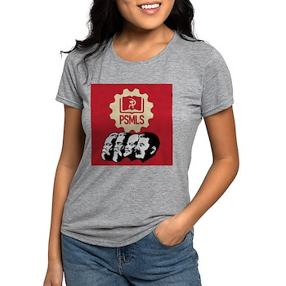







PSMLS Propaganda
peoplesschool.us/media & peoplesschool.us/store
Materials to help promote the school!

Slide 38

View From Left Field
https://viewfromleftfield.libsyn.com
The Old PSMLS Youtube is now the Youtube of View From Left Field, a podcast of analysis and discussion of current events from a progressive perspective.
Like the Youtube videos and subscribe with 5 star ratings on your podcast platforms.

Slide 39

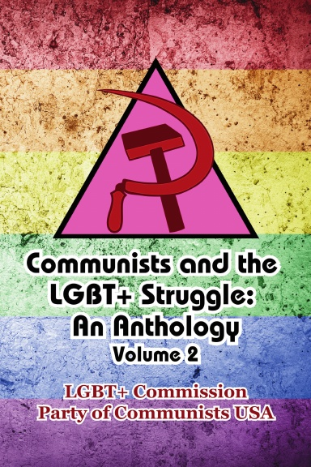
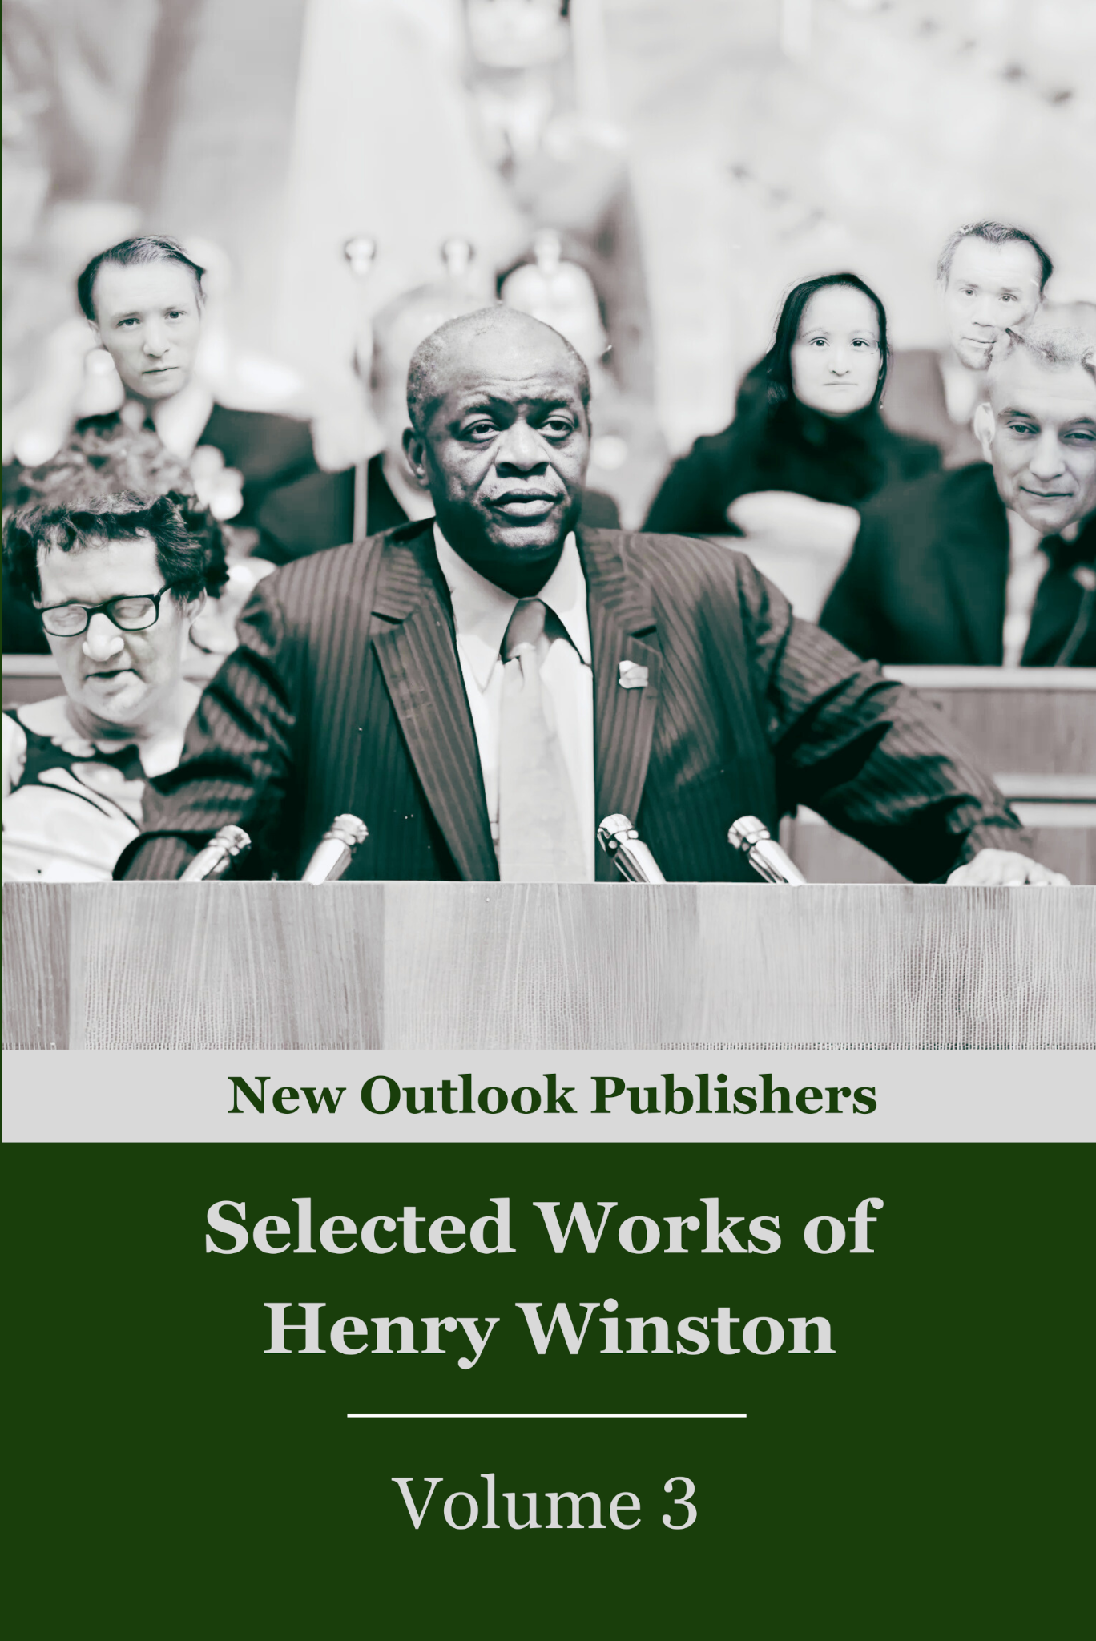
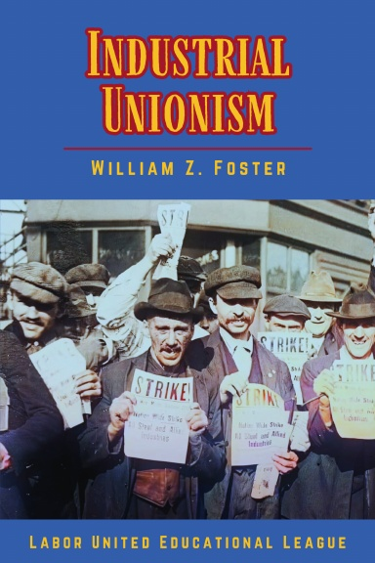

New Outlook Publishers
newoutlookpublishers.store
Latest Releases

Slide 40


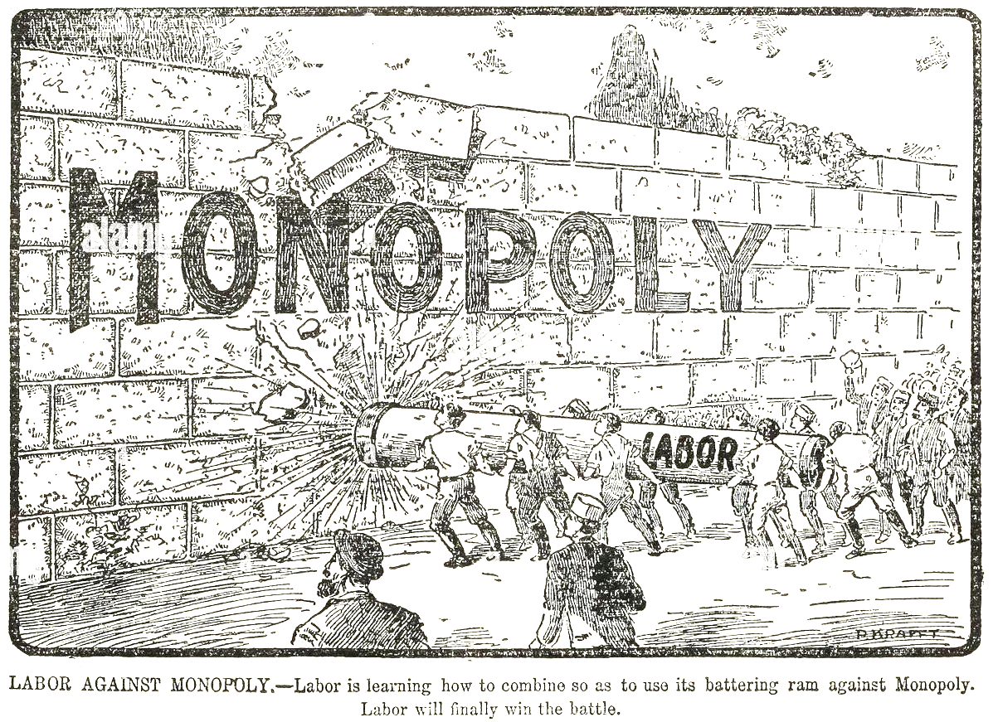
Harry Bridges School of Labor
luel.us/laborschool/
The Harry Bridges School of Labor is a monthly class held 2x per month. Classes cover a variety of topics aimed at building class conscious among union members.
July’s class will be a continuation of Labor and the Anti-Monopoly Coalition. Class will be July 2, 2025 at 8pm EST/5pm PST and Saturday July 5, 2025 at 7pm EST/4pm PST.

Slide 41

I Want To Break Free by Queen

