Slide 1


Tear the Fascists Down - Woody Guthrie

Slide 2

PSMLS 04/08/25

Slide 3
What we’ll be learning today:
The Nature of Fascism
The Germ of American Fascism
Effects of the Economic Crisis

Slide 4
Nature of Facism

Slide 5
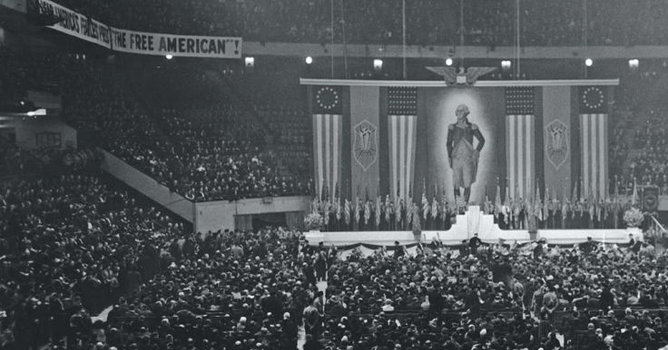
Fascist Demagogues Hide the True Nature of Fascism
Americans who hate fascism because they know what it means in Europe and who would reject it under its own name, sometimes follow fascist and semi-fascist organizations, when these hide their real purposes and programs under the cloak of “1oo per cent Americanism.” Most Americans, while maintaining a healthy abhorrence of fascism, have only the vaguest conception of its nature and origin. They identify fascism with brown or black shirts, with clicking heels and marionette salutes. They would not recognize it in a full dress suit, or a priest’s cassock, or the homespun of a backwoods Hitler.
German-American Bund Convention 1939

Slide 6
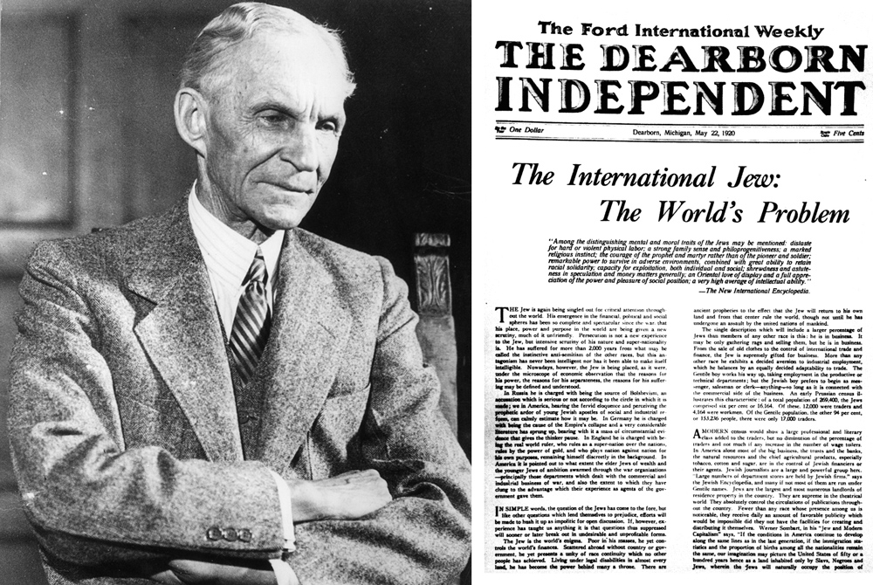
Fascist Demagogues Hide the True Nature of Fascism
Fascism takes on many disguises. It cannot afford to reveal itself, to proclaim its aims. Hitler would never have achieved power, if he had announced to the German masses that his program was the program of big business, of the Thyssens and the Krupps; that Nazi rule meant lower wages, ersatz clothing, concentration camps and cannon instead of butter. It was necessary for Hitler to call his party “National Socialist”; to promise to abolish “unearned income,” confiscate war profits and nationalize the trusts. The “Socialist” coloration of Nazi demagogy was necessary because a large majority of the German working class and a good part of the lower middle class believed in Socialism.
Henry Ford, American monopolist founder of Ford Motor Co., supported and supplied Hiter’s Third Reich
Ford was only one among many capitalists that supported Nazi Germany.

Slide 7
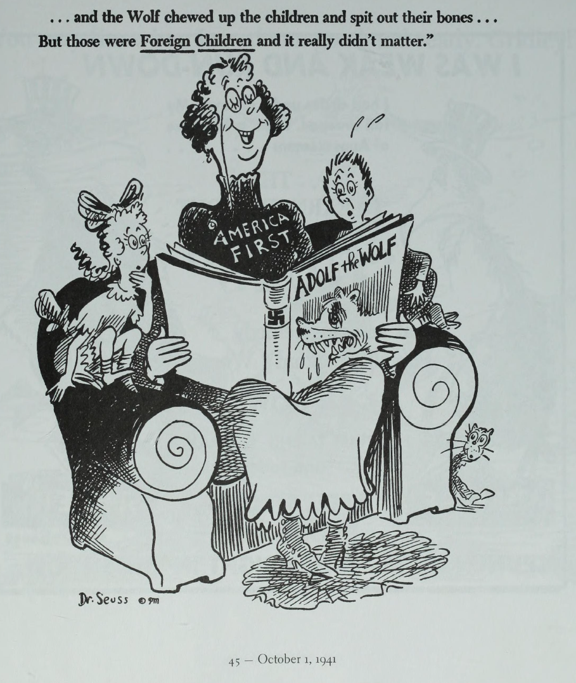
Fascist Demagogues Hide the True Nature of Fascism
In the United States, where there is as yet no widespread socialist sentiment, fascism takes on different, and specifically American, disguises. In order to win popular support, it must appeal to the ideals and slogans in which most Americans still believe — to liberty and freedom. It must even pronounce itself anti-fascist.

Slide 8
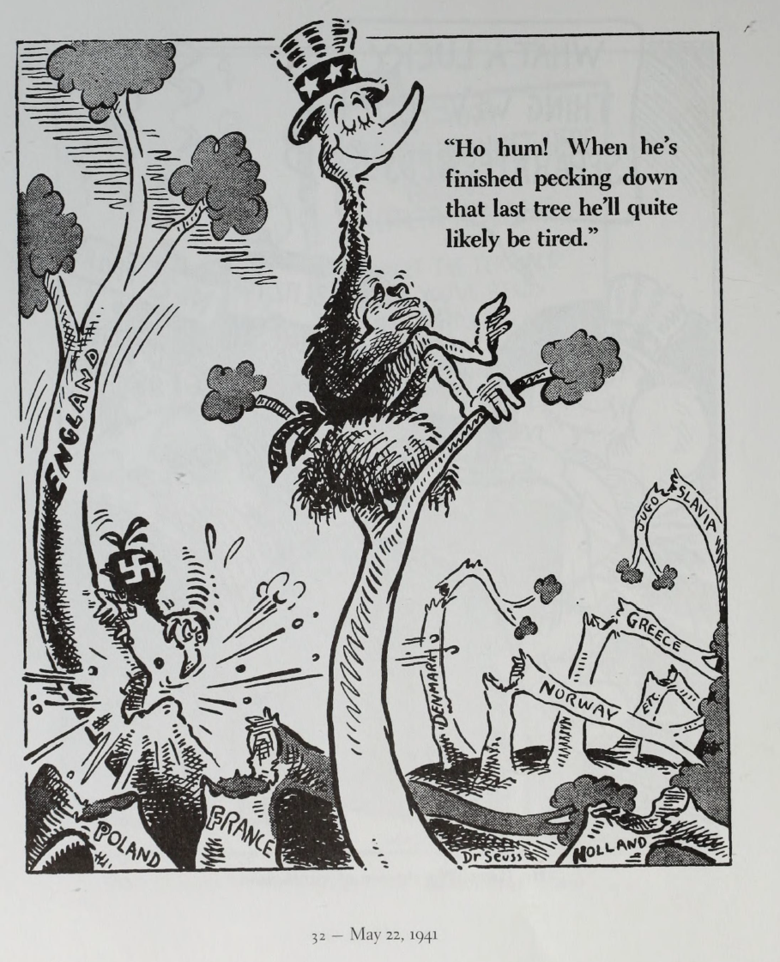
There is no American Exception to Fascism
An even greater danger arises from the belief that the United States is immune to fascism. Most persons who hold this view regard fascism as a specifically European virus that can never — or hardly ever — thrive in “free America” which has known the blessings of democratic government.

Slide 9
Class Basis of Fascism
The visible attributes of fascism have been clearly perceived, even if not sufficiently understood, by most Americans. From recent events in Germany and Italy, most people in this country know that fascism means rule by force and terror; that it suppresses democratic rights; that it destroys independent workers’ organizations; that it fosters race hatred; that it brings cultural stagnation and decay; that it means jingoism and war.
But these attributes do not exhaust the definition of fascism. They do not explain who exercises this rule by force and why. They do not explain the class basis of fascism. Without such an understanding, we do not know the real nature of fascism, whence it arises and, consequently, how to guard against it.

Slide 10
Class Basis of Fascism Cont.
Writers on this question advance various and totally different explanations of the class character of fascism. Some — accepting the pronouncements of the fascists at their face value — deny that fascism has any class basis whatsoever and maintain that fascism means the establishment of the “authoritarian” state, which stands above all classes, parties and sectional interests. Others hold that fascism represents an independent movement of the impoverished and desperate lower middle classes against capitalism, on the one hand, and against the working class on the other. Still a third view is that fascism is open terrorist rule exercised by and on behalf of the most reactionary sections of big business against the masses of the population, and especially against the working class.

Slide 11
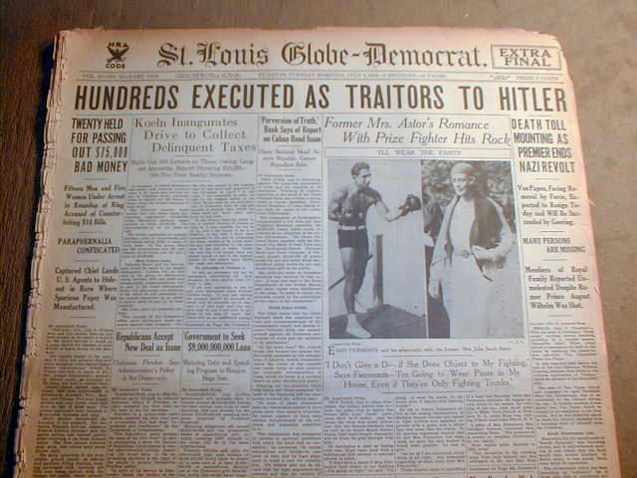
Class Basis of Fascism Cont.
The flawed conception of fascism, as a “middle class revolution” is based on the fact that fascism, in order to win popular support, raises pseudo-radical slogans, and that in Germany and Italy it succeeded in finding mass support in the lower middle classes. But neither the propaganda nor the popular following of a political party are adequate criteria for judging its real class nature. The avowed programs of most capitalist parties are notoriously at variance with their real aims; and the most reactionary capitalist parties can, under certain conditions, succeed in winning support among classes with diametrically opposed interests.
After rising to power on their backs, Hitler has his petty bourgeois supporters purged and executed in the Night of Long Knives.

Slide 12

Class Basis of Fascism Cont.
From its very inception, the Nazi movement had the support powerful bankers and industrialists. Since 1927 it has had the backing of all of the Ruhr steel interests, headed by the industrial tycoon, Fritz Thyssen. Ernest Henri, in Hitler Over Europe , describes in incredible detail how Thyssen organized the Ruhr coal, iron, and steel barons behind the Hitler movement and collected large sums fr0m them for Nazi election funds. In the 1932 elections alone, he writes, “Thyssen provided the Nazis with more than three million marks within a few days.”
These were profitable investments for the Thyssens and the Krupps— as the history of Germany since 1933 demonstrates. According to the statistics concocted by the co-ordinated statisticians of the Third Reich, profits during the first four years of Nazi rule soared to enormous heights, while wages dropped even below 1932 crisis levels.
Elon Musk giving his endorsement to far-right, semi-fascist Alternative for Germany Party

Slide 13

Sound Familiar?
Who is funding Heritage Foundation and Project 2025?
Adolph Coors Foundation's tax documents reported by both ProPublica and SourceWatch.org. According to those tax documents, the Adolph Coors Foundation contributed $1,325,000 to The Heritage Foundation between the tax-filing years 2008 and 2022.
According to tax filings and forms published on ExxonSecrets.org mentioning ExxonMobil Corporation's private foundation, ExxonMobil Foundation, which spanned the years 1998 through 2012 showed ExxonMobil contributed at least $730,000 to The Heritage Foundation.
The Walton Family Foundation describes itself on its website as "[continuing] a philanthropic vision begun by Walmart founders Sam and Helen Walton." The website's grants page (archived) featured a search box allowing users to easily locate past contributions. The website displayed contributions to The Heritage Foundation from 1992 through 2018 totaling $650,000.
Notice that the anti-labor, anti-civil liberties Heritage Foundation uses the Liberty Bell as its logo

Slide 14
Discussion

Slide 15
The Germ of American Fascism

Slide 16
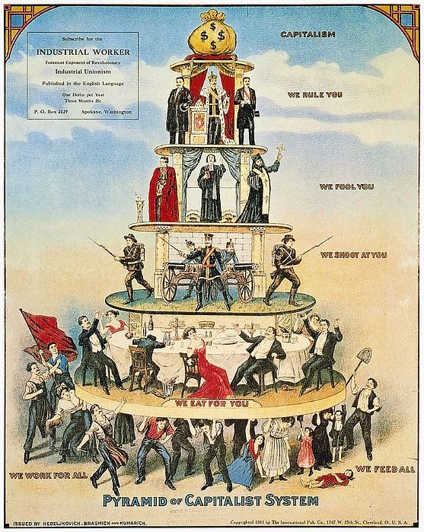
The Development of American Capitalism
American capitalism developed in a rich land, unhampered in the main by feudal restrictions; and society was not divided, as in Europe, along sharp and comparatively fixed class lines. There were merchant princes and propertyless wage earners; semifeudal plantation lords and chattel slaves, but the uniqueness of American society lay in the fact that property ownership was widespread and class lines exceptionally fluid. Perhaps a majority of the American population consisted of free and independent farmers and small artisans owning their own means of production.
However, the swift development of American capitalism, inevitably accompanied by the concentration and centralization of capital, rapidly narrowed the social basis of American democracy. Decisive for the development of all sections of the population and for the future of American democracy was the emergence of capitalist monopoly and trustification, growing inexorably out of this centralization and concentration of capital. Triumphant capitalism not only bound the workers to wage slavery, but narrowed property ownership by steadily squeezing the farmers, petty manufacturers and merchants. The former independent commodity producers of the frontier were transformed into small capitalist farmers selling their products to markets controlled by the monopolists, buying their manufactured goods at high prices dictated by the monopolists, paying tribute to the same monopolists in the form of interest, exorbitant railroad rates and high tariffs.

Slide 17
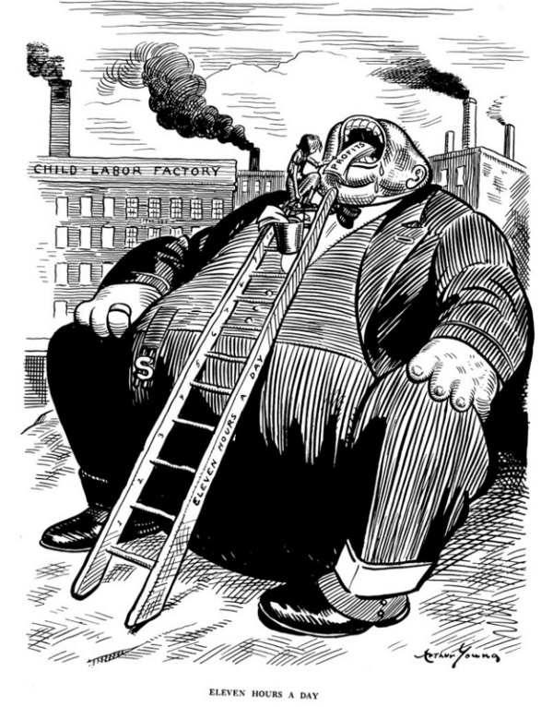
No Longer a “Land of Opportunity”
Thus by the beginning of the twentieth century the United States was no longer a “land of opportunity” where the acquisition of property was comparatively simple and where classes were in continual flux. American society was now divided along substantially the same fixed class lines as the advanced European countries. At the top were a few giant capitalists who controlled the means of production; at the bottom were the vast masses of property less wage earners; in between were the middle-class people of city and country, ground down by the oligarchs at the top.
The fruits of the toil of millions are boldly stolen to build up colossal fortunes for the few, unprecedented in the history of mankind; and the possessors of these, in turn, despise the republic and endanger liberty. From the same prolific womb of governmental injustice, we breed two great classes of tramps and millionaires. - Contained in the 1892 Populist Party Program, p.43
With the era of monopoly capitalism, the American democratic credo lost its social basis. Democracy, as Lenin remarked, became more strictly “bound by the narrow framework of capitalist exploitation” and consequently a “democracy for the minority, only for the possessing classes.” Freedom meant the freedom of monopolies to exploit ruthlessly wage labor, to exact tribute from the farmers, to crush petty rivals. Equality of opportunity meant the right of the worker to sell his labor power, if and when he could, and the right of the petty capitalist to compete on “equal” terms with the giant monopolies, which controlled sources of raw materials, markets and patents.

Slide 18
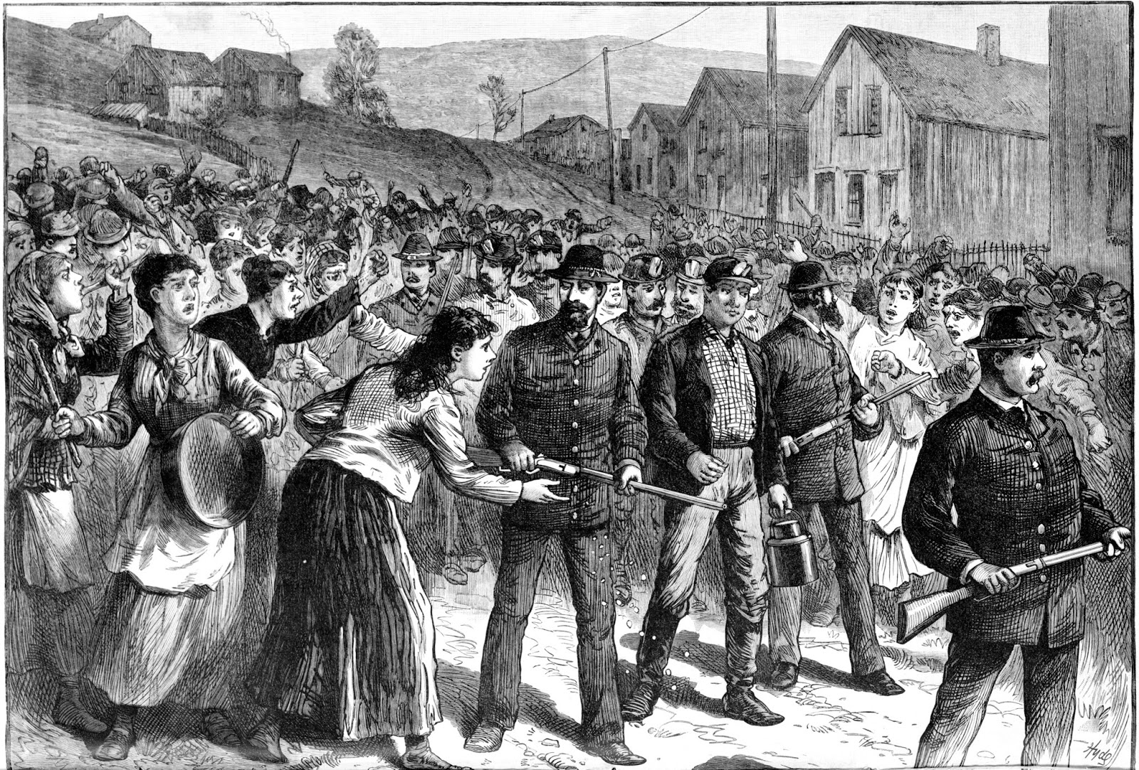
Transforming the American Government
Big business lost little time in starting its task of transforming the American government to suit its own needs. Hardly had the Civil War ended when it pushed through a clause in the fourteenth amendment to the Constitution, forbidding the separate states to enact or enforce laws depriving “any person of life, liberty or property without due process of law.” This seemingly harmless provision, smuggled into an amendment supposedly intended to guarantee rights for Negroes, attracted little attention at the time; but it constituted a profound governmental change, vastly enlarging the powers of the Supreme Court. Under this clause every state law attempting to limit hours of work, establish minimum wages, restrict child labor, etc., became subject to the review of nine men, generally former corporation lawyers, appointed by the President to the Supreme Court for life.
The assault against democratic rights was begun on a large scale during the series of gigantic strikes which swept across the country during the 1870s and 80s. The courts revived the doctrine that trade unions were “malicious conspiracies.” State legislatures began to turn out new “conspiracy laws” to restrict the right to organize. Numerous state armories were erected throughout the country to facilitate official strike-breaking by troops. Industrial barons began to build up their own private armies of professional killers, armies of “company police” which in some industrial communities soon became a force far more powerful than the “law.” At the same time there grew up private detective agencies furnishing gunmen and spies to those employers who did not maintain their own mercenary armies. The notorious Pinkerton Agency being the most famous among them.

Slide 19
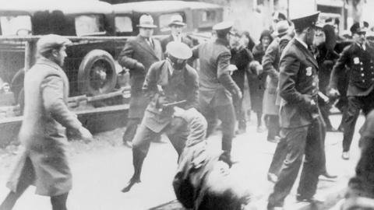
Important Innovations in Capitalist Rule
In an effort to crush the trade unions and maintain the existing working hours, the ruling class introduced three important innovations in its technique of rule: the labor frame-up, the use of formerly innocuous city ordinances for the suppression of civil liberties, and the anti-labor injunction. The frame-up was not a new invention. Similarly, most cities had long maintained ordinances against “obstructing the streets,” “trespass,” “intimidation,” “inciting to riot,” etc. The injunction— an ancient legalistic device which had never before been used in labor disputes— was brought back and remodeled into an anti-strike weapon. The use of the injunction in labor conflicts represents a profound alteration in the methods of capitalist rule and a drastic abridgement of democratic rights. It completely sets aside ordinary legal procedure. A court may issue an anti-strike injunction which completely nullifies the workers’ supposed rights of free speech, press and assemblage. A worker violating such a court order is deprived of trial by jury. He is, instead, haled to court and sentenced by the very judge whose order he is accused of violating!
The 1890s also saw the creation of additional devices for restricting the liberties of the people. Perhaps the greatest contribution made during this period to the new methods of capitalist rule was the use of “state martial law” in strikes. Under martial law, ordinary civil processes and democratic rights could be suspended, and troops, acting under a governor’s orders, could imprison strikers without the troublesome formality of court hearings and trials.

Slide 20
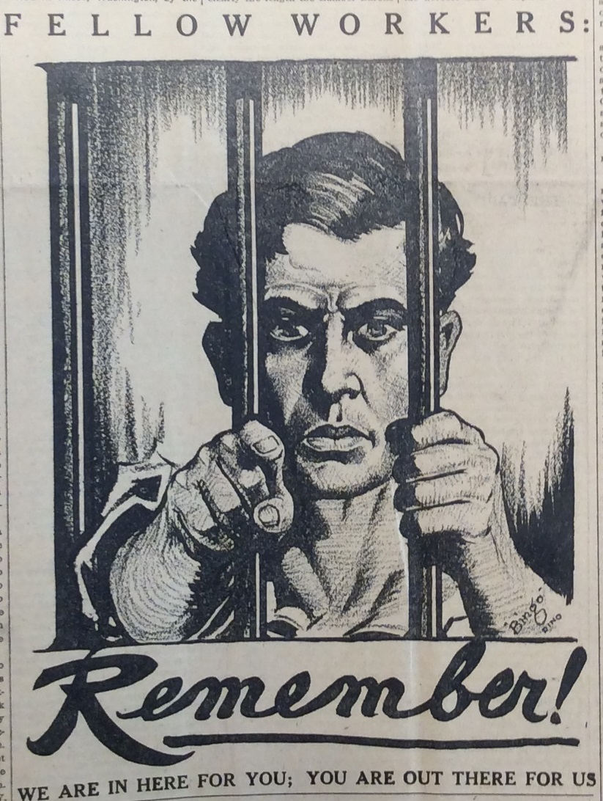
The Germ of American Fascism
In June, 1917, Congress passed the Espionage Act, imposing heavy penalties on any person obstructing recruiting, encouraging insubordination or otherwise interfering with the mobilization of the country’s military forces. The law, written in broad enough language to include practically all forms of opposition to the imperialist war, was used to jail militant working-class leaders. In May, 1918, Congress passed the even more sweeping Sedition Act. Workers were thrown into jail for doubting that the World War was fought to make the world safe for democracy. Pacifists, socialists and militant trade unionists were spied upon, hounded, tortured and jailed. Newspapers criticizing America’s entrance into the war were suppressed, provocateurs and spies were planted in workers’ organizations, and an unofficial espionage force of 200,000 private citizens was organized by the Department of Justice to snoop on friends, neighbors and fellow-workers.
Beginning in 1923, there was a steady concentration of power in the hands of executive officials and a corresponding diminution in the power of legislative bodies. There was also a rapid increase in the size of the government bureaucracy and particularly in the size of the armed forces, maintained by the federal, state and local governments. As economic power becomes increasingly concentrated in the hands of a few financiers and as the interests of this small oligarchy become more and more sharply differentiated from the interests of the masses of people, there is a growing tendency to reduce the power of democratically elected bodies and to substitute open force for democratic processes.
Thus glancing back over the history of American capitalism, we see that it repudiated the traditions of its own revolutionary past and created new traditions of naked violence and that monopoly capitalism bears within it the germ of fascism.

Slide 21
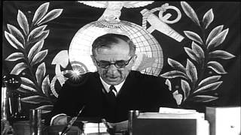

Slide 22
Discussion

Slide 23
Effects of the Economic Crisis

Slide 24
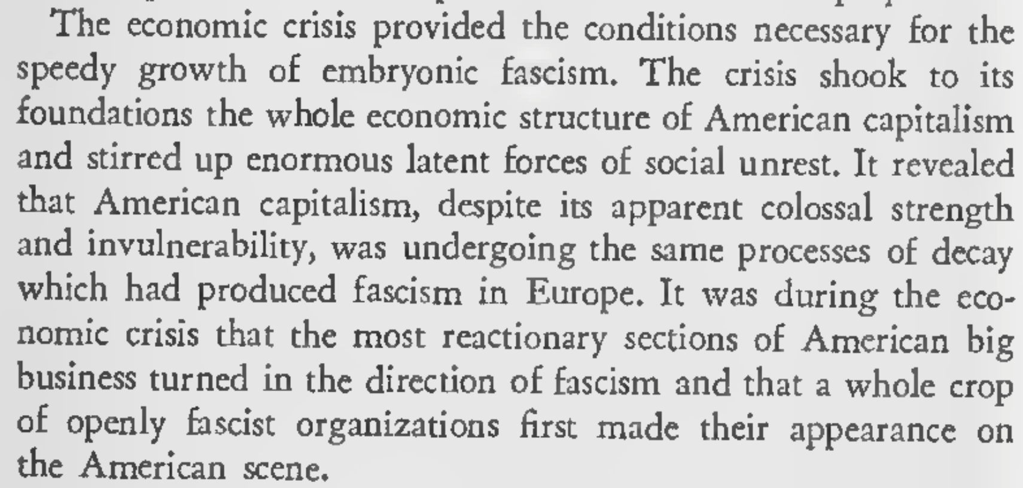
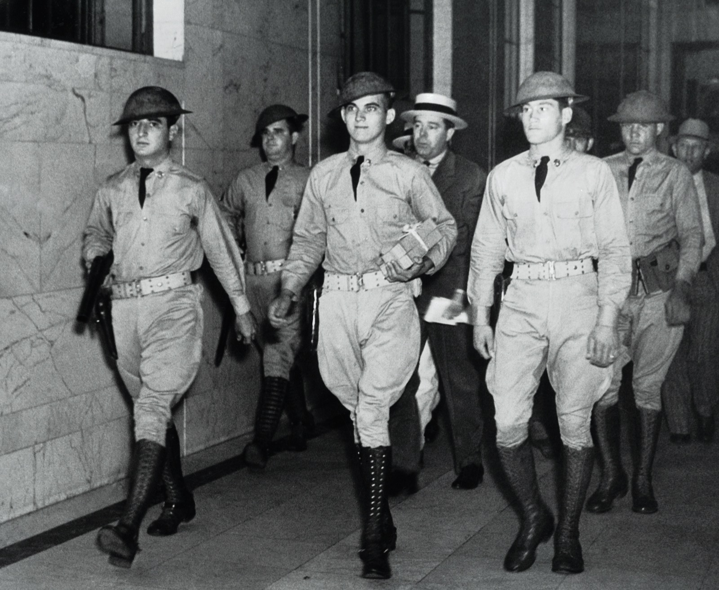
THE EFFECTS OF THE ECONOMIC CRISIS

Slide 25
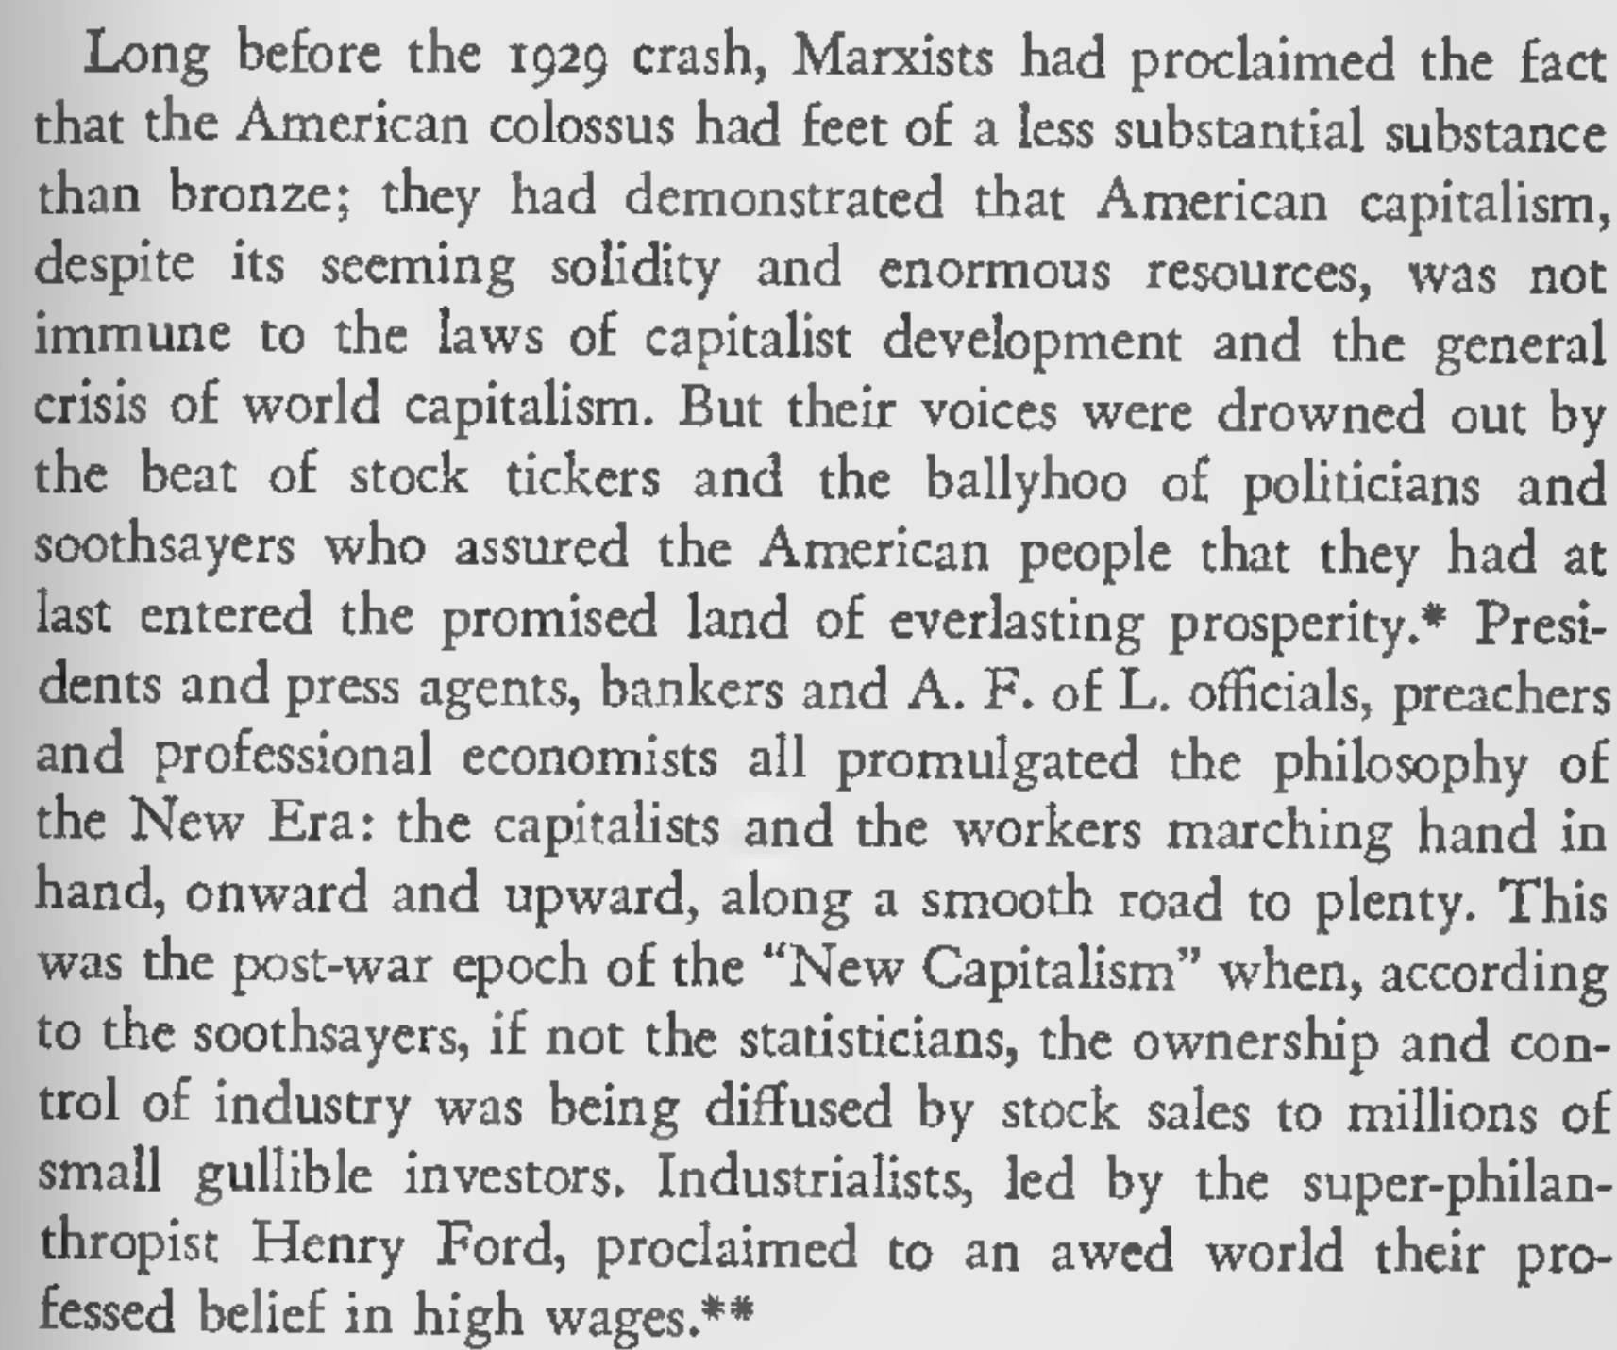
The General Crisis of Capitalism
“In America Negroes do not have to be told what fascism is,” the poet and activist Langston Hughes told an audience in the 1930s. “We know.”

Slide 26
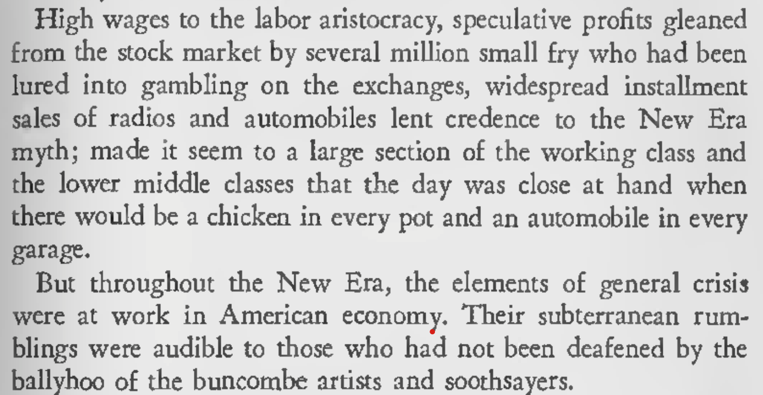
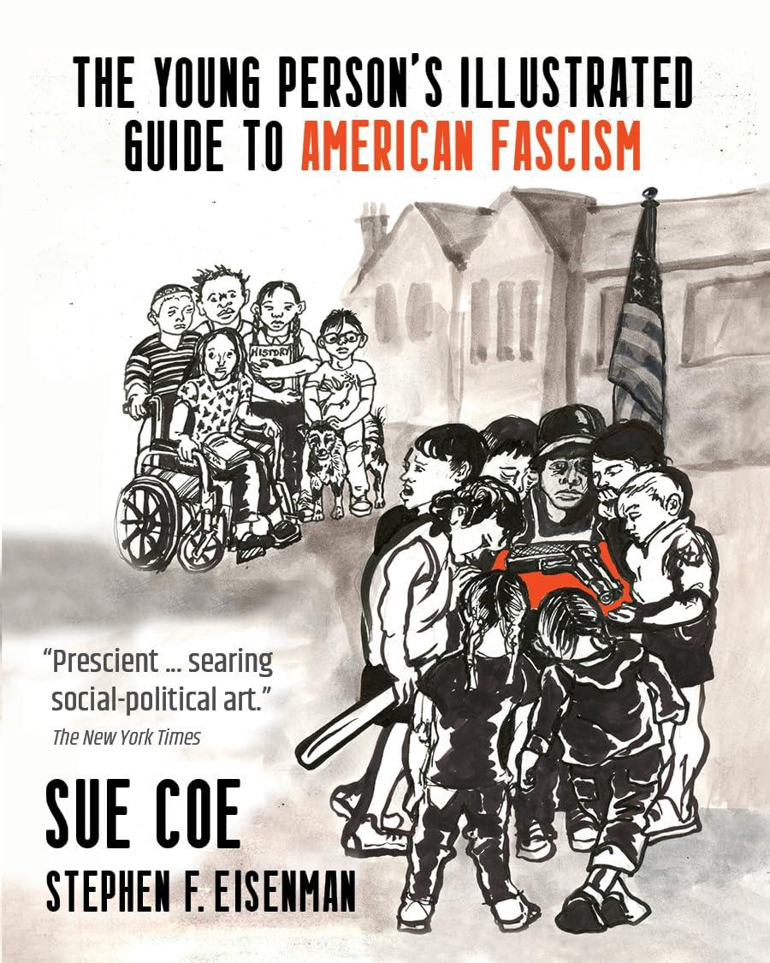
The General Crisis of Capitalism

Slide 27
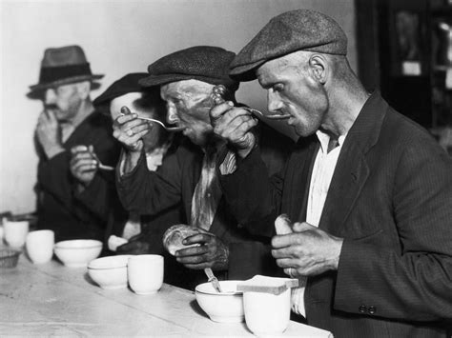
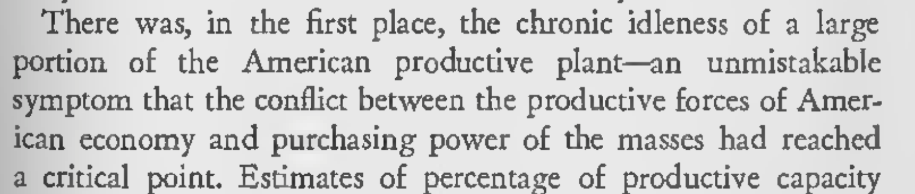
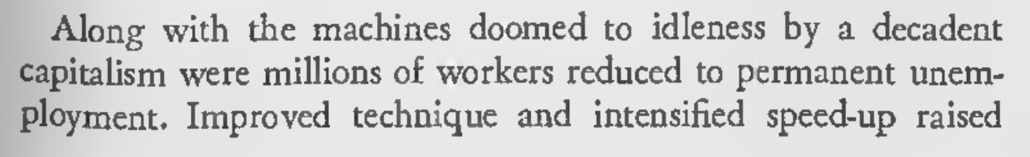
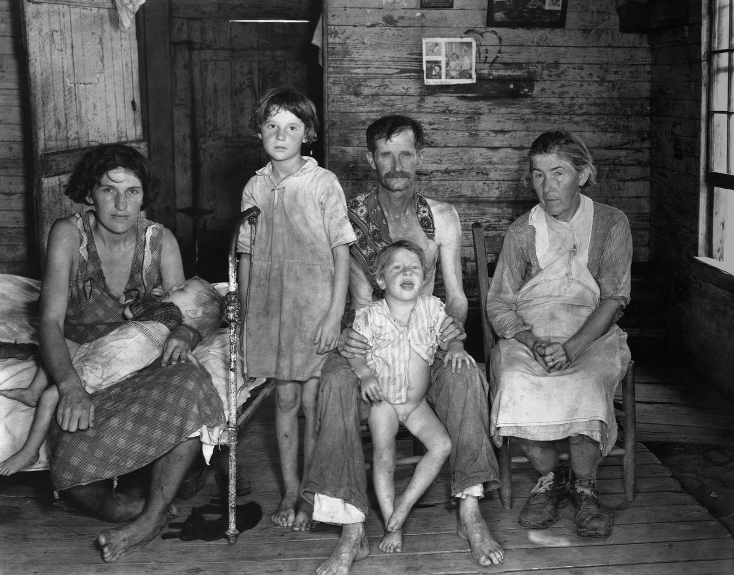
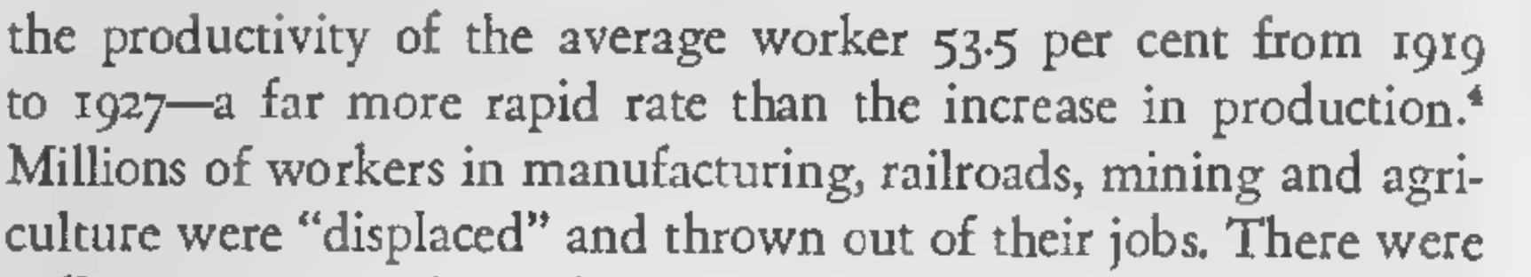
The General Crisis of Capitalism

Slide 28
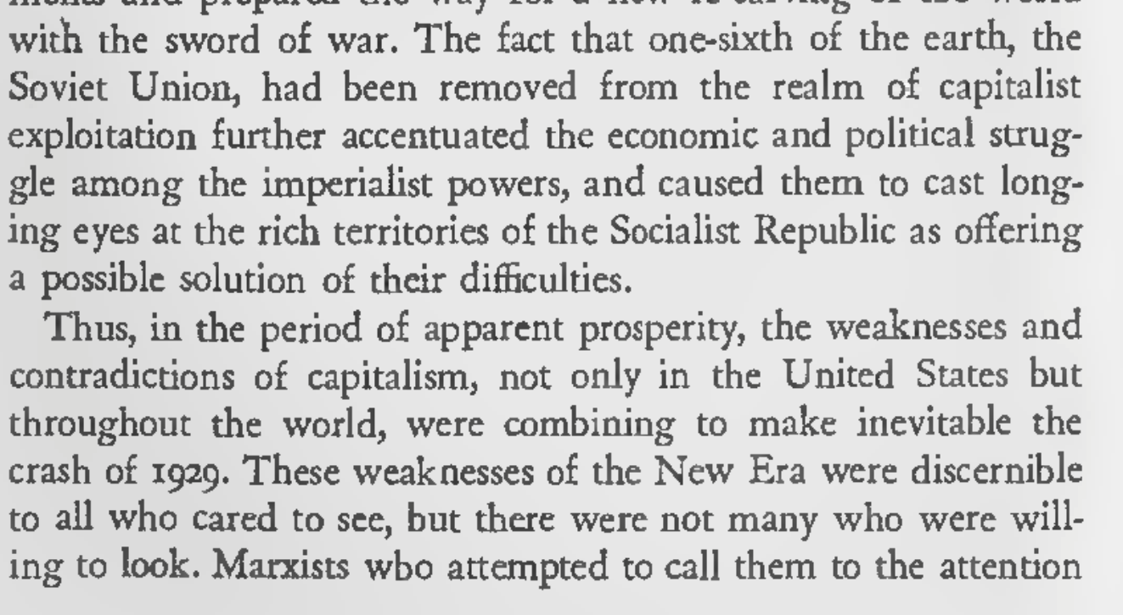
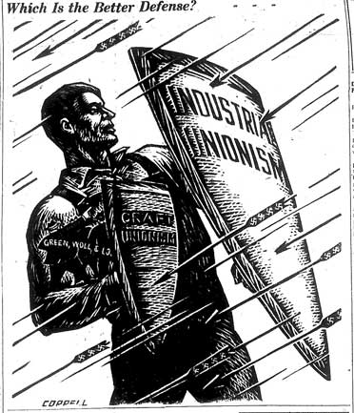
The General Crisis of Capitalism

Slide 29
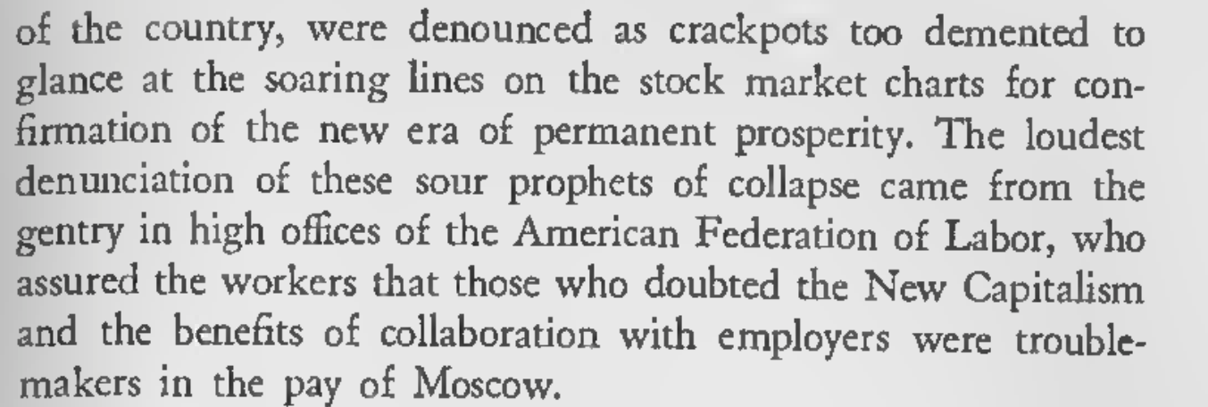
The General Crisis of Capitalism
“...the people can always be brought to the bidding of the leaders. That is easy. All you have to do is to tell them they are being attacked, and denounce the pacifists for lack of patriotism and are exposing the country to danger. It works the same in every country.”
Hermann Goring(From his prison ce//)

Slide 30
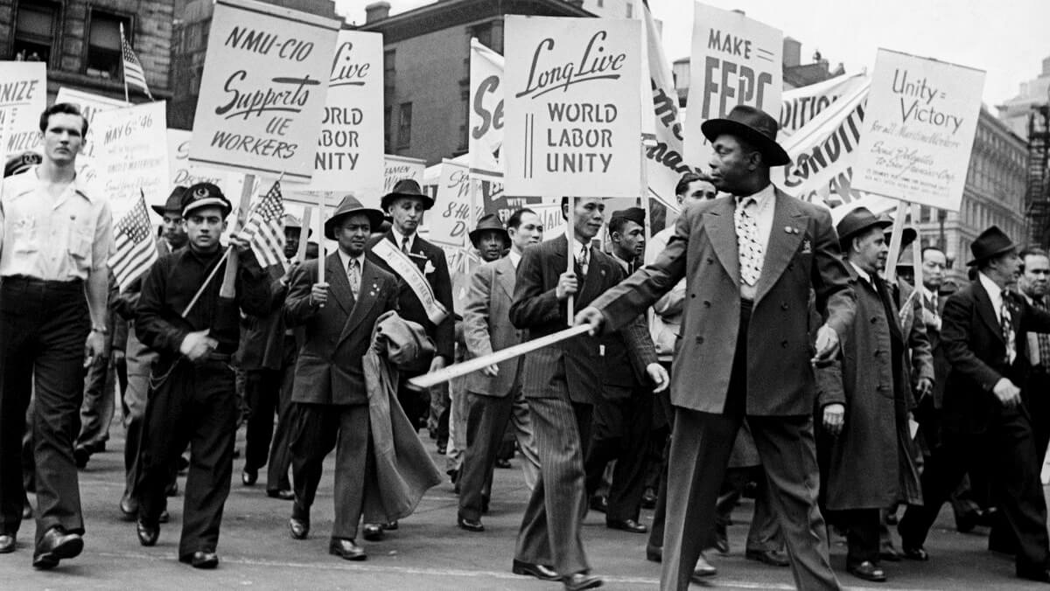

Slide 31
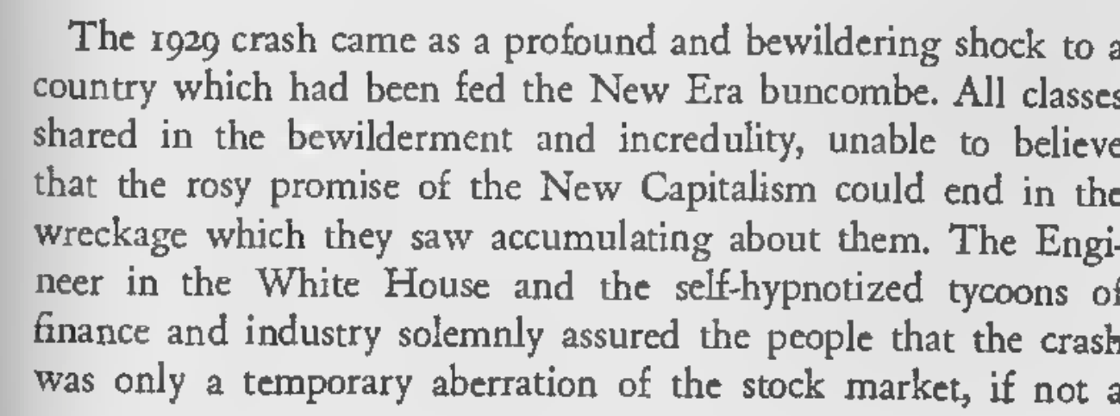
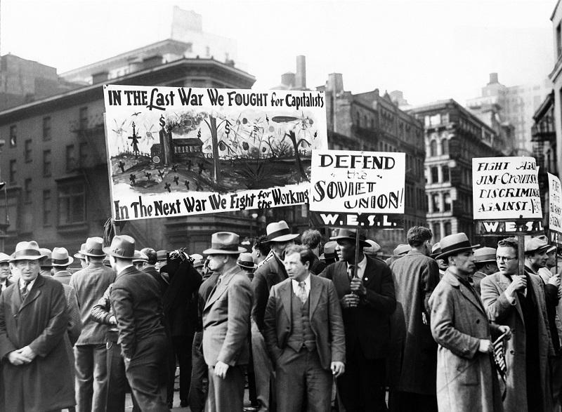
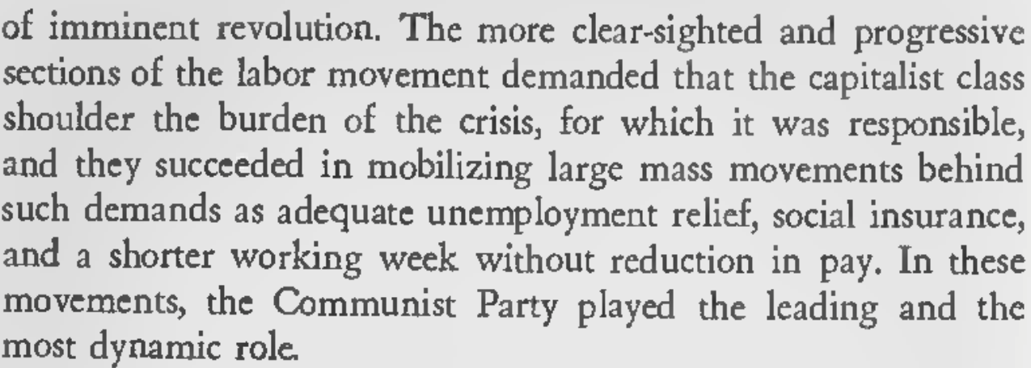
Economic Collapse of 1929

Slide 32
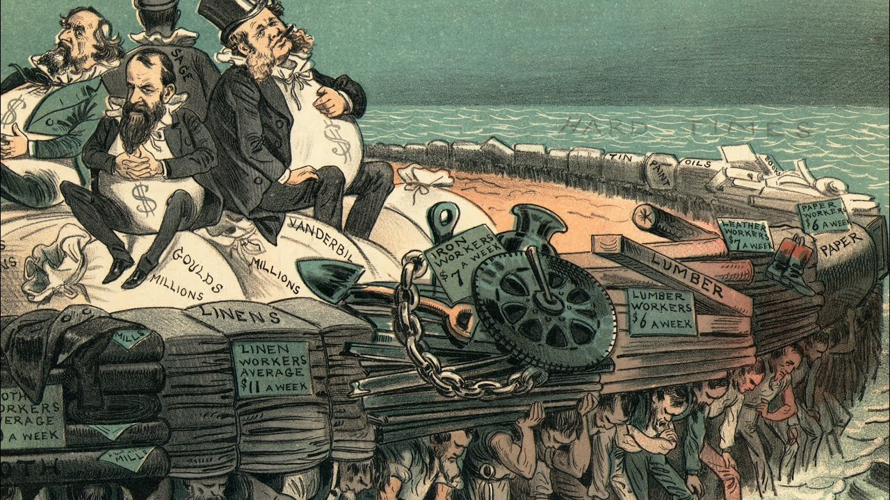
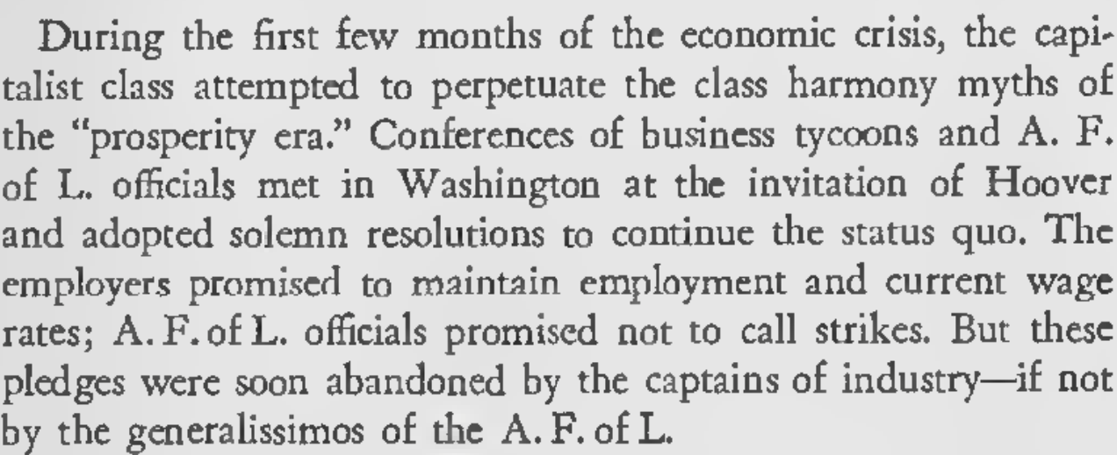
Big Business Program for the Crisis

Slide 33
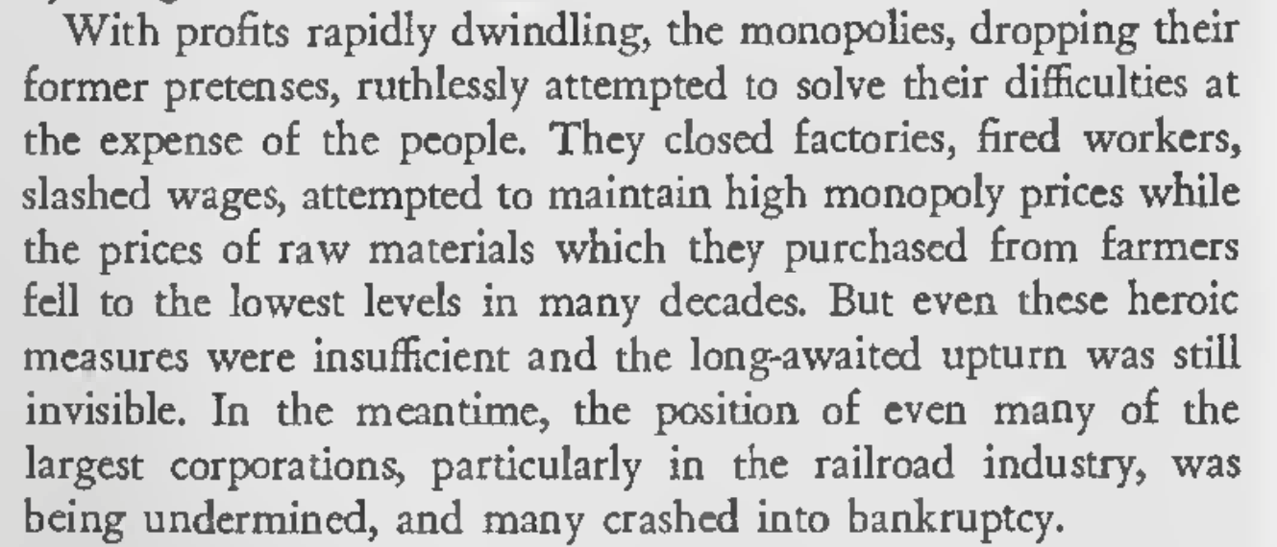
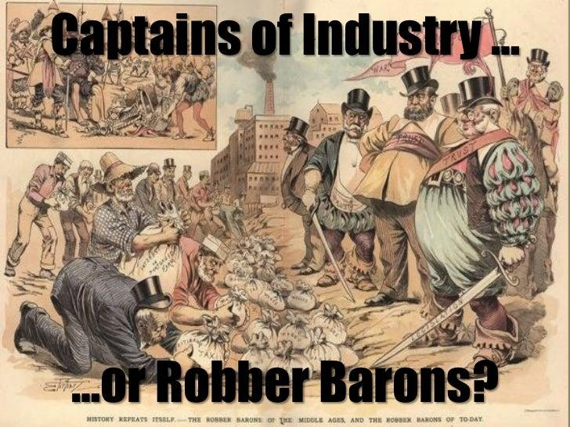
Big Business Program for the Crisis

Slide 34
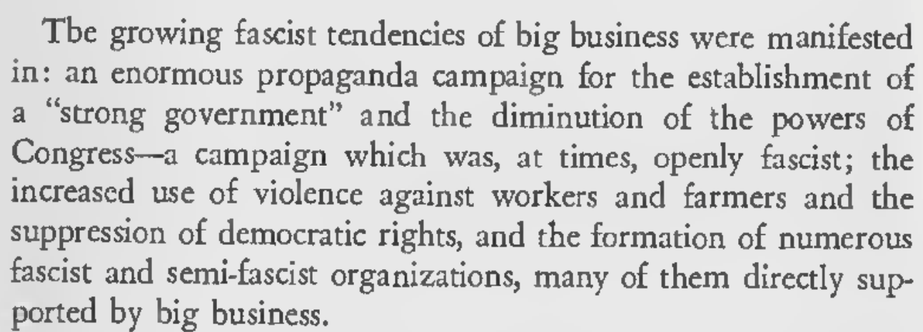
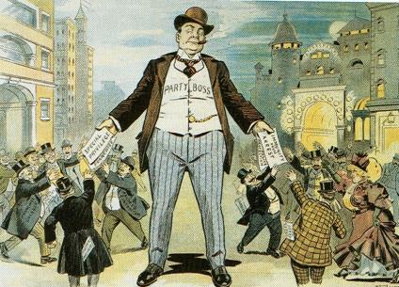
Big Business Moves Toward Fascism

Slide 35
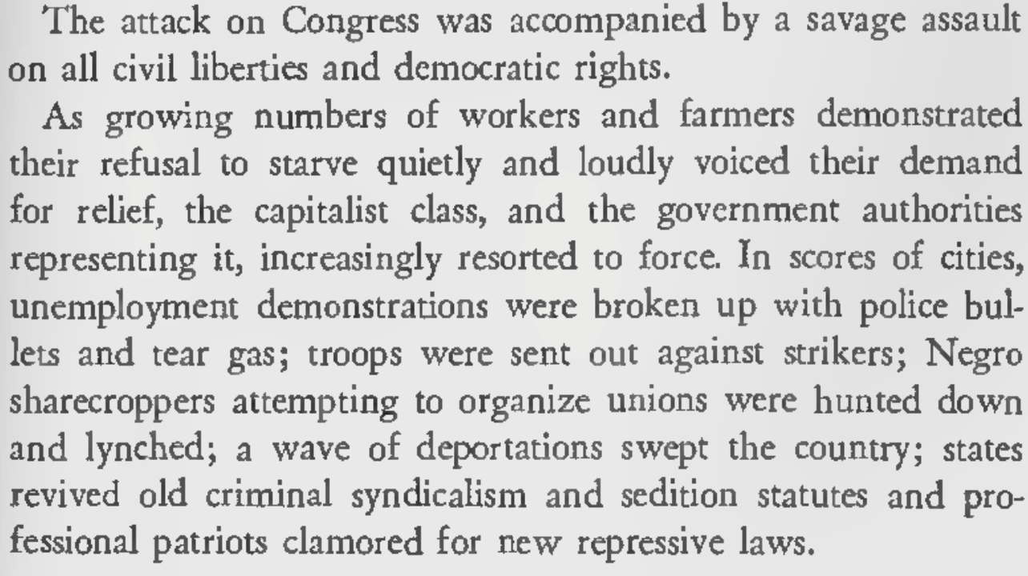
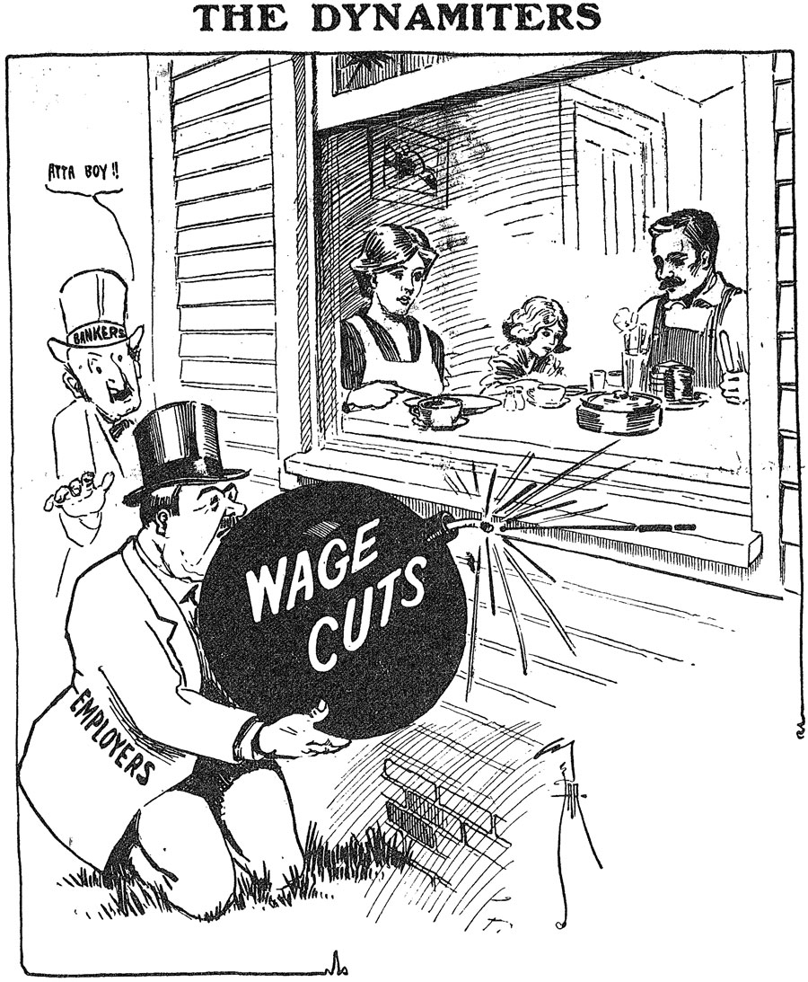
Big Business Moves Toward Fascism

Slide 36
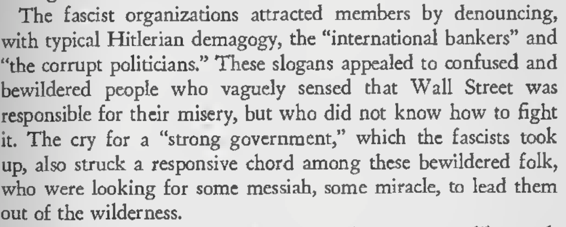
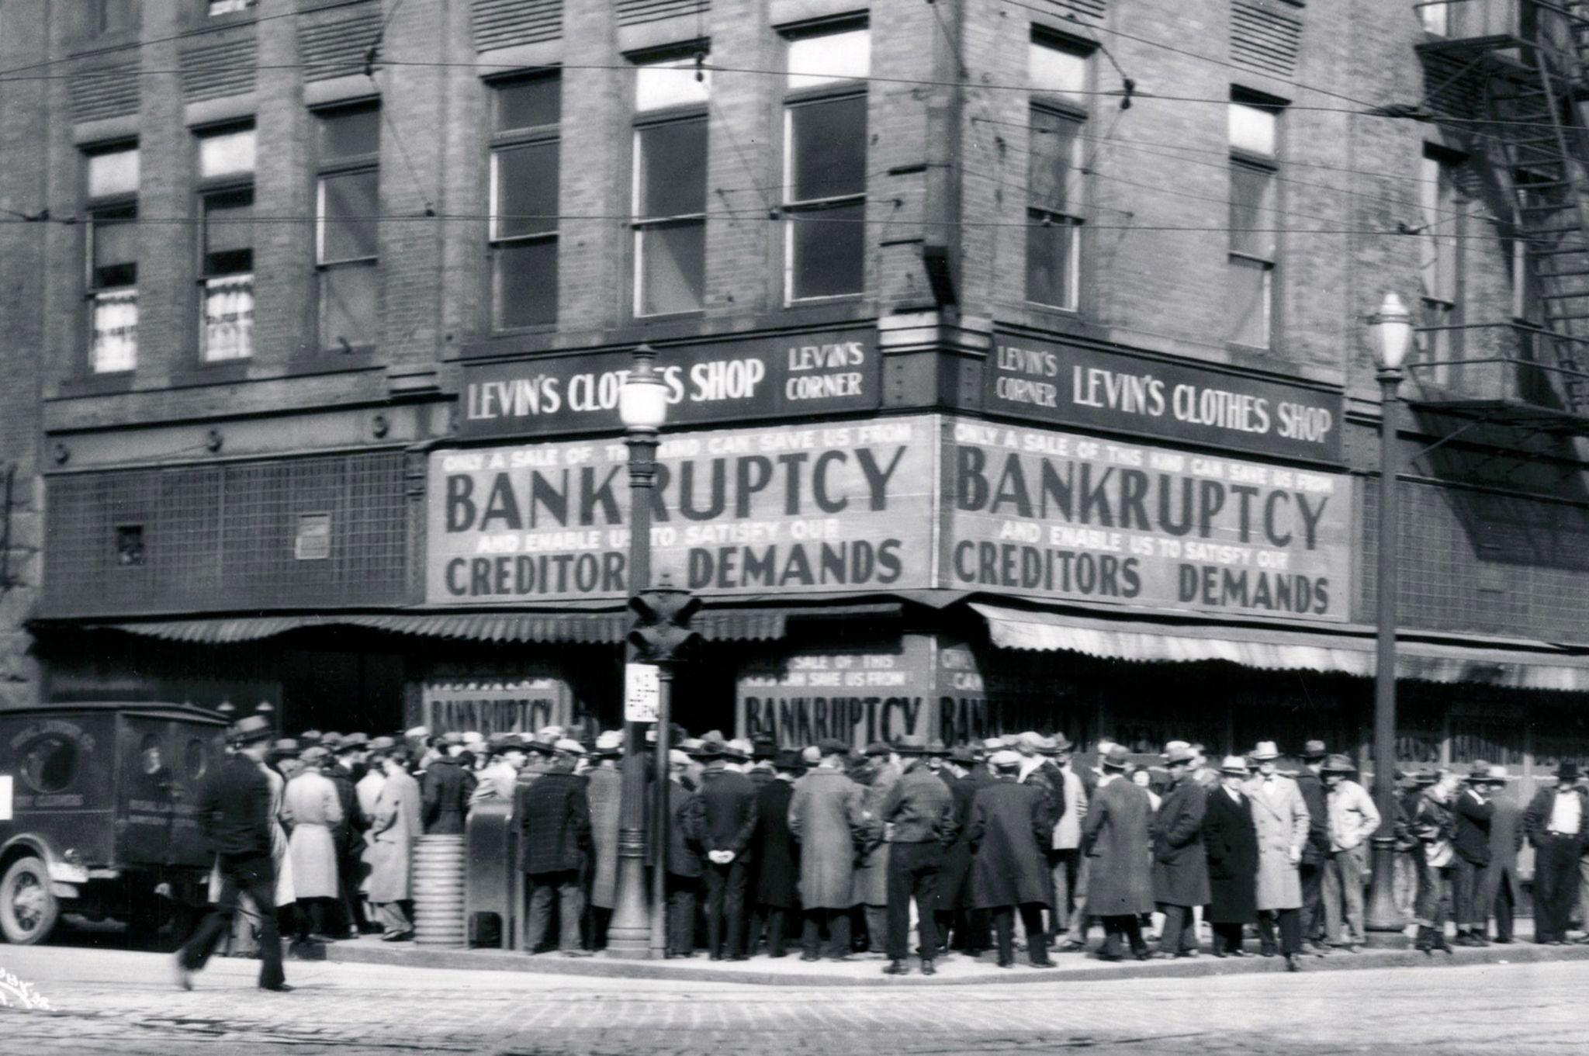
Big Business Moves Toward Fascism

Slide 37
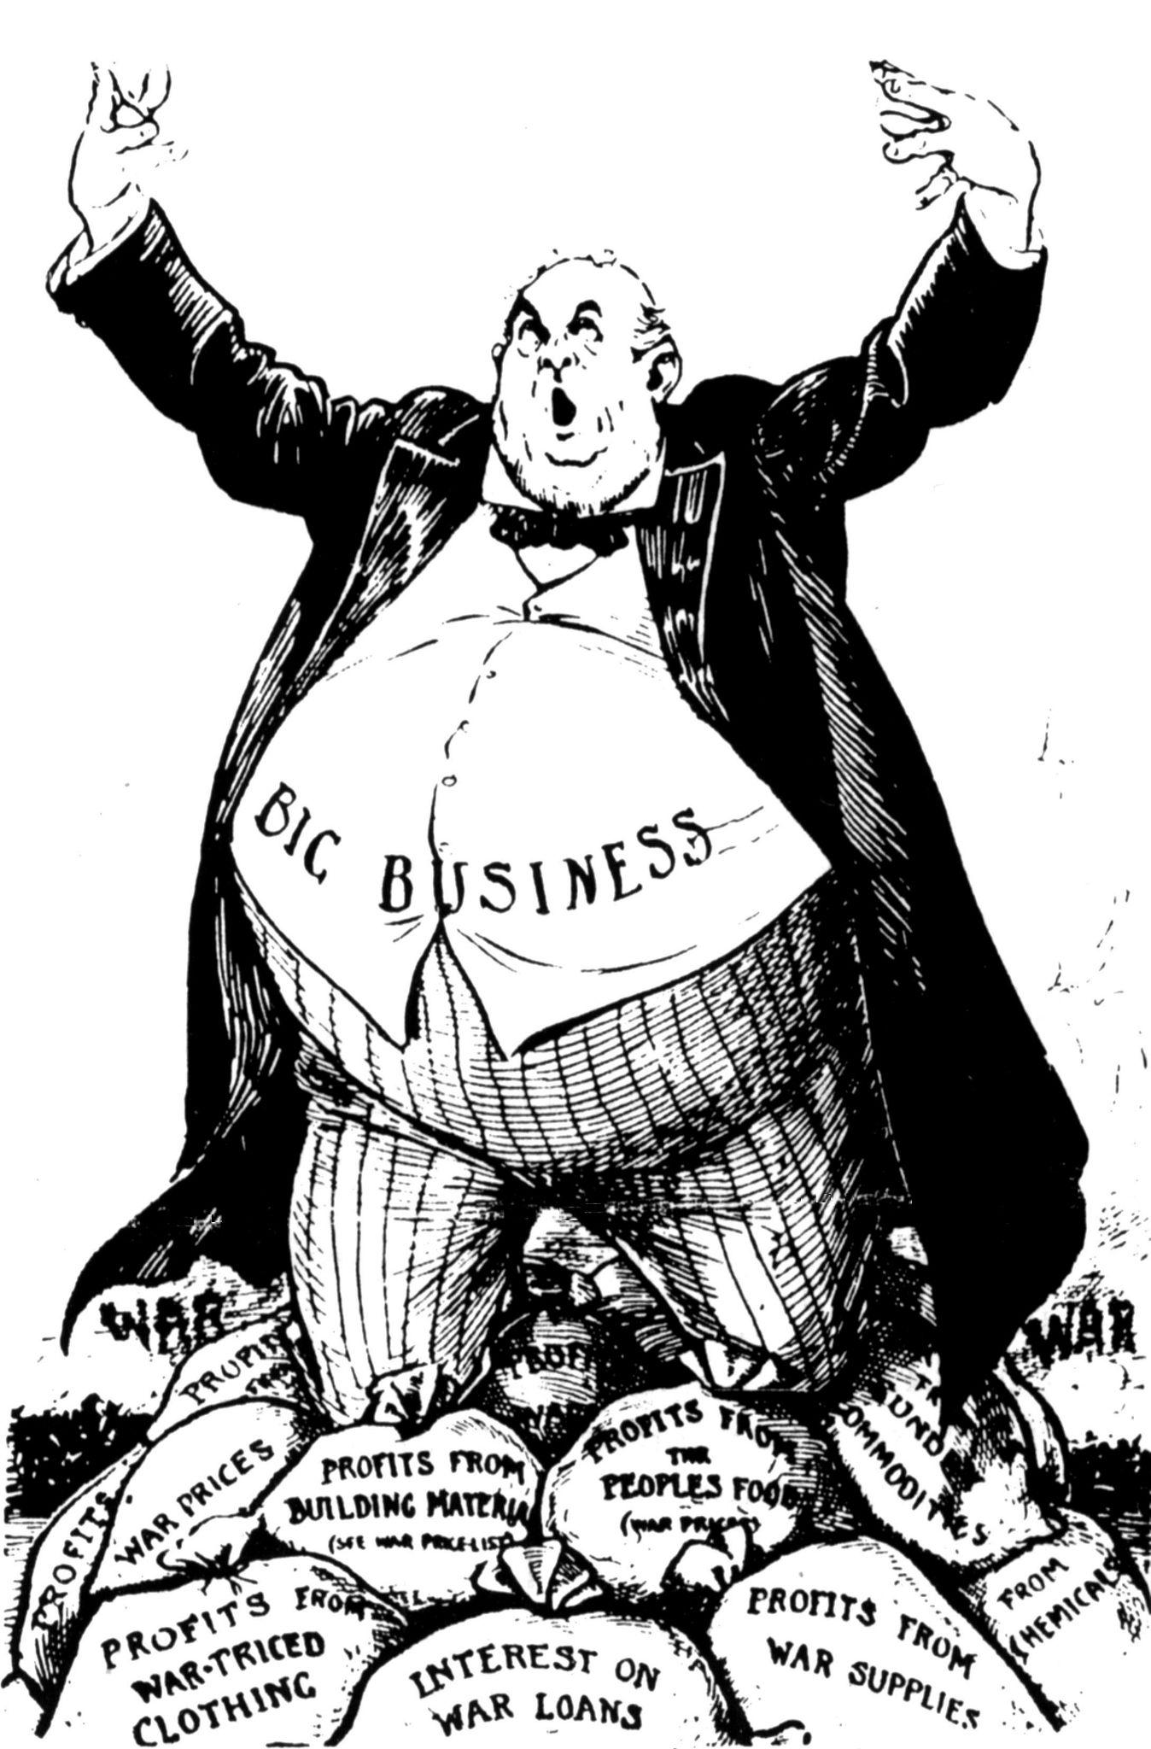
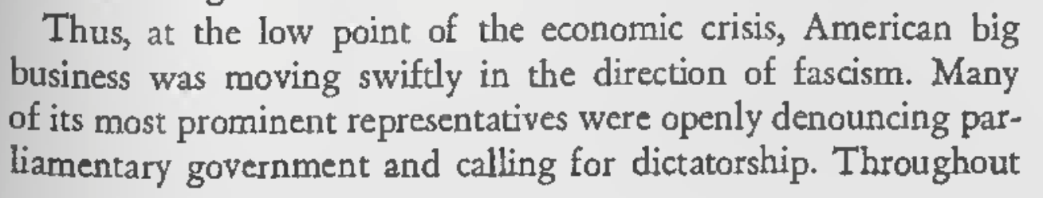
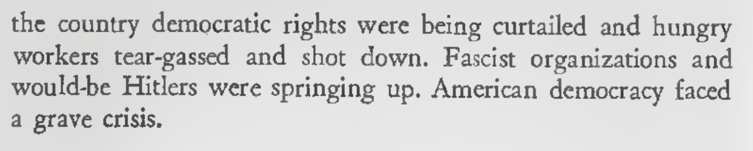
Big Business Moves Toward Fascism

Slide 38
Discussion & New Members Introductions

Slide 39
New Member Introductions
What is your name, pronouns and state (or country/territory)?
Where do you work? Is it unionized?
How did you find out about the People’s School?
What do you think about tonight's class?

Slide 40
Discussion & Wrap Up

Slide 41
Announcements
The PSMLS has recovered our old Youtube account we lost to wreckers in 2022 and we have re-uploaded all our old videos. Like, subscribe, and check out what subjects we covered prior and what we aware saying in the past.
PCUSA Cell Chairs need to call members of their cells to remind them about attendance.
The next issue of New Masses (2025) has begun production. If you have art you want us to feature, email it to info@partyofcommunistsusa.net.

Slide 42
Volunteers Needed!
We are in need of volunteers for the staff of the People’s School! Here’s a few roles we need filled:
People to help manage posting on our social media and podcast platforms
Video Editors, Audio Editors, Graphic Designers, Artists, Narrators
Facilitators, Web Controls, Moderators
Email info@peoplesschool.us if you’re interested and try to attend our next staff meeting if possible.

Slide 43





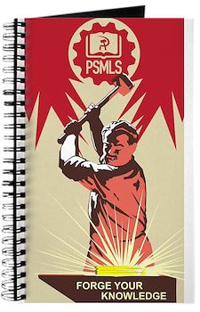

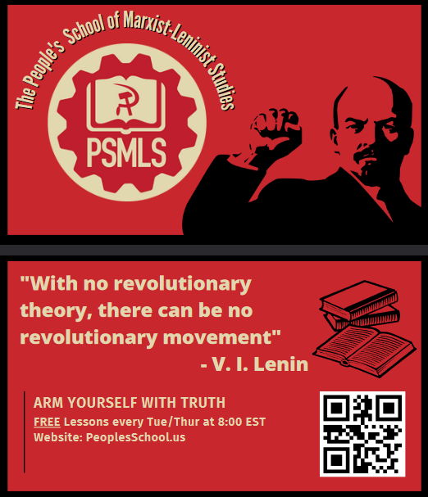


PSMLS Propaganda
peoplesschool.us/media & peoplesschool.us/store
Materials to help promote the school!

Slide 44

View From Left Field
https://viewfromleftfield.libsyn.com
The Old PSMLS Youtube is now the Youtube of View From Left Field, a podcast of analysis and discussion of current events from a progressive perspective.
Like the Youtube videos and subscribe with 5 star ratings on your podcast platforms.

Slide 45

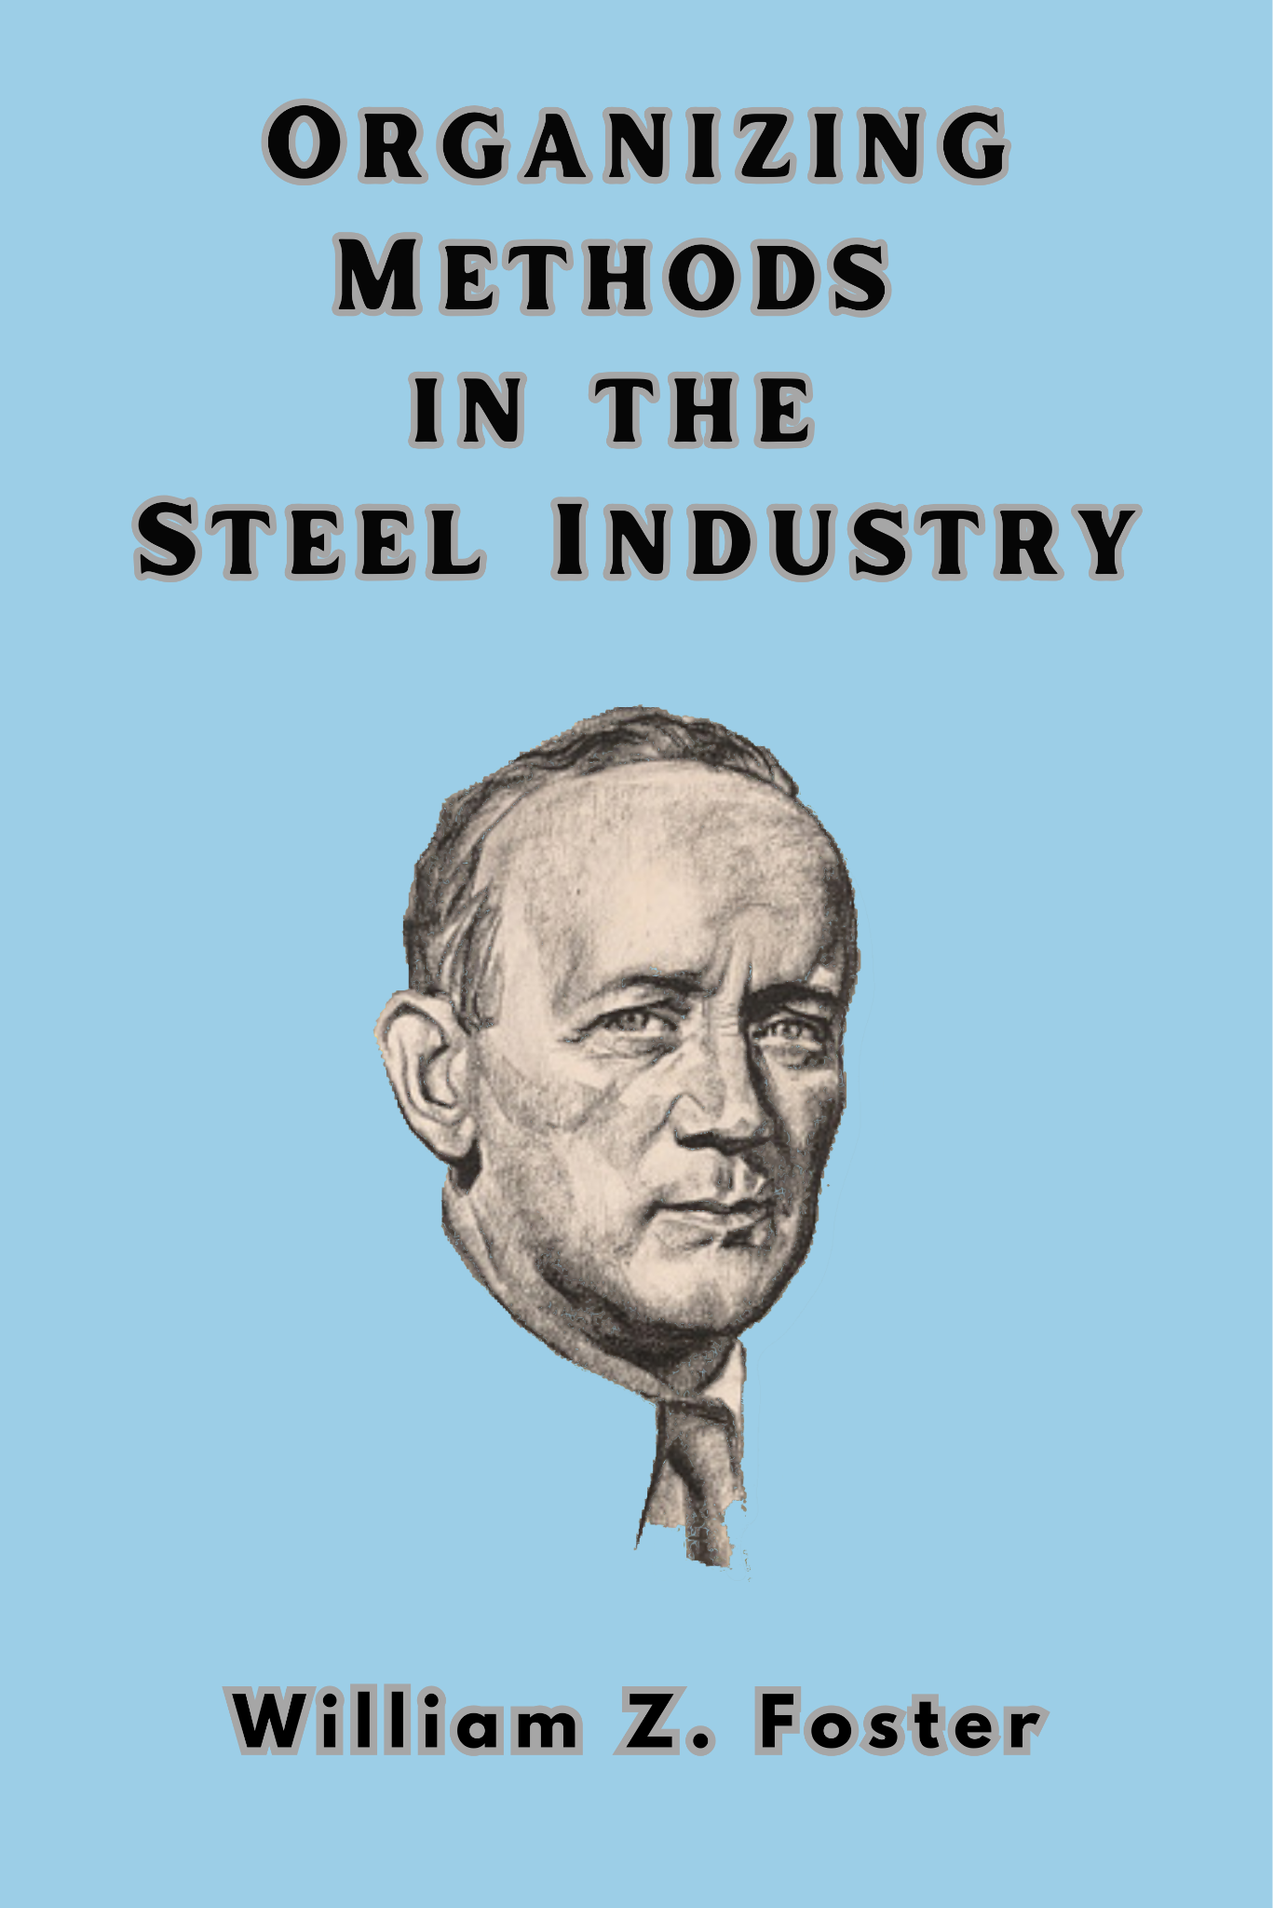

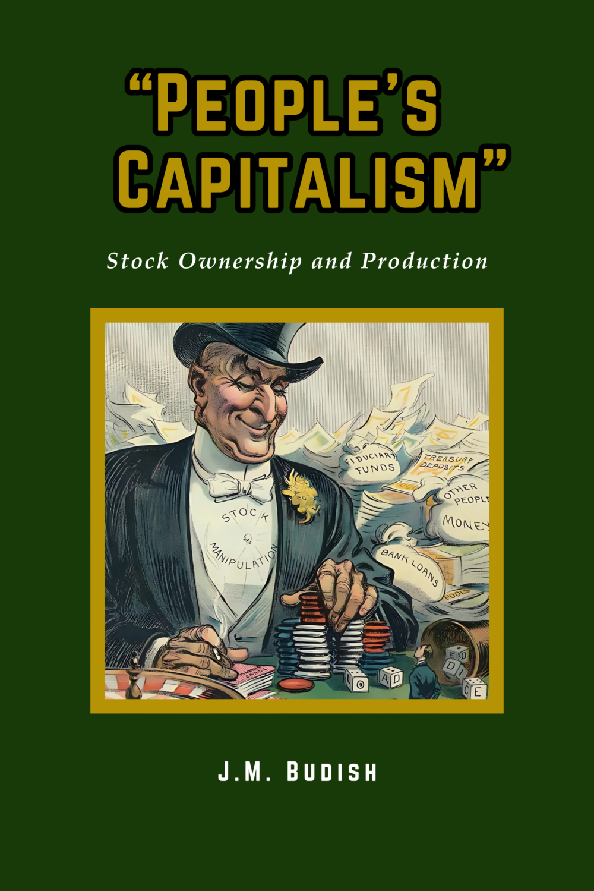
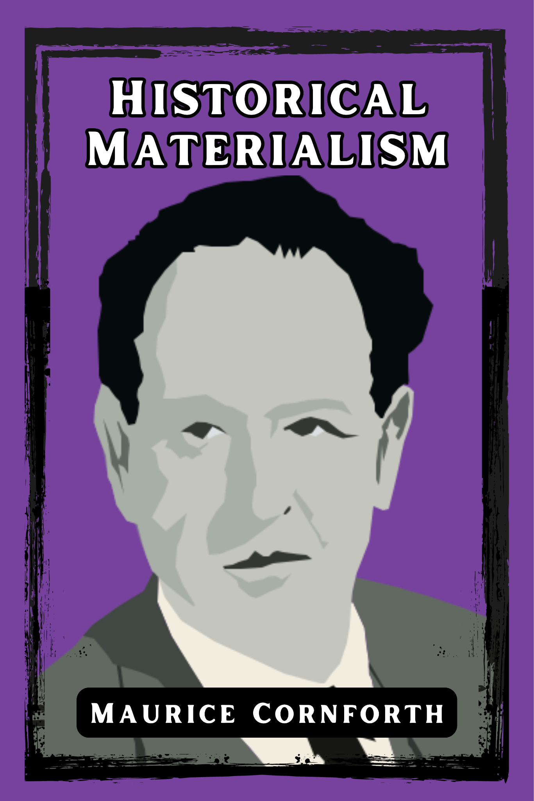
New Outlook Publishers
newoutlookpublishers.store
Latest Releases

Slide 46


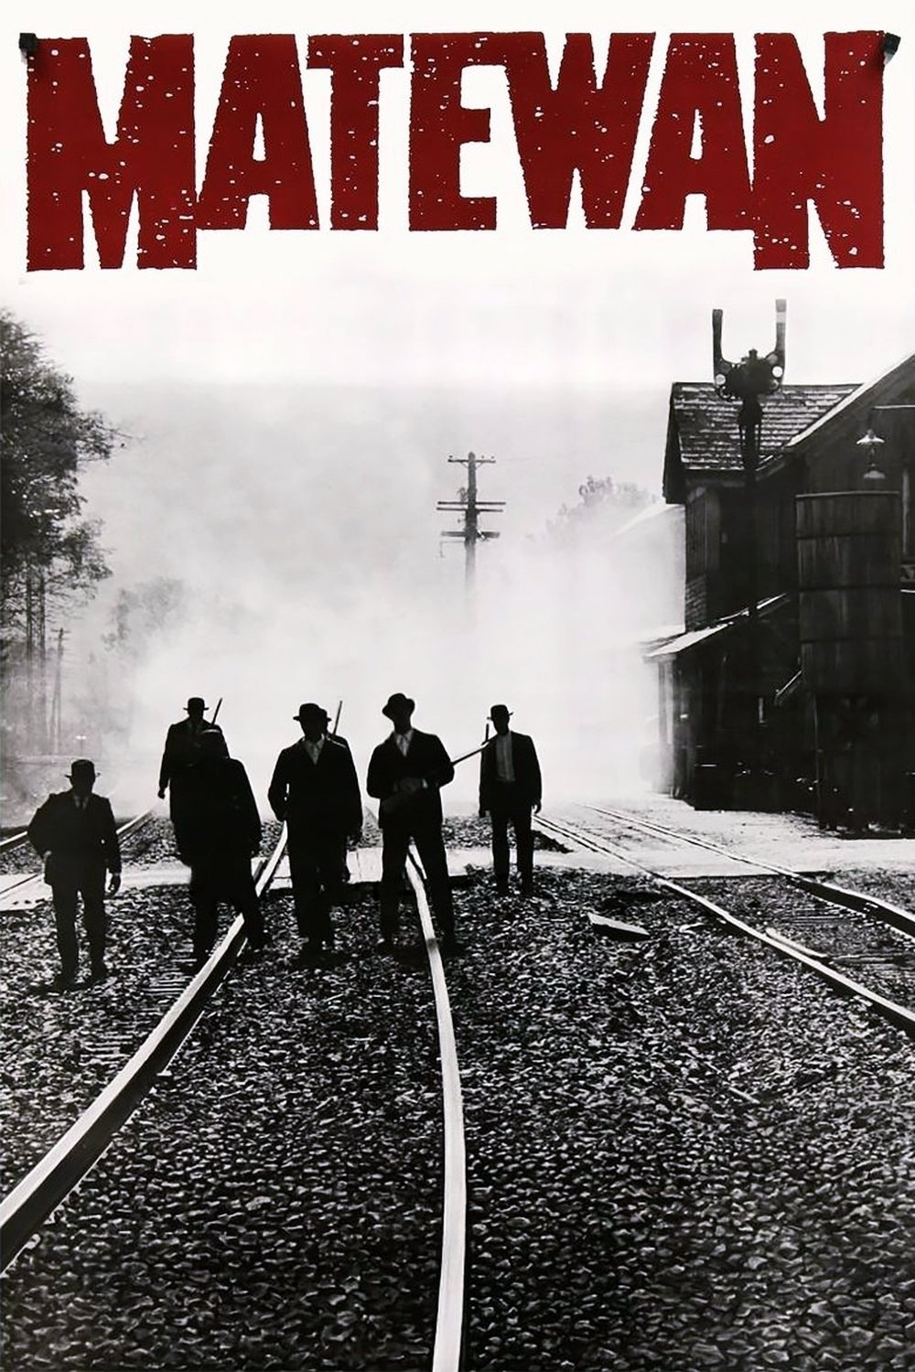
Harry Bridges School of Labor
luel.us/laborschool/
The Harry Bridges School of Labor is a monthly class held 2x per month. Classes cover a variety of topics aimed at building class conscious among union members.
May’s class is a movie viewing of “Matewan” Class will be May 7, 2025 at 8pm EST/5pm PST and Saturday May 10, 2025 at 7pm EST/4pm PST.

Slide 47

The House I Live In

