Slide 1

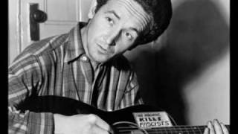
Woody Guthrie - All You Fascists Bound to Lose.

Slide 2
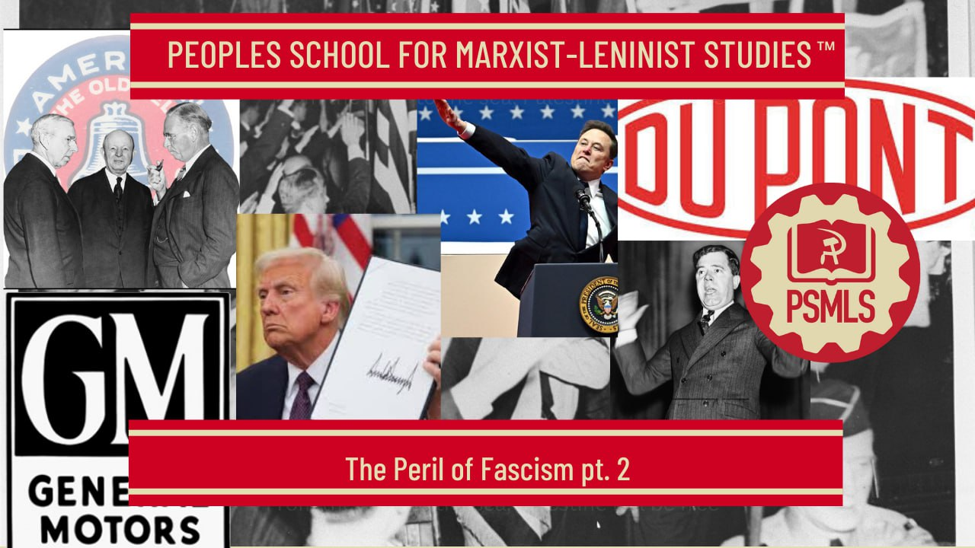

PSMLS May 20, 2025

Slide 3
What we’ll be learning today:
The Battle Lines Form
Big Business: Fountainhead of Fascism
Apostles of Liberty and Demagogues of Fascism

Slide 4
Early 1930s: Battle Lines Form

Slide 5
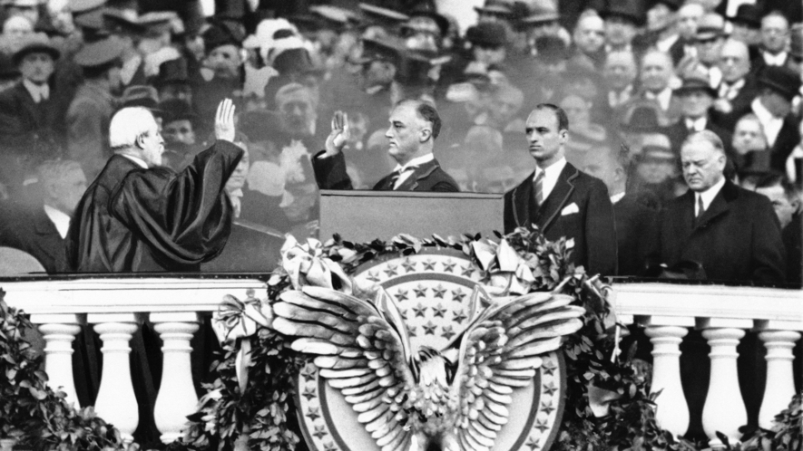
1932 Roosevelt Administration
To understand the relationship between big business and the Roosevelt administration during the first phase of the New Deal, in the spring and summer of 1933, it is necessary to recall that when Roosevelt entered office, the entire capitalist system appeared, to at least some of the more fearful plutocrats, to be on the verge of collapse.

Slide 6
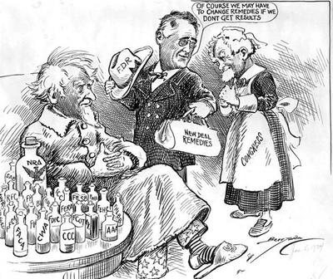
1932 Roosevelt Administration
His administration, at this stage, represented a broad coalition of heterogeneous interests, ranging from the lords of finance, demanding measures to strengthen the monopolies, to lower middle class strata clamoring for government action to restrain the monopolies.
Roosevelt gathered together this strange conglomeration of irreconcilable forces for what he regarded as a great national crusade to lift the economic system from the abyss of the crisis.

Slide 7
1932 Roosevelt Administration
The basis for coalition was slim and precarious indeed. Big business was willing for the moment to go along in a “national coalition” in order to achieve its principal immediate objectives — the relaxation of the anti-trust laws and increased government assistance to key industrial and financial units on the verge of bankruptcy; but it was bitterly opposed to even the smallest concessions to the workers and farmers. Only its extreme desperation in the critical spring days of 1933 made it tolerate the reformist elements in the Roosevelt program. Once out of the pit of the crisis, it was certain to fight for the withdrawal of all reforms and concessions to the people.

Slide 8
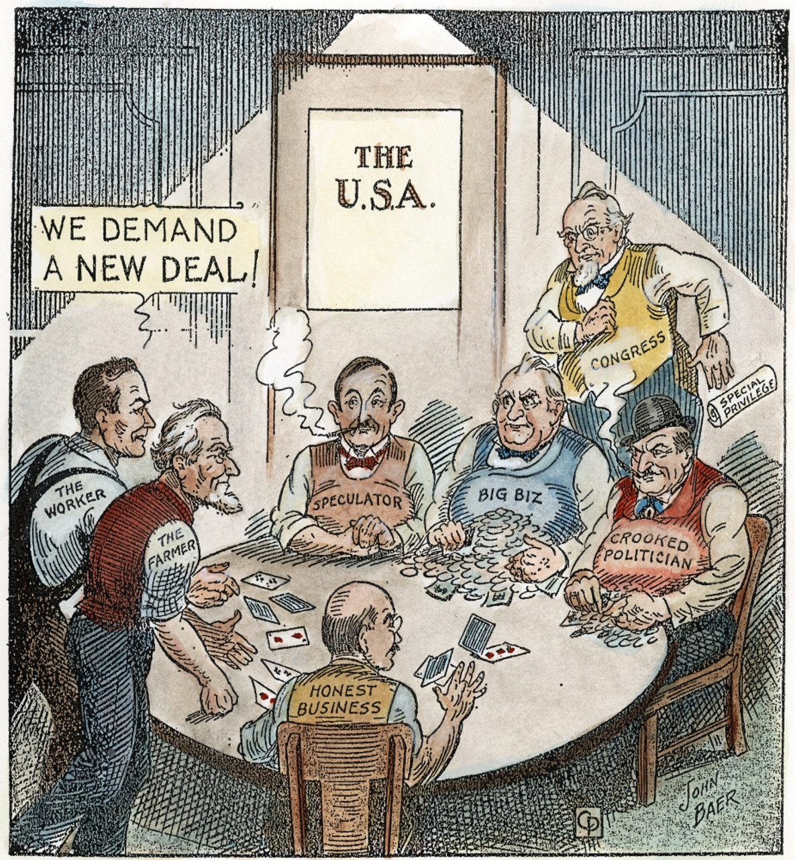
1932 Roosevelt Administration
The Roosevelt program even at this stage had certain progressive features, providing partial relief for the unemployed — which Hoover had refused through three and a half years of unemployment and hunger— and holding out the promise of collective bargaining. But these progressive features were heavily overshadowed during the first phase of the New Deal by the big business program.

Slide 9
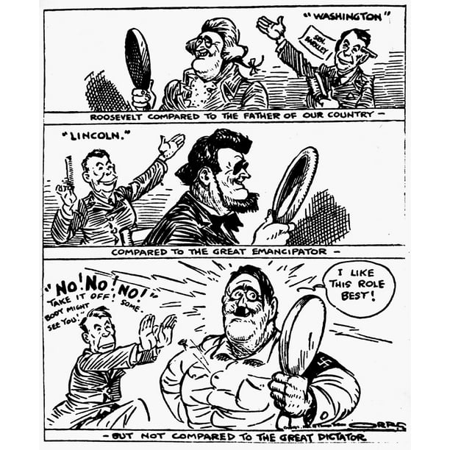
National Recovery Administration
Insofar as the first phase of the New Deal carried out the program of the economic royalists, it contained certain definite fascist elements. It was for this reason that the Communists sharply attacked the Roosevelt administration, at a time when practically every other political group, including the Socialists, accorded it warm support.

Slide 10
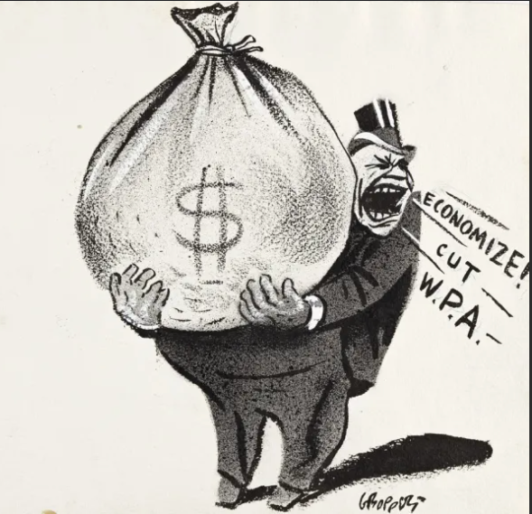
Economic Recovery and Class Realignment
The recovery, deformed from its inception by the general crisis of capitalism, had the effect of sharpening instead of alleviating class tensions and, consequently, of accelerating the fascist tendencies of the plutocracy.
Its first effect was to relieve the economic royalists of the fear of bankruptcy which had impelled them to tolerate the progressive features of the New Deal. The self-confidence and arrogance of big business rose with its profits.

Slide 11
Economic Recovery and Class Realignment
But the recovery which brought such vast benefits to the economic overlords at the same time increased the desperation of the masses of people. Despite the sharp increase in production, unemployment throughout 1933 and 1934 remained well above ten million. Average money wages rose; but the gains were more than offset by rapidly rising retail prices.
The rural population likewise profited little from recovery. Crop curtailment benefited the upper and some middle strata of the farm population, but at the same time drove off the land many thousands of poor tenants; and the rise in land values encouraged creditors to crack down harder on indebted farmers.

Slide 12
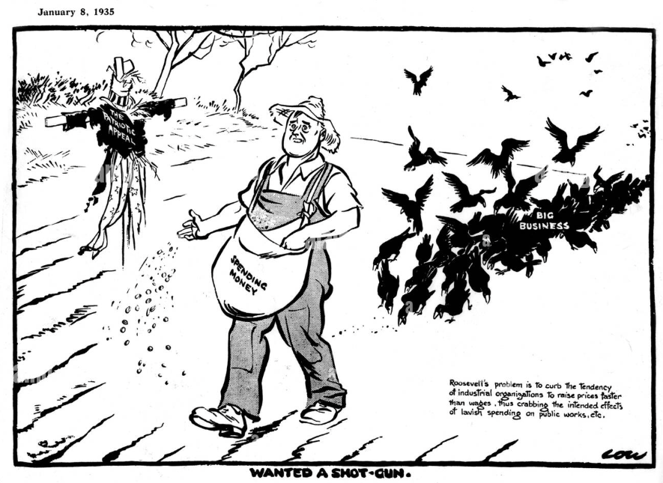
Economic Recovery and Class Realignment

Slide 13
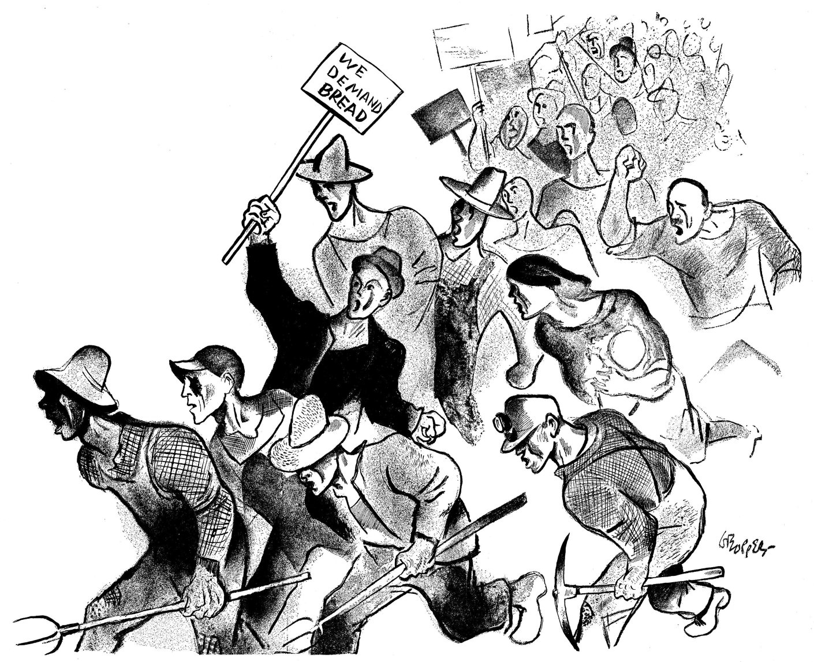
Economic Recovery and Class Realignment
In the contradiction between the prosperity of the financial magnates and mass misery was the basic explanation of the upsurge of popular struggle which forced the break between big business and Roosevelt. After five years of unemployment, hunger and evictions, workers and farmers were determined to obtain a really new deal.

Slide 14
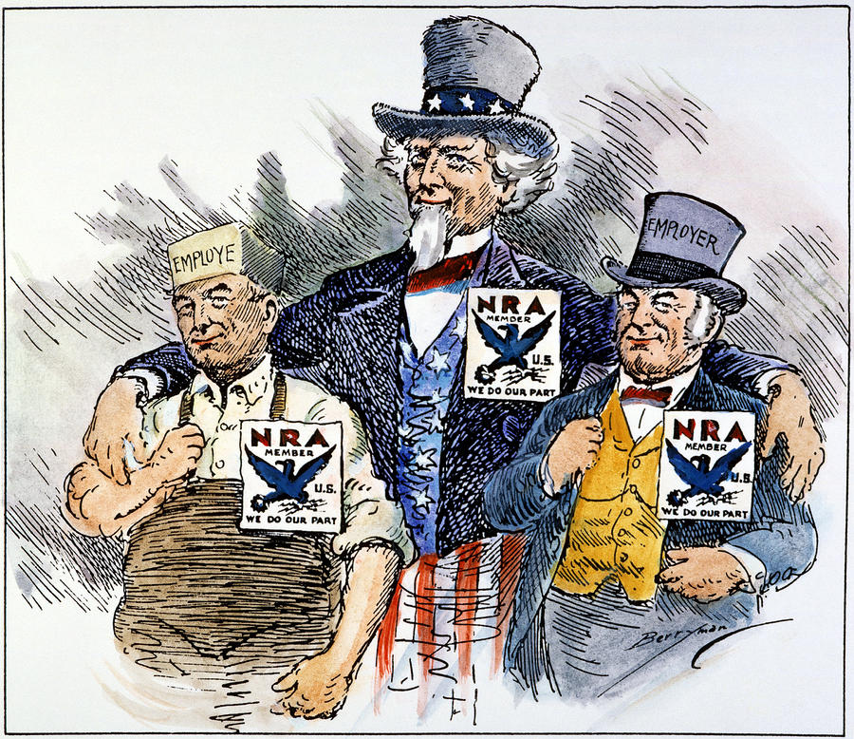
Economic Recovery and Class Realignment
The growth of popular unrest gradually crystallized big business sentiment against the New Deal. The position of the economic autocrats had been greatly strengthened by the relaxation of the anti-trust laws, huge loans to the banks and railroads, the devaluation of the dollar and the intensification of the speed-up under the N.R.A.

Slide 15
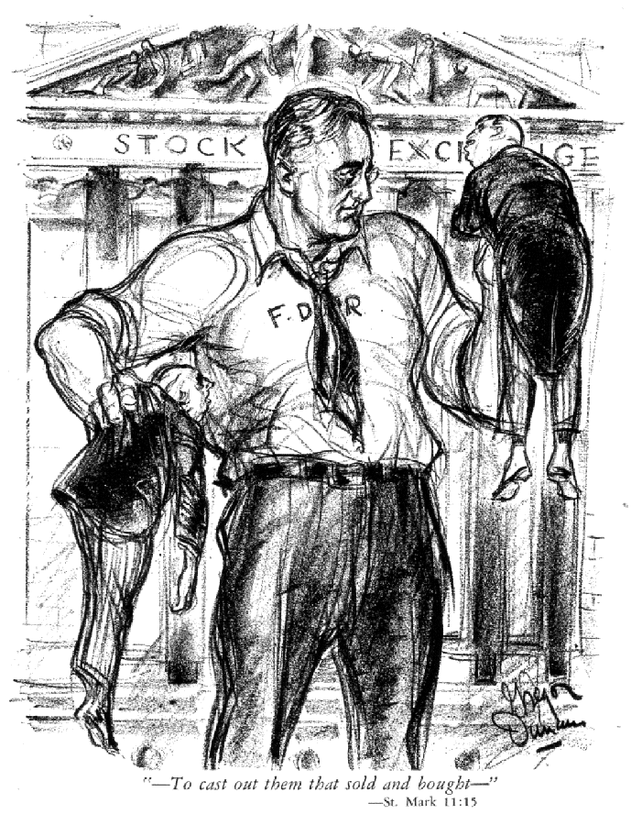
Big Business Breaks with Roosevelt
The rift which developed between big capital and the Roosevelt administration widened as recovery continued and as the Wall Street reactionaries felt strong enough to demand the complete fulfillment of their program. They mobilized their forces in an effort to compel Roosevelt to change his course — or, if that failed, to drive him out of office.

Slide 16
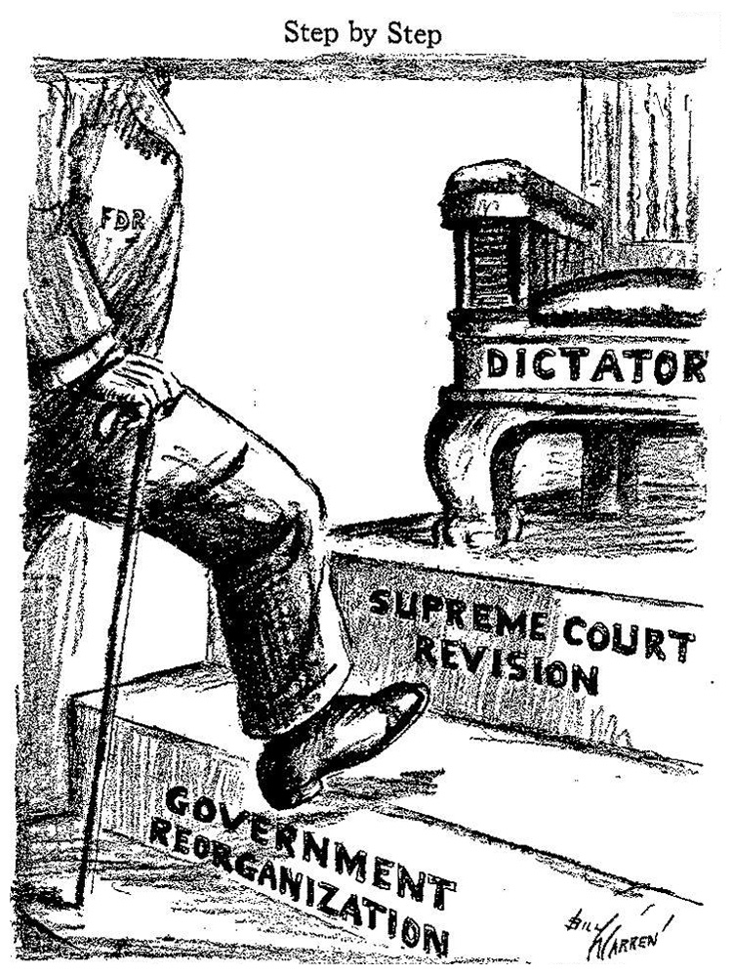
Big Business Breaks with Roosevelt
The first open assault against Roosevelt came as early as October, 1933, when Alfred Smith — who two years earlier had proposed the shelving of the Constitution — denounced the administration as “bureaucratic.” This was promptly followed by a barrage from Hearst excoriating Roosevelt as a “dictator.” Smith and Hearst constituted the vanguard of reaction.

Slide 17
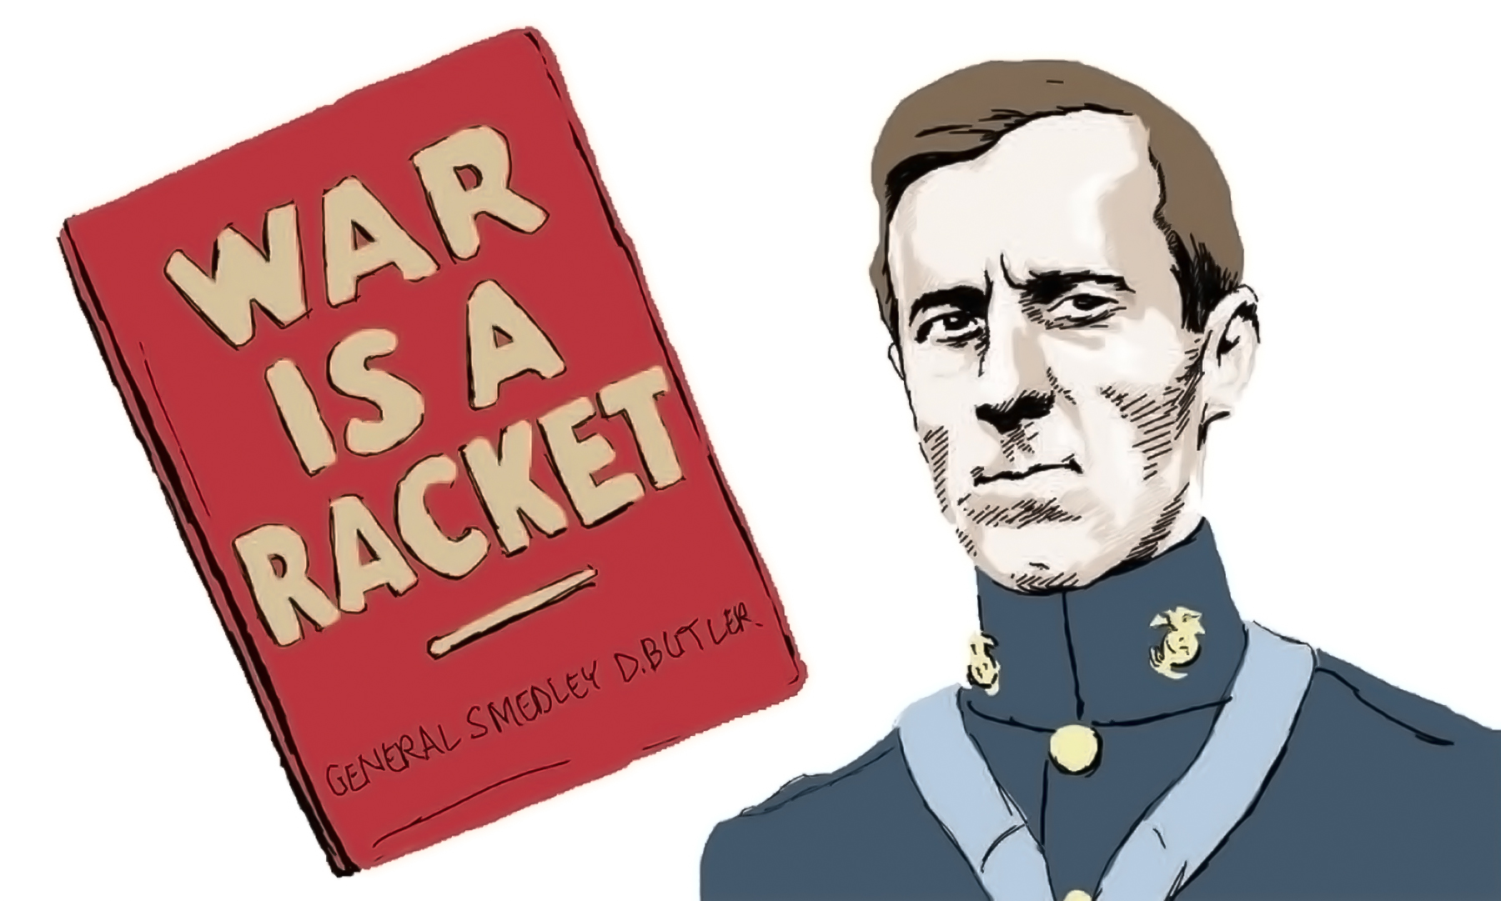
Big Business Breaks with Roosevelt
Some of the more adventurous sections of Wall Street even toyed with the idea of a fascist coup d’etat. In November, 1934, General Smedley Buder, former head of the Marine Corps, announced that Gerald P. MacGuire, a salesman for a leading Wall Street brokerage firm, Grayson M.-P. Murphy, had proposed that Butler march a half million war veterans to Washington and seize power.

Slide 18
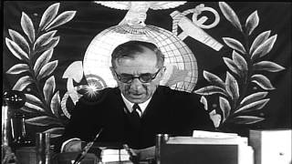
Big Business Breaks with Roosevelt

Slide 19
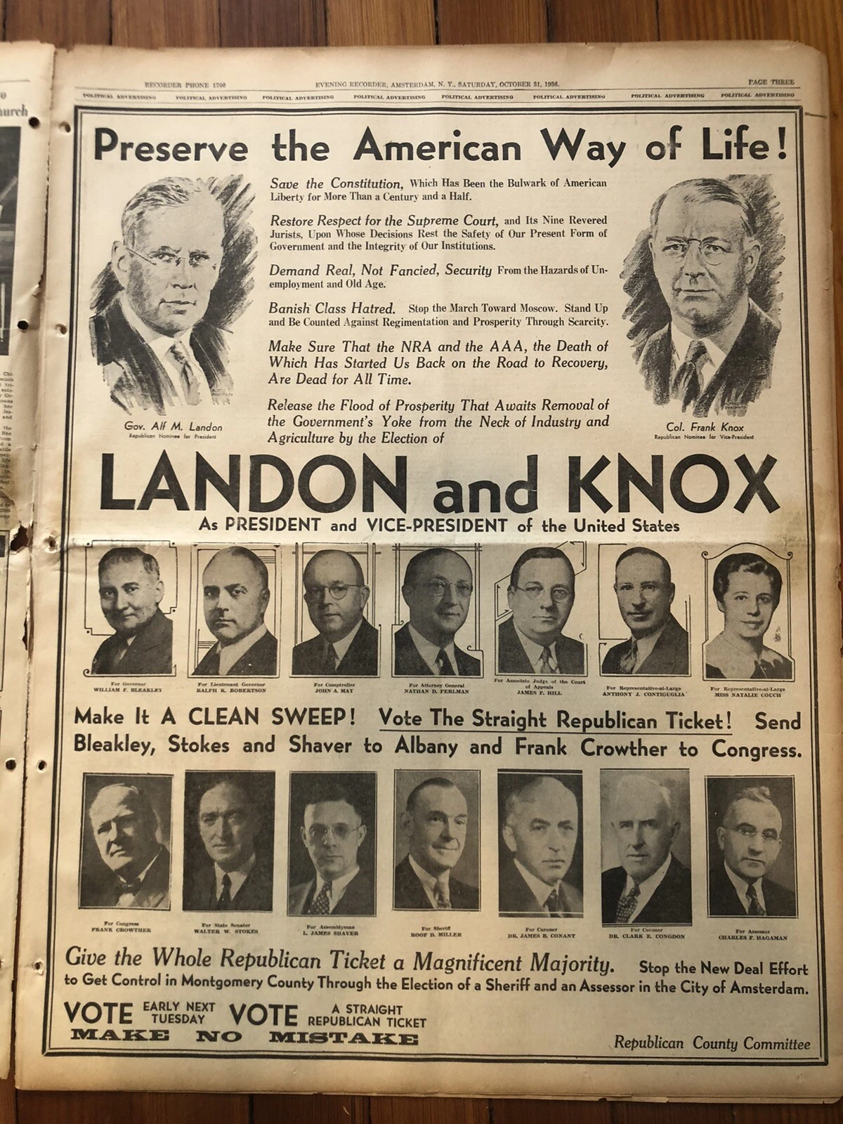
Election of 1936
During the early stages of the Presidential campaign, the Landon forces maintained the pretense of “democracy” and “progressivism,” conducting their fascist, anti-labor, anti-Negro and anti-Semitic agitation through underground channels and through subsidiary organizations like the Southern Committee to Uphold the Constitution.

Slide 20
Election of 1936
But as the campaign wore on, the Republican leadership abandoned its democratic pretenses and revealed its true position. Early in October, Republican National Chairman Hamilton demanded that Roosevelt give “the government investigators a free hand to rout out the alien agitators of Communism” for deportation. Echoing the editorials of the Hearst press, he clamored for a drive on “un-Americanism.” Like Hearst, Hamilton adopted a definition of “un-Americanism” broad enough to include anyone who refused to subscribe to the fascist doctrines of the professional patriots. According to Hamilton, even the mildly liberal trade union leader Dubinsky was a “red” and a “Communist,” Spanish democracy was “Communistic” and its leaders, who were fighting to crush fascist tyranny, were “murderers.”

Slide 21
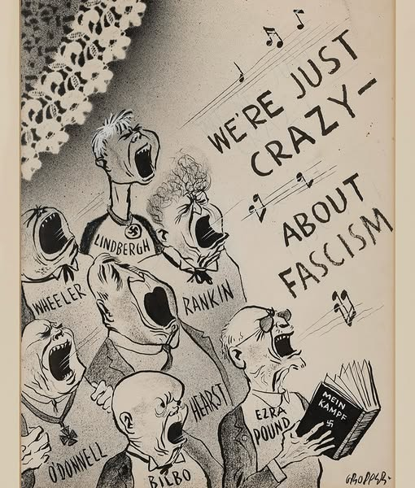
Fascist Temper of Finance Capital
By the middle of 1937 fascist ideas had made considerable progress in the United States, permeating not only big business circles, but large layers of the middle classes and the exploited poor in backward sections of the country.
In the eight years from 1929 to 1937, the most important sections of big business had traveled far on the road to fascism. They were not yet fully prepared to espouse openly the whole fascist program; but they had gone a long way in that direction.

Slide 22
Discussion

Slide 23
Big Business: The Fountainhead of Fascism

Slide 24
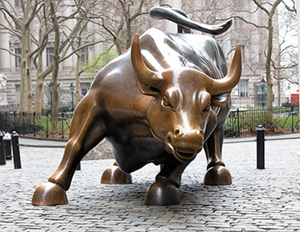
The First Stages of the Fascist Disease
The scattered streams and trickles of developing American fascism have a common source: Wall Street. The “fascist-mindedness” of the tycoons of Wall Street is a reflection of their whole social role in the period of the general crisis of capitalism. It may be asked in what respects big business is fascist-minded today, as distinct from its character before the first world war, in view of the fact that bloody strike-breaking, invasions of civil liberties and such institutions as private gunmen and labor spies have existed for many years. We have already pointed out that all these phenomena in the past constituted the germs of fascism, and that if today we can speak of the first stages of a virulent disease, that disease represents the maturing of tendencies which developed within the system of capitalist democracy.
The Charging Bull - A statue representing Wall Street in the Financial District of NYC

Slide 25
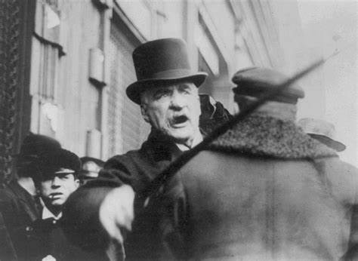
The First Stages of the Fascist Disease
Nor have the spokesmen for big business, despite their protestations of affection for democracy and liberty, ceased entirely the nostalgic expressions of sympathy for fascist dictatorship. Thus, W. M. Kiplinger, wrote in the May, 1935, issue of Nation’s Business, organ of the U. S. Chamber of Commerce:
“Most people have only a vague idea of what fascism is. Many big businessmen think well of it and secretly hope for it.”
Fascist and semi-fascist tendencies do not, however, express themselves merely in openly pro-fascist statements and activities; they are part and parcel of monopoly capital in the present period
J. P. Morgan - One of the Conspirators of the Wall Street Putsch of 1933

Slide 26
The Driving Force in the Development of Fascism
The driving force in the development of fascism in this country, as in every capitalist country, are the employers’ associations. They represent the concentrated might of big business and are today more completely dominated by the large finance capitalist groups than at any time in their history. In addition, big capital has sponsored and financed organizations functioning in specialized fields whose membership, though drawn predominantly from the ranks of big business, is open to the general public.
The National Association of Manufacturers was founded in 1895 and has a dues-paying membership of between four and five thousand business enterprises. In 1938 the Senate (LaFollette) Committee investigating violations of civil liberties showed that their leading officers contributed generously to various fascist and semi-fascist organizations, including the American Liberty League, the Crusaders, the Sentinels of the Republic, the National Economy League, the Farmers’ Independence Council and the Johnstown Citizens’ Committee.

Slide 27
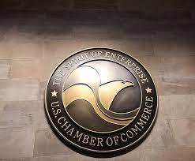
The Driving Force in the Development of Fascism
The Chamber of Commerce of the United States, which includes not only manufacturers, but employers in other branches of business, was organized in 1912 to unite various local and state chambers that had been functioning for some time. Besides its central organization, the Chamber, unlike the N.A.M., also has state and local units. Many of the latter do not limit themselves to propaganda and lobbying, but intervene directly in labor disputes. These two comprehensive employers’ associations constitute the general staff of big business reaction today. They encourage company unionism, labor espionage and vigilante violence. They sponsor legislative attacks on civil liberties. They promulgate a philosophy of Americanism whose chief postulate is that the welfare of the entire community is bound up with the interests of the employer who, by virtue of superior talents and achievements, is the natural and predestined leader not only in industry, but in politics as well.
The U.S. Chamber of Commerce was founded in 1912 and remains the largest lobbying group in the U.S.

Slide 28
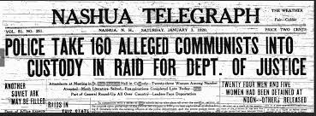
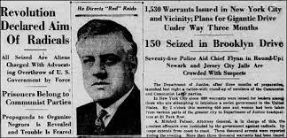
The Assault on Civil Liberties
To the Chamber of Commerce fell the task of openly and directly assaulting civil liberties under the guise of a crusade against Communism. In 1934 the Chamber set up a Committee on Combating Subversive Activities under the chairmanship of Felix Marcus McWhirter. The Chamber’s vendetta against “subversive activities” was another indication that the anti-democratic practices of big business had entered a new stage. Prior to the first world war, employer-inspired attacks on civil liberties and legislative proposals for restricting the rights of labor and radical organizations were by no means rare. But it was in the wartime Espionage and Sedition Acts, in the state criminal syndicalism and sedition laws and in the Palmer Red raids after the war that the drive against civil liberties for the first time achieved a highly organized and concentrated character.

Slide 29
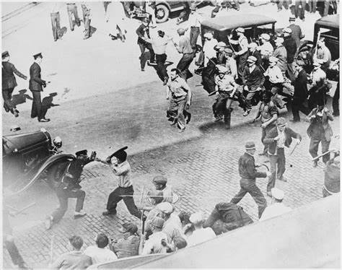
The Assault on Civil Liberties
From the destruction of the trade unions (this would today include, of course, the C.1.O. as well as the A. F.of L.) to the destruction of the rights of all citizens save a few at the top, is not such a long step, as Hitler and Mussolini have shown. And the Chamber of Commerce patriots have not contented themselves with seeking to save the country through legislative means, but have in city after city taken a hand in the organization of anti-labor violence.
“What we want to do is to destroy the whole A. F. of L. It’s a racket from top to bottom....Oh, we’re not against unions. In fact, we help to organize lots of them.” - L. L. Baleisen, industrial secretary of the Brooklyn Chamber of Commerce
Police Attacking Workers During the 1934 General Strike

Slide 30
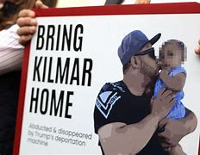
The Assault on Civil Liberties
One of the chief collaborators in the Chamber’s crusade against civil liberties has been its kid brother, the Junior Chamber of Commerce. Announcing that it was “absolutely proven that the United States is even now in the midst of an incipient Communist revolution,” it called for what would be tantamount to a clear sweep of every vestige of democratic liberties. Among the proposals was:
“We think a federal law should be passed under the terms of which an individual convicted of revolutionary activities should be incarcerated, and continually held in a concentration camp, and that, in the case of an alien so convicted, he should be kept in confinement until such a time as laws may be passed, and deportation treaties entered into, providing for his return to his native land.”
KIlmar Abrego Garcia - A Union Sheet Metal Worker Abducted and Deported by the Trump Administration

Slide 31
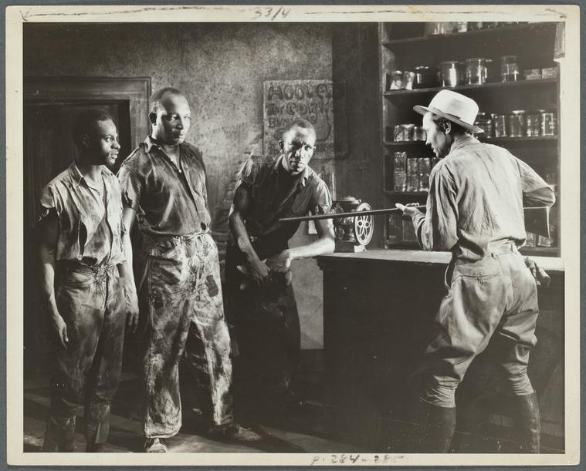
The Authoritarian and Anti-Democratic Structure of Capitalism
It should be borne in mind that the very structure of capitalist industry is authoritarian and anti-democratic. A large corporation may have thousands of stockholders, but policy in all matters is determined by a self-perpetuating small group who own the controlling stock and are closely linked with the large banks. Within the individual factory the employer or the head of the corporation is the apex of a hierarchical pyramid of lesser officials, foremen and straw-bosses who are the symbols and the instruments of a power that is absolute. This is particularly true of the mass production industries; and the larger the factory, the greater the enslavement and helplessness of the individual worker is likely to be, and the more completely do his own personality, needs and desires become reduced to a blank page on which those in command stamp their will.
A Straw-boss Meets a Delegation of Turpentine Workers Demanding Higher Pay and Better Working Conditions

Slide 32
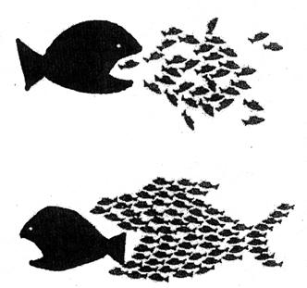
The Fascist Drive Against Unionism
The axis of fascist development in the United States, as in other capitalist countries, is the drive against unionism. Unions threaten the absolute dictatorship of the employer over his workers. They seek to introduce some measure of industrial democracy, though so long as the means of production are in the hands of the capitalists, this democracy at best will be limited. Moreover, unions express in embryo the organized power of an entire class —the class that is destined to transform all social relationships and lead humanity to a higher level of civilization. It is this potential power, striking at the foundations of the profit system itself, that the reactionary big capitalists see rising out of every question of wages and hours and the right to organize, even though the unions themselves pursue modest aims realizable under capitalism. In the drive against unionism, two auxiliaries, company unions and the armies of spies and strikebreakers, both directly organized by the corporations, play an important role.
There is Power in a Union

Slide 33
The Machinery of Espionage
In its preliminary report to the Senate, February 8, 1937, the LaFollette Committee said:
“...It is clear that espionage has become the habit of American management. Until it is stamped out the rights of labor to organize, freedom of speech, freedom of assembly will be meaningless phrases. Men cannot meet freely to discuss their grievances or organize for economic betterment; they may not even express opinions on politics or religion so long as the machinery of espionage pervades their daily life. That private persons or interests should be allowed to maintain arsenals is surprising enough. That industry should be permitted to arm unscrupulous men under their own pay, gravely wearing the badge of the law is startling. That there is allowed to flourish a gigantic commercial enterprise in which employers collaborate with professional spies in assaulting citizens because they exert their lawful right to organize for collective bargaining, is shocking to any true defender of constitutional government.”

Slide 34
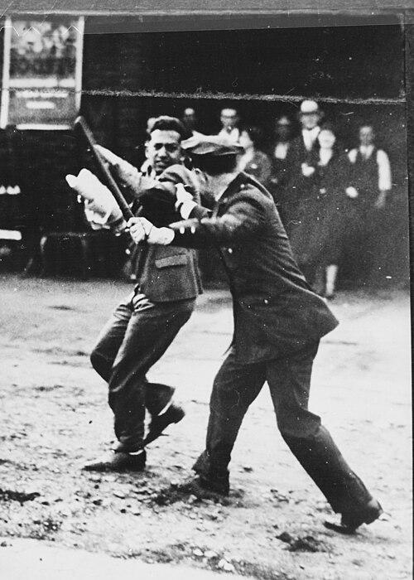
One committee witness, testified that during the San Francisco marine strike, an agent for Federal Laboratories, J. M. Roush, had fired a gas projectile at a striking longshoreman. The striking worker was severely wounded. In his report to B. H. Barker, vice-president of Federal Laboratories, Roush stated:
“I might mention that during one of the riots, I shot a long range projectile into a group, a shell hitting one man and causing a fracture of the skull from which he has since died. As he was a Communist, I have had no feeling in the matter and I am sorry that I did not get more.”
A policeman attacking a striker with a nightstick during the San Francisco General Strike

Slide 35
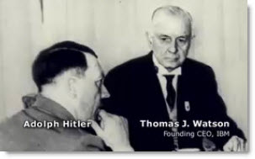
A Juggernaut of Growing Fascism
Here, then, is the portrait of big business: a juggernaut of wealth and power, dominating the economic life of the country, organizing its private armies of spies and gunmen, assembling its arsenals, suppressing elementary constitutional rights, preparing violence and murder—a juggernaut of incipient and growing fascism.
Hitler Pictured with the Founder and CEO of IBM

Slide 36
Discussion

Slide 37
Apostles of Liberty and Demagogues of Fascism

Slide 38
American Liberty League: Blueprint for American Fascism since 1934
“The American Liberty League may be dead, but its soul monopoly capital — goes marching on.
The Liberty League marked the first large-scale attempt to set up a reactionary bi-partisan political coalition under the direct leadership of the most powerful Wall Street groups. As such it exhibited in concentrated form all of the salient characteristics of nascent American fascism. Though the Liberty League has practically ceased to exist since the overwhelming rejection of its program in the 1936 elections, the reactionary coalition that it represented has not only continued to function, but has greatly extended its scope, enlisting many recruits from among rightwing Democrats who had found it expedient to support the reelection of Roosevelt. In other words, while one form of big business coalition on the political field has outlived its usefulness, new forms are emerging, and the whole struggle between the forces of democracy and fascism is developing more sharply and on a vaster scale than ever before.”

Slide 39
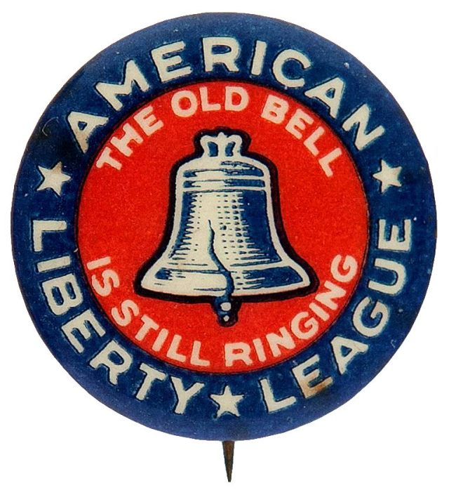
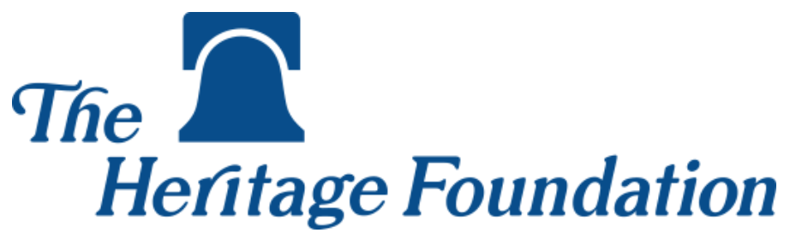
Demagogy: Monopoly Interests and Fascism Dressed as Democracy
Both American Liberty League and The Heritage Foundation of today use the Liberty Bell in as the key icon in their logos while actually working against democracy
“And its special character as a synthesis of the chief pro-fascist tendencies in American life is revealed in the fact that while it wrapped itself in the democratic traditions of the American people, the League and its leaders became the inspirers, organizers and subsidizers of a whole series of fascist and semi-fascist groups which sought to play on the prejudices and confusions of the poor.”

Slide 40
TITLE
There should be some very definite organization — wrote Raskob — that would come out openly with some plan for educating the people to the value of encouraging people to work; encouraging people to get rich; showing the fallacy of Communism in its efforts to tear down our capital structure, etc.
Five months later the American Liberty League was born. It was intended, according to its incorporators, “to combat radicalism, preserve property rights, uphold and preserve the Constitution.”

Slide 41
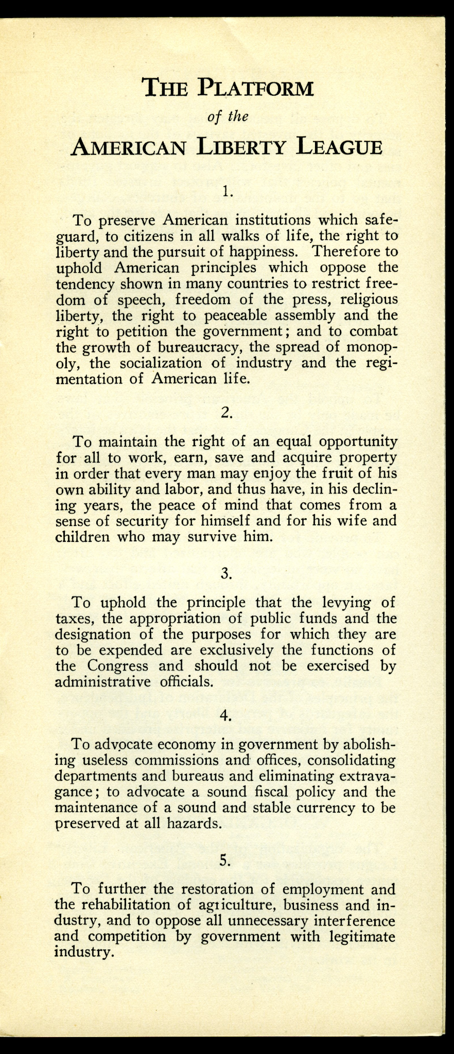
TITLE
The charter of incorporation, dated August 15, 1934, is entirely in the spirit of the Raskob letter:
The particular business and objects of the Society shall be to defend and uphold the Constitution of the United States and to gather and disseminate information that (1) will teach the necessity of respect for the rights of persons and property as fundamental to every successful form of government, and (2) will teach the duty of government to encourage and protect individual and group initiative and enterprise, to foster the right to work, earn, save and acquire property, and to preserve the ownership and lawful use of property when acquired.

Slide 42
TITLE
That the founders of the Liberty League did originally expect to enlist the rank and file of middle-class people in the cause of defending and expanding the liberty of its Wall Street sponsors appears likely from the announcement of its president, Jouett Shouse, that occupational divisions would be set up and that the League “will unite several millions of people from all walks of life who are now without organized influence in legislative matters.” One newspaper expressed the hope that “the debt-paying and industrious people of the villages and countryside will be as responsive to its [the League’s] plans as will be the millionaires.” 3 The obtuse plain people, however, failed to respond to the alarm sounded by Paul Revere alias Irenee duPont, and so the League had to content itself with the millionaires. But of these it managed to corral the pick of the country.

Slide 43
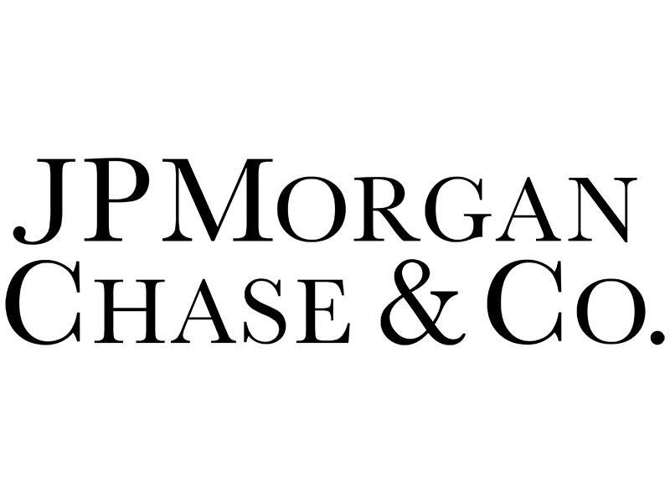


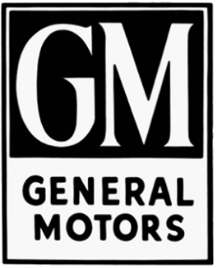
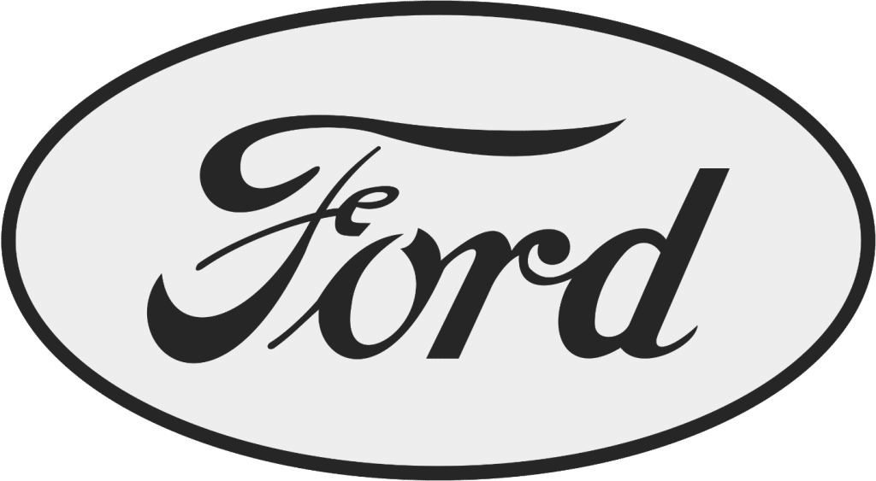
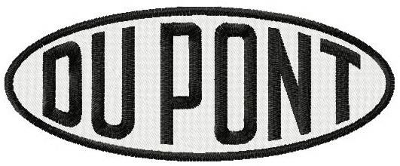
TITLE
Leadership of the American Liberty League was controlled by DuPont Chemical, J.P. Morgan Banking, and Mellon Banking and industrial metals, and Rockefeller Oil and mineral interests. However, the American Liberty League represented generally the most reactionary monopoly interests of American society.

Slide 44
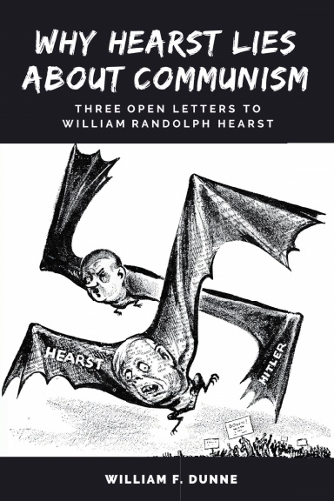
TITLE
The DuPont label and the League’s rabidly Tory (Reactionary) attitude on such questions as unemployment relief, taxation and the Supreme Court served to alienate the very people whom it sought to influence. So discredited did the Liberty League become that even William Randolph Hearst, who had everything in common with the League and is the last person in the world to cast this particular kind of stone, found it necessary to issue on February 11, 1936, the following confidential instructions to his editors:
“I think that any Eliminations by the Liberty League should be ignored unless of very great importance, like the Smith speech. The gentleman who spoke this morning, Mr. Shouse, I think did more harm than good; and I think that as a rule these utterances that emanate from the Liberty League do more harm than good. Because the Liberty League stands for anything but its name in the eyes of the public.”
William Randolph Hearst was no stranger to fascist demagogy
Learn more by ordering a copy of “Why Hearst Lies” by William F. Dunne available on New Outlook Publishers

Slide 45

TITLE
The American Liberty League couched its appeal in terms which, it is now clear, constitute the chief form in which the demagogy of budding American fascism is expressing itself. The specific characteristic of fascist and quasi-fascist demagogy in the United States is that it appears in the guise of defense of democracy and opposition to fascism. Therein lies its strength and its deceptiveness.
Trump “working” at a McDonald’s do appeal to working Americans before November 2024 Election

Slide 46
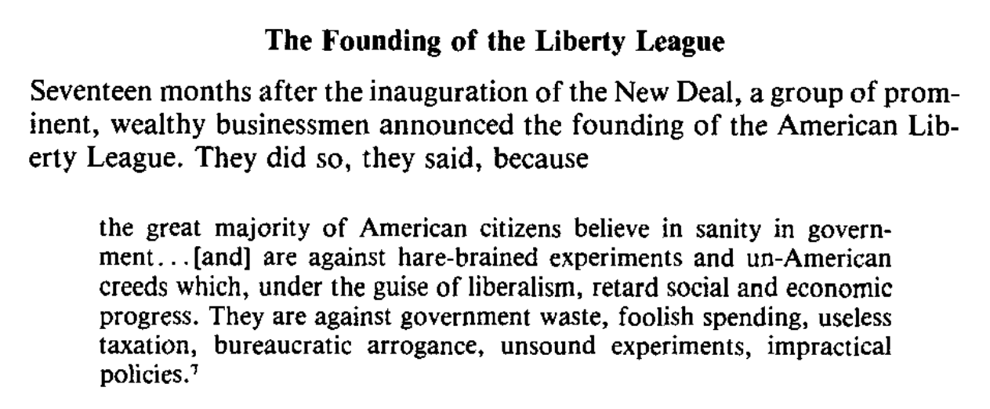

American Liberty League and Today’s Heritage Foundation: Cut From the Same Cloth?
Logo of the “Department of Government Efficiency” which takes on a role similar to the adjacent text

Slide 47
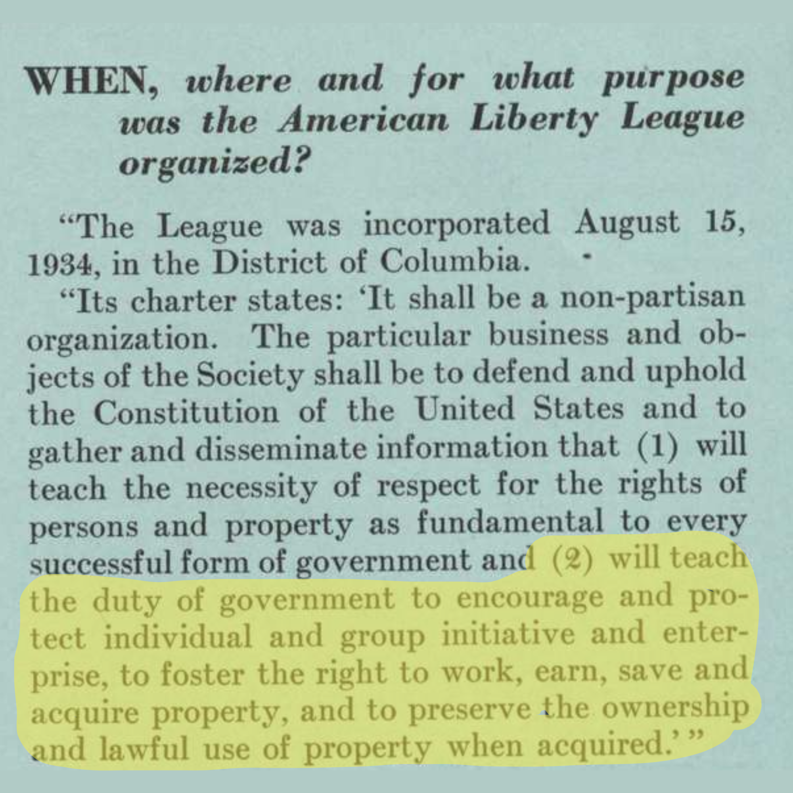
Mission Statement of American Liberty League

Slide 48
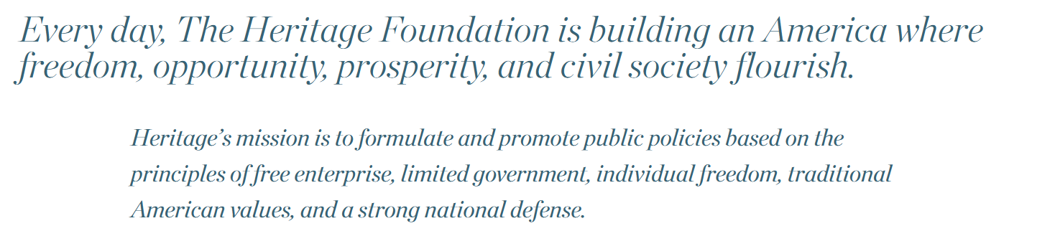
Mission Statement of the Heritage Foundation

Slide 49
Discussion & New Members Introductions

Slide 50
New Member Introductions
What is your name, pronouns and state (or country/territory)?
Where do you work? Is it unionized?
How did you find out about the People’s School?
What do you think about tonight's class?

Slide 51
Discussion & Wrap Up

Slide 52
Announcements
The PSMLS has recovered our old Youtube account we lost to wreckers in 2022 and we have re-uploaded all our old videos. Like, subscribe, and check out what subjects we covered prior and what we aware saying in the past.
PCUSA Cell Chairs need to call members of their cells to remind them about attendance.
The next issue of New Masses (2025) has begun production. If you have art you want us to feature, email it to info@partyofcommunistsusa.net.

Slide 53
Volunteers Needed!
We are in need of volunteers for the staff of the People’s School! Here’s a few roles we need filled:
People to help manage posting on our social media and podcast platforms
Video Editors, Audio Editors, Graphic Designers, Artists, Narrators
Facilitators, Web Controls, Moderators
Email info@peoplesschool.us if you’re interested and try to attend our next staff meeting if possible.

Slide 54

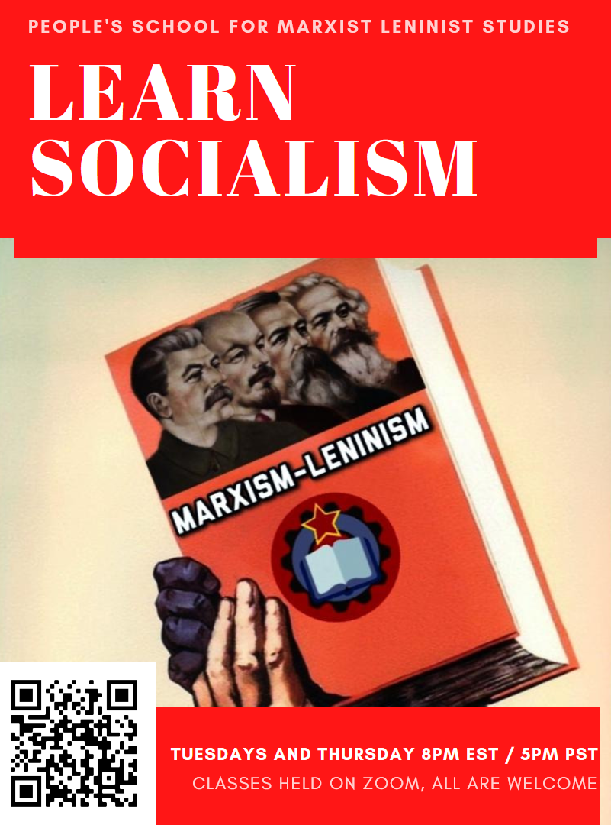
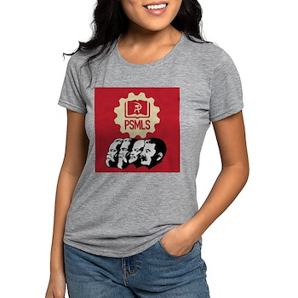


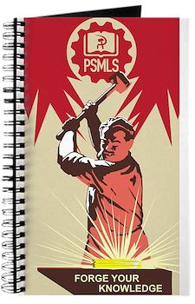

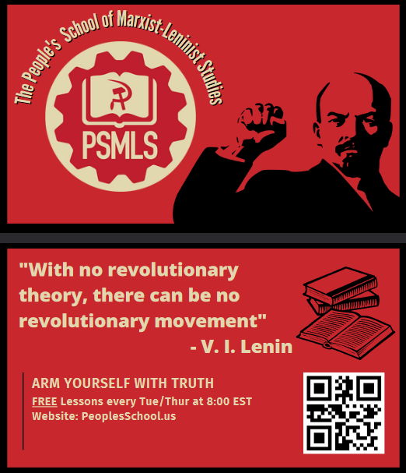


PSMLS Propaganda
peoplesschool.us/media & peoplesschool.us/store
Materials to help promote the school!

Slide 55

View From Left Field
https://viewfromleftfield.libsyn.com
The Old PSMLS Youtube is now the Youtube of View From Left Field, a podcast of analysis and discussion of current events from a progressive perspective.
Like the Youtube videos and subscribe with 5 star ratings on your podcast platforms.

Slide 56

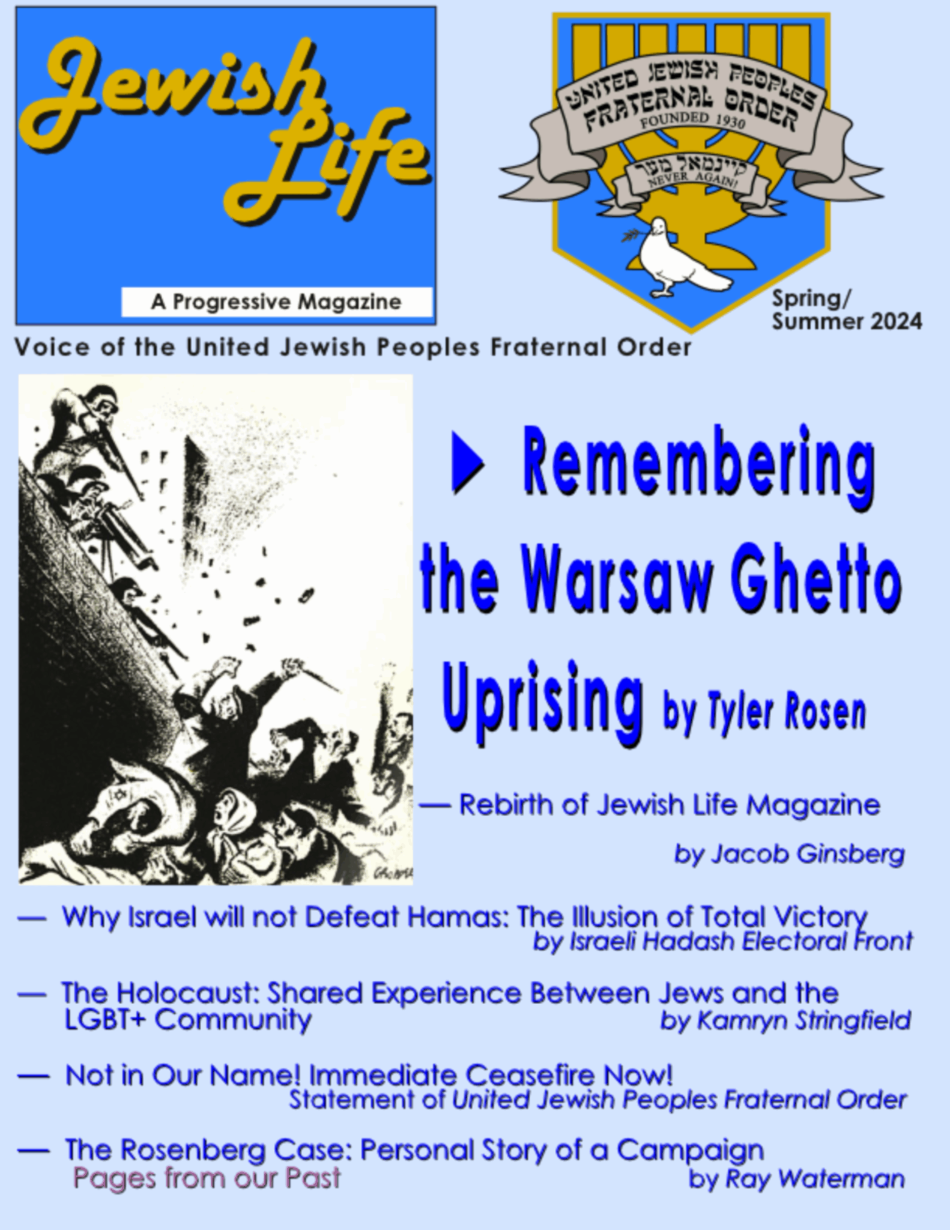
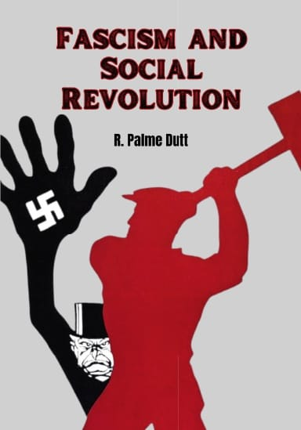
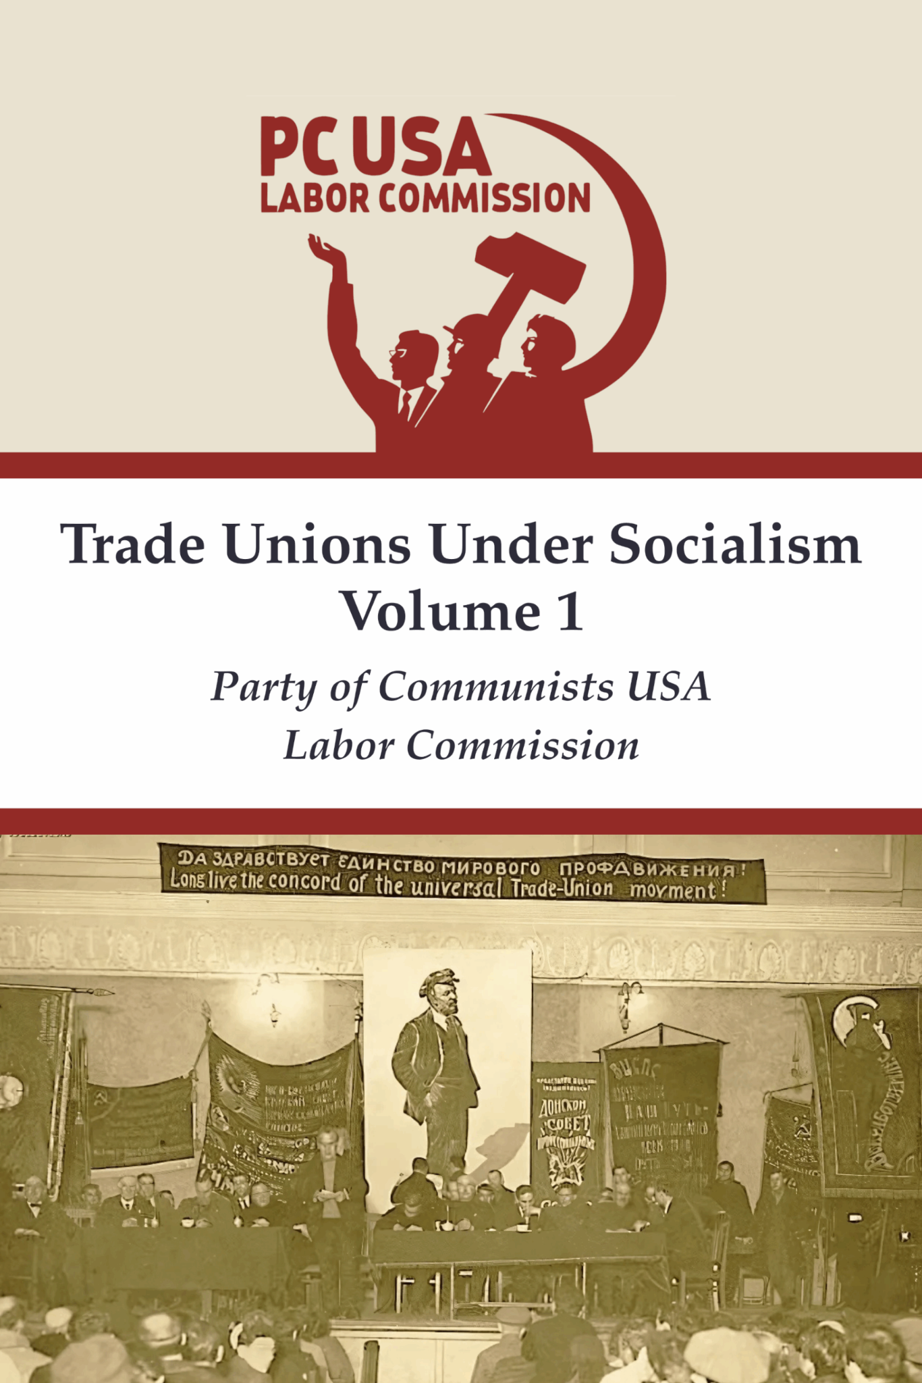

New Outlook Publishers
newoutlookpublishers.store
Relevant and Latest Releases

Slide 57


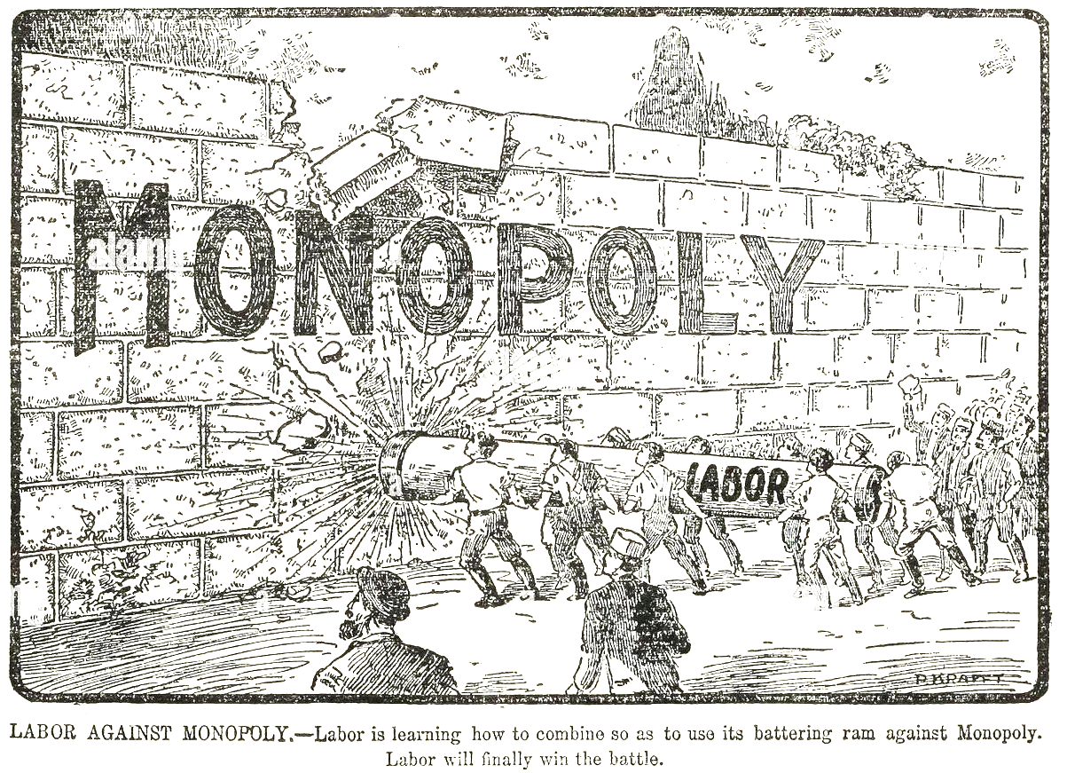
Harry Bridges School of Labor
luel.us/laborschool/
The Harry Bridges School of Labor is a monthly class held 2x per month. Classes cover a variety of topics aimed at building class conscious among union members.
March’s class is on “Labor and the Anti-Monopoly Coalition.” Class will be June 4, 2025 at 8pm EST/5pm PST and Saturday June 7, 2025 at 7pm EST/4pm PST.

Slide 58
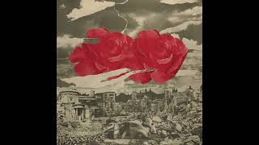
Peggy Seeger - Song of Choice

