Slide 1

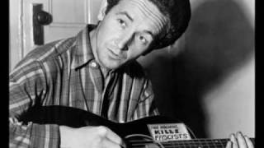
Woody Guthrie - All You Fascists Bound to Lose.

Slide 2

PSMLS June 10, 2025

Slide 3
What we’ll be learning today:
American Terror Inc. - The Role of Terrorist Paramilitaries In the Service of Monopoly
The Threat From Without - The Role of Fascist Powers and Organizations Internationally
The Crisis of American Democracy - The Struggle Between Progressive and Reactionary Forces in America

Slide 4


Slide 5
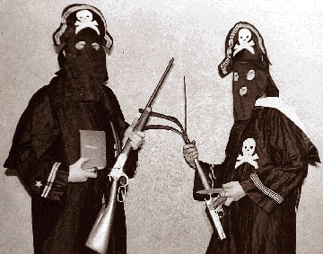
Terror as a Profession and Murder as an Art
The two chief weapons of fascism are demagogy and terror. And in both, amateurism gives way to science, the sporadic and haphazard are supplanted by system and organization. The lynch mobs of the South, which spring up suddenly, live briefly, and as suddenly melt away, the vigilante bands which function only during specific labor disputes, are the Black Legion in embryo— but only in embryo. In the period of mounting disintegration and decay, when capitalism is beset by chronic ills it never knew before, these primitive forms of mob violence no longer suffice. Organizations of a more permanent kind, with a more stable membership and a more elaborate program are required. Hence the modern Ku Klux Klan, the Black Legion, the Silver Shirts— groups for whom terror is a profession and murder an art.
The Black Legion’s Uniform and Weapons

Slide 6
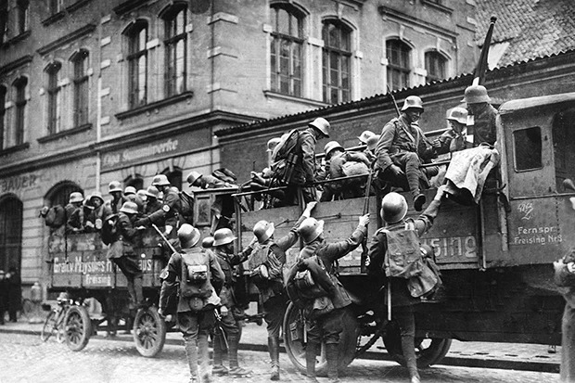
A Society that Breeds Fascism
The Black Legion may appear in retrospect a bit fantastic and unreal, but no more so than Hitler’s rowdies in the Munich beerhall days. The full truth about this brotherhood of hate and murder will perhaps never be known. Too many higher-ups of the industrial and political world were involved for complete candor. But enough has been revealed to indicate that while this terrorist organization may have been born in more or less spontaneous fashion, it was suckled and reared by the great automobile corporations of Detroit and Michigan. Of course, even the so-called spontaneous birth of such movements is possible only in a society which breeds fascism as filth breeds germs.
Members of the SA arrive at the Munich beer hall during Hitler'putsch. Tensions between Nazi militia and the Bavarian police soon erupted into violence.

Slide 7
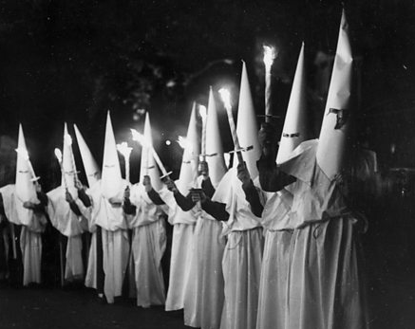
The Evolution of the Ku Klux Klan
It is an omen of what can happen here that this country gave birth to one of the earliest semi-fascist terrorist organizations in the world, the modern Ku Klux Klan. Launched in November, 1915, it antedated the Fascisti of Mussolini and the Storm Troops of Hitler. It is significant, however, that not till after the World War, in the wake of the social dislocations that followed the conclusion of imperialist bloodshed, did the Ku Klux Klan, like the Fascisti in Italy and the various terror groups in Germany, really come into its own. The Klan was, however, in its first stage less pronouncedly fascist than were the Italian and German murder gangs.
Klan Members Holding Burning Torches

Slide 8
The Evolution of the Ku Klux Klan
The Ku Klux Klan united two main strands of American social and political life: the anti-Catholic and anti-alien traditions of the American Chauvinist, Know Nothing and similar movements dating from the thirties, forties and fifties of the nineteenth century, and the traditions of anti-Negro terror of the original Klan formed after the Civil War. The choice of name may have been an act of sentimental nostalgia on the part of Colonel William Joseph Simmons, founder of the modern Klan, yet it expressed the important element of terror which his organization had taken over from its prototype. And it expressed, too, the spiritual affinity between the two organizations, the one the instrument of the slaveholders’ counter-revolution directed at the democratic achievements of the Civil War, the other the instrument of the capitalist counter-revolution of today, directed at the democratic rights of millions of Americans, Negro and white.
It will be noted that the period of the Klan’s greatest strength coincided with the post-war crisis of capitalism and the first emergence of fascist tendencies throughout the capitalist world, including the United States. Furthermore, the Klan, after its eclipse during the years of temporary capitalist stabilization, has been revived in another period of economic and social stress. It is significant, too, that while the Klan’s main emphasis in the days of its great efflorescence was on anti-Catholicism, it soft pedaled the anti-Catholic issue when it re-emerged during the economic crisis and directed its main energies against labor, under the guise of combating Communism.

Slide 9
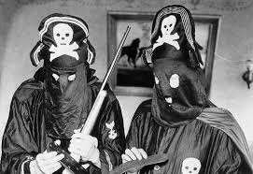
The Birth of the Black Legion
The Black Legion was organized sometime between 1931 and 1933 by Klansmen and former Klansmen in Michigan, Ohio and Indiana— states which had been strongholds of the K.K.K. in its heyday. The menace of the Black Legion lay not in its numbers. What gave it national significance was the peculiarly violent character of its activities, its penetration into police departments and high places in city, county and state government, its connections with the Republican Party, and the fact that it was interwoven with the espionage systems and company unions of the automobile corporations. The Legion is, moreover, typical of a large number of lesser organizations that clog the pores of our social system.
Black Legion Members

Slide 10
An Advance over the Klan as an Instrument of Terror
The Black Legion was something more than a “depraved Ku Klux Klan,” as one writer has described it. As an instrument of fascist terror it marked in certain respects an advance over the Klan. In the first place, it developed not primarily in small towns and villages, as did the K.K.K., but in the centers of heavy industry, dominated by some of the greatest monopolies in the world. This gave it a more pronounced anti-labor character. Secondly, its members were armed and organized on a semimilitary basis, which made possible a more highly developed technique of terror. Thirdly, even more than has been the case in the Klan, violence was the alpha and omega of the Black Legion’s activities, and it assumed particularly bloodthirsty and sadistic forms. One need only recall the “thrill” murder of the Negro hod-carrier, Silas Coleman, which was described by Dayton Dean, Black Legion “trigger man.” Coleman was killed after a drinking party of several Legionnaires because “Colonel” Harvey Davis “wanted to know what it felt like to shoot a Negro.” And finally, the Black Legion was more completely than the Klan the product of the direct efforts of open shop employers to create an instrument for the subjugation of labor and the entire community. As such it was in some cases practically incorporated, together with the company unions and the spy systems, into the union-smashing apparatus of the auto barons.

Slide 11
How the Madness of Fascism is Made
Terroristic organizations of essentially the same type as the Black Legion and the Ku Klux Klan have appeared in various parts of the country throughout the years. Among them have been the Khaki Shirts, the White Legion, the White Crusaders and George W. Christians’ White Shirts Crusaders (also called the Crusaders for Economic Liberty). None of these has, however, been as extensive in its operations or as pretentious in its program as William Dudley Pelley’s Silver Shirts. At one time negotiations were said to have been started to unite the Black Legion and the Silver Shirts, but nothing came of them. The Silver Shirts has also been variously known as the Christian Party, the Silver Legion, die Silver Rangers, the Silver Legion Rangers and the Councils of Safety.
All this may appear too hare-brained to be taken seriously. Yet it is out of such buffooneries that the grim madness of fascism is made. It is true, however, that the Silver Shirts is perhaps too much of a carbon copy of the Hitler movement to appeal to any large number of average Americans. The most characteristic and the most menacing type of American fascism is that which wraps itself in the Constitution and the flag and exploits the democratic desires of the middle-classes for anti-democratic purposes. This is the technique which is common to the Liberty League, the Hearst press, the Crusaders, the National Civic Federation, Father Coughlin, the Ku Klux Klan, the Black Legion and the vigilante bands.

Slide 12
Vigilantes Vs. Democracy
Vigilantism is not a new phenomenon in American life. It is a product of the early frontier, where it served in place of a frequently non-existent legal authority to curb the excesses of over-adventurous spirits, crooks and racketeers in communities where life was hard and perilous and each man was too often a law unto himself. In the California Gold Rush of 1849 Vigilance Committees served a progressive purpose. But by their very nature such committees were susceptible to abuse, and the natural heir of vigilantism was the Ku Klux Klan which rode through the South after the Civil War.
With the onward rush of capitalism the vigilante groups began to take on a new character, appearing in labor disputes as the strikebreaking instruments of the big industrialists. Not until after the World War, however, did vigilantism really come into its own. Chambers of Commerce had only to say the word and “citizens’ committees” and “law and order leagues,” composed largely of white-collar workers and small merchants, sprang up to deal in the old-fashioned American way with “alien agitators” and pacifists whose nefarious activities were undermining the home, the church and American institutions.

Slide 13
The Professional Patriots
The professional patriots are comparatively recent arrivals; they date from the war and post-war periods and their activities are essentially part of the pattern of fascist and semi-fascist tendencies that began to take shape in the war days. The kind of demagogy exploited by the professional patrioteer is, of course, not new in American life. Throughout our history reaction has draped itself in the flag and masqueraded in the garments of Washington, Jefferson and Lincoln. What was distinctive in the rise of the host of super-chauvinistic organizations during and after the war was that for the first time this type of demagogy became institutionalized and developed its own specialists and skilled practitioners.
The old-line patrioteering societies, with their small memberships, drawn for the most part from the upper classes, have in a sense been outmoded and many of them have gone into decline. But the type of Red-baiting, anti-democratic propaganda in which they specialized has flourished as never before. And contemporary red-baiting is no longer directed merely at radical and liberal groups and individuals, but at bourgeois democratic government itself. Today, in other words, we are no longer dealing with a relatively isolated and limited type of activity, but with a phenomenon that has assumed a mass character, deriving its energy from the leading circles of monopoly capital.

Slide 14
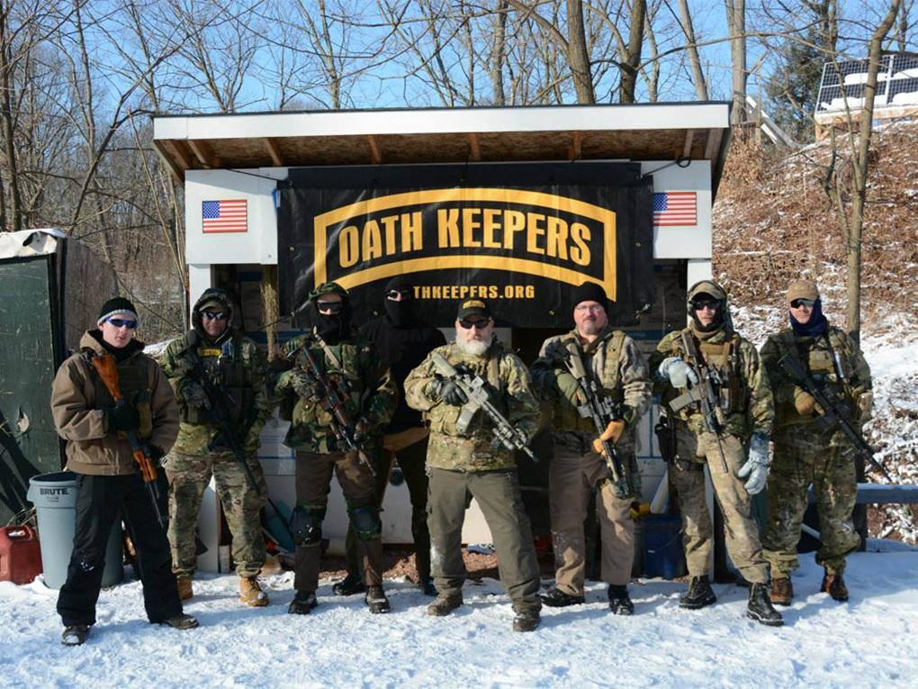
Oath Keepers and Proud Boys: Our Modern Equivalents
The Oath Keepers were an anti-government extremist organization formed in 2009 that quickly became one of the largest groups within the militia movement. What differentiated them from other anti-government extremist groups was their explicit focus on recruiting current and former military, law enforcement and first responder personnel. The group garnered national attention for their significant participation in the January 6, 2021, storming of the U.S. Capitol. Members of the group planned actions in advance, established a weapons arsenal near Washington, D.C., played a significant role in the breach of the Capitol on January 6 itself, and assaulted Capitol police and other law enforcement officers. Prior to the January 6 Capitol attack, the group gained notoriety for their armed participation in disputes between ranchers or miners and federal agencies, particularly in 2014 and 2015. Members of the Oath Keepers have been arrested in connection with a wide range of criminal activities independent of the U.S. Capitol attack.
Members of the Oath Keepers Posing with Their Weapons

Slide 15
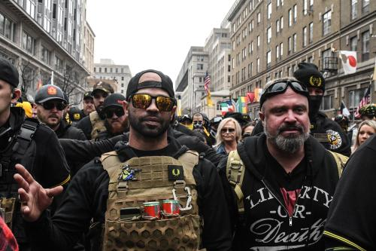
Oath Keepers and Proud Boys: Our Modern Equivalents
The Proud Boys is a far-right neo-fascist organization founded by Gavin McInnes in 2016. Formed just before the 2016 Presidential Election, the Proud Boys rose to national attention as a result of their repeated violent confrontations with anti-fascist groups during protests on college campuses and during the summer of 2020 Black Lives Matter protests. The organization’s membership is open exclusively to men, recruiting potential members by appealing to what they perceive as the erosion of Western culture by feminists, socialists, immigrants, and the LGBTQ+ community in an ultimate plot to oppress men. According to Samantha Kutner, the Proud Boys use the coded term “western chauvinism as code for white, multiculturalism reinterpreted as White genocide, and caustic labels given to feminists and civil rights activists to mark them as opposition.”
Leaders of the Proud Boys Pictured at a Protest in D.C.

Slide 16
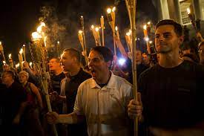
Oath Keepers and Proud Boys: Our Modern Equivalents
In 2017, several Proud Boys attended the Unite the Right rally organized by white supremacist Jason Kessler–and former Proud Boy–in Charlottesville, Virginia. In the national fallout following the rally, which intensified after the murder of Heather Hyer by neo-Nazi James Alex Fields, McInnes attempted to distance himself and the organization from the broader alt-right movement. Following the death of George Floyd in Minneapolis in May 2020, Proud Boys clashed with Black Lives Matter protestors across the country, most notably in the Pacific Northwest in cities such as Portland and Seattle. In Portland, Proud Boys member Skylor Jernigan drove his vehicle through a group of counterprotestors, firing gunshots at the crowd. A year later, Jernigan pleaded guilty to three misdemeanors, receiving three years probation. Several Proud Boys participated in breaching the U.S. Capitol on January 6, with Enrique Tarrio, Joseph Biggs, Ethan Nordean, and Zachary Rehl being convicted of seditious conspiracy.
White Supremacists and Neo-Nazis Marching in Charlottesville, VA

Slide 17
Discussion

Slide 18
The Threat From Without

Slide 19
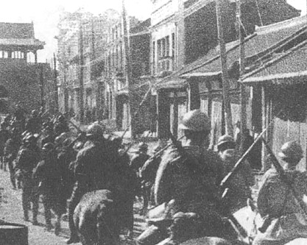
The Threat From Without
The threat of fascism in the United States comes not only from within but from without the borders of the nation. Whether we like it or not, the fortunes of our country are inextricably connected with those of the rest of the world. The aggressions of the three major fascist nations, Germany, Italy and Japan—all linked in a military alliance—create a major threat to American peace and democracy.
Germany, the leader of the fascist offensive, has seized Austria and sent its armies into Spain. Japan has taken Manchuria and occupied much of northern and central China. Italy has grabbed Ethiopia, occupied the Spanish island of Majorca and sent an army of 200,000 into Spain itself.
Japanese troops entering Shenyang in China during the 1931 Mukden Incident

Slide 20
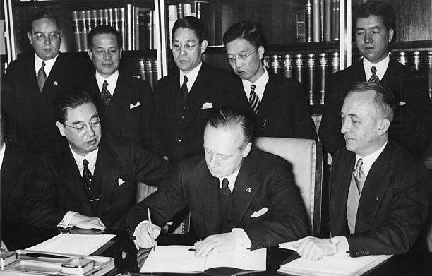
The Threat From Without
The menace presented by the open and concealed aggressions of the fascist powers is magnified by the conclusion of the anti-Communist protocol signed in Rome in November, 1937. The protocol ostensibly has the purely “ideological” purpose of “combating Communism”; but even the published text provides that the signatories “communicate instructions and defense measures to one another.” The nature of these “defense measures” is indicated by the attendance of the German and Japanese military, naval and air attaches at the signature ceremonies in Rome. The holy crusade against Communism is merely camouflage for a full-fledged alliance of aggressor states and it is recognized as such by the chancellories of the world. In a report on the American naval program before a House committee, Admiral William D. Leahy, Chief of Naval Operations, frankly discussed the navies of Germany, Japan and Italy as “constituting one powerful armaments bloc.” The officials of other governments take a similar view.
Japanese ambassador to Germany Kintomo Mushanokōji and the German ambassador-at-large Joachim von Ribbentrop sign the Anti-Comintern Pact.

Slide 21
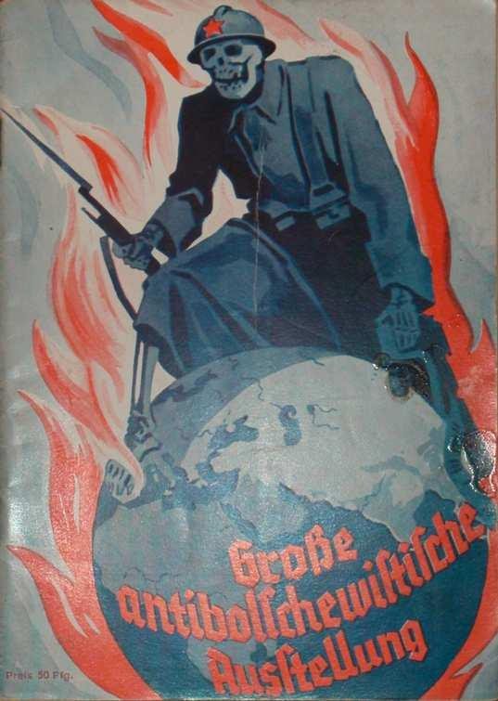
The Threat From Without
The military agreement reached at Rome is directed not merely against the Soviet Union, but against any and all countries whose resources are coveted by the aggressor states. Fascism’s definition of Communism is elastic enough to cover all contingencies. Germany and Italy invaded Spain on the pretext of “crushing Communism,” when there was not a single Communist in the Spanish cabinet. Japan invaded China on the same pretext, at a time when Chiang Kai-shek was fighting the Communists. The Nazi press, preparing for a new German adventure in Central Europe, denounces Czechoslovakia as “Communistic.” The Tory government of Neville Chamberlain and the United States government will also come within the fascist definition of “Communism,” if the fascist powers believe it possible and opportune to move in these directions.
The Nazi propoganda poster says in German “Great Anti-Bolshevist Exhibition”

Slide 22
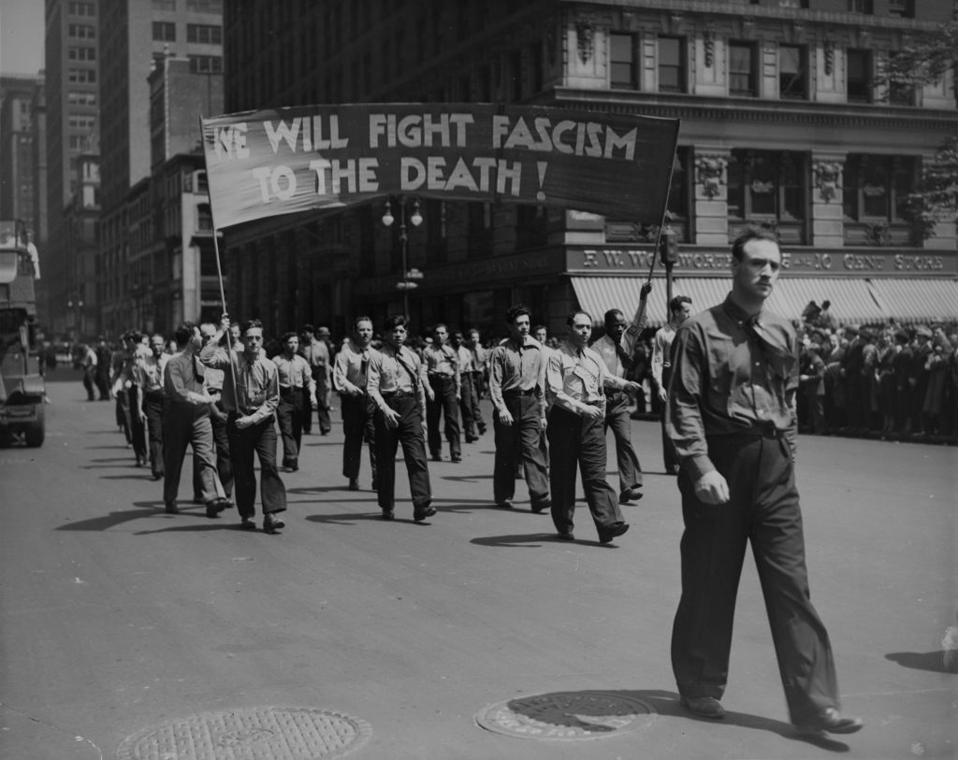
The Threat From Without
Every victory for fascism and reaction abroad has its immediate repercussions in the United States, encouraging fascist groups here to new aggressions against democratic rights. Conversely, every victory for democracy, in any part of the world, encourages the democratic forces here. The victory of Hitlerism profoundly influenced events in the United States, not merely by creating large active Nazi groups in this country, but by accelerating the fascist tendencies of the American economic royalists. Similarly, the fascist offensive in Spain, the war in China, the struggles of the French People’s Front reverberate here, influencing the struggle between reaction and progress. What nonsense, then, to pretend that American democracy is or can be indifferent to the outcome of the wars launched by the fascist powers.
A May Day parade in New York City in the 1930s. Banner reads “WE WILL FIGHT FASCISM TO THE DEATH!”

Slide 23
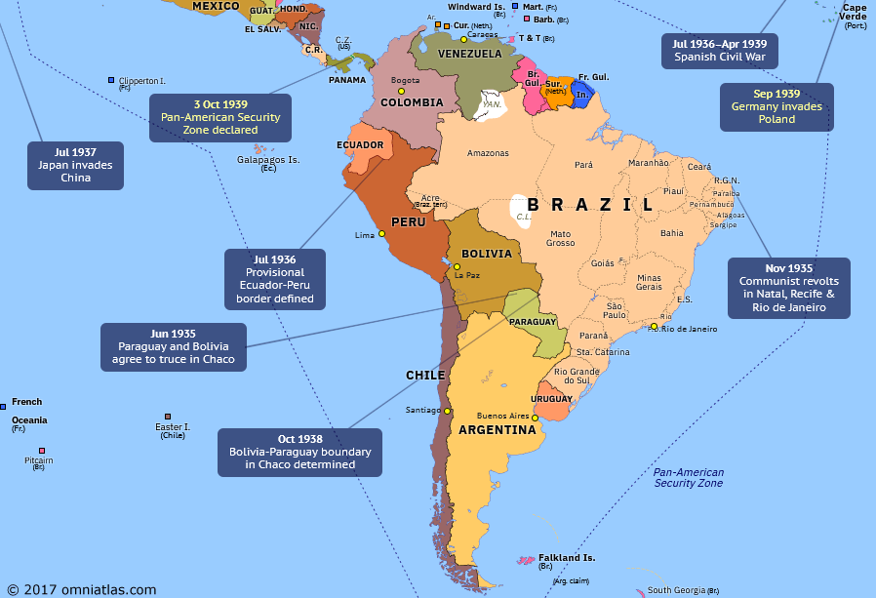
Fascist Offensive in the Western Hemisphere
Even more ominous for the United States is the recent intensification of fascist activity in the vicinity of the Panama Canal, key to the American defense system. Germany and Japan have been particularly active in this area. Germany has recently acquired large tracts of land near the Atlantic coast of Costa Rica, a short distance from the canal zone, and made strenuous efforts to improve its already close relations with the Dominican Republic. “There is no doubt,” says Carleton Beals, “that the Hitler regime has been casting eyes upon Santo Domingo as a possible friendly base near the Panama Canal in case of international struggle.” These activities, taken in conjunction with German control over Colombia’s commercial air system, the SCADTA, would seem to give the Nazis a strong position for possible military operations against the Panama Canal.
South America in 1939 (one year after Eril was published)

Slide 24
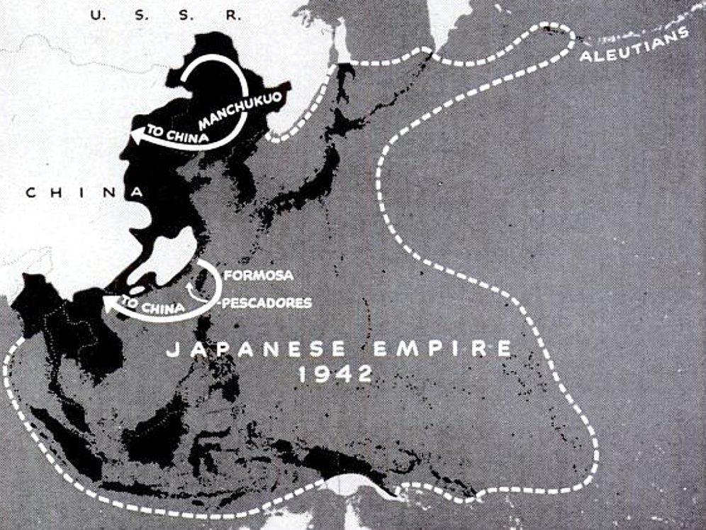
Fascist Offensive in the Western Hemisphere
Japanese activities in the Caribbean are supplemented by similar activities in other strategic regions. Japanese political and economic influence has vastly increased in recent years in the Philippines, particularly in Davao province where half of the arable land and most industry is in
Japanese control. In Hawaii nearly one-half of the population is Japanese. In the strategically situated Aleutian islands, which stretch in a vast arc from Alaska to the Asiatic continent, and in Alaska itself, the Japanese have been engaged in mysterious activities which have engaged the attention of American military experts. Particularly active are extraordinarily well-equipped Japanese “fishing” vessels, which according to widely published reports, have taken soundings and made hydrographic studies of adjacent waters. Both the Philippines and Alaska are vulnerable to Japanese attack.
Map of the Japanese Empire at the height of its expansion in 1942

Slide 25
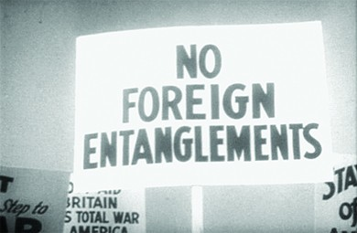
Unneutral Neutrality
Considerations of this nature have led increasing numbers of Americans to doubt the efficacy and the wisdom of the “neutrality” policy adopted by the United States in the early stages of the fascist offensive.
The neutrality law was rushed through Congress in August, 1935, because Americans correctly feared that fascist aggression might lead to a general war and mistakenly believed that the United States could avoid its consequences.
To ensure that the United States did not get drawn into another war, Congress passed a series of Neutrality Acts in the second half of the 1930s. The Neutrality Act of 1935 banned the sale of armaments to warring nations.

Slide 26
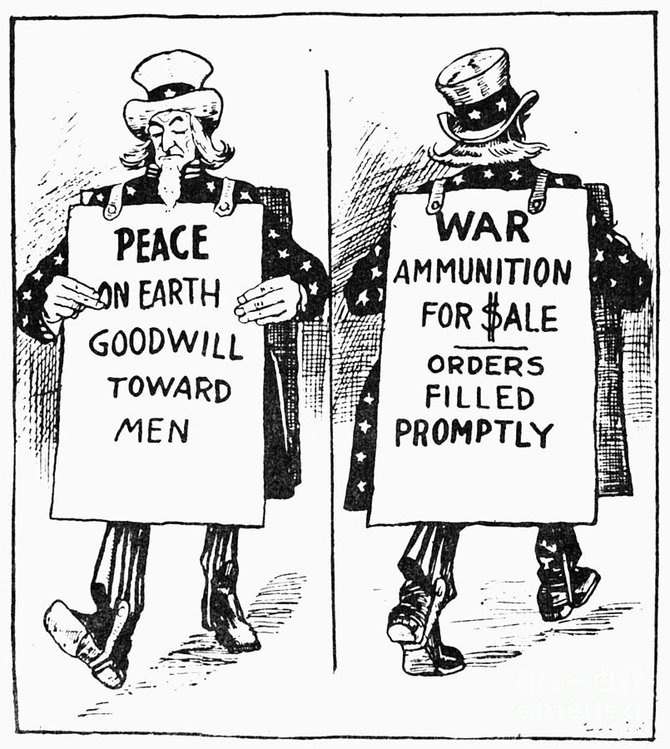
Unneutral Neutrality
Leaving aside for the moment the broader considerations raised by the fascist offensive, the fact is that the financial and commercial interests of the United States render real isolation impossible. The hearings of the Nye Committee and the voluminous documentary evidence published since the war, indicate how interests of America’s ruling class inexorably dragged the United States into the last World War, in spite of attempts at neutrality. Should another war sweep the world, there is no reason to believe that the same forces would not be at work. In the early stages of such a war, American financiers and munition makers, wheat and cotton growers, the makers of a thousand and one commodities, would find an enormously expanded market for their goods and the pressure of these interests would swiftly sweep aside “neutrality” laws which sought to dam the flood of capital and commodity exports.

Slide 27
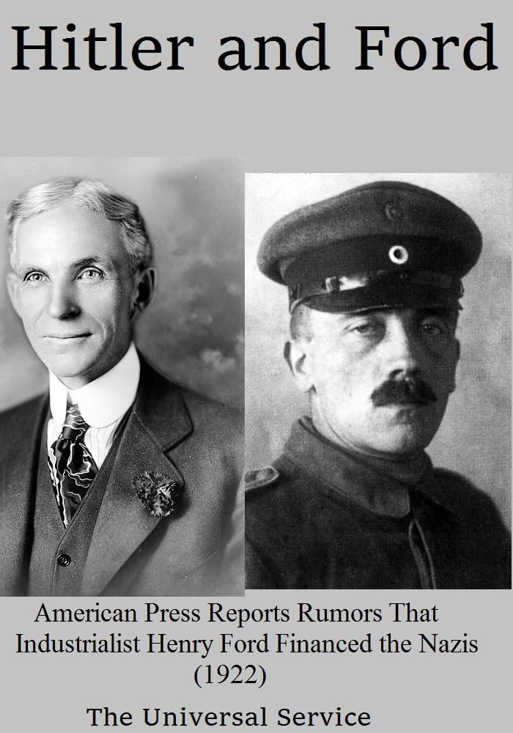
Unneutral Neutrality
American economy, already heavily dependent on foreign markets, would be deeply involved in the fortunes of a European war. Political and military involvement would swiftly follow. In such a situation vague pacifist and isolationist sentiment, now so prevalent, would be swiftly transformed into rampant jingoism.
Tied by innumerable links to world capitalist economy, the United States cannot cut itself off from world markets and world sources of raw material. Autarchy, of both the national and “hemispheric” varieties, is either an illusion or a fraud. Any attempt to impose such an absurd policy upon the United States would soon be abandoned under the exigencies of the laws of capitalist development.

Slide 28
A Realistic Peace Program
In his speech in Chicago, on October 5, 1937, President Roosevelt clearly recognized the impossibility of American insulation from the disturbances caused by fascist aggression. His speech implied a departure from ostrich-like isolationism and an important step in the direction of a realistic peace policy:
The peace-loving nations must make a concerted effort in opposition to those violations of treaties and those ignorings of humane instincts which today are creating a state of international anarchy and instability from which there is no escape through mere isolation.
Those who cherish their freedom and recognize and respect the equal right of their neighbors to be free and to live in peace must work together for the triumph of law and moral principles in order that peace, justice and confidence may prevail in the world…
When an epidemic of physical disease starts to spread the community approves and joins a quarantine of the patients in order to protect the health of the community against the spread of the disease.

Slide 29
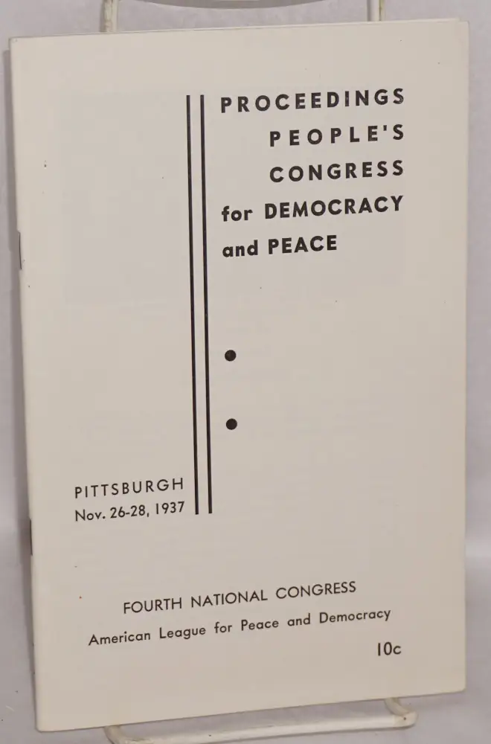
A Realistic Peace Program
Following Roosevelt’s Chicago speech, large organizations with an aggregate membership of many millions, and impressive groups of prominent individuals, came out for collective security and against isolationism. The declarations of these organizations and groups, in some instances, still showed traces of isolationist confusion; but, on the whole, they reflected a significant popular trend away from the moronic isolationist viewpoint which had gripped America in 1934 and 1935.
In November, 1937, the People’s Congress for Peace and Democracy, attended by representatives of organizations with nearly four and a half million members, declared itself in favor of revision of the neutrality law to distinguish between aggressors and victims of aggression. The resolutions of the Congress recognized “the necessity of denying our economic resources to warmaking, treaty-breaking aggressors and opening them up to victims, under conditions designed to remove the risk of our being drawn into war.” It flatly affirmed “the necessity of concerted action to quarantine aggressors.” A month later, the American Students Union adopted a similar program.

Slide 30
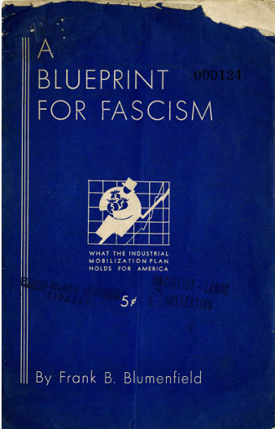
A second corollary to the struggle for a genuine peace policy is the defeat of measures like the Sheppard-Hill and May bills which provide for the establishment of fascist-like rule in the event of war or “an emergency due to the imminence of war. These and other bills of the same sort, embodying the War Department’s Industrial Mobilization Plan, explicitly or implicitly provide for a draft of labor and give the captains of industry unlimited powers.
If American democracy should be required to defend itself against fascist aggression, it must exercise the utmost vigilance to prevent the loss of that democracy through the machinations of fascist-minded officers in the War Department and of the generalissimos of business who stand behind them
An analysis of the Industrial Mobilization Plan

Slide 31
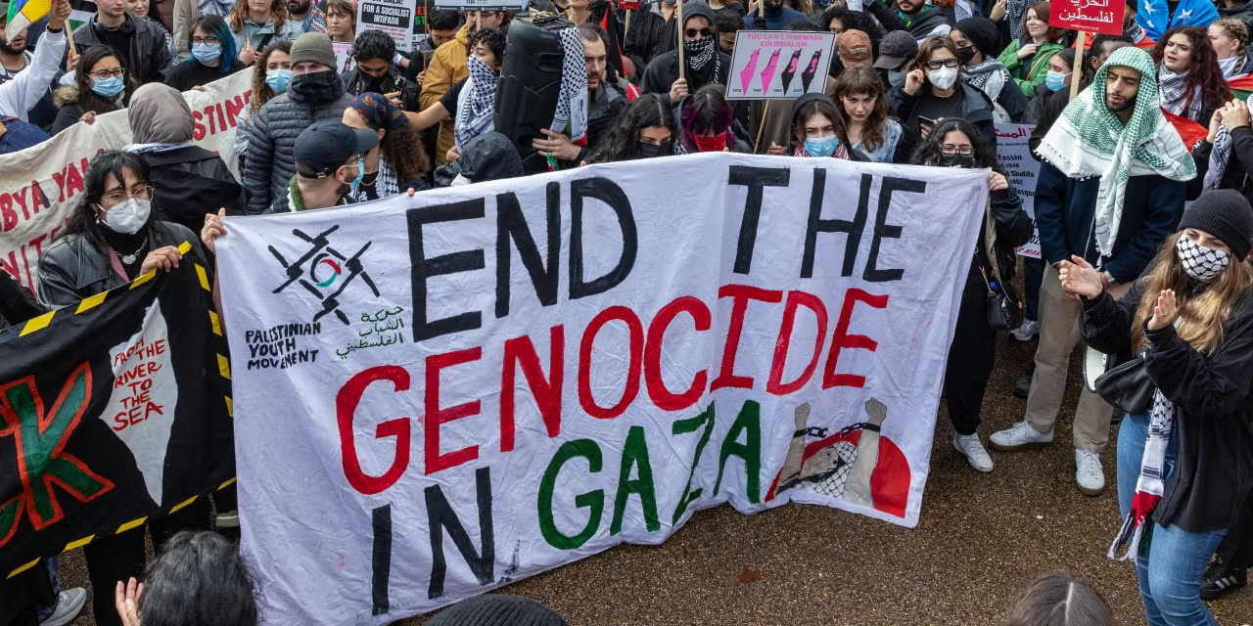
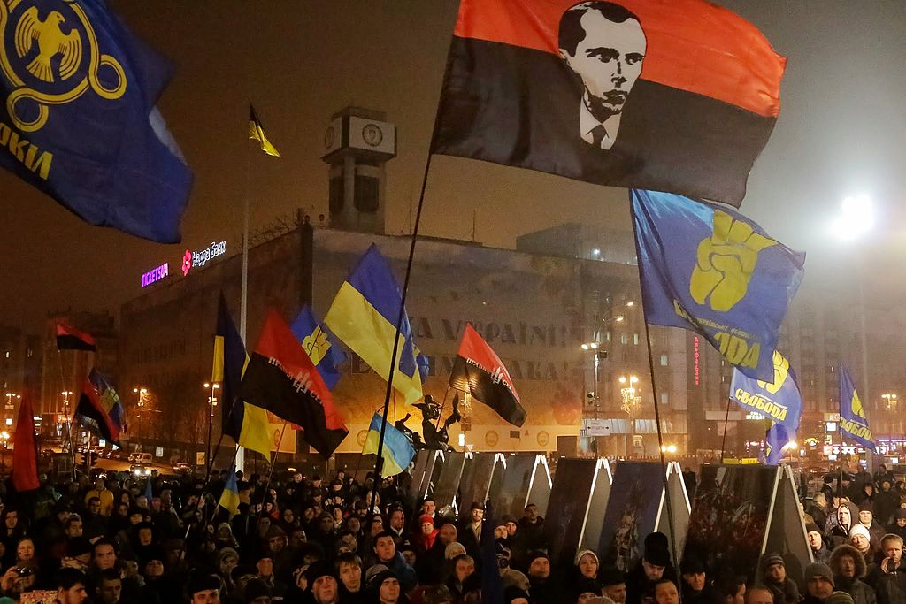
Fascism Today
Fascism continues today with American enablement and complacency. Israel under Netanyahu continues a genocide in Gaza. American weapons manufacture continues to send weapons to yield large profits.
Ukraine since 2014, led by pro-western and fascist forces continues to fight Russia in a regional war. Funding for fascism comes directly from American imperialist and capitalist forces. American grain has tried to push into the Ukrainian market since the Russian SMO.
The far-right Alternative for Germany (AfD) continues to gain grounds since Germany’s last election. Elon Musk has contributed heavily to the party financially.

Slide 32
Discussion

Slide 33
The Crisis of American Democracy

Slide 34
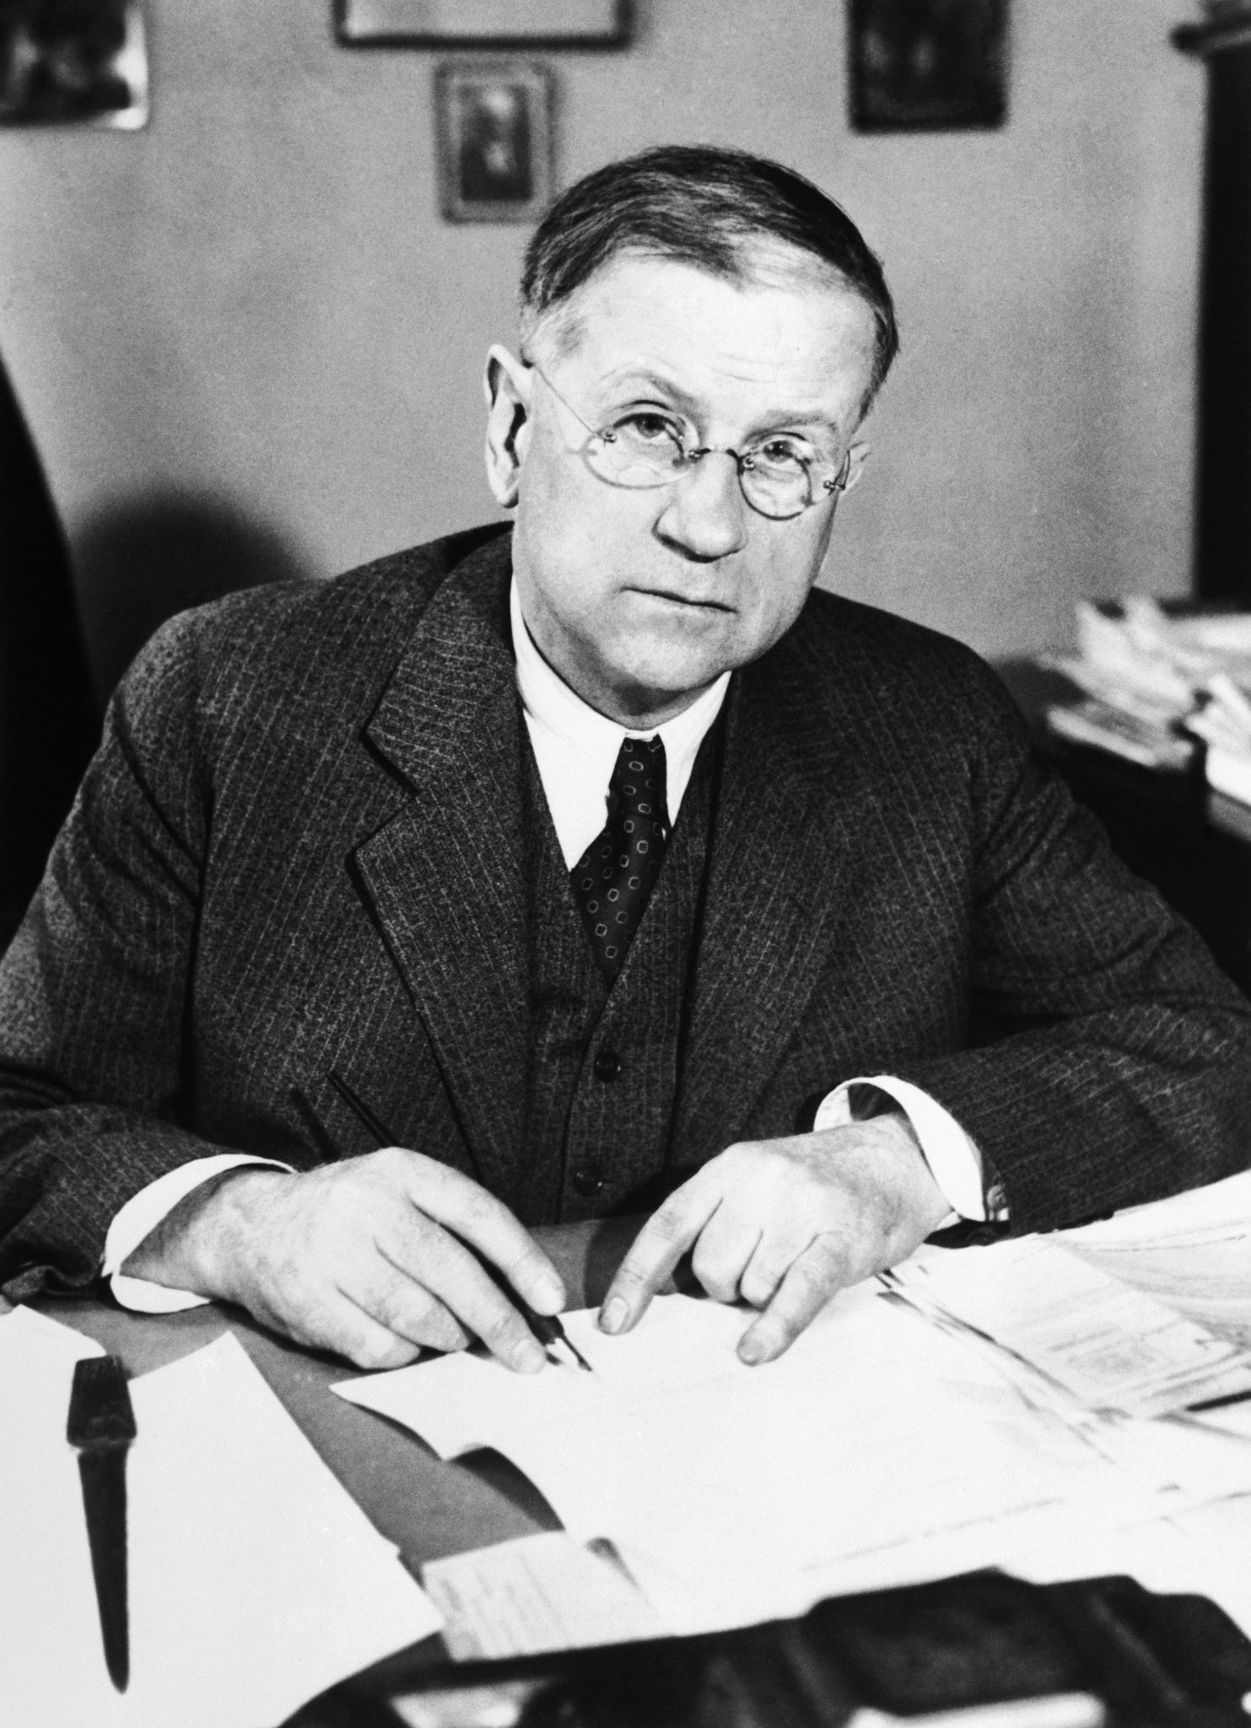
Secretary of the Interior Harold Ickes address on the threat of fascism
Secretary Ickes indicated the issue in his radio address of December 30, 1937:
Underneath the unchanging words of the institution— he said underneath the unchanging appearance of our public institutions, there is happening here, as truly as in Europe and Asia, a struggle for power, for the control of lives, labor and possessions of whole peoples — a struggle between the many and the few, a struggle between those who would live and let live and those who want the thrill of the power of ruling others.
Here in America it is the old struggle between the power ot money and the power of the democratic instinct. In the last few months this irreconcilable conflict, long growing in our history has come into the open as never before, has taken on an intensity which makes it clear that it must be fought through to a sure finish — until plutocracy or democracy — until America’s 60 families or America’s 120,000,000 people win.

Slide 35
Which Side Are You On?
This is the nature of the American crisis. It is a crisis which permits of no neutrality, and which increasingly divides the American people into two huge warring camps, progressive and reactionary.
Note: today we are facing a similar struggle. There are the most reactionary sections represented by the Trumpian Republican party on one hand and on the other there are progressive candidates struggling to expand democracy and improve the living standards of the working masses with housing, labor, and healthcare reforms (to name a few). However, there are also the Neoliberal Democrats, who holding onto the past, think they can capitulate to the most reactionary forces in an attempt to preserve the status quo. These reactionary Democratic leaders such as Nancy Pelosi, Chuck Schumer, Andrew Cuomo, and company, would prefer to compromise on issues such as labor’s right to organize, further eroding medicare access, and bow down to landlords than to concede to up-and-coming progressives such as NYC Mayoral Candidate Zohran Mamdani.

Slide 36
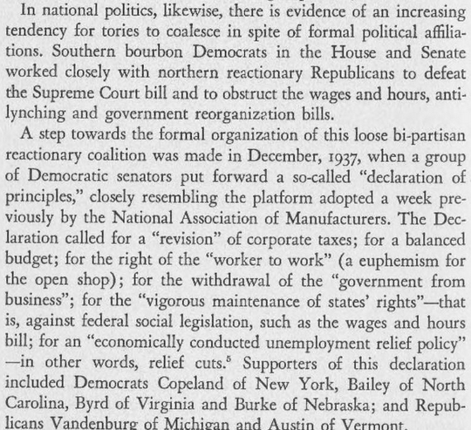
Which Side Are You On? Cont.

Slide 37
Which Side Are You On? Cont.
The 1936 elections marked the first large-scale battle between the gathering hosts of progress and reaction. Since then, the struggle has grown in scope and intensity.
For a brief moment after the 1936 elections there was a lull in the struggle. Reactionary organizations momentarily withheld their savage attacks against the Roosevelt administration and suggested that the wounds of the election battle be healed and an “era of good feeling” inaugurated — suggestions based on the hope that Roosevelt, having won rc-election, would abandon his reform policies and veer sharply to the right.
The brief period of “harmony” was shattered, however, as the progressive forces demonstrated that they had no intention of purchasing “good feeling” at the high price of capitulation to the corporate overlords, but, on the contrary, were determined to carry out the popular mandate of November. In the industrial field, the workers, under the leadership of the C.I.O., pressed forward with demands for higher living standards and for the right to organize and bargain collectively. In the political field, Roosevelt, under popular pressure, extended his program to include among his proposed reforms that bulwark of reaction, the Supreme Court.

Slide 38

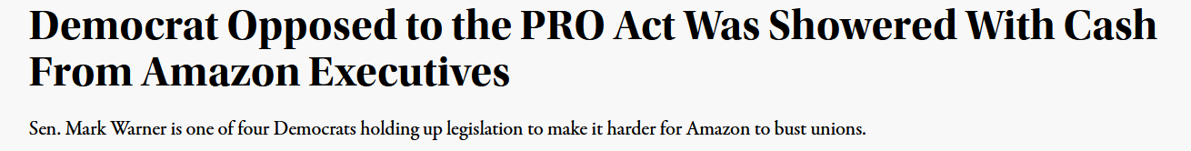
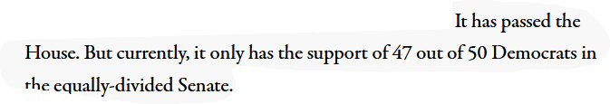
Sound Familiar?
The eight-months session of Congress, which ended late in August, 1937, and the special session of Congress which opened in November, reflected the obstructionist tactics of the reactionary bloc. Congress enacted little legislation, except for routine appropriation measures. The proposed reform of the Supreme Court, the wages and hours bill, the bill to extend government power projects, the proposed ban against child labor, the anti-lynching bill and the bill to place the Civilian Conservation Corps on a permanent basis were either defeated or shelved. Probably no Congress,” wrote the conservative magazine Sphere, speaking of the regular session, “ever sat so long and did so little.

Slide 39
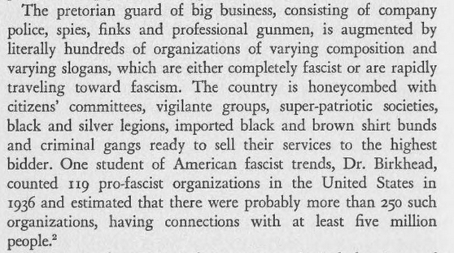
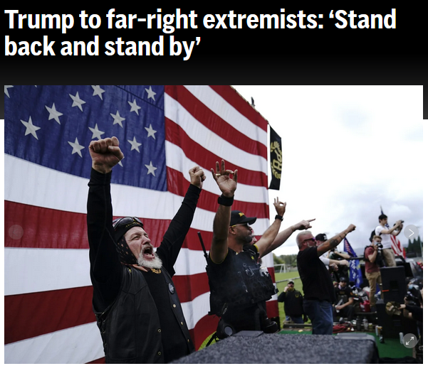
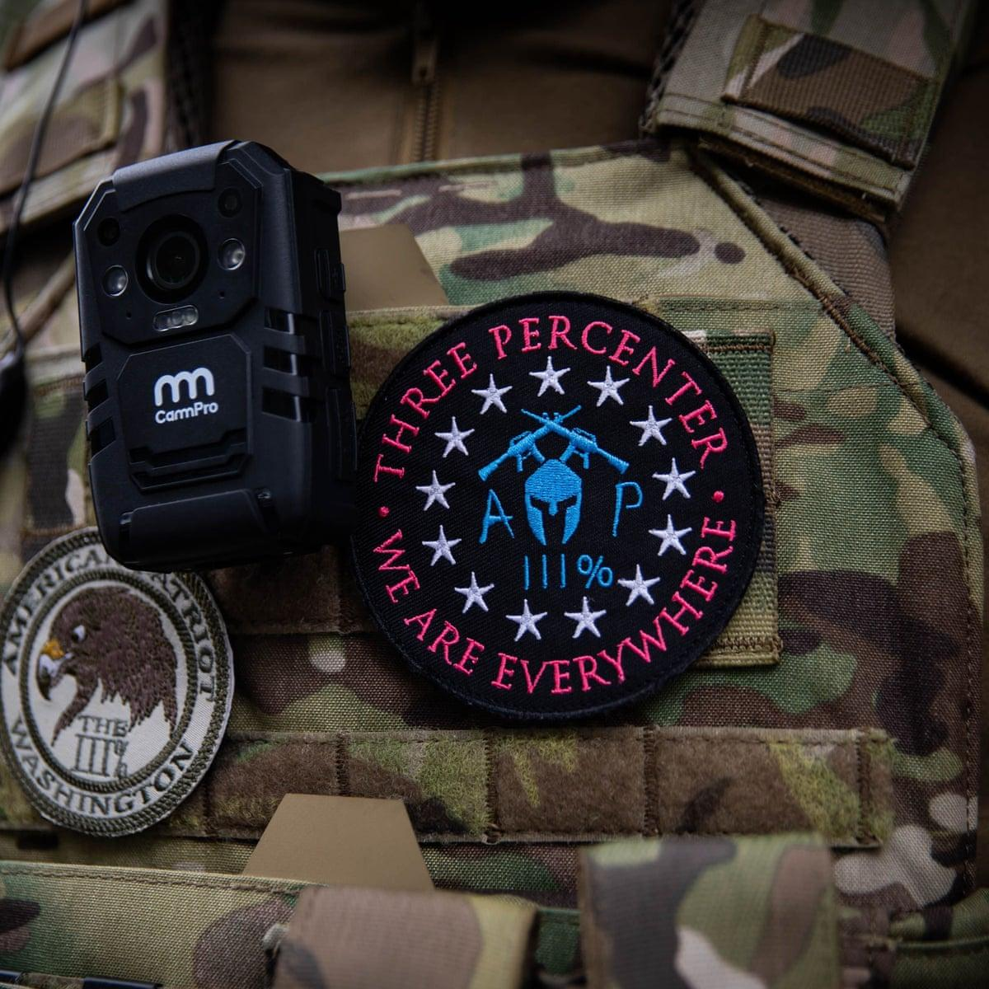
Far-Right Groupings in the Service of Big Business

Slide 40
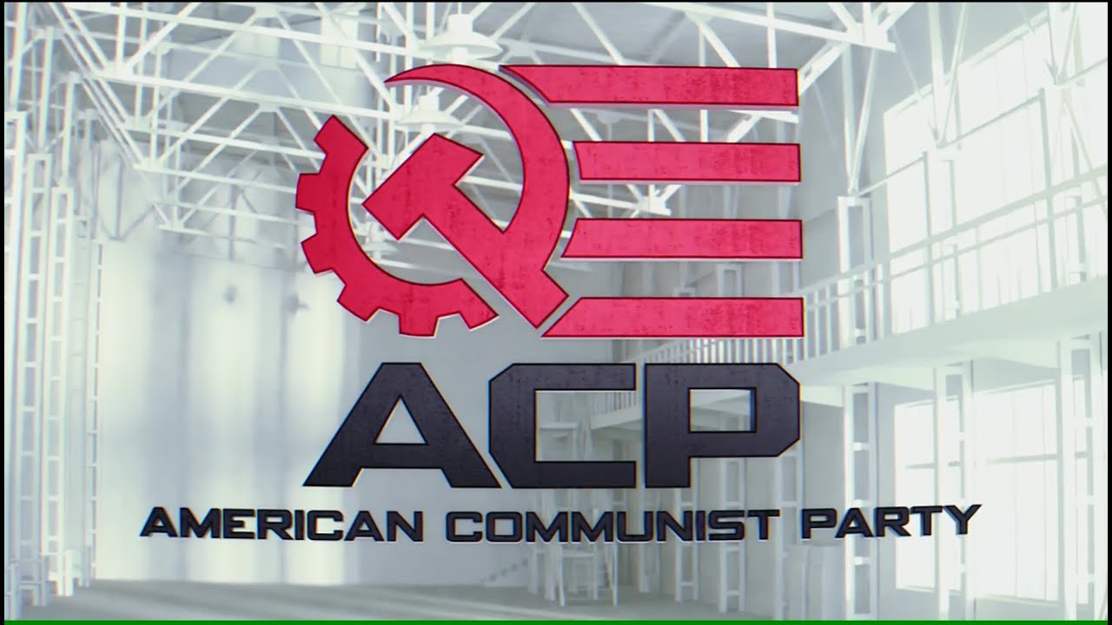
American Reaction And Their Foot Soldiers
The army of reaction is heterogeneous. It includes titans of finance and professional criminals; members of the Union League Club and primitive Ku Kluxers from the most backward regions of the south; die-hard Republicans and self-styled Jeffersonian Democrats; professional patriots and “super-left” Trotskyist stooges. But despite its variegated composition, all of these forces have one thing in common: they are all directly or indirectly in the service of the most reactionary sections of big business. It is from the precincts of Wall Street that money flows for “popular” movements of the Coughlin variety. It is in the corporation offices that “citizens committees” and “law and order leagues” are organized.
Example of a “Left” Group today that objectively serves the interests of Corporate America

Slide 41
The Democratic (Peoples) Front
While the reactionary camp thus begins to take form, there is simultaneously a growing tendency toward cohesion among the progressive forces. The 1936 presidential elections which swept Roosevelt into office with over 27 million votes demonstrated not merely the progressive temper of the people, but the growing political consciousness and independence of labor. In the 9 o elections, and since, new independent labor and other organizations have emerged, and these together with developing progressive movements within the old parties, and older independent progressive groups, show a tendency to coalesce into a single powerful democratic movement.
This process is still in its early stages, but its direction is clear. The progressive movement, although still largely inchoate and unformed has been described with considerable reason by Thomas Woodlock of the Wall Street Journal and otto discerning reactionaries as an embryonic People's Front movement. The nature of this trend has not been widely understood, however , because it assumes forms completely different from those of the People’s Front movements in Europe. These distinct political forms are determined by the peculiarities of party politics in the United States, by the weight of American tradition and by the size and complexity of the country.

Slide 42
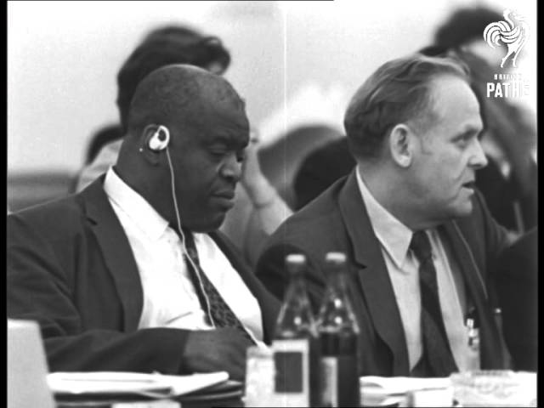
Today We Are Building The Labor-Led Anti-Monopoly Coalition
The declaration of the 1969 International Meeting of Communist and Workers’ Parties stated:
In the course of anti-monopolist and anti-imperialist united action, favorable conditions are created for uniting all democratic trends into a political alliance capable of decisively limiting the role played by the monopolies in the economies of the countries concerned, of putting an end to the power of big capital and of bringing about such radical political and economic changes as would ensure the most favorable conditions for continuing the struggle for socialism. The main force in this democratic alliance is the working class. These objectives can be achieved, above all, by diverse forms of powerful mass action by the working class and the broadest sections of the population. While making use of all possibilities of parliamentary activity, Communists emphasize that the mass movement of the working class and of all working people is the decisive factor in the struggle for democracy and socialism.
Comrades Henry Winston (Left) and Gus Hall (Right) Representing the CPUSA at the International Meeting of Communist and Workers’ Parties conference in 1969

Slide 43
Discussion & New Members Introductions

Slide 44
New Member Introductions
What is your name, pronouns and state (or country/territory)?
Where do you work? Is it unionized?
How did you find out about the People’s School?
What do you think about tonight's class?

Slide 45
Discussion & Wrap Up

Slide 46
Announcements
Please like, subscribe, and share our youtube page and its videos as well as our social media pages.
PCUSA Cell Chairs need to call members of their cells to remind them about attendance.
The next issue of New Masses (2025) has begun production. If you have art you want us to feature, email it to info@partyofcommunistsusa.net.

Slide 47
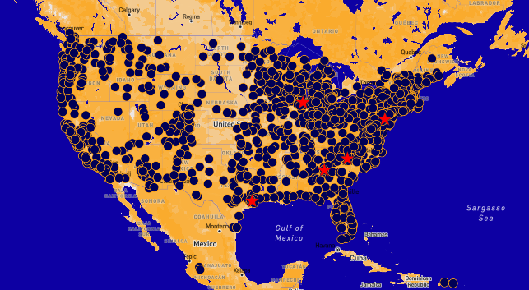
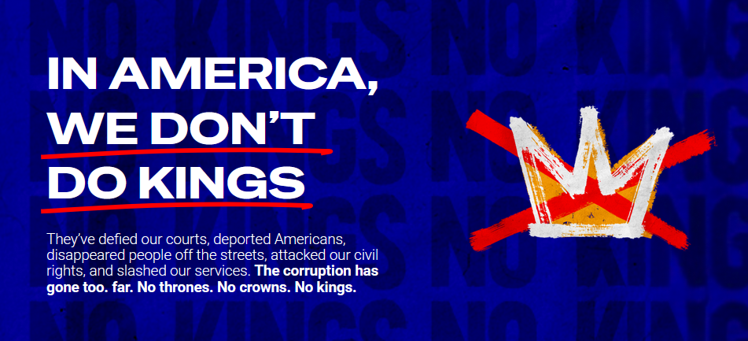
“No Kings” Rallies Across the Country
Find an Event Near You and RSVP!
3rd iteration of the Indivisible organized events such as 50501 and Hands Off
https://www.nokings.org/#map
June 14th

Slide 48

Please Help Comrades Attend Camp Red Star!
Camp Red Star is an opportunity for our young comrades to build camaraderie and learn skills that will help them build up the Party of Communists USA and its youth league, the League of Young Communists USA.
With financial hardship plaguing the country, we request that those with the means to help spare what they can to help our comrades attend. Any amount is greatly appreciated!
Donate at: https://partyofcommunistsusa.net/donations/
Choose “one-time donation”
under donation reasons click “other”
in the following text box labelled “donation reason” type in “LYC Summer Camp Subsidy”

Slide 49

Happy Pride Month!
Happy Pride from People’s United LGBT+ Society!
During this pride month, attend a parade near you. Download our brochure and our Stonewall Lives Bulletin and distribute. https://peopleslgbt.org/
Literature can also be requested using the literature request form on the member’s portal.

Slide 50
Volunteers Needed!
We are in need of volunteers for the staff of the People’s School! Here’s a few roles we need filled:
People to help manage posting on our social media and podcast platforms
Video Editors, Audio Editors, Graphic Designers, Artists, Narrators
Facilitators, Web Controls, Moderators
Email info@peoplesschool.us if you’re interested and try to attend our next staff meeting if possible.

Slide 51

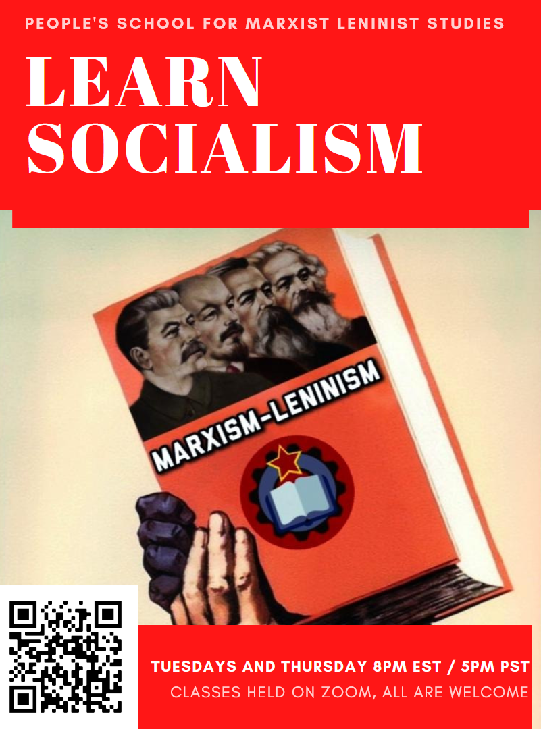



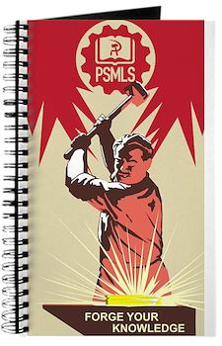




PSMLS Propaganda
peoplesschool.us/media & peoplesschool.us/store
Materials to help promote the school!

Slide 52

View From Left Field
https://viewfromleftfield.libsyn.com
The Old PSMLS Youtube is now the Youtube of View From Left Field, a podcast of analysis and discussion of current events from a progressive perspective.
Like the Youtube videos and subscribe with 5 star ratings on your podcast platforms.

Slide 53

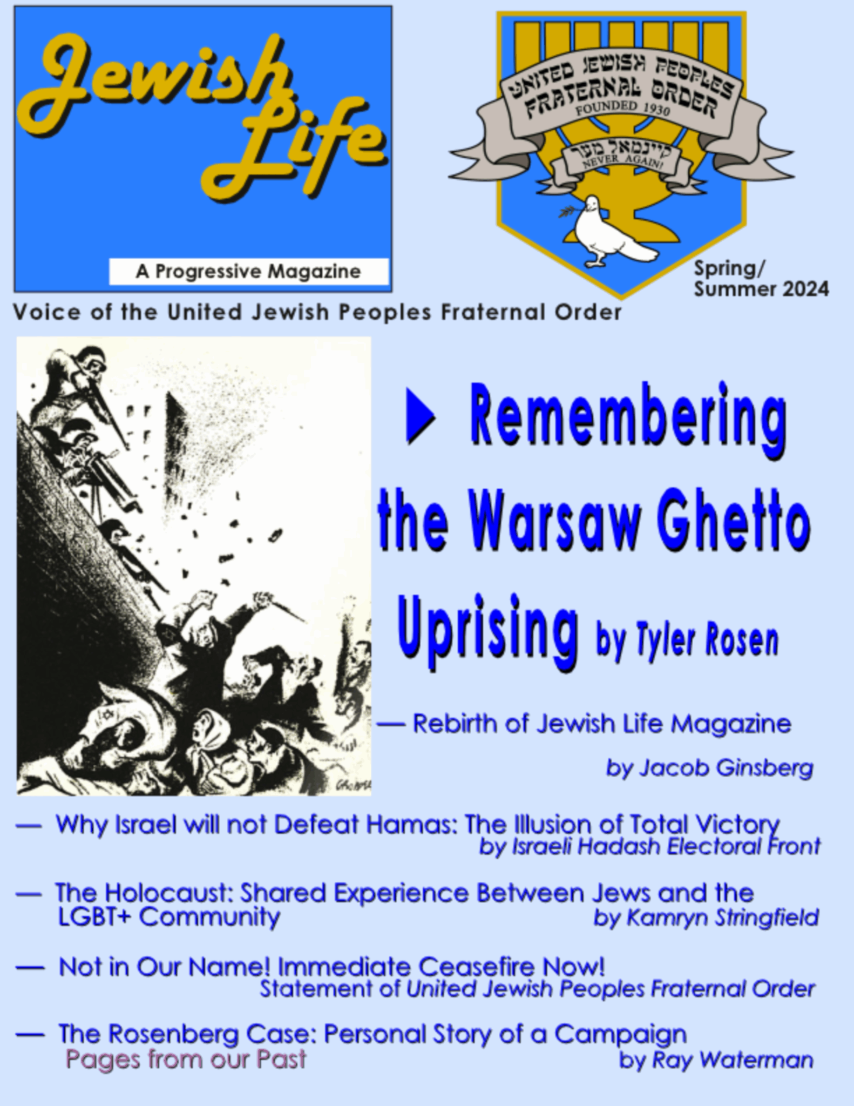
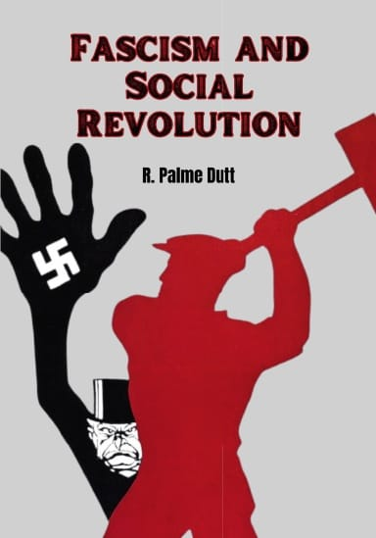
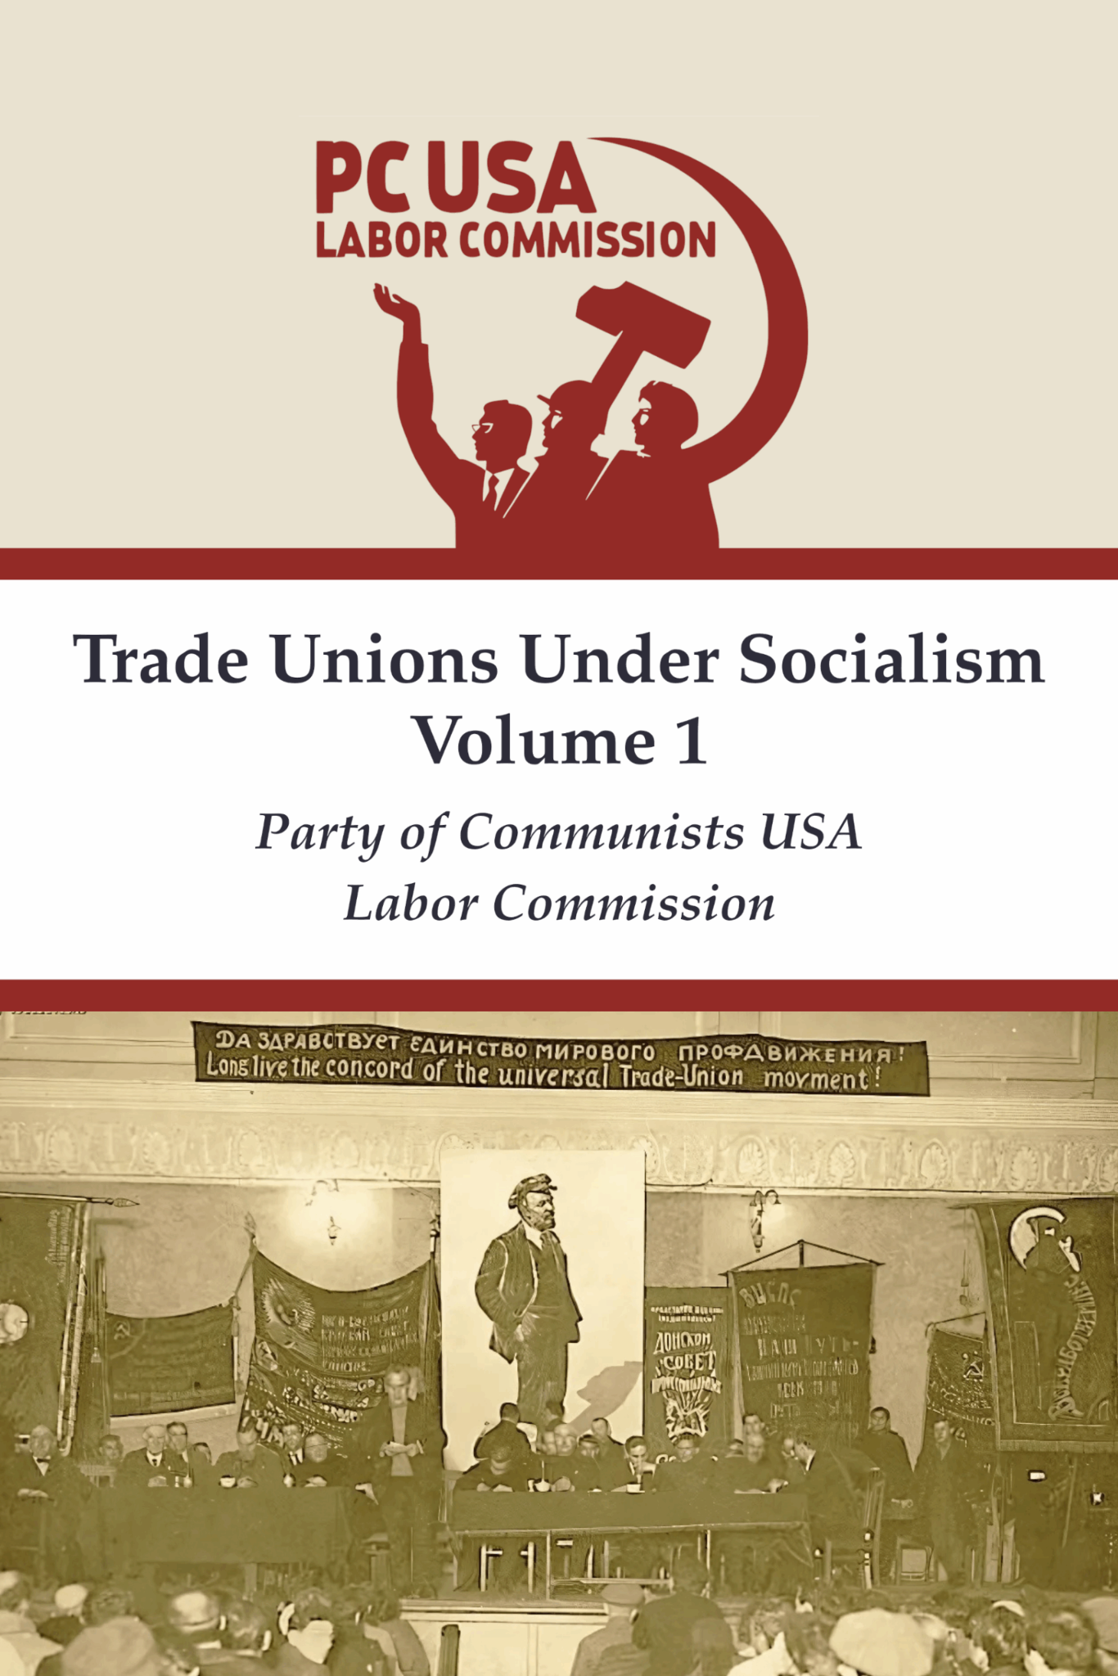

New Outlook Publishers
newoutlookpublishers.store
Relevant and Latest Releases

Slide 54


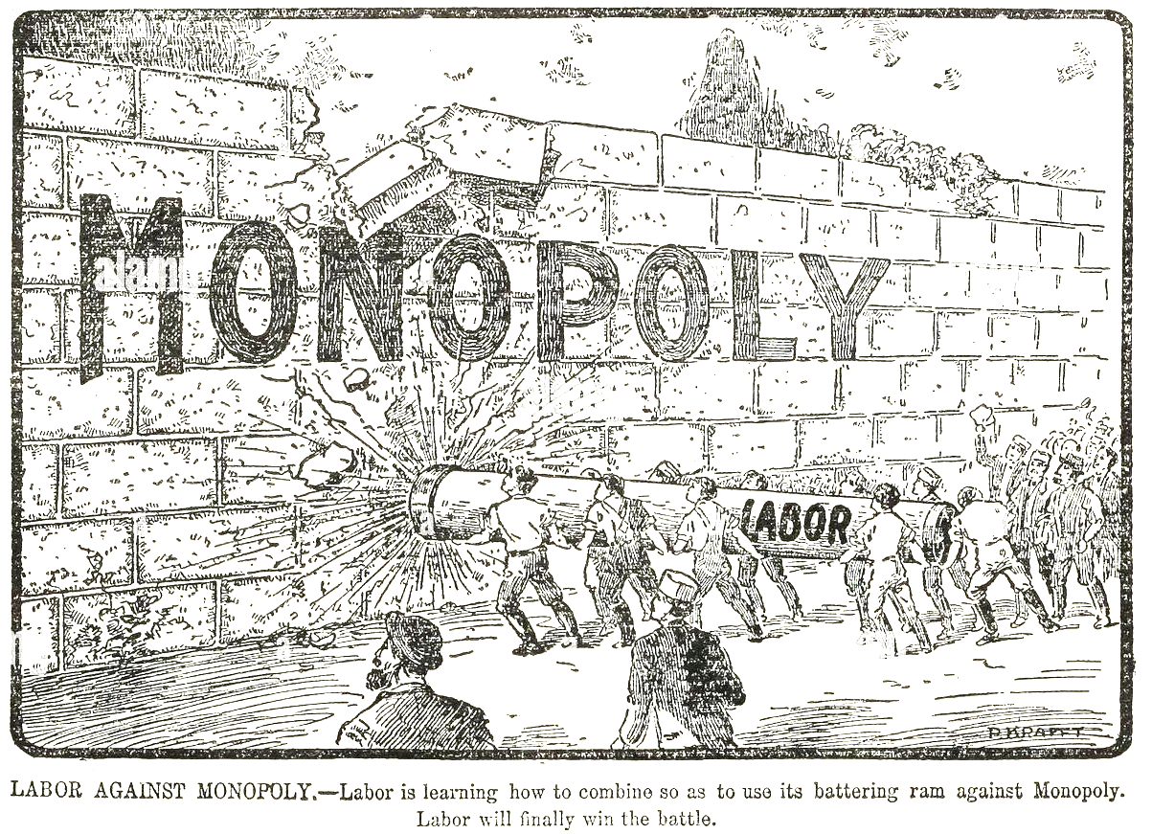
Harry Bridges School of Labor
luel.us/laborschool/
The Harry Bridges School of Labor is a monthly class held 2x per month. Classes cover a variety of topics aimed at building class conscious among union members.
July’s class will be a continuation of Labor and the Anti-Monopoly Coalition. Class will be July 2, 2025 at 8pm EST/5pm PST and Saturday July 5, 2025 at 7pm EST/4pm PST.

Slide 55
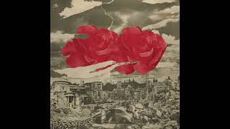
Peggy Seeger - Song of Choice

