Slide 1

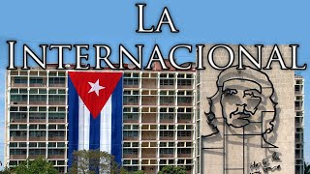
The Internationale (Cuban Version)

Slide 2

PSMLS 7/29/25

Slide 3
What we’ll be learning today:
Cuba Under Batista: Why the Revolution Happened in Cuba
Socialist Cuba and its achievements
Solidarity with Cuba today

Slide 4
Cuba Under Batista: Why the Revolution Happened in Cuba

Slide 5
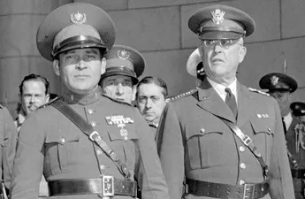
From President to Dictator
Fulgencio Batista (born January 16, 1901, Banes, Cuba—died August 6, 1973, Marbella, Spain) was a soldier and political leader who twice ruled Cuba—first as President in 1933–44. After his term ended in 1944, Batista traveled abroad and lived for a while in Florida, where he invested part of the huge sums he had acquired in Cuba.
Before the presidential election in 1952, Batista returned to Cuba and staged a military coup. He was back in power, as a dictator, jailing his opponents, using terrorist methods, and making fortunes for himself and his associates while receiving financial, military, and logistical support from the United States government.
Fulgencio Batista (left), with Gen. Malin Craig, chief of staff of the U.S. Army, in Washington, D.C.

Slide 6
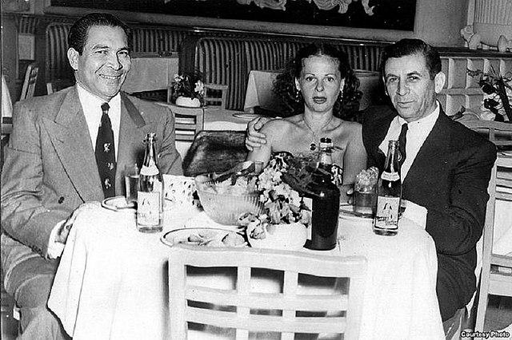
The Gangster Capitalist
Batista wasted no time in suspending the 1940 Constitution and revoking most political liberties, including the right to strike. He also outlawed the Popular Socialist Party in 1952. He then aligned with the wealthiest landowners who owned the largest sugar plantations.
Eventually, it reached the point where most of the sugar industry was in U.S. hands, and foreigners owned 70% of the arable land. As such, Batista's repressive government then began to systematically profit from the exploitation of Cuba's commercial interests, by negotiating lucrative relationships with both the American Mafia, and with large U.S.-based multinational companies who were awarded lucrative contracts. To quell the growing discontent amongst the populace, Batista established tighter censorship of the media, while also using his Bureau for the Repression of Communist Activities secret police to carry out wide-scale violence, torture, and public executions. Many people were killed, with estimates ranging from hundreds to about 20,000.
Fulgencio Batista, Thelma Lansky & Meyer Lansky. Lansky was known as the “Mob’s Accountant”

Slide 7
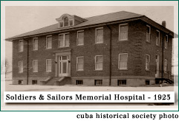
Healthcare Under Batista
Prior to the Revolution, Cuba had a high ratio of hospital beds to population, however, around 80% of these beds were located in the city of Havana.
There was only one rural hospital, and it was equipped with only 10 beds.
In 1951, the World Bank reported that between 80 and 90% of children in rural areas suffered from some form of intestinal parasites.
In 1956 about 13% of the rural population had a history of typhoid and 14% at one point had tuberculosis.
A study conducted in 1959 by public health authorities found that throughout the country around 72% of the population was afflicted with parasitism and in the rural areas this percentage was as high as 86.54%.

Slide 8
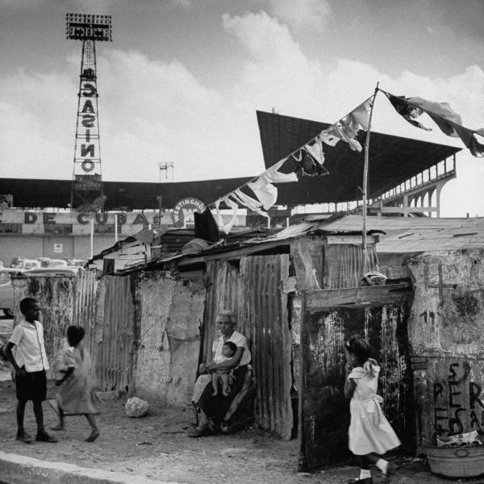
Life for the Cuban Peasant
Only 11% of farm worker families drank milk, and rural infant mortality stood at 100 per 1000 live births. Only 1 in 4 peasants were able to afford regularly eating meat, eggs and fish and chronic unemployment was at 25%.
Cuba was a very unequal society with a mere 8% of landowners owning approximately 75% of the land, and while one-fifth of the population took in 58% of the national income, the bottom fifth got 2% of it, the lowest rates for the bottom 20% in the world then and even now.
Photo of the Havana slums taken in 1954

Slide 9
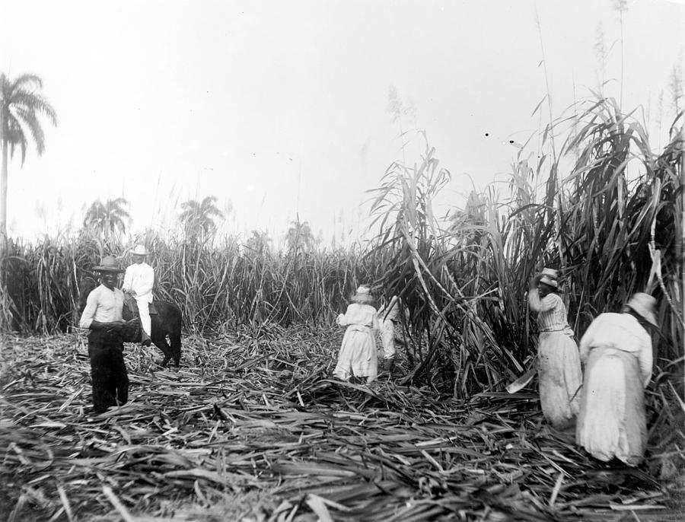
Profound Inequality
There were profound inequalities in Cuban society -- between city and countryside and between whites and blacks. In the countryside, some Cubans lived in abysmal poverty. Sugar production was seasonal, and the macheteros -- sugarcane cutters who only worked four months out of the year -- were an army of unemployed, perpetually in debt and living on the margins of survival. Many poor peasants were seriously malnourished and hungry. Neither health care nor education reached those rural Cubans at the bottom of society. Illiteracy was widespread, and those lucky enough to attend school seldom made it past the first or second grades. Clusters of graveyards dotted the main highway along the foothills of the Sierra Maestra, marking the spots where people died waiting for transportation to the nearest hospitals and clinics in Santiago de Cuba.
Cuban macheteros harvesting sugarcane

Slide 10
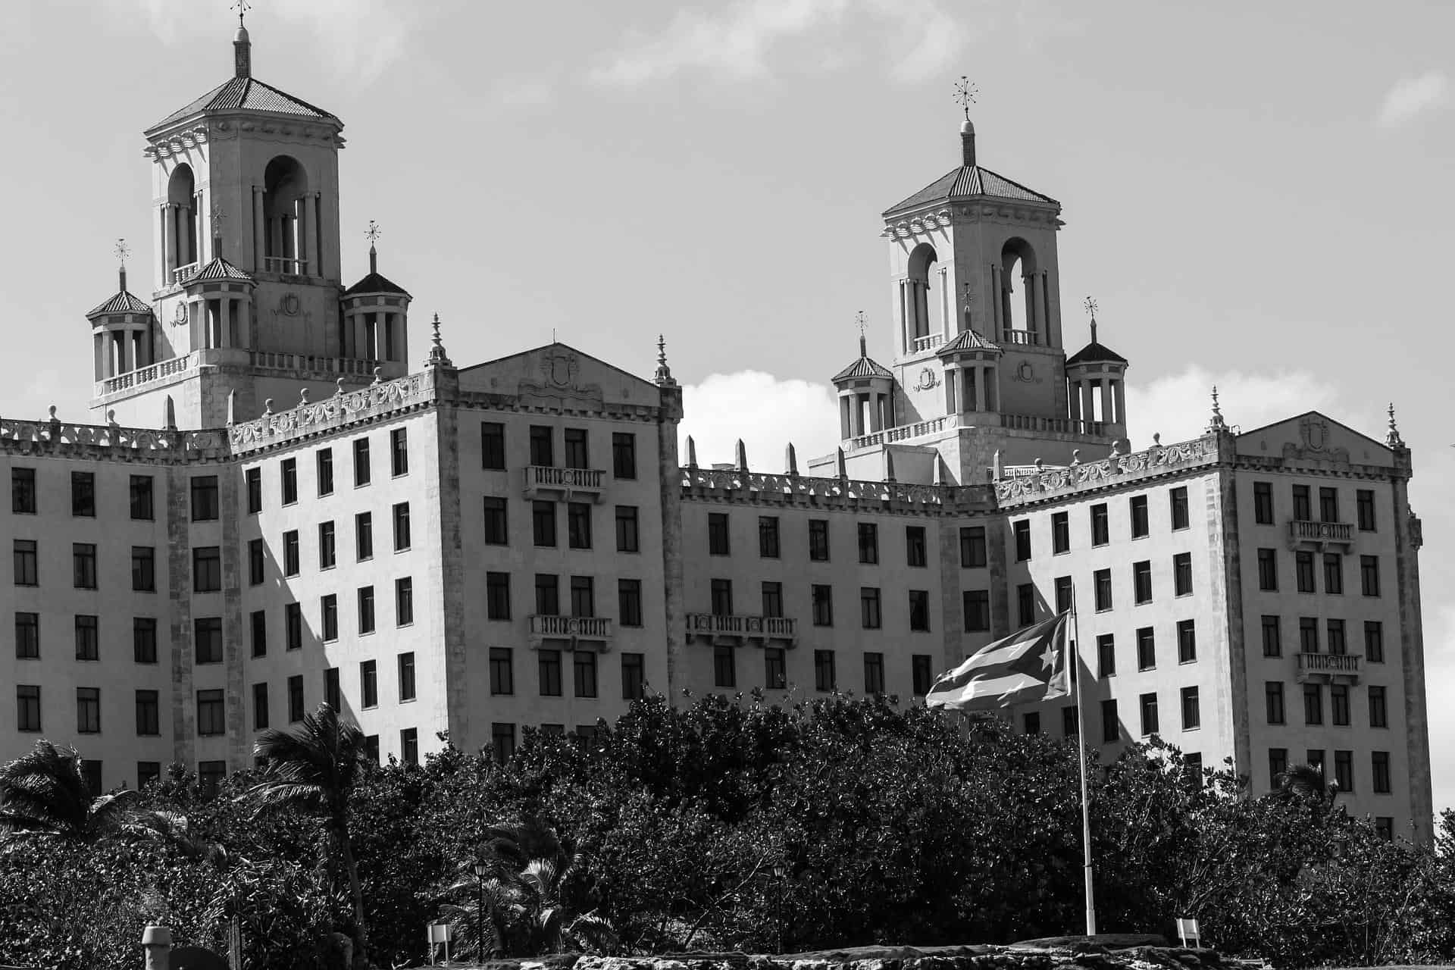
A Strict Racial Hierarchy
Racism also blighted Cuban society. The island's private clubs and beaches were segregated. Even President Fulgencio Batista, a mulatto, was denied membership in one of Havana's most exclusive clubs. The photo to the left shows the segregated Hotel Nacional de Cuba, which turned away such black luminaries as Nat King Cole, Joe Louis, Marian Anderson, Jackie Robinson, and Josephine Baker.
"One might best summarize the complex situation by saying that urban Cuba had come to resemble a Southern European country (with a living standard as high or surpassing that of France, Spain, Portugal and Greece) while rural Cuba replicated the conditions of other plantation societies in Latin America and the Caribbean," analyst Mark Falcoff.

Slide 11
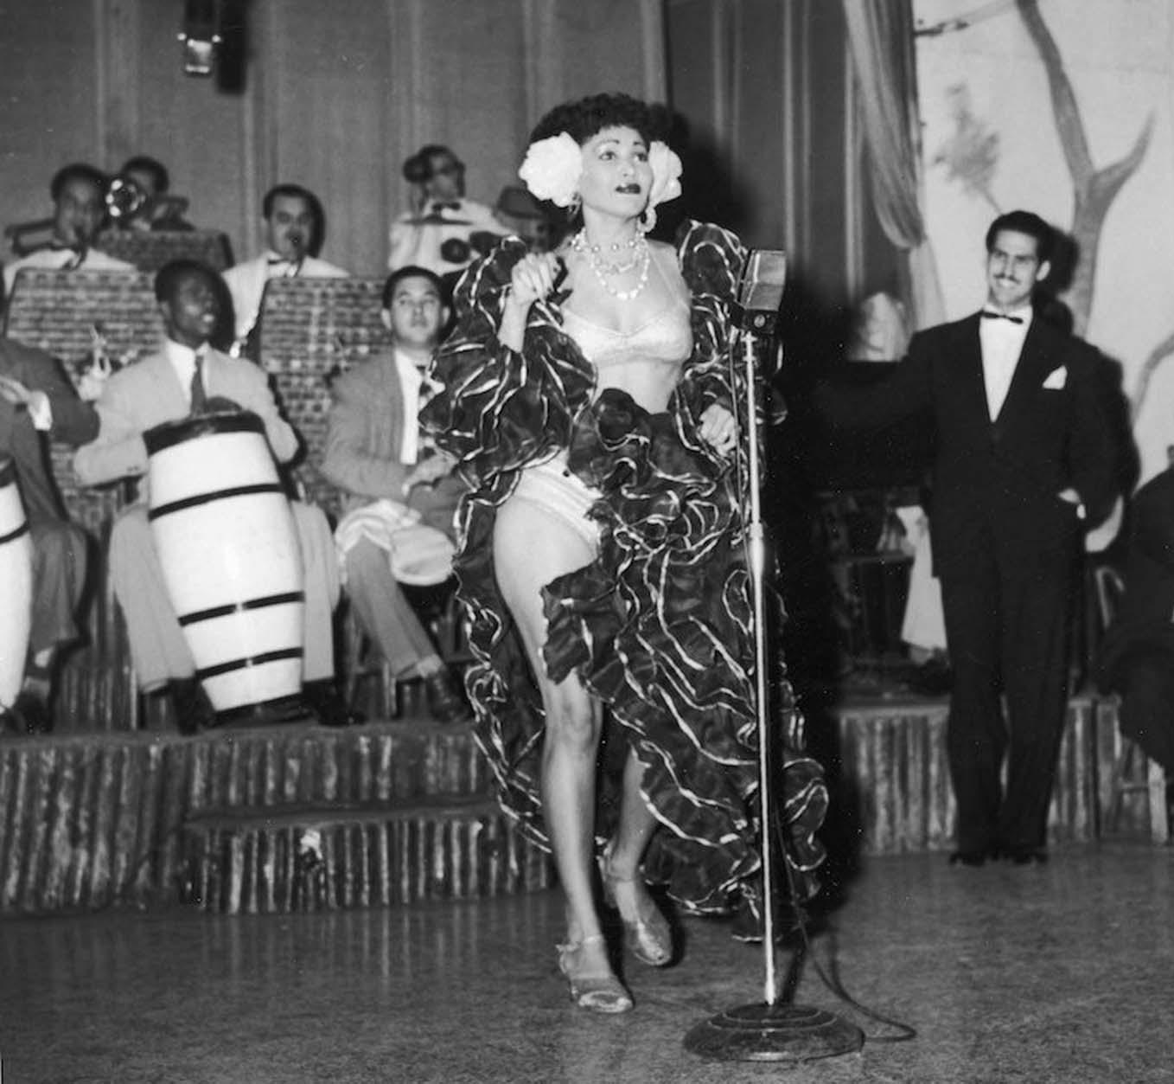
American Stereotypes of Cuba
To the American popular eye, pre-revolutionary Cuba was the island of sin, a society consumed by the illnesses of gambling, the Mafia, and prostitution. Prominent American intellectuals echoed that view. Even in 1969, when Cuban reality had changed drastically, Susan Sontag, in an article in Ramparts, described Cuba as “a country known mainly for dance, music, prostitutes, cigars, abortions, resort life, and pornographic movies.” In a 2004 article for the Nation, Arthur Miller, based on what he had learned from people who had worked in the film industry in the island, described the Batista society “as hopelessly corrupt, a Mafia playground, a bordello for Americans and other foreigners.”
Cuban macheteros harvesting sugarcane
A Cuban rhumba dancer named Zulema performs on stage with a band at the Zombie Club in Havana. 1946

Slide 12
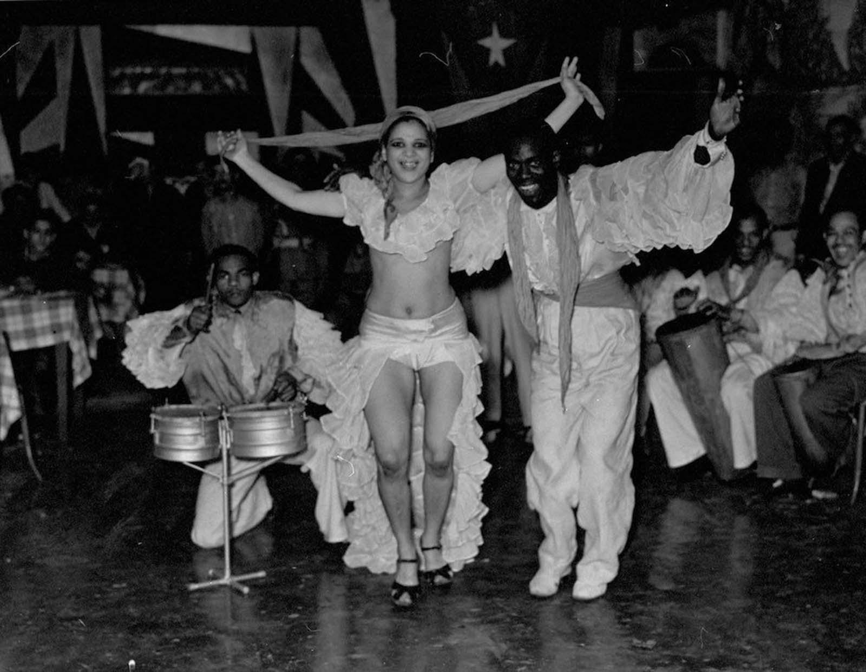
The North-American Colonial Worldview
Although most Cubans would have readily admitted that Sontag and Miller had touched some of Cuba’s real wounds, they would have hardly seen them as the most representative, or as the most pressing problems that affected the island. The perceptions dominant in America’s media revealed far more about the North American colonial worldview than anything about Cuba itself, a feature of the mainstream culture of the US that continues to prevail today.
Dancing in Havana. 1937.

Slide 13
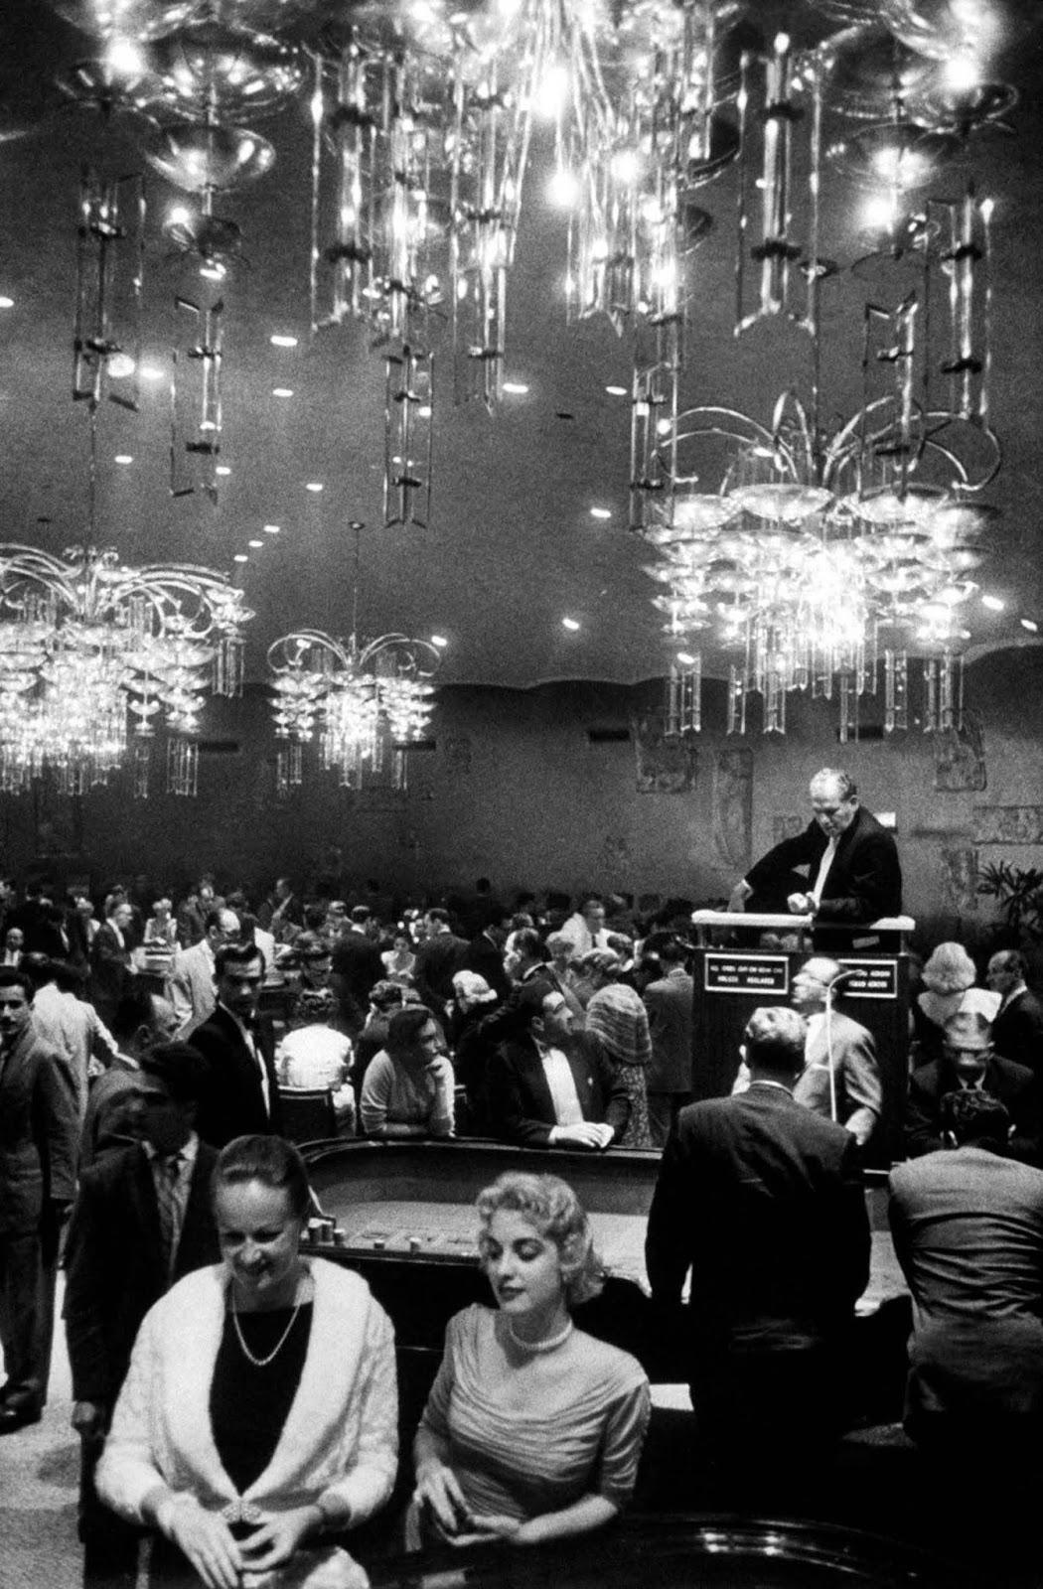
“The Island of Sin”
Casinos began to develop in Cuba in the 1920s in connection with the growth of tourism. After several ups and downs in the following three decades, the casino industry took off in the mid- to late 1950s as Batista and his cronies, working together with American Mafiosi, used the resources of Cuban state development banks, and even union retirement funds, to build hotels, all of which hosted casinos, like the Riviera, the Capri, and the Havana Hilton (today’s Havana Libre). In the process both Cuban rulers and Mafiosi lined their own pockets, skimming the casinos’ proceeds, cheating investors, and trafficking drugs. But as Rosalie Schwartz, a historian of Cuban tourism, has pointed out, “disgust with government excesses preceded and outstripped outrage over casinos . . . Revolutionaries charged Batista henchmen with torture and murder — not casino operations — when they put them on trial.”
Havana casino. 1958.

Slide 14
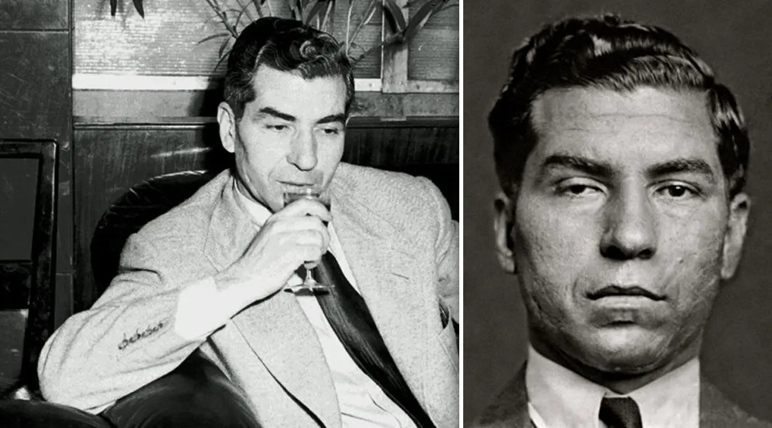
Exporting American Gangsterism
Several Mafia families entertained the idea of taking their business to Cuba both as a means to expand their enterprises and to evade the FBI and the IRS, among other US government agencies. In December 1946, Havana’s Hotel Nacional hosted an important gathering of the Mafia attended by the heads of the most powerful families and organized by Lucky Luciano, who had been residing in the island since October of that year. Eventually, under heavy American pressure, the Cuban government deported Luciano in February of 1947. Other gangsters, such as Meyer Lansky and Tampa’s Santo Trafficante Jr, had a much longer stay on the island and were closely connected to casino gambling. There were undoubtedly strong links between the Mafia and the Batista regime, however, the Mafia in Cuba was only one interest group of many. The Mafia had no interest in running Cuba; it just wanted a place to pursue their interests, primarily in gambling, and also in the drug trade, unmolested by the US or the Cuban government.
American Mafia Boss Lucky Luciano

Slide 15
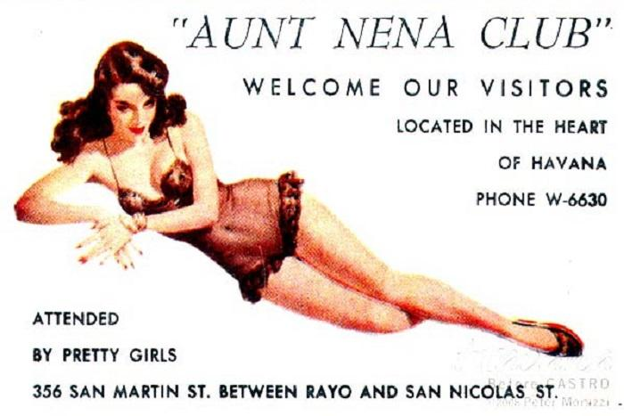
“A Bordello for Americans and Other Foreigners”
Sex work was relatively common in the pre-revolutionary Cuba of the fifties, but North American opinion gave it a lot more importance than people did in Cuba, including the most radical critics of the island’s social and economic status quo. Despite the high number of Cuban women engaged, and exploited, in the industry, there were many more Cuban women in other highly exploited sectors. Poor and unemployed young rural women, a major recruitment zone for the Havana bordellos, were far more likely to end up working as maids in a middle- or upper-class urban household than as prostitutes. The moral economy of the Cuban peasant and agricultural proletariat, which included notions of dignity, strong parental authority, and folk religion, were powerful forces against sex work.
Lobby card sample issued by brothels to patrons and tourists.

Slide 16
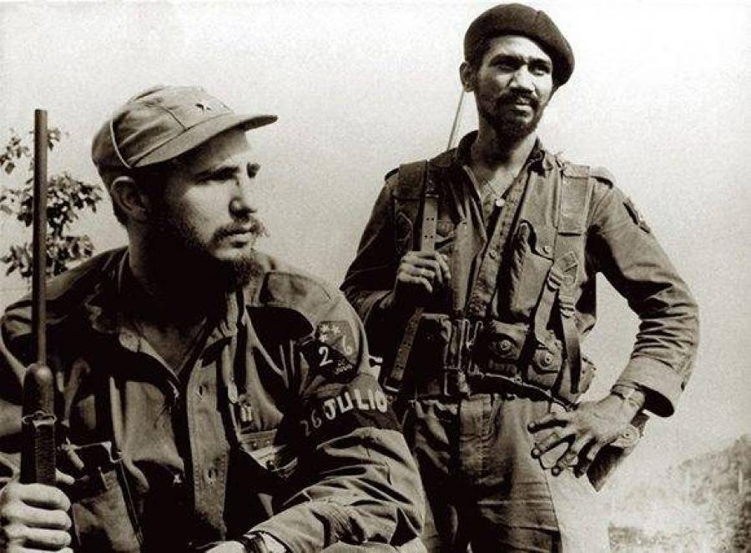
Social Symptoms of the Fundamental Disease
If many Americans, including sections of the American liberal and radical left, saw casino gambling, the Mafia, and prostitution as defining characteristics of what was wrong with the Cuba of the 1950s, the Cuban opposition on the island had bigger fish to fry — dictatorship, widespread corruption of public officials, the evils of the one-crop economy and extreme rural poverty, high unemployment (particularly among young people, in both urban and rural Cuba), and in the case of the Communist opposition to Batista, US imperialism. That does not mean that Castro and other Cuban reformers and revolutionaries did not regard those phenomena as social ills or that they were indifferent to their effects. But they saw them as secondary problems, in a sense derivative from more fundamental issues that in their eyes characterized 1950s Cuba.
Fidel Castro and Commander Juan Almeida Bosque

Slide 17
Discussion

Slide 18
Socialist Cuba and Its Achievements

Slide 19
The Successes of Socialist Cuba
Despite Cuba’s conditions before the Revolution of being a corrupt resort for American businessmen and criminals, and a crippling US blockade after the Revolution Cuba has been able to endure and progressively advance the living standards of its people .
Fidel, Raul, and Vilma Castro created a communist infrastructure that guaranteed basic human needs—healthcare, housing, education, and dignity.
Cuba is a living testament as to what can be achieved in a socialist state.

Slide 20
Healthcare as a Right
Cuba provides universal and free healthcare accessible for all citizens—no insurance, no copays, no bankruptcies.
It also has more doctors per capita than almost any country in the world, as Cuba’s free education system produced many great doctors.
Despite a blockade that prevents critical medical materials from getting into the island nation being imposed by the USA, infant mortality in Cuba is lower is than the U.S.
Cuba has even developed its own biotech and vaccines recently. Cuba was able to produce multiples of its own vaccines to fight back against covid-19
Cuba has sent over 400,000 health workers abroad since 1960 in solidarity volunteer work to help other countries in need.

Slide 21
Housing and Basic Living Standards
There is no mass homelessness in Cuba. Cuba has a Constitutionally protected right to housing. Between 1959 and 1983, Cuba raised the share of the population living in adequate housing from 43% to 85%, according to the UN Economic Commission for Latin America and the Caribbean (ECLAC).
Most Cubans own their homes or pay very low rent capped at 10% of their income.
Basic food, electricity, and fuel is subsidized—even under blockade.
Life expectancy rose from 58 years (1958) to 77 years (early 2000s) — despite the U.S. embargo.

Slide 22
Education for All
Cuba’s Literacy rate is near 100% as opposed to 60-70% pre revolution.
Cuba provides Free schooling through university, including medical and technical degrees for all.
Cuba also has a high density of well trained teachers.
Cuba even exports literacy programs to other countries showing its internationalist roots and solidarity despite its own precarious home conditions due to imperialist strangulation.

Slide 23
Women’s and LGBTQ+ Rights in Cuba
Today Cuba can say 60% of its university graduates are women, and nearly 50% of its National assembly are women.
Mass women’s organization are extremely important in Cuban society, like the Federation of Cuban Women (FMC) who helps drives public policy.
Legal abortion, maternal leave, and childcare support were all established under socialist Cuba
and as of recent Cuba has taken a progressive step in the LGBT+ field becoming a leading example on the world stage.
This is highlighted by their 2022 Family Code: which legalized same-sex marriage, adoption by gay couples, and recognition of diverse families. It is widely is considered the most pro-lgbt+ piece of legislation in the world.

Slide 24
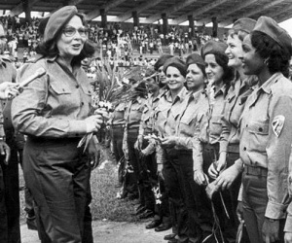
The Federation of Cuban Women
Formed in 1960 right after the successful revolution
The Cuban women, who also helped in the Revolution, sent a delegation to Vilma Castro to help them fight the chauvinistic culture that pervaded Cuba.
The literacy rate was abysmal in the countryside, hygiene was non-existent, women had no rights, and mortality rates for both mothers and babies were high. In her first year, she supervised the opening of 800 nursery day care centers. It was easy, the men and women were paid to work, the mansions and governmental buildings were re-purposed, the workers received all the materials they needed, and they organized community outreach committees.
To combat literacy and poor hygiene among the dwellers of the mountainous areas, Fidel used trains to bring 4000 village women to Havana for months at a time while they learned how to organize, how to machine sew, proper health care procedures, etc. These women, upon graduation were then sent, with government authority, back to their villages to be community leaders.
Vilma was President for 47 years until her death in 2007. To this day, one of her daughters still carries on the progressive work of the Federation.

Slide 25


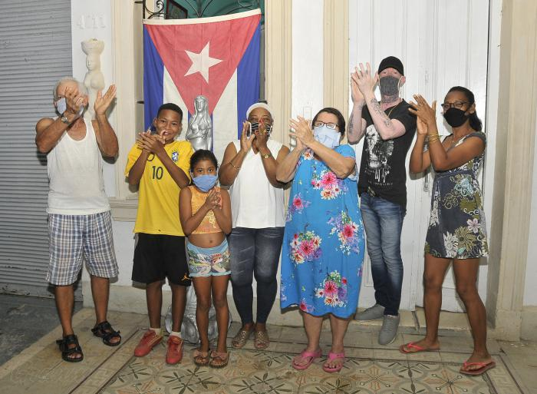
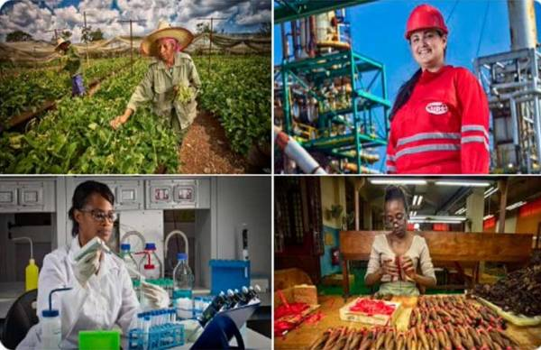
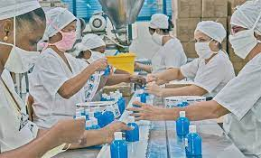
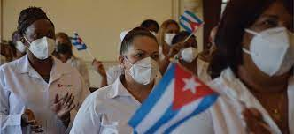
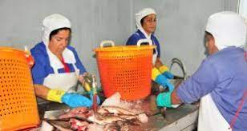
National Program for the Advancement of Women 2022

Slide 26
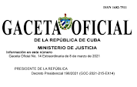
National Program for the Advancement of Women 2022
COUNCIL OF MINISTERS
Presidential Decree 198
PAM
Summarizes the feeling and political will of the Government of The Republic of Cuba, National Program for the Advancements of Women formalizes the current positive practices and contributes to the institutionalization of the policies of gender equality.
8 de marzo de 2021

Slide 27
The Families Code
Places love, affection, solidarity, and responsibility as the highest family values.
Reflects the Cuban family realities, as they have been studied for more than 40 years by various social sciences and by legal practice.
Is based on the guiding principles promoting equality and non-discrimination, family plurality, because it seeks to establish a legal code of statutes including different family models, the principle of solidarity, and protection of the most vulnerable, both minors and the elderly.
Protects people from family violence and discrimination, Supporting more opportunities and equality of rights for all.

Slide 28
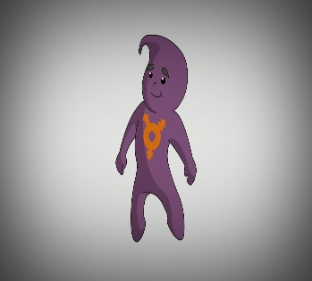

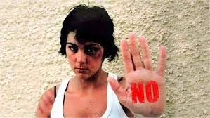
Work Done
Created a methodological development for devising Institutional Protocols for prevention of violence and assistance to victims of violence.
Created a Guide to Comprehensive Intervention for gender-based violence and intra-family violence
Signed an Agreement of Collaboration with the Ministry of Justice.
Presented a Practical Guide for the Introduction of Gender Focus in Legislative Work.

Slide 29
Discussion

Slide 30
Solidarity With Cuba Today

Slide 31
Frederick Engels in Dialectics of Nature
The social science of the bourgeoisie, classical political economy, is predominantly occupied only with the directly intended social effects of human actions connected with production and exchange. This fully corresponds to the social organisation of which it is the theoretical expression. When individual capitalists are engaged in production and exchange for the sake of the immediate profit, only the nearest, most immediate results can be taken into account in the first place. When an individual manufacturer or merchant sells a manufactured or purchased commodity with only the usual small profit, he is satisfied, and he is not concerned as to what becomes of the commodity afterwards or who are its purchasers. The same thing applies to the natural effects of the same actions. What did the Spanish planters in Cuba, who burned down forests the slopes of the mountains and obtained from the ashes sufficient fertiliser for one generation of very highly profitable coffee trees, care that the tropical rainfall afterwards washed away the now unprotected upper stratum of the soil, leaving behind only bare rock? In relation to nature, as to society, the present mode of production is predominantly concerned only about the first, tangible success; and then surprise is expressed that the more remote effects of actions directed to this end turn out to be of quite a different, mainly even of quite an opposite, character;

Slide 32
Statement by Maury Hechevarria Bermudz, Vice Minister of Agriculture of Cuba at Ministerial Round Table “Transforming food systems to achieve the Sustainable Development Goals”
Given July 27, 2021 at UN Pre-Summit on Food Systems
I appreciate the invitation to this Pre-Summit on Food Systems.
Cuba, like the vast majority of countries, has been affected by the health crisis caused by COVID-19, which has deepened the global socio-economic crisis, whose greatest effects fall on developing countries.
The Cuban government gives the highest priority to feeding our population, which is considered a national security issue. The Constitution of the Republic promulgates in its articles the right to food for all.
Cuba shows progress in this area, including the achievements made in the fight against hunger, recognized by FAO in 2014. Similarly, Cuba is the first country in Latin America and the Caribbean to eliminate child malnutrition in children under 5 years of age, a fact recognized and validated by UNICEF in 2015.

Slide 33
Statement by Maury Hechevarria Bermudz, Vice Minister of Agriculture of Cuba at Ministerial Round Table “Transforming food systems to achieve the Sustainable Development Goals
Amid the difficult challenges marked by the lack of agricultural inputs and fuel, Cuban farmers have demonstrated their capacity for innovation and commitment to food security. For example, in the months of greatest confrontation with the new coronavirus, one of the fundamental tasks was to supply food to the Health Centers for the care and isolation of people affected by the pandemic, as well as to hospitals and other health facilities.
In 2021, we faced the impossibility of importing the necessary fertilizers and nutrients for crops such as rice, just to cite one example; as a solution to this obstacle, national variants were used to a greater extent.
In addition, more than 8,678 hectares of crops were damaged by the intense rainfall and floods associated with the passage of tropical storm Eta through several Cuban provinces.
Adverse phenomena are compounded by the restrictions imposed by the criminal economic, commercial and financial blockade of the United States (USA) government, exacerbated by the 243 measures adopted by the Donald Trump government, which remain today intact.

Slide 34
Statement by Maury Hechevarria Bermudz, Vice Minister of Agriculture of Cuba at Ministerial Round Table “Transforming food systems to achieve the Sustainable Development Goals
In July 2020, the National Plan for Food Sovereignty and Nutrition Education (SAN Plan) was approved, the first of its kind in the nation's history, which highlights the need to reduce dependence on food and input imports, guarantee quality and food safety and avoid food losses and waste. The Plan aims to facilitate the organization of local, sovereign and sustainable food systems that integrate production, transformation, marketing and consumption.
The high commitment of the Cuban government to universal coverage of health, education and food, without leaving anyone helpless, is confirmed today in the work of scientists, who in the midst of the pandemic have produced 4 vaccine candidates against COVID -19, and 2 vaccines with high efficiency and results.
We work in our country on the basis of the use of agro-ecological technologies, with a deep sense of territorial sustainability using local (endogenous) resources and food sovereignty. As a priority, the production of seeds, the production of organic fertilizers, the production of biological media and direct marketing are highlighted, stimulating the circular economy. Scientific and technical achievements have been used, such as obtaining new varieties and new bio-products.

Slide 35
Statement by Maury Hechevarria Bermudz, Vice Minister of Agriculture of Cuba at Ministerial Round Table “Transforming food systems to achieve the Sustainable Development Goals
With a strategic vision and based on the National Development Plan until 2030, risk reduction plans have been drawn up, especially for the months of June to November, during hurricanes, to counteract the effects of climatic events, the attack of pests and diseases, with agro-technical and organizational practices, as well as guidelines that facilitate the Cuban State the organization of Local, Sovereign and Sustainable Food Systems, for their immediate implementation.
With a multisectoral approach, Cuban academic, government, business and civil society institutions have prepared diagnoses of the local food situation and the Action Plan to meet the population's food needs, taking into account the natural resources available in the localities, as well as the Territorial Development Plan. We will continue to work for a sustainable agriculture system that takes into account the improvement of nutrition and agricultural productivity.
In this area, we call on developed countries to share their positive experiences and provide technology transfer to achieve food systems for all.
We are working in the most difficult conditions created by COVID-19 and in the midst of the strengthening of the economic, commercial and financial blockade of the United States against Cuba, which in a period of one year accounts for damage to the productive chain and agriculture by an amount of 428 million dollars.

Slide 36
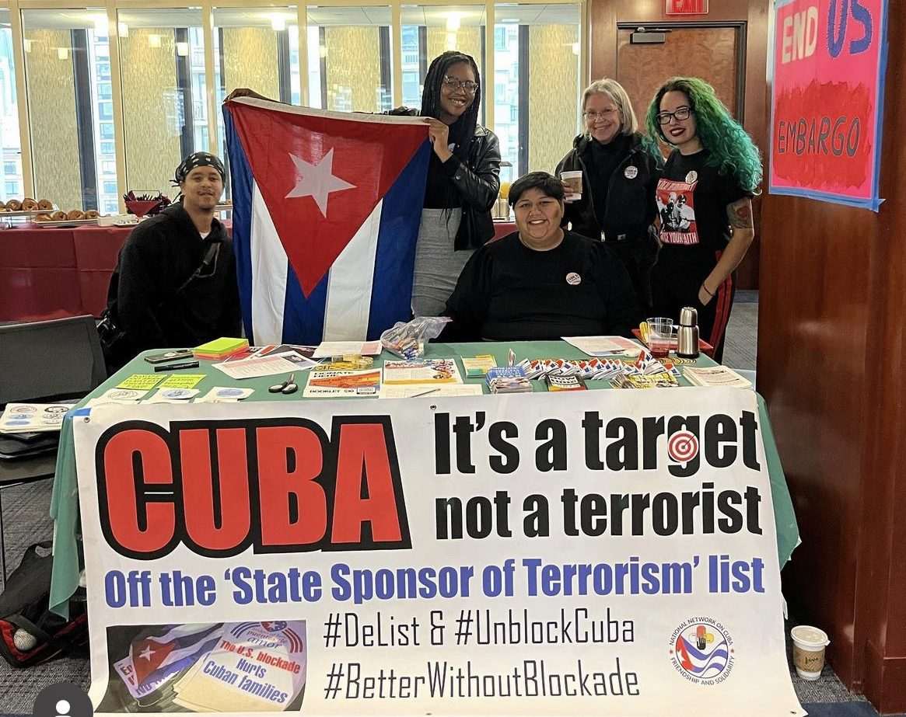
The NNOC is a U.S.-based umbrella organization composed of more than 60 organizations advocating for an end to Washington’s hostility towards Cuba, especially the inhumane U.S. economic blockade against Cuba
https://nnoc.org

Slide 37
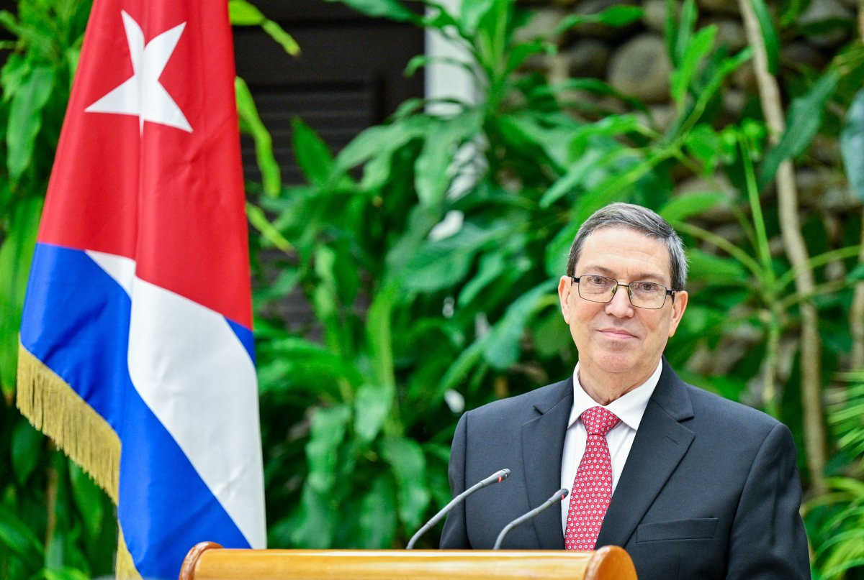
Statement by Cuban Foreign Ministry on January 14, 2025
(The decisions made by the US government were rescinded immediately upon entry of the Trump Administration on January 21, 2025)
On January 14, 2025, the government of the United States announced the following decisions:
1. Remove Cuba from the State Department list of countries that allegedly sponsor terrorism;
2. Make use of the presidential faculty to prevent US courts from taking action with regards to lawsuits that might be filed by virtue of Title III of the Helms-Burton Act; and
3. Eliminate the list of restricted Cuban entities that designates a group of institutions which US citizens and institutions are not allowed to make financial transactions with, which has had an impact on third countries.
Cuban Foreign Minister Bruno Rodríguez Parrilla

Slide 38
Statement by Cuban Foreign Ministry on January 14, 2025
Despite its limited scope, this is a decision that points to the right direction and is in line with the sustained and firm demand by the government and the people of Cuba, as well as the broad, emphatic and reiterated call by numerous governments, particularly those of Latin America and the Caribbean; Cubans residing abroad; political, religious and social organizations and numerous political figures of the United States and other countries. The government of Cuba expresses its gratitude to all of them for their contribution and sensitivity.
This decision puts an end to specific coercive measures which, together with many others, seriously damage the Cuban economy and have a severe impact on the population. This is, and has been, an ever-present issue in all official exchanges between Cuba and the Government of the United States.
It is important to point out that the economic blockade and a large part of the tens of coercive measures entered into force since 2017 to further strengthen it, still remain in force, with their full extraterritorial impact and in violation of International Law and the human rights of all Cubans.

Slide 39
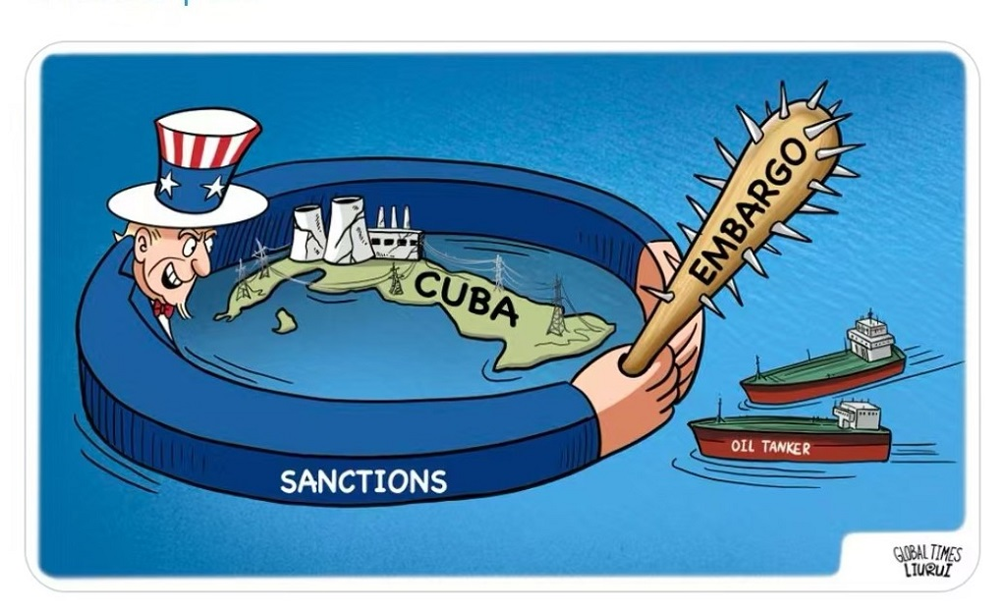
Statement by Cuban Foreign Ministry on January 14, 2025
The following are just a few examples: The illegal and aggressive persecution of the fuel supplies that Cuba is legally entitled to import continues. The cruel and absurd persecution of the legitimate international medical cooperation agreements that Cuba has signed with other countries is maintained, thus threatening to deprive millions of persons of health services and limiting the potential of Cuba’s public health system. The international financial transactions of Cuba or those of any national that might be linked to Cuba continue to be subject to prohibitions and reprisals. Merchant vessels touching Cuban ports continue to be under threats.
Besides, US citizens, companies or subsidiaries of US corporations are not allowed to trade with Cuba or Cuban entities, with very limited and regulated exceptions. Harassment, intimidation and threats against a national from any country intending to trade with Cuba or invest in this country continue to be part of the official policy of the United States. Cuba continues to be a destination banned for US citizens by their government.
The economic warfare is still in place and persists in posing a major obstacle to the development and recovery of the Cuban economy, with a high human cost for the population; and continues to be an incentive for emigration.

Slide 40
Statement by Cuban Foreign Ministry on January 14, 2025
The decision announced today by the United States, rectifies, in a very limited way, some aspects of a cruel and unjust policy. This is a rectification that is being introduced right now, on the verge of a change of government, when it should have been materialized years ago, as an elemental act of justice, without asking for anything in return and without fabricating pretexts to justify inaction, if there was a true intention to act properly. Recognition of the truth, the absolute absence of reasons for such designation and the exemplary performance of our country in the combat of terrorism, something that has been recognized even by several US government agencies, should have sufficed to remove Cuba from the arbitrary list of State sponsors of terrorism.
It is known that the government of that country could reverse in the future the measures that have been adopted today, as has already happened in the past, and as an expression of the lack of legitimacy, ethics, consistency and reason in its behavior towards Cuba.

Slide 41
Statement by Cuban Foreign Ministry on January 14, 2025
To do that, US politicians usually do not take time to find an honest justification, as long as the vision described in 1960 by the then Deputy Assistant Secretary, Lester Mallory, and his expressed intention to put Cubans on their knees by way of economic siege, misery, hunger and desperation, remain in force. They will not take time to find justifications as long as that government continues to be unable to recognize or accept Cuba’s right to self-determination, and as long as it remains ready to pay the political cost meant by the international isolation caused by its genocidal and illegal economic suffocation policy against Cuba.
Cuba will continue to face and condemn that economic warfare policy, the foreign interference programs and the disinformation and discredit operations financed every year with tens of millions of dollars of the US federal budget.
It will also continue to be ready to develop a respectful relation with that country, based on dialogue and non-interference in the internal affairs of both countries, despite the differences.

Slide 42
Discussion & New Members Introductions

Slide 43
New Member Introductions
What is your name, pronouns and state (or country/territory)?
Where do you work? Is it unionized?
How did you find out about the People’s School?
What do you think about tonight's class?

Slide 44
Discussion & Wrap Up

Slide 45
Announcements
PCUSA Cell Chairs need to call members of their cells to remind them about attendance.
The next issue of New Masses (2025) has begun production. If you have art you want us to feature, email it to info@partyofcommunistsusa.net.

Slide 46
Volunteers Needed!
We are in need of volunteers for the staff of the People’s School! Here’s a few roles we need filled:
People to help manage posting on our social media and podcast platforms
Video Editors, Audio Editors, Graphic Designers, Artists, Narrators
Web Controls, Moderators
Email info@peoplesschool.us if you’re interested and try to attend our next staff meeting if possible.

Slide 47

View From Left Field
https://viewfromleftfield.libsyn.com
The Old PSMLS Youtube is now the Youtube of View From Left Field, a podcast of analysis and discussion of current events from a progressive perspective.
Like the Youtube videos and subscribe with 5 star ratings on your podcast platforms.

Slide 48

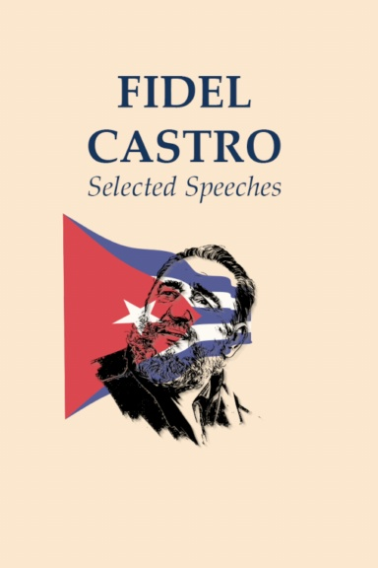
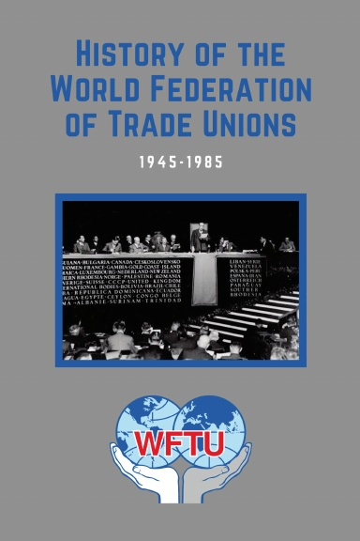
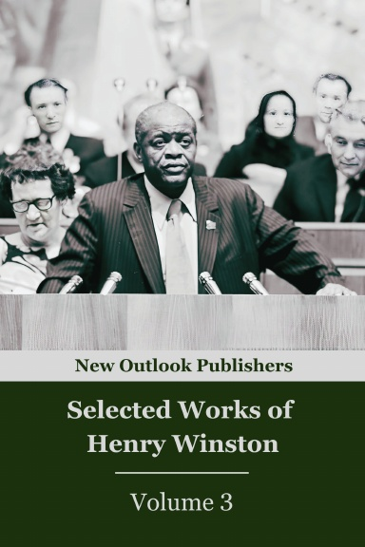

New Outlook Publishers
newoutlookpublishers.store
Latest Releases

Slide 49



Harry Bridges School of Labor
luel.us/laborschool/
The Harry Bridges School of Labor is a monthly class held 2x per month. Classes cover a variety of topics aimed at building class conscious among union members.
August’s class will be a viewing of “Salt of the Earth.” Class will be Wednesday August 6, 2025 at 8pm EST/6pm PST and Saturday August 9, 2025 at 7pm EST/4pm PST.

Slide 50
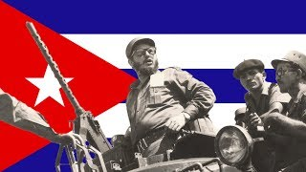
March of the 26th of July Movement!

