Slide 1

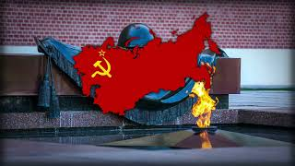
Click Insert -> Click Video -> Past Youtube link to song you want -> select song when it pops up
Do the [Soviet] Russians Want War? - Alexander Popovich
Soviet Anti-War Song Written in 1961

Slide 2

``
Insert Class Thumbnail Here
PSMLS 09/09/25

Slide 3
What we’ll be learning today:
History Repeated: Ukraine Neo-Nazis Turn To Old Ally Us For ‘Help’
By Equating USSR to Nazi Germany, the West Covers up its own Shameful History
Who Controls the Past Controls the Future: Why does the West Hate Stalin?

Slide 4
The bourgeois state and its institutions, especially used by the most reactionary, is there to preserve capitalism
“At a certain stage of development, the material productive forces of society come into conflict with the existing relations of production or -- this merely expresses the same thing in legal terms -- with the property relations within the framework of which they have operated hitherto. From forms of development of the productive forces these relations turn into their fetters. Then begins an era of social revolution. The changes in the economic foundation lead sooner or later to the transformation of the whole immense superstructure. In studying such transformations it is always necessary to distinguish between the material transformation of the economic conditions of production, which can be determined with the precision of natural science, and the legal, political, religious, artistic or philosophic -- in short, ideological forms in which men become conscious of this conflict and fight it out.”
Karl Marx in his preface to the Contribution of the Critique of Political Economy

Slide 5
The bourgeois state and its institutions, especially used by the most reactionary, is there to preserve capitalism
Marx, in the passage, states that at point of maturity of the capitalist mode of production, the social nature of production and advanced techniques which create an abundance of commodities comes into conflict with the private expropriation of the commodities into fewer and fewer hands.
Thus, in order prevent a social revolution, the capitalist class, and in particular, the monopolies, use bourgeois institutions such as the state, mass media, and research and educational institutions to hamper the class consciousness of the working class and its allies.
The most reactionary sections of society will resort to eliminating democracy and liberal traditions in the form of fascism when needed. However, in some cases, integrating fascist propaganda within the bourgeois democratic institutions is sufficient.
In today’s class, we will particularly observe how former Nazis and their collaborators in Ukraine were used by the American state to undermine the USSR and socialism.

Slide 6
Section 1

Slide 7
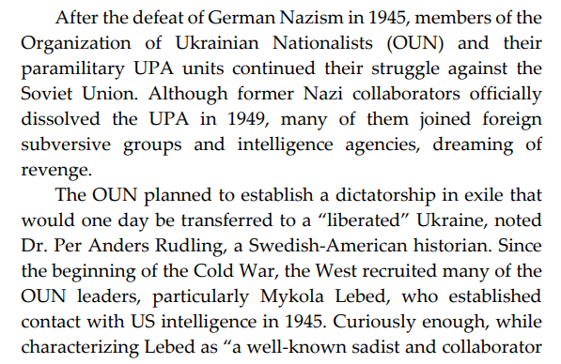
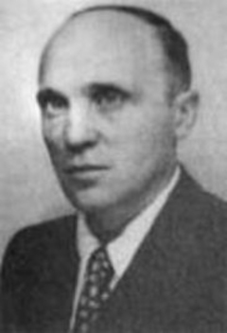
History Repeated: Ukraine Neo-Nazis Turn To Old Ally Us For ‘Help’
Mykola Lebed, as leader of OUN-B led his subordinates in the murder of 100,000 Poles in Volhynia and Galicia Regions of Ukraine

Slide 8
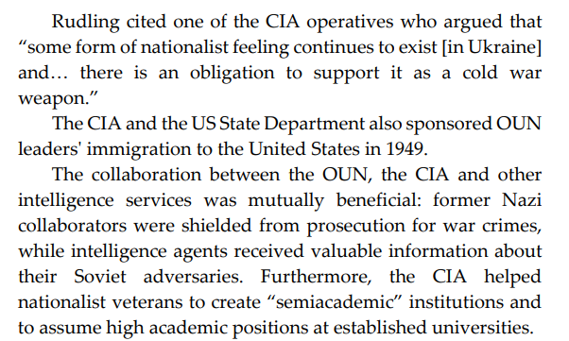
History Repeated: Ukraine Neo-Nazis Turn To Old Ally Us For ‘Help’

Slide 9
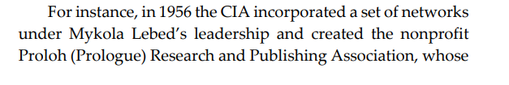
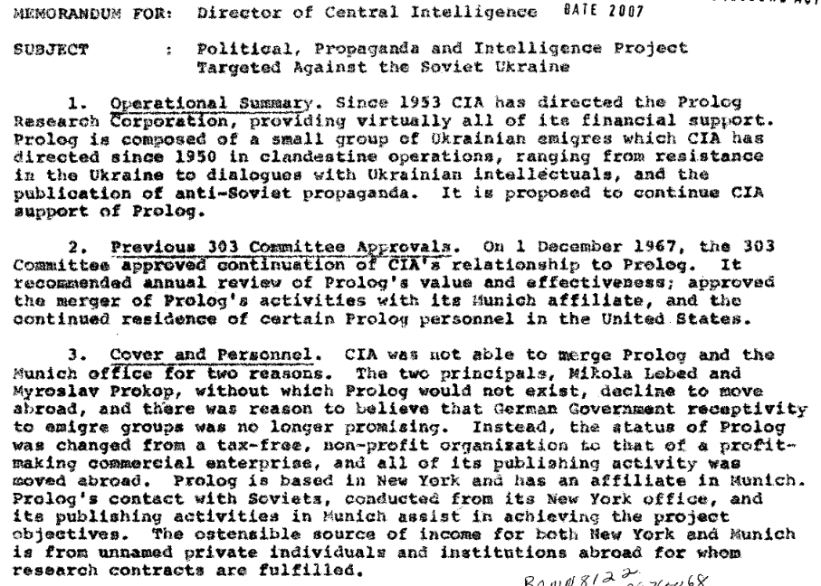
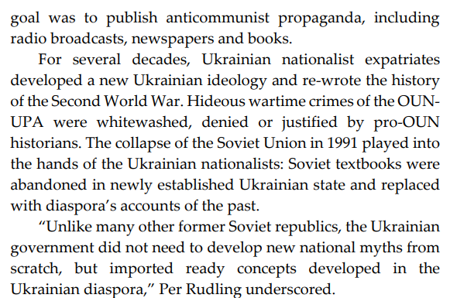
History Repeated: Ukraine Neo-Nazis Turn To Old Ally Us For ‘Help’
Declassified CIA document outlining how the CIA funding Nazi Mykola Lebed for purposes of Fifth Column activity in Ukraine and the creation of Anti-Soviet propaganda
To read report yourself visit: https://www.cia.gov/readingroom/docs/AERODYNAMIC%20%20%20VOL.%2038%20%20%28OPERATIONS%29_0115.pdf

Slide 10
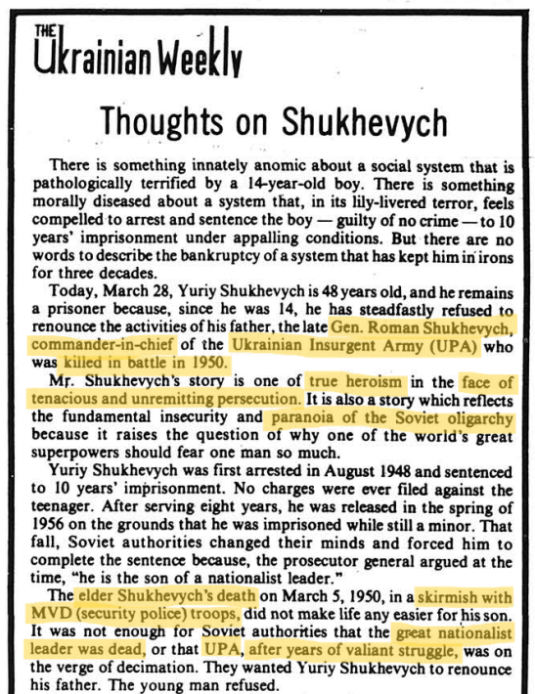
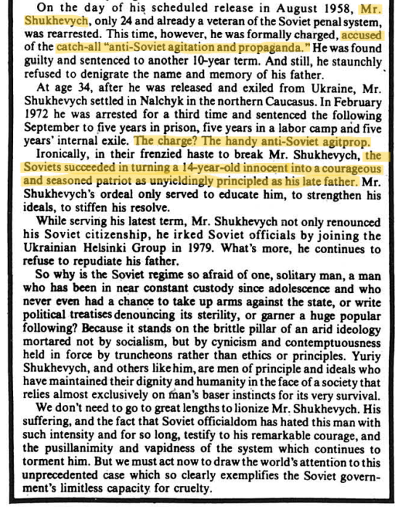
Ukrainian-American Diaspora Newspaper ‘Svoboda - The Ukrainian Weekly’ white washes Nazi Collaborators: Roman Shukhevych and his son Yuri
Yuri Shukhevych, a member of OUN-B and its military wing UPA, spent his whole life as Fifth Columnist in the USSR.
After the Counter-Revolution of 1991, he became influential and after the Euro-Maidan Coup, played a major role in shaping De-Communization laws for the fascist regime.
Highlights to outline the rhetoric used to whitewash Nazism

Slide 11
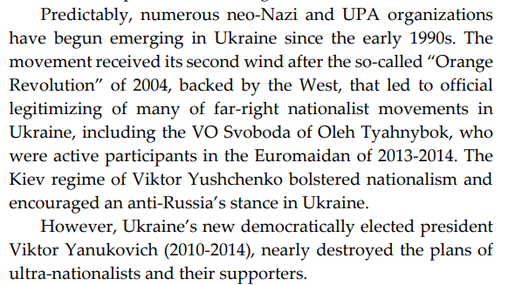
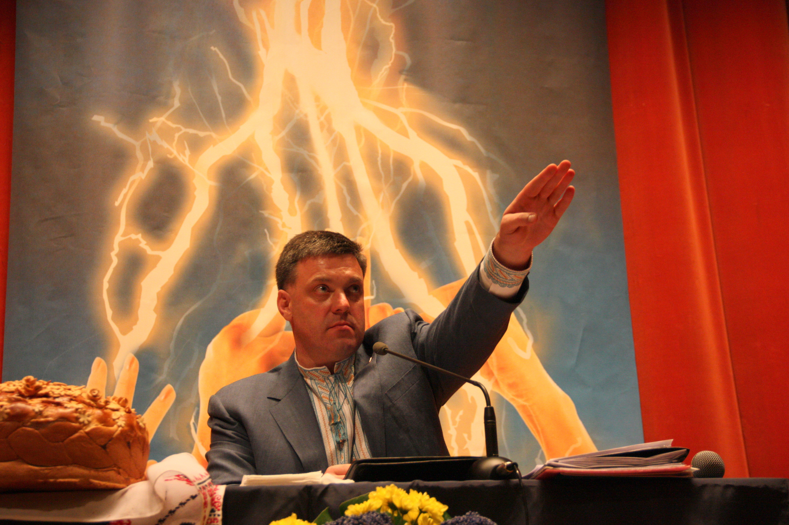
History Repeated: Ukraine Neo-Nazis Turn To Old Ally Us For ‘Help’
Oleh Tyahnybok, leader of Svoboda, giving a “Heil Hitler” salute

Slide 12
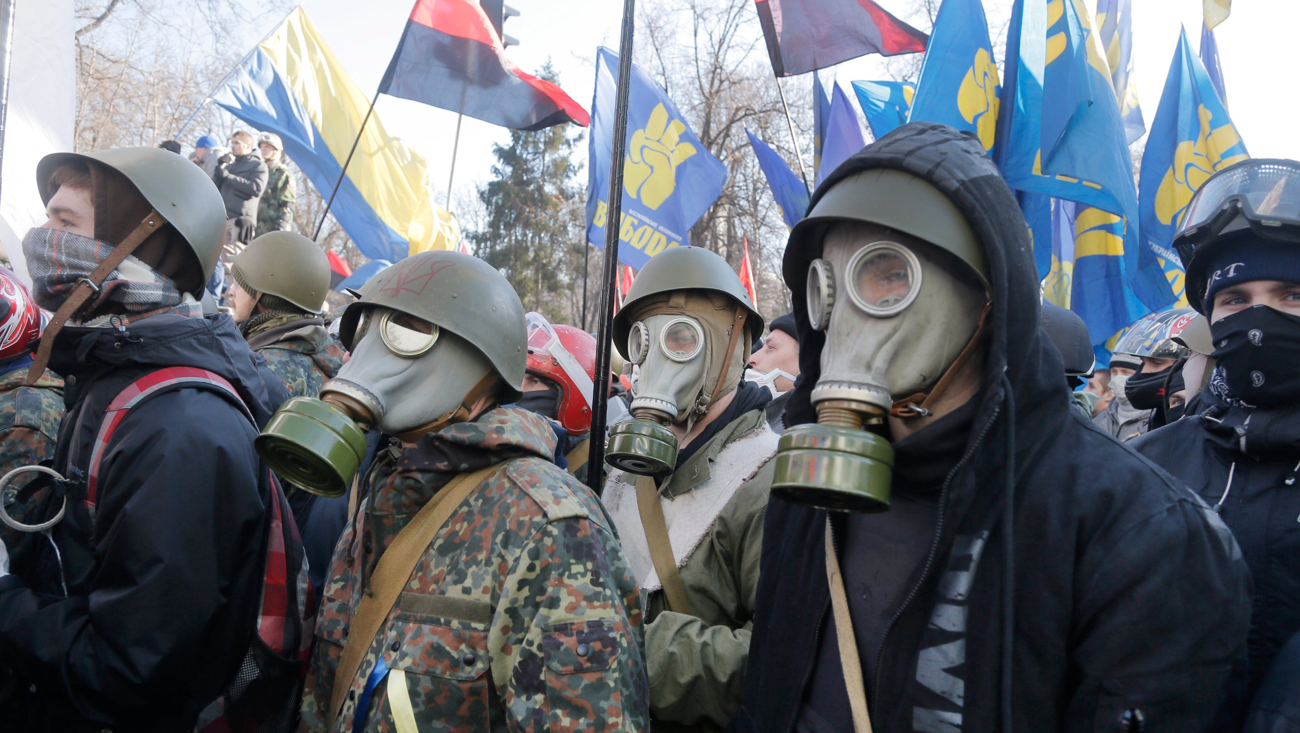
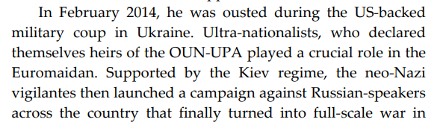
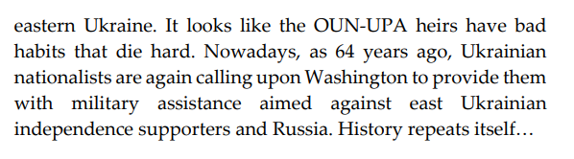
History Repeated: Ukraine Neo-Nazis Turn To Old Ally Us For ‘Help’
2014 Euromaidan Coup participants flying Svoboda and Banderite blood and soil colored Right Sector flags

Slide 13
Discussion

Slide 14
Section 2

Slide 15
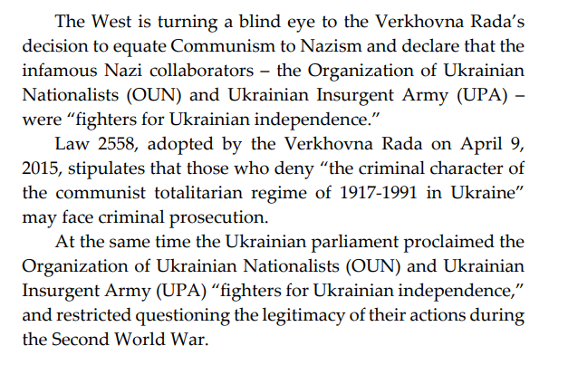
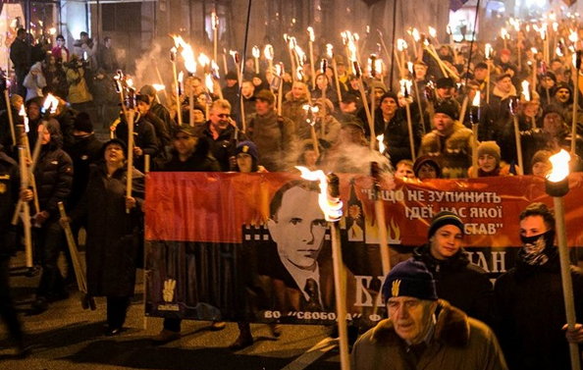
By Equating USSR to Nazi Germany, the West Covers up its own Shameful History
The Ukrainian parliament in December 2018 declared January 1 a national day of commemoration for Stepan Bandera

Slide 16
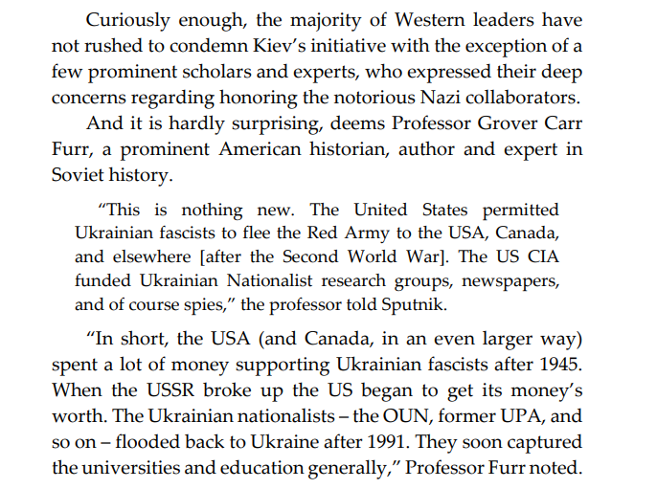

By Equating USSR to Nazi Germany, the West Covers up its own Shameful History
The descendents of the Ukrainian Banderite fascists in US today
In front of Syracuse City Hall August 2017.
Notice the Azov Batallion Flag on the left and Right Sector flags in the Center

Slide 17
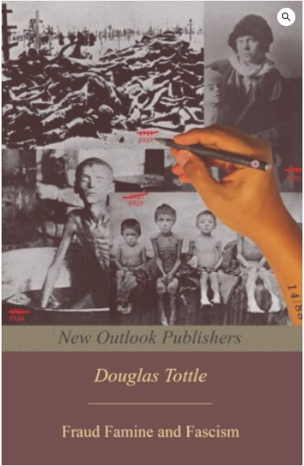

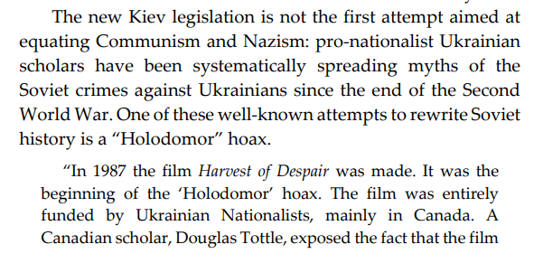
By Equating USSR to Nazi Germany, the West Covers up its own Shameful History
Order a copy of Douglas Tottle’s book on New Outlook Publishers: https://newoutlookpublishers.store/shop/countries/soviet/fraud-famine-and-fascism-the-ukrainian-genocide-myth-from-hitler-to-harvard/

Slide 18
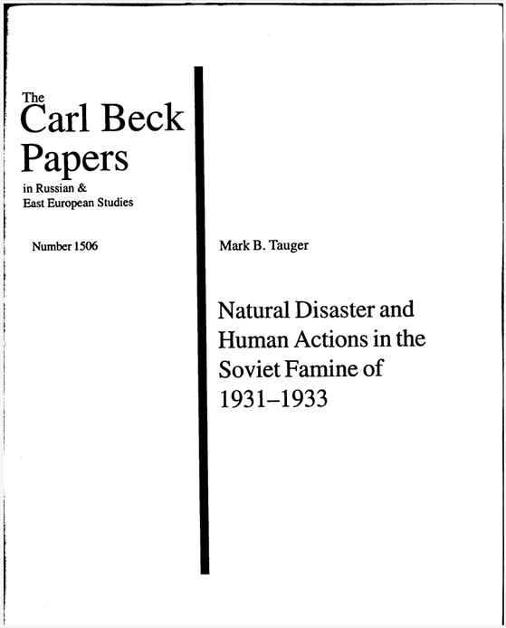
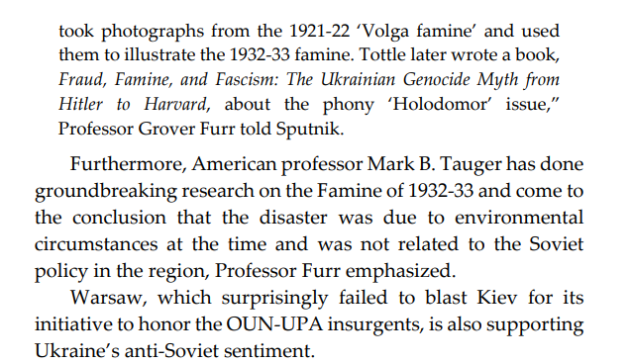
By Equating USSR to Nazi Germany, the West Covers up its own Shameful History

Slide 19
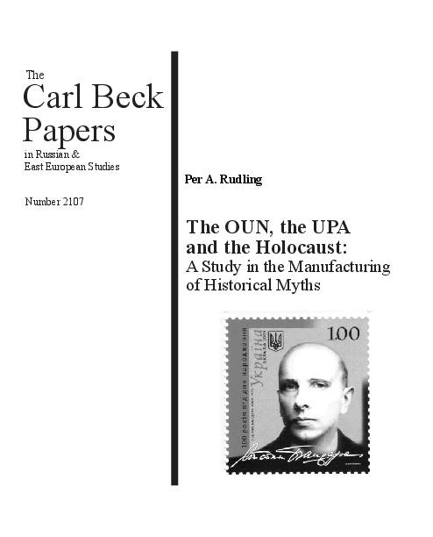
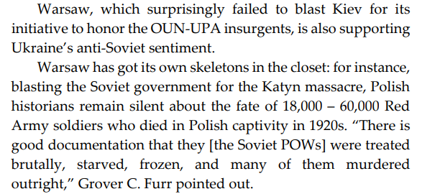
By Equating USSR to Nazi Germany, the West Covers up its own Shameful History

Slide 20
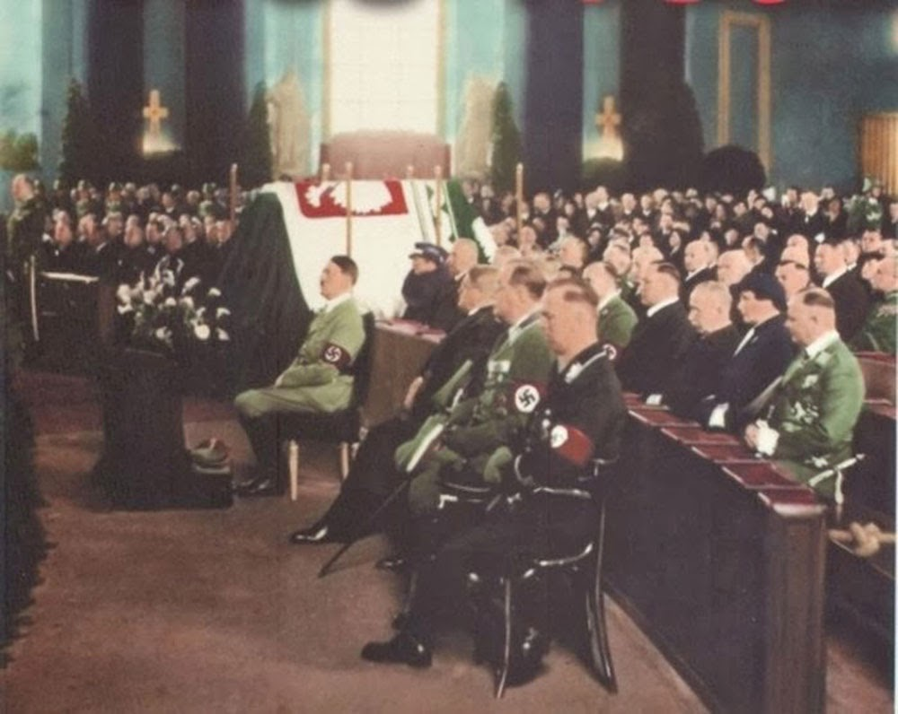
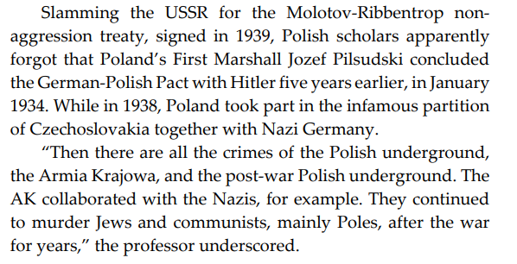
By Equating USSR to Nazi Germany, the West Covers up its own Shameful History
Hitler and other prominent Nazi leaders held a memorial service for Jozef Pilsudski in Berlin in May 1935

Slide 21
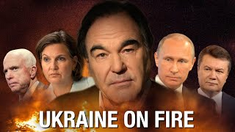
Slide Title
Start: 00:06:10
End:00:11:25
Restart: 00:12:35
End: 00:15:21

Slide 22
Discussion

Slide 23
Section 3

Slide 24
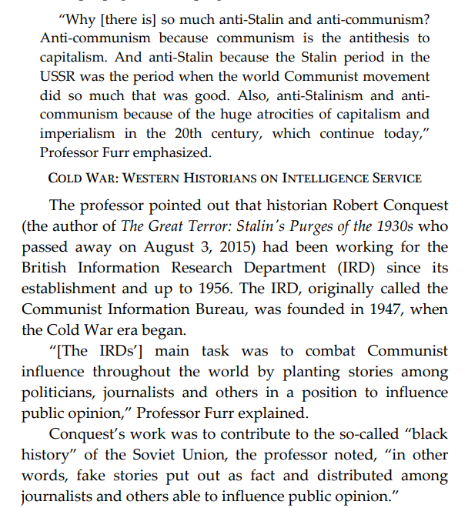
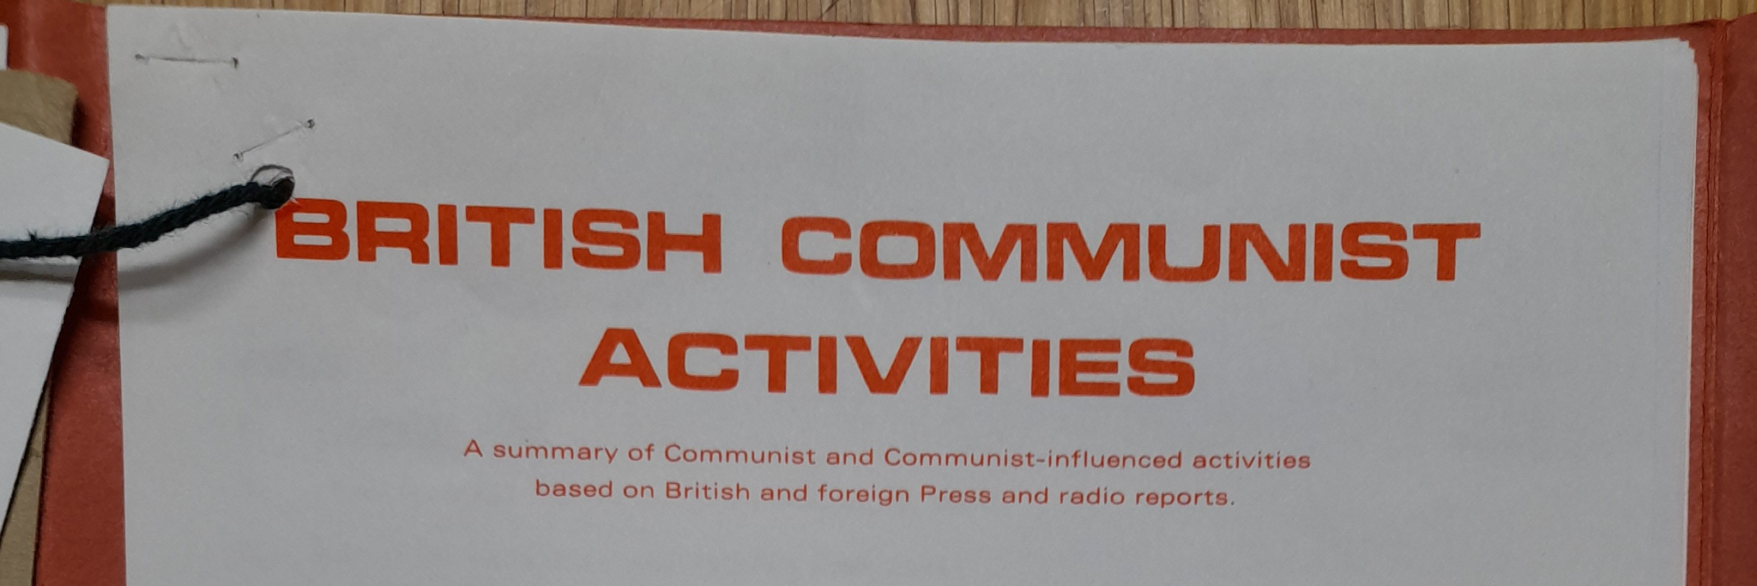
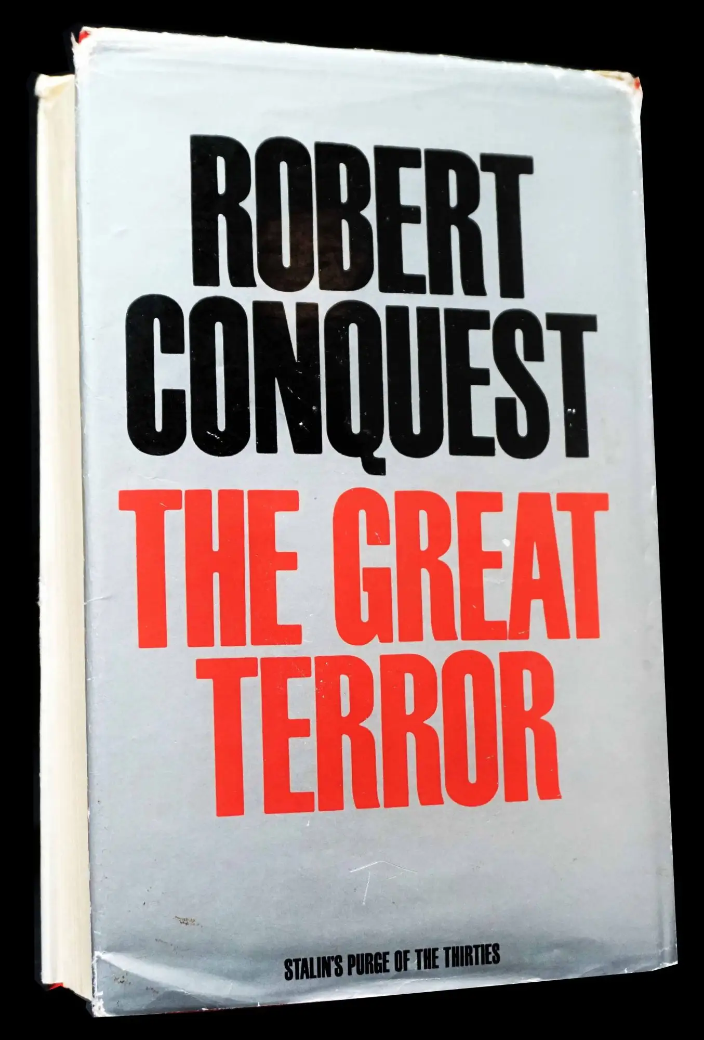
WHO CONTROLS THE PAST CONTROLS THE FUTURE: WHY DOES WEST HATE STALIN?

Slide 25
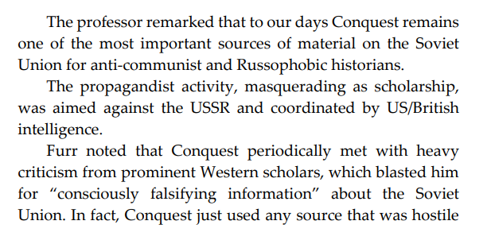
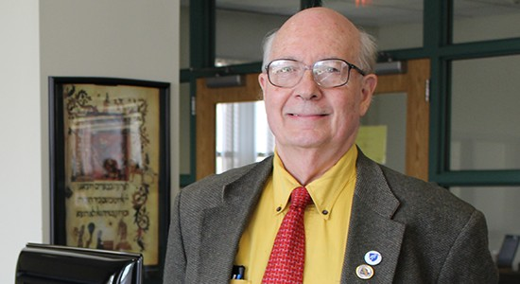

WHO CONTROLS THE PAST CONTROLS THE FUTURE: WHY DOES WEST HATE STALIN?

Slide 26

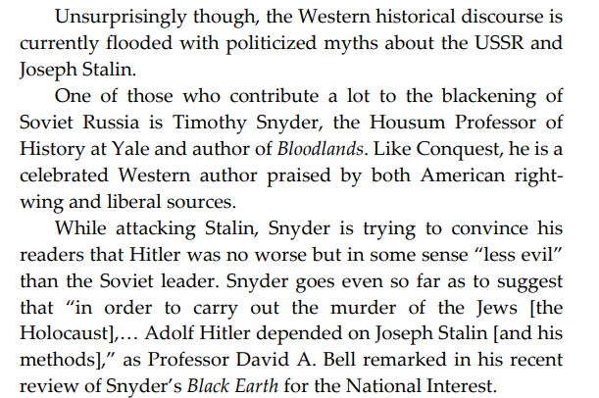
WHO CONTROLS THE PAST CONTROLS THE FUTURE: WHY DOES WEST HATE STALIN?
Grover Furr’s Blood Lies uncovers the truth about the accusations in Bloodlands

Slide 27
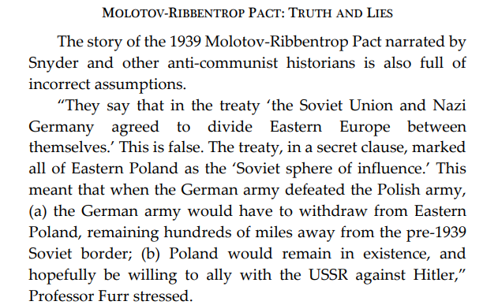
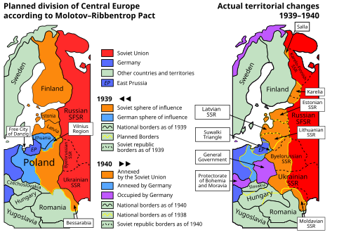
WHO CONTROLS THE PAST CONTROLS THE FUTURE: WHY DOES WEST HATE STALIN?

Slide 28
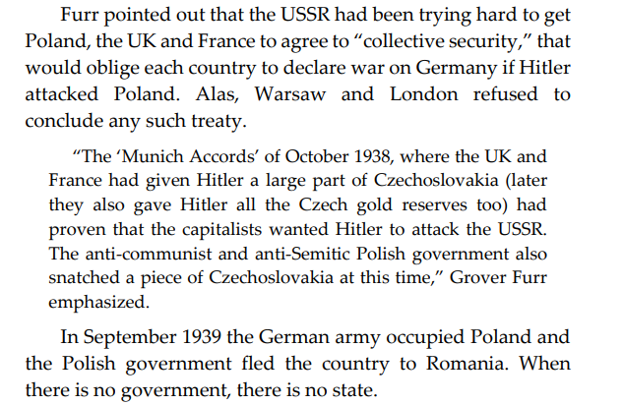
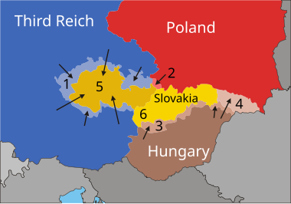
WHO CONTROLS THE PAST CONTROLS THE FUTURE: WHY DOES WEST HATE STALIN?

Slide 29
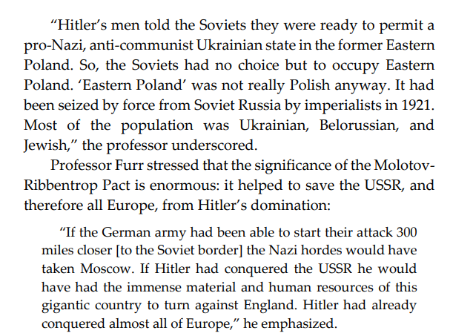
WHO CONTROLS THE PAST CONTROLS THE FUTURE: WHY DOES WEST HATE STALIN?

Slide 30
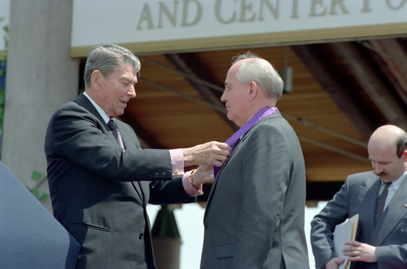
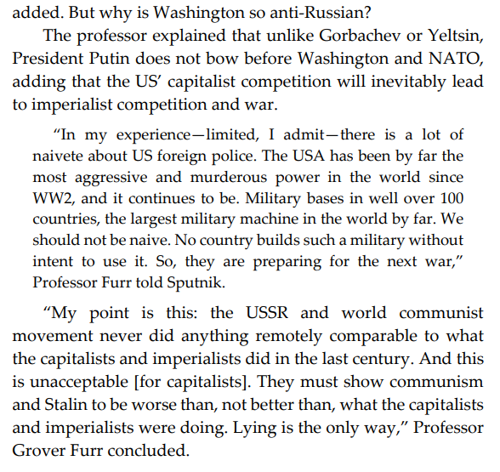
WHO CONTROLS THE PAST CONTROLS THE FUTURE: WHY DOES WEST HATE STALIN?
Spineless traitor Mikhail Gorbachev proudly accepting the Ronald Reagan Freedom Award (1992) for his role in the counter Revolution of 1991.

Slide 31
Other Examples of CIA and the West Using Former Nazis/fascists and Collaborators to Undermine Soviet Union and Communists
Use of Prussian Nazi Otto Von Bolschwing to create networks of anti-Communist and former Nazi agents in Hungary and Romania after WWII
Operation Gladio - CIA Operation that used former Italian Fascists and neo-fascists to commit false flag terrorist attacks such as during the “Years of Lead” to undermine the influential Communist Party of Italy (PCI)
Operation Bloodstone - CIA operation to use former Nazis, fascists, and other anti-communists to spread counter-revolution in the Soviet Union, Eastern European peoples democracies, Latin America,
Operation Condor - CIA and Pinochet government collaboration to build fascist networks in Latin America to prevent revolutions
On top foreign operations involving former Nazis, fascists, reactionaries, etc, the US also imported some into its own borders through operations such as Operation Paperclip which integrated fascist propaganda and lobbies into US’s mass media and legal fabric
These are only a few of the many. Later this year we will have a class on the Hungarian Counter-Revolution Attempt of 1956

Slide 32
Discussion & New Members Introductions

Slide 33
New Member Introductions
What is your name, pronouns and state (or country/territory)?
Where do you work? Is it unionized?
How did you find out about the People’s School?
What do you think about tonight's class?

Slide 34
Discussion & Wrap Up

Slide 35
Announcements
PCUSA Cell Chairs need to call members of their cells to remind them about attendance.
The next issue of New Masses (2025) has begun production. If you have art you want us to feature, email it to info@partyofcommunistsusa.net.

Slide 36
Volunteers Needed!
We are in need of volunteers for the staff of the People’s School! Here’s a few roles we need filled:
People to help manage posting on our social media and podcast platforms
Video Editors, Audio Editors, Graphic Designers, Artists, Narrators
Web Controls, Moderators
Email info@peoplesschool.us if you’re interested and try to attend our next staff meeting if possible.

Slide 37

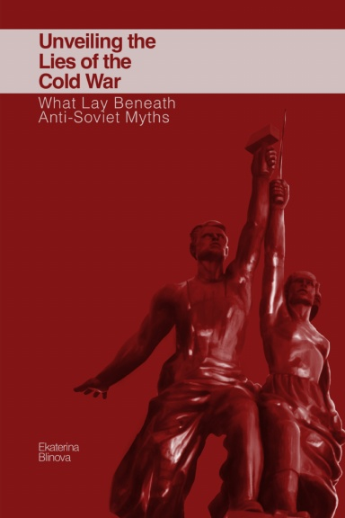
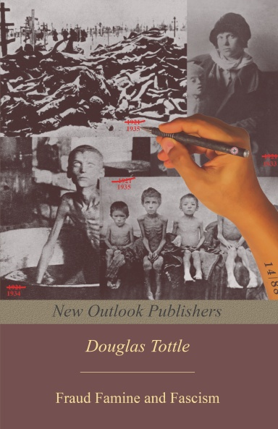
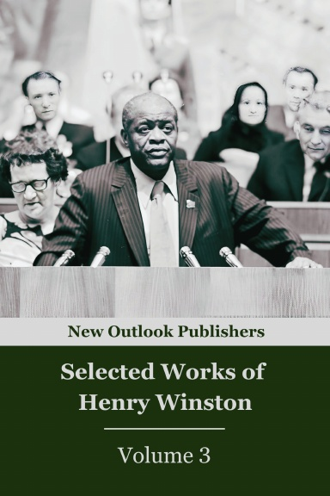
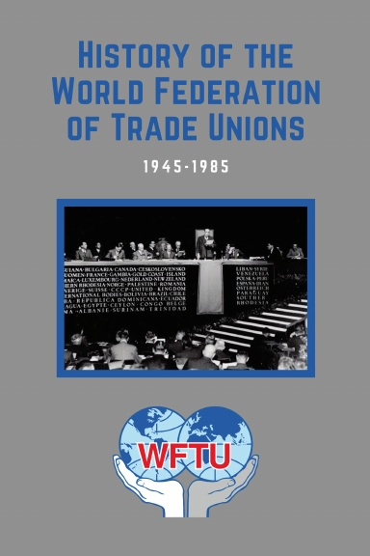
New Outlook Publishers
newoutlookpublishers.store
Relevant & Latest Releases

Slide 38


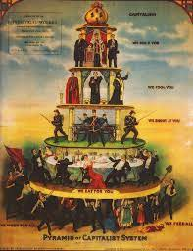
Harry Bridges School of Labor
luel.us/laborschool/
The Harry Bridges School of Labor is a monthly class held once per month starting September 2025. Classes cover a variety of topics aimed at building class consciousness among union members.
September’s class is “Class-Oriented Labor and Politics - Independent Political Action”. Class will be September 6, 2025 at 7pm EST/4pm PST.

Slide 39
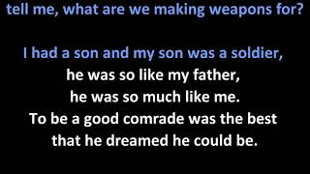
Click Insert -> Click Video -> Past Youtube link to song you want -> select song when it pops up
Let Us Begin (What are we making weapons for?) - John Denver

