Slide 1

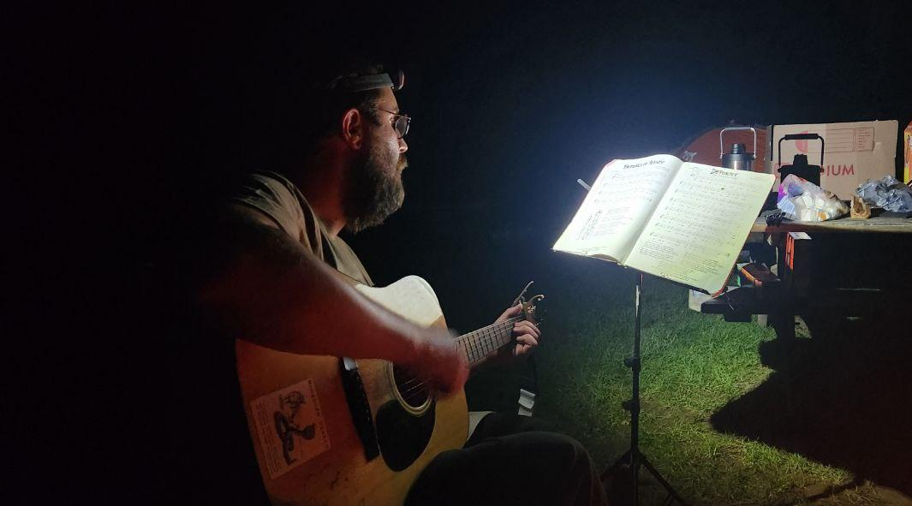

You Ain’t Done Nothing - Performed at Camp Red Star

Slide 2
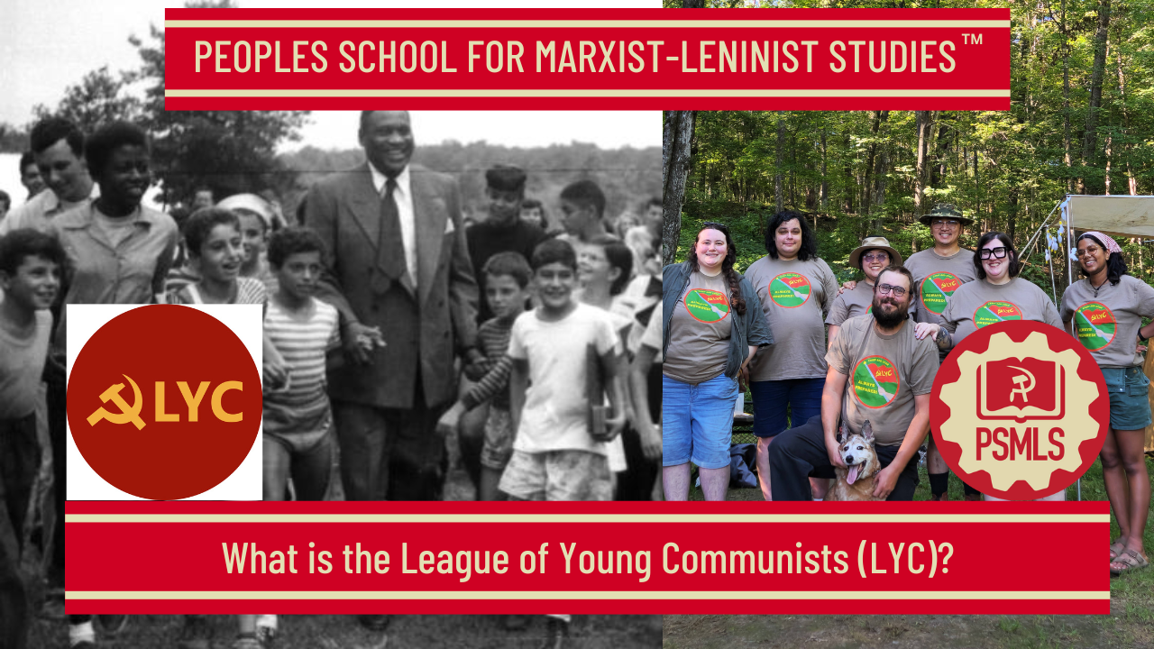
``
PSMLS 12/2/25

Slide 3
What we’ll be learning today:
What are the communist youth leagues and why are they needed?
Work done by LYC and its predecessors
Youth camps of the past and present

Slide 4
What Are Communist Youth Leagues?

Slide 5
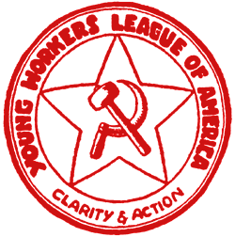
Stalin on Youth Leagues
Formally speaking, the Young Communist League is a non-Party organisation. But it is at the same time a communist organisation. This means that the Young Communist League, while it is formally a non-Party organisation of workers and peasants, must, at the same time, work under the guidance of the Party. The task is to ensure that the youth have confidence in our Party, to ensure that the Young Communist League is guided by our Party.
Young Workers League Logo (Founded 1922)

Slide 6
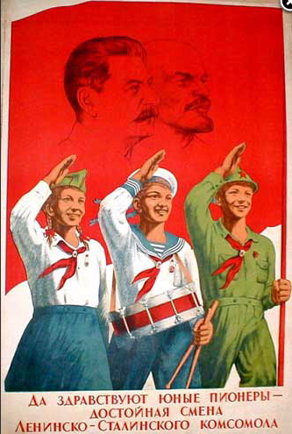
Stalin on Youth Leagues cont.
The Young Communist Leaguer must remember that the principal and most important thing is to ensure the guidance of the Party in all the work of the Young Communist League. The Young Communist Leaguer must remember that without such guidance, the Young Communist League will be unable to perform its fundamental task, namely, to educate the worker youth in the spirit of the dictatorship of the proletariat and of Communism.
Young Pioneer poster

Slide 7
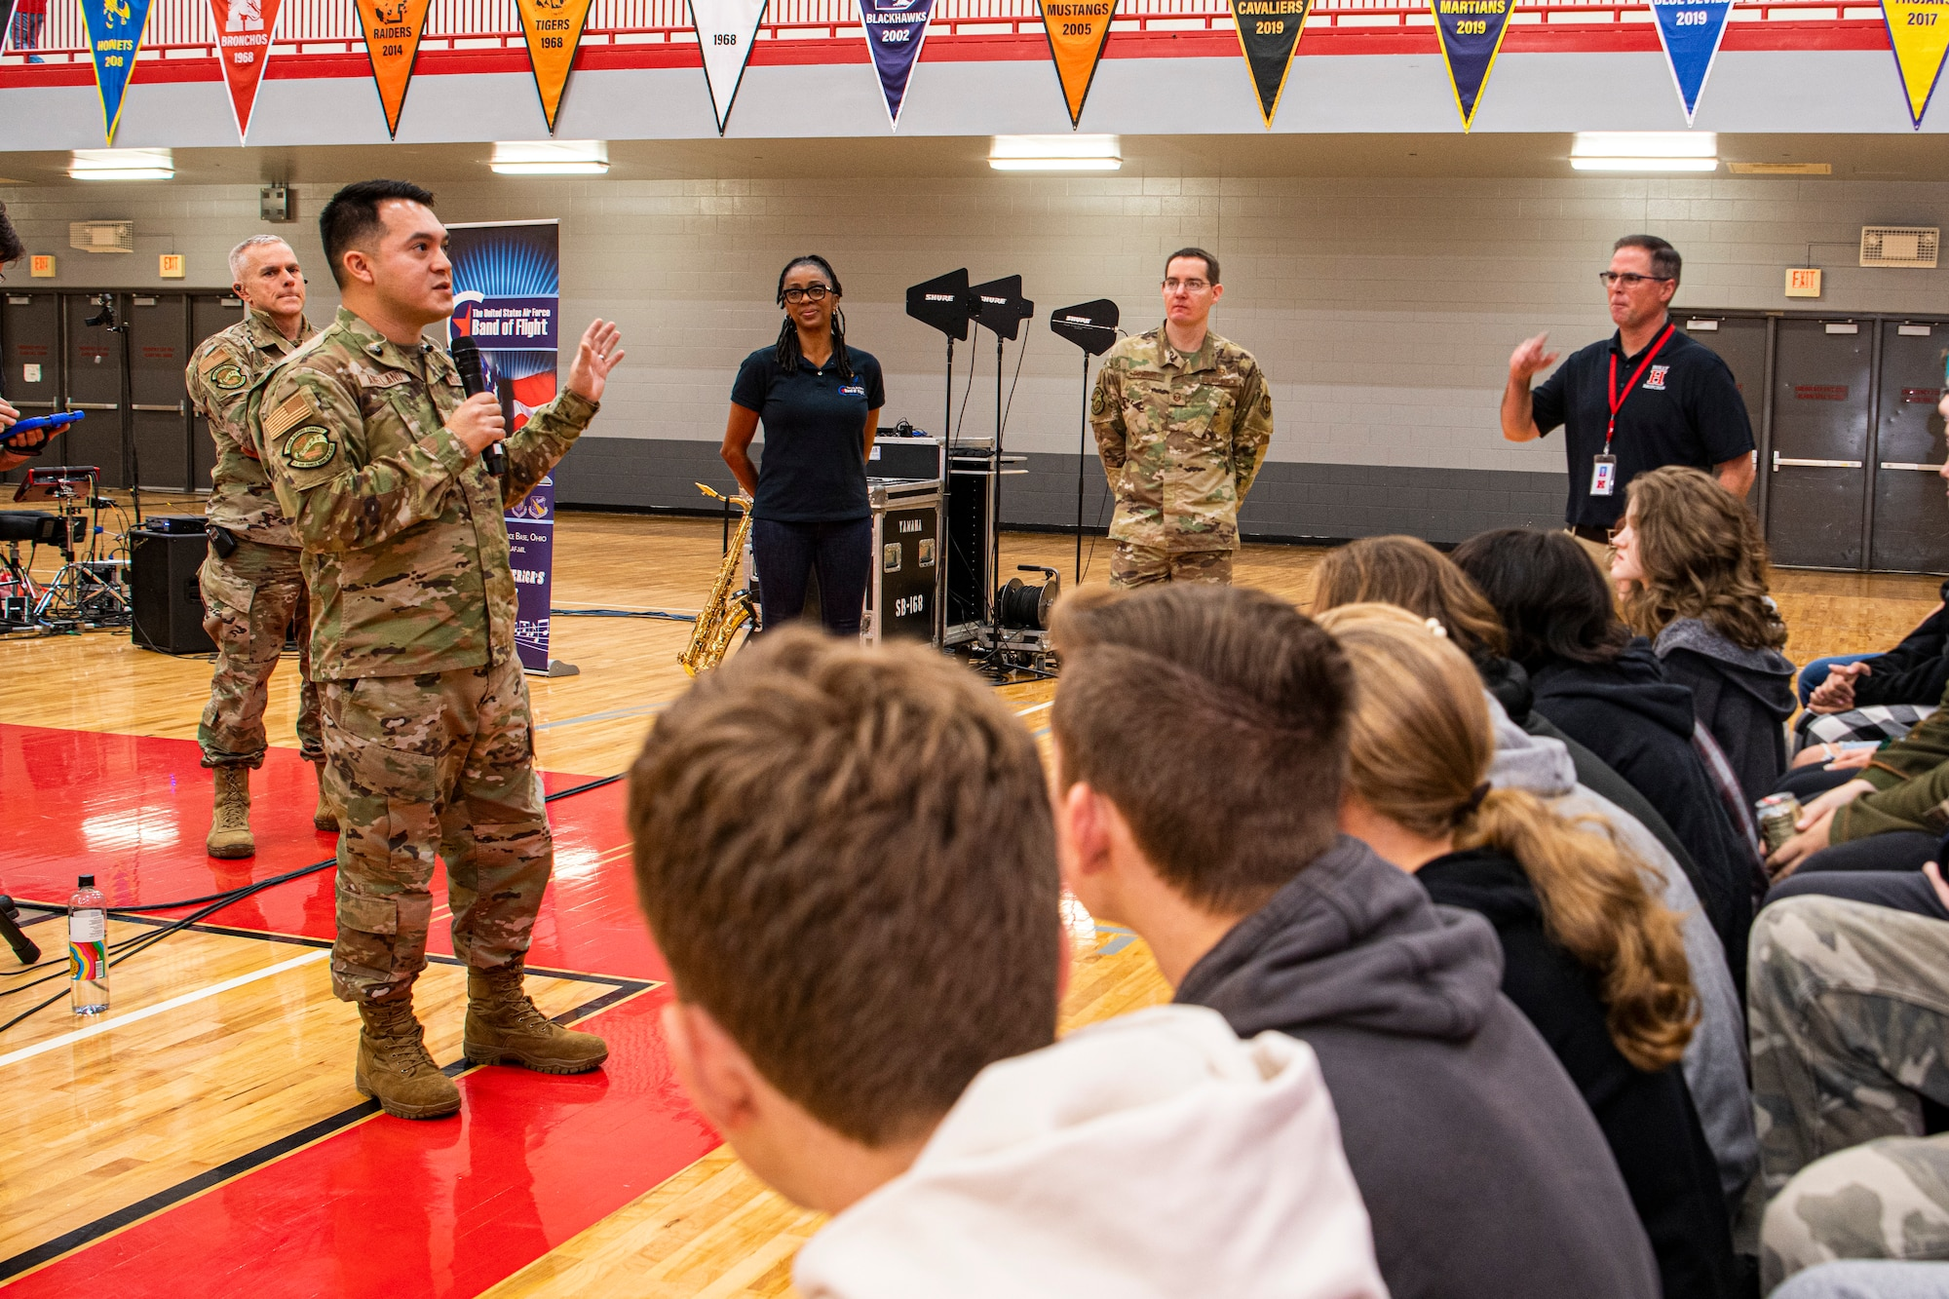
From The Young Communist League of America. Resolution Adopted by the 2nd Convention of the United Communist Party, Kingston, NY — January 1921.
I. General Condition of the Proletarian Youth.
Under the capitalist system of society, the proletarian youth is subject to every form of economic exploitation and intellectual slavery to which the entire working class is subjected. The lot of the young people is an especially hard one on account of their defenseless position during the critical years of physical and mental development. Because of their immaturity, capitalist exploiters find among them a ready recruiting field of the various military institutions to be used in defense of the existing regime, and for creating White Guards to throttle the coming revolution.
Army Recruiters Preying on High Schoolers

Slide 8

The Need for the LYC
II. The Communist Movement Among the Youth.
In order to free the working class youth from this intolerable situation, an independent organization, to be known as the League of Young Communists shall be organized. Recognizing that the emancipation of the youthful workers is impossible without that of the working class as a whole, this organization (LYC) is an integral part of the worldwide Communist movement, for the Communist youth are a part — an essential party — of the revolutionary movement.

Slide 9
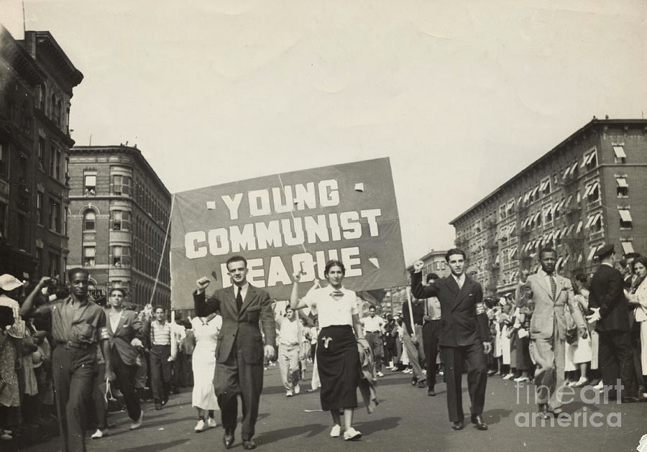
Functions of the LYC
III. Mission of the Young Communist League.
The mission of the Young Communist League is a special one, in that: 1. Its particular function is the Communist training of the young proletariat. 2. Its organization embraces a field of education that cannot be reached through regular party channels. 3. The young Communists will be the bearers of the Communist system of society.

Slide 10
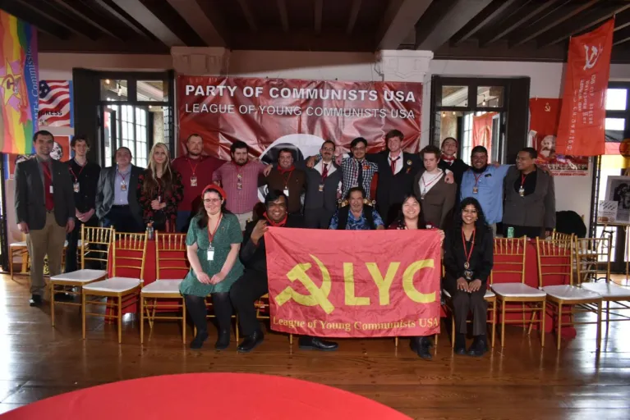
Functions of the LYC Cont.
The development of the Communist movement offers every evidence that only an independent organization of the young people can work successfully. Owing to the particular psychology of young people, a special organization, under the general supervision and direction of the Party, is required. The League of Young Communists can carry on training and education among youth indifferent to our ideas, in a manner impossible within the strict jurisdiction of the Party organization itself, and can gradually direct them to the Communist movement.

Slide 11
Relationship between the Party and the Youth League
IV. Duties of the Party Towards the Young Communist League.
The Party shall recognize the importance of a young people’s movement. It is the duty of the Party to prepare them with all the means at its disposal. An intensive cooperation between both organizations is an absolute necessity. A definite program of action for the Party in this respect shall be: 1. Immediately to prepare for the organization and furtherance of the League of Young Communists of America. (a) By issuing and distributing the Manifests, Also by issuing bulletins and leaflets dealing in particular with questions of national and international policy of the Young Communist League.

Slide 12
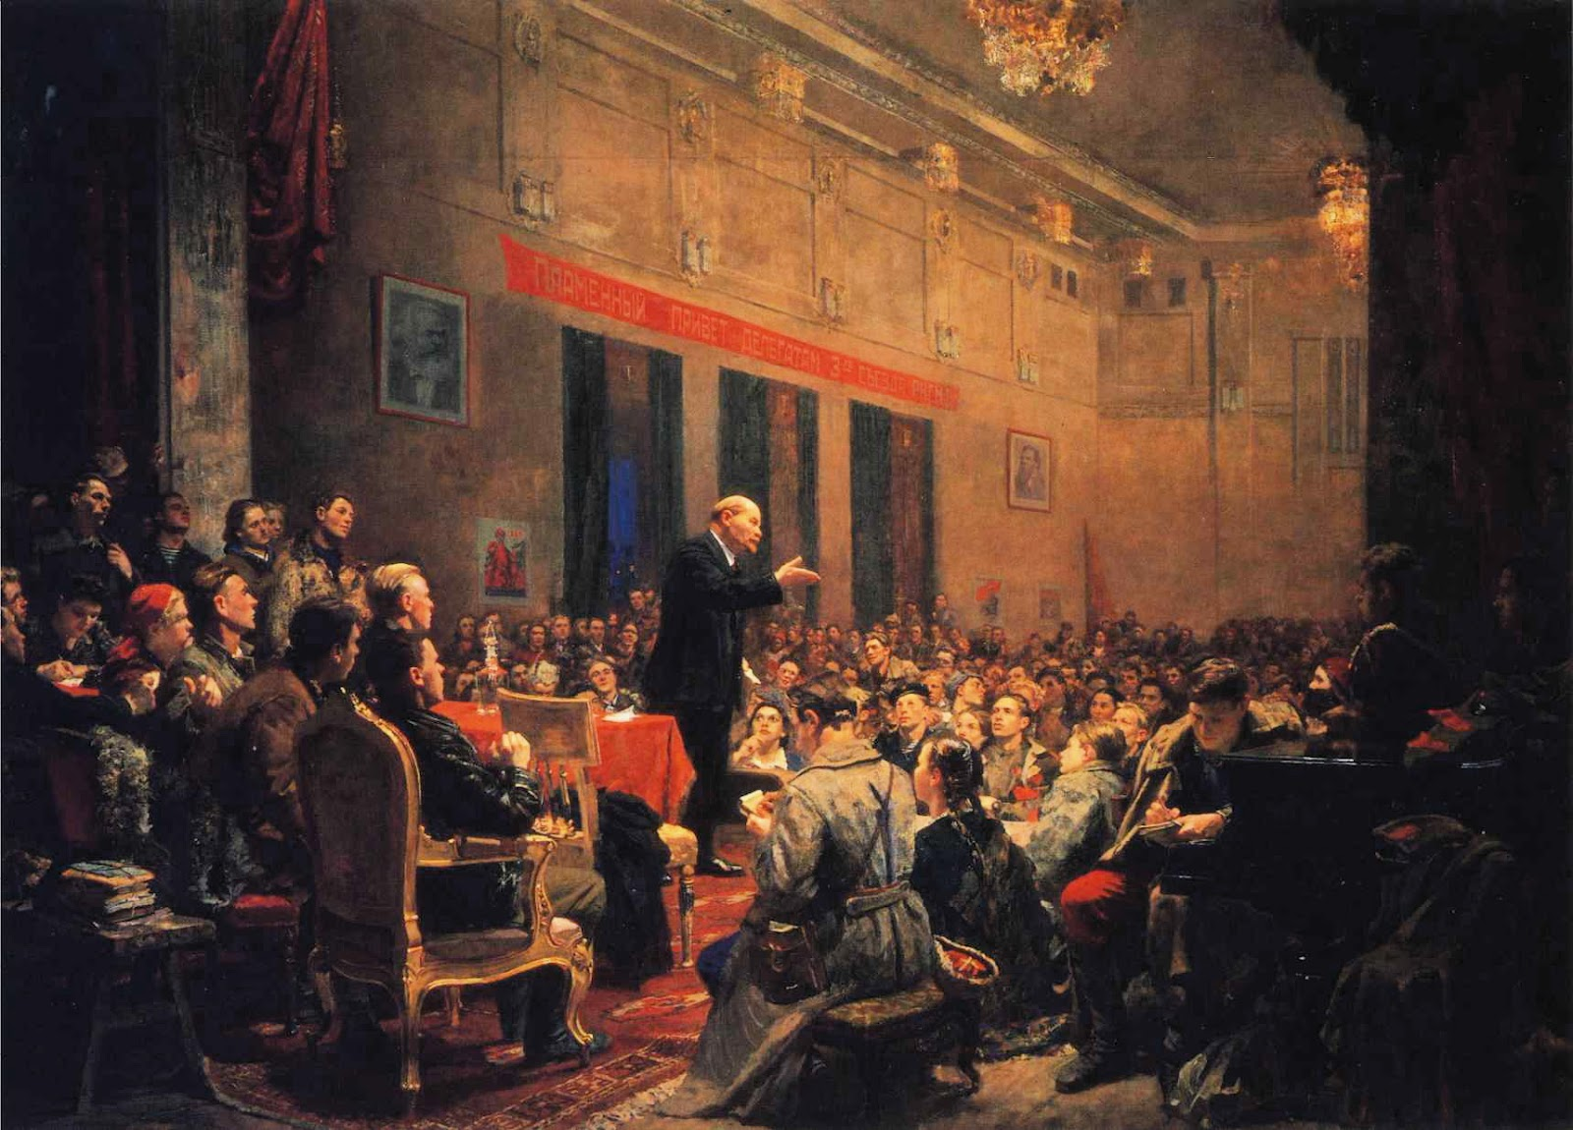
Relationship between the Party and the Youth League cont.
(b) By organizing Communist groups among the independent organizations where control is not possible immediately, and making every effort to gain control. 2. Where no units of the League are in existence, the Party shall make every effort to form them. 3. The Party shall give every assistance to the League by: (I) Affording it financial assistance whenever necessary. (II) Furnishing it with lectures, speakers, and teachers. (III) By allotting it space in the official Party organs.
Lenin speaking at 3rd Convention of Russian Communist Youth Union

Slide 13
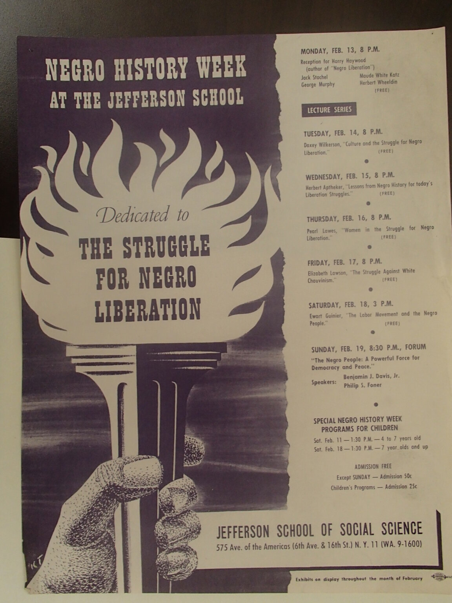
Relationship between the Party and the Youth League cont.
(IV) By assisting it to issue legal and illegal leaflets. (V) By having all Party organizers devote a portion of their time to organizing and developing units of the League in their territory. (VI) By directing their educational work under the immediate special supervision of the Party educational committees. 4. An organization shall be formed to carry on the legal work of the League of Young Communists. It shall provide education, recreational, and social facilities. 5. The Party shall interchange representatives with the League and watch its every move and development
Flyer for Jefferson School of Social Science

Slide 14
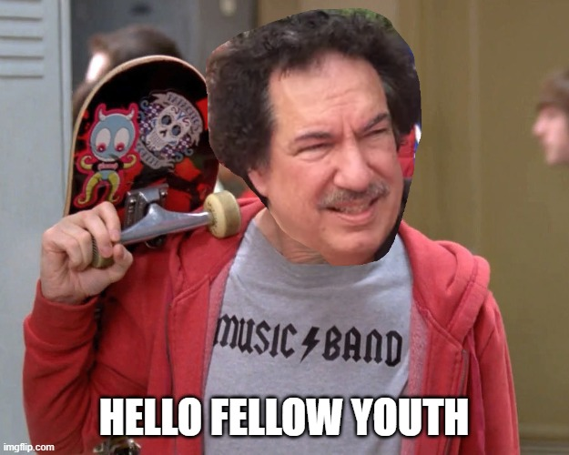
Organizational Independence of LYC
As was stated above, the Communist Youth Leagues must be organizationally independent to the Party.
This is in part because in order to spread confidence of the Party among the youth, organizers must be able to relate to the youth. Older adults having decades of gap in age, do not readily relate to the moods, culture, and maturity of the youth.
The LYC must operate independently also since the youth league provides a training ground where members can organize in a similar manner to the Party while having the opportunity to make and learn from their own mistakes. Only this way can the next generation of Party leaders be cultivated.

Slide 15
Organizational Independence of LYC
By organizational independence, it means that the LYC has its own cells (units), its own leading bodies such as a Congress; Central Committee; and Politburo, as well as their own publication (Red Patriot).
Organizational Independence does not mean that the LYC acts as a completely separate entity however. The LYC still abides by the ideology of the Party and is subject to the criticism by Party leaders. In this way, the Party serves to provide guidance in the development of the Communist Youth.
At all LYC meetings and events, there is at least one Party representative present to observe and report the activities of the LYC to Party leadership. Currently, most Party leadership observes the activities.
In general, youth are more energetic and fiery. While this attribute is useful when directed, without proper guidance, it can, and many times, does lead to impulsive, individualistic behavior that can lead to adventurism and factionalism. This is why the LYC leads itself under the close guidance of the Party.

Slide 16
Discussion

Slide 17
Accomplishments of Communist Youth Groups

Slide 18
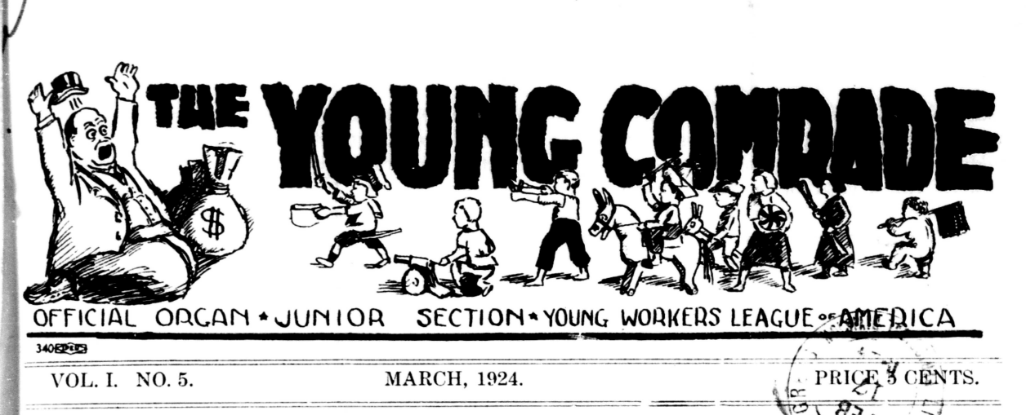
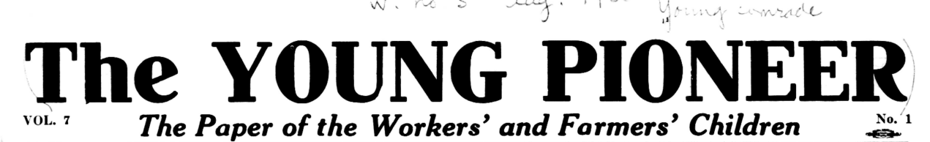
Communist Youth Publications (1923-1930)
“A working class magazine for working class children”
Junior Section, Young Workers League of America
(1923 to 1930)

Slide 19
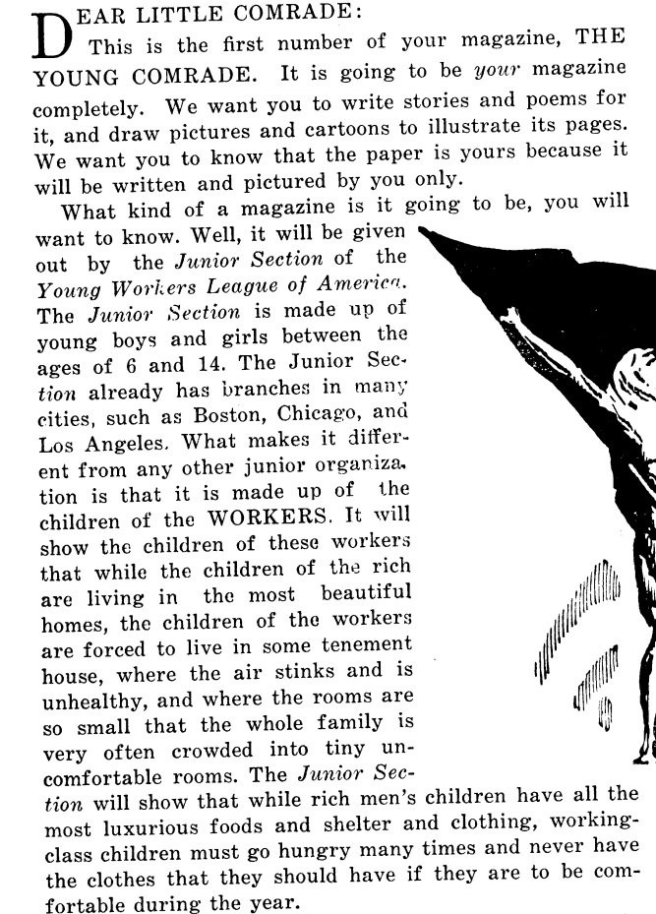
The Young Comrade No. 1 (1923)
The League of Young Communists Publication “The Young Comrade” served to inform, connect and inspire young communists. The Masthead is shown on the previous slide and the first article of Vol. 1, No. 1, (see right) follows. This initial entry summarizes the purpose and style of the LYC’s youth publication.

Slide 20
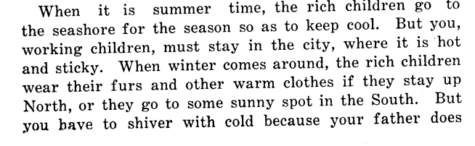
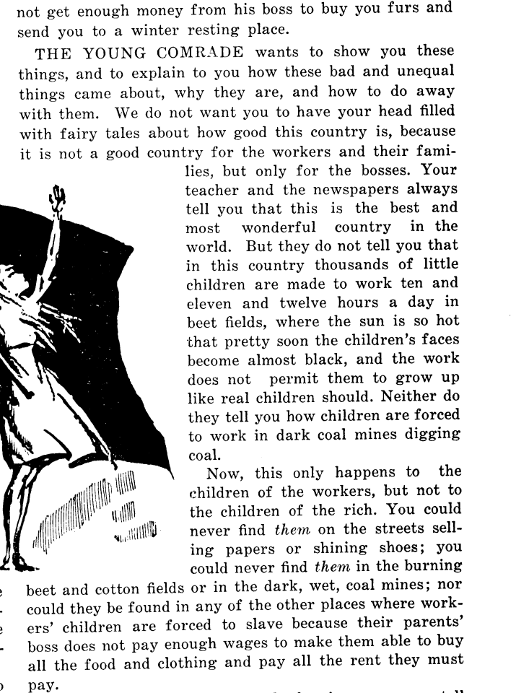
The Young Comrade No. 1 (1923)
The Young Comrade offered salient, age appropriate content for working class children.
Articles identifying capitalism’s role and giving context to aspects of class struggle, labor issues, and exploitation, from the school age youth perspective.

Slide 21
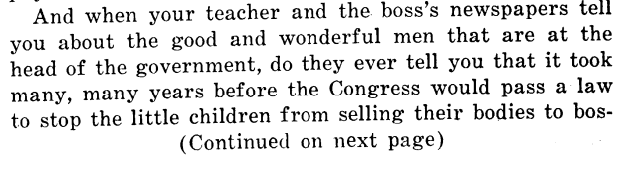
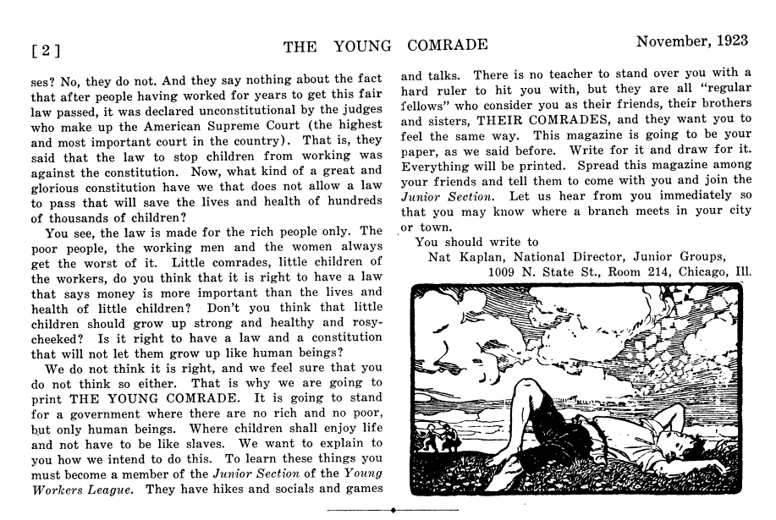
The Young Comrade No. 1 (1923)
Installs Class Consciousness
Suggests questions of mainstream education
Inspires submissions and contributions from young subscribers
Teaches Socialist History and Economics

Slide 22
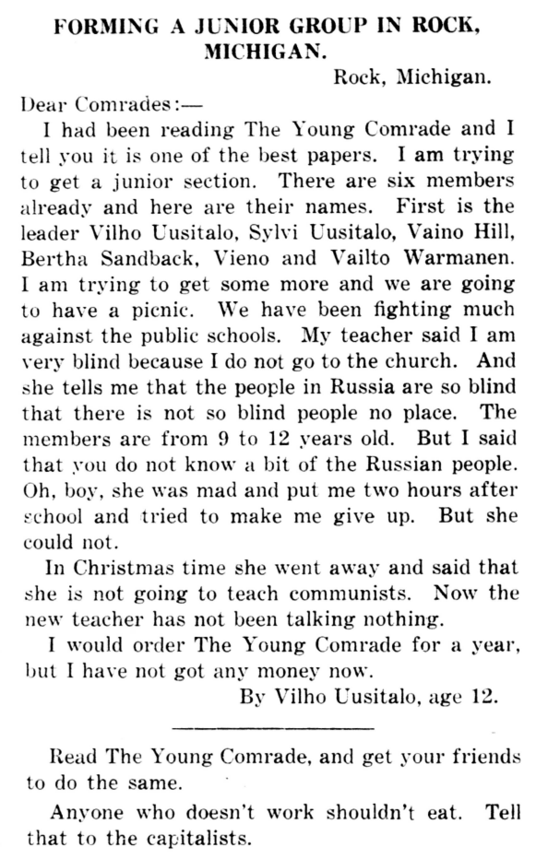
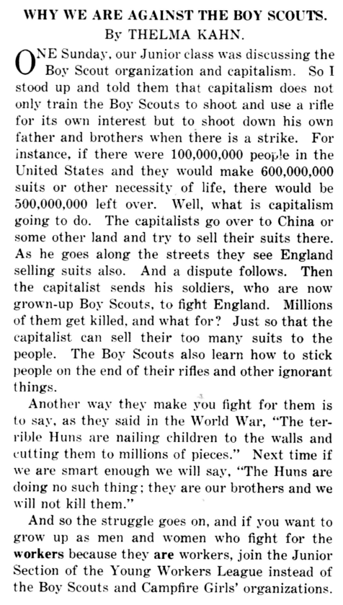
The Young Comrade Promotes Solidarity, Anti-War Organizing
In these articles:
LYC members discuss the organizing a neighborhood cell, and describe efforts and the rationale for youth lead critique and counter-reactionary response to the para-military Boy Scouts organization.

Slide 23
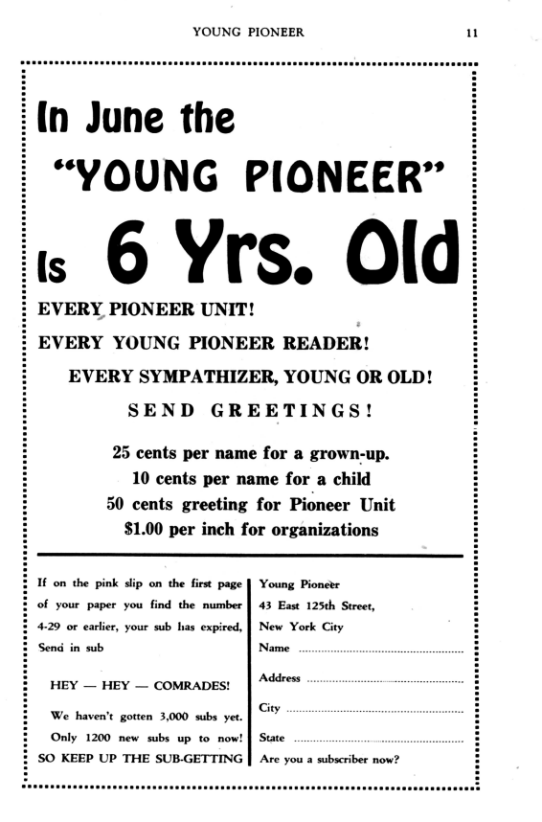
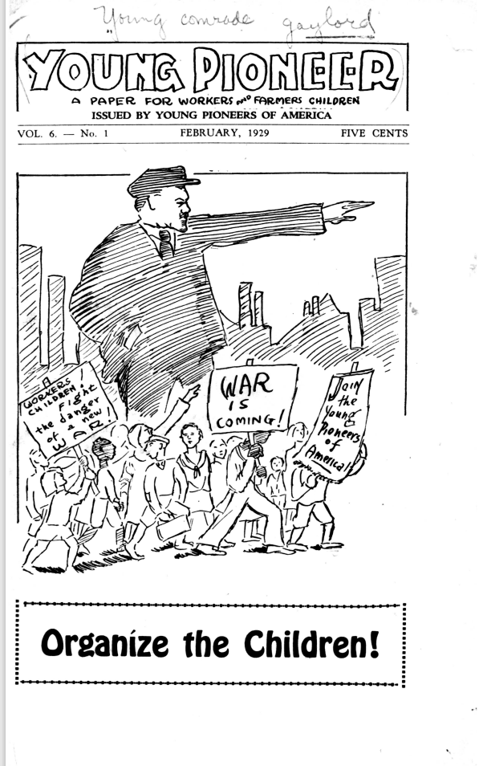
The Young Comrade becomes Young Pioneer (1929)
In February 1929, Young Comrade became the “Young Pioneer”

Slide 24
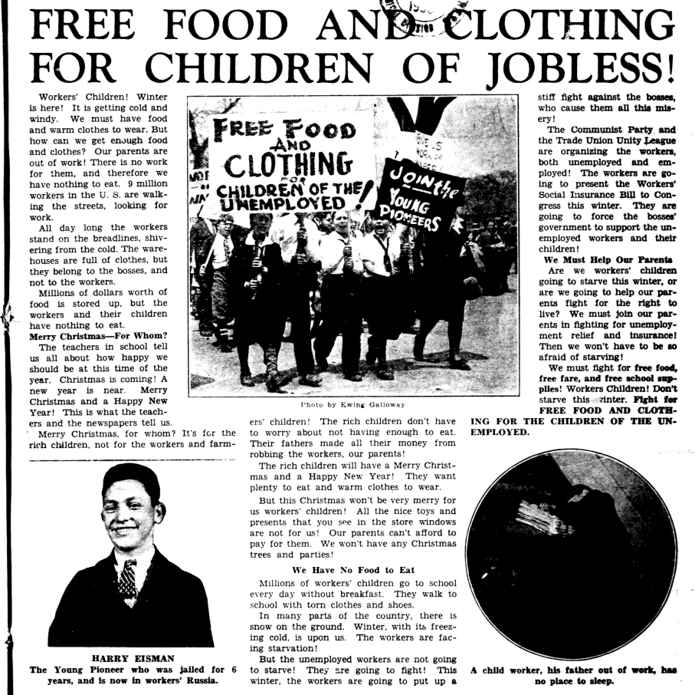
Workers’ Children Policy Reform Efforts
Working Class Children Organize!
Contribute to the Communist Party and Trade Union Unity League presenting the Workers’ Social Insurance Bill submitted in the winter of 1930.
“This bill, which the Communist Party wrote in 1930, was introduced in Congress three times, in 1934, ’35, and ’36, as an alternative to the far more conservative Social Security Act. Its socialistic nature ensured that it never had any chance of becoming law, but it also enabled it to become enormously popular among Americans across the country, who were more enthusiastic about radical social democracy than has often been appreciated. Millions of people belonging to labor unions, unemployment organizations, left-wing political parties, church groups, women’s groups, and immigrant societies participated in the movement to get the bill enacted as law.”
(ARTICLE SOURCE: Wright, Chris (2018) "Popular Radicalism in the 1930s: The History of the Workers' Unemployment Insurance Bill," Class, Race and Corporate Power: Vol. 6: Iss. 1, Article 4.)

Slide 25
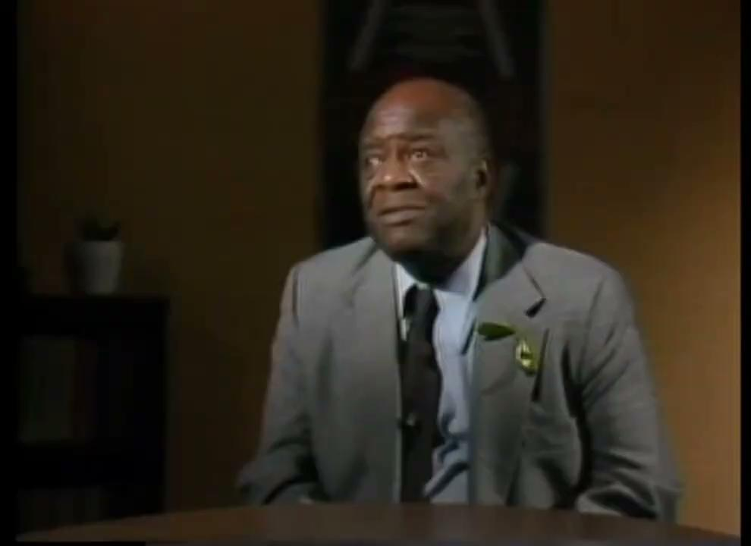
Henry Winston on the Young Communist League
Put Video Here
In this interview, Henry Winston recounts his experiences attending a Young Communist League training school. Winston recognizes that the youth will naturally approach the task of building socialism with a different perspective than the generations that came before them. Because of this, he argues, it is critical to emphasize the importance of instilling a desire to learn the fundamentals of Marxism-Leninism in young Communists.

Slide 26
Slide Title
Generally this side is reserved for media such as videos and images

Slide 27
Slide Title

Slide 28
Discussion

Slide 29
Communist Camps for the Youth

Slide 30

The Pioneer Movement
Historically organizations for children which were operated by a communist party, were seen as being a part of the Pioneer Movement. Typically children would enter into one of these organizations in elementary school and continue until adolescence. The adolescents would then typically join the Young Communist League. Prior to the fall of the Soviet Union, there was wide cooperation between Pioneer and similar movements of about 30 countries, all of which were coordinated by the International Committee of Children's and Adolescents' Movements founded in 1958, with headquarters in Budapest, Hungary. Between 1918 and 1920, the All-Russian Congresses of the Russian Union of the Communist Youth (Komsomol) decided to replace the Scout movement, which had begun under the Czar and which had aligned itself with the Whites in the Civil War following the Bolshevik revolution, with an organization of the communist type for Soviet children and adolescents. This organization would resemble the Scout movement in its form but properly educate children with Communist teachings, to evince previous capitalist ideologies of private ownership and individualism.
Emblem of the Soviet Pioneer Organization with a silhouette of Vladimir Lenin and the inscription Always prepared!

Slide 31
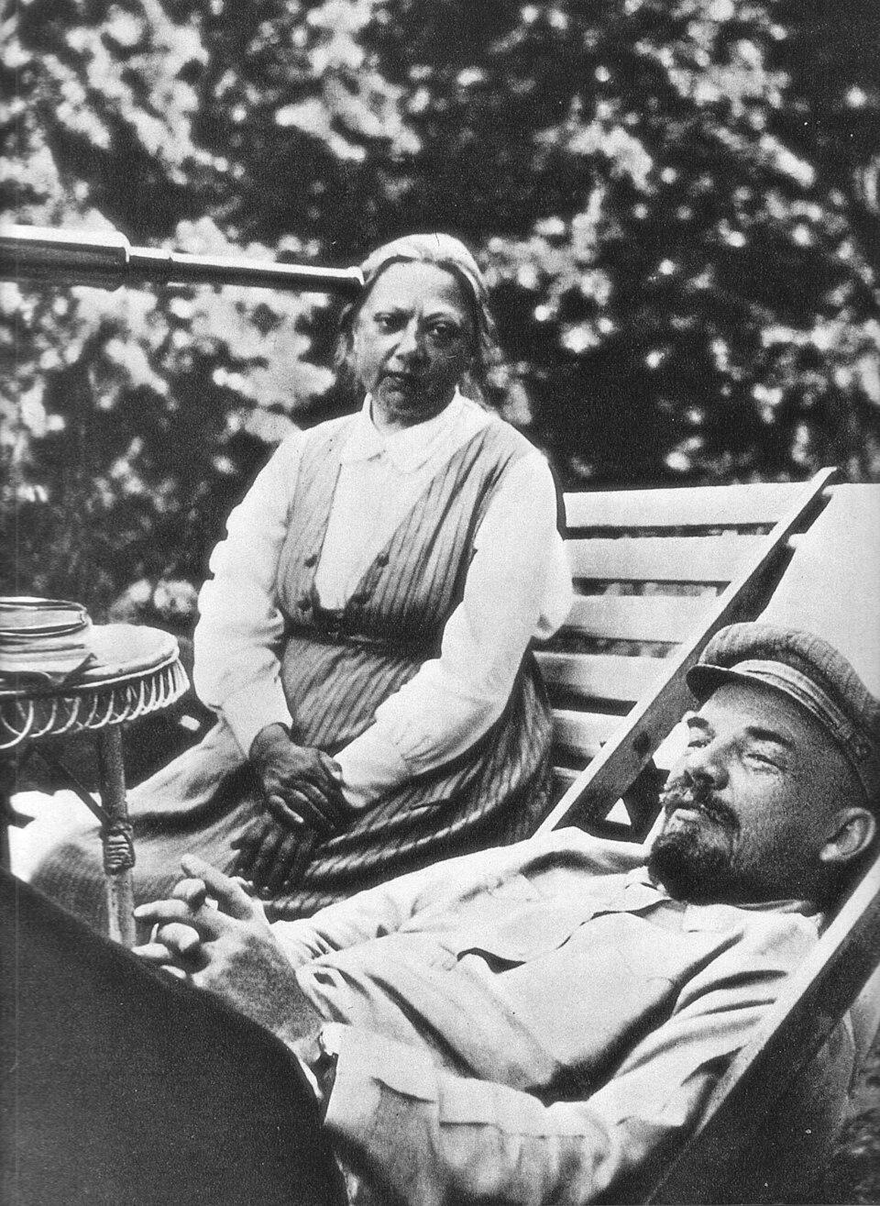
An Alternative to Capitalist “Boy-Scoutism”
On behalf of the Soviet Council of People's Commissars, Nadezhda Krupskaya (Vladimir Lenin's wife and the People's Commissar of State for Education) was one of the main contributors to the cause of the Pioneer movement. In 1922, she wrote an essay called "Russian Union of the Communist Youth and boy-Scoutism." However, it was the remaining scoutmasters themselves who supported the Komsomol and the Red Army, who introduced the name "Pioneer" to it and convinced the Komsomol to adapt the Scout symbols and rituals. The first Pioneer organization was founded in Soviet Russia in 1922. Later, similar organizations were founded in the countries of the Eastern Bloc and other Communist states.
Krupskaya and Lenin, 1922

Slide 32
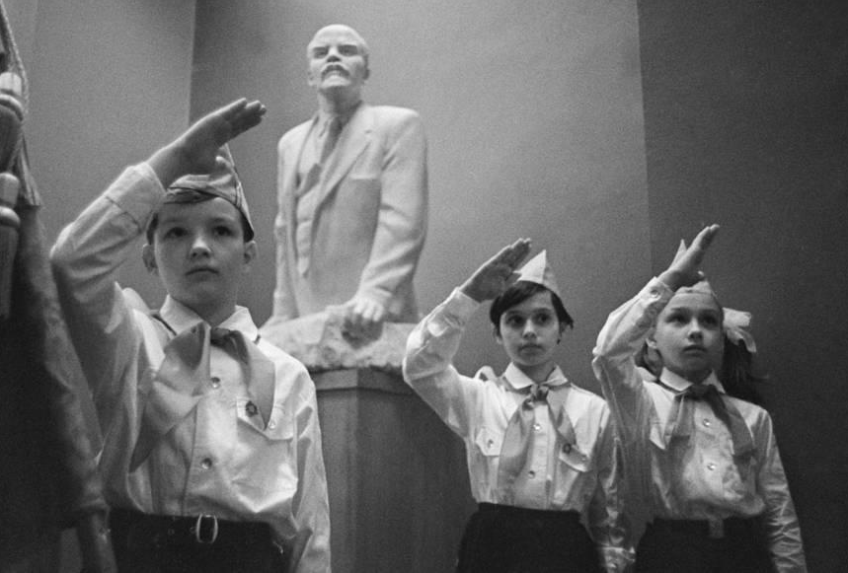
Teaching Collectivism and Communist Principles
The Pioneer movement was modelled in many aspects on the Scout movement. The two movements share some principles like preparedness and promotion of sports and outdoor skills. The motto Always prepared! was adopted by the pioneer movement from the Scout Motto. A member of the movement is known as a Pioneer, with the name stemming from the pioneering activity in Scouting. A red neckerchief – is the traditional item of clothing worn by a pioneer. This tradition was adapted from the Scout uniform.
But there are some distinct differences between the two movements. Most notably, the Scout movement receives government funding but does not overtly claim to evince the ideologies of the political economy. In contrast, the Pioneer movement is fully subsidized by the government and does make overt connections to the political economy. Thus, it teaches communist principles, including community-oriented and needs-based equal-pay labouring for the larger collective.
Ceremony of Admission to the Pioneers, 1969

Slide 33
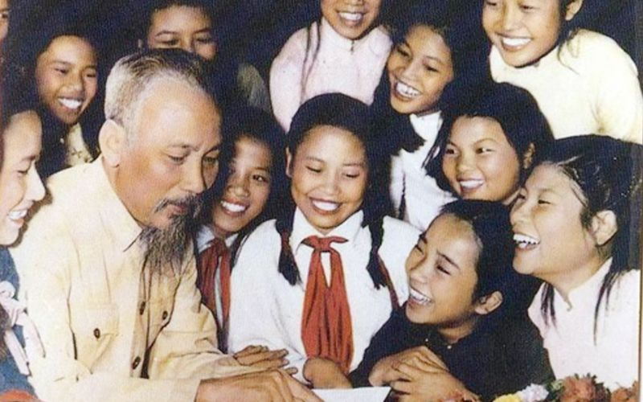
A Young Pioneer Organization for Every Communist Nation
Pioneer movements have existed and still exist in countries where the Communist Party is in power as well as in some countries where the Communist Party is in opposition, if the party is large enough to support a children's organization. In countries governed by Communist Parties, membership of the pioneer movement is officially optional. However, membership provides many benefits, so the vast majority of children typically join the movement (although at different ages). During the existence of the Soviet Union, thousands of Young Pioneer camps and Young Pioneer Palaces were built exclusively for Young Pioneers, which were free of charge, sponsored by the government and trade unions. There were many newspapers and magazines published for Young Pioneers in millions of copies. A national pioneer organization is often named after a famous party member that is considered a suitable role model for young communists, such as Vladimir Lenin in the Soviet Union, Enver Hoxha in Albania, Georgi Dimitrov in Bulgaria, José Martí in Cuba, Ernst Thälmann in East Germany, Damdin Sükhbaatar in Mongolia, and Ho Chi Minh in Vietnam.
Ho Chi Minh Meeting With the Young Pioneers in Vietnam

Slide 34
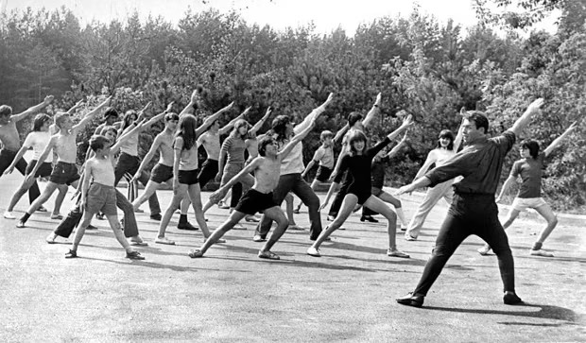
The Young Pioneer Camp Phenomena
The Young Pioneer camps of the Soviet Union were the place of vacation for children from the Young Pioneer organization of the Soviet Union during summer and winter holidays. The first All-Union Young Pioneer camp, Artek was formed on June 16, 1925. The Young Pioneer camp phenomenon grew in popularity and in 1973 approximately forty thousand Young Pioneer camps existed in the USSR. In that year, approximately 9,300,000 children had vacations in these camps. There were different types of camps: sanitation camps, sports camps, tourist camps, thematic camps (for young technicians, young naturalists, young geologists and children of other potential careers). Generally speaking if parents wanted their child or children to go to one of these Young Pioneer camps, they had to pay a fee to apply for accommodation in the camp. However, typically the state organization where the parent worked "sponsored" the child by allotting the worker's child a place in the camp free of charge to the parent or parents as an incident to the parent's employment.
'Every morning, we were were woken by a bugle and hurriedly changed into our gym attire for the exercise session' - A Former Young Pioneer Reminisces About Group Exercises Like Those Seen in This Photo

Slide 35
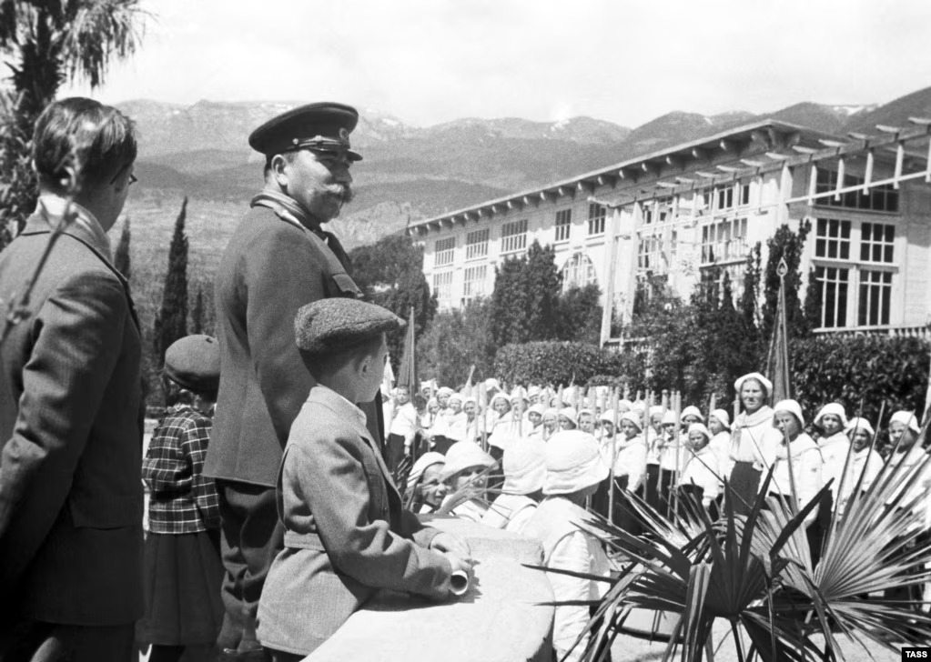
The First Young Pioneer Camp: A Legacy of the USSR
Artek (Russian: Артек) still exists as an international children's center on the Black Sea in the town of Gurzuf located on the Crimean Peninsula, near Ayu-Dag. It was established in 1925 as the V. I. Lenin All-Union Pioneer Camp.
Artek was considered to be a privilege for Soviet children during its existence, as well as for children from other communist countries. During its heyday, 27,000 children a year vacationed at Artek. Between 1925 and 1969 the camp hosted 300,000 children including more than 13,000 children from 70 foreign countries. After the breaking up of the Young Pioneers in 1991 its prestige declined, though it remained a popular vacation destination. Traditionally Artek provided a base (known as a School of Pedagogues-Organizers) for hands-on training of students of pedagogical schools. This tradition has been continued today and the camp is known as the Humanitarian Institute 'Artek'. In 2005 students from Ukraine, Russia, Belarus, Moldova and Kazakhstan were trained there.
Pedagogy refers to the academic study of teaching methods. Artek (pictured above) similarly to other Young Pioneer Camps was a school as well as a vacation destination and training ground.

Slide 36
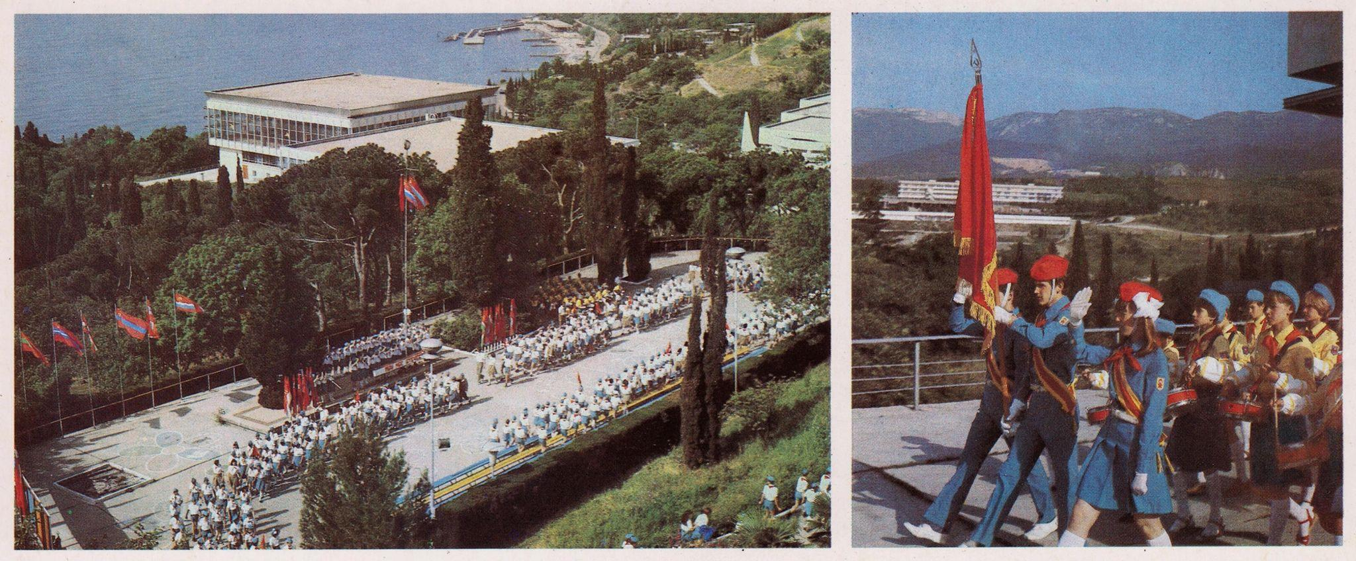
Artek From the Soviet Perspective
From a postcard folder and notes, distributed by the Soviet Union to advertise camp Artek, circa 1985:
Traditionally, the Young Pioneers' day starts with a camp lineup and the hoisting of the flag in each of the Artek camps. Each shift begins with a ceremonial parade before the Camp's Banner, the state flag of the USSR. As the early sunrays light up the top of Mount Ayudag, the camp awakens to the soft rustle of the wind in the pines and cypresses, the murmur of the waves and the cheerful call of the bugle. When the morning exercises start, the whole of Artek becomes a gigantic stadium. Artek means sunshine, the sea and a few kilometers of beaches. When leaving the camp, each boy and girl is sure to take home as a souvenir a few pretty pebbles worn smooth by the gentle waves of the warm sea. Each of the camps has a charm of its own.

Slide 37
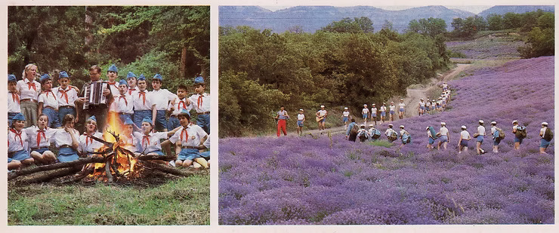
Artek From the Soviet Perspective Cont.
Among the duties of the children at Artek is serving meals and clearing away in the canteens, cleaning up the territory, taking care of the trees and flowers in the parks, and keeping the beaches clean and in order. The National Communist Subbotnik (A Saturday when voluntary unpaid work is done collectively) is Artek's greatest working holiday. On that April day the children at Artek, just like other people all over the country, contribute to the nation-wide collective effort. Artek's children enjoy going on hikes to Mount Ayu-Dag. The hikers have an opportunity to test their endurance and participate in all kinds of open-air activities. The route is specially chosen so that they can see some of the most beautiful sights in the Crimea. The children look forward to singing around the bonfire in the evening.

Slide 38
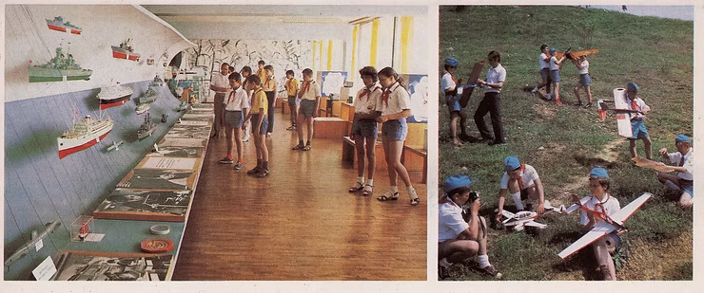
Artek From the Soviet Perspective Cont.
When at Artek you can see the Exhibition of Model Ships, launch a glider you have made with your own hands, and visit the Space Exhibition, which was set up with the participation of Yuri Gagarin, the pioneer of space flight. The classes at Artek's school start on September 1. The school has large classrooms and laboratories and numerous visual aids. Textbooks are available in the language of all the constituent republics of the USSR. Among the things the children take home from Artek with them is the traditional herbarium, a collection of minerals and photographs of beauty spots in Artek and the rest of the Crimea. Each delegation of foreign children has its own National Day. It is a festival when children perform their national dances and songs and tell their friends about democratic children's organizations.

Slide 39
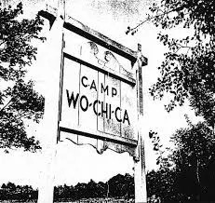
Wo-Chi-Ca - The Worker’s Children Camp
Wo-Chi-Ca camp was birthed in 1934 amidst World War II, McCarthyism, The Great Depression, and the Cold War. Wo-Chi-Camp is short for Workers Children’s Camp. It was an interracial co-educational summer vacation camp found in New Jersey.The emergence of this camp came from summer vacation homes designed for people with ties to the Communist Party. Originally, these spaces were inter-generational, but the adults began to realize that the youth needed their own summer community as well. In 1934, a New Jersey farmer and his wife donated 127 acres of land to start Camp Unity, the first interracial camp supported by the communist party in the United States. Camp Unity would then be called Workers Children’s Camp or Wo-Chi-Ca for short. “The idealist who would found Wo-Chi-Ca wanted their children to experience ‘The World of the Future’ today, through shared living with those of different racial and ethnic backgrounds. They especially wanted to welcome negro children to their new camp. Labor-based, co-educational, affordable, interracial- for a children’s camp in 1934, a revolutionary concept.”

Slide 40
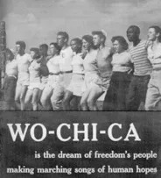
Building Relationships Across Ethnic and Racial Divides
Wo-Chi-Ca’s directors wanted ethnic diversity and racial integration. Many of the campers came from union families and so the ethnic diversity was not hard to get, but the racial integration was more difficult. African Americans at the time were barred from most unions and were segregated in the ghettos. So, the organizers of the camp decided to reach out to Black neighborhoods in order to ensure that Black children had the same opportunities as Whites. This was particularly important because the McCarthy era had created distance among the NAACP and the Communist Party. Wo-Chi-Ca would serve as a way to support the Civil Rights Movement. Wo-Chi-Ca was very successful at doing this and in 1943, there was one Black child for every 5 White children at Wo-Chi-Ca. Camp ran for five periods of two weeks each, with room for 200 children at any given time. The camp committed itself to music and the arts. It was well known for its commitment to raising awareness and building appreciation for arts and music. Art and music was used as a strategy to build relationships across ethnic and racial divides that were happening as a result of the segregation that was in place. Wo-Chi-Ca committed itself to diversity both in their campers and their staff.

Slide 41
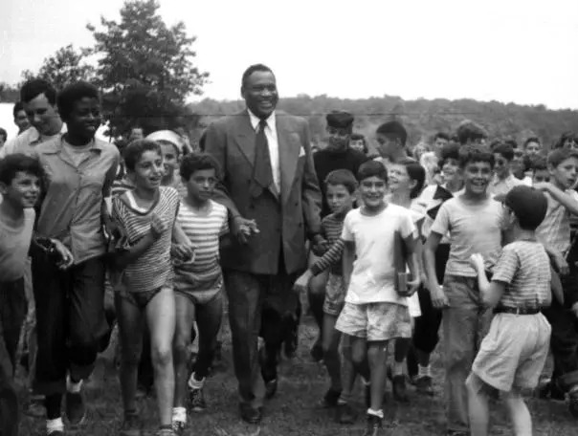
A Glimpse of What the World Should Be
Famous artist Pete Seegar, Paul Robeson,and Woody Guthrie had visited or worked at the camp during it’s time. Paul Robeson, an American singer and actor, was actively involved in the camp. He first came to the camp in 1940 and returned every year to sing, play ball, and talk to the campers. The camp also saw other notable artist such as Charles White, Canada Lee, Pearl Primus, Ernest Crichlow, Jacob Lawerence, and political figures such as Howard Fast and Dr. Edward Barsky. By diversifying the staff and campers and inviting prominent leaders from the Black community to the camp, the camp served as a uniquely strong educational environment. The camp served as a glimpse of what the world should be. It softened prejudices and stereotypes and created friendships with children before they were socialized into racism. This camp also reflected a change in ideology that was in line with society. This ideology was one that was child inclusive, labor oriented, and community focused. They did this through art programming that connected art education with deeper understanding of collective struggle.
Paul Robeson Surrounded by Children at Camp Wo-Chi-Ca

Slide 42
A Progressive and Educational Summer Camp for Kids
Camp Wo-Chi-Ca, like other leftist camps at the time, believed in intentionally and openly discussing race and class. However, Wo-Chi-Ca’s focus on intentional dialogue was also complemented by the everyday camp practices. Camp Wo-Chi-Ca addressed race and class in two separate, but connected ways: through staffing (discussed earlier) and programming. This intersection of staff and programming seeped into several categories: visual arts, performing arts, recreation, and political activism.
Wo-Chi-Ca was a progressive educational summer camp for kids. These young pioneers were activists and leaders. Judy Hodges was among the campers who during the 1930’s and 1940’s was learning about the importance of loving all humankind as well as playing board games and receiving swimming lessons.
In the early 1950’s the camp fell to the pressure of McCarthyism and closed it’s doors. Like many other leftist camps, Wo-Chi-Ca struggled with threats ranging from community members to state and federal pressures. The biggest pressure was financial. After the IWO was placed on the U.S. Attorney General’s “List of Subversive Organizations,” the camp could no longer get federal tax exemptions. The camp’s name was changed several times in order to avoid the financial issues, but to no avail. The camp was forced to close but its commitment to social justice and racial integration was carried out into the future by the campers and staff members who spent their summers there.

Slide 43
Discussion & New Members Introductions

Slide 44
New Member Introductions
What is your name, pronouns and state (or country/territory)?
Where do you work? Is it unionized?
How did you find out about the People’s School?
What do you think about tonight's class?

Slide 45
Discussion & Wrap Up

Slide 46
Announcements
PCUSA Cell Chairs need to call members of their cells to remind them about attendance.
The next issue of New Masses (2026) has begun production. If you have art you want us to feature, email it to info@partyofcommunistsusa.net.

Slide 47
Volunteers Needed!
We are in need of volunteers for the staff of the People’s School! Here’s a few roles we need filled:
People to help manage posting on our social media and podcast platforms
Video Editors, Audio Editors, Graphic Designers, Artists, Narrators
Web Controls, Moderators
Email info@peoplesschool.us if you’re interested and try to attend our next staff meeting if possible.

Slide 48

View From Left Field
https://viewfromleftfield.libsyn.com
The Old PSMLS Youtube is now the Youtube of View From Left Field, a podcast of analysis and discussion of current events from a progressive perspective.
Like the Youtube videos and subscribe with 5 star ratings on your podcast platforms.

Slide 49

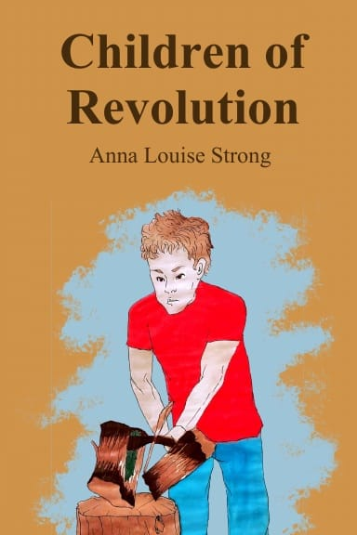



New Outlook Publishers
newoutlookpublishers.store
Relevant and Latest Releases

Slide 50


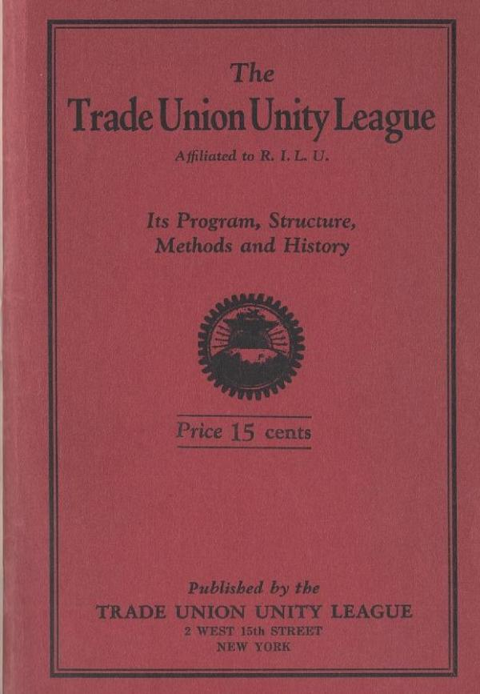
Harry Bridges School of Labor
luel.us/laborschool/
The Harry Bridges School of Labor is a monthly class covering a variety of topics aimed at building class consciousness among union members.
December’s class is on the history of the Trade Union Unity League (TUUL). Class will be Saturday December 6th, 2025 at 7pm EST/4pm PST.

Slide 51
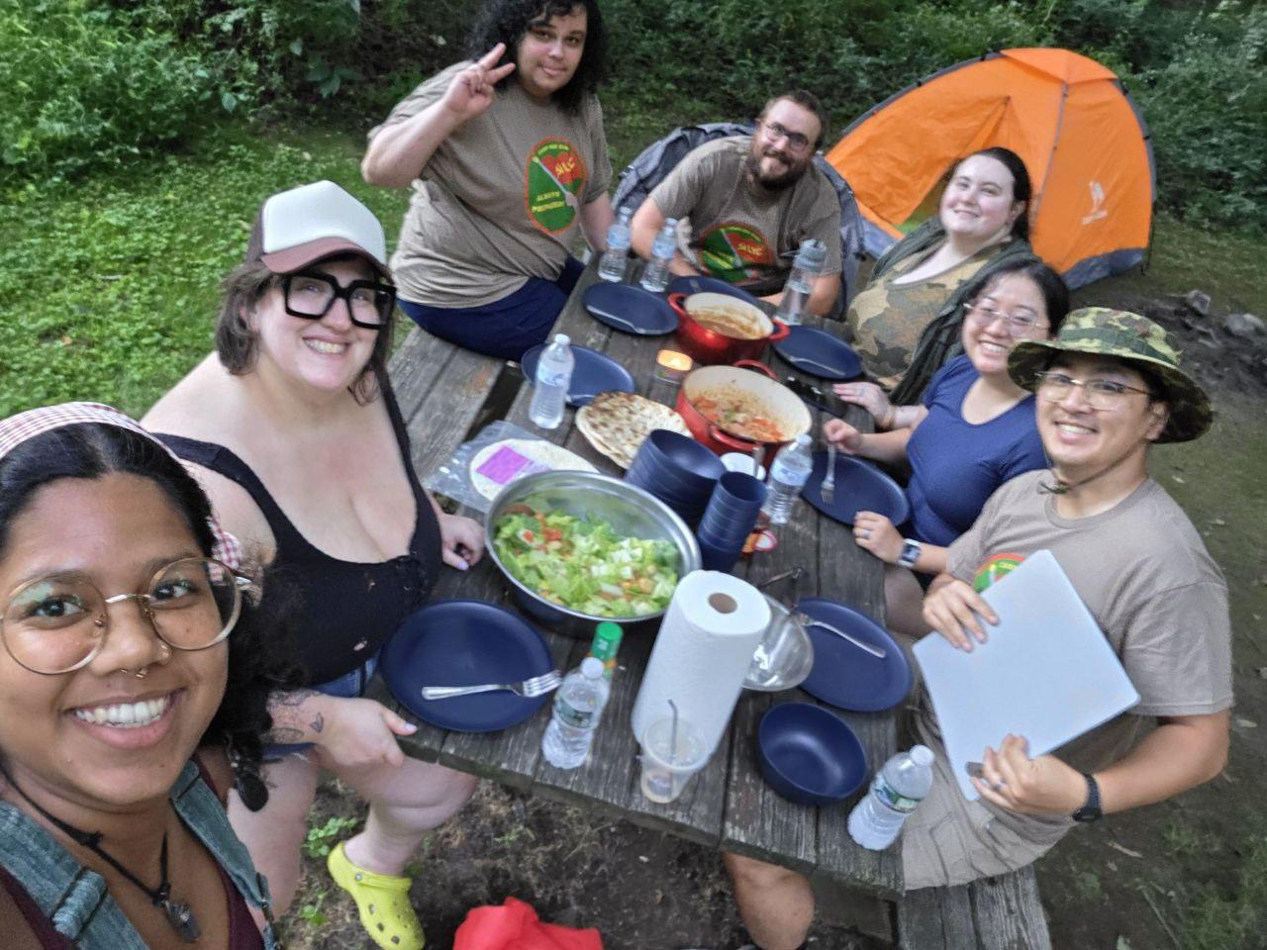
Solidarity Forever - Performed at Camp Red Star

